Slide 1
Assimilating HIWRAP Doppler velocity data with an ensemble Kalman filter
Jason Sippel, Scott Braun- NASAs GSFC
Acknowledgements: Yonghui Weng, Fuqing Zhang, Gerry Heymsfield

Slide 2
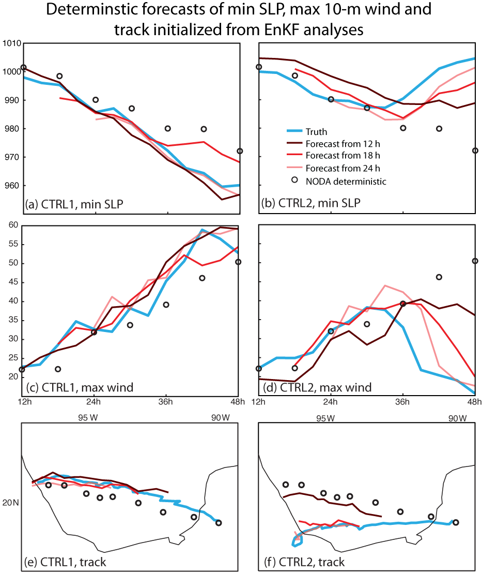
Previous simulated-data results
Background
Focus on Hurricane Karl (2010)
Assimilation significantly reduces analysis error compared with NODA
Subsequent forecast error is reduced relative to NODA, particularly from 36-48 h

Slide 3
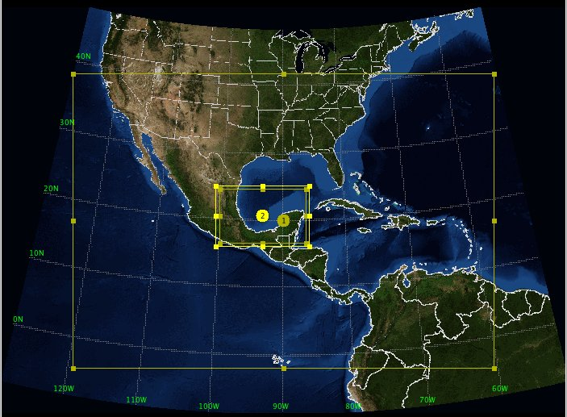
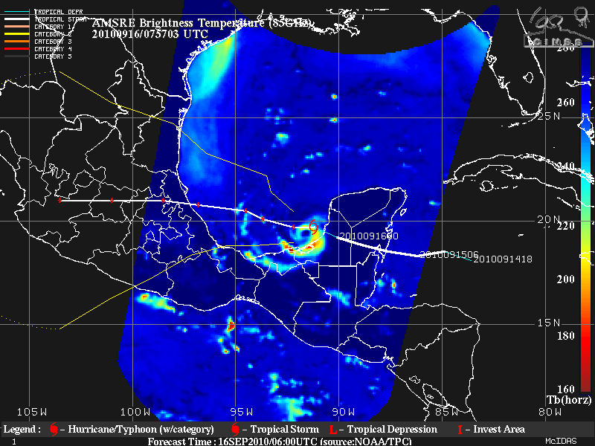
Experiment setup
Methods
EnKF from Zhang et al. (2009) with Weather Research and Forecasting (WRF-ARW) model & 30 members
Initialize at 12Z 9/16, 6-h spin-up
Assimilate HIWRAP Vr & position/intensity from 18Z-7Z
3-km nest
Model domains
Karl’s track

Slide 4
Real-data vs. OSSE: difficulties
Methods
Only inner beam is available
  Observing more of w than in OSSEs
  Observation cone narrower
QC and fallspeed issues
  Fallspeed corrected according to Marks & Houze method
  Noise needs to be removed; QC similar to F. Zhang’s SO methods
Data thinning required
Lat/lon view of Vr superobs (QCd and fs corrected)
0100 UTC 9/17
0600 UTC 9/17

Slide 5
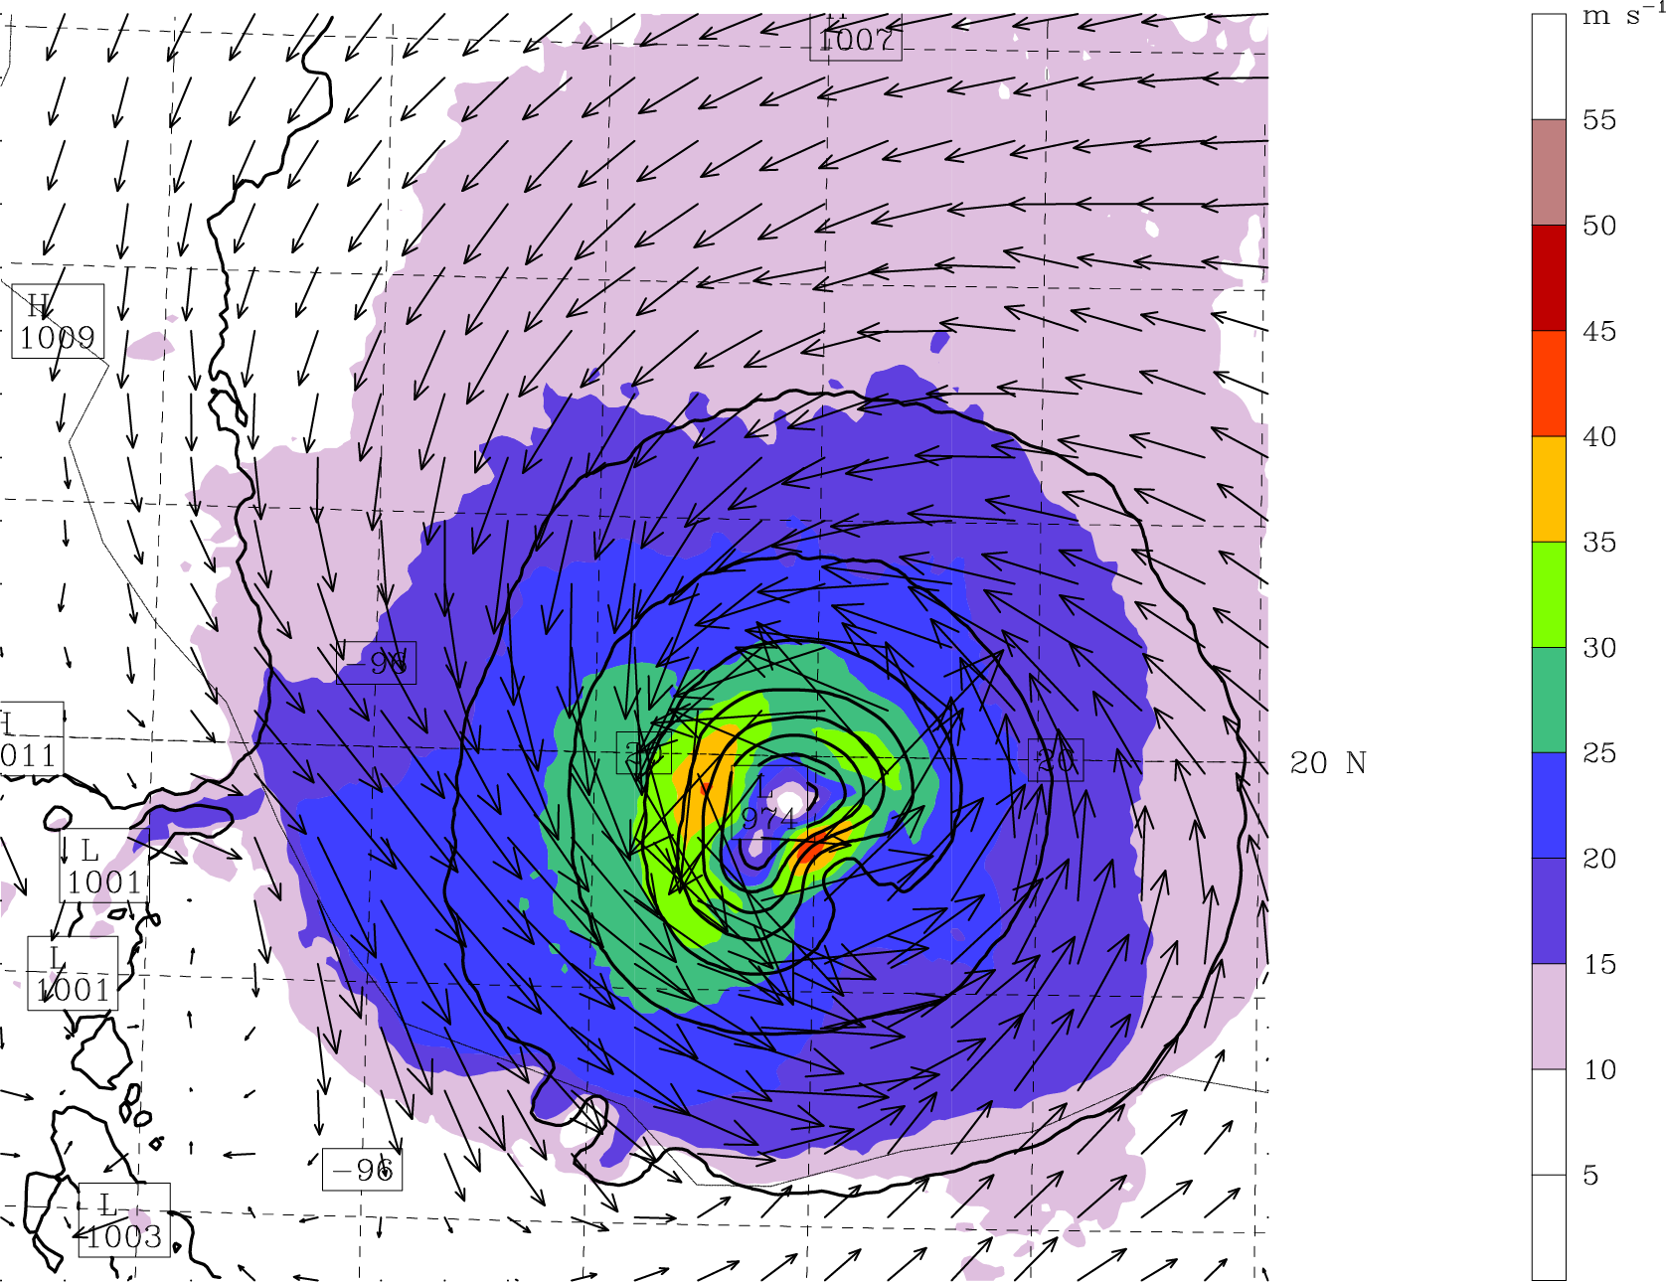
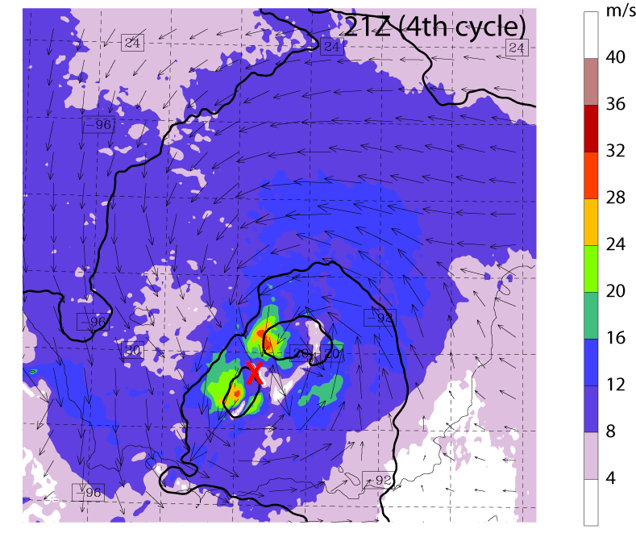
Problems encountered
Methods
Trial and error - what NOT to do:
  Allow innovations > 2*error
  Assimilate hourly data only from current hour
  Assimilate Vr when dBZ < 25
  Assimilate Vr < +/-15 m/s (?)
  Give system too many obs (?)
0100 UTC 9/17
EnKF analysis of SLP/wind
Fail – unrealistic asymmetries for too many obs (ROI-dependent)
Fail – dual vortices when only 1-h of SOs used per cycle, innovations > 2*error (irrecoverable)

Slide 6
Creating super-observations
Methods
1-h SO, 5 m/s Vr threshold
Reject all raw Vr when dBZ < 25 or Vr magnitude < 5 (15) m/s
Each SO is median value (after rejection and further QC) from a 5 degree x 2 km bin
For each hour, combine superobs from t +/- 1 h
3-h SO, 5 m/s Vr threshold

Slide 7
Creating super-observations
Methods
Comparing observations for different Vr-cutoff thresholds
3-h SO, 5 m/s Vr threshold
3-h SO, 15 m/s Vr threshold
This works best

Slide 8
Assimilating SOs (15 m/s)
Methods
Basic idea - Use background vortex as “strong constraint” for assimilating new Vr data by assimilating P/I FIRST, then rejecting data with a large innovation
✓
L

Slide 9
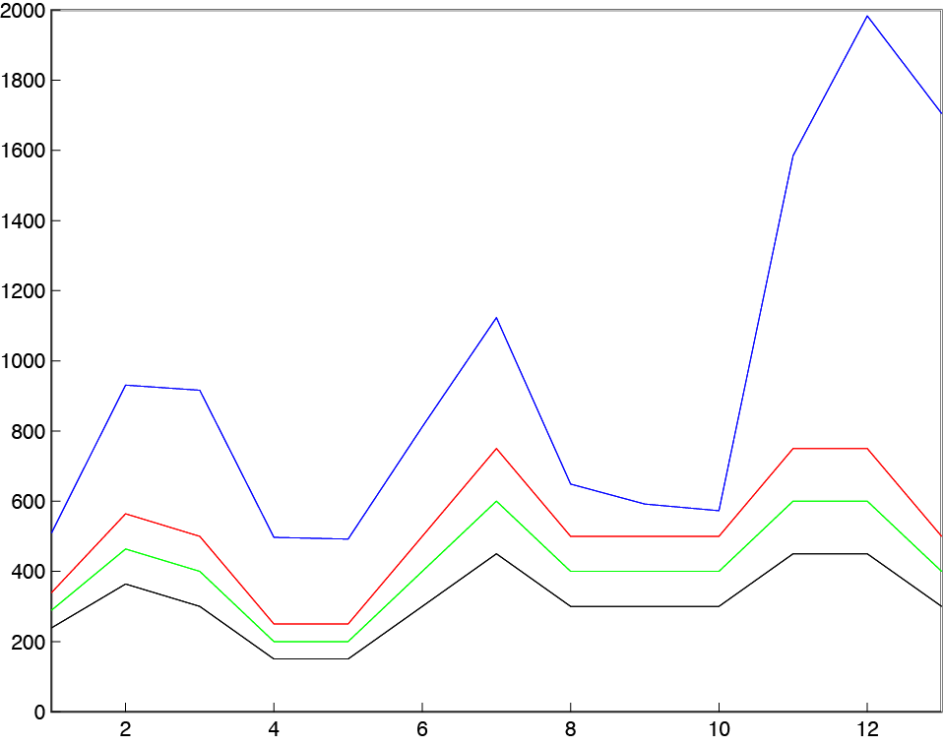
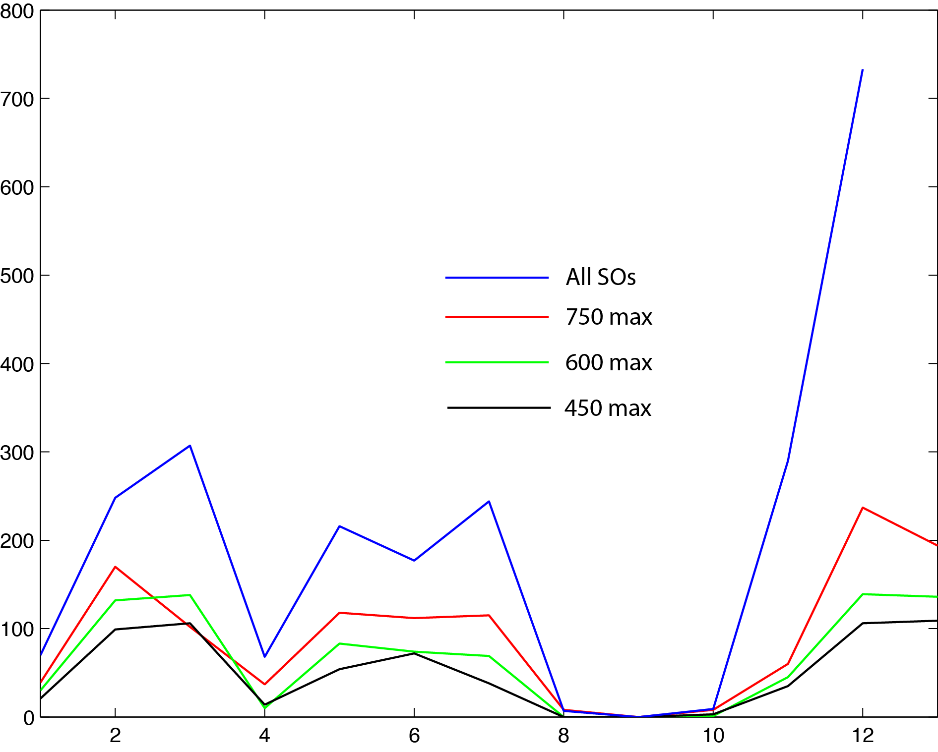
Assimilating SOs (15 m/s)
Methods
Several experiments where SO files contained a maximum of 450, 600, 750, and all available SOs
Assimilate P/I FIRST, then EnKF rejects obs. where innovation > 2*error
About 80-85% of Vr SOs are rejected (position mismatch)
Nobs given / cycle
Nobs assimilated / cycle

Slide 10
EnKF Analyses
Results
Minimum SLP
All analyses perform better than does NODA
All Vr + P/I analyses perform better than does P/I only
Experiment with 450/h max SOs is most stable
Maximum winds

Slide 11
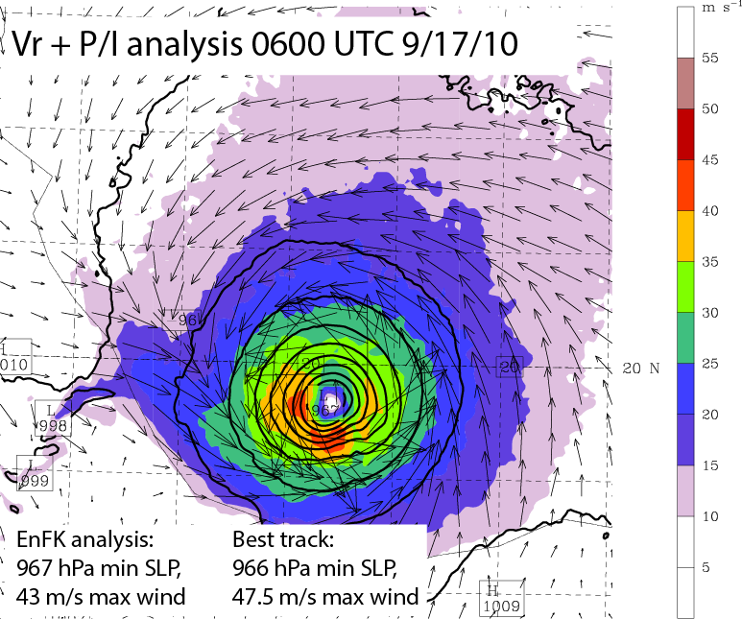
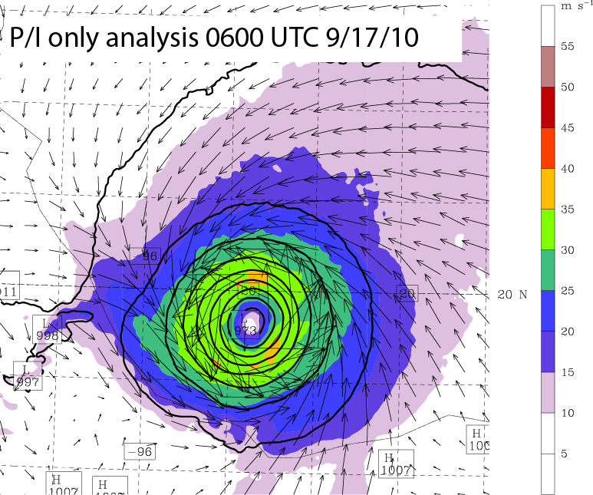
EnKF Analyses
Results
Vr + P/I analysis produces a stronger, more compact storm than does P/I only
Difference between
Vr + P/I and best track is within obs. error after 12 h of assimilation
SLP and sfc winds

Slide 12
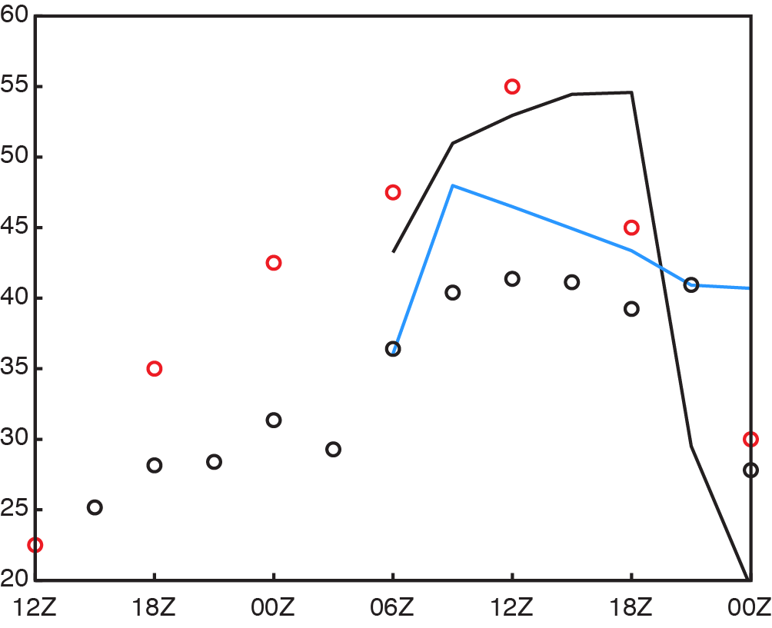
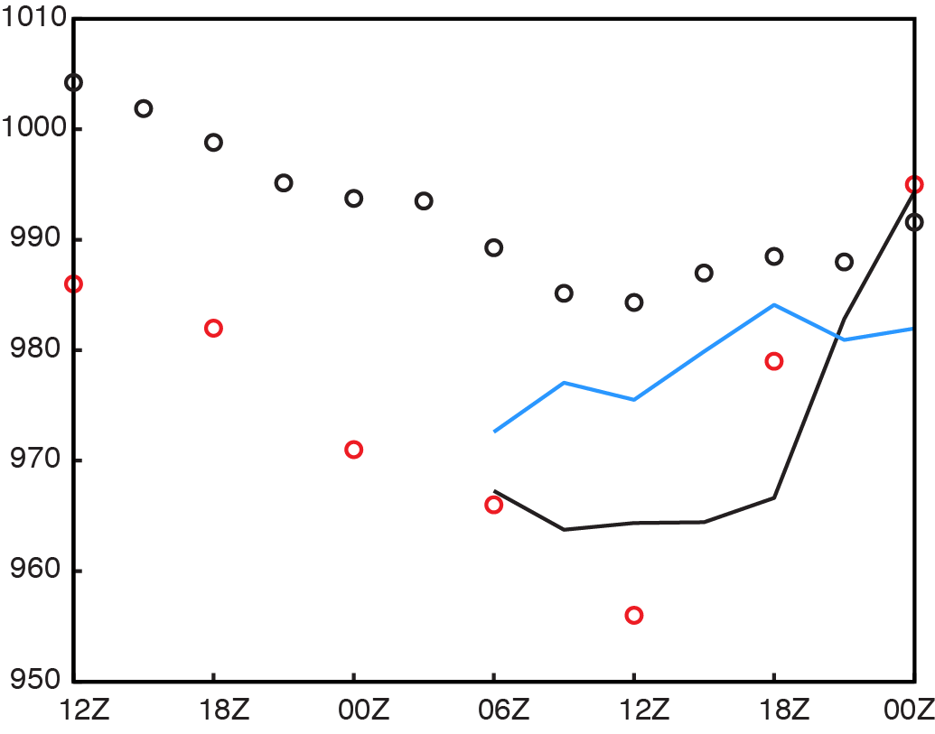
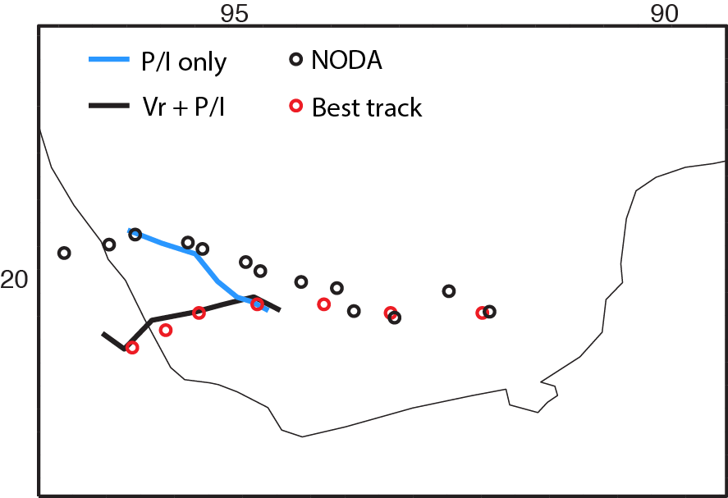
EnKF-initialized forecasts (12 h)
Results
Maximum winds
Despite difficulties in assimilation, Vr data provides obvious benefit to track and intensity forecast
Minimum SLP

Slide 13
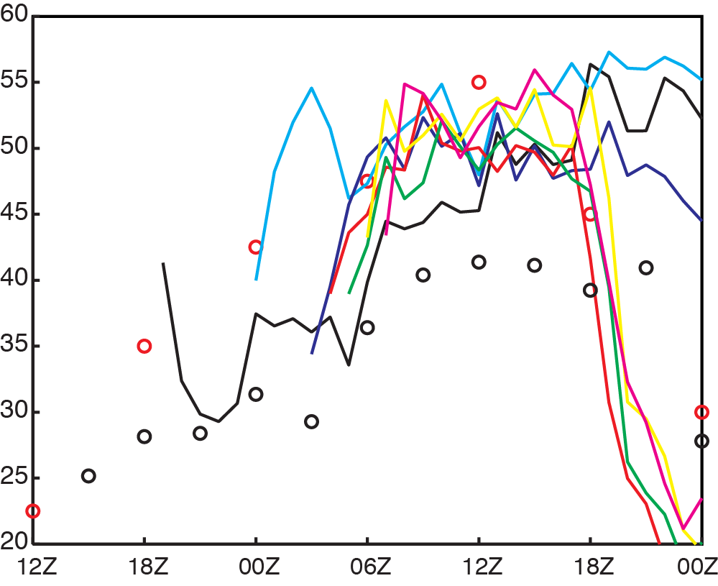
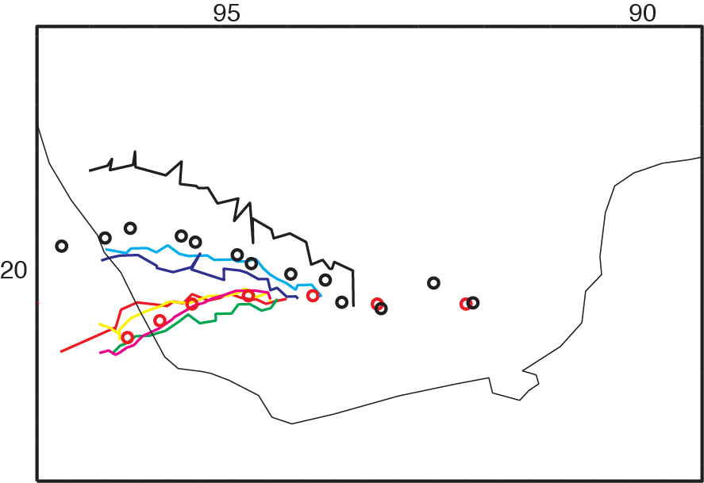
EnKF-initialized forecasts (all)
Results
Some intensity improvement after 1 cycle, but best results tied to track improvement
No significant track improvement until ~10 cycles, but thereafter nearly perfect
Maximum winds

Slide 14
Conclusions
OSSEs with simulated HIWRAP data showed great promise
Real data has been challenging for various reasons (noise, no outer beam)
Given sufficient constraints, inner beam data can be used to improve analyses and forecasts
This can only get easier… hopefully

