Slide 1
Meteorological Outlook, 20131011
Lenny Pfister, NASA/ARC

Slide 2
Outline
Local weather outlook for next week and long term
Convection and cirrus climo for this season
Long range forecast for deployment – ENSO, QBO, tropical tropopause temperatures
A brief look at the met web site

Slide 3
Local Weather Outlook
Strong upper level ridge over the Eastern Pacific and trough downstream just to the east of us, lots of cold air aloft (surprise). We are poleward of the main jet, so winds will die down. No warmup until Tuesday.
Ridge will move east, some stronger (20knot) winds from the NE on Monday as the jet crosses over us, then warming to near normal by Tuesday/Wednesday.
Parked under ridge for rest of next week, normal temps (highs in 50s), favorable winds, no rain. Remember next prospective flight date (Thursday-Friday) is 6-7 days away, at edge of model capabilities.

Slide 4
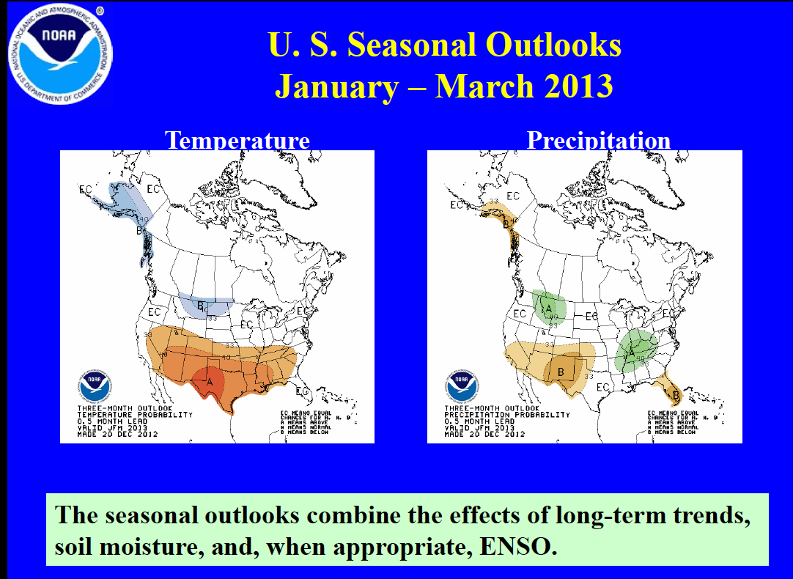
Long Term Forecast

Slide 5
A look at the winter climos for convection and cirrus in the TTL

Slide 6
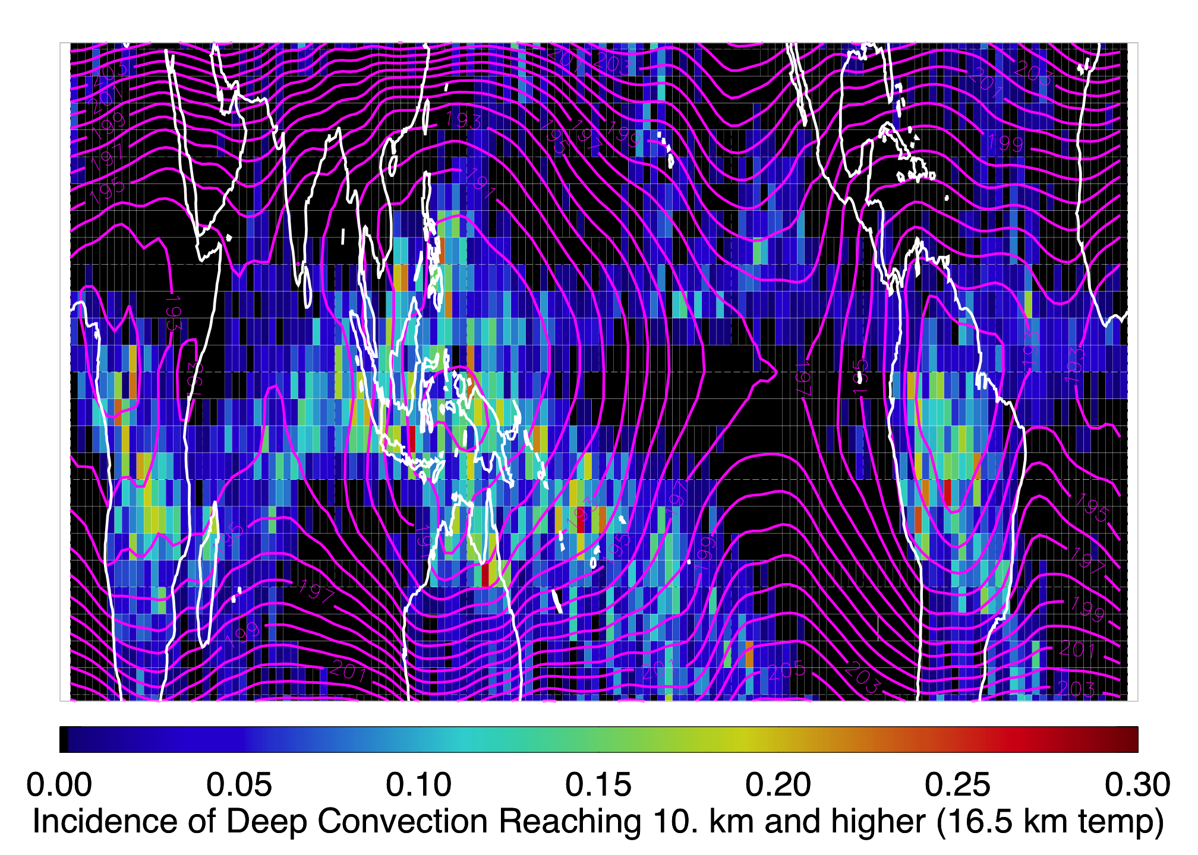
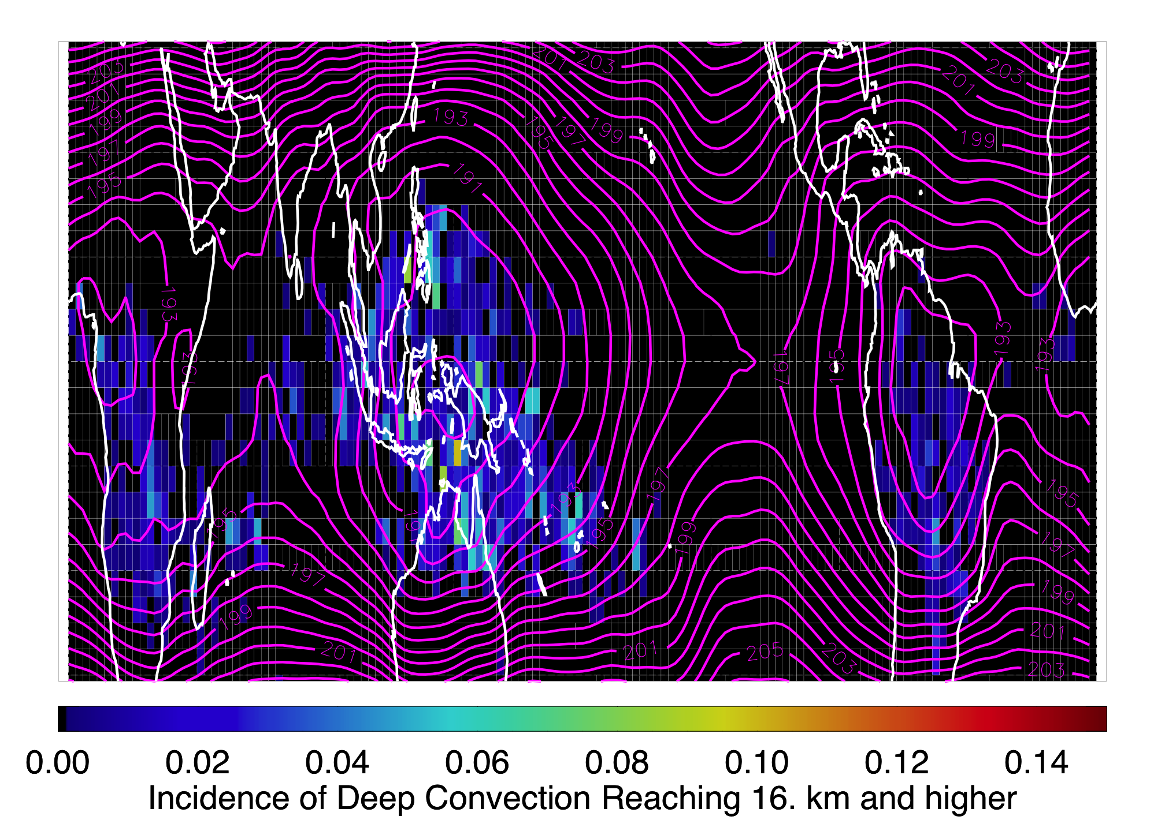
Convective Cloud Climo
Convective cloud top distributions for winter 0809 (ENSO neutral)
Note ITCZ convection rarely gets to 16 km.
Should see outflow from western Pacific, and southwest Pacific (if
we fly far enough south and west.
Our effective range extends roughly to the equator, west to Hawaii, east
to the Galapagos.

Slide 7
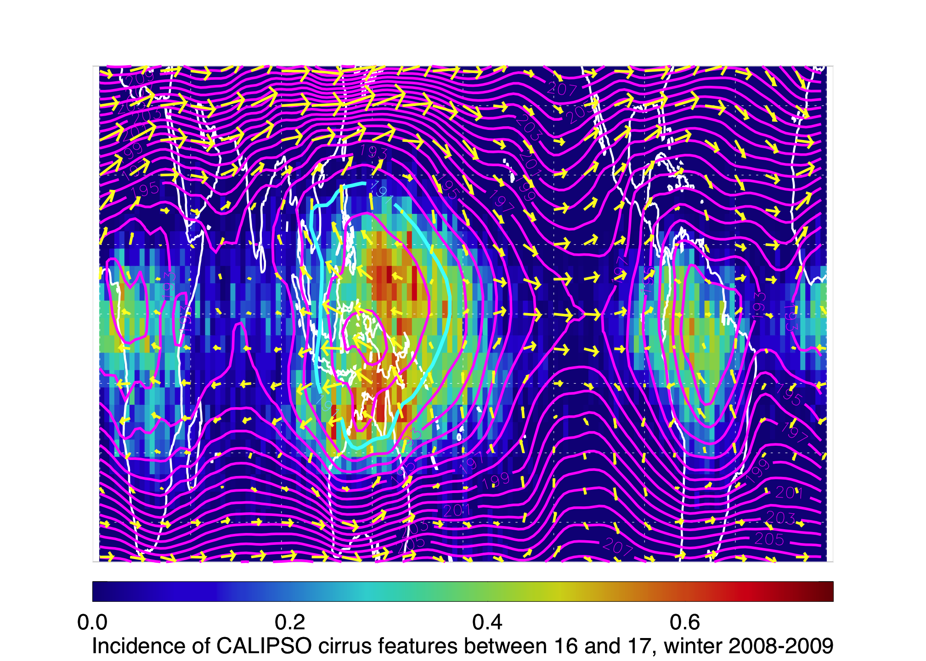
Tropopause Cirrus Climo
High thin cirrus is clearly related to temperature, so dominated by West Pac.
Cirrus does occur outside of cold pool.

Slide 8
Tropical long-term indicators
Stratospheric QBO – tropopause temperature amplitude of about .5K – approaching easterly phase indicating colder than normal tropopause temperatures.
ENSO cycle (multi-year, irregular) – important for distribution of convection in the Pacific and for the overall tropopause temperature distribution. Index is decreasing, approaching neutral conditions. Means deepest convection will be in Western Pacific, and coldest temperatures there also.
Madden Julian oscillation – intraseasonal (30-60 days) variation in tropical convection. Strengthened in the first days of January and is propagating eastward. Expect normal to slightly enhanced tropical convection in our region for the science flight next week (diagram), based on GFS dynamical and statistical model forecast of the MJO.

Slide 9
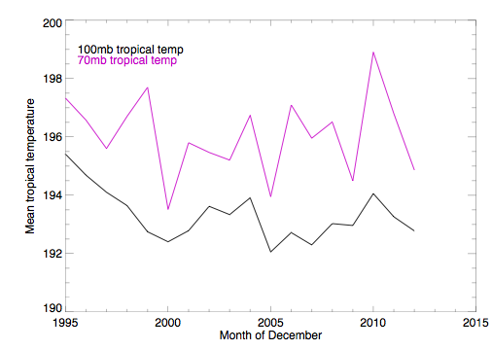
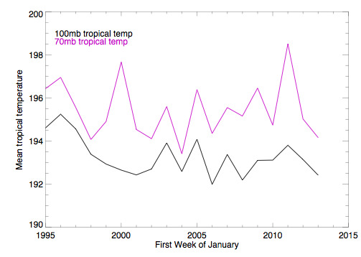
Expected Tropopause Temperatures
Months of December
Average temperatures (tropics, within 10 deg of equator) since 1995 for
December (left) and 1st week of January (right). We should have a colder than
Normal GLOBAL tropopause.

Slide 10
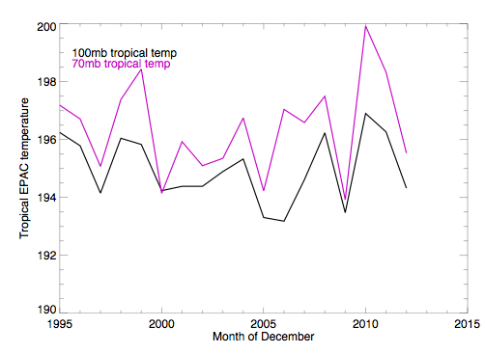
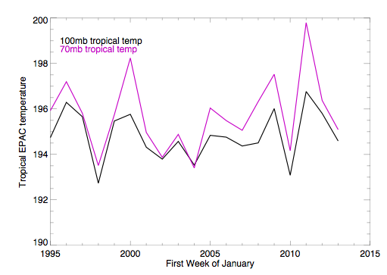
Expected Tropopause Temperatures (Eastern Pacific)
For the eastern Pacific region, we are NOT below average, but the trend is
downward.

Slide 11
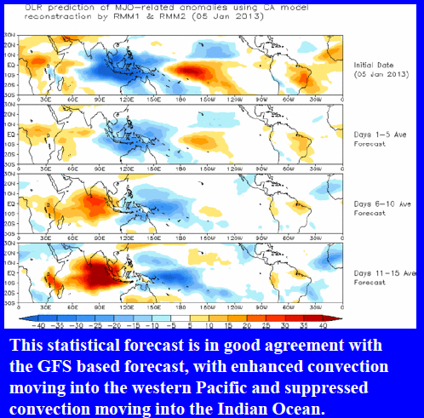
Jan 16-20
Forecast indicates slight enhancement in convection just south of us

Slide 12
Met web page
http://bocachica.arc.nasa.gov/ATTREX_2013/attrex.html

