Slide 1



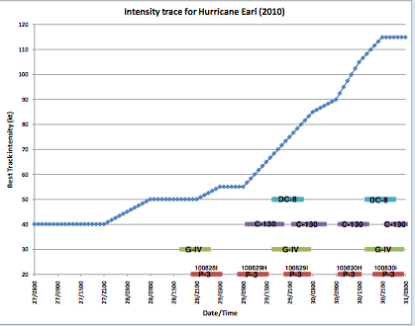
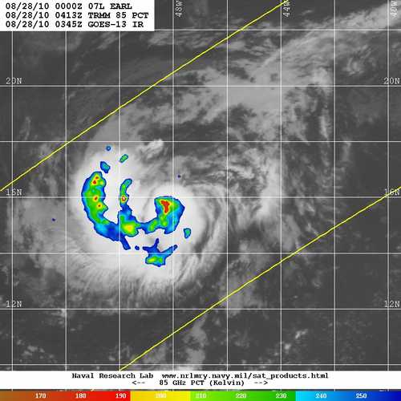
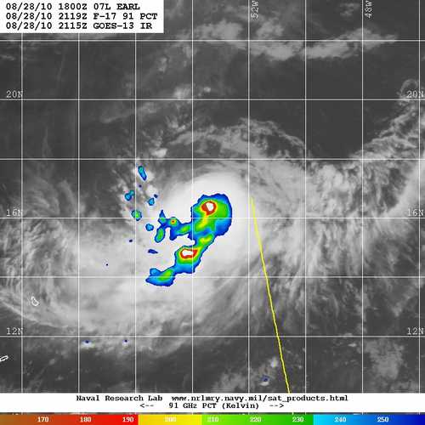
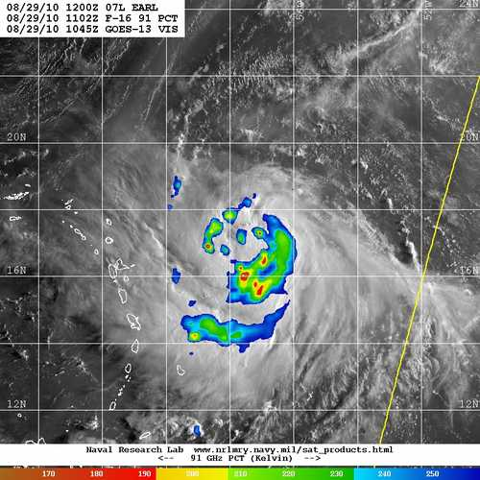
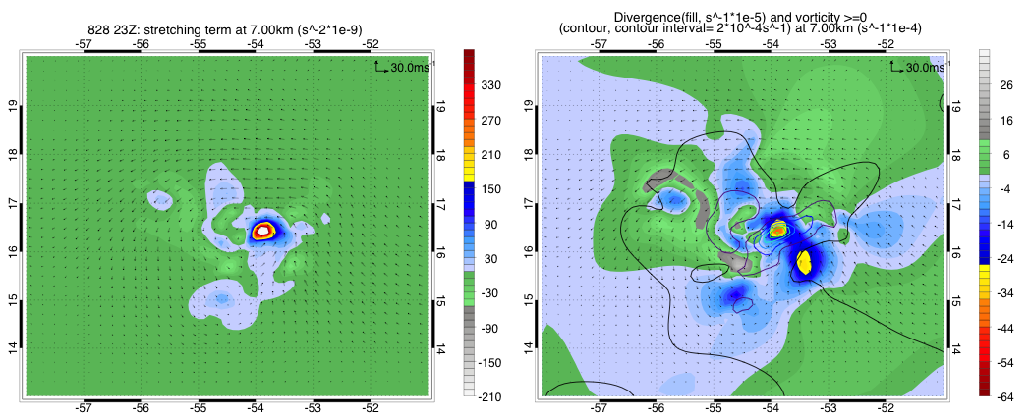
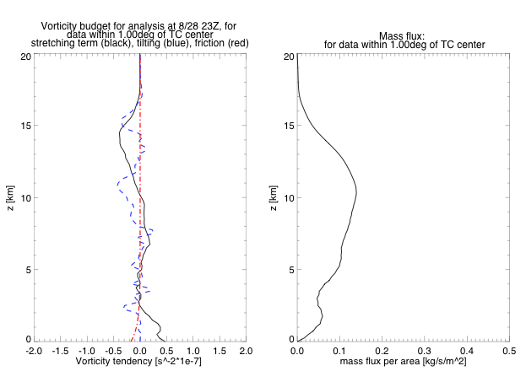
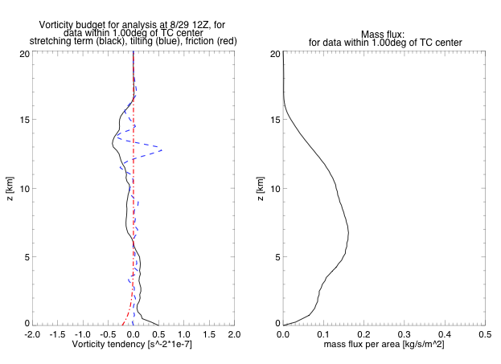
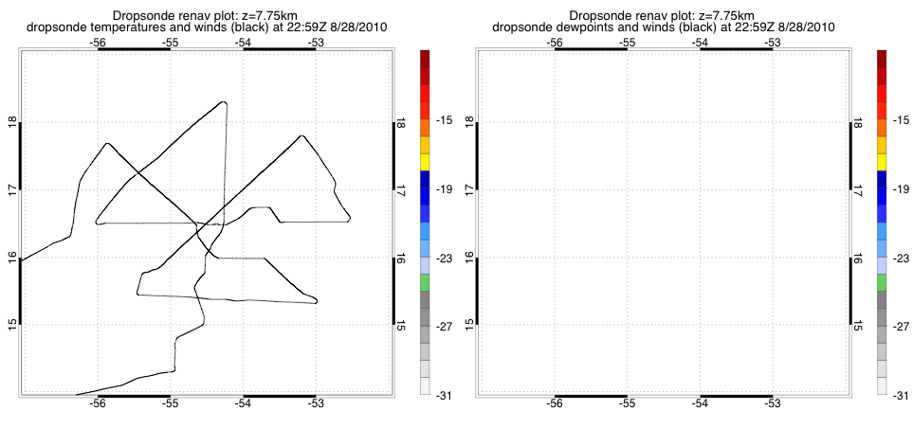
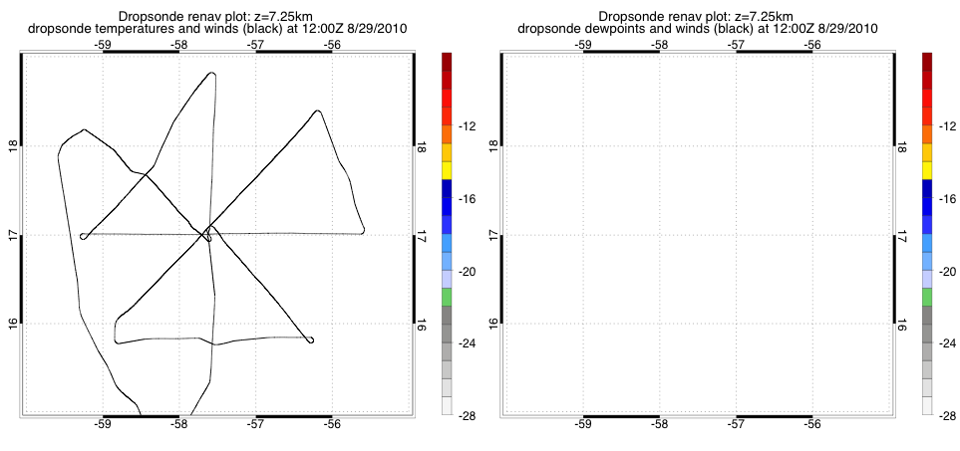
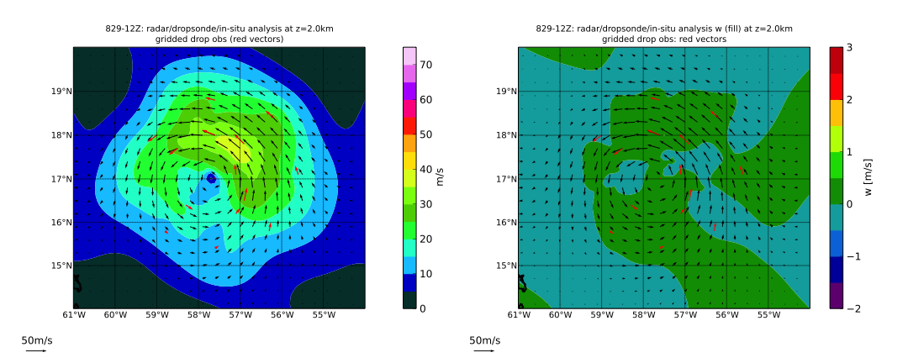
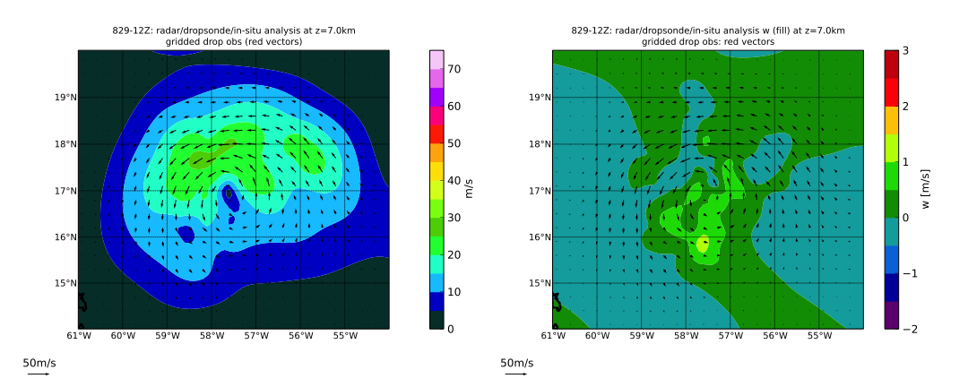
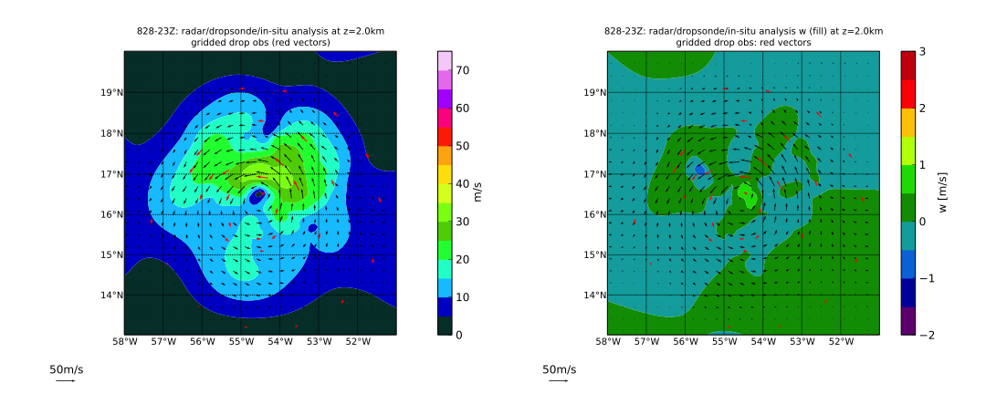
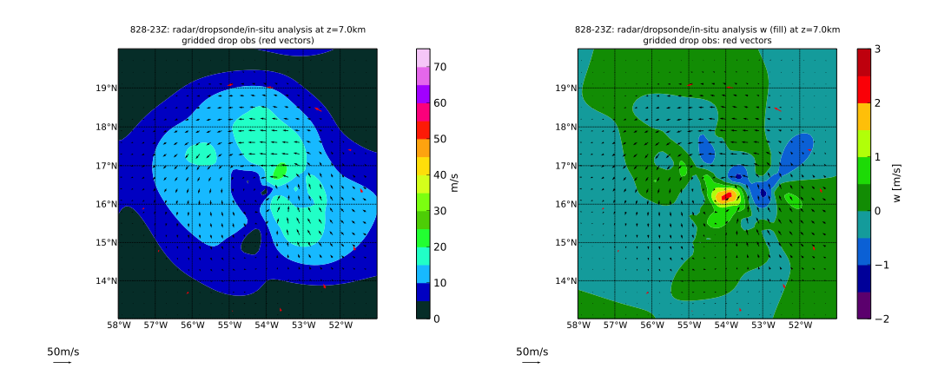
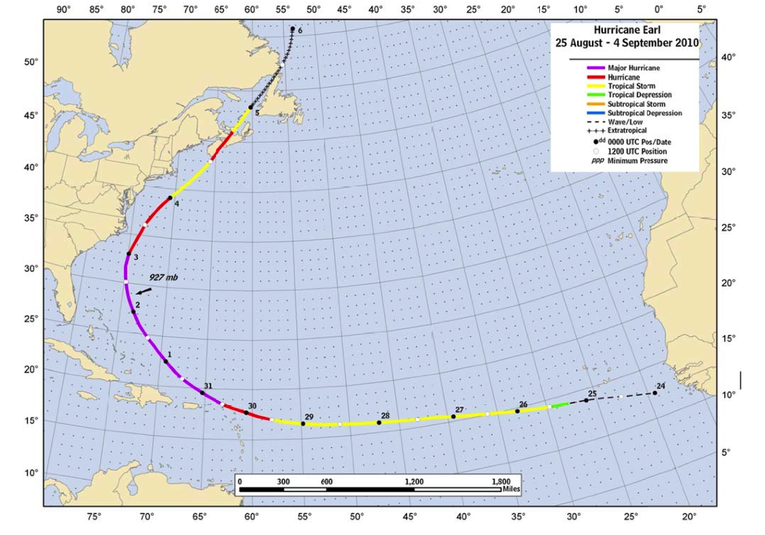
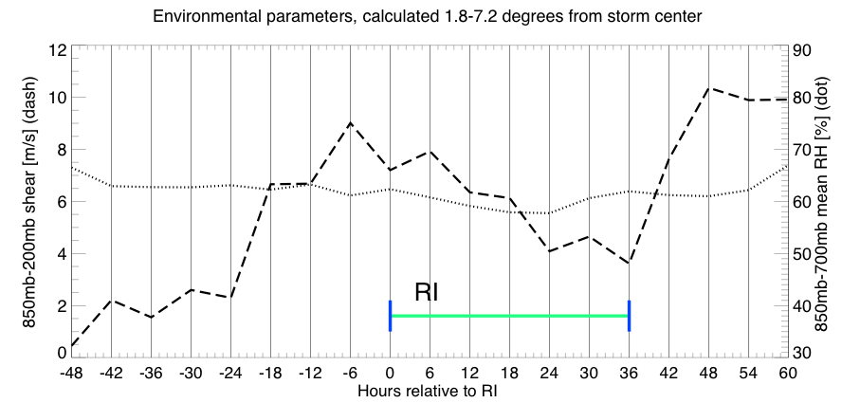
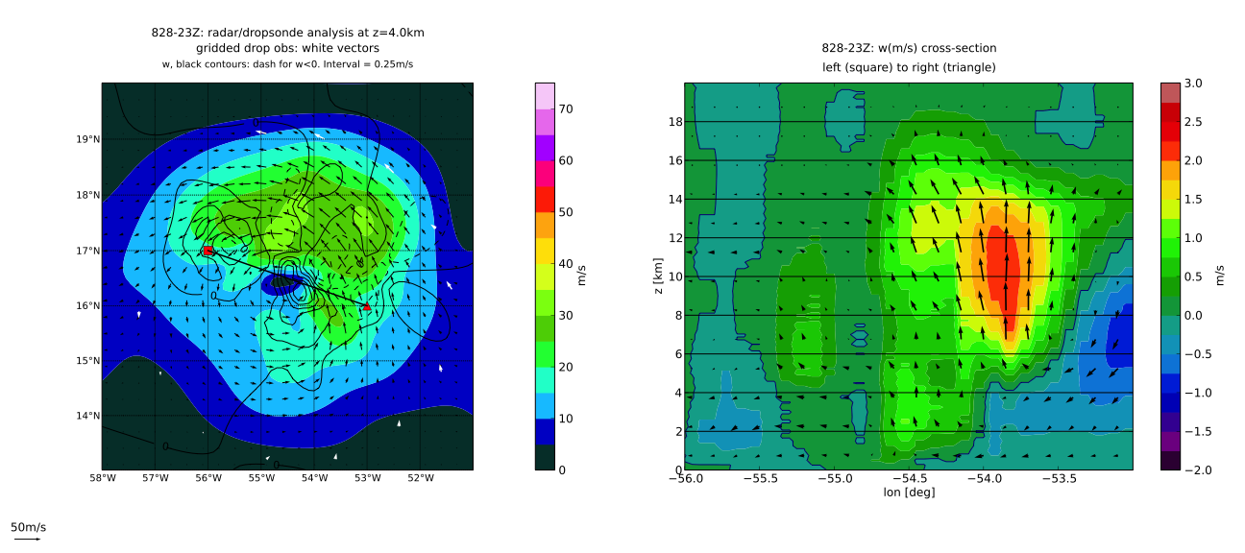
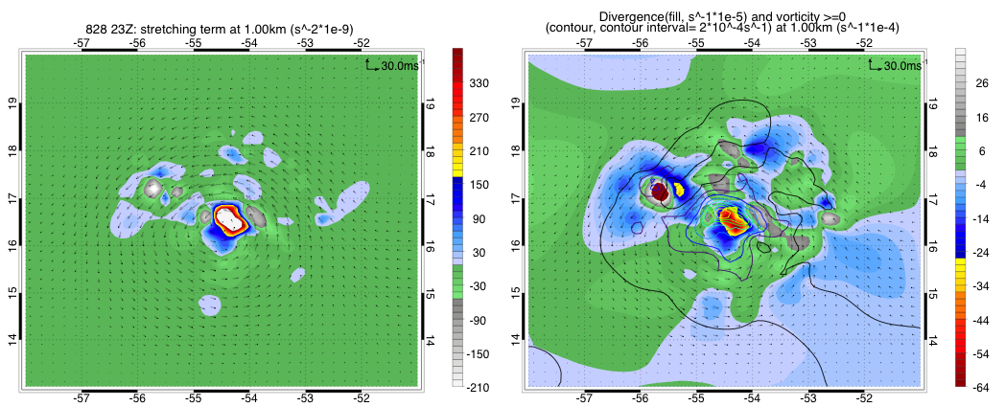
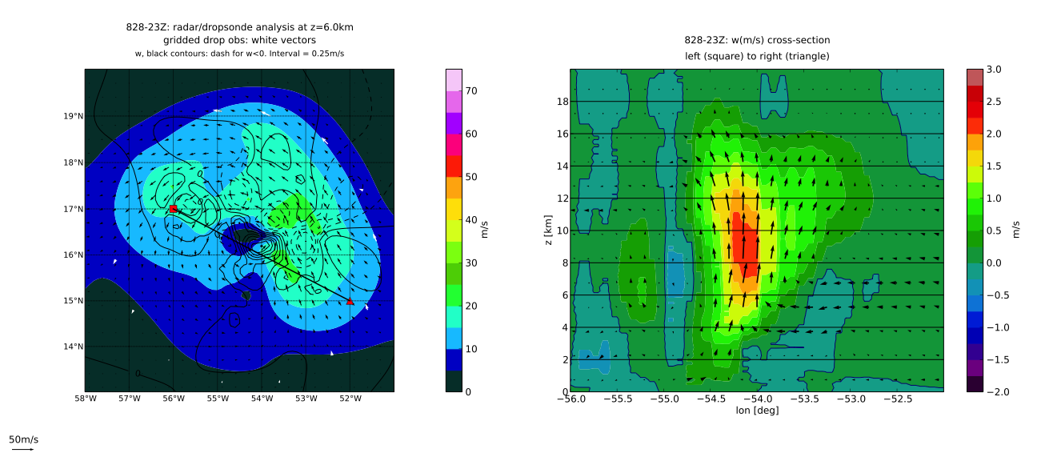
Rapid Intensification of Hurricane Earl (2010): Vorticity and Mass Flux Budgets
Gabriel A. Susca-Lopata, E.J. Zipser, C. Lopez-Carillo, D. Raymond, and R.F. Rogers.
1. University of Utah. 2. NOAA/AOML Hurricane Research Division 3. New Mexico Institute of Mines and Technology
1
1
3
3
2
1. Motivation: Various studies have emphasized the importance of different precipitation characteristics/structures for tropical cyclone intensification, such as convective rings (Willoughby, 1990, J. Atmos. Sci.), intense convective ”hot towers” (Guimond et. al., 2010, J. Atmos. Sci.), and rotating convective “vortical hot towers” (Nguyen et. al., 2008, Q. J. R. Meteorol. Soc.). All of these precipitation processes may occur in real tropical cyclones, but some might have a greater impact than others on tropical cyclone intensity. Goals: Use data collected during the GRIP/IFEX field campaigns to assess the impact of different precipitation structures on the intensification of Hurricane Earl (2010).
2. Hurricane Earl (2010): Between 0600 UTC 29 August 2010 and 1800 UTC 30 August 2010, Earl underwent a rapid intensification (RI, Kaplan and DeMaria, 2003) from a 55-knot tropical storm to a 115-knot hurricane. Figure 1. Right: track and intensity of Hurricane Earl, from the NHC Tropical Cyclone Report on Earl: http://www.nhc.noaa.gov/pdf/TCR-AL072010_Earl.pdf . Left: best-track intensity, and timing of flights into Earl, from Rogers et. al. (2010).
3. Environmental Conditions Figure 2. Deep-layer wind shear and low-level relative humidity in the vicinity of Earl, calculated from 6-hourly NCEP FNL analysis fields.
4. Precipitation Field Before RI and Immediately After the Onset of RI: Left-of-shear convective asymmetry developed as northeasterly shear increased leading up to RI. Immediately after the onset of RI (lower right panel), the precipitation had become more symmetric even though the shear remained at nearly the same magnitude. Figure 3. 85ghz PCT from various microwave sensors at 0413Z 8/28 (left), 2119Z 8/28 (center), and 1102Z 8/29 (right).
5. Mesoscale Wind Analyses: Mesoscale three-dimensional wind analyses were generated from the NOAA P3 tail radar radial velocity measurements. The P3 flew into Earl once before the onset of RI, three times during the RI, and once at the end of the RI. Dual-doppler three-dimensional wind retrievals were generated using the variational analysis scheme of Lopez Carillo and Raymond (2010)*. P3/C130/G4 dropsonde wind measurements and P3 flight-level horizontal winds were also incorporated into the dual-doppler analyses. Here we present results from dual-doppler analyses for the first two NOAA P3 flights- the August 28 evening flight (“Earl 1”) just before the onset of RI and the August 29 Morning flight (“Earl 2”) just after RI began. During this time period, Earl strengthened from a 55kt tropical storm to a 65kt hurricane (NHC best-track, not shown).
6. P3 Flights Figure 4. NOAA P3 Flight tracks for “Earl 1” (re-navigated relative to 23Z 8/28) and “Earl 2” (re-navigated relative to 12Z 8/29)
0413Z 8/28
2119Z 8/28
1102Z 8/29
7. Wind-Field Evolution Between First and Second P3 flight: Environmental shear remained at nearly the same magnitude (fig. 2) between “Earl 1” and “Earl 2”, but the vortex tilt decreased dramatically. Figure 5. Left Panels: Horizontal wind vectors (black) and horizontal wind speed (fill). Right Panels: Horizontal wind vectors (black) and vertical velocity (fill). Re-navigated, interpolated dropsonde winds plotted as red vectors.
*3dvar Analysis Method: see Lopez Carrillo, Carlos, and D.J. Raymond (2010): Retrieval of three-dimensional wind fields from Doppler radar data using an efficient two-step approach. Atmos. Meas. Tech, 4, 2717-2733.
Earl 1
Earl 2
Earl 1
8. Inner-Core Vorticity Tendency and Mass Flux Profiles Figure 6. Inner-core profiles of area-averaged vorticity tendency terms (left panels) and vertical mass flux per unit area (right panels)
9. Why is the Max. Mass Flux at Upper-Levels During “Earl 1”
Earl 1
Figure 7. Left panels: Horizontal wind vectors, wind speed (fill) and vertical velocity (contour) from “Earl 1” analysis. Right panels: “Earl 1” analysis cross sections of vertical velocity (fill) and vector projection of three-dimensional wind on the cross-section plane (black vectors).
2km
2km
4km
4km
Earl 2
7km
7km
Earl 2
6km
2km
2km
Figure 8. Stretching term at 1km (left) and 7km (right) calculated from “Earl 1” analysis.
10. Conclusions: Between “Earl 1” and “Earl 2”, Earl’s vortex became vertically aligned and Earl strengthened, even in the presence of moderate wind shear. In the boundary layer and low levels, inner-core spin-up by stretching exceeded frictional spin-down just before the onset of RI (“Earl 1”) and a few hours after the onset of RI (“Earl 2”). Before the onset of RI (“Earl 1”), strong convection occurred on the left-of-shear side of Earl’s low-level center. There was strong ascent at mid and upper-levels in this convection, and this convective region was responsible for the upper-level maximum of inner-core mass flux and the secondary upper-level maximum of inner-core vorticity stretching seen in the “Earl 1” vorticity tendency profile. Some of the convection in this left-of-shear convective region may have also dynamically contributed to low-level spin-up through stretching. However, the region of boundary layer/low-level convergence in Earl’s center was partially displaced from the region of strongest mid/upper-level ascent, and much of the strongest upper-level ascent occurred above a region of low level subsidence. So during the “Earl 1” time period before RI, low-level vorticity generation in the region of strong inner-core convection was likely limited by a region of low-level subsidence beneath that convection. This region of low-level descent may have been due to convective downdrafts, or it may have been due to mesoscale low-level cooling as part of a balanced response to the vortex tilt.
7km
7km
Note the horizontal displacement of the 1km and 7km +stretching regions
Acknowledgements: This research was funded by the NASA HSRP grant NNX09AC44G. We would like to thank Paul Reasor for his help with the NOAA Tail Doppler Radar dataset. We also wish to thank Jonathan Zawislak for his feedback and helpful discussions about this research.

