Slide 1
Influence of cloud-radiative processes on tropical cyclone storm structure and intensity
HSRP meeting 9 May 2013,
NASA Ames
Robert Fovell and Yizhe Peggy Bu
University of California, Los Angeles
rfovell@ucla.edu
Collaborators:
Hui Su and Longtao Wu, JPL; Greg Thompson, NCAR/DTC;
Ligia Bernardet and Mrinal Biswas, DTC; Brad Ferrier, NCEP

Slide 2
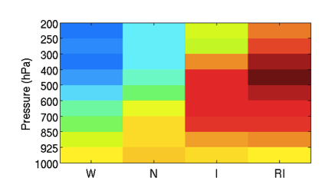
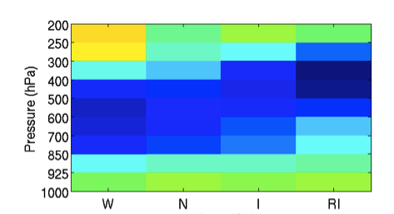
W: Weakening; N: Neutral;
I: Intensifying; RI: Rapidly Intensifying
Relative humidity anomalies in TC front-right quadrant
Near environment
(200-400 km)
Far environment
(600-800 km)
Wu et al. (2012, GRL)

Slide 3
Relevant science questions
How does the outflow layer interact with the environment?
How do intrusions of dry air impact intensity change?

Slide 4
Background

Slide 5
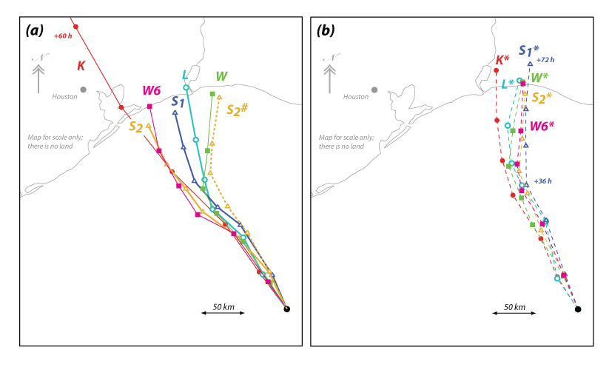
Semi-idealized experiment
very small part of domain shown
Real-data WRF-ARW @ 3 or 4 km
72 h
Uniform SST
No initial flow
NO LAND
7 microphysics (MP) schemes
One initial condition
Fovell et al. (2009)
Fovell et al. (2010)

Slide 6
Semi-idealized experiment
very small part of domain shown
These MP schemes yielded different…
…amounts of various hydrometeors
…diabatic heating patterns
…symmetric wind structures
…asymmetry patterns
…motions
…intensities
Fovell et al. (2009)
Fovell et al. (2010)

Slide 7
Influence of cloud-radiative feedback (CRF)
CRF on
CRF off
CRF-on
CRF-off
Fovell et al. (2010)

Slide 8
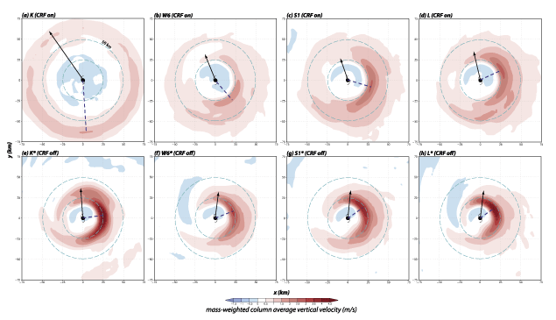
Troposphere-averaged vertical velocity
150 km
CRF caused storms to be wider, less asymmetric, weaker
Fovell et al. (2010)
with ARW, curved Earth
Top row: CRF on
Bottom row: CRF off

Slide 9
Hypotheses
CRF amplifies differences among MP schemes
CRF actively leads to wider anvils
Anvil self-spreading mechanism
CRF indirectly enhances outer core convective activity
Moistening of outer core region
CRF leads to weaker inner core intensity
Competition between eyewall and outer core convection
CRF results in wider eyes
Possible direct (CRF diabatic forcing) and indirect (via enhanced convection) influences
Lack of CRF in HWRF may explain eye size and intensity biases
HWRF eyes tend to be too small, too annular
HWRF storms tend to be too intense
Notes:
Have to walk some of these back…

Slide 10
More semi-idealized WRF-ARW simulations
f-plane & curved Earth

Slide 11
Experimental design
WRF 3.4.1 “real-data” version
f-plane 20˚N or fully curved Earth
4 km resolution
No land, uniform SST
Modified Jordan sounding
No initial wind or shear
Bubble initialization
Thompson microphysics (among others)
RRTMG LW and SW radiation (among others)
96 h simulations with and without CRF

Slide 12
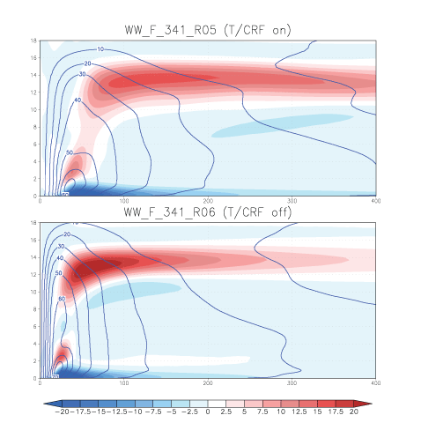
Temporally & azimuthally averaged – last 24 h
f-plane
Radial (colored) and tangential (contoured) winds
Top: CRF-on
Bottom: CRF-off
CRF-off storm is narrower, stronger
CRF-on storm has more extensive radial outflow
400 km
Notes:
Azimuthal and temporal averages

Slide 13
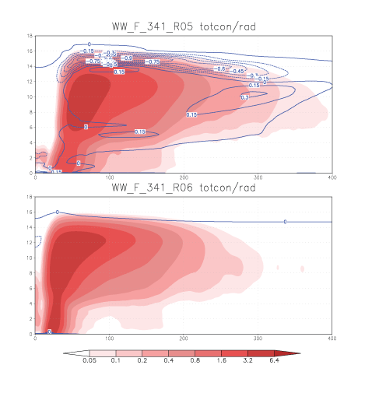
f-plane
-0.9 K/h
C
Condensate (colored)
and net radiative forcing (contoured)
Top: CRF-on
Bottom: CRF-off
W
CRF-on storm has more extensive anvil
only clear sky
400 km
Notes:
Azimuthal and temporal averages

Slide 14
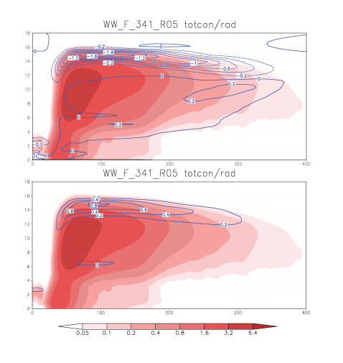
f-plane
-1.6 K/h
Condensate (colored)
and radiative forcing (contoured)
Top: LW component
Bottom: SW component
LW
0.8 K/h
Substantial cancellation between LW & SW… during the day
SW
Over 24 h
400 km
Notes:
Azimuthal and temporal averages

Slide 15
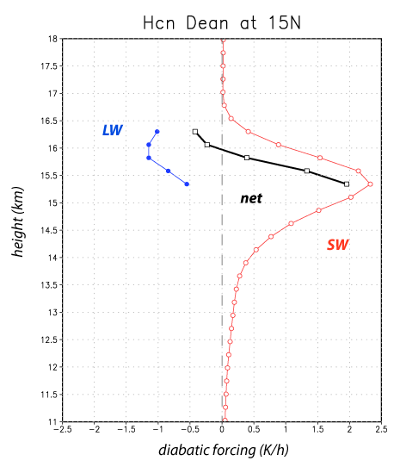
f-plane
-1.6 K/h
Condensate (colored)
and radiative forcing (contoured)
Top: LW ONLY
Bottom: SW ONLY
LW
0.8 K/h
CloudSat
obs
Substantial cancellation between LW & SW… during the day
Wu and Su,
JPL
SW
400 km
Notes:
Instantaneous obs

Slide 16
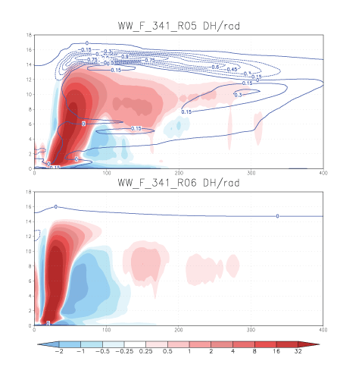
f-plane
Diabatic heating from microphysics (colored)
and net radiative forcing (contoured)
Top: CRF-on
Bottom: CRF-off
CRF-on storm has more upper-level heating, less lower-level cooling
400 km
Notes:
Azimuthal and temporal averages

Slide 17
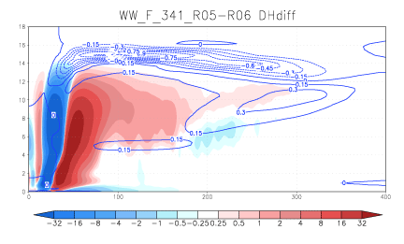
f-plane
Difference fields for
diabatic heating from microphysics (colored)
and net radiative forcing (contoured)
Top: CRF-on
Bottom: CRF-off
Extra heating
CRF-on storm has more extensive heating, concentrated in upper troposphere
400 km
Eye width
difference
Notes:
Azimuthal and temporal averages

Slide 18
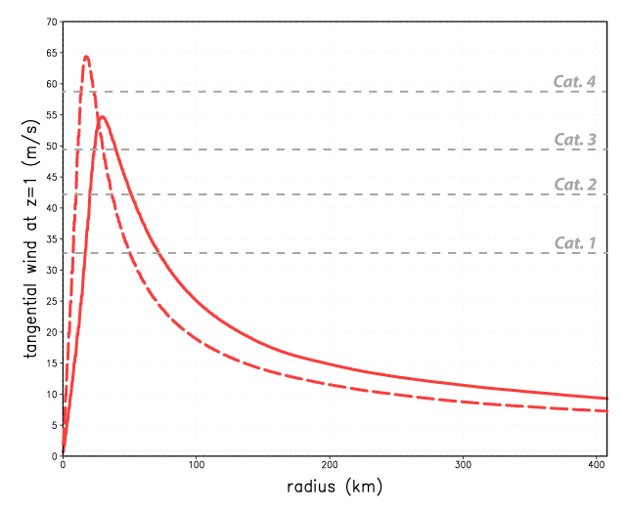
Tangential wind at lowest model level: CRF-on vs. CRF-off
10 m/s or 20 kt
CRF-on is:
weaker
wider
broader
CRF-on
CRF-off

Slide 19
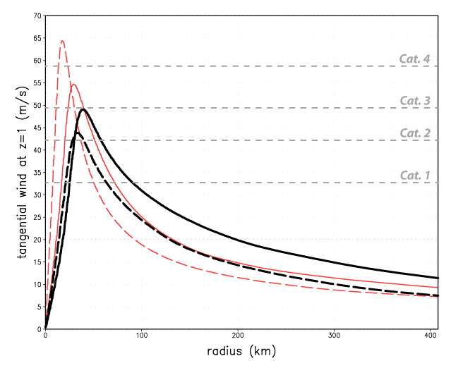
Tangential wind at lowest model level: f-plane vs. curved Earth
10 m/s or 20 kt
Curved Earth
CRF-on now more intense;
outer winds still stronger
curved Earth
CRF-on
CRF-off

Slide 20
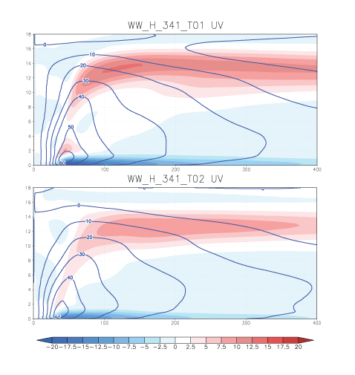
Curved Earth
Radial (colored) and tangential (contoured) winds
Top: CRF-on
Bottom: CRF-off
CRF-off storm is slightly narrower, but weaker
CRF-on storm has more extensive radial outflow
400 km
Notes:
Azimuthal and temporal averages

Slide 21
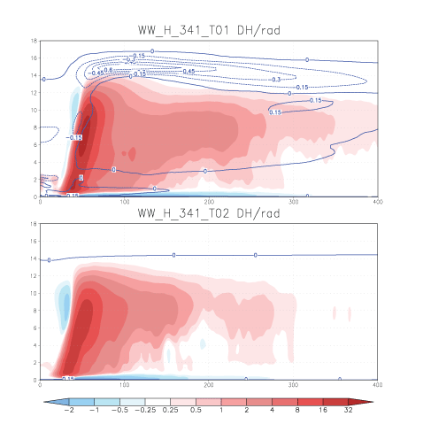
Curved Earth
Diabatic heating from microphysics (colored)
and net radiative forcing (contoured)
Top: CRF-on
Bottom: CRF-off
CRF-on storm has more outer core heating;
little net cooling seen
400 km
Notes:
Azimuthal and temporal averages

Slide 22
ON
OFF
Diabatic forcing
f-plane
curved Earth

Slide 23
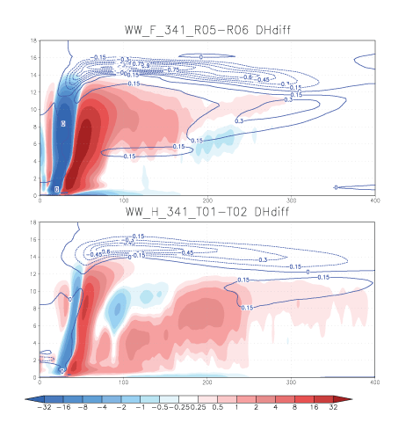
Difference fields for
diabatic heating from microphysics (colored)
and net radiative forcing (contoured)
Top: f-plane
Bottom: curved Earth
Heating difference patterns are different
400 km
Notes:
Azimuthal and temporal averages

Slide 24
Impacts of CRF
Strengthens radial outflow
Enhances outer region convection
Broadens wind field
Widens storm eye
No systematic influence on intensity
Sensitivity to microphysics scheme
Large in schemes rich in cloud ice and snow
Small in “graupel-happy” parameterizations
Operational HWRF (still) has no CRF
May help explain some model size, structure biases
Red text = not shown here

Slide 25
The physics of CRF: how and why
Axisymmeric simulations with CM1
Moist and dry versions

Slide 26
CM1 experimental design
Axisymmetric framework (f-plane 20˚N)
5 km resolution
16 day simulations
Rotunno-Emanuel moist-neutral sounding
Goddard radiation (modified)
Thompson microphysics
Averaging period: last 4 days

Slide 27
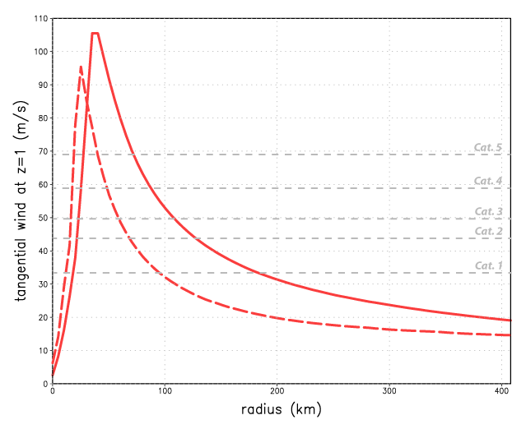
Tangential wind at lowest model level
10 m/s or 20 kt
CRF-on stronger than CRF-off;
Both much stronger than 3D versions
10 m/s
CRF-on
CRF-off
Notes:
T01_LW15 and T02_LW15

Slide 28
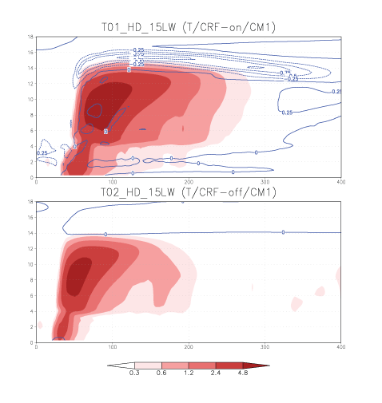
Condensate (colored)
and total radiative
forcing (contoured)
Top: CRF-on
Bottom: CRF-off
CRF-on storm has wider anvil, and is also deeper
400 km
Notes:
CRF-on storm is deeper than CRF-off storm, as well as wider

Slide 29
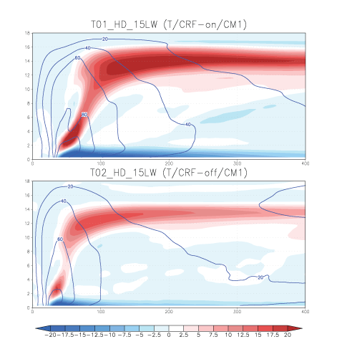
Radial (colored) and tangential (contoured) winds
Top: CRF-on
Bottom: CRF-off
CRF-on storm again wider with stronger outflow
but also higher intensity
400 km
Notes:
CRF-on storm is very strong rel to ARW runs
CRF-on inflow also quite strong

Slide 30
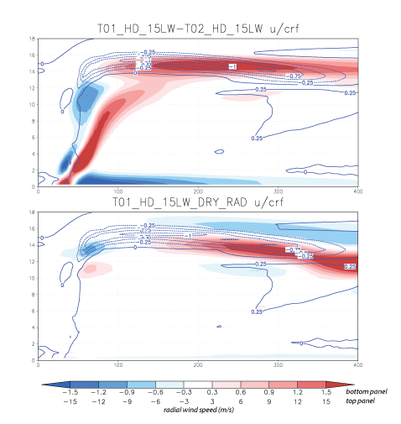
Radial wind (colored)
and CRF forcing
(contoured)
Top: CRF differences
Deeper, stronger,
more extensive outflow
By itself, CRF forcing encourages stronger radial outflow
Eye width
difference
Notes:
CRF-on storm is very strong rel to ARW runs

Slide 31
Radial wind (colored)
and CRF forcing
(contoured)
Top: CRF differences
Bottom: dry model
By itself, CRF forcing encourages stronger radial outflow
Notes:
CRF-on storm is very strong rel to ARW runs

Slide 32
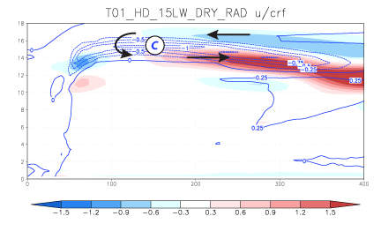
Direct response to CRF forcing
• CRF induces stronger radial outflow
• Outflow advects hydrometeors that carry the CRF forcing
• Anvil expansion (positive feedback)
Notes:
Zoom in of figure at bottom on last slide

Slide 33
Condensate (colored)
and total radiative
forcing (contoured)
Top: CRF-on
Bottom: CRF-off
Is the cloud-radiative forcing active or passive?
400 km
Notes:
Repeated slide
Experiment to prove that CRF is not a passive player in anvil expansion

Slide 34
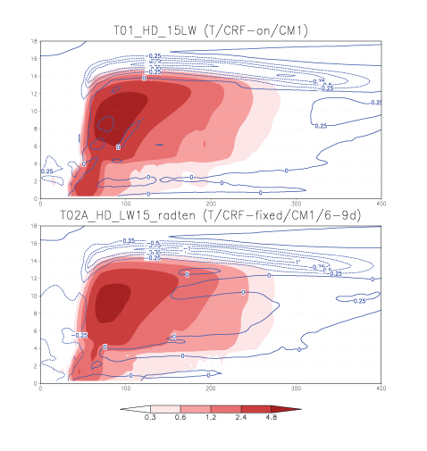
Condensate (colored)
and total radiative
forcing (contoured)
Top: CRF-on
Bottom: CRF-fixed
CRF is active.
CRF forcing averaged over
last 3 days, applied &
held fixed. Background
LW cooling removed.
400 km
Notes:
T02A is for days 6-9 rather than 9-12, as anvil keeps expanding in all CRF runs

Slide 35
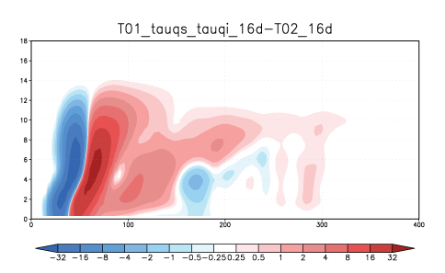
A diabatic heating difference field (CRF-on – CRF-off)
Extra heating owing to CRF
Eye width
difference

Slide 36
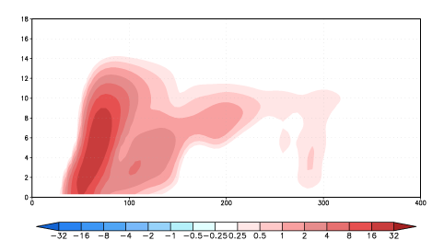
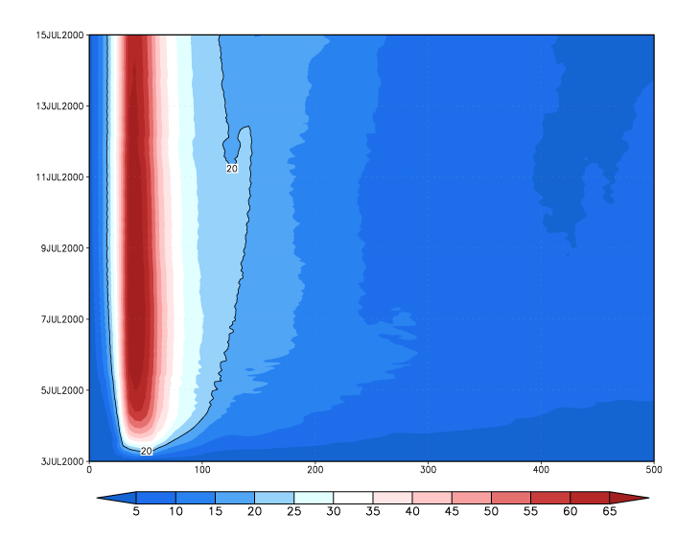
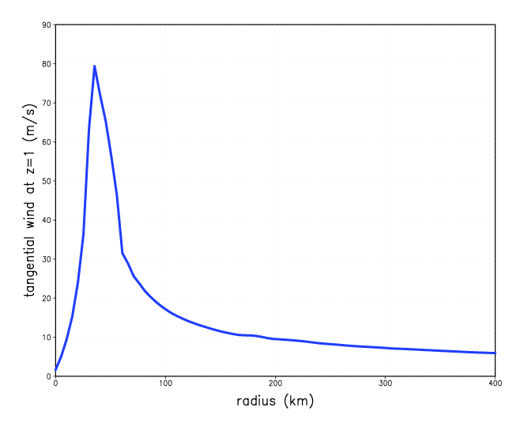
Diabatic forcing from moist model
CRF-on
500 km
Dry model response
400 km

Slide 37
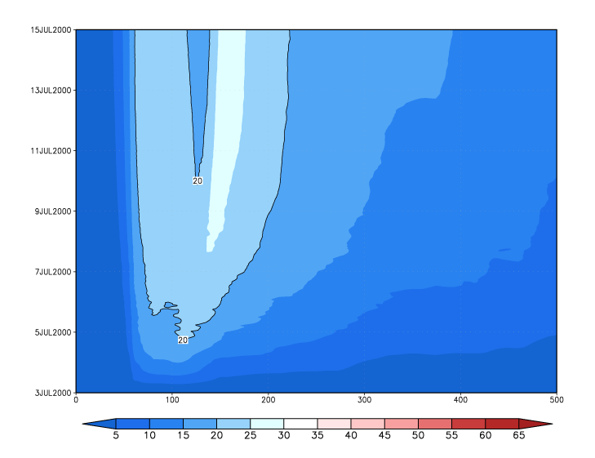
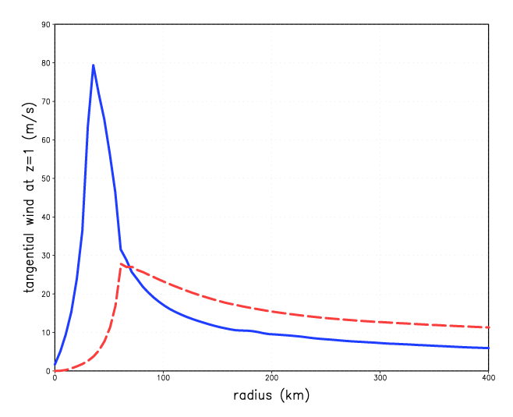
Diabatic forcing from moist model
CRF-on
500 km
widens, broadens
Dry model response
400 km

Slide 38
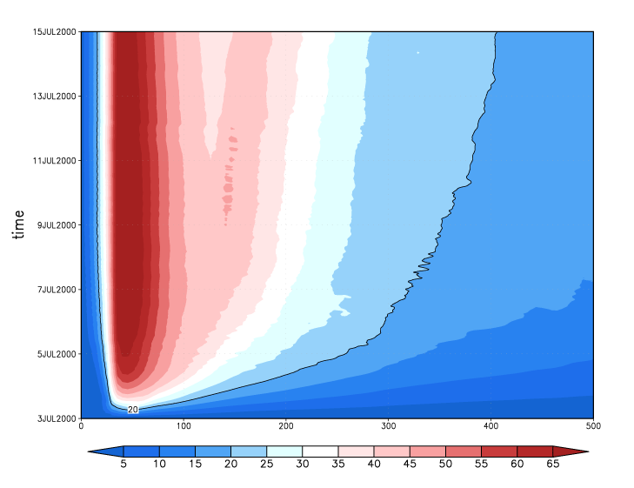
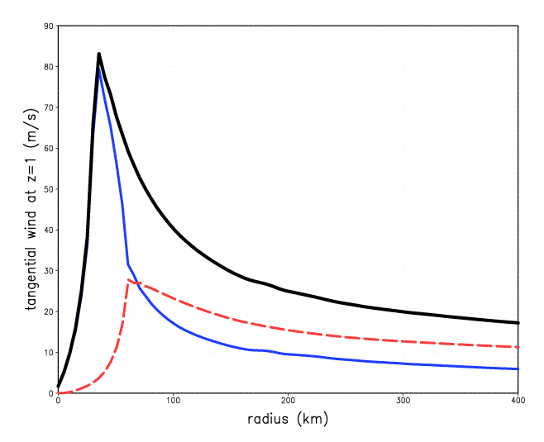
Diabatic forcing from moist model
CRF-on
500 km
Dry model response
400 km

Slide 39
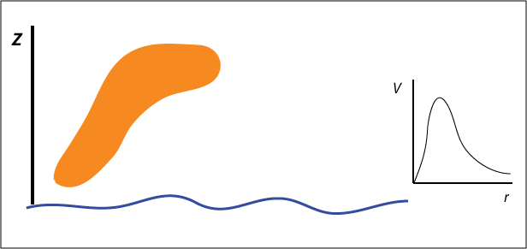
Cartoon

Slide 40
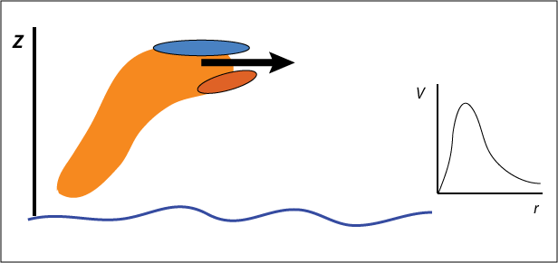
Cartoon
CRF

Slide 41
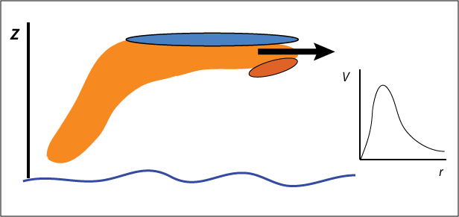
Cartoon

Slide 42
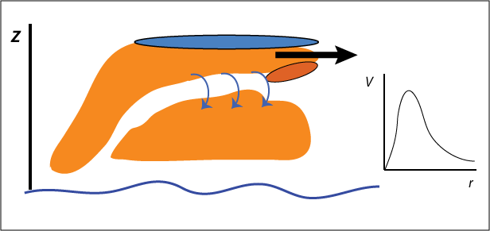
Cartoon

Slide 43
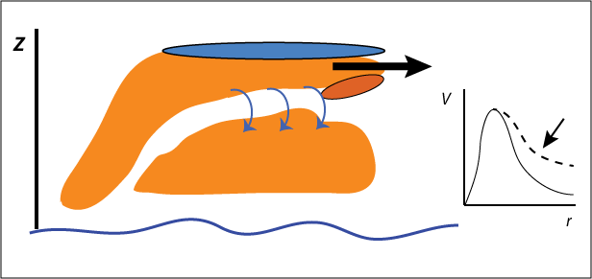
Cartoon

Slide 44
Conclusions
CRF (directly) encourages stronger radial outflow, and (indirectly) establishes stronger cyclonic winds
Influence on intensity … adds to uncertainty
Significant diurnal cycle also results (not shown)
Dependent on particle sizes (microphysics assumptions)
May explain some model structural biases
Need better understanding (observations) of LW & SW forcing magnitudes

Slide 45
[end]

Slide 46
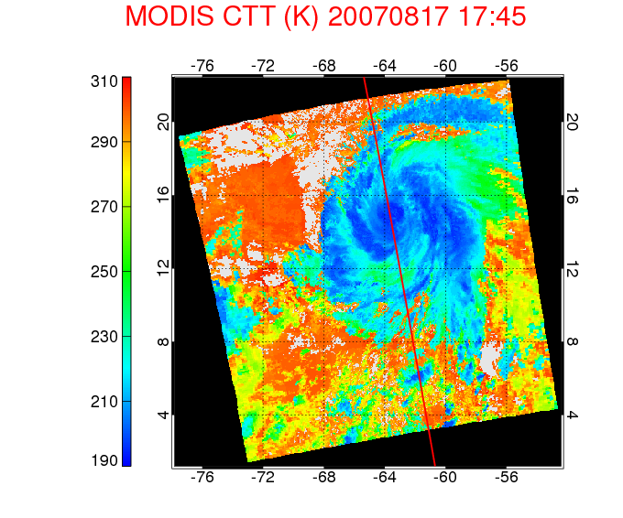
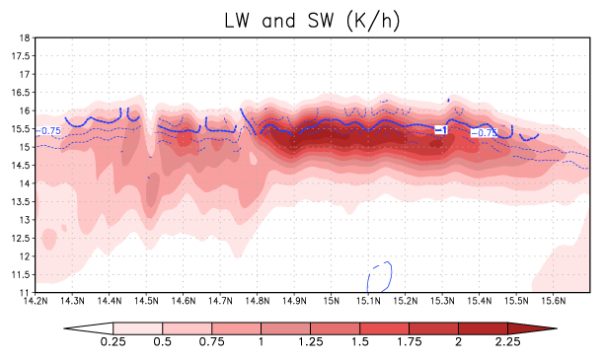
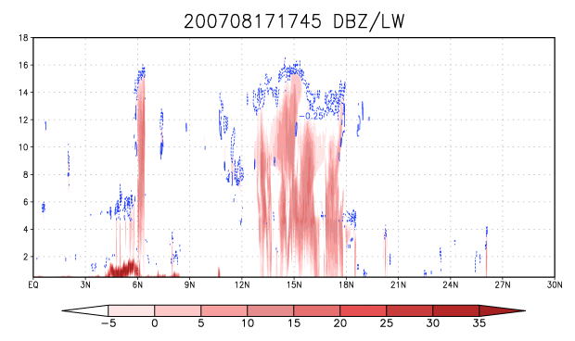

Slide 47
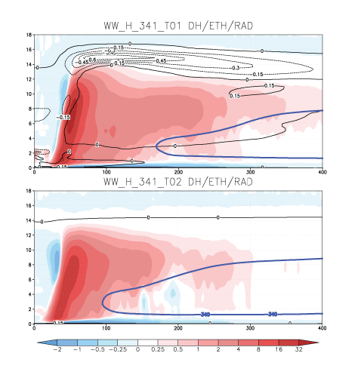

Slide 48
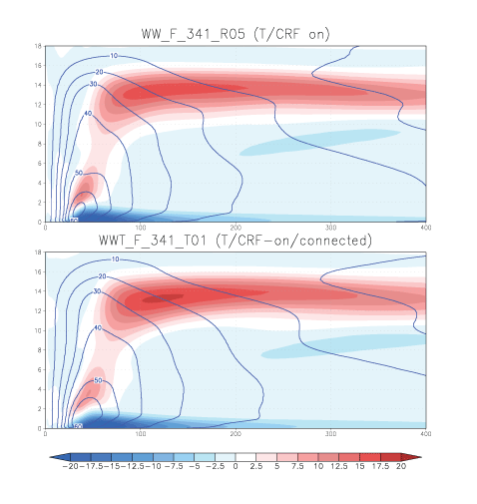
ARW with Thompson MP: RRTMG vs. “connected RRTMG”
f-plane
Radial (colored) and tangential (contoured) winds
Top: RRTMG standard
Bottom: RRTMG connect
Passing particle size information from microphysics to radiation has little impact
400 km

Slide 49
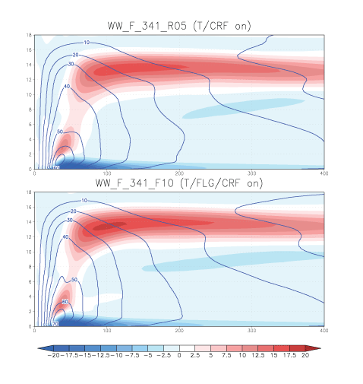
ARW with Thompson MP: RRTMG vs. Fu-Liou-Gu radiation
f-plane
Radial (colored) and tangential (contoured) winds
Top: RRTMG LW/SW
Bottom: FLG LW/SW
Radiation scheme makes
little difference
400 km

Slide 50
How does dry air impact TC storm development and/or intensity?
Possible negative influences
Promote downdrafts, lowering inflow CAPE and/or blocking inflow
Ventilation above surface layer
Encourage asymmetric convection
Possible positive influences
Suppress outer core convective activity

Slide 51
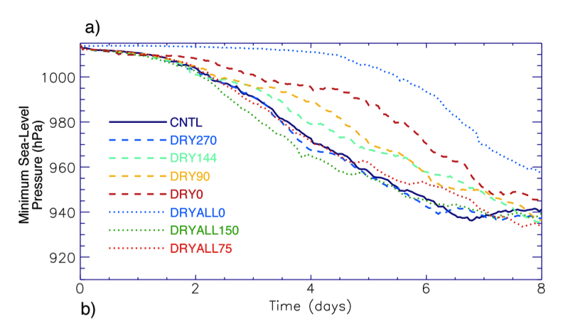
• Close proximity of dry air delays TC development,
primarily by encouraging asymmetric convection
• Eventually, TC moistens its local environment
Braun et al. (2011)

Slide 52
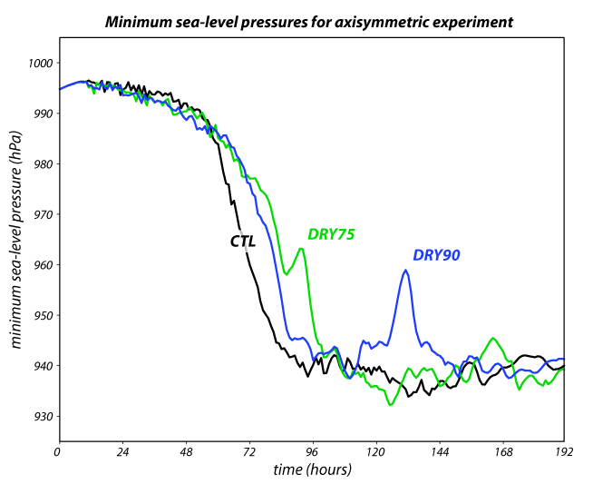
Axisymmetric model experiments
Bu (2012)
Notes:
time_series_without_NOEVAP.ai

Slide 53
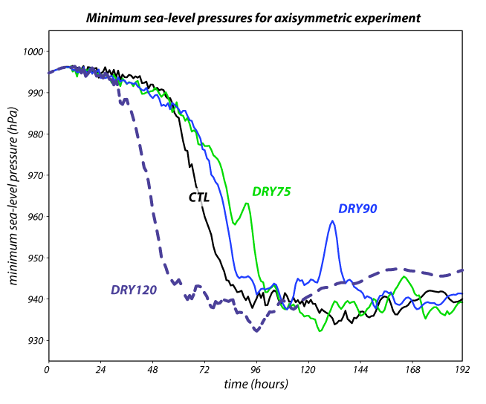
Axisymmetric model experiments
Bu (2012)
Notes:
time_series_without_NOEVAP.ai

Slide 54
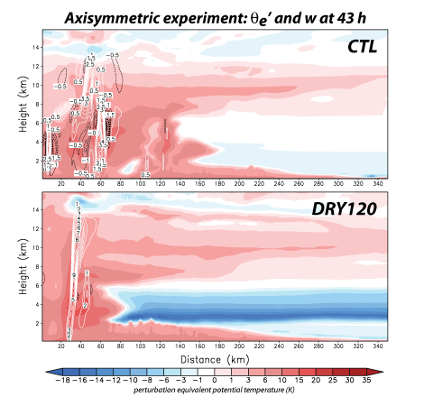
Bu (2012)

Slide 55
W: Weakening; N: Neutral;
I: Intensifying; RI: Rapidly Intensifying
Relative humidity in TC front-right quadrant
Near environment
(200-400 km)
Far environment
(600-800 km)
Wu et al. (2012)

Slide 56
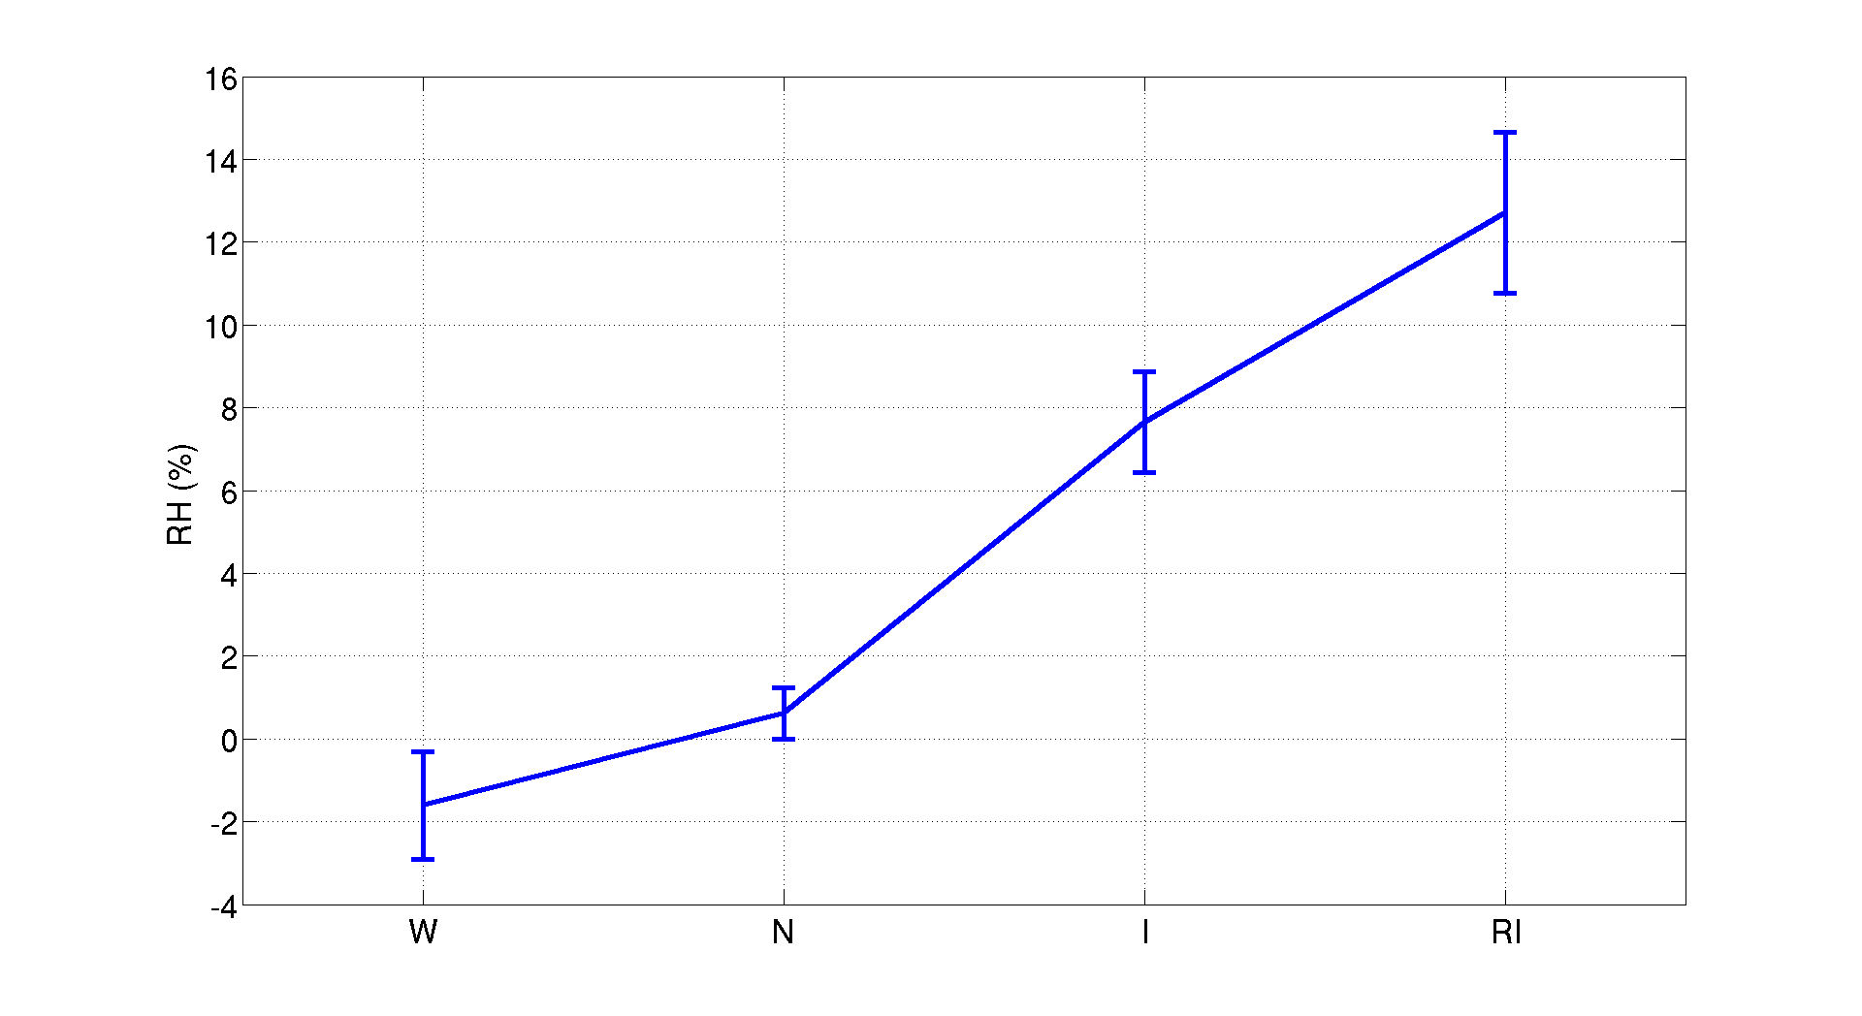
Relative humidity in TC front-right quadrant
Near environment
(200-400 km)
Near-Far RH gradient
Far environment
(600-800 km)
Wu et al. (2012)

Slide 57

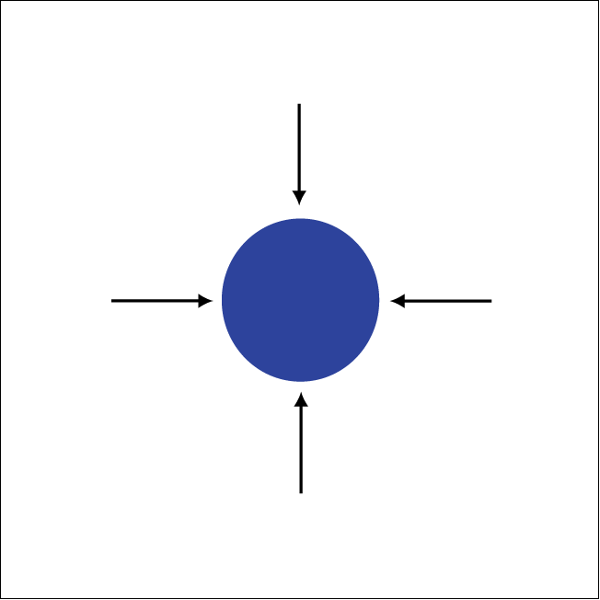
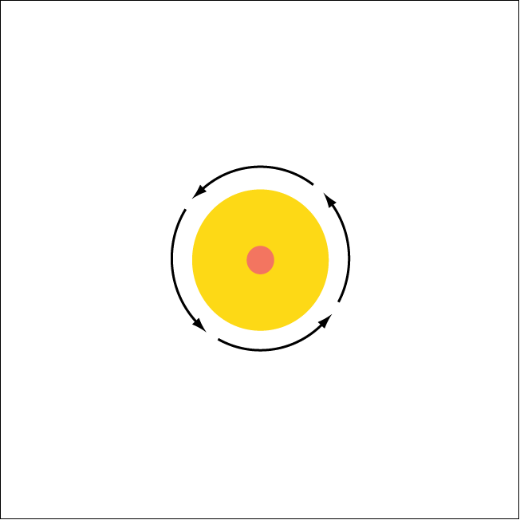
“Bubble” initialization
Small portion of domain shown
Notes:
TS strength in 24 h

Slide 58
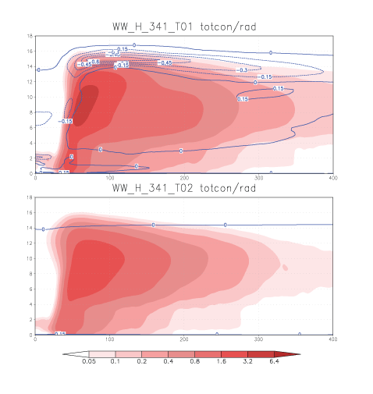
Curved Earth
Condensate (colored)
and net radiative forcing (contoured)
Top: CRF-on
Bottom: CRF-off
CRF-on storm has more extensive anvil
400 km
Notes:
Azimuthal and temporal averages

Slide 59
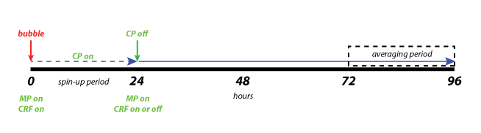
ARW simulation strategy
All plots are temporally averaged in a vortex-centered reference frame
between 72 and 96 h.
Vertical cross-sections are also averaged azimuthally.

