Slide 1





Utilizing NASA Reconnaissance Assets to Investigate Hurricane Upper-Level Warm Core Evolution, Inner Core Pulsing, and Near-Environment
Moisture Interactions
Jason P. Dunion¹, Christopher S. Velden², Lance F. Bosart³, Derrick C. Herndon²,
Bjorn Lambrigsten⁴, Charles Helms³, and Sarah Monette²
1 University of Miami/CIMAS – NOAA/AOML/HRD
2 UW-CIMSS
3 SUNY Albany
4 Jet Propulsion Laboratory
Funding Support: NASA HSRP (Grant # NNX12AK63G)

Slide 2
Discussion Outline
1) Real-Time Mission Support
2) Satellite Products (Real-time & Experimental)
Tropical Overshooting Tops (TOTs)
Cloud-Top Height Product
Warm Core Anomaly Evaluation (HAMSR, SSMS, AMSU, ATMS)
3) Phase Space Composites
Subset Compositing (pre-genesis)
4) RGB Air mass Imagery
5) Upper-Level Outflow & the TC Diurnal Cycle
2010 Earl (GRIP) and 2012 Nadine HS3
Sunset and the TC CDO
6) Conclusions

Slide 3
Aircraft Mission Design &
Real-Time Mission Support
2012
SAL Flight Module Team
Mission and flight track design
Real-Time GH GPS Dropsonde Processing
HRD Global Hawk Dropsonde Processing Team
Satellite Data and Product Support
Tropical Overshooting Tops (TOTs)
Cloud-Top Height Analysis Produced (pressure alt)
2013
Real-Time Global Hawk GPS Dropsonde Processing Support
HRD Global Hawk Dropsonde Processing Team
Satellite Data and Product Support
Tropical Overshooting Tops (TOT)
Cloud-Top Height Analysis Produced (pressure alt)
GOES-14 1-min rapid scan coordination
Mission Support (Wallops)
Forecasting: Chip Helms (SUNY), Derrick Herndon (CIMSS), John Sears (CIMSS)
Mission Scientist: Chris Velden

Slide 4
Satellite Products
Real-time and Experimental

Slide 5
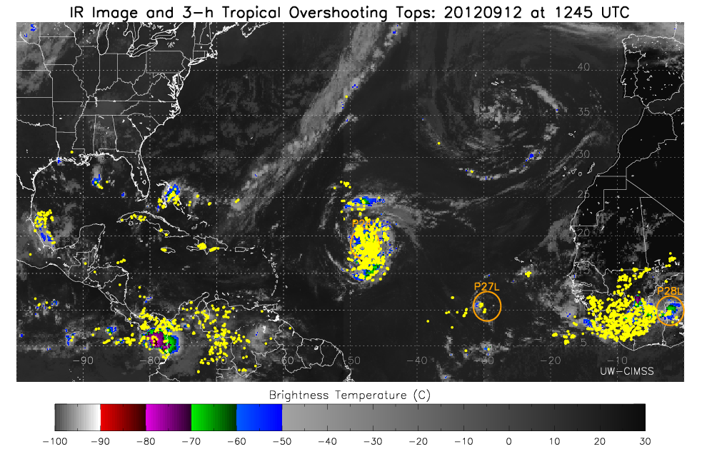
Satellite Product Support for HS3
Tropical Overshooting Tops (TOTS)
TOTs indicate areas of vigorous active convection, potentially hazardous to research aircraft.
This real-time product was used in daily HS3 weather briefings.
Example:
TOTs (squares) are displayed on BT (Brightness Temperature) imagery as the Global Hawk flies around Nadine. Colors represents TOT magnitude (BT colder than surrounding anvil).
Ongoing research includes estimating and adding height values to the TOTs.

Slide 6
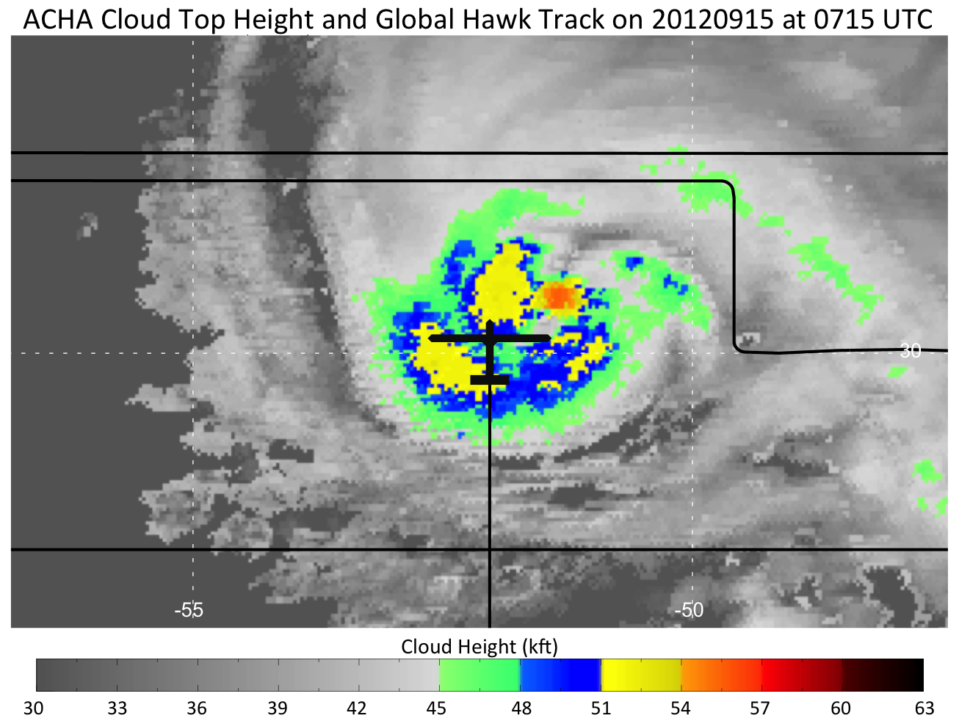
Satellite Product Support for HS3
Cloud-Top Heights
IR-based cloud top height estimates using the Advanced Cloud Height Algorithm (ACHA) in geopotential coordinates were provided for the 2012 HS3 campaign.
For 2013, the cloud top heights will be provided in pressure altitude, the coordinate system used by the GH pilots.
ACHA cloud top heights are being compared/validated using the GH Cloud Physics Lidar (CPL) and Scanning-HIS, as well as Calipso/Cloudsat data.

Slide 7
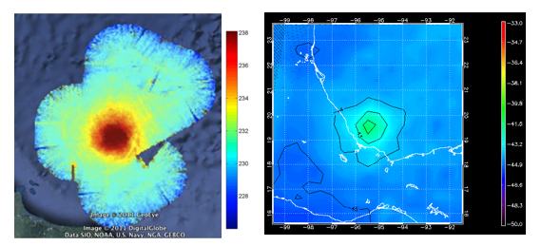
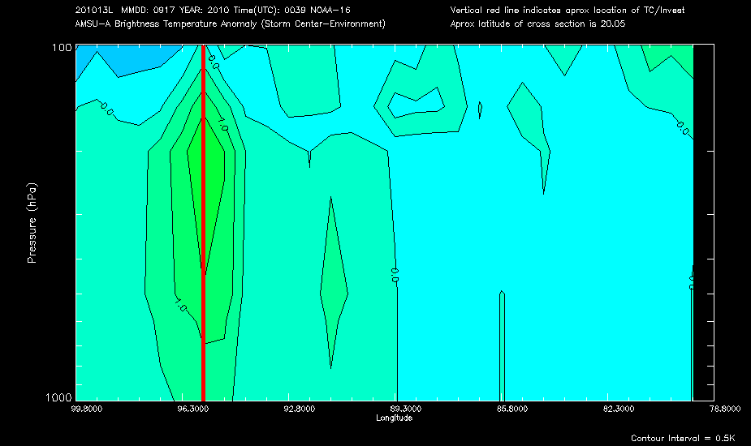
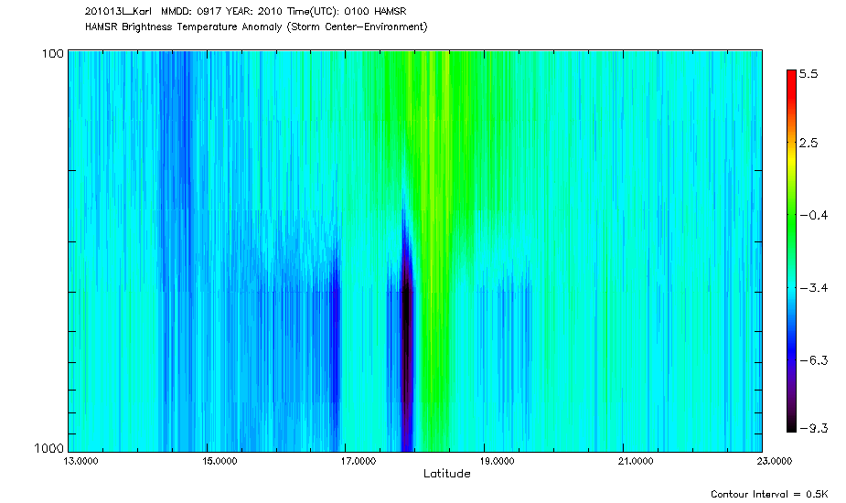
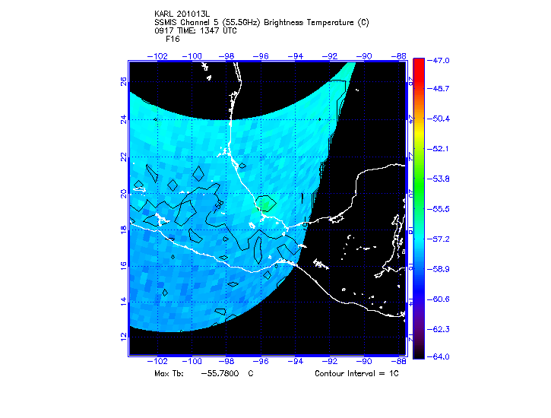
Monitoring the Warm Core Anomaly Evolution
Goal: Use GH HAMSR over-flights to calibrate satellite estimates
Tb Anomaly for Hurricane Karl (2010) During Rapid Weakening
E-W
N-S
HAMSR
0700 UTC
AMSU
1000 UTC
SSMIS
1300 UTC
CIMSS has developed an operational algorithm that relates the strength of the warm core anomaly as observed by satellite-based microwave sounders, to TC intensity (MSLP and Max Winds).
Addition of the over-storm GH with HAMSR, and ATMS on NASA’s Suomi NPP satellite, will allow for inter-comparison of four microwave sounders during HS3 field experiment in 2013.
Notes:
X-sect: 8 HAMSR channels (~50 GHz range)

Slide 8
Phase Space Compositing
Pre-Genesis Systems

Slide 9
Using a Phase Space to Composite Pre-genesis Systems
Select a subset of cases with similar structure
More homogenous subsets provide greater detail in composites
Select subsets using a phase space
Position in phase space indicates current state of important, highly variable structures
Composite all cases located in a given phase space volume
Retain detail (like case studies)
Representative results (like composite studies)

Slide 10
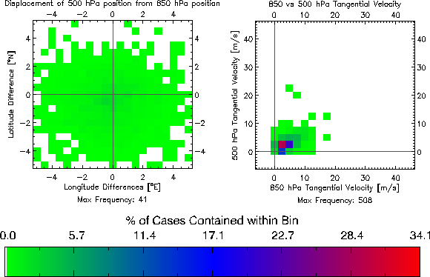
Example Phase Space
All Invest and Pre-genesis lows (2005-2012, CFSR)
Notes:
CFSR data

Slide 11
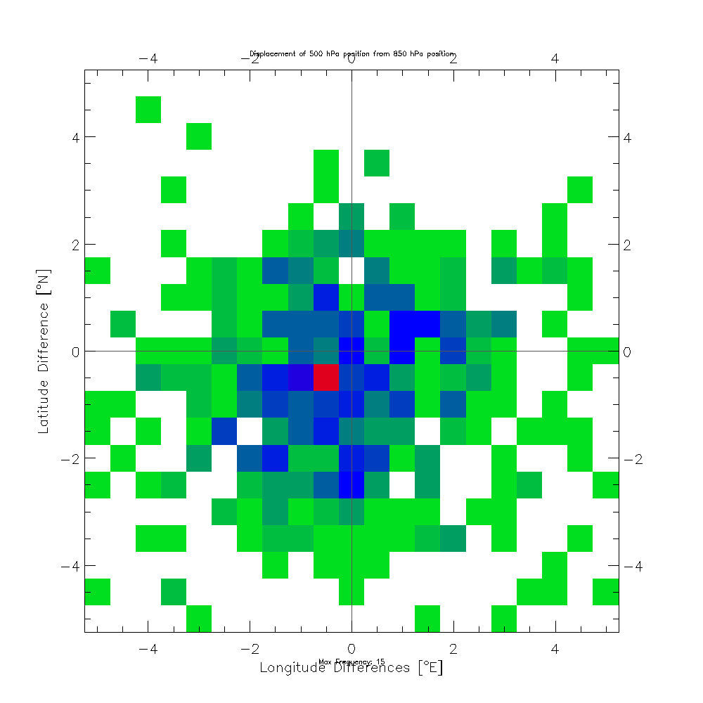
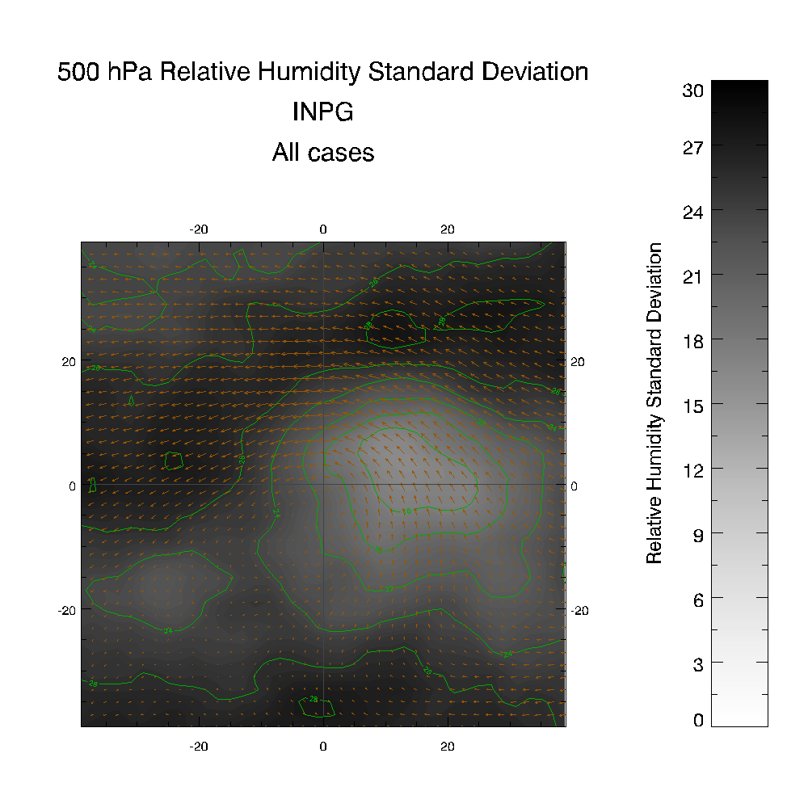
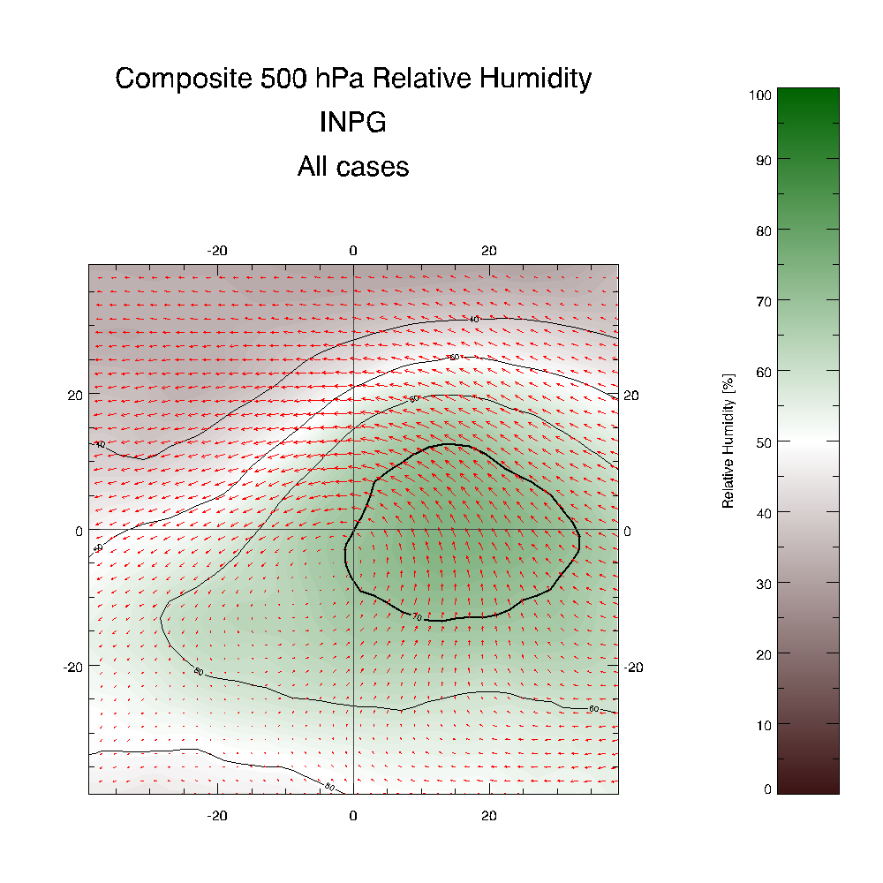
Phase Space: Proof of Concept
500 hPa position
(relative to 850 hPa position)
INVESTs+Pre-Genesis 2010
N=516, Red=15
16<σ<22
No 80% Contour
Notes:
If we only look at INVESTs and Pre-Genesis lows from 2010, our distribution of 500 mb centers looks like this. In total there are 516 center positions in this distribution and for reference, the red pixel corresponds to a count of 15 cases.
--
Here I’ve composited the 500 mb relative humidity using all of these cases. The green shading indicates moist air and the browns dry air. The thick contour is 70% relative humidity and the 500 mb composite winds are indicated by the vectors. One thing I want to point out
--
Is that there is no 80% contour here.
--
This is the distribution of standard deviation corresponding to the relative humidity composite. Standard deviation is indicated by both the green contours and the shading with darker shading indicating higher standard deviation. There are two things I want to point out here:
--
First, the composite system is almost vertically aligned. This isn’t too surprising considering the peak in the distribution is in this region. Additionally, averaging eastward and westward tilted systems together tends to remove them from the composite. I also want to point out that the standard deviation in
--
This area is between 16 and 22 percentage points.

Slide 12
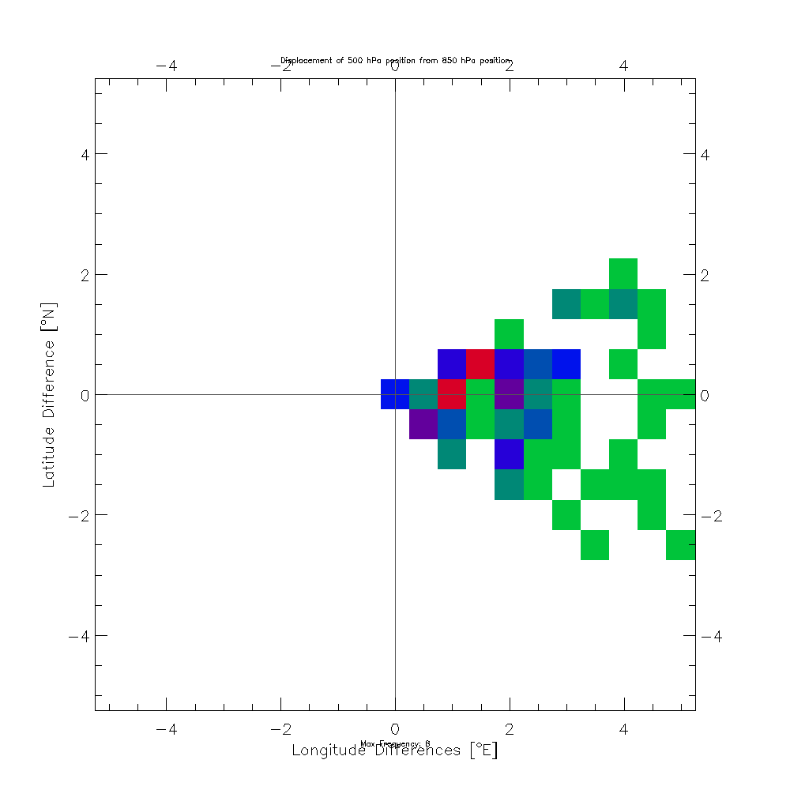
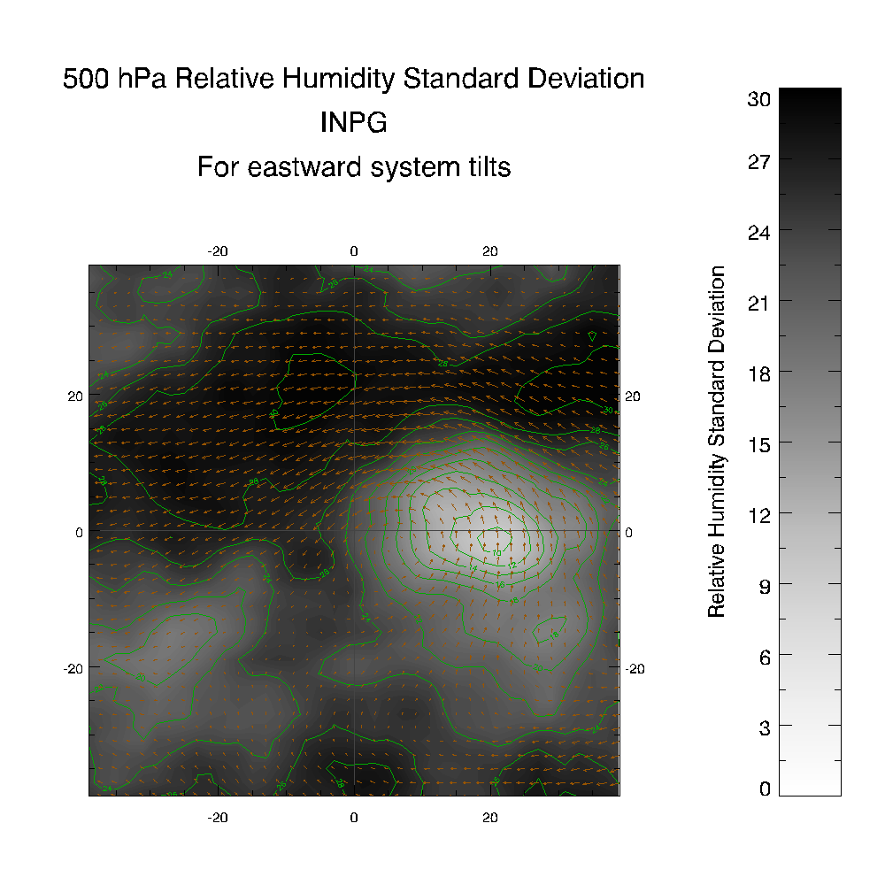
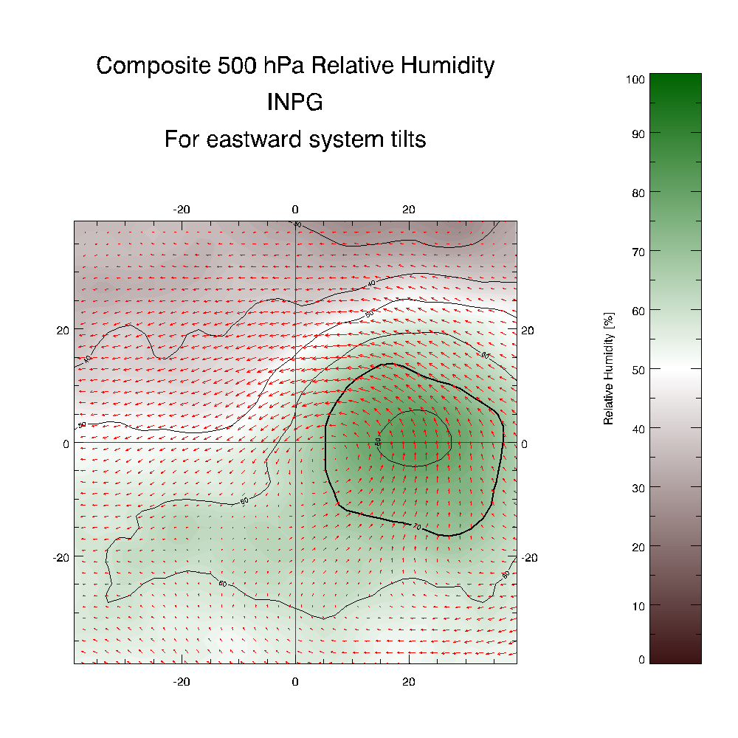
Phase Space: Proof of Concept
500 hPa position
(relative to 850 hPa position)
INVESTs+Pre-Genesis 2010
N=107, Red=6
8<σ<22
80% Contour
Was 16<σ<22
Notes:
If we limit our composite to only those cases with an eastward tilt, we get this distribution.
--
Here is the corresponding composite 500 mb relative humidity. Notice that by subsetting the cases,
--
We now have an 80% contour in our composite.
--
We also find that the standard deviation has decreased over in this area.
--
I should also point out that, not surprisingly, the 500 mb center is now located to the east of the 850 mb center. Going one step farther…

Slide 13
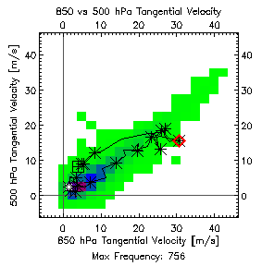
Future Work
Identify pre-genesis systems without relying on best track
Test and finalize phase space variables
Examine composites
-e.g. Dev vs Non-dev
Look for key features from composites in observational data
System evolution in phase space
850 vs 500 hPa Tangential Velocity
Hurricane Sandy
Notes:
Red diamond is at time of maximum 850 hPa tangential velocity, white star is initial time, black 4-square pattern is final time. Trajectory proceeds up the spine of the distribution (created with all HURDAT+INVESTs 2005-2012) until it reaches peak strength, then makes landfall and low levels drop off faster than midlevels.

Slide 14
Hurricane Nadine: 13 Sept 2012
Airmass Tracking (GOES-R Proving Ground)

Slide 15
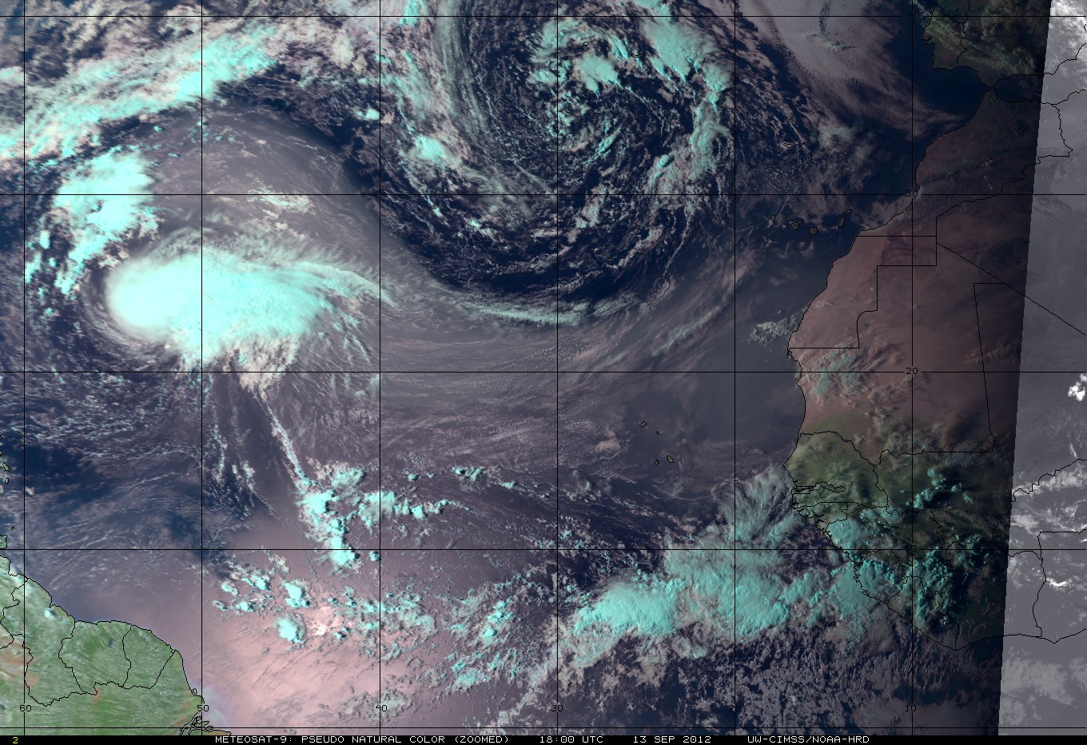
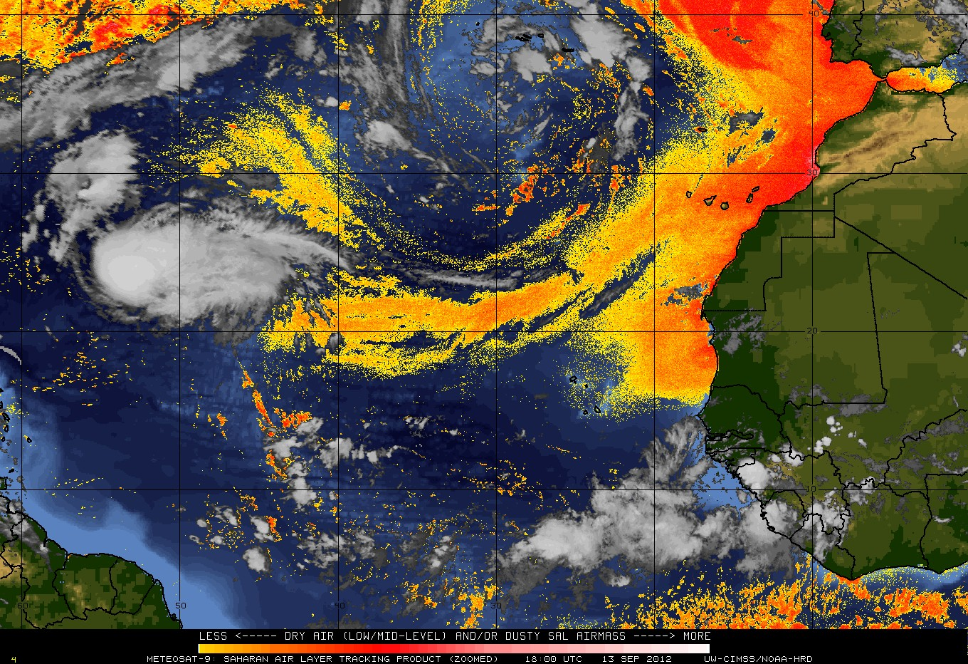
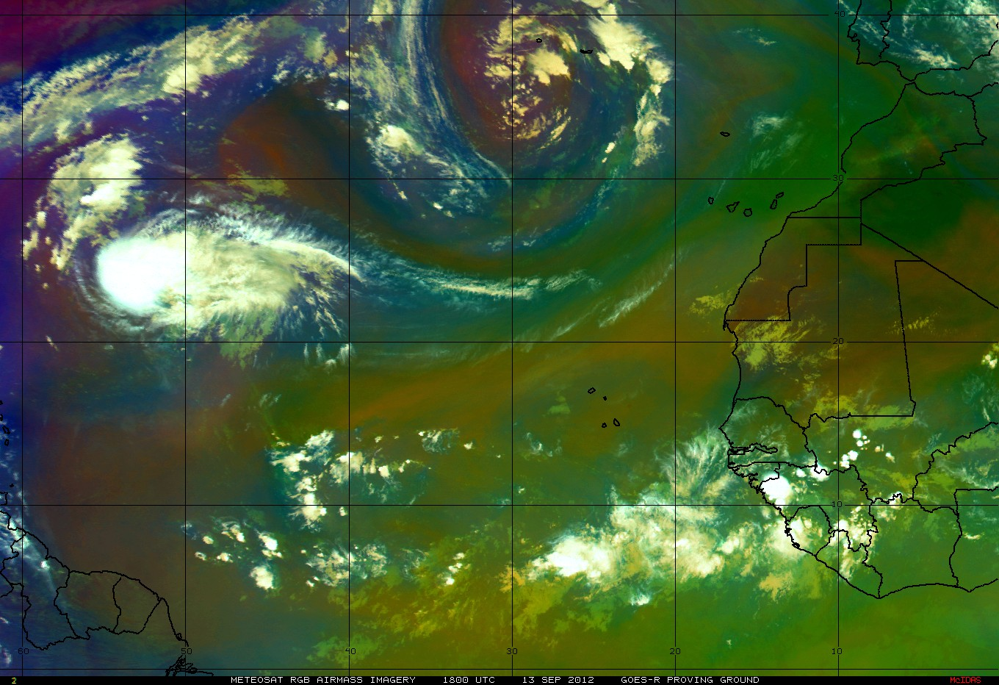
Tropical Storm Nadine: 13 Sept 2012
Met-9 Pseudo Natural Color, SAL, and RGB Airmass Imagery (6.2, 7.3, 9.7, 10.8 μm)
Polar+
PV Anomaly
Polar
SAL
Polar
Polar
SAL
Jet Streak
SAL
SAL
Tropical
High Clouds
Tropical Airmass
high trop
low ozone
Tropical Airmass
Warm
Dry mid-levels
Polar Airmass
Low trop
High ozone
Polar Airmass+
Low trop
High ozone
PV Anomaly
Jet Steak
Tropical below
Warm/Dry

Slide 16
Hurricane Earl: 31 August 2010
TC Diurnal Cycle & Upper-level Outflow

Slide 17
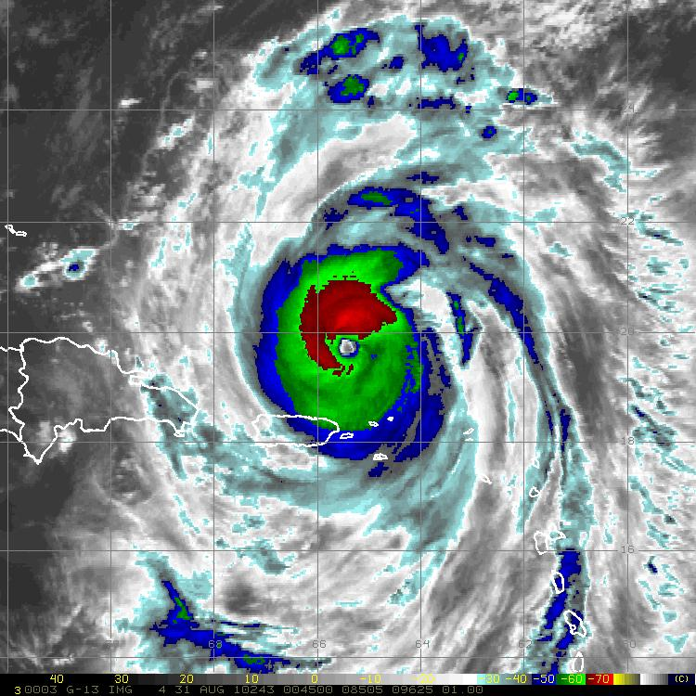
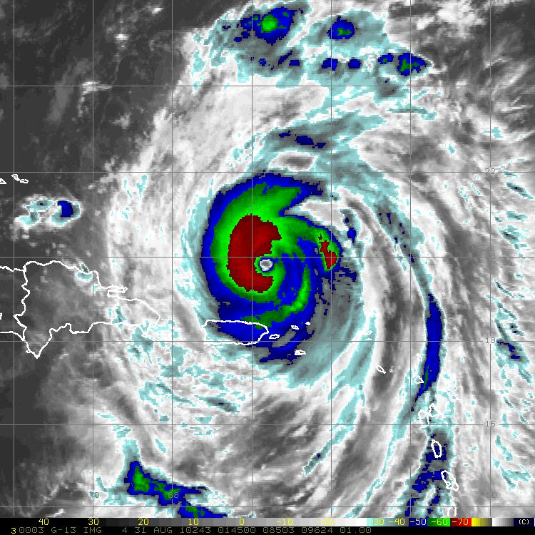
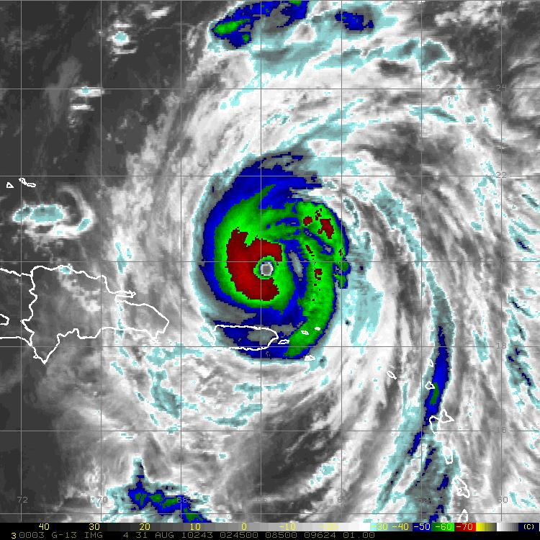
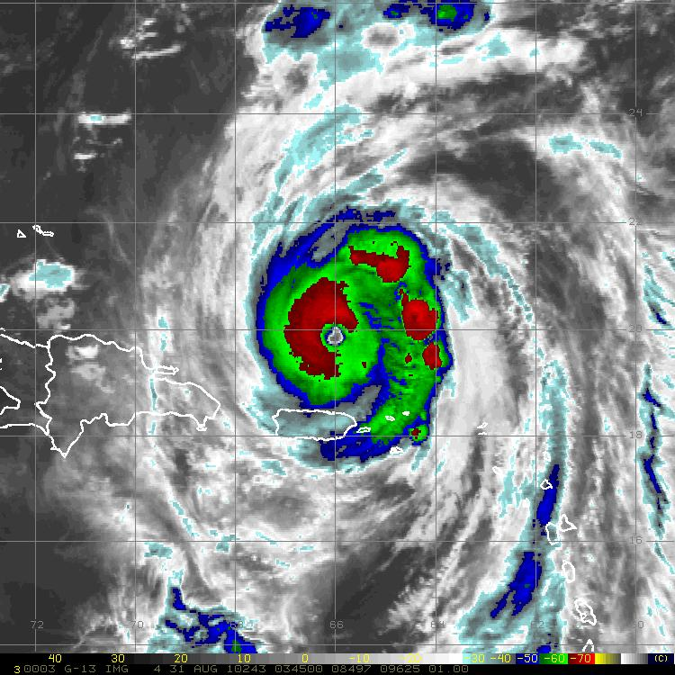
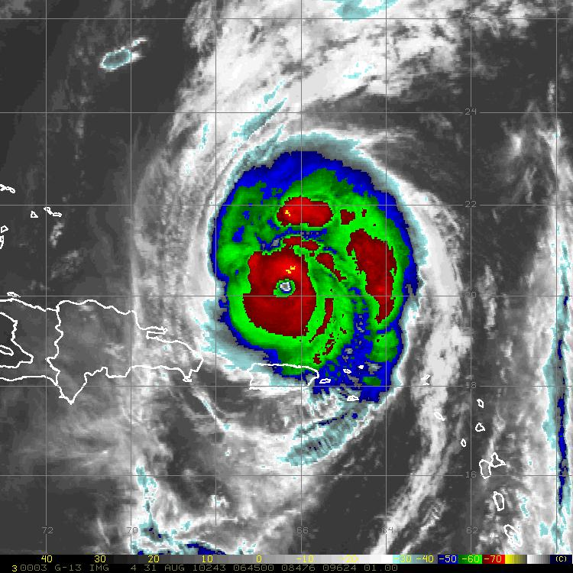
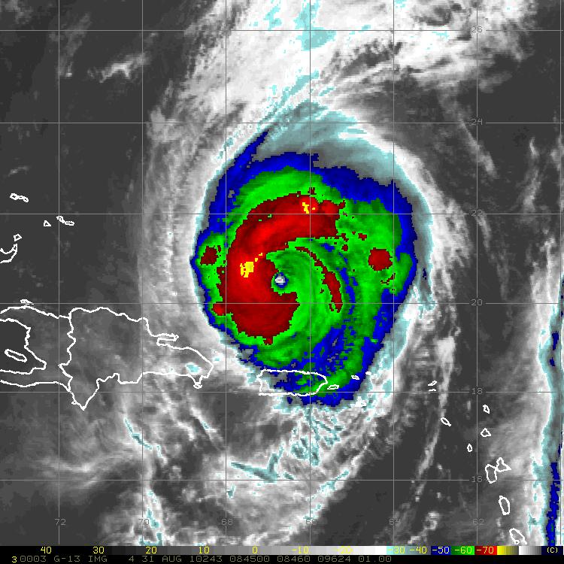
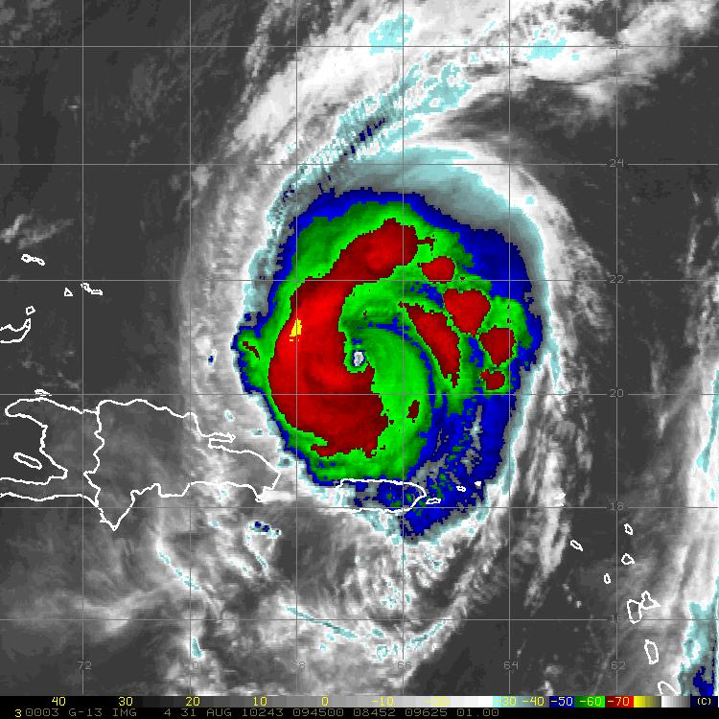
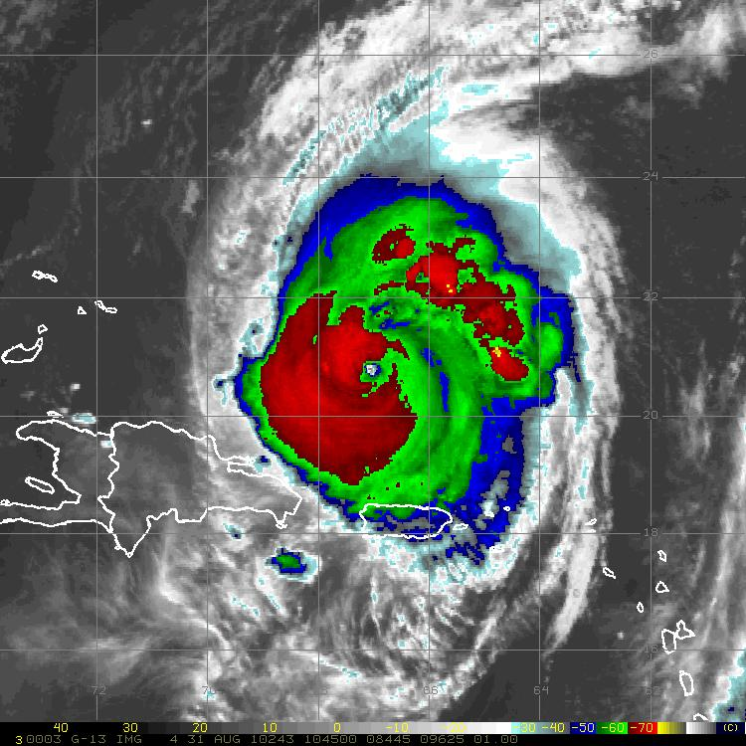
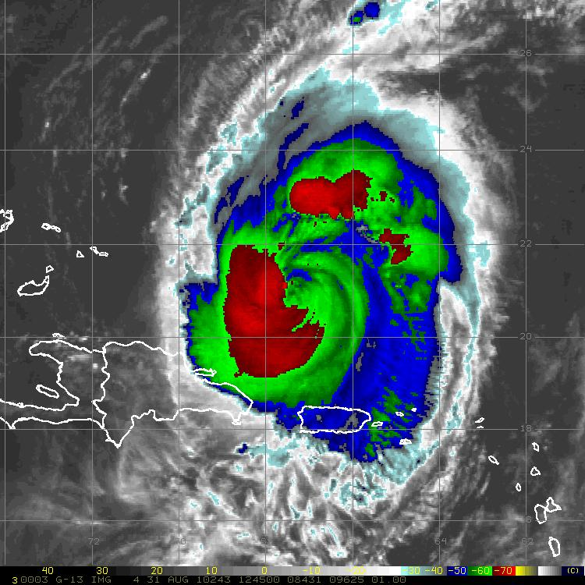
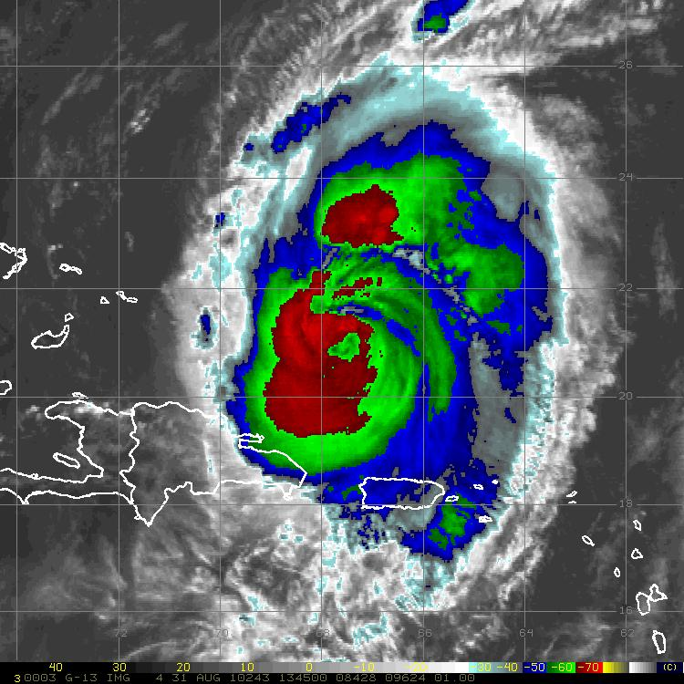
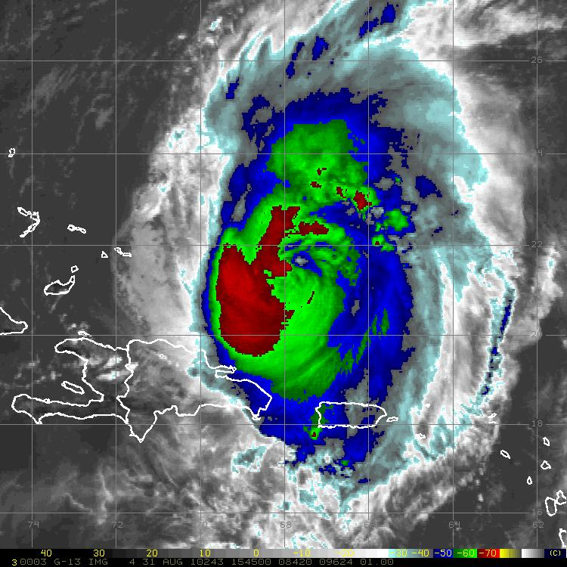
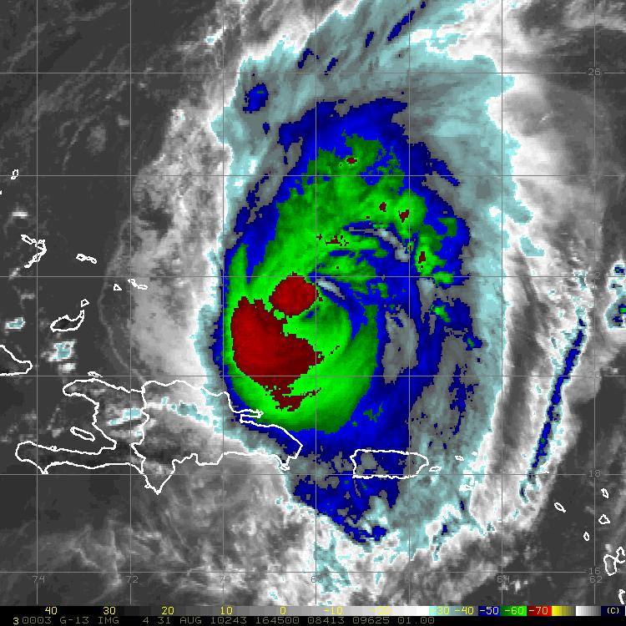
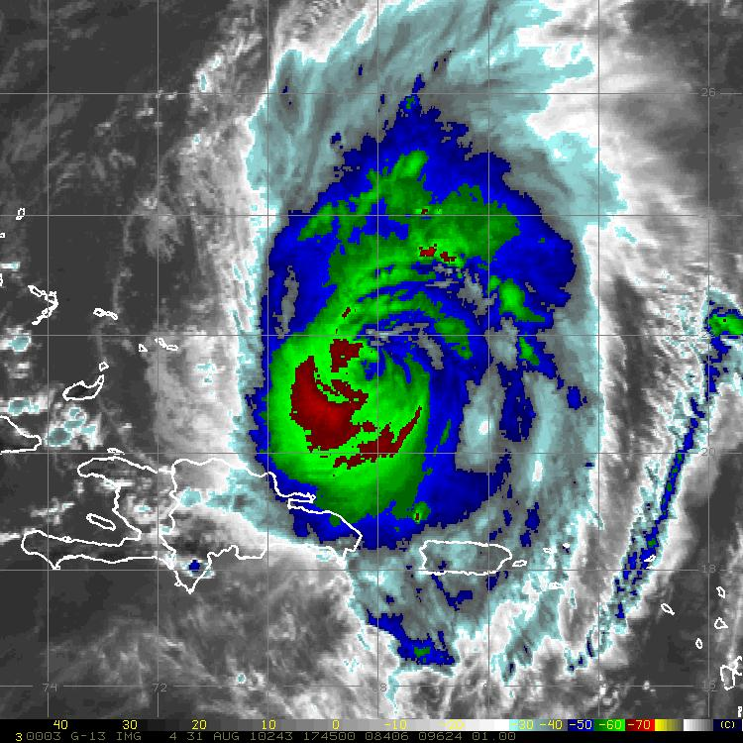
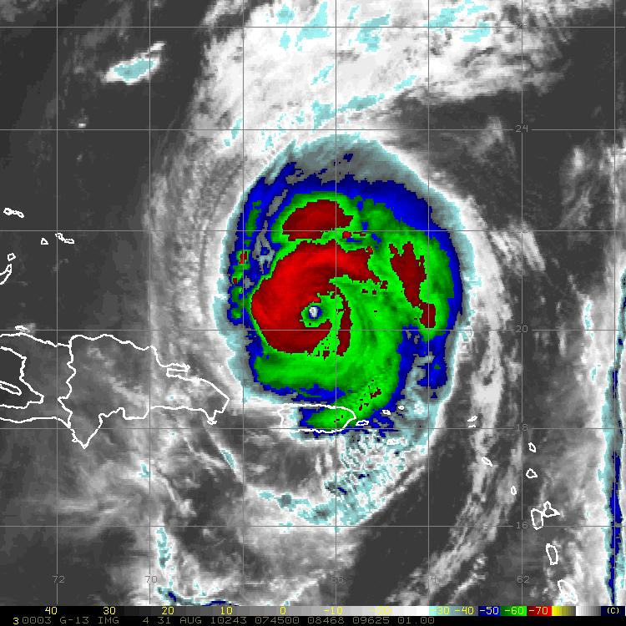
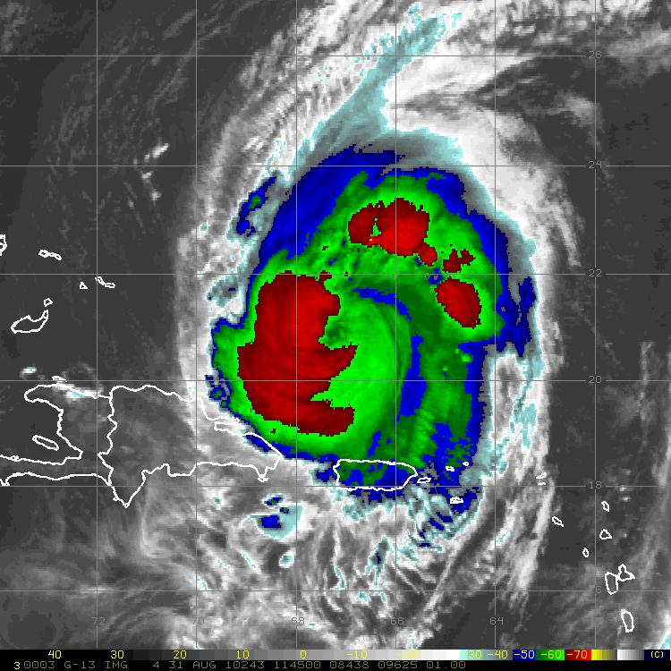
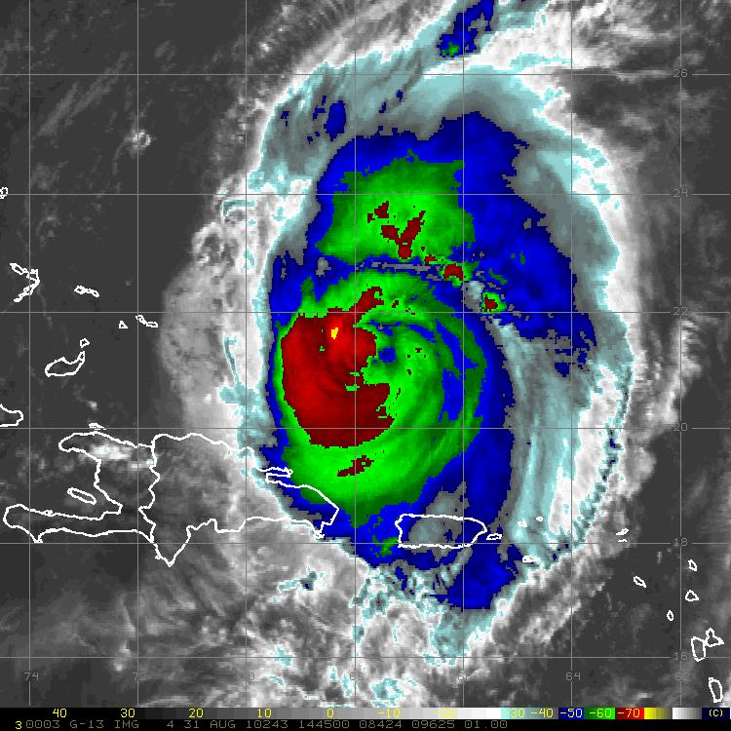
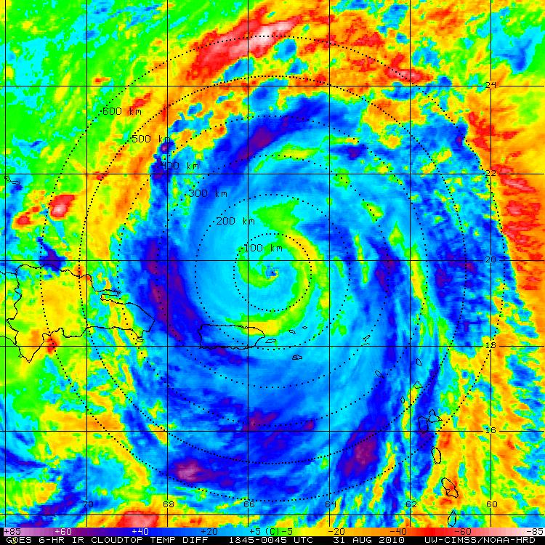
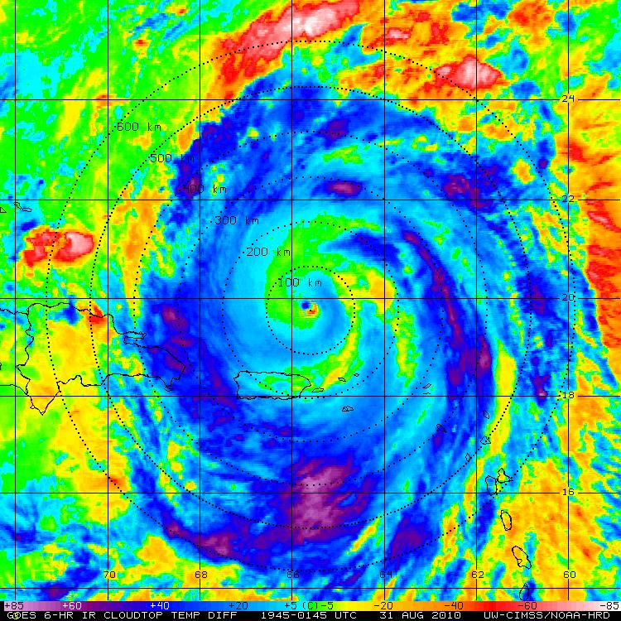
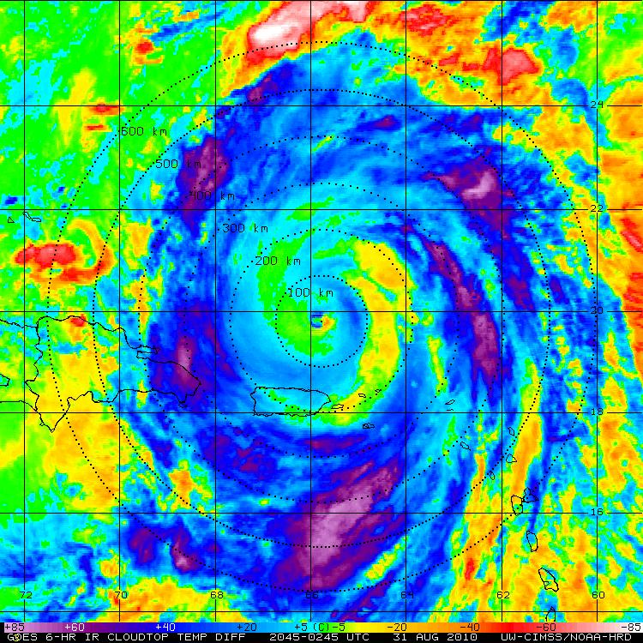
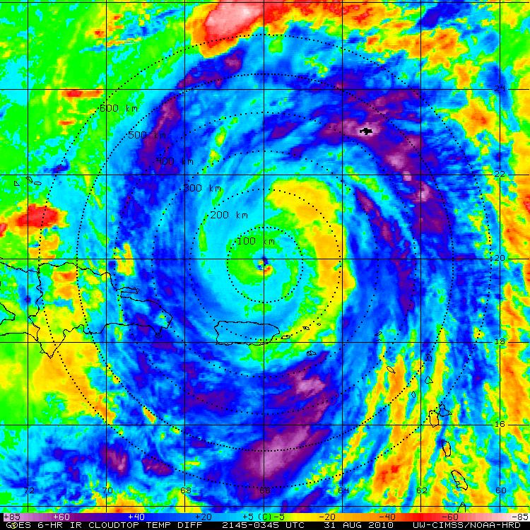
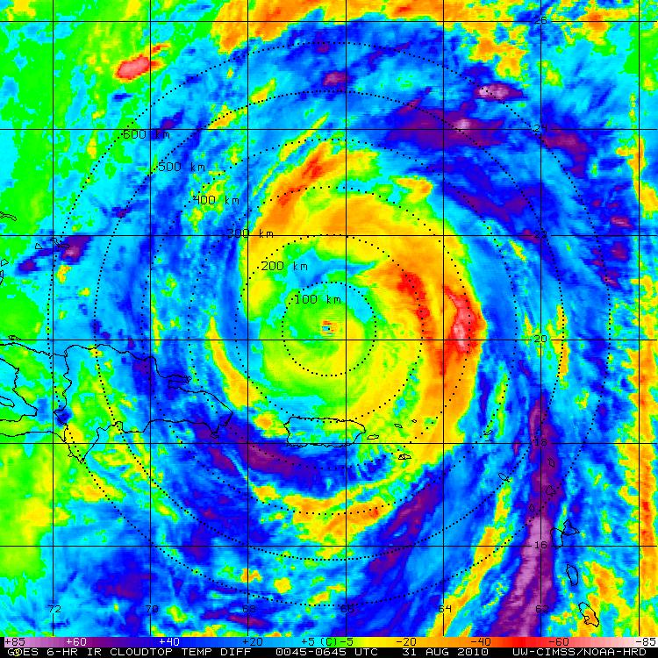
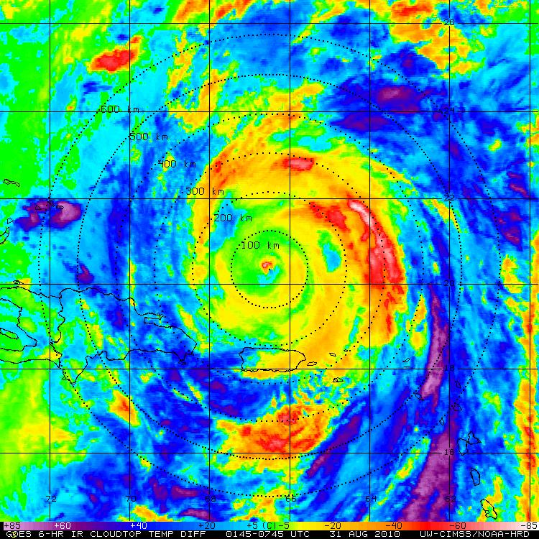
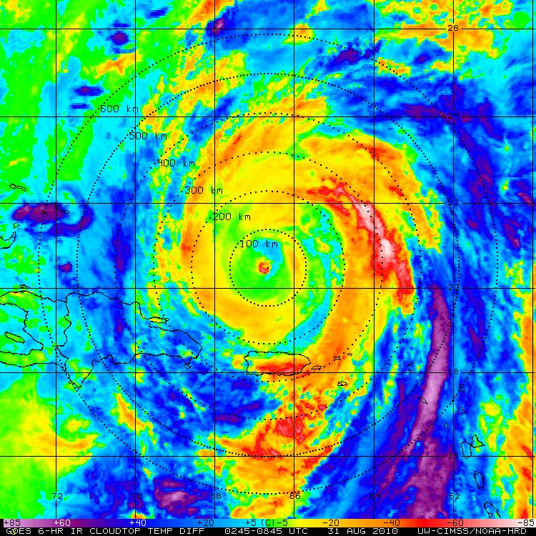
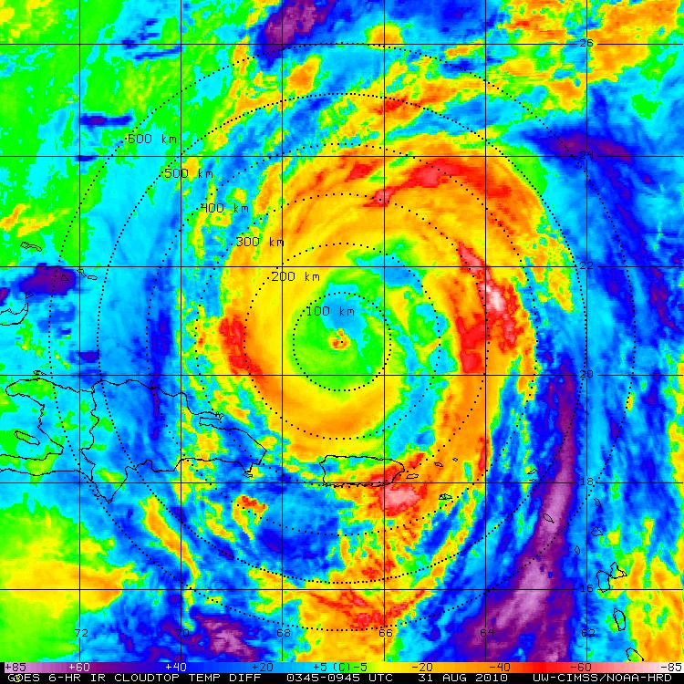
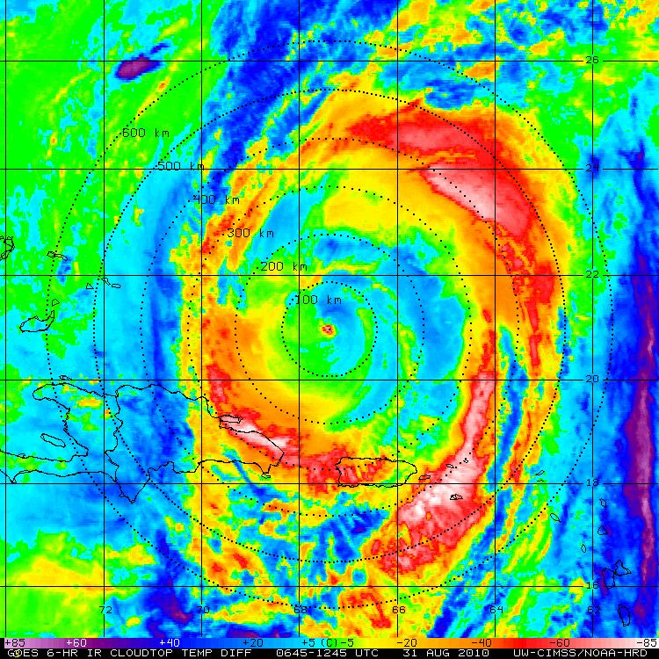
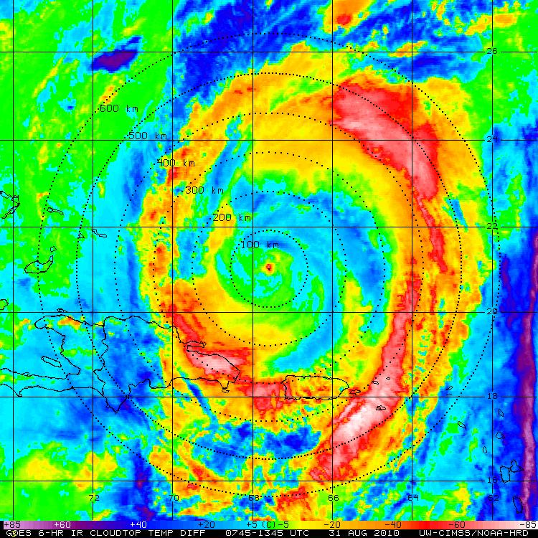
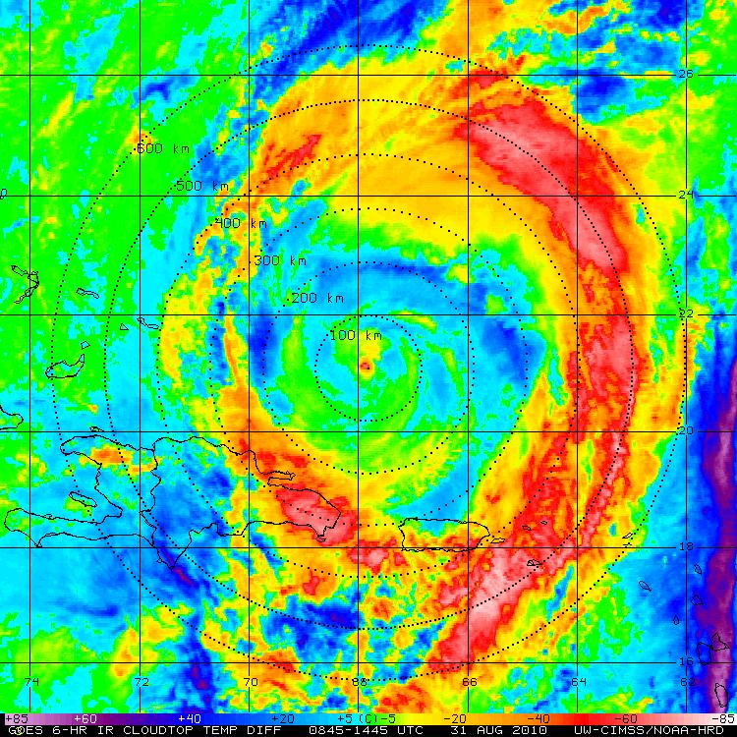
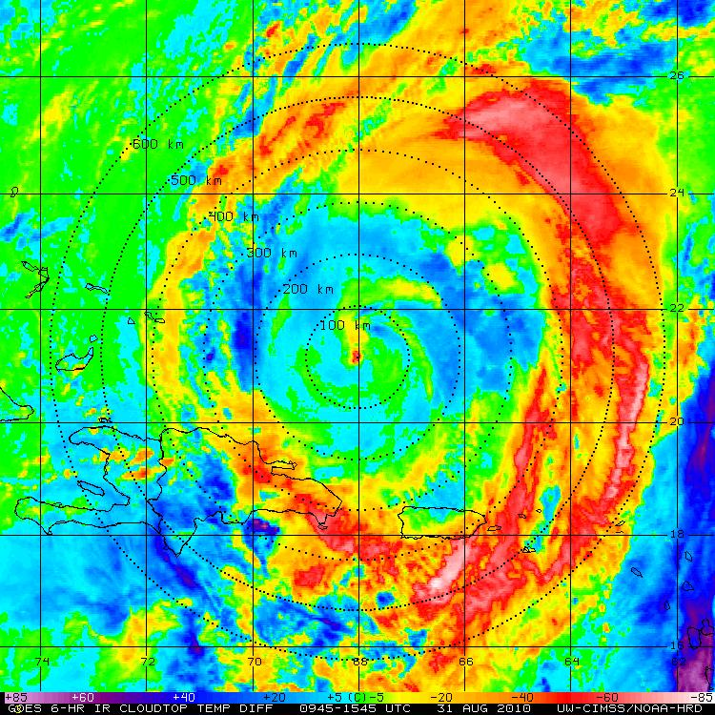
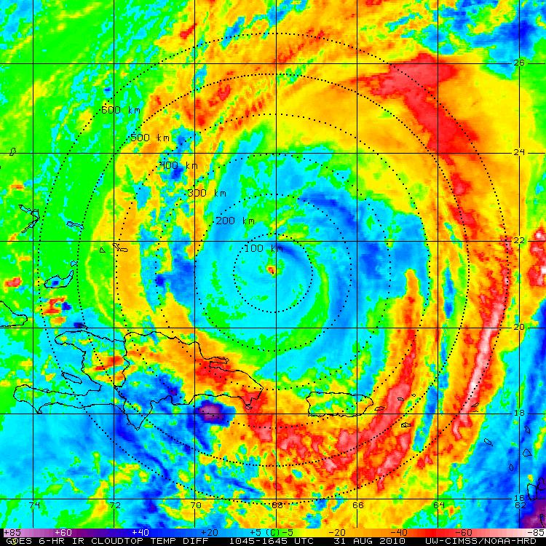
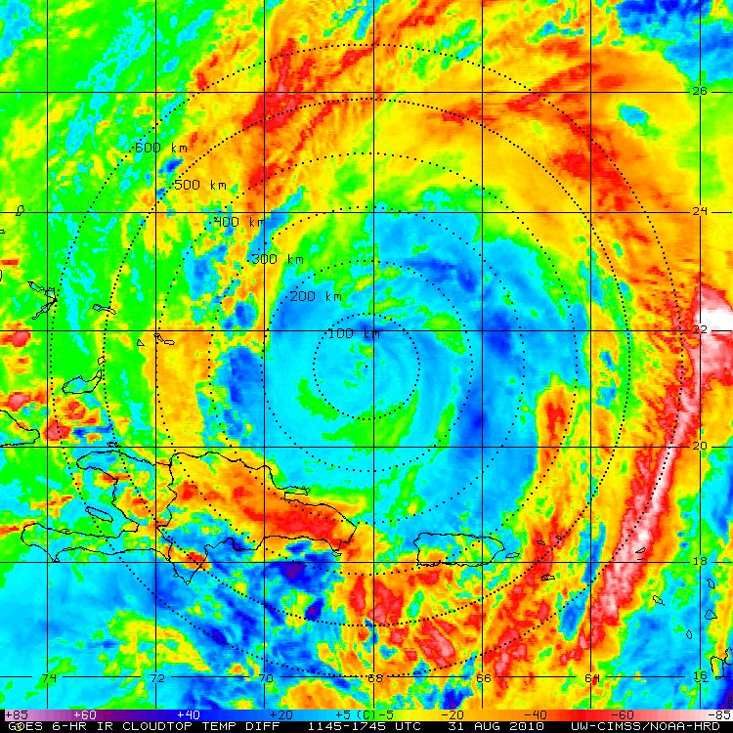
Hurricane Earl: 31 August 2010
GOES IR (storm relative)
GOES IR BT Diff (storm relative)
Notes:
Earl: strong Cat3 to weak Cat4

Slide 18
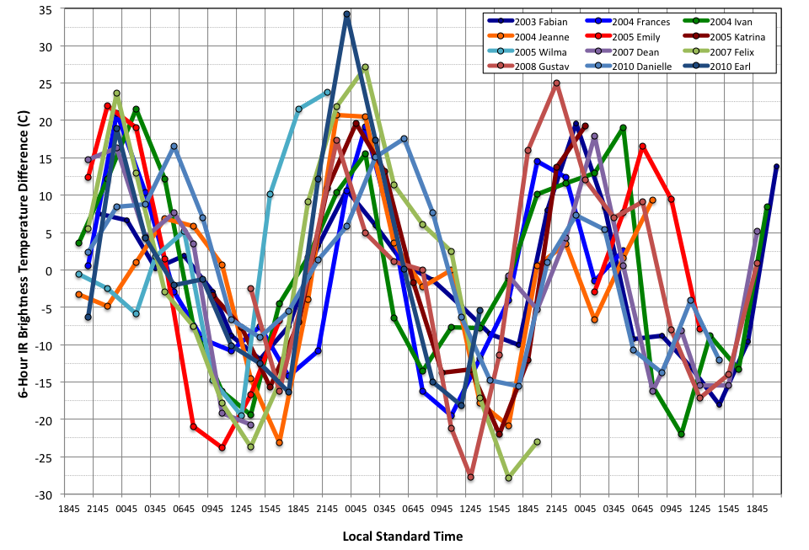
TC Diurnal Cycle
IR Brightness Temperatures (Azimuthal Mean; R=400 km)
“Cool Rings” (~11-16 LST)

Slide 19
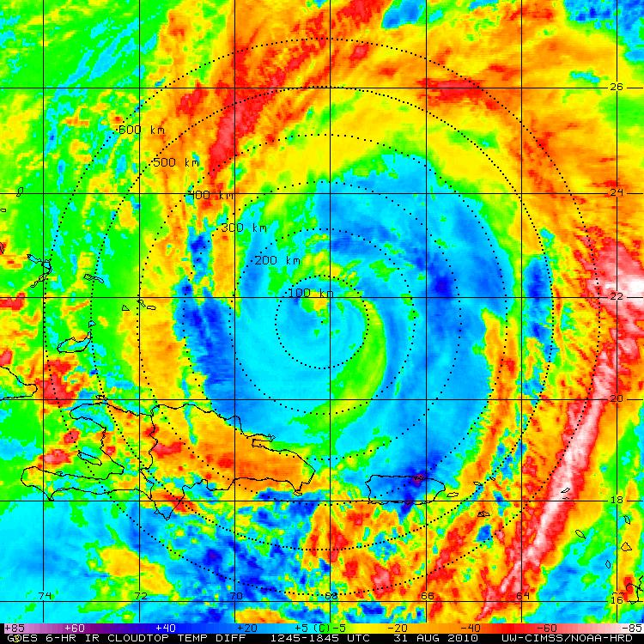
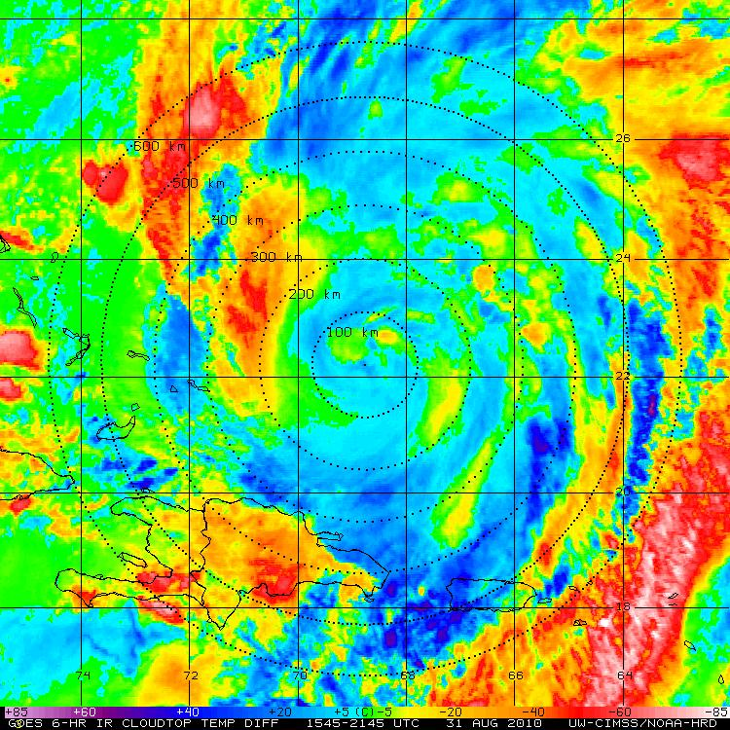








Hurricane Earl: 31 August 2010
GOES IR BT Diff (storm relative)
CIMSS WV Winds (storm relative)

Slide 20








Hurricane Earl: 31 August 2010
GOES IR BT Diff (storm relative)
CIMSS 150-300 hPa DVG (storm relative)

Slide 21
Hurricane Nadine: September 2010
TC Diurnal Cycle & Upper-level Outflow

Slide 22


























Hurricane Nadine: 26-27 Sept 2012
GOES IR BT Diff (storm relative)
GOES IR (storm relative)

Slide 23








Tropical Storm Nadine: 26 Sept 2012
GOES IR BT Diff (storm relative)
CIMSS WV Winds (storm relative)

Slide 24








Tropical Storm Nadine: 26 Sept 2012
GOES IR BT Diff (storm relative)
CIMSS 150-300 hPa DVG (storm relative)

Slide 25






Hurricane Nadine: 15 Sept 2012
Sunset and the TC CDO
Global Hawk GPS Dropsondes, NASA CPL
14660 m (141 hPa)
No CPL Layer Indicated
CDO Level (CPL)
Notes:
CDO top = ~48,000 ft >> G-IV only gets up to ~45,000 ft toward end of mission

Slide 26



Hurricane Nadine: 15 Sept 2012
Sunset and the TC CDO
Global Hawk GPS Dropsondes, NASA CPL
CPL CDO Height: 14,600 m
CPL CDO Height: 14,600 m
VWS: 27 kt @39 deg
NOAA G-IV
(41-45K ft)
Notes:
Shear: 25-35 kt outlfow (SW) below inversion, weak NW above

Slide 27



TC Diurnal Cycle
Hurricane Earl: 30 Aug – 01 Sept 2010
Hurricane Nadine: 25-28 Sept 2012
Peak DVG (0-200 km)
Peak DVG (0-200 km)
Increased shear

Slide 28
Conclusions
Real-Time Mission Support
GH SAL flight module design
Real-time GH GPS dropsonde processing (2012/2013)
Forecasting (2013)
Satellite Products (Real-Time & Experimental)
Tropical Overshooting Tops (TOTs)
Cloud-Top Height Product
Warm Core anomaly evaluation (satellite and HAMSR)
Phase Space Composites
Pre-genesis “subset compositing” >> more robust analyses
Optimal parameters being tested (e.g. tilt, shear, moisture, Dev/Ndev)
RGB Air Mass Imagery
Highlights various air masses in the TC environment (real-time?)
TC Diurnal Cycle & Upper-Level Outflow
TC diurnal pulses >> possible links to changes in TC UL outflow
Sunset and the TC CDO >> radiation may be the key
http://tropic.ssec.wisc.edu/real-time/tc_diurnal_cycle/tc_diurnal_cycle.php

