Slide 1
An Overview of SEAC4RS Contributions to Better Understanding of Biomass Burning
Bob Yokelson for the SEAC4RS Science Team (presented by Jeff Reid)

Slide 2
Talk outline
BB major uncertainties (impacts in models)
Uncertainties SEAC4RS data could address
Which uncertainties are being addressed
Some remaining gaps we could, should address?

Slide 4
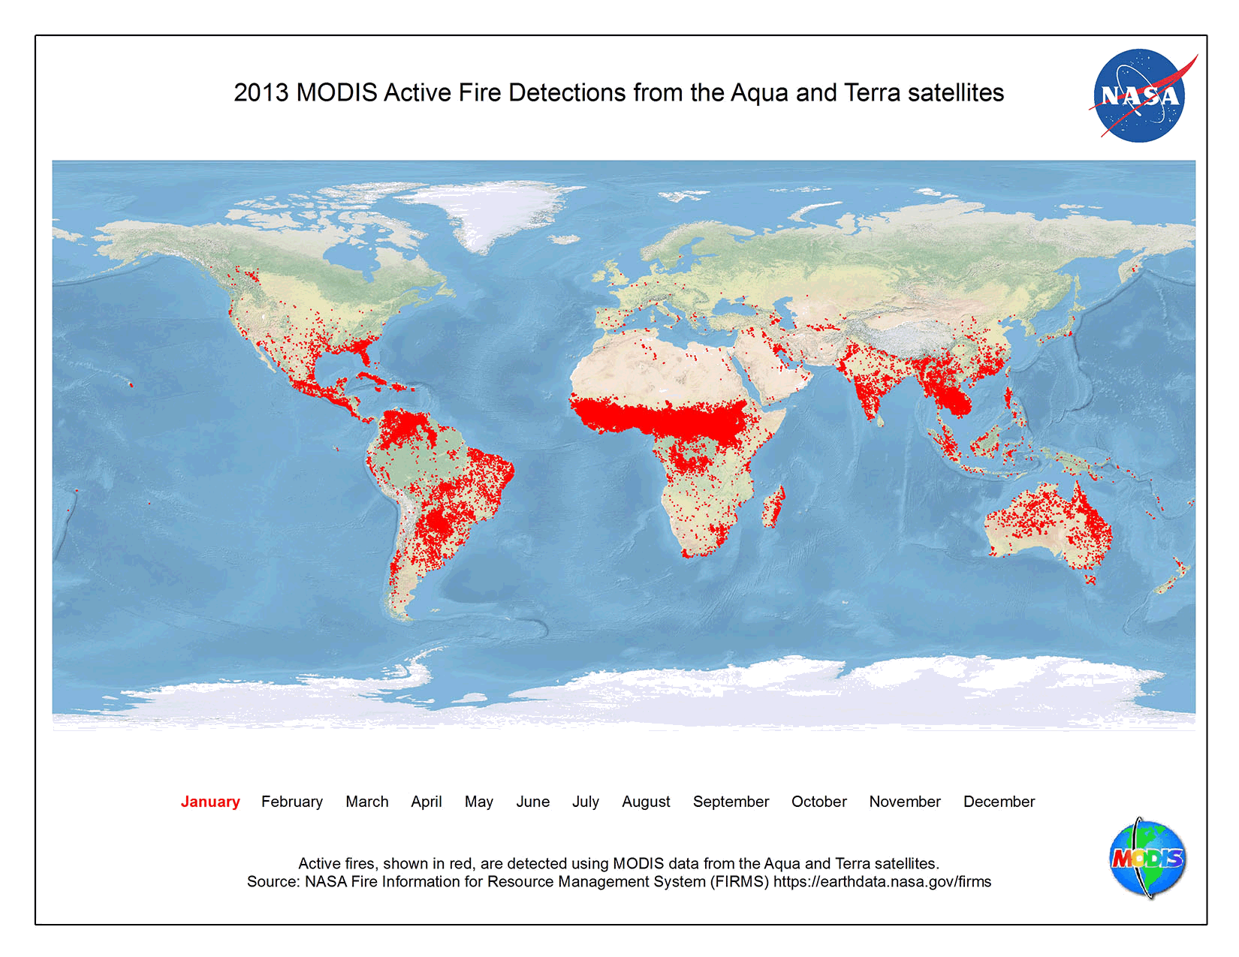

Slide 5
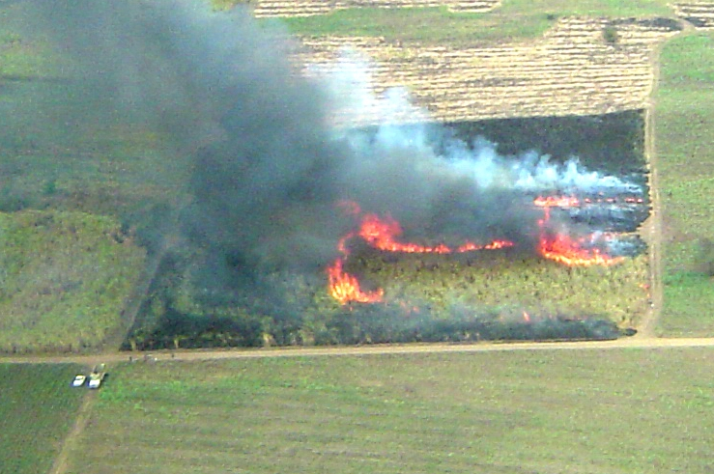
Summarize major uncertainties
Summary: smoke amount, chemical and optical props of both fresh and aged, evolution, mapping.
See 2014 Yokelson STM talk for details: https://espo.nasa.gov/home/seac4rs/content/Science_Meeting_April_15-18_2014_Boulder_Co
Smoke production bottom up:
Missing fires (clouds, cloud mask, orbital gaps, size, etc)
Burned area uncertainty
Misassigned vegetation or fuel consumption per unit area (kg/m²)
Unknown emission factors
(g/kg)

Slide 6
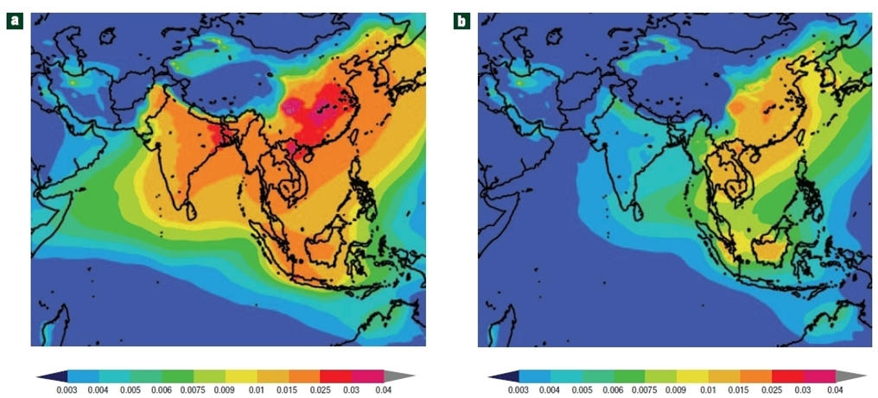
Summarize major uncertainties (continued)
Smoke production top-down:
Missing fires
Missing products (clouds, mask, gaps, AND limited species that can be measured)
Uncertain air mass factors
Unknown and variable injection altitude
Unknown/uncertain meteorology
Unknown emission ratios (ER)
Differential/unknown evolution of constrained and unconstrained species
Mixing effects
Misassigned product sources

Slide 7
Summarize major uncertainties (continued)
Undersampled sources:
Wildfires as opposed to prescribed fires
Crop residue burning (“ag fires”)
Peat, cooking, etc
Unknown gases and aerosol properties in all fire types:
SVOC organic aerosol (OA) precursors, OA volatility
Optical properties: e.g. core/shell valid? enhancement?
BrC in coatings?
Unknown evolution gases and aerosols all fire types:
Cloud-free day time
Night-time
In (rinse, bath)/over/under clouds
Plume mixing impacts (Δt)
Study Year | OA/POA aged
2009 | 2.5
2012 | 0.8
2014 | 8
2015 | 4

Slide 8
US BB a small fraction of global, different? Chaotic, unconstrained source, how can SEAC4RS help?
Advanced remote and in-situ payload on 3 platforms
DC-8, ER-2: good ceiling (stratosphere) and long range for long time scales. Coordinated with SPEC.
Coordination with space-based & worlds best ground-based network
Mapping where pollution is and its chemical, optical, structural details > speciated mapping
With good flight planning insight into processes!

Slide 9
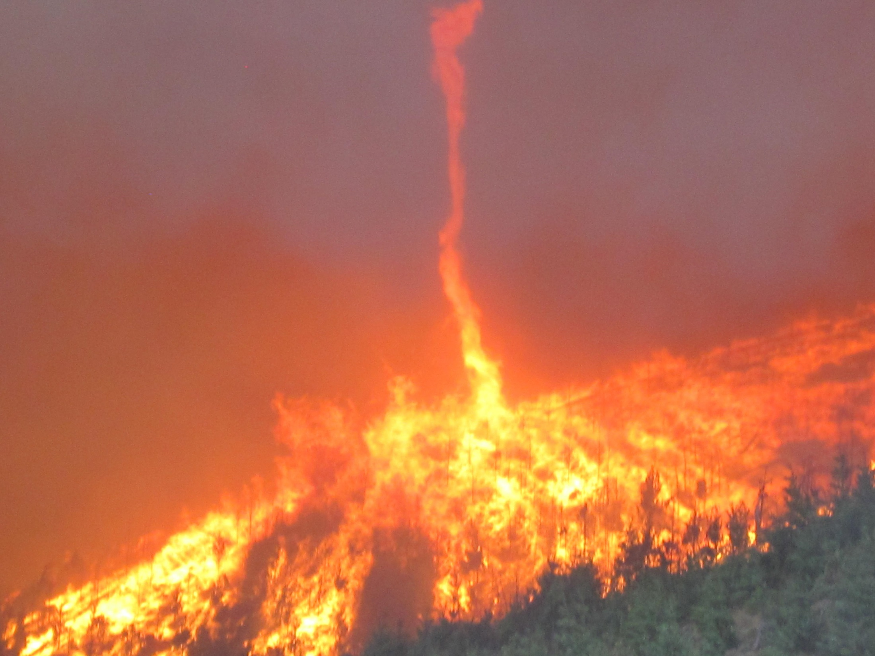
Half dozen well-characterized wild fires (previously undersampled)
Douglas Complex: Aug 6
Photo: INCI Website

Slide 10
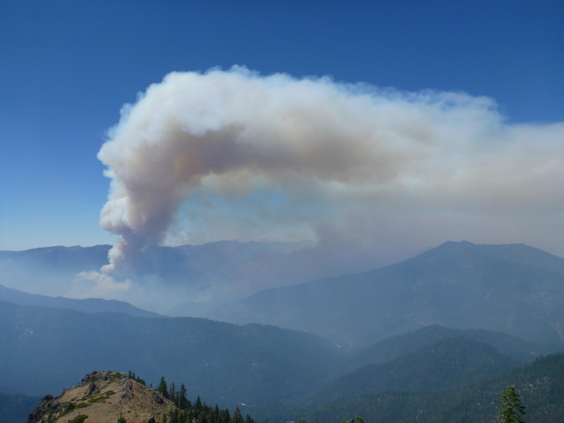
The fresh smoke sampled Aug 6 was transported to Pacific and over a cloud deck
Salmon River Complex: Aug 6
Photo INCI Web

Slide 11
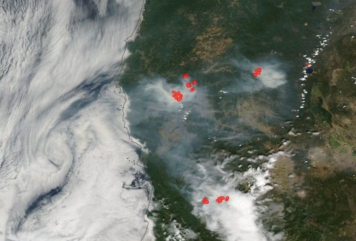
Wildfire smoke up to 20 h age over clouds (frying pan) “Smoke on the water” flight plan: Aug 6
Salmon River Complex

Slide 12
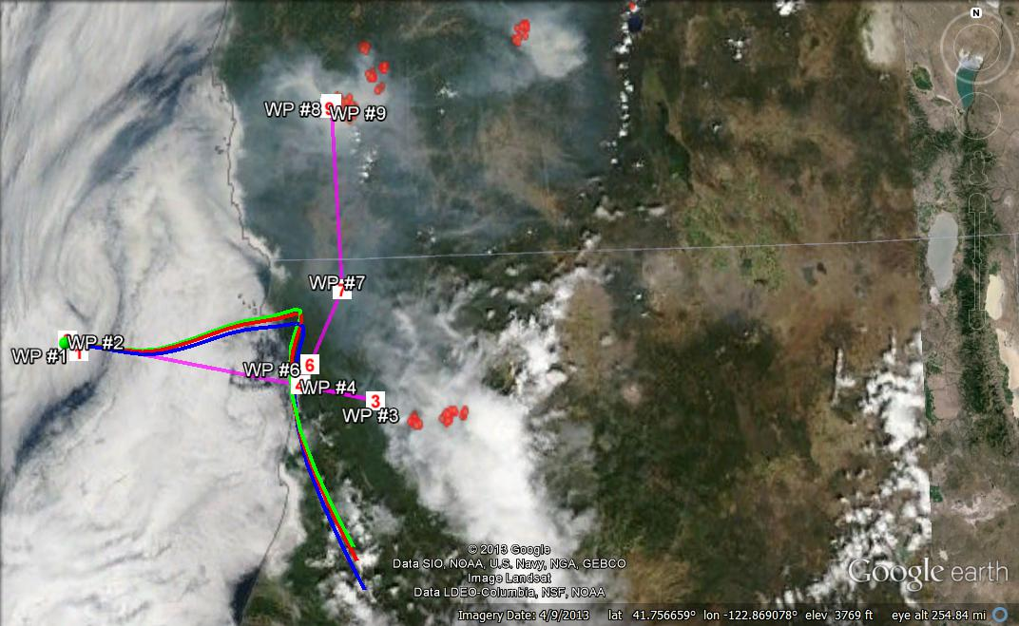
Salmon River Complex

Slide 13
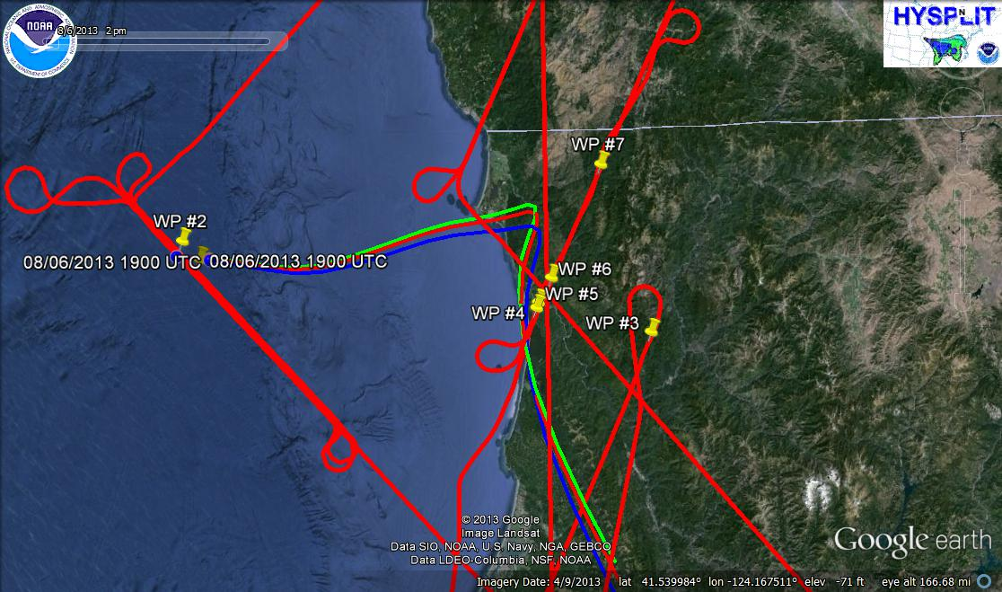
Salmon River Complex

Slide 14
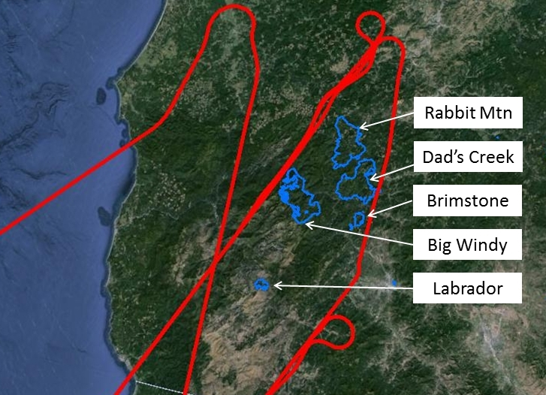

Slide 15
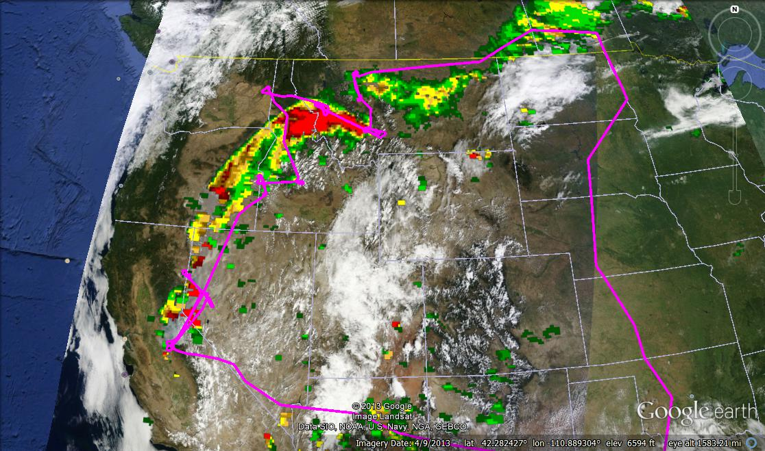
Wildfire smoke 20 h cloud-free aging, then constrained mixing (“The long and winding road” flight plan)
Rim Fire +
30 hr
Rim Fire +
48 hr
LQ Fire +
0 hr
Rim Fire
18 h
Rim Fire
4 hr
Rim Fire Accomplishments
Source samples and DIAL profile with AQUA
In-situ isolated plume evolution for 20 h
Walls @ 4 & 18 h for S:N or variability at “age slice”
Aging on ~50 h time scale with constrained mixing impacts
Rim Fire
0 hr

Slide 16
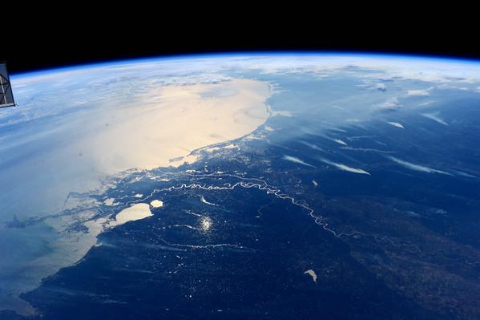
17 agricultural fires in the Mississippi valley
(previously undersampled)

Slide 17
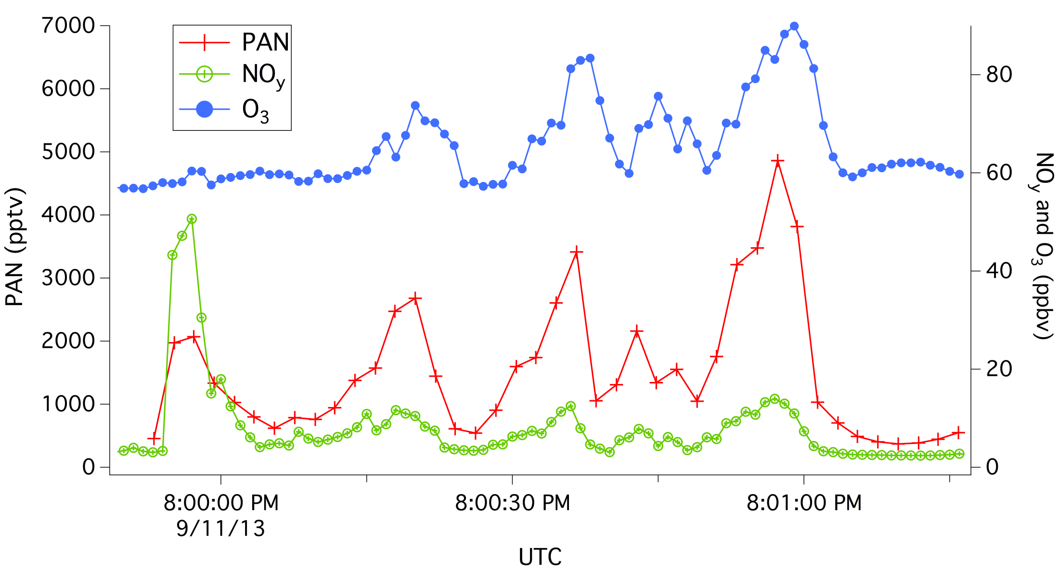
Ag-fire smoke plume evolution cloud-free
PAN: Xiaoxi Liu, Greg Huey, Dave Tanner GA Tech. NOy, O₃: Tom Ryerson NOAA.
Notes:
This addresses need for fine-scale details on PAN formation and towards a PAN climatology and one of the undersampled sources

Slide 18
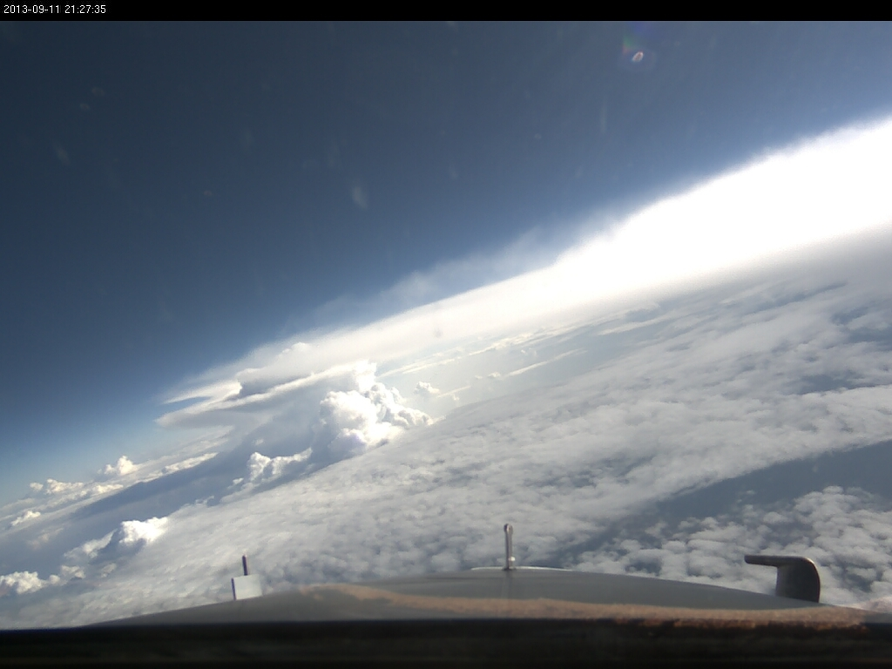
Smoky regional haze before & after cloud processing (previously unsampled)
“Stairway to heaven” flight plan

Slide 19
How much burns, improvements
1. Aircraft data can evaluate inventories scaled with “usual” constraints
Randles, da Silva (assimilation), Saide (more constraints), Hyer, Petersen (improved drivers)
2. New products and sensor from space
Jethva, (MODIS smoke over cloud AOD) Remer (VIIRS aerosol)
VIIRS in orbit
VIIRS-750: 26-70% more hot-pixels than MODIS
VIIRS-375: 3/25 X more hot-pixels than VIIRS-750 day/night
GOES-R launch early 2016:
4X better spatial res
5X better time res

Slide 20
Tracers/indicators/markers/photochemical clocks
Tracers for undersampled fire types measured in SEAC4RS
Acetonitrile, HCN
C3-C4 alkynes
SPMS smoke marker, BBOA, m/z 60, SAGA smoke signature, BrC?
DIAL smoke product
AMS BB tracers observed after gas-phase tracers at background
Photochemical clocks in smoke of measured age in SEAC4RS
NOx/NOy, ΔO3/ΔCO, benzene/toluene, etc
PAN(s) show extent of aged plumes: contrast with low background
SAGA nitrate ratios
F44/F60

Slide 21
Summary of types of on-going efforts
Process level: e.g. Buchholtz Beyersdorf, Chatfield, Hair, Hall, Liu, Simpson, Weber, Yates, Yokelson (ACCDAM with Blake, Wisthaler, Alvarado)
Product/model validation: e.g. Da Silva, Kahn, Hyer, Peterson, Park, Randles, Saide, Jethva, Remer, Yu
Fast variable chemistry connects processes and products (e.g. inverse modeling or assimilation)

Slide 22
Glimpse of some selected preliminary results
First detailed field sampling of ag fire and wildfire emissions (Liu, Simpson, Yates)
Case studies of rapid chemical/physical evolution of gases and aerosol in isolated plumes (Liu), hv (Hall), clouds (Wisthaler)
Case study of fast evolution integrated with longer-term evolution (Simpson NMOG, Webber BrC)
Using aircraft observations to evaluate operational constraints (MODIS, AERONET) work (Randles, DaSilva, Saide)
Improved operational products Kahn (MISR mapping ), Jethva (smoke over cloud AOD), Remer (VIIRS aerosol)

Slide 23
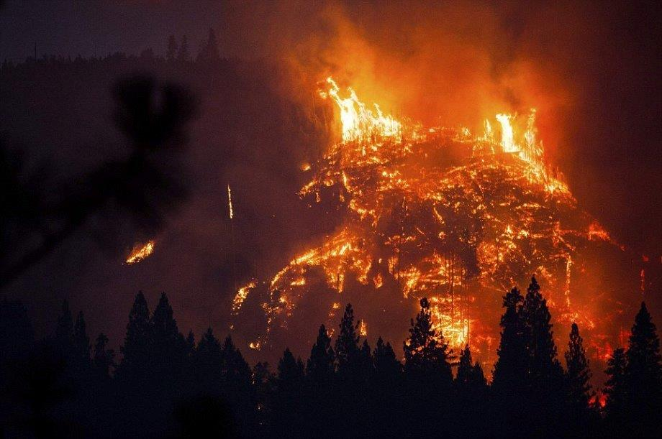
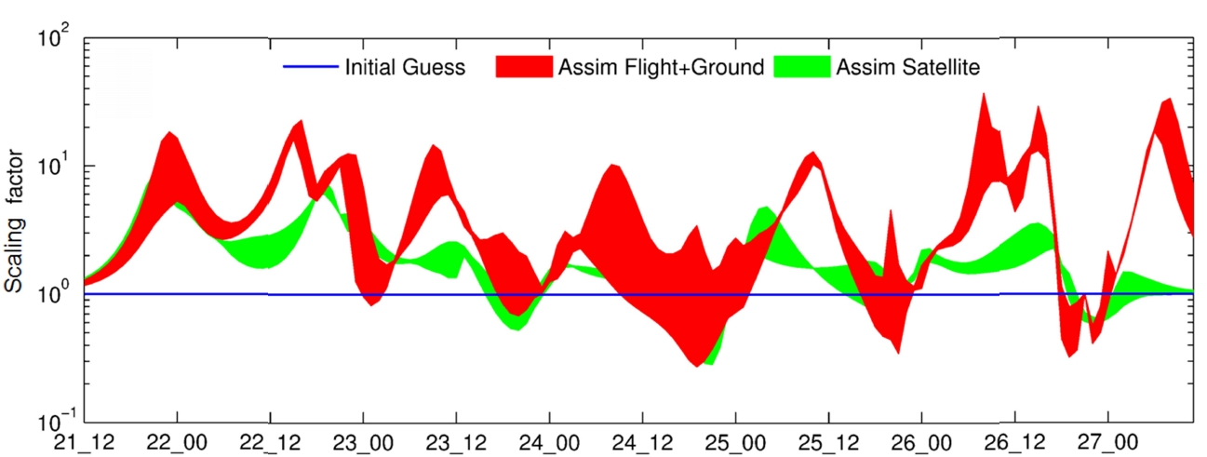
Saide et al 2015
Only possible in US!
Courtesy: Georgia Dempsey USFS Rim Fire Recovery Team
The government may read your email,
but they also watch Mother Nature better than anywhere else!
Notes:
Its not just the gubmint reading your emails. In the US we keep a close watch on Mother Nature. GOES, ground-based, DC-8, new FRP

Slide 24
Yokelson, Blake, Simpson, Alvarado, Wisthaler
ACCDAM project
Objectives:
Update database of BB emission factors (EF)
Identify aging scenarios good for improving models
Incorporate SEAC4RS, other NASA, and non-NASA data
Progress both as lead and as resource for instrument PIs
Update on progress (since 1-Nov 2014):
Alvarado: SOA, O3 modeling paper(func/frag, HOx recycle)
Wisthaler: Plume evolution paper
UCI: Paper on WF & AG EF and aging in Rim Fire (poster)
UM: Collaborating with GT (Liu), U-Iowa (Saide) papers in progress
UM: Updated Akagi et al 2011 from FLAME-4
UM: Team in Nepal sampling now; EF added via ACCDAM

Slide 25
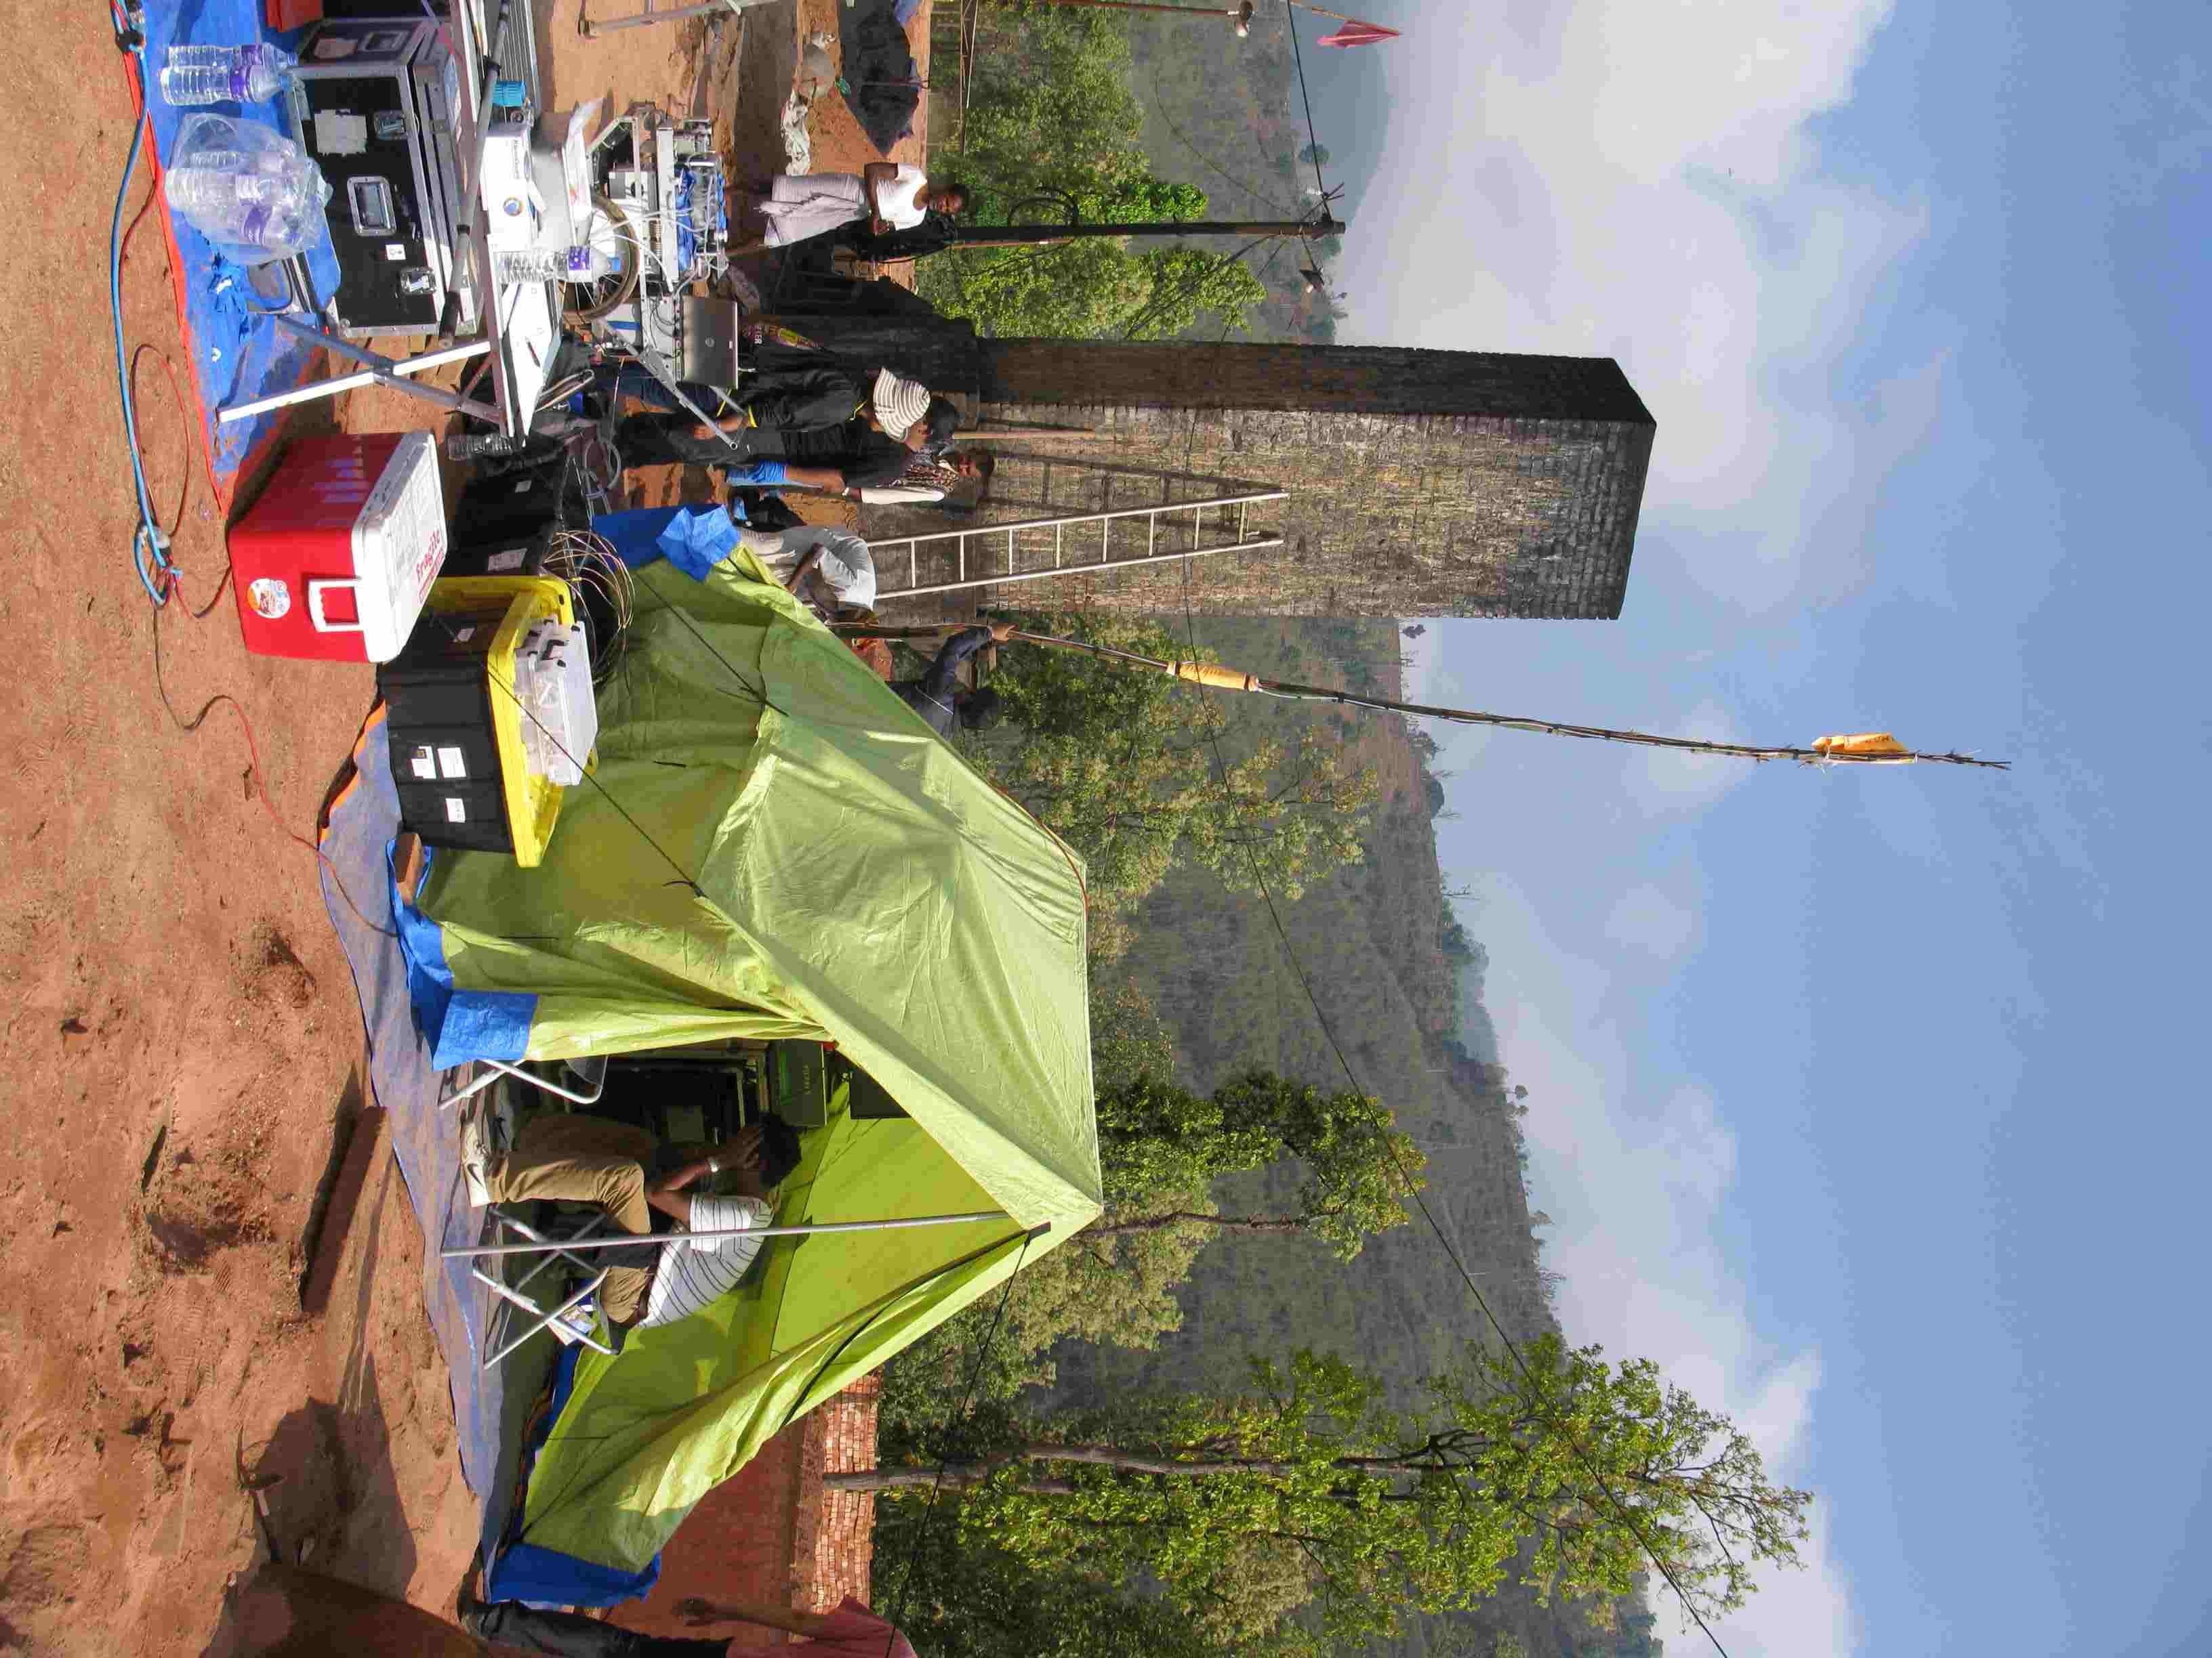
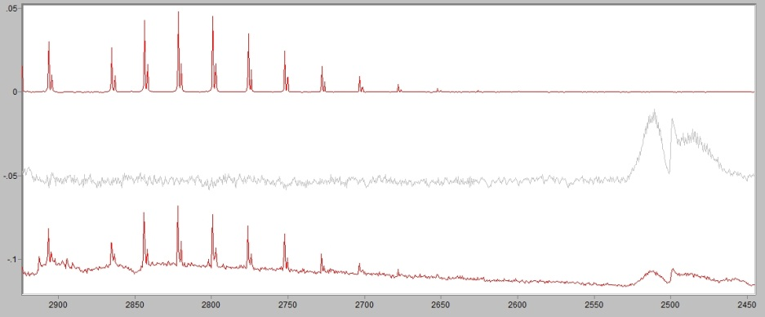
HCl
ACCDAM supports integration of EF from SEAC4RS, other NASA and non-NASA
SEAC4RS inspired, NSF-funded Nepal source sampling of cooking fires, crop residue and garbage burning, diesel, kilns, etc with:
Picarro (Panday, ICIMOD)
FTIR, PAX 405 and 870 (UM)
T/Q Filters (Stone, Iowa)
WAS (UC-Irvine)
Mini AMS, SPMS AE33 (DeCarlo, Drexel
Kathmandu “supersite”
SP-AMS NOx, O3, (Drexel)
CO ceilometer, AE33 (IASS)
WAS (UCI)
Filters (Iowa, Keene UVA)
SO2
Brick kiln

Slide 26
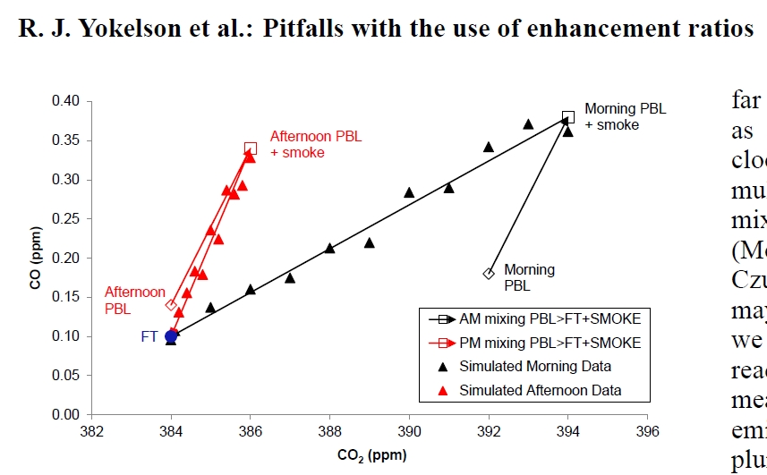
Yokelson et al ACCDAM project
Collaborate with instrument teams: increase production
e.g.
Perspective:
One case study does not constrain all fires (recall SOA example). Explaining “why” is the goal!
Technique:
“Pitfalls paper” AMT 6, 2015
Fire list spreadsheet
EF calculation help
Integrate over puffs (S:N)
BC/CO test for source changes (time machine flight plan)

Slide 27
Courtesy: Xiaoxi Liu
“Smoldering”
“Flaming”

Slide 28
Remaining gaps: ideas for “big picture” papers
Comparing multiple photochemical clocks and smoke tracers along an extensive isolated plume:
How well do different clocks retrieve known ages?
How does plume mixing reset clocks?
Uncertainty in initial tracer ratios, tracer stability
Benefits of multiple tracers
Mixing effects
What controls BBSOA yields?
BBOP synthesis: evolution & ag fires (more samples and more crops)
Evaluation of convective cloud pollution-processing measurements in the last few years
New science, insights into other cloud types
Recommendations for new approaches
Wild vs prescribed fire emissions

Slide 29
Paper ideas (continued)
How do light and radiative heating behave above, below, and throughout smoke plumes above various surface albedos?
Over clouds(frying pan)
Over land
Photochemical, dynamical (self lofting) manifestations?
Validation and application of new products: smoke over clouds AOD, FRP, VIIRS, GASP
Evaluate and integrate into fire/smoke forecasting and hindcasting
Fire/smoke hind/forecast intercomparison and ensemble average
Compare hind/forecasts to measurements in various scenarios
New species from UCI, GT, UI, and CT CIMS, CU-AMS, dust on SPMS
Variability and sampling issues on large scales
Think of one and lead

Slide 30
Thank you!
Sorry I could not join you all: feel free to email me if you have questions!
bob.yokelson@umontana.edu

