Slide 1

Alkyl nitrate formation and loss in the oxidation of isoprene:
Impact on NO_{x}
SEAC⁴Rs Science Team
Paul Wennberg, John Crounse, Alex Teng, Tran Nguyen, Jason St. Clair
Caltech, Pasadena CA

Slide 2
Top science questions
What is the impact of biogenic emissions on tropospheric ozone and organic aerosol? How does this impact change with changes in anthropogenic emissions?
Percent change in tropos-pheric ozone column if all humans emitted NO_{x} (NO+NO₂) like North Americans (in 2008).
Paulot, et al., Atmos. Chem. Phys., 2012

Slide 3
Top science question
Why is the response so large?
  - This is classic NO-limited ozone chemistry:
R’ + OH + O₂
RO₂

Slide 4
Top science question
Why is the response so large?
  - This is classic NO-limited ozone chemistry:
hν
hν
NO
NO₂
NO
NO₂
R’ + OH + O₂
RO₂
R=O + HO₂
OH

Slide 5
Top science question
Why is the response so large?
  - This is classic NO-limited ozone chemistry:
O₃
O₂
O₃
O₂
hν
hν
NO
NO₂
NO
NO₂
R’ + OH + O₂
RO₂
R=O + HO₂
OH

Slide 6
Top science question
Why is the response so large?
  - This is classic NO-limited ozone chemistry:
O₃
O₂
O₃
O₂
hν
hν
NO
NO₂
NO
NO₂
R’ + OH + O₂
RO₂
R=O + HO₂
OH
HO₂
ROOH

Slide 7
Top science question
What do alkyl nitrates have to do with this?
  - Given fixed NO_{x} emissions, the formation of alkyl nitrates reduces NO_{x} and sends more of the RO₂ radicals to peroxides:
O₃
O₂
O₃
O₂
hν
hν
NO
NO₂
NO
NO₂
1-α
R’ + OH + O₂
RO₂
R=O + HO₂
OH
HO₂
NO
yield = α
ROOH
RONO₂

Slide 8
Top science question
What do alkyl nitrates have to do with this?
  - Their potency as NO_{x} scrubbers depends on how quickly and how inefficiently they return the NO_{x}:
O₃
O₂
O₃
O₂
hν
hν
NO
NO₂
NO
NO₂
1-α
R’ + OH + O₂
RO₂
R=O + HO₂
OH
HO₂
NO
yield = α
HONO₂
τ (HONO₂)
ROOH
RONO₂
τ (NO₂)
NO₂
=> The yield (α) and the ratio of loss to NO_{x} vs loss to HNO₃ are the key variables

Slide 9
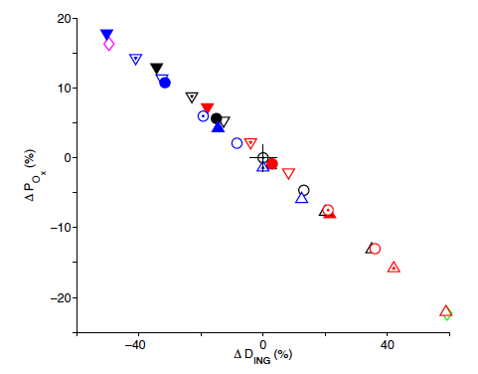
Top science question
Indeed, the interaction of isoprene oxidation with NO is THE central controlling dynamic.
Paulot et al. illustrated that the sensitivity of ozone in the tropics to uncertainty in the yield and fate of the isoprene nitrate chemistry is extreme and that this sensitivity could be understood simply by diagnosis of the impact of the chemistry on local NOx loss.
Paulot, et al., Atmos. Chem. Phys., 2012

Slide 10
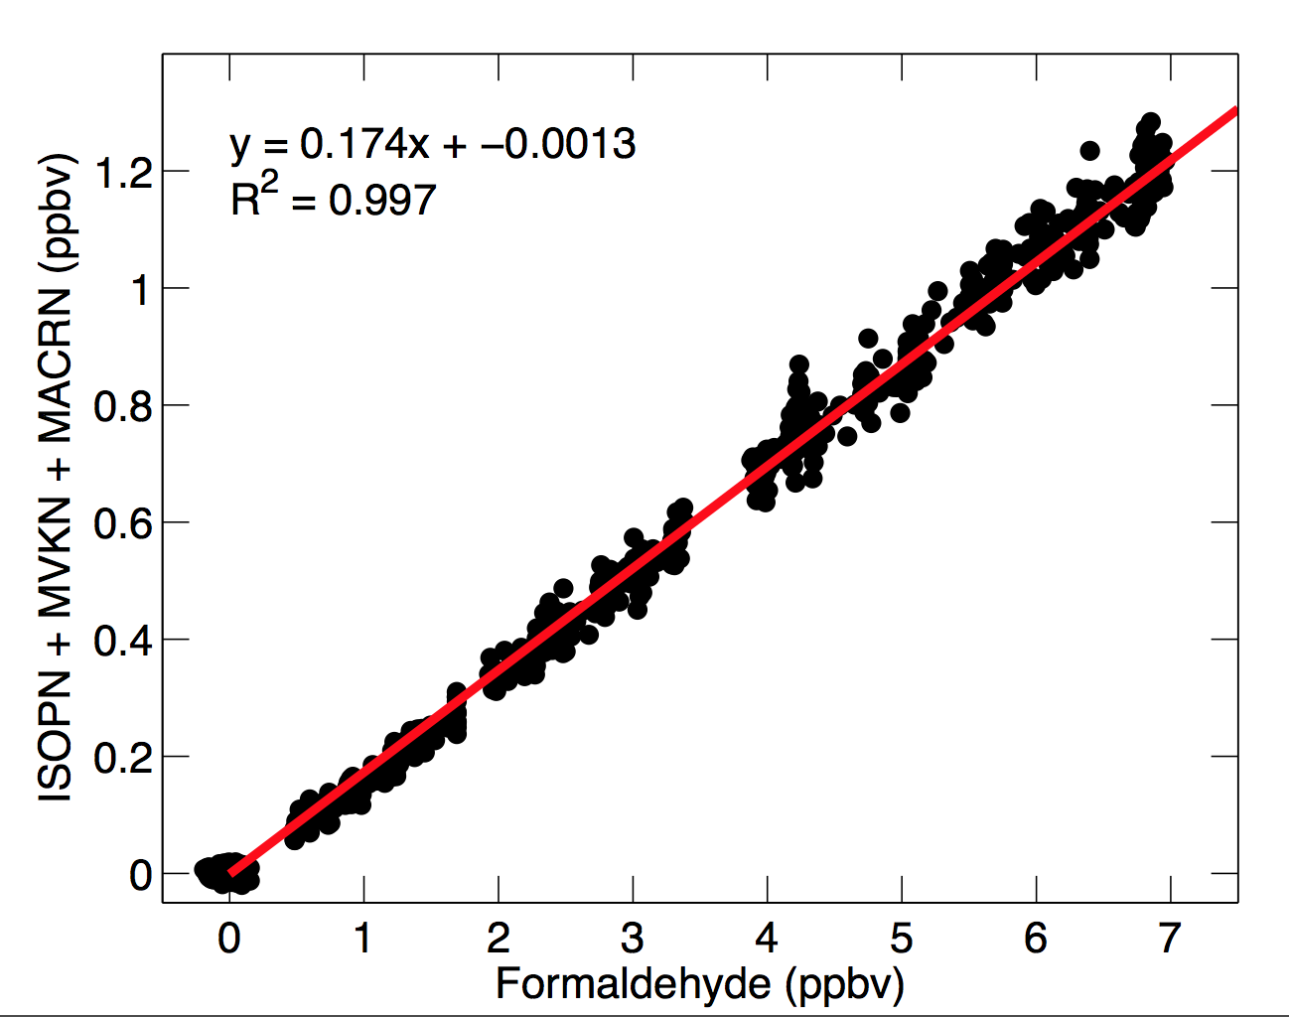
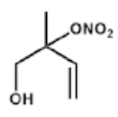
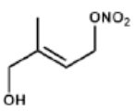
What is the yield & fate of the nitrates produced in isoprene oxidation? I. Yield from OH Chemistry
RO₂ lifetime = ~4 s (red); ~10 ms (blue).
FIXCIT – H2CO c/o Frank Keutsch
Nitrate yield from isoprene + OH is 12±1.5%. Yield is > 90% beta isomers for atmospheric conditions. [Only refers to daytime chemistry].
1,2 isomer > 2 × 4,3 isomer

Slide 11
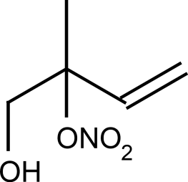
What is the yield & fate of the nitrates produced in isoprene oxidation? IIa. Gas Phase Loss of ISOPN
Atmospheric Fate (Gas Phase):
1,2 ISOPN + OH → MACRN (τ ~ 6 – 12 hours depending on OH (NO))
+ OH →
4,3 ISOPN + OH → MVKN (τ ~4 – 8 hours)
+ OH →
K(300) = ~2.5 x 10⁻¹¹ (unpublished)
New!
K(300) = 3.4 x 10 ⁻¹¹ (Lee et al., 2014)
These rates are faster than MVK/MACR.
Gas phase lifetime ISOPN ~25% shorter.

Slide 12
What is the yield & fate of the nitrates produced in isoprene oxidation? IIb. MACR and MVK nitrates
MACRN yield from MACR < 1% for NO < 1 ppb (Crounse et al, 2012 )
http://pubs.acs.org/doi/abs/10.1021/jp211560u
MVKN yield from MVK = 4% (Praske et al, 2014 )
http://pubs.acs.org/doi/pdf/10.1021/jp5107058
MACRN photolysis lifetime is short (< 1hour): → NO₂
MVKN photolysis lifetime is also short (~ 5 hours):
(Müller et al., 2014) → NO₂
http://www.atmos-chem-phys.net/14/2497/2014/acp-14-2497-2014.html
The majority of the MVKN/MACRN come from photoxidation of isoprene nitrates
They rapidly recycle NOx by photolysis

Slide 13
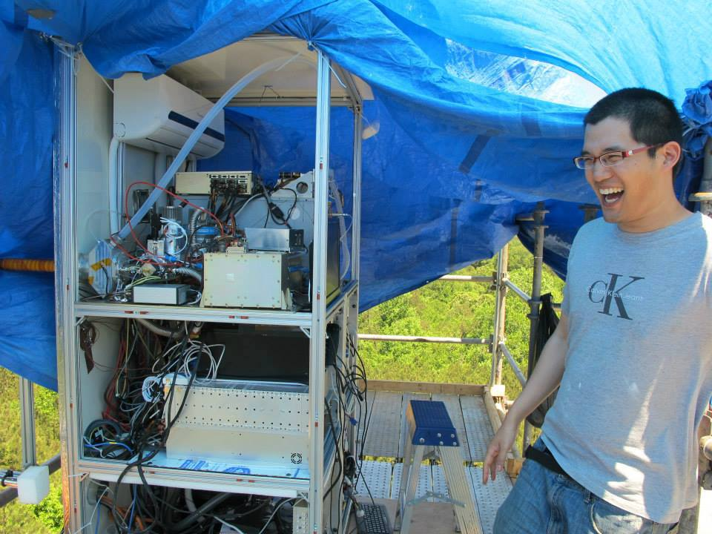
What is the yield & fate of the nitrates produced in isoprene oxidation? IIc. Photolysis of ISOPN
We have measured the condensed phase UV spectrum of the 4,3 HN.
We estimate photolysis lifetime is ~15 +- 5 hours
hv
→ NO₂ + MACR ???
=> Photolysis may be competitive when [OH] is low. Generally, not.

Slide 14
What is the yield & fate of the nitrates produced in isoprene oxidation? IIc. Gas Phase Loss
ISPO₂
NO
yield = 13.5%
HONO₂
τ (HONO₂)
ISOPN
τ (NO₂) ≤1 day
NO₂
=> If OH oxidation or photolysis rules, ISOPN will be converted to NOx with high efficiency in less than a day.

Slide 15
What is the yield & fate of the nitrates produced in isoprene oxidation? III. Routes to HNO₃
ISPO₂
NO
yield = 13.5%
HONO₂
τ (HONO₂)
ISOPN
τ (NO₂) ≤1 day
NO₂
=> To be competitive, routes from ISOPN to HNO3 will need to be fast (τ (HONO₂) << day)

Slide 16
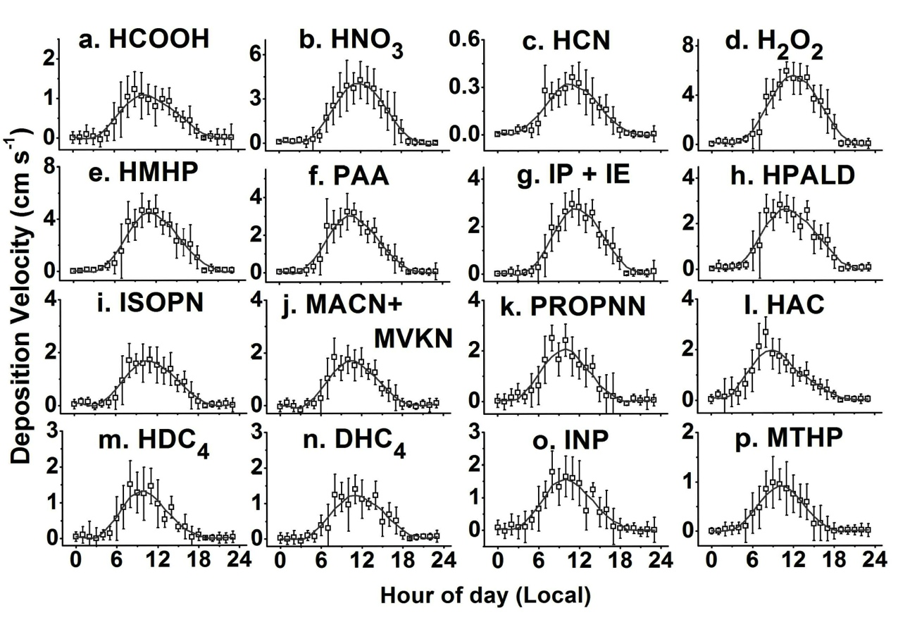
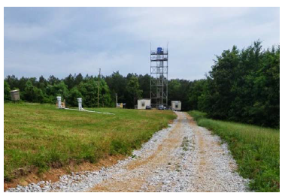
What is the yield & fate of the nitrates produced in isoprene oxidation? IIIa. Deposition during SOAS
6 –
Deposition velocity is ~ 1 cm s⁻¹ average during daytime. For 1500 m boundary layer, tau is ~2 days.
Tran Nguyen,
PNAS, 2015.
=> Deposition may be competitive when [OH] is low. Generally, not.

Slide 17
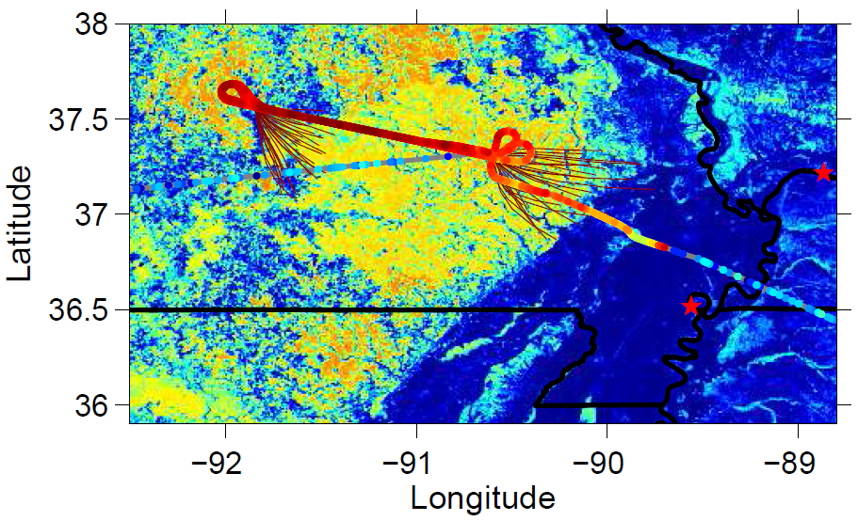
SEAC4RS, DC8 flight of September 6
What is the yield & fate of the nitrates produced in isoprene oxidation? IIlb. Other routes? Aerosol?
Ozark runs
Wisthaler, Isoprene

Slide 18
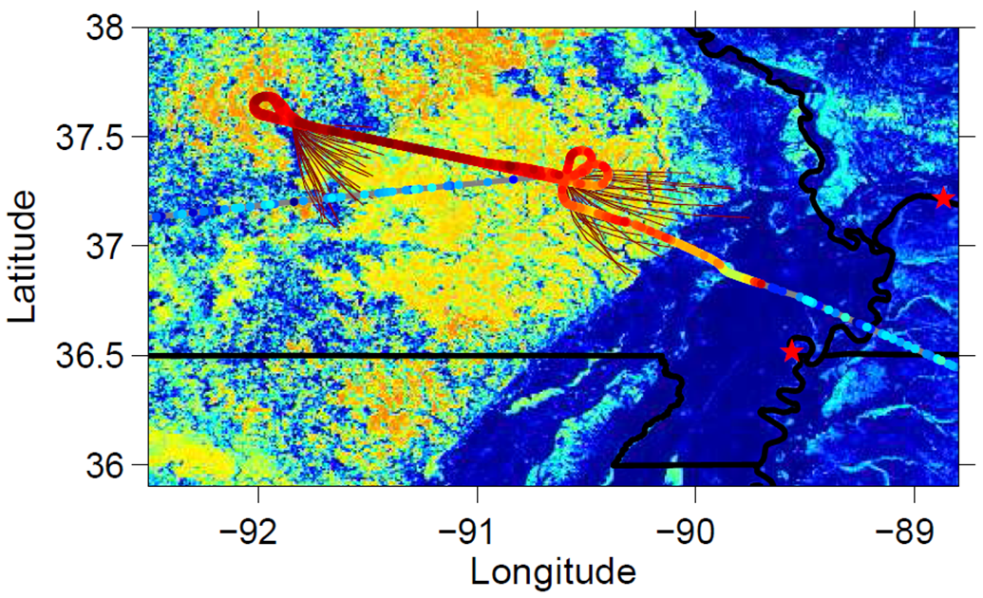
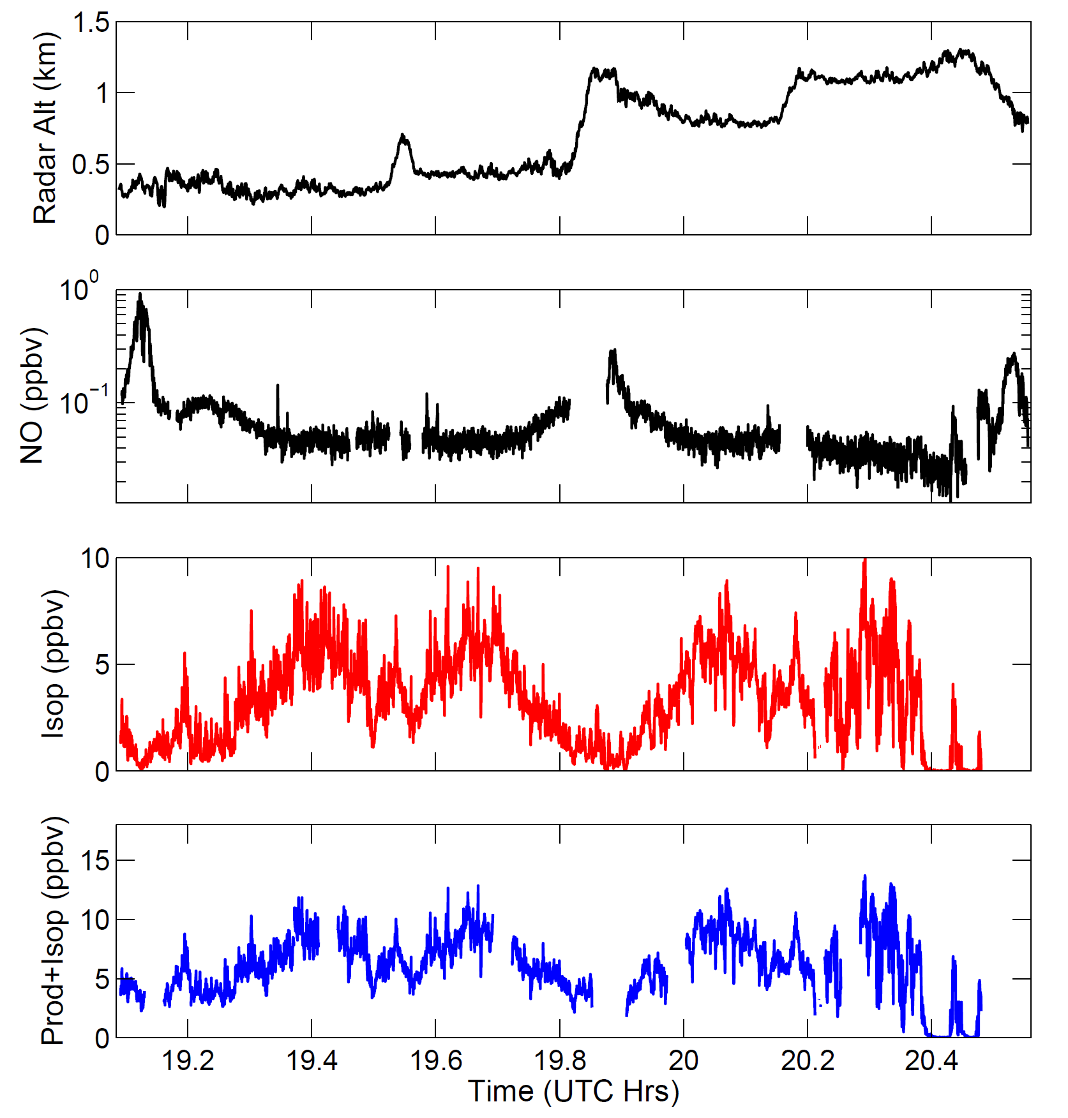
E
W
E
W
E
NO Ryerson; Isoprene Wisthaler

Slide 19
Recall from the laboratory
FIXCIT – H₂CO Frank Keutsch
In the laboratory (FIXCIT), lifetime of the sum of ISOPN and its oxidation products (MACRN/MVKN) and of H₂CO is long. Slope reflects the relative yields.

Slide 20
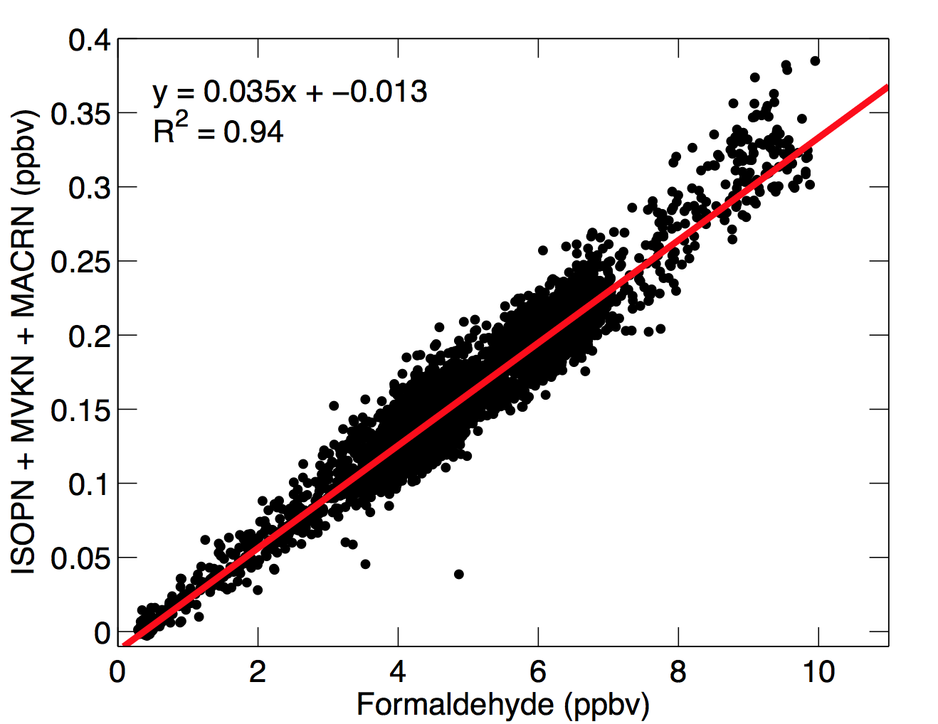
Beautifully correlated in field as well, but …
SEAC4RS – H₂CO Hanisco/Wolfe
In the laboratory (FIXCIT), lifetime of the sum of ISOPN and its oxidation products (MACRN/MVKN) and of H₂CO is long. Slope reflects the relative yields.
SEAC4RS, Ozark, Sept. 6:
.. the slope is ~¼ that of the laboratory.

Slide 21
Constraint from MVK+MACR
In low NO environments, ISOPOOH is often a large fraction of the compounds that PTR observes at m/z 79.
Over the campaign as a whole, the ratio of the Alkylnitrates produced from isoprene are correlated with MVK+MACR and the slope is close to that expected based on the yields of both (0.8/.12 = 6.7)

Slide 22
Constraint from MVK+MACR
In low NO environments, ISOPOOH is often a large fraction of the compounds that PTR observes at m/z 79.
Correlations much worse; slope different if you don’t account for ISOPOOH.

Slide 23
Constraint from MVK+MACR
When [NO]> ~150 pptv, the ratio of the isoprene nitrates to MVK+MACR is consistent with laboratory observations.
At low NO the ratio decreases. Why? We interpret this to suggest that when NO is low, OH is low and therefore the gas-phase lifetimes of the ISOPN become long.
We hypothesize that the faster lost of ISOPN than expected at low OH is in part due to heterogeneous loss of 1,2 isomer leading to formation of HNO3.
Because much of the world where isoprene emissions are large lives in the regime where NO is low, this process may represent a substantial fraction of the nitric acid formation globally.
ISOPN+MVKN / MVK+MACR vs NO

Slide 24
Constraint from isomer distribution
We hypothesize that the faster lost of ISOPN than expected at low OH is in part due to heterogeneous loss of 1,2 isomer leading to formation of HNO3.
Because much of the world where isoprene emissions are large lives in the regime where NO is low, this process may represent a substantial fraction of the nitric acid formation globally.

Slide 25
But, still confused. Why is slope of H2CO vs both MVK+MACR and ISOPN so high?
There is a big puzzle in the SEAC4RS data.
The formation of isoprene nitrates is broadly consistent with our expectation that one ISOPN is produced with each MVK+MACR.
The amount of formaldehyde is far too high (at least 2x) to be explained by EITHER the observed MVK+MACR or the ISOPN.
Either there are large sources of CH2O that produce neither of these or the lifetime of CH2O is much longer than we expect [doubtful – dominated by photolysis].
SEAC4RS – H₂CO Hanisco/Wolfe
SEAC4RS, Ozark, Sept. 6:
.. the slope is ~¼ that of the laboratory.

Slide 26
Back to the Top science question
Indeed, the interaction of isoprene oxidation with NO is THE central controlling dynamic.
Takeaway Points:
Laboratory and field data have substantially reduced the uncertainty in our description of the ISOPN gas phase chemistry and deposition dynamics.
However, the laboratory data are inconsistent with the apparent short lifetime of these compounds. If the 1,2 ISOPN is lost to aerosol quickly as suggested by the field observations and this leads to HNO₃, aerosol uptake of ISOPN will completely dominate the loss of NO_{x} from the atmosphere in many regions of the world.
Paulot, et al., Atmos. Chem. Phys., 2012
Higher Yield of ISOPN and faster loss to HNO3

Slide 27
Acknowledgements
Tom Ryerson – NOx and O₃
Armin Wisthaler – Isoprene
Tom Hanisco & Glenn Wolfe – Formaldehyde
SEAC4Rs Fight Planners and flight crew – For thoughtful planning and remarkable execution of meaningful experiments
SOAS organizers and enablers
DC3, SEAC4Rs, SOAS, and FIXCIT science team – For a very rich data set
NASA & NSF – Funding

Slide 28
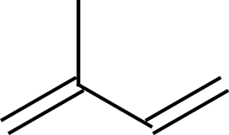
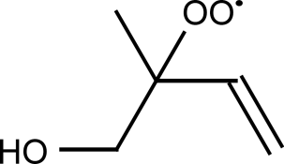
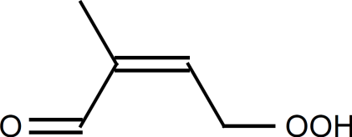
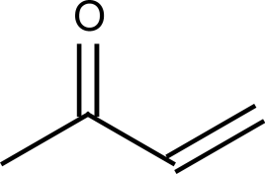
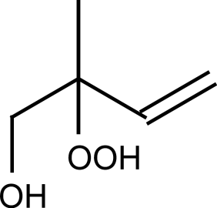
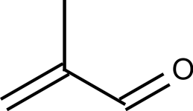
Isoprene Chemistry
+ OH + O₂
isom
RO₂
(1 of 8)
HOx neutral?
isoprene
HPALDs
(1 of 2)
HO₂
NO
yield: unknown
MVK
Makes ozone,
Sustains HOx
Aerosol?
+
Destroys Ox
Produces known aerosol precursor
MACR
ISOPOOH
(1 of 8)
+
HCHO
ISOPN
(1 of 8)
~90% yield
~75% yield
~12% yield

Slide 29
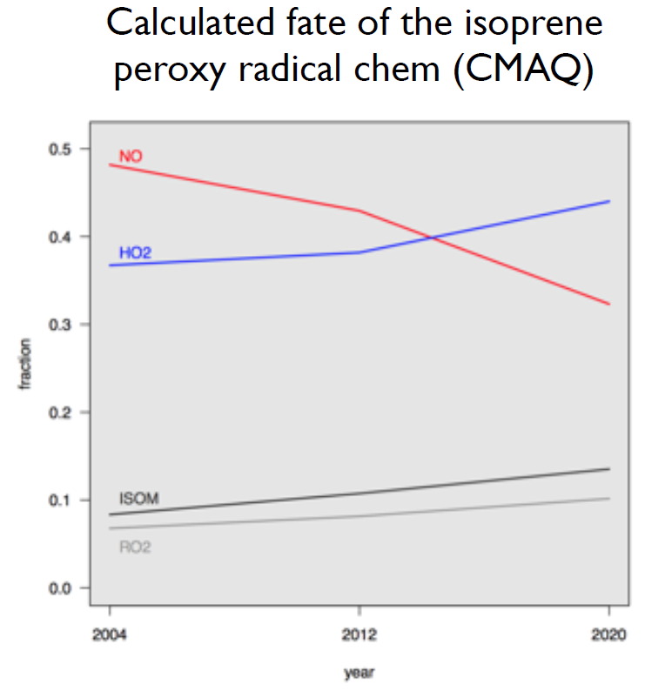
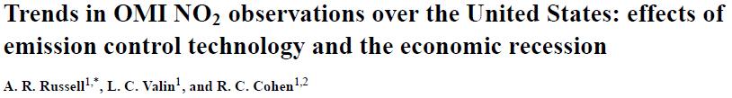
The chemistry of the Southeast
US is rapidly changing.
2005
2011
Rob Pinder, EPA
Atmos. Chem. Phys., 12,12197-12209, 2012

