Slide 1
Outflow Flight Module
Outflow Module Team
Jim Doyle, Jon Moskaitis, Peter Black, Leslie Lait, Russ Elsberry, Chris Velden
Overall Science Objectives
Observe and document the tropical cyclone (TC) outflow layer structure (e.g., depth, lateral and vertical shear, stability etc.), evolution, and its interaction with inner core convection and the environment.
Deploy dropsondes in sensitive regions (including the outflow jet) and assess the impact on TC prediction.
Under what conditions would you fly the module?
Storms with outflow and that are accessible for the GH.
Generalized modules have been formulated for small and large storms, and for storms that are interacting with troughs.
Under what conditions would you not fly? What are the guidelines?
Weak storms or storms in formation that have poorly defined outflow.
TCs that require long ferries and on-station time is thus limited

Slide 2
Outflow Flight Module
How would you de-scope the plan if the system is at long range or some other factor(s) limits on-station time?
One module could be performed (instead of repeated module)
Partial lawnmower or linear segment could be performed
Dropsonde plan
Higher frequency sondes across regions of interest such as jet cores or the outflow edge.
Deploy dropsondes every 1-2 degrees.
Deploy dropsondes near way points where possible
Deploy dropsondes in sensitive regions (including the outflow jet) as diagnosed from ensemble or adjoint targeting products.
Modules designed to be repeated twice during a flight
Lawnmower
Double lawnmower pattern (for 2 outflow jets) with core transect
Polar coordinate pattern
Square Spiral
Linear Repeat (Time Evolution- Hovmöller) for fast-moving TC

Slide 3
Outflow Flight Module Design Strategy
Three basic pattern types
Lawnmower
Square spiral
Linear Repeat (Time Evolution- Hovmöller)
Four Basic Orientations
Fixed (square)
Stretched (rectangular)
Rotated (along-feature)
Distorted (trapezoidal)
Three Outflow Regions
Poleward Outflow Jet (POJ)
Storm-Centric Outflow (SCO)
Equatorward Outflow Jet (EOJ)
Three Coordinate Reference Systems
Earth-Relative
Storm-Relative
Feature-Relative
Three Flight Module Strategies (standard size)
Fly POJ, SCO and EOJ modules twice
Fly POJ and SCO once each
Fly SCO and EOJ once each

Slide 4
Outflow Dropsonde Deployment Strategy
Flight Times
Center pattern on T₀ = 1200 GMT
Block-Out (T.O.-30 min) T1= 0000 GMT
Block-In (Landing+30 min) T2= 2400 GMT
Center pattern on T₀ = 0000 GMT
Block-Out (T.O.-30 min) T1= 1200 GMT, day 1
Block-In (Landing+30 min) T2= 1200 GMT, day 2
Sonde Spacing/ number of sondes/leg along and across track/ total sondes
Small: 0.5-1.0º lat (30-60 nm, 55.5-111 km)/ e.g.
Standard 1.5-2.0º lat (90-120 nm, 166.5-222 km)/ e.g.6x5
Large 2.5-3.0º lat (150-180 nm, 275.5-333 km)
Input Parameters
Storm initial location (lat, lon); forecast speed and direction of motion
Feature speed and direction of motion
Initial Point, IP (radius, azimuth from initial storm location)
Initial heading

Slide 5
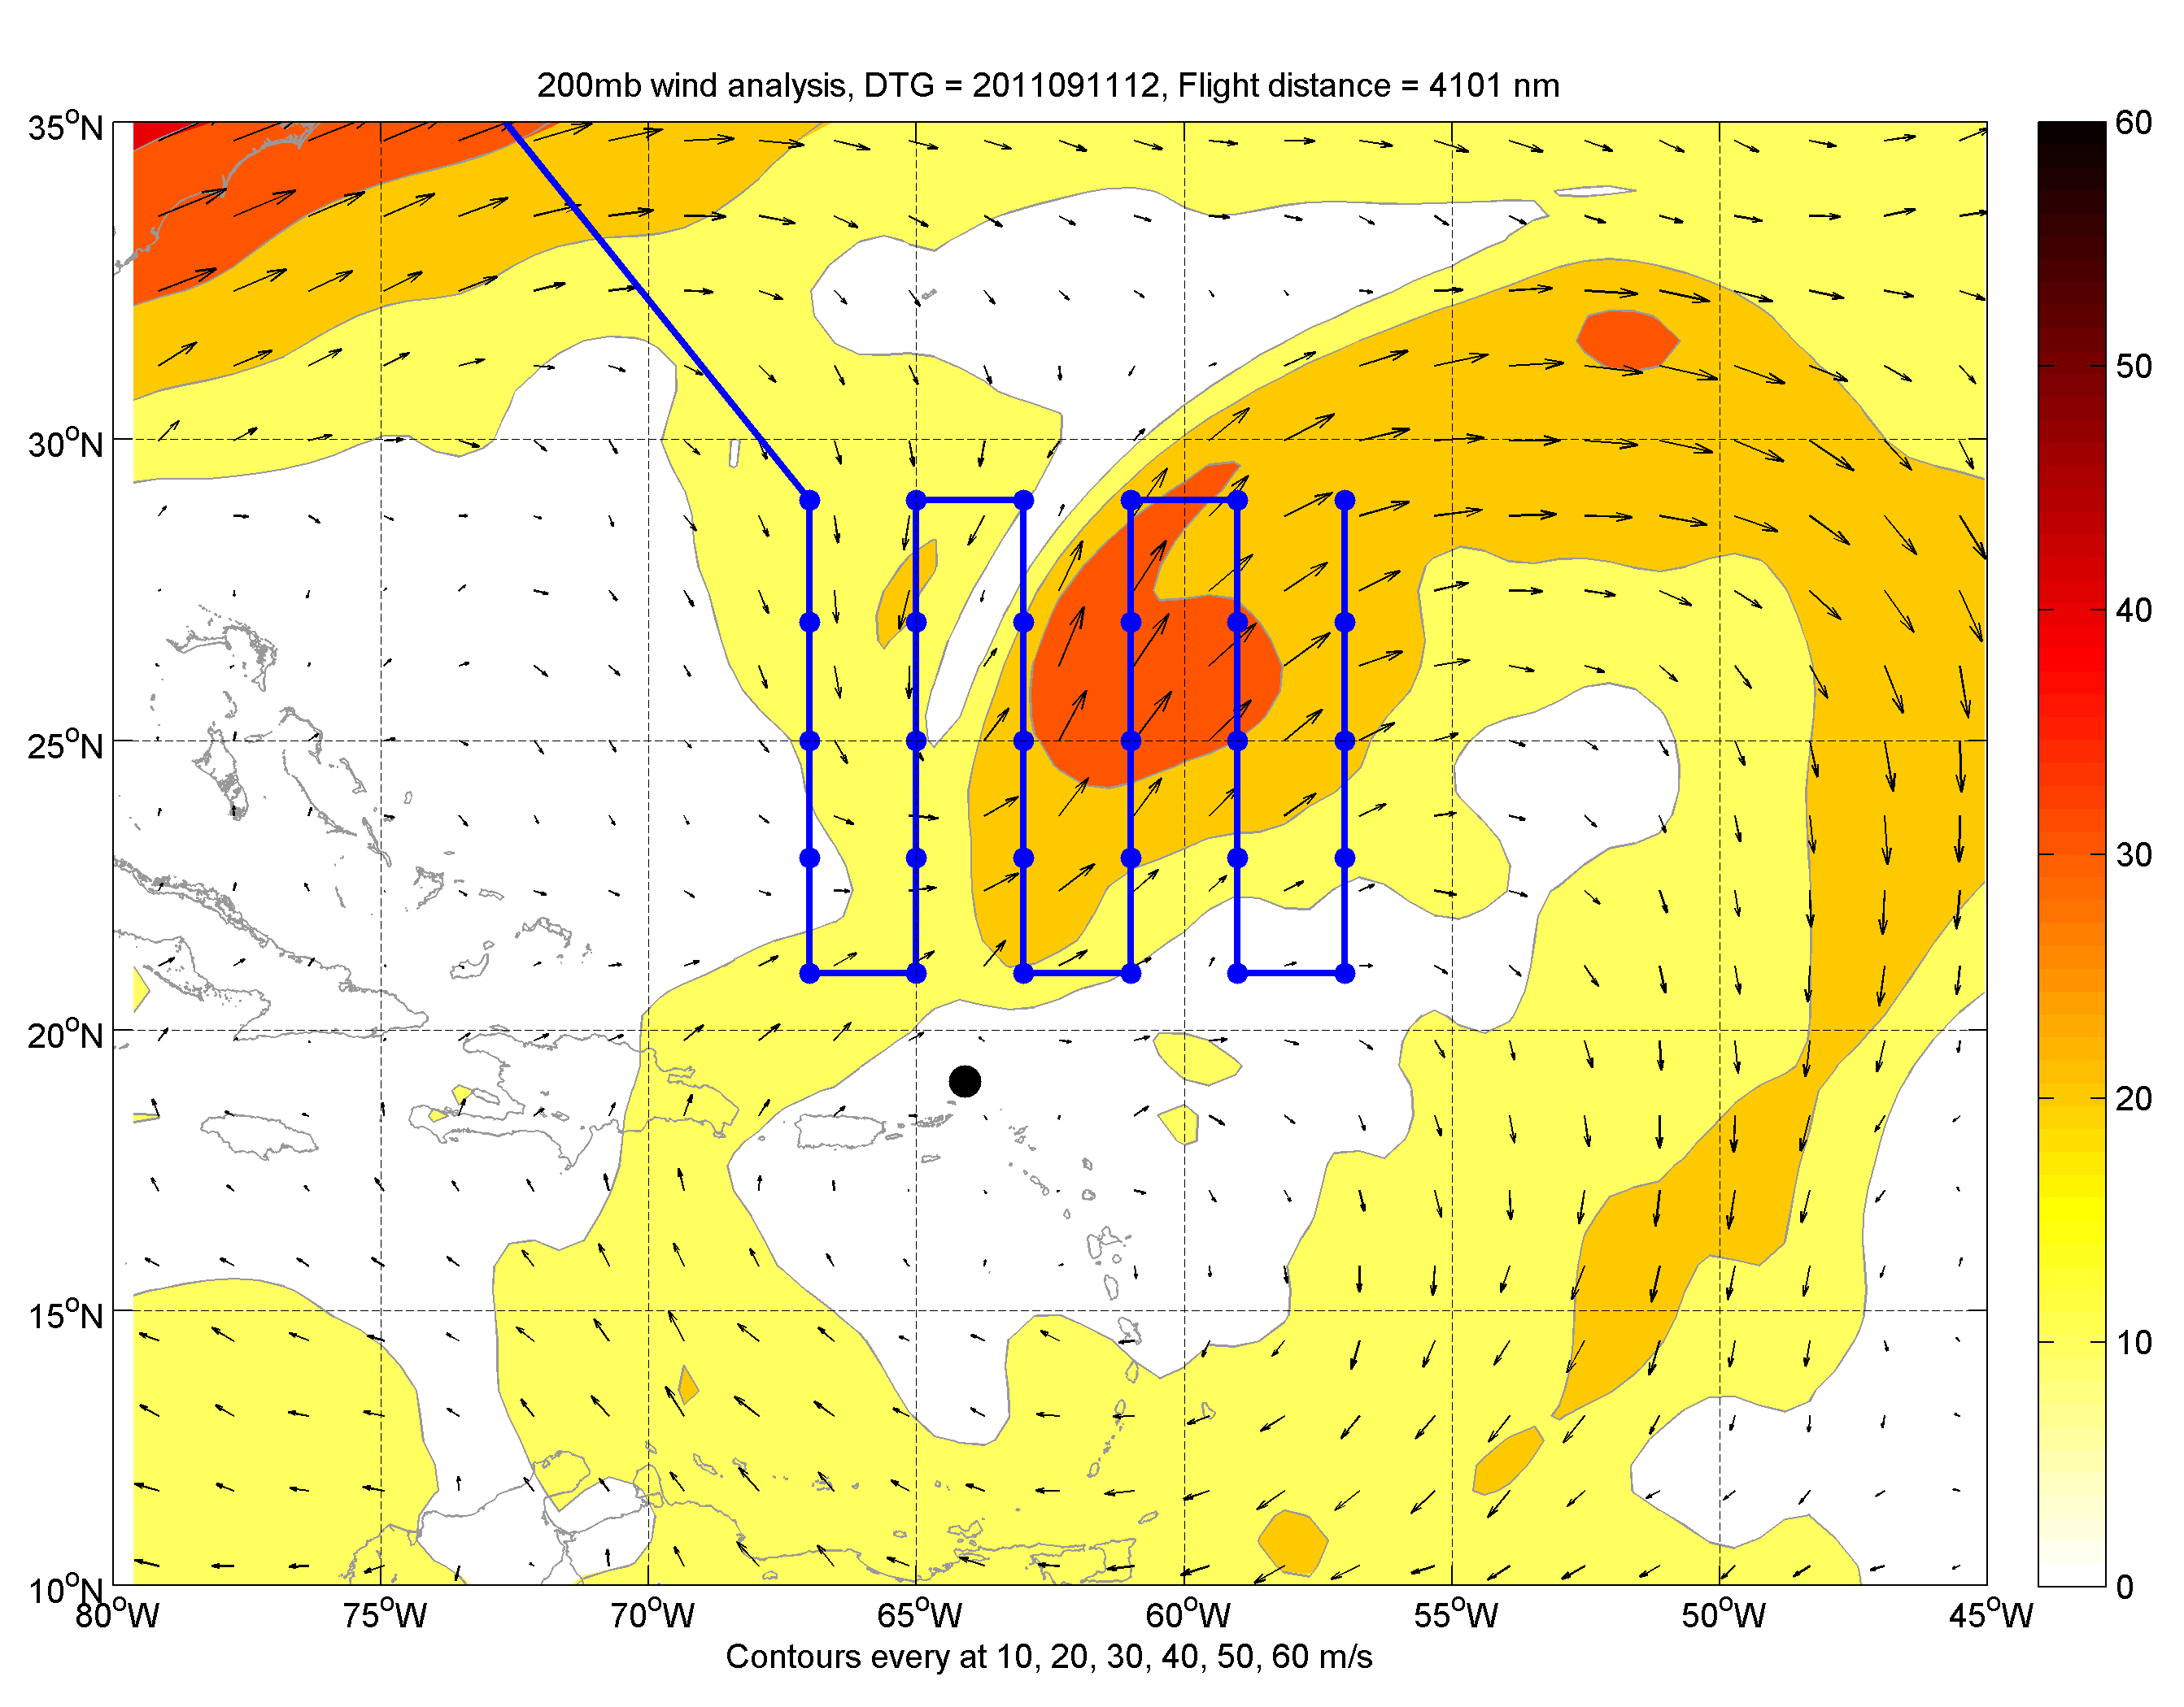
Module 1: Lawnmower pattern: Maria (2011) example
Flight legs 2º apart,
and 30 drops in
2ºx2º grid in this
example
Repeat pattern and
fly home or move on
to another objective
Black dot: Best-track position Blue line: Flight track Blue dots: Dropsondes

Slide 6
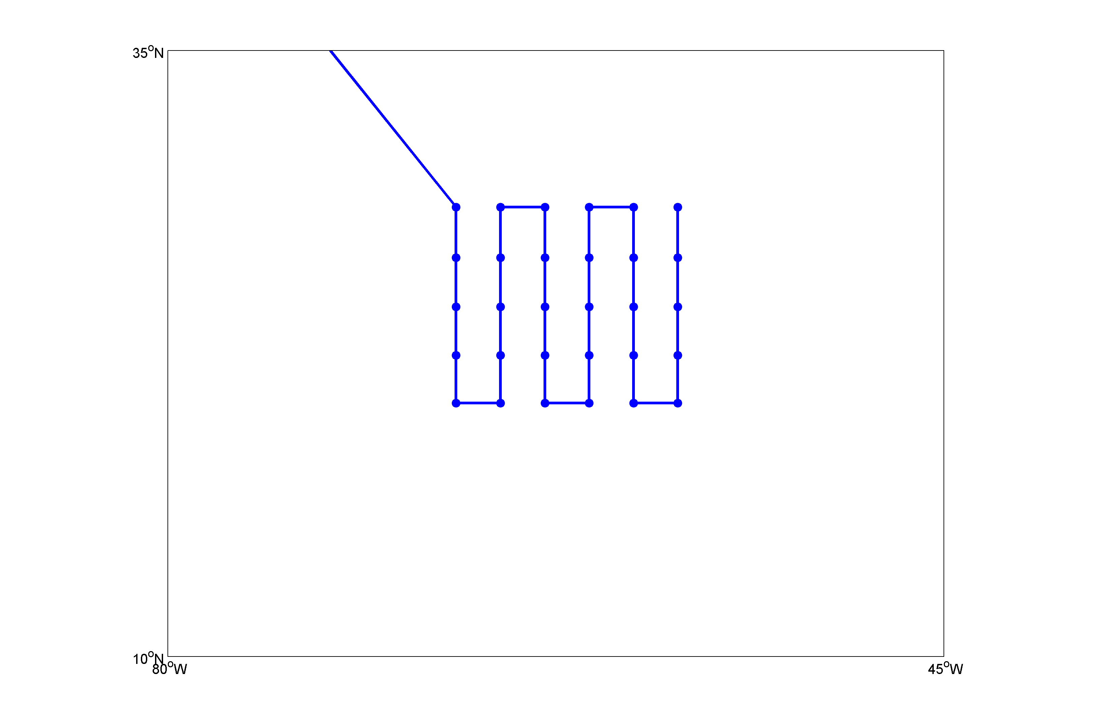
Module 1: Lawnmower pattern: Maria (2011) example
A
Flight legs 2º apart,
and 30 drops in
2ºx2º grid in this
example
Repeat pattern and
fly home or move on
to another objective
Options:
Rotate, Stretch/ Compress
Fixed, storm or feature relative
A- go home: 30 sondes
B- Repeat: 60 sondes
C- Fly another feature: 60 sondes
Black dot: Best-track position Blue line: Flight track Blue dots: Dropsondes

Slide 7
Module 1: Lawnmower pattern: Maria (2011) example
A
Flight legs 2º apart,
and 30 drops in
2ºx2º grid in this
example
Repeat pattern and
fly home or move on
to another objective
B
Options:
Rotate, Stretch/ Compress
Fixed, storm or feature relative
A- go home: 30 sondes
B- Repeat: 60 sondes (option: ferry to start pt. over outflow core)
C- Fly another feature: 60 sondes
Black dot: Best-track position Blue line: Flight track Blue dots: Dropsondes

Slide 8
Module 1: Lawnmower pattern: Maria (2011) example
A
Flight legs 2º apart,
and 30 drops in
2ºx2º grid in this
example
Repeat pattern and
fly home or move on
to another objective
B
C
Options:
Rotate, Stretch/ Compress
Fixed, storm or feature relative
A- go home: 30 sondes
B- Repeat: 60 sondes
C- Fly another feature: 60 sondes
Black dot: Best-track position Blue line: Flight track Blue dots: Dropsondes

Slide 9
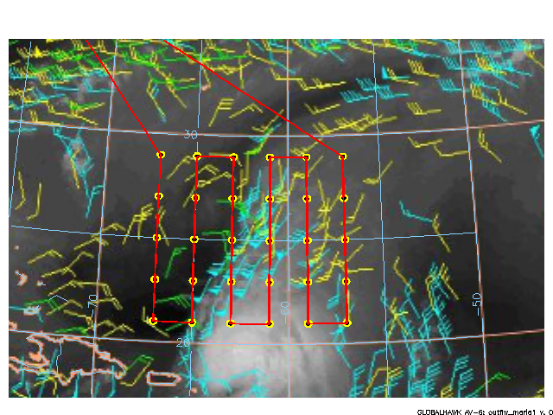

Slide 10
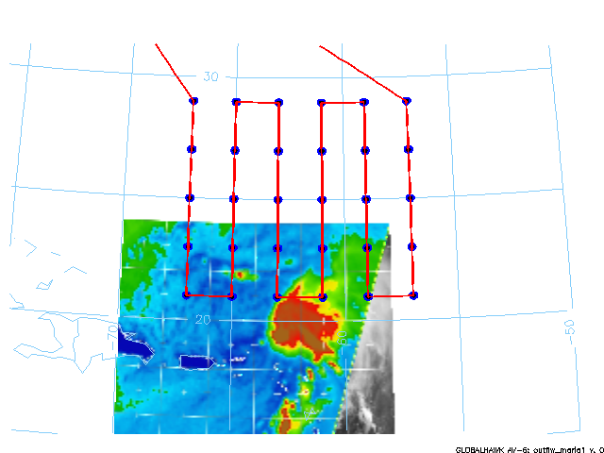

Slide 11
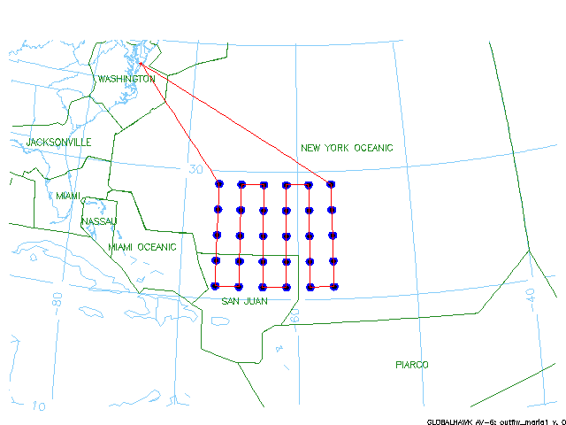

Slide 12
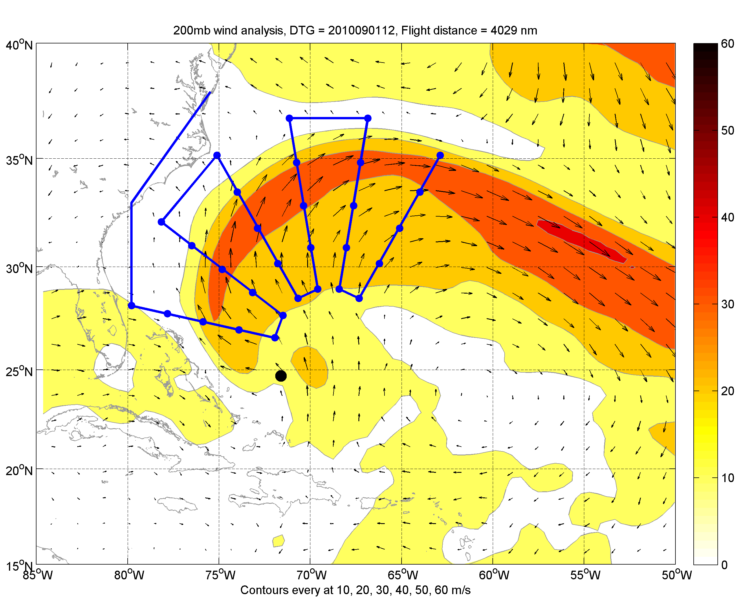
Module 1: Lawnmower variant – Polar Coordinate Transform: Earl (2010)
Radial legs are evenly
spaced in azimuth and
30 drops in this example
Re-center pattern and
fly again before returning
home
Ferry flight segment over land is for illustrative purposes only. Not feasible during experiment.
Black dot: Best-track position Blue line: Flight track Blue dots: Dropsondes

Slide 13
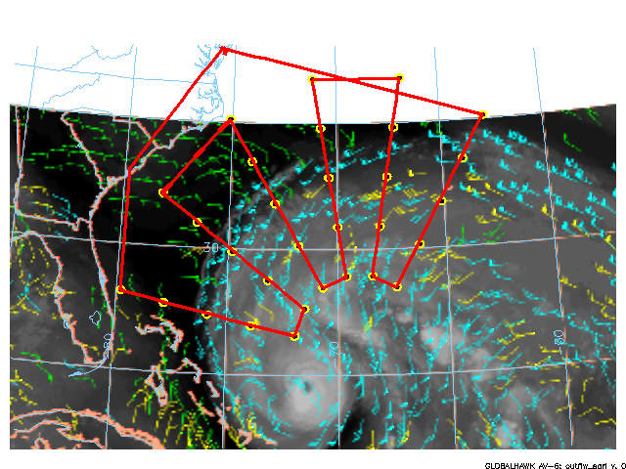

Slide 14
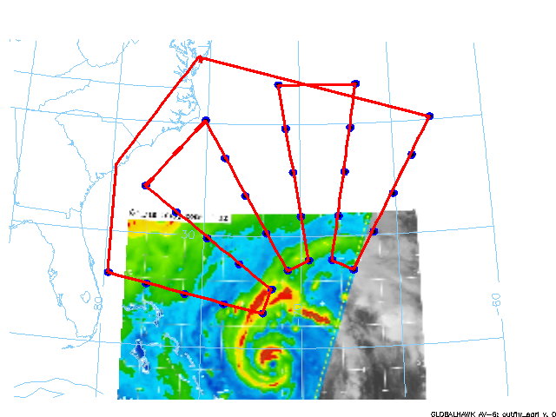

Slide 15
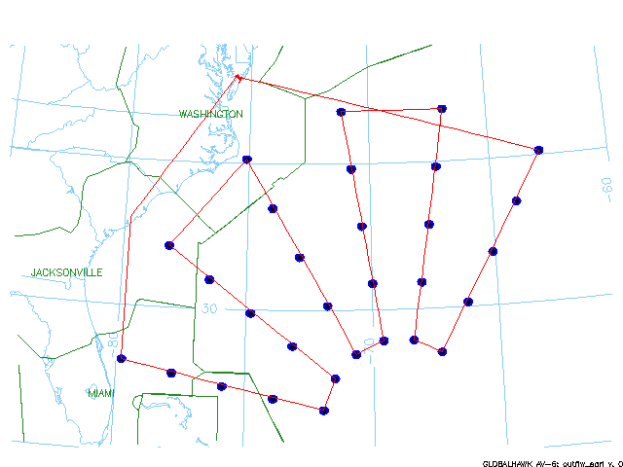

Slide 16
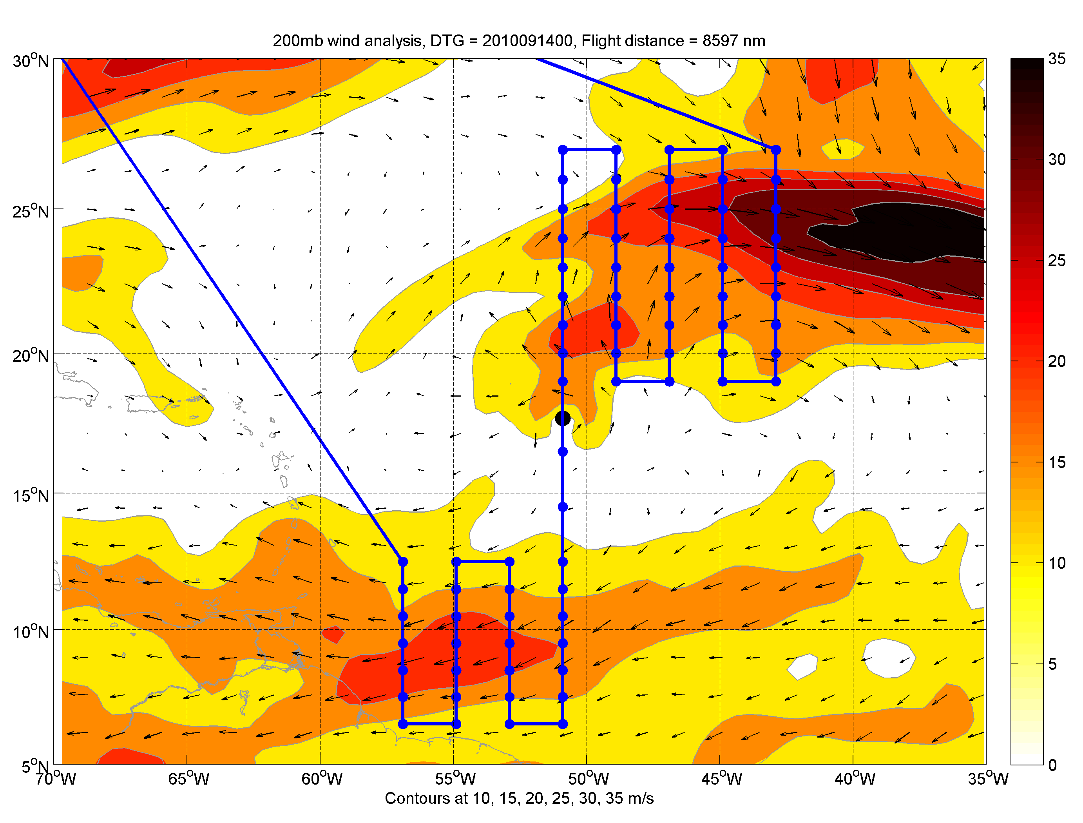
Module 1: Lawnmower Variant Igor (2010) example
75 drops in this example
Black dot: Best-track position Blue line: Flight track Blue dots: Dropsondes

Slide 17
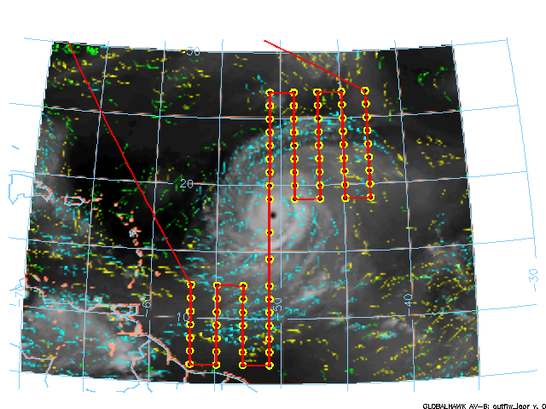

Slide 18
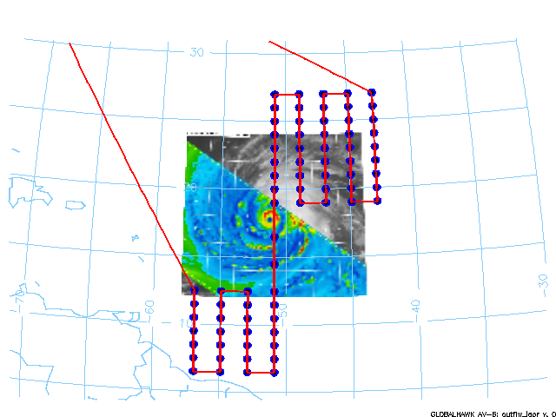

Slide 19
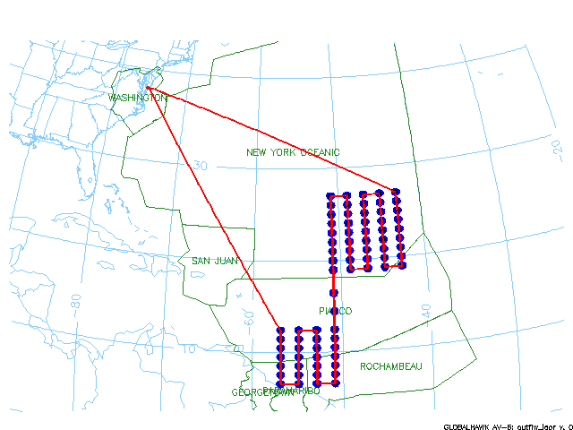

Slide 20
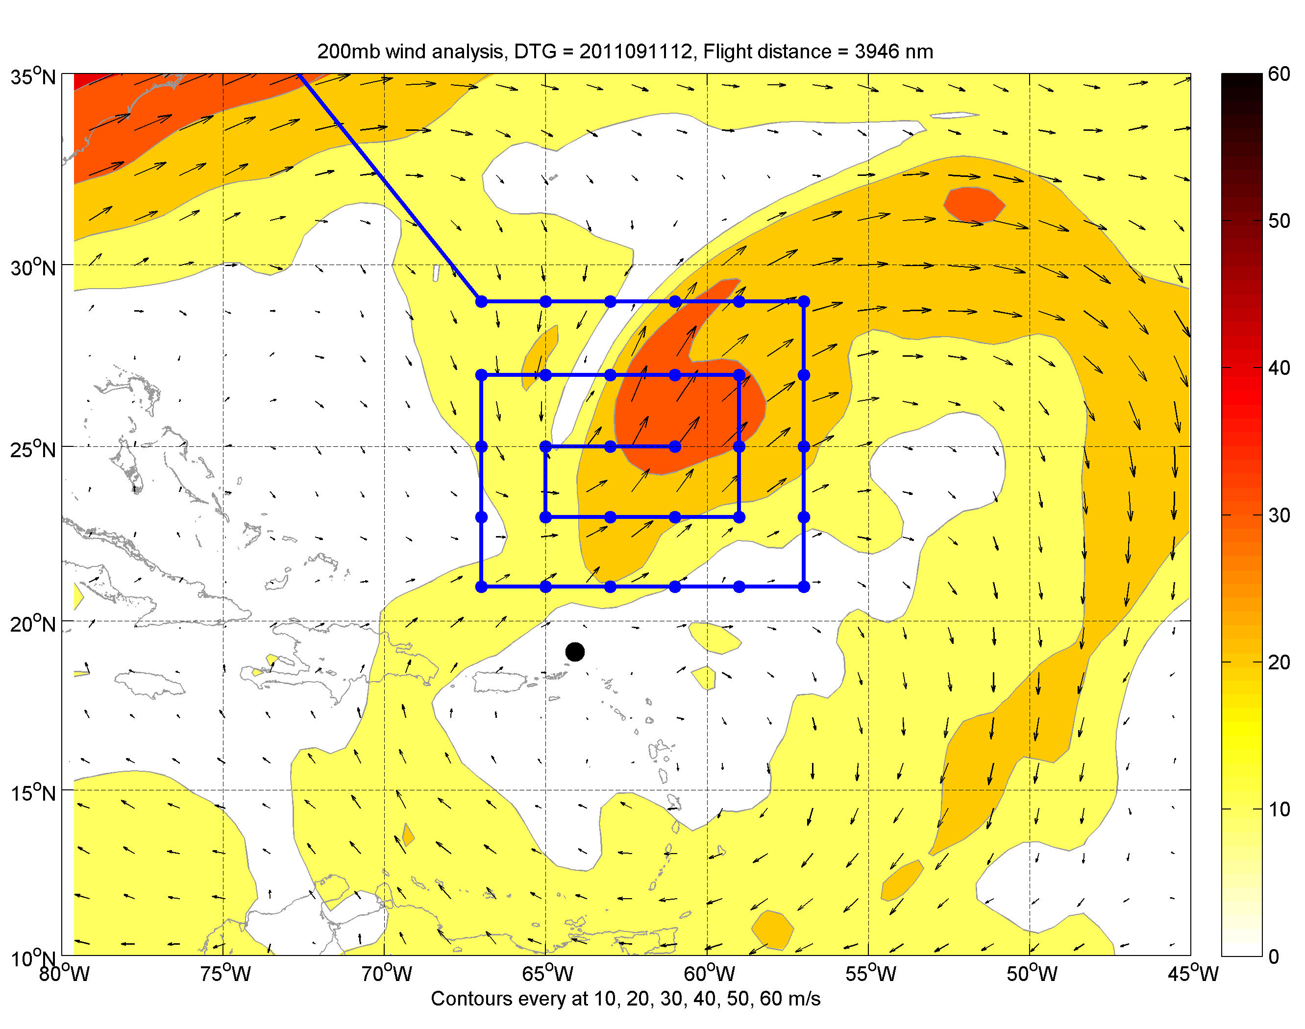
Module 2: Square spiral pattern: Maria (2011) example
Flight legs 2º apart,
and 30 drops in
2ºx2º grid in this
example
Repeat pattern and
fly home or move on
to another objective

Slide 21
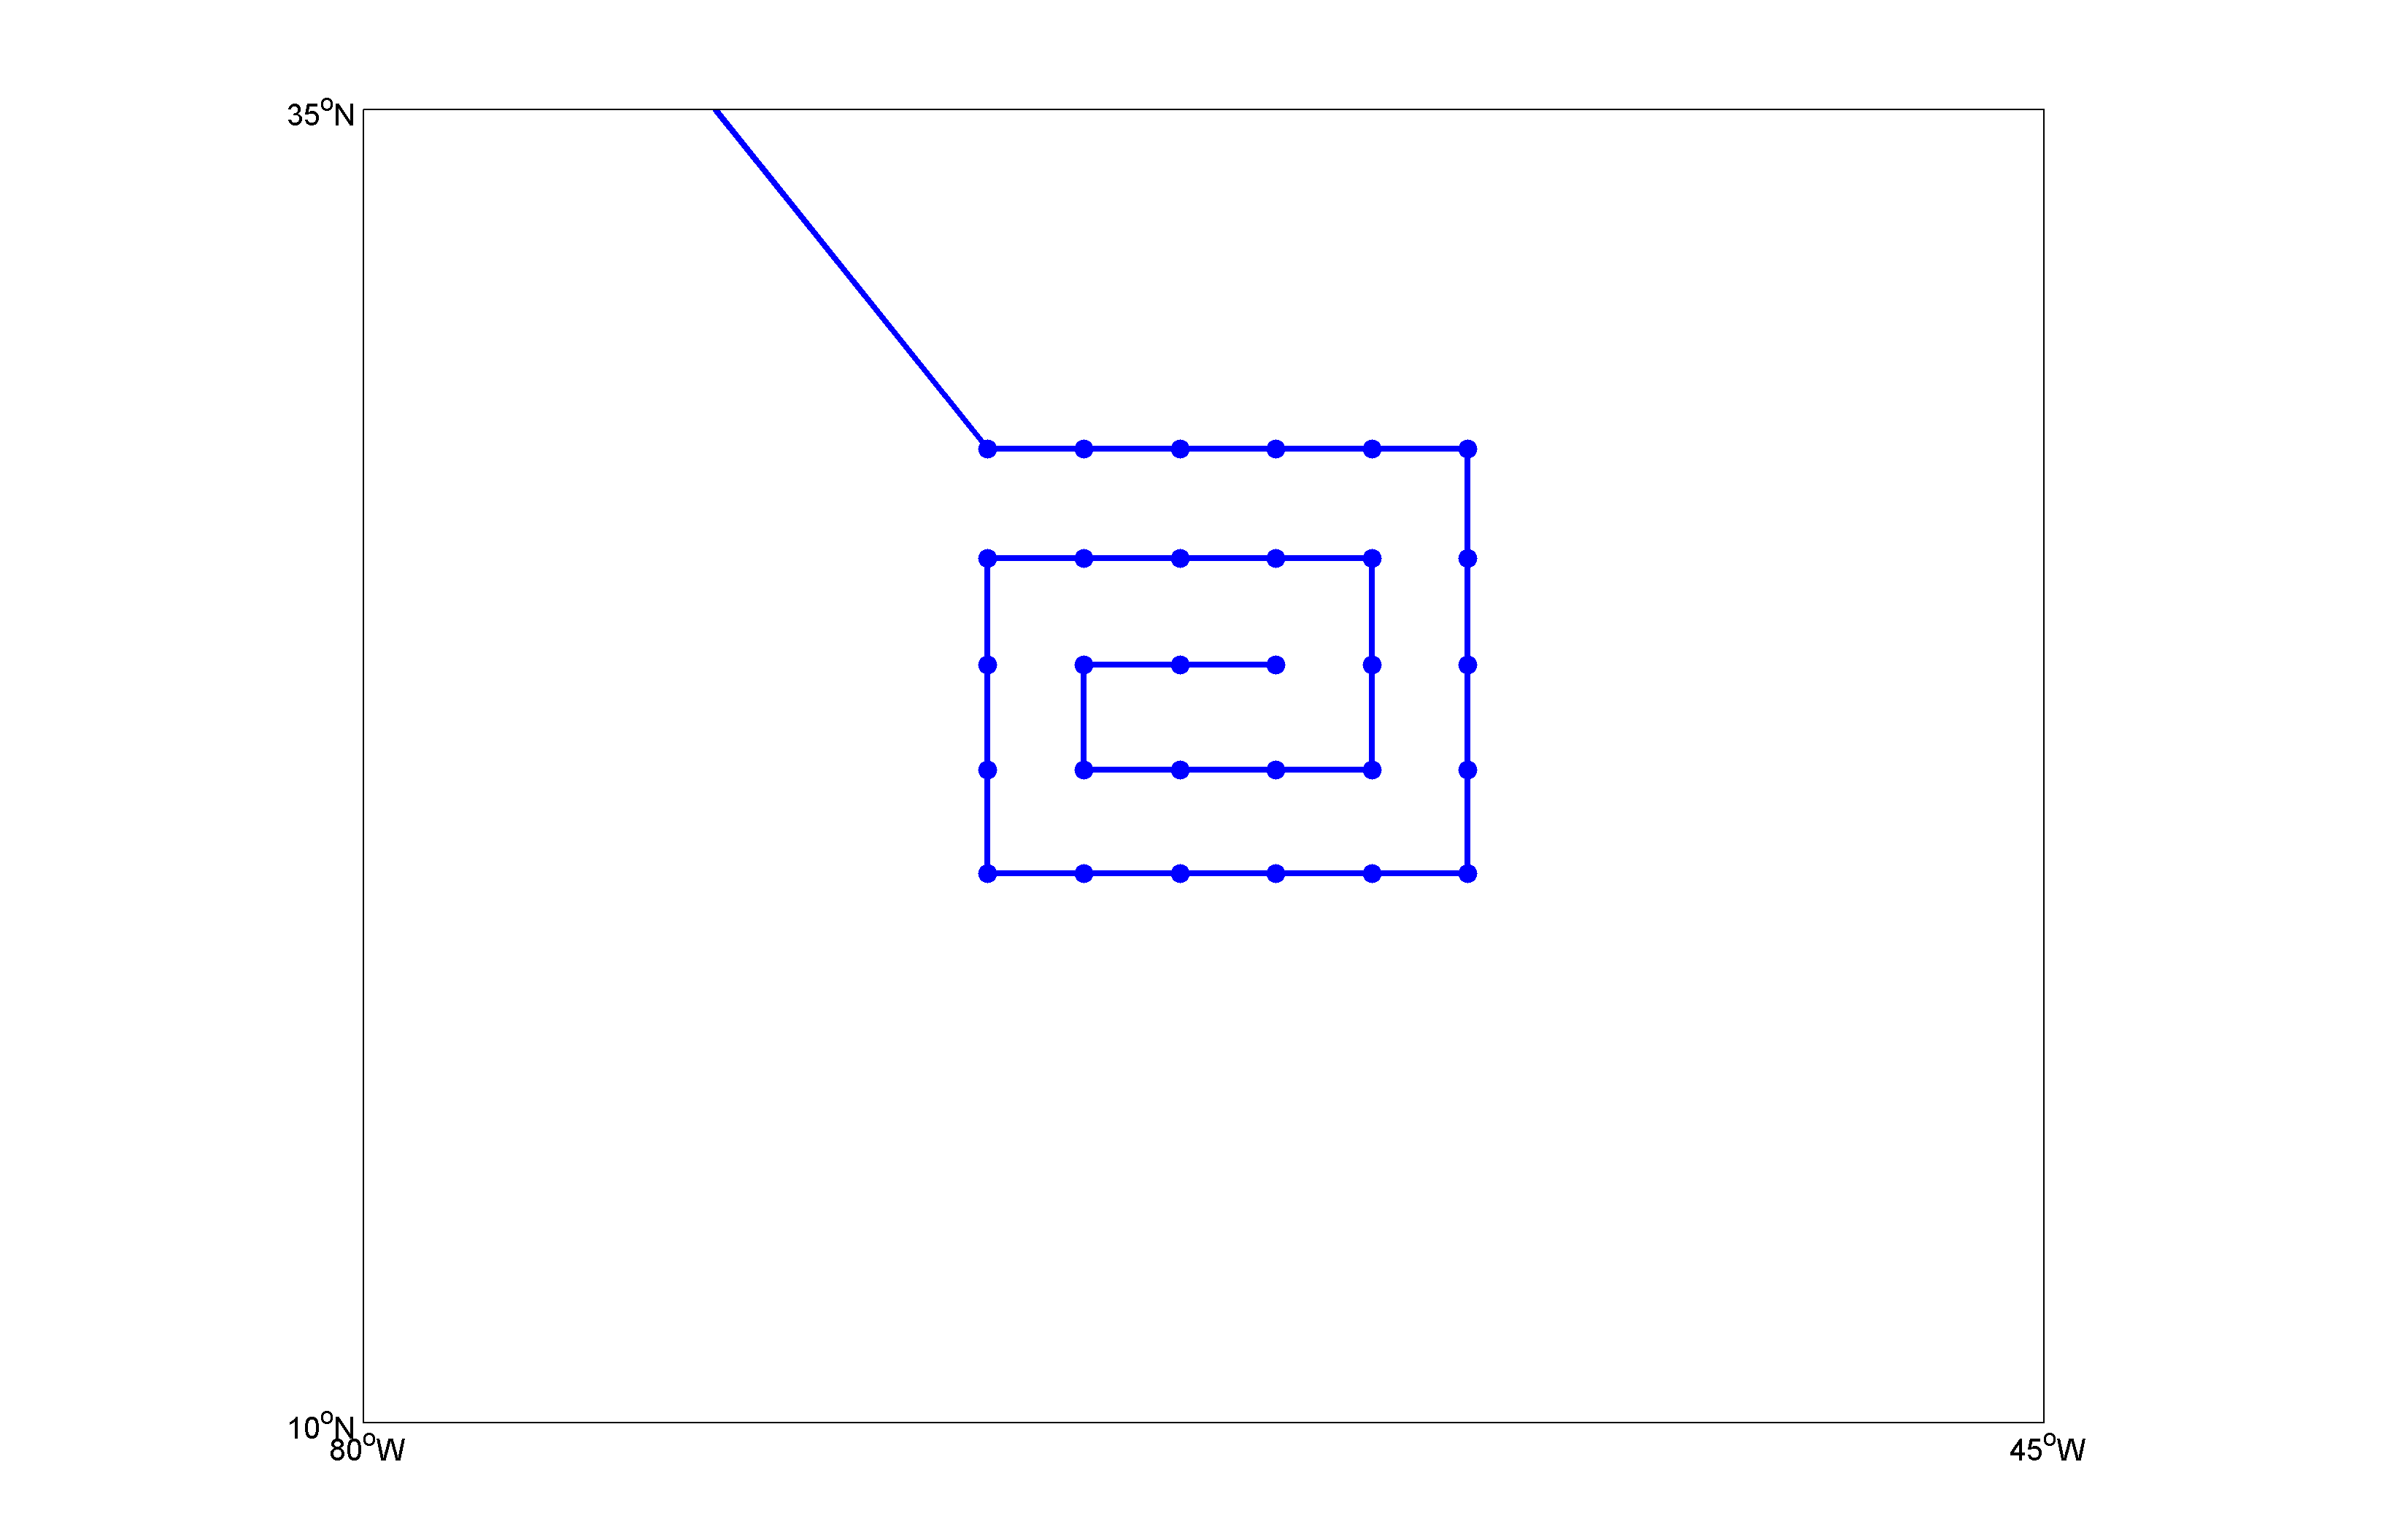
Module 2: Square spiral pattern: Maria (2011) example
Flight legs 2º apart,
and 30 drops in
2ºx2º grid in this
example
Repeat pattern and
fly home or move on
to another objective
A
Options:
Rotate, Stretch/ Compress
Fixed, storm or feature relative
A- go home: 30 sondes
B- Repeat: 60 sondes
C- Fly another feature: 60 sondes
Black dot: Best-track position Blue line: Flight track Blue dots: Dropsondes

Slide 22
Module 2: Square spiral pattern: Maria (2011) example
Flight legs 2º apart,
and 30 drops in
2ºx2º grid in this
example
Repeat pattern and
fly home or move on
to another objective
A
B
Options:
Rotate, Stretch/ Compress
Fixed, storm or feature relative
A- go home: 30 sondes
B- Repeat: 60 sondes
C- Fly another feature: 60 sondes
Black dot: Best-track position Blue line: Flight track Blue dots: Dropsondes

Slide 23
Module 2: Square spiral pattern: Maria (2011) example
Flight legs 2º apart,
and 30 drops in
2ºx2º grid in this
example
Repeat pattern and
fly home or move on
to another objective
A
B
Options:
Rotate, Stretch/ Compress
Fixed, storm or feature relative
A- go home: 30 sondes
B- Repeat: 60 sondes
C- Fly another feature: 60 sondes
C
Black dot: Best-track position Blue line: Flight track Blue dots: Dropsondes

Slide 24
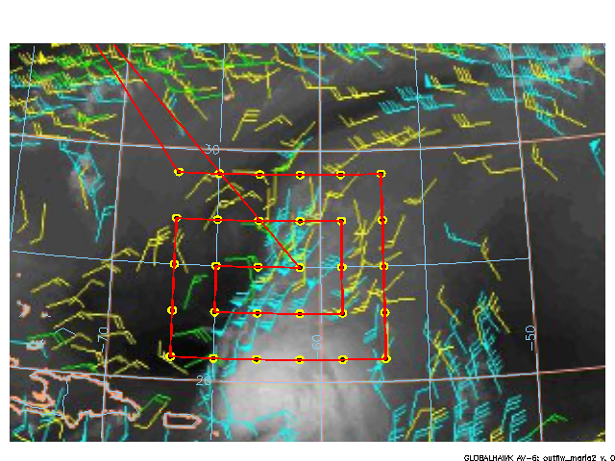

Slide 25


Slide 26
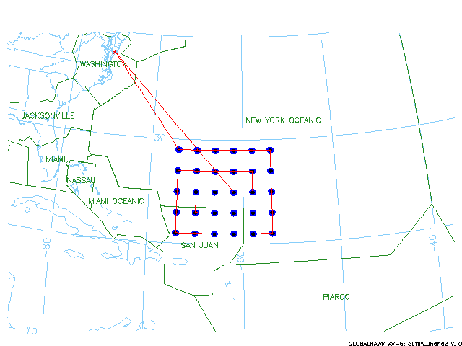

Slide 27
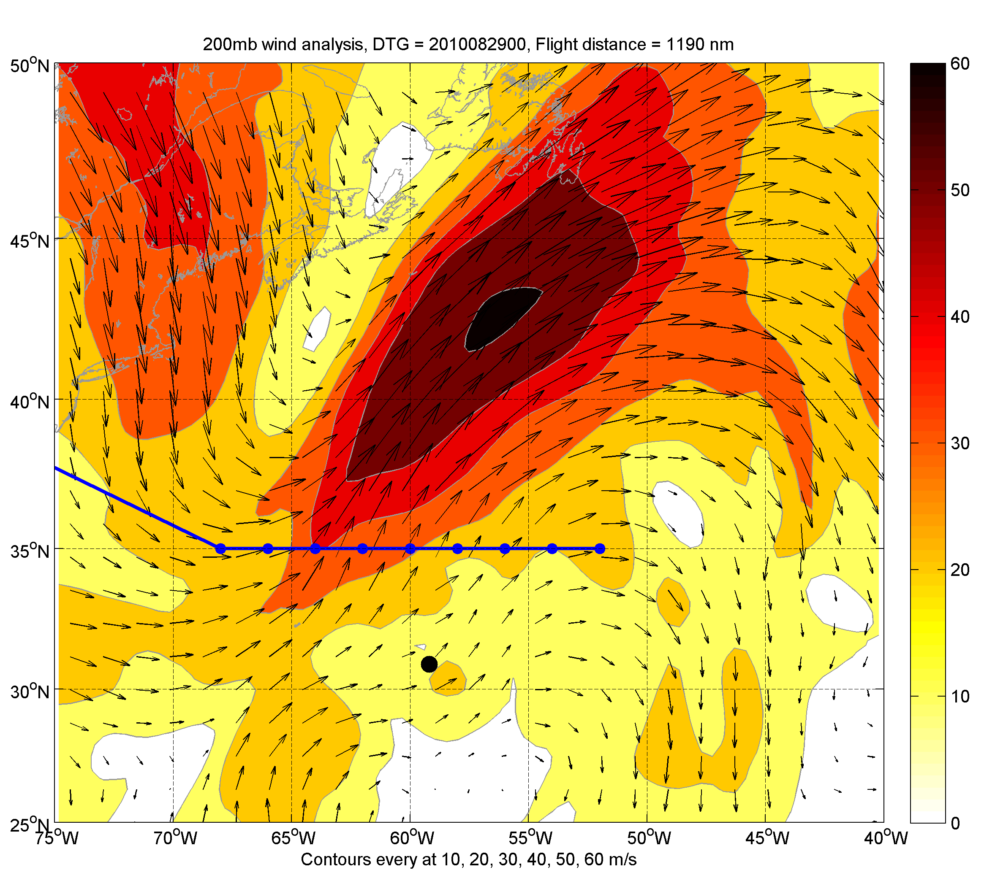
Module 3: Linear Repeat: Danielle (2010) example
Ferry to 35ºN and travel back
and forth as many times as
desired, while storm translates
rapidly northeast
Combine with extratropical
transition objective
Time Evolution- Hovmöller
Black dot: Best-track position Blue line: Flight track Blue dots: Dropsondes

Slide 28
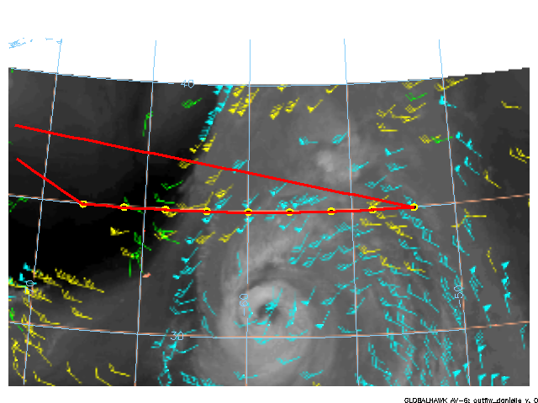

Slide 29
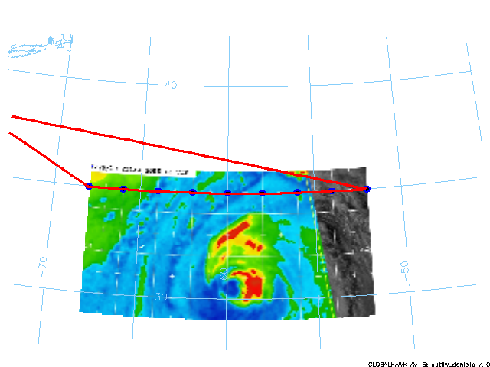

Slide 30
