Slide 1


NAME modelling activities for
ATTREX-CONTRAST-CAST
VSLS measurements
Michal Filus, Neil Harris, Matt Ashfold*, John Pyle – University of Cambridge, UK (*now: Nottingham University Malaysia Campus, Malaysia)
Elena Meneguz, Alistair Manning – UK Meteorological Office, UK
Elliot Atlas, Maria Navarro, AWAS team – Rosenstiel School of Marine and Atmospheric Science, University of Miami, US
Boulder, CO, Joint Science Meeting for ATTREX-CONTRAST-CAST, 20-24.10.2014
Notes:
Logos here and a picture of 3 aircraft together
1

Slide 2


Goals
Investigate transport and distribution of Very Short Lived Species (VSLS)
Use NAME as a tool for projecting atmospheric transport and apply procedure to model VSLS distributions in the Tropics
Compare NAME model data with observations from CONTRAST and ATTREX flights

Slide 3
Approach: Model Setup
NAME is a UKMO Lagrangian model using UM 3D met fields at 17 km*
No convection scheme applied
Used in Guam campaign, Jan - Mar’14, for flight planning and coordination
Developing a procedure for post-flight analysis, especially for GWAS observations

Slide 4
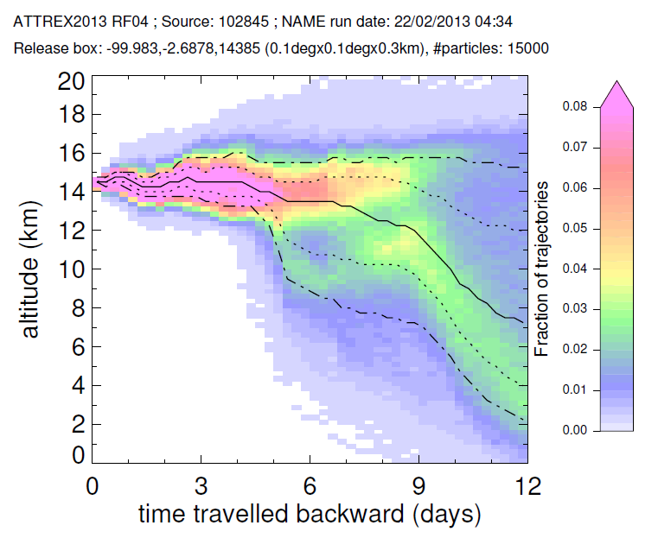
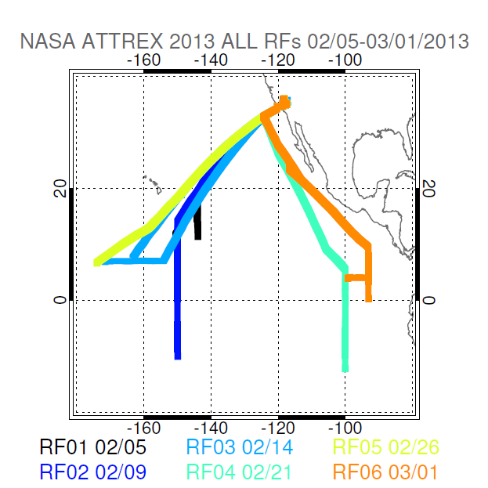
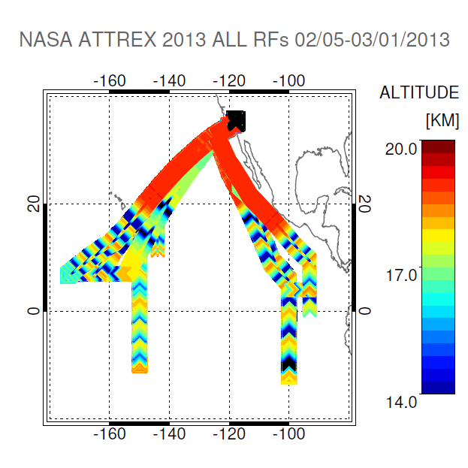
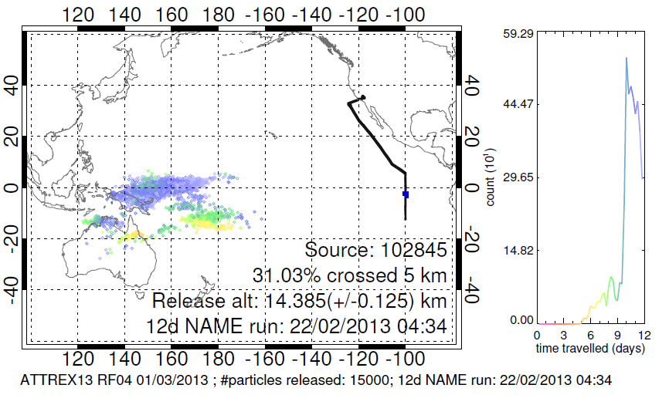
ATTREX 2013 – e.g. NAME use
Altitude-vs-Time and Crossing Location Plots

Slide 5
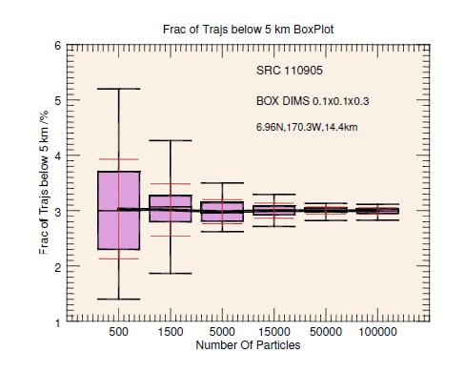
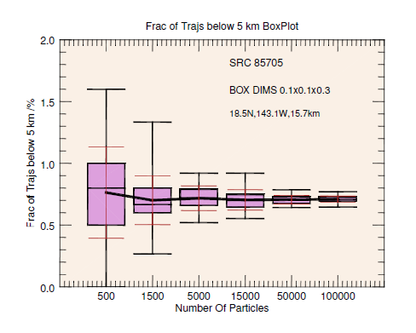
Developing a technique – sensitivity tests
  Aim to select number of trajectories and source release box dimensions
  Box dimensions: 0.1° x 0.1° x 0.3 km to match GWAS sample time and location

Slide 6
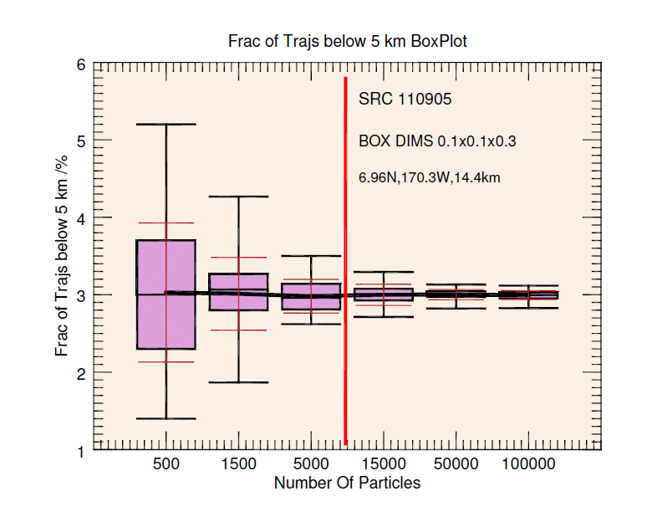
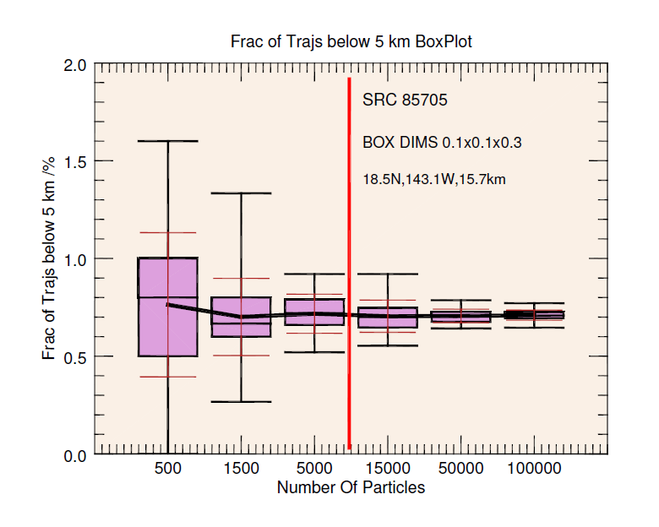
Developing a technique – sensitivity tests
  Running NAME with different number of particles
  Aim to select number of trajectories: #NP15000 gives statistically robust results

Slide 7
NAME products for CONTRAST-ATTREX
Each flight track divided into segments
Particles released and followed back to identify low-level sources of air
Fractions of trajectories calculated according to particles which cross below 5/1 km
Products
  Altitude vs time plots
  Crossing location maps
ATTREX2013 RF04 SRC102845
02/22/13 04:34 (99.9W,2.7S,14.3km)
5km: 31.03%
1km: 2.91%

Slide 8
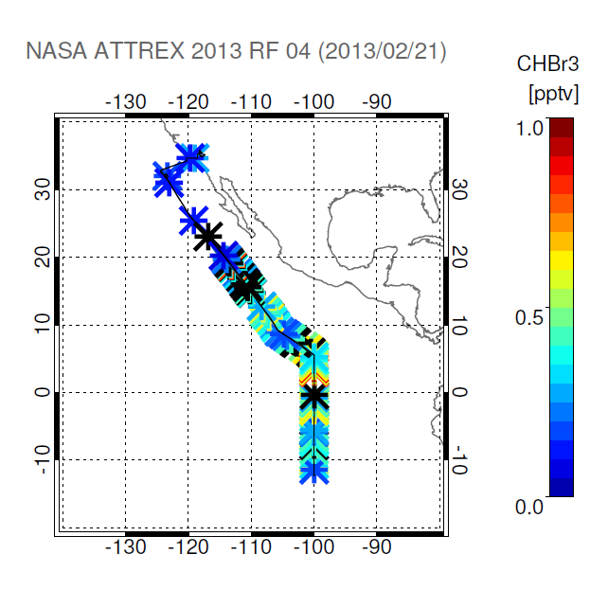
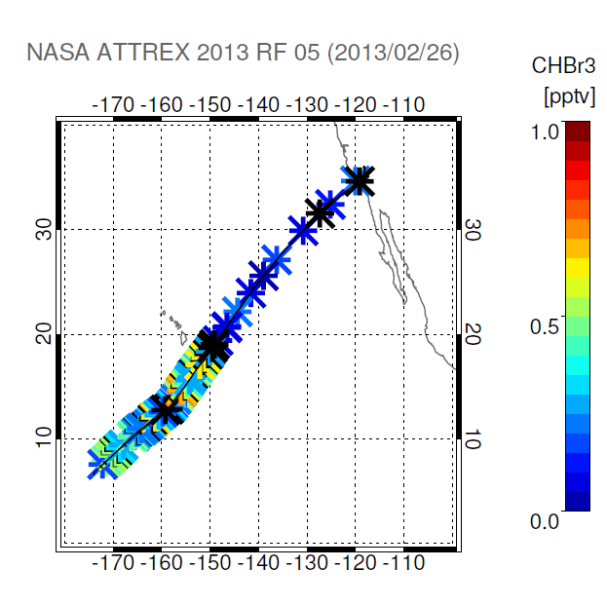
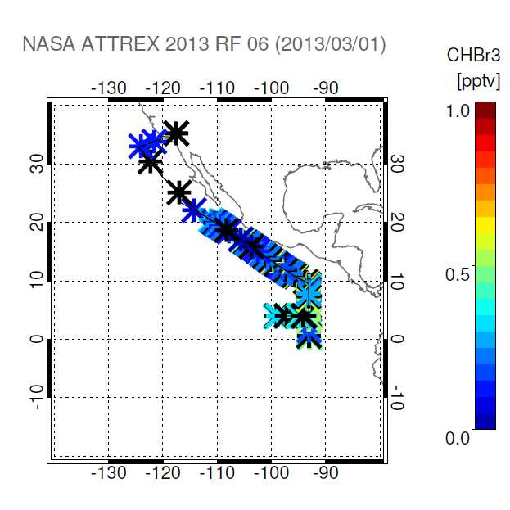
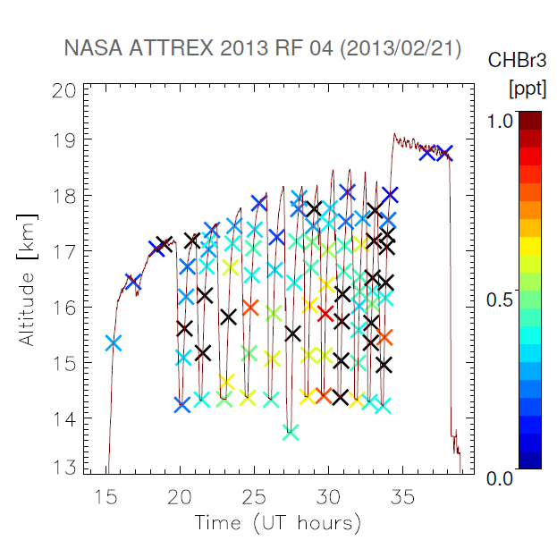
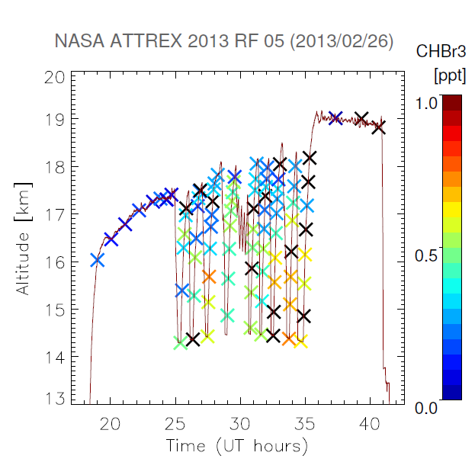
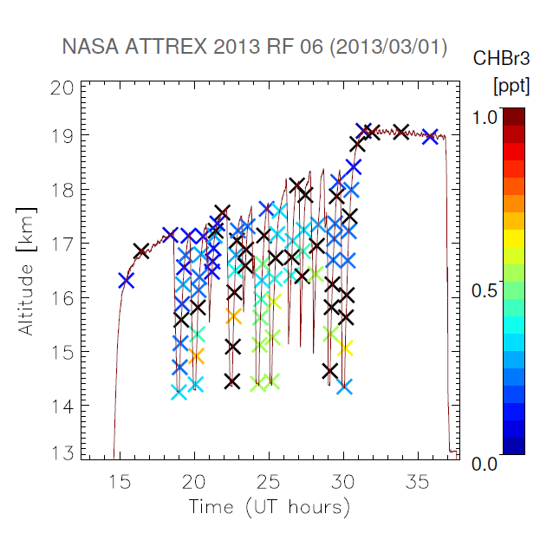
3 Flights Selected For Analysis: ATTREX 2013 RF04,05,06
RF04 02/21/13 CHBr3
RF05 02/25/13 CHBr3
RF06 03/01/13 CHBr3

Slide 9
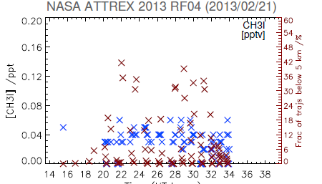
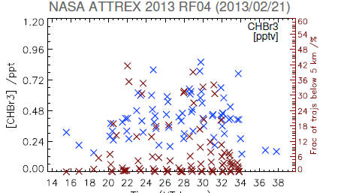
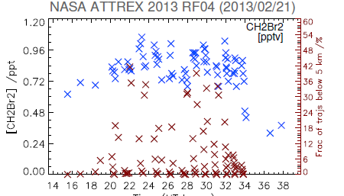
GWAS observations vs NAME results for ATTREX 2013 RF04
- Timeseries for GWAS observations and
fractions of trajectories below 5 km
- Can we see instances of both increased
concentrations and elevated fractional
contribution?

Slide 10
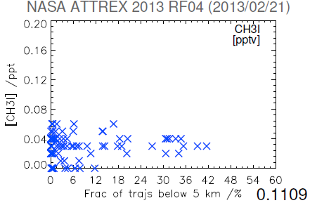
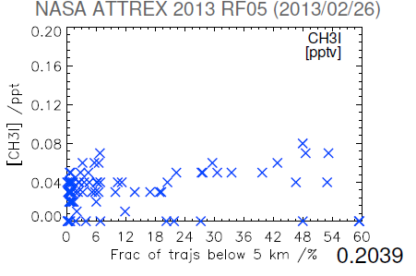
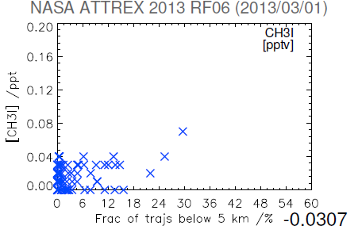
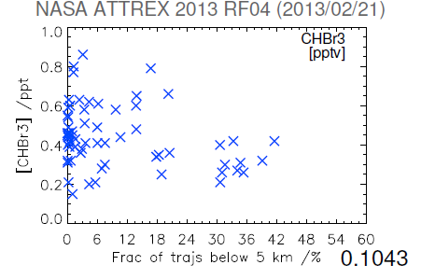
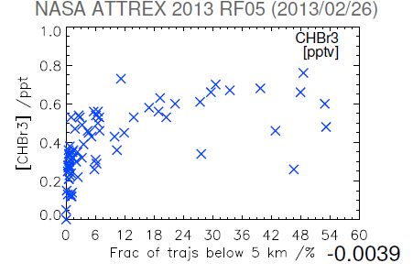
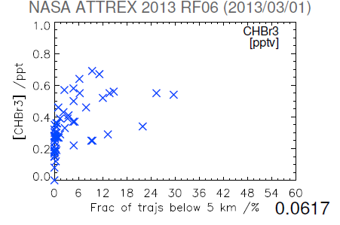
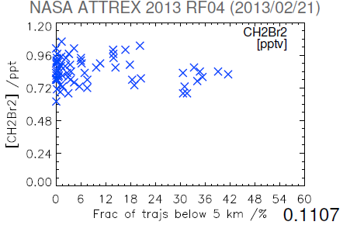
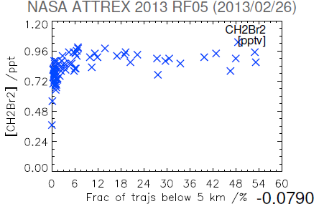
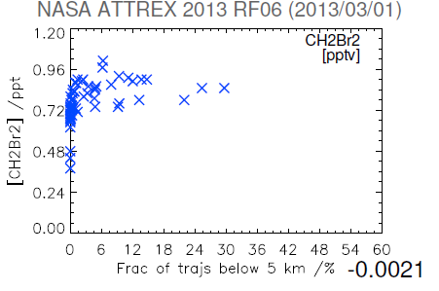
NAME for ATTREX 2013 – Correlation Plots

Slide 11
CHBr3
NAME for ATTREX 2013 – Correlation Plots
CH2Br2
CH3I

Slide 12
ATTREX2013 RF04: Evidence of a Kelvin Wave
NP15000, box dimensions: 0.1 deg x 0.1 deg x 0.3 km

Slide 13
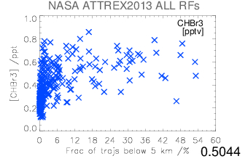
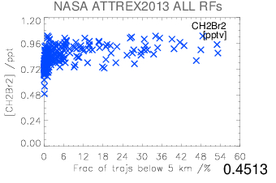
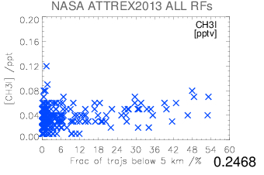
NAME for ATTREX 2013 – Correlation Plots Summary

Slide 14
Conclusions & future work
Some correlation of high fractions of trajectories from below 5 km and high tracer concentration (meteorology? Convection scheme? ATTREX too high?)
NAME accounts for some of influence of low-level airmass in UTLS
Compare NAME results with GWAS observations
CONTRAST 2014 vs ATTREX 2013 vs ATTREX 2014 – ongoing work
Look into tracer relationships more closely – test other tracers/instruments
Use new convection scheme, developed for new version of NAME
Initial concentrations for VSLS assigned to particles which originated from below 5/1 km → final concentrations at flight altitudes determined based on e-folding equation

Slide 15
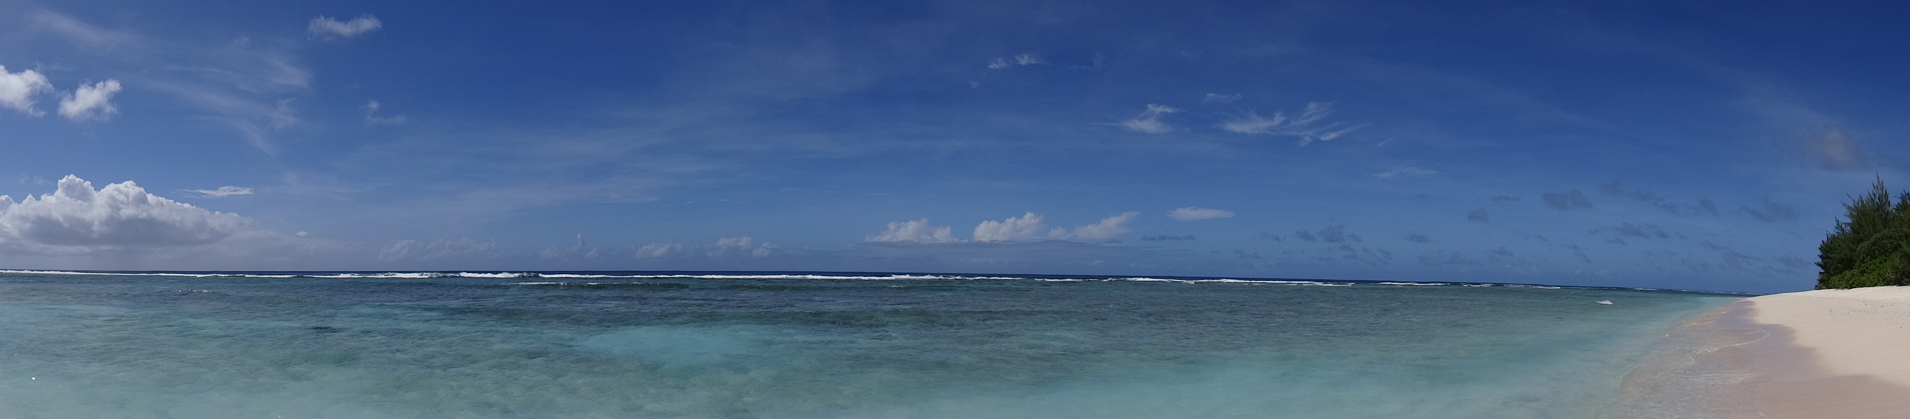
Acknowledgements
Many thanks to:
  Neil Harris, CAST team
  ATTREX/CONTRAST GWAS/AWAS team
  UK Met Office: Elena Meneguz and Alistair Manning, Atmospheric Dispersion Group
  CAS colleagues: Michelle Cain, Sarah Connors, Matt Ashfold
  Address for correspondence/questions/collaboration: mtf34@cam.ac.uk
  Centre for Atmospheric Science, www.atm.ch.cam.ac.uk
  CAST website: www-cast.ch.cam.ac.uk

Slide 16
NAME for ATTREX 2013 – Research Flight 04

Slide 17
NAME for ATTREX 2013 – Research Flight 04

Slide 18
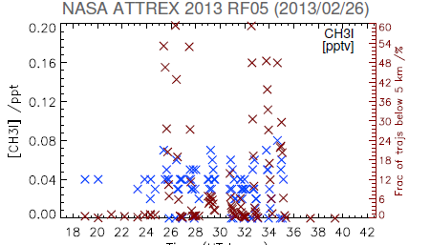
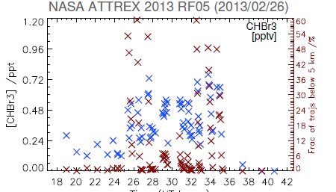
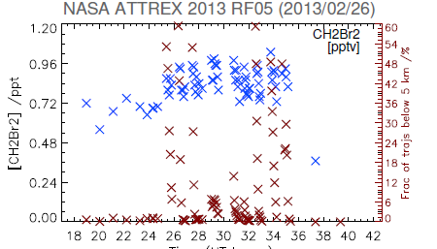
NAME for ATTREX 2013 – Research Flight 05

Slide 19
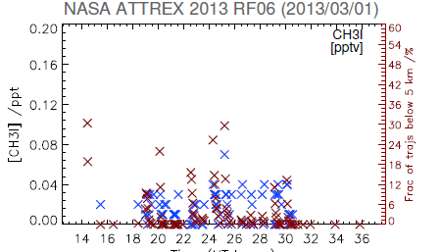
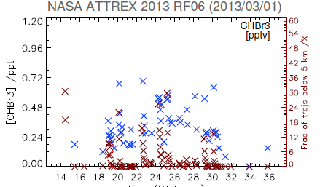
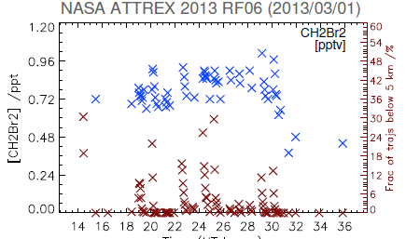
NAME for ATTREX 2013 – Research Flight 06

Slide 20
NAME for ATTREX 2013 – Correlation Plots

Slide 21
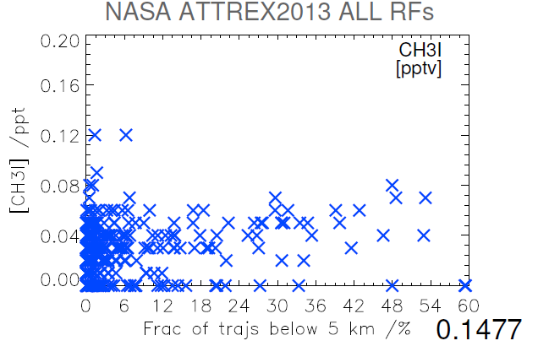
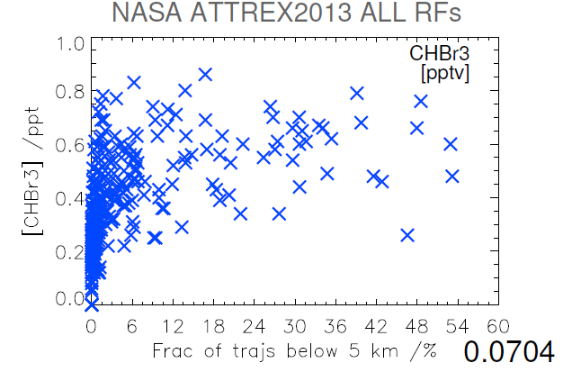
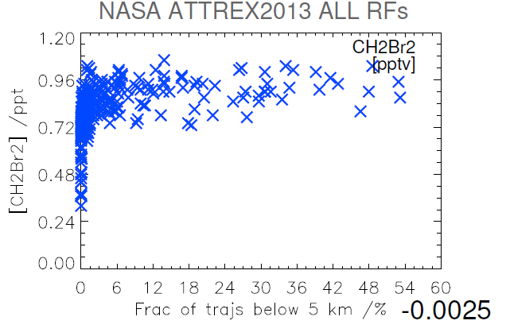
NAME for ATTREX 2013 – Correlation Plots Summary

Slide 22
1st half of the abstract
The UK Met Office Numerical Atmospheric dispersion Modeling Environment (NAME) is used to assess the spatial and temporal variability of transport of very short-lived halogenated organic species (VSLS), in particular bromoform, dibromomethane and methyl iodide, within the West Pacific tropical region. The NAME modelling results are compared with airborne measurements of VSLS taken during NASA ATTREX, NCAR CONTRAST and NERC CAST campaigns in January-March, 2014. In this work, the NAME model is used to link the aircraft measurements to examine the vertical distribution of VSLS in the West Pacific troposphere. The major focus will be on assessing vertical transport in deep convection which is one of the crucial factors in redistributing chemicals within the tropical troposphere.

