Slide 1
Disruption of the Organization of Convection from High Aerosol Number Concentrations
Dr. T. N. Krishnamurti
COLLBORATORS: Drs. Robert Ross, Anu Simon, AypeThomas
HS3 Science & Deployment Preparation Meeting
May 7-9, 2013
NASA Research Park, Moffett Field, CA
HSRP Oral Presentations
May 9, 10:30 a.m.

Slide 2
Disruption of Organization of Convection Leading to the Demise of Monsoon Depressions

Slide 3
2011 HAD ZERO DEPRESSIONS

Slide 4
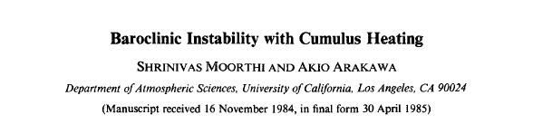

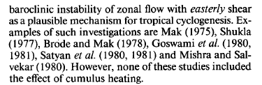
JAS, 1985

Slide 5
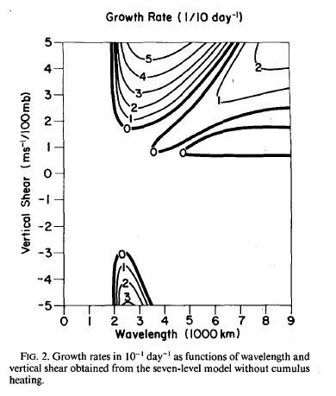
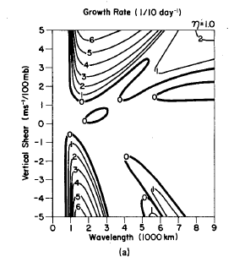
Relevant to Monsoon Lows
Relevant to Monsoon Depressions

Slide 6
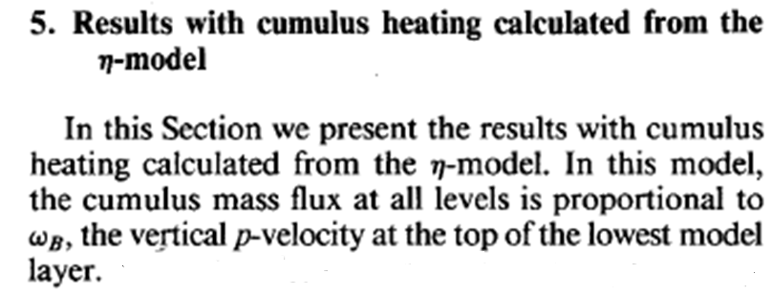
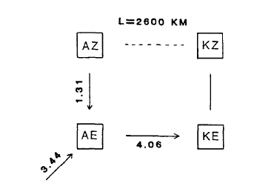

Slide 7
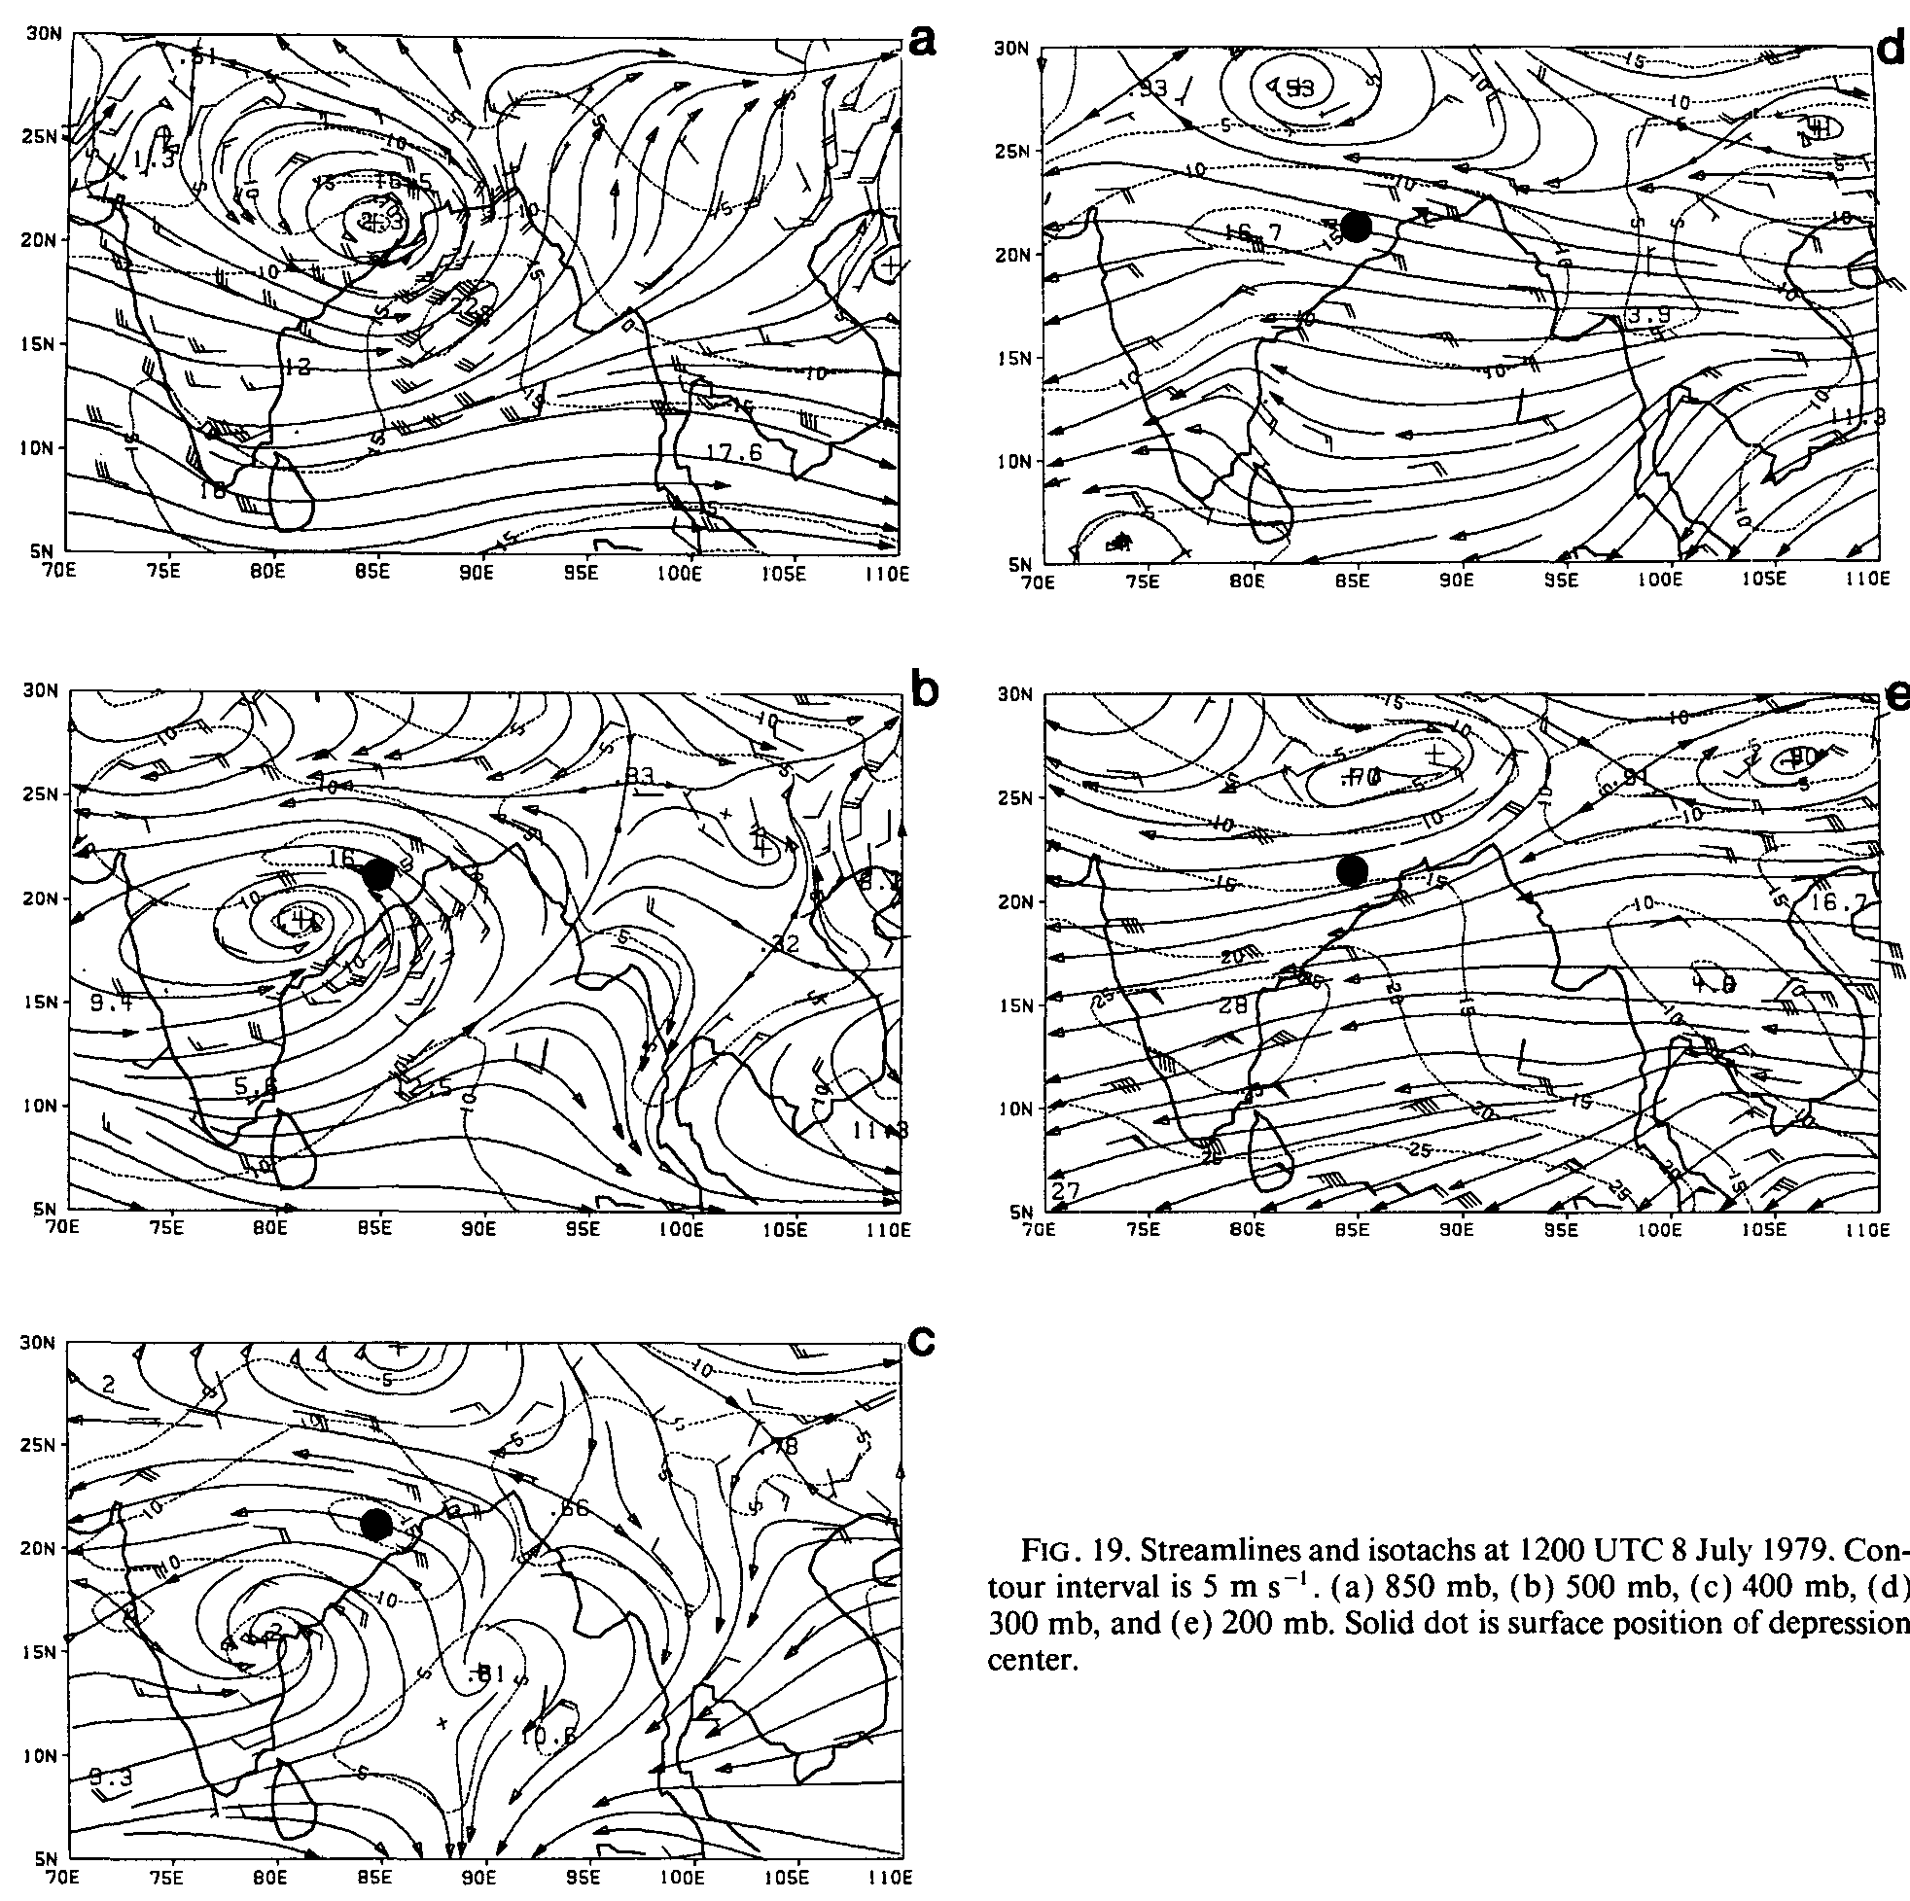
Vertical tilt of a baroclinic /convective Monsoon depression
Streamlines and isotachs at 1200 UTC, 8th July 1979 (a) 850 hPa, (b) 500 hPa, (c) 400 hPa, solid dot is surface position of depression.

Slide 8
On the energetics of the monsoon depression
The calculations of energy exchanges and generation and dissipation are formulated essentially following Lorenz (1967).
We define the principal energy quantities as follows: (Refer to the Appendix for a list of symbols.)
Where , , and are respectively, the zonal available potential energy, eddy available potential energy, zonal kinetic energy and eddy kinetic energy over a closed domain of mass m.
ii) The principle energy transformation functions are the following:

Slide 9
iii) The generation of available potential energy is expressed by the relations:
where and are respectively, the generation terms for the zonal and the eddy available potential energy. The subscript denotes the generation for a particular heating function . In the following analysis we shall speak of four types of heating functions and their respective n contributions to the generation of available potential energy. These heating functions are,

Slide 10
H_{R} = Radiative warming;
H_{ST} = Stable heating, i.e., large scale condensation;
H_{CON} = Convective heating (parameterized form);
H_{SEN} = Sensible heat flux from ocean and land surfaces.
= the zonal available potential energy
= eddy available potential energy
= zonal kinetic energy
= eddy kinetic energy
iv) The dissipation of kinetic energy is given by the expressions,

Slide 11
where D and D' denote the dissipation of zonal and eddy kinetic energy, respectively, and are the corresponding frictional forces per unit mass of air, the formulation of the function should be consistent with the momentum equations of the dynamical model in use. The formulation is same as that used in Krishnamurti (1969).
Symbol Meaning of Symbol
g acceleration due to gravity
P precipitation per unit mass of the air
R gas constant for air
T temperature of air
Θ potential temperature of air
C_{p} specific heat at constant pressure
[ ] zonal average of a variable
areal average of a variable
’’ departure of a variable from the meridional average
’ departure of a variable from the zonal average
<A.B> energy exchange from A to B

Slide 12
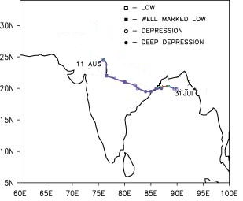
Complete Computations of Energy Exchange for a
Monsoon Depression (Aug 05, 2006)
ZONAL
EDDIES
H_{R}
H_{ST}
H_{CON}
H_{SEN}
H_{R}
H_{ST}
H_{CON}
H_{SEN}
Track of monsoon depression over Indian region 31July - 11Aug, 2006
2.93 .23 4.38 .28
1.6 .03 12.93 1.11
Down the Gradient Heat Flux
0.138
Local Hadley Cell
Vertical Overturning
13.38
28.24
0.67
Barotropic Stability

Slide 13
ZONAL
EDDIES
Cases of Monsoon Depression
H_{R}
H_{ST}
H_{CON}
H_{SEN}
H_{R}
H_{ST}
H_{CON}
H_{SEN}
0.71 3.01 4.27 0.33
6.14 5.98 9.09 0.49
P
Down the Gradient Heat Flux
P′
0.59
Local Hadley Cell
14.25
19.48
Vertical Overturning
K
0.52
K′
Barotropic Stability
ZONAL
EDDIES
H_{R}
H_{ST}
H_{CON}
H_{SEN}
H_{R}
H_{ST}
H_{CON}
H_{SEN}
(a) 20th July 1996
(b) 21st July 1996
0.65 2.50 7.96 0.75
4.60 6.84 11.12 0.81
P
Down the Gradient Heat Flux
P′
0.88
Local Hadley Cell
13.86
26.15
Vertical Overturning
0.97
K
K′
Barotropic Stability

Slide 14
False Alarms
Typical false alarms in forming monsoon depressions from a comprehensive global model (ECMWF) forecasts, during 2010 monsoon season.

Slide 15
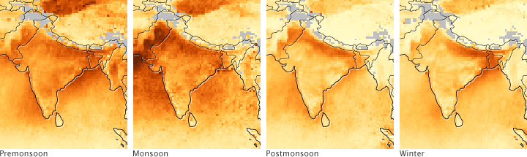
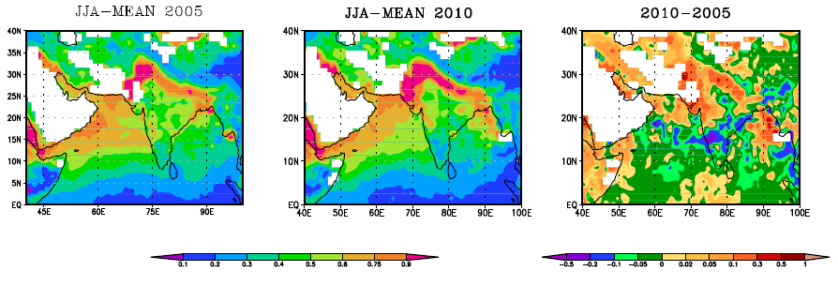
Aerosols are tiny solid and liquid particles suspended in the air, and they come from many natural sources, including volcano emissions, sand and dust storms, and salt from sea spray. Nearly 90 percent of all aerosols (by mass) arise naturally, and most tend to be relatively large particles. The rest of the aerosol load in the air comes from man: sulfates, black and brown carbon, and other pollutants associated with the burning of fossil fuels and of agricultural land. Aerosols produced by human activity tend to be smaller and more damaging to human lungs. (Reference: Dey, S., Di Girolamo, L. (2010) A climatology of aerosol optical and microphysical properties over the Indian subcontinent from 9 years (2000–2008) of Multiangle Imaging Spectroradiometer (MISR) data. Journal of Geophysical Research, Vol. 115, D15204, 22 PP.)
MODIS
AOD
MODIS Terra Aerosol Optical Depth (550 nm)

Slide 16
RATIONALE FOR PROPOSED EXPERIMENTS 1.In-situ measurements in convective clouds (up to the freezing level) over the Amazon basin show that smoke from deforestation fires prevents clouds from precipitating until they acquire a vertical development of at least 4 km, compared to only 1–2 km in clean clouds. 2. The average cloud depth required for the onset of warm rain increased by roughly 350m for each additional 100 cloud condensation nuclei per cm3 at a super-saturation of 0.5% (CCN0.5%). In polluted clouds, the diameter of modal liquid water content grows much slower with cloud depth (at least by a factor of 2), due to the large number of droplets that compete for available water and to the suppressed 10 coalescence processes. 3. The time scale of shear flow dynamics towards the organization of convection around a monsoon depression is of the order of a couple of days. If however the clouds take a long time to grow in a heavily polluted environment then there can be a mismatch for the dynamics and the convection to work together and a disruption in the organization of convection can occur, thus making it difficult to maintain a depression. This is what we have noted in our experiments.
E. Freud, Rosenfeld, D., Andreae M.O., Costa. A.A and P. Artaxo, 2005: robust relations between CCN and the vertical evolution of cloud drop size distribution in deep convective clouds. Atmos. Chem. Phys. Discuss., 5, 10155-10185.

Slide 17
AEROSOL CCN EFFECTS SHORT SUMMARY
“1st aerosol indirect effect” (Twomey, 1977), in which all else being equal, an increase in the CCN number concentration will result in a higher cloud droplet number concentration and hence smaller particles. More numerous smaller particles act to increase the cloud optical depth and thus the cloud albedo that ultimately results in a reduction of the shortwave radiative flux that reaches the surface (cooling effect at the surface).
“2nd aerosol indirect effect” (Albrecht, 1989), in which changes in the CCN number concentration may affect cloud lifetime and precipitation efficiency. An increase in the CCN number concentration will result in smaller cloud droplets. The smaller, more numerous cloud droplets coalesce less efficiently, suppressing precipitation and tend to increase the liquid water content, the cloud lifetime and the cloud thickness.
Physical properties such as total number concentration; size distribution and the chemical composition of submicron atmospheric aerosol particles are key parameters that control the indirect radiative forcing of the climate by aerosols.
Aerosol schemes in climate models are too simplistic.
Nenes et al. (2002) examined various chemical factors resulting from anthropogenic activities and argued that if neglected they could produce variations in droplet number concentrations comparable to those of Twomey effect.
It is therefore of great importance to assess the relative contributions of particle size distribution and chemical composition to CCN activity. Dusek et al. (2006) have recently showed that aerosol particles’ ability to act as CCN (i.e. CCN concentrations) are mainly determined by the aerosol size or the number size distribution and that the particles’ chemical composition plays a secondary role in CCN activation.
References for Aerosol Background:
Wood, R. (2000), Parameterization of the effect of drizzle upon the droplets effective radius in stratocumulus clouds, Q.J.R. Meteorol. Soc., 126, 3309-3324, doi:10.1002/qj.49712657015
Pincus, R. and Baker, M., 1994: Effect of precipitation on the albedo susceptibility of clouds in the marine boundary layer, Nature, 372, 250-252.
Jiang, H., G. Feingold, and W. R. Cotton, Simulations of aerosol-cloud- dynamical feedbacks resulting from entrainment of aerosol into the marine boundary layer during the Atlantic Stratocumulus Transition Experiment, J. Geophys. Res., 107(D24), 4813, doi:10.1029/2001JD001502, 2002.
Ackerman, A. S., Kirkpatrick, M. P., Stevens, D. E., and Toon, O. B. 2004: The impact of humidity above stratiform clouds on indirect climate forcing, Nature, 432, 1014-1017.
Albrecht B. A., 1989: Aerosols, cloud microphysics, and fractional cloudiness. Science, 245, 1227-1230.
Chuang, C. C., J. E. Penner, J. M. Prospero, K. E. Grant, G. H. Rau, and K. Kawamoto., 2002: Cloud susceptibility and the first aerosol indirect forcing: Sensitivity to black carbon and aerosol concentrations, J. Geophys. Res., 107, doi:10.1029/2000JD000 215.
Dusek U., Coauthors, 2006: Size matters more than chemistry for cloud-nucleating ability of aerosol particles. Science, 312, 1375-1378.
Nenes, A., Charlson, R.J., Facchini, M.C., Kulmala, M., Laaksonen, A., Seinfeld, J.H., 2002: Can chemical effects on cloud droplet number rival the first indirect effect? Geophysical Research Letters 29 (17), 1848.

Slide 18
Modeling Aspects
WRF/CHEM (Model) Configuration
The model used in this study is WRF/CHEM version 3.2.1 with the WRF-ARW dynamic core. The Chemistry routines in the model are described by Grell et al. (2005) and the technical description of version 3 of WRF-ARW can be found in Skamarock et al (2008).
As mentioned before, the initial and boundary conditions required to run the ARW are provided by the GFS 1 degree FNL analysis. In addition, the NCEP Real-Time Global SST dataset (Gemmil et al 2007) is used to specify sea surface temperature for boundary and input files.
The background aerosol state in WRF/CHEM is populated by emission estimates. The static emission datasets are the GOCART climatology emissions dataset for natural and anthropogenic emissions (Ginoux et al. 2001) and the RETRO global emissions dataset for industrial emissions. (http://retro.enes.org/index.shtml) Daily varying emissions from wildfires come from MODIS global fire detection (Justice et al, 2002), and the WRF/CHEM wildfire emissions preprocessor.
Both the WRF-ARW dynamic core and the WRF/CHEM chemical drivers require parameterization of some physical processes. Aside from the aerosol model, the shortwave radiation model, and the microphysics model, the choices of other parameterizations do not impact the scientific goals of the study. Their choice is therefore somewhat arbitrary, as long as their inclusion does not cause unrealistic forecasts.
The other parameterization choices are
• The MM5 rapid radiative transfer model (RRTM) for longwave radiation,
• The MM5 similarity theory surface layer model,
• The Yonsei Univeristy boundary layer model,
• The Noah unified land surface model, and
• Cloud resolving model with full microphysics.
The model grid has a horizontal resolution of 3 km. The domain extends meridionally from 15 degrees south latitude to 36 degrees north latitude, or from well south of the typical summer ITCZ position to the middle of the Tibetan Plateau. The zonal extent of the domain is from 56 degrees east longitude to 106 degrees east longitude, or from the eastern end of the Arabian peninsula to the Gulf of Tonkin at 20 degrees north.
The grid vertical dimension is divided into 28 levels. The WRF-ARW vertical coordinate is a terrain following coordinate based on the computed hydrostatic surface pressure. The vertical coordinate η is calculated by , where p_{h} refers to the hydrostatic component of the local pressure, p_{hs} is the hydrostatic pressure at the surface, and p_{ht} is the fixed pressure of the model top boundary (50 hPa in this study). The vertical coordinate thus varies from 0 to 1. The 34 levels in this study are slightly unbalanced with closer spacing below η = 0.7.

Slide 19
Text explaining indirect effect without prognostic aerosols in WRF
The main engine behind the indirect effect in monsoon depressions experiments is the WRF/ARW and its two physics models, the Lin-Purdue microphysics scheme and the interstitial aerosol to ccn solver prescribe_aerosol_mixactivate. First we will look at the Lin-Purdue microphysics.
Microphysics models calculate the production and loss of hydrometeors in saturated regions of the parent model. This particular scheme tracks 5 types of hydrometeor. The two suspended in cloud are liquid water (qcl) and ice (qci). The so-called precipitating hydrometeors are rain (R), snow (S), and hail (H). Water vapor is also tracked, since it provides source terms for the other hydrometeors, and the microphysics term must begin to cannibalize some of the hydrometeors if the water vapor mixing ratio drops below saturation level.
A partial differential equation is solved for each class of hydrometeor, with processes such as riming, freezing, melting, accretion, and evaporation represented by empirical source/sink terms in the equations. The equation for rain contains a term for autoconversion (i.e. collision and coallescence of cloud droplets) which is a source for the rainwater mixing ratio (R). It is through this autoconversion term that indirect effects of aerosols can effect the production of rain in the WRF. High aerosol concentration within a cloud causes the cloud-droplet distribution to be skewed towards smaller drops. This negative skew causes the autoconversion process to be less efficient at producing rain. Key modifications have been made to the original Lin scheme based on the theoretical work of Yangang Liu and other
collaborators. The autoconversion rate is now truncated based on the cloud droplet concentration and the relative dispersion of the cloud droplet distribution. The relative dispersion is calculated within the Lin scheme at each timestep based on the number of newly activated cloud-condensation nuclei. The job of calculating new activated ccn is handled by the separate code prescribe_aerosol_mixactivate. Based on the aerosol number concentration, supersaturation and other environmental parameters, prescribe_aerosol_mixactivate calculates the number of interstitial aerosols which grow hygroscopically to the point at which they are ccn and the number of ccn which return to the interstitial state in the case of a less than saturated environment.
Under normal operation of the WRF/CHEM model, the prognostic aerosol solver would provide an aerosol number concentration to prescribe_aerosol_mixactivate. In the experiments currently examining the indirect aerosol effect in monsoon depressions, this aerosol number concentration is fed directly to the model as a user provided input. In each the control forecasts and the forecasts with enhanced indirect effect, the profile of aerosol number concentration does not vary horizontally over the domain. In the control forecasts, the number concentration is invariant in the vertical as well and is set at 10⁸ /kg dry air. These are the conditions that the model would forecast under if the WRF-ARW model was run in standard configuration with no additional input, and represent a clean air marine environment. For the forecasts with enhanced indirect effects, the aerosol number concentration varies in the vertical dimension, with a peak value of over 5.0 x 10¹¹ /kg dry air just above the boundary layer and tapering quickly to 10¹⁰ at upper levels. These values are indicative of polluted conditions measured in several Indian Ocean field experiments. The vertical shape of the profile matches that of a Bay of Bengal pollution plume forecast by the WRF/CHEM run with full chemistry and aerosol emissions for the 2007 summer monsoon season.

Slide 20
Methodology for determining activated CCN over Bay of Bengal and Northern India in WRF/CHEM cloud-resolving forecasts of monsoon depressions
The WRF/Chem regional model has the ability to estimate the impact of the aerosol second indirect effect on precipitation when aerosols and clouds are co-located in the model.
The WRF/Chem simulates this phenomena by a three-step process. First, the aerosol chemistry and model advection determine the aerosol number concentration at a given model grid point.
Second, some number of interstitial aerosol are converted into cloud condensation nuclei (ccn). This number is based on aerosol number concentration, supersaturation, pressure, temperature and some chemical characteristics of the aerosol themselves.
Third, the new CCN are added to the cloud droplet number concentration and this is used by the microphysics driver to compute autoconversion from cloud droplets to rain.
In this experiment, we are allowing the WRF/Chem to run without computing the chemical reactions. This decreases computational expense greatly. Instead, we specify an aerosol number concentration profile that is used by the aerosol mixactivate routine to compute number of activated cloud condensation nuclei. Only the number is specified at each model vertical level, the aerosol internal composition remains the standard ratios which are present at WRF/Chem initialization.

Slide 21
The microphysics routine is fed an aerosol number concentration which matches either a heavily polluted column (in the increased ccn forecast) or a pristine southern ocean marine environment (in the control run). The microphysics routine then calculates number of activated cloud condensation nuclei at each time step and uses this to diagnose the relative dispersion of the cloud droplet distribution. This in turn modifies the rain production term in the microphysics solver.
The aerosol number concentration is the only additional input to the model above the meteorological variables that a standard WRF run requires .
There are no emission sources or constituents to the pollution. (even with full chemistry turned on, the cloud microphysics of WRF/CHEM does not preferentially treat one type of aerosol as more hygroscopic than any others, the only important parameter is aerosol number concentration).
The prescribed aerosol number concentration is constant throughout the forecast. It varies vertically matching the profile of Bay of Bengal plumes which are produced in our previous full-chemistry WRF/CHEM runs for the monsoon region for June 2007 experiments. This profile is normalized and then scaled to a mean number concentration representing either a pristine or polluted condition. The mean number concentration matches that found by Ramanathan et al during an ABC field campaign in the Indian Monsoon region.

Slide 22
The aerosol number concentration is specified each time the microphysics driver is called. The microphysics first calculates how many of the aerosol are "activated" as CCN. This calculation is done in 3 dimensions using updraft velocity, pressure, temperature and supersaturation. The number of cloud droplets which evaporate, leaving an aerosol particle behind is also calculated. The difference becomes the net number of activated CCN. The net number of activated CCN is added to the number of cloud droplets. The total number of cloud droplets, along with some other diagnosed information about the cloud drop size distribution, is used to prognostically solve for the mass mixing ratio of cloud, rain and ice phases. After the microphysics PDEs are solved, the number of cloud droplets is diagnosed again. The next time that the microphysics driver is called, the process is repeated. Therefore the cloud droplet number, and the cloud drop size distribution is allowed to vary prognostically. If full chemistry was turned on, the number of aerosol activated to CCN and the number returned from cloud droplets through evaporation would change the aerosol number concentration. There would be other processes outside of a cloud which change aerosol number concentration as well. However these processes are turned off, and it is assumed that there is a reservoir of aerosols which keeps the aerosol concentration at 5 x 10^11 /kg. Or 1 x 10^8 for the pristine (clean) forecasts.

Slide 23
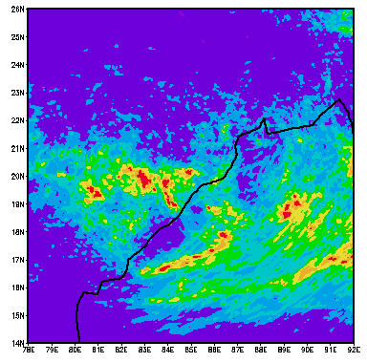

Accumulated Rainfall (mm)
FOR THE CONTROL RUN
July 26 18Z, 2005 – 162 hour Forecast
850 hPa WINDS
FOR THE CONTROL RUN
July 26 18Z, 2005 – 162 hour Forecast

Slide 24
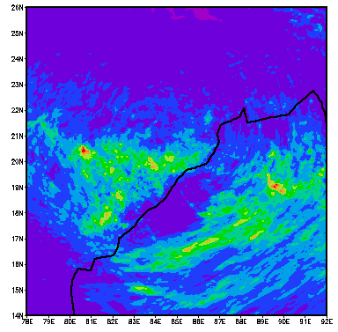
Accumulated Rainfall (mm)
MODIFIED CCN
July 26 18Z, 2005 – 162 hour Forecast
850 hPa WINDS
MODIFIED CCN MINUS THE CONTROL RUN
July 26 18Z, 2005 – 162 hour Forecast

Slide 25
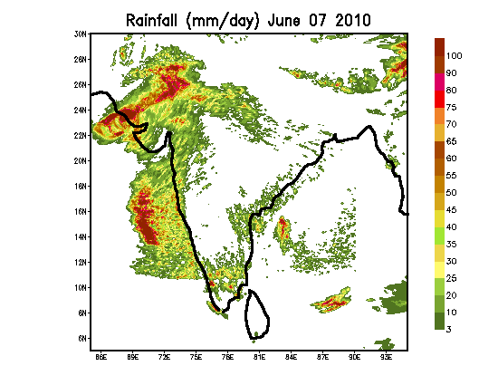
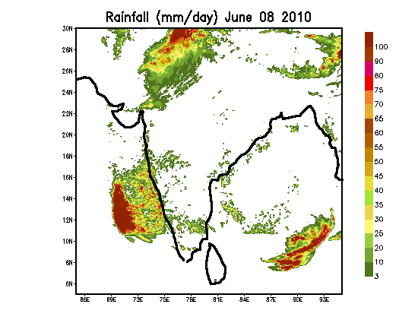
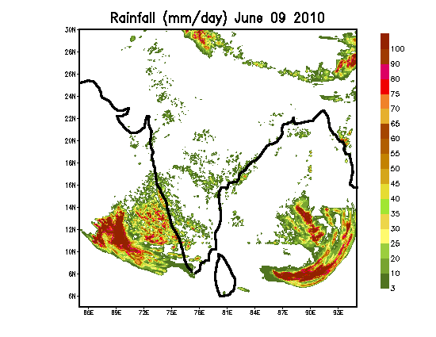
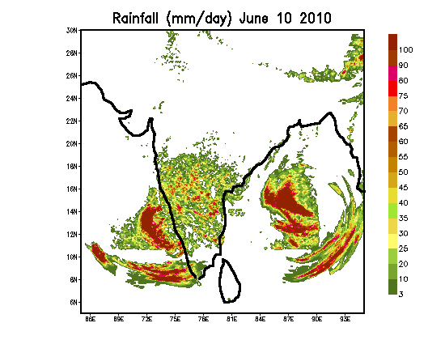
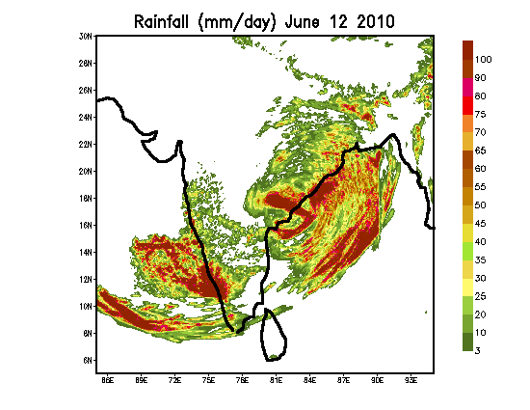
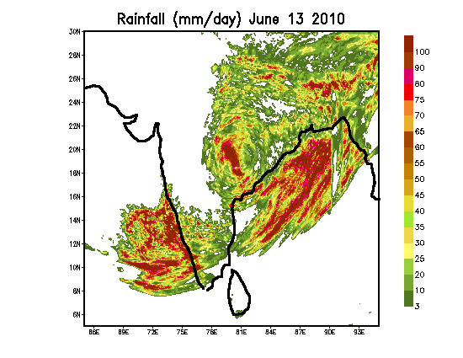
TIME HISTORY OF A FALSE ALARM
RAINFALL FROM THE CONTROL EXPERIMENT

Slide 26
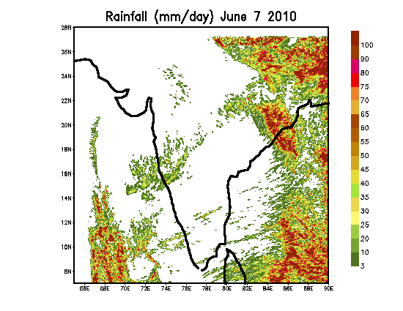
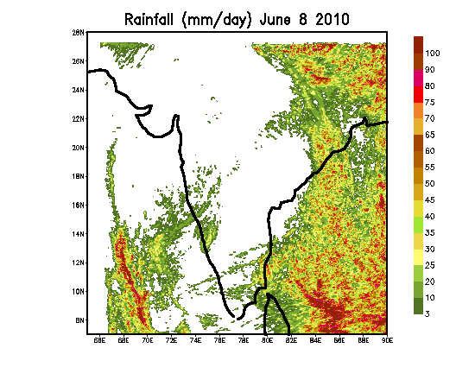
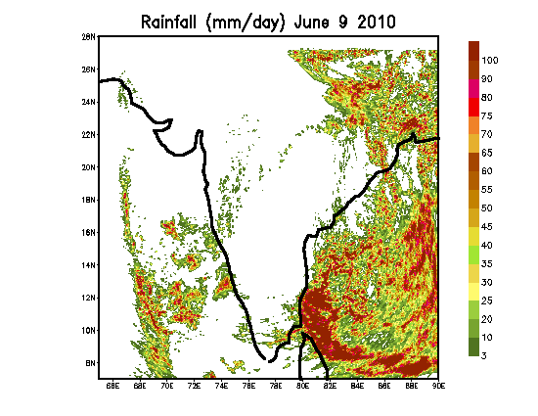
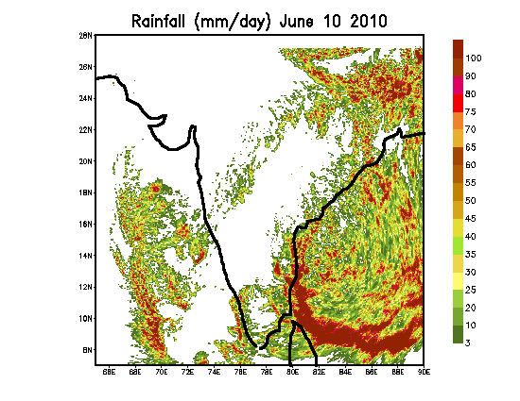
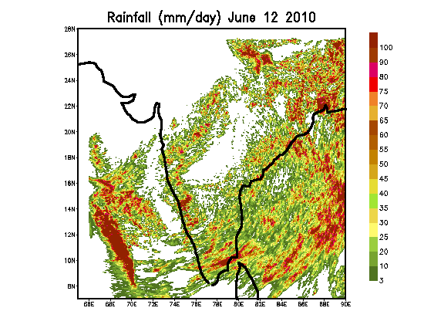
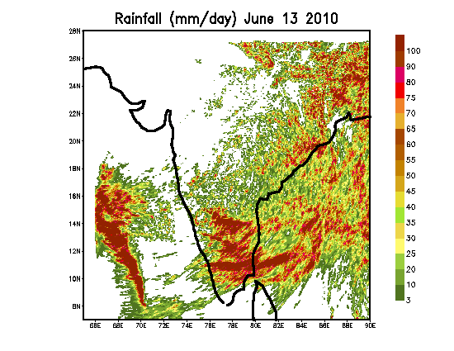
RAINFALL FROM THE MODIFIED CCN EXPERIMENT

Slide 27
Next Hurricane Florence is presented
Tropical Storm Florence of 2012 developed from a tropical wave that departed the West African coast early on 2 August
The disturbance became a tropical depression around 1800 UTC 3 August
The system became a tropical storm near 0600 UTC 4 August and reached peak intensity of 50 knots at 0000 UTC 5 August with a central dense overcast and curved banding features.
Florence weakened to a depression by 0600 UTC 6 August, about 30 hours after its peak intensity, as deep convection diminished. The system became a remnant low 6 hours later at 1200 UTC 6 August
Weakening was evidently associated with the influx of Saharan air into the storm’s circulation

Slide 28
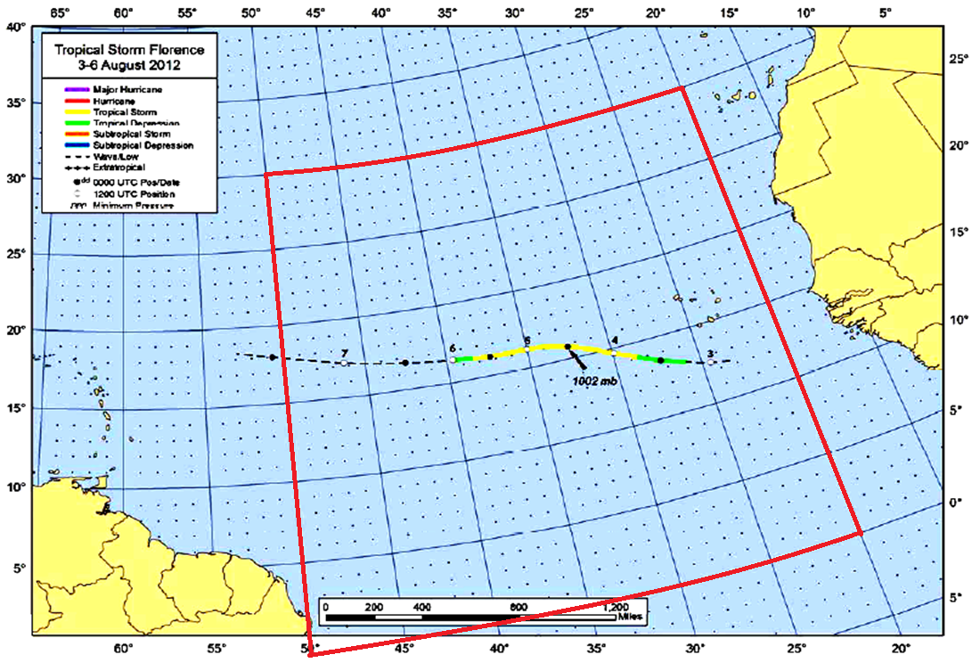
Track for Florence and the domains used in the WRF control
and the WRF-CHEM runs

Slide 29
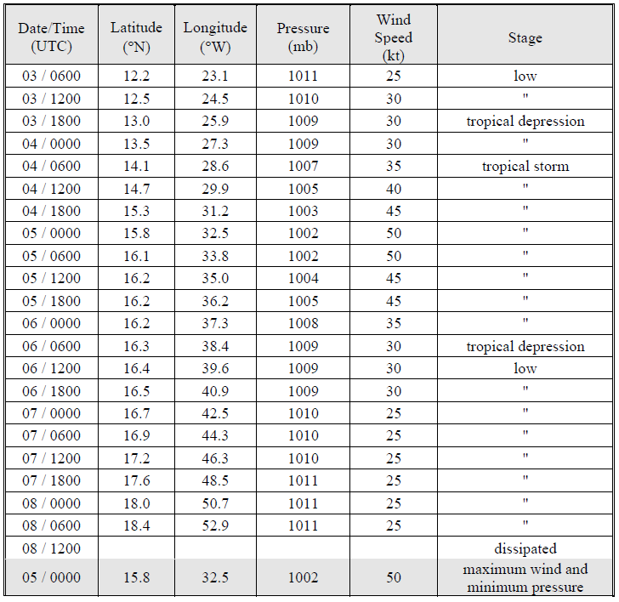
BEST TRACK OF TROPICAL STORM FLORENCE

Slide 30
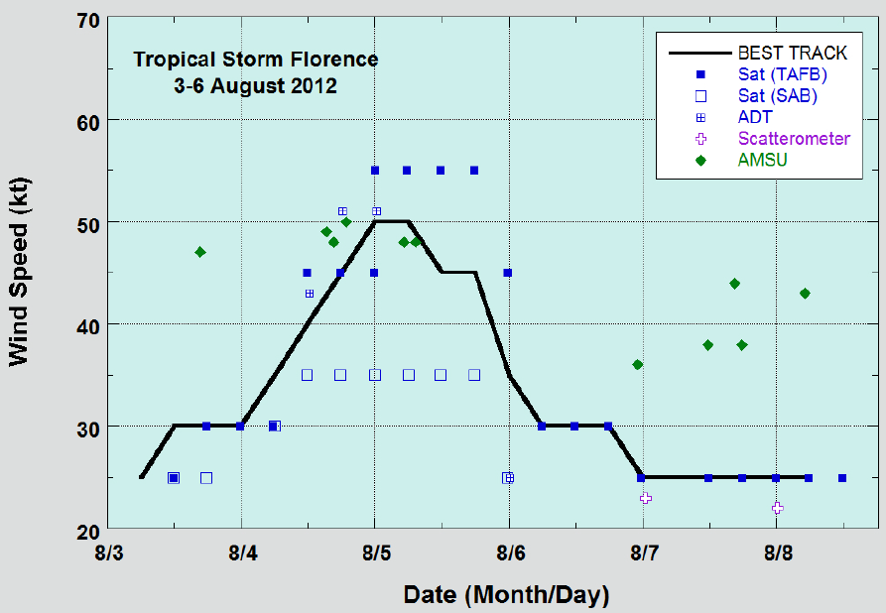
Selected wind observations and
best track maximum sustained surface wind speed curve

Slide 31
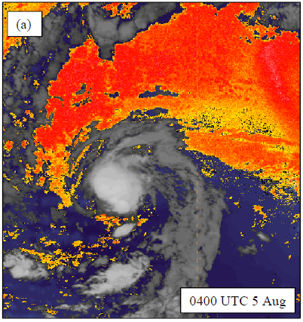
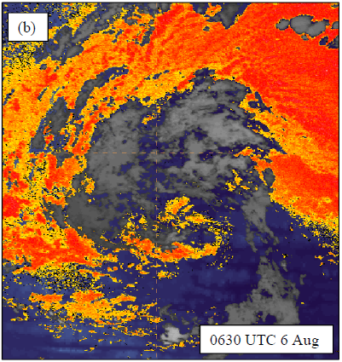
GOES-R proving ground Saharan Air Layer product
from Meteosat-9 of Florence
(a) near peak intensity (b)around the time it degenerated to a remnant low

Slide 32
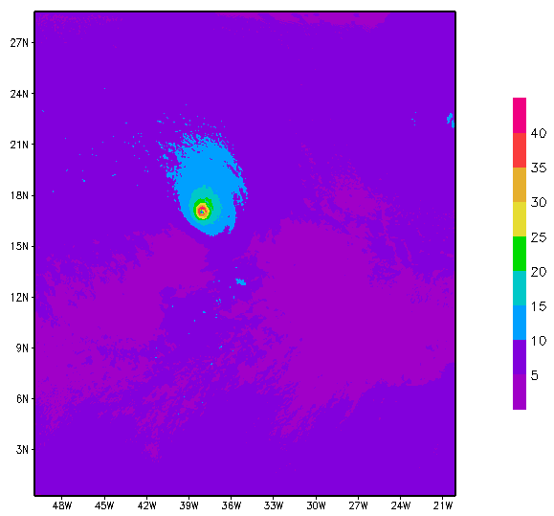
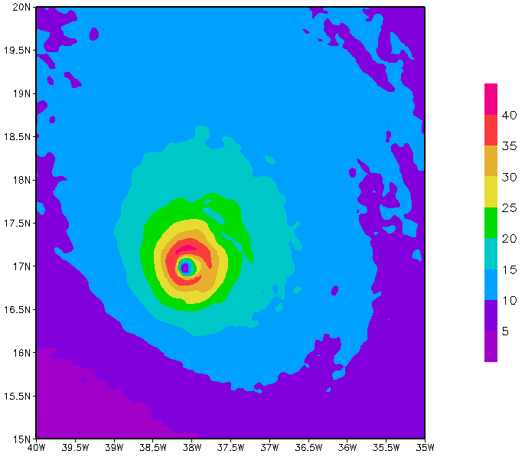
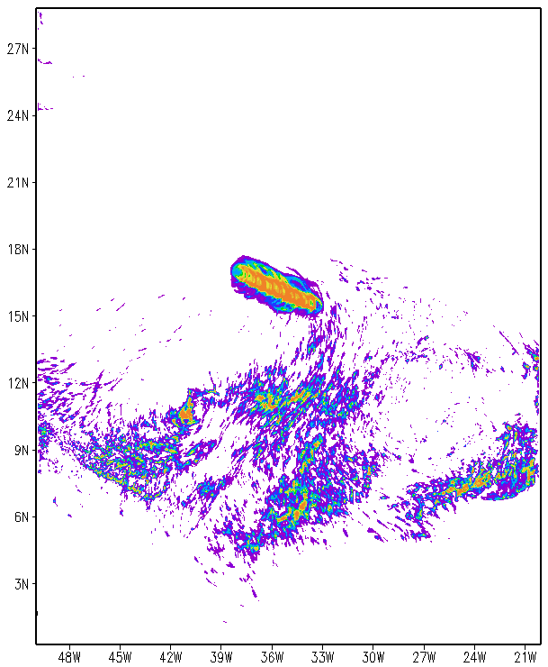
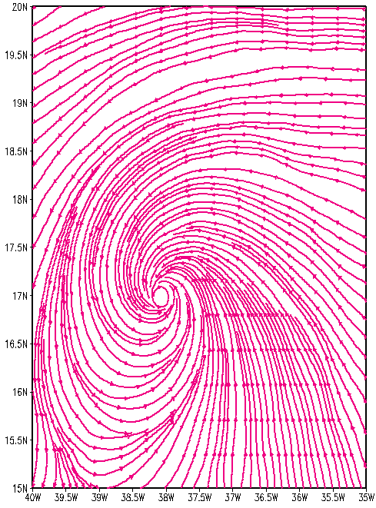

LOW AEROSOL EXPERIMENT SHOWING day-6 forecast of 10m winds, precipitation , and streamlines.
12z07AUG2012

Slide 33
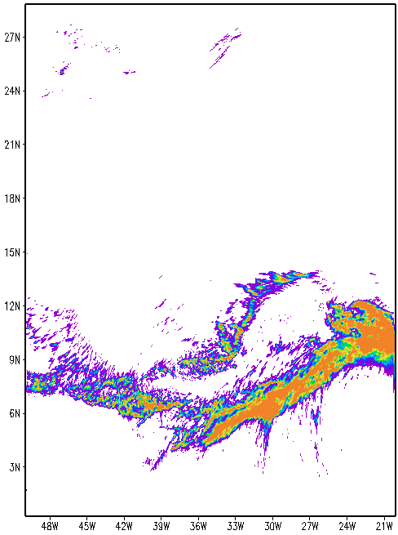
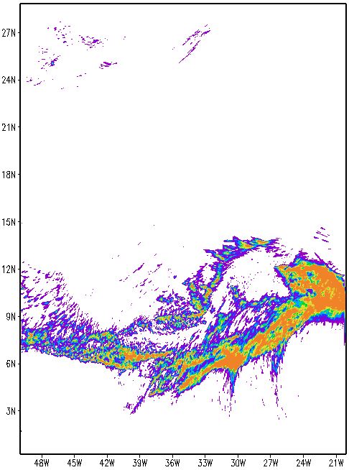
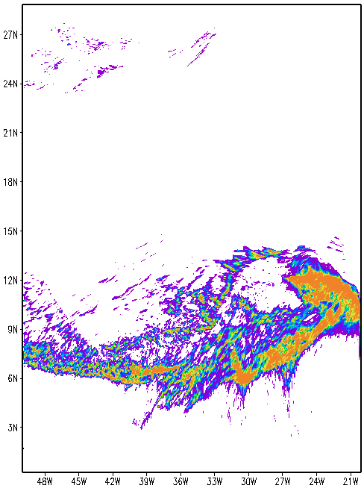
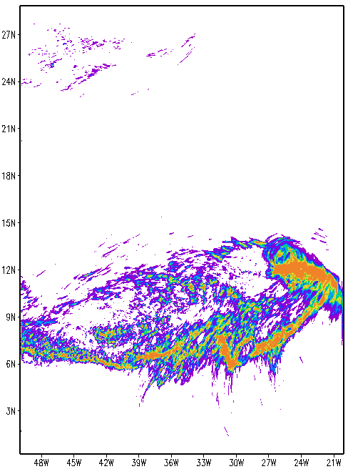
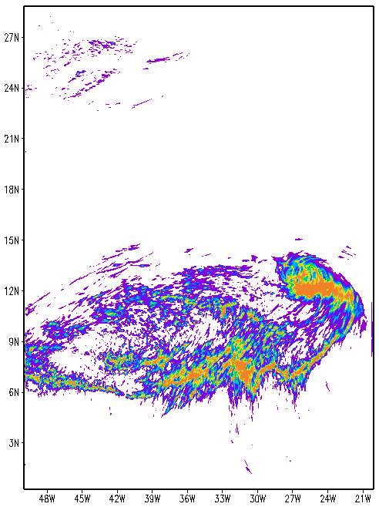
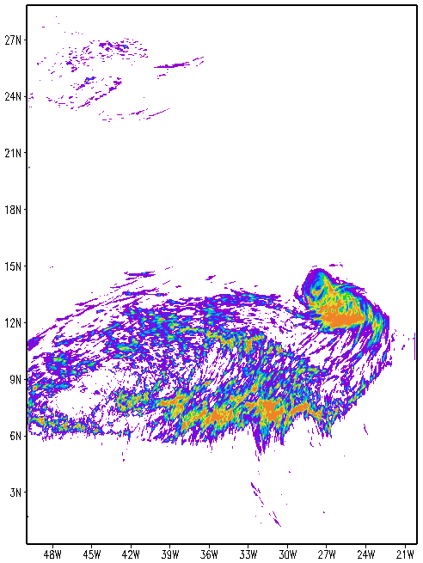
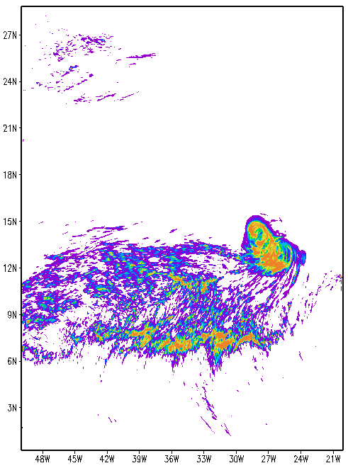
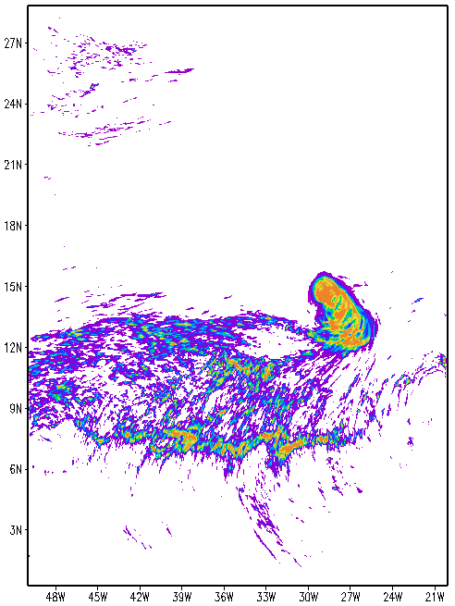
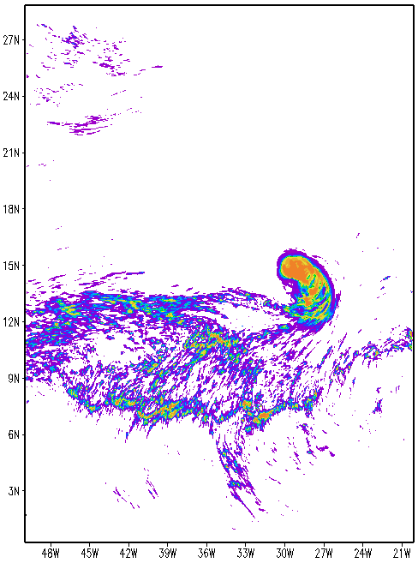
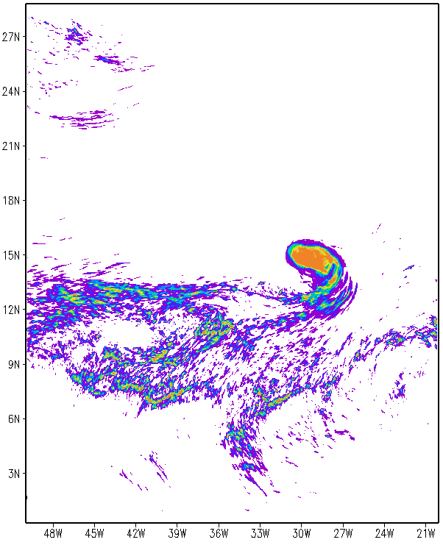
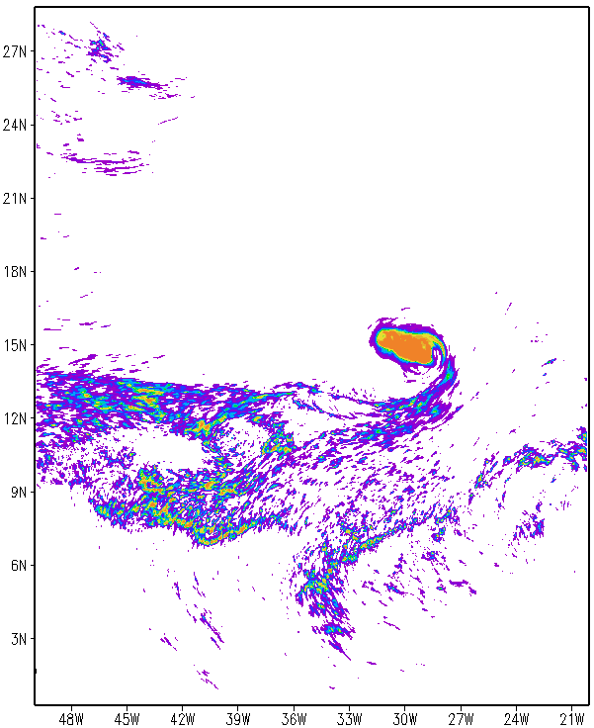
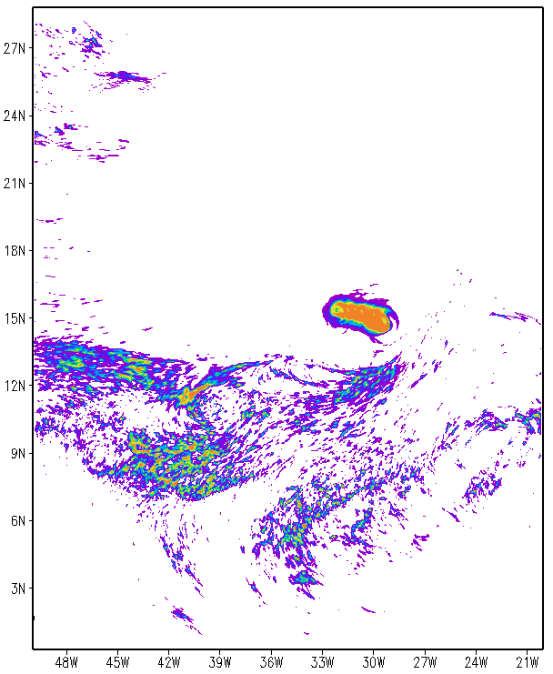
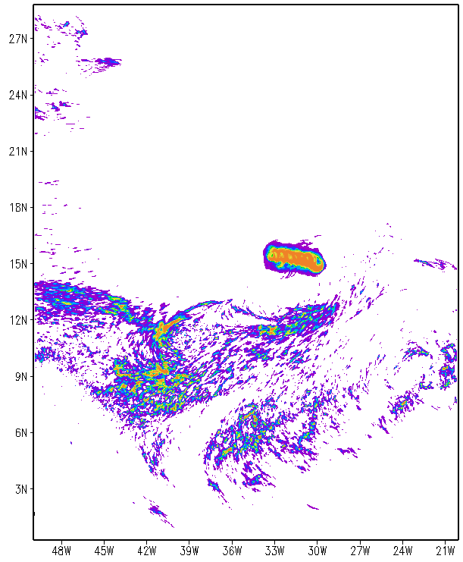
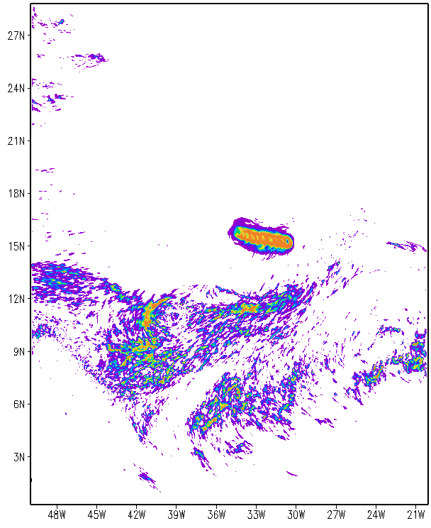
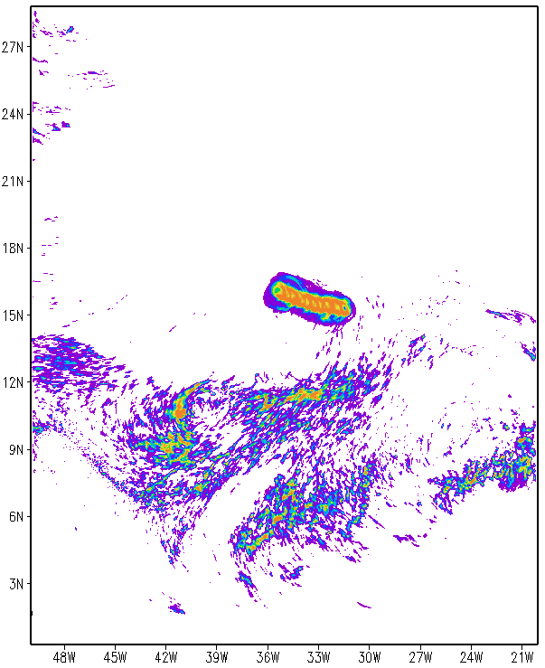
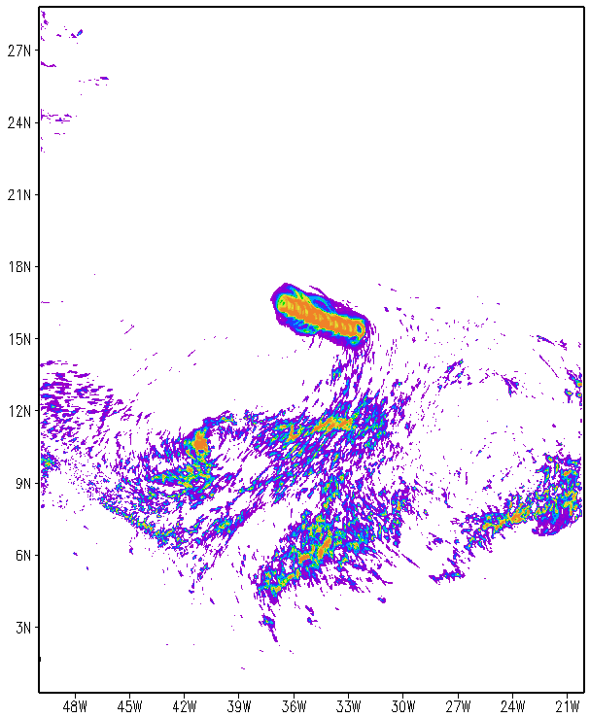
A 6-hourly sequence of precipitation for the low aerosol experiment
12z03AUG2012
18z03AUG2012
00z04AUG2012
06z04AUG2012
12z04AUG2012
18z04AUG2012
00z05AUG2012
06z05AUG2012
12z05AUG2012
18z05AUG2012
00z06AUG2012
06z06AUG2012
12z06AUG2012
12z07AUG2012
18z06AUG2012
00z07AUG2012
06z07AUG2012

Slide 34
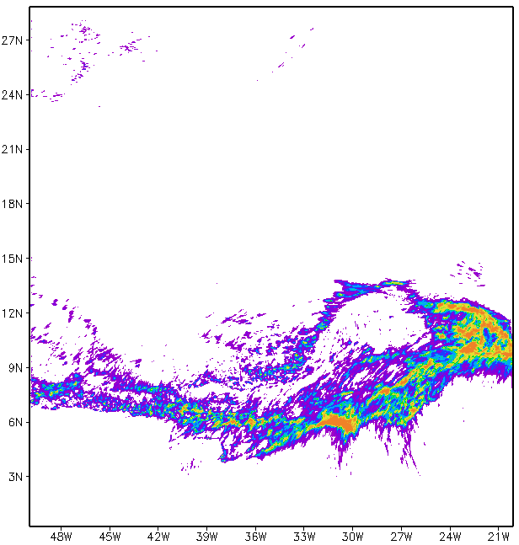
















A 6-hourly sequence of precipitation for the high aerosol experiment
12z03AUG2012
18z03AUG2012
00z04AUG2012
06z04AUG2012
12z04AUG2012
18z04AUG2012
00z05AUG2012
06z05AUG2012
12z05AUG2012
18z05AUG2012
00z06AUG2012
06z06AUG2012
12z06AUG2012
12z07AUG2012
18z06AUG2012
00z07AUG2012
06z07AUG2012

Slide 35

Hourly frames of vertically integrated Liquid water mixing ratio (650-750hPa) for the low aerosol experiment starting on 12 UTC 02 August, 2012, Florence. A 6 day forecast.

Slide 36

Hourly frames of vertically integrated Liquid water mixing ratio (650-750hPa) for the high aerosol experiment staring on 12 UTC 02 August, 2012, Florence. A 6 day forecast.

Slide 37
A case of Hurricane FLORENCE
Control Run on 5th Day
Heavy Aerosols Run on 5th Day

Slide 38
Summary & Conclusions
THE SLOW GROWTH OF FINE DROPS IN THE
EXPERIMENT WITH A HIGH NUMBER CONCENTRATION
OF AEROSOLS RESULTS IN A MISMATCH BETWEEN THE
DYNAMICS AND CONVECTION .
THIS IS NOTED FROM A COMPARISON OF ENERGETICS
FOR THE LOW AND THE HIGH AEROSOL CONTENT
EXPERIMENTS.
THE RELATIONSHIP BETWEEN AEROSOLS AND
CIRCULATIONS IS A TIME INTEGRATED EFFECT
AND IS NOT A SINGLE SNAP SHOT SYNOPTIC RELATIONSHIP.
WE ARE NOW WORKING ON A FULL CHEMISTRY
EXPERIMENT WHERE THE NUMBER CONCENTRATION
OF AEROSOLS ARE BEING PREDICTED.

