Slide 1

HS3 Data Catalog
Amber Emory, Dan Chirica, and Jim Doyle

Slide 2
Roadmap
What we planned
What we did
- Model Products: Examples from GMAO, NRL COAMPS TC, and SHIPS
- Operational Products: Examples from NRL Tropics and CIMSS Brightness Temperatures and TOTs
- Research (Instrument) Products
What needs to improve for this year

Slide 3
What we planned…
Many items on PREDICT page are already provided on the ESPO HS3 website or through Mission Tools
Provide archived images of Operational, Model, and Research (Instrument) Products from the ESPO HS3 website
Ftp site housed at NASA GSFC (Emory) and front-end website administered from NASA Ames (Chirica)

Slide 4
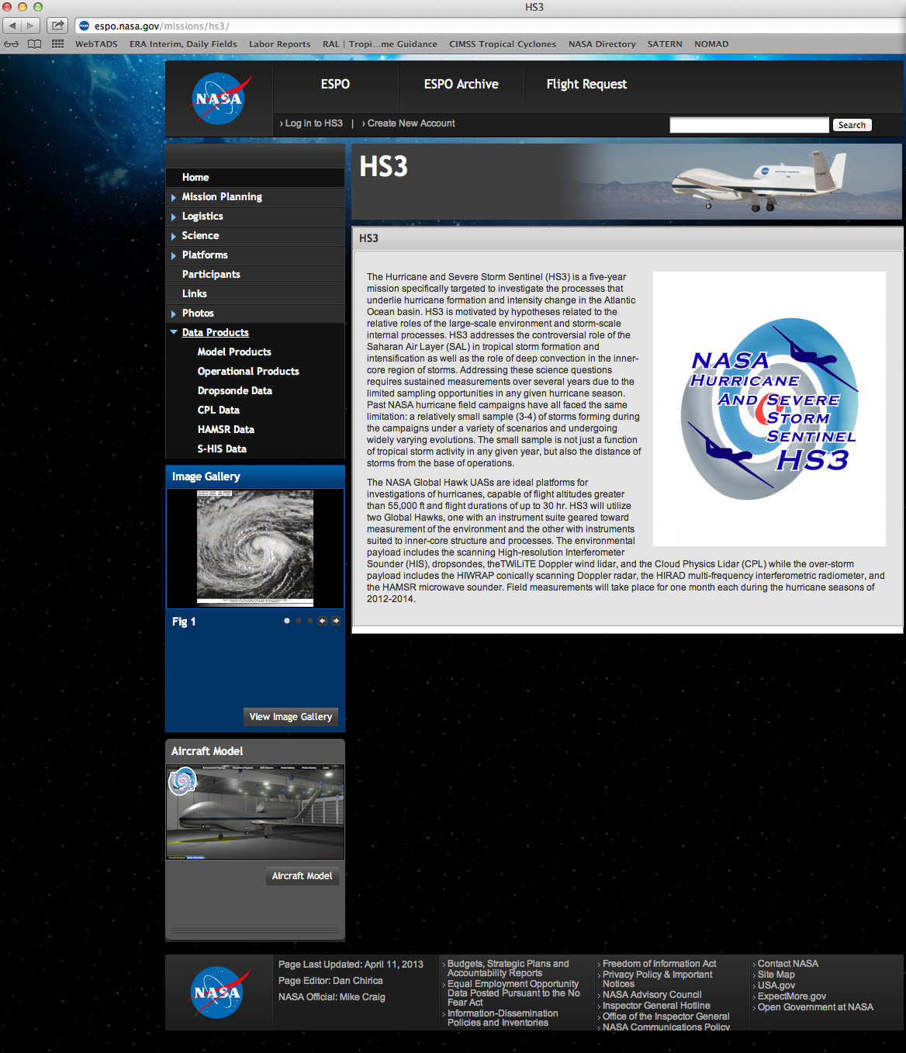
What we did…
- Operational Products
- Model Products
- Research Products

Slide 5
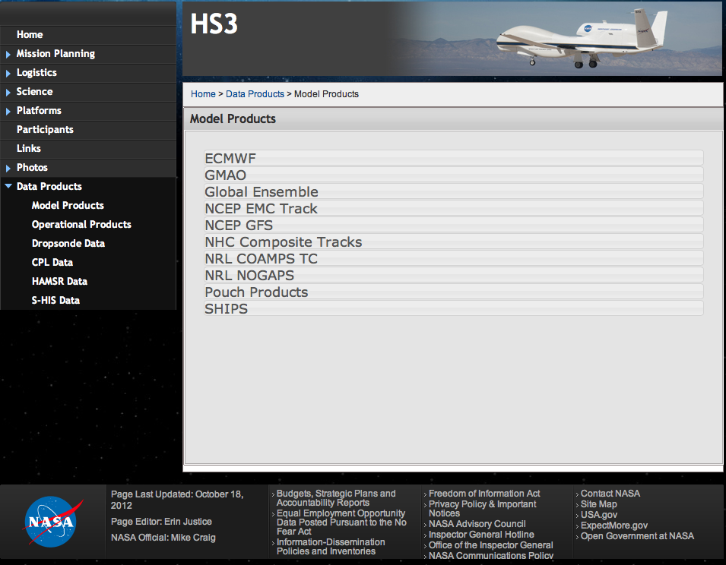
Model Products

Slide 6
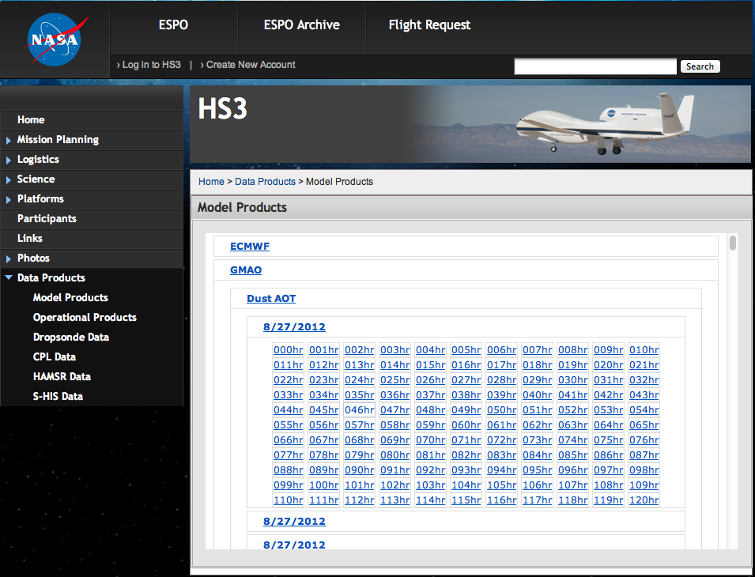
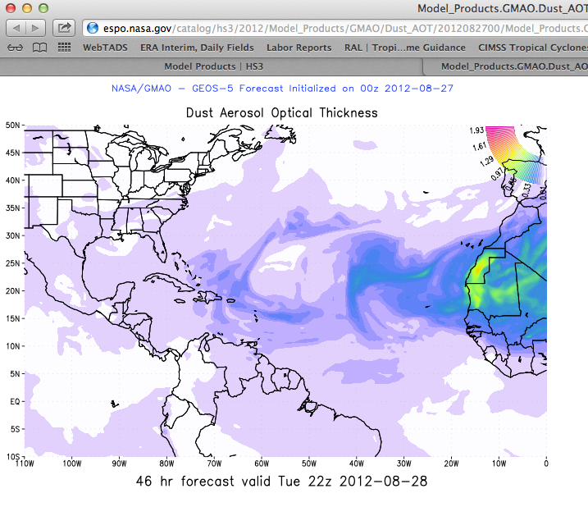
Model Products Example:
GMAO Dust AOT
GMAO provided GEOS-5 forecasts of Dust AOT out to 120 hours initialized 4X/day (00, 06, 12, 18 UTC) from Aug. 27 – Oct. 20, 2012

Slide 7
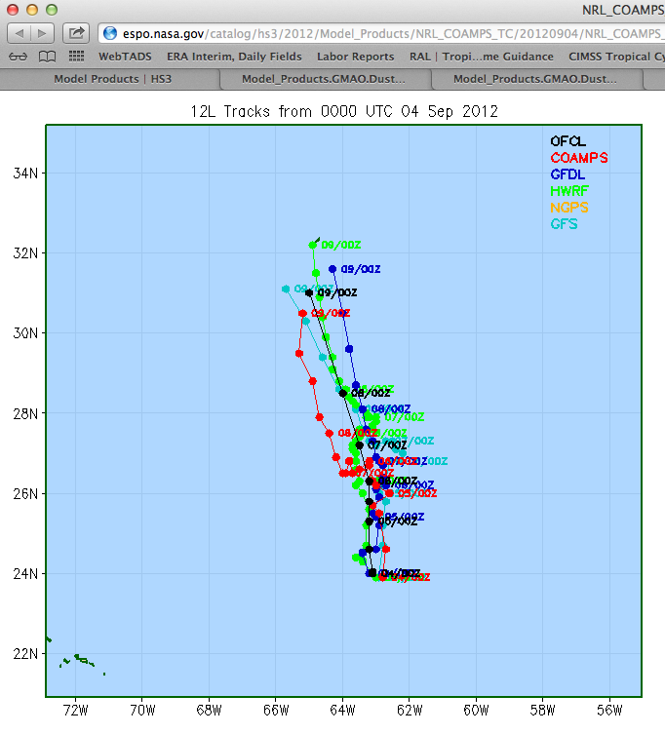
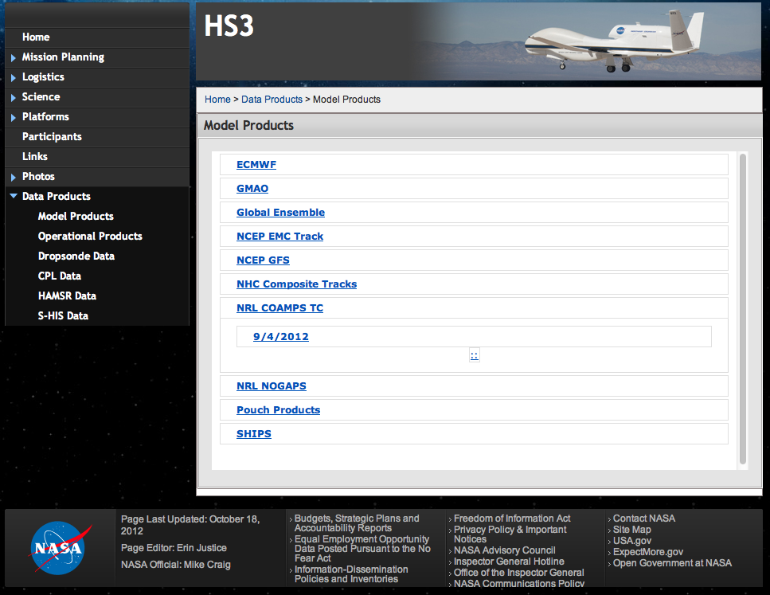
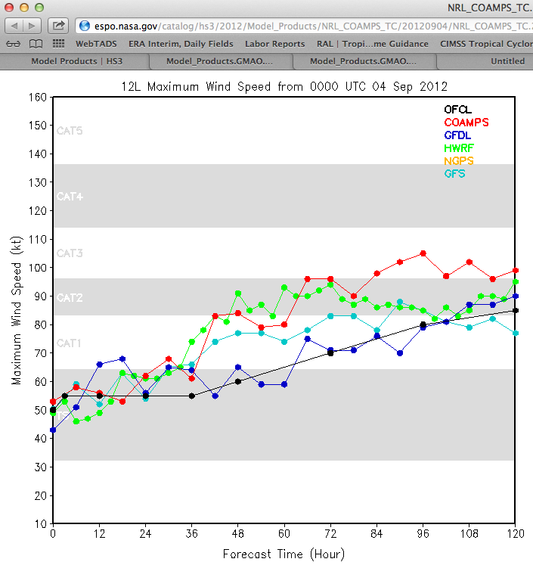
Model Products Example:
NRL COAMPS TC
Tracks
Forecasted Max Winds

Slide 8
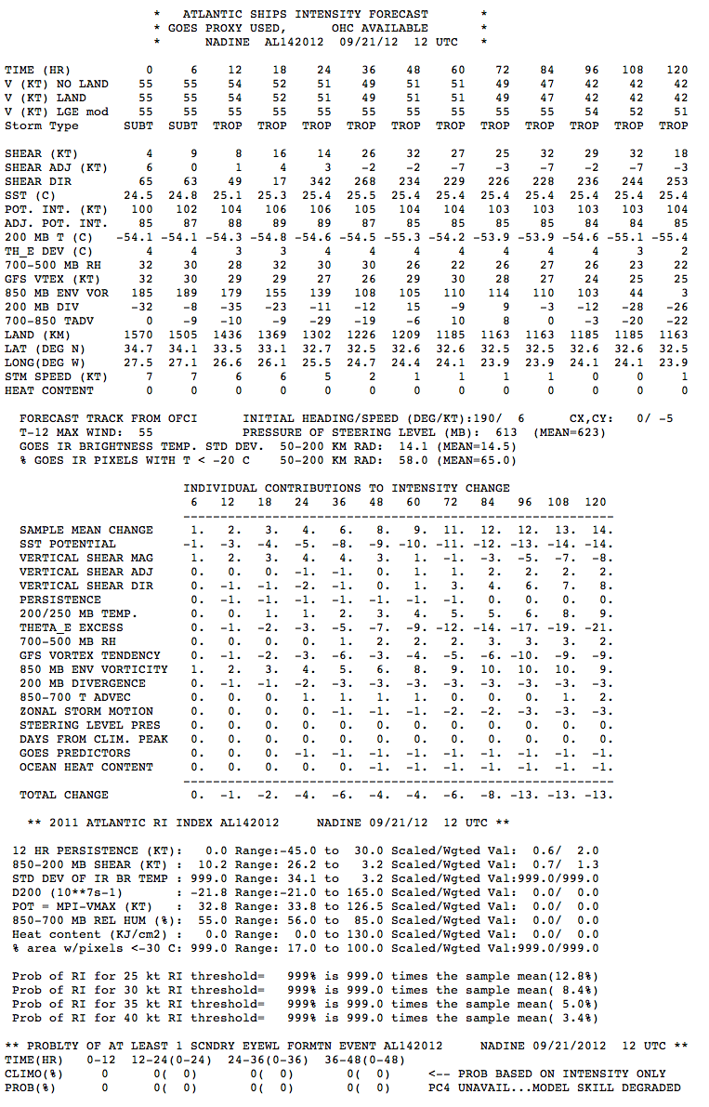
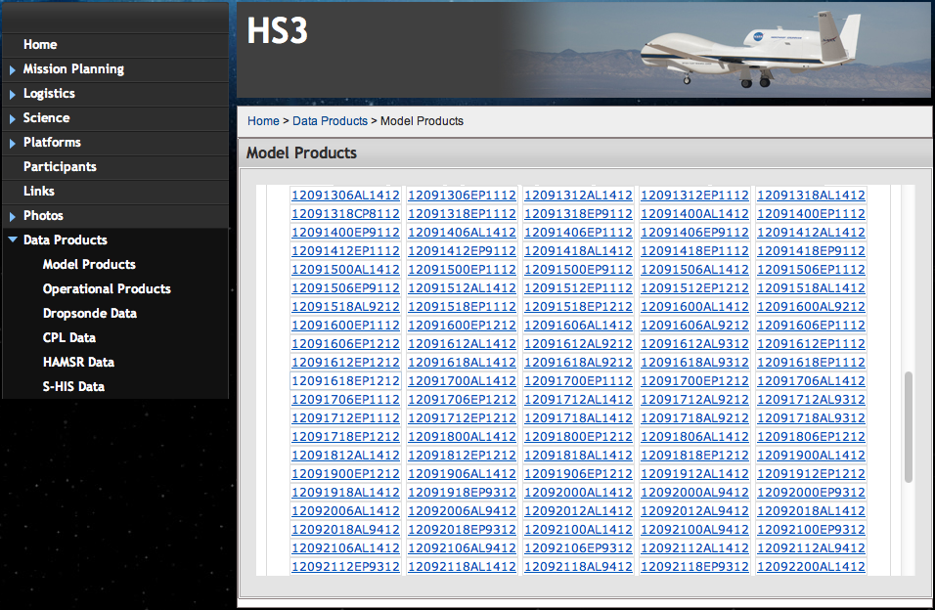
Model Products Example:
SHIPS
SHIPS provided Intensity Forecast for the Eastern Pacific as well as the Atlantic

Slide 9
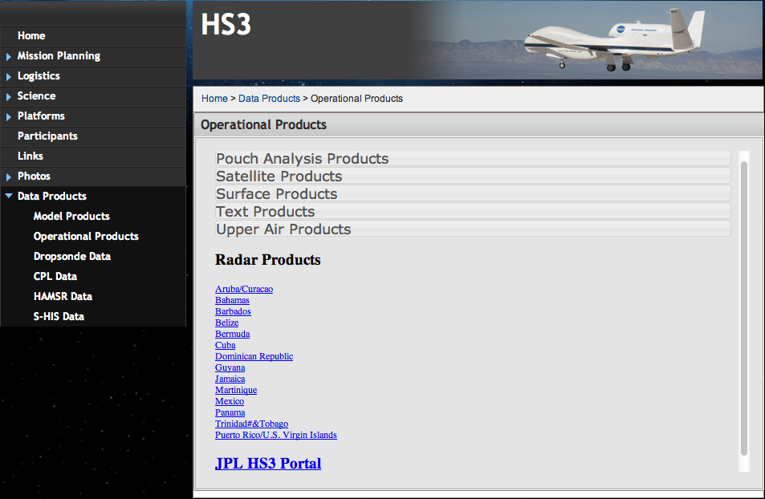
Operational Products
Links to Radars in Caribbean
Link to NASA Airborne Science Data Page

Slide 10
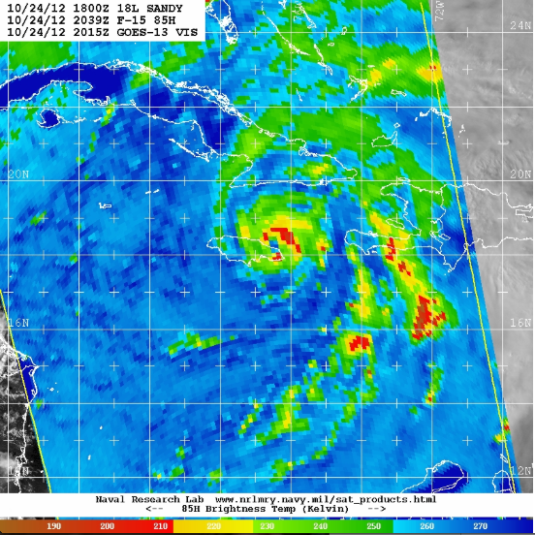
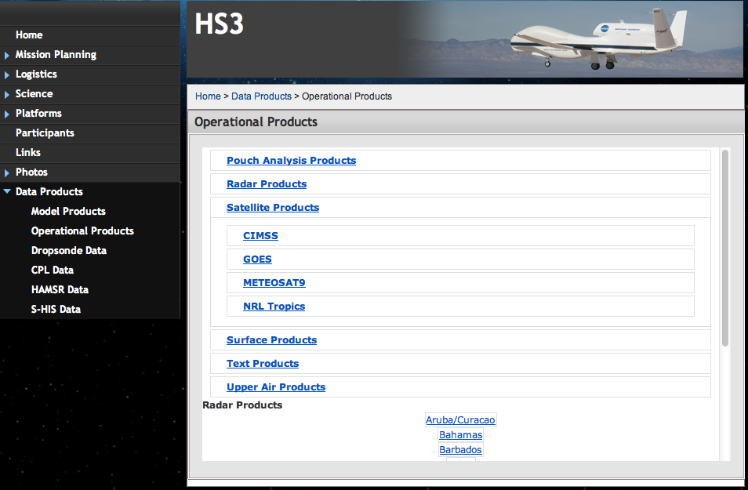
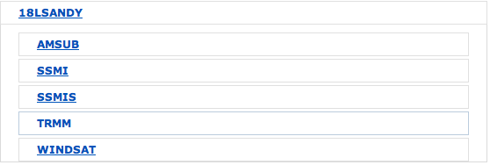
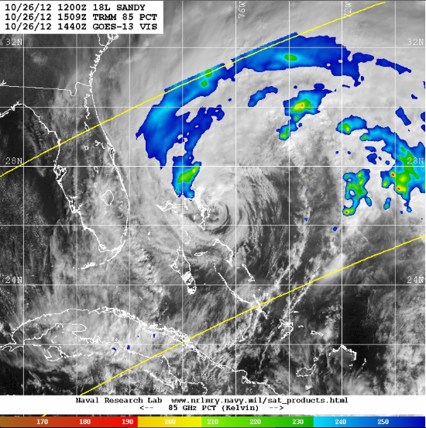
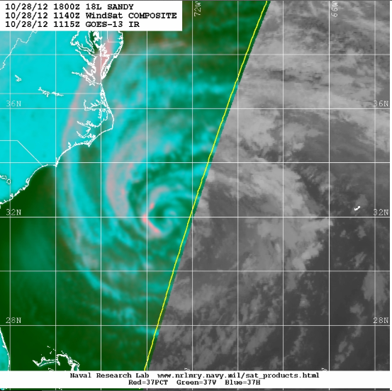
Operational Products Example: NRL Tropics
Organized by invest, disturbance, or tropical storm/hurricane name

Slide 11
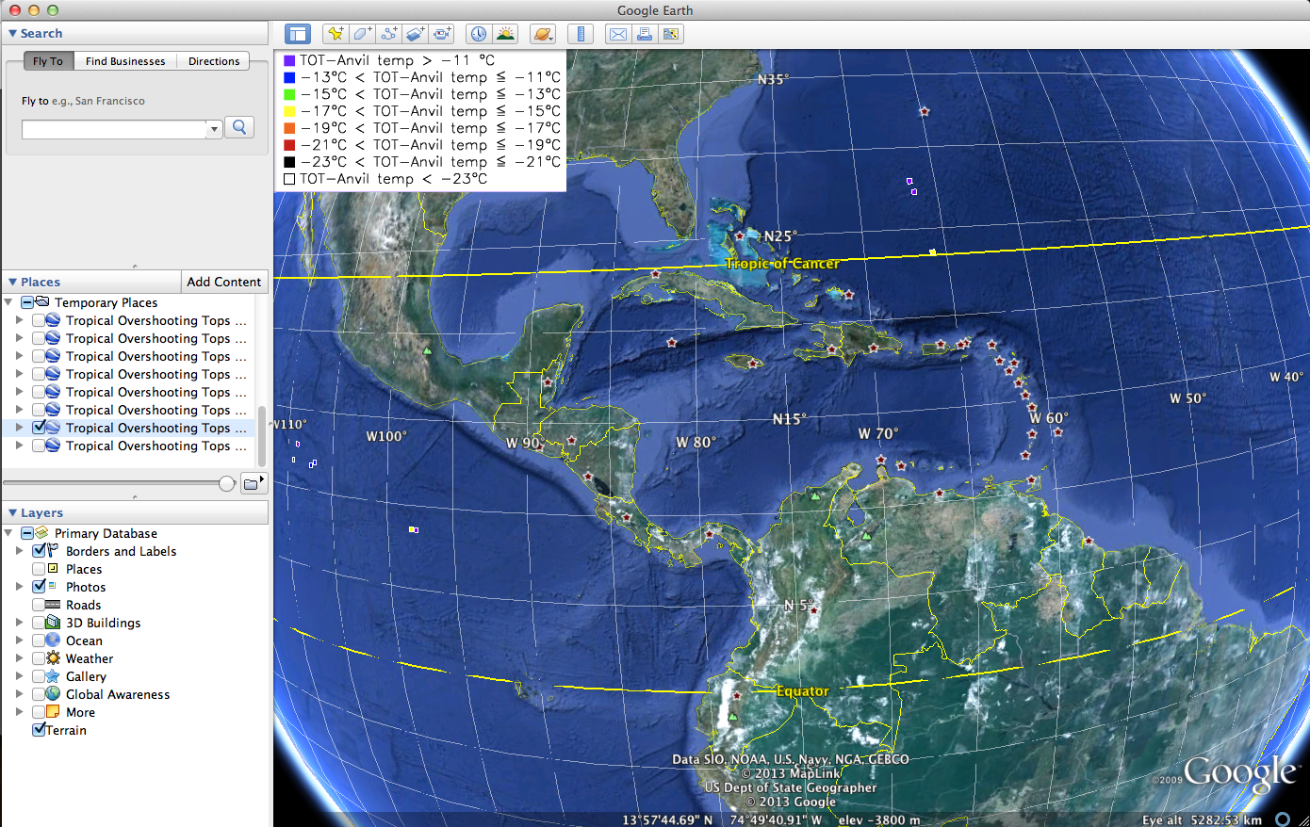
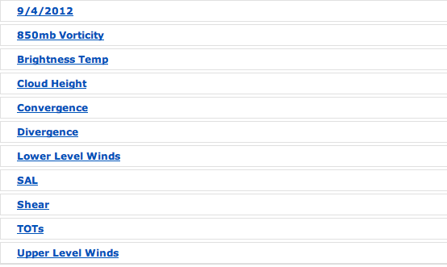
Operational Products Example: CIMSS Tropical Overshooting Tops

Slide 12
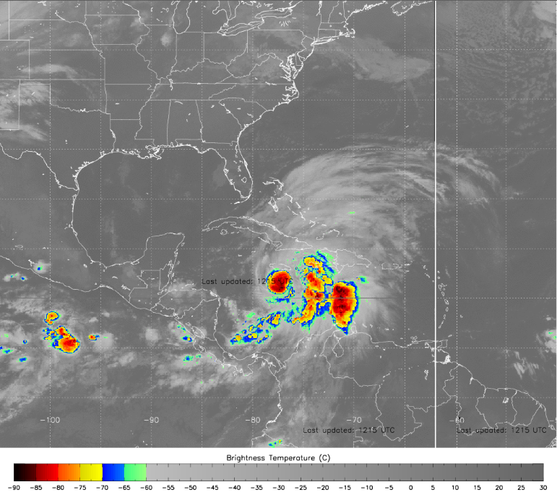
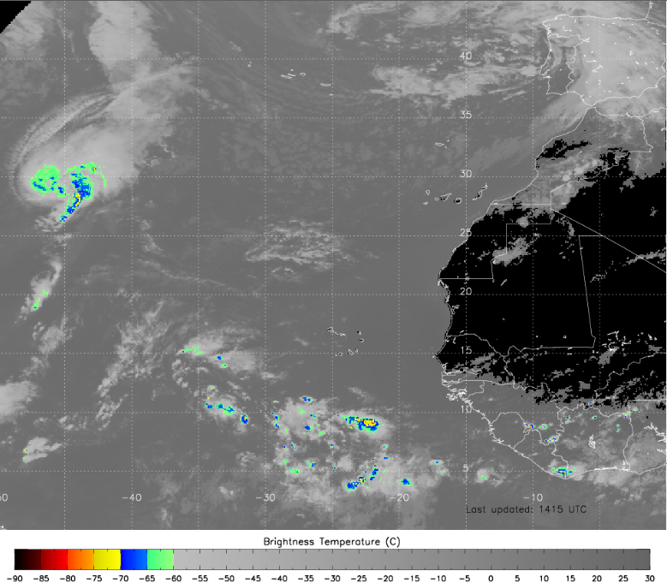
Operational Products Example: CIMSS Brightness Temperatures

Slide 13
Research Products
Links provided to individual instrument pages:
- Gave PI’s more control over how to distribute Quicklooks and data
- Also provided solution for limited storage for ftp site hosted at GSFC

Slide 14
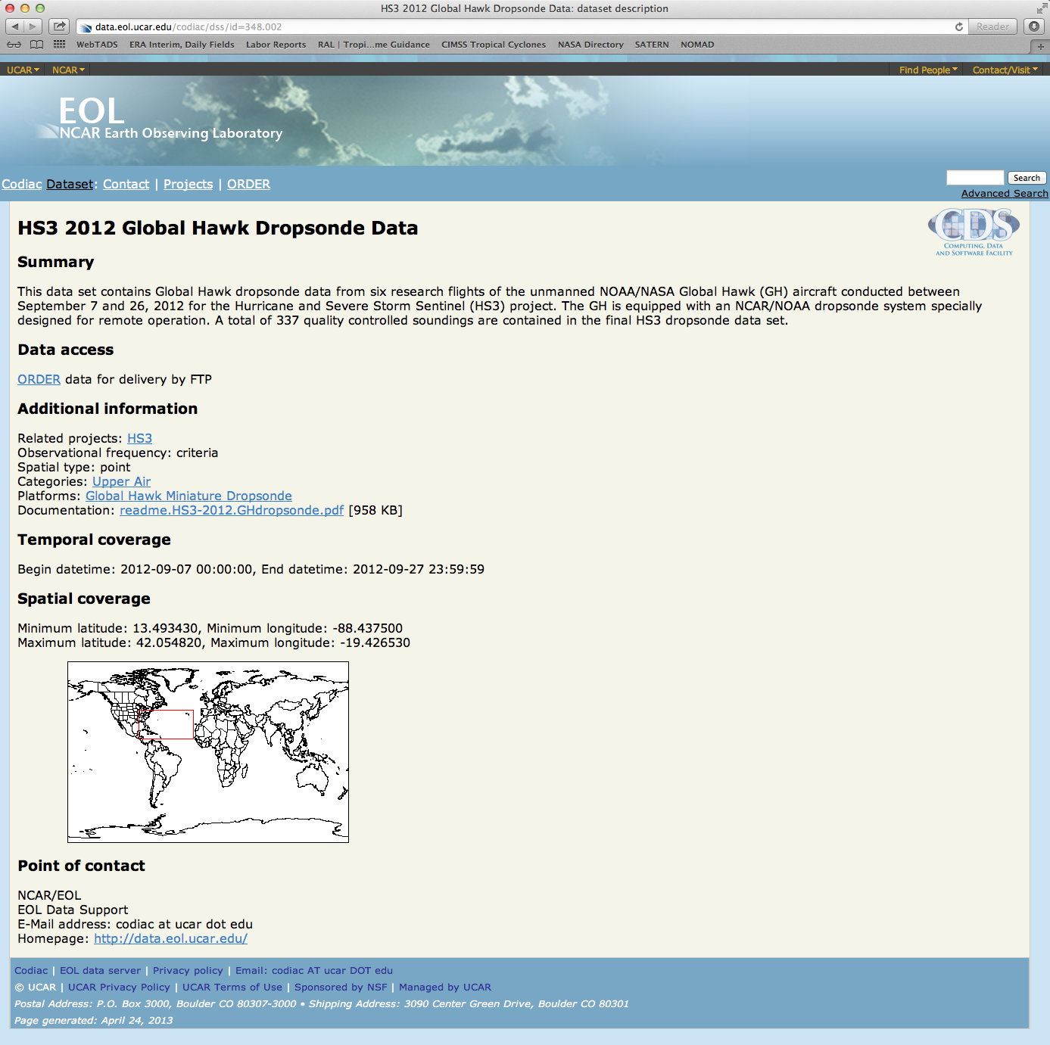
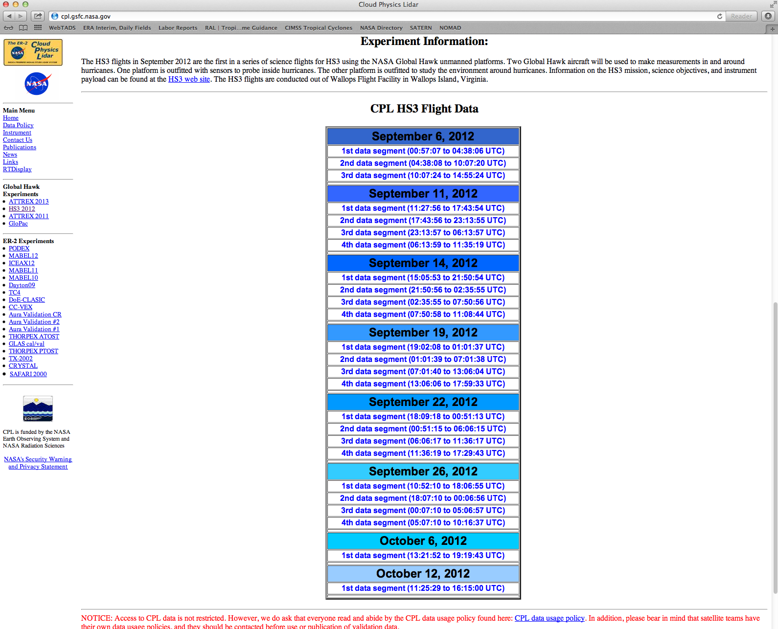
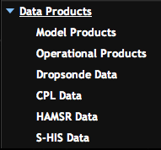
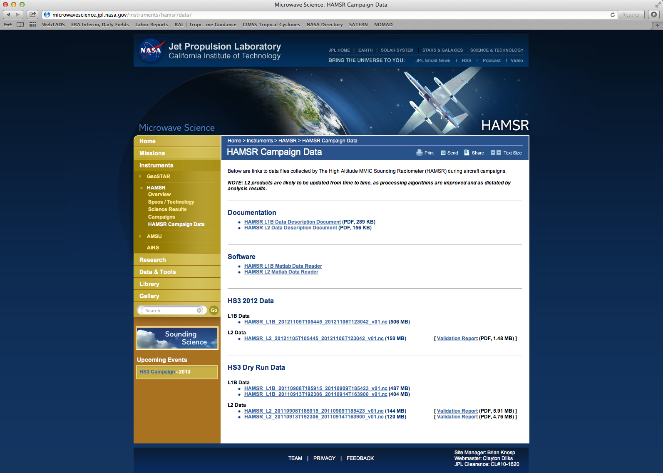
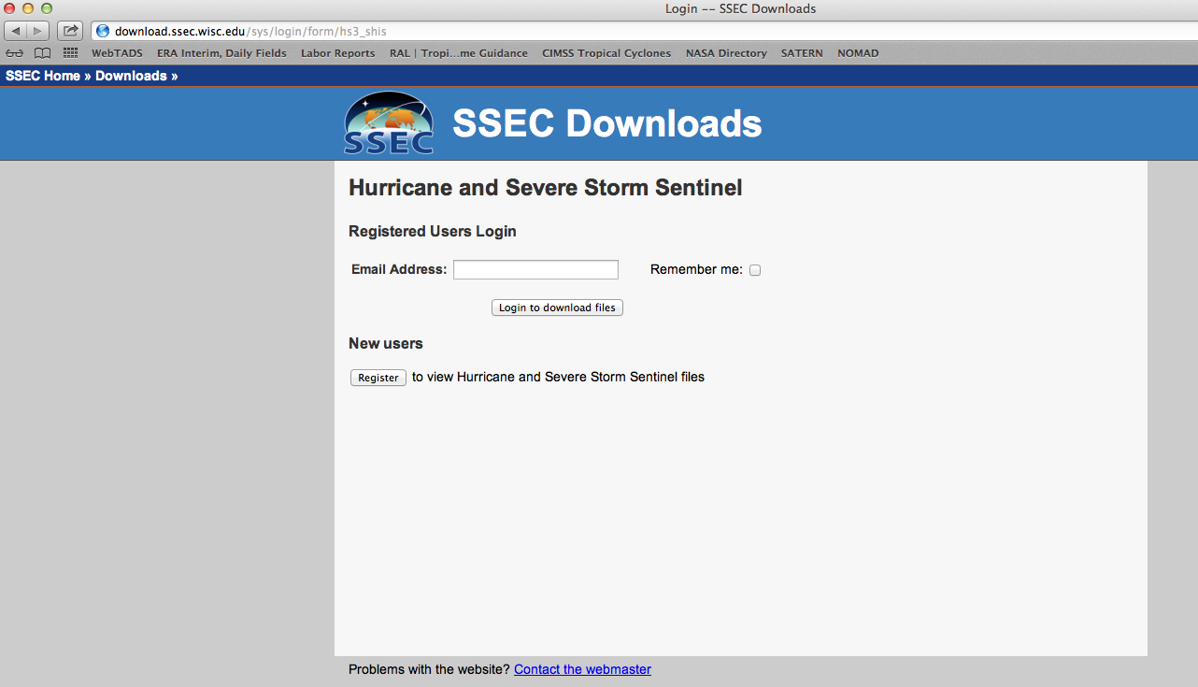

Slide 15
What needs to happen to improve this year…
Better communication with forecast team to provide/archive products that are used on a daily basis
Archive of ground-based radar products
Add in HIRAD and HIWRAP links when ready
Add in NOAA products:
- NHC Aircraft Reconnaissance Plan of the Day (link)
- NOAA HRD Updates
- AOML SST analysis, TC Heat Potential
- OPC Surface Analysis

Slide 16
What needs to happen to improve this year…
“Many hands make light work.” – John Heywood
If you have products to share, let us know. The process to get products to us is very easy:
1.) Open a terminal window: ftp meso.gsfc.nasa.gov
2.) Enter “hs3” when prompted for name.
3.) Enter password when prompted.
At the 2012 meeting, there was lots of demand for a PREDICT-like page for HS3. We have the architecture in place, but need contributions from the team!

Slide 17
Questions???
Comments???
Suggestions???

