Slide 1

HS3 Science Team Meeting
Field Operations for 2013
M.Vasques
9 May 2013

Slide 2
Operations Overview
• Integration and De-Integration at DFRC
• Staff PMOF/POR at WFF for Pre-CST (see calendar)
• If we use GHMOF or PMOF and GHMOF; some operations at Hangar 159.
• AV-1 (871)transits 8/13 and AV-6 (872) transits 8/15
• Take off and landing during daylight hours.
• Weather limitations
• Country clearances will limit options.

Slide 3
General Mission Schedule
WFF
DFRC
• ESPO Mission Calendar on website
• POD Daily Schedule on website
• POD and more via List serve
Mission Scientists and Forecasters shift schedules will be on MTS (Contacts and Schedules).
• Mission Science (Scott)
• Forecasters (Jeff)

Slide 4
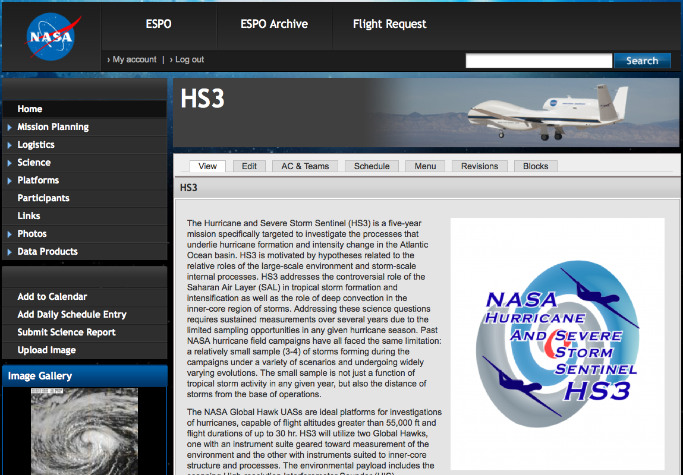
http://espo.nasa.gov/missions/hs3/

Slide 5
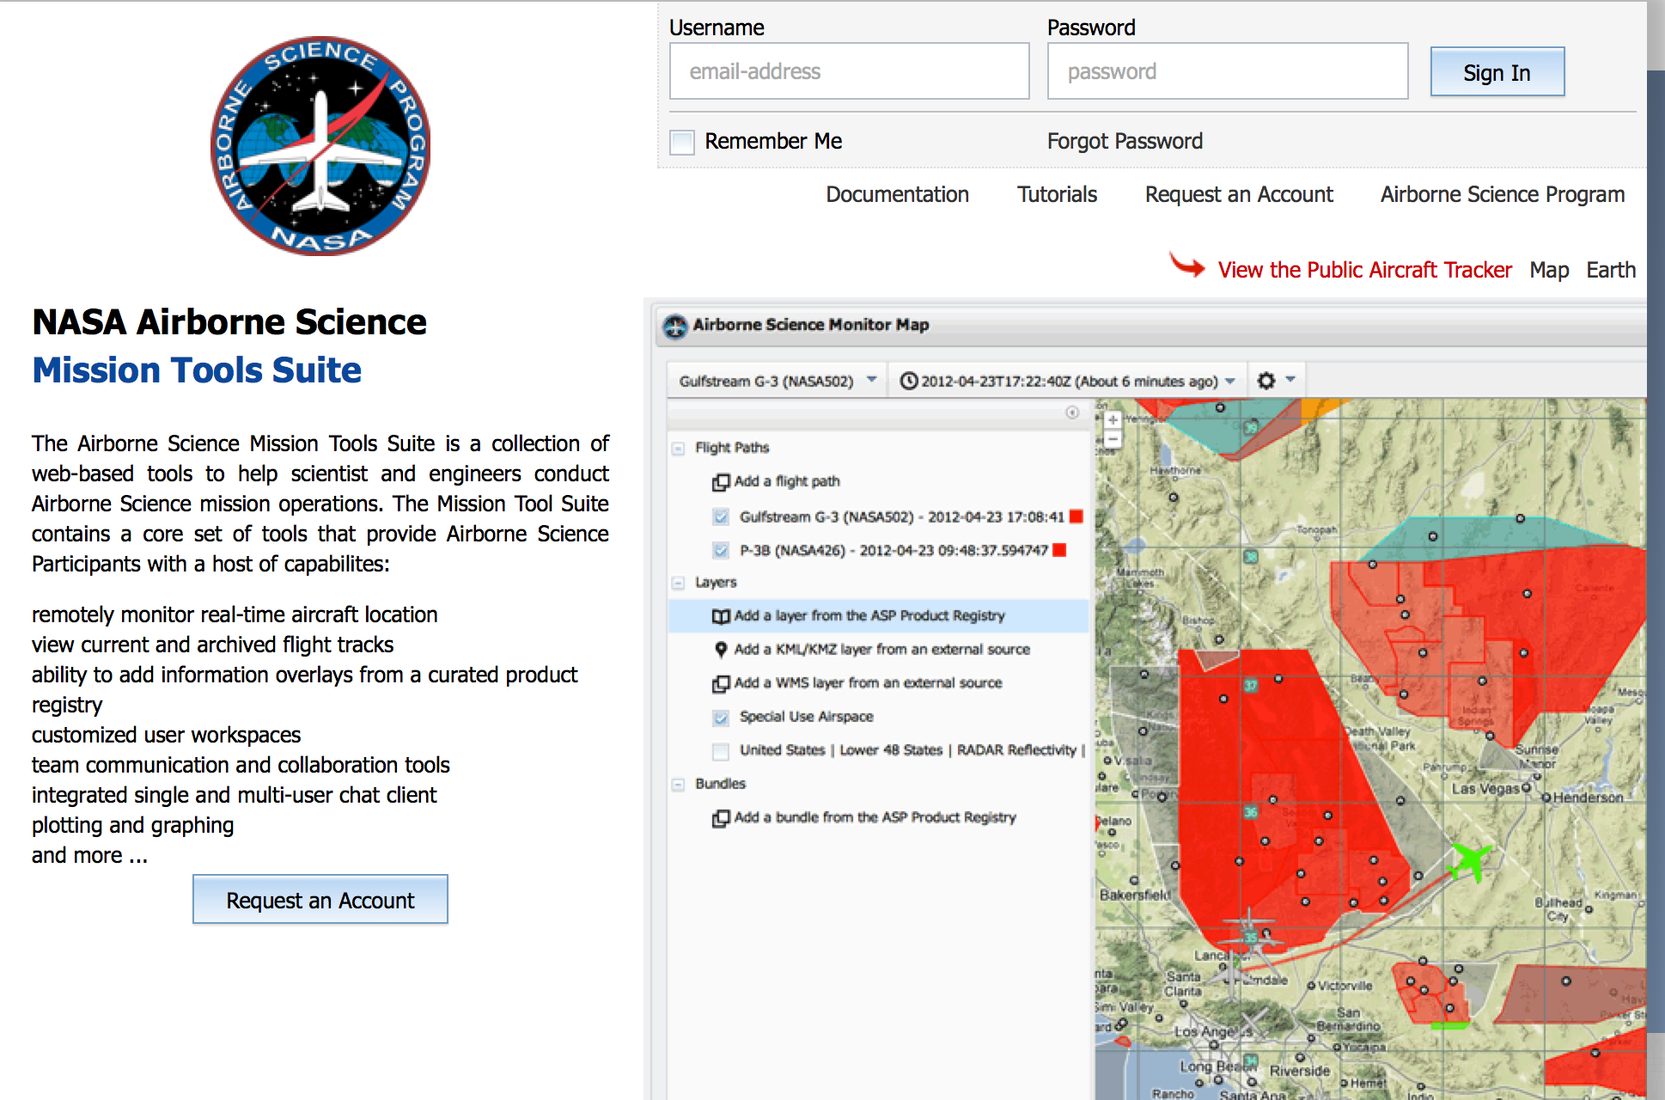
http://mts.nasa.gov/
MTS Training 8/5 and Dry Run 8/6-19

Slide 6
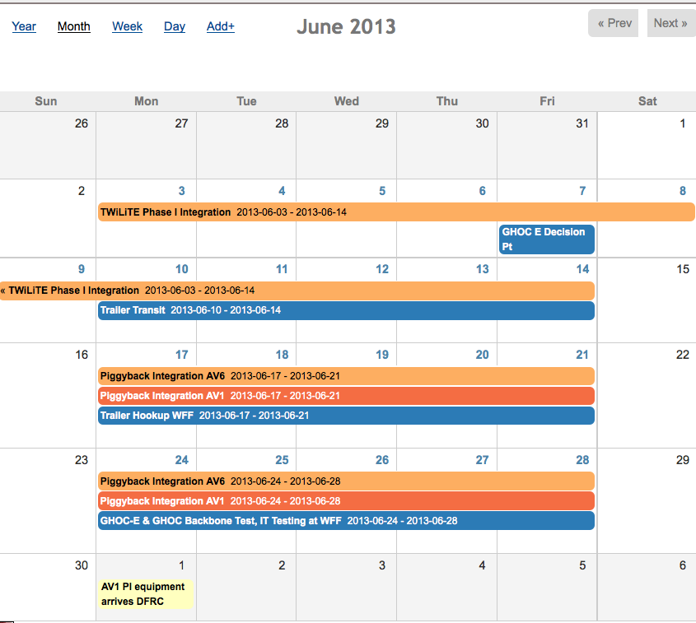
Schedule: 2013 Deployment

Slide 7
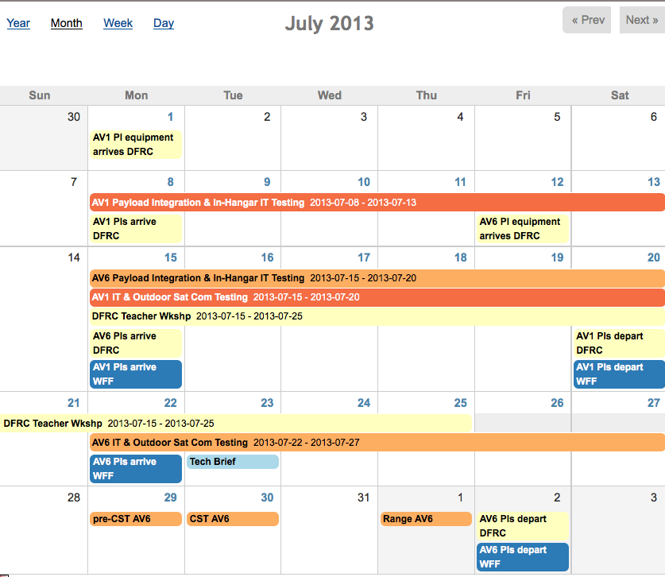
Schedule: 2013 Deployment

Slide 8
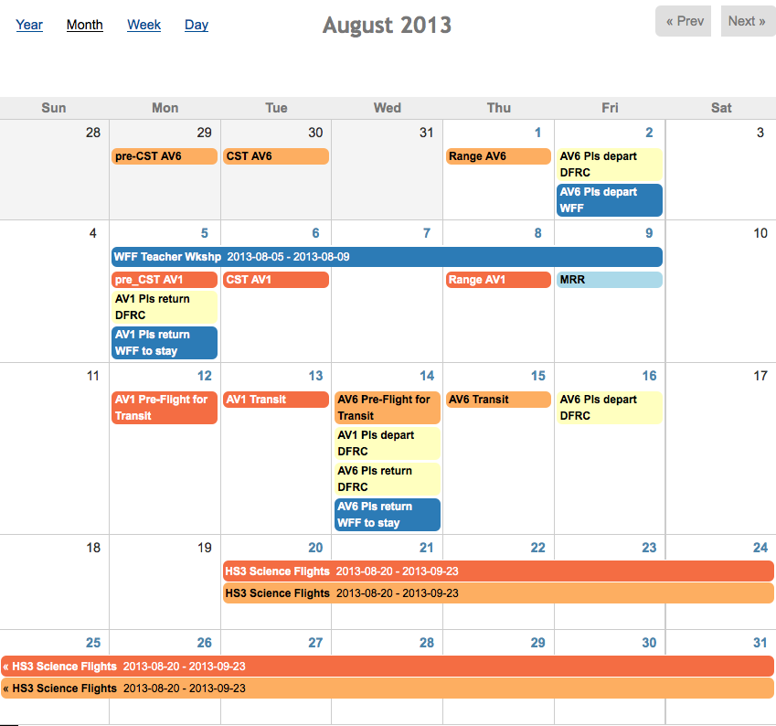
Schedule: 2013 Deployment

Slide 9
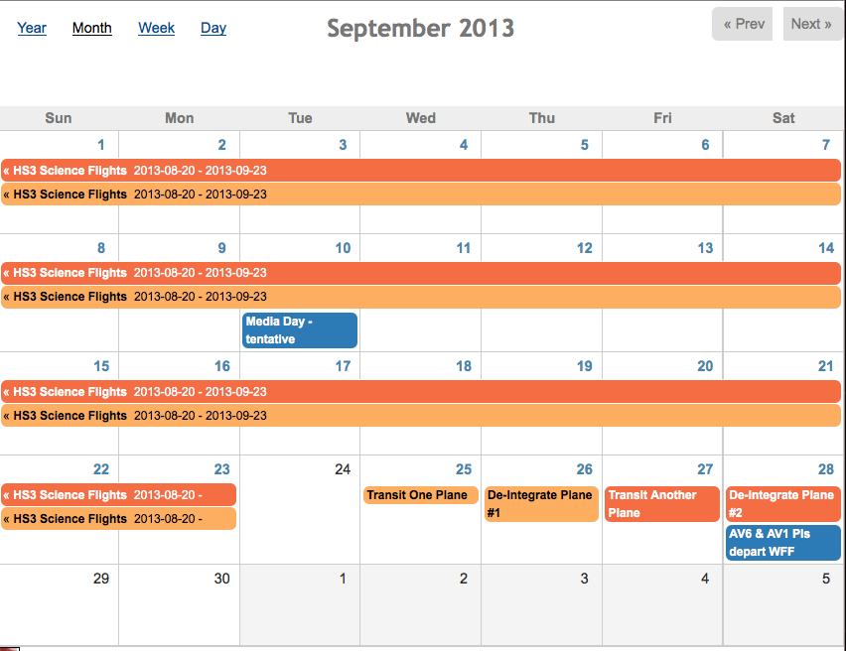
Schedule: 2013 Deployment

Slide 10
Hangar Operations
• COMSEC
• Escort required for aircraft access
• 24/7 access to HS3 teams – Lights & buddy system
• Do NOT leave equipment operating overnight unattended
• Power - Extension Cords outlets and Power strips must be 18 inches off floor
• No unattended battery charging at night
• No RF transmissions (No personal Wifi sources, walkie talkies, etc.)
• Internet access (wireless accounts, wired guest)

Slide 11
Hangar Operations
• Personal tools not allowed outside “Payload Op’s Area”
• Instruments will be installed by GH personnel using GH tools. Instrument adjustments allowed using GH tools and GH staff observation
• Proper protective equipment
hearing protection available in hangar
closed toed shoes required
• Smoking outdoors, away from flight line, only

Slide 12
Travel - Safety/Orientation
WFF
• Website
• Orientation package
Mosquitoes
PMOF can be cold
• All Hands (tentative date 8/19); Check out video
• Evac Plan – have a team plan
• Covering shift hours
• Overlap and training

Slide 13
Travel - Safety/Orientation
DFRC
• Website
• Orientation package
Dry weather
• Covering both integration and de-integration
• Covering shift hours
• Overlap and training

Slide 14
Evacuation Plan
Category 1 – Winds of 74-95mph; Storm surge 4’-5’ above normal
Category 2 – Winds of 96-110 mph; Storm surge 6’-8’ above normal
Category 3 – Winds of 111-130 mph; Storm surge 9’-12’ above normal
Category 4 – Winds of 131-155 mph; Storm surge 13’-18’ above normal
Category 5 – Winds greater than 155 mph; Storm surge 18’+ above normal

Slide 15
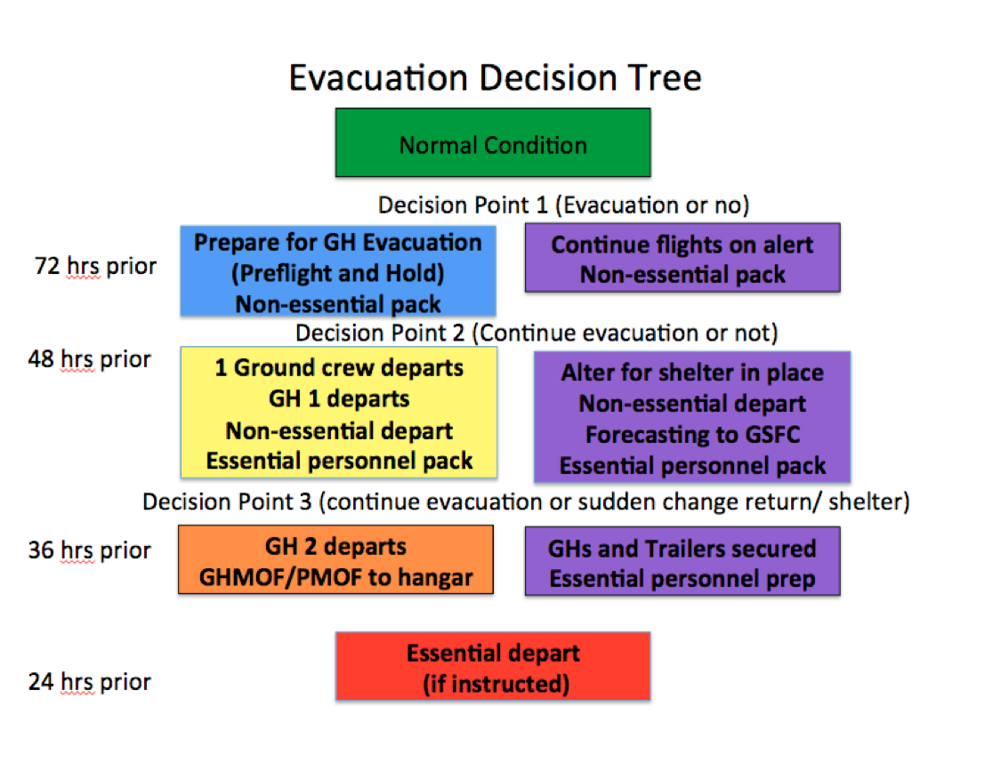

Slide 16
Housing
WFF
• Hotel list provided on Website
• Navy housing – family visitors must be on Erin C. list
DFRC
• Hotel list provided on Website
• Anne O. will coordinate on base housing.

Slide 17
Badging
• Both WFF and DFRC use the database
• All requirements (lab, network, shipping)
• Will need MSDSs
• All personnel (yes even those with NASA badges)
• IDMAX requires one prime and one visit. If you mark you are going to DFRC, WFF will be guest.

Slide 18
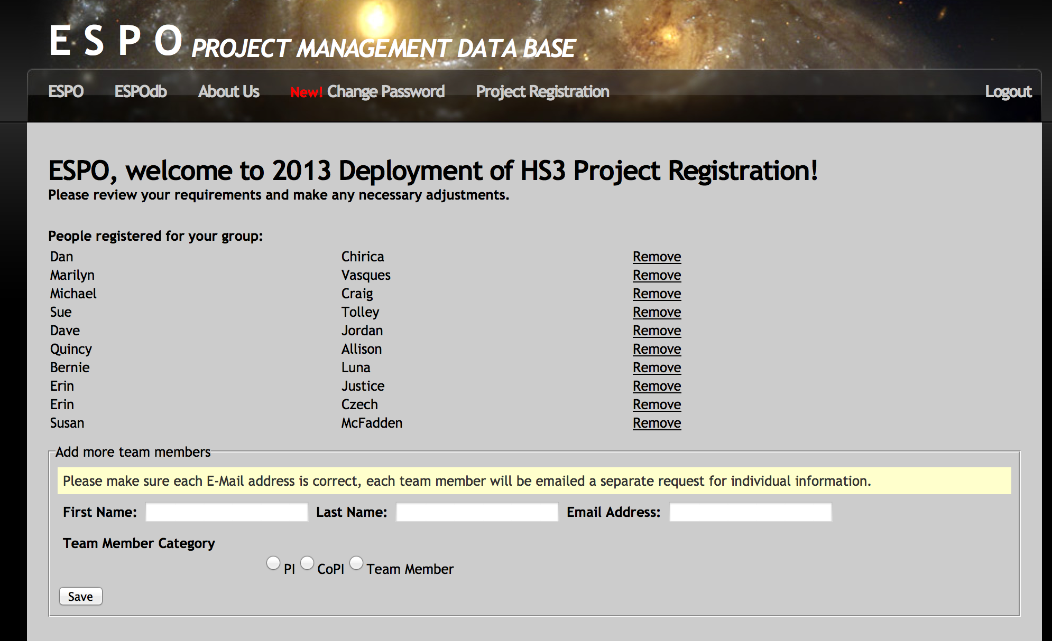
Database
The lead inputs name and email addresses of team and database emails
them for travel dates and badging into

Slide 19
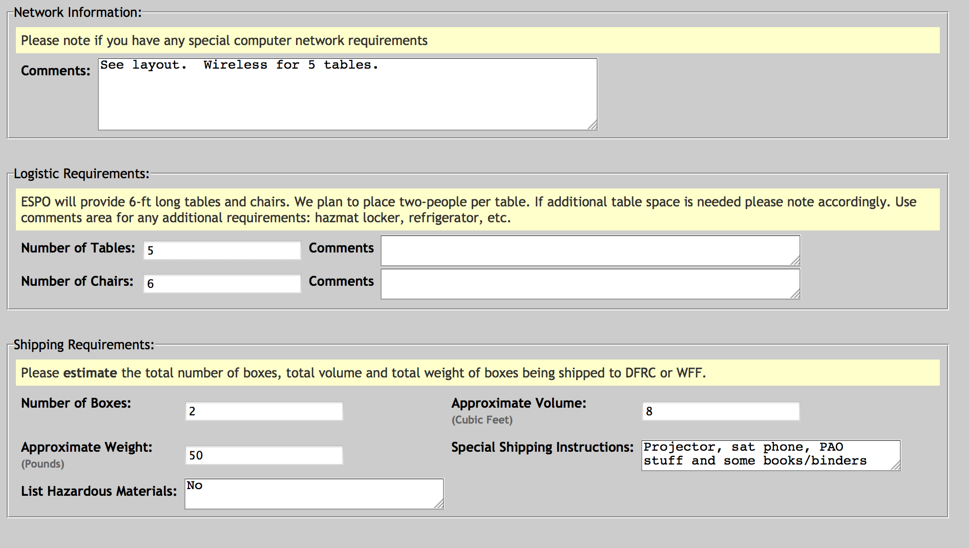
Database
This is where we get any special requirements

Slide 20
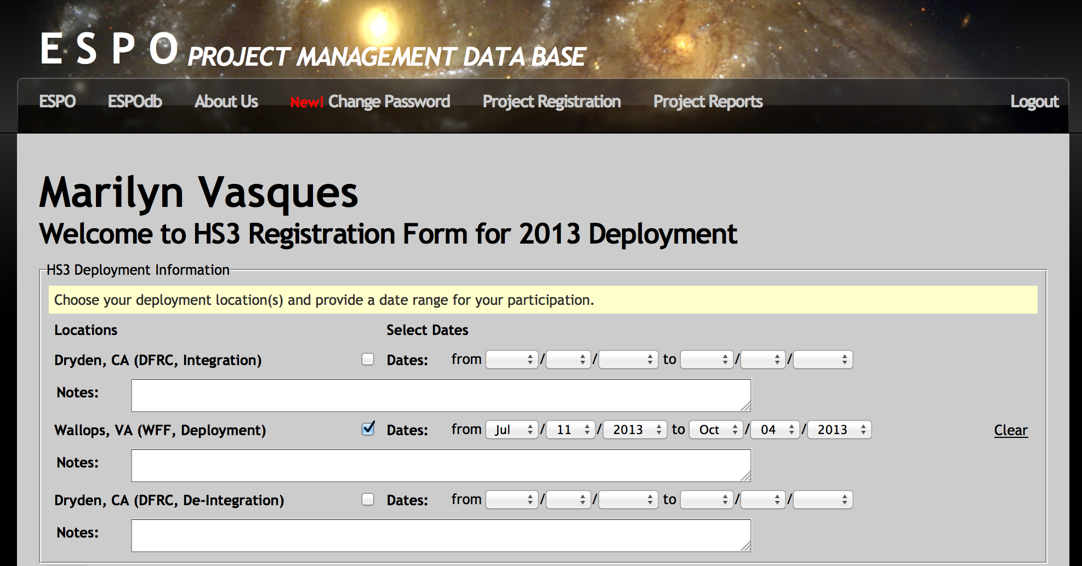
Badging
Input your specific travel dates.
IMPORTANT: Update when travel changes.

Slide 21
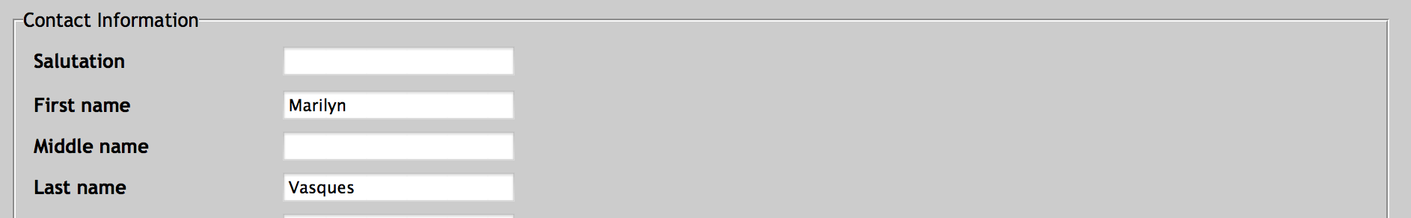
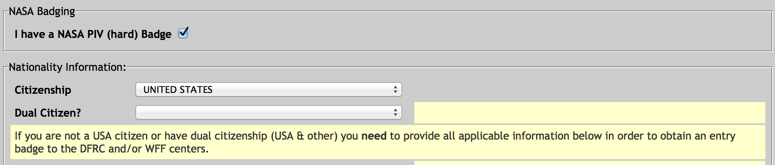
Badging
FN: Must be escorted by person with NASA issued hard
badge or on the designated escort list (see Erin Czech).
No personnel from designated countries

Slide 22
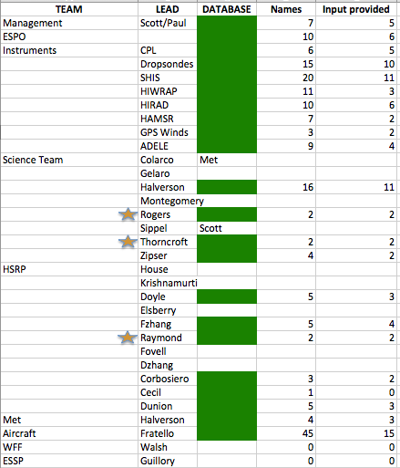
Badging

Slide 23
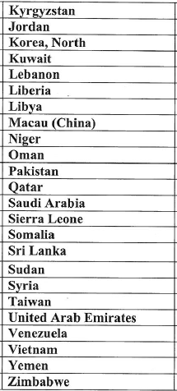
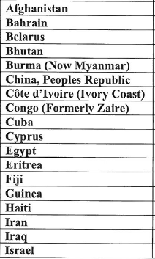
Designated Countries

Slide 24
Labs/Offices
WFF – Hangar D-1
GHMOF
PMOF
Ku radar
DFRC – Hangar 4840
GHOC 4840

Slide 25
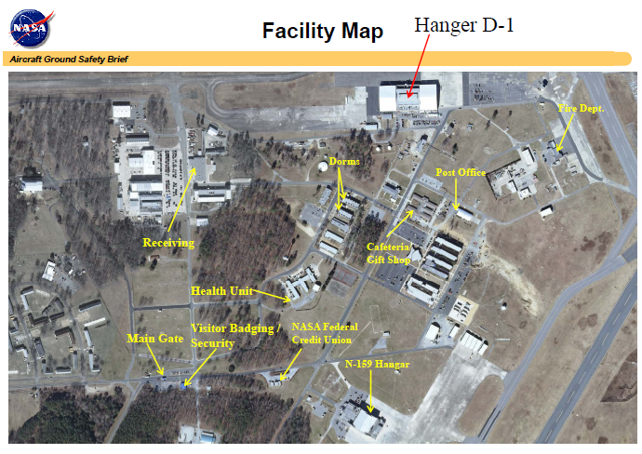

Slide 26
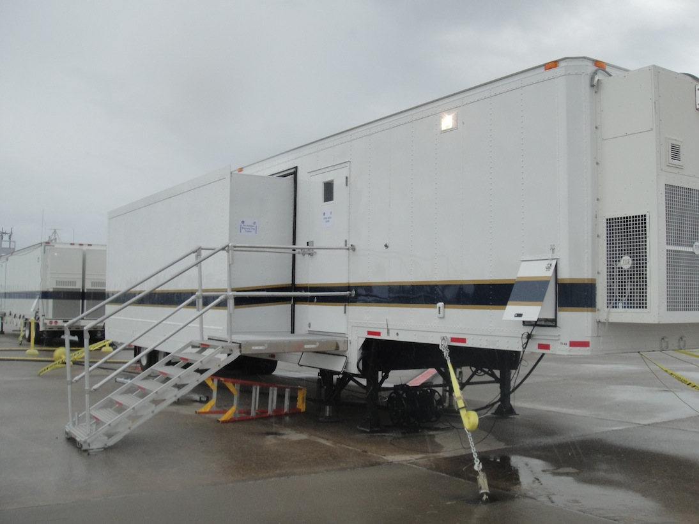
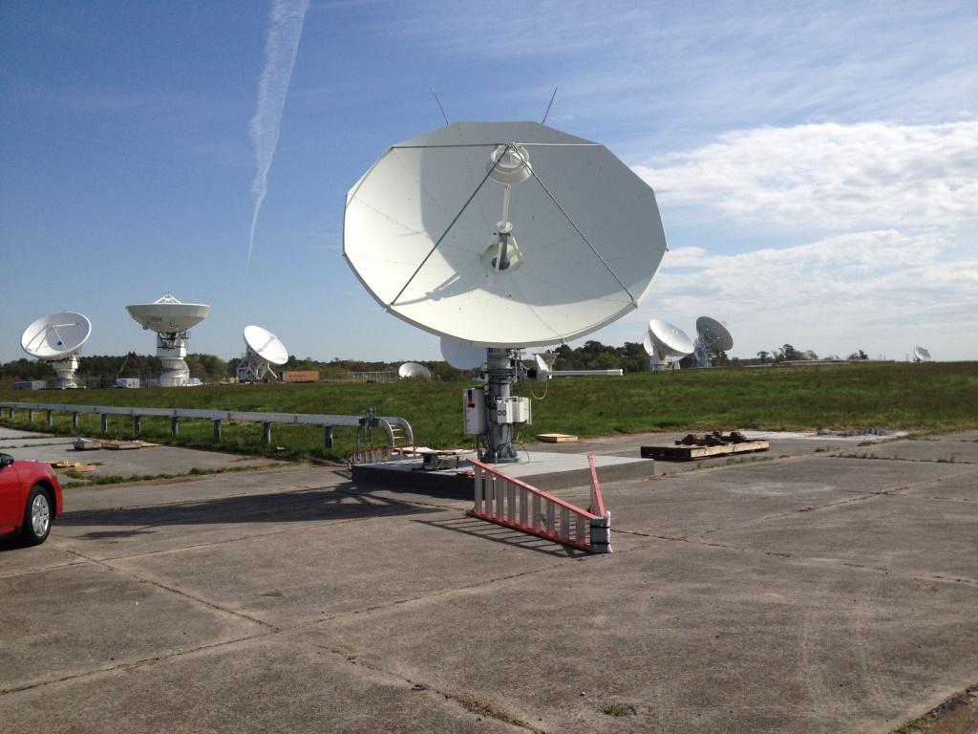
New Ku
GHMOF and PMOF

Slide 27
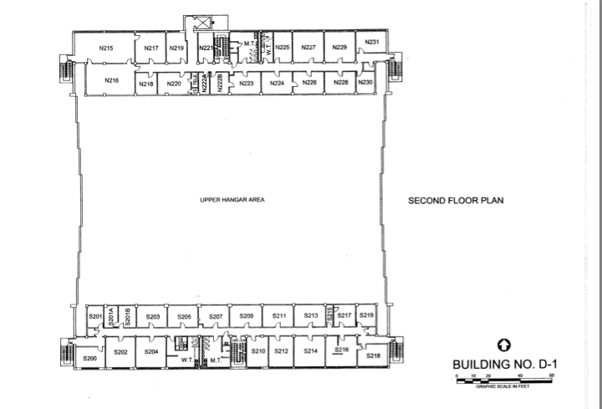

Slide 28
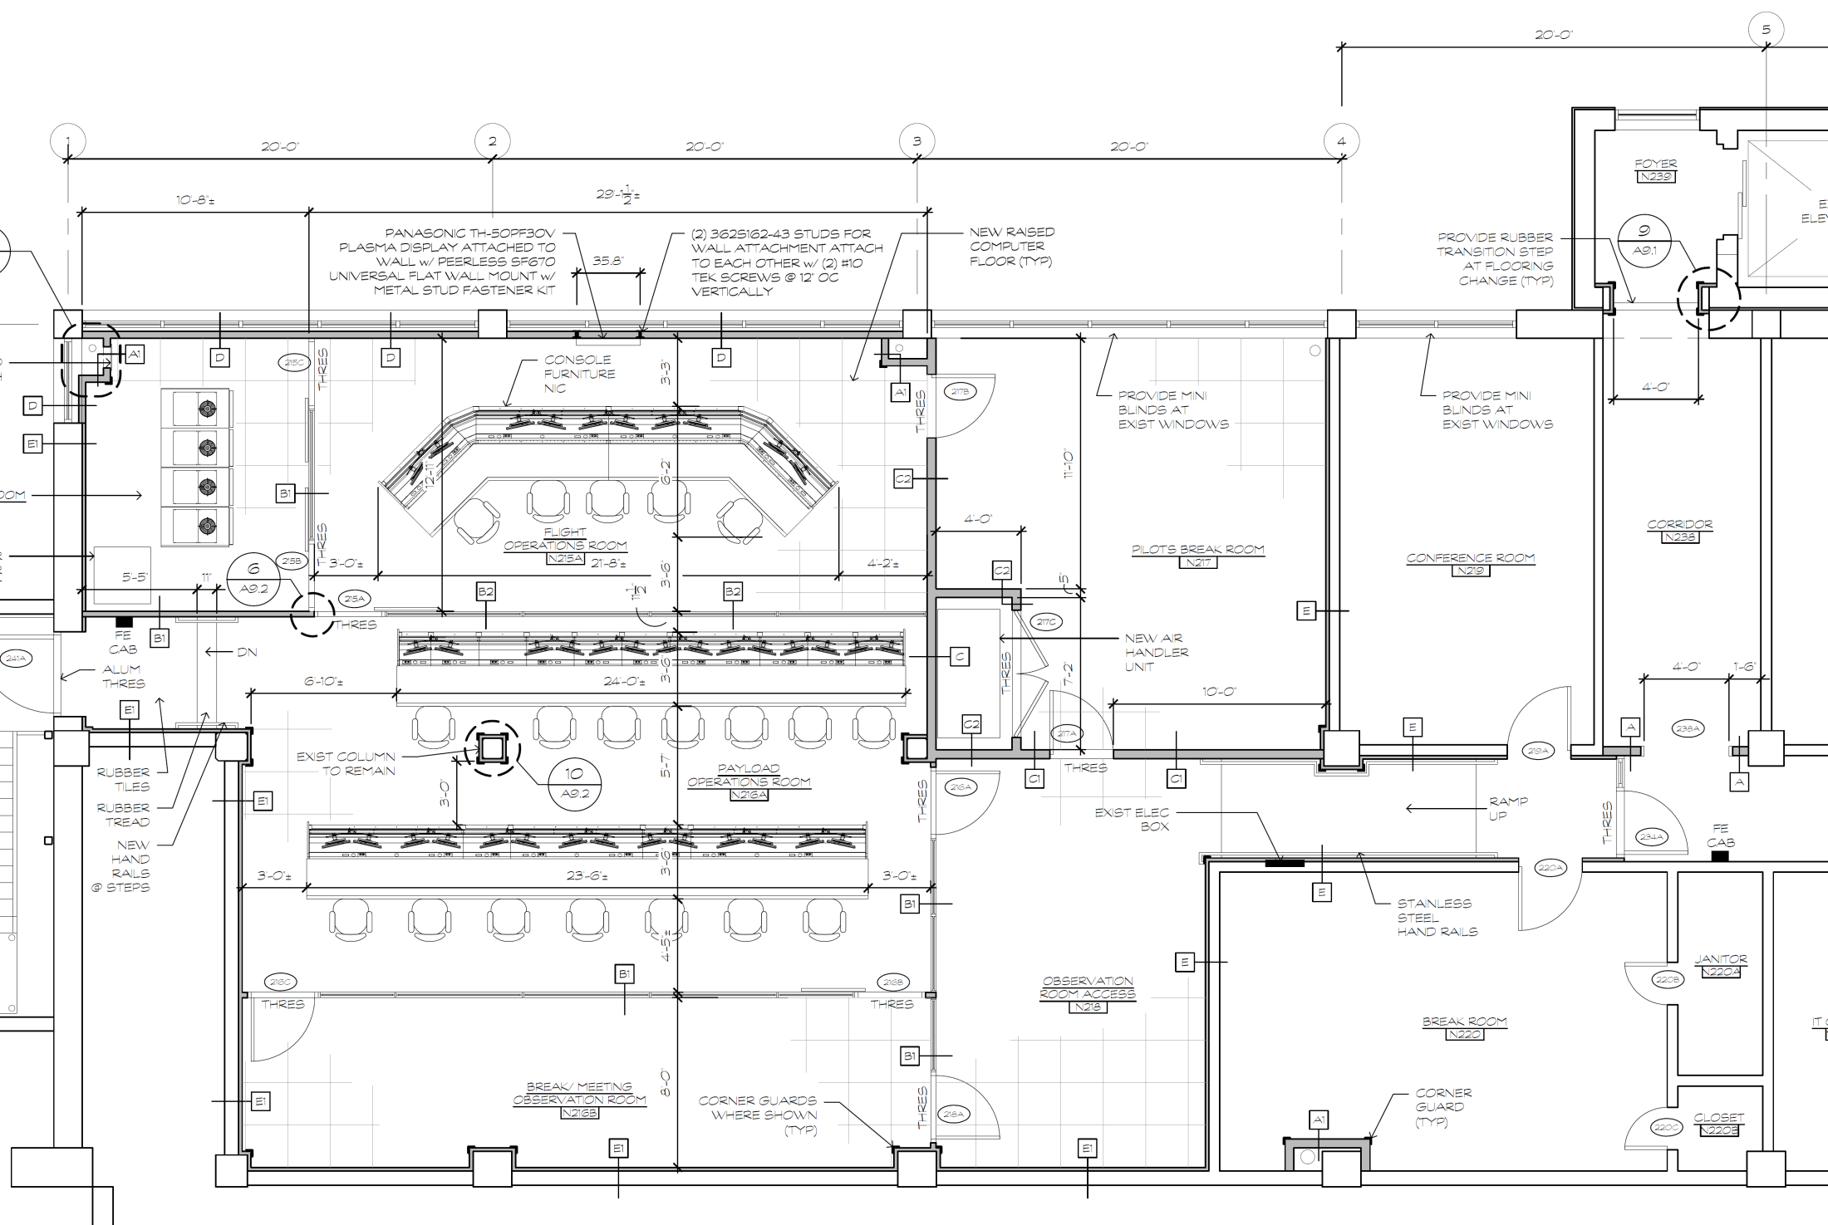
GHOC-E Doors
Ron Walsh
4/12/2013
215C
217B
SER
FOR
Pilot‘s Break
Confer.
215B
215A
241A
POR
217A
219A
216A
234A
220A
Side Obs
General Break
216C
Rear Obs
216B
218A
hinged door with badge reader (5 ea)
sliding door with cylinder lock (2 ea)
sliding door with badge reader (2 ea)
hinged door with cylinder lock, and alarm if opened (1 ea)

Slide 29
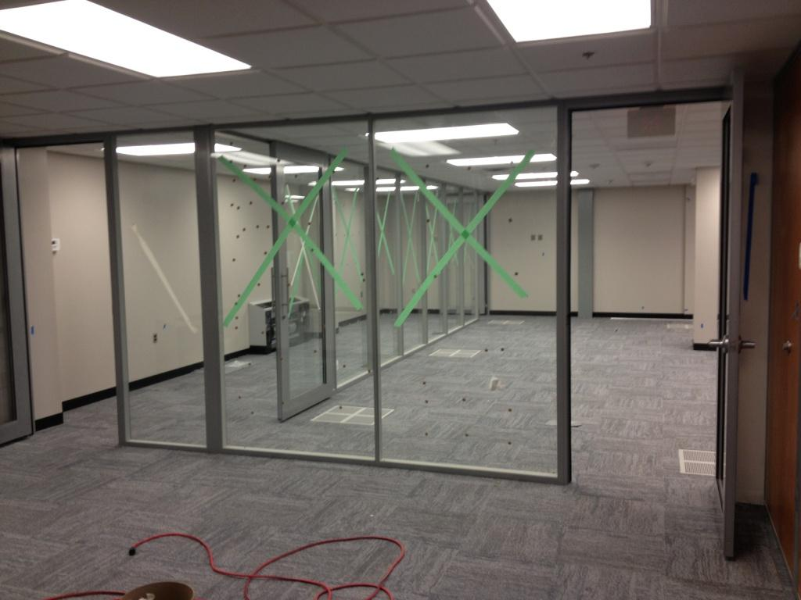
GHOC – E (POR and visitor area)

Slide 30

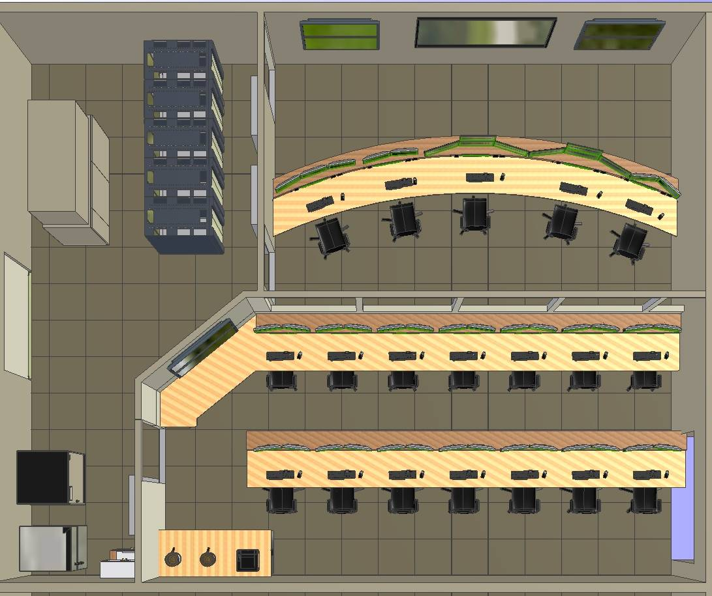
GHOC Payload Op’s Room - Assignments
Support Equipment
Pilot in Command
Flight Support Engineer
Mission Director
GHOC Operator
RSO / SOR
MD
PT
CPT
GO
RSO
Flight Operations Room (FOR)
ESP1
ESP2
MS1
MS2
SHIS
CPL
HMSR
1
2
3
4
5
6
7
Project Manager
Mission Scientist
--
SHIS
CPL
--
Project Manager
Mission Scientist
HAMSR
Intercom Display
Labels
PM
SAT
AVP1
AVP2
FCST
Pay2
Pay1
8
9
10
11
12
13
14
Payload Manager
HDVis / SatCom
AVAPS
AVAPS
--
IT Support
Displays,& Software
Forecast
Payload Operations Room (POR)

Slide 31
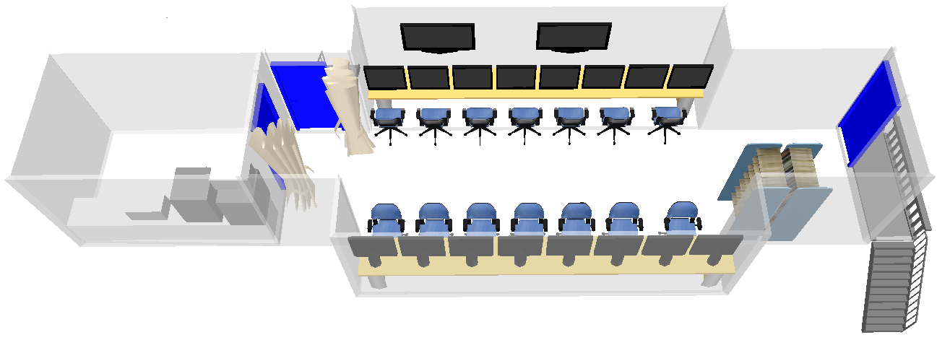
PMOF Trailer - Environment
Guest
S-HIS
CPL
IT
AVAPS
Mission
Scientists
ESPO
Payload Manager

Slide 32
PMOF Trailer - Overstorm
Guest
HAMSR
HIWRAP
IT
HIRAD
Mission
Scientists
ESPO
Payload Manager

Slide 33
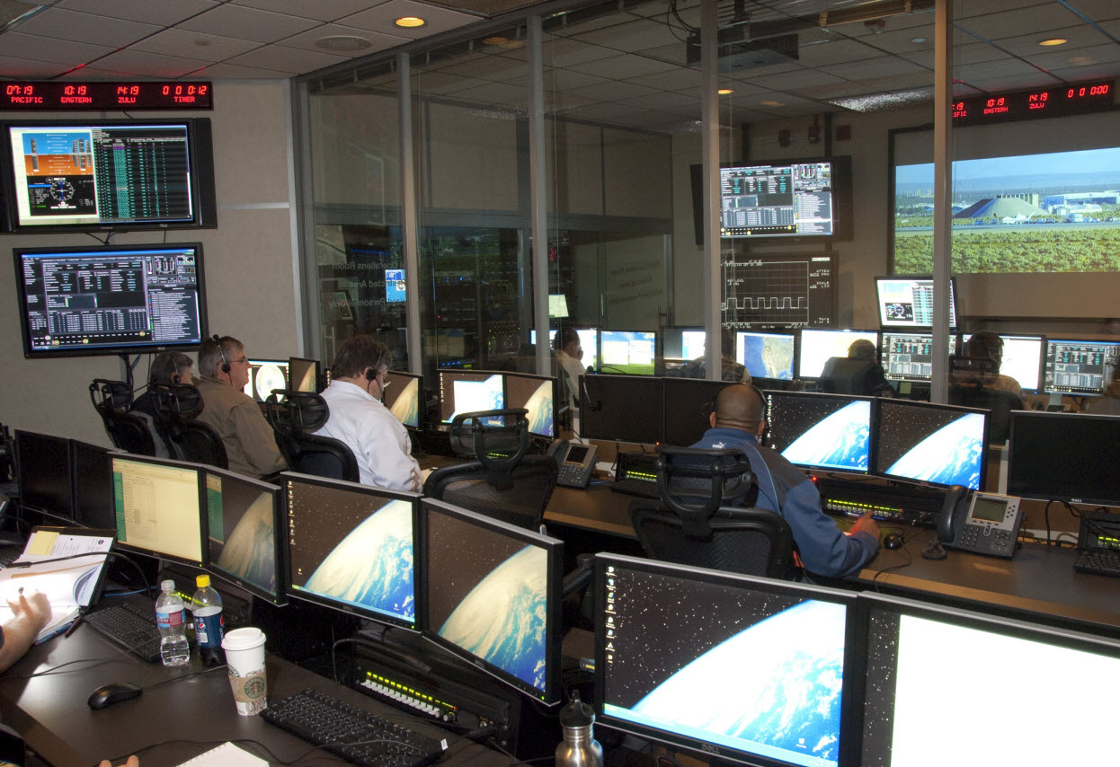
GHOC – Payload Op’s Room Rules
GHOC Etiquette
Staff at engine start.
Common Sense consideration of others
Noise, food, coffee pot, etc.
Clean up
Access for Team Members, Visitors
No access to or photos of “Flight Op’s Area”
Mishap considerations
Cell Phones, computers, etc.
Laptops
Network designed to accommodate your system
Scheduled scan - First scans at Dryden are 7/8 and 7/15; first scans at Wallops are 7/15 and 7/22.
Intercom / Video / Chat
“Instrument” Comm’s, comm’s available in Hangar, etc.
Flight Video to be available in Hangar
Orientation
Layout will be posted
Software install (see IT)

Slide 34
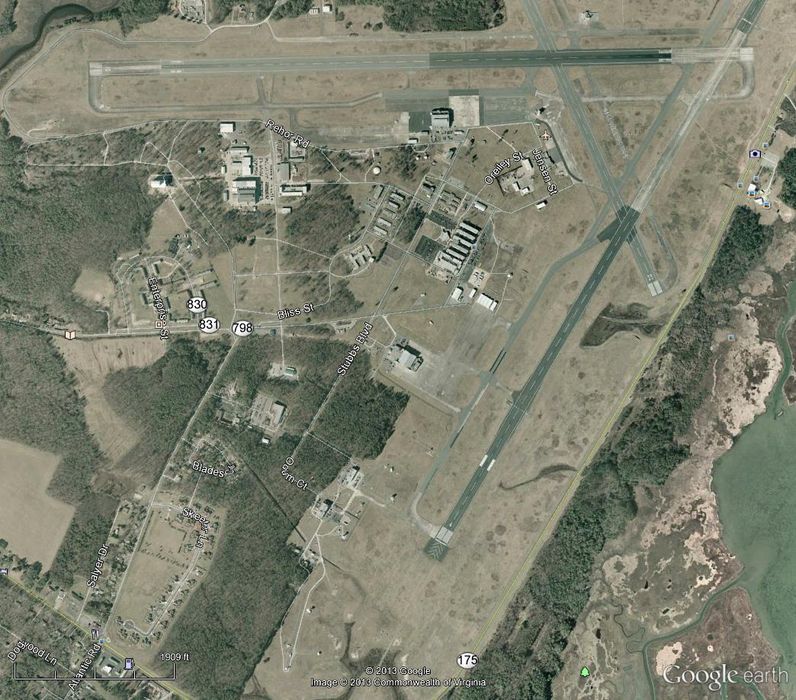
Runway 10-28
Hangar D-1 Viewing Area
for Rwy 10-28 operations
Runway 04-22
Hangar N-159 Viewing Area
for Rwy 04-22 operations
(by trailers; same as in 2012)

Slide 35
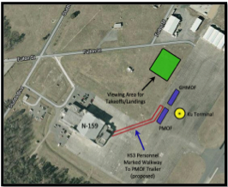
Viewing area Hangar 159

Slide 37
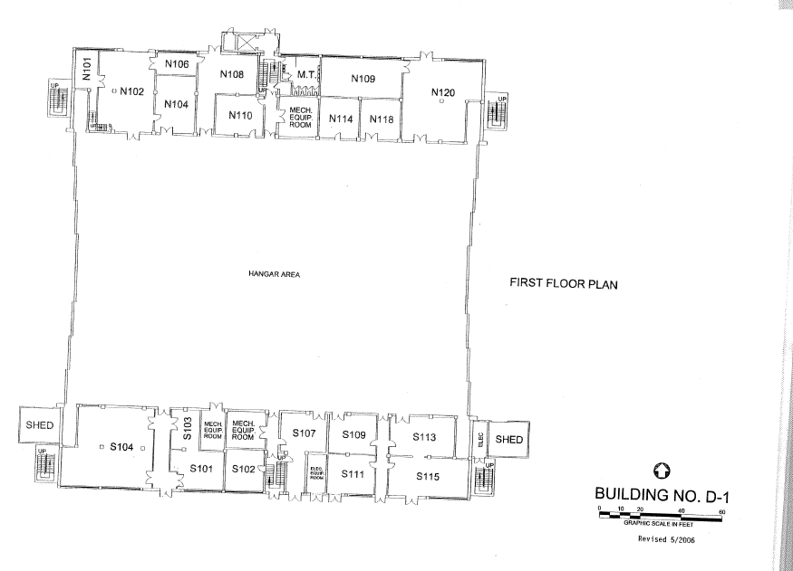

Slide 38
LAYOUT – First Floor
440 power
N104
(6C)
N110
N114
N118
Storage;
ESPO
Storage;
Furniture
Break
Storage
Data station
(3 benches)
AV-6
AV-1
Visitors
AV-6
AV-6
AV-1
S103
(4C)
S107
S109
S113
S101(4C)
S102
S115
Conference Room

Slide 39
Room S107- AV6 Lab
22’4”
TWiLiTE
AVAPS
19’6”
22’4”
Door
Extended room here – See 107B next page

Slide 40
Room S107b- AV6 Lab
9’3”
Door
Piggybacks
19’

Slide 41
S109 – AV6 Lab
SHIS
19’6”
CPL
Door
Printer
22’10”

Slide 42
Room S113 - AV1 Lab
HIWRAP
HIRAD
HIRAD
19’6”
Door
HAMSR
HIWRAP
31’9”

Slide 43
Room S115 - Conference room
38’10”
Credenza
Copier
Door
10x4
19’
Microwave
2 mini refrigerators
Large refrigerator
Spare chairs
Door to outside

Slide 44
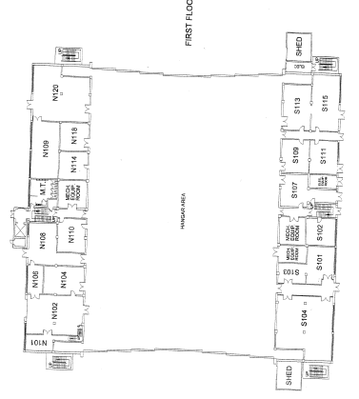
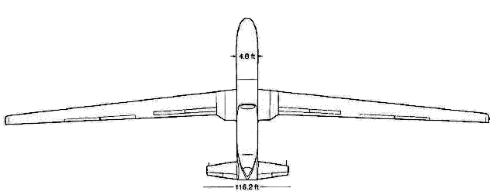
Option 1
D-1 hanger bay:
132’-8” wide
188’ long at center
(N-159 is 160’x160’)

Slide 45
Hangar Floor space in center
Hangar wall
IT
PM
GH Crew
Crew Chief
GH Crew

Slide 47
LAYOUT – Second Floor/South-East
(RTS)
219
Pilots
209
GH MD/PM
211
Flt Planning
& Leslie L
213
GH QA, Ops
217
IT
(P)
(RTS)
Restrooms and Kitchenette down the hall
(P)
(P)
210
ESPO
212
SB/PN
214 (TV)
Mission Science
216 (TV)
Forecasting
218
Science
Stairs (Instrument labs, conference room
And visitor room downstairs)
(P) = Printer
(TV) = Closed circuit TV
(RTS) = Intercom
NOTE:
119E in Hangar 159
(TV) and (RTS)
Use printer in Hall

Slide 48
Room S209 – GH Management
~ 12’
~14’
Mission Directors
Door
PM and Payload Manager

Slide 49
Room S210 – ESPO
~18’
PM
dPM
~14’
Logistics
Coordinator
Door
Integration Lead
Printer

Slide 50
Room S211 – Flight Planning
~12’
RTS
Leslie Lait
~14’
Door
Flight Planning
Printer

Slide 51
Room S212 – Lead PIs (Scott/Paul)
~18’
Scott
~14’
Door
Paul

Slide 52
Room S213 – Crew
~14’
Avionics
QA
~12’
Door
Avionics
Ku

Slide 53
Room S214 – Mission Scientists
~18’
~18’
Door
TV

Slide 54
Rooms S216 – Forecasters
Door
TV

Slide 55
Room S217 – IT
~12’
~12’
Door
RTS
IT Closet

Slide 56
Rooms S218 – Science Overflow
Printer
Door

Slide 57
Room S219 – Pilots (Also space in GHOC E)
~13’
~7’
Door

Slide 58
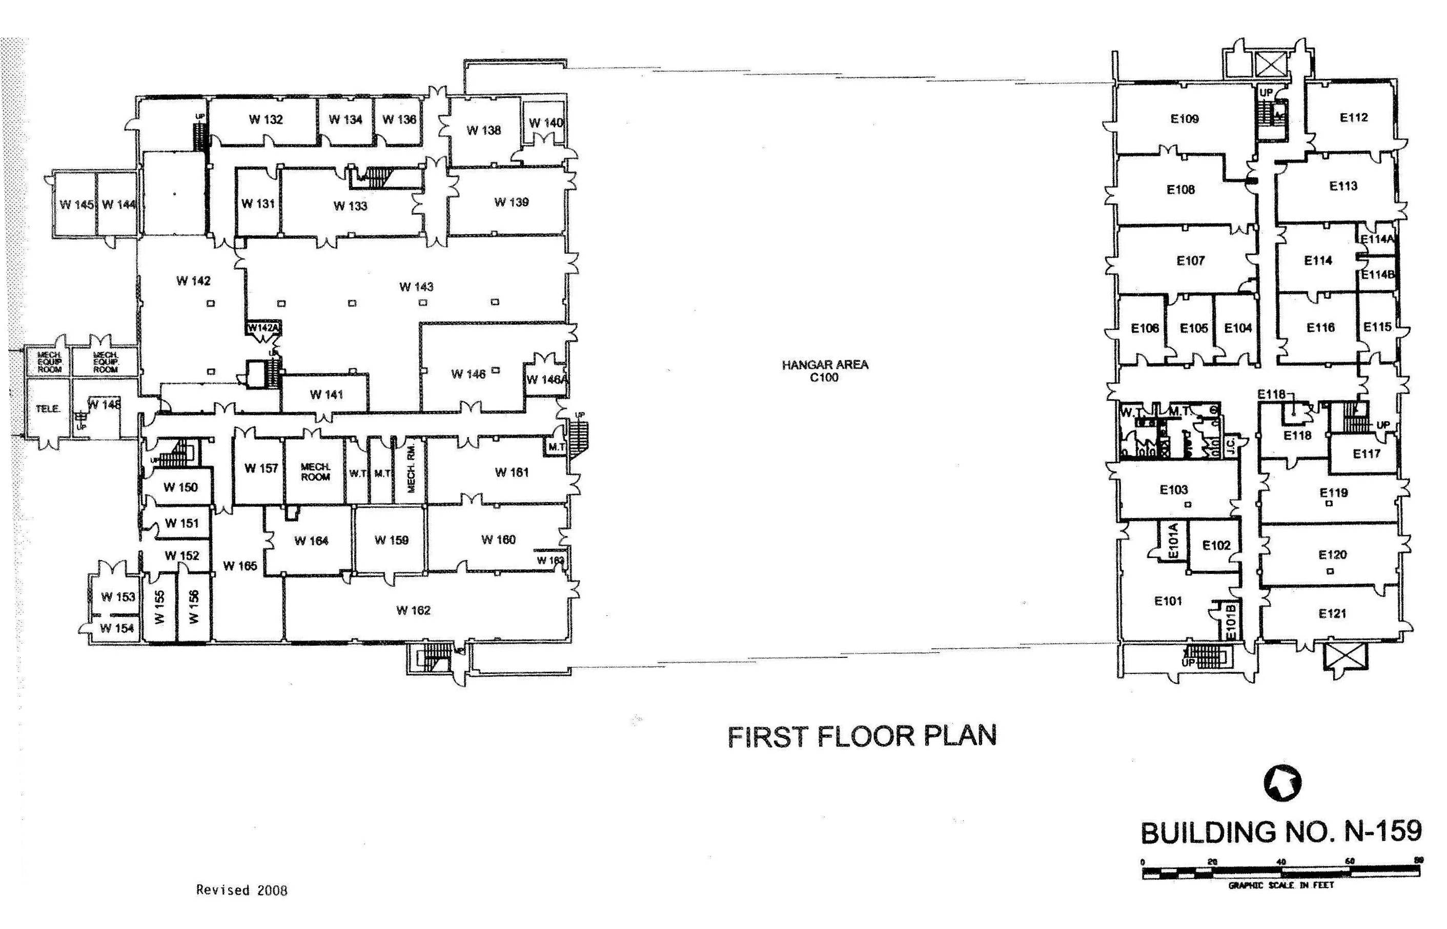
N-159 (1st floor)

Slide 59
Room E119 – Trailer Mission Ops
Pilots
RTS
Refrigerator
Closed circuit TV

Slide 60
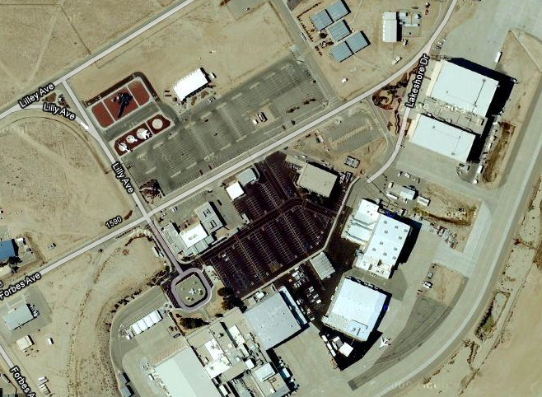
Key Locations @ DFRC for HS3
4830A – GH Offices & GH Conf. Room
4840 – “GHOC” & Conf. Rooms
4825 - DFRC Badging & Security
Small & Large Mezzanine Conf. Rooms (2nd Floor)
4801 – GH Hangar

Slide 61
Education and Public Outreach
Education Outreach
• Teacher Workshops
NSTA 2013
MTS Flyer & chats
Curriculum aide
Education Day at WFF
• Videos
• Lenticulars
• Visualization
• GH Interactive
Public Affairs
• Media Day 9/10 (backup 9/12)
• VIPs

Slide 62
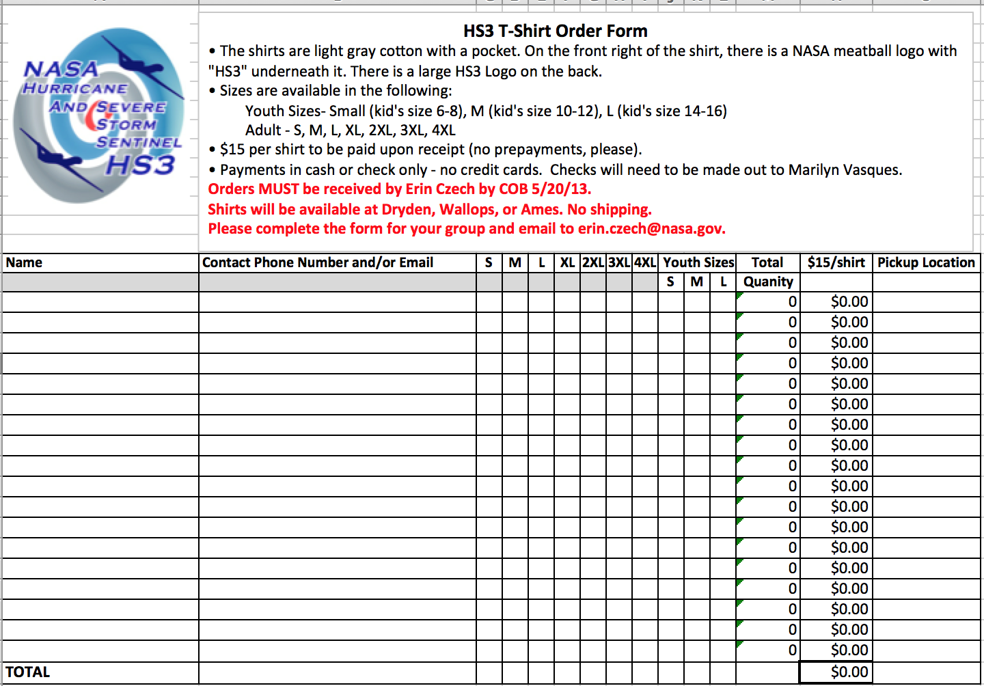

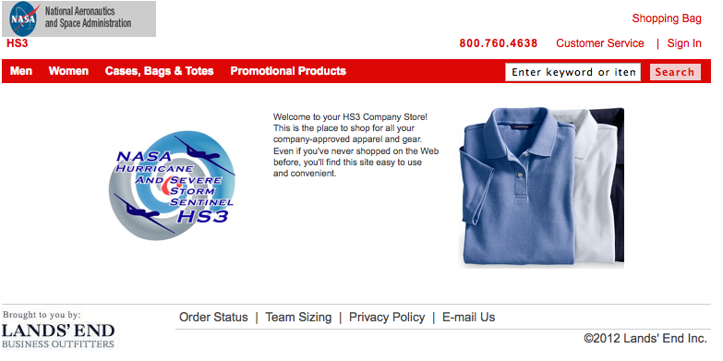
T-SHIRTS
DUE 5/20
Lands End SHIRTS

Slide 63

Thank you

