Slide 1
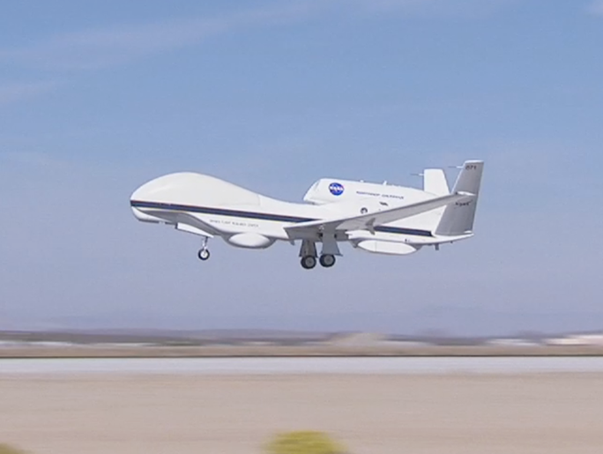

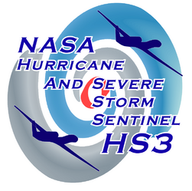
NASA Global Hawk- Lessons Learned Aircraft, Staffing, Flight Op’s
Dave Fratello
HS3 Science Team Meeting
May 7, 2013

Slide 2
Lessons Learned - Aircraft
  Spares, GSE shortages (Fuel Freeze Tester, Defuel Kit,
  Fuel Nozzles, Spare Parts, etc.)
    - Mike Bereda taking lead… yes, we’ll have spare bulbs
  Runway 22 Departure GPS Mission Pt. (AGE Equip)
    - New Start Pt. identified, being entered into Mission Plan
  Crew Staffing Levels & Qualifications
    - Every OA Tech and Lead now VTC Qualified
    - New Staffing Plan in place (to be discussed later)
  GHMOF to Trapper VHF Comm’s intermittent for 22 Departure
    - In Work – will not be an issue if GHOC-East is used
  VAPCAPES Scheduling constraints
    - Being worked – DFRC-proposed Track C&D will open Op’s

Slide 3
Lessons Learned – GH Staffing
  2013 Staffing Plan is complete and approved at DFRC
    - GH Team (all groups) will provide 1200+ man-days support
    at WFF
    - Hangar Crew (Mech’s , Tech’s) Staffing Plan will provide
    7-day/wk, 15-hr/day support
  AV-1 Readiness Issue (HS3 delay was a Staffing issue)
    - Aircraft is flight ready (currently being used for UAVSAR / LVIS
    Cert. flights)
  Personnel “Fatigue” Assessment – DFRC requirement
    - Caused issues in 2012
    - Current 2013 WFF/DFRC Staffing is “Green” Fatigue Assessment
  No demonstration of Back-to-back Op’s
    - GH Team is committed to 3 Back-to-back Flight Op’s
      A take-off approx. 2-3 hrs after a landing of other aircraft
    - WFF ‘13 GH Staffing Plan will provide Back-back flights

Slide 4
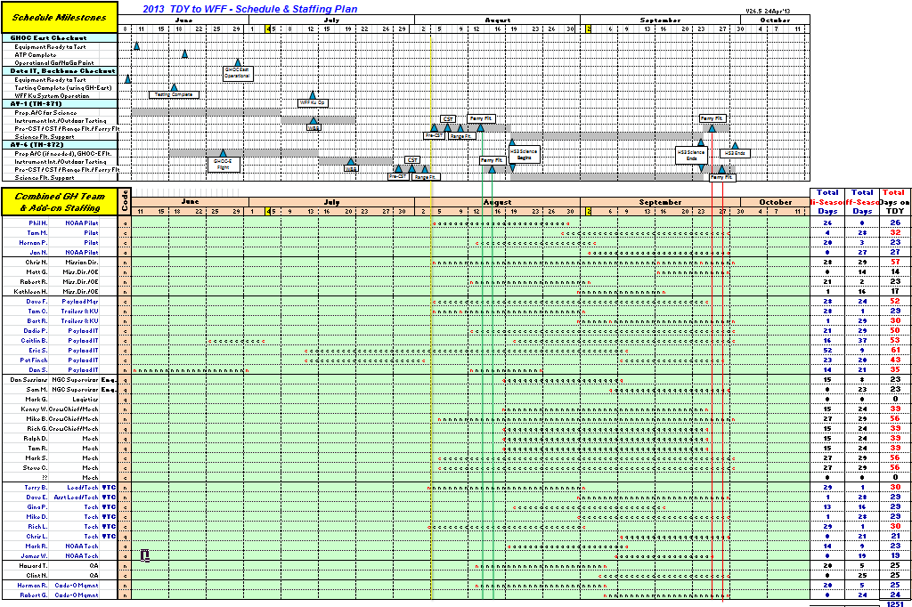
Lessons Learned - Staffing

Slide 5
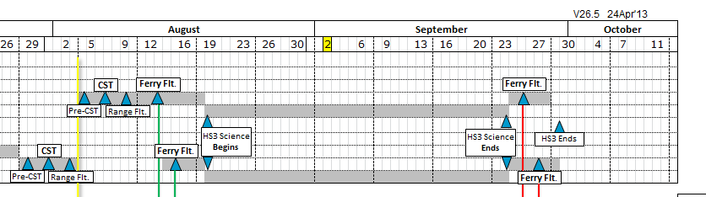
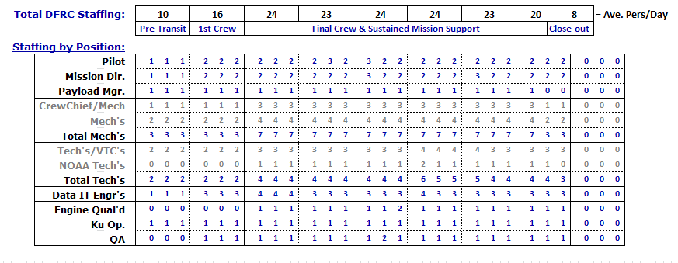
Lessons Learned - Staffing

Slide 6
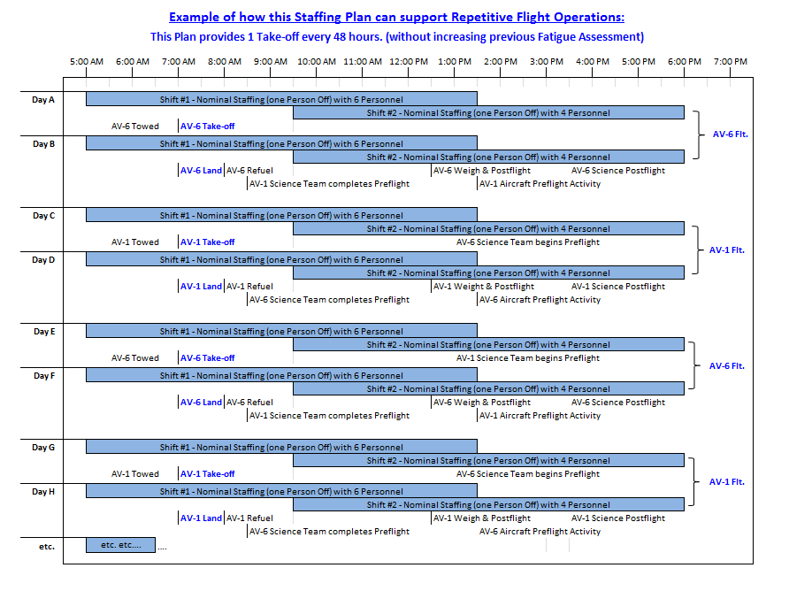
Lessons Learned - Staffing

Slide 7
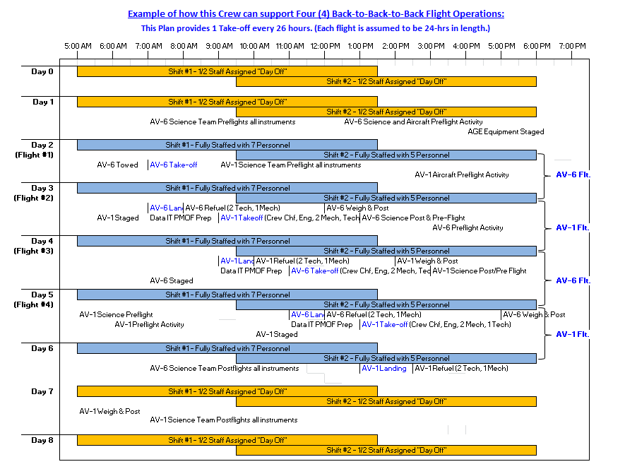
Lessons Learned - Staffing

Slide 8
Lessons Learned – Others
  Instrument issues related to Aircraft:
    AVAPS and HIRAD RF issues being worked
    HIWRAP Temp. issuebBeing worked with P.I. and possible Heater wiring change
  Camera Performance
    HDVis Camera icing
      Issue believed resolved, demonstrated during ATTREX
    Low-light Camera resolution, etc
      New lens in work, Camera software. Same on both aircraft
  “Piggyback” Integration being worked prior to start of HS3 Integ.
  IT “Backbone Data-rate limitation
    Increased significantly – possibly no “web” restriction
  COMSEC – now a requirement for 24/7 Access to GH Hangar
  Fire Waiver – being worked

Slide 9
Lessons Learned – Flt. Op’s
Flight Operations:
Early coordination with FAA and DOD resulted in no surprises with operations and COA.
  early engagement and face-to-face meetings pay large dividends
Issuing of COA was delayed due to an unexpected USAF event.
  start process as early as feasible
Dropsonde coordination went smoothly
  Getting real time traffic information from ATC was provided by controllers despite
  NY Center’s initial concerns
VACAPES is a very busy workspace and potentially difficult to schedule.
  the current 72 hour requirement is not ideal, but is stipulated in their standard procedure
  The Test Track-C Scheduling Requirement for not more than 2, 1 hour periods per day almost was the cause of a flight cancellation.
    This is being reviewed in the updated LOA
    More info on later slide
The Mission Tool Suite was essential to hazardous weather avoidance.
  pilots and scientists worked to make this a valuable decision making tool
A dedicated flight planning pilot (not on the flight schedule) is essential for coordinating multi-day flight operations.
  There will be a dedicated Pilot at WFF to handle all Flight Planning and FAA Coordination

Slide 10
Lessons Learned – Flt. Op’s
In-Flight Weather Limitations:
Do not approach thunderstorms within 25 nm during flight at FL500 or below
When flying above FL500:
  Do not approach reported lightning within 25NM in areas where cloud tops are reported at FL500 or higher.
  Aircraft should maintain at least 10000 ft vertical separation from reported lightning if cloud tops are below FL500
No over-flight of cumulus tops higher than FL500
No flight into forecast or reported icing conditions
No flight into forecast or reported moderate or severe turbulence
Lesson Learned: The pilots were able to maintain weather limitations using MTS tools.
- If it is believed that the limitations in Item 2 should be changed, a technical case can
be made to DFRC management through the Tech Brief Process.

Slide 11
Other Questions
1) Will New York's "close vetting" of our pre-flight dropsonde patterns
be relaxed?
  Dropsonde procedures are described in the Interagency Hurricane Operations Plan, which requires a NOTAM (issued prior to flight).
  Pilots have the ultimate responsibility for release of sondes.
  Dropsondes deployed in the hurricane environment may have greater flexibility, depending on the type of clearance received (box, circle, other traffic, etc).
2) Will the CoA allow CPL to operate over land for altitudes > FL530?
  Extensive Laser Ops to be permitted during the Range Flt (using R-2502)
  Discussions have been conducted with FAA and it seems likely we will get approval for CPL operations during the over-land transit portions of the flight.
  Once FAA approves the flight track for CPL, an addendum to the COA is required
3) Can we open up the possibility of night flights from WFF?
  This will be discussed by WFF and DFRC flight ops teams to see if this can be conducted safely.
4) Will expanded scheduling of VACAPES be a big problem?
  The LOA with VACAPES, PAX River, WFF, and DFRC is currently being revised.
  Test Track C is being split in half to allow PAX River to access airspace during GH departures and arrival to reduce the impact to F-35 test flights
  NASA has requested two (2) three hour windows per calendar day for scheduling

Slide 12
