Slide 1

Discussion on Wednesday
Forecasting procedures (Sippel)
Flight modules & planning (Braun)
PayMOF operations (Newman)

Slide 2
HS3 Forecasting
(for ops manual)

Slide 3
GENERAL RESPONSIBILITIES/COMMENTS
Forecast briefings for 2012 were held at 0800 and 2000 LST, but they will be moved back to 0830 and 2030 LST (1230Z and 0030Z) so that 0600Z and 1800Z model guidance (in particular NCEP-GFS) can be examined.
Forecasters should call in to HRD forecast discussions when possible.
A written discussion should accompany the forecaster briefing
Forecasters should communicate/update one another at the shift change to maintain continuity in knowledge/awareness

Slide 4
GENERAL RESPONSIBILITIES/COMMENTS
When possible, 2 forecasters per shift. On flight days, a minimum of one forecaster for 0830/2030 LST briefings and 2 during core science flight hours (usually overnight hours). On non-flight days, night shift can work relaxed hours (shifted toward late afternoon/evening).
During core flight hours, forecasters should keep an hourly log of center fixes to be prepared to relay to mission scientists. This should include reference to whatever data was used to make the fix.

Slide 5
PREPARING FORECASTS
Forecasters should keep in mind that the official NHC forecasts tend to outperform model guidance, so if they significantly deviate from NHC, there should be a concomitant explanation of why.
When preparing forecasts, forecasters should examine at least the following core forecast products:
  Satellite products (GOES/MODIS AOD/PMW/SST)
  Pouch products (if relevant)
  SHIPS track/intensity forecasts and probability of RI
  Operational guidance/ensembles (GFS/ECMWF/GEOS-5/GFDL/HWRF), with focus on track/intensity uncertainty
  GOES-5 AOD forecast from GMAO
  Experimental guidance such as WRF/ENKF system at PSU
  Operational forecasts – track/intensity and genesis probability

Slide 6
PREPARING FORECASTS
When examining numerical guidance, forecasters should know caveats associated with the products they are examining. There are several locations to get this information, including: http://www.nhc.noaa.gov/modelsummary.shtml and
http://www.ral.ucar.edu/hurricanes/guide/
It is also always nice to see where the official forecast track lies within the guidance envelope (e.g., www.wunderground.com or another site that does such overlays that are easy to toggle on/off). Websites such as http://www.ral.ucar.edu/hurricanes/realtime/current/ have spaghetti plots, but the inability to toggle certain track forecasts on/off is cumbersome at times.

Slide 7
PREPARING FORECASTS
Forecast time ranges:
  0-48 h forecasts should focus on cloud system evolution, synoptic environment, track/intensity guidance, guidance for preparation of final flight plan
  48-72 h forecasts should focus on potential targets for immediate flight planning for submittal of plan 24 h later
  72-120 h forecasts should evaluate likelihood of potential targets. Should we continue to alert for an ongoing target or are new and better targets likely?

Slide 8
Review of Science Goals
Environment:
What impact does the Saharan Air Layer (SAL) have on intensity change?
How do storms interact with shear produced by large-scale wind systems? In particular, how do horizontal and vertical variations in shear impact intensity change?
How does the outflow layer interact with the environment?
Inner-core:
What is the role of deep convective towers (bursts) in intensity change?
  Are they critical to intensification?
  How does the low-level wind field respond to convective bursts?
  How does the upper-level warm core depend on convective bursts?
How do intrusions of dry air impact intensity change?
What changes in storm structure occur prior to and during genesis and rapid intensification?

Slide 9
Flight Planning Issues/Constraints
Flight plans to FAA 2 business days in advance
For AV-6:
  Need to file actual flight path & dropsonde points
  AV-6 flight plans should account for storm track uncertainty, shouldn’t depend on flying a detailed storm-centered pattern
  For Saturday-Monday flights, need to have plans sent to FAA on Thursday.
  For Sunday, Monday flights, use of AV-1 (no dropsondes) provides greater flexibility to make adjustments during flight
For AV-1:
  Can file circle and notional plan (storm-centered block), but can make changes as needed within that circle
  Trade-off between sampling inner-core precipitation only vs. also getting near-environment
  Sampling mature storms vs. genesis events
Hazardous weather (lightning, >50kft tops) avoidance options

Slide 10
In-Flight Weather Constraints
Do not approach thunderstorms within 25 nm during flight at FL500 or below
If lightning is indicated & GH > FL500:
  Cloud tops above FL500 – Do not approach reported lightning within 25NM
  Cloud tops below FL500 - Aircraft should maintain at least 10,000 ft vertical separation from reported lightning
No over-flight of cumulus tops higher than FL500
No flight into forecast or reported icing conditions
No flight into forecast or reported moderate or severe turbulence

Slide 11
GH Flight Modules
In order to simplify the Pilot – Mission Scientist interface, we plan to work on the basis of “Flight Modules”.
These modules are pre-determined patterns that the pilots have been briefed on, and can immediately implement with a minimum of communications
AV-6:
  Lawnmower module
AV-1:
  (a) Figure-4, (b) Butterfly, (c) Rotating Figure-4, (d) Race Track-Across, (e) Race Track-Around (f) Convective Lawnmower, (g) other

Slide 12
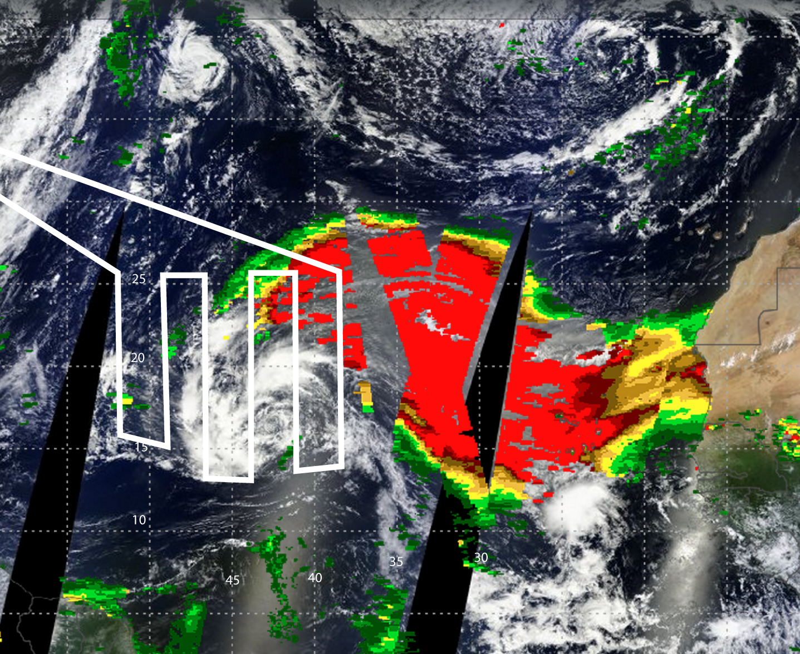
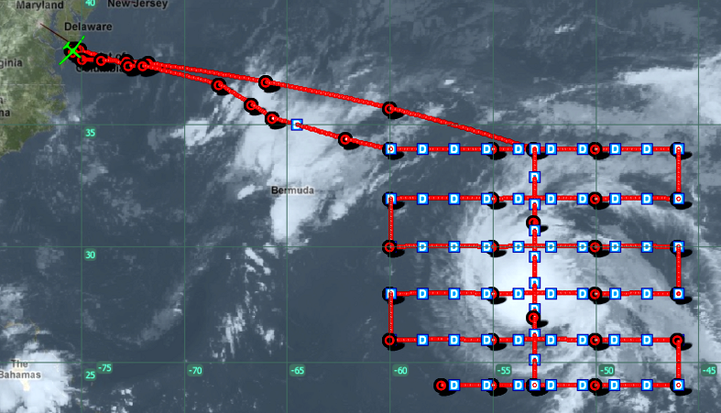
AV-6 Flight Modules
Large-Scale Lawnmower
11-12 Sept 2012
14-15 Sept 2012
Storm movement: East to west
Pattern direction: West to east
Storm movement: South to north
Pattern direction: North to south
Notes:
AV-6 would use just the lawnmower pattern due to FAA constraints (2 day notice, limited flexibility to change).

Slide 13
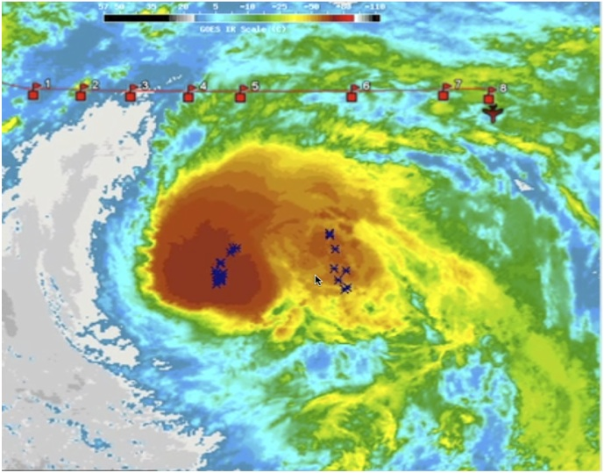
AV-6 Flight Module+ Hazard Avoidance
Planned Lawnmower Pattern
During flight, deep (>50 kft) convection with lightning was along future flight path

Slide 14
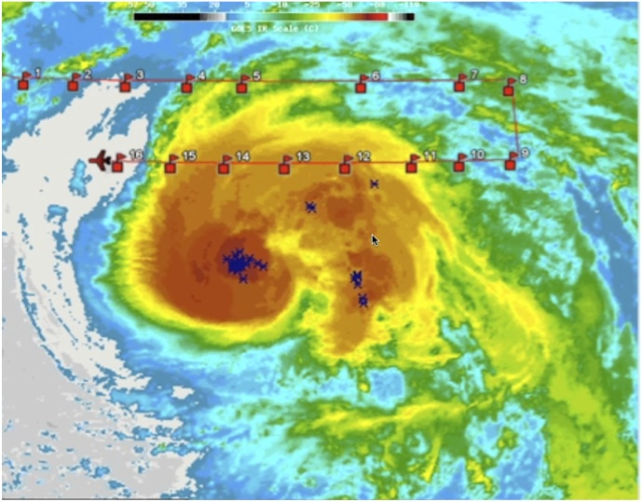
AV-6 Flight Module+ Hazard Avoidance
Planned Lawnmower Pattern
To continue drops, but avoid deep storms, new flight plan had to be submitted here…
Lightning and deep convection continued as we approached…

Slide 15
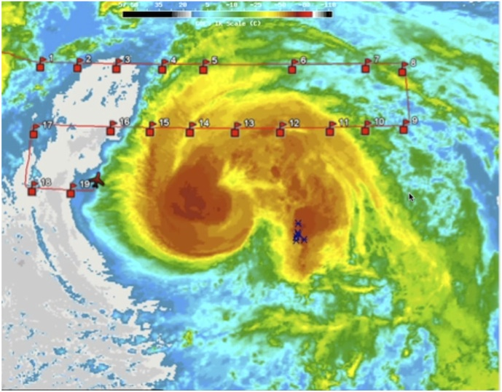
AV-6 Flight Module+ Hazard Avoidance
Planned Lawnmower Pattern
…convection/lightning starting decreasing as diversion occurred

Slide 16
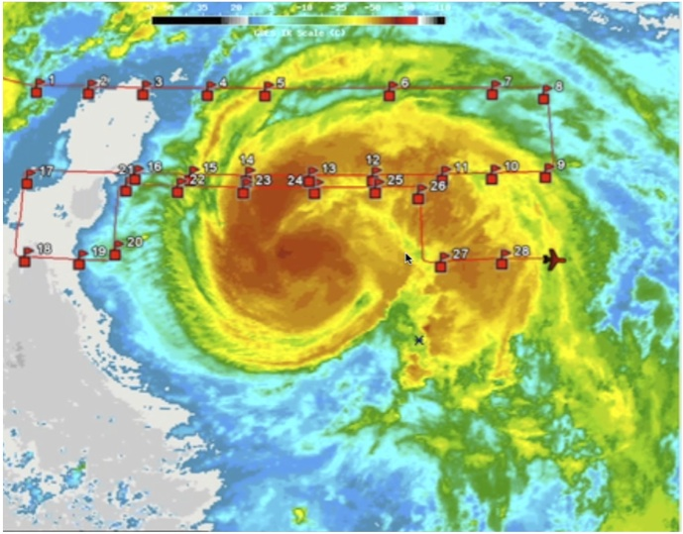
AV-6 Flight Module+ Hazard Avoidance
Planned Lawnmower Pattern
To continue drops, but avoid deep storms, flight plan had to be submitted when we were here…
…leading to a larger area of potentially flyable weather missed
Options:
• Continue with drops during diversion—file revised flight plan well in advance
• Discontinue drops and get past deep convection with as little diversion as possible

Slide 17
AV-1 Flight Modules
a) Figure-4
b) Butterfly
c) Rotating Figure-4
d) Race Track Across
e) Race track-Around
f) Convective Lawnmower

Slide 18
a) Figure-4 Flight Module
Required Parameters:
Track length
Pattern rotation or track heading
Storm center location
Note that headings do not need to be orthogonal
B.
A.
C.

Slide 19
b) Butterfly Flight Module Example
Example Parameters:
200 km (108 nmi)
Headings of 180°, 300°, 60°
Forecaster-provided storm center location
300°
60°
180°

Slide 20
b) Butterfly Module diversions the case of developing convective burst that would exceed 50kft:
1. Divert around the burst (adds a short period)
2. Rotate to avoid the burst (e.g., 20˚ clockwise, shortens
320°
300°
60°
80°
200°
180°
Reorient butterfly

Slide 21
Convective Burst Flight Module d) Race Track-Across
B.
Required Parameters:
Track length
Pattern rotation or track heading
Path center locations
C.
A.

Slide 22
Convective Burst Flight Module d) Race Track-Across
Required Parameters:
80 km (43 nmi)
300° and 120°
Lats/Lons of segment midpoints
Separation of segments by ~30 km would minimize gaps in HIWRAP coverage
B.
C.
A.

Slide 23
Convective Burst Flight Module e) Race Track-Around
For times when conditions do not allow for overflight
A.
C.
Required Parameters:
Track length
Pattern rotation or track heading
Path center locations
B.

Slide 24
Convective Burst Flight Module f) Convective Lawnmower
Required Parameters:
80 km (43 nmi)
headings, 120°, 300°, 120°
Lats/Lons of segment midpoints
Separation of segments by ~30 km would minimize gaps in HIWRAP coverage
B.
C.
A.

Slide 25
Convective Burst Flight Module g) Convective Fan
Required Parameters:
80 km (43 nmi)
headings, 135°, 120°, 300°
Lats/Lons of segment midpoints
Separation of segments by ~30 km would minimize gaps in HIWRAP coverage
B.
C.
A.

Slide 26
When To Use CB Modules
In mature storms, should seldom be used
Best used in weak storms, highly sheared storms (exposed center), and genesis events
IR cold cloud top
Lower portion
of updraft
Upper portion
of updraft

Slide 27
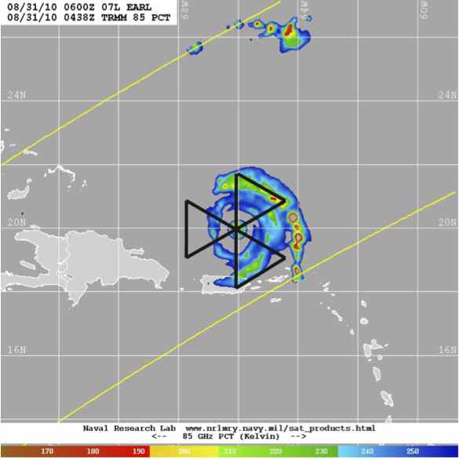
AV-1 Flight Strategies
For mature, more symmetric storms, a
repeating pattern such as the butterfly pattern works well.
Leg lengths can be varied depending on the desired number of eye crossings vs getting outer band structure
Headings can be adjusted to align tangential line segments with convective features

Slide 28
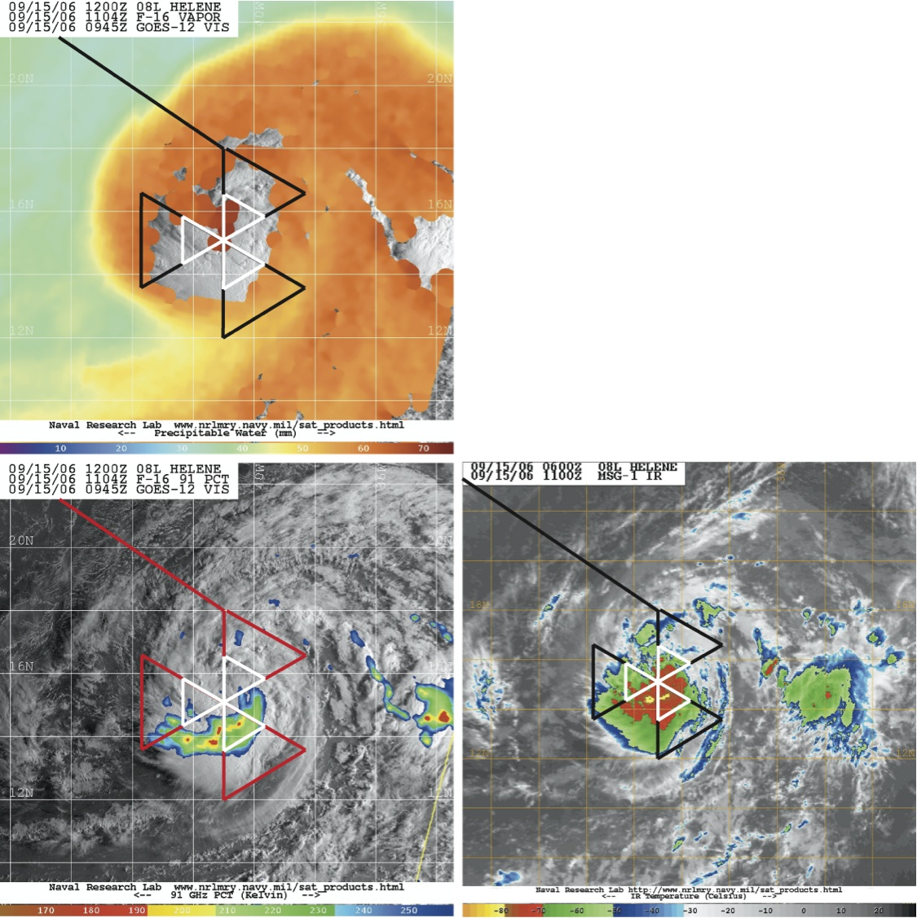
AV-1 Flight Strategies
For dry air intrusion events or when center is not well define, a broad survey pattern can be done first followed by a smaller repeating pattern

Slide 29
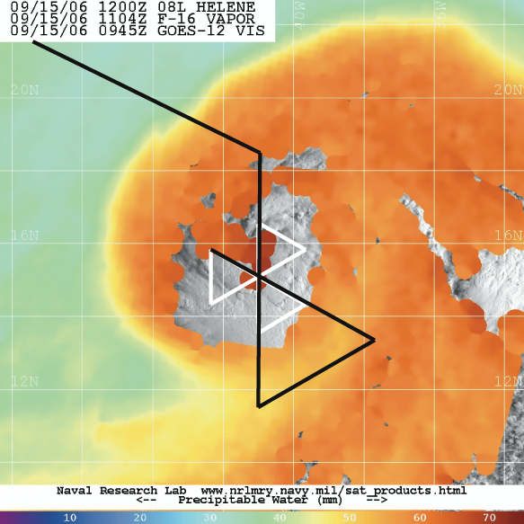
AV-1 Flight Strategies
Broad butterfly survey ~ 4-5 hours.
Can perform shortened survey

Slide 30
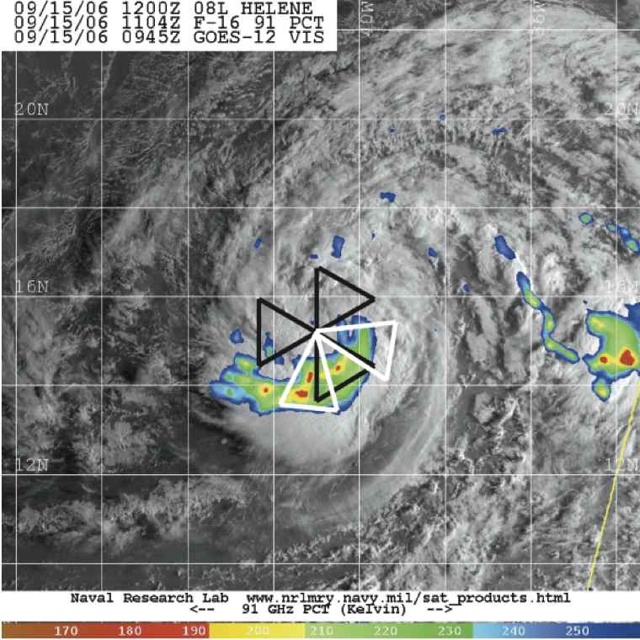
AV-1 Flight Strategies
For many storms, butterfly pattern will be the default.
If alternative pattern is performed, return to default right after.

Slide 31
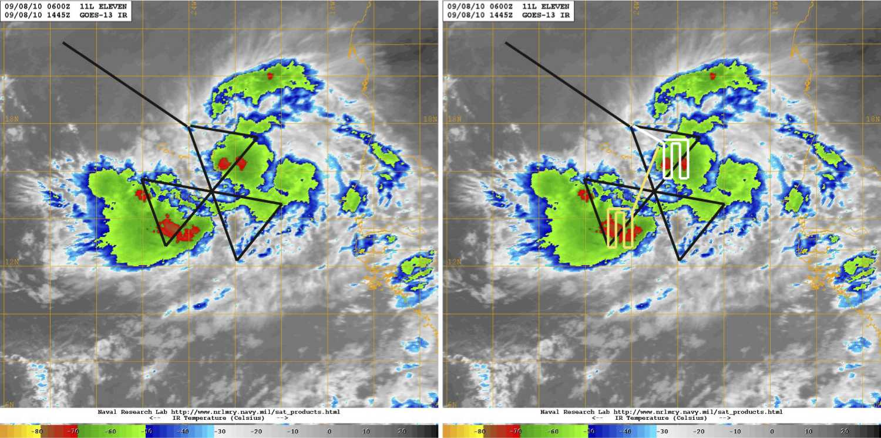
AV-1 Flight Strategies
For weakly organized, asymmetric storms, an initial survey should be done followed by other modules

Slide 32
Mission Selection
Relevance
  Will it address core mission goals
  Will it involve a single flight or multiple flights
  Additional targets expected soon?
Storm location and time-on-station (generally should be west of 40°W)
Partner (NOAA, USAF) flights
Flight difficulties
  Too many islands, e.g., Bahamas
  Too many FIR boundaries
  Too close to coast (perhaps more an issue for the environmental GH)

Slide 33
PayMOF Operations: General Rules
The Payload Mobile Operations Facility (PayMOF) is the science operations area for the GH. Staffing includes the Mission Scientists (MS), the Payload Manager (PM), the IT specialist, and instruments Investigators (IIs).
PayMOF needs to be staffed prior to GH engine start. Late arrivals cause late take-offs
The PayMOF should be staffed by IIs during the entire flight. Relief periods and furloughs are allowable per agreement and approval of the PM.
Each station has an intercom & Windows PC. Phones and a printer are available. Internet connectivity available, but bandwidth limits and rules on appropriate use apply.
Laptops are allowed (but discouraged) in the PayMOF – must be scanned by NASA IT personnel. Wireless internet is not allowed in the PayMOF.
Cell phones and cameras are allowed, but in the event of an aircraft incident, all recording devices (laptops, tablets, cell phones, cameras, flash drives etc.) will be impounded.
PayMOF Quiet should be maintained for creating an operations friendly work environment. Head-set mics should generally be “off” except for monitoring the GH and communicating with other team members.
Guests in the PayMOF require the approval of the PM.
Food and beverages are allowable, but liquids must be in closed containers. A small refrigerator and a Keurig coffee maker are available.
There is no PayMOF janitorial service. Police your area and pack out trash.

Slide 34
PayMOF operations: routine
The MSs & forecasters should provide a regular update (~ every hour) of weather conditions along the projected flight path to the PM, MM, and Ps. This would include cloud tops, lighting, storm location, etc.
The MSs are in charge of maintaining the flight report.
The PM is the point of contact between the MM and the IIs. The PM should keep the team apprised of AC issues (via headset and chat).
The MSs and PM are also in charge of updating the team (via headset and chat). Regular updates on the mission progress is necessary for the mission management, mission planner, and later shifts. For example, the forecasters and flight planners follow the flight via MTS, chat, and the headsets.
The IIs should keep the MSs and PM apprised of instrument performance. Further, the IIs should monitor their real-time products on the mission tools for accuracy and timeliness.
The IIs are also responsible for notifying the MSs of interesting features that are observed in their data.

Slide 35
PayMOF operations: flight changes
Altering the GH flight plan in mid-flight requires coordination amongst the Mission Scientists (MS), science team (ST), Payload Manager (PM), Mission Manager (MM), and Pilots (P)
There are two scenarios for the MSs to keep in mind. 1) A correction that requires immediate action (i.e., a fast developing system that will pop over FL500), and 2) movement of the eye or other slow change that would lead to a new module or adjustment of the pre-planned module.
Scenario 1:
  MS notifies MM, PM, and P of the lat/lon location and other details of the burst. Indicate the module diversion that you prefer.
  Notify the mission forecasters and flight planners

Slide 36
PayMOF operations: flight changes
Scenario 2:
  MSs should first map out the course correction in coordination with the flight planners and forecasters. Things to keep in mind:
    Drop patterns and other “location” maneuvers and operations planned for after the course correction will need to be eliminated or altered.
    Landing times will change – mind the fuel.
    Be aware of regions that you “re-direct” towards. A convective burst seen 60-min prior to arrival may collapse, and a region you re-direct towards may develop.
  If you’ve decided on a course correction, notify the MM, PM, and P that you are planning a course correction. Indicate when you’ll have a plan put together and how you’ll communicate the plan to them.
  Pass the course correction to the P. This is best done digitally to avoid transcription errors. Lat/lon should be in degrees and minutes (not decimal degrees). Distances should be in nautical miles. Pilots will be well briefed on the modules, so it is best to stick to those modules and not try to “free-fly” the GH.
  Discuss the correction with the pilots to make sure that the correct pathway is being implemented.
  Notify the Science Team of the course adjustment (via headsets and chat).

Slide 37
PayMOF operations: flight changes
Scenario 3: Pilot adjusted course. The Ps or MM may decide on a course correction for aircraft purposes, independent of the science requirements.
  The Ps and MM should notify the PM and MSs of the course correction. The MSs or PM should pass this along to the science team (via headsets and chat).
  The MSs should adjust the flight plan to account for this change, and they should quickly inspect the new path for weather.
Scenario 4: Instrument failures. Does the instrument failure mean the science objectives cannot be met?
  Can the remaining instruments still provide valuable data?
  Can the GH return to base sooner (e.g., would it mean a prohibited nighttime landing?)

