Slide 1
Roles of Convective Structure, Organization, and Intensity in Tropical Cyclone Intensification
Dan Cecil
NASA MSFC
Kenneth Leppert II
University of Alabama - Huntsville

Slide 2
HSRP Proposal Objective
Examine intensification processes as related to interplay between:
Convective Structure (HIWRAP, HAMSR)
3-D wind field (HIWRAP)
Surface Wind (HIRAD)
Warm Core Development (HAMSR)
HS3 2012 flights were “less than optimal” for addressing this (AV-1 North Pacific flight)

Slide 3
Working Hypotheses
Spatial structure, location, persistence of deep convection are key aspects of hurricane intensification
Strength of individual convective bursts relatively less important
Relative importance of these characteristics differs in TD, weak TS stages compared to Hurricane stage

Slide 4
Working Hypotheses
Spatial structure, location, persistence of deep convection are key aspects of hurricane intensification
Strength of individual convective bursts relatively less important
Lots of TRMM and related evidence supporting these ideas:
Cecil and Zipser 1999 SSMI study finds strong relationship between area-average 85 GHz TB (or areal coverage of moderate scattering) and future hurricane intensity, weaker relationships with minimum TB (strength of convection)
Jones et al. 2006 statistical forecast has greater signal from area-average 19 GHz TB than from min 85 GHz or max 19 GHz
Jiang and Kieper RI tool keys on azimuthal completeness of a ring with weak convection, not needing strong convection

Slide 5
TC Genesis from Easterly Waves
Ken Leppert dissertation, 2013 MWR papers
Easterly waves separated into trough, ridge, northerly, and southerly phases
June – November 2001–2010
DWs separated from NDWs (dvlpg / non-dvlpg waves)
Day Zero identified for both DWs (day of genesis) and NDWs (day of peak 850 hPa vorticity)
Notes:
Wave phase separation based primarily on 700-hPa meridional winds extracted from NCEP-NCAR reanalysis dataset (700-hPa vorticity used to help identify wave phases unable to be identified with meridional wind alone); DW/NDW separation based on NHC storm reports; DWs also separated according to where each wave developed a TC; For DWs, D0 when tropical depression first identified by the NHC; For NDWs, D0 day on which maximum 850-hPa vorticity occurs (must be able to be tracked for at least 7 days and achieve a vorticity value of 8E-06 s⁻¹; Waves traced from D-5 to D+1

Slide 6
Methodology
Convective Coverage
Fractional coverage by IR brightness temperatures
≤ 240 K and ≤ 210 K over 2.5° boxes
Percentage convective coverage (from TRMM PR)
Convective Intensity
Lightning Imaging Sensor flash rates
Mean convective Precipitation Radar reflectivity profiles
Polarization corrected temperatures at 37.0 and 85.5 GHz
Created composites as a function of wave phase/type over each longitude band (Eulerian) and as a function of day relative to D0 (Lagrangian)
Notes:
IR brightness temperatures from the NASA global-merged IR brightness temperature dataset; TRMM PR includes a convective/stratiform classification which was used to calculate the percentage of PR pixels classified as convective over each synoptic-scale box; LIS flash rates in units of flashes/day/2.5° box; Convective reflectivity profiles with rain bottom below 2 km not classified as warm rain from 1-18 km with 1-km height resolution; PCTs from TMI

Slide 7
Lagrangian 240 K IR Threshold
Developing Waves
Non-developing Waves
Cold Cloud coverage increases with time for both Dvlpg and Non-Dvlpg Waves
Dvlpg Waves have greater areal coverage than Non-Dvlpg Waves
Greater coverage appears to be more important for genesis than the evolution of that coverage
Similar result using 210 K threshold
Notes:
Land mask was used for all Lagrangian composites; Evolution of cold cloud tops is not that different between two wave types

Slide 8
37 GHz Scattering in Deep Convection
Dvlpg Wave Trough
Non-Dvlpg Wave Trough
Increasing Intensity
Convective intensity decreases with time for Dvlpg Waves, ~steady with time for Non-Dvlpg Waves.
These plots are conditioned on having low brightness temperature indicative of deep convection, so the means among those pixels relate to how strong that convection is.

Slide 9
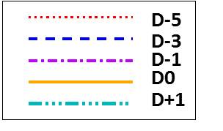
PR Convective Reflectivity
Dvlpg Wave Trough
Non-Dvlpg Wave Trough
Convective reflectivity remains ~steady for Dvlpg Waves, increases with time for Non-Dvlpg Waves

Slide 10
Lagrangian Lightning Flash Rates
Developing Waves
Non-developing Waves
Trends in flash rates for Dvlpg Waves suggest a decrease in intense convection with time
Flash rates for NDWs vary from day to day, but values on D0 are greater than those on D-5
Large variability (not shown), not much coherence in signal
Notes:
DWs show a decrease in trough and northerly phases every day after D-4, except on D0 in the trough; The D+1 value in the DW southerly phase is less than that on D-5, but this phase does show an increase on D0; The flash rates for NDWs may suggest a constant intensity with time due to the increasing coverage by cold cloudiness; Note that trends are small compared to standard deviation of 1133.3 flashes/day

Slide 11
Conclusions
Cold Cloud fractional coverage or fractional convective coverage (from PR, not shown here) distinguish between Developing and Non-Developing Easterly Waves better than measures of the strength of the convection.
Fractional coverage increases with time for both Dvlpg and Non-Dvlpg Waves, but coverage is greater for Dvlpg waves.
Intensity of convection appears to weaken as the day of genesis is approached, but coverage of convection increases. Consistent with Zawislak and Zipser, others…

Slide 12
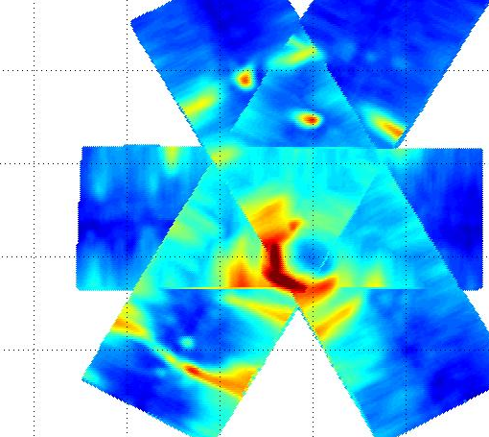
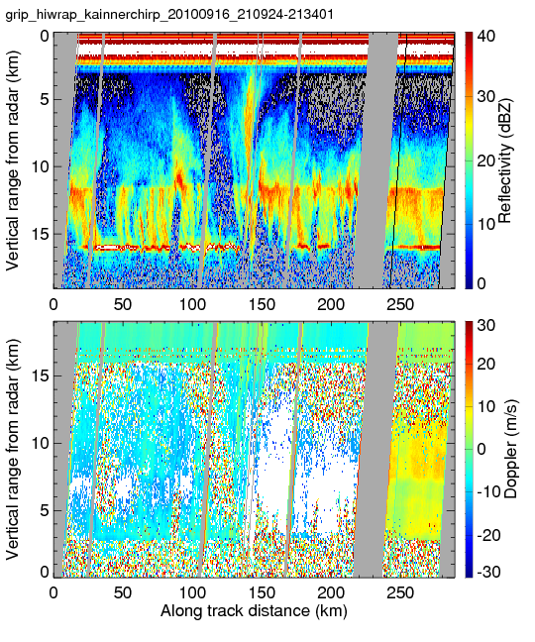
Future Work
HS3 2013 Case Studies using AV-1!
Focus uses HIRAD, HIWRAP, HAMSR combination, along with relevant satellite data
Fall-back: Analysis from GRIP

