Slide 1


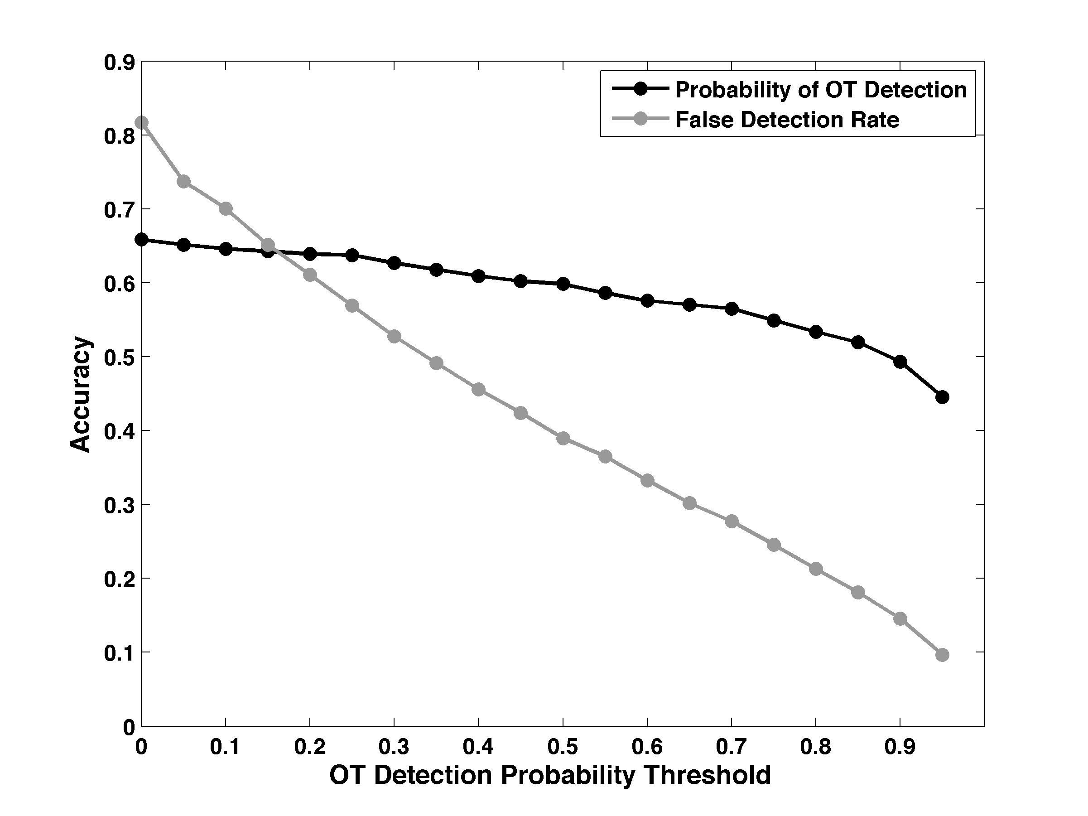
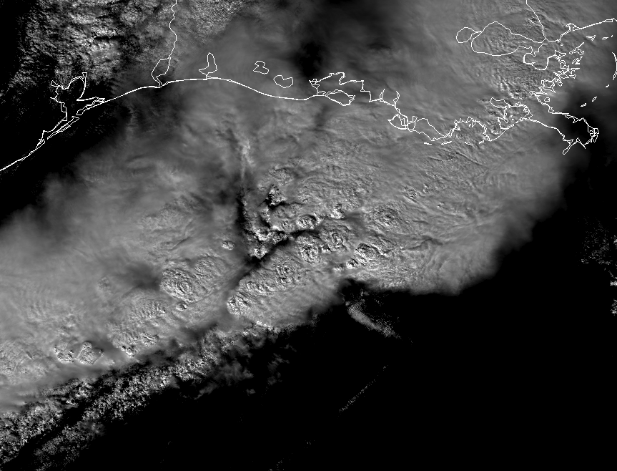
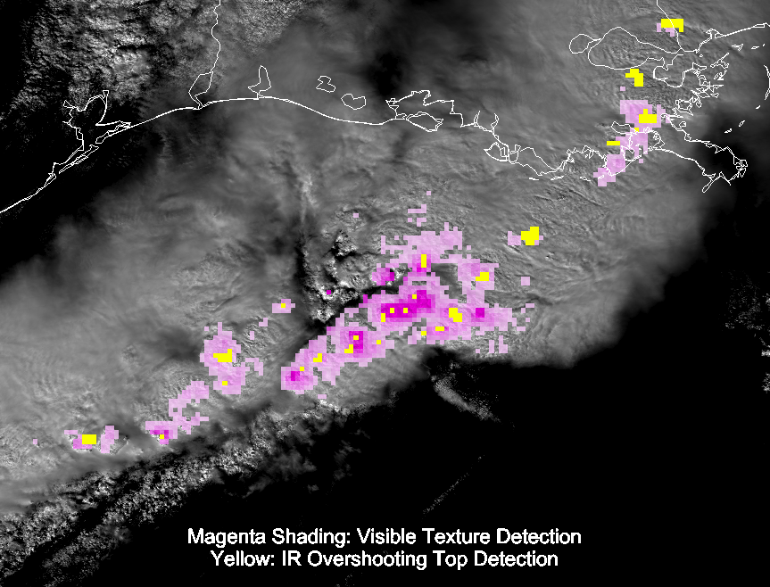
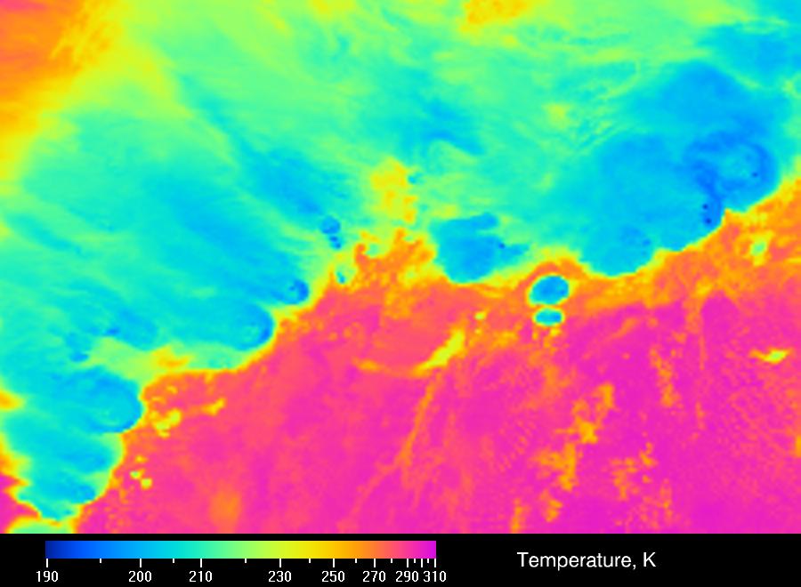
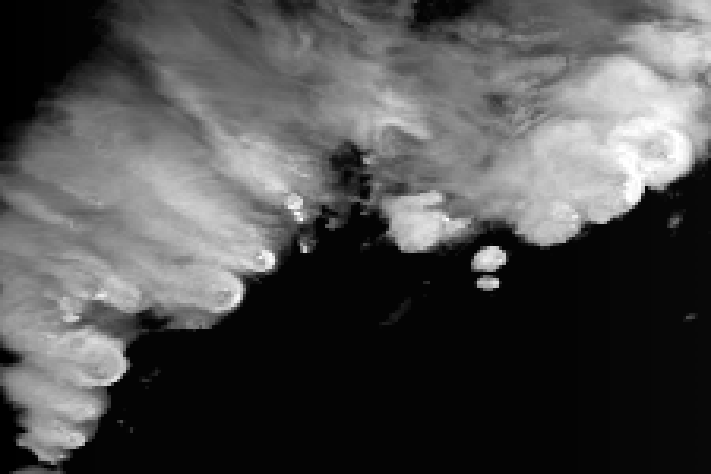
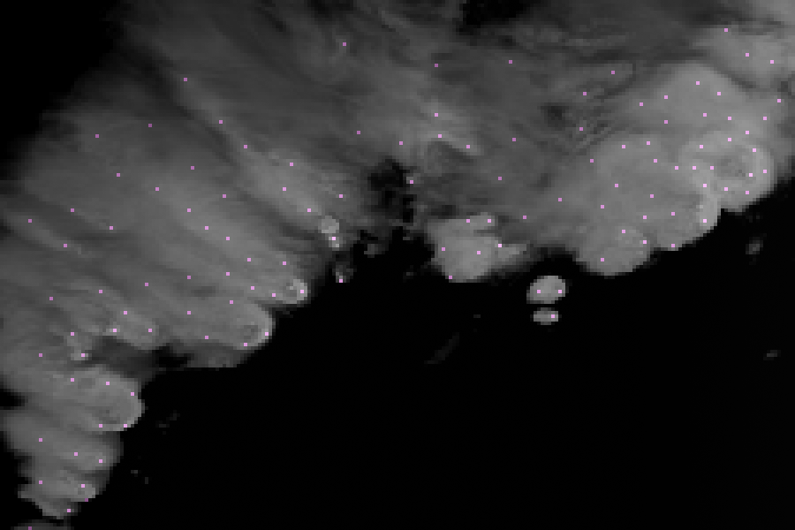
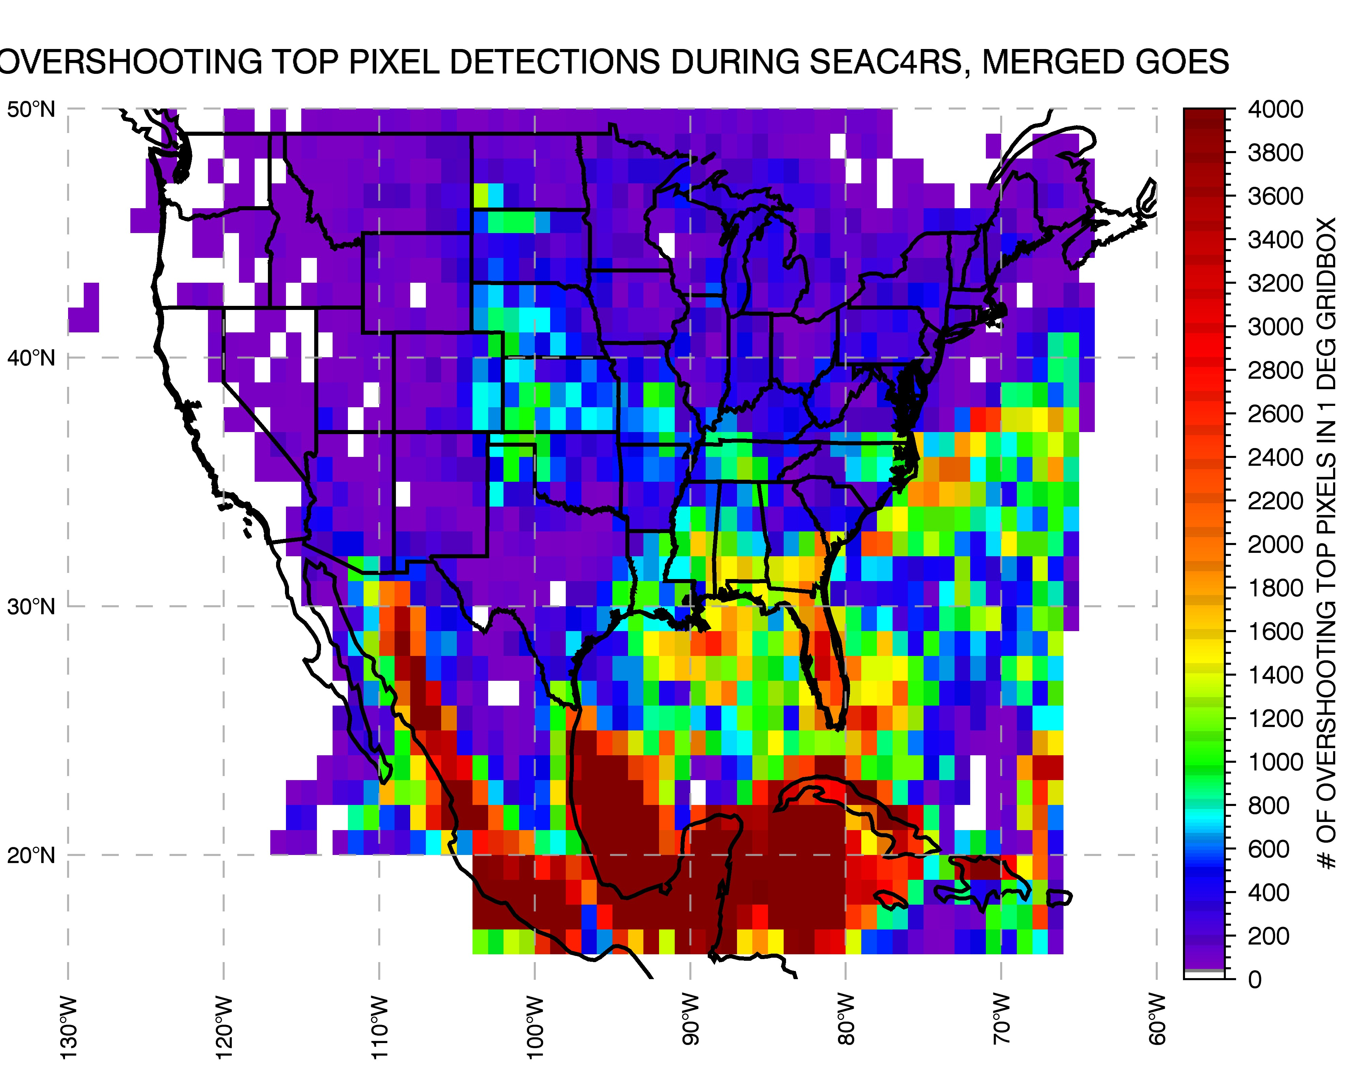
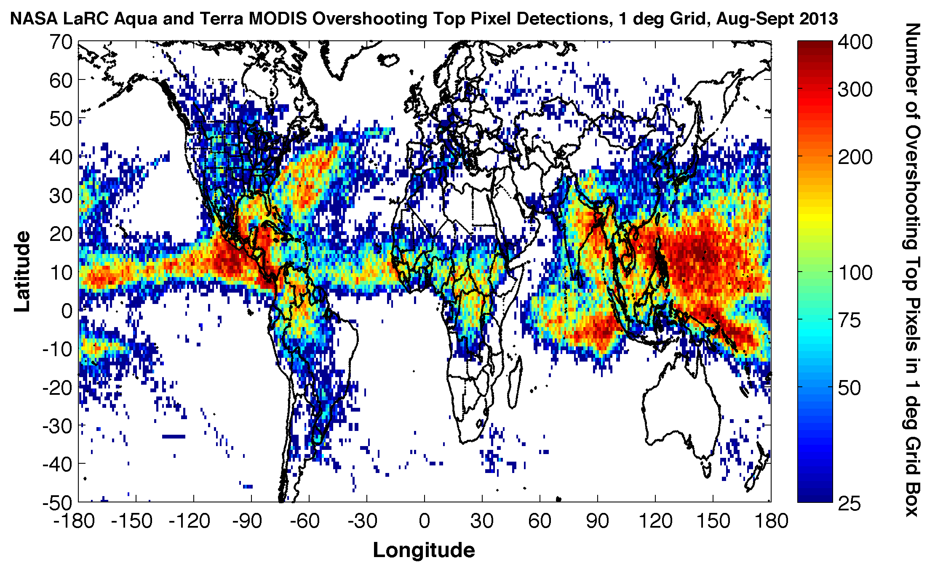
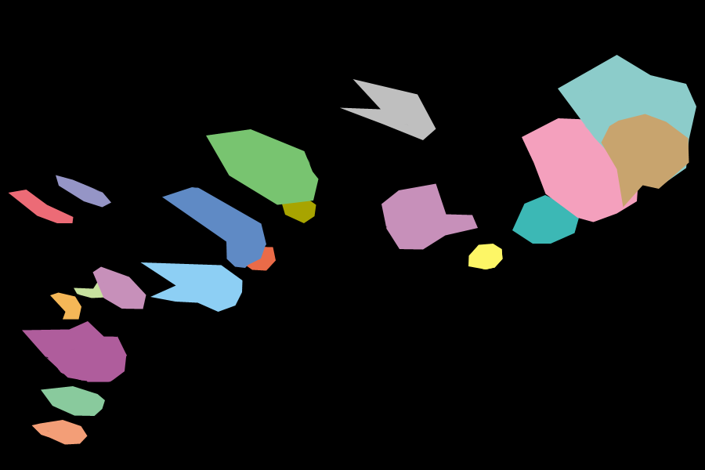
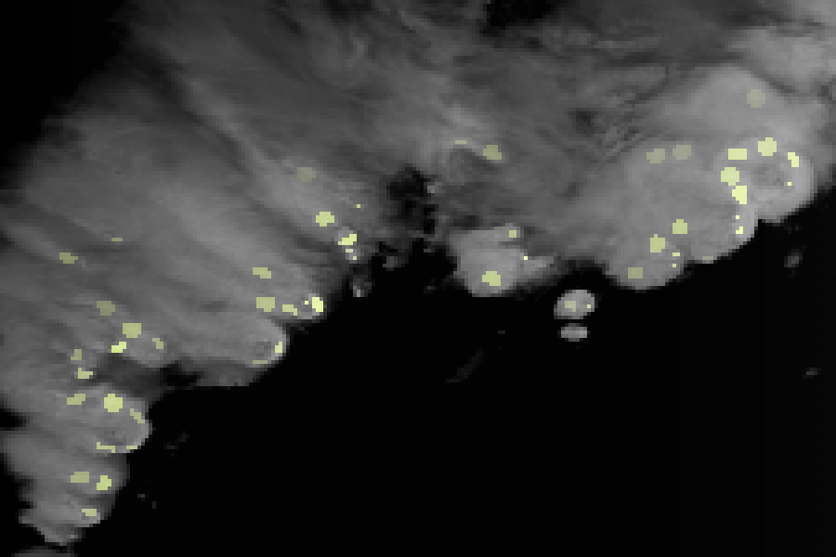
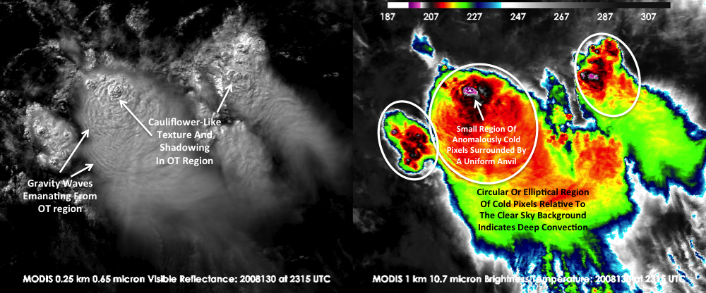
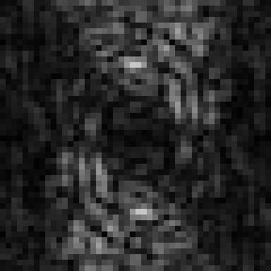
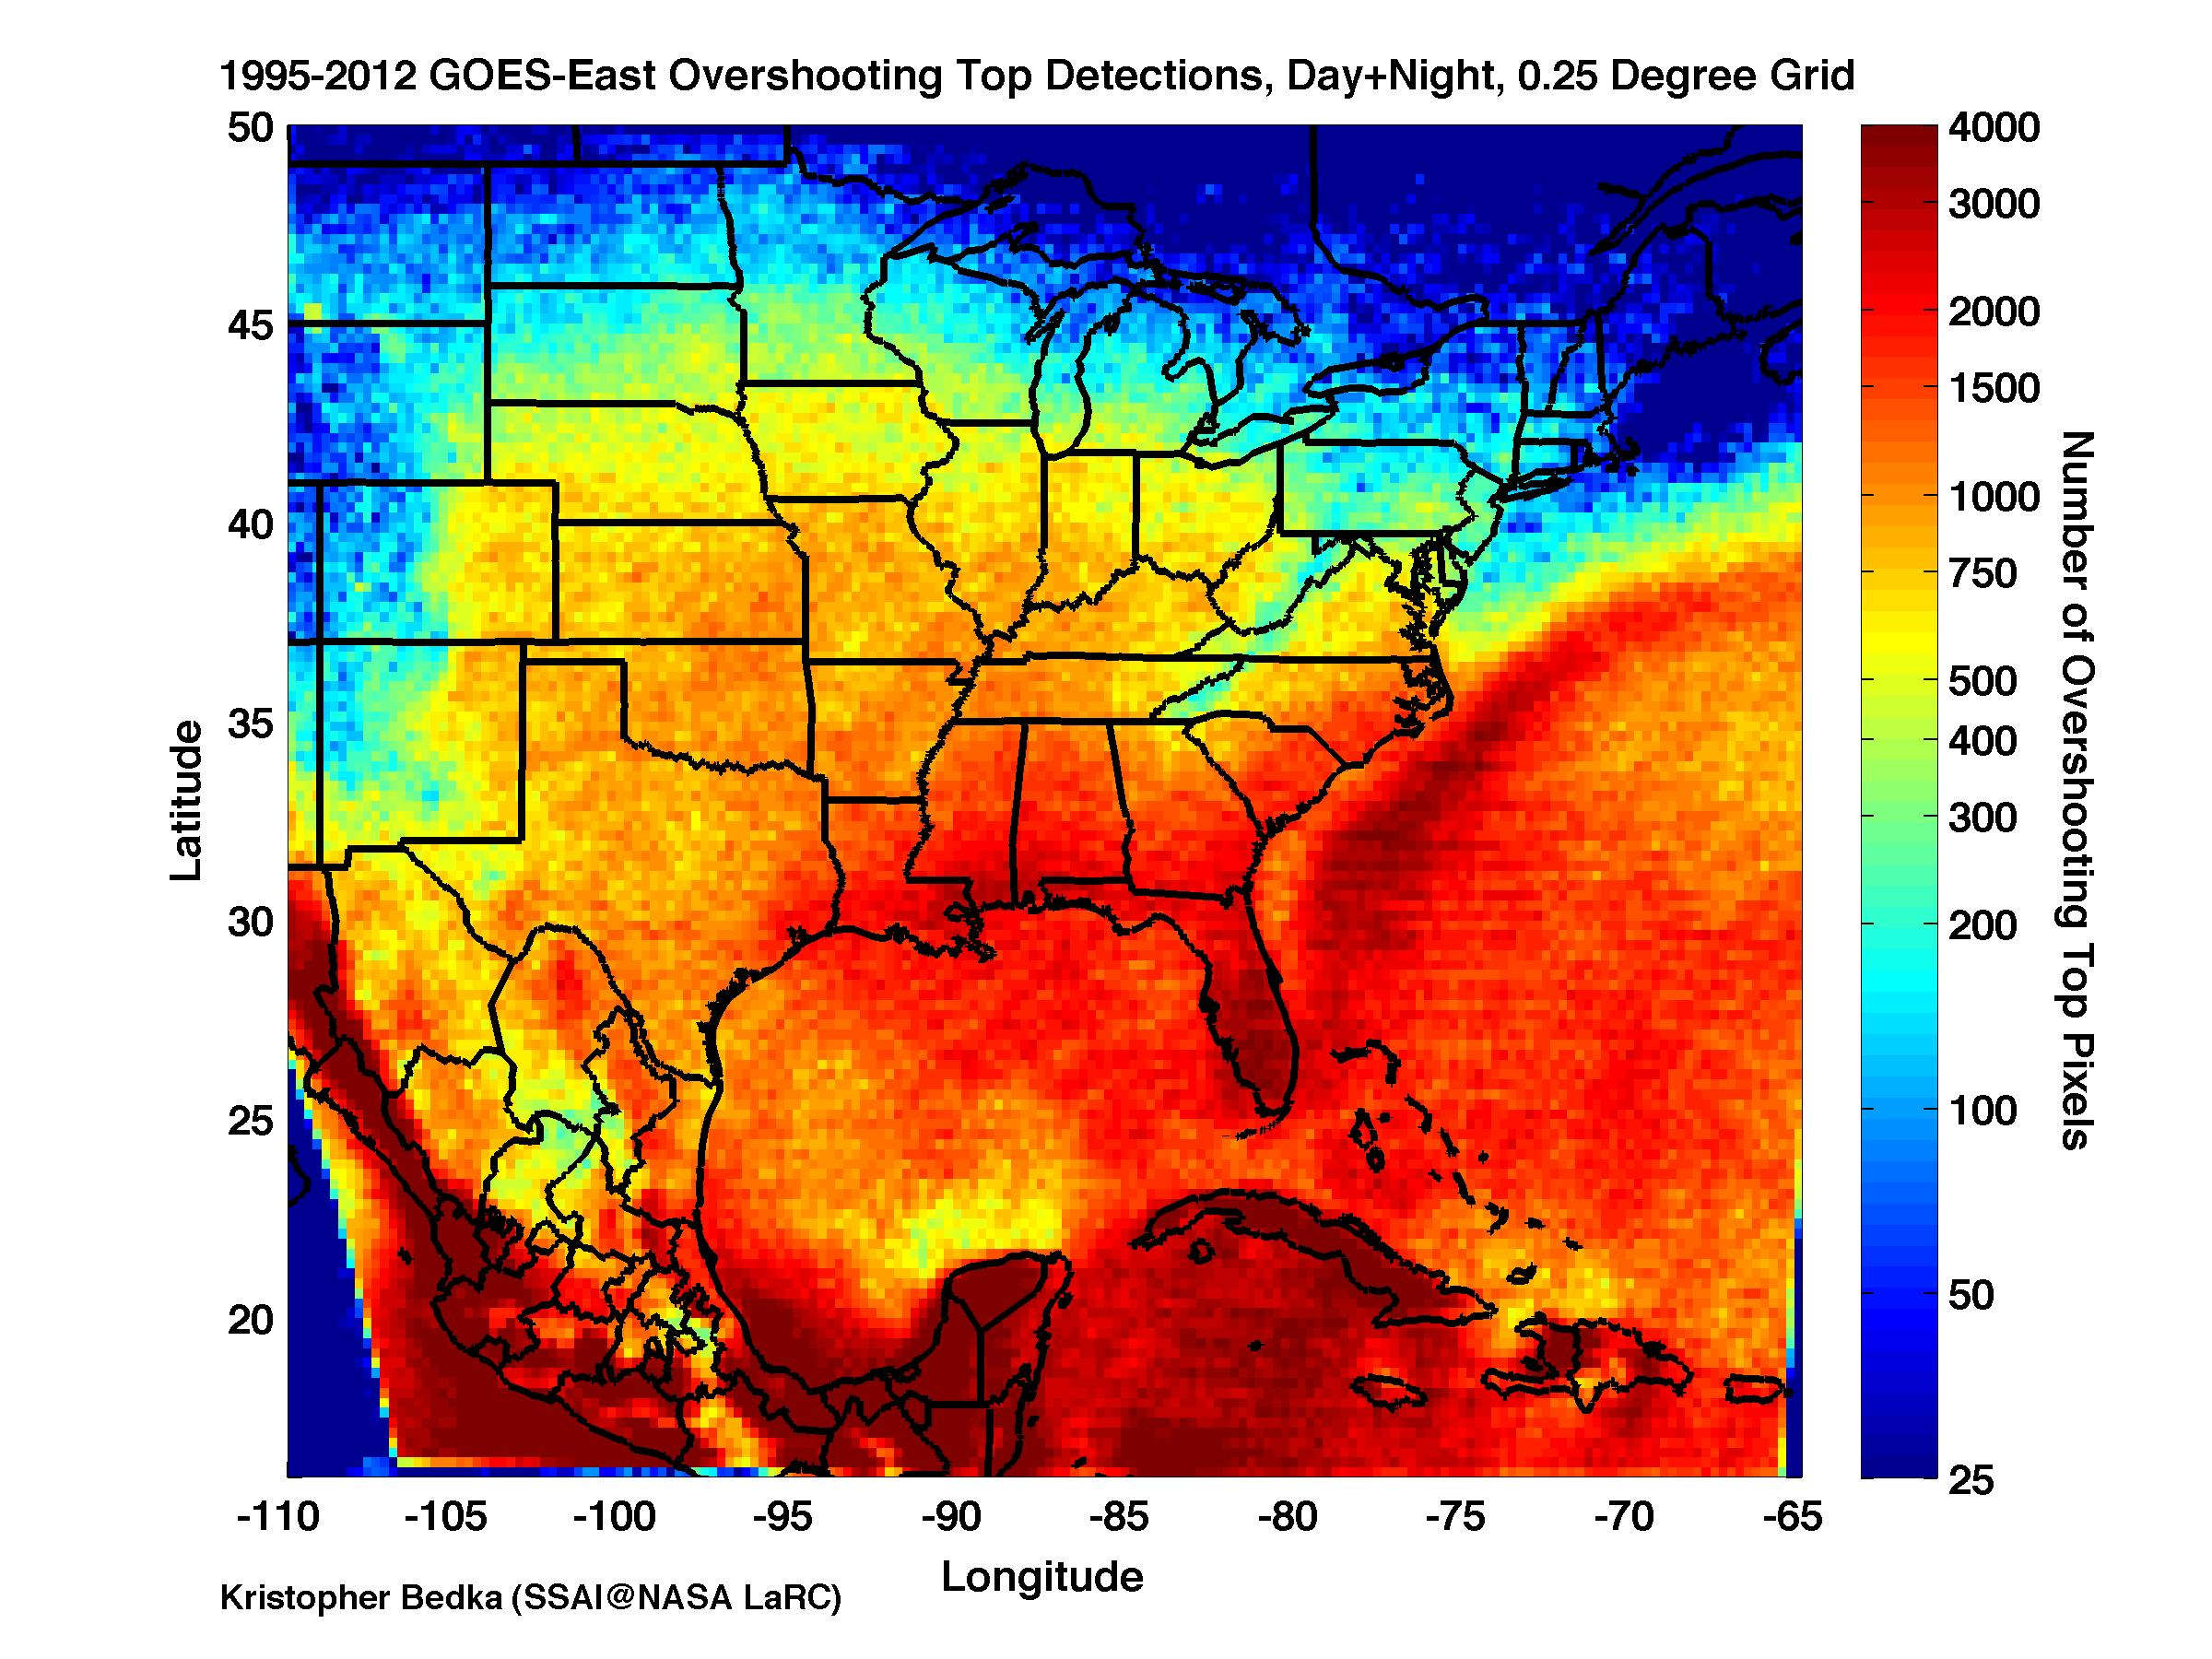
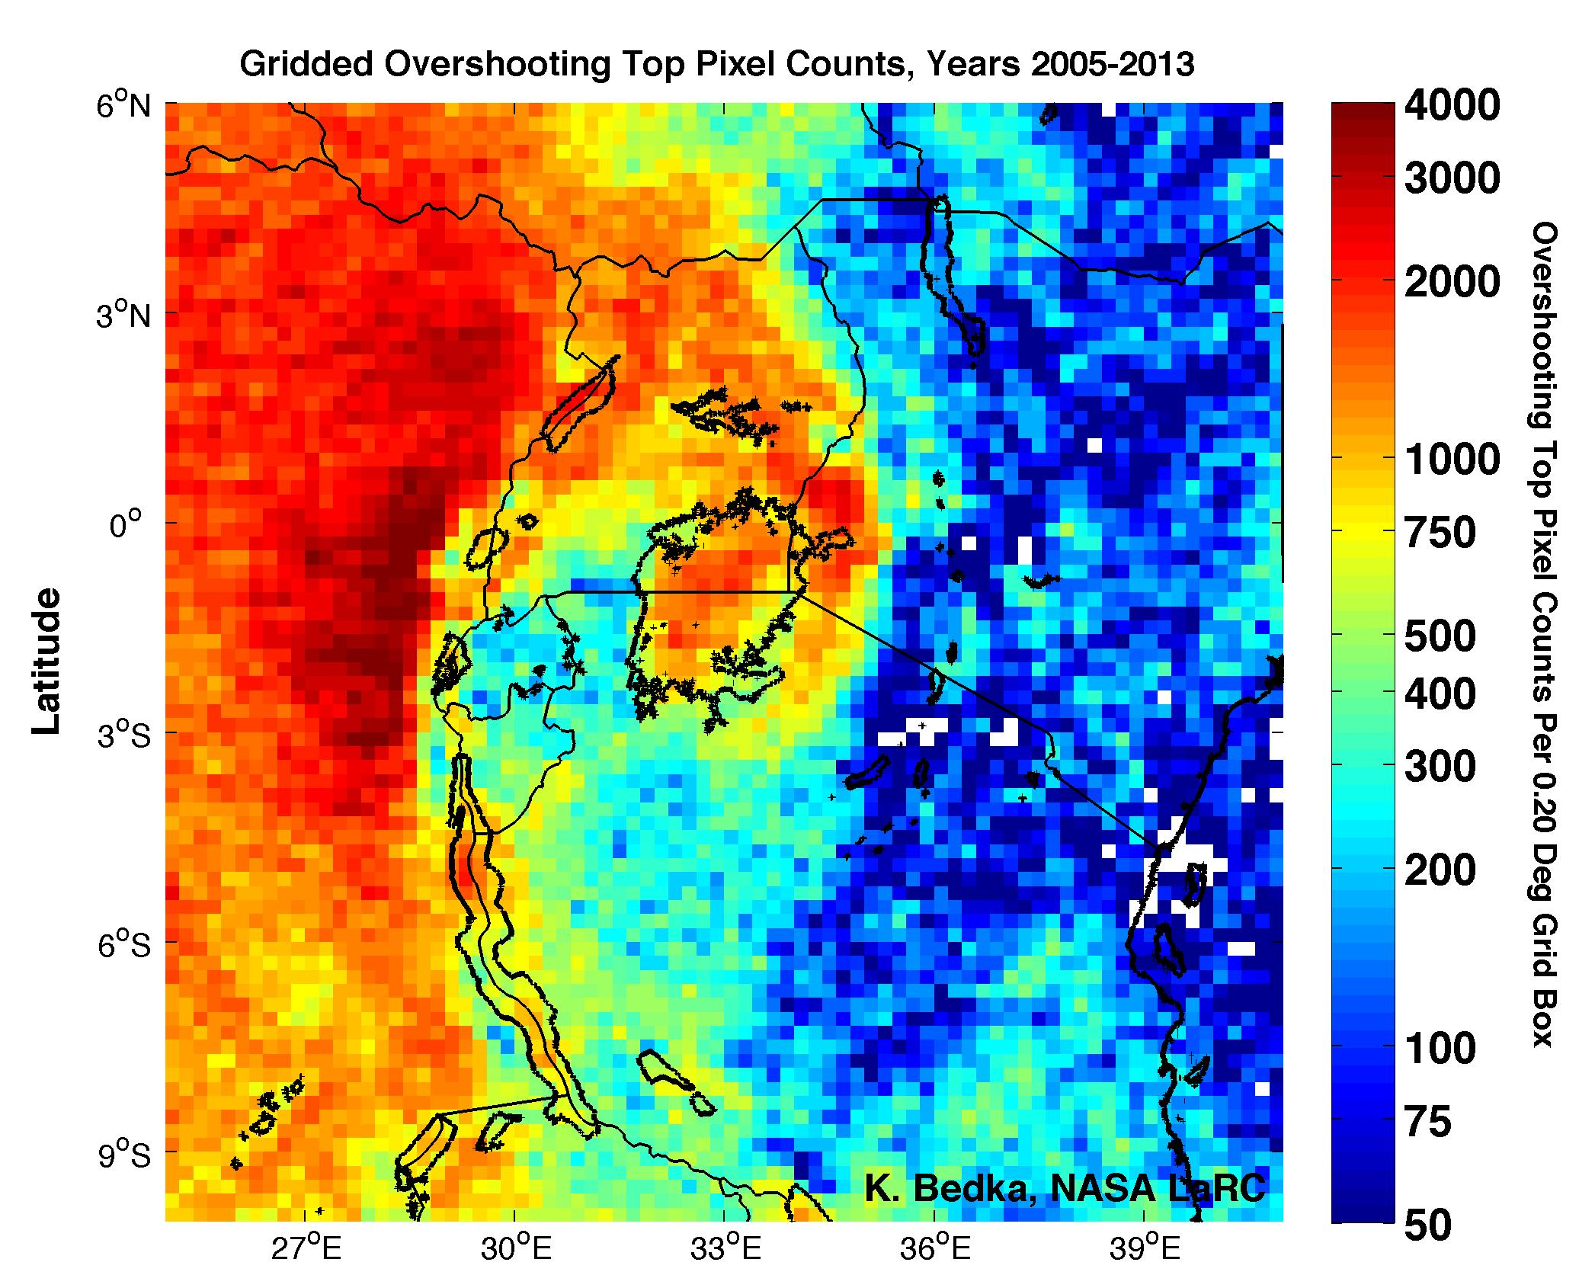
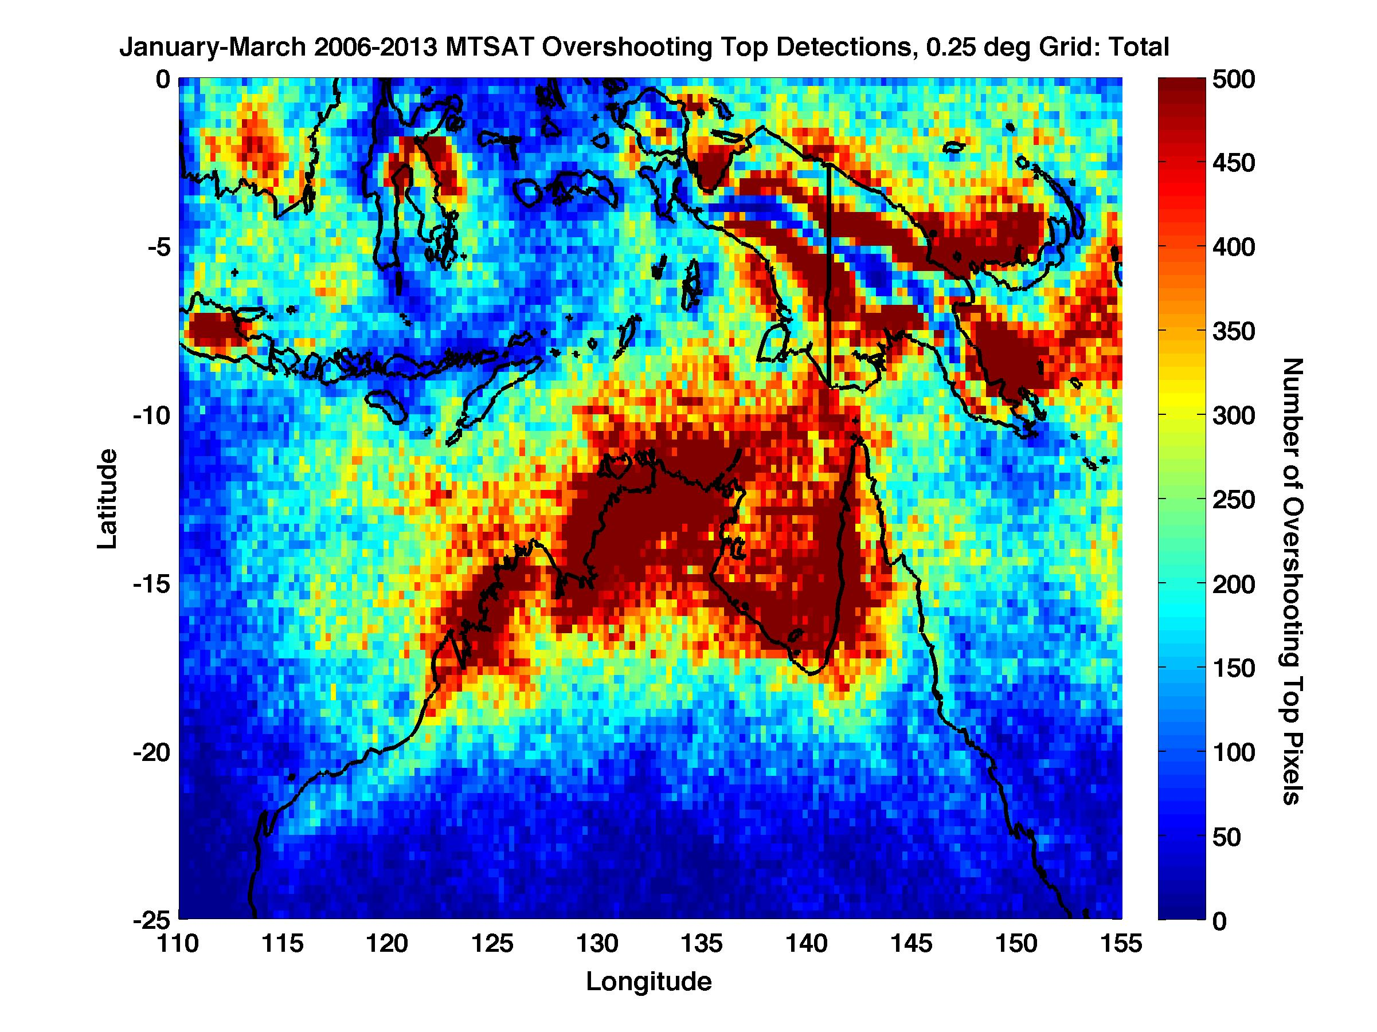
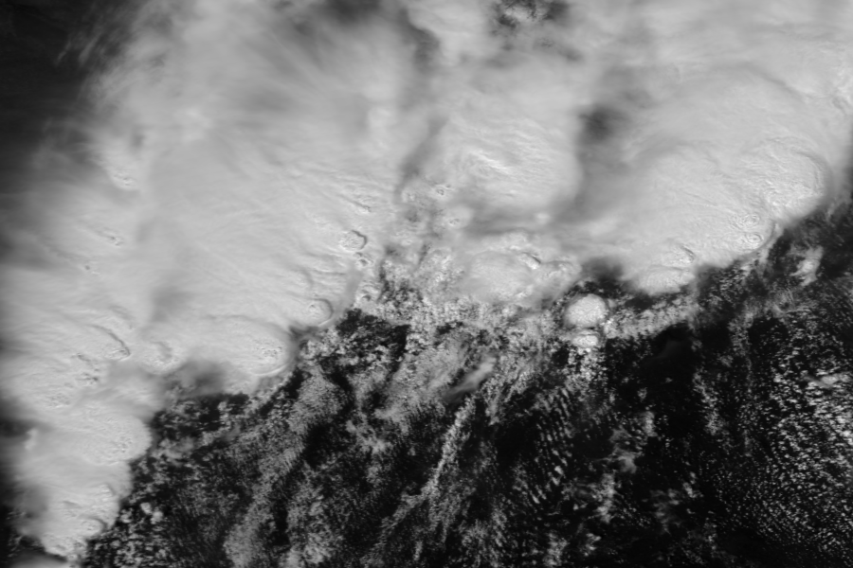
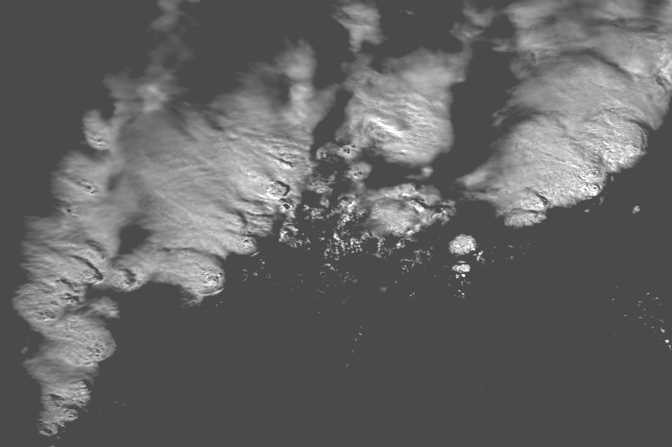
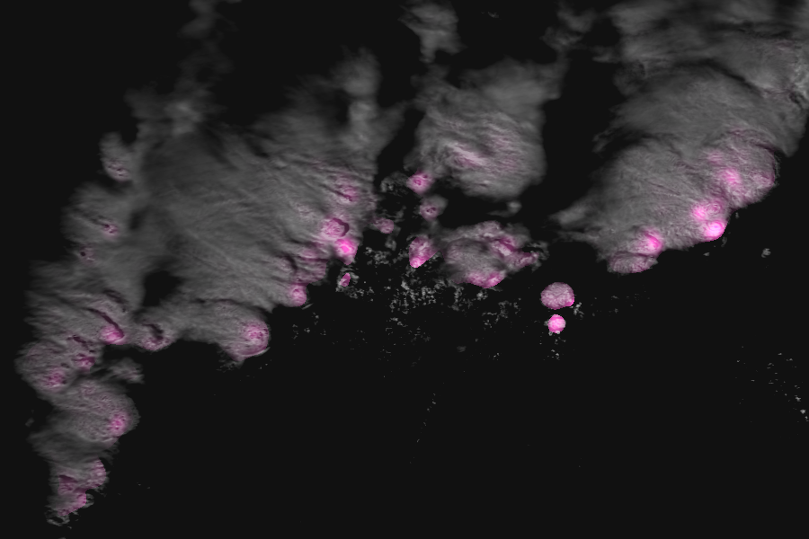
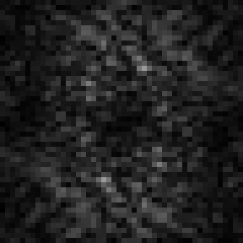
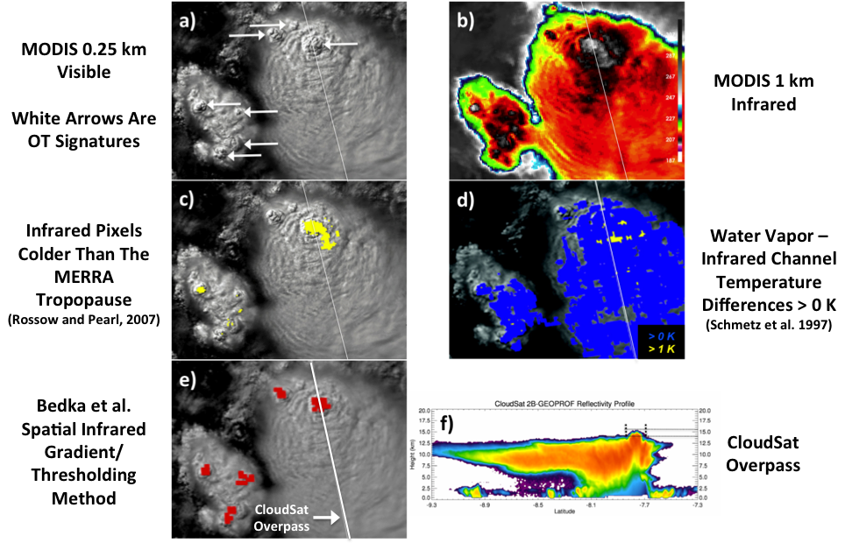
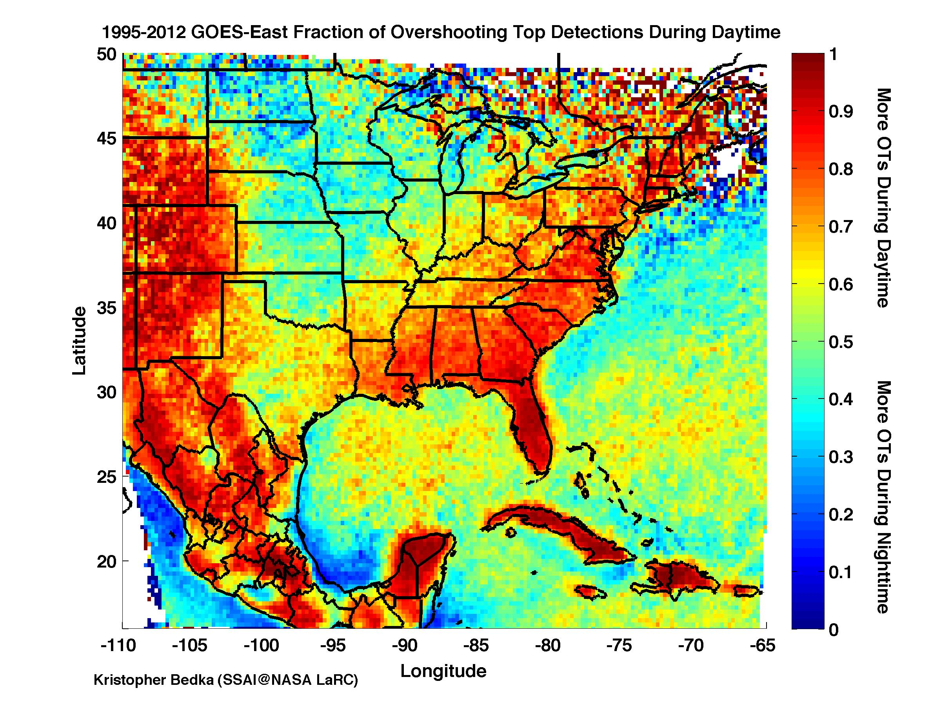
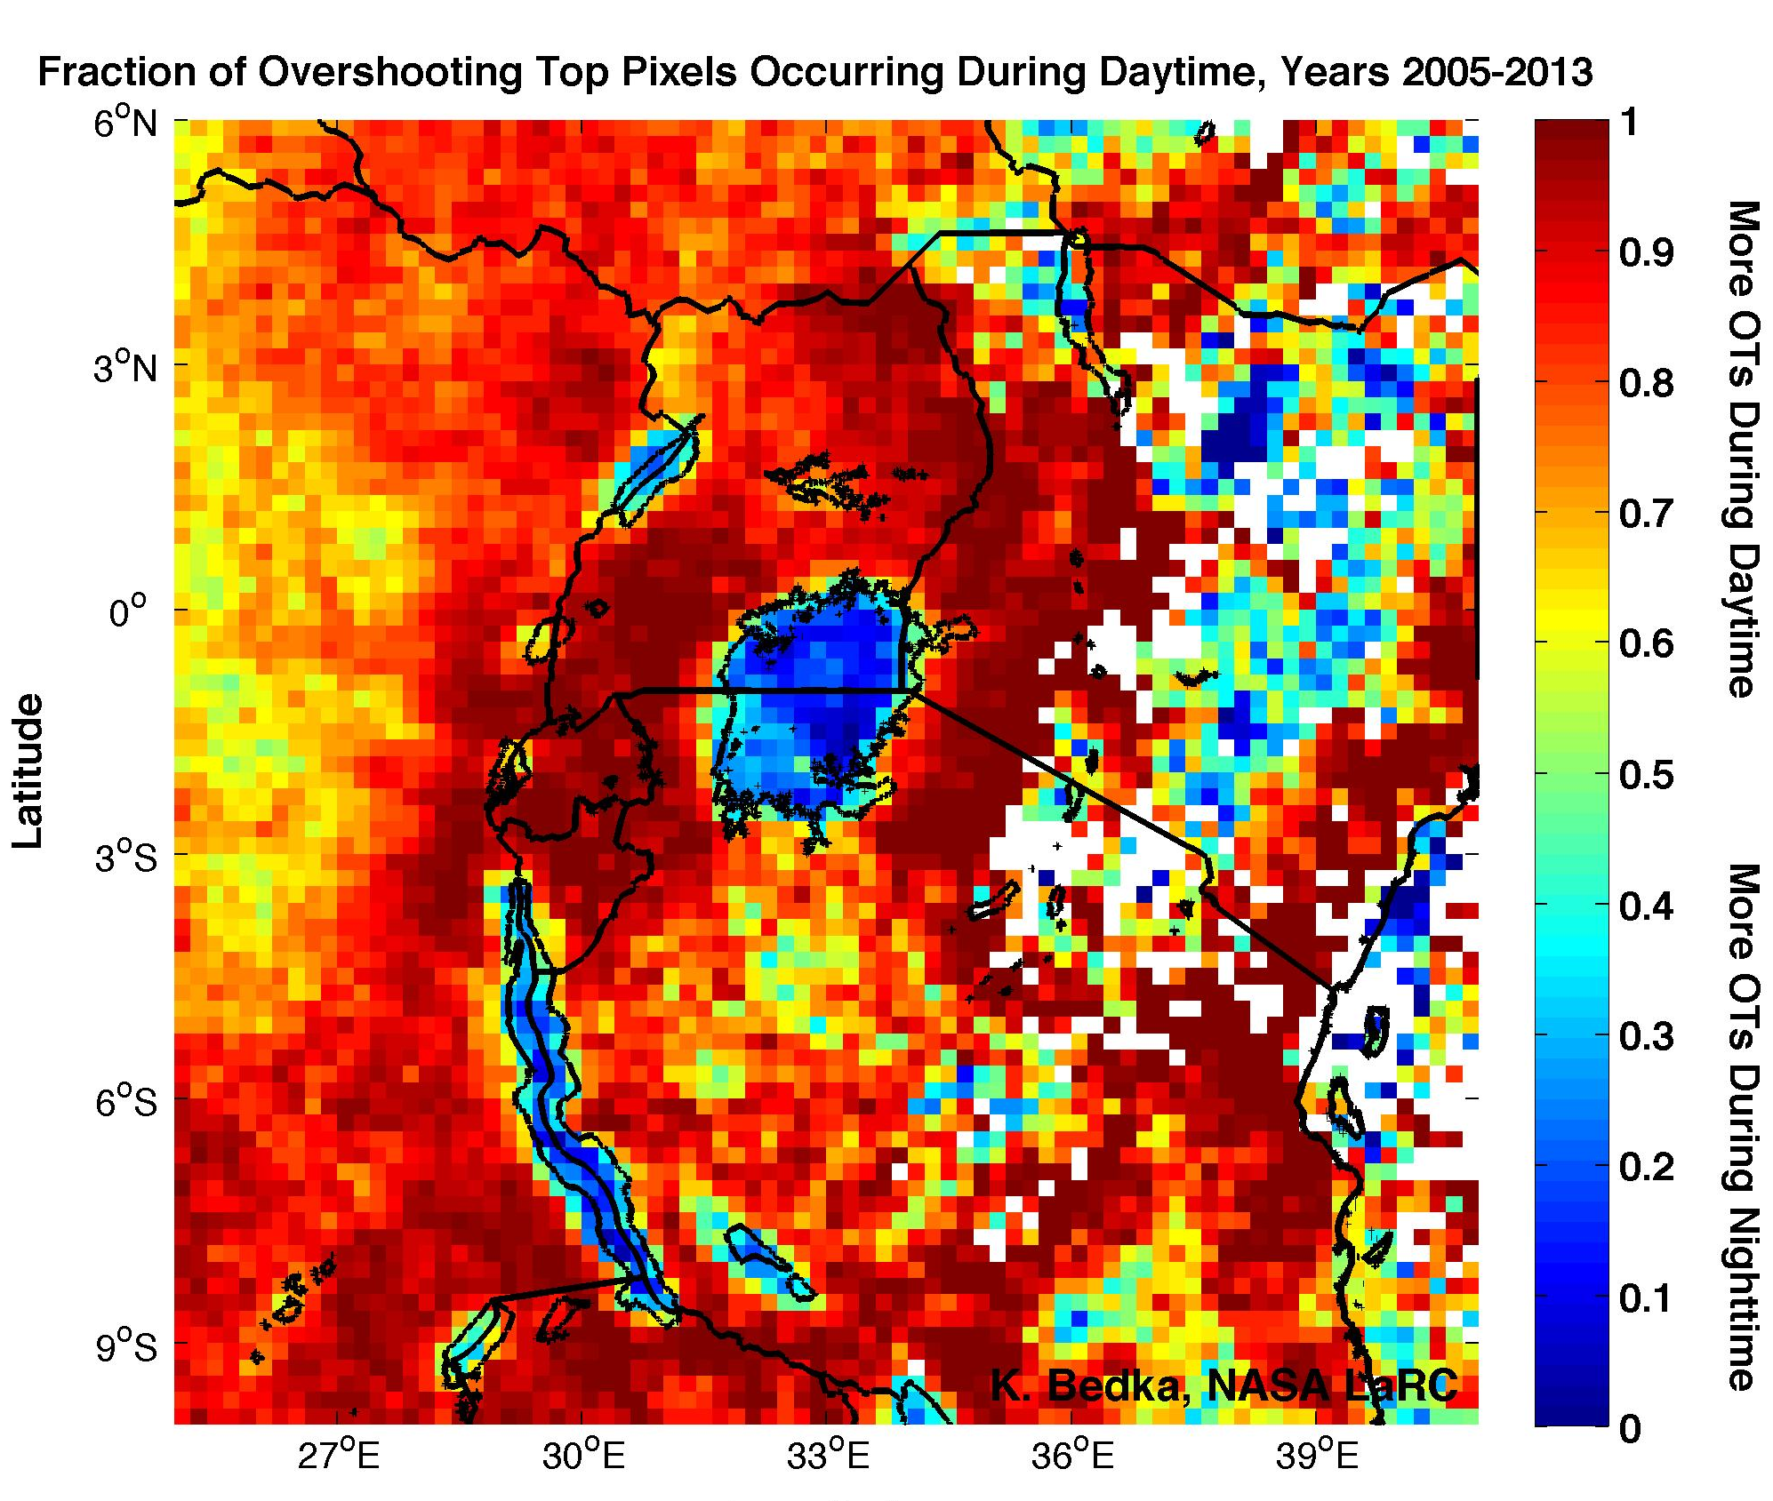
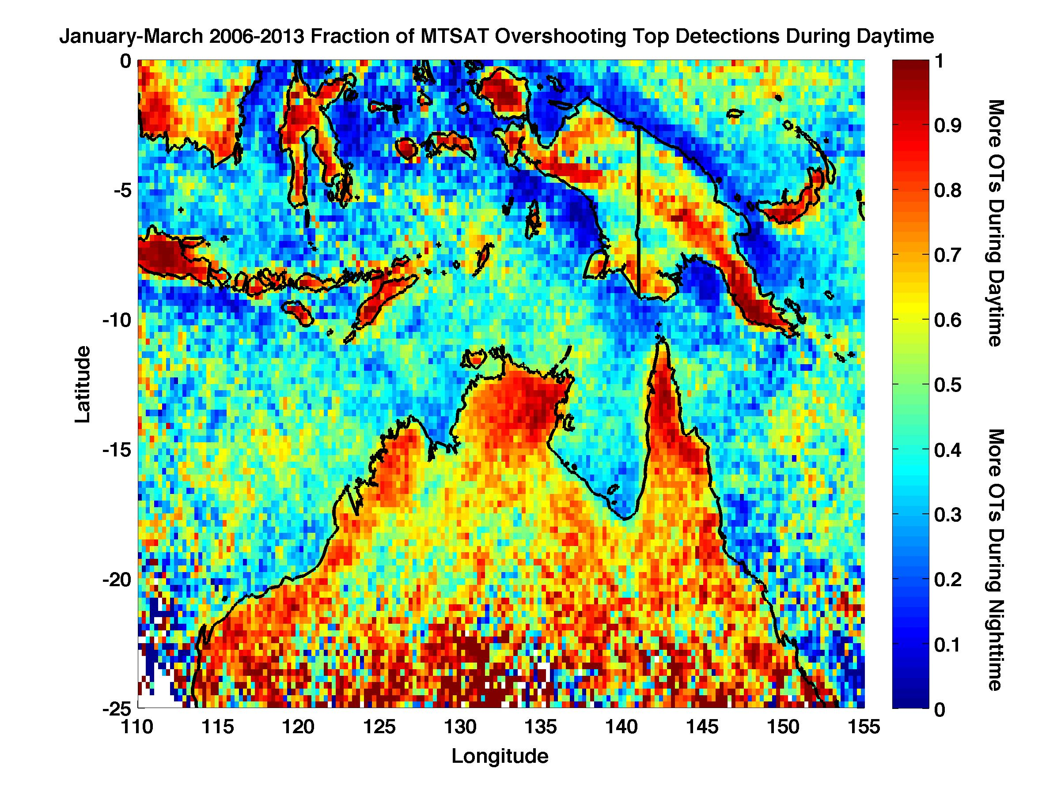
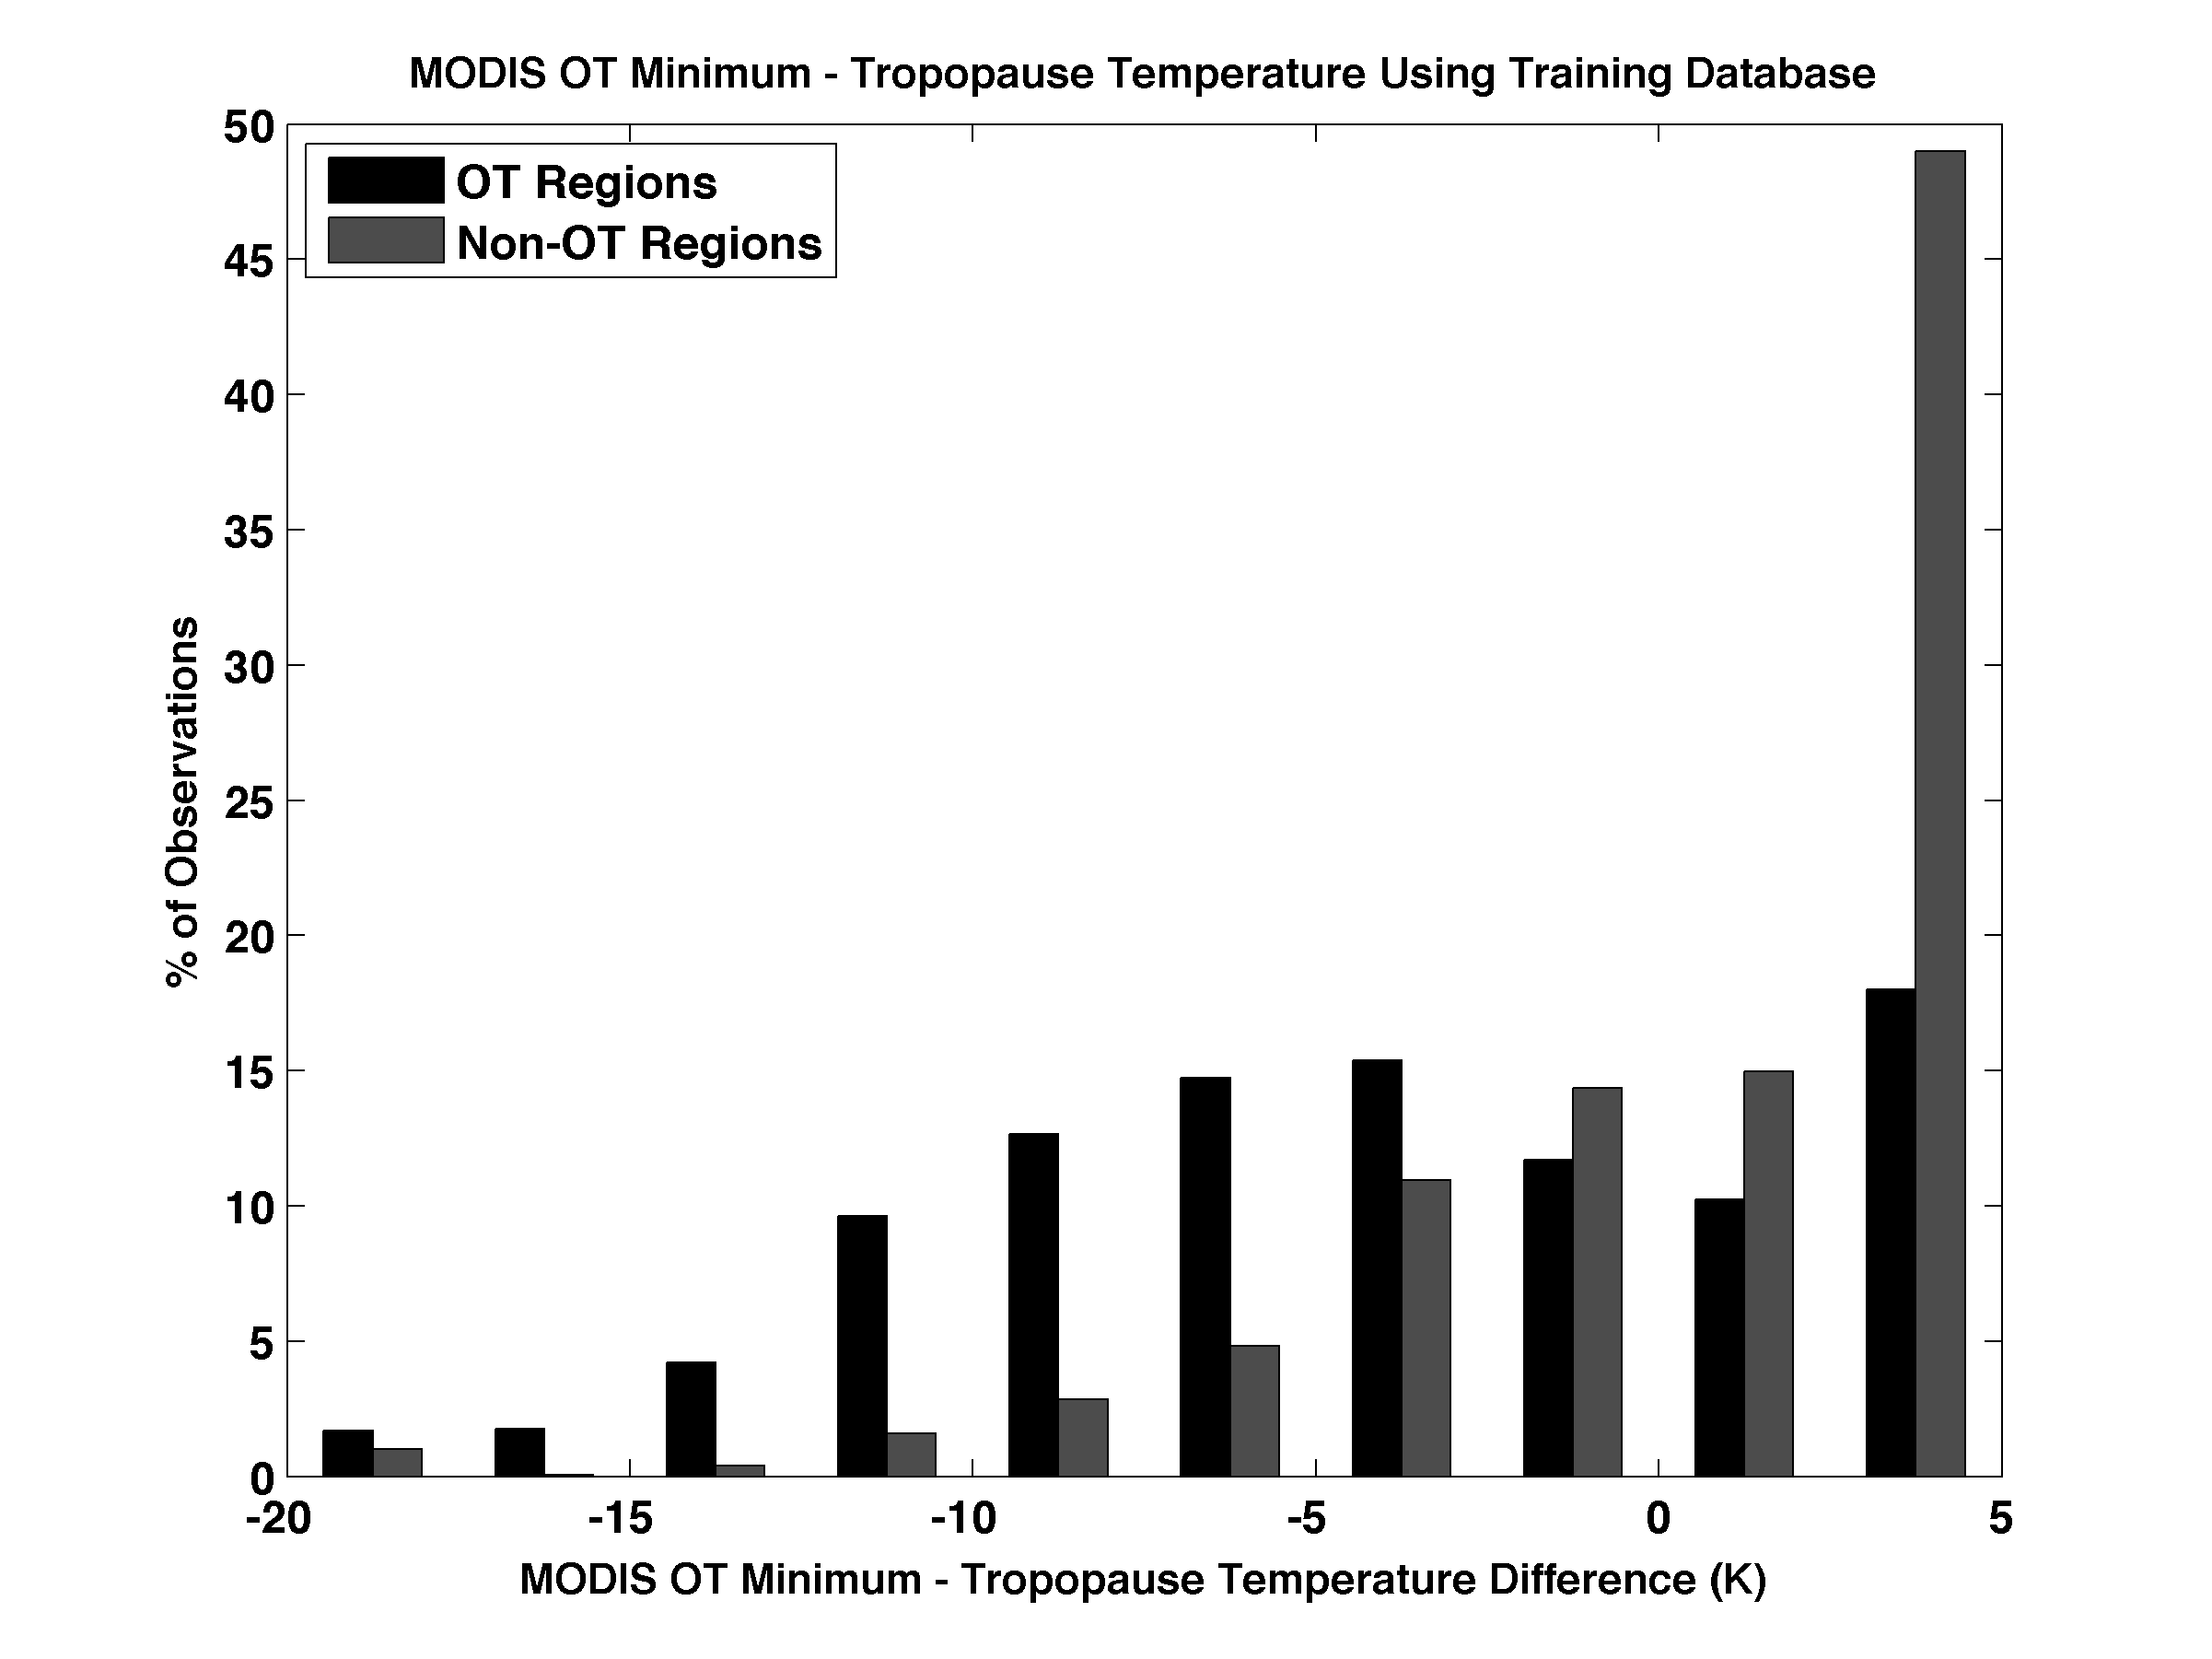
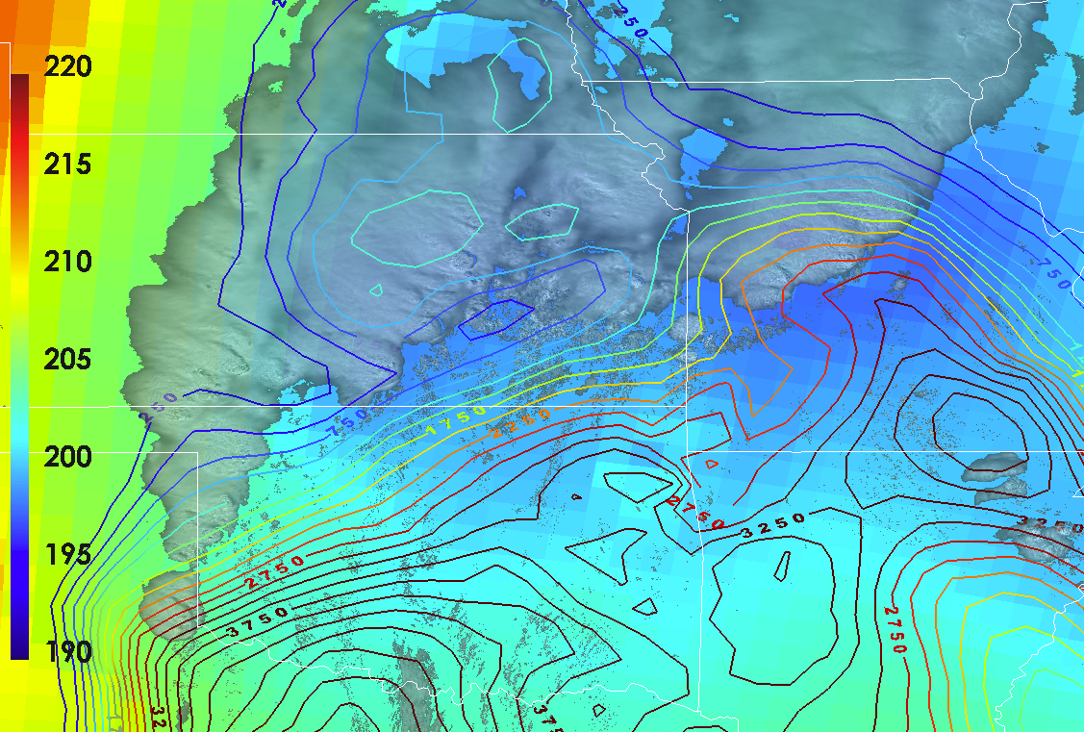
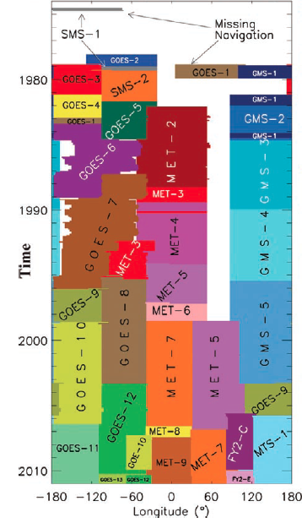
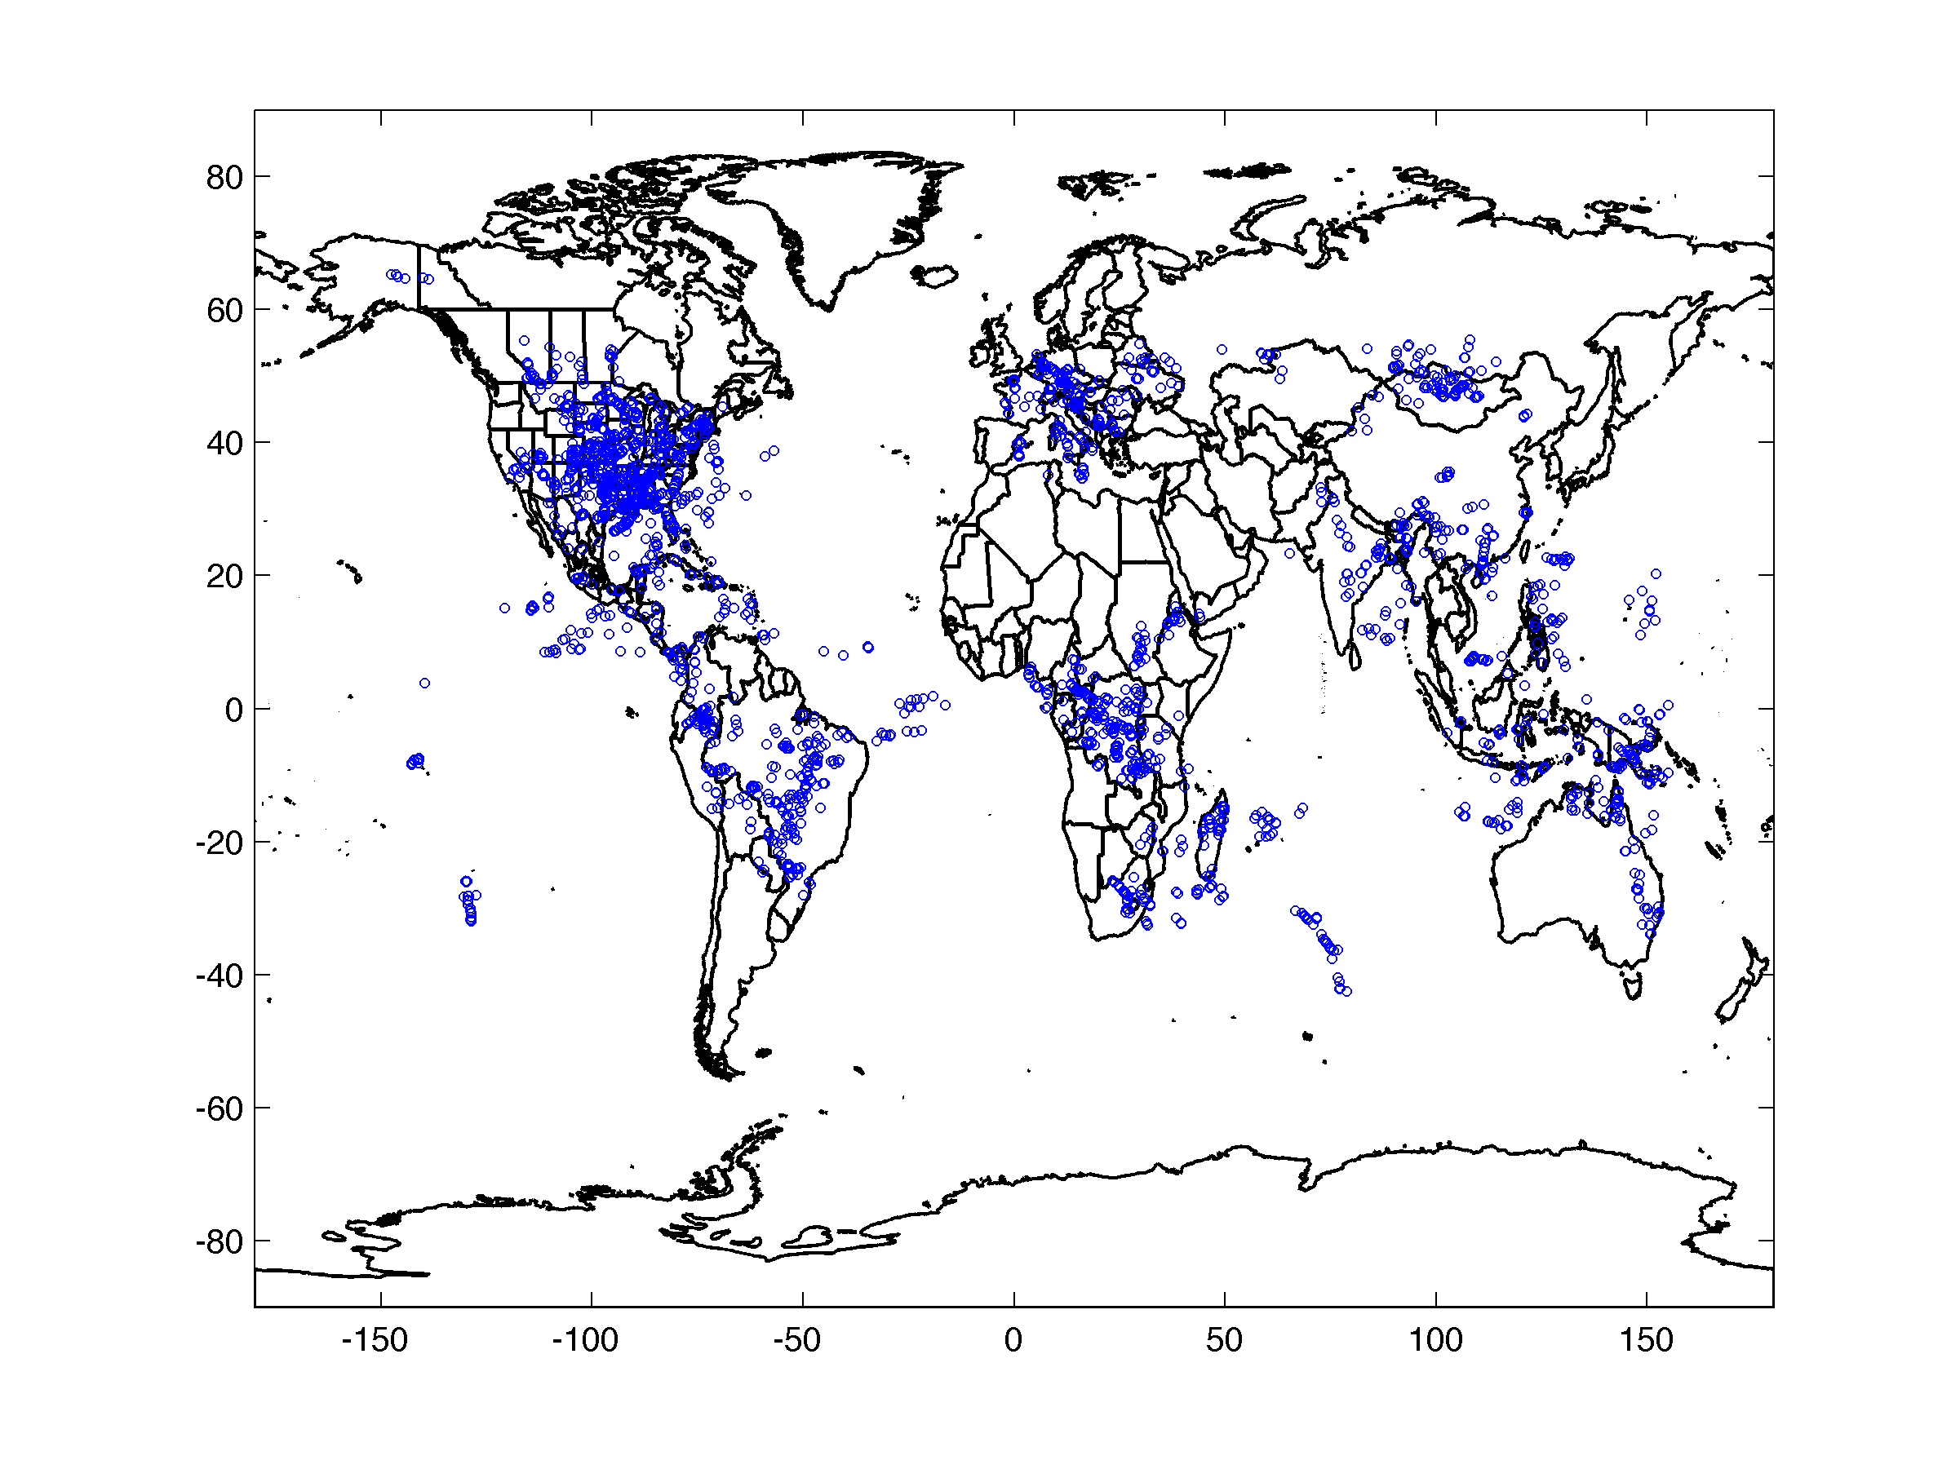
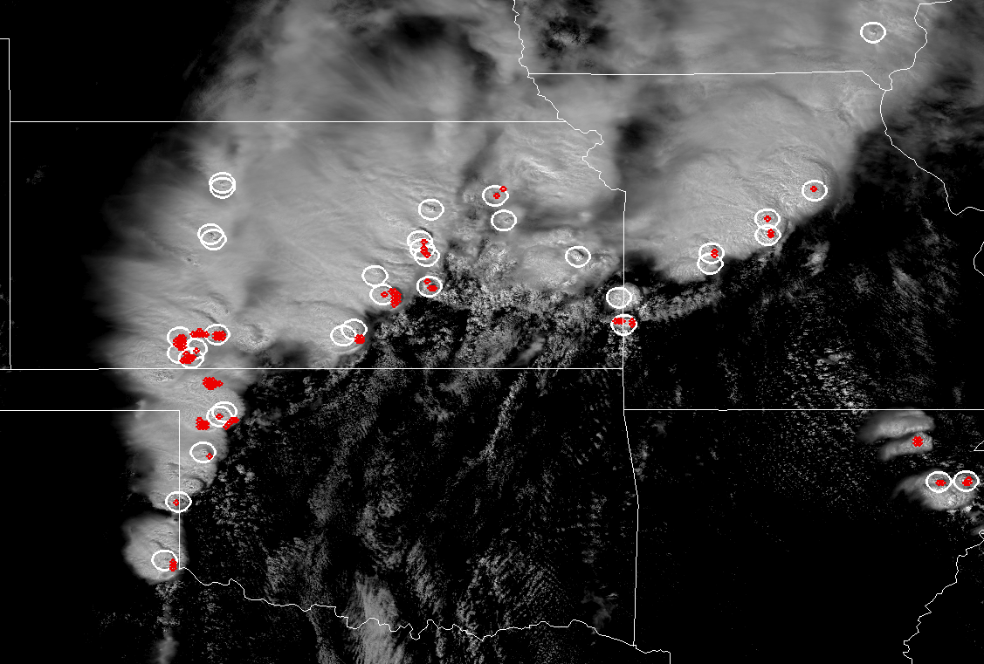
Efforts Toward Development Of A Global Climatology Of
Overshooting Cloud Top Events Using Satellite Imager Data
Kristopher Bedka¹, Konstantin Khlopenkov², and Patrick Minnis¹
¹NASA Langley Research Center, Hampton, VA ²Science Systems and Applications, Inc., Hampton, VA
Corresponding Author Email: kristopher.m.bedka@nasa.gov
INTRODUCTION AND BACKGROUND
PROBABILISTIC SATELLITE IMAGER-BASED OVERSHOOTING CLOUD TOP DETECTION
OT DETECTION PRODUCT EXAMPLE AND VALIDATION
Overshooting Top: A domelike protrusion above a cumulonimbus anvil, representing the penetration of an updraft through its equilibrium level
AMS Glossary of Meteorology
Why are Overshooting Tops (OTs) Important?
Tropospheric ice, water vapor, and chemical constituents are transported into into the Upper Troposphere – Lower Stratosphere (UTLS) region in OT regions which have significant impacts on the Earth Radiation budget and climate. Weather-related hazards such as heavy rainfall, lightning, aviation turbulence and icing, strong winds, large hail, and tornadoes are typically concentrated near OT regions.
Automated Satellite-Based OT Detection
Due to the importance of and hazards associated with OT regions, the NASA Applied Sciences, GOES-R Algorithm Working Group, and GOES-R Risk Reduction Research Program have supported development of an automated satellite imager-based OT detection algorithm (Bedka et al. (JAMC, 2010)). This algorithm detects OT signatures via 1) recognition of IR brightness temperature (BT) patterns present within a thunderstorm anvil consistent with typical OTs and 2) comparison of IR BT with tropopause temperature from a numerical model analysis to ensure that the satellite-observed cloud top is within the UTLS region. This algorithm can efficiently process data from any high spatial resolution satellite imager (< 5 km at nadir) and the products have been increasingly been used by private industry, climate researchers, and the operational weather forecasting community.
Though the OT detection product has been widely used by many communities, fixed detection thresholds and lack of sophisticated pattern recognition in this Bedka et al. first-generation algorithm reduces overall detection capabillity. Issues such as these can 1) inhibit identification of trends in hazardous storm activity associated with climate change and 2) cause some severe weather events to be missed, reducing the product’s utility for severe weather forecasting. This poster describes a second generation overshooting cloud top (OT) detection algorithm designed to address limitations of the previous Bedka et al. (2010) approach.
GOAL: Mimic the process used by the human mind to identify overshooting cloud tops using visible & infrared satellite imagery and numerical weather prediction model data within an automated computer algorithm
MODIS 250 m Visible
Gulf of Mexico, Louisiana Coast
Overshooting Top Detection
Magenta: Visible Texture Rating
Yellow: > 80% IR-Based OT Probability
Step 1. Identify Candidate OT Regions Using IR Imagery
Input image of (MODIS 2007/05/06 19:26) channel 31 BT, reduced to 4 km/pix to emulate the current GOES spatial resolution and to smooth out spurious features that can adversely impact OT pattern recognition
BT Score:
is used to eliminate need for a fixed BT threshold, to enhance deep convection, and to filter convective from non-convective clouds
Local peaks of BT score are first identified. These locations are used as candidates for the subsequent cloud anvil analysis
>80% IR OT Probability
POD: 53%
FAR: 20%
PREVIOUS REGIONAL OT DETECTION DATABASES (Using Bedka et al. 2010 Method)
GOES and MODIS OT Databases During The SEAC4RS Timeframe
Boundaries of anvil clouds are automatically defined via pattern recognition. The BT difference between OT candidates and the mean anvil is computed to identify significant UTLS penetrations
Pattern recognition is then used to ensure that the region being analyed is a deep convective cloud and with a shape and prominence typical of an OT
The pattern recognition scheme analyzes:
  The shape of the OT region
  OT prominence relative to surrounding anvil
  Anvil flatness, roundness, and edge sharpness
The net result is a cumulative rating obtained for each possible OT region. Pixels with a rating > 0 are considered final OT candidates
Final candidate OT locations (yellow shading) based on IR analysis overlaid on the BT Score image
How Do Our Minds Identify an Overshooting Top in Satellite Imagery?
Step 2. Identify Regions With OT-Like Texture Using Visible Imagery
GOES-East
1995-2012
MSG SEVIRI
Lake Victoria 2005-2013
MTSAT
January-March 2006-2013
Input image of calibrated channel 01 Visible reflectance
Non-linear brightness correction to highlight convective clouds and suppress other cloud types
Visible Texture Rating (pink) overlaid on the input reflectance image
Fourier frequency spectrum of a typical OT region. Ring fragments in the spectrum can be identified
Existing Approaches For Automated Overshooting Top Detection
Fourier frequency spectrum of an area with random spatial variability. No ring pattern in the spectrum
Step 3. Estimate Magnitude Of Overshooting Via Comparison Of Satellite
IR Temperature With NWP Tropopause And Level Of Neutral Buoyancy
Convective available potential energy (CAPE, contours) overlaid upon the Visible reflectance and tropopause temperature
Step 4. Optimally Weight Satellite And NWP Parameters Based On A Database Of Known MODIS OT Events To Derive OT Detection Probability
Satellite-based pattern recognition alone does not produce a sufficiently accurate OT detection
IR BT, IR BT - Anvil BT Difference, IR BT - tropopause temp, IR BT – most unstable equilibrium level temp were statistically significant predictors at the 99% level. Each of these parameters were derived for OT and non-OT anvil cloud regions manually identified in 100 granules of MODIS imagery. The Visible Texture Rating is used to constrain detection during daytime.
A logistic regression model is trained to discriminate between the OT and non-OT anvil populations using these IR and NWP-based parameters as input. An OT Detection Probability ranging from 0 to 1 is derived for each candidate OT.
SUMMARY
Global GEO
Satellite Imager History
From Knapp et al. (BAMS, 2011)
The probabilistic OT detection framework can provide the most robust climate data record to date of strong convective updraft locations globally throughout the diurnal cycle using both LEO and GEO satellite imager data.
This approach is the first to 1) incorporate visible + IR imagery and NWP information and 2) incoporate a large sample of known OT events for algorithm training. It is also the first to quantify the number of individual OT events for analysis of time trends of extreme storm activity
The entire geostationary imager and NASA MERRA reanalysis data records are immediately accessible to NASA LaRC, allowing for efficient generation of a global OT climatology
The OT detection product is designed to operate on < 5 km resolution IR imagery, allowing one to extend the climatology back to ~1994 with GEO imagers and 1978 with AVHRR. Global GEO-based OT analyses could be produced at up to 15 min frequency.
Aqua MODIS OT Locations Used
For Algorithm Training and Validation
Final OT detections (red) overlaid top OTs manually identified in 250 m Visible imagery (white circles)
8 km
IR
Limitations of Current Satellite-Based OT Detection Approaches
All approaches use fixed criteria for binary yes/no OT detection which can be problematic, especially when the NWP tropopause temperature is wrong or the satellite imagery has coarse spatial resolution
Only a subset of satellite imagers have a water vapor (WV) channel. Detection techniques that use WV data often identify large portions of the convective anvil and are not capable of isolating only OT regions.
Bedka et al (2010) is the only approach that uses spatial analysis of the anvil cloud for detection. This approach is improved signifcantly using pattern recognition logic described on this poster
No approches use the visible channel, which typically provides the clearest indication of an OT. Variations in solar illumination throughout a day makes automated visible-based OT recognition especially challenging
A database of ~1900 OT events was compiled via manual analysis of 100 daytime Aqua MODIS 250 m visible images. A similar number of non-OT anvil regions were also identified. This database is used to train and validate a logistic regression model to identify only OT-like features
< 5 km
IR
POD: 66%
FAR: 8%

