Slide 1
Title (Verdana 24)
Principal Investigator Name and Institutional Affiliation (Verdana 16)
Key Research Result/Scientific Development: [Replace with a high-level overview of the key result or scientific advancement. You might address 1-2 of the following using limited text:
What did we learn and/or discover about the Earth system that we did not know before?
Did we learn something that we already knew, but in a different way? If so, how is it new or different?
How is the development different and/or better than what we currently have?
What does the new knowledge, insight, method, or advance allow us to know/do that we did/could not before?]
Significance: [Replace with optional statement:
What is the overall importance for Earth system science?]
[Additional talking points and details should be placed in the slide notes section]
[Replace with 1-2 key images that demonstrate the highlighted research result or scientific advance.
You do not need to use a 2-column layout. You can adjust the position of the summary, image(s), and caption sections if your graphics have a larger horizontal span.]
Figure caption
Notes:
Please provide the following additional details:
Background: [Insert a brief motivation for the research or advance. What is the current unknown or challenge in Earth system science?]
Key Research Result or Scientific Development: [What were the key findings of the work? This can be somewhat more comprehensive than above, but please focus on the observations, conclusions, interpretations, and/or developments highlighted in the slide.]
Significance for Earth System Science: [Insert Text]
NASA Assets: [Please identify specific spaceborne platforms or instruments, airborne instruments or campaigns, surface networks, reanalysis or modeling systems, data products, etc. that enabled this work]
Reference Publication or Presentation: [Optional, include text as appropriate]

Slide 2
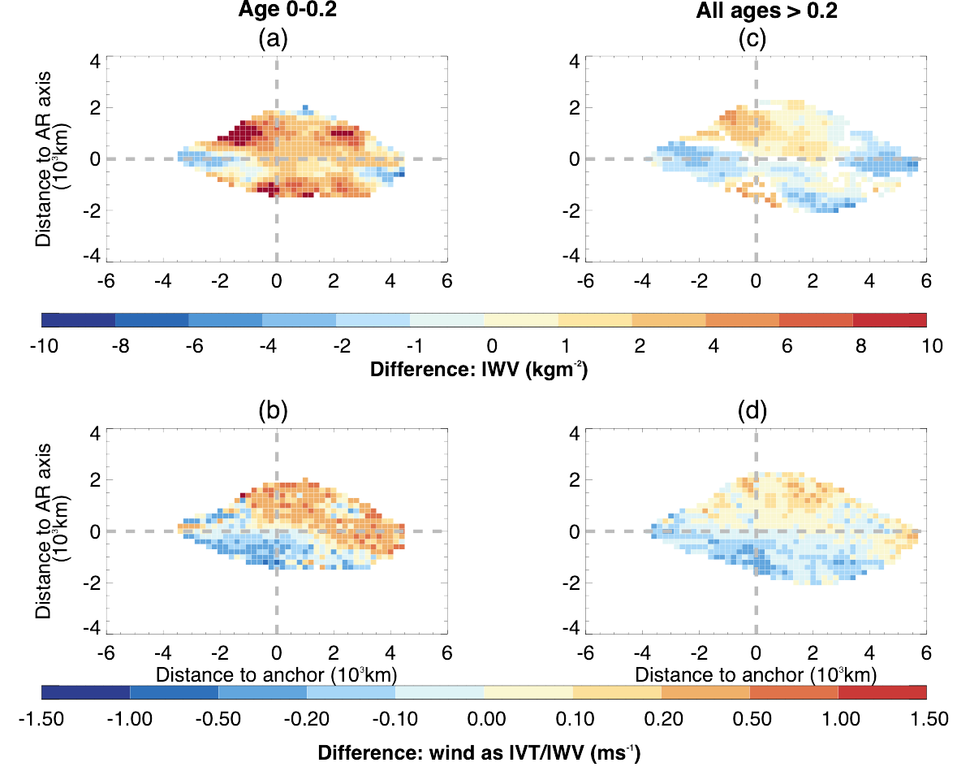
Does Convection in Developing Atmospheric Rivers affect Rain Production Downstream as they Mature?
Catherine Naud, Columbia University/NASA-GISS
Key Research Results: Significant convective activity early during the development of atmospheric rivers (ARs) has the following effects:
Does not deprive ARs from moisture where/when it occurs or downstream as the system matures
Impacts surface winds and AR strength when quantifying transport
Causes greater precipitation production for ARs throughout their full lifecycle
Along filament differences in (top) integrated water vapor (IWV, i.e., moisture) and (bottom) integrated winds between ARs with appreciable convection when first forming and those without. (left) ARs near the formation time and (right) later in life.
Notes:
Background: Atmospheric rivers (ARs) are long filaments of poleward moisture transport, which can produce inordinate amounts of precipitation at landfall. Forecasting rain totals for these events is complicated by the lack of observations over the remote oceans where they first form. Furthermore, there is additional reliance on models’ ability to accurately represent moist processes and deep convection. Using GPM convective/stratiform rain identification and IMERG precipitation rates, the authors contrasted ARs with significant convective activity early in their development phase to those with weaker convection. Combined with a lifecycle compositing technique, the team explored the sensitivity of deep convection on the temporal evolution of AR precipitation.
Key Research Result: The analysis confirmed that convective activity in ARs affects precipitation production throughout their lifecycle. More specifically, it answered the following questions:
Does convection deprive ARs of moisture (i.e., thereby working against rain production)?
- No, the moisture amounts in ARs with significant convective activity is larger throughout the AR lifecycle than in ARs with weak convective activity.
Does convection strengthen ARs through latent heat release (as idealized models suggest), thereby enhancing rain production?
- Yes, ARs with significant convective activity are stronger and produce more precipitation than ARs with weak convective activity.
Significance for Earth system science: The analysis demonstrates the importance of upstream convection for precipitation production in extratropical weather systems and why it is important for forecast models to accurately represent convection. The occurrence of convection over the remote oceans is also shown to impact downstream extratropical precipitating systems.
NASA Assets: Level 2 GPM radar convective/stratiform precipitation type and near surface precipitation rates, IMERG precipitation rates, MERRA-2 based AR database and matching integrated water vapor transport, and vertically integrated water vapor.
Reference Publication: Naud, C. M., R. Luna Niño, D. J. Posselt, J. A. Crespo, and A. Gershunov, 2026: Does convection in atmospheric rivers at genesis impact precipitation production later in their lifecycle? Clim. Dyn., 64 (6), 271. https://doi:10.1007/s00382-026-08241-w.

Slide 3
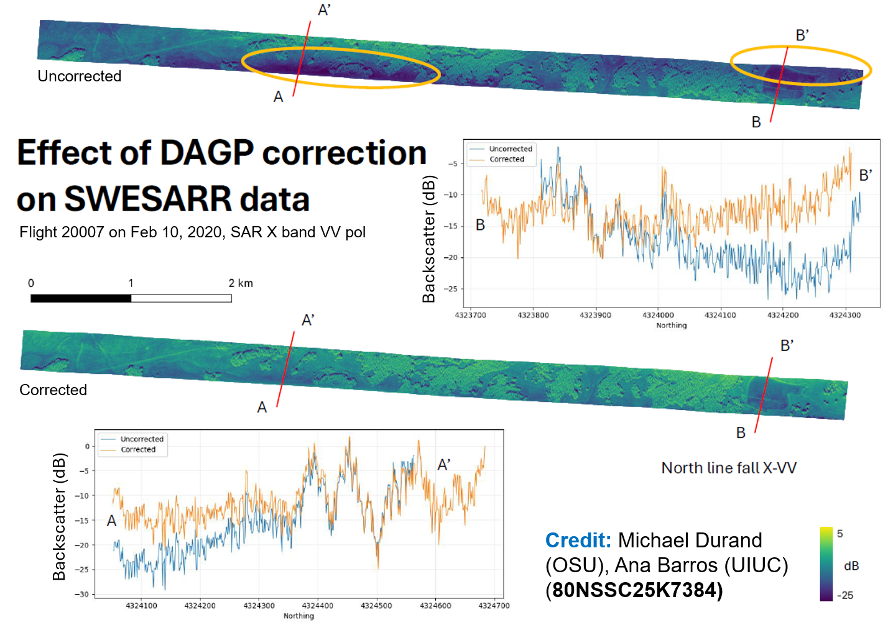
Snow Water Equivalent Synthetic Aperture Radar and Radiometer (SWESARR) Data Processing
Michael Durand, Ohio State University
Key Result: First science-ready, SWESARR data for SnowEx Grand Mesa, CO (2019-2020)--and soon-- Fairbanks and North Slope, Alaska (2023)
Significance: The SnowEx data can now be used as intended to improve multi-frequency, active/passive SWE retrieval algorithms and satellite snow mission concepts
Notes:
Background: SWESARR is an airborne remote-sensing instrument that can measure the amount of water stored in snowpacks. It combines a multi-frequency synthetic aperture radar (SAR) with a microwave radiometer. The instrument achieves a nominal radar range resolution of about 1.1 meters with swath widths spanning 250 to 450 meters depending on frequency when flown at low altitudes. Active radar bands include X-band (9.65 GHz) and a dual Ku-band (13.6 and 17.25 GHz) collecting dual-polarization data (VV, VH). Passive radiometer bands measure brightness temperature at 10.65, 18.7, and 36.5 GHz.
Key Scientific Development: The first science-ready, SWESARR data was produced because of these efforts. The data was acquired during for SnowEx campaign in 2020, over Grand Mesa, Colorado. The now-proven automated processing approach will be used to process all SnowEx 2020 (Colorado) and 2023 (Alaska) SWESARR data, and ultimately, the data will be handed over the NSIDC. Processing overcomes two primary issues including 1) Timing & Focusing Errors: During SnowEx 2020 and 2023, a damaged primary time server forced the use of a lower-accuracy alternative, causing severe focusing errors, and was corrected via GAMMA Time Domain Back Projection (TDBP) software. In addition, 2) SAR Image Artifacts: imagery exhibiting antenna pattern artifacts was corrected via the Dynamic Antenna Gain Pattern (DAGP) correction algorithm (Batu Osmanoglu).
Significance for Earth System Science: The data is expected to improve multi-frequency, active/passive SWE retrieval algorithms and satellite snow mission concepts.
NASA Assets: SnowEx campaign data
Reference Presentation: Pan, M. P.-C., and coauthors, 2026: A first look at SnowEx SWESARR reveals snow class and land cover type controls on radar backscatter. IGARSS 2026, TH2.R2.3, Washington, DC. https://2026.ieeeigarss.org/view_paper.php?PaperNum=3946&SessionID=1647.

Slide 4
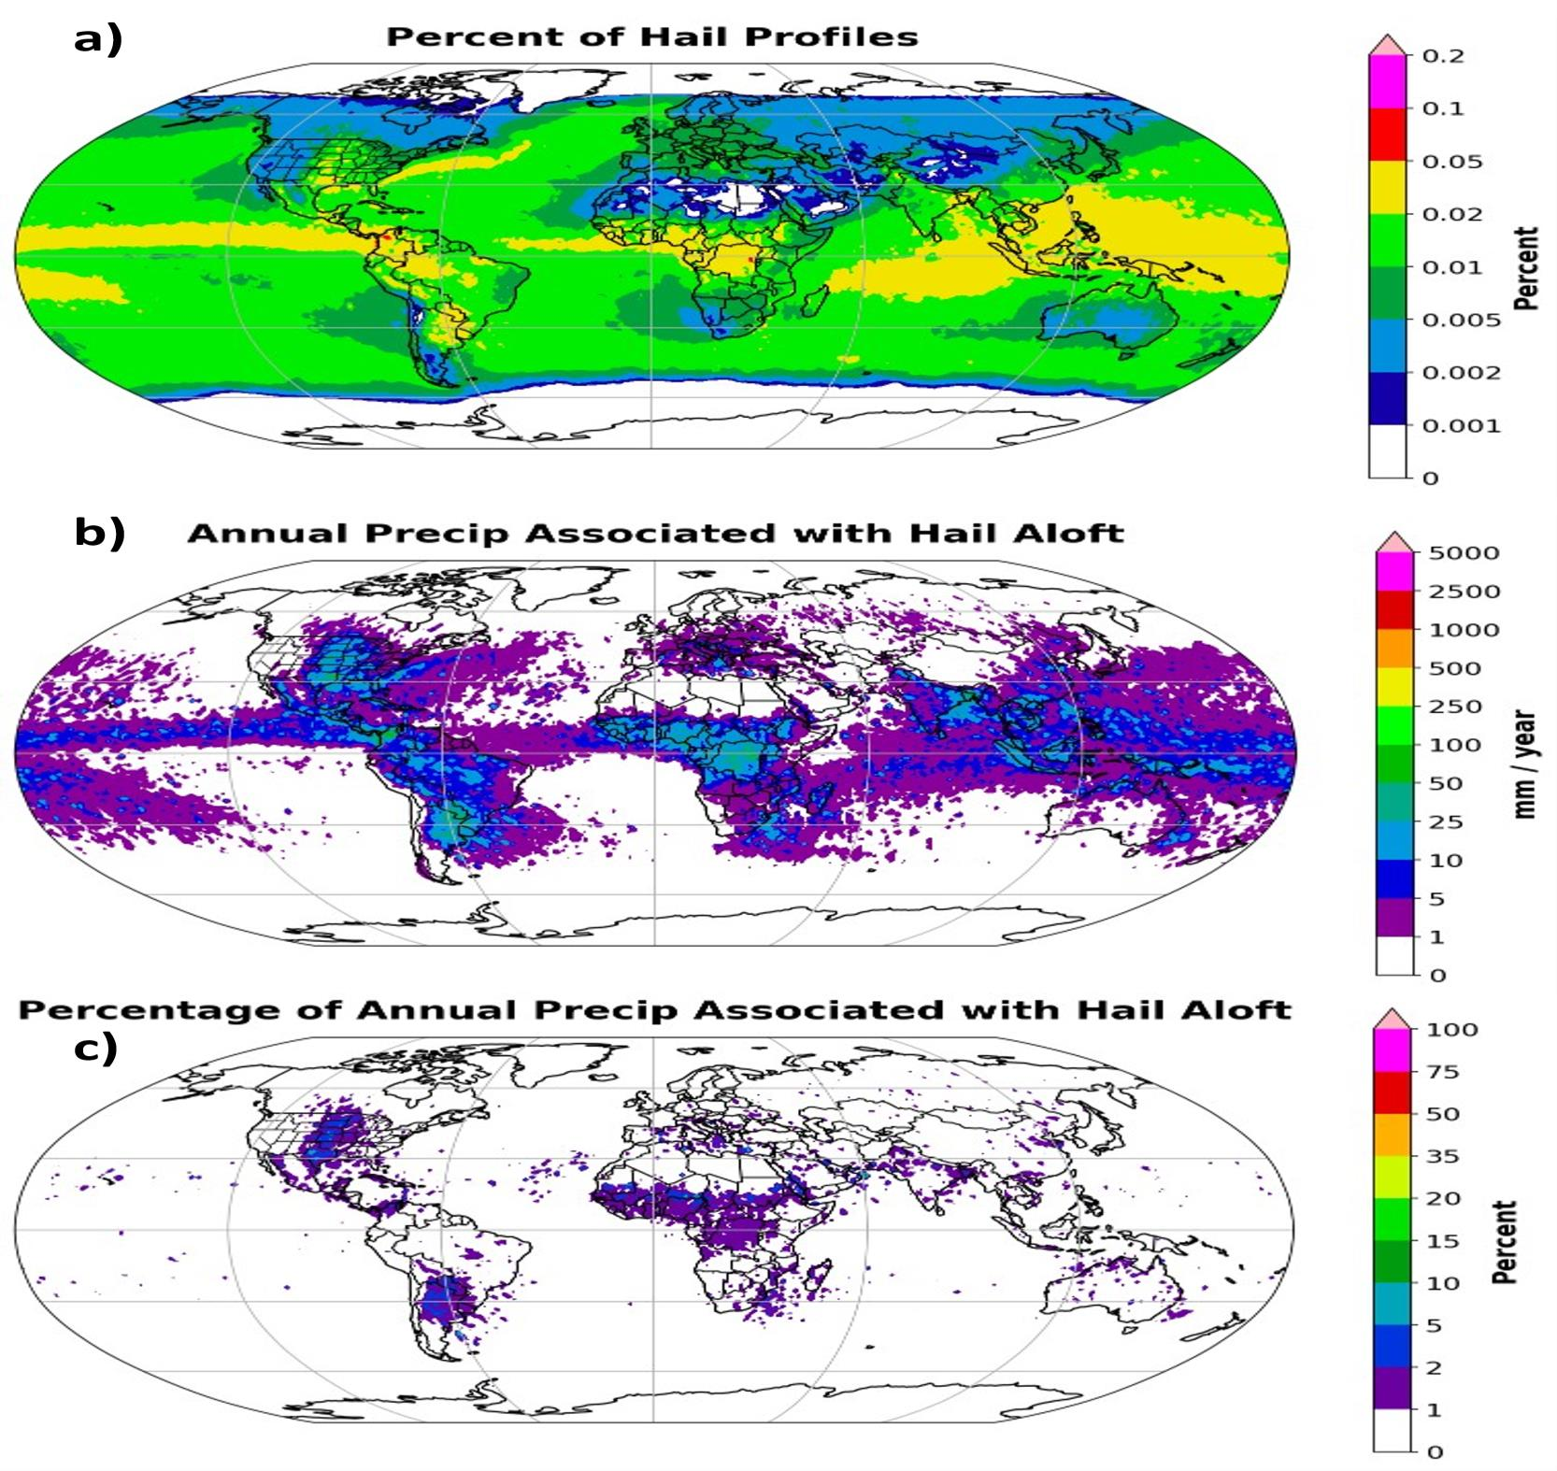
Using GMI Brightness Temperatures to Monitor Global Distribution of Hydrometeor Species
Daniel J. Cecil, NASA MSFC and Michael B. Solomon, Univ. of Alabama in Huntsville
Key Discovery/Advance: An updated methodology is presented for identifying hydrometeor species using brightness temperatures from the Global Precipitation Measurement (GPM) Microwave Imager (GMI)
Up to 5% of precipitation is associated with hail-producing storms over continental regions associated with strong convection (vertical motions), like the Great Planes over the Central US
The percentage of precipitation associated with hail-producing storms relative to the total precipitation at a given point
Notes:
Background: Through this research, NASA scientists have refined the ability to better identify hydrometeor type (i.e., rain, snow, graupel, or hail) detection from space. Specifically, measurements from the Global Precipitation Measurement (GPM) Microwave Imager (GMI) were used to help refine a near-global climatology of precipitation type from more than 30,000 orbits (2015-2020). The refined algorithm uses a more conservative threshold for associating precipitation with hail, thus creating more realistic hailfall areas that are better restricted to storm cores of stronger convection compared to prior approaches. Training for hydrometeor identification and validation were constructed by comparing GMI data with ground-based polarimetric radar.​
Key Research Result: The key discovery is thus a better knowledge of where certain hydrometeor types (including hail) are found, in addition to their contributions to precipitation, when measuring from space. Despite hail identifications being more limited here than in the prior approach, the oceanic Intertropical Convergence Zone (ITCZ), western North Pacific, and Gulf Stream all stand out as places with many hail identifications, besides the continental regions that are typically expected to have more hail (e.g., central United States, northern Argentina, Bangladesh). The high number of hail signatures over certain oceanic regions is driven by the frequent deep convection there.​
​
The above scientifically is worth noting since the amount of hail and hydrometeor types more broadly have important effects on heating distributions and retrieval errors. Products using this method are now being generated in a test environment by the GPM Precipitation Processing System. This could improve near-real time estimates of satellite precipitation as IMERG early reports with an approximate 4-hour latency. ​The above does not indicate that hailfall is reaching the ground, although related research work is underway.
​
Significance: A method has been refined for determining whether precipitation scenes observed by the Global Precipitation Measurement (GPM) Microwave Imager (GMI) are consistent with hail aloft, graupel, other lower density ice, or all liquid. Products using this method are now being generated in a test environment by the GPM Precipitation Processing System. The different hydrometeor types identified here are likely associated with different heating distributions and have different effects on precipitation retrieval errors.​
NASA Assets: Global Precipitation Measurement (GPM) Microwave Imager (GMI) Level-1 brightness temperatures and Level-2 probability of precipitation​
Reference Publication: Solomon, M. B., and D. J. Cecil, 2026: Using GMI brightness temperatures to monitor global distribution of hydrometeor species. J. Appl. Meteor. Clim., conditionally accepted with minor revisions.​

Slide 5
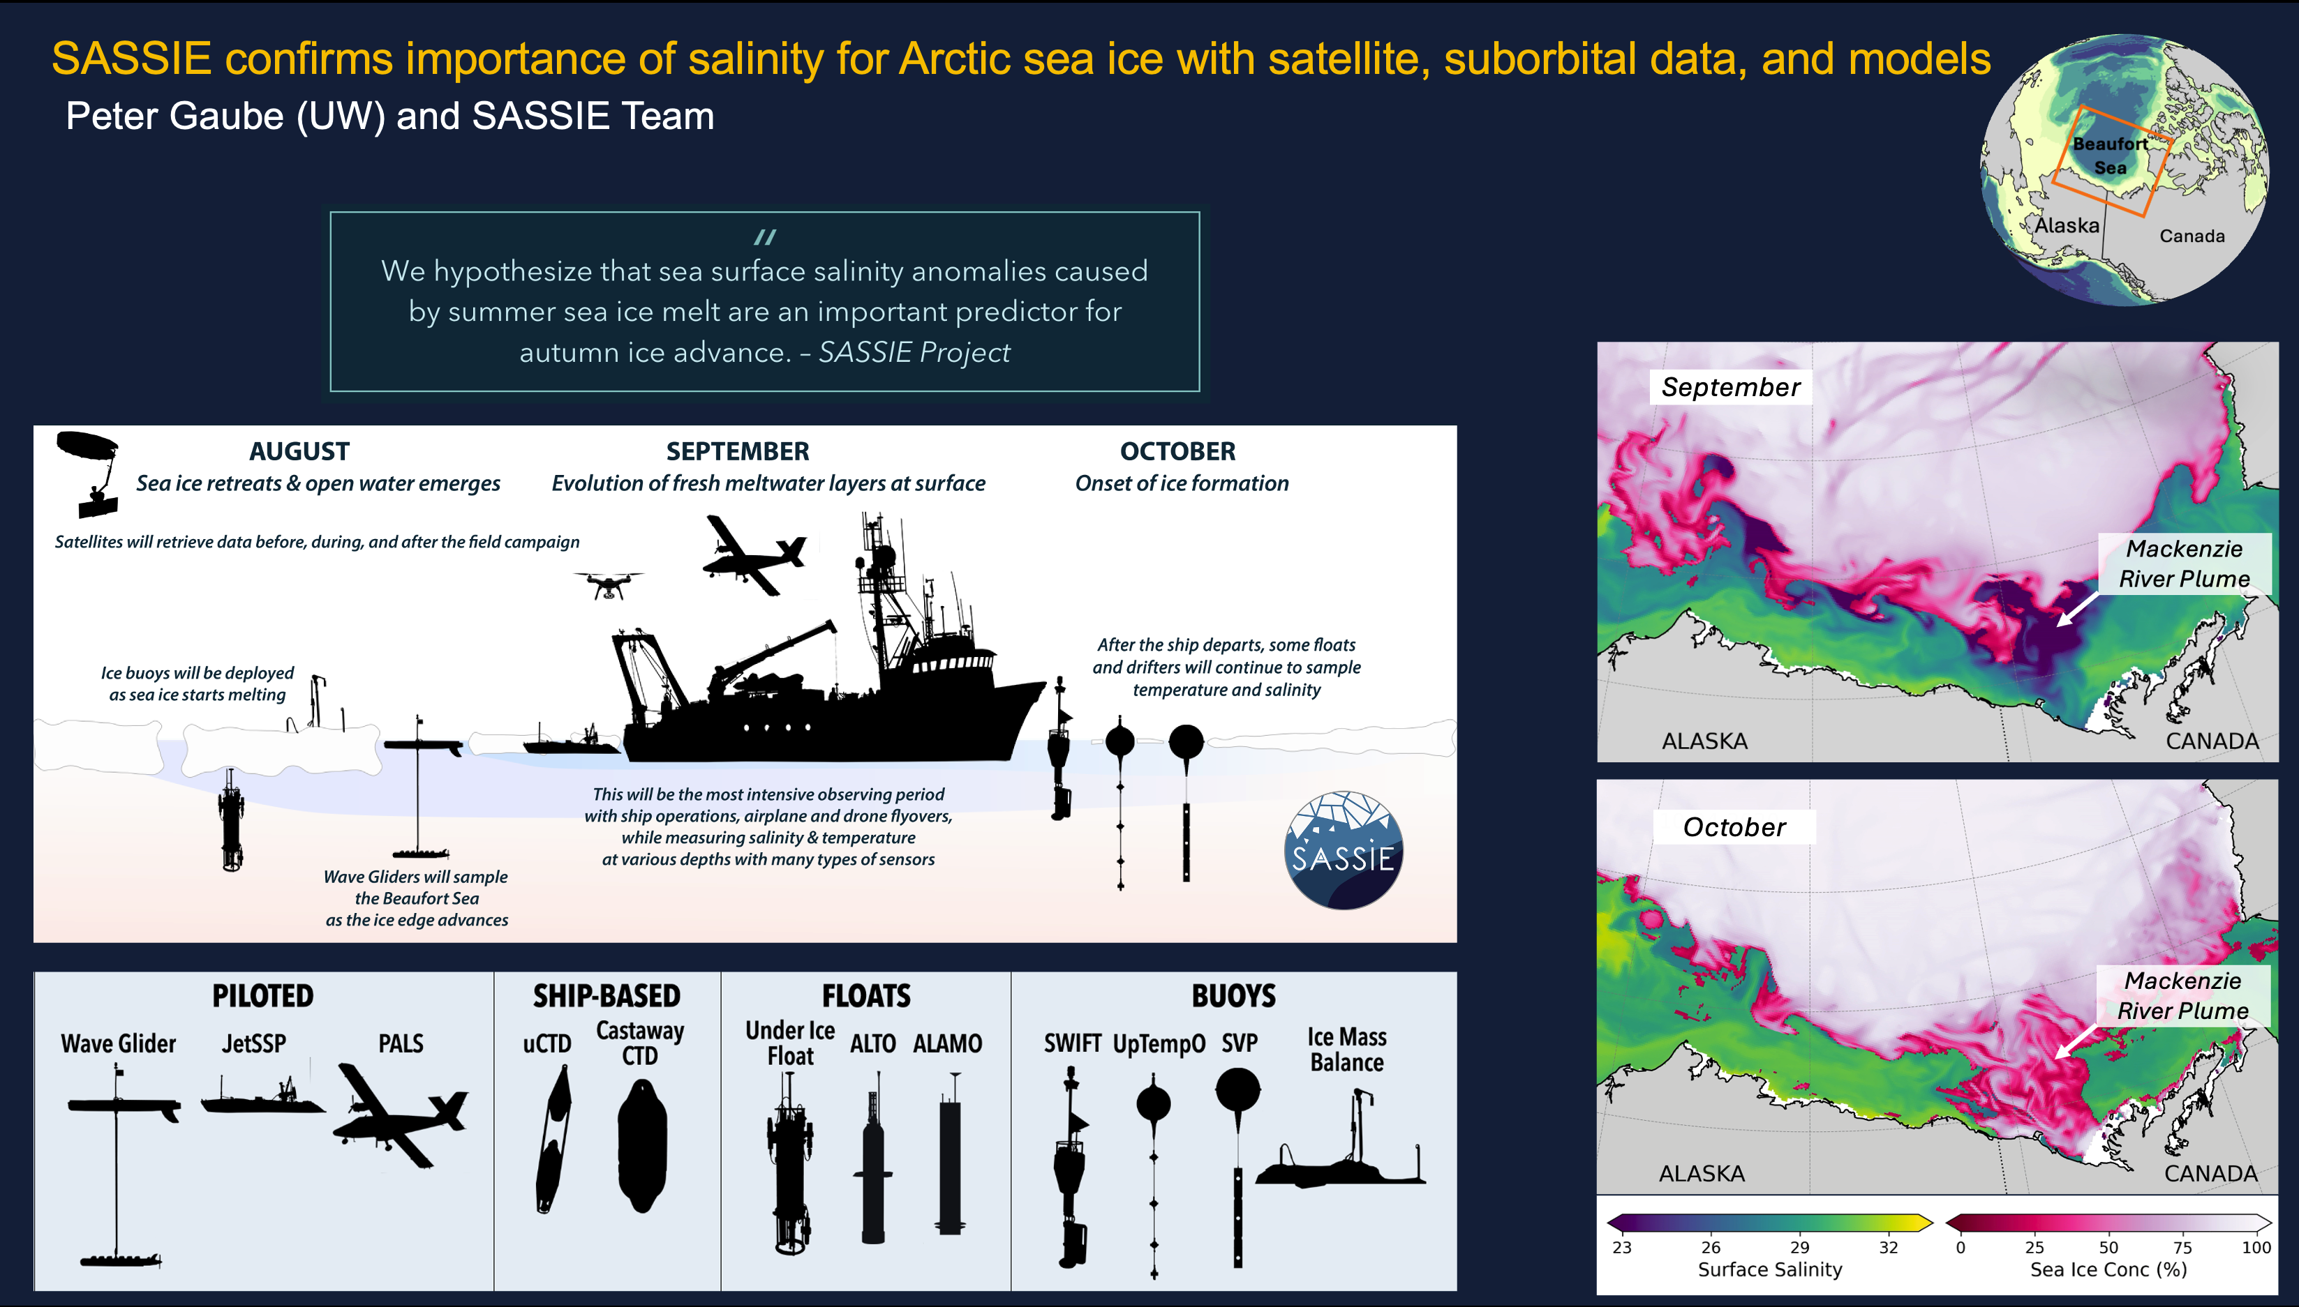
SASSIE Confirms Importance of Salinity for Arctic Sea Ice with Satellite, Suborbital Data, and Models
Peter Gaube (UW) and SASSIE Team
Notes:
Background: Sea ice extent in the Arctic Ocean has declined dramatically over the past decades. Autumn ice advance is slower and occurs later, while summer ice retreat is faster and occurs earlier. The result is a lengthening open-water period each year, leading to changes in air-sea heat and momentum fluxes, the freshwater cycle, surface albedo feedbacks, primary production, and regional and global climate as well as human and ecological health. The Salinity and Stratification at the Sea Ice Edge (SASSIE) experiment examined how summer ice melt evolves into and is inexorably linked with autumn sea ice advance.
Key Research Result: NASA SASSIE confirmed the central hypothesis about ocean-ice interaction. Specifically, researchers found that regions influenced by freshwater melt plumes experienced sea ice onset an average of 3 weeks earlier than adjacent, saltier waters. The earlier ice formation was associated with enhanced stratification, shallower mixed layers, and reduced upper ocean heat content, all of which promotes faster surface cooling.
Significance for Earth System Science: Salinity plays important role in sea ice formation. This research can enable better prediction of ice formation in the fall based on summer salinity values.
NASA Assets: Satellites (SMAP and SMOS), suborbital SASSIE data, models, AI/ML
Reference: https://salinity.oceansciences.org/sassie.htm

Slide 6



National Ocean Science Bowl 2026 is a Wrap
Nick Rome, Center for Ocean Leadership
Description: The NOSB is an academic competition and program that has been running for 28 years. It introduces high school students to and engaging them in ocean science, preparing them for ocean science-related and other STEM careers.
This year there were 15 regional competitions with 176 teams and 874 students, with the theme “Ocean Conservation: Connecting Science and Stewardship for a Healthy Ocean”
3 of 15 teams that won regional bowls this year, that were held at George Mason University, Pittsburg, PA, and a fully virtual bowl.
Notes:
Background: The National Ocean Science Bowl (NOSB) is an academic competition and program that has been running for 28 years. It addresses a national gap in environmental and earth sciences in public education by introducing high school students to and engaging them in ocean science
Key Development: This year there were 15 regional competitions with 176 teams and 874 students. This year’s theme was “Ocean Conservation: Connecting Science and Stewardship for a Healthy Ocean.” NASA is one of the supporters.
Significance for Earth System Science: The NOSB helps prepare high school students for ocean science-related and other STEM careers.
NASA assets: People
Reference: https://nosb.org/

Slide 7
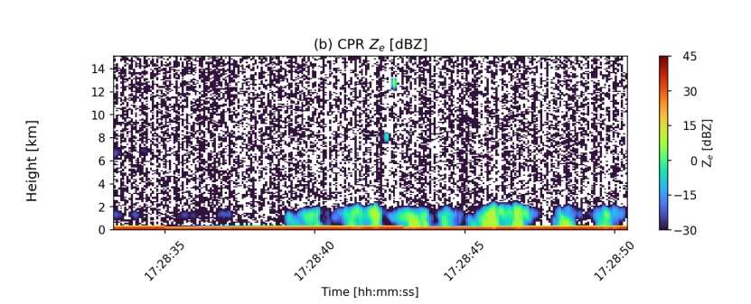
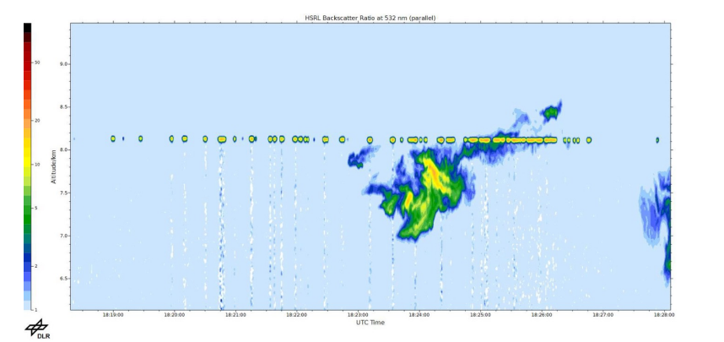
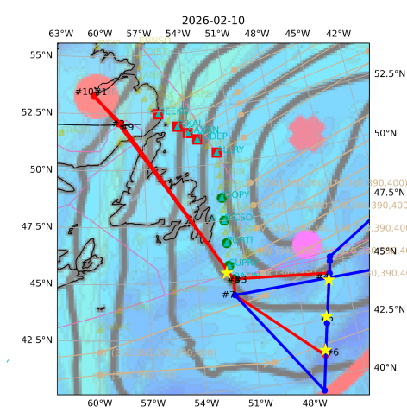
Coordinated Flights of US and European Aircraft in Support of EarthCare
NURTURE Science Team
On 10 Feb 2026, the EarthCARE satellite was underflown by the NASA LaRC Gulfstream III, based out of Goose Bay, Canada in coordination with DLR’s High Altitude and Long Range Research Aircraft (HALO), based out of Shannon, Ireland. Both aircraft were visible on the EarthCARE radar, and the NASA LaRC Gulfstream contrail was visible on the EarthCARE lidar.
The High Altitude Lidar Observatory (HALO) and CloudCube instrument onboard the NASA G-III provided radar and lidar observations from the same platform for the first time.
Top: EarthCARE Cloud Profiling Radar (CPR) reflectivity indicating the HALO (~12.5 km) and NASA G-III (~8 km) along the track. Bottom: HALO sampling of G-III contrail.
Notes:
Background: The North American Upstream Feature-Resolving and Tropopause Uncertainty Reconnaissance Experiment (NURTURE) campaign is focused on understanding drivers of high-impact winter weather. The overarching goal of NURTURE campaign is to quantify the impact that perturbations poleward of the jet stream have on jet stream variability and high-impact weather events and coordinated with NAWDIC observations that typically occurred in the northeast Atlantic.
In addition, a key programmatic objective of the 2026 campaign was to provide underflights of the ESA/JAXA EarthCARE satellite.
Key Research Result or Scientific Development: The image shows a successful coordination along an EarthCARE orbit for the NURTURE (G-III) and NAWDIC (HALO) aircrafts during their respective field campaigns.
Significance for Earth system Science: The calibrate/validate observations collected here are important for partner missions (i.e., EarthCare).
NASA Assets: High Altitude Lidar Observatory (HALO) and CloudCube radar
Reference Publication or Presentation: N/A

