Slide 1
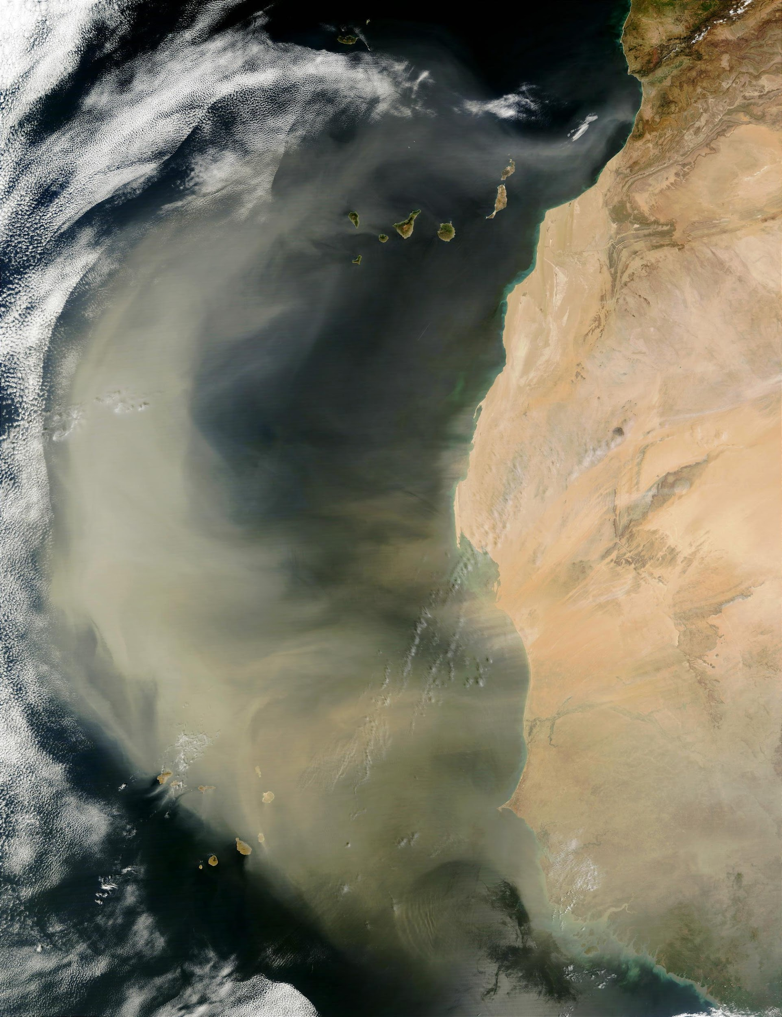

Aerosol/Cloud
Report Out
Aerosol/Cloud Community
Atmosphere Community Meeting April 2026, LaRC

Slide 2

Full list of aerosol / cloud science questions
https://docs.google.com/document/d/16pj5mYW3yAnynjTShOnfh9L7JW6HLTaWzHNyL5xf21o/edit?usp=sharing
Notes:
A group of 15 NASA GSFC experts in aerosols, clouds, convection and precipitation reached out to 35 internal/ external SMEs from national/ international agencies and universities, requesting ~430 relevant peer-reviewed papers and opinions in emails. The goal was to show the progress made so far on three science questions from the 2017 decadal survey, potential progress in the next five years and limitations that cannot be addressed using contemporary observations. In this 90’ talk, we present two aerosol/ cloud questions; Please do not cite these papers. The output of the AI/LLM was not checked for the extent to which the text may have been drawn directly from the cited source material or rewritten by the AI/LLM. It is recognized that some of the citations provided by the AI/LLM may include recursive references.

Slide 3
2014 Workshop: Aerosols (Part 1)
How are natural and anthropogenic aerosols and their impact on the radiation budget at the top, within, and at the bottom of the atmosphere changing in response to a warming climate, and how to these changes feed back to the climate system?
How will projected changes in atmospheric circulation affect aerosols within the climate system through generation, transport, and deposition mechanisms and through their impact on biogeochemical cycles?
What regions are most susceptible to aerosol phenomena, how are different aerosol types affecting regional brightening or dimming and what impacts are regional pollution controls and emissions changes having?
What are the connections between forcing in one region and impact in another and what are the underlying transport mechanisms of different aerosol types?
What are the meteorological processes that control the distribution, transport, and deposition of aerosols?
Clouds as transformative and removal processes.
Vertical redistribution, PBL entrainment/detrainment

Slide 4
2014 Workshop: Aerosols (Part 2)
What are the important underlying mechanisms through which aerosols impact the meteorological cycle? What are the relative magnitudes of the dynamic, radiative, microphysical, and thermodynamic effects, and when and where are these important?
At what temporal and spatial scales and at what loadings do different aerosol types impact the meteorological cycle, especially through their activation as cloud droplets?
How do biogenic emissions regulate secondary aerosol formation and how is this process influenced by cloud processing?
What is the vertically resolved distribution of atmospheric heating due to the presence of different types of aerosols in clear sky, partly cloudy, and cloudy conditions?
How do aerosol changes affect the radiation budget through the diurnal cycle?
How do different aerosol types, stratified by size and composition, from natural and anthropogenic sources affect air quality in the PBL and surface layer?

Slide 5
2014 Workshop: Clouds
What is the sensitivity of the climate system to low-level cloud structure and variability over the middle and high latitude oceans?
How will the radiative balance over sea ice and permafrost change as the polar regions warm? What are the important feedback mechanisms between clouds, precipitation, and surface processes in the high latitudes?
How will shortwave cloud forcing change as the climate warms?
How will long-wave cloud forcing change as climate warms?
How do clouds respond to perturbations in aerosols Cloud Condensation Nuclei (CCN) and Ice Nuclei (IN)?
What is the role of (mixed phase) snow and rain in cloud processes and how is this modulated by aerosols and dynamics?

Slide 6
High-Level Science Questions
NASA has the observational and modeling tools to monitor and understand consequences of geo-engineering.
  Community should make an assessment of the current observing system’s capabilities for detecting changes to the Earth system that result from environmental interventions.
How do we explain recent and future trends in EEI and reduce uncertainty in the ECS by improving aerosol and cloud observations?
  Leveraging current Program of Record (PoR) and innovative integrated modeling and observations?
The community needs to better tie in to stakeholders via NASA’s Earth Action activities.
  E.g., air quality, wildfires, extreme events, etc.
How do aerosols, clouds, and precipitation interact with the PBL evolution and surface atmosphere exchange?
  Wet/dry deposition was a focus of much discussion. Also affects on air quality, resources (solar radiation), trace gas mixing, etc.
How do clouds and aerosols interact with circulations at all scales through radiative and latent heating processes?
  Scales range from meters to global circulations.

Slide 7
Notable Specific Themes/Topics
Aerosol/cloud community strongly supports synergistic orbits for FALCON-lidar and FALCON-radar to optimize science ROI
Support integrated quantitative observing-modeling frameworks, e.g., calibrated physics ensembles
  Bridges gap between modeling and observations
  Can inform on the observational gaps and future measurement needs
  Can be used to quantify societal impacts of global change, e.g., floods, droughts, etc.
  Clearly define the roles of IMVI in facilitating science and identify mechanisms to support modeling outside the current scope (e.g., LES, stratospheric aerosols, etc.)
Better leverage the PoR (orbital and sub-orbital)
  Stewarding key datasets (i.e., calibration, GVs - continuity) and ground networks
  Identify opportunities for synergistic retrievals using both orbital and airborne data
  Prioritize efforts at characterizing uncertainty to enhance usefulness
Identify airborne field campaign opportunities to complement FALCON radar/lidar/radiometer (filling science gaps, cal/val, etc.)
Various non-observed processes were identified that need attention for modeling applications. What else? Can such gaps inform new innovative space instrumentation?
Need identified for working group (or similar) targeted at ML best practice guidelines
A lot of emphasis on temporal evolution and cloud dynamics as key to constraining processes at various scales
Also a lot of emphasis on vertical profiling of both aerosol and cloud keeps. Current capabilities are not sufficient for many science questions. I.e., radiative fluxes/heating rates, boundary layer science, etc.
NASA is uniquely positioned to support high risk/high reward research on new techniques of data assimilation, assimilating new datasets (e.g., active instruments and cloudy observations), etc.
Need to identify and acknowledge cross-cutting research themes (e.g., with radiation budget and weather themes; hydrosphere)
A common theme is that we’re still asking the same questions as we were in 2014. How do we better utilize what we have, and organize ourselves, to make better progress.

