Slide 1
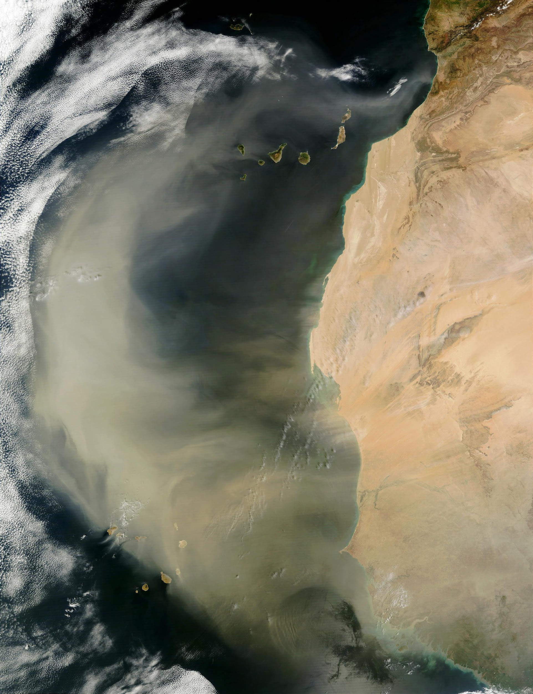

Aerosol/Cloud
Alphabetical Order (speaker): S. Bauer, B. Cairns, P. Castellanos, P. Colarco, L. Ding, G. Elsaesser, R. Espinosa, J. Gong, M. Kacenelenbogen, M. Lebsock, K. Loftus, X. Lu, W. Marais, D. McCoy, K. Meyer, R. Moore, C. Orbe, L. Oreopoulos, R. Schulte, P. Selmer, S. Stamnes, T. Thorsen, F. Tornow, T. Vadal, M. van Lier-Walqui, H. Yu, T. Yuan, L. Zamora, ARCSIX team
Atmosphere Community Meeting April 2026, LaRC

Slide 2

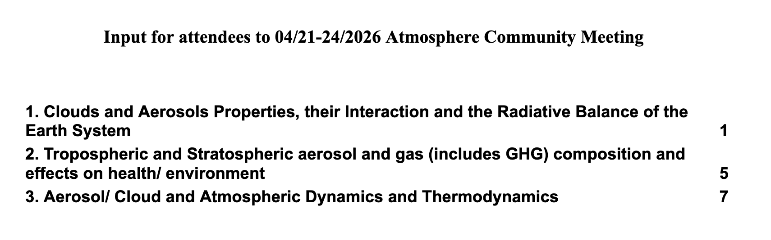
Intro
Modeling
Orbital
Suborbital
Q&A
Compiled list of your aerosol / cloud science questions for this meeting
Please add comments online with your name today
https://docs.google.com/document/d/16pj5mYW3yAnynjTShOnfh9L7JW6HLTaWzHNyL5xf21o/edit?usp=sharing
Notes:
A group of 15 NASA GSFC experts in aerosols, clouds, convection and precipitation reached out to 35 internal/ external SMEs from national/ international agencies and universities, requesting ~430 relevant peer-reviewed papers and opinions in emails. The goal was to show the progress made so far on three science questions from the 2017 decadal survey, potential progress in the next five years and limitations that cannot be addressed using contemporary observations. In this 90’ talk, we present two aerosol/ cloud questions; Please do not cite these papers. The output of the AI/LLM was not checked for the extent to which the text may have been drawn directly from the cited source material or rewritten by the AI/LLM. It is recognized that some of the citations provided by the AI/LLM may include recursive references.

Slide 3
Baseline
Intro
Modeling
Orbital
Suborbital
Q&A
NASA has global climate (ModelE) and Seasonal/NWP-scale (GEOS) models with various compositional capabilities at representing aerosols (bulk, moments/modal, sectional) and couplings to chemistry, radiation, and clouds
Horizontal scales range from ~100 km to ~2 km depending on application. Vertical scales presently to ~80 km; work ongoing to increase vertical resolution (e.g., 72 -> 181 levels) and model top to go above mesosphere.
Fundamental aerosol-relevant outputs include CMIP-class simulations (ModelE), S2S and NWP (GEOS), including reanalyses (MERRA-2, MERRA-21C)

Slide 4
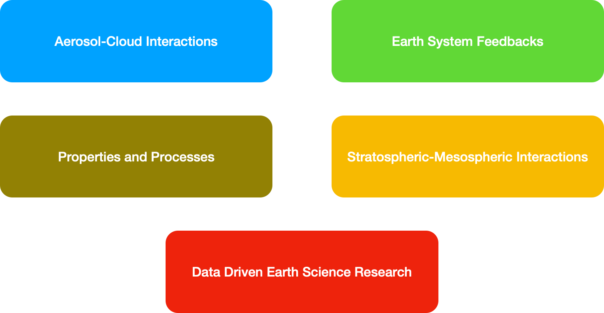
Where do we want to take these models?
Intro
Modeling
Orbital
Suborbital
Q&A

Slide 5
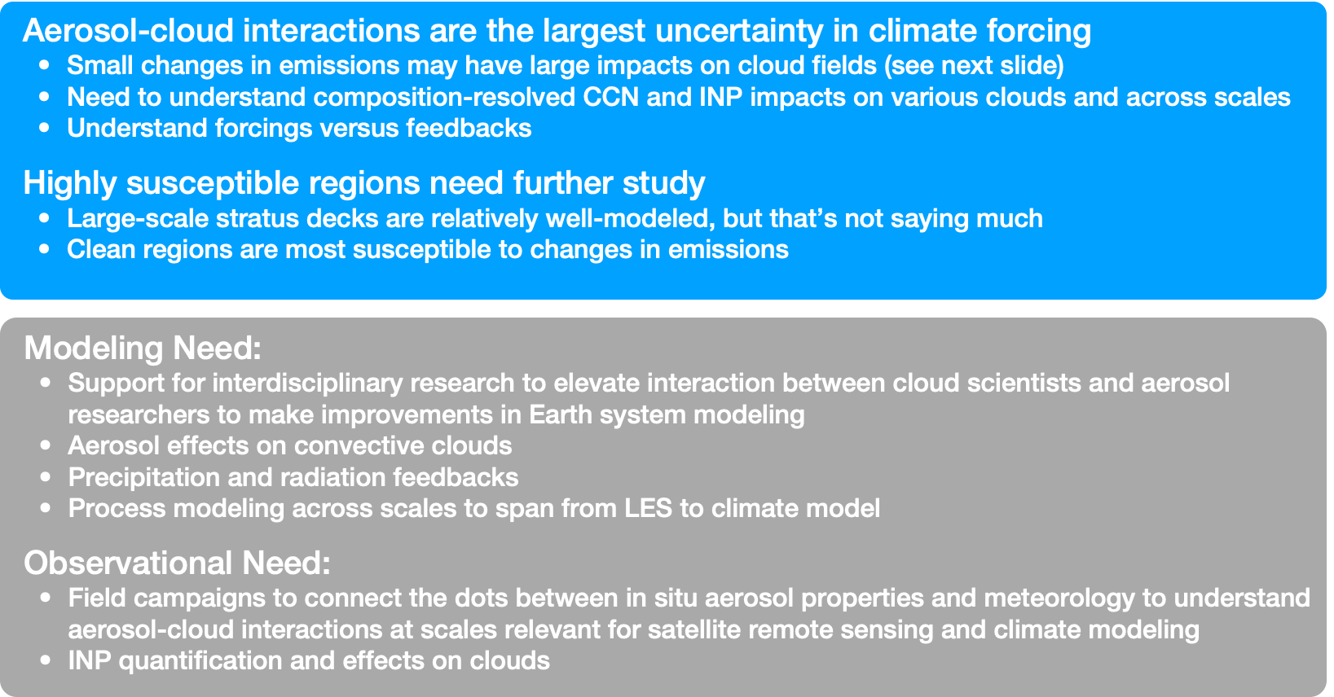
Aerosol-Cloud Interactions
Intro
Modeling
Orbital
Suborbital
Q&A

Slide 6
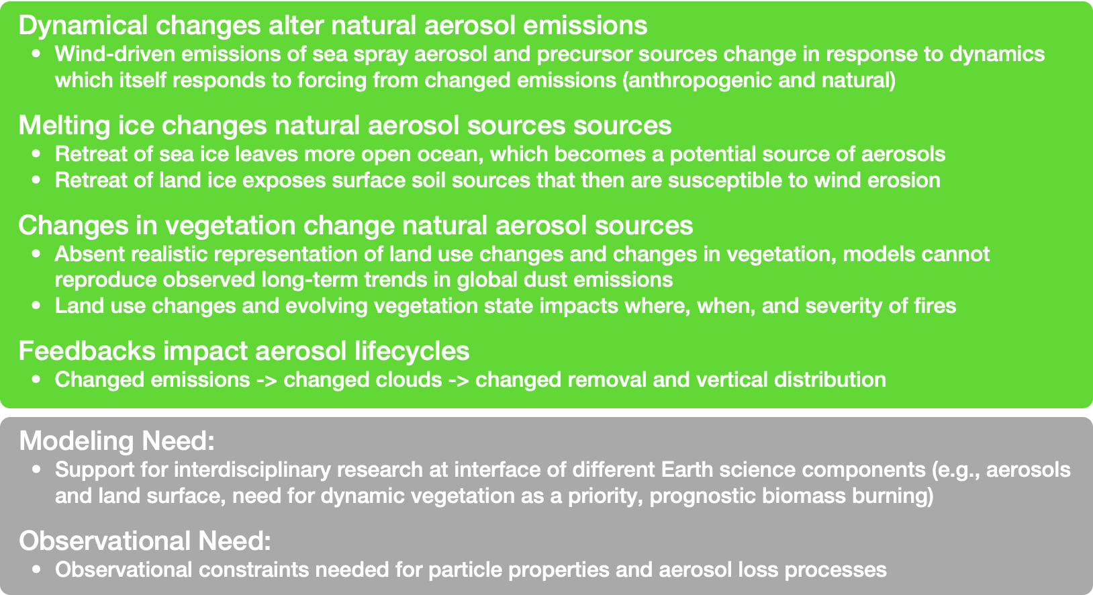
Earth System Feedbacks on Natural Aerosols
Intro
Modeling
Orbital
Suborbital
Q&A

Slide 7
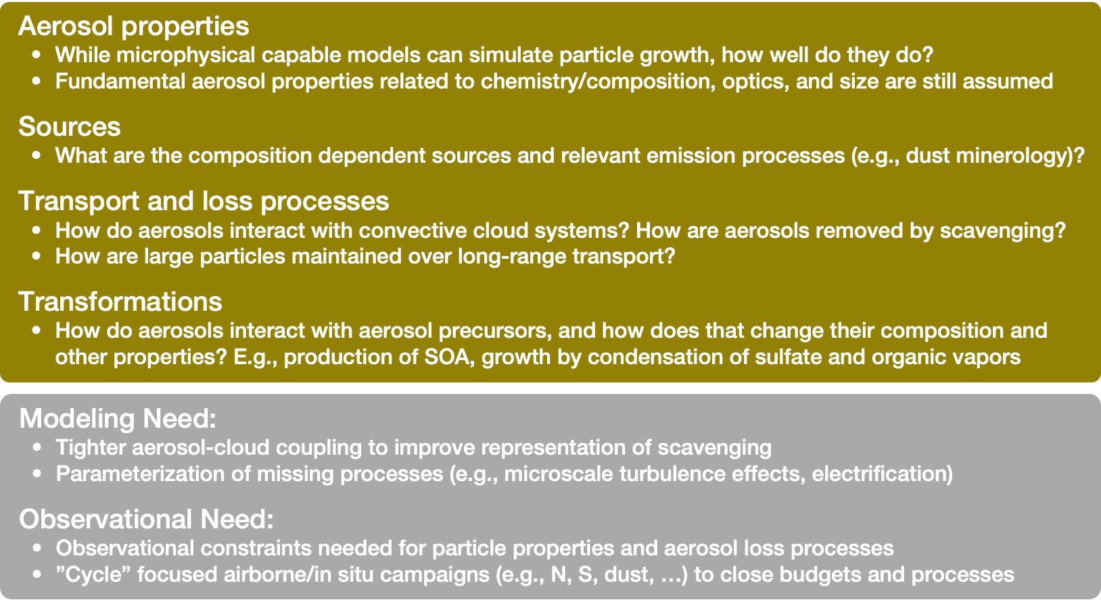
Properties and Processes
Intro
Modeling
Orbital
Suborbital
Q&A

Slide 8
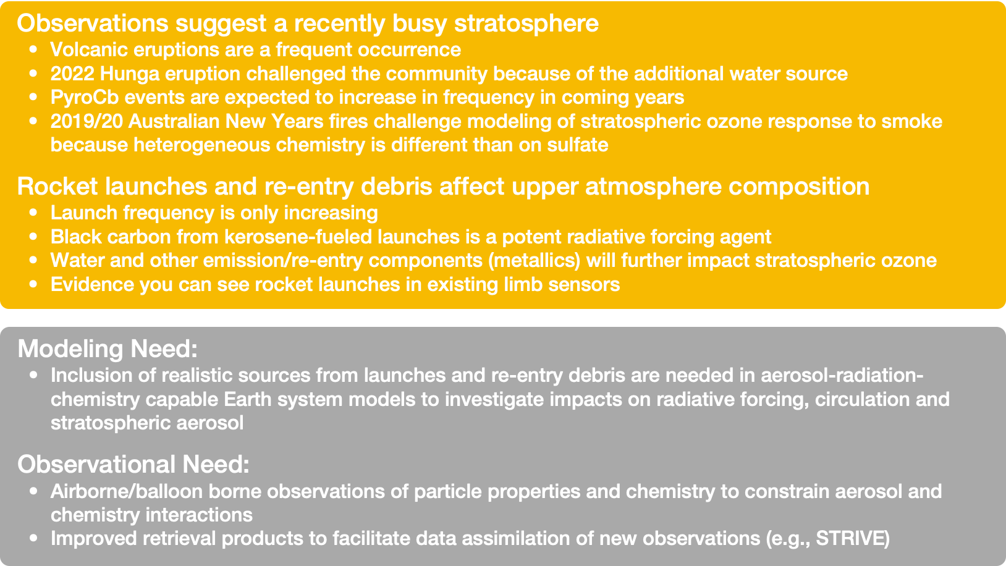
Stratospheric-Mesospheric Aerosols
Intro
Modeling
Orbital
Suborbital
Q&A

Slide 9
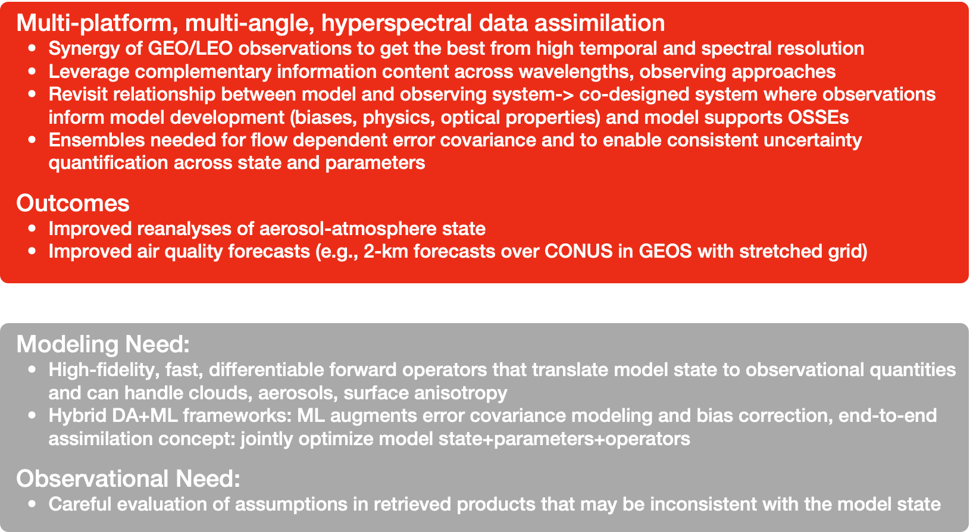
Data Driven Modeling
Intro
Modeling
Orbital
Suborbital
Q&A

Slide 10
Satellite Program of Record (PoR) for Aerosols and Clouds
Intro
Modeling
Orbital
Suborbital
Q&A
The Program of Record (PoR) consists of the concurrent (over the next decade) domestic and international spaceborne missions that provide observations and geophysical variables of relevance for aerosols and clouds.
  The PoR is an essential enabling capability that can be integrated with current and future missions and whose observations/geophysical retrievals can be leveraged by those missions to meet mission requirements.
    Example: NOAA’s JPSS has enabled the extension of many key EOS data records (e.g., MODIS, AIRS, AMSR-E, CERES → VIIRS, CrIS, ATMS, CERES/Libera)
  Also includes sub-orbital, ground networks, or other assets (next topic)
Some caveats…
  The breadth of the concurrent spaceborne observations that can be leveraged to address aerosol and cloud science questions over the next decade is large and difficult to summarize succinctly in a few slides.
    Scope expanded further by commercial instruments – not included here, though their role is expected to increase
  Instead, we provide a high-level overview of the general capabilities offered by the PoR – some instruments/missions, and instrument specifics and other detailed information, may be incomplete or missing.
  For context, we also include notable EOS/A-Train heritage instruments, many of which are passivated or nearing passivation. And, we will avoid, to the extent possible, naming specific algorithms and products.

Slide 11
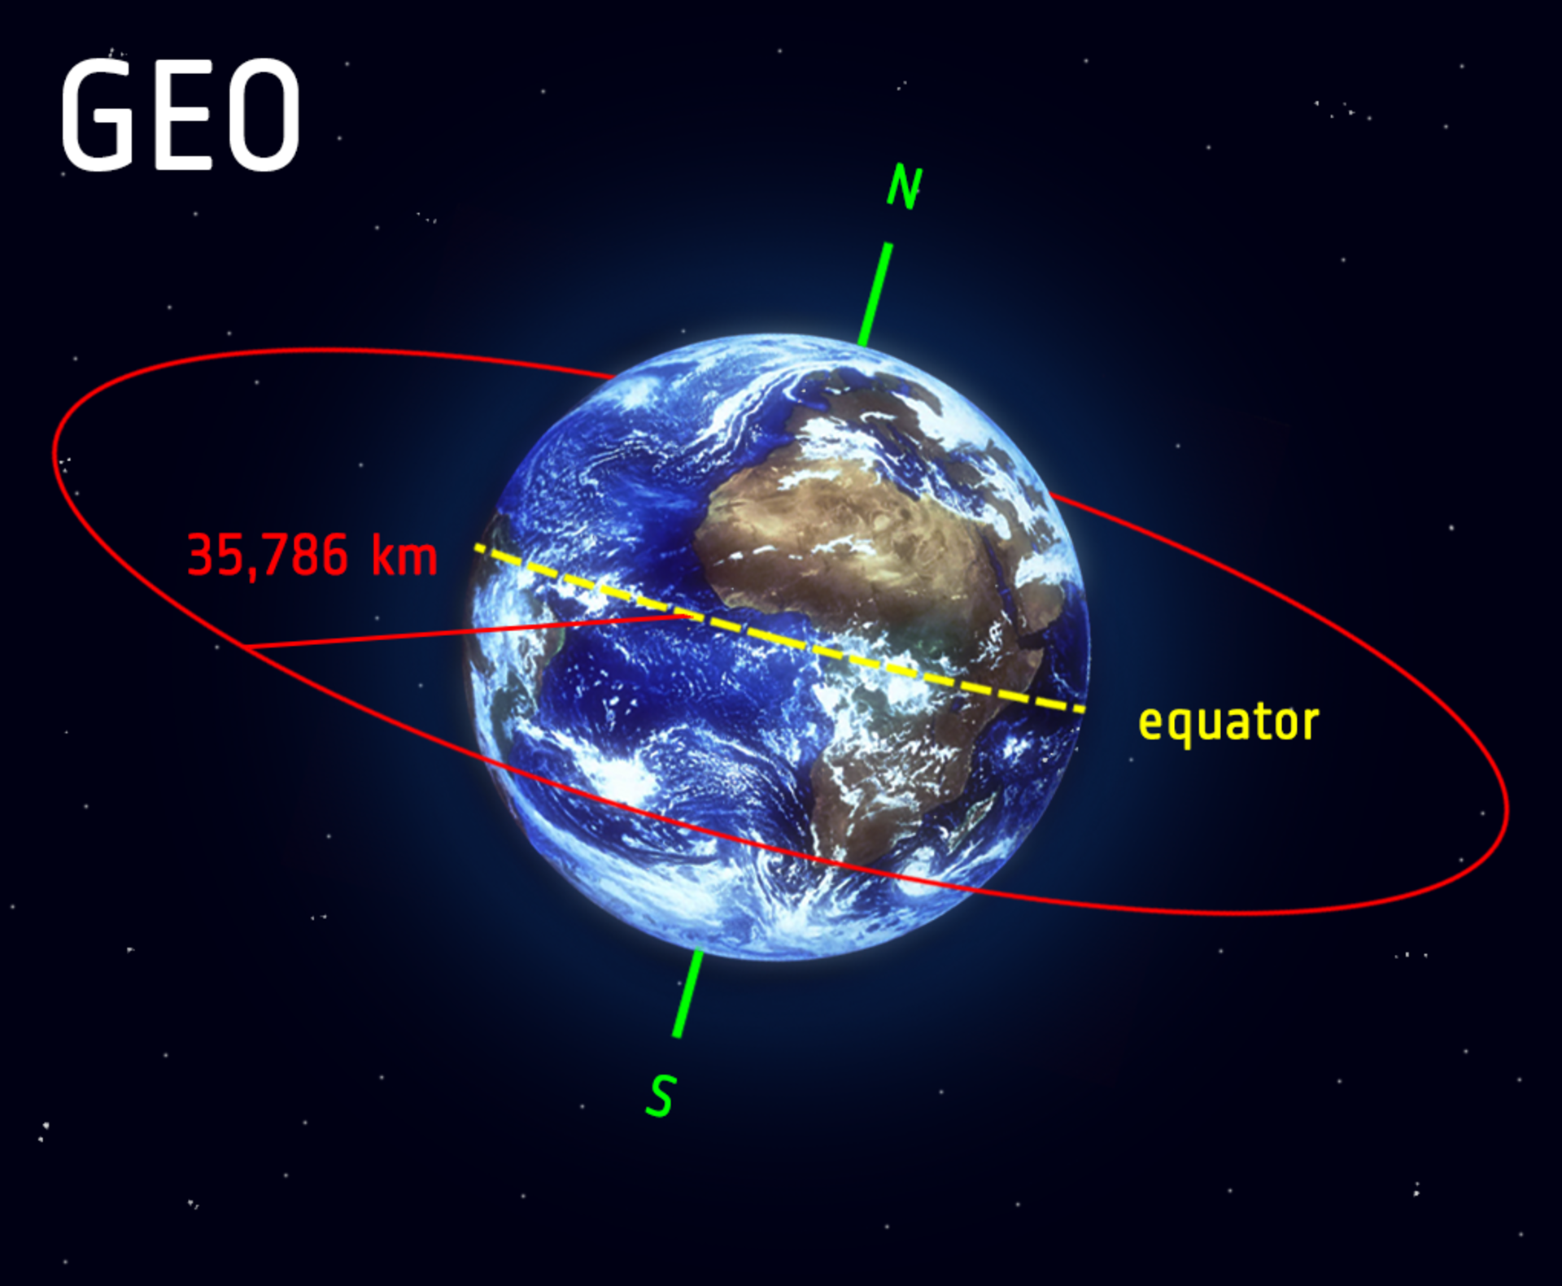
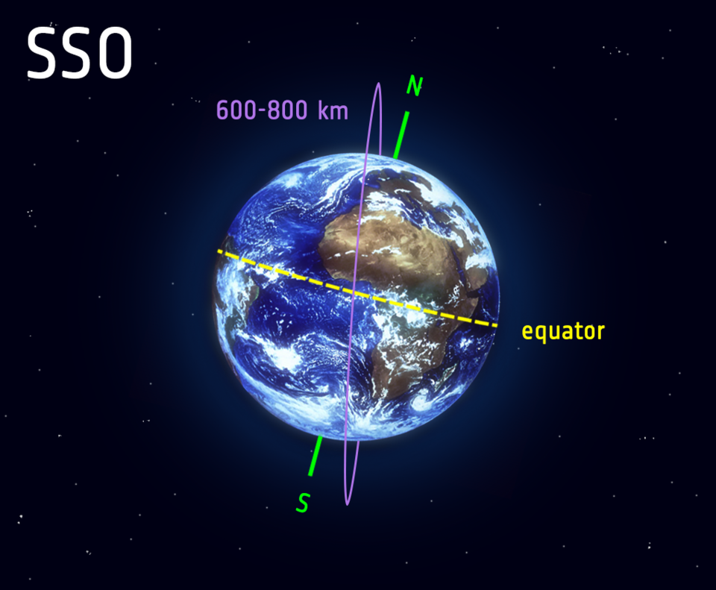
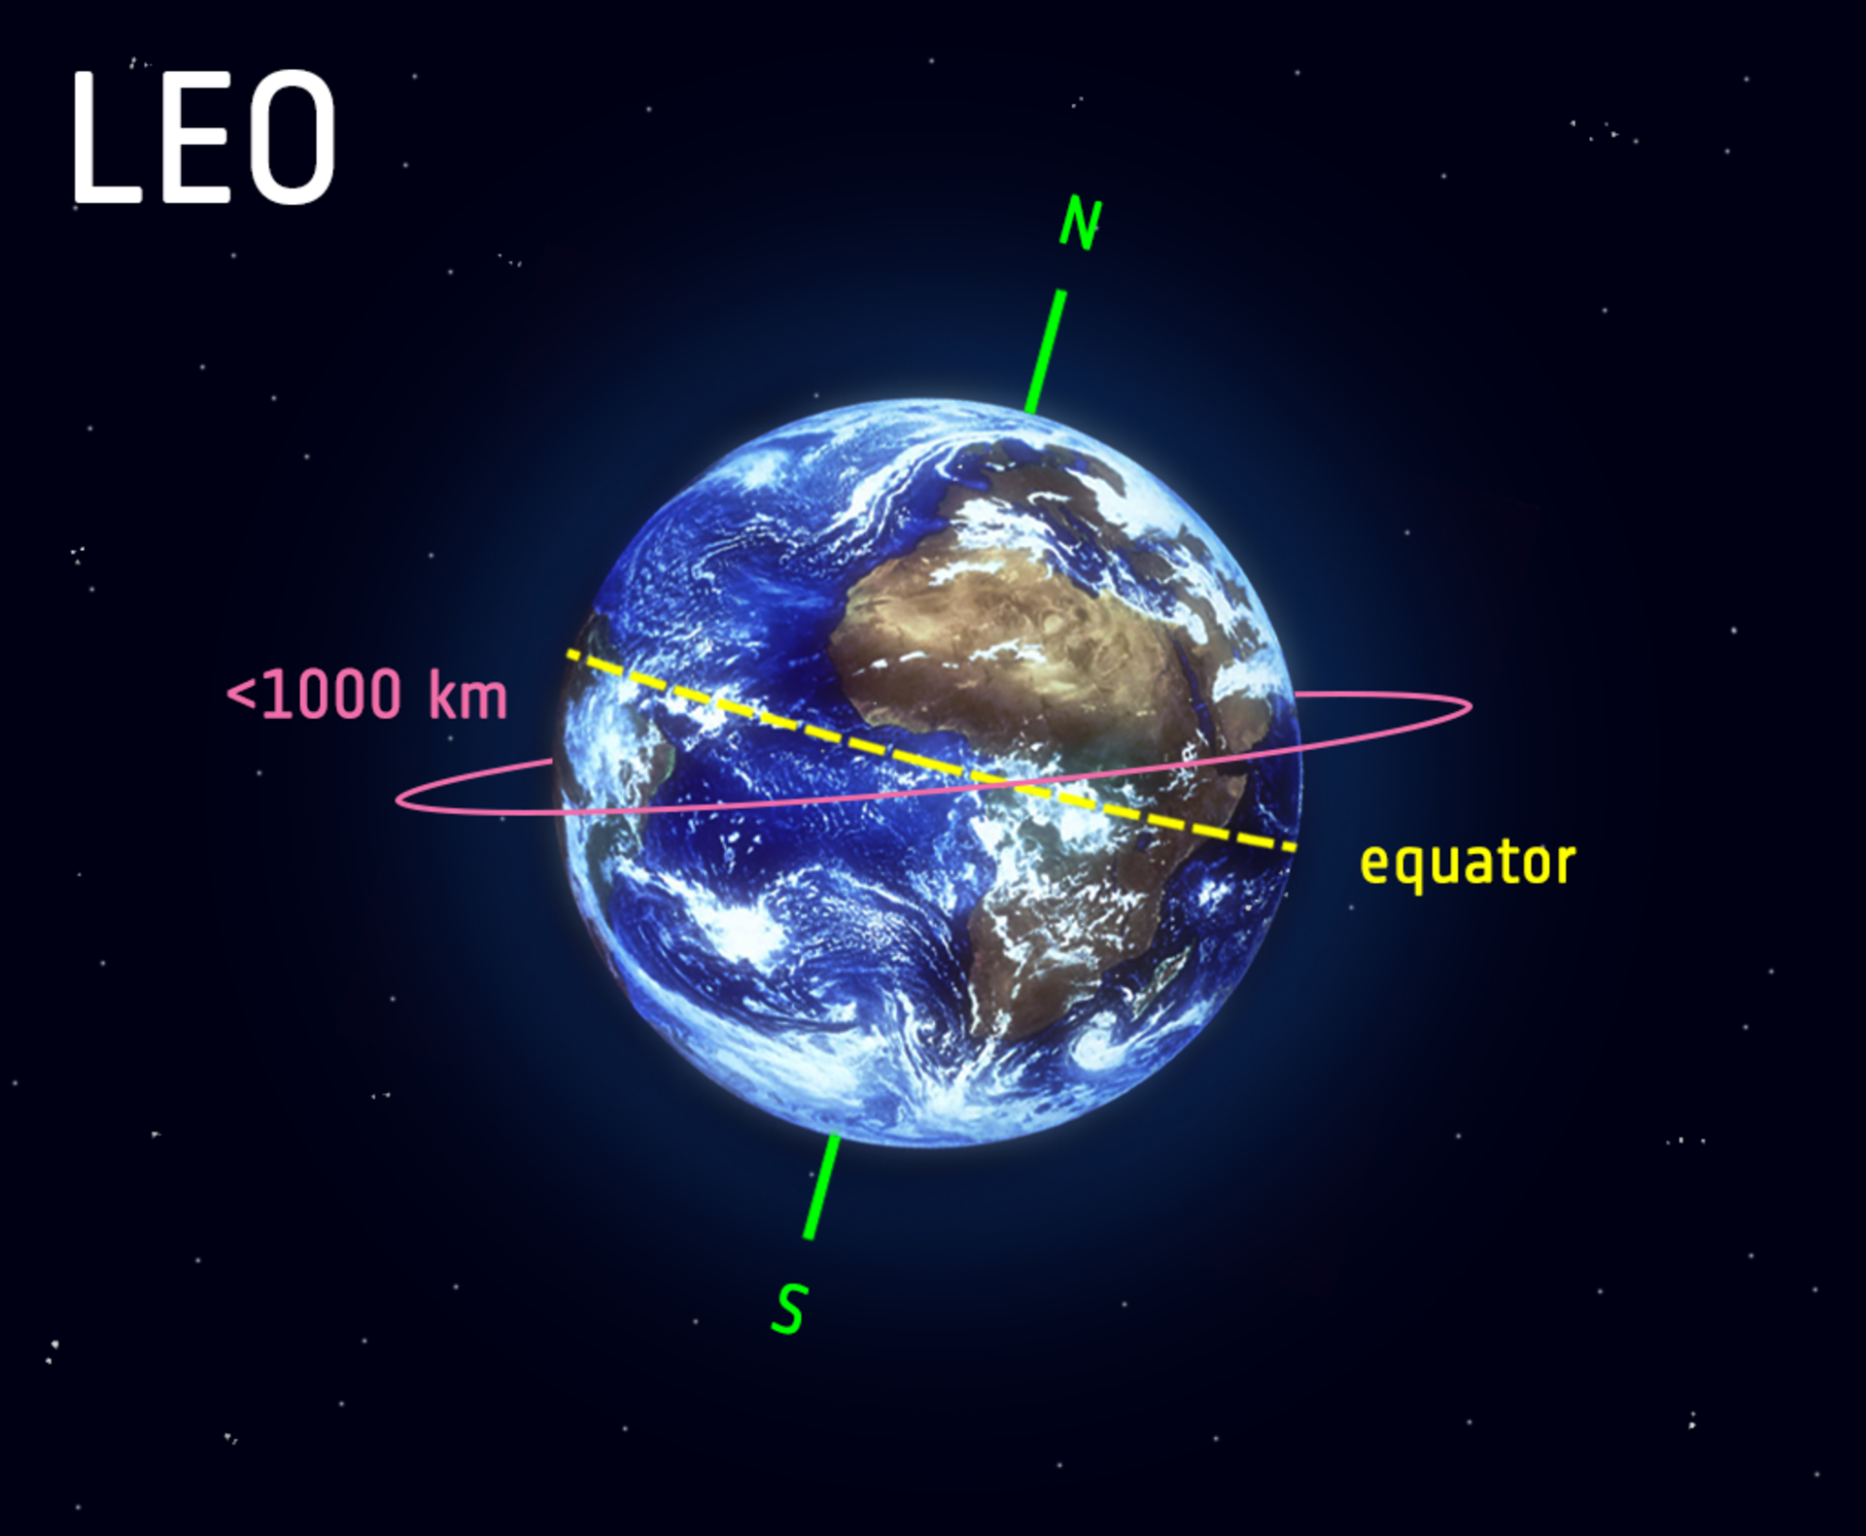
Satellite Program of Record: Orbit Types
GEO
Geostationary (geosynchronous – GEO)
  Orbit at ~36,000 km altitude to match Earth’s rotation
  Provide continuous observations of the same portion of the globe, day and night
  Altitude, large field of regard, and operational requirements historically have limited instrument spectral/spatial resolution capabilities
    But, capabilities are advancing rapidly (e.g., current GEO imagers, IR sounders recently launched or currently in development, etc.)
Polar orbit (sun-synchronous low earth orbit – SSO)
  Orbit at ~600-850 km
  Cross equator at fixed local times, thus observing a given location only twice per day
  Lower altitude enables sensors to observe Earth with moderate to high spectral and/or spatial (and angular) capabilities
    Also enables both active (lidar, radar) and passive (imagers, polarimeters, radiometers, sounders) observations
Precessing/inclined (asynchronous low earth orbit – ASO)
  Orbit altitude similar to SSO but with extremely inclined orbits
  Equator crossing times “precess” throughout the day, enabling varying observation times at a given location, though locations at higher latitudes (e.g., poles) may never be observed
Additional special orbits
  Lagrange points; elliptical/Molinya (“Tundra”)
SSO
Low Earth Orbit (LEO)
ASO
Image Credit: ESA

Slide 12
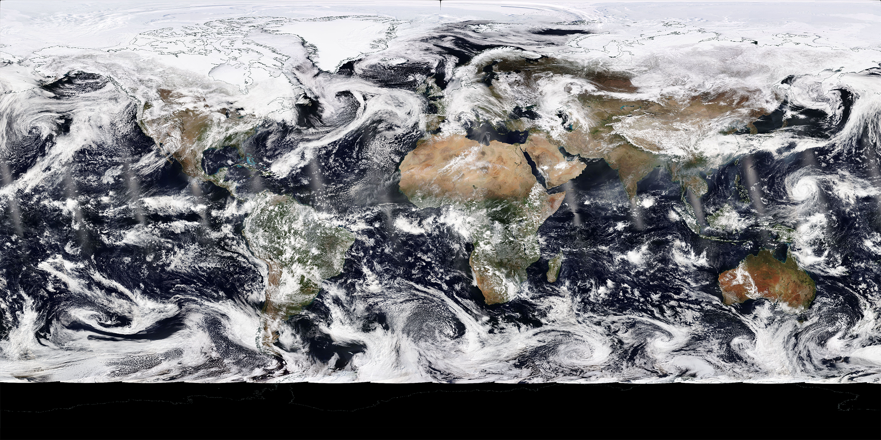
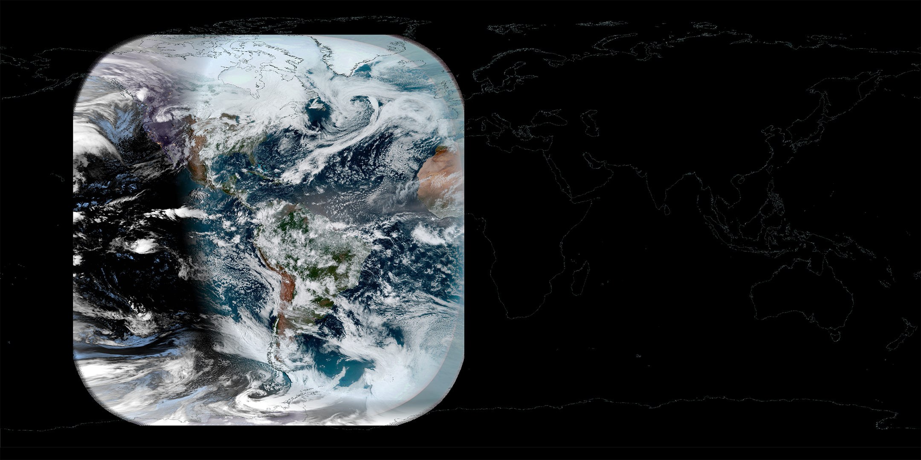
Notable SW Imagers
Satellite Program of Record: Imagers
 | Instrument (Platform) | Enabled Geophysical Observables
GEO | TEMPO (NASA Comm. Sat) | Aerosols (optical properties, type)
LEO-SSO | EOS Heritage: MISR (Terra); OMI (Aura) OMPS-N (NOAA-20+); OCI (PACE); MSI (EarthCARE, Sentinel-2); SLSTR (Sentinel-3); UVNS (Sentinel-6) | Aerosols (optical properties, type, ATH) Clouds (CEP, optical properties, phase)
LEO-ASO | EMIT (ISS) | Aerosols (optical properties, type)
Spectral capabilities:
  Observe reflected solar (shortwave – SW) or emitted terrestrial (thermal infrared – IR; microwave – MW) radiation
  Resolution/sampling: Often narrowbands; some SW imagers provide contiguous sampling
Spatial capabilities:
  Coverage: swath (LEO) or disc (GEO)
  Resolution (pixel size): meters to kilometers
Geophysical capabilities:
  Column macrophysical, optical, and microphysical aerosol and cloud properties
Notable SW+IR Imagers
 | Instrument (Platform) | Enabled Geophysical Observables
GEO | ABI (GOES-E/W); AHI (Himawari); AMI (GEOKOMPSAT-2A); FCI (MTG) | Aerosols (optical properties) Clouds (CTP, optical properties, phase)
LEO-SSO | EOS Heritage: MODIS (Terra, Aqua); ASTER (Terra) VIIRS (NOAA-20, etc.); METimage (Metop-SG) | Aerosols (optical properties) Clouds (CTP, optical properties, phase)
GOES-E ABI
13 Apr 2026 (1340 UTC)
(Image Credit: NASA Worldview)
Notable IR and MW Imagers
 | Instrument (Platform) | Enabled Geophysical Observables
LEO-SSO | EOS Heritage: AMSR-E (Aqua) MWI, ICI (Metop-SG); PREFIRE; MWR (Sentinel-3); AMR-C, HRMR (Sentinel-6); AMSR-2 (GCOM-W1); FALCON-Radiometer*; TICFIRE (HAWC) | Clouds (liquid/ice water path, optical properties)
LEO-ASO | PolSIR | Clouds (cloud ice content)
NOAA-21 VIIRS
13 Apr 2026
(Image Credit: NASA Worldview)
U.S. (e.g., NASA, NOAA), International Partners
* Included here for reference only; orbit, spectral, etc. details still TBD

Slide 13
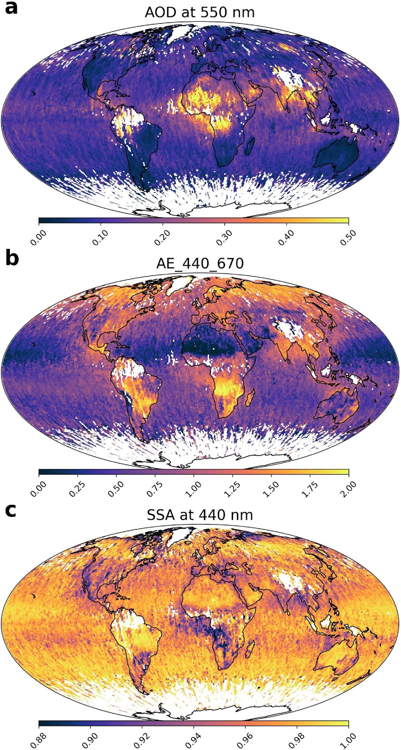
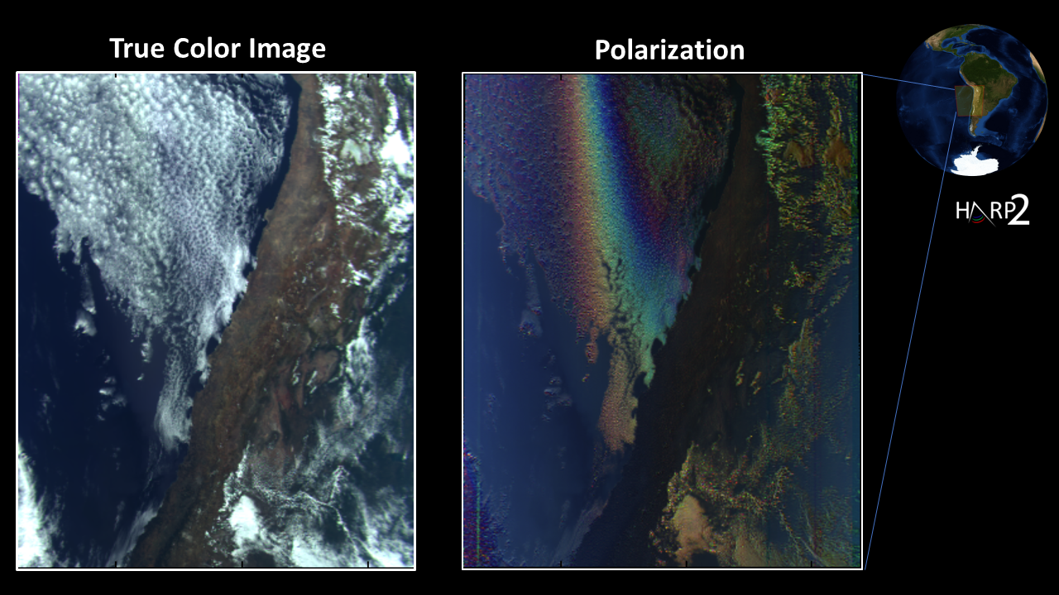
Satellite Program of Record: Polarimeters
Spectral capabilities:
  Observe intensity and the linear polarization state of reflected solar (SW) radiation (typically UV/VIS/NIR)
  Resolution/sampling: Narrowbands or contiguous
Spatial capabilities:
  Coverage: swath
  Resolution (pixel size): kilometers
Geophysical capabilities:
  Column macrophysical, optical, and microphysical properties of aerosols and clouds
  Enhanced capability when used alongside lidars, particularly for aerosols
Notable Polarimeters
 | Instrument (Platform) | Enabled Geophysical Observables
LEO-SSO | A-Train Heritage: POLDER (PARASOL) HARP-2, SPEXone (PACE); 3MI (Metop-SG); SLSTR (Sentinel-3); MAIA | Aerosols (optical & microphysical properties, aerosol type) Clouds (CEP, phase, optical properties, size distribution [effective radius and variance])
U.S. (e.g., NASA, NOAA), International Partners
PACE SPEXone Aerosol Retrieval Statistics
23 Feb – 31 Aug 2024
(Image Credit: Fig. 4, Fu et al., 2025)
PACE HARP-2 “First Light”
11 Mar 2024
(Image Credit: UMBC)

Slide 14
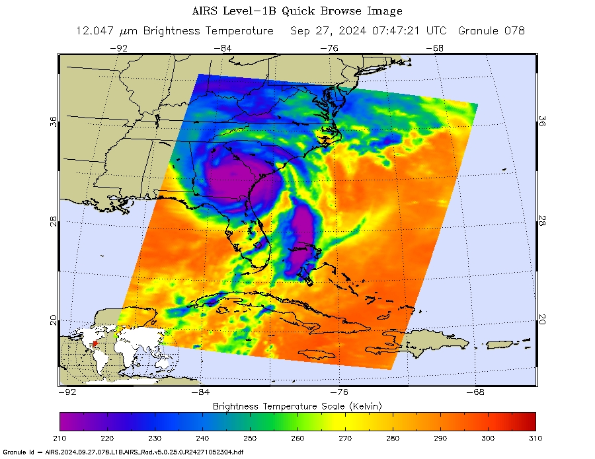
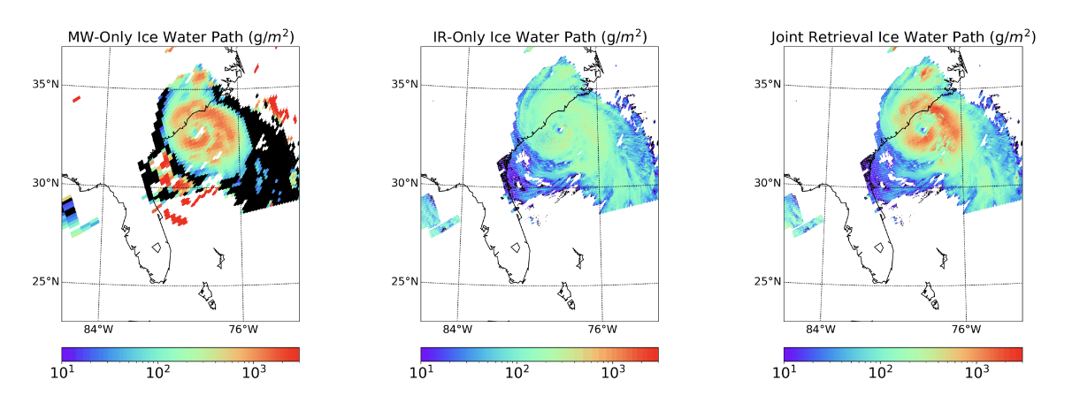
Satellite Program of Record: IR and MW Sounders
Notable IR and MW Sounders
Spectral capabilities:
  Observe emitted terrestrial (thermal infrared – IR; microwave – MW) radiation
  Resolution/sampling: Contiguous (or nearly) over broad portions of the spectrum
Spatial capabilities:
  Coverage: swath (LEO) or disc (GEO)
  Resolution (pixel size): kilometers
Geophysical capabilities:
  Column macrophysical, optical, and microphysical cloud properties; some limited aerosol information content (e.g., dust in the IR)
  Profiles of atmospheric properties (improved vertical information compared to narrowband imagers)
  Consistent day/night performance
 | Instrument (Platform) | Enabled Geophysical Observables
GEO | IRS (MTG); GXS (GeoXO) | Clouds (CTP, phase, optical properties)
LEO-SSO | EOS Heritage: AIRS, AMSU (Aqua); MLS (Aura) CrIS, ATMS (NOAA-20+); MWS (Metop-SG); MWR (AWS/EUMETSAT-Sterna); ALICE, ARGOS (STRIVE)*; ALI (HAWC)* | Clouds (liquid/ice water path, CTP, phase, optical properties)
U.S. (e.g., NASA, NOAA), International Partners
* Limb profilers, categorized here with instrument “kin”
SNPP ATMS + VIIRS Ice Water Path Retrievals
3 Jul 2024 (1805 UTC)
Aqua AIRS 12.047µm BT
Hurricane Helene landfall, 27 Sep 2024
(Image Credit: NASA JPL/CalTech)

Slide 15
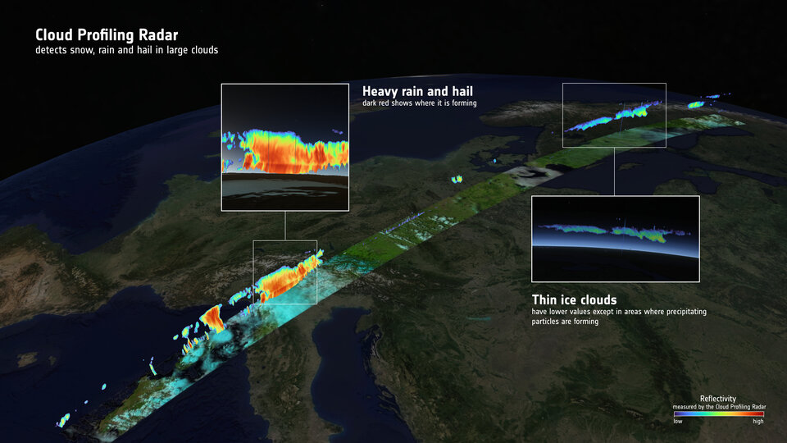
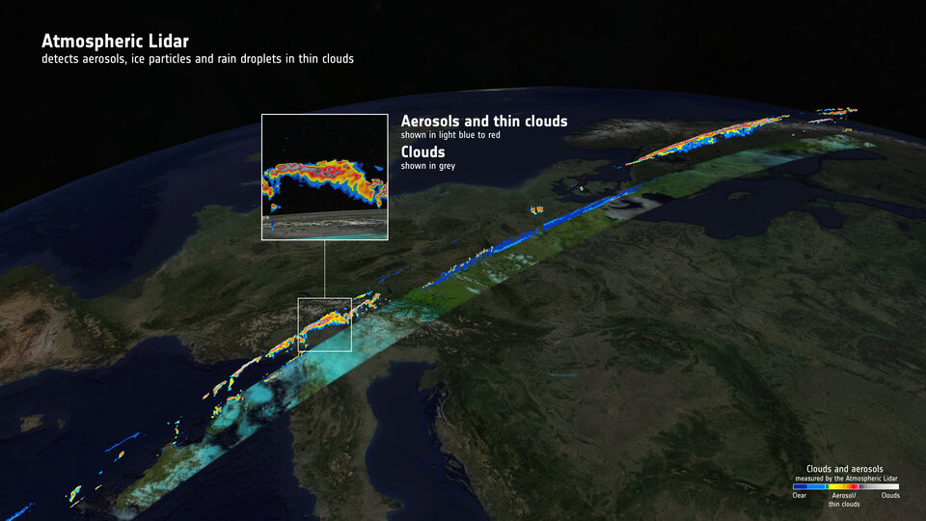
Satellite Program of Record: Active Lidar/Radar
Spectral capabilities:
  Observe returned SW (lidar) or MW (radar) instrument-emitted pulses
  Resolution/sampling: Near monotonic wavelength (lidar) or frequency (radar)
Spatial capabilities:
  Coverage: nadir only (or limited ”swath” from multiple beams)
  Resolution: meters to kilometers
Vertical profiling capabilities:
  Provide direct measurement of vertical profile of aerosols and clouds
Geophysical capabilities:
  Profiles of macrophysical, optical, and microphysical aerosol and cloud properties
  Often used as training/validation datasets for passive algorithms
Notable Lidars and Radars
 | Instrument (Platform) | Enabled Geophysical Observables
LEO-SSO | EOS Heritage: CALIOP (CALIPSO); CPR (CloudSat) Other Recent Heritage: AWL (Aeolus) ATLID, CPR (EarthCARE); ICESat-2; FALCON-Lidar*, FALCON-Radar*; LUCE | Aerosols (AOD, type) Clouds (CTH, COT, WP)
U.S. (e.g., NASA, NOAA), International Partners
* Included here for reference only; orbit details still TBD
EarthCARE CPR/ATLID Curtains
18 Sep 2024
(Image Credit: ©ESA)
Notes:
EarthCARE imagery from https://www.esa.int/Applications/Observing_the_Earth/FutureEO/EarthCARE/EarthCARE_synergy_reveals_power_of_clouds_and_aerosols.

Slide 16
Satellite Program of Record: Considerations and Challenges
Intro
Modeling
Orbital
Suborbital
Q&A
Spatial/temporal sampling and operational periods (“disaggregation”):
  Differences in orbits, swath, operational periods, among others, inherently determine inter-sensor spatial/temporal coincidence and, ultimately, how the various PoR observations can be used collectively
  Enabling activities (MIO? MAAP?) focused on data staging, co-location, dataset merging, and other related tools will be essential to fully leverage the PoR.
Data products, availability, and stewardship:
  A mission/instrument may have spectral/observational capabilities sufficient for aerosol and/or cloud work, but relevant geophysical algorithms/products may not exist…
  …or, relevant algorithms/products may exist, though from various sources and may not be internally consistent (with NASA-heritage algorithms/products or otherwise)
    E.g., RT assumptions; aerosol/cloud radiative model assumptions; scene classification decision making (e.g., cloud mask); etc.
  Divergent operational/mission requirements, or agency/organization mandates, may not prioritize stable, well-characterized radiometric (L1B) and/or geophysical (L2/L3) datasets, nor inter-sensor consistency
  Strategic investment (FDP?) may be needed to identify (informed by modeling efforts?) and close perceived gaps and to enable stewardship of essential observational and geophysical data records (continuity).
Programmatic:
  Future mission designs seeking to leverage PoR observations/geophysical datasets for synergistic science and/or synergistic algorithms must assume the availability of those PoR datasets
  Again, strategic investment may be necessary to identify and close perceived gaps and for stewardship of essential data records.

Slide 17
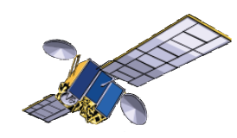

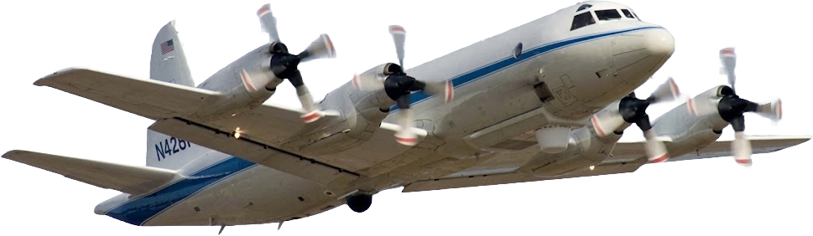
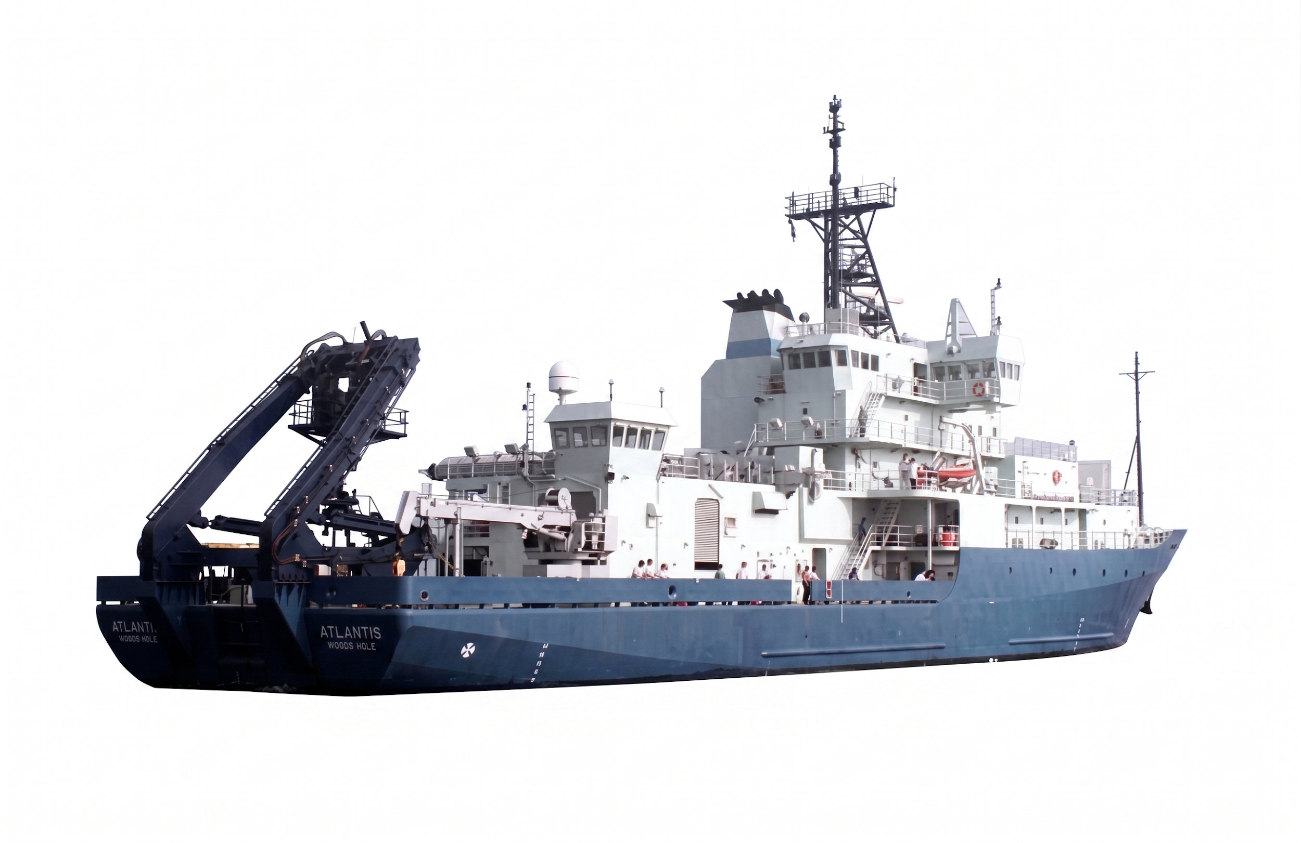
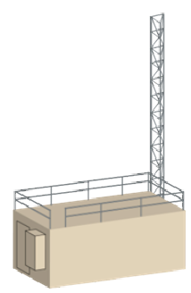
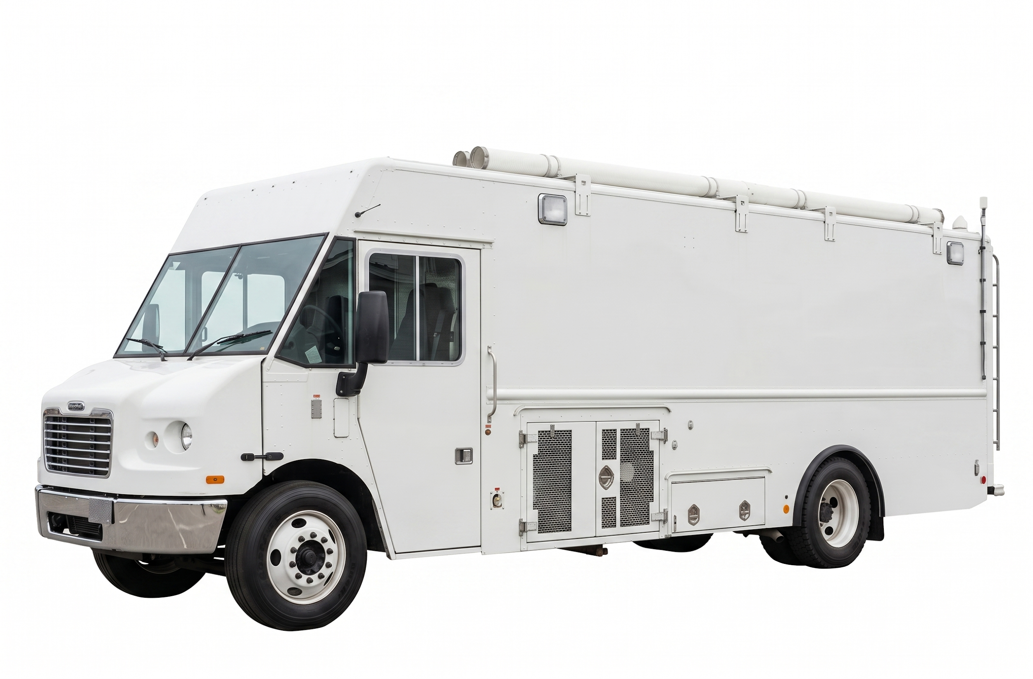
Integrated Observing System
Intro
Modeling
Orbital
Suborbital
Q&A
Satellite
Broad spatial coverage
Daytime coverage (GEO)
Limited frequency (LEO)
Limited vertical resolution
Airborne
Limited temporal and spatial coverage
Detailed vertical structure
Comprehensive in situ composition
Passive and active remote sensing
Satellite calibration/validation
Algorithm development
Model error evaluation
Diagnostic modeling studies
Correlative information
Data assimilation
Small scale process studies
Surface
Limited spatial coverage
Continuous day/night observation
Comprehensive in situ composition
Passive and active remote sensing
Model
Aerosol emissions, transport, & chemistry
Cloud activation & evolution
Atmospheric dynamics
Figure from Jim Crawford, Katie Travis, NASA Langley
See also “Three-way street”, Kahn et al., Rev. Geophys., 2023

Slide 18
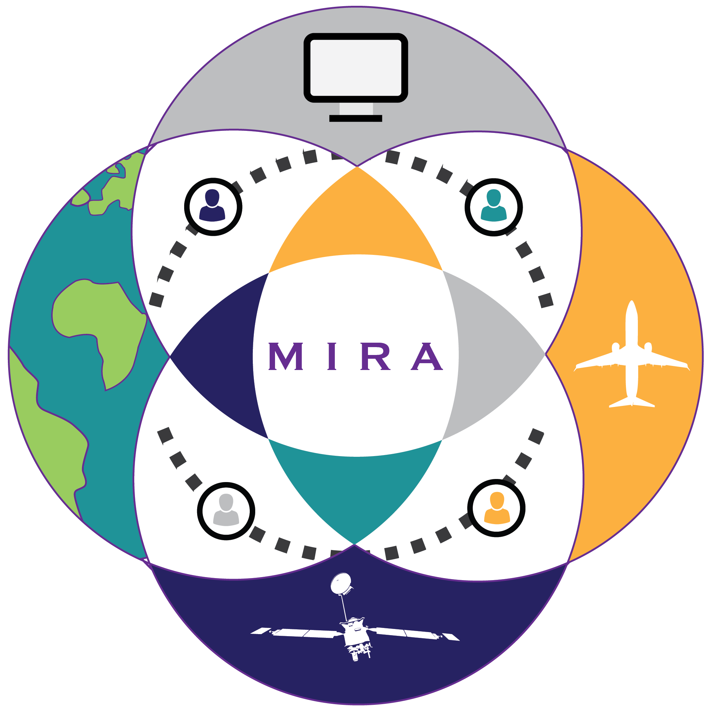
Evolving Scope of Suborbital Campaigns
Intro
Modeling
Orbital
Suborbital
Q&A
Extensive campaign program of record (NASA, NOAA, NSF, DOE, and Int’l Partners)
  Evolved from exploratory studies in the 1990s, 2000s to taking a more systematic, statistically-driven approach to science objectives in 2010-2020s.
  Earth Venture Suborbital missions, in particular, capture multiple seasons and years.
  Most datasets remain underutilized.
Extensive list of ground networks and observational campaigns
  Opportunities to augment existing networks with additional instruments.
  Leverage temporary or mobile ground assets by placing along orbit tracks and during airborne campaigns. ARM mobile facility is a particularly useful asset.
Goals for systematic sampling
  Build statistics of repeated, methodically comparable observations that can inform models and remote sensing algorithm development.
  Constrain the PDF of real-world variability for aerosol-cloud types & atmospheric regimes (https://science.larc.nasa.gov/mira-wg/).
  Quantify sub-grid-scale variability.
  Capture seasonality or large dynamic range at a single regional location.
  Capture dynamic range or representativeness across different regional locations.
Adapted from AOS Suborbital Working Group

Slide 19
Much aerosol instrument commonality across recent statistically-focused Tropospheric Chemistry, Radiation Sciences, and EV-S airborne campaigns
Intro
Modeling
Orbital
Suborbital
Q&A
Measurement Variables | 2024 | 2024 | 2024 | 2020-2022 | 2019 | 2019 | 2015-2018 | 2016-2018 | 2016-2018 | 2016 | 2013 | 2012 | 2011-2014
 | ARCSIX | ASIA-AQ | PACE-PAX | ACTIVATE | FIREX-AQ | CAMP2EX | NAAMES | ORACLES | ATom | KORUS-AQ | SEAC4RS | DC3 | DISCOVER-AQ
Extinction Coefficient (3-wavelengths) | Neph + PSAP | Neph + PSAP | Neph + PSAP | Neph + PSAP | Neph + PSAP + CRD | Neph + PSAP | Neph + PSAP | Neph + PSAP |  | Neph + PSAP | Neph + PSAP | Neph + PSAP | Neph + PSAP + CRD
Absorption Coefficient (3-wavelengths) | PSAP | PSAP | PSAP | PSAP | PSAP + Photoacoustic | PSAP | PSAP | PSAP |  | PSAP | PSAP | PSAP | PSAP
Particle Hygroscopic Growth Factor, f(RH) | Humid Neph | Humid Neph | Humid Neph | Humid Neph | Humid Neph | Humid Neph | Humid Neph | Humid Nephs |  | Humid Neph | Humid Neph + DASH | Humid Neph + DASH | Humid Neph
Particle Size Distribution | SMPS, LAS, UHSAS, FIMS | SMPS, LAS, UHSAS | UHSAS, POPS, APS | SMPS, LAS | SMPS, LAS, UHSAS | SMPS, LAS, FIMS | SMPS, LAS, FIMS | SMPS, UHSAS, APS | NMASS, UHSAS | SMPS, UHSAS, APS | SMPS, UHSAS, APS | SMPS, UHSAS, APS | SMPS, UHSAS/LAS, APS
Particle Composition | AMS + SP2 + ATOFMS | AMS + SP2 |  | AMS + PILS | AMS + Filters + SP2 | AMS + PILS + SP2 | AMS + PILS + SP2 | AMS + SP2 | AMS + SP2 + PALMS | AMS + Filters + SP2 | AMS + Filters + SP3 | AMS + Filters + SP2 | PILS + SP2
Particle Scattering Phase Function |  |  | LI-Neph |  | PI-Neph |  |  |  |  |  | PI-Neph | PI-Neph
Mass Extinction Efficiency | Neph + PSAP + AMS | Neph + PSAP + AMS | Neph + PSAP + Size + Assumed density | Neph + PSAP + AMS | Neph + PSAP + AMS | Neph + PSAP + AMS | Neph + PSAP + AMS | Neph + PSAP + AMS |  | Neph + PSAP + AMS | Neph + PSAP + AMS | Neph + PSAP + AMS | Neph + PSAP + AMS
Real Refractive Index | Neph + PSAP + UHSAS | Neph + PSAP + UHSAS | LI-Neph / Neph + PSAP + UHSAS | Neph + PSAP + LAS | Neph + PSAP + LAS | Neph + PSAP + LAS | Neph + PSAP + LAS | Neph + PSAP + UHSAS |  | Neph + PSAP + LAS | Neph + PSAP + LAS | Neph + PSAP + LAS | Neph + PSAP + LAS
Trace Gases (CO2, NO2, O3) |  | Extensive Chemistry Payload |  | LGR, 2B Tech | Extensive Chemistry Payload | DACOM | LGR, 2B Tech | CO | Extensive Chemistry Payload | Extensive Chemistry Payload | Extensive Chemistry Payload | Extensive Chemistry Payload | Extensive Chemistry Payload
Temperature, Pressure, Relative Humidity | Static T,P; Hygrometer | Static T,P; Hygrometer | Static T,P; Hygrometer | Static T,P; Hygrometer | Static T,P; Hygrometer | Static T,P; Hygrometer | Static T,P; Hygrometer | Static T,P; Hygrometer | Static T,P; Hygrometer | Static T,P; Hygrometer | Static T,P; Hygrometer | Static T,P; Hygrometer | Static T,P; Hygrometer
Aircraft Position | GPS, INS | GPS, INS | GPS, INS | GPS, INS | GPS, INS | GPS, INS | GPS, INS | GPS, INS | GPS, INS | GPS, INS | GPS, INS | GPS, INS | GPS, INS
Ambient Scattering Phase Function
Ambient Extinction (multiple wavelengths) | HALO, MARLi | HSRL-2 | HSRL-2 | HSRL-2 | DIAL-HSRL | HSRL-2 | HSRL-1 | HSRL-2 |  | DIAL-HSRL | DIAL-HSRL | DIAL-HSRL | HSRL-2
Large particle / cloud probe | FCDP, 2DS, CPI, HVPS | CDP, CPSPD | PCASP, CAPS | CDP, CAPS | CDP, CPSPD | PCASP, CPI, HVPS, FCDP | CDP, CAPS | PCASP, CAPS, 2DS, HVPS | CAPS | CDP, CPSPD | CDP, CPSPD | CDP, CPSPD | CDP, CAPS
Aerosol Layer Heights | HALO, MARLi | HSRL-2 | HSRL-2 | HSRL-2 | DIAL-HSRL | HSRL-2 | HSRL-1 | HSRL-2 |  | DIAL-HSRL | DIAL-HSRL | DIAL-HSRL | HSRL-2
Radiation | SSFR, BBR |  |  |  |  | SSFR, BBR | 4STAR | SSFR, 4STAR |  |  | SSFR, BBR | SSFR, BBR
Cloud Radar | APR-3 |  |  |  |  | APR3 |  | APR3
Adapted from AOS Suborbital Working Group

Slide 20
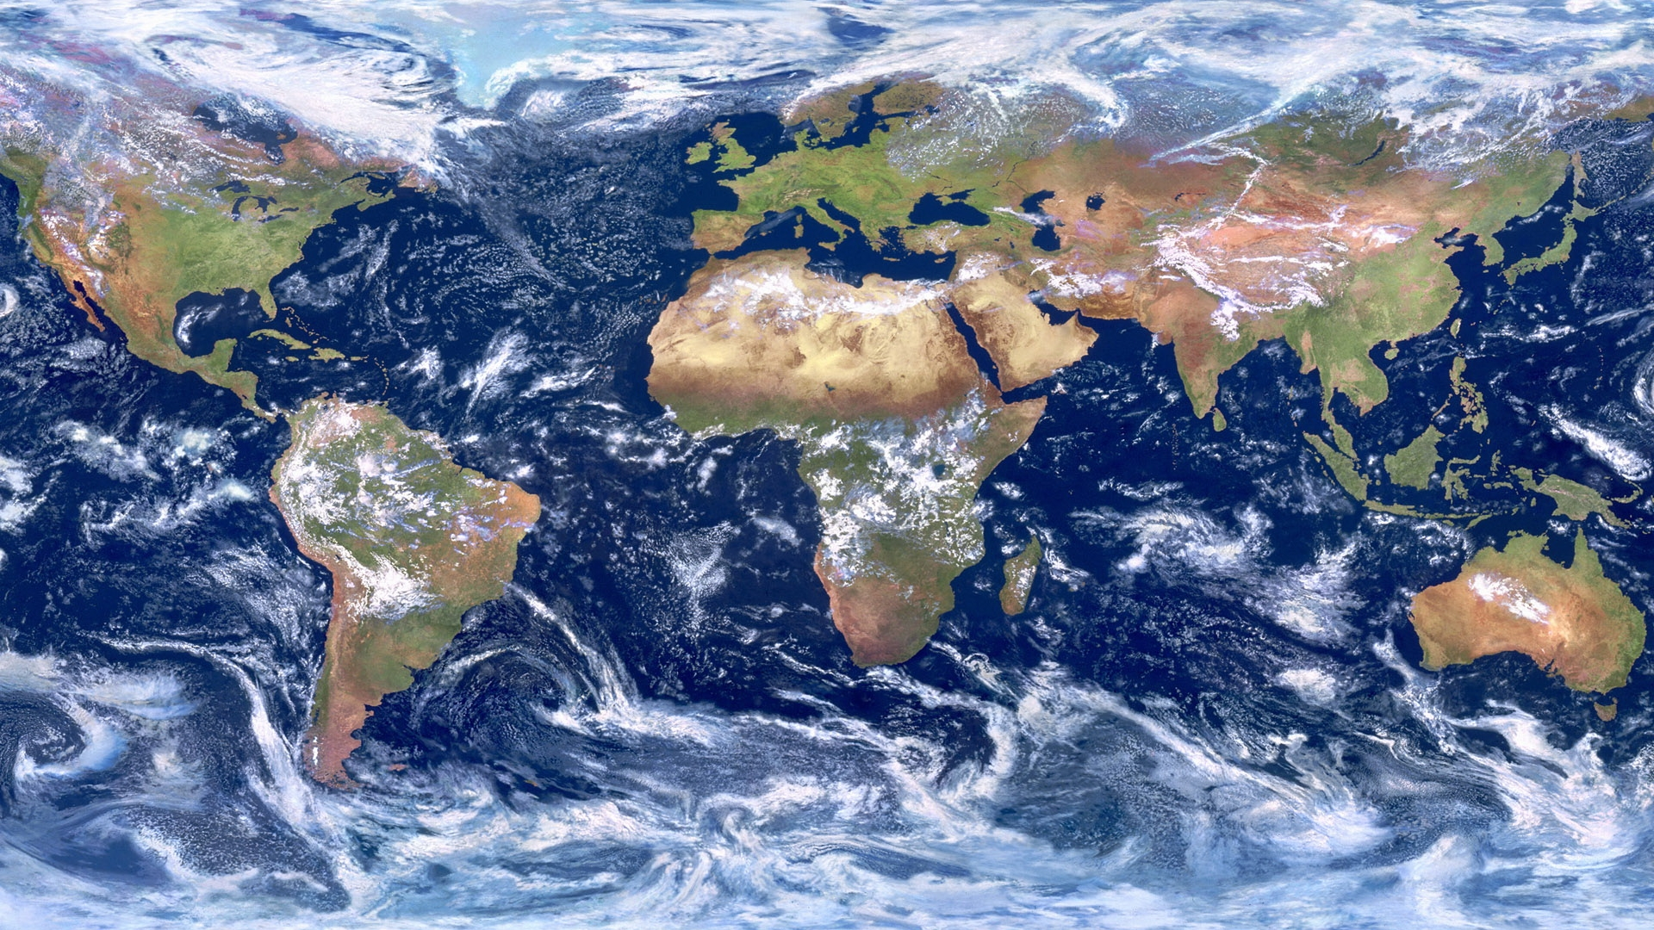
NETCARE
ARCSIX
ARCTAS
ARISE
NAAMES
DC3/SEAC4RS
FIREX-AQ
INSPYRE
KORUS-AQ
TCAP
FarmFlux
ACTIVATE
ACE-ENA
DISCOVER-AQ
ASIA-AQ
HAMAQ
CAMPEX
EPIC
ORACLES
VOCALS
SOCRATES/ MARCUS
Adapted from AOS Suborbital Working Group
Originally created by Rob Wood, Allison McComiskey

Slide 21
Attractive regimes for low cloud-aerosol system study
Subtropical Sc-Cu
  Well-studied but not from radiative impacts perspective with two aircraft. New measurement approaches would add new value
Midlatitude low clouds
  Not as well studied (NAAMES had no radar; SOCRATES had minimal aerosol)
Canadian-Atlantic-European Corridor
continental, remote marine.
Midlatitude low clouds
Caribbean Corridor.
marine, pollution, dust
Subtropical Sc-Cu
Midlatitude low cloud
Southern Ocean Corridor.
remote marine, polar
Adapted from AOS Suborbital Working Group

Slide 22
Aerosol-Cloud Suborbital Science Gaps
Intro
Modeling
Orbital
Suborbital
Q&A
Dust
  Convective redistribution
  Nuclei for ice cloud formation
  Optical properties for algorithms, constraining priors
  Link to corridor measurements
Remote Regions (low-aerosol, CCN-limited conditions); synergistic with low clouds
  Arctic regions (e.g., 2024 ARCSIX); Upcoming International Polar Year in 2032-2033
  Remote Oceans (e.g., revisit North Atlantic NAAMES region); Southern Oceans
Aerosols between and below clouds
  Vertically-resolved ACI (both aerosols feeding clouds and cloud processing detrainment)
  Link to corridor measurements (Caribbean in particular)
Efforts to reduce uncertainties in modelled climate sensitivities
  Systematic measurements to constrain PDFs / priors of aerosol-cloud properties and atmospheric regimes
  Quantify sub-grid-scale variability
Efforts to improve orbital observations and remote sensing algorithms
  Systematic measurements to constrain PDFs / priors of aerosol-cloud properties and atmospheric regimes
  Quantify sub-grid-scale variability
Adapted from AOS Suborbital Working Group

Slide 23

Must not forget about aerosol-cloud interactions for high clouds!
Recent Academies’ report calls for routine in situ piggyback measurements during aircraft transits, remote sensing missions (30-40 kft. altitudes)
Intro
Modeling
Orbital
Suborbital
Q&A
Finding: Upper tropospheric aerosol number concentrations and properties are poorly understood for both continental and, especially, remote marine regions.
Finding: Natural cirrus form on ice-nucleating particles and the role of aircraft engine particle emissions in altering these aerosol-cloud interactions near flight corridors is highly uncertain.
Recommendation: NASA should identify and enable a minimum set of key aerosol instruments that can be flown on multiple missions with the goal of characterizing the aerosol composition of the upper troposphere and uncovering the contribution of aviation emissions relative to other sources.
National Academies of Sciences, Engineering, and Medicine. 2025. Developing a Research Agenda on Contrails and Their Climate Impacts. Washington, DC: The National Academies Press. https://doi.org/10.17226/111.

Slide 24
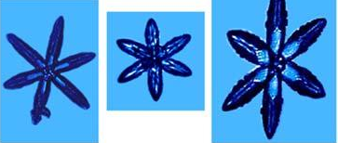
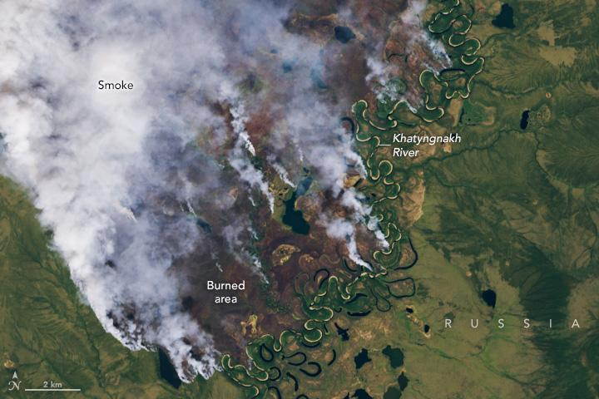
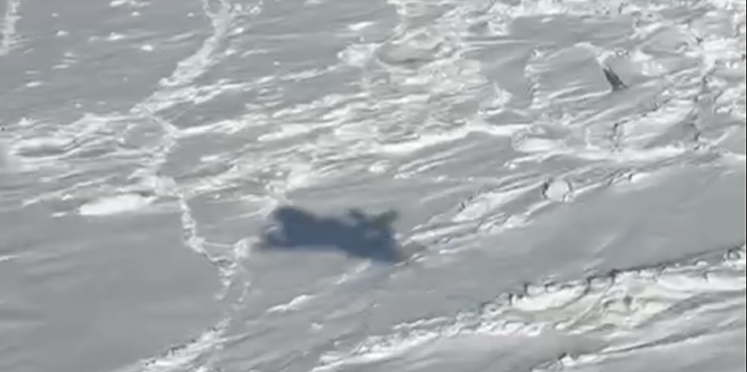
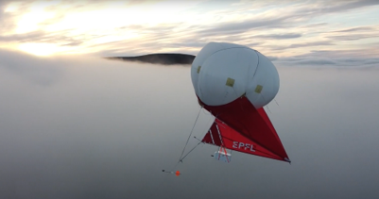
Future airborne science contributions to the upcoming
International Polar Year (IPY), 2032-2033
Intro
Modeling
Orbital
Suborbital
Q&A
Polar regions have an outsize impact on climate models, and are challenging to observe
Value of suborbital data
Some potential IPY (2032-33) science priorities
Examples of community needs and future platforms
Ç
√ç√
Fills gaps of spaceborne sensors, e.g.:
Validation
INP/CCN
Ice habit
In-cloud processes like entrainment, etc.
Mixed phase clouds and secondary ice production
Cloud microphysics
Cloud radiative effects and climate feedbacks (e.g., Southern Ocean cloud brightening)
Cirrus-aerosol interactions
Atmospheric chemistry and aerosol sources (leads, fires, shipping, newly exposed land, microplastics)
Polar boundary
layer & surface
mass balance
Integration:
Modeler involvement
Dedicated data-analysis funding
Local/Indigenous community engagement (e.g., climate intervention topics)
New opportunities:
B777 extended range, cross-disciplinary payload capacity
UAS & Balloons: miniaturized sensors, campaign optimization
AI/ML
Credit: NASA Earth Observatory
Credit: Spec, Inc.
Credit: ARCSIX
Credit: L. Favre
Based in part on community input gathered by the QuIESCENT and CATCH international scientific groups; also see Zamora et al. (2025) BAMS
Slide from Lauren Zamora

Slide 25
Conclusion
Intro
Aerosol
Cloud
Model-Obs.
Pair Obs.
ML/AI
Q&A
Total aerosol radiative forcing & Cloud radiative feedbacks – uncertainties remaining
Large cloud radiative feedback uncertainties due to: short term ≠ long term; fast response ≠ slow response; global models ≠ observations
Many more science questions related to aerosol/cloud
We’ve compiled your questions/ comments, add some more!
The orbital PoR is an essential science and mission enabling capability; fully leveraging will require strategic thought (and perhaps investment).
Suborbital is key component of the Integrated Observing System: enabling process understanding, constraining model inputs, advancing satellite algorithms.
Need to develop flexible, comparatively-inexpensive, and quantitative frameworks to demonstrate what observations constrain ESM physics/processes.
Let’s continue to unleash the power of AI while maintaining science integrity

Slide 26
Discussion
Intro
Aerosol
Cloud
Model-Obs.
Pair Obs.
ML/AI
Q&A
Suggestions to get us started…
Why are we asking the same questions over and over again? Has progress been too slow? Why?
How to best use model-observation synergies to maximize our impact and strategically target future aerosol/cloud efforts?
How to use orbital/suborbital observations to reduce the range of observation-based ERFaci estimates?
What cloud & radiation observations/products do we need to credibly quantify cloud feedback?
How to use cloud observations to improve clouds in global models, from diagnosing performance to development of physical schemes?
How can we best leverage the known orbital PoR, and what are the remaining needs?
What opportunities does the NASA Atmosphere Focus Area realignment bring with regard to interdisciplinary suborbital field campaigns?
How do we best report uncertainties in observational products? (important for observations-model synergy)
How do we develop flexible quantitative frameworks demonstrating value of proposed obs in constraining physics across all models?
How do we improve model representation of aerosol-cloud interactions beyond low stratiform clouds (ice clouds, convection, for example)?
How do you validate your modeled low stratiform cloud ACI when OBS only give you near cloud-top info?
What do you think about building AI protocols into mission development pipeline to monitor and ensure AI integrity for high-quality retrieval products, model integration and rigorous science?

