Slide 1
Radiative Balance of the Earth System
Advances since 2014, Science Priorities, and Data needs
Yolanda Shea, Patrick Taylor, Maria Hakuba

Slide 2
NASA Earth Science Guiding Question:
How is Earth's climate changing, and how do natural and human-caused changes affect our planet?

Slide 3


NASA’s End-to-end Earth System Science Capability
Technology
Flight
Research
Data and Modeling
Earth Action
10 Tech Infusions/year
24 Missions on Orbit
1,330 Active Research Projects
48 States
Collect 160 TB/Day
Serving 600 TB/Day
>10M Users
World-Class Models
Agriculture
Energy
Disasters
Wildfires
& more
12.11.2025

Slide 4

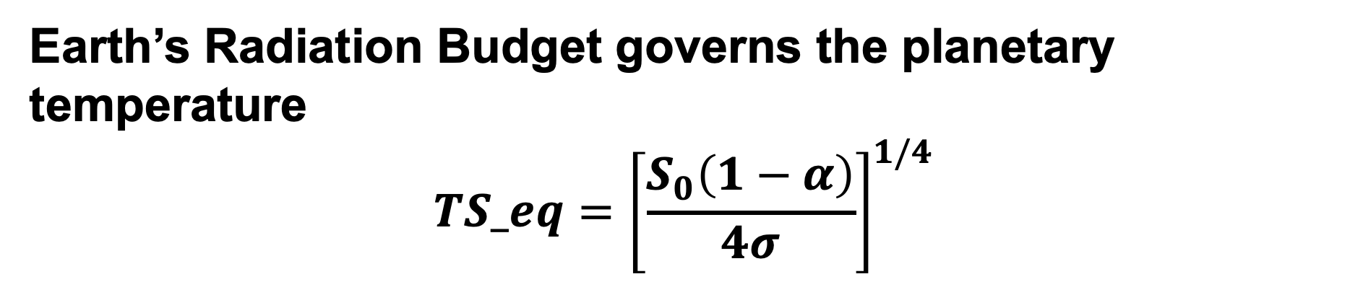
Earth’s Radiation Budget governs the planetary temperature
$$TS_eq={\left[\frac{S_{0}\left(1−α\right)}{4σ}\right]}^{1/4}$$
Notes:
In this animation, you see the ERB in action and many of the themes already presented.
Another way of say this is that the ERB is the integrated representation of earth system processes and their influence on climate.
So, why is ERB science important?
The most straightforward way I can articulate the importance is that the balance or imbalance (as it were) of radiative energy flows at the TOA governs Earth’s temperature.
Many processes that influence the ability of humanity to thrive on a changing planet are sensitive to planetary temperature.
More specifically, Earth’s temperature and surface energy budget modulate the intensity of the water cycle and the carbon cycle.
Moreover, the latitudinal structure of the energy budget drives the general circulation of the atmosphere and ocean.

Slide 5
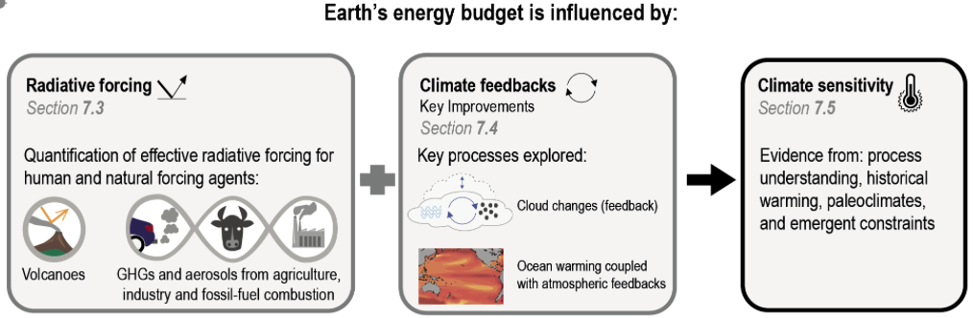
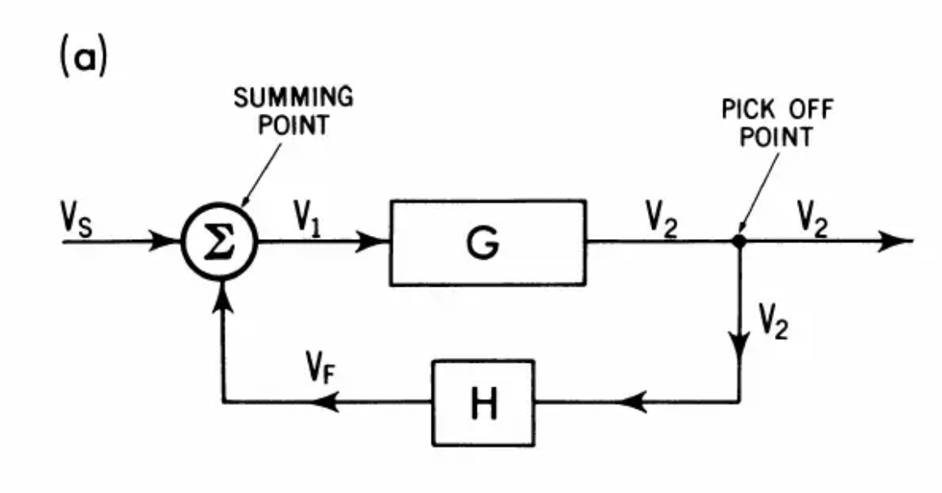
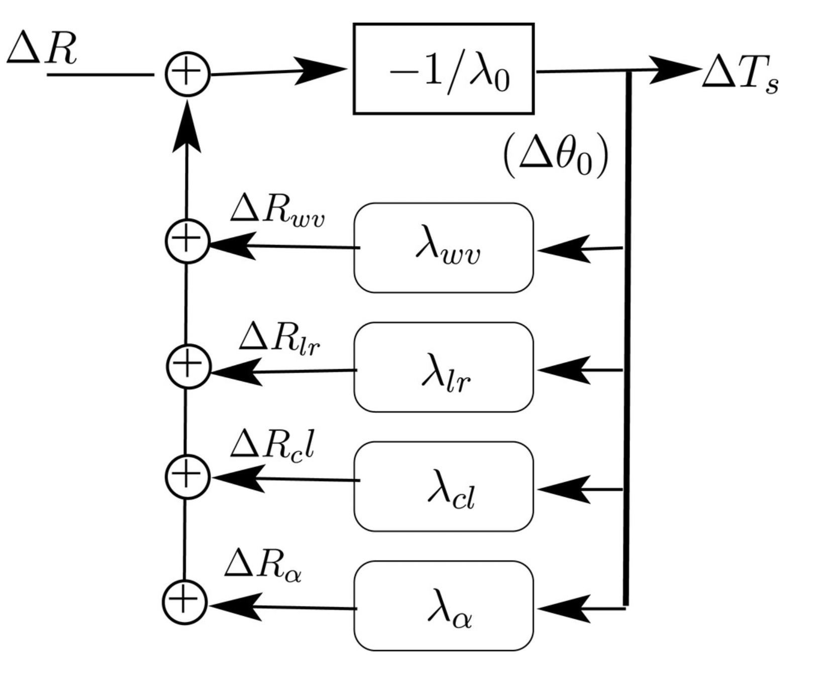
Forcing-Feedback-Response Paradigm
IPCC (2021)
Lahellec and Dufresne (2013)
Peixoto and Oort (1992)

Slide 6
Earth Radiation Budget (ERB) Science Priorities:
Earth Energy Imbalance (EEI)
Equilibrium Climate Sensitivity (ECS) and Transient Climate Response (TCR)
Influence of Clouds on Earth Radiation Budget
Radiative Forcing of Earth Radiation Budget
Causality of Polar Amplification and Energy Budget Change
Energy Budget-Water Cycle Interactions
Circulation-Energy Budget Interactions
Regional energy budgets, forcing, and response

Slide 7
Radiative Balance of the Earth System
Summary of Advances since 2014
Yolanda Shea, Maria Hakuba, Patrick Taylor

Slide 8

How Has Our Understanding of ERB Advanced since 2014?
2014: What questions the community was targeting
Italics = direct language from the 2014 report
[Brackets] = my interpretation of related questions from the 2014 report
How the conversation has shifted
How our progress points us to the future
Advances Since 2014
Wild et al., 2015
Please share your ERB-related feedback/inputs on our board.net collaborative area!
https://board.net/p/Radiation_Balance_Atmospheres_Investigators

Slide 9
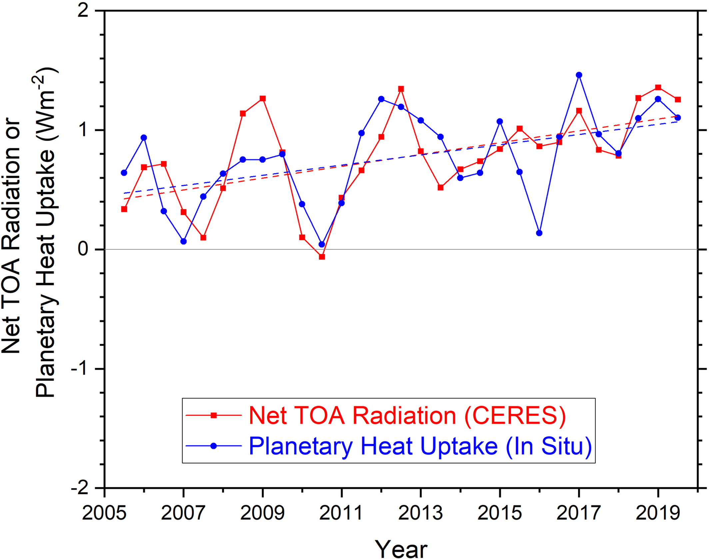
Priority 1: Earth Energy Imbalance (EEI)
2014: Where We Were
What is the TOA global net radiative balance, variability, and change over time, and their explanation?
  What is the annual net radiation (1σ) and uncertainty in interannual variations to 0.1 Wm⁻² (1σ)?
[What measurements are needed to help us explain the global warming hiatus?]
Loeb et al., 2021
Advances Since 2014
Advances
Resolution on the “hiatus”: energy redistribution and data gaps
Conversation shift to EEI and its trend
  EEI doubled between 2005 and 2019 (Loeb et al., 2021; Mauritsen et al., 2025) confirmed by CERES TOA and in situ Argo measurements (Cheng et al., 2019/2022; Hakuba et al., 2024).
Recognition of need for continuity in Space-based Earth Radiation Budget measurements
  Libera (EV-C) ensures near-term ERB continuity, but what comes after?
  SORCE continuation, TSIS-1 Launch & extension, & development of TSIS-2 for TSI/SSI continuity

Slide 10
NASA’s End-to-end Earth System Science Capability
Technology
Flight
Research
Data and Modeling
Earth Action
10 Tech Infusions/year
24 Missions on Orbit
1,330 Active Research Projects
48 States
Collect 160 TB/Day
Serving 600 TB/Day
>10M Users
World-Class Models
Agriculture
Energy
Disasters
Wildfires
& more
12.11.2025

Slide 11
Priority 2: Equilibrium Climate Sensitivity (ECS) & Transient Climate Response (TCR)
2014: Where We Were
Uncertainty in climate sensitivity remained a factor of 4 (IPCC 2007/2013)
Historical observations estimated lower ECS and TCR than climate models
There weren’t explicit questions focused on reducing ECS and TCR uncertainty
Advances Since 2014
Advances
AR6: ECS and TCR bounds (finally) narrowed
  How: combining improved process understanding, historical warming records, and paleoclimate data
  Emergent constraints used to rule out climate models with unrealistic climate sensitivities (e.g. Sherwood et al., 2020)
Recognition of pattern effect (Andrews et al., 2015) and disconnect between models and observations (Andrews et al., 2018): spatial pattern of SST warming influences climate sensitivity (also links to Priority 7 & 8)
IPCC, AR6

Slide 12
Priority 3: Clouds and Earth Radiation Budget
2014: Where We Were
What observations are needed to reduce cloud feedback uncertainty by at least a factor of 2 versus IPCC AR5 results?
Cloud feedback uncertainty dominant contributor to climate sensitivity spread
  Low clouds a dominant contributor to cloud feedback uncertainty
Zelinka et al., 2020
Advances Since 2014
Advances
CMIP6 models have higher climate sensitivity largely due to positive extratropical low cloud feedbacks (Zelinka et al., 2020)
  Tropical low clouds exhibit positive feedback under warming, constrained by observed cloud sensitivity to SST and inversion strength (Klein et al., 2017; Myers et al., 2021)
  Emergent constraints have improved characterization of low cloud feedback uncertainty (Klein and Hall, 2015)
Observational cloud feedback signals detectable in satellite record (Norris et al., 2016)
  High cloud response (FAT/PHAT) observationally supported (Saint-Lu et al., 2020)

Slide 13
Priority 4: Forcings of Earth Radiation Budget
2014: Where We Were
What observations and modeling are required to determine the anthropogenic aerosol forcing for direct, indirect and semi-direct effects?
What observations and modeling are required to reduce uncertainty in anthropogenic aerosol by at least a factor of 2 relative to the AR5 IPCC estimate?
Advances Since 2014
IPCC, AR6
Advances
AR6 summarized progress on 2014 questions: Aerosol ERF better constrained with total forcing likely to be negative and with ERFaci dominant over ERFari (Forster et al., 2021)
New hyperspectral capabilities (PACE) and mineral dust mapping (EMIT) provide additional observations of aerosols
First direct measurements of CO₂ surface radiative forcing (AERI + RTM) (Feldman et al., 2015)
Observational detection of GHG forcing increase in spectral OLR record (Raghuraman et al., 2023)
To effectively simulate positive trend in EEI with ESMs increase in anthropogenic radiative forcing (and associated climate response) must be included (Raghuraman et al., 2021)

Slide 14
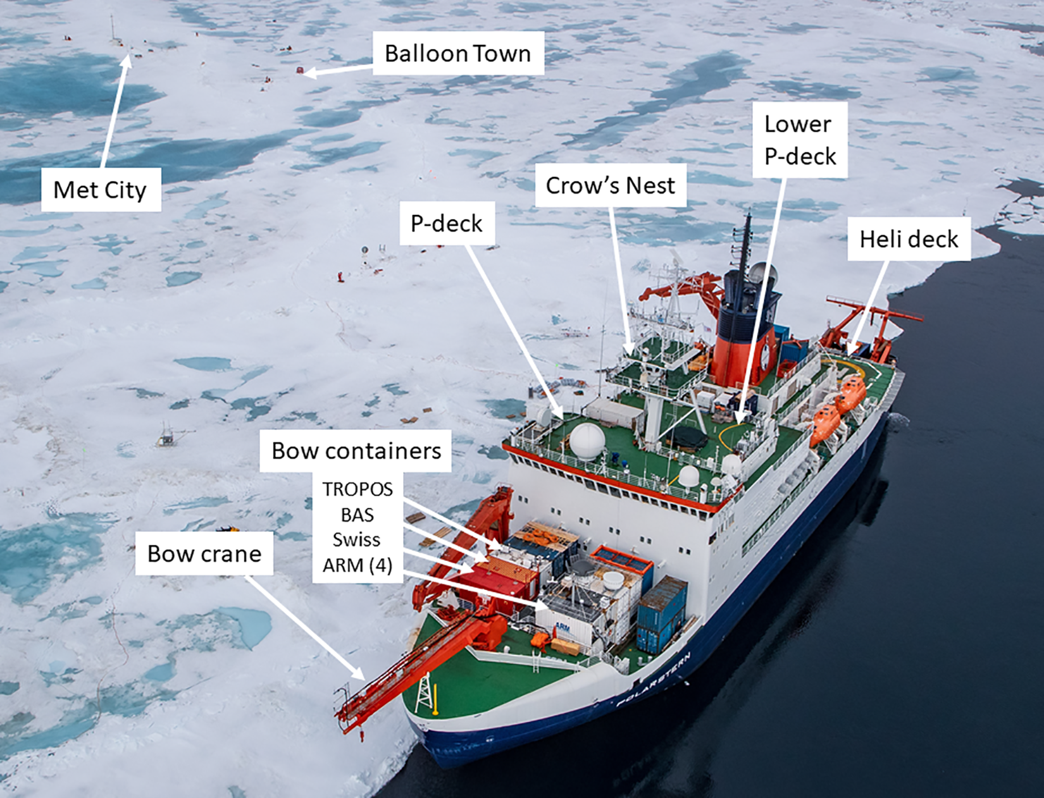
Priority 5: Polar Energy Budget Change
2014: Where We Were
How is the Arctic radiative environment changing as sea ice extent rapidly decreases?
  Interest in partitioning surface and cloud feedback components
Do clouds in the Arctic increase or reduce the rapid warming there?
Advances Since 2014
Shupe et al., 2022, doi: 10.1525/elementa.2021.00060
Advances
Obtained CERES-derived observational estimates of Arctic albedo feedback (Pistone et al., 2014; 2019)
Temperature feedback a dominant contributor to Arctic amplification (Pithan & Mauritsen, 2014)
Arctic Amplification conversation shifted to being inclusive of FIR (L'Ecuyer et al., 2021): PREFIRE
Field Campaigns provided a zoomed in perspective: MOSAiC on Arctic surface energy budget (Cox et al., 2023; Solomon et al., 2023); ARCSIX on evolution of geophysical properties spanning melt season
Southern Ocean SW radiation bias: persistent GCM bias in Southern Ocean shortwave absorption (Bodas-Salcedo et al., 2014; Kay et al., 2016)
Antarctic sea ice saw record low in 2023 after period of relative stability (Purich & Doddridge, 2023; Josey et al., 2024)

Slide 15
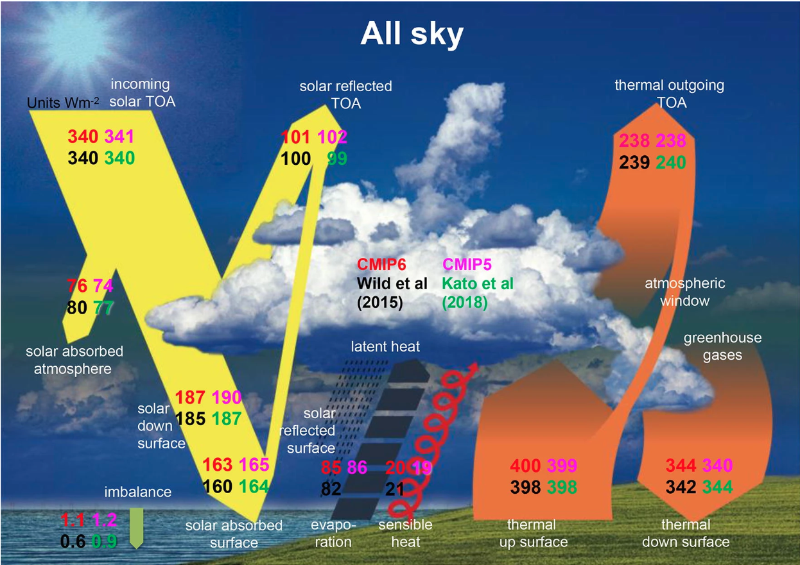
Wild et al., 2020
Priority 6: Surface Energy Budget
2014: Where We Were
[Inability to close surface and atmosphere energy budget to better than 15 Wm⁻²]
  What observations are required to close the surface and atmosphere net energy budget to within less than 5 Wm⁻²?
Model/Observations discrepancies in downwelling SW & LW identified but unresolved
Advances Since 2014
Advances
Revised global mean surface energy budget estimates with tighter uncertainty bounds (Wild et al., 2015, 2020)
Improved surface flux from CERES EBAF has helped constrain the closure problem (Kato et al., 2018)
Ground-based network expansion (BSRN, ARM, SURFRAD): direct surface flux observations constrain satellite-derived products (e.g. Driemel et al., 2018)
Global dimming and brightening: decadal variations in surface solar radiation linked to aerosol loading and cloud changes (Wild et al., 2021)
Regional changes in surface net radiation partitioning between latent vs. sensible heat has ERB (and circulation – see Priority 7) implications

Slide 16
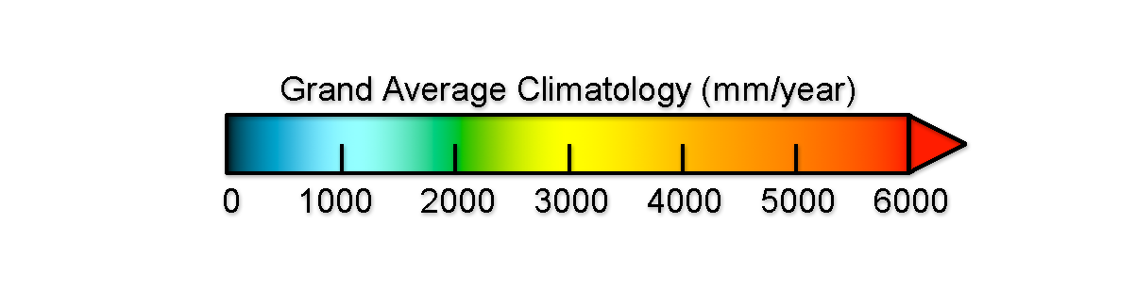
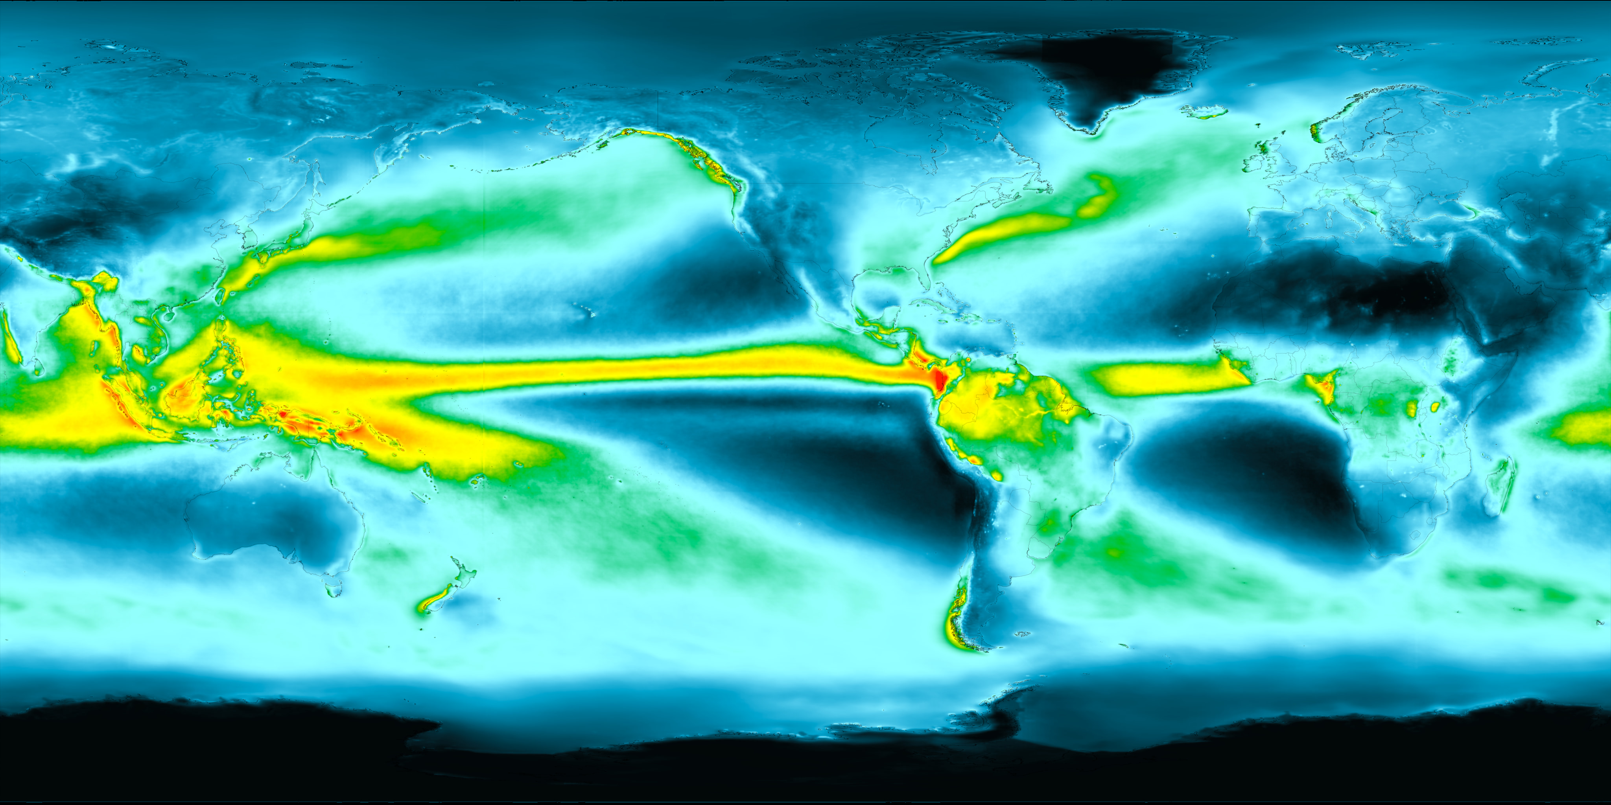
Priority 6: Energy Budget-Water Cycle Interactions
2014: Where We Were
[What is the water vapor greenhouse effect and feedback in far-infrared?]
[What measurements (esp FIR) are needed to verify the H₂0_{v} greenhouse effect and feedback in models?]
Latent heat release the largest and most uncertain term in surface energy budget
Energetic constraints on global mean precipitation change were known, but regional distribution of that change was poorly understood
Advances Since 2014
NASA GSFC SVS
Advances
PREFIRE can contribute to our understanding of the H₂0_{v} greenhouse effect in FIR (L'Ecuyer et al., 2021)
The "wet gets wetter, dry gets drier" paradigm being refined and challenged – dynamic changes can amplify or dampen thermodynamic signal (Byrne & O'Gorman, 2015)
GPM has improved our understanding of latent heat release, including partition between convective vs. stratiform rainfall impacting how energy is vertically distributed (Skofronick-Jackson et al., 2018)
Atmospheric rivers account for disproportionate fraction of poleward moisture and latent heat transport (Gimeno et al., 2014)

Slide 17
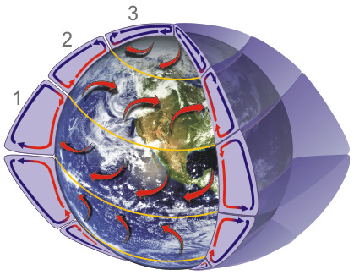
Priority 7 & 8: Circulation-Energy Budget Interactions & Regional Impacts
Polar
Ferrel
2014: Where We Were
Focus was on global means and polar region impact
Hadley
Advances Since 2014
Advances
Pattern Effect: regional SST patterns modulate global radiative feedbacks (e.g. Andrews et al., 2022)
ITCZ/cross-equatorial energy transport framework: hemispheric aerosol indirect effect asymmetries quantitatively linked to ITCZ shifts (Schneider et al., 2014; Chung and Soden, 2017)
NOAA
Regionally concentrated aerosol forcing drive remote circulation and energy budget responses (Shindell et al., 2015; Persad et al., 2018)
North Atlantic regional energy budget variability linked to AMOC and deep ocean heat uptake patterns (Robson et al., 2016; Trenberth and Fasullo, 2017)

Slide 18
What comes next?
Some Takeaways
The conversation has shifted from characterizing the mean state to understanding change, variability, and coupling
Some areas have seen improvements (e.g. EEI trend, ECS bounds) – is it “enough?”
New areas of focus have emerged (e.g. pattern effect, regional-global coupling)
New tools available and in development are influencing our questions: hyperspectral observations, in situ networks, targeted field campaigns etc – combining tools has been key
Implications for Our Priorities
These advances (and others) identify where the science is mature enough to make precise, answerable questions
They also reveal new gaps that 2014 didn't anticipate and thus new priority targets!
Next Up? Translating this into actionable science priorities & quantified objectives
Advances Since 2014
Please share your ERB-related feedback/inputs on our board.net collaborative area!
https://board.net/p/Radiation_Balance_Atmospheres_Investigators

Slide 19
Radiative Balance of the Earth System
Science Priorities, Objectives, and Questions
Patrick Taylor, Maria Hakuba, Yolanda Shea

Slide 20
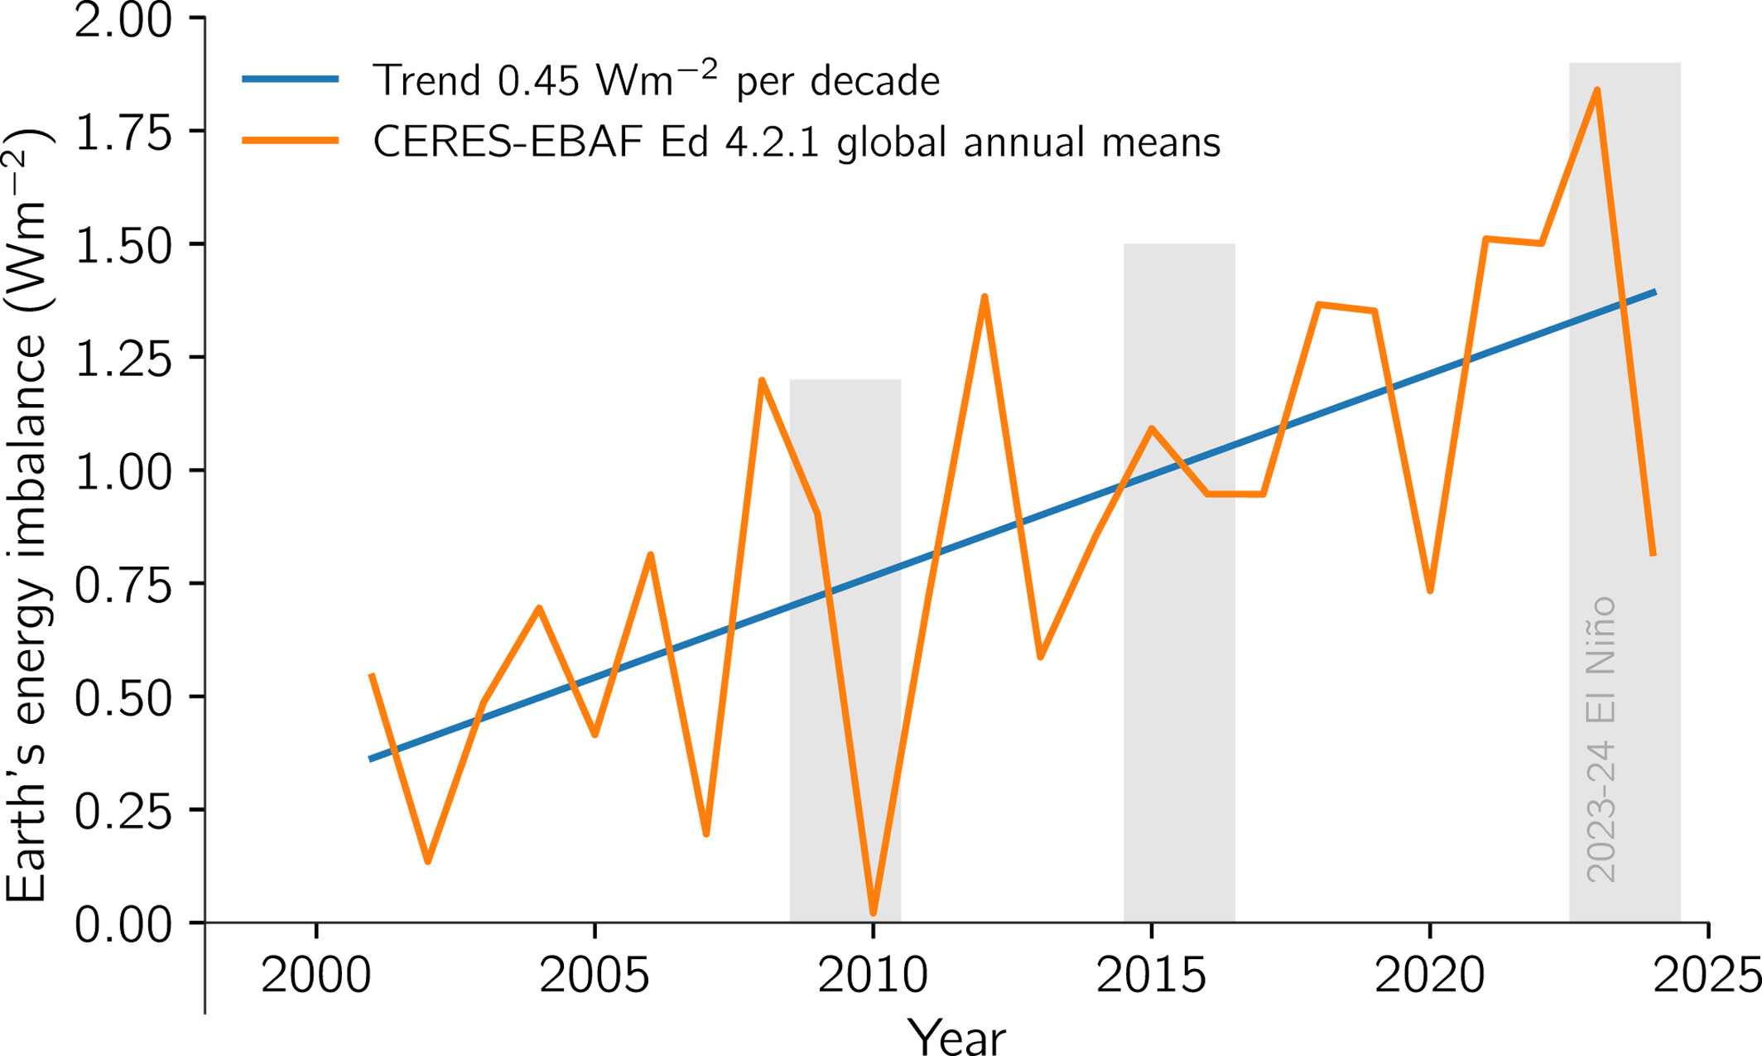
Priority 1: Understanding Earth Energy Imbalance
Objective: Within the next decade, quantitatively articulate the principal drivers of the growing EEI and reconcile the disagreement between observations and climate models.
Motivation:
Earth’s energy imbalance (EEI) represents the accumulation of energy within the Earth system.
EEI represent the cumulative effects of forcing and feedbacks on the planet that the system has yet to respond to.
Direct ties to Equilibrium Climate Sensitivity and the Transient Climate Response.
Mauritsen et al. (2025)
Key Questions:
How is Earth’s Energy Imbalance changing on interannual and longer time scales?
What factors contribute to the observed fluctuations and trends in EEI?
What are the implications for accelerating EEI?
Can we disentangle the contributions of forcing, feedback, and natural variability?
Why do state-of-the-art climate models struggle to reproduce the observed EEI?

Slide 21
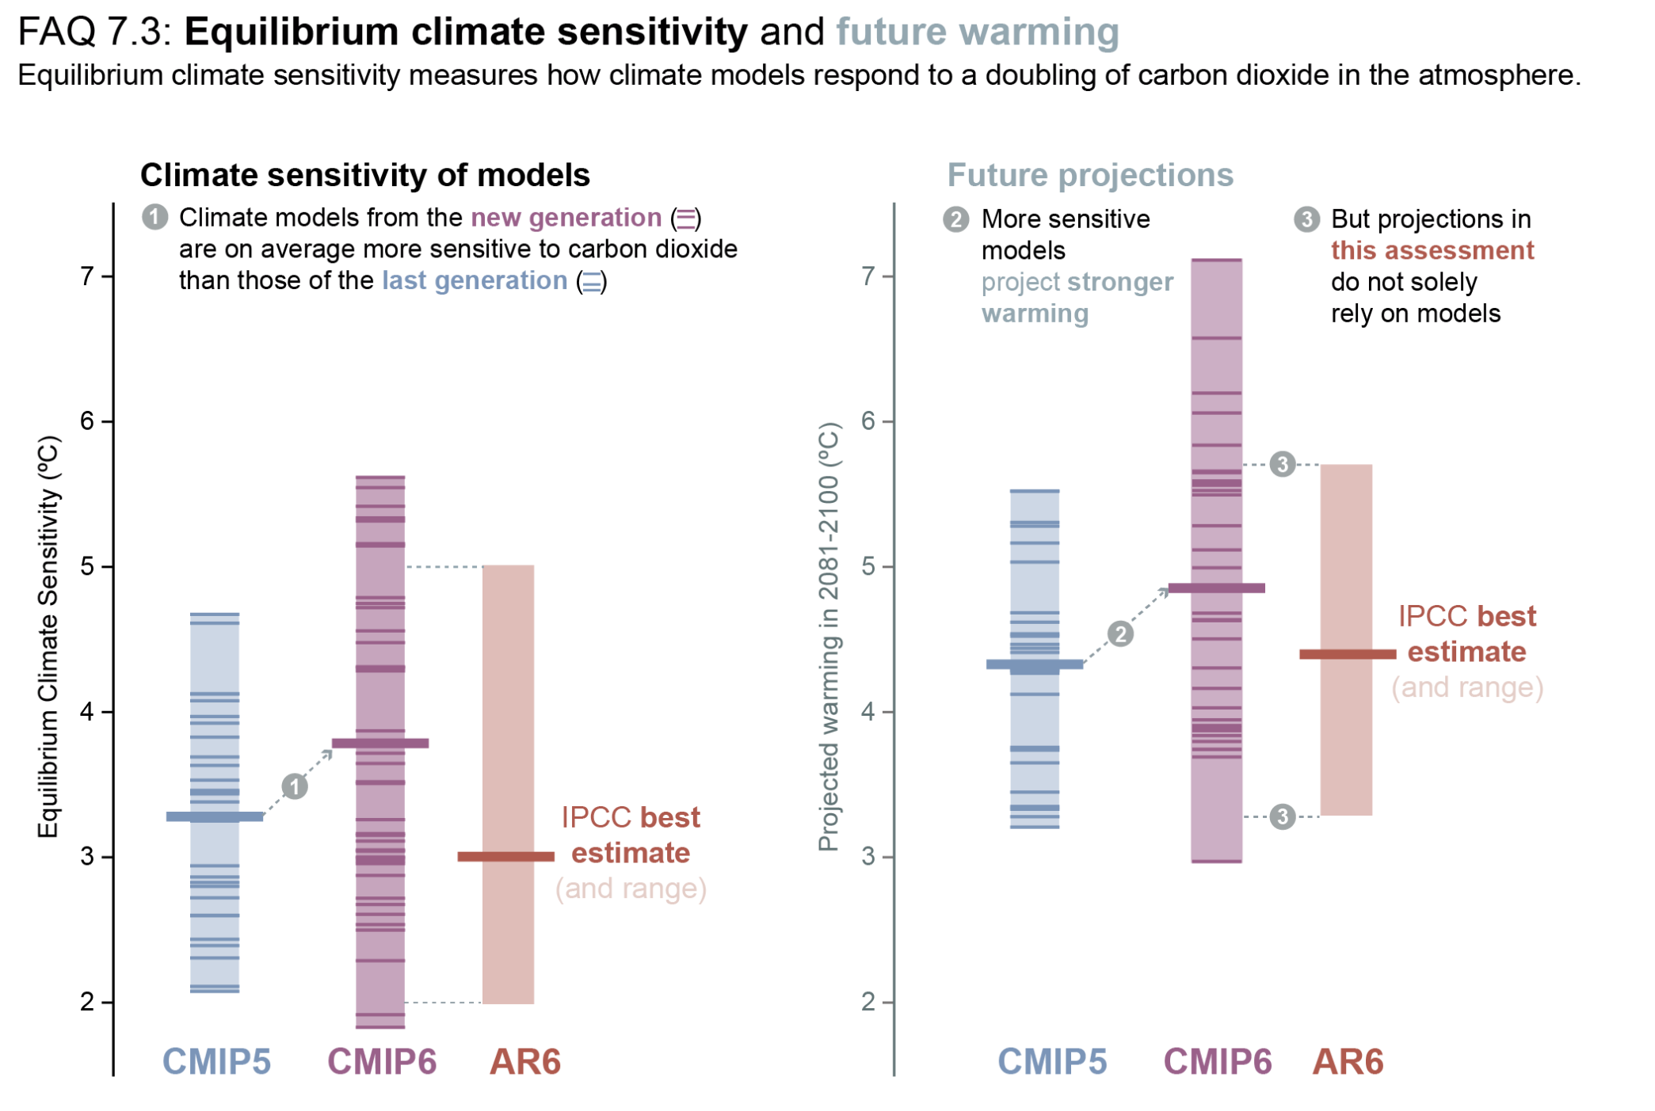
Priority 2: Equilibrium Climate Sensitivity and Transient Climate Response
Objective: Within the next decade, reduce uncertainty in upper bound of ECS by 25% and quantitatively link TCR to ECS to enhance our ability to use observations to constrain the climate response.
Motivation:
Global surface air temperature (GSAT) has cascading effects on physical properties (e.g., atmospheric circulation, ice sheet mass balance, global sea level, water cycle, carbon cycle)
GSAT impacts resource availability (water, food, and energy, and water) and health.
IPCC (2021)
Key Questions:
What system properties and mechanisms dictate the relationship between TCR and ECS?
How can observations be used to constrain TCR and ECS?
How are the sources of the uncertainty in ECS and TCR evolving?
How do feedback contributions differ for TCR and ECS?

Slide 22
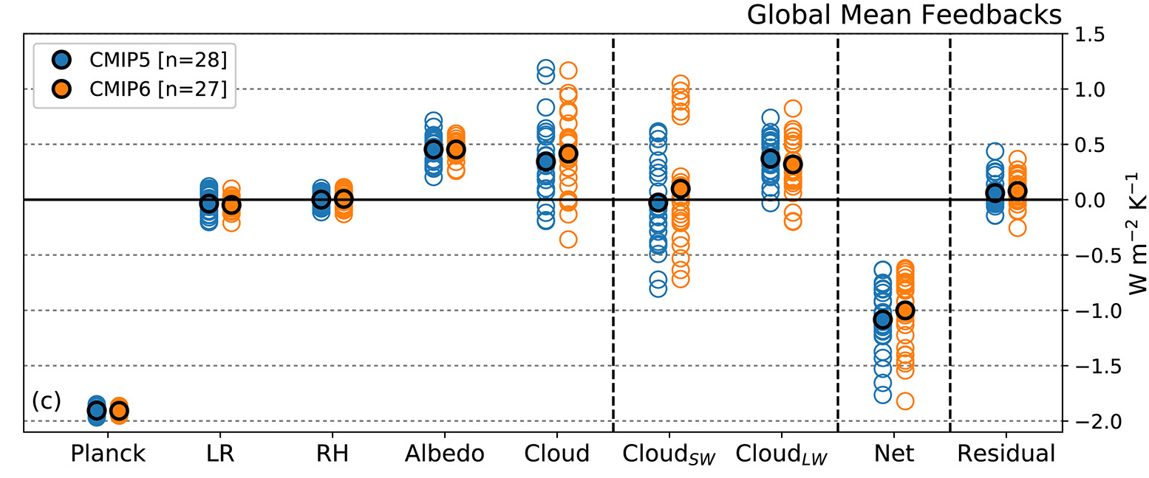
Priority 3: Influence of Clouds on Earth Radiation Budget
Objective: Within the next decade, isolate the processes responsible for cloud feedback spread and constrain them with satellite observations and process studies.
Motivation:
Cloud feedback represents the largest source of inter-model spread in ECS
Cloud changes are making a substantial influence on observed EEI.
Clouds cover ~70% of the Earth at any given time, small changes in cloud cover or type
Zelinka et al. 2020
Key Questions:
How is the influence of clouds on Earth Radiation Budget (ERB) variability and change evolving?
What processes influence the interannual and interdecadal variability and trends in global and regional cloud radiative effects?
How do cloud-circulation interactions contribute to fluctuations and trends in ERB?
How does the global distribution of cloud properties influence ERB variability and change?

Slide 23
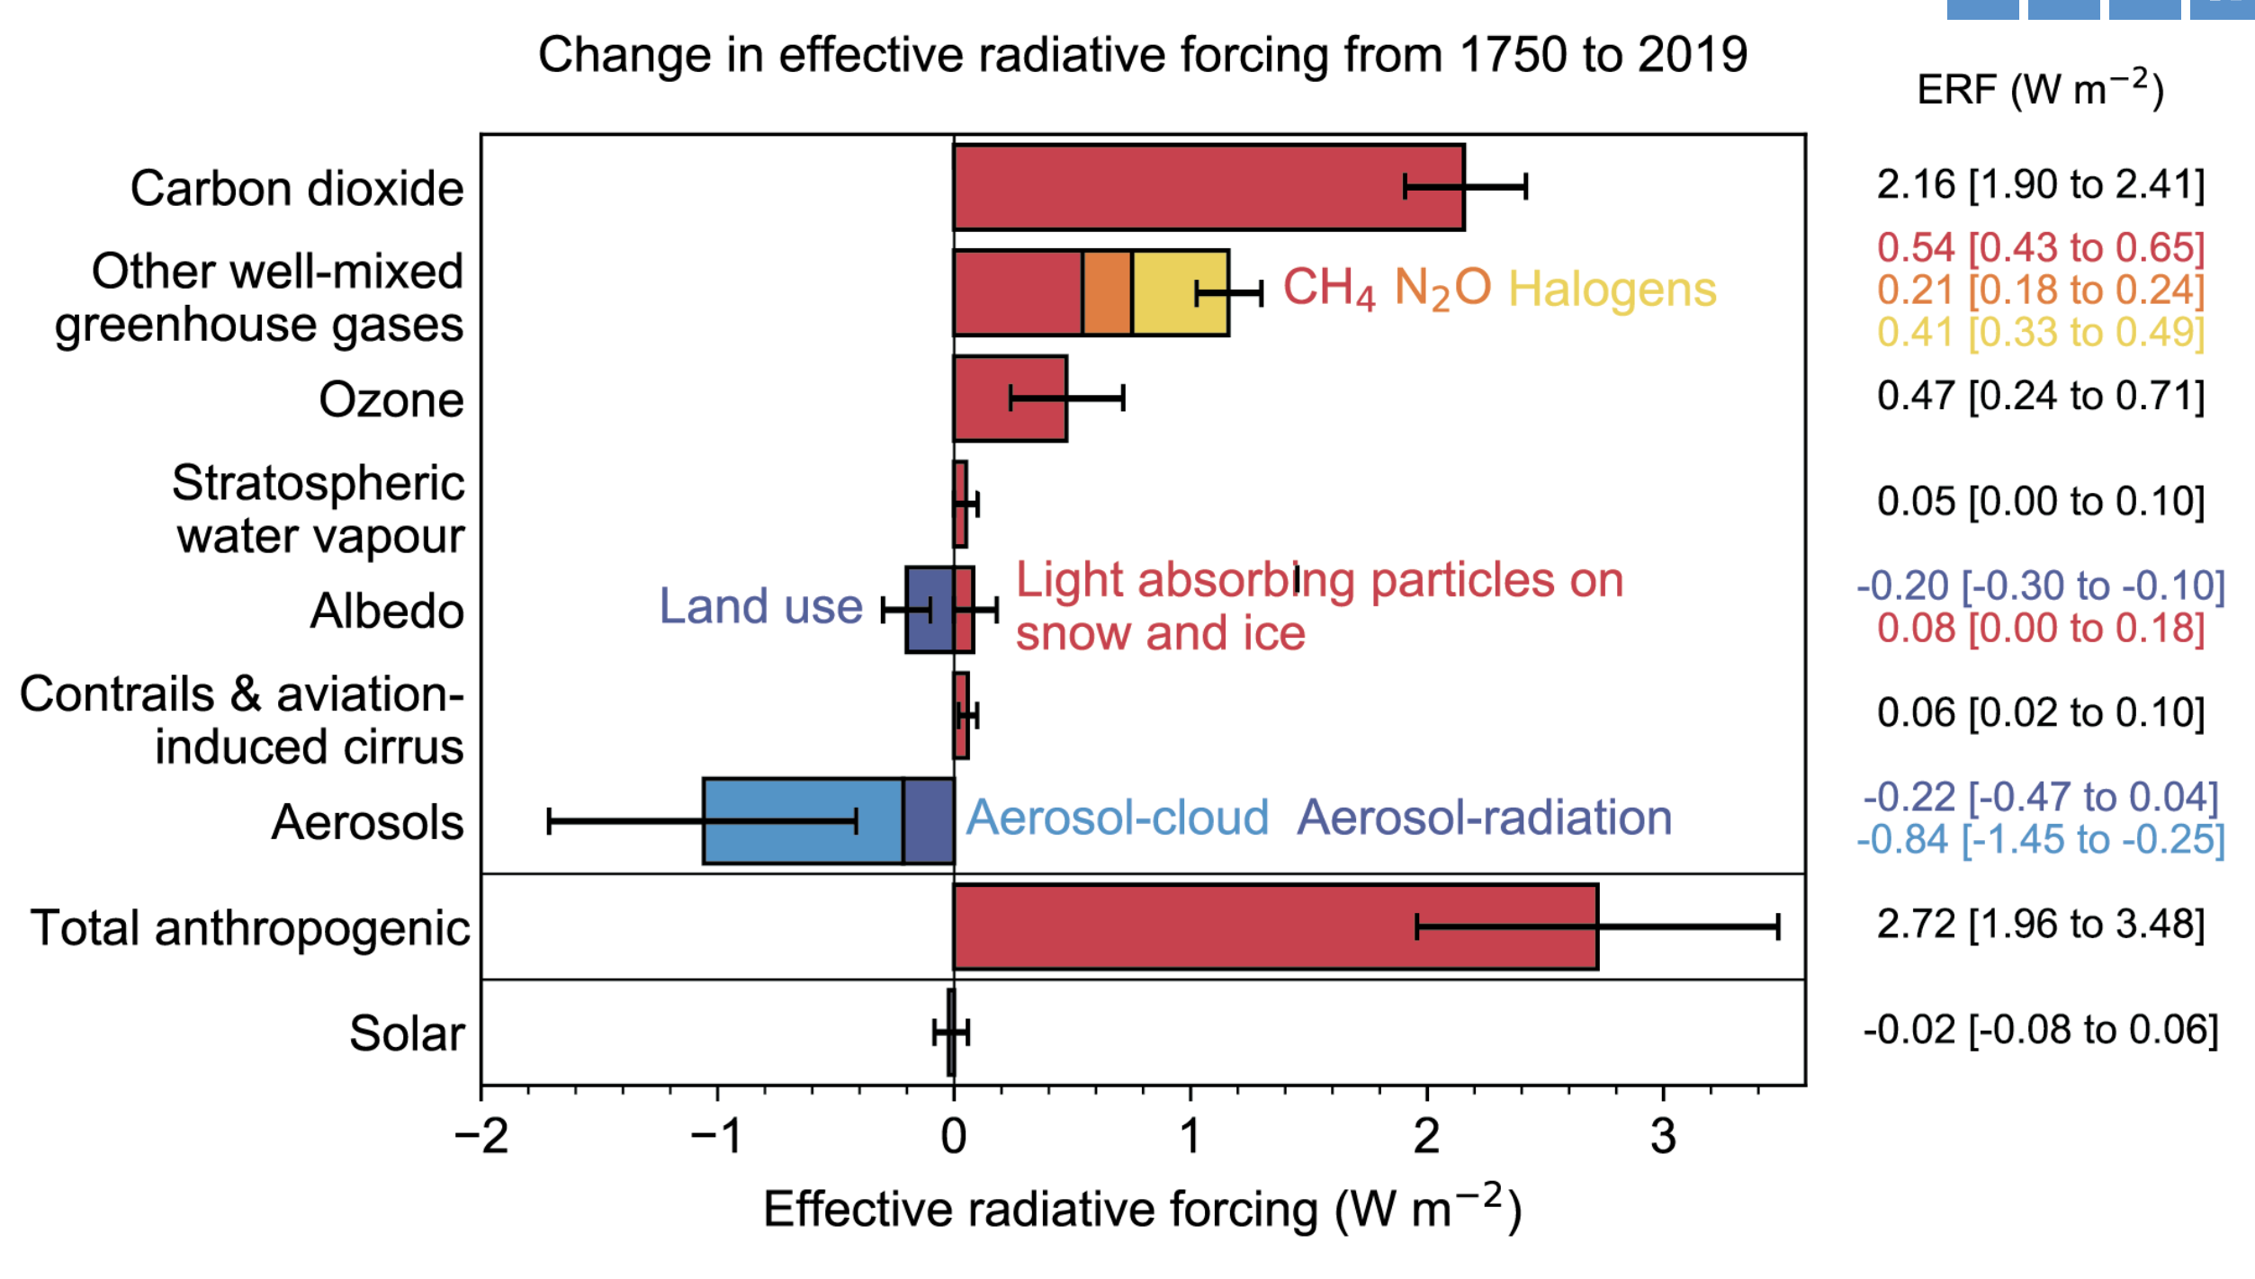
Priority 4: Radiative Forcing of Earth Radiation Budget
Objective: Within the next decade, develop an observation-modeling system that tracks the radiative forcing operating on the planet in near-real time. Isolate the mechanisms of source-specific forcing adjustments.
Motivation:
Radiative forcing represents the net change in the ERB due to an external perturbation
Determination of the magnitude and source of the radiative forcings are essential to assessing climate sensitivity and to understand the pace and magnitude of earth system change.
IPCC (2021)
Key Questions:
What is the impact of atmospheric composition change on past and future Earth surface, atmosphere, and TOA energy budgets?
What are the global and regional radiative forcings associated with aerosol-radiation and aerosol-cloud interactions? How do they depend on cloud and meteorological regimes?
What are the physical mechanisms behind radiative forcing adjustments?
How do aerosol-cloud interaction forcing adjustments vary by cloud regime?

Slide 24
NASA’s End-to-end Earth System Science Capability
Technology
Flight
Research
Data and Modeling
Earth Action
10 Tech Infusions/year
24 Missions on Orbit
1,330 Active Research Projects
48 States
Collect 160 TB/Day
Serving 600 TB/Day
>10M Users
World-Class Models
Agriculture
Energy
Disasters
Wildfires
& more
12.11.2025

Slide 25
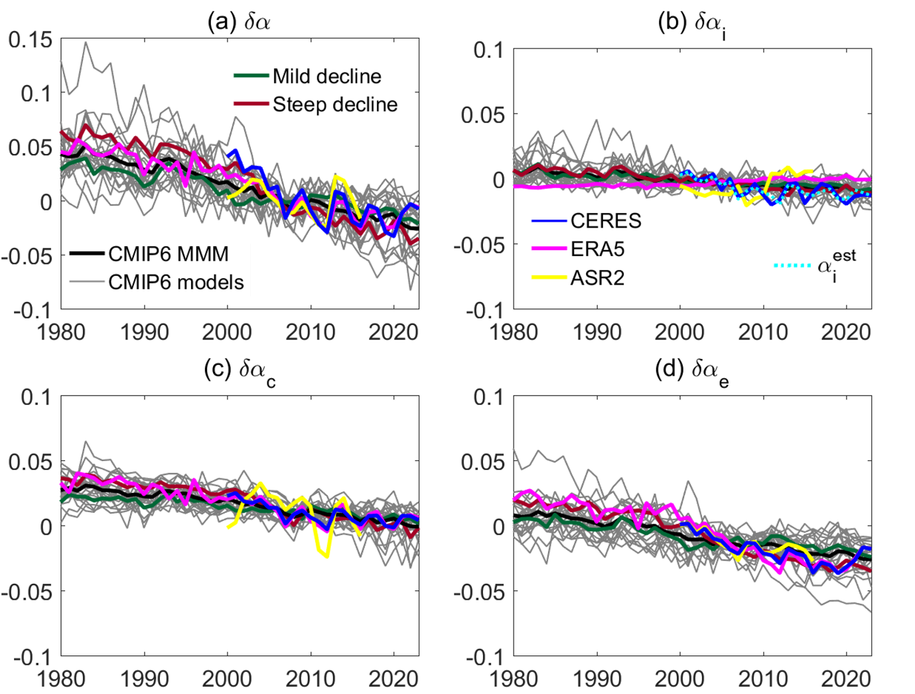
Priority 5: Causality of Polar Amplification and Energy Budget Change
Objective: Within the next decade, provide an integrated understanding of the energy flows and feedback processes that drive sea ice loss. Isolate remote and local process contributions to polar energy budget change.
Motivation:
The polar regions are critical planetary radiative energy sinks connected to global atmospheric and oceanic circulations.
The Arctic is changing faster than another other region of the planet and is a geopolitical and economically important region.
Kim and Taylor (2026)
Key Questions:
What energy flows drive changes in sea ice at the poles?
What are the implications of polar change to the global Earth Radiation Budget ?
How are cloud-sea ice and cloud-aerosol interactions contributing to observed warming and sea ice loss?
What are the contributions of episodic heat transport events (e.g., atmospheric rivers and cyclones) on the polar energy budget change and sea ice loss?

Slide 26
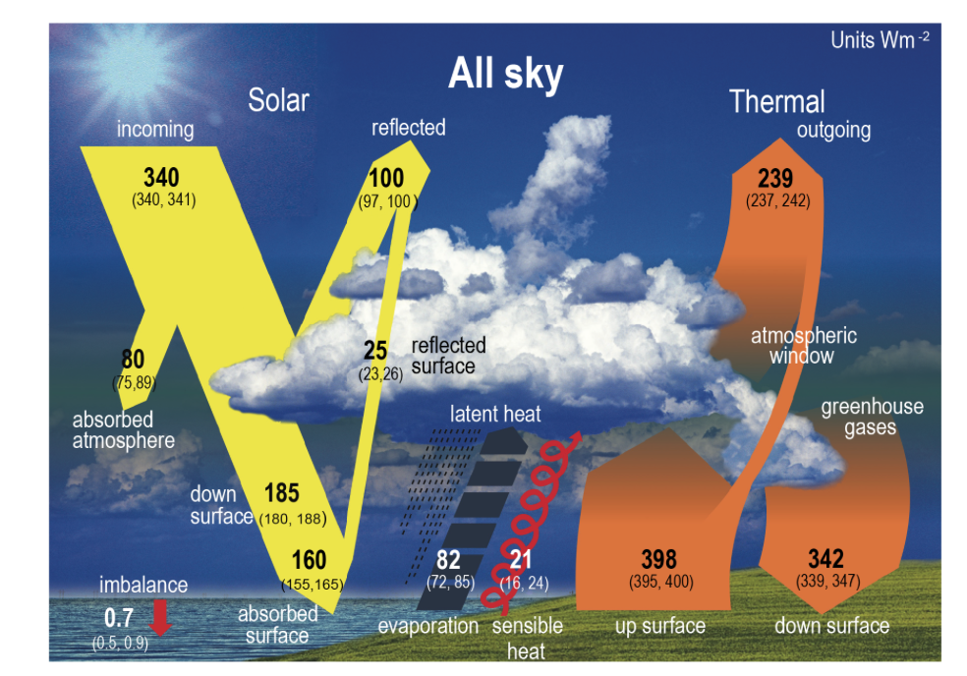
Priority 6: Surface energy budget-Water cycle (SEB-WC) Interactions
Objective: Within the next decade, advance understanding of the mechanisms of decadal scale variability in surface energy budget (SEB) and close the SEB-WC within +/-5 Wm⁻².
IPCC 2021
Motivation:
The surface energy constrained the total amount of global mean precipitation.
Closure of the surface energy budget and water cycles provide a constraint on models.
Key Questions:
What short-term processes and feedbacks give rise to the long-term closure of the energy budget-water cycle?
What are the causes and implications of the growing surface energy imbalance?
What mechanisms drive decadal scale variability in the surface energy budget?
How does the surface energy budget and related processes influence water cycle extremes?

Slide 27
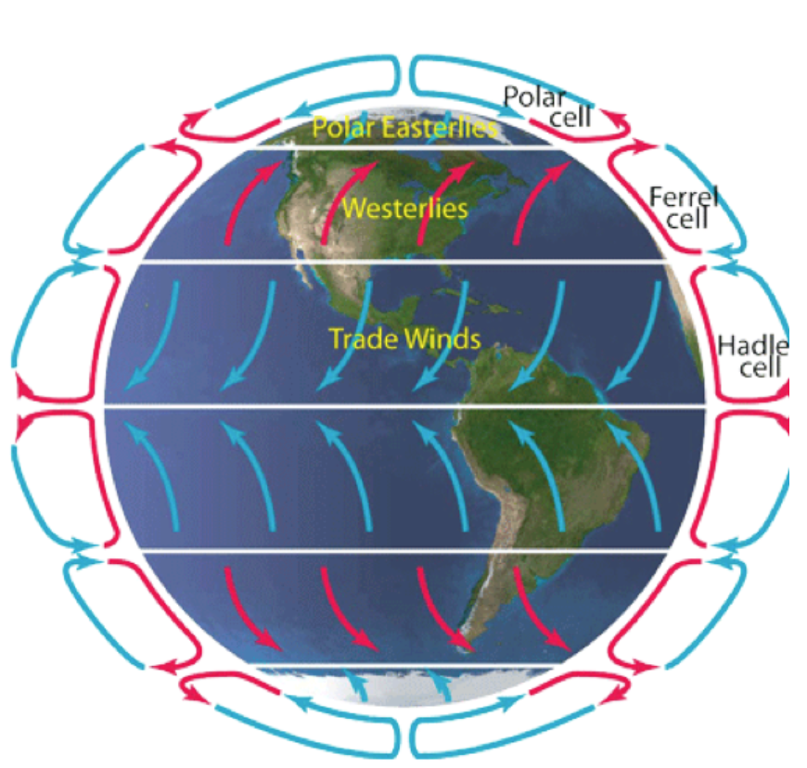
Priority 7: Circulation-Energy Budget Interactions
Objective: Within the next decade, advance understanding of the contributions of circulation variability and response to Earth energy budget and water cycle variability and the mechanisms.
Motivation:
Atmospheric and oceanic circulation response and feedback influence Earth Radiation Budget variability and modify the system response to forcing.
There are strong connections between the atmospheric circulation regimes and feedback processes (e.g., clouds and water vapor)
Key Questions:
How does the large-scale atmospheric circulation respond to global and regional radiative forcing and at what time scale(s)?
How has atmospheric and oceanic circulation variability influenced ERB fluctuations?
What mechanisms drive the circulation influence on ERB variability and change?
How is the hemispheric symmetry/asymmetry in planetary albedo influencing the position of rain belts (ITCZ)?

Slide 28
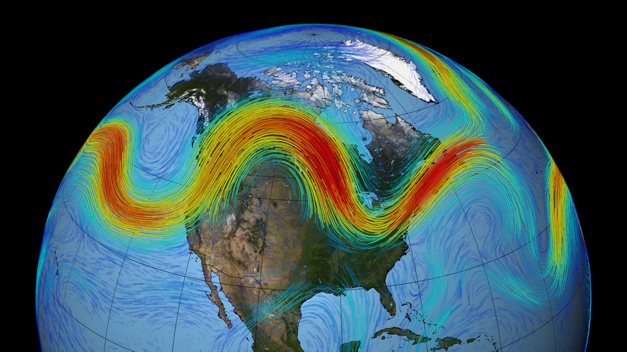
Priority 8: Regional energy budgets, forcing, and feedback
Objective: Within the next decade, advance understanding of the linkages between regional forcing and feedback and the global Earth Radiation Budget.
Motivation:
Regional energy budgets links global changes to the physical manifestation as weather, ocean circulations, and land surface evolution
Local physics => Global impact
Key Questions:
What are the mechanisms and implications of regional change and radiative forcing on global Earth Radiation Budget?
What are the teleconnections between a radiative forcing in one region and an impact in another?
How do regional manifestations of forcing (instantaneous and adjustments) and feedback influence the global system response (ECS and TCR)?

Slide 29
Radiative Balance of the Earth System
Data needs & future observing system
2026 NASA Atmosphere Investigator Meeting, April 23
Maria Hakuba, Yolanda Shea, Patrick Taylor

Slide 30
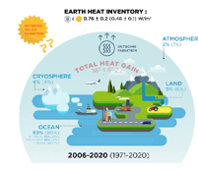
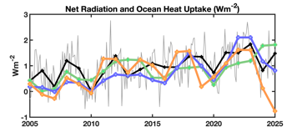
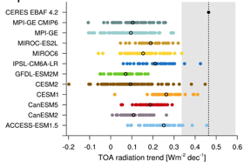
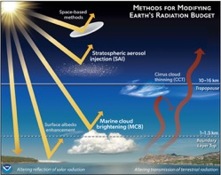
Why is Earth Radiation Science important?
  ERB & EEI are fundamental metrics of Earth System change
  - our planet’s thermostat.
  EEI increase implies an acceleration of global change.
  Spread in EEI trends from different methods;
  Earth System model trends are systematically low.
  “Radiation management” requires monitoring
  & understanding of EEI magnitude and change.

Slide 31
What are some of the key Priorities in Earth Radiation Science?
  Continuity: Maintaining seamless ERB and EEI continuity and the capacity to detect short-and long-term variations robustly
  Process understanding: Improve our understanding of ERB & EEI changes, their causes & their implications (cross-theme)
  Quantify EEI and Earth’s heat uptake: Improve indirect constraints through heat inventory and/or direct measurements of EEI (cross-sphere)
  What could the future ERB & EEI Observing System look like?

Slide 32







Minimum needs for ERB Continuity
Continuity defined as “business as usual”: maintaining SOA and CERES EBAF-like record
  Gold standard Broadband scanning radiometry
    SW, LW, TOT
    all-sky, CRE, clear-sky, pristine
    TOA, surface, atmosphere (profiles)
  Total Solar Irradiance (TSI) & Spectral Solar Irradiance (SSI)
  Collocated Spectral imaging for scene context and CRE
  Ocean heat monitoring for EEI constraint
  Ground Truth – surface + airborne for validation, closure & process studies
  All require overlap to predecessor or the means to intercalibrate. Gap filling?

Slide 33
Enhanced needs for ERB Continuity + reduce cost & science
Leverage innovative technology to maintain seamless continuity and expand science goals.
  Miniaturized Broadband radiometry on free-flyers
    SW, LW, TOT
    all-sky, CRE, clear-sky, pristine
    TOA, surface, atmosphere (profiles)
  TSI & SSI CubeSats
  Collocated or in-tandem Spectral imaging for scene context and CRE
  Heat inventory monitoring
  ocean + ice, land & atm
  for EEI constraint
  Ground Truth – surface + airborne expanded on land, to ocean and spectral
  All require overlap to predecessors and caution re measurement/orbit characteristics and intercalibration

Slide 34
New discoveries & science priorities require additional observations
Priority | Questions to identify observational needs?
1. Earth Energy Imbalance | Can we constrain EEI absolute magnitude from space?
2. ECS & TSR | What observations and model improvements will help us tighten the ECS range?
3. Clouds and Earth Radiation Budget | What synergistic measurements do we need to improve CRE and cloud feedback?
4. Forcings of Earth Radiation Budget | What measurements (at what level) do we need to detect change and detangle forcing (SRM), feedback, internal variability?
5. Polar Energy Budget Change | What process studies are needed to advance our understanding?
6. Energy Budget-Water Cycle Interactions | How can we tighten uncertainties of the surface and atmospheric energy budgets?
7. Circulation-Energy Budget Interactions | How can we support model development and boundaries to improve understanding of energy-circulation feedbacks?
8. Regional energy budgets, forcing, and response | What sampling resolutions are required to support next-gen ESMs and applied science?

Slide 35
New discoveries & science priorities require additional observations
Priority | Questions to identify observational needs?
1. Earth Energy Imbalance | Can we constrain EEI absolute magnitude from space?
2. ECS & TSR | What observations and model improvements will help us tighten the ECS range?
3. Clouds and Earth Radiation Budget | What synergistic measurements do we need to improve CRE and cloud feedback?
4. Forcings of Earth Radiation Budget | What measurements (at what level) do we need to detect change and detangle forcing (SRM), feedback, internal variability?
5. Polar Energy Budget Change | What process studies are needed to advance our understanding?
6. Energy Budget-Water Cycle Interactions | How can we tighten uncertainties of the surface and atmospheric energy budgets?
7. Circulation-Energy Budget Interactions | How can we support model development and boundaries to improve understanding of energy-circulation feedbacks?
8. Regional energy budgets, forcing, and response | What sampling resolutions are required to support next-gen ESMs and applied science?

Slide 36

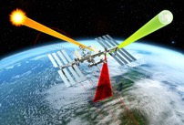
Unprecedented absolute accuracy for EEI monitoring
Libera closed-loop ESR technology enhances absolute radiometric accuracy (improvement factor 2-6).
  Future ERB observing system with comparable or exceeding radiometric capability?
Intercalibration with SITSats (CLARREO-PF) is expected to reduce error of known sign, and tie multiple sensors to a common radiometric scale.
  Future constellation of SITSat + distributed “lower quality” sensors?
Independent methods to provide constraint on EEI magnitude and change.
  Fill gaps in heat inventory approach.
  Accelerometry or WFOV radiometry for independent and direct EEI measurement at TOA.

Slide 37
New discoveries & science priorities require additional observations
Priority | Questions to identify observational needs?
1. Earth Energy Imbalance | Can we constrain EEI absolute magnitude from space?
2. ECS & TSR | What observations and model improvements will help us tighten the ECS range?
3. Clouds and Earth Radiation Budget | What synergistic measurements do we need to improve CRE and cloud feedback?
4. Forcings of Earth Radiation Budget | What measurements (at what level) do we need to detect change and detangle forcing (SRM), feedback, internal variability?
5. Polar Energy Budget Change | What process studies are needed to advance our understanding?
6. Energy Budget-Water Cycle Interactions | How can we tighten uncertainties of the surface and atmospheric energy budgets?
7. Circulation-Energy Budget Interactions | How can we support model development and boundaries to improve understanding of energy-circulation feedbacks?
8. Regional energy budgets, forcing, and response | What sampling resolutions are required to support next-gen ESMs and applied science?

Slide 38
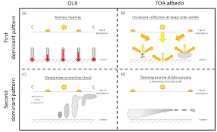

Enhanced information content for process understanding, applied science and ESM evaluation
Diurnal sampling from LEO orbits can reduce uncertainty due to diurnal modeling and provide valuable information for the renewable energy sector and ESM evaluation.
Enhanced spatial resolution may be of added value to discern cloud-aerosol-radiation interactions, to support the applied science sector and the high-res modeling community.
  Define target resolution and address challenges (e.g., 3D effects, data volume)
Above requirements could suggest a constellation of miniaturized ERB systems including scene context and synergistic Earth observations.
Context:
CERES moved from Terra+Aqua orbits to only “afternoon” sampling
Priorities: add morning orbit? fill diurnal cycle more densely?
Role of geostationary – do current diurnal filling approaches provide sufficient confidence in sub-daily variations? What are the key applications and needs?

Slide 39
New discoveries & science priorities require additional observations
Priority | Questions to identify observational needs?
1. Earth Energy Imbalance | Can we constrain EEI absolute magnitude from space?
2. ECS & TSR | What observations and model improvements will help us tighten the ECS range?
3. Clouds and Earth Radiation Budget | What synergistic measurements do we need to improve CRE and cloud feedback?
4. Forcings of Earth Radiation Budget | What measurements (at what level) do we need to detect change and detangle forcing (SRM), feedback, internal variability?
5. Polar Energy Budget Change | What process studies are needed to advance our understanding?
6. Energy Budget-Water Cycle Interactions | How can we tighten uncertainties of the surface and atmospheric energy budgets?
7. Circulation-Energy Budget Interactions | How can we support model development and boundaries to improve understanding of energy-circulation feedbacks?
8. Regional energy budgets, forcing, and response | What sampling resolutions are required to support next-gen ESMs and applied science?

Slide 40

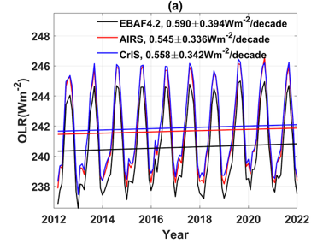
Additional information content for process understanding and ESM evaluation
Spectral ERB observations of the “unknown” are shown to carry valuable information for process fingerprinting and to improve model assumptions.
They may serve to complement broadband irradiance and support a spectral-to-broadband closure test.
Spectra also contain info on scene context and might allow some freedom from collocated multi-spectral imaging – potentially a key step towards a multi-free-flyer ERB system.
If tech. capabilities allow, why not sense ERB spectrally (continuous)?

Slide 41
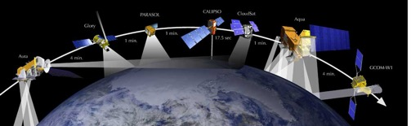
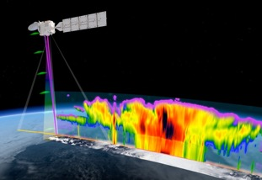
Additional information content for process understanding and ESM evaluation:
Synergistic radiation, passive & active cloud and composition sensing (atm + sur)
  Akin legacy of A-train, EarthCare, AOS (Falcon)
  Satellite, airborne + in-situ
  Models put the pieces together!
Context:
Discern cloud property change impacts on radiation
Tighten knowledge on cloud feedback & other processes
Conduct radiative closure experiments (broadband & spectral) (to verify our understanding of cloud and aerosol radiative effects)

Slide 42
High level summary of observation needs
A balanced top-level integrative approach between process understanding & continuity
EEI – the advent of SI-traceable radiometry & independent EEI monitoring
Spectral ERB for process understanding, modeling and radiation closure
Enhanced spatiotemporal sampling – for applied and modeling sectors
Synergistic Earth observations for critical science questions (cross-theme)
Improved heat inventory which also links to EEI impacts (cross-sphere)
Expand “ground truth” in space and capability (e.g., BSRN, Argo)
Continuity and innovation do not contradict.
  Careful transitions with sufficient overlap?
Observing system architecture could consider:
If continuity and accuracy is priority: a gold standard ERB system
Process oriented studies may work with smaller and distributed systems
  - And may be intermittent to focus on certain targets.

Slide 43
ERB & EEI satellite observing system of the future
Leverages and improves upon the Program of Record (POR).
Utilizes innovation to make measurements better, more cost-effective, more resilient, and provide more information content.
Requires governance and oversight.
Requires a strategy and architecture study.
A strategy that aims to address a set of science questions and their requirements, e.g.,:
What is the magnitude of Earth’s energy flows, how much are they changing, why are they changing, and what are the implications?

Slide 44
BOSS-E: A Better Observing System Strategy for ERB & EEI
… addresses challenges in Earth radiation and EEI research:
  Foundational climate observations & science:
  Earth radiation and EEI magnitude & change.
  Resilience to observing gaps and discontinuities.
  Integrated system view: Causes and implications of ERB/EEI change.
  Enhances accuracy, sampling and information content (spectral).
  Self-consistent & complementary: components can serve to calibrate/verify each other.

Slide 45
NASA’s End-to-end Earth System Science Capability
Technology
Flight
Research
Data and Modeling
Earth Action
10 Tech Infusions/year
24 Missions on Orbit
1,330 Active Research Projects
48 States
Collect 160 TB/Day
Serving 600 TB/Day
>10M Users
World-Class Models
Agriculture
Energy
Disasters
Wildfires
& more
12.11.2025

Slide 46




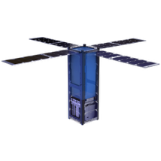



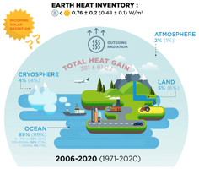


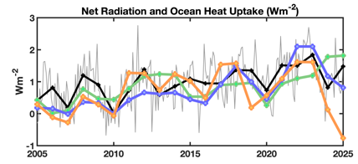


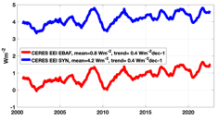

BOSS-E - A Better Observing System Strategy for ERB & EEI:
Multi-sensor composite constellation
SUNCUBEs TSI & SSI
Total solar irradiance
Spectral solar irradiance
Key component of ERB – Earth’s energy input
Can help with stability tracking of other systems
Complements RAD-Sats
Novel tech exists
RAD-SATs
Earth radiation and change in EEI
(Spectral) UV-FIR radiances
Scanners: Daily coverage, <20km
To address:
  ERB Continuity broadband
  Process understanding
  Scene context
  Composition
  Facilitate closure
Multi-SSO to sample diurnal cycle
High-res changes in SW, LW, EEI and their causes.
Potential need for gold standard central observatory?
HOT-EARTH
(HOT-OCEAN)
(Ocean) heat inventory
In-situ, Altimetry - gravimetry
Independent indirect EEI estimate
Links to EEI impacts
0.4 - 1.2 Wm⁻²
EEI-DIRECT
Direct net irradiance - Global annual EEI
Fundamental Earth system change indicator
Uniform sensitivity UV-FIR
WFOV, accelerometry, …
Precessing LEO orbits
Constraint/independent for RAD-SAT, HOT-EARTH
SYN-RAD
Cloud, aerosol & composition sensing
Radiative closure
Models & reanalysis
In-situ & airborne
Regional foci?
What process studies to prioritize?

Slide 47
Conclusions & Considerations: ERB & EEI Roadmap
Threshold Continuity
Near-term gap prevention
  Yesterday
Baseline Continuity+
Leverages innovation & extended science
  Next 5-10 years?
Integrated ERB observing system Enables discovery & new science
  > 10 years?

Slide 48
Conclusions & Considerations
ERB is changing, why? A leading question for our community
What we have is good, we need to maintain it, but there are gaps
Review accuracy, precisions, stability needs for application/science questions to guide tech development & potential ERB gap-filling techniques.
Continuity and innovation do not contradict, but what does “continuity” mean?
Integration of science and observations across spheres, themes, observing systems, and models is key to making progress on ERB/EEI priorities.
  Atmosphere – hydrosphere
  Radiation – cloud & aerosols
  Satellite, airborne, surface observations
  (Earth System) Models/Assimilation/AI
Adding new observables (spectral ERB, direct EEI, synergistic obs.) provide a route to new discoveries and addressing science priorities
Build data needs pyramid for ERB continuity, science priorities, measurement requirements?

Slide 49
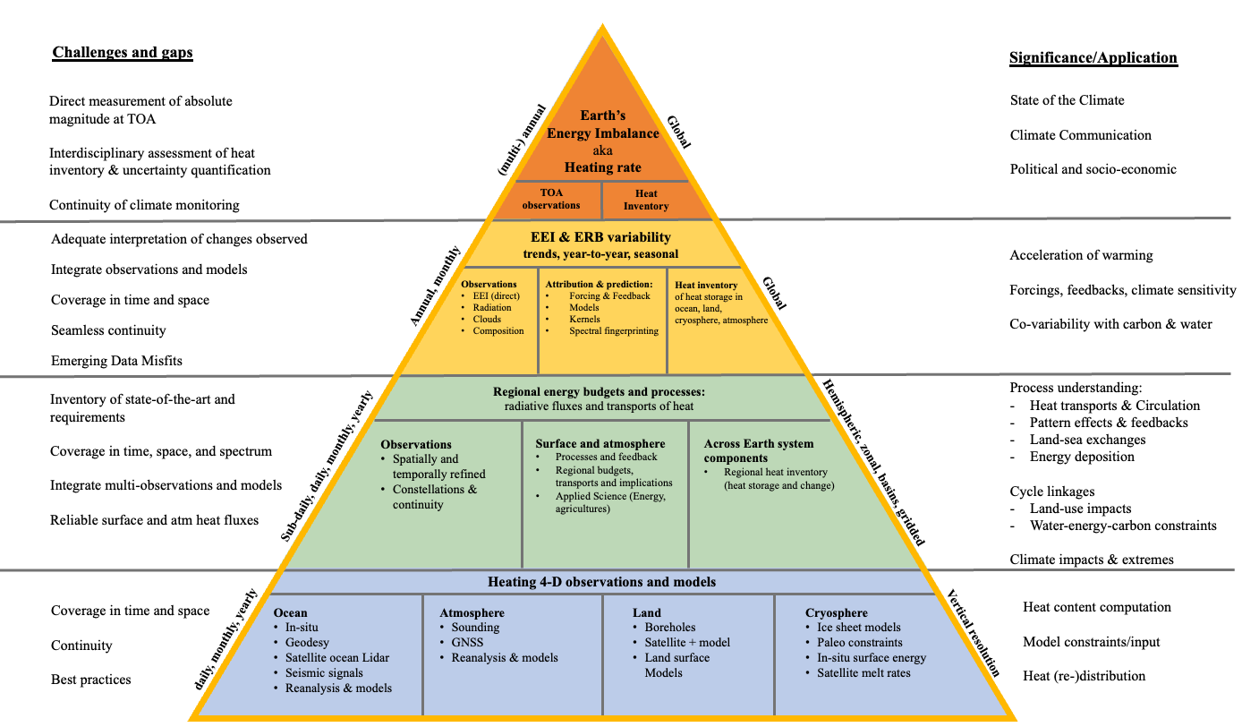
Summarizing the data needs, challenges and significance of EEI Research

