Slide 1
Stratospheric Composition
Qing Liang (NASA GSFC)
Rei Ueyama (NASA ARC)
Pam Wales (NASA GSFC / Morgan State University)

Slide 2
Community input on Stratospheric Composition
STRATOSPHERE
MEASUREMENTS • MODELING • AEROSOLS
OZONE • CIRCULATION • SATELLITE • CLIMATE
COMPOSITION • RECOVERY • AIRBORNE • DATA GAPS • TRENDS
Space Debris • Rocket Launches • Wildfires • Geoengineering • Validation
STRIVE • CMIP • CCMI • UTLS • Solar Occultation • Limb Scatter • Brewer-Dobson • Radiative Forcing • PyroCb • Tropopause

Slide 3
Priority themes for Stratospheric Composition
Ozone and related trace gases
  Advance understanding of processes controlling the long-term recovery and variability of the stratospheric ozone layer
Stratospheric circulation and transport
  Quantify how stratospheric circulation, transport, and mixing changes influence the distribution of key trace gases in the stratosphere and troposphere
Stratospheric aerosols
  Understand the role of stratospheric aerosols – background sulfate, biomass burning aerosols, extreme episodic occurrences, space entry debris – in modifying chemical pathways and radiative balance

Slide 4
Key points to address under each theme
What are the key process-level uncertainties and emerging research questions that will define scientific priorities?
What are the core capabilities, limitations, and challenges of the current observational system, including satellite remote sensing, ground-based measurements, and in situ / airborne observations?
What are the model limitations and predictive capability, including the potential to leverage modeling systems to monitor and predict stratospheric composition?

Slide 5
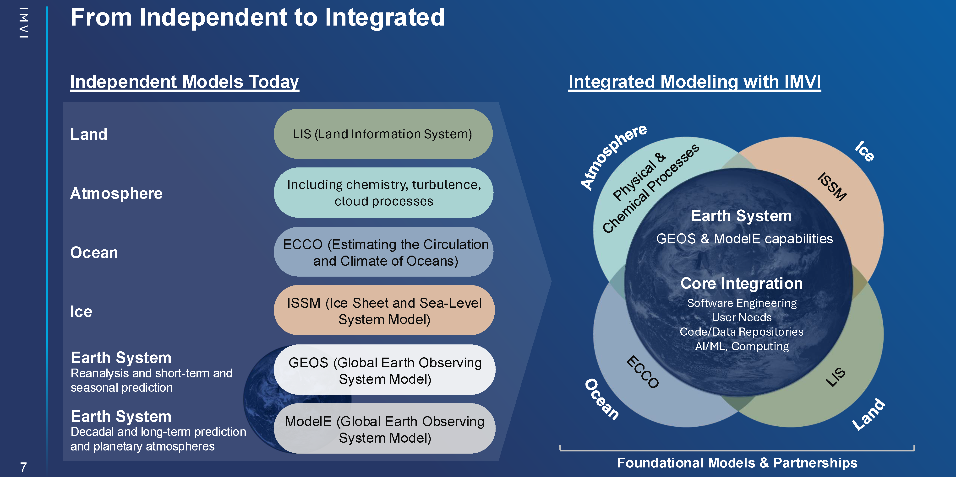
Integrated Modeling Virtual Institute (IMVI)

Slide 6
Stratospheric Composition Modeling under IMVI
Continued modeling effort in IMVI/NASA Context
  Chemistry-climate modeling
  Data assimilation and reanalysis (e.g. long-term ozone records)
  Expanding scope beyond ozone (e.g. water vapor, chemistry-dynamics coupling, volcanic impact, wildfires)
Limitation/pain points
  Persistent issues with transport
  Need to better connect chemistry-dynamics interactions
  Observational transition: long-term observations data are going away
New opportunities
  STRIVE
  Impact of space activities; connections to upper-atmosphere processes
  Role of S2S/S2D prediction through chemistry-dynamics coupling
Contribution from Lesley Ott (IMVI Project Scientist)

Slide 7
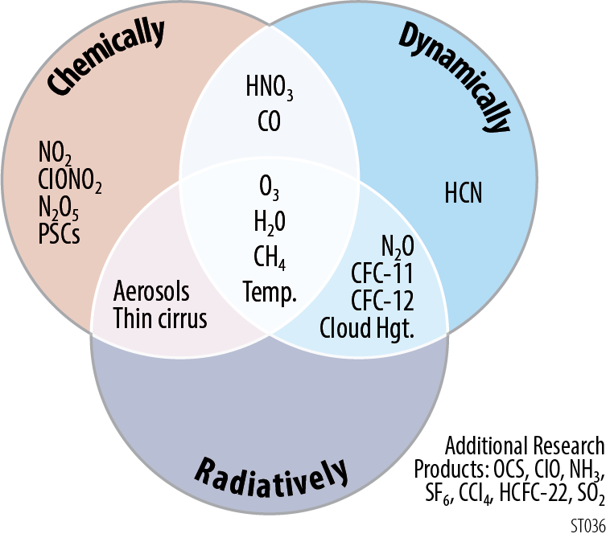
Ozone and related trace gases
STRIVE Products
Advance our understanding of processes controlling the long-term recovery and variability of the ozone layer
  Improve constraints on the budgets and partitioning of key chemical families (halogens, NO_{y}, HO_{x})
  Bridging current and future observational platforms

Slide 8
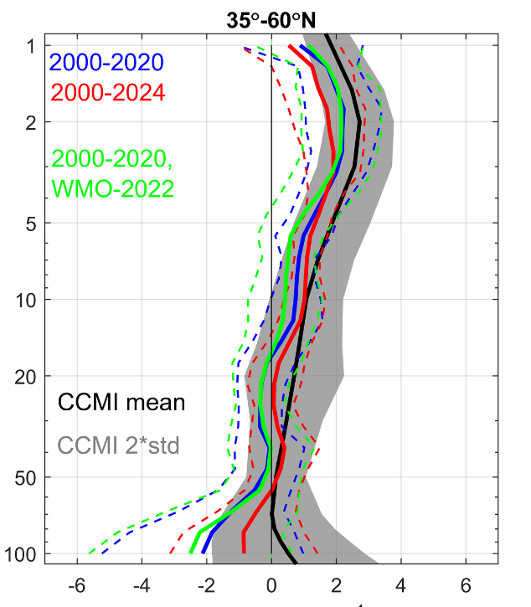
Ozone layer recovery and variability
Regional, vertically resolved ozone trends
  Separate chemical and dynamical impacts
Significant variability in lower stratospheric global ozone
  Complicates interpretation of total and tropospheric column trends
What are the drivers of biases in projections?
Pressure (hPa)
Ozone trends (% decade⁻¹)
Sofieva et al. (2026)

Slide 9
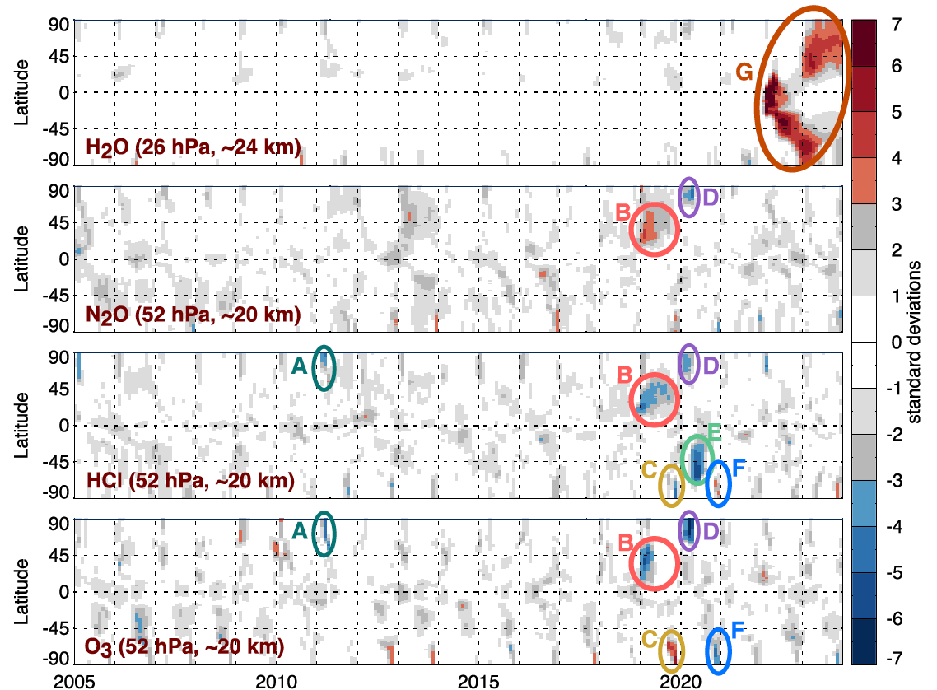
Ozone layer recovery and variability
Separating chemical and dynamical signals for attribution of recovery
  Combination of tracers used to interpret trends and events
Long-term interactions between composition and circulation changes
Anomalies in MLS Reanalysis
H₂O
N₂O
HCl
O₃
Salawitch et al. (2025)
Notes:
Give an example of an emergent event upfront

Slide 10
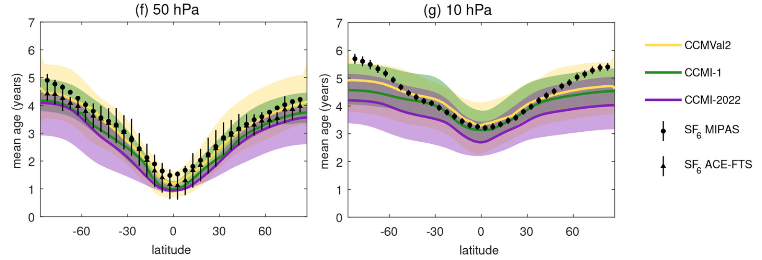
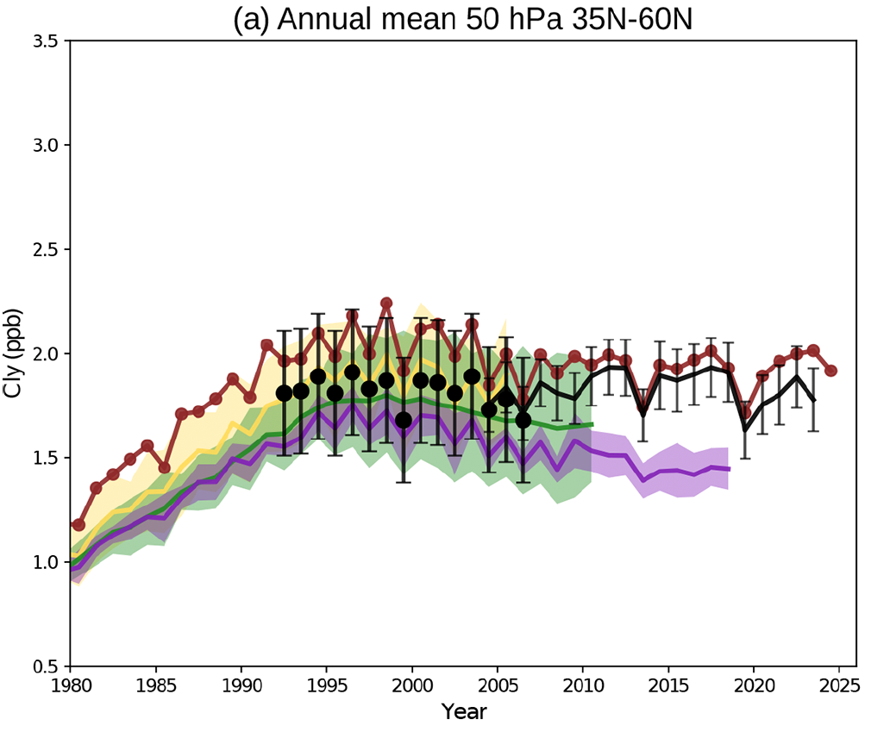
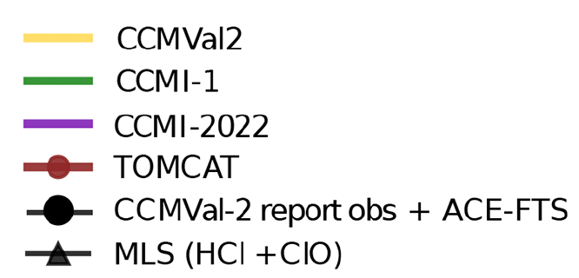
Ozone layer recovery and variability
Separating chemical and dynamical signals for attribution of recovery
  Combination of tracers used to interpret trends and events
Long-term interactions between composition and circulation changes
  Degradation in model performance
Mean age (years)
Chlorine (ppb)
Abalos et al. (2026)
Notes:
Give an example of an emergent event upfront

Slide 11
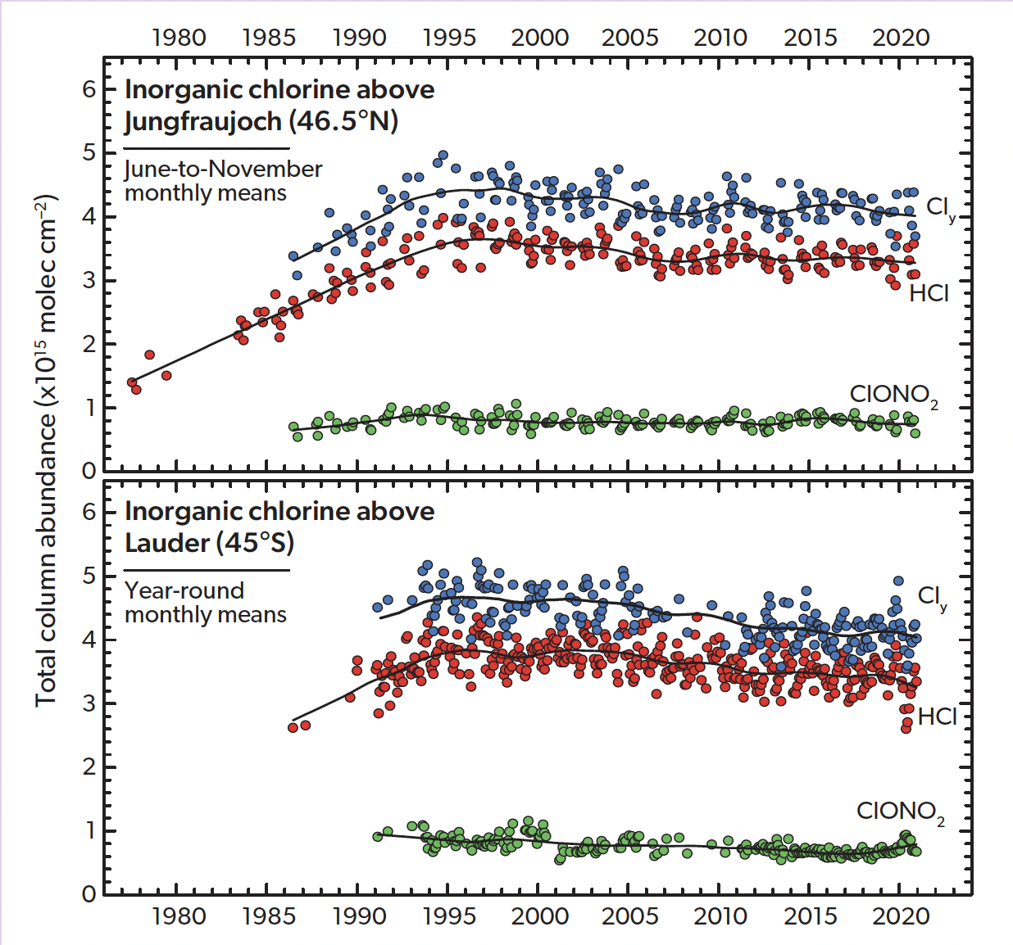
Trace gas budget and partitioning
NDACC Chlorine Columns
Ongoing need to understand trends in chemical families
  Impact of N₂O and CH₄ growth
  Detection of rouge and unregulated emissions
Chemical processing and transport in the UT/LS
  Sensitivity to aerosol interactions
  ODS lifetimes
WMO 2022 Ozone Assessment
Notes:
Relevant community input (my comments):
-- understanding ODS lifetimes (understanding how the surface monitoring imprints on ozone layer trends, uncertainties in banks/projections)
-- trace gas partitioning in UT/LS (understanding transport to the stratosphere, interpretation of BrO columns?)
-- In lower stratosphere: changes in aerosol, ODSs

Slide 12
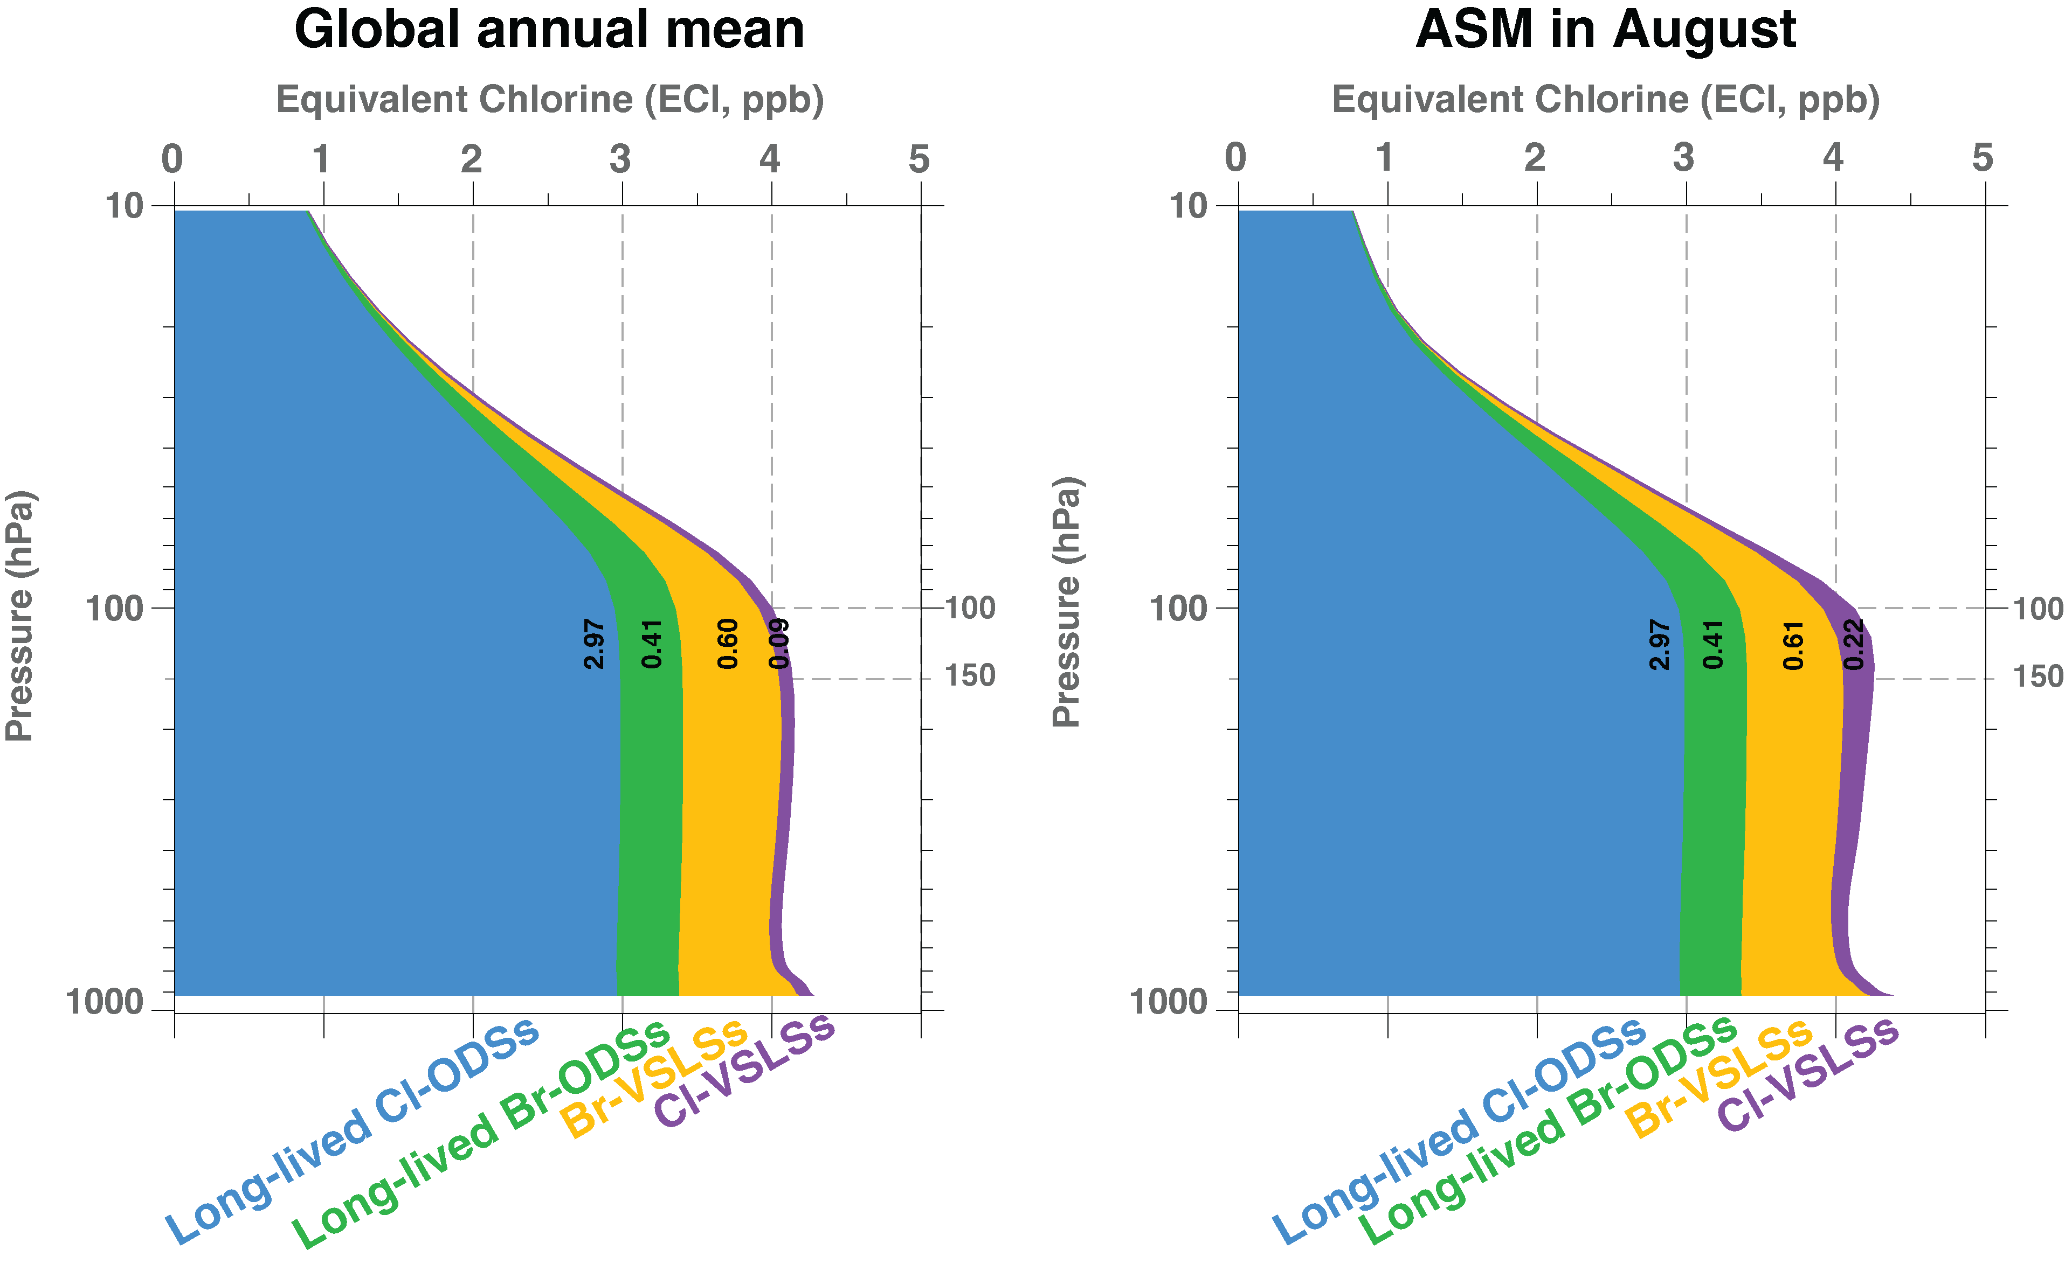


Continued monitoring of surface ODS and high-altitude in-situ sampling are needed for accurate estimation of halogen input to the stratosphere
Surface abundance of
Controlled long-lived ODS
UT/LS sampling of Cl-VSLSs
Near Asian outflow
Modeling estimate of the global annual mean (2020-2022) stacked contribution to Equivalent chlorine (ECl) from long-lived and very-short-lived halogen source gases (Figure from Liang et al. 2025)

Slide 13
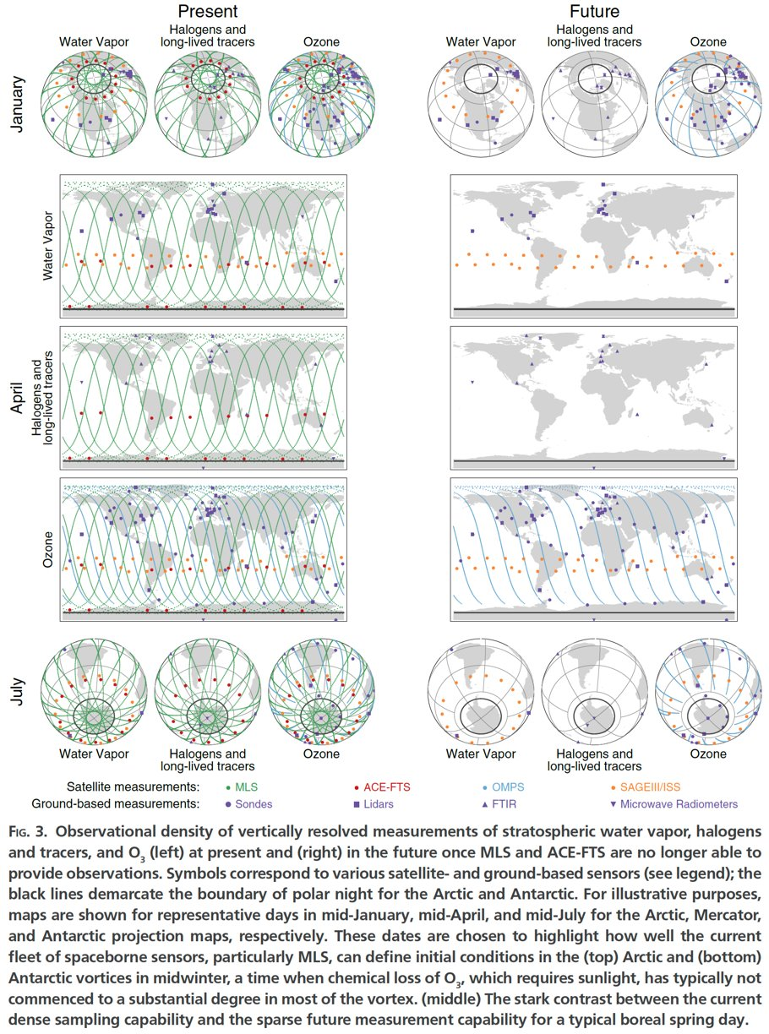
Understanding long-term trends
Current
Intermediate
Stratospheric water vapor is a key dynamical tracer
  SAGE instrument onboard International Space Station
Water Vapor
MLS (since 2004) ACE-FTS (since 2003)
SAGE III/ISS Ground stations
OMPS instruments
Chemical & Long-lived Tracers
OMPS Instruments onboard NOAA satellites
  SNPP will end in December
Ozone
Salawitch et al. (2025)
Notes:
OMPS will be key for meteorological reanalysis. Both Ozone and water vapor will be measured by

Slide 14
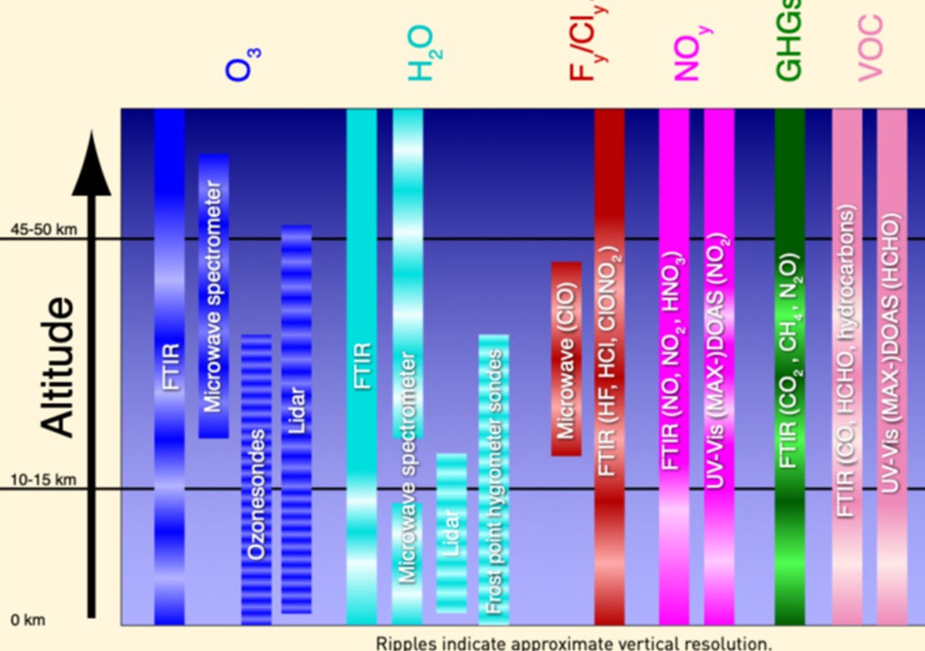
Understanding long-term trends
NDACC Observational Capabilities
Current
Intermediate
Water Vapor
Chemical & Long-lived Tracers
Columns: OClO, BrO, NO₂, CFC-11, CFC-12
Ozone
Salawitch et al. (2025)
Notes:
OMPS will be key for meteorological reanalysis. Both Ozone and water vapor will be measured by

Slide 15
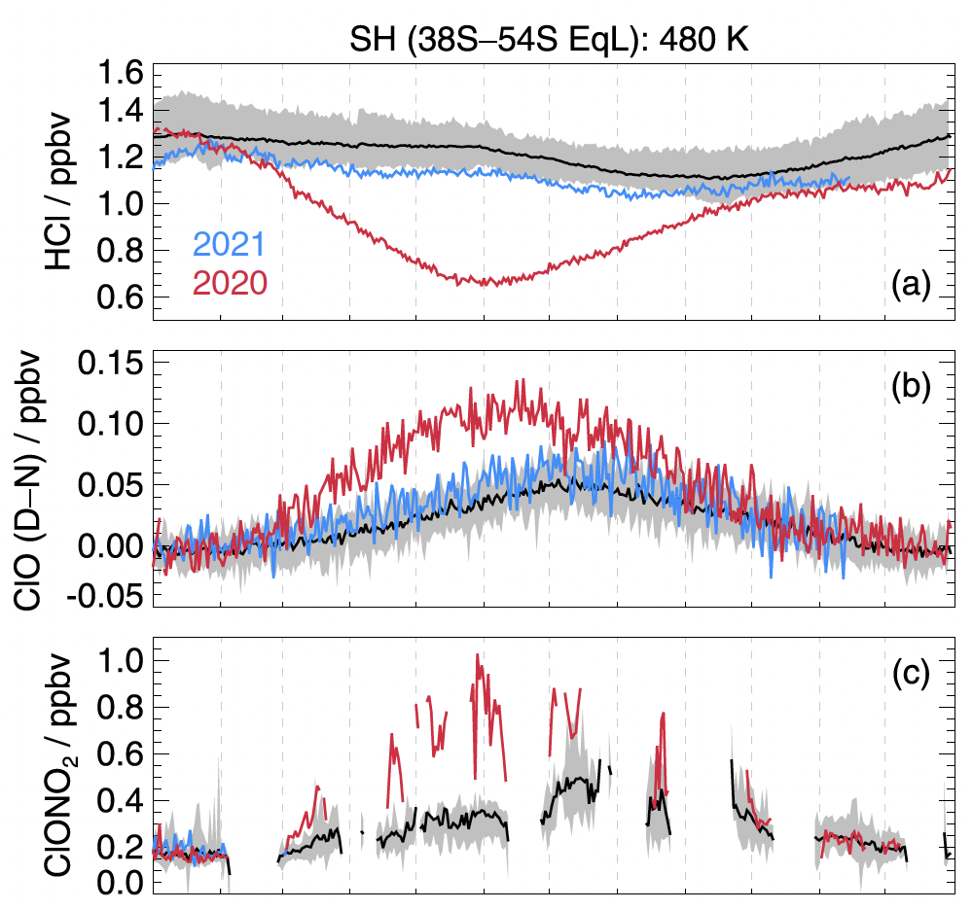
Identifying emergent emissions and anomalous events
Australian Wildfires
Recently detected anomalies associated with:
  Extreme dynamical events
  Wildfire and volcanic emissions
From community input:
  Increased wildfire activity
  Impact of space economy, aircraft
  Natural and anthropogenic aerosol interactions
MLS
MLS
ACE-FTS
Mar
Jun
Sept
Dec
Santee et al. (2022)
Notes:
Not only how will this be managed in between MLS and STRIVE

Slide 16
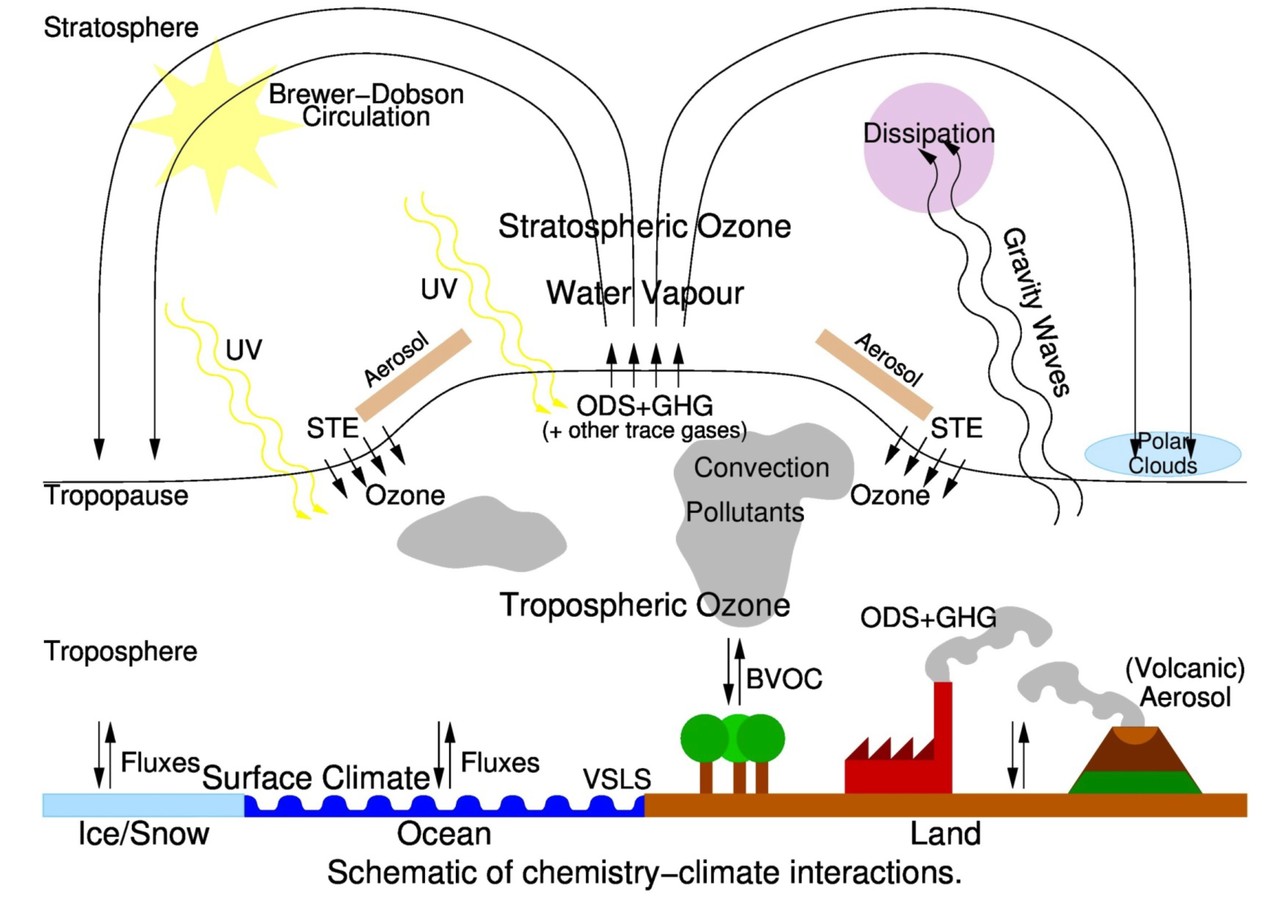
Stratospheric circulation and transport
Broad themes:
Climate-driven changes in stratospheric circulation
Stratosphere-troposphere transport and coupling processes
courtesy of P. Braesicke

Slide 17
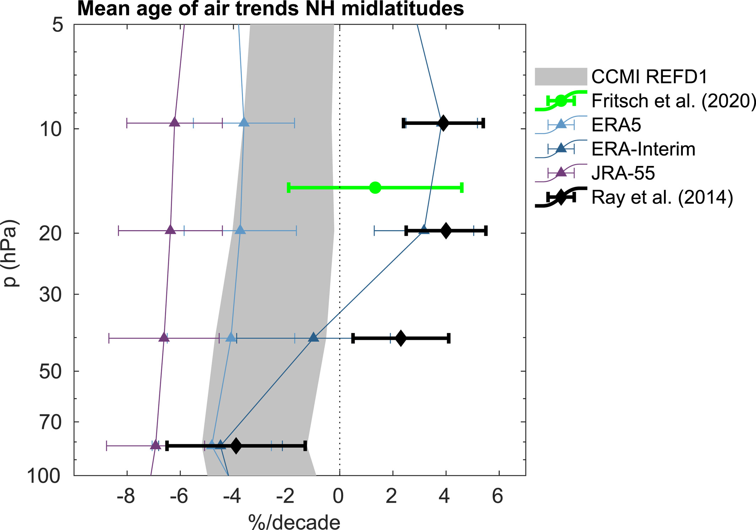
Climate-driven stratospheric circulation changes
Stratospheric transport is too fast in current chemistry-climate models. The predicted acceleration of the Brewer-Dobson circulation (BDC) is confirmed by observations in the lower stratosphere, but measurements are too uncertain to confirm or disprove middle stratospheric trends.
What are the combined impacts of increasing GHG, ozone recovery, and episodic dynamics (volcanos, wildfires, SAI) on the BDC?
How will climate-driven stratospheric circulation changes alter the distribution of stratospheric trace gases (e.g., ozone, water vapor)?
Garny et al. (2024)

Slide 18
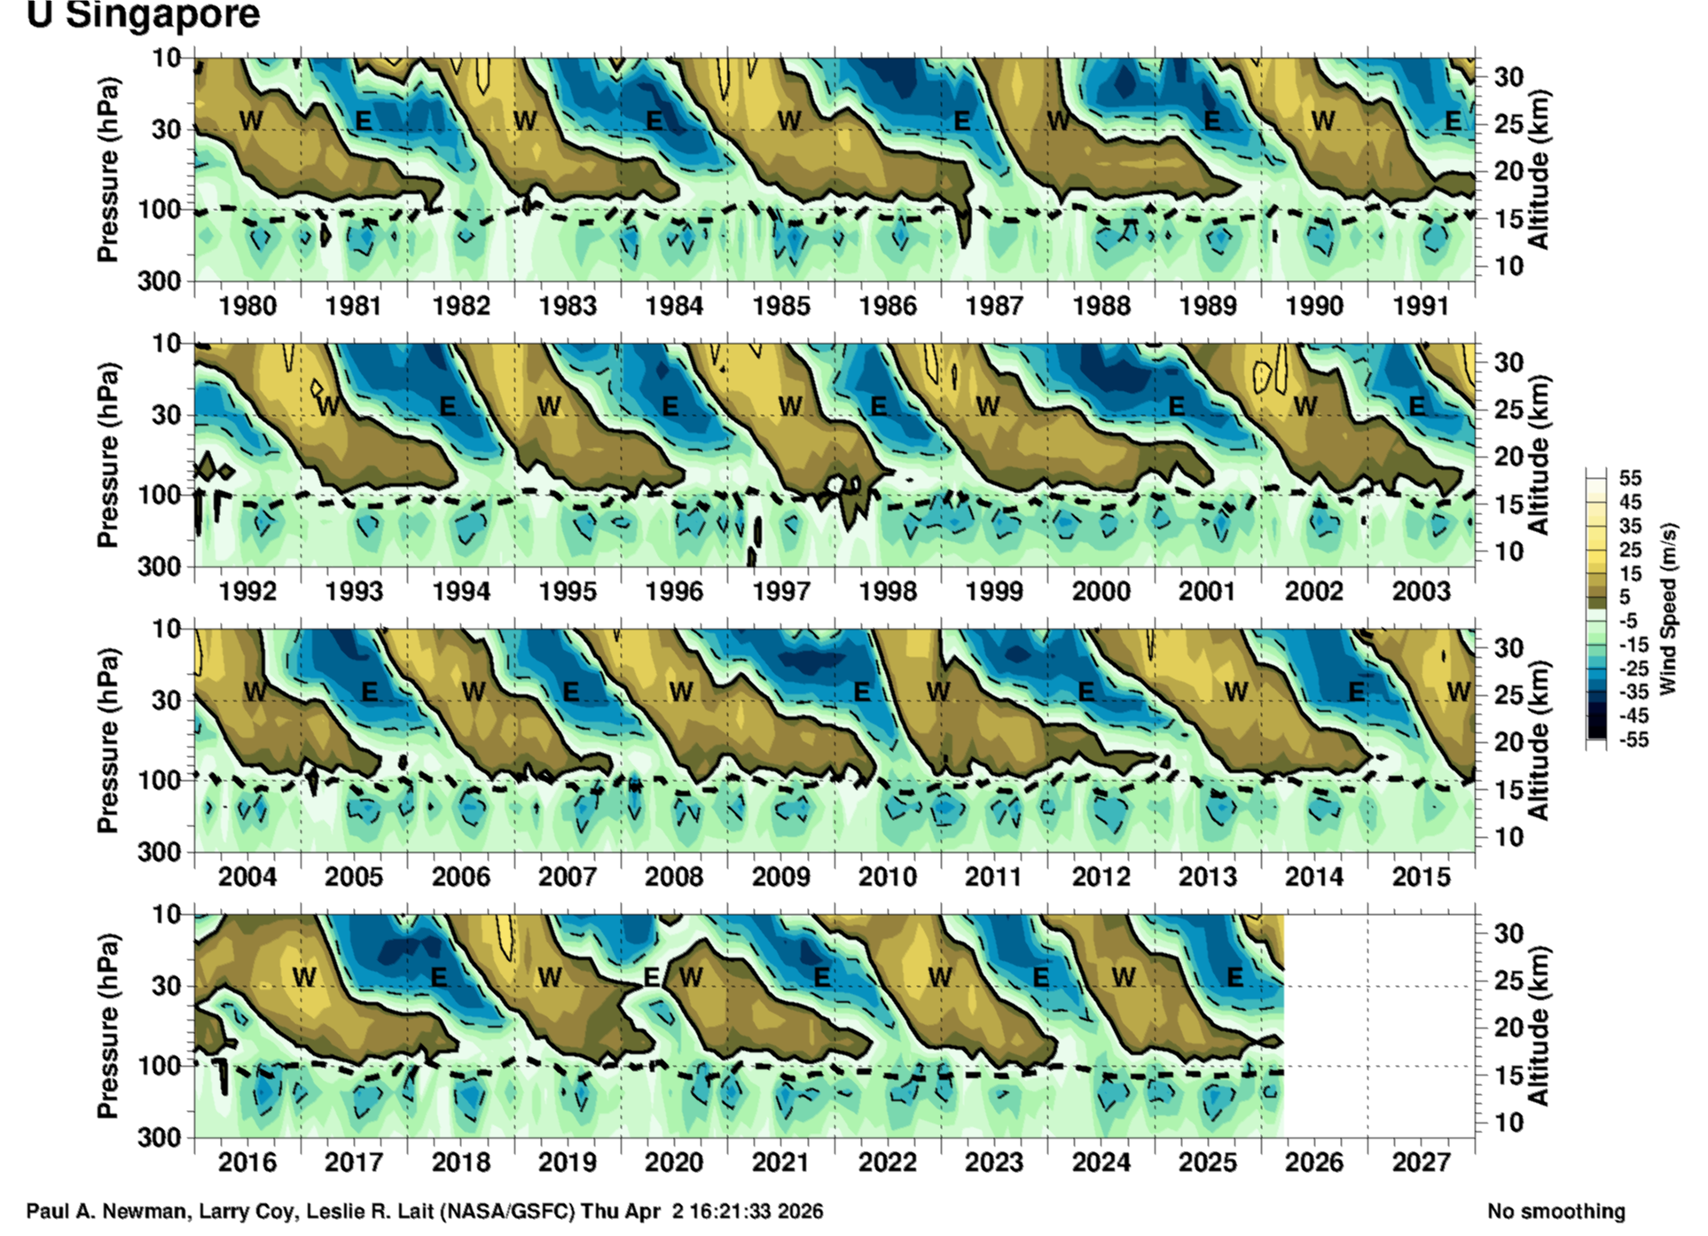
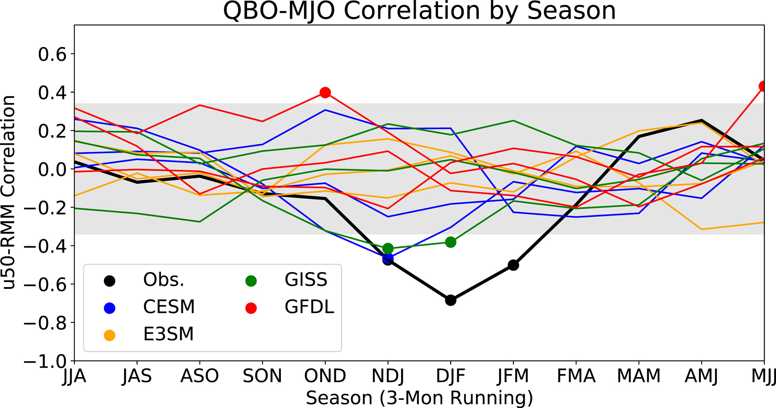
Climate-driven stratospheric circulation changes
Global models struggle with accurate representation of the Quasi-Biennial oscillation (QBO) and its future trend.
How do the different modes of variability interact (e.g., seasonal cycle of the BDC, QBO, ENSO, MJO) and how will that impact stratospheric transport?
c
c
Newman et al.
Martin et al. (2023)

Slide 19
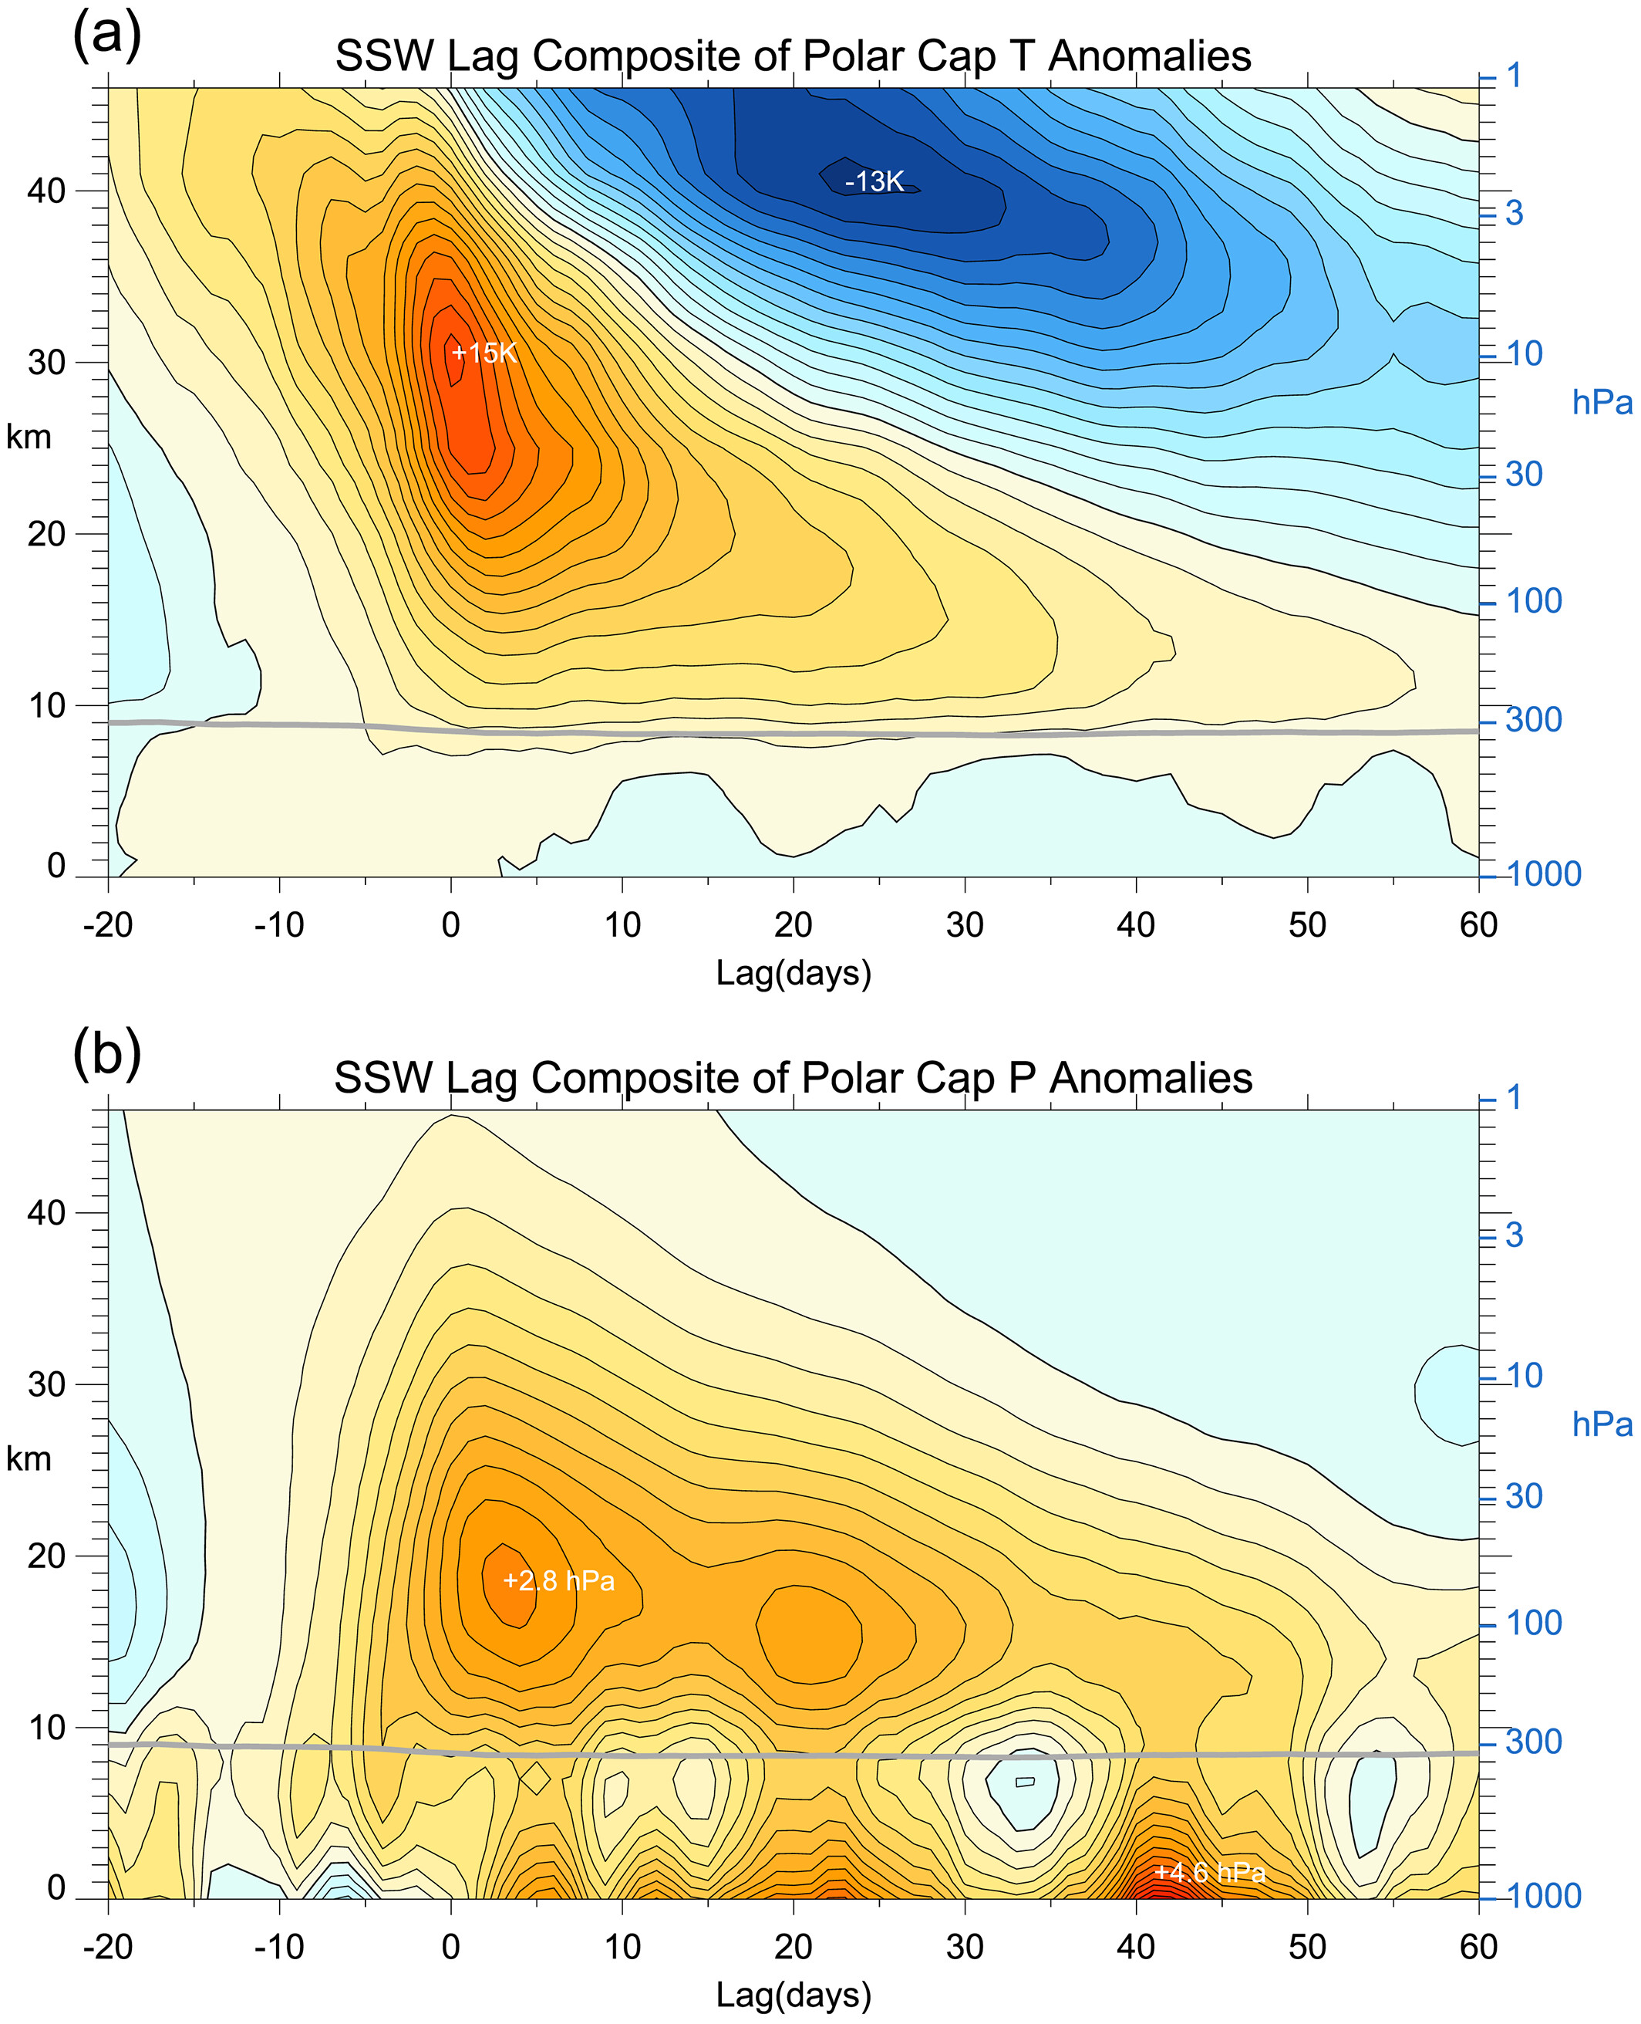
Stratosphere-troposphere transport and coupling processes
Stratospheric variability and related stratosphere-troposphere (ST) coupling in the Arctic and tropics are not well understood, adding uncertainty to surface projections.
What are the mechanisms of ST coupling processes across time scales?
How will the stratospheric polar vortex, ST transport (e.g., deep convection), and mixing evolve under climate change?
What is the role of ST coupling in ocean variability and trends?
→ Implications for S2S predictability
Baldwin et al. (2021)

Slide 20
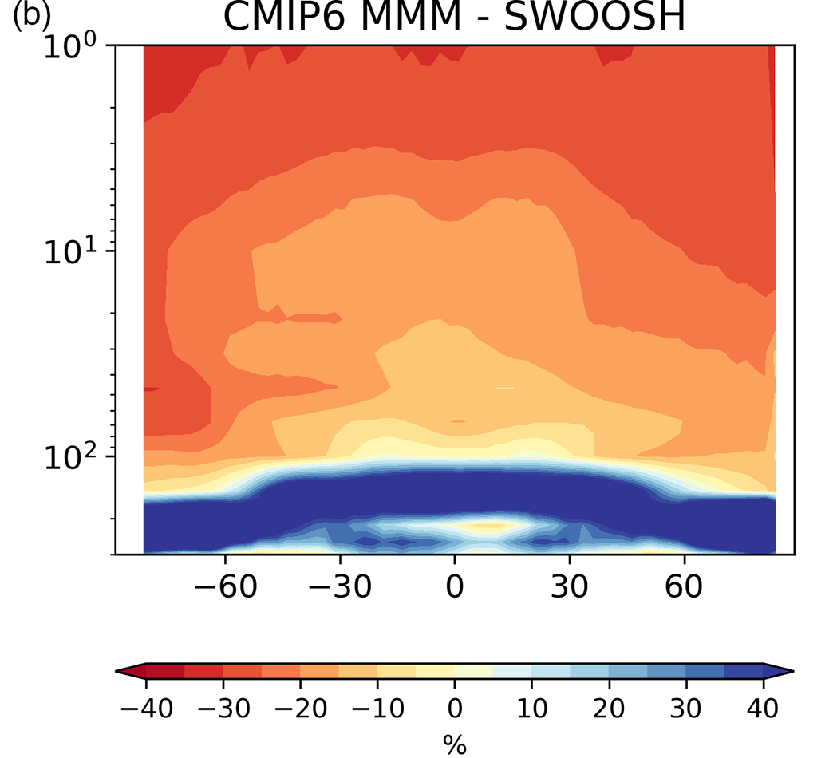
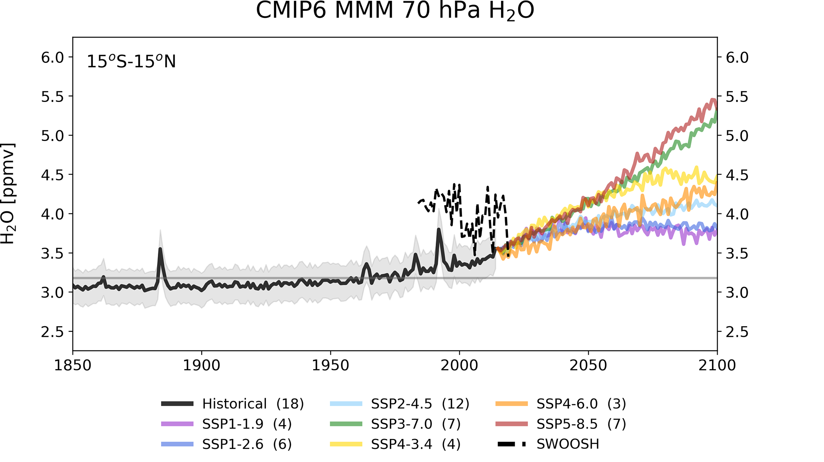
Stratosphere-troposphere transport and coupling processes
Large discrepancies between models and observations exist in clouds and water vapor in the upper troposphere / lower stratosphere (UTLS) .
What controls the long-term trend and variability of stratospheric H₂O and its feedback on radiative forcing?
How will changes in stratospheric H₂O affect ozone chemistry, climate forcing, and circulation in future climate?
Keeble et al. (2021)

Slide 21
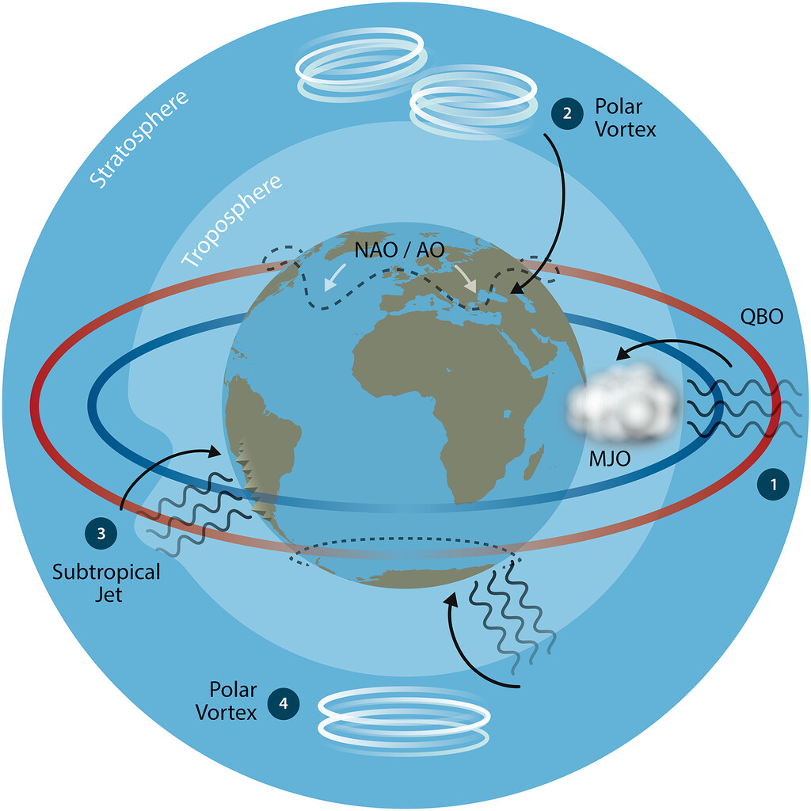
"Atmosphere" contributions to stratospheric circulation and transport modeling
Evaluation of stratospheric transport in models (e.g., predicted acceleration)
Development of observation-based...
  diagnostics of individual transport processes
  metrics for evaluating stratospheric biases in S2S forecast systems
  methods to constrain model uncertainty
Improved process-level understanding of the UTLS
Benchmarks for gravity wave and convective parameterizations
Achatz et al. (2024)

Slide 22
Current measurement capabilities and needs for stratospheric circulation and transport
High-quality measurements of multiple Age of Air tracer concentrations (e.g., SF₆, CO₂, CH₄, N₂O) especially in the tropics and Southern Hemisphere

Slide 23
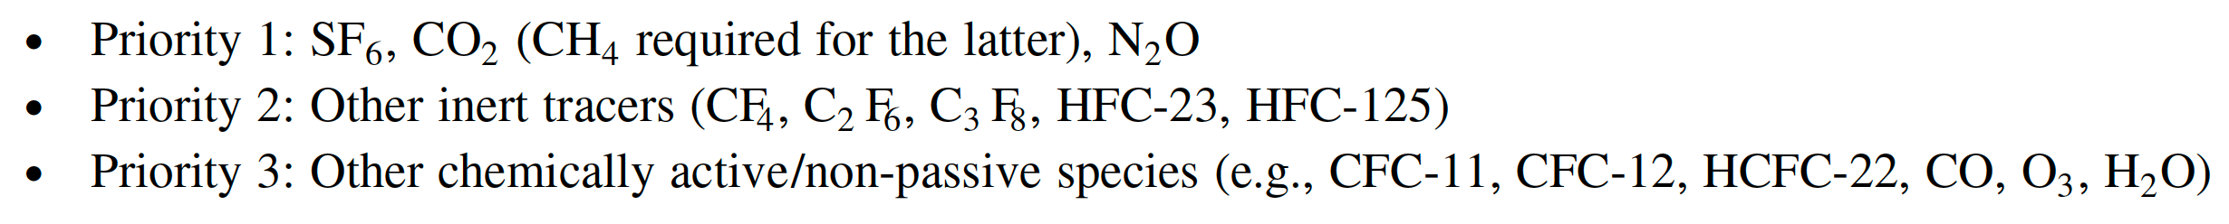
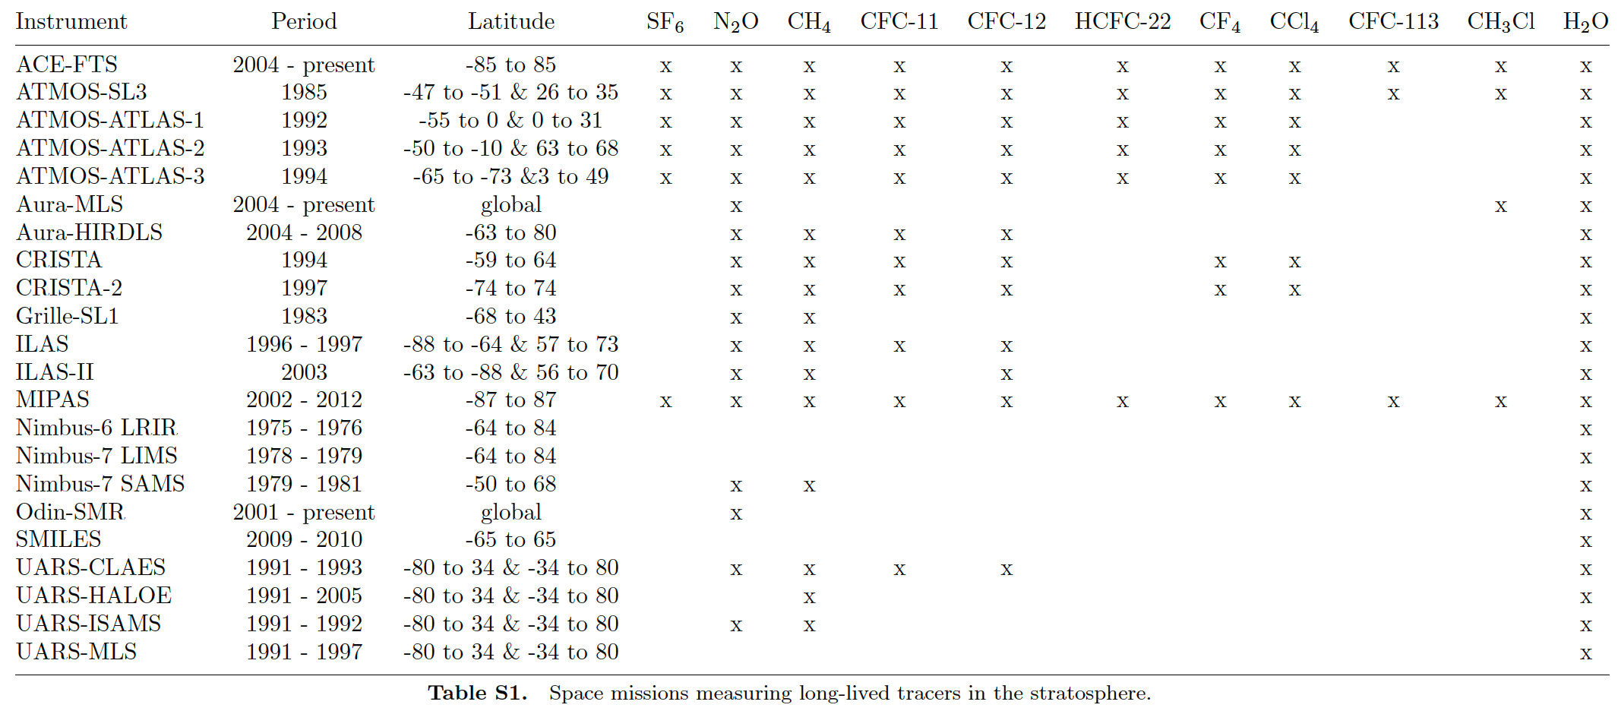
Age of Air tracers
STRIVE
Garny et al. (2024)
Notes:
Garny et al. (2024)

Slide 24
Current measurement capabilities and needs for stratospheric circulation and transport
High-quality measurements of multiple Age of Air tracer concentrations (e.g., SF₆, CO₂, CH₄, N₂O) especially in the tropics and Southern Hemisphere
In situ and remote sensing, vertically-resolved trace gas measurements (e.g., H₂O, O₃, CO) in the UTLS
Observations of gravity waves and their interactions with subgrid-scale processes (e.g., convection, turbulence)

Slide 25
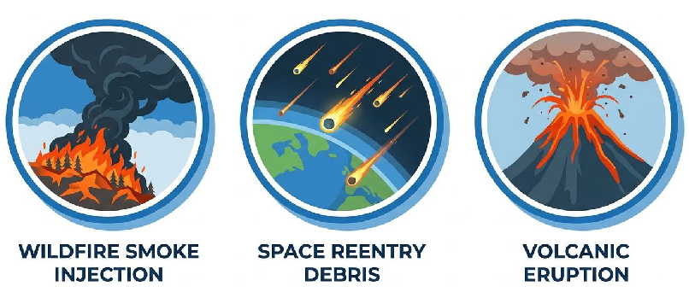
Stratospheric aerosols
Emerging research questions
How do wildfire smoke injections and other extreme events perturb stratospheric aerosol chemistry? Do organic-rich smoke particles alter heterogeneous chemistry differently than sulfate aerosols?
What are the impacts of increasing space launch activity on stratospheric composition and ozone? How significant are emissions of black carbon, alumina, and reactive chlorine from rockets?
How do moderate volcanic eruptions influence long-term stratospheric aerosol variability and chemistry? What role do these eruptions play in driving interannual variability in ozone and radiative forcing?

Slide 26
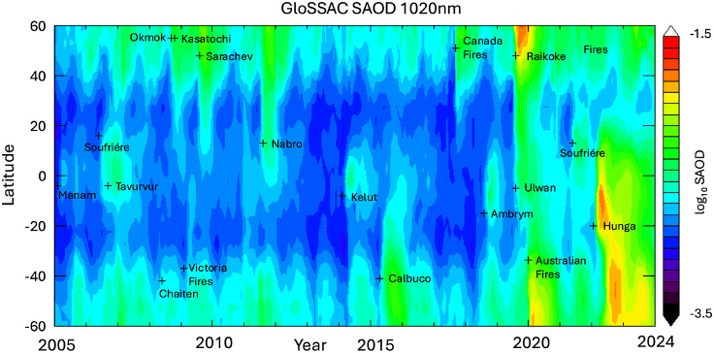

Unusual recent stratosphere with greatly enhanced stratospheric aerosol loadings from various volcanic eruptions and large wildfires

Slide 27




Scarce In situ measurements of stratospheric aerosol composition (recent and ongoing suborbital missions)
2017-2018
(DC-8)
2022
(ER-2)
2021-2022
(WB-57)
2023, 2025, …
(WB-57)
2026
(ER-2)

Slide 28
Scarce In situ measurements of stratospheric aerosol composition (recent and ongoing suborbital missions)
2017-2018
(DC-8)
2022
(ER-2)
2021-2022
(WB-57)
2023, 2025, …
(WB-57)
2026
(ER-2)
A good collection of background stratospheric aerosol composition (e.g. sulfate, organic-sulfate)
Stratospheric aerosol composition in the continental monsoon regions (anthropogenic sources)
Very limited encounter of pyroCb particles (Canadian wildfire)
Spacecraft reentry debris particles in the lower stratosphere

Slide 29

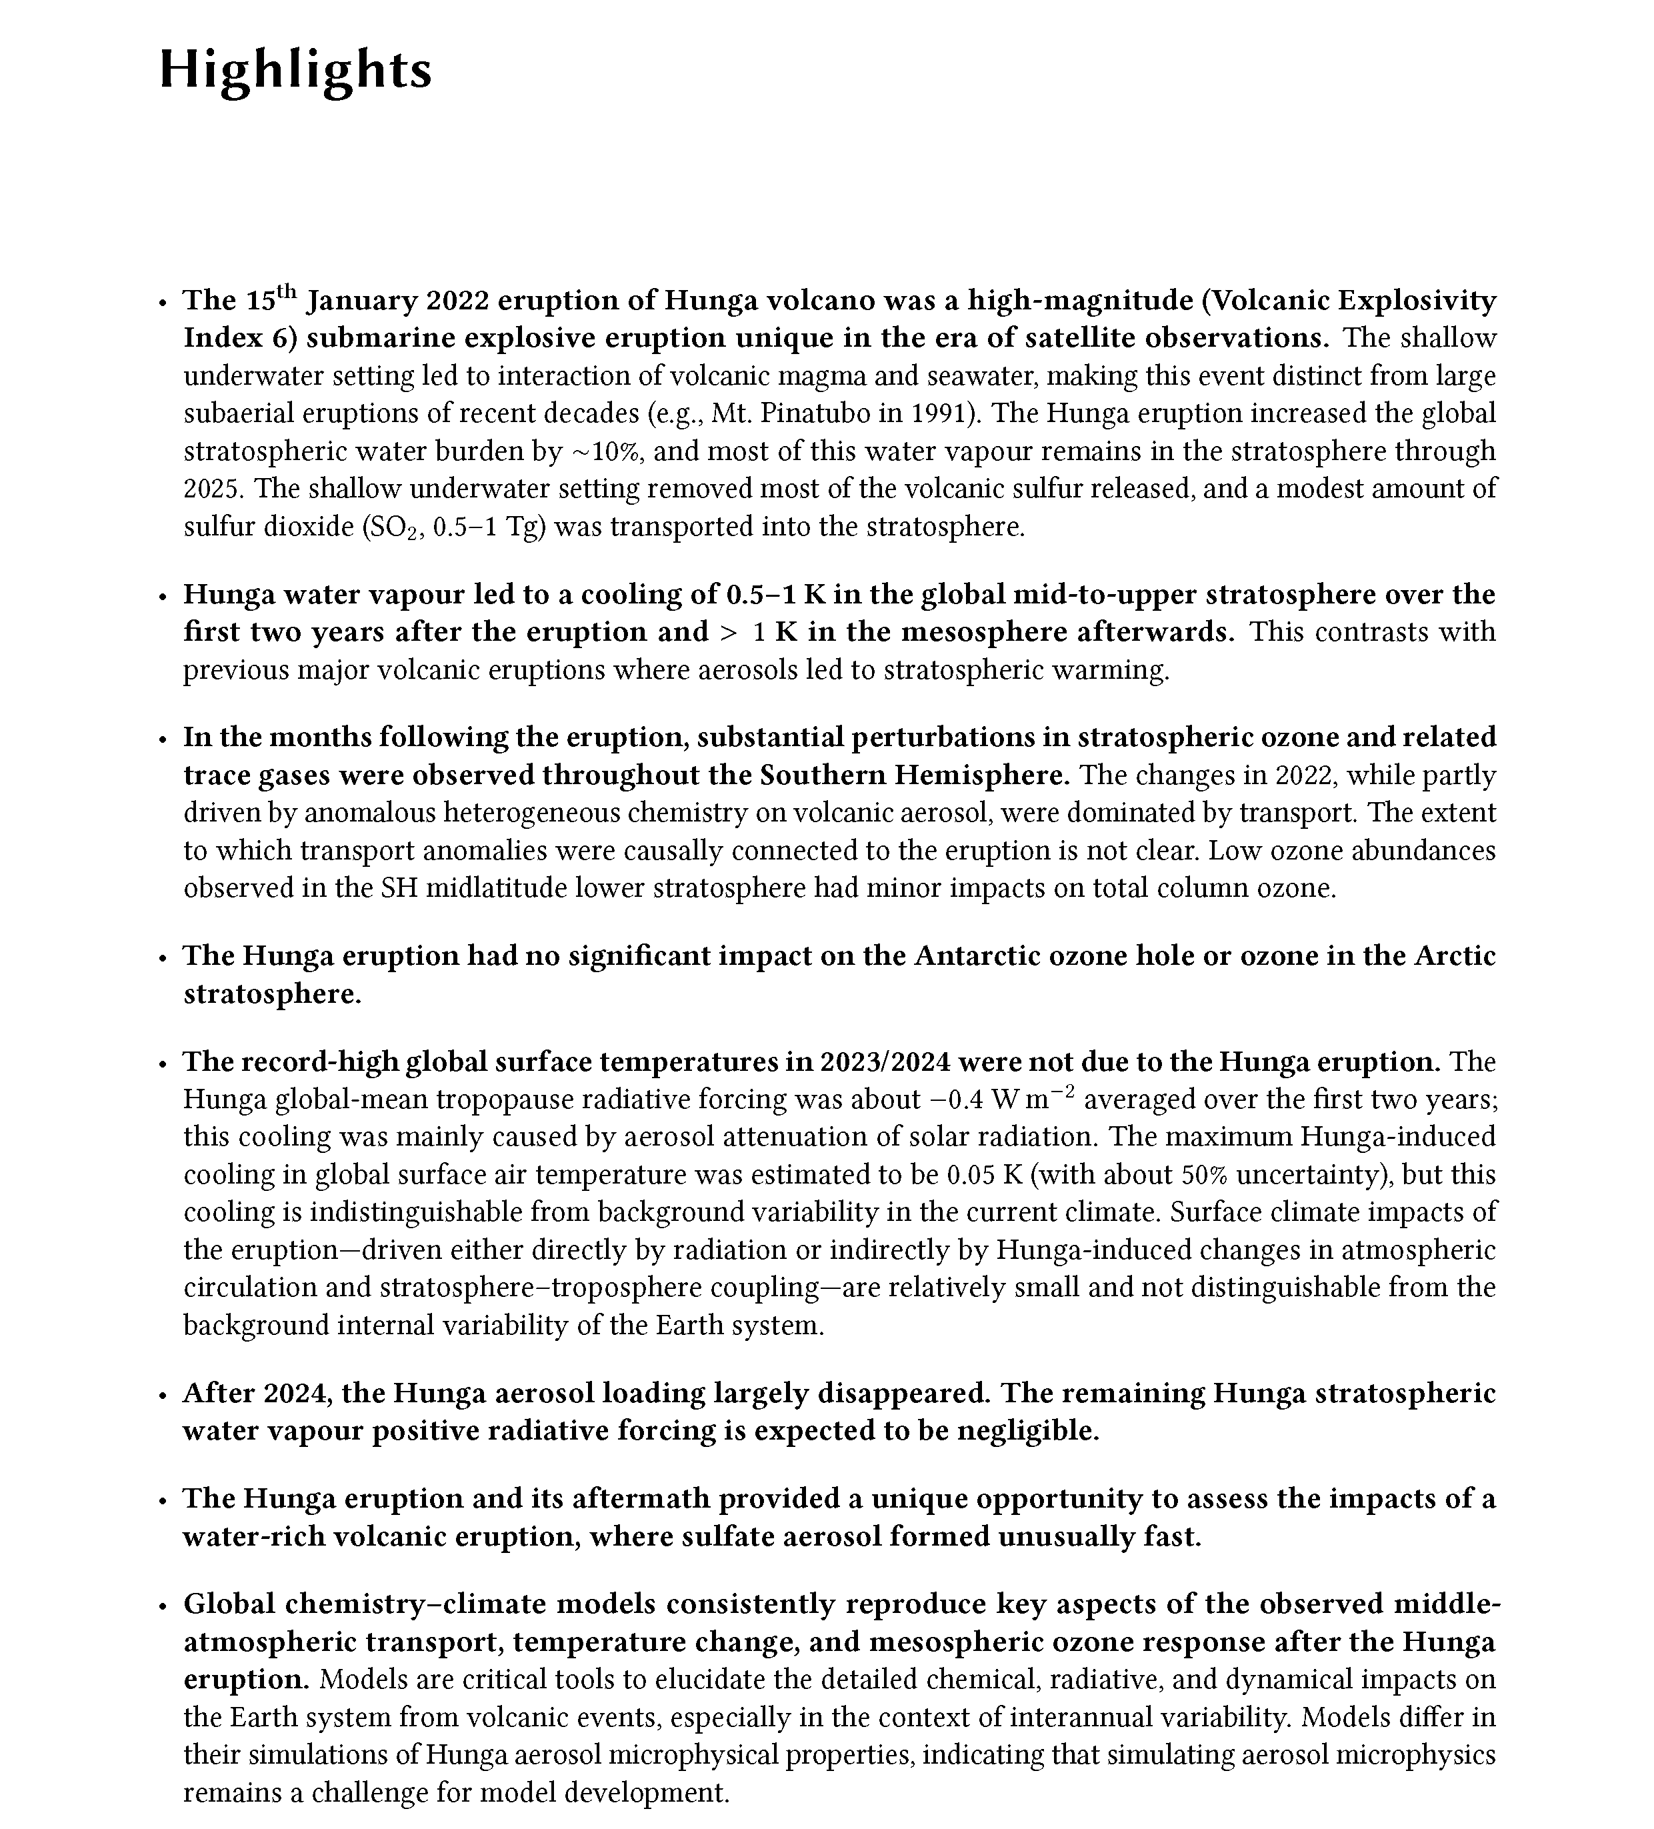
APARC No11 Report: The Hunga Volcanic Eruption Atmospheric Impacts Report (382p)

Slide 30
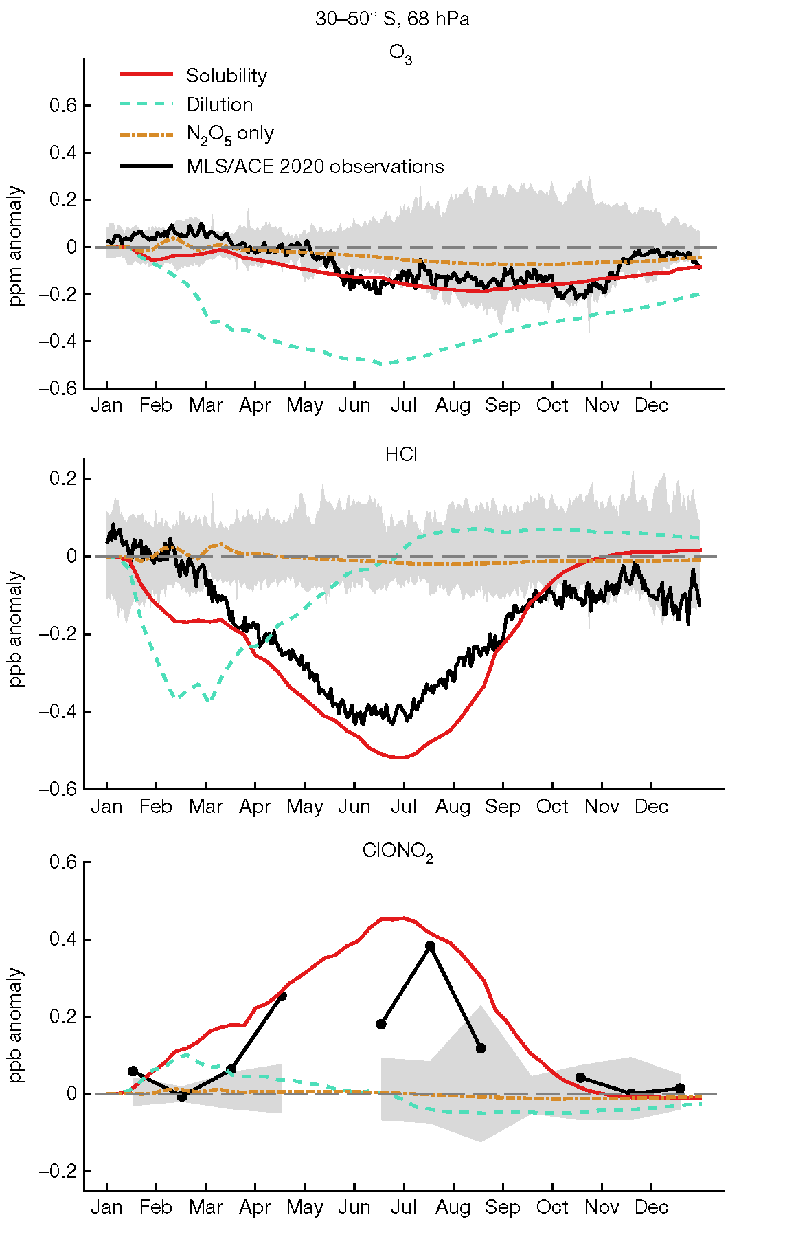
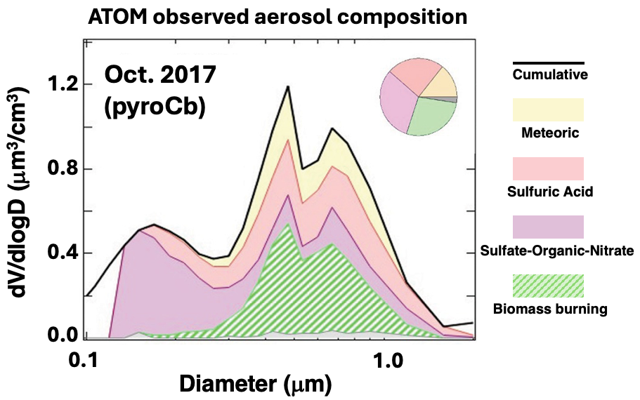
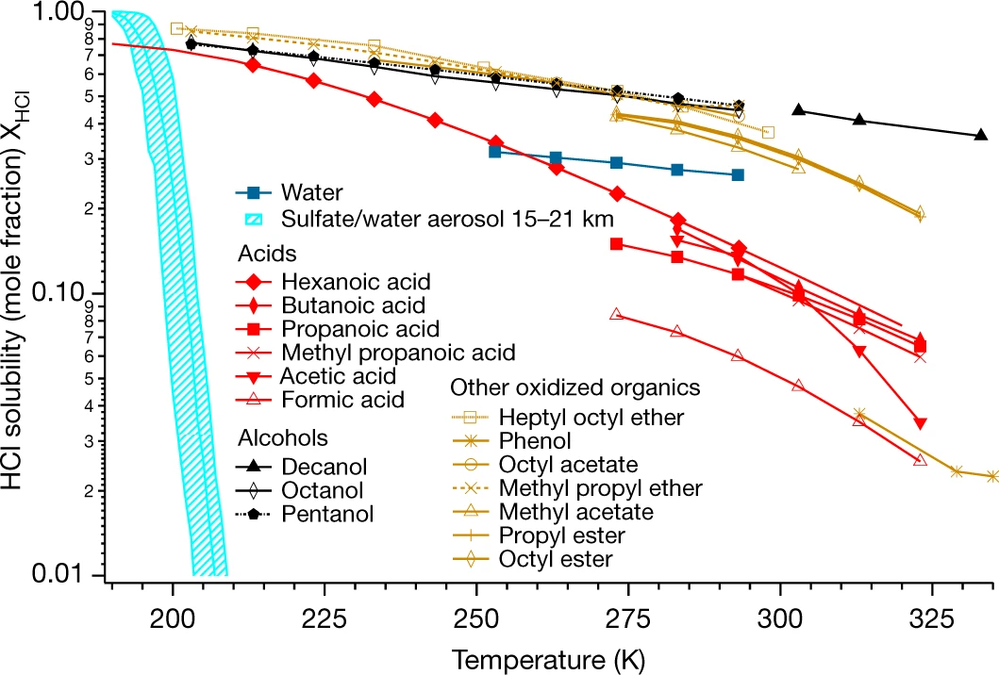
Impact of the Australian New Year (ANY) Wildfire
Solomon et al. (2023)
Reproducing the ANY wildfire impact on stratospheric composition in global chemistry modeling was possible with the particle size information from Atom in situ sampling and earlier lab kinetic results.
PyroCb particles (green) are likely between 0.3 and 1 μm (Katich et al., 2023)
HCl solubility can increase by orders of magnitudes on organic species (Solomon et al., 2023)

Slide 31
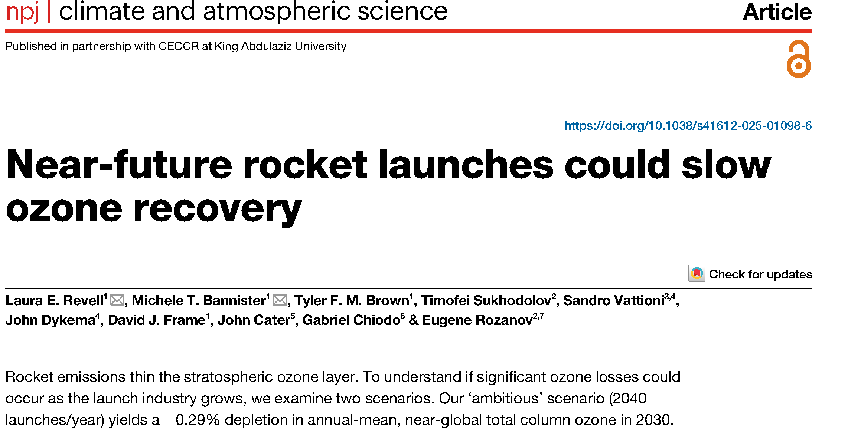
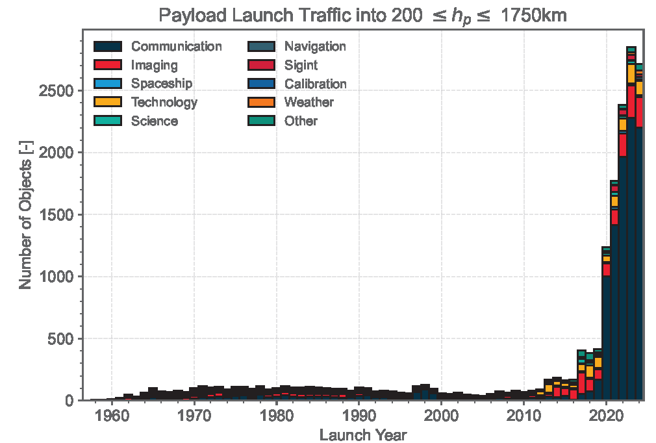
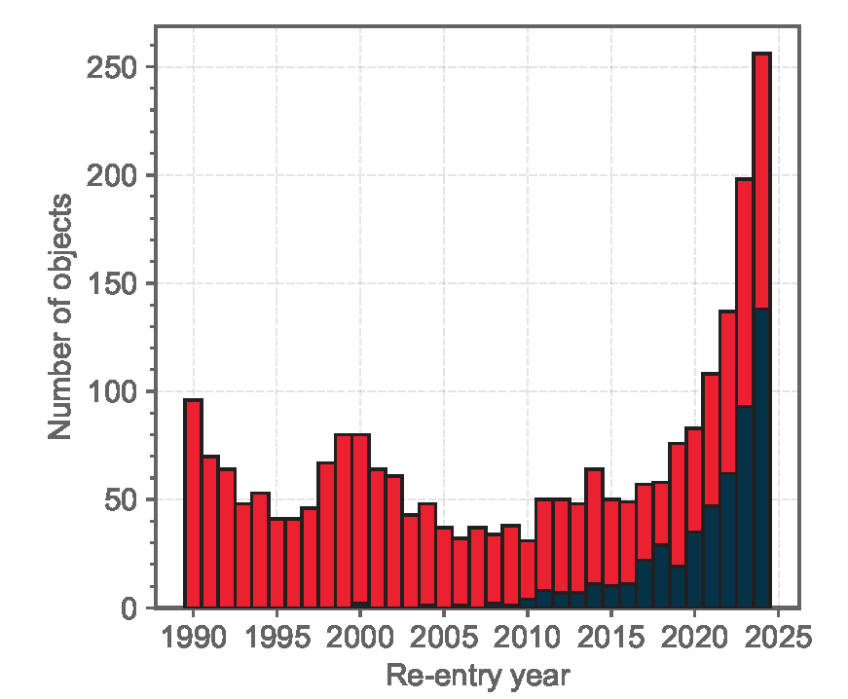
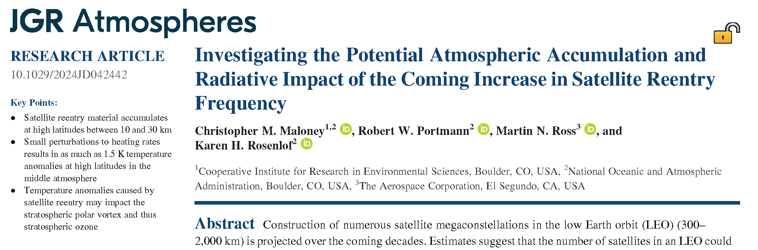
Rapid growing spacecraft activities
ESA’s 2025 annual space environment report
Rocket bodies
Controlled/uncontrolled

Slide 32
Rapid growing spacecraft activities
ESA’s 2025 annual space environment report
Hypothetical/theoretical modeling studies suggest that spacecraft retry debris could delay ozone recovery and warm the upper atmosphere, but uncertainty in impacts are too large to assess
→ Need observational information on debris location, particle composition, size, optical property, …
Rocket bodies
Controlled/uncontrolled

Slide 33
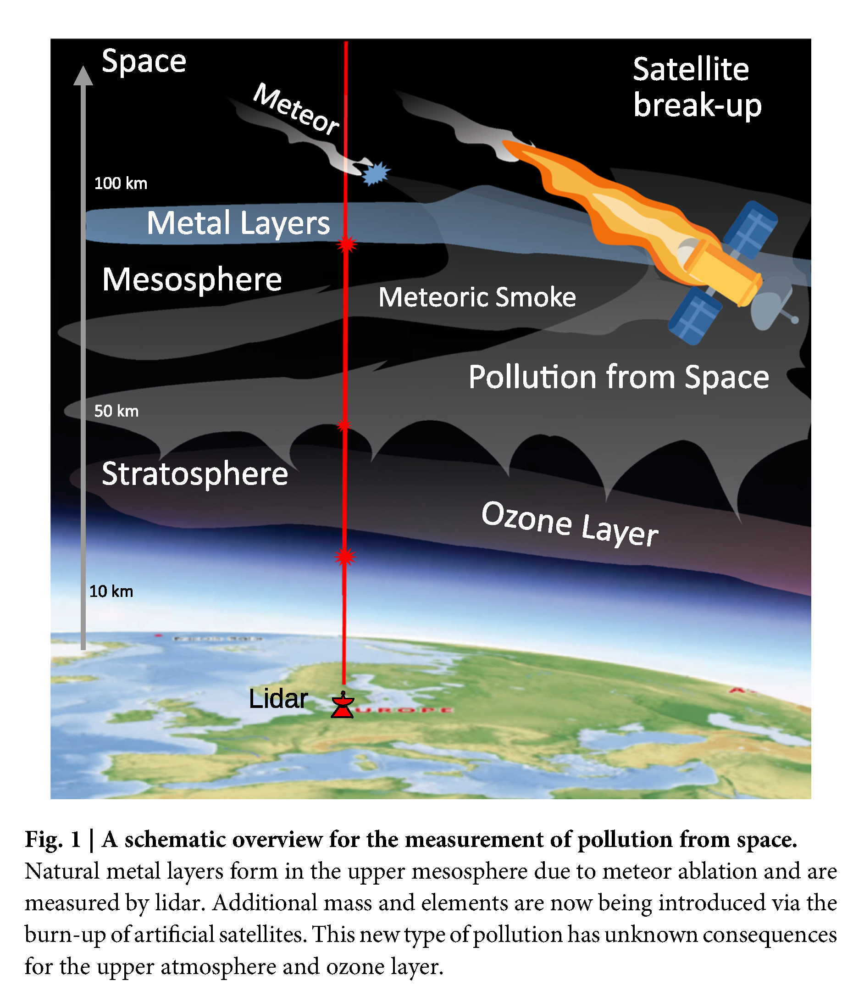
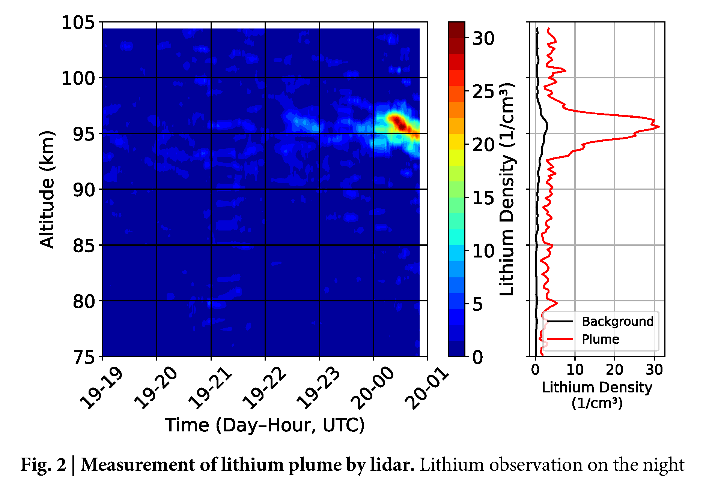
Wing et al. (2026) presents first ground-based lidar measurements of a Falcon 9 rocket debris at 100 km altitude

Slide 34

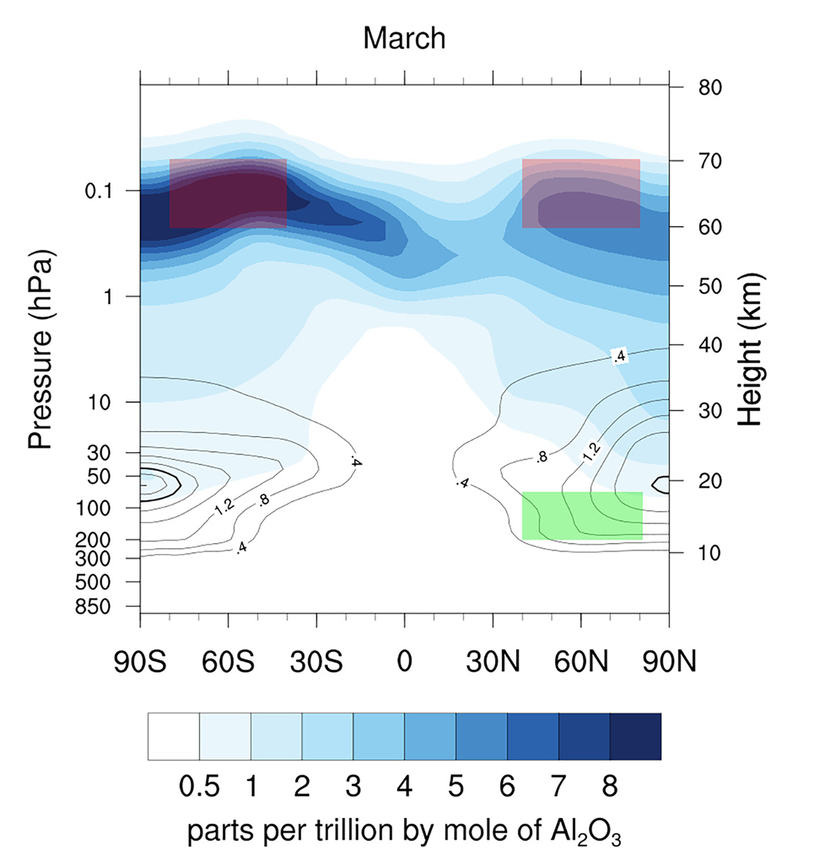
SABRE measurements show that metals vaporized during spacecraft reentries can be measured in stratospheric sulfuric particles
About 10% of stratospheric particles contain spacecraft debris
SABRE

Slide 35
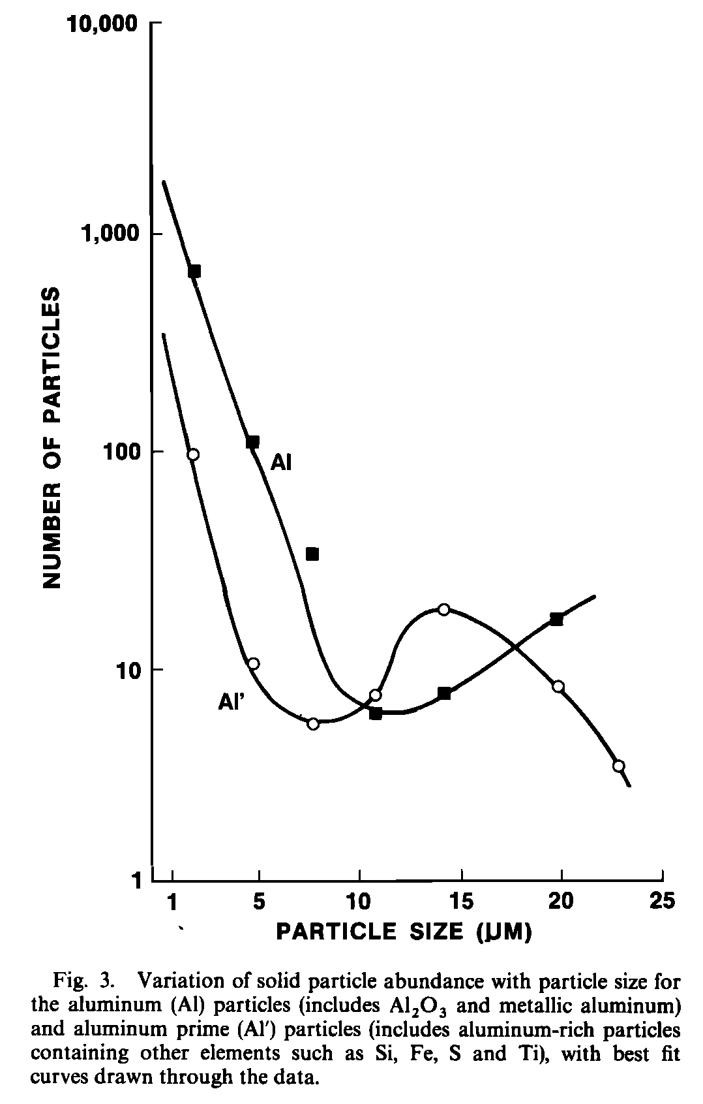
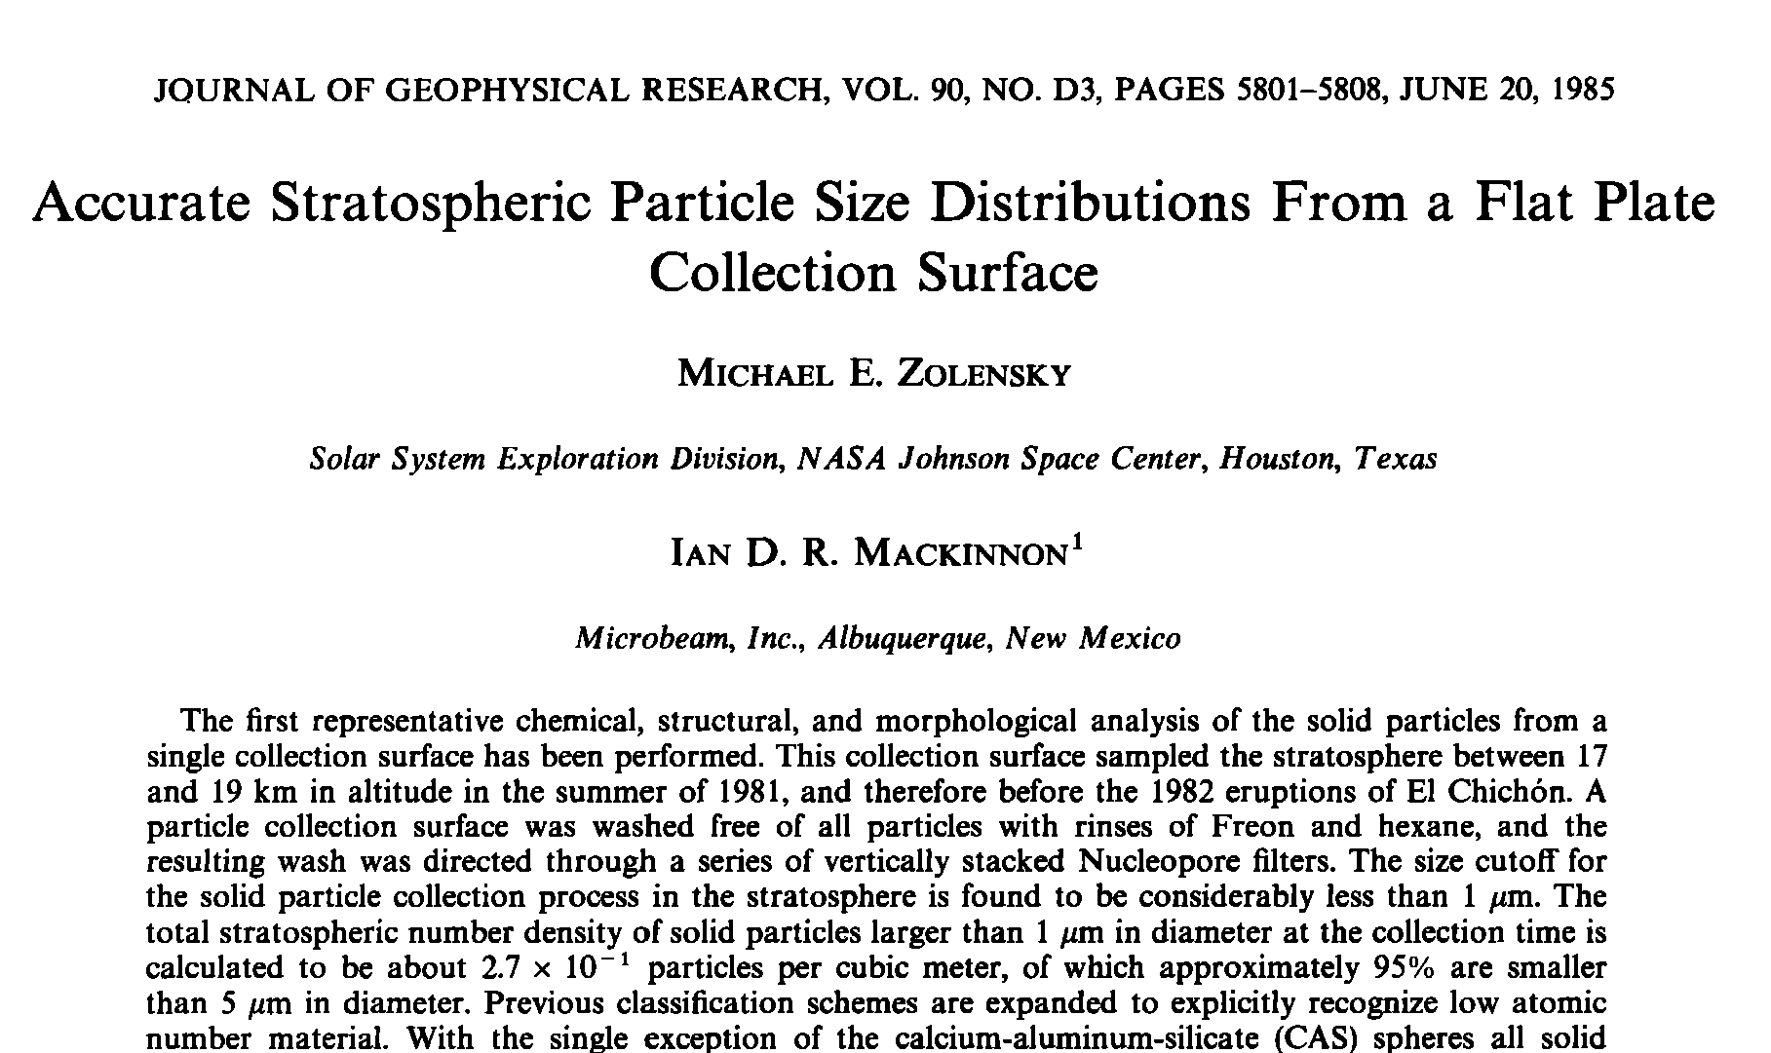
Zolensky and Mackinnon ( 1985) show bi-modal size distribution of rocket exhaust and spacecraft-related particles

Slide 36
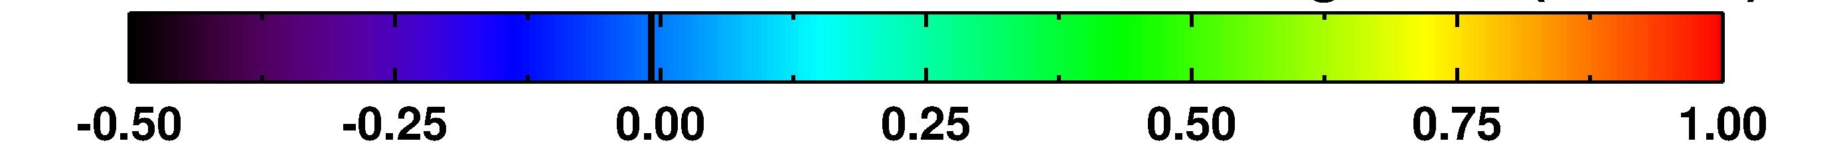
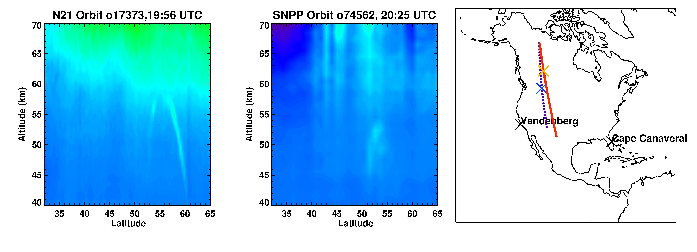
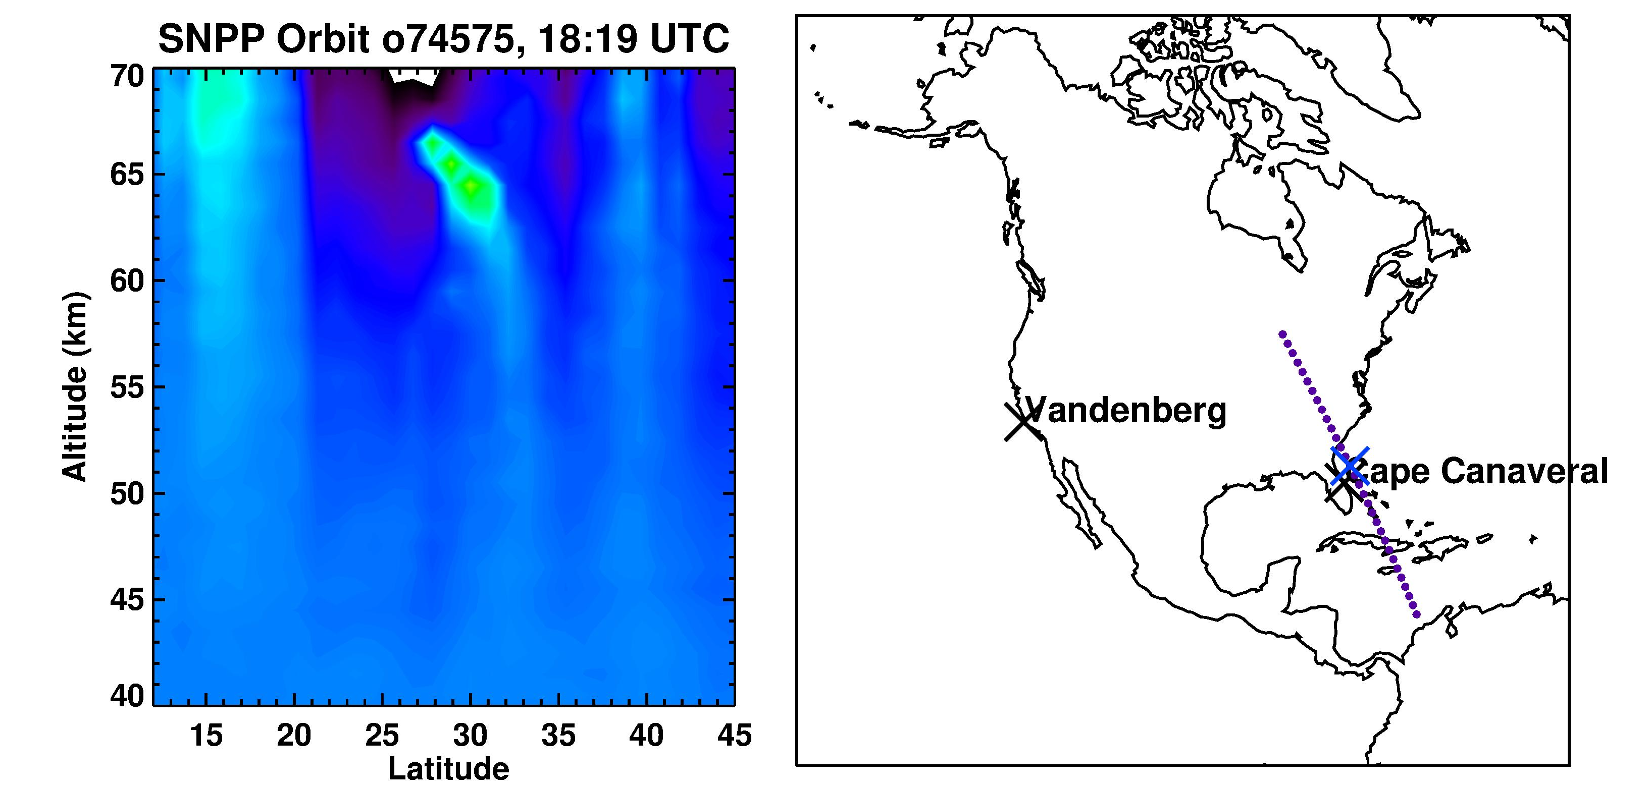
First-look of remote-sensing information of space reentry debris detection from OMPS-LP
Three unusual high altitude aerosol layers were observed by OMPS-LP (NOAA-21 & SNPP) between 50 and 65 km over three days. The presence of these layers coincided with SpaceX rocket launches from Cape Canaveral and Vandenberg Space Force Base.
Data: OMPS-LP aerosol profile measurements
March 18, 2026
Possible layer source: Falcon 9, launched on March 17, 05:19 UTC from Vandenberg, CA
March 19, 2026
Black crosses are for the launch sites. Orange and blue crosses are for the layers’ location. White circles indicate the detected aerosol layer.
Possible layer source: Falcon 9, launched on March 19, 14:20 UTC from Cape Canaveral, FL
Ghassan Taha (UMBC/NASA GSFC)

Slide 37
Potential remote-sensing information from future missions for space reentry debris
OMPS LP on JPSS-4 (2027) & JPSS-3 (2032): Similar capabilities to SNPP and NOAA-21.
STRIVE (~2030), ARGOS, & ALICE: ARGOS offers OMPS LP-like capabilities with better coverage, while ALICE’s high-spectral resolution data can identify particle types
→ Stratospheric Capabilities:
  Instruments are designed for the stratosphere; can measure aerosol particle type and size once rocket plumes have mixed with the main layer.
→ Upper Stratospheric/Mesospheric Challenges (35–80 km)
  Measuring isolated rocket plumes is difficult due to reduced signal-to-noise ratio and higher straylight contamination.
  While plume detection and location tracking are possible, extinction retrievals require algorithm optimization and better straylight corrections or even using ML algorithms.
  Further work is needed to fully characterize instrument capabilities and retrievals in the mesosphere.
Ghassan Taha (UMBC/NASA GSFC)

Slide 38

Geoengineering (Or not?)
No congressional mandate to conduct geoengineering-related research
Controversial topic from various angles

Slide 39
Observational needs to better understanding and accurate model representation of the impact of the emerging stratospheric aerosol sources on ozone and climate
In situ observations with high-altitude suborbital missions, including measurements of particle sizes, composition, optical properties
Remote-sensing information from current and future missions
Lab measurements of space debris particles, including optics, morphology
Potential ground-based measurements?

Slide 40
Stratospheric Composition (Theme 4)
What are the key process-level uncertainties and emerging research questions that will define scientific priorities?
What are the core capabilities, limitations, and challenges of the current observational system, including satellite remote sensing, ground-based measurements, and in situ / airborne observations?
What are the model limitations and predictive capability, including the potential to leverage modeling systems to monitor and predict stratospheric composition?

Slide 41

What other research questions should be included?

Slide 42

What topics would you like to discuss at the breakout session tomorrow?
Breakout session: Room 112/113

Slide 43
Stratospheric Composition breakout session
Science & Modeling Gaps, Measurement Needs
  Slower than expected ozone recovery
  Model-obs discrepancy in circulation and transport
  Sustaining continuity and increasing accuracy of aerosol record
Emerging Forcings: Spaceflight & Extremes
Strategy of Measurement Continuity & Integrated Methodologies (remote/in-situ, aircraft/balloons/ground)
Cross-Cutting Themes
  S2S
  Operational & modeling integration

Slide 44
Comments and suggestions from attendees
Ozone
Slower than expected ozone recovery
  Relative role of slower than expected decline in halogens vs dynamics
  How much is connected to rising GHG and changes branches of the BDC
  How will this impact weather and sub-seasonal forecasts
  Model bias in UTLS
ClO is a key chemical tracer not measured by STRIVE
  NDACC microwave stratospheric ClO
Observing total ozone beyond OMPS. Last will be launched in 2032
Chemical adjustments from ozone depletion/recovery (e.g., impacts on OH, CH4 lifetime, subsequent feedback on O3 depletion etc.)

Slide 45
Comments and suggestions from attendees
Transport et al.
What measurements would provide better constraints on age of air?
CH4 is a key source of stratospheric H2O. Whether satellite obs and models show consistent long-term trends throughout the middle atmosphere.
Can we adequately model the removal of the Hunga water perturbation from the stratosphere? (overall overturning rates)
How do gravity waves contribute to mixing, especially in UTLS

Slide 46
Comments and suggestions from attendees
Transport et al. (UT/LS)
There is growing interest in how sub-seasonal changes in UTLS gases (e.g. O3, H2O, CH4) affect surface weather and climate through radiative forcing adjustments. Do we have modeling and observational capability to assess these impacts?
TTL has diurnal and geographical changes and is critical for understanding UTLS transport. (advocate for a higher priority)
  PBL-related missions can produce a better tropopause thermodynamic retrievals as a "by-product"
One of the challenges on the UTLS side is that the scales required to address problems span a broad range. For some processes, horizontal resolution is more important than vertical resolution. Others, vertical resolution takes precedence. In some cases needs evolve over time.

Slide 47
Comments and suggestions from attendees
Aerosols
How to sustain accuracy and continuity of aerosol record
  Reliability for radiative forcing estimates
Remote retrievals should consider different assumptions of particle properties
  Provide particle typing and related extinction/scattering products
Better aerosol measurements (composition, optical properties) in the upper troposphere and tropopause regions where the remote sensing has difficulties in separating aerosols and clouds

Slide 48
Comments and suggestions from attendees
MLS to STRIVE and General Observations
Comments on balloon-borne observations
  AirCores for CO2/CH4/N2O and CFCs/SF6
  sustained observations and networks
  Aerosol size distribution measurements
  MkIV interferometer
  How often would launched need to be
Site locations for enhancing ground-based observations for long-term and gap needs
Be prepared to evaluate and validate STRIVE measurements in key regions such as the Asian Summer Monsoon
Application of ML: derive water vapor from OMPS Limb
ALTIUS for O3,aerosol extinction profiles (limited CH4, H2O)

Slide 49
Comments and suggestions from attendees
Emergent Emissions
In terms of measurements in the upper strat, should more be done with sounding rockets or put in situ instrumentation on rockets to capture vertical profiles on launch.

Slide 50
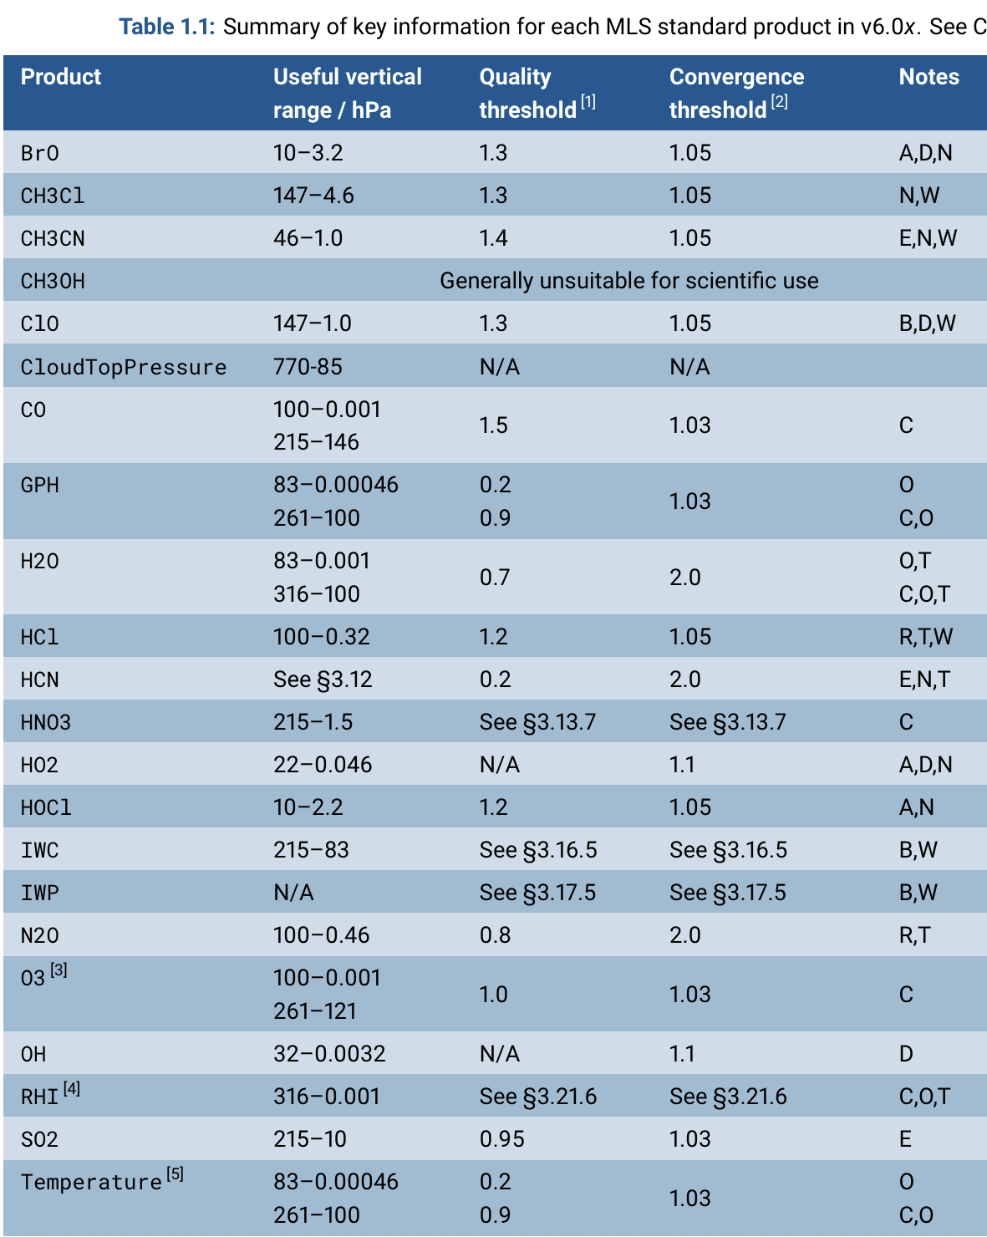
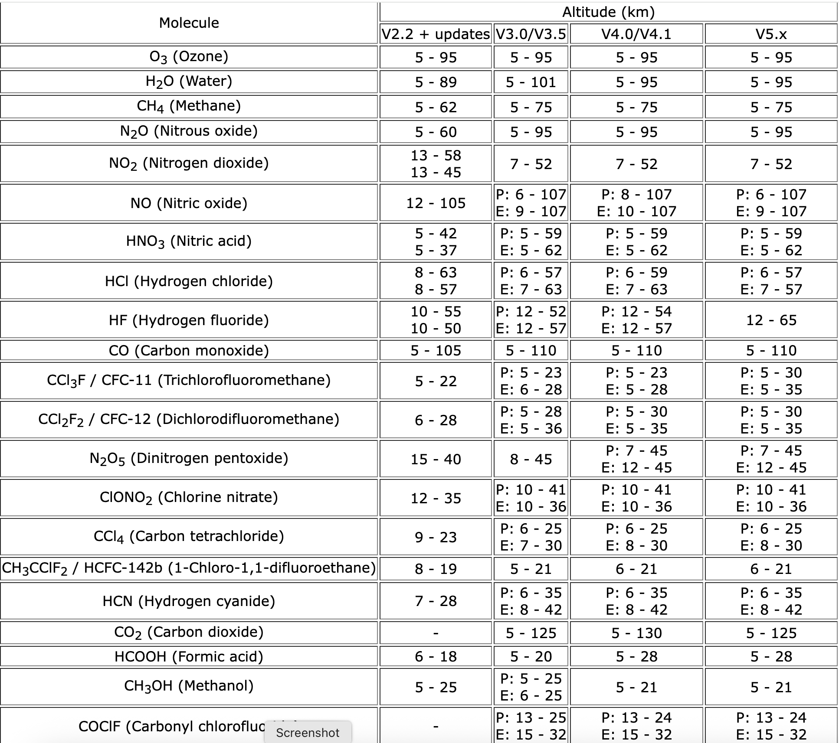
MLS
ACE-FTS (partial list)

Slide 51
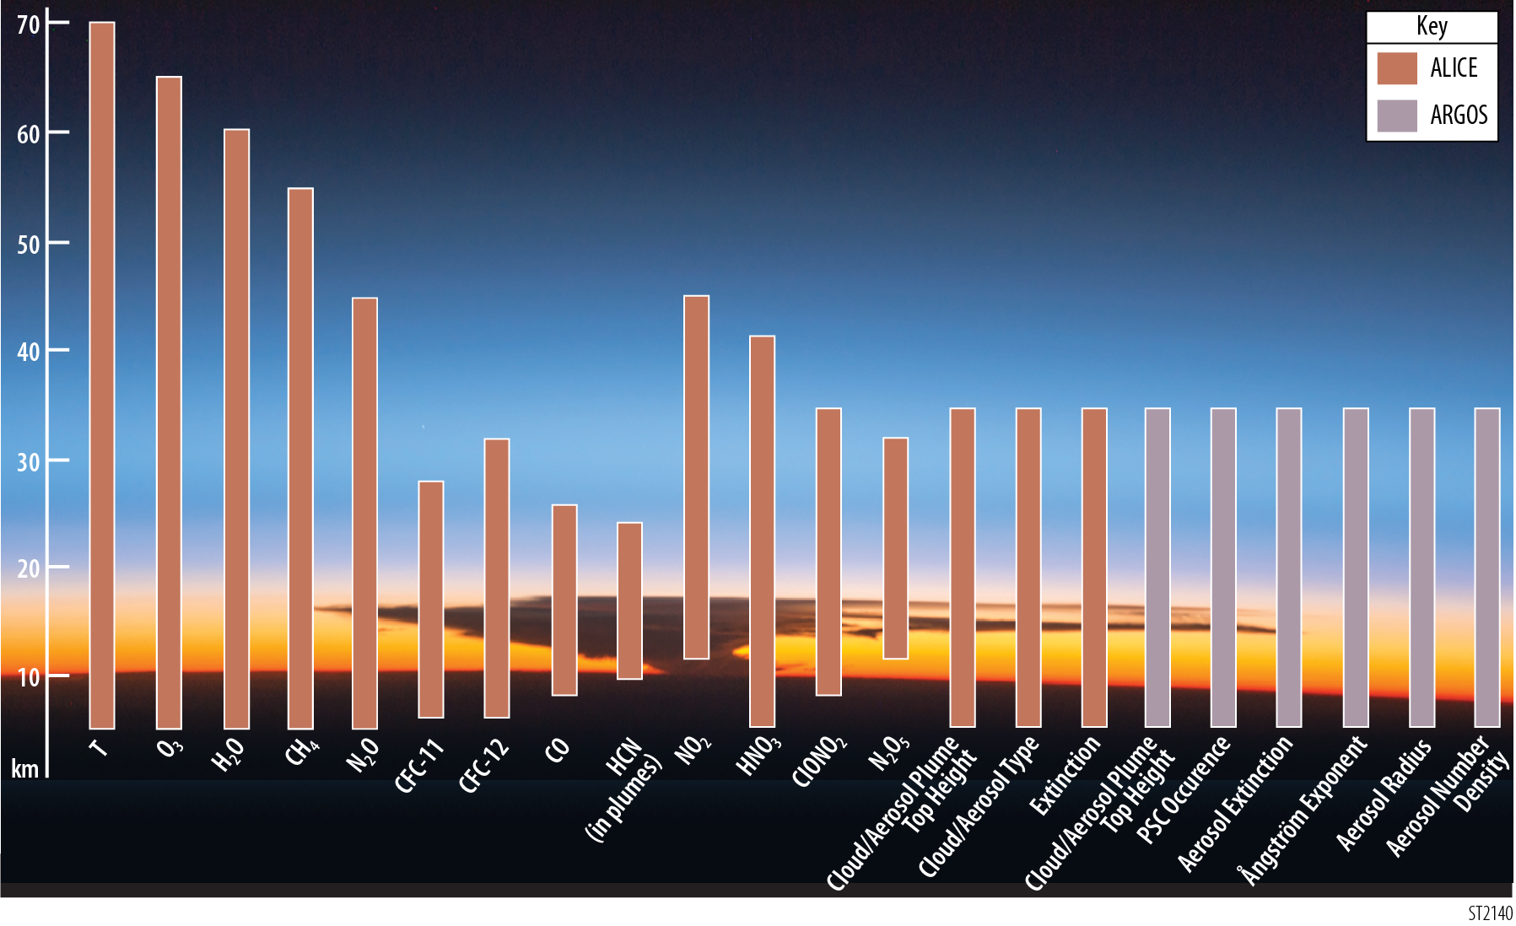
STRIVE Products and Altitude Range
Temperature
O₃
H₂O
CH₄
N₂O
NO₂
Cloud/Aerosol Type
HNO₃
Aerosol Properties
CFC-12
ClONO₂
Extinction
N₂O₅
CFC-11
CO
PSC
HCN
CTH
CTH
Additional species with enhancement options: OCS, polar ClO, CCl₄, HCFC-22, SF₆, NH₃, PAN, plume SO₂, among others
ALICE
ARGOS
ALICE’s measurements in the information rich mid-longwave IR has many more potential species for additional products and is significantly complemented with ARGOS enhanced aerosol measurements.

Slide 52
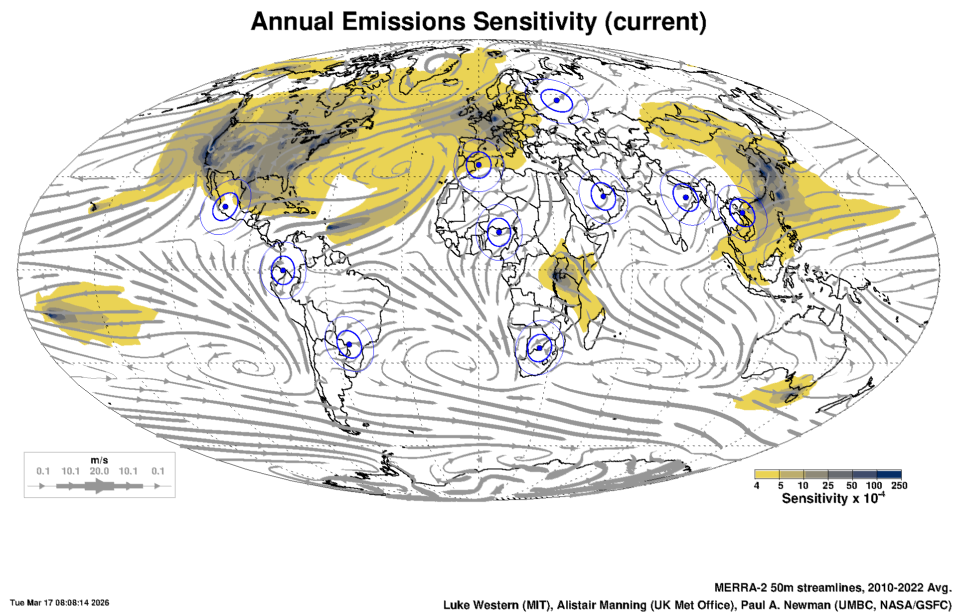
Surface ODS monitoring: AGAGE current sites and detection sensitivity

Slide 53
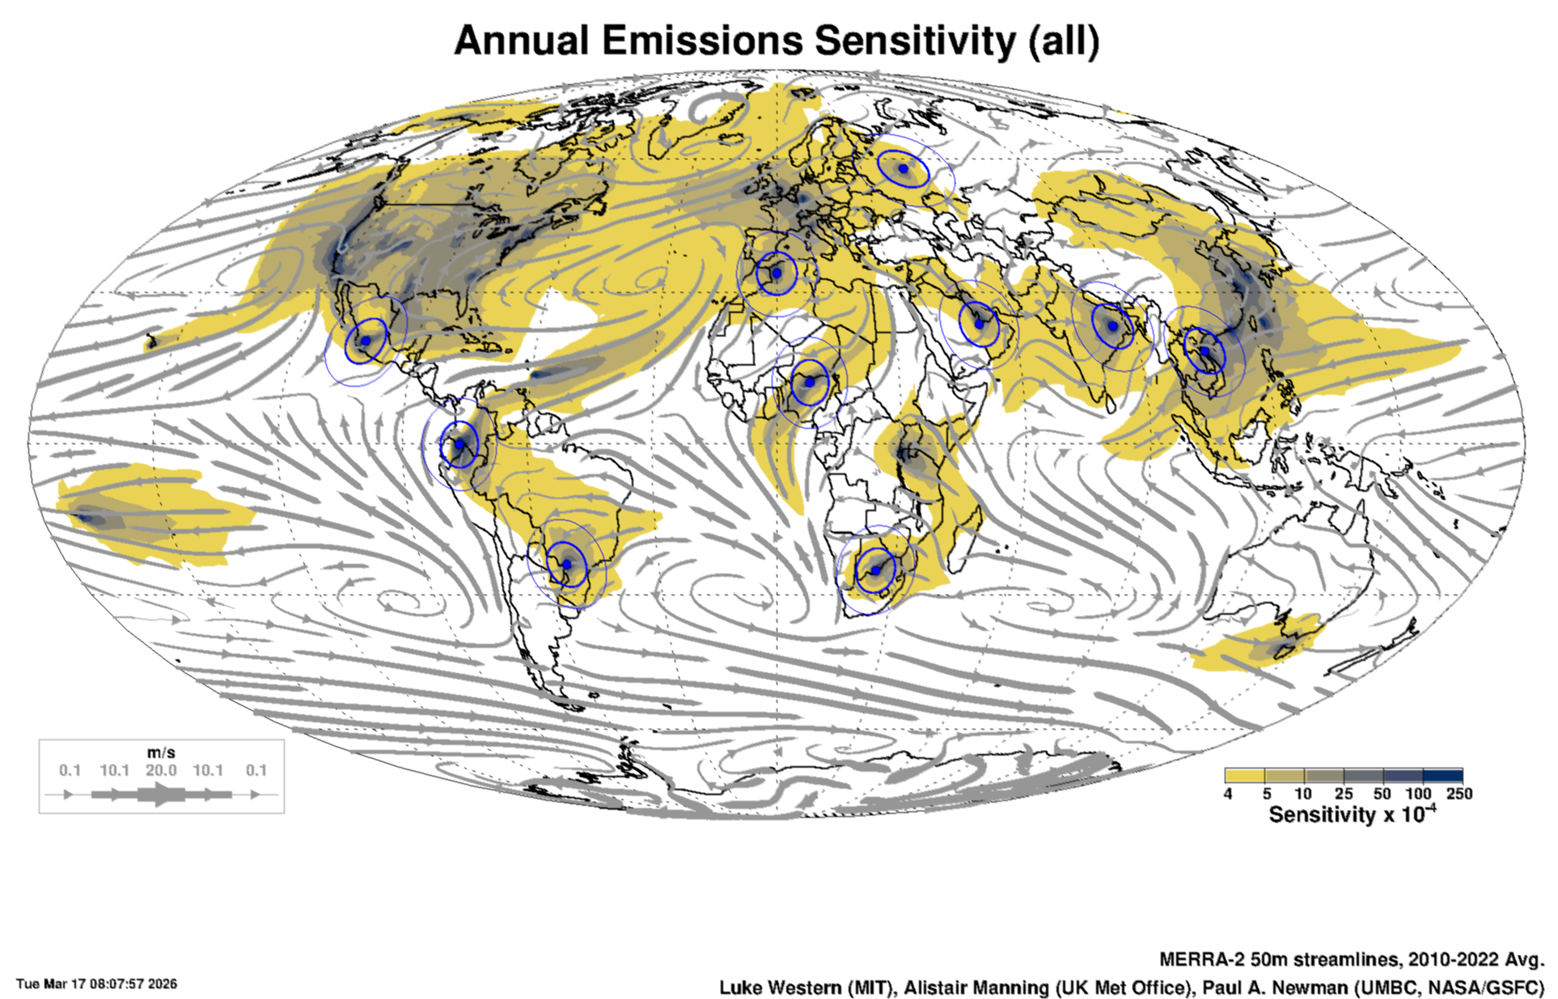
Surface ODS monitoring: proposed potential sites and detection sensitivity

Slide 55
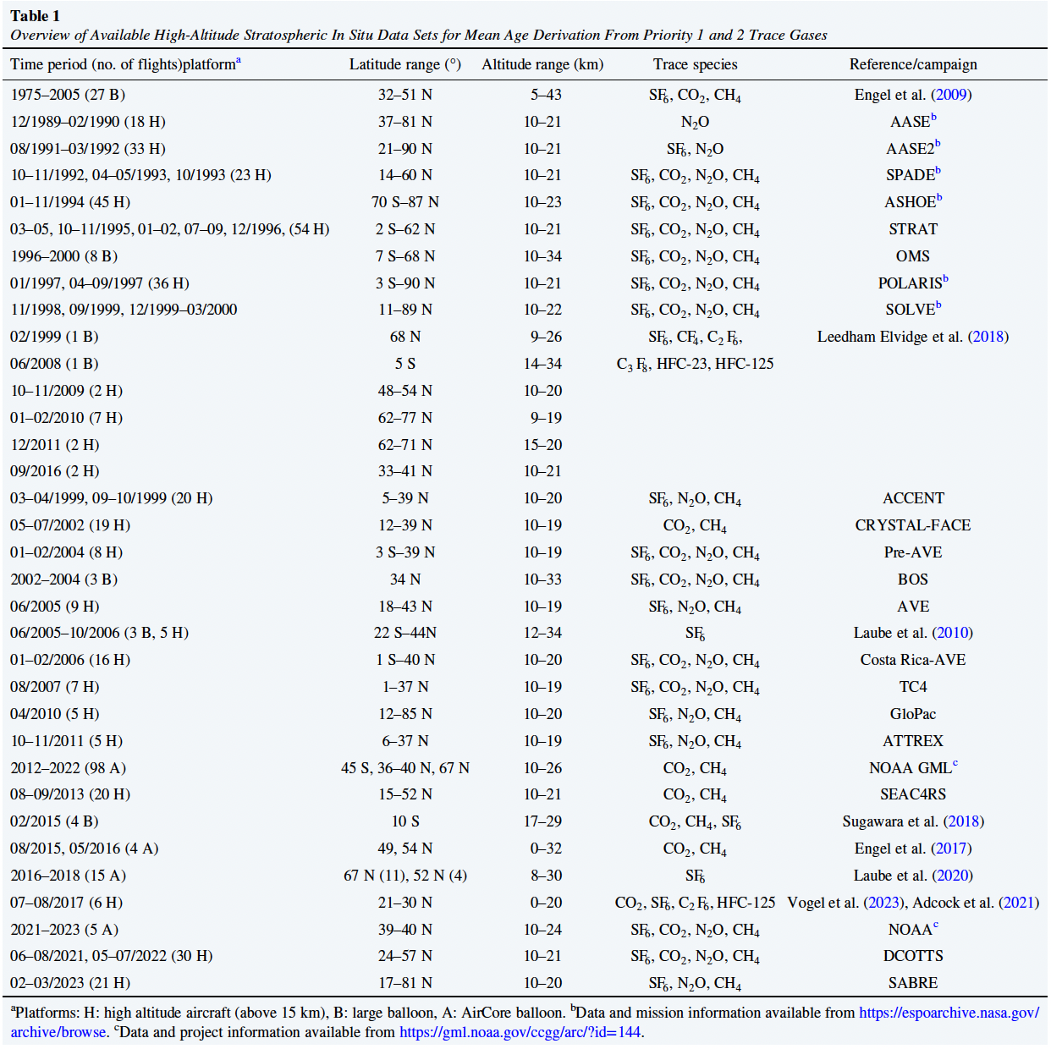
Garny et al. (2024)

Slide 56

NASA Aircraft Capabilities for High-altitude Missions
30
Manned Performance Envelope
Stratosphere
ER-2
20
Max. polar O₃ loss
WB-57
Tropical Tropopause
Altitude (km)
SVC
B777
Convective Detrainment
10
Polar Tropopause
Synoptic Scale
Walker Circulation
Planetary Scale
ITCZ Width
Troposphere
Mesoscale
0
Boundary Layer
0
4000
8000
12000
Range (nm)
Payload is proportional to font size (w+10) e.g., GH font =10.8, DC-8=25)

Slide 57
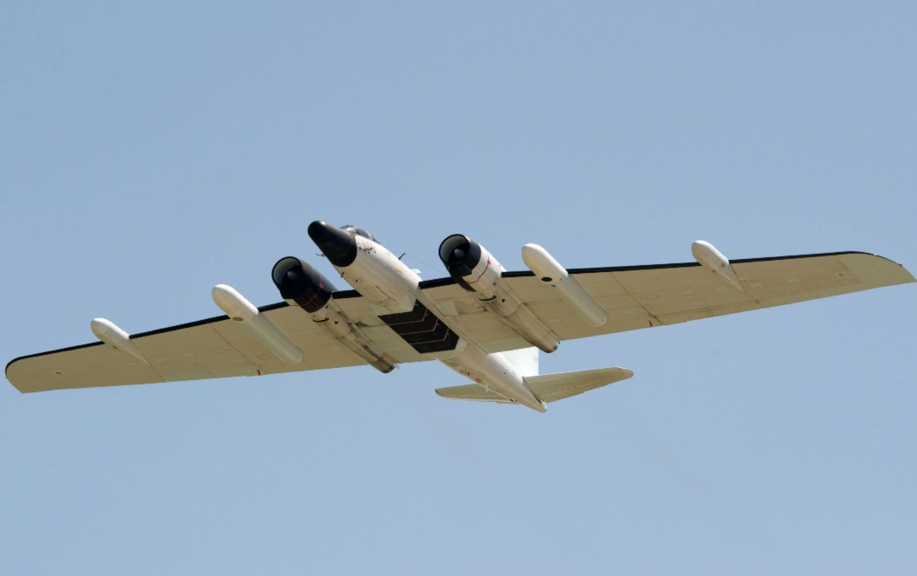
Measurement | WB-57
State Parameters
Position, Pressure, Temperature, Winds, RH | Aircraft, MMS
Temperature profile (above/below aircraft)
Trace Gases
CO | COMA, COLD2, ACOS
CO₂ | (ACOS)
CH₄
N₂O | COMA
O₃ | UAS O3
NO, NO₂ | NO-LIF
SO₂ | SO2-LIF
HCl, HO₂NO₂, HNO₃ HCOOH, CH₃COOH
CH₂O | ISAF
COS | ACOS
H₂O | DLH, CHiWIS
H₂O Isotopes | ChiWIS
VOCs (many) | WAS
Aerosols
Particle size/mass distributions | NMASS, UHSAS, POPS, CAPS
Chemical composition/size | PALMS
cloud particle size/imaging | CAPS
cloud droplet size | CAPS
Cloud/aerosol distributions above/below aircraft | ROSCOE
Radiation
Radiative flux/Photolysis frequencies | BBR
WB-57 Payload from ACCLIP
Nose:
PALMS
MMS (probes)
Left Super Pod:
O3
ISAF
(DLH Target)
Left Spear Pod:
DLH
ACOS
Right Super Pod:
ROSCOE (LiDAR)
Right Spear Pod:
COLD2
CAPS
Pallet Bays:
Forward Transition: MMS Electronics
1. UTLS-AMP, SP2 2. LIF-SO2, LIF-NO
3. Chi-WIS, COMA 4. WAS
Aft Transition: BBR
NASA WB-57
Duration: ~ 6 hr
FL 430 (13 km) and FL 620 (19 km)

Slide 58
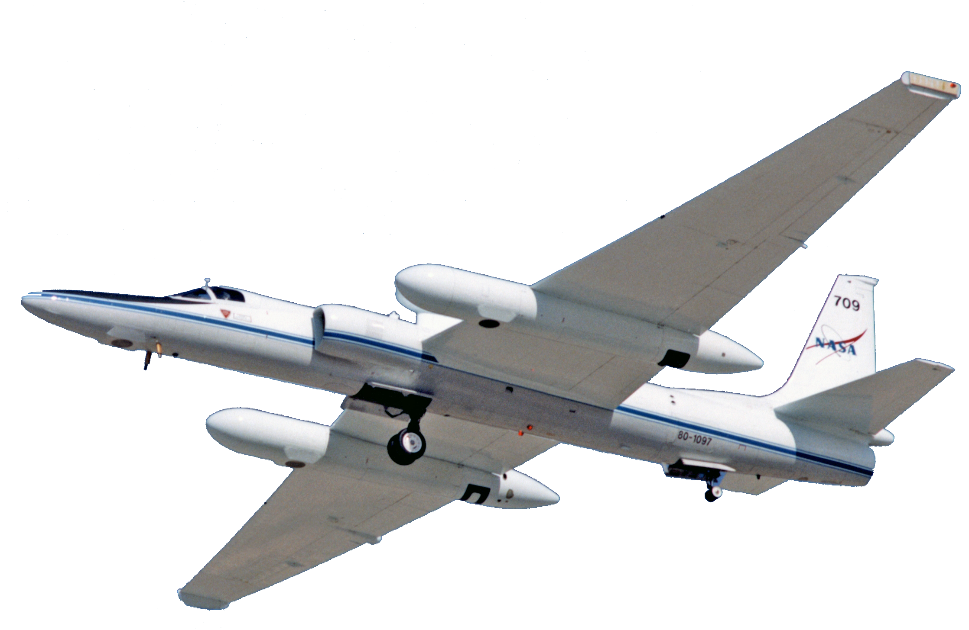
ER-2 PLATFORM VERSATILITY
Upper Atmosphere
STEP, AAOE, AASE 1/2
SPADE, STRAT, ASHOE,
SUCCESS, POLARIS, SOLVE
TC-4, SEAC4RS
Natural Disaster Support
Mount St. Helens,
Fire Assessment,
Gulf Oil Spill
Radiation Sciences
C-F, CC-VEX, TC-4,
SAFARI, SEAC4RS
Carbon Cycle and Ecosystems
AVIRIS, MASTER, NACP
Atmospheric Dynamics
THORPEX, TEFLUN,
CAMEX-3/4, TRMM-LBA,
TCSP, MC3E
Astromaterials
Cosmic Dust
Water and Energy
SMEX, CLASIC
Cryospheric Sciences
Mabel
Satellite Instrument Development
3D WINDS, ACE, ACOS, ASCENDS, CLARREO, GEO-CAPE, GPM, HyspIRI, ICESat-2, NPP, SAGEIII, SMAP
Satellite Calibration and Validation
AQUA, AURA, CALIPSO, CloudSat, MODIS, SAGE/2, TRMM

Slide 59
courtesy Bryan Duncan

Slide 60
courtesy Bryan Duncan

Slide 61
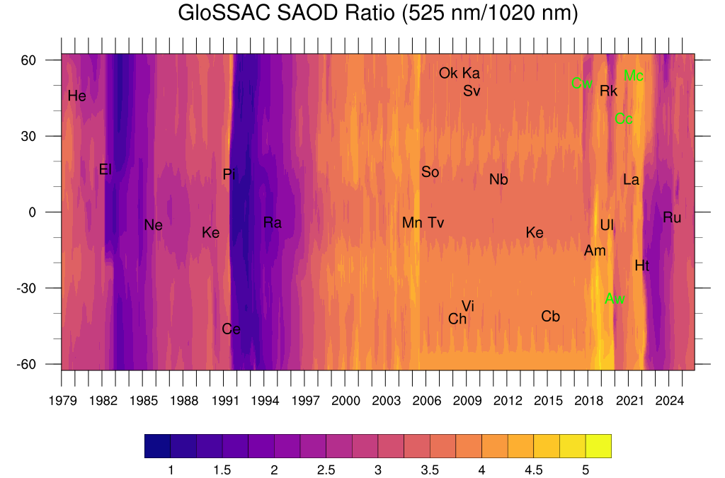
courtesy Mahesh Kovilakam
Major volcanic eruptions (black) and wild fire events (green) with abbreviated two-letter code with their respective latitude and time of occurrence that are listed here. The event names shown are St. Helens (He), El Chichon (El), Nevado del Ruiz (Ne), Kelut (Ke), Pinatubo (Pi), Cerro Hudson (Ce), Rabaul (Ra), Manam (Mn), Soufrière Hills (So), Tavurvur (Tv), Chaiten (Ch), Victoria (Vi), Okmok (Ok), Kasatochi (Ka), Sarychev (Sv), Nabro (Nb), Kelut (Ke), Calbuco (Cb), Canadian wildfire (Cw), Ambae (Am), Raikoke (Rk), Ulawun (Ul), Australian wildfire (Aw), California Creek Fire (Cc), La Soufrière (La), McKay Creek fire (Mc), Hunga Tonga (Ht), and Ruang(Ru).

