Slide 1
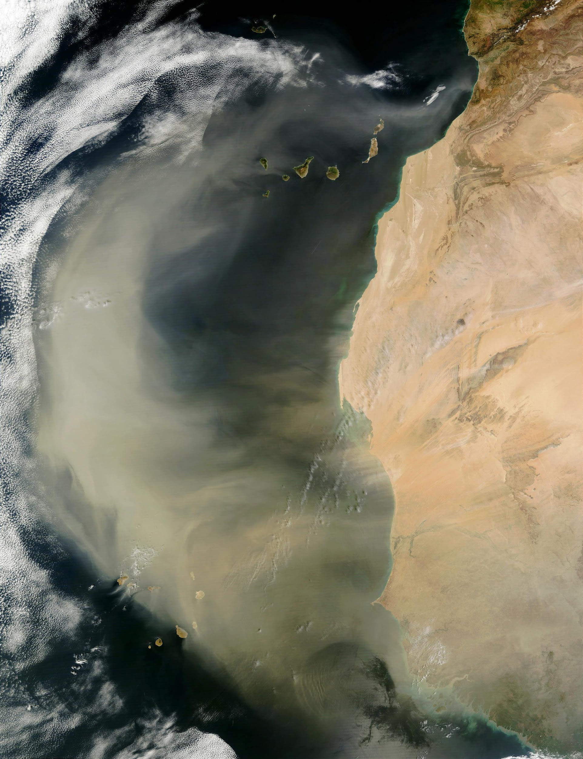

Aerosol/Cloud
Each slide's notes section contain references and ancillary information
Alphabetical Order (speaker): S. Bauer, B. Cairns, P. Castellanos, P. Colarco, L. Ding, G. Elsaesser, R. Espinosa, J. Gong, M. Kacenelenbogen, M. Lebsock, K. Loftus, X. Lu, W. Marais, D. McCoy, K. Meyer, R. Moore, C. Orbe, L. Oreopoulos, R. Schulte, P. Selmer, S. Stamnes, T. Thorsen, F. Tornow, T. Vadal, M. van Lier-Walqui, H. Yu, T. Yuan, L. Zamora, ARCSIX team
Atmosphere Community Meeting April 2026, LaRC

Slide 2
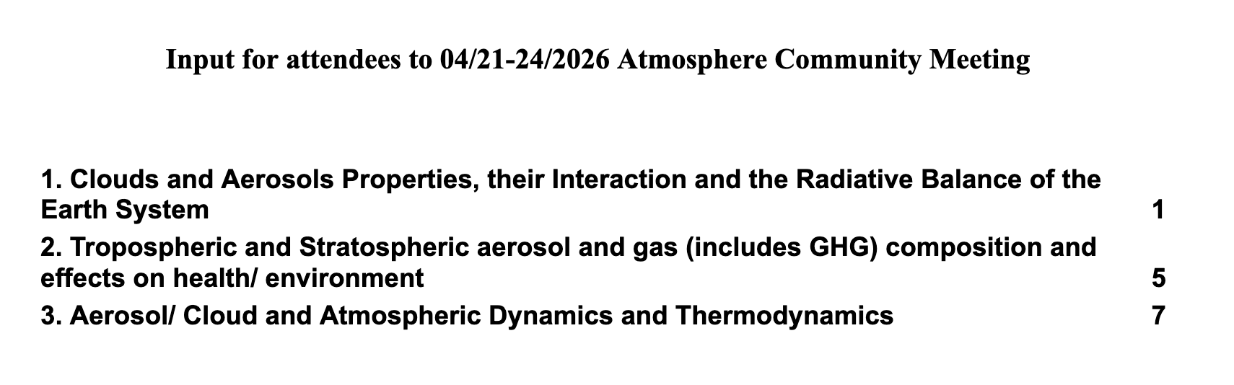

Intro
Aerosol
Cloud
Model-Obs.
Pair Obs.
ML/AI
Q&A
← Compiled list of your aerosol / cloud science questions for this meeting
Please add comments online with your name by Friday
https://docs.google.com/document/d/16pj5mYW3yAnynjTShOnfh9L7JW6HLTaWzHNyL5xf21o/edit?usp=sharing

Slide 3

Intro
Aerosol
Cloud
Model-Obs.
Pair Obs.
ML/AI
Q&A
The 2016 Decadal Survey helped guide NASA science priorities
Aerosols / Clouds crosscut ~all atmospheric research areas in the NASA Earth System Science research Program (ESSRP)
Discussed >500྾ each in 2016 Decadal Survey
← Compiled list of your aerosol / cloud science questions for this meeting
Please add comments online with your name by Friday
https://docs.google.com/document/d/16pj5mYW3yAnynjTShOnfh9L7JW6HLTaWzHNyL5xf21o/edit?usp=sharing

Slide 4
Intro
Aerosol
Cloud
Model-Obs.
Pair Obs.
ML/AI
Q&A
Key climate uncertainties:
Total aerosol radiative forcing: An initial disruption to Earth's energy balance caused by a change in aerosols
Colarco et al. reviews updated satellite observation needs based on new science since last Decadal Survey (NTRS 20250009663)
Cloud radiative feedback: A response of clouds to changes in temperature, which, in turn, modifies the planet's radiation budget
Corresponding Meyer et al. review (NTRS 20250009667)
← Compiled list of your aerosol / cloud science questions for this meeting
Please add comments online with your name by Friday
https://docs.google.com/document/d/16pj5mYW3yAnynjTShOnfh9L7JW6HLTaWzHNyL5xf21o/edit?usp=sharing

Slide 5
Aerosol total radiative forcing
Initial disruption to Earth's energy balance caused by a change in aerosols
Intro
Aerosol
Cloud
Model-Obs.
Pair Obs.
ML/AI
Q&A
Effective Radiative Forcing (ERF):
Quantifies perturbations to Earth’s TOA energy budget
Driven by anthropogenic GHGs, aerosols, and their precursors
Includes consequent adjustments
IPCC AR6 (2021):
Anthropogenic aerosols offset ~1/3 of the GHG warming
  ERF:-1.1 (aerosol) vs. 3.8 W m⁻² (GHG)
Largest source of uncertainty
  ~1.3 (aerosol) vs. 0.8 W m⁻² (GHG)
  Likely underestimated because characterized by model diversity
Warning: Aerosol ERF varies spatially & does not simply cancel GHG ERF on a regional basis

Slide 6
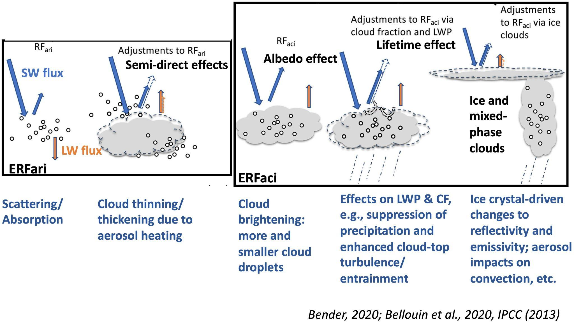
Aerosol total radiative forcing
Initial disruption to Earth's energy balance caused by a change in aerosols
Intro
Aerosol
Cloud
Model-Obs.
Pair Obs.
ML/AI
Q&A

Slide 7
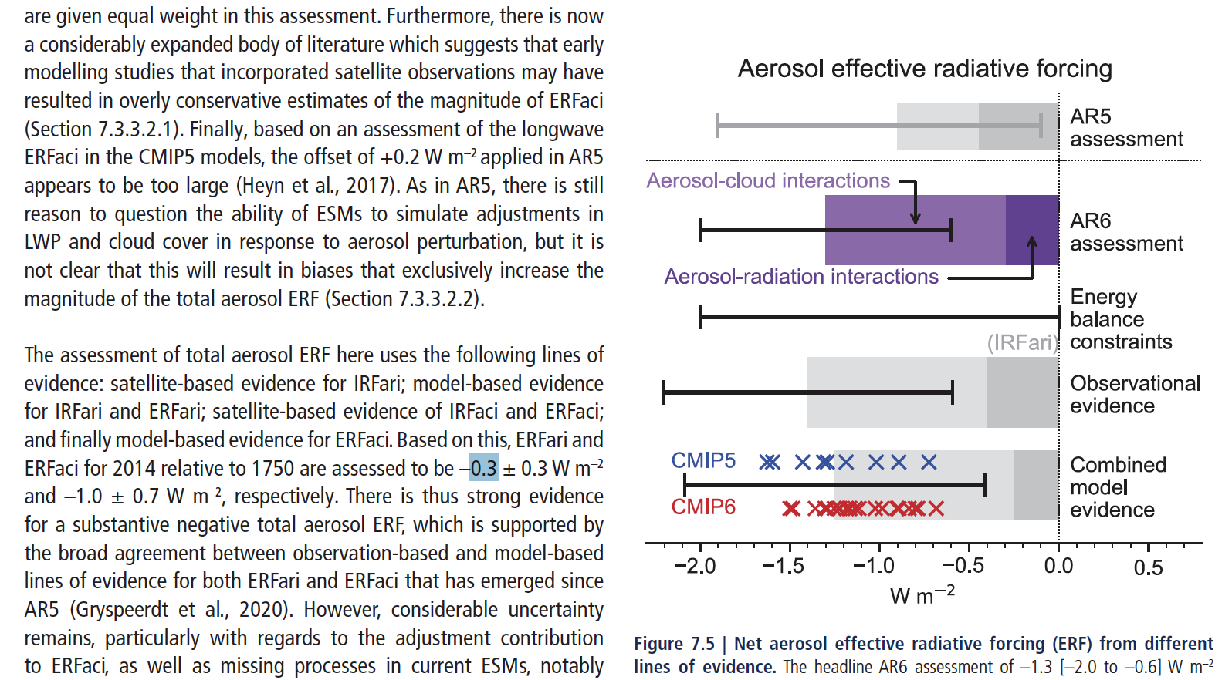
Aerosol total radiative forcing
Initial disruption to Earth's energy balance caused by a change in aerosols
Intro
Aerosol
Cloud
Model-Obs.
Pair Obs.
ML/AI
Q&A
Progress from IPCC AR5 (2013) to AR6 (2021)
Better understanding of aerosol processes, causality in aerosol-cloud relationships, and persistent retrieval uncertainties
ERFari (aerosol-radiation)
Reduced mean (~ -0.2 W m⁻²) and a narrower uncertainty range (0.5 W m⁻²)
A growing list of publications using observations to compute present day direct radiative effects has reduced clear sky and all sky uncertainties
ERFaci (aerosol-cloud)
Increased mean impact (0.8 W m⁻²), relatively high uncertainty (1.2 W m⁻²)
Foster et al., 2021
ERFaci impact is 4x larger than ERFari, and its uncertainty is more than double

Slide 8
Aerosol total radiative forcing
Initial disruption to Earth's energy balance caused by a change in aerosols
Intro
Aerosol
Cloud
Model-Obs.
Pair Obs.
ML/AI
Q&A
To reduce uncertainties in ERFari and ERFaci, we need improved models and observations
We have a long wish list of global vertical profiles of aerosols, clouds, precipitation (macro- to micro- physical scales) in the troposphere/stratosphere
  Close to clouds
  Over all Earth’s surface types
  Spanning clean to polluted environments
  Multiple times during day/night
Foster et al., 2021
Resources are constrained.
How to best use model-observation synergies
to maximize our impact and strategically target future efforts?

Slide 9
Aerosol total radiative forcing
Initial disruption to Earth's energy balance caused by a change in aerosols
Intro
Aerosol
Cloud
Model-Obs.
Pair Obs.
ML/AI
Q&A
Some approaches:
Opportunistic experiments: Using volcanic emissions and ship tracks to investigate ACIs and estimate ERFaci (e.g., Yuan et al., 2013, Painemal et al., 2020, Christensen et al., 2022, Yuan et al., 2023-2024, Yuan et al., 2026)
Statistical methods: Leveraging global satellite observations and reanalysis data (e.g., Park et al., 2025, Wall et al., 2022), including Lagrangian experiments (Eastman and Wood 2016, Christensen et al. 2020)
Model-observation comparisons: Suggest an important role of ERFaci (Hodnebrog et al., 2024, von Salzen et al., 2025, Yukimoto et al., 2026)
Many previous suborbital campaigns targeted ACI, including ACTIVATE, ARISE, HALO-AC³, NAAMES, ORACLES, SOCRATES, etc.

Slide 10
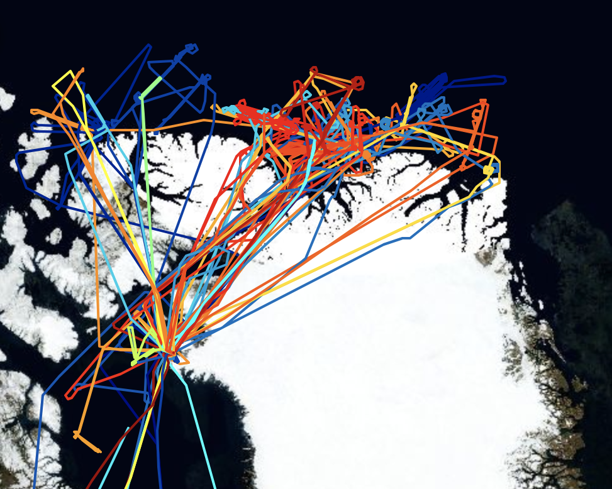
Aerosol total radiative forcing
Initial disruption to Earth's energy balance caused by a change in aerosols
Intro
Aerosol
Cloud
Model-Obs.
Pair Obs.
ML/AI
Q&A
Targeting of important regimes
E.g., polar regions have an outsize impact on climate models, and are challenging to observe. Many mixed phase clouds.
An example of recent progress:
NASA’s ARCSIX aircraft campaign, the most comprehensive Arctic aircraft-based cloud, aerosol, meteorology, sea ice, & remote sensing data set ever collected
Greenland
May-August
2024
3 aircraft, 159 flight hours, many international partners

Slide 11
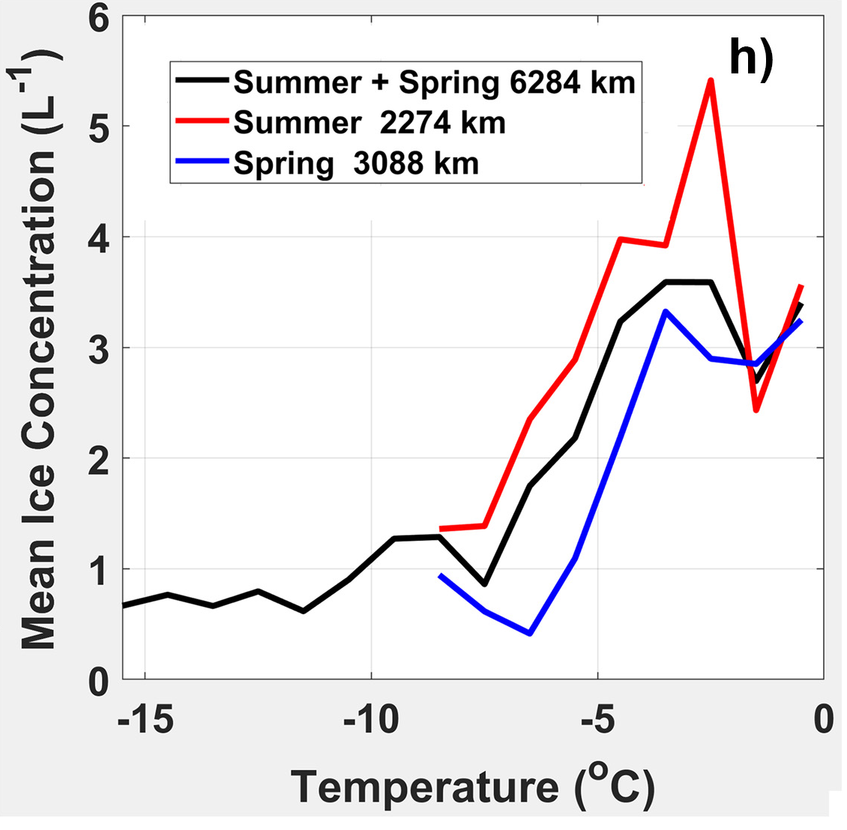
Aerosol total radiative forcing
Initial disruption to Earth's energy balance caused by a change in aerosols
Intro
Aerosol
Cloud
Model-Obs.
Pair Obs.
ML/AI
Q&A
NASA’s ARCSIX aircraft campaign
Satellite underflights; ground site overflights
Multiple cloud walls with in situ + remote sampling
Quasi-Lagrangian sampling for ACI
Detailed particle data, including ice nucleating particles (INPs) at high altitude, single particle composition, size, etc.
Smoke, new particle formation, dust, aged volcano, aerosols over melt ponds, leads, open ocean
Greenland
May-August
2024
3 aircraft, 159 flight hours, many international partners
An example of early findings:
Dust glaciates Arctic summertime clouds below ~ -10°C & is associated with cloud radiative effects (Zamora & Kahn, 2024)
Clouds ice is often produced from unknown production pathways (Korolev & Lawson, 2026)
Some science gaps:
Integrating lab, modeling, suborbital & satellite communities to, e.g., elucidate ice production pathways
Satellite coverage over data-sparse regions with enhanced aerosol, cloud, surface resolution
Long-term CCN/INP data and data on efficient biological INPs
International Polar Year
(IPY5) 2032-33
Much more on the way!

Slide 12
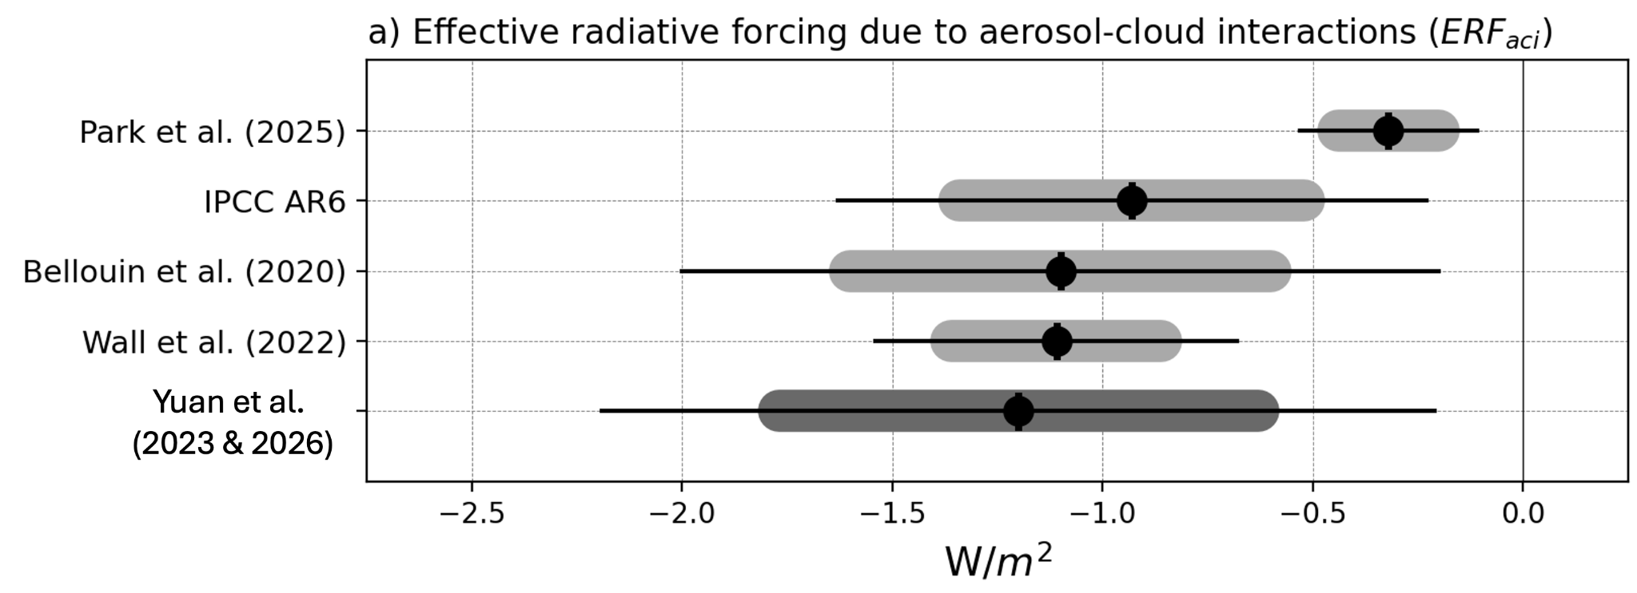
Aerosol total radiative forcing
Initial disruption to Earth's energy balance caused by a change in aerosols
Intro
Aerosol
Cloud
Model-Obs.
Pair Obs.
ML/AI
Q&A
ERFaci updates since AR6
Observation-based methods yield starkly different ERFaci estimates (-0.3 to -1.2 W m⁻²), despite all relying on NASA observations
Aerosol ERF themes we suggest revisiting in the discussion:
Process-level understanding of ACI through analyzing experiments
Continuation and improvement of observational records
Identify key factors contributing disagreements among approaches
Cloud fraction adjustment needs better constraint
Controlled field experiments
How to best use model-observation synergies to maximize our impact and strategically target future efforts?
How to use orbital/suborbital observations to reduce the range of observation-based ERFaci estimates?
Other ideas? Please add in the document

Slide 13
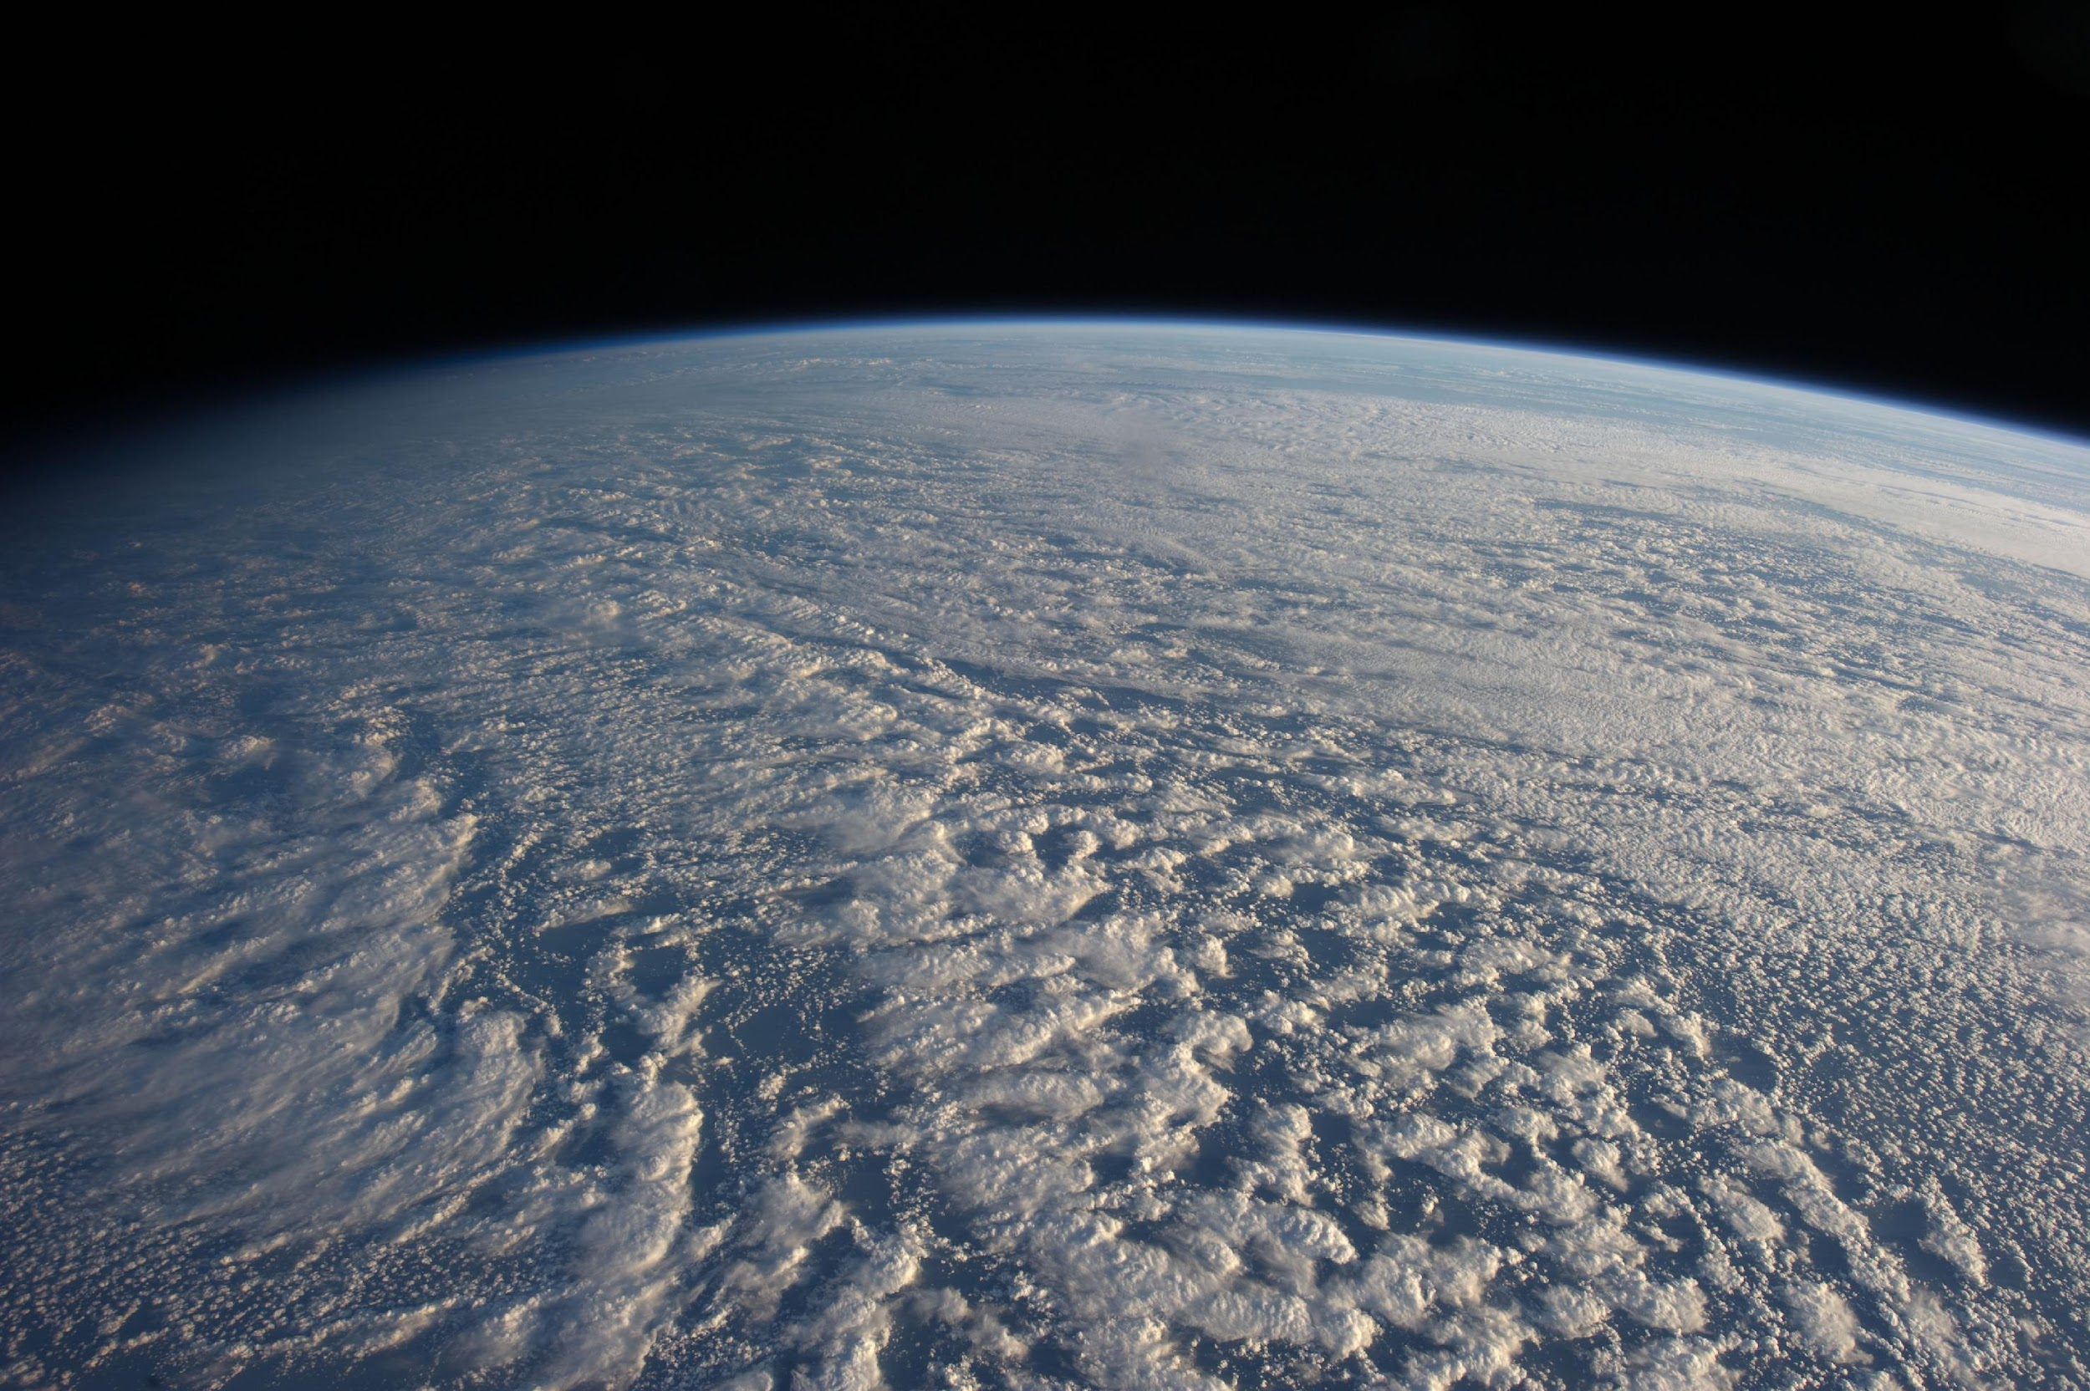
Intro
Aerosol
Cloud
Model-Obs.
Pair Obs.
ML/AI
Q&A
Cloud radiative feedback
The response of clouds to changes in temperature, which in turn modifies the planet's radiation budget
“One of the biggest challenges in climate science has been to predict how clouds will change in a warming world and whether those changes will amplify or partially offset the warming caused by increasing concentrations of greenhouse gases and other human activities.” (IPCC, AR6)
"The most uncertain of those climate feedbacks are clouds, as they respond to warming in complex ways that affect both the emission of thermal radiation and the reflection of sunlight.” (IPCC, AR6)
“Cloud feedback” is the single most important cause of uncertainty in Equilibrium Climate Sensitivity (ECS)—the equilibrium global warming following a doubling of atmospheric carbon dioxide” (Ceppi and Nowack, PNAS 2021)
Notes:
Cloud feedback has been persistently identified as one of the biggest challenges in predicting future climates and for narrowing down the range of estimated equilibrium climate sensitivity.
Reference: P. Ceppi, & P. Nowack, Observational evidence that cloud feedback amplifies global warming, Proc. Natl. Acad. Sci. U.S.A. 118 (30) e2026290118, https://doi.org/10.1073/pnas.2026290118 (2021).

Slide 14
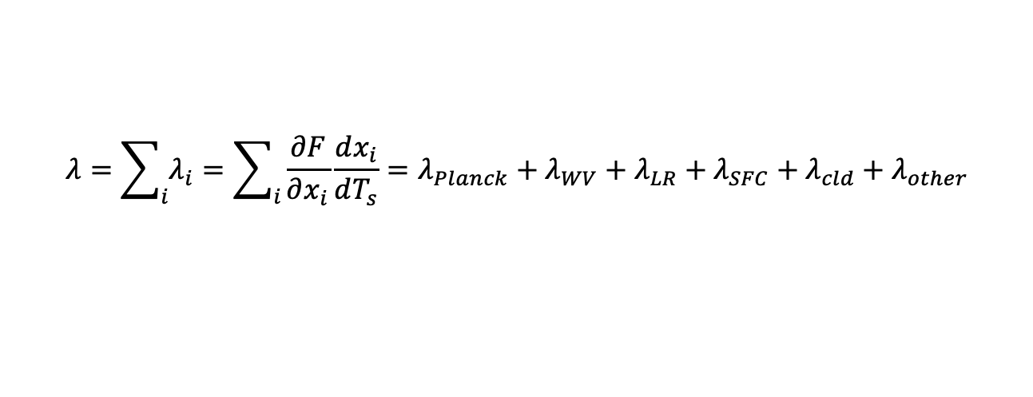
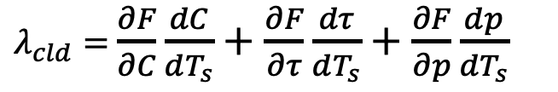
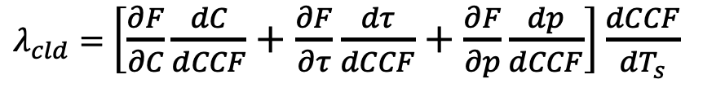
Feedback framework and cloud feedback
Intro
Aerosol
Cloud
Model-Obs.
Pair Obs.
ML/AI
Q&A
climate feedback parameter
Additive property of feedbacks: Each feedback is due to a single radiatively active property perturbation, while all other properties are fixed.
Cloud feedback is mainly due to perturbation of three cloud properties, amount, optical thickness and top pressure in response to a temperature anomaly
most studied
Cloud property response to temperature anomalies can be thought as cloud response to CCF anomalies caused by temperature anomalies
CCF=cloud controlling factor
Notes:
We define the climate feedback parameter as the linear sensitivity of the net TOA flux to a global surface temperature perturbation under an external forcing to which we often add the near-instantaneous radiative response of the environment, giving rise to the concept of effective radiative forcing ERF. For a positive global temperature anomaly, a negative feedback parameter changes net flux towards restoration of radiative equilibrium. The additive property of feedback is the principle that the total climate feedback parameter is simply the sum of the parameters corresponding to individual feedback processes, i.e., it is assumed that feedbacks act independently. To calculate individual feedbacks, we assume that only the radiatively active property specific to that feedback changes while all other properties remain fixed. For clouds specifically, only cloud properties change while the surrounding environment remains unchanged. The three cloud properties whose change matters most for radiation are cloud amount, cloud optical thickness and cloud top pressure. We assume that these respond to a global surface temperature change, not necessarily directly, but rather through CCFs, environmental properties modulating clouds.

Slide 15



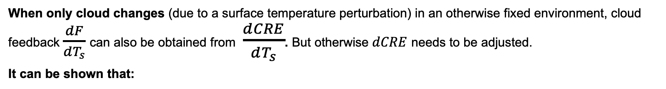
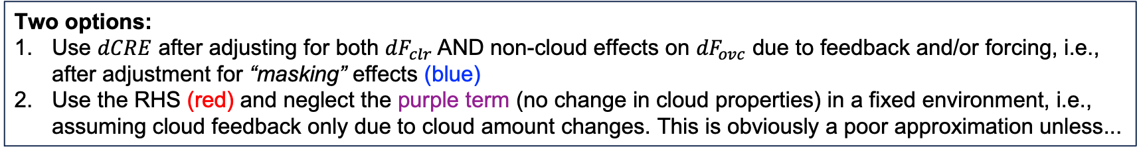
Intro
Aerosol
Cloud
Model-Obs.
Pair Obs.
ML/AI
Q&A
Cloud Feedback and CRE
overcast CRE
Adjusted CRE anomaly method
Cloud Radiative Kernel (CRK) method
overcast flux anomaly due to cloud property (other than cloud amount) changes
Notes:
Again, cloud feedback estimates require that we isolate the change in net flux F only due to cloud changes. This is however not so straightforward in practice, so we have often resorted to the alternative of examining anomalies in cloud radiative effect, the difference between a gridcell’s all-sky and clear-sky fluxes. CRE can also be written as the product of gridcell cloud amount C and the difference between overcast and clear-sky fluxes which we call the overcast CRE. For CRE anomalies to serve as a substitute of all-sky flux anomalies there should be no flux anomalies due to non-cloud effects, IOW, the distortion (“masking”) of CRE by non-cloud effects should be removed. We can show that this is equivalent to the combined contributions of a cloud amount perturbation weighted by overcast CRE and the anomaly of the overcast flux due to cloud property changes weighted by cloud amount. Cloud feedback can be assumed to come only from cloud amount anomalies if Fovc is nearly constant which seems like a poor approximation unless...

Slide 16
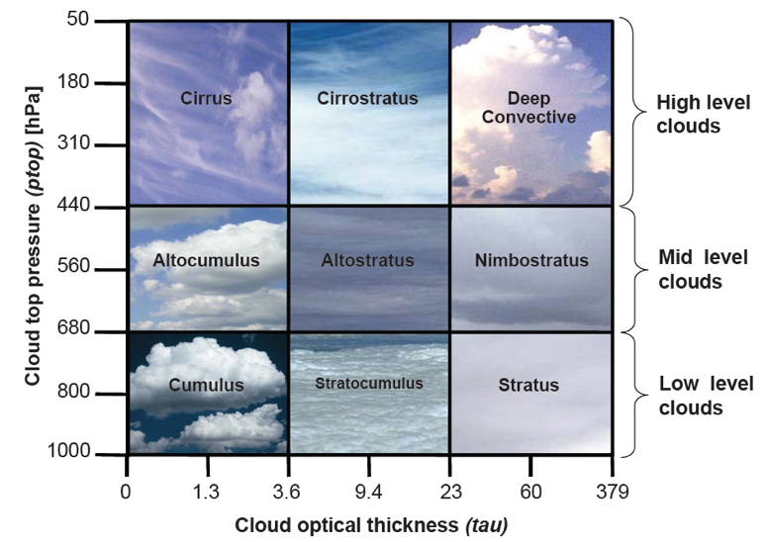
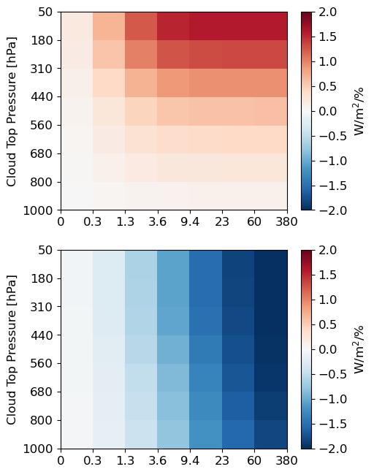
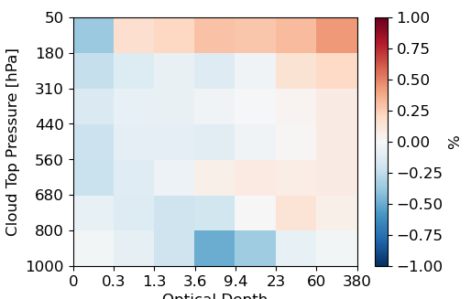



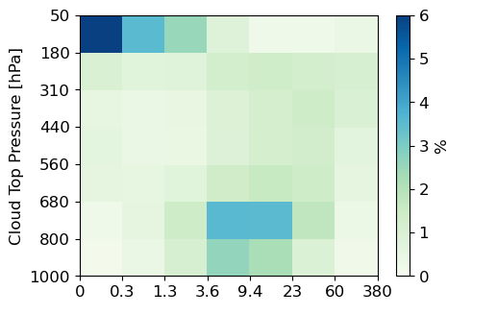


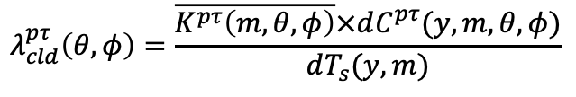

Intro
Aerosol
Cloud
Model-Obs.
Pair Obs.
ML/AI
Q&A
Cloud Radiative Kernels
Can be precalculated (fixed), resolved by month, latitude (e.g., Zhou et al. 2013)
Schematic: Swati Gehlot
×
More detailed cloud fraction distribution by cloud type (49 cloud types)
Available from satellite observations. For models need subcolumn generator (e.g. COSP’s SCOPS) and perhaps simulator (e.g. COSP’s ISCCP/MODIS simulators)
available from CERES Flux By Cloud Type product (FBCT)
Courtesy of Mark Zelinka
available from FBCT, MODIS/VIIRS COSP
geographically resolved feedback
Notes:
... we break the problem by cloud type where one can assume semi-fixed cloud properties. In the satellite era of passive imaging spectroradiometers, a common definition of cloud types is based on cloud top pressure and optical depth combinations within a specific range. The classic ISCCP definition of 9 cloud types is obviously not appropriate, as the range of CTP and TAU values is too wide. Assuming something like 49 cloud types makes constant Fovc a better approximation for a fixed location and environment. By convolving anomalies of such joint histograms, now also available from satellite observations, with the sensitivities of overcast CREs to a unit of cloud fraction change (the cloud radiative kernel) we obtain flux anomalies due to cloud type amount anomalies resolved by cloud type. CRKs can be either precalculated as a function of latitude and month or come from observations like the CERES FBCT product. Convolving spatiotemporally resolved CRKs with similarly resolved observed cloud amount distribution anomalies we can obtain spatially resolved cloud feedback.
Reference: Zhou, C., M. D. Zelinka, A. E. Dessler, and P. Yang, 2013: An Analysis of the Short-Term Cloud Feedback Using MODIS Data. J. Climate, 26, 4803–4815, https://doi.org/10.1175/JCLI-D-12-00547.1.

Slide 17
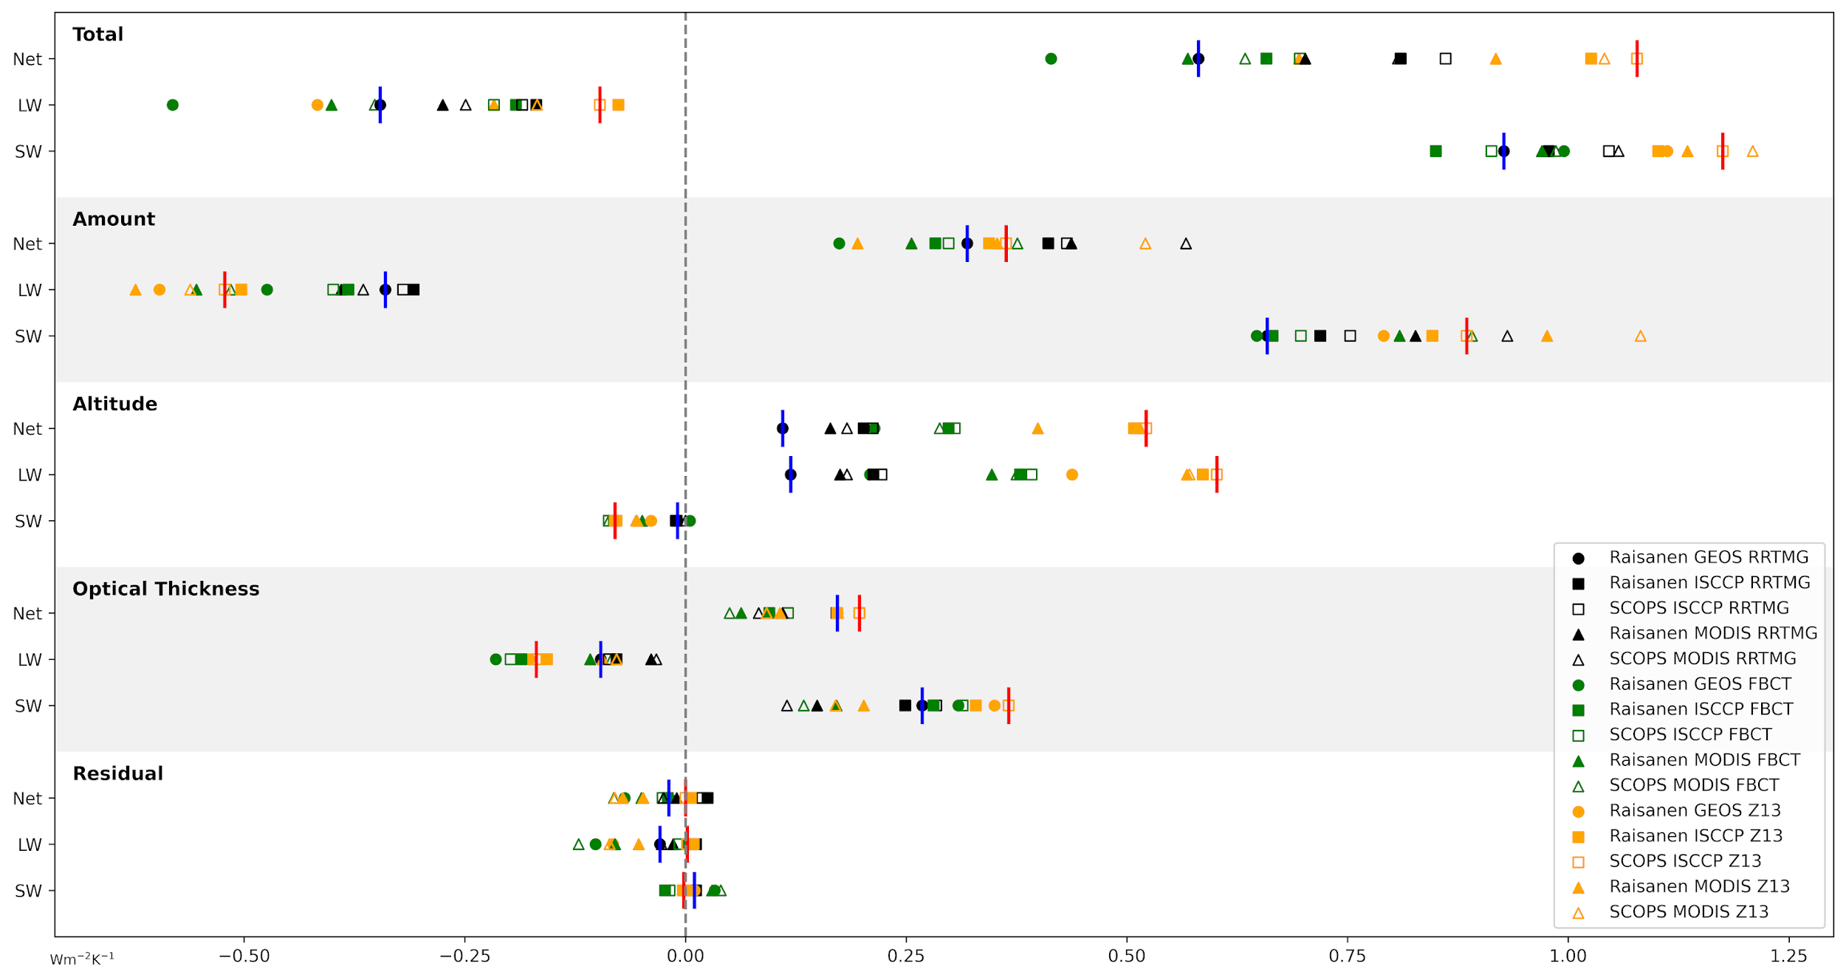
Intro
Aerosol
Cloud
Model-Obs.
Pair Obs.
ML/AI
Q&A
most popular
0.4–1.1 Wm⁻²K⁻¹
best
GEOS +4K AMIP experiment
Lee and Oreopoulos (2024)
Cloud feedback depends on how joint histograms are generated and what CRKs are used
Notes:
When we applied the CRK method to a GEOS perturbation experiment combining 5 different ways to generate joint histograms and three different kernel datasets we found a wide range of net cloud feedback which is a sobering indicator of how much our feedback estimates depend on the details of the calculation.
Reference: Lee, D., & Oreopoulos, L. (2025). Multiple cloud feedbacks in a global model from a single perturbation experiment. Geophysical Research Letters, 52, e2025GL116120. https://doi.org/10.1029/2025GL116120.

Slide 18
Options to calculate cloud feedback
(and implementation challenges)
Intro
Aerosol
Cloud
Model-Obs.
Pair Obs.
ML/AI
Q&A
CRK method
The good: Feedback by cloud type; also collectively due to cloud amount, optical depth, cloud altitude anomalies.
What kernels to use? Observed kernels are time-varying
How to create joint histograms in models
Anomalies WITHIN cloud types omitted; also, cloudy flux not uniquely defined by cloud optical depth and top altitude
Passive view of clouds: clouds vertically resolved only at the gridcell level, NOT the pixel level
Adjusted CRE anomaly method
The good: Intuitive connection to a widely used observed quantity
A framework exists based on (non-cloud) radiative kernels to remove masking effects due to water vapor, temperature, surface albedo feedback
  But the radiative kernels are state-dependent (variable) in principle
Harder to remove masking due to instantaneous radiative forcing
Partial radiative perturbation (PRP)
The good: Potentially the most robust
Expensive in terms of computation and storage if done properly; hugely expensive to do cloud feedback breakdowns
Feasible in both model and observational realms; for example:
  Model: Run perturbation experiment, save 3D cloud property fields (often); run baseline experiment with double-call radiation: one with baseline clouds (interactive) and another with saved perturbed clouds (diagnostic); take flux differences
  Observations: Need observed clouds sufficiently resolved spatiotemporally (daily, pixel) because of radiation non-linearity; forward radiative transfer at beginning and end of period with fixed environment (e.g., re-analysis); take flux differences
Previous slide demonstrated the impact
Notes:
Here is a summary of our options for obtaining cloud feedback from either observations or models. (1) We have the aforementioned CRK method, based on the passive view of clouds conveyed by the JHs, which actually allows conversion of cloud type feedback into feedback contributions by CF, TAU, CTP. In models we face choices in how to create JHs and what exactly CRKs to use. (2) The adjusted CRE anomaly method where you face the challenging task of removing masking effects due to either feedback or forcing on clear-sky and overcast flux anomalies (3) The brute force PRP method where you have to resolve baseline and perturbed clouds at sufficiently high spatiotemporal resolution to tackle non-linearities. Cloud feedback is inferred from flux differences of two states, one with the baseline clouds and one with the perturbed clouds in the same environment; you can obviously have many permutations of such expensive experiments.

Slide 19
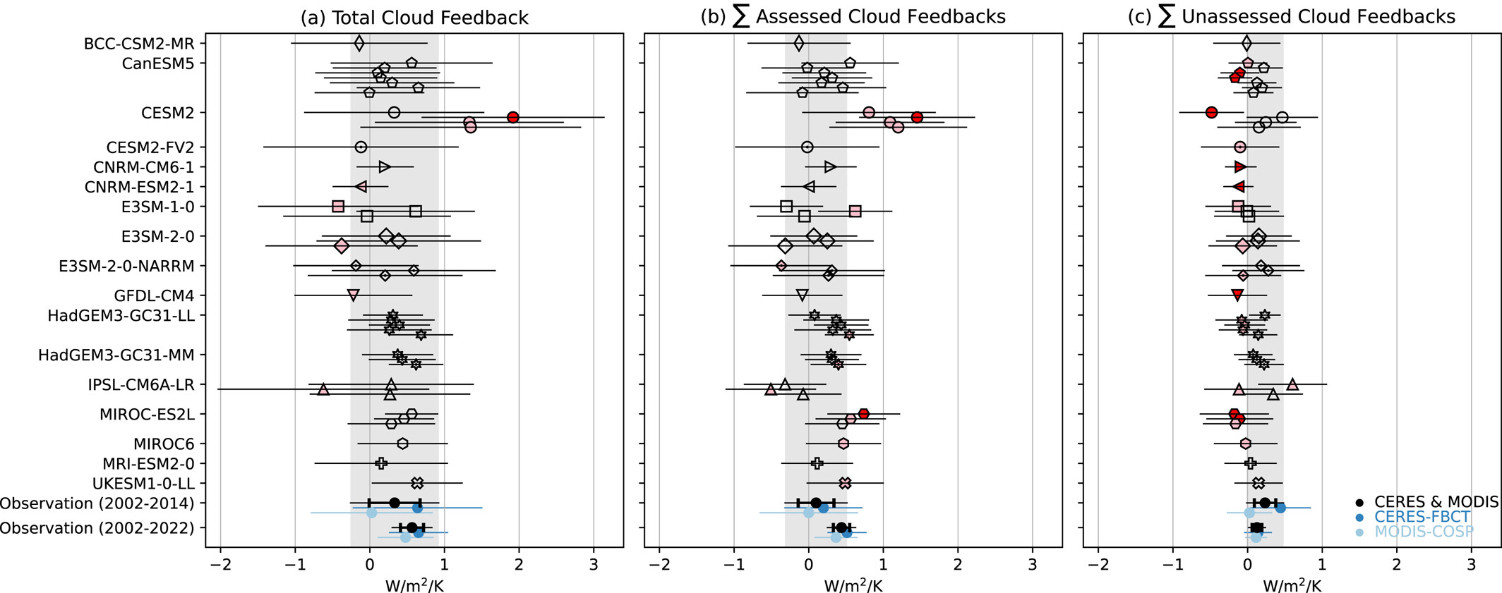
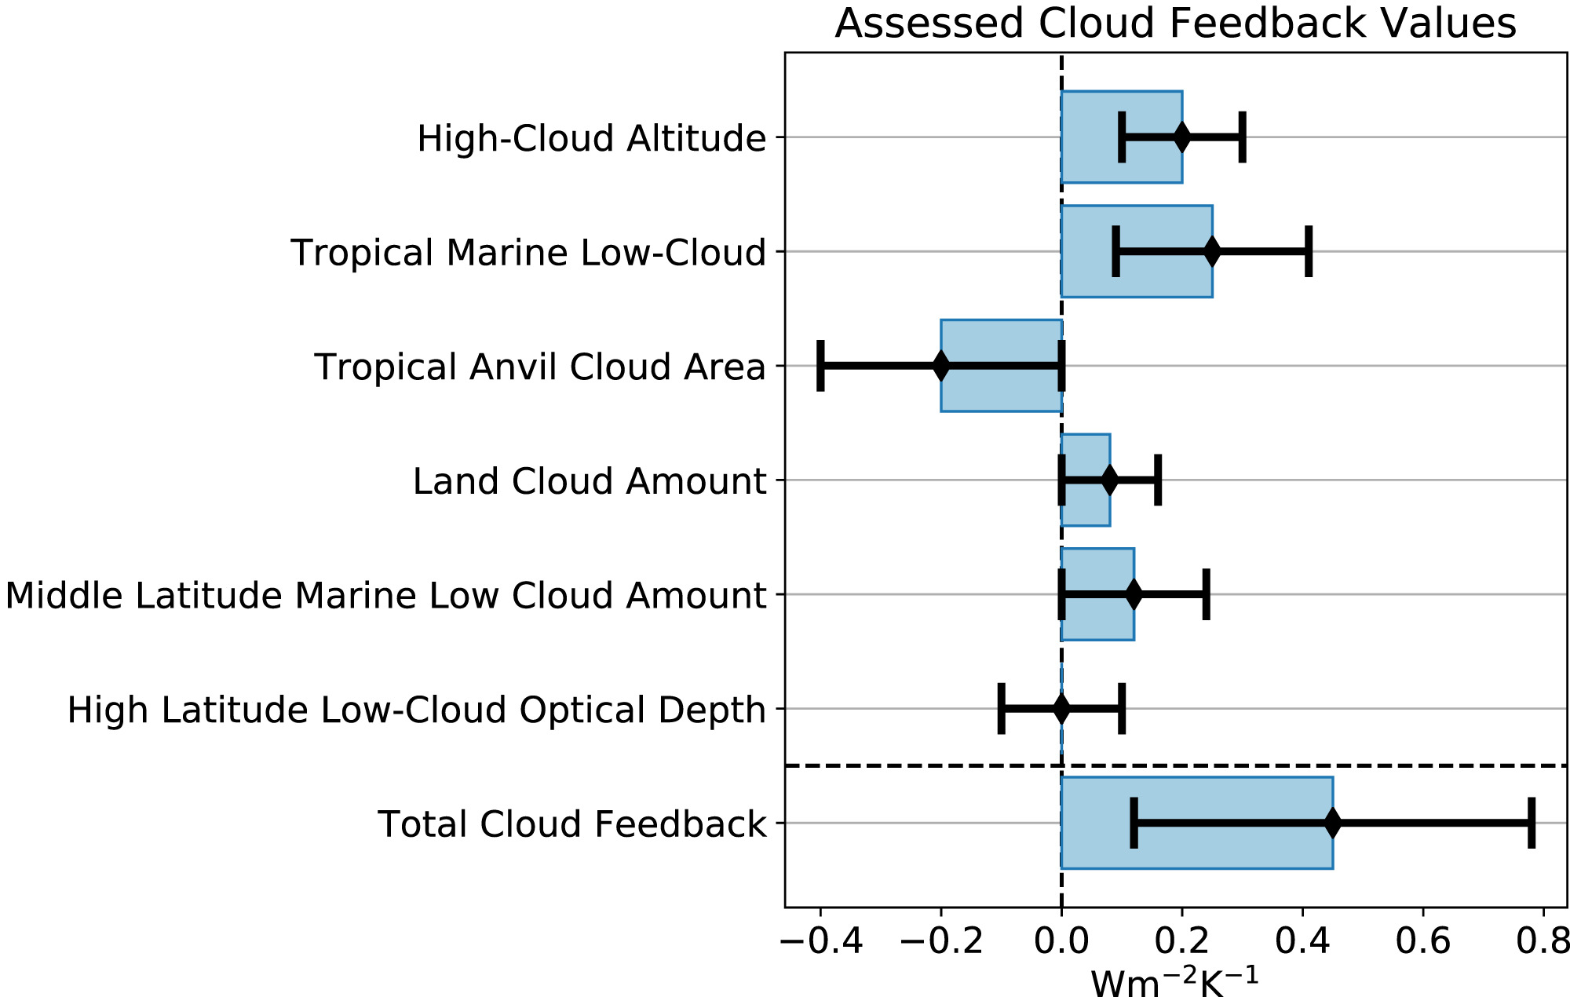
Intro
Aerosol
Cloud
Model-Obs.
Pair Obs.
ML/AI
Q&A
What aspects of cloud feedback are we currently studying?
(a non-exhaustive list)
What part of EEI variability is due to cloud feedback
Comparison between observed and modeled feedback
Comparison between short-term and long-term feedback (models)
Model feedback vs fidelity of clouds in current climate
Evaluation of model feedbacks vs “expert judgement”
Comparison between feedbacks from adjusted dCRE and CRK
Feedback by cloud type/regime
Regional feedback (tropical, midlatitude, polar)
Cloud phase feedback
Cloud (amount) and flux response to CCF anomalies (marine low clouds)
Effective radiative forcing due to ACI (ERFaci, NOT cloud feedback)
Pattern effect
Chao et al. 2024
Sherwood et al. (2020)
Notes:
I’m providing here my own perception of current cloud feedback work. I’d like to underscore that there’s currently a lot of work on ACI motivated by advances in two-moment cloud microphysics in climate models and the recent substantial reductions in anthropogenic aerosol emissions which we believe cause cloud changes detectable from space. But ACI is NOT part of cloud feedback since it is considered a fast cloud response to aerosol anomalies unrelated to temperature perturbations. Some of the most important topics are short term feedback as a proxy for long-term feedback, how feedbacks from observations and global models compare, and how to decide which models predict the most reliable cloud feedback. There is a growing body of literature on how anomalies in CCFs, like atmospheric stability indices, relate to CF anomalies of low marine clouds.
References:
Chao, L.-W., Zelinka, M. D., & Dessler, A. E. (2024). Evaluating cloud feedback components in observations and their representation in climate models. Journal of Geophysical Research: Atmospheres, 129, e2023JD039427. https://doi.org/10.1029/2023JD039427.
Sherwood, S. C., Webb, M. J., Annan, J. D., Armour, K. C., Forster, P. M., Hargreaves, J. C., et al. (2020). An assessment of Earth's climate sensitivity using multiple lines of evidence. Reviews of Geophysics, 58, e2019RG000678. https://doi.org/10.1029/2019RG000678.

Slide 20
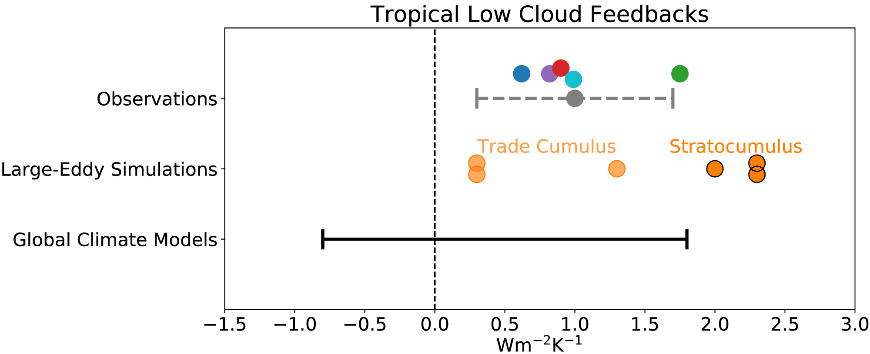
Intro
Aerosol
Cloud
Model-Obs.
Pair Obs.
ML/AI
Q&A
Fundamental challenges
How to separate temperature-mediated from fast response (subtract fast response from GCM?)
Decadal/ sub-decadal variability (e.g., ENSO, PDO) obfuscates cloud feedback due to external forcing (see next slide); need long, continuous, trusted cloud and radiation records
What cloud observations do we need? At what accuracy? Currently we have choice between sparse vertically resolved (active) and dense column-integrated (passive)
Can high resolution (cloud/eddy resolving) models help? How do validate them?
Can CCF analysis be meaningfully extended beyond low marine clouds?
How to create/ interpret model subgrid cloud variability; what model to trust (emergent constraints)?
How to use cloud observations to improve clouds in global models
Philosophical on the cloud feedback concept:
Appropriate given that the ultimate climatic effect of clouds depends on the environment they are embedded in? Perhaps dCRE better?
Is the single-parameter TOA vantage point all we need to assess cloud climatic effects?
Sherwood et al. (2020)
Notes:
Cloud feedback is a difficult problem with many outstanding issues. I close with some of my own perspectives on the topic. There is the issue of attributing cloud responses and flux anomalies to global temperature anomalies, i.e., ignoring immediate cloud responses to forcing; appropriately designed GCM experiments (fixed SST) may perhaps help us make corrections. Then there is the issue of using insufficiently long time series where temperature anomalies can be due to internal variability like ENSO, and thus unrelated to radiative forcing. Here I show that the geographical distribution and magnitude of regional cloud feedback magnitude seems to be greatly influenced by ENSO. When we applied an adjustment to the global temperature fluctuations to account for ENSO, the regional magnitudes weakened substantially, but the global value, a result of extensive cancellations of strong local feedbacks, does not change much. There are also the grand questions of what kind and how accurate cloud observations are needed to not only calculate cloud feedback, but to also use to improve cloud representation in global models (and how exactly do we accomplish that?). Finally, I conclude with some philosophical questions: First, is the feedback paradigm as constructed appropriate given that the climatic effect of clouds ultimately depends on what environment they are embedded in? Second, should we be focusing only on the TOA perspective when clouds affect the distribution of radiative heating/cooling in the atmosphere and the radiation at the surface?
Reference: Sherwood, S. C., Webb, M. J., Annan, J. D., Armour, K. C., Forster, P. M., Hargreaves, J. C., et al. (2020). An assessment of Earth's climate sensitivity using multiple lines of evidence. Reviews of Geophysics, 58, e2019RG000678. https://doi.org/10.1029/2019RG000678.

Slide 21
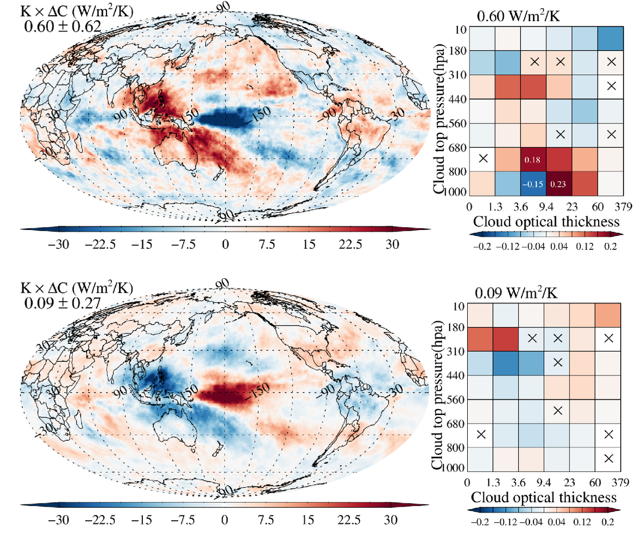
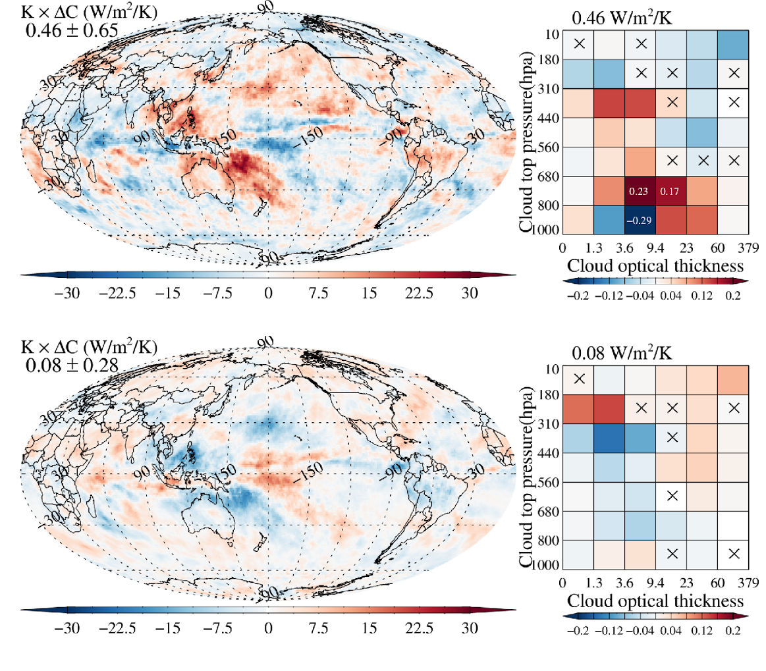
Intro
Aerosol
Cloud
Model-Obs.
Pair Obs.
ML/AI
Q&A
ENSO affects regional cloud feedback
SW
NO ENSO correction
ENSO correction
LW
Oreopoulos et al. (2026)
Notes:
Reference: Lazaros Oreopoulos, Nayeong Cho, Ryan Kramer, et al. Cloud Radiative Effect Variability in the Recent Satellite Record and Associated Cloud Feedback. ESS Open Archive. 13 February 2026. DOI: https://doi.org/10.22541/essoar.177100425.52102553/v1.

Slide 22
Modeling PoR
Intro
Aerosol
Cloud
Model-Obs.
Pair Obs.
ML/AI
Q&A
NASA has global climate (ModelE) and Seasonal/NWP-scale (GEOS) models with various compositional capabilities at representing aerosols (bulk, moments/modal, sectional) and couplings to chemistry, radiation, and clouds
Horizontal scales range from ~100 km to ~2 km depending on application. Vertical scales presently to ~80 km; work ongoing to increase vertical resolution (e.g., 72 -> 181 levels) and increasing model top to go above mesosphere.
Fundamental aerosol-relevant outputs include CMIP-class simulations (ModelE), S2S and NWP (GEOS), including reanalyses (MERRA-2, MERRA-21C)
More on modeling and observation needs this Friday 08:30 in the aerosol/cloud break out discussion
Courtesy of Peter Colarco

Slide 23
Orbital PoR
Intro
Aerosol
Cloud
Model-Obs.
Pair Obs.
ML/AI
Q&A
Current satellite Program of Record (PoR) includes a host of domestic and international missions and instruments targeting aerosol/cloud geophysical variables
  Active instruments (lidar/radar) providing profiling capabilities; passive instruments (imagers, radiometers, polarimeters, sounders, etc.) providing column quantities
  GEO (time resolved), LEO asynchronous (pseudo-time resolved), and LEO sun-synchronous (global twice-daily)
The satellite PoR is an essential enabling capability:
  Can be integrated with other datasets to address key science; can be leveraged by future missions to meet mission/science requirements
Challenges: orbital, operational, and sampling differences; divergent requirements on data/product stewardship; availability and inter-consistency of data products
More on modeling and observation needs this Friday 08:30 in the aerosol/cloud break out discussion
Courtesy of Kerry Meyer

Slide 24
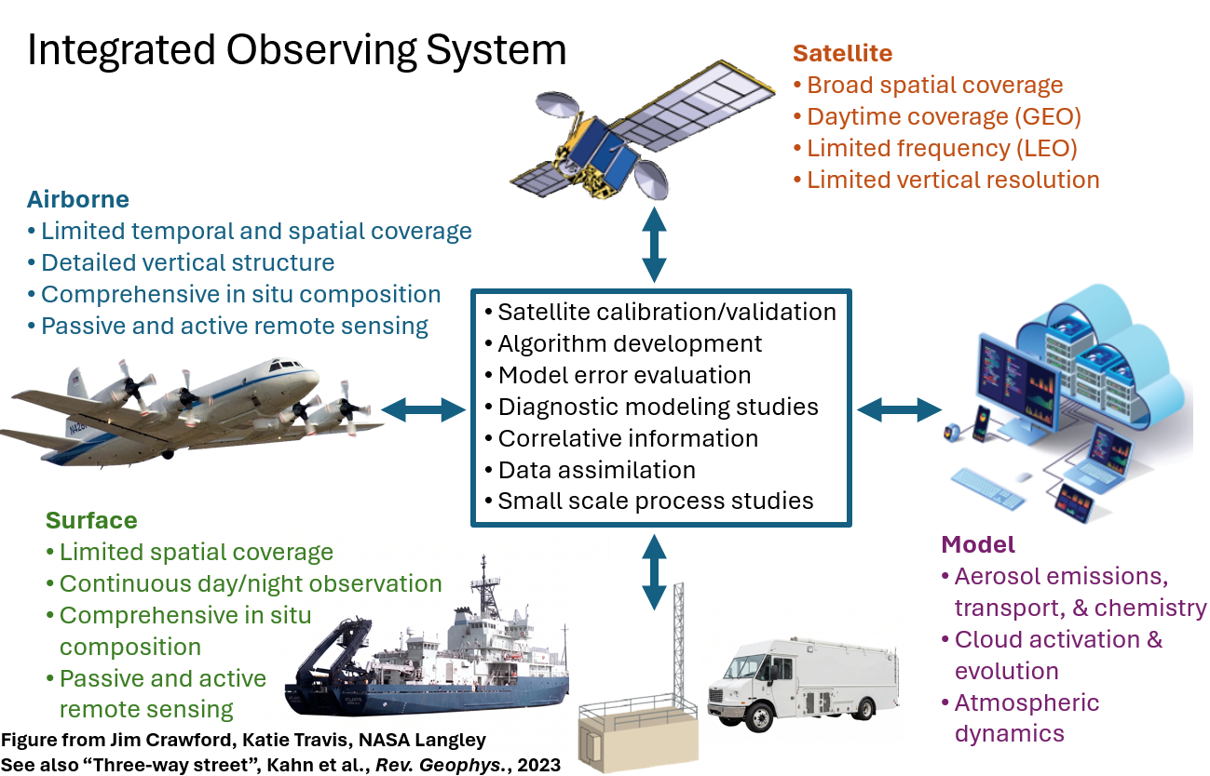
Suborbital
Intro
Aerosol
Cloud
Model-Obs.
Pair Obs.
ML/AI
Q&A
Airborne/Surface observations are key
to the Integrated Observing System
Transition from exploratory studies in
the 1990-2000’s to statistically-driven
approach in 2010-2020’s (driven by EV-S)
Opportunity to achieve aerosol-cloud
  objectives in interdisciplinary AtmoSphere
  (TCP+RSP+UARP+WADP) campaigns
Science gaps: CCN-limited regions, dust, aerosol near/below clouds, representative properties for aerosol types and atmospheric/cloud regimes
Force multipliers: Upcoming Int’l Polar Year (‘32-’33), temporary mobile assets (DOE ARM), IAGOS-style modular automated payloads for routine ASP piggybacks
Suborbital Sensor SBIR Solicitation out yesterday: https://www.nasa.gov/sbir_sttr/
More on modeling and observation needs this Friday 08:30 in the aerosol/cloud break out discussion
Courtesy of Richard Moore

Slide 25
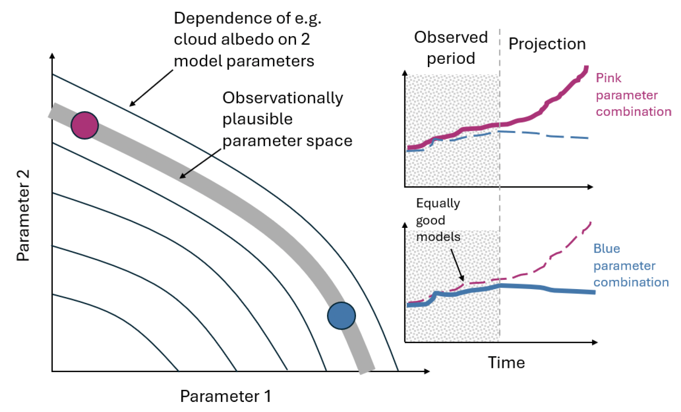
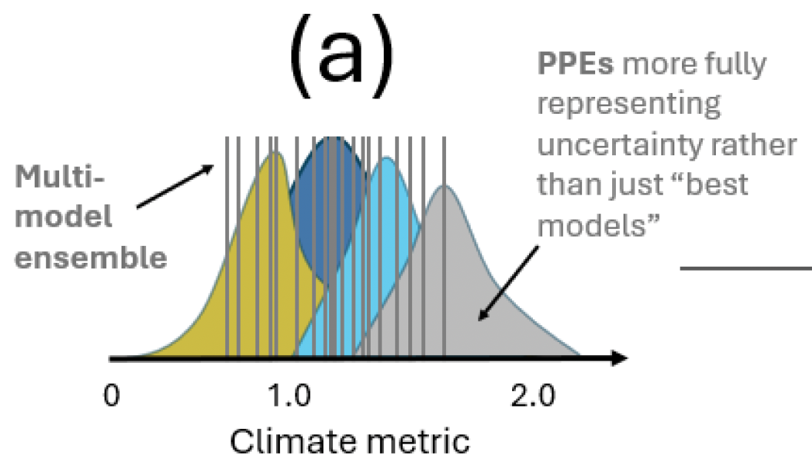
Intro
Aerosol
Cloud
Model-Obs.
Pair Obs.
ML/AI
Q&A
Earth System Models (ESMs) and Observations: Questions and need to advance model-obs. fusing to constrain ESM physics
ESMs are increasingly complex, and for any ESM, there are likely multiple variants comparing similarly to observations (but with different feedbacks and predictions, and thus UQ on predictions?)
How best to use observations (e.g., timescales, joint co-variations of precip-clouds-aerosols) to determine these variants, and how to do so in a tractable way?
Would ESM variants across multiple ESM code-
bases overlap? (also supports science Qs: how do process representations affect clouds, prediction, ...?)
Constraint implies we can quantify what current observations are doing for us, and what planned observations may further (quantitatively) do.
Variant N
Process Parameter 2
Carslaw et al. (2025)
Variant N+1
Process Parameter 1
Carslaw et al. (2026)
ESM
OBS
Notes:
References: Carslaw, K.S., L.A. Regayre, U. Proske, A. Gettelman, D.M.H. Sexton, Y. Qian, L. Marshall, O. Wild, M. van Lier-Walqui, A. Oertel, S. Peatier, B. Yang, J.S. Johnson, S. Li, D.T. McCoy, B.M. Sanderson, C.J. Williamson, G.S. Elsaesser, K. Yamazaki, and B.B.B. Booth, 2026: Opinion: The importance and future development of perturbed parameter ensembles in climate and atmospheric science. Atmos. Chem. Phys., 26, no. 7, 4651-4667, doi:10.5194/acp-26-4651-2026.

Slide 26
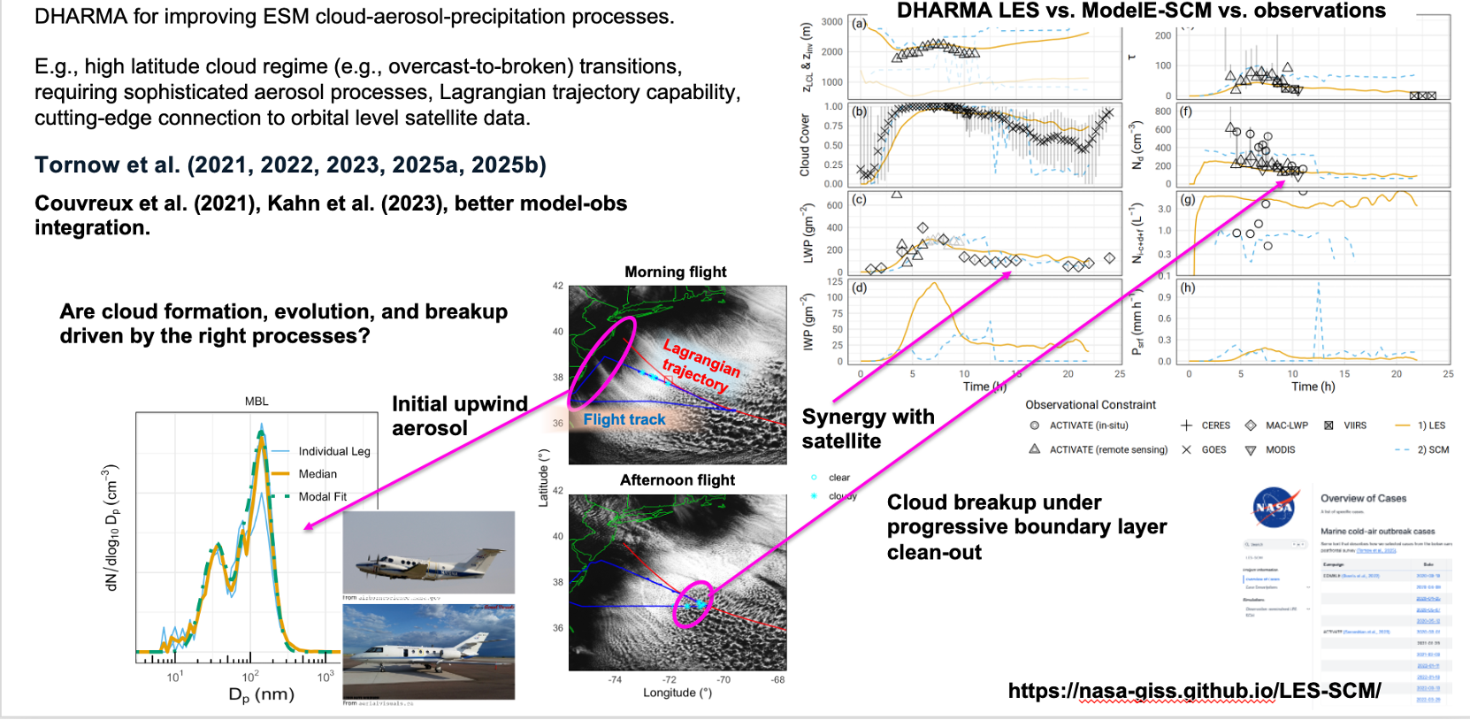
Intro
Aerosol
Cloud
Model-Obs.
Pair Obs.
ML/AI
Q&A
Importance of framework for integration of field campaign, LES, and orbital level satellite data to determine prior ESM variants

Slide 27
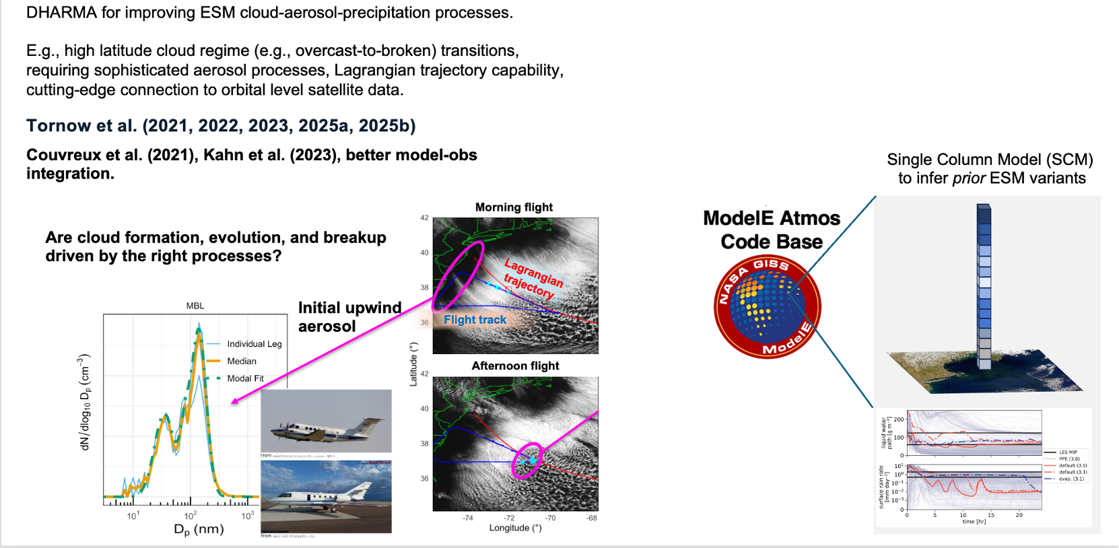
Intro
Aerosol
Cloud
Model-Obs.
Pair Obs.
ML/AI
Q&A
Importance of framework for integration of field campaign, LES, and orbital level satellite data to determine prior ESM variants

Slide 28
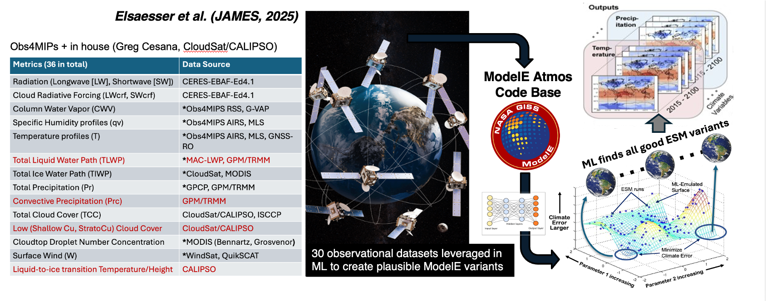
Intro
Aerosol
Cloud
Model-Obs.
Pair Obs.
ML/AI
Q&A
Incorporation of numerous satellite climatologies, further physics constraint and final posterior : Calibrated Physics Ensemble (CPE)
Perform global simulations and use ML to emulate ESM outputs as a function of varying physics (key). Apply Bayesian methods (e.g., MCMC) to model emulator to infer final (posterior) set of parameter yielding ESM variants satisfying global constraints. Result: CPE
Elsaesser, van Lier-Walqui, et al. (JAMES, 2025)

Slide 29
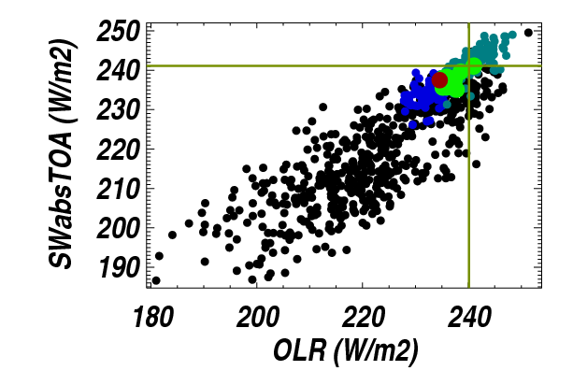
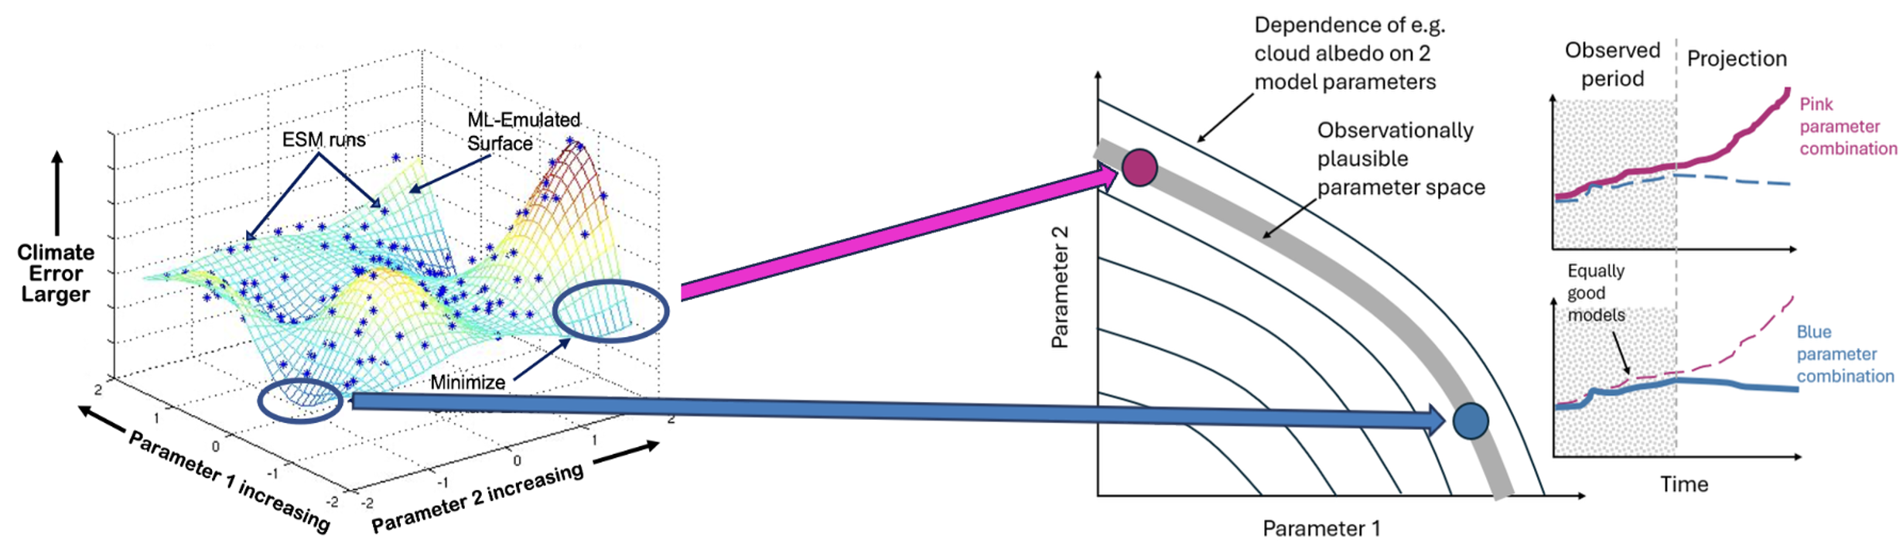
Intro
Aerosol
Cloud
Model-Obs.
Pair Obs.
ML/AI
Q&A
Calibrated Physics Ensemble (CPE) Frameworks
Support UQ, OSSEs for value of Obs on ESM physics (complementary to OSSEs for initial state), and science with global-scale models.
Variants closer to matching field campaign data PLUS many other global variables [by design] (CREs, clouds, aerosols, convection, proxies for longer-term behavior (e.g., QBO)…)
Elsaesser et al. (2025); Carslaw et al. (2026), Fridlind et al. (2026); Zhang et al. (2026)
LES+SCM field campaigns ;
Program of Record (POR)! ;
Energy/Water cycle variables ;
Variables for aerosol-cloud interactions (low cloud, convection, and ice!)...and more!
Train Neural Net to map physics settings (microphysics, turbulence) to output variables (observables, now and new) & feedbacks / predictions.
ESM Physics 🡪 ESM variables compared to OBS 🡪 feedbacks/predictions/proxies for QBO, …
Loop Back, “OSSE”

Slide 30
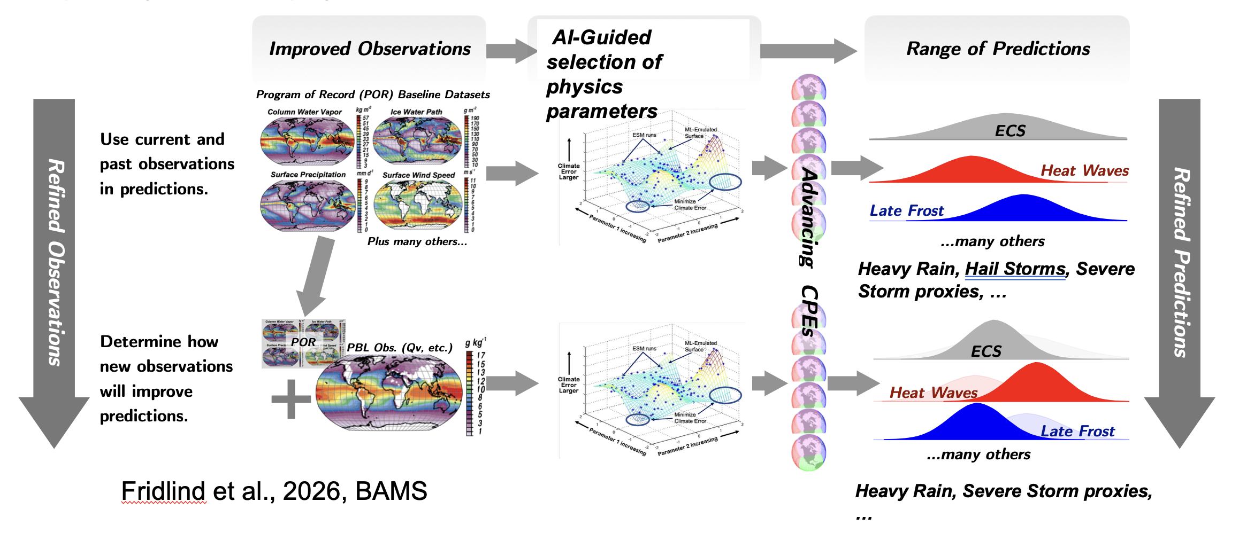
Intro
Aerosol
Cloud
Model-Obs.
Pair Obs.
ML/AI
Q&A
CPEs and Contribution to Satellite/Obs Mission Planning
Not for testing data assimilation/improvements in initial state; this is a new capability for ESM physics constraint (also a ‘climate OSSE’, or COSSE).

Slide 31
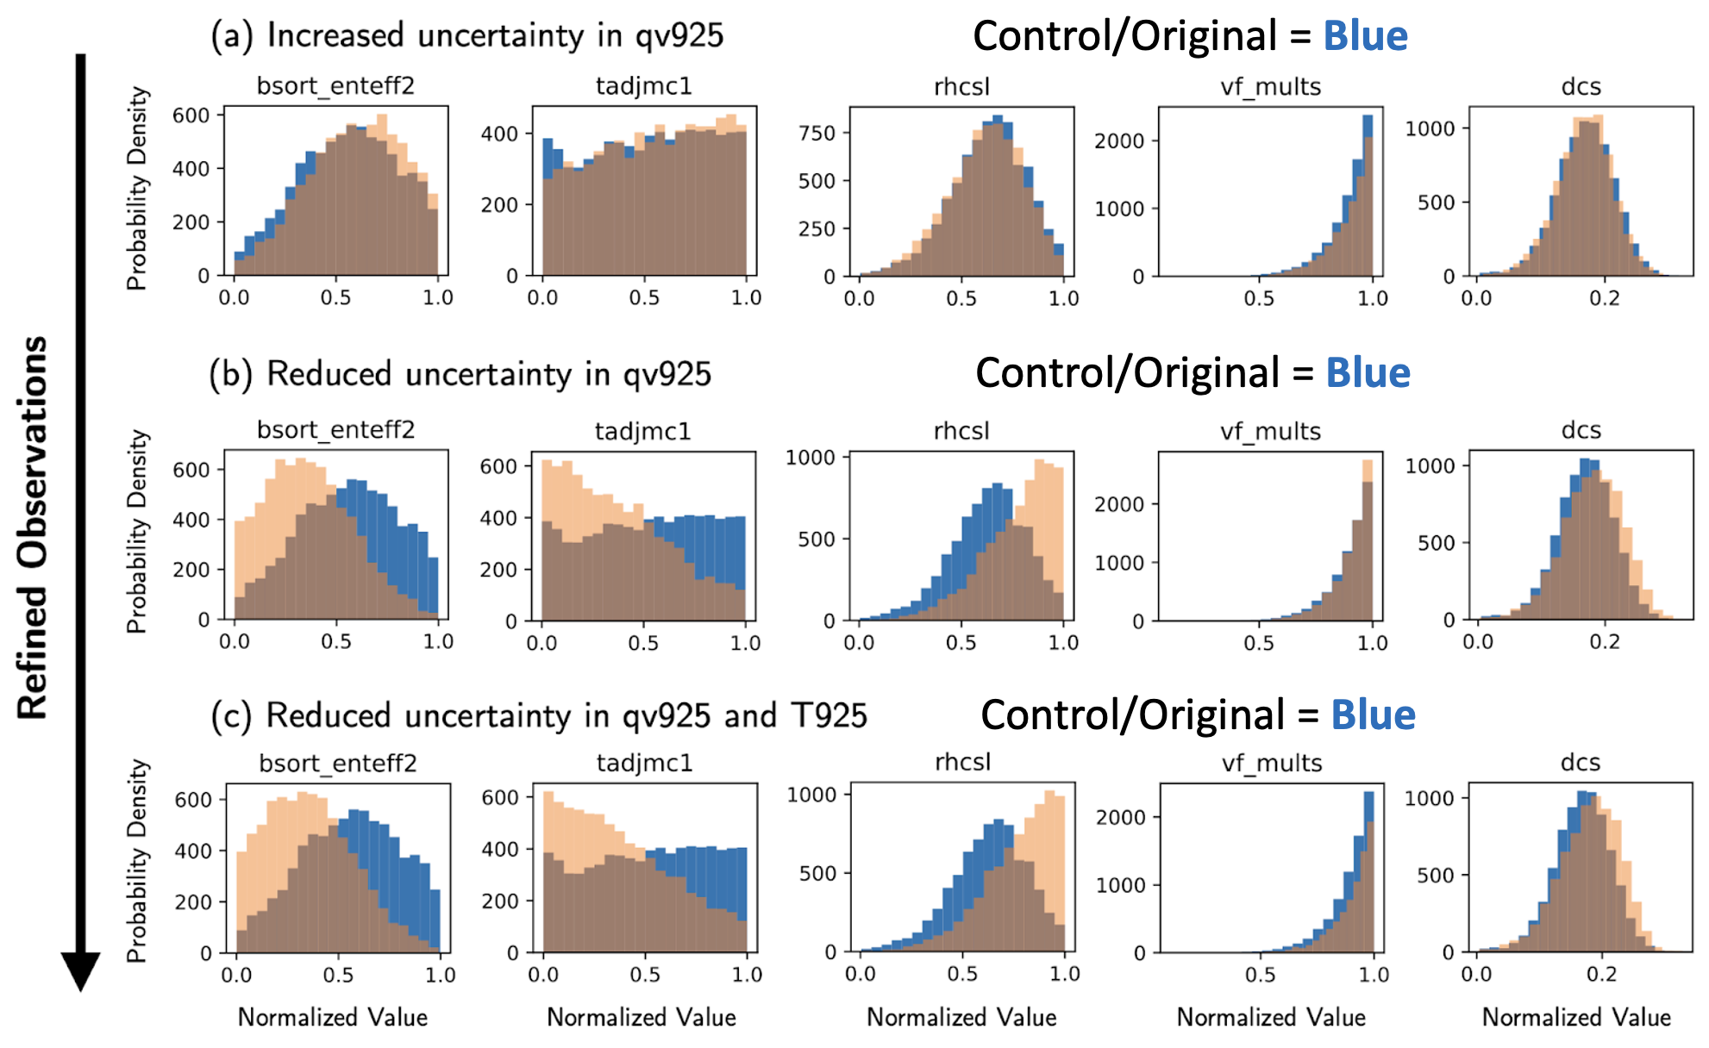
Intro
Aerosol
Cloud
Model-Obs.
Pair Obs.
ML/AI
Q&A
CPEs and Contribution to Satellite/Obs Mission Planning
Demonstration imagining improved (Bulk) PBL T and Qv observations.
ESM physics more sensitive to near-surface moisture (qv) than temperature (T), suggesting improving retrievals of PBL qv -vs- T would give more “bang for your buck” to constrain an ESM.
(Consistent w/ Suselj et al., 2020)
…but, potential for improvement depends on meaningful UQ for retrievals! Not common (?)
Fridlind et al., 2026 (BAMS)

Slide 32
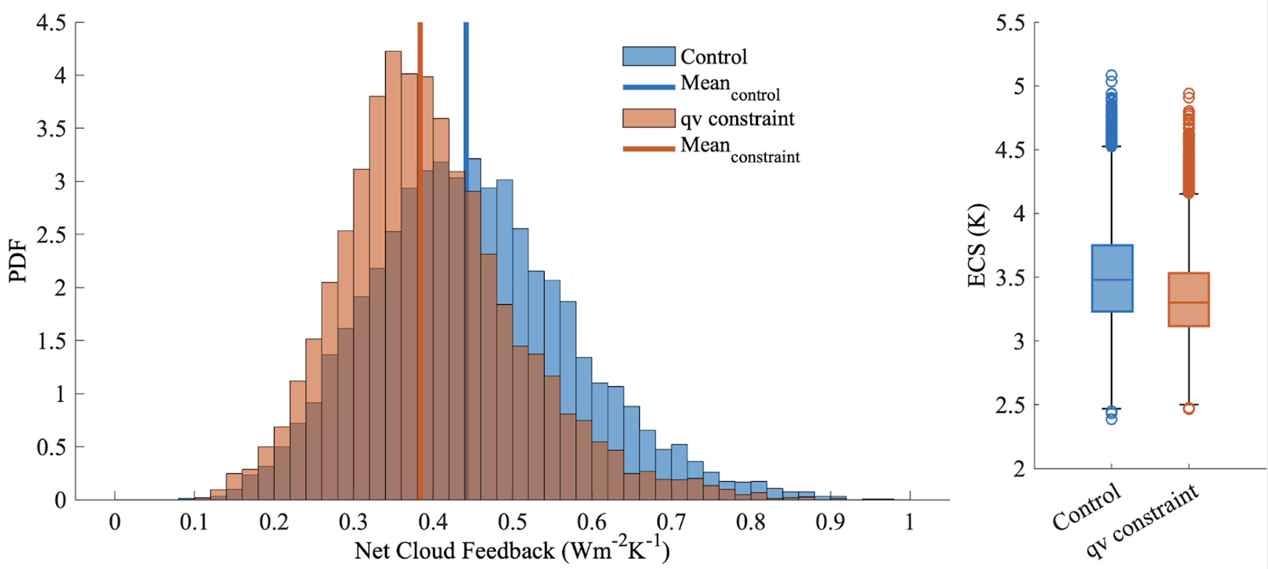
Intro
Aerosol
Cloud
Model-Obs.
Pair Obs.
ML/AI
Q&A
CPEs and Contribution to Satellite/Obs Mission Planning
Demonstration imagining improved (Bulk) PBL T and Qv observations.
Fridlind et al., 2026 (BAMS)
Carrying through to the change in cloud feedback and climate sensitivity for constrained variants.
Summary & Thoughts:
Developing framework to add evidence supporting such a statement: “these new observations will make model & predictions better.”
Inexpensive framework (even more so, when compared to cost of any mission), due to use of ML; also flexible, as outputs (or observables) can be numerous spanning cloud, aerosol-cloud (low-cloud, ice) interactions, etc; supports model-observation developer integration.
Notes:
References on slide:
Fridlind, A.M., G.S. Elsaesser, M. van Lier-Walqui, G.V. Cesana, E. Weatherhead, G. Tselioudis, G. Schmidt, D. Barahona, B. Cairns, W.D. Collins, D. Considine, L. Cucurull, L. DiGirolamo, A. Emory, O. Hasekamp, S. He, R. Kramer, M. Lebsock, T. Lee, S. Leroy, W. Lin, S. Lugauer, D. Miller, J. Mülmenstädt, L. Oreopoulos, D.J. Posselt, and M.D. Zelinka, 2026: Towards a climate OSSE framework for satellite mission design. Bull. Amer. Meteor. Soc., 107, no. 4, E431-E445, doi:10.1175/BAMS-D-24-0242.1.:

Slide 33
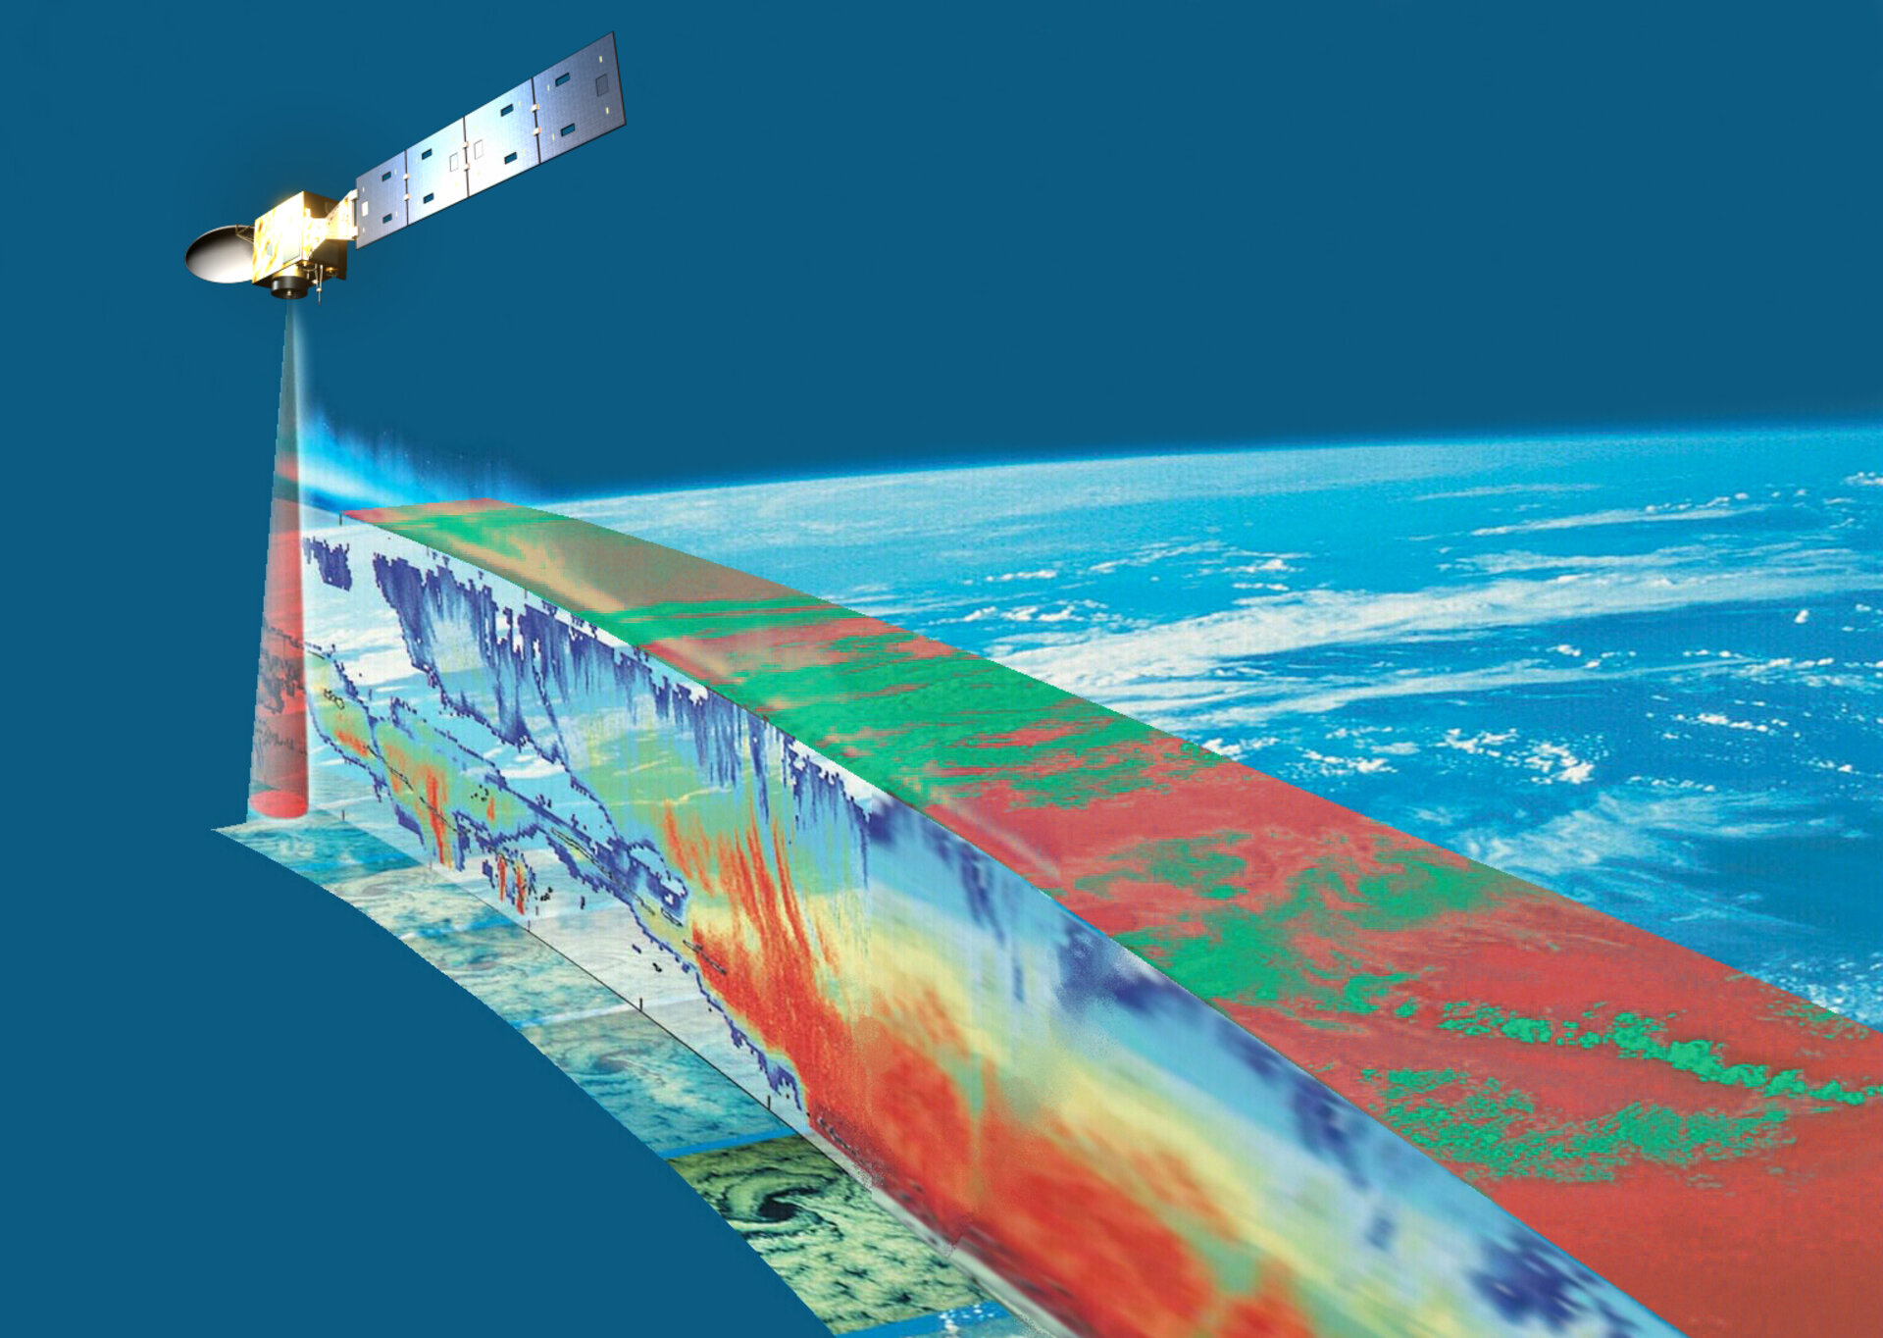
Instrument Synergy in Aerosol & Cloud Remote Sensing
Intro
Aerosol
Cloud
Model-Obs.
Pair Obs.
ML/AI
Q&A

Slide 34
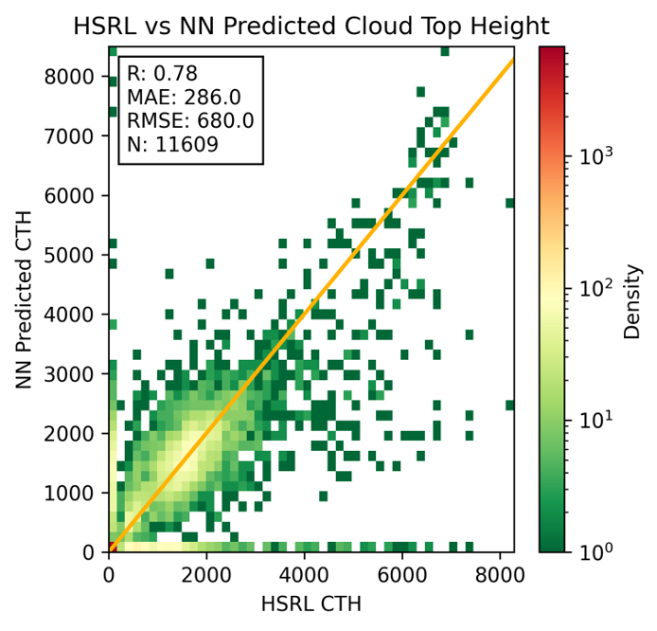
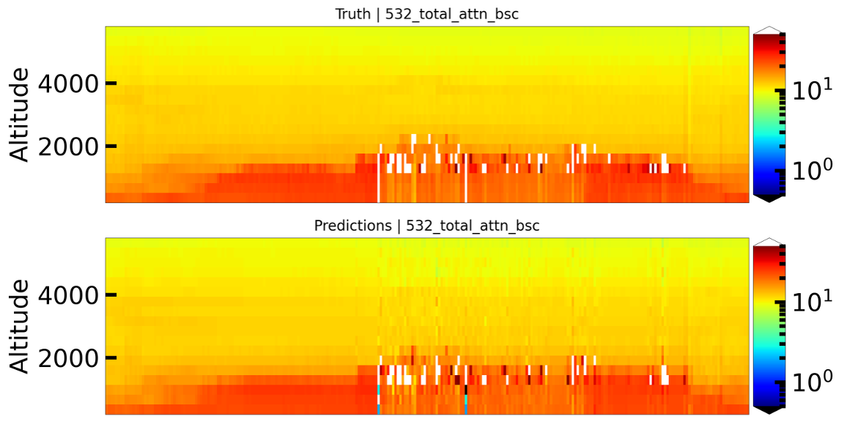
Intro
Aerosol
Cloud
Model-Obs.
Pair Obs.
ML/AI
Q&A
Lidar-seeded 4D polarimetry
ACTIVATE 2/1/2021. Top: HSRL profile (top).
Bottom: The lidar-seeded NN retrieves HSRL-like profiles from the Research Scanning Polarimeter (Jones, Stamnes, Lu, et al., in prep.)
Entire ACTIVATE field campaign.
The lidar-seeded NN retrieves cloud mask and cloud top height from the Research Scanning Polarimeter (Lai, Stamnes, Lu, et al., in prep.)

Slide 35
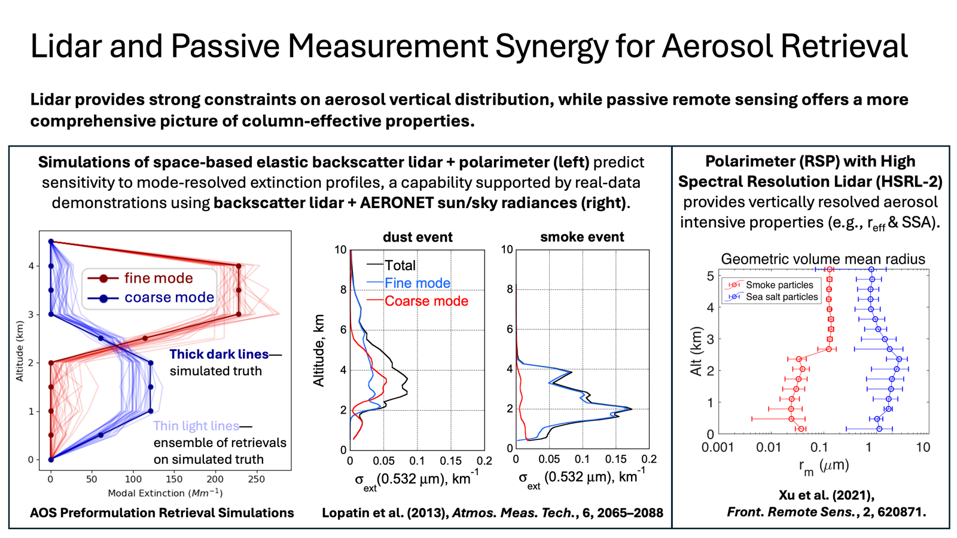
Courtesy: Reed Espinosa
Intro
Aerosol
Cloud
Model-Obs.
Pair Obs.
ML/AI
Q&A

Slide 36
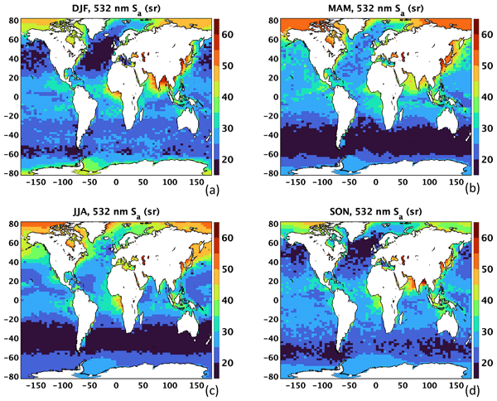
Intro
Aerosol
Cloud
Model-Obs.
Pair Obs.
ML/AI
Q&A
Constraining Aerosol Lidar Ratio using MODIS and Model Constraints
Main point: A measurement–model synergy approach significantly improves global marine aerosol characterization by producing more realistic, regionally varying lidar ratios for CALIPSO.
Role of MODIS: Provides observed aerosol optical depth (AOD), which is used to constrain (anchor) the lidar ratio retrievals where satellite observations are available.
Role of GOCART: Supplies global, continuous estimates of aerosol composition (e.g., sea salt fraction) to extend and generalize the retrievals where MODIS data are sparse or missing.
Big-picture outcome: Combining MODIS observations with GOCART simulations captures coastal pollution–marine mixing and regional variability, yielding more accurate aerosol properties for climate and remote sensing applications.
Toth, T. D., Clayton, M. B., Li, Z., Painemal, D., Rodier, S. D., Kar, J., Thorsen, T. J., Ferrare, R. A., Vaughan, M. A., Tackett, J. L., Bian, H., Chin, M., Garnier, A. E., Welton, E. J., Ryan, R. A., Trepte, C. R., and Winker, D. M.: Mapping 532 nm lidar ratios for CALIPSO-classified marine aerosols using MODIS AOD constrained retrievals and GOCART model simulations, Atmos. Meas. Tech., 18, 6765–6793, https://doi.org/10.5194/amt-18-6765-2025, 2025.

Slide 37
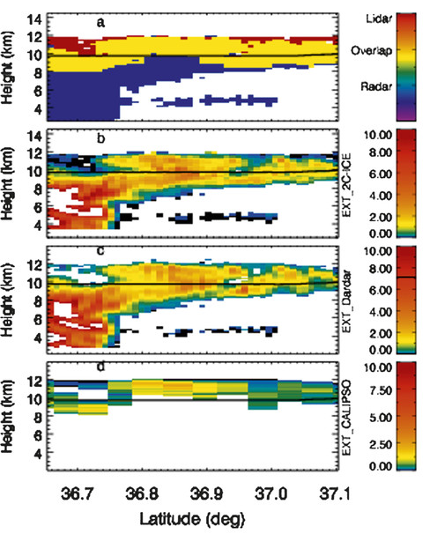
Intro
Aerosol
Cloud
Model-Obs.
Pair Obs.
ML/AI
Q&A
Radar/Lidar synergy for ice clouds
Complementarity:
Lidar and Radar are sensitive to different parts of the cloud volume
Synergy:
Radar ~ D⁶
Lidar ~ D²
Intelligent use of a-priori constraint allows combination of synergy and complementarity.
Deng, M., G. G. Mace, Z. Wang, and R. P. Lawson, 2013: Evaluation of Several A-Train Ice Cloud Retrieval Products with In Situ Measurements Collected during the SPARTICUS Campaign. J. Appl. Meteor. Climatol., 52, 1014–1030, https://doi.org/10.1175/JAMC-D-12-054.1.

Slide 38
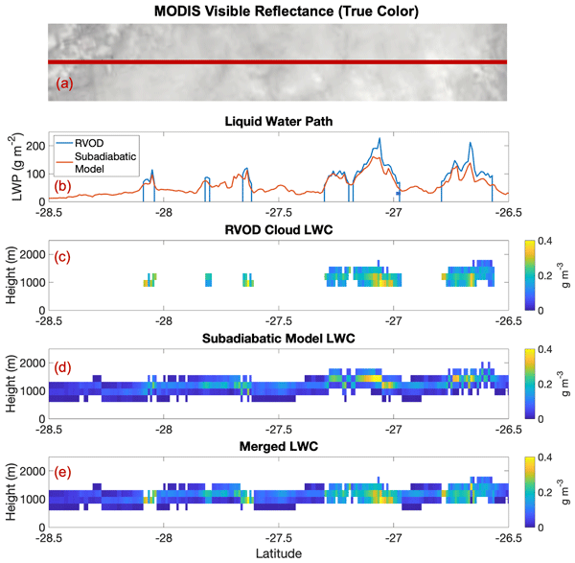
Intro
Aerosol
Cloud
Model-Obs.
Pair Obs.
ML/AI
Q&A
CloudSat/A-train liquid water synergy
-Combine CloudSat/CALIPSO/MODIS to derive continuous liquid cloud profiles even where radar does not detect them.
-Train a ML algorithm to extend method to night (w/o MODIS)
-Depends critically on a-priori knowledge of cloud vertical structure (adiabatic profiles)
Schulte, R. M., Lebsock, M. D., and Haynes, J. M.: What CloudSat cannot see: liquid water content profiles inferred from MODIS and CALIOP observations, Atmos. Meas. Tech., 16, 3531–3546, https://doi.org/10.5194/amt-16-3531-2023, 2023.
Schulte, R. M., Lebsock, M. D., Haynes, J. M., and Hu, Y.: A random forest algorithm for the prediction of cloud liquid water content from combined CloudSat–CALIPSO observations, Atmos. Meas. Tech., 17, 3583–3596, https://doi.org/10.5194/amt-17-3583-2024, 2024.

Slide 39
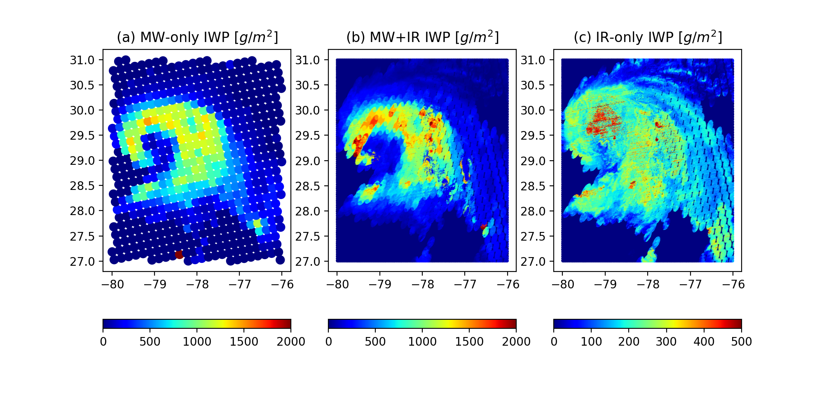
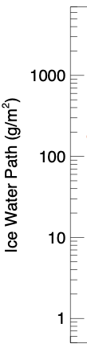
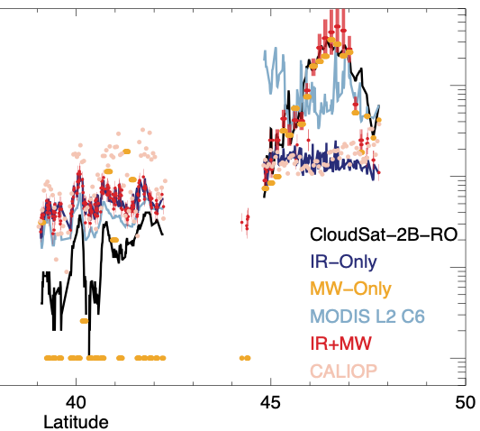
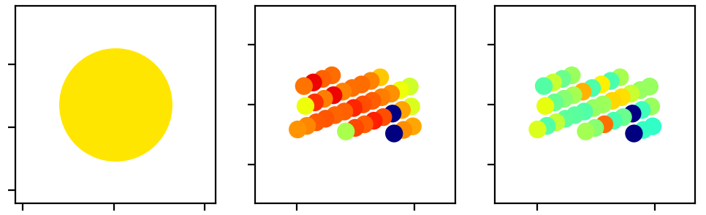
Courtesy: Jie Gong
Intro
Aerosol
Cloud
Model-Obs.
Pair Obs.
ML/AI
Q&A
GEO-LEO passive Ice Water Path
This is a case demo using VIIRS (IR) + ATMS to retrieve the full-spectrum ice water path (IWP) at VIIRS footprint size (~ 2km). This physical algorithm assures radiance field conservation and correct uncertainty quantification. A ML-based speed-up is under development.
MW-only, low-res, missing thin clouds
IR+MW, high-res, seeing both cloud & precip
IR-only, high-res but only cloud top
Independent validation with collocated CloudSat/CALIPSO
(Wang et al., 2020)

Slide 40
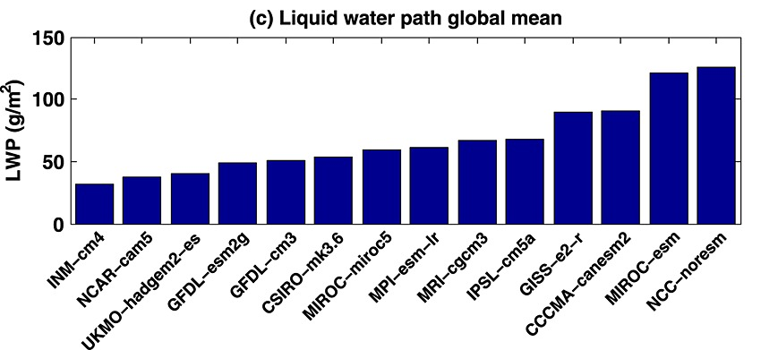
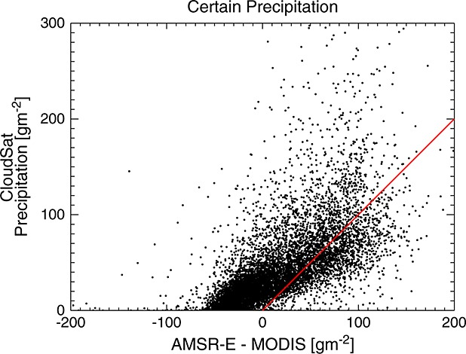
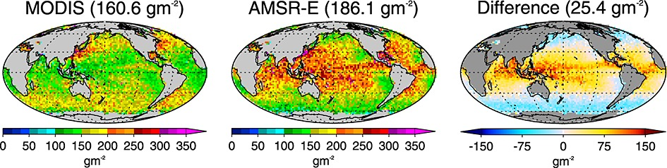
VISNIR + Microwave Synergy for Liquid Clouds
Liquid water path is not well constrained in models
VISNIR and Microwave disagree in magnitude and geographical distribution
Differences can be explained by influence of precipitation water path
  Passive + passive synergy possible for cloud+precipitation water path

Slide 41
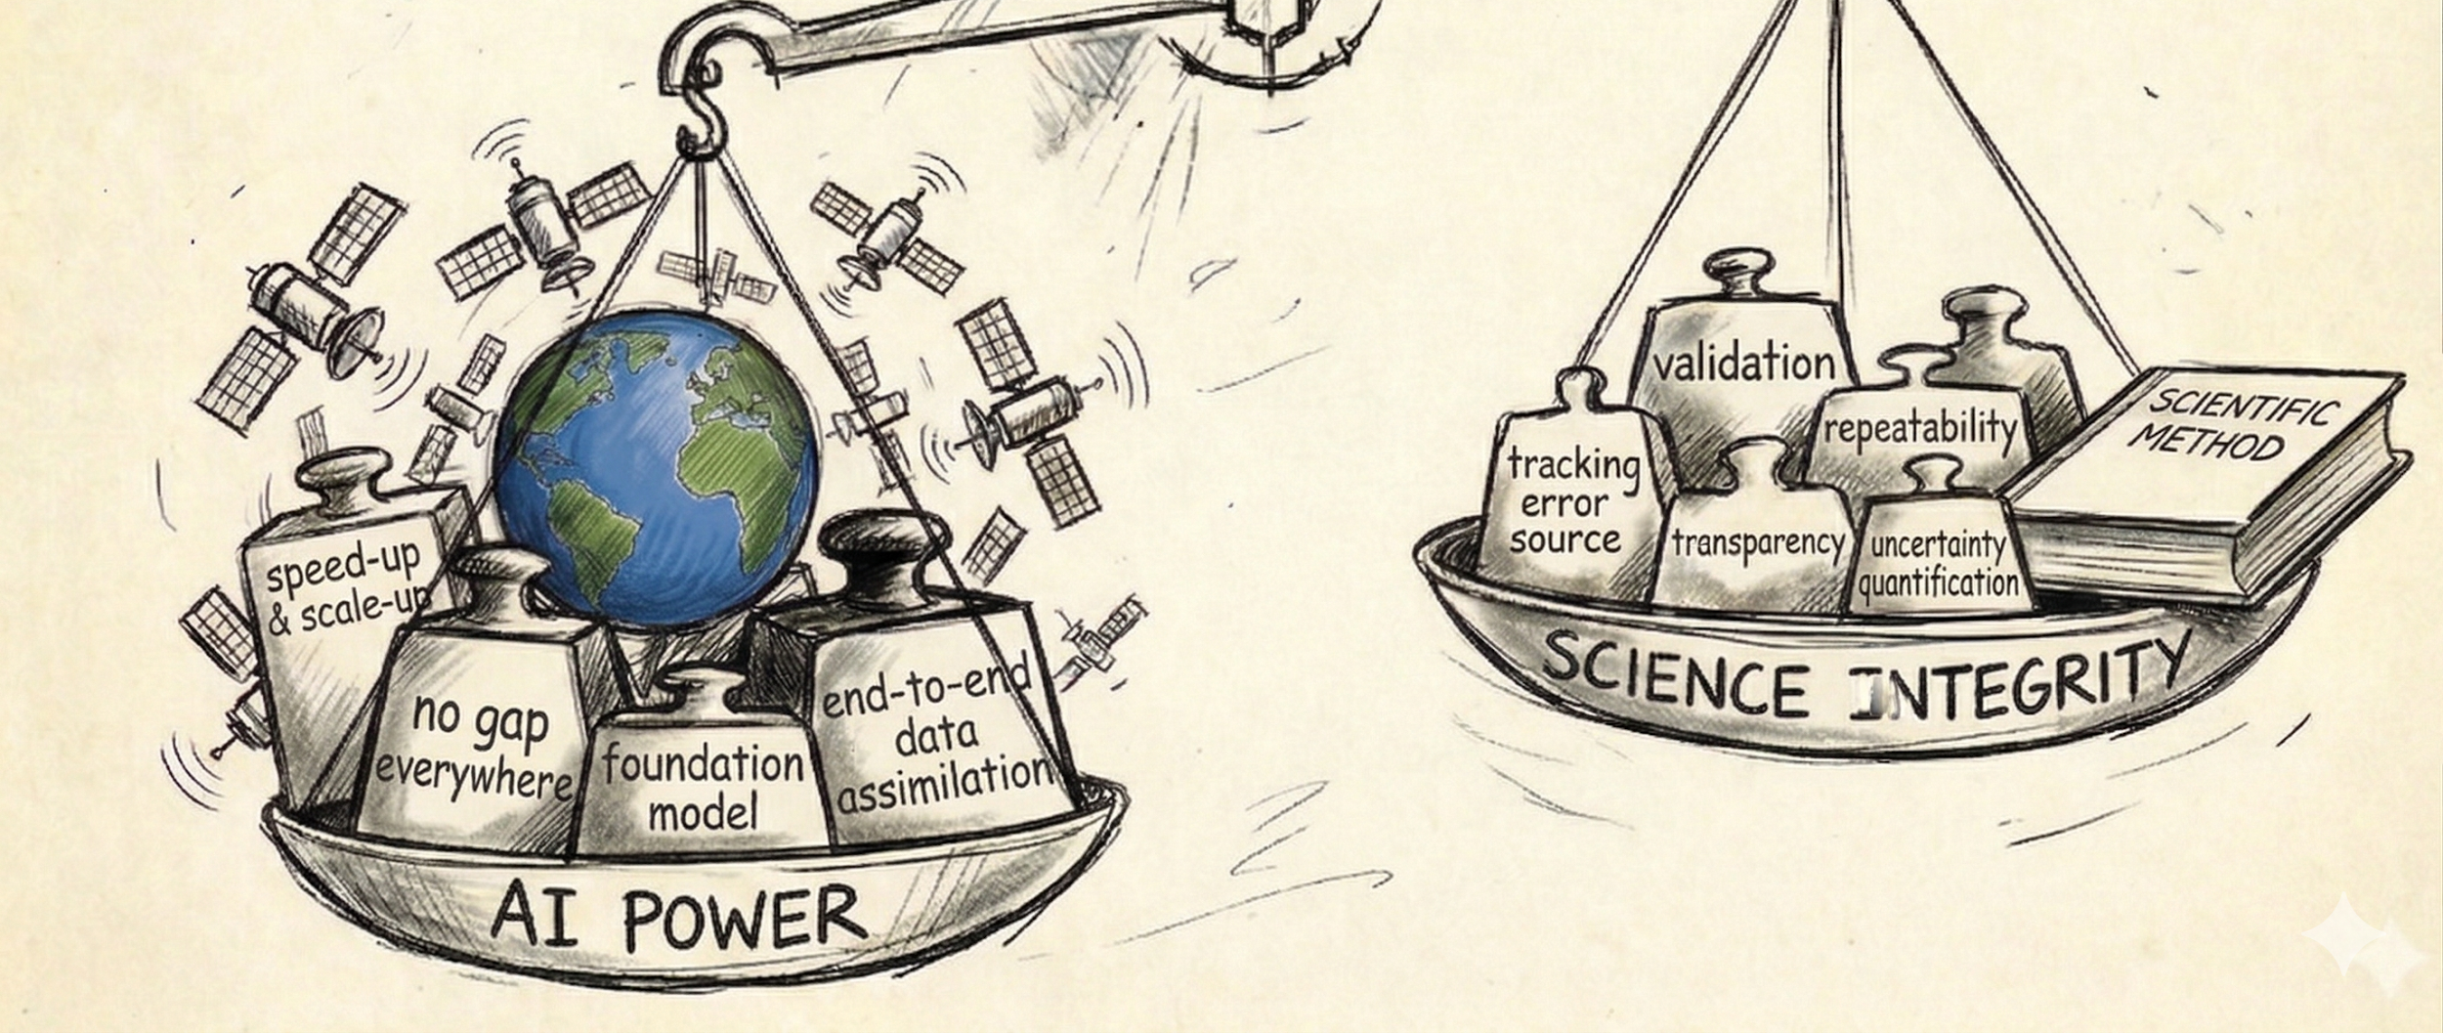
Unleashing the AI Power &
Maintaining Science Integrity in NASA “Atmo”sphere science and applications in the era of AI
Intro
Aerosol
Cloud
Model-Obs.
Pair Obs.
ML/AI
Q&A

Slide 42
ML has been appearing more and more often in geoscience and showing great power especially at combining multi-instrument observations in generating improved retrievals or new products
Intro
Aerosol
Cloud
Model-Obs.
Pair Obs.
ML/AI
Q&A

Slide 43

Example 1: single-instrument denoising to reveal faint signals
Intro
Aerosol
Cloud
Model-Obs.
Pair Obs.
ML/AI
Q&A
Noise suppression will make future space lidar missions more affordable
Preserves spatial resolution and better identifies aerosol/ cloud features
DDUnet on spaceborne CATS, ICESat-2, airborne CPL, Roscoe [Selmer er al., 2024, Yorks et al., in review] and spaceborne CALIOP, ATLID, airborne HALO [Lu X. et al., in prep] – CATS daytime Signal to Noise Ratio (SNR) increased by a factor of 2.5
UW SSEC lidar denoising – Employs state-of-the-art ML denoising methods validated on CALIOP, HSRL, WV DIAL, and easily adaptable to other atmospheric lidar instruments [Fliss, Marais, Nowak, Holz et al., in prep]
Entropy Quantum computing – [Huang and Hu, 2025] applied to CALIPSO; early-stage technology (TRL 4); much faster/ most appropriate for onboard real-time processing
Notes:
https://arxiv.org/abs/2502.08591

Slide 44


Example 2: GEO-FM: Combing Geostationary and Ground network obs. for observation-driven nearcasting
Intro
Aerosol
Cloud
Model-Obs.
Pair Obs.
ML/AI
Q&A
(Stormscope, NVIDIA, 2026, arxiv)

Slide 45


Example 3: From one-curtain of “truth” to everywhere on the globe
(GEO/passive 3D cloud reconstruction trained on collocated LEO/active)
Intro
Aerosol
Cloud
Model-Obs.
Pair Obs.
ML/AI
Q&A
Merged GEOS-IR trained on CloudSat+CALIPSO for 3D cloud ice
GOES-ABI trained on CloudSat+CALIPSO for 3D cloud mask
(Amell et al., 2024, ACP)
(Wang et al., 2023, TGRS)

Slide 46


Example 4: AI-speed up for GEO-GEO AMV retrieval enabling NRT retrieval/application
Intro
Aerosol
Cloud
Model-Obs.
Pair Obs.
ML/AI
Q&A
90 million wind vectors every 10 mins
Trained on nature run and validated against Carr et al. (2020) physical retrievals
(Credit: Thomas Vadal, Jim Carr, Dong L. Wu)

Slide 47

Example 5: Feature tracking
Intro
Aerosol
Cloud
Model-Obs.
Pair Obs.
ML/AI
Q&A
Smoke plume auto-identification from SEVIRI
(Meta SAM3 model; credit: Esmaeel Adrah)

Slide 48
What is the unique value about NASA Earth science data?
Intro
Aerosol
Cloud
Model-Obs.
Pair Obs.
ML/AI
Q&A
Rank | Keyword
1 | Free and Open Access
2 | Data Continuity
3 | Interoperability
4 | Societal Benefit
5 | Calibration/Validation
6 | Global Perspective
Trustworthiness
(Google Gemini response)

Slide 49

Intro
Aerosol
Cloud
Model-Obs.
Pair Obs.
ML/AI
Q&A
Accuracy and Reliability are both required for science rigor.
In multi-instrument combination or observation-model integration using AI, single instrument contribution and uncertainty quantification/propagation often lose track. ”No gap” looks nice but is dangerous without knowing where the information comes & how large the uncertainty is.
A possible framework: train to predict both target value and error distribution
Ice water path retrieval from NPP-ATMS trained on CloudSat/CALIPSO
(Credit: Leah Ding)

Slide 50

Real long-term trend vs. instrument artifact?
Intro
Aerosol
Cloud
Model-Obs.
Pair Obs.
ML/AI
Q&A
Long-term trend is critical for applications as well (e.g., insurance company in assessing customer premium cost; local government in building resilience in infrastructure planning).
How to make sure AI-based retrieval maintain the PoR required standard to detect real long-term trend?
Source: https://terra.nasa.gov/news/sensor-degradation-leads-to-calibration-improvements

Slide 51




Digital twin is a fancy buzz word. But does it learn real atmosphere physics?
Intro
Aerosol
Cloud
Model-Obs.
Pair Obs.
ML/AI
Q&A

Slide 52
Guard railing AI to Enhance its Usage
Intro
Aerosol
Cloud
Model-Obs.
Pair Obs.
ML/AI
Q&A
Frontier AI developers are driven by profit. Science field is not and should never be. We have different priorities with Tycoon companies.
NASA builds its community trustworthiness on its high standard on technology and science rigor from its birth. It’s easy to destroy the reputation by abusing AI, especially for operational products.
We can embrace and harness the AI power only by championing transparency, interoperability and repeatability.
What do you think about building AI protocols into mission development pipeline to monitor and ensure AI integrity for high-quality retrieval products and rigorous science?

Slide 53
Conclusion
Intro
Aerosol
Cloud
Model-Obs.
Pair Obs.
ML/AI
Q&A
Total aerosol radiative forcing & Cloud radiative feedbacks – uncertainties remaining
Large cloud radiative feedback uncertainties due to: short term ≠ long term; fast response ≠ slow response; global models ≠ observations
Many more science questions related to aerosol/cloud
We’ve compiled your questions/ comments, add some more!
The orbital PoR is an essential science and mission enabling capability; fully leveraging will require strategic thought (and perhaps investment).
Suborbital is key component of the Integrated Observing System: enabling process understanding, constraining model inputs, advancing satellite algorithms.
Need to develop flexible, comparatively-inexpensive, and quantitative frameworks to demonstrate what observations constrain ESM physics/processes.
Let’s continue to unleash the power of AI while maintaining science integrity
Break out sessions on friday 8:30-10:00 and 10:30-12:00:
. 30’ Three stage-setting talks on PoR orbital, PoR suborbital and modeling
. 60’ + 90’ Freestyle

Slide 54
Discussion
Intro
Aerosol
Cloud
Model-Obs.
Pair Obs.
ML/AI
Q&A
Suggestions to get us started…
Why are we asking the same questions over and over again? Has progress been too slow? Why?
How to best use model-observation synergies to maximize our impact and strategically target future aerosol/cloud efforts?
How to use orbital/suborbital observations to reduce the range of observation-based ERFaci estimates?
What cloud & radiation observations/products do we need to credibly quantify cloud feedback?
How to use cloud observations to improve clouds in global models, from diagnosing performance to development of physical schemes?
How can we best leverage the known orbital PoR, and what are the remaining needs?
What opportunities does the NASA Atmosphere Focus Area realignment bring with regard to interdisciplinary suborbital field campaigns?
How do we best report uncertainties in observational products? (important for observations-model synergy)
How do we develop flexible quantitative frameworks demonstrating value of proposed obs in constraining physics across all models?
How do we improve model representation of aerosol-cloud interactions beyond low stratiform clouds (ice clouds, convection, for example)?
How do you validate your modeled low stratiform cloud ACI when OBS only give you near cloud-top info?
What do you think about building AI protocols into mission development pipeline to monitor and ensure AI integrity for high-quality retrieval products, model integration and rigorous science?

