Slide 1

ESSRP
Overview
HQ Atmosphere
Atmosphere Website

Slide 2


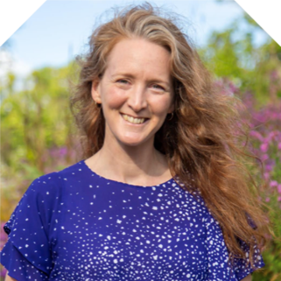



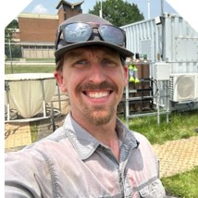
Atmosphere
Ken Jucks
Upper Atmosphere
Emma Knowland
Tropospheric Composition
Will McCarty
Atmospheric Physics
Ed Nowottnick
Radiation Sciences
Justin Stachnik
Atmospheric Physics (Assoc.)
John Sullivan
Atmospheric Composition
2026 ATMOSPHERE INVESTIGAOR MEETING
Atmosphere
Website

Slide 3
Theme Leads
Clouds/Aerosols:
  Meloë Kacenelenbogen (meloe.s.kacenelenbogen@nasa.gov)
  Matt Lebsock (matthew.d.lebsock@jpl.nasa.gov)
  Kerry Meyer (kerry.meyer@nasa.gov)
Atmospheric Dynamics/Thermodynamics:
  Amin Nehrir (amin.r.nehrir@nasa.gov)
  Derek Posselt (derek.posselt@jpl.nasa.gov)
  Patrick Duran (patrick.t.duran@nasa.gov)
Tropospheric Composition:
  Glenn Wolfe (glenn.m.wolfe@nasa.gov)
  Katie Travis (katherine.travis@nasa.gov)
  Matt Johnson (matthew.s.johnson@nasa.gov)

Slide 4
Theme Leads
Stratospheric Composition
  Qing Liang (qing.liang@nasa.gov)
  Rei Ueyama (rei.ueyama@nasa.gov)
  Pam Wales (pamela.a.wales@nasa.gov)
GHG Implications for the Atmosphere
  Sean Crowell (sean.crowell@rochester.edu)
  Junjie Liu (junjie.liu@jpl.nasa.gov)
  Josh Laughner (josh.laughner@jpl.nasa.gov)
Radiative Balance of the Earth System
  Patrick Taylor (patrick.c.taylor@nasa.gov)
  Yolanda Shea (yolanda.shea@nasa.gov)
  Maria Hakuba (maria.z.hakuba@jpl.nasa.gov)

Slide 5
Plenary Themes
Each theme will get 90 minutes to brief the community on their theme
There will be room for thematic information prepared from community input before the meeting, followed by discussions and questions on the topics
Goal: Start the discussion on “what is seen as the most pressing science issues for the NASA Atmosphere to address over the next decade(s)”
Goal: Entice you to go to their specific breakout room on Friday where the conversation will continue (room details on last slide)

Slide 6
Plenary Themes
We are particularly interested in:
  Questions requiring long-term observations vs. process studies (or somewhere in between)
  Linking process studies needed to inform modeling capabilities and satellite retrievals
  Multiple strategies for answering driving science issues (not single point solutions/architectures)
  Cross-Sphere and Intra-Sphere cross cutting questions
  Take advantage of existing white papers relevant to your “area”
Near Term Deliverable: Synthesis report will be presented Friday afternoon will follow on discussions.
Final Deliverable: written synthesis of this meeting, for reference by us, you, and others…

Slide 7
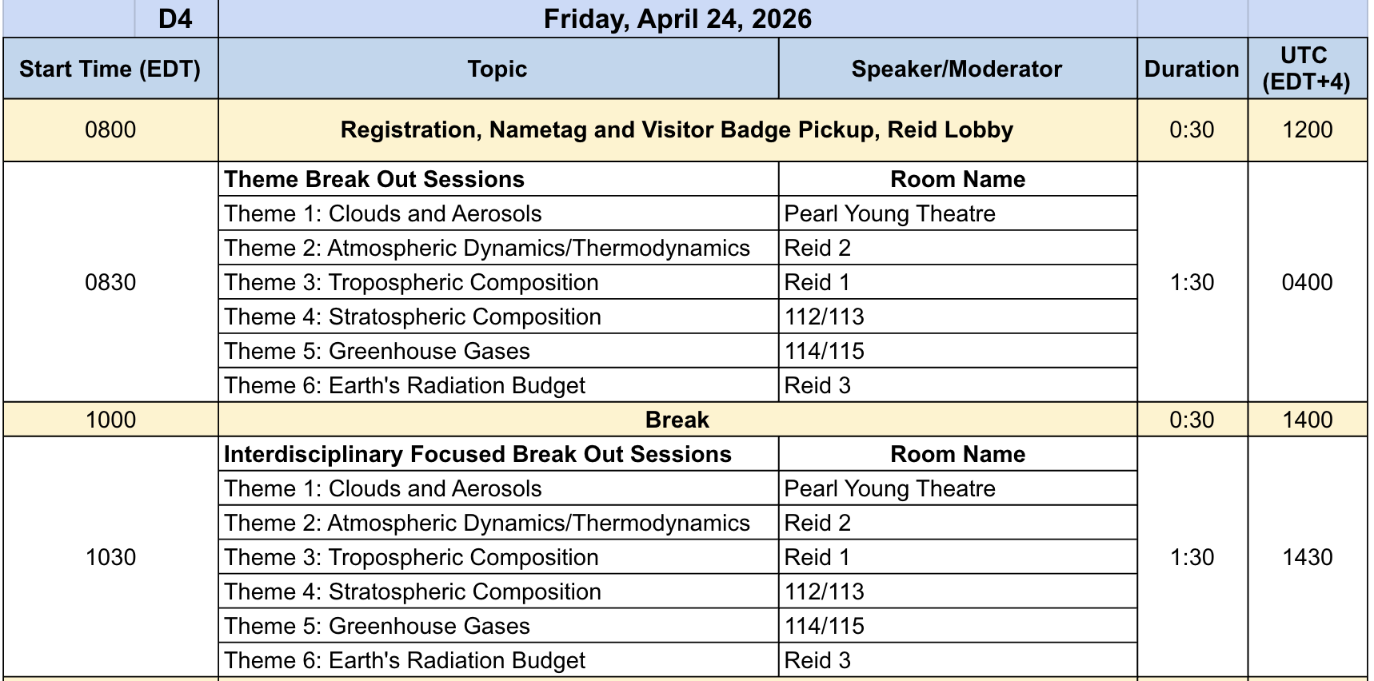
Breakouts on Friday*

