Slide 1
NASA COMMERCIAL SATELLITE DATA ACQUISITION(CSDA) PROGRAM
NASA CSDA Program Update- 2026
Melissa Martin​, CSDA Program Manager​
Earth Science Division​, NASA Headquarters
Dana Ostrenga, CSDA Project Manager
Earth Science Division, Goddard Space Flight Center

Slide 2
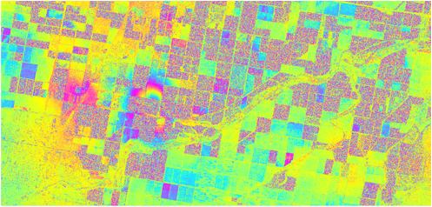
NASA COMMERCIAL SATELLITE DATA ACQUISITION(CSDA)PROGRAM
Why does NASA buy commercial data?
NASA’s fleet delivers global, first-of-its kind observations with open, validated data
that forms the backbone of Earth-system science and applications.
NASA CSDA PROGRAM
Commercial data enhances our science and applications and makes unique contributions to our mission by offering:​
Higher resolution & more frequent observations​
Taskable observations​
Flexible, real-time, niche data services​
Cost-effective options for users
22-day image pair in Sothern California showing ​agricultural fields and a geothermal plant. Includes copyrighted material of Airbus U.S copyright 2020-2021, all rights reserved.

Slide 3



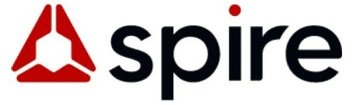











NASA CSDA Vendors
CH₄ Emissions
GNSS –R & RO
Multispectral
Synthetic Aperture Radar
Precipitation Radar
DEMs
Hyperspectral

Slide 4
Current Active Task Orders (as of April 20, 2026)
Vendor |  | Type of Data | Period of Performance
Airbus |  | Data for evaluation (Pléiades Neo, Pléiades, and SPOT 6/7, WorldDEM) InSAR SAR Mulitspectal | 08/04/2025 – 04/07/2026 07/28/2025 – 07/27/2027 09/25/2025 – 09/24/2026 11/26/2025 – 11/24/2026
Capella |  | SAR | 09/26/2025 – 09/25/2026
Vantor |  | Data for evaluation (DSM, DTM) Multispectral | 09/29/2024 – 12/31/2025 11/25/2025 – 11/24/2026
Pixxel |  | Data for evaluation (Hyperspectral - L1C and L2A) | 09/27/2024 – 11/26/2025 (extended)
Planet Labs |  | Multispectral | 11/25/2024 – 11/24/2025 New contract: 11/25/2025 – 11/24/2025 (Allocated access)
PlanetiQ |  | Neutral Atmosphere Radio Occultation products, Ionosphere Total Electron Content (TEC) | In collaboration with NOAA Radio Occultation Delivery Order 5
NASA CSDA PROGRAM

Slide 5
Current Active Task Orders (as of April 20, 2026)
Vendor |  | Type of Data | Period of Performance
Satellogic |  | Data for evaluation (Electro-Optical - L1 Basic and L1 Orthorectified) | 09/27/2024 – 12/26/2025 (extended)
Spire Global |  | GNSS-RO | In collaboration with NOAA Radio Occultation Delivery Order 5
Tomorrow.io |  | Data for evaluation (Precipitation Radar - L1C-geoprof and L2A-PRECIP) | 09/27/2024 – 12/26/2025
Umbra |  | SAR | 09/26/2025 – 09/25/2026
GHGSat |  | Greenhouse Gas Emission Rate | 02/11/2025 – 02/10/2027
ICEYE |  | InSAR SAR | 07/29/2025 – 07/28/2027 09/26/2025 – 09/26/2026
MDA |  | SAR | 09/26/2025 – 09/26/2026
NASA CSDA PROGRAM

Slide 6
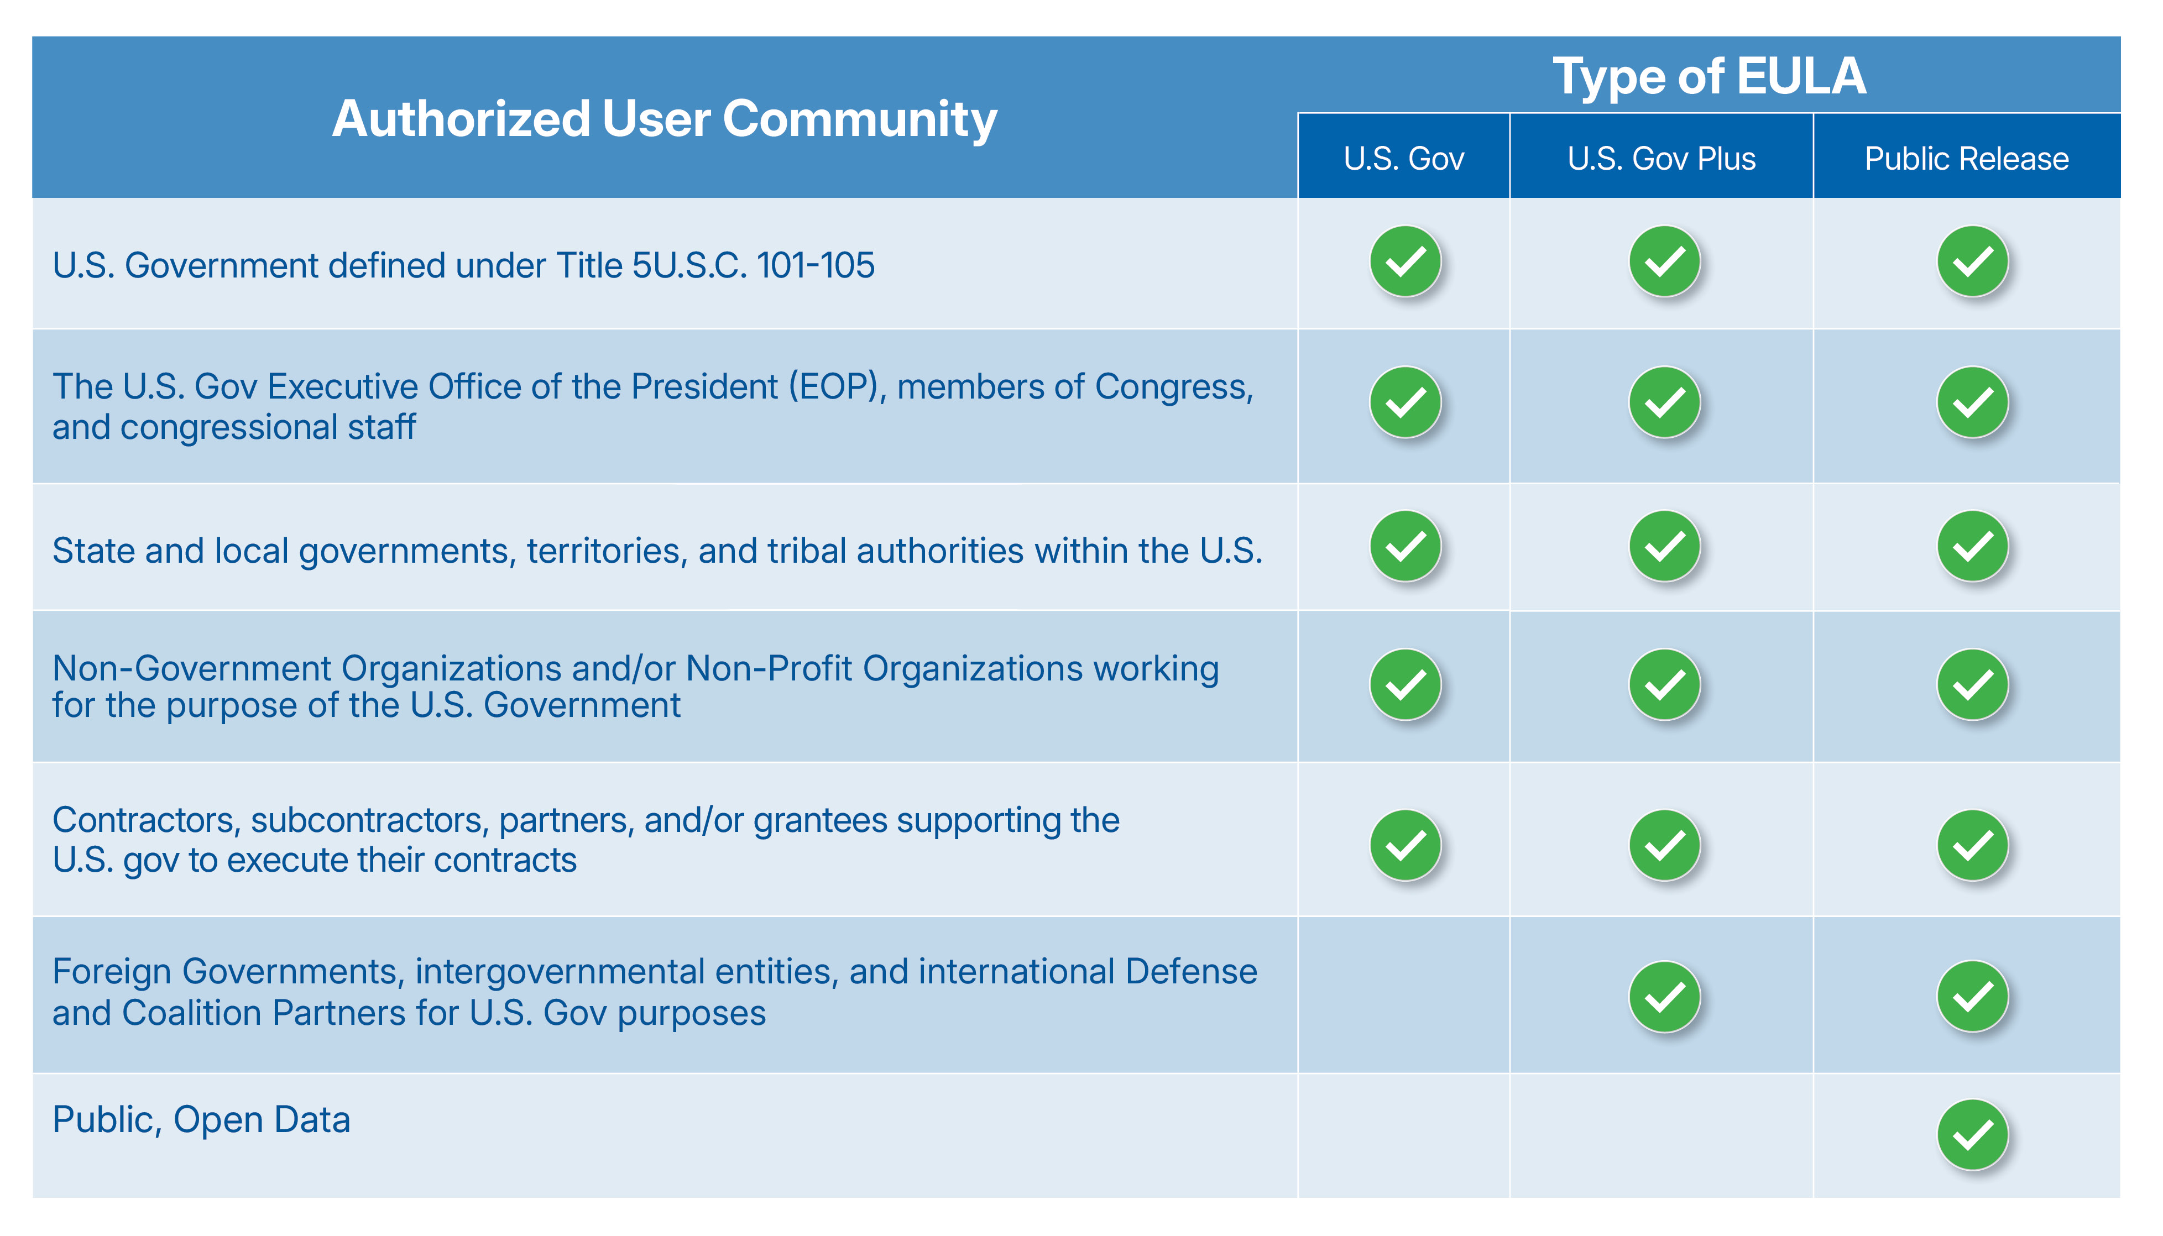
Three-Tiers of End User License Agreements (EULAs)
USG license is minimum level for CSDA
Scientific Non-Commercial Use License
Modeled after National Reconnaissance Office (NRO) Geospatial Intelligence Systems Acquisition Directorate Commercial Systems Program Office (CSPO) common, standardized family of EULAs.

Slide 7
Expanding the Use of Commercial Data at NASA
NASA will provide commercial data to agency partners under the agreed EULA by request. NASA will not prohibit agency usage of the data if it abides by the EULA requirements, as specified in Contract Attachment B. Use is not intended for the development of commercial products or services and does not include activities funded or sponsored by non-governmental organizations.
NASA CSDA PROGRAM

Slide 8


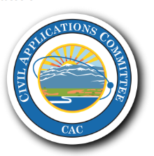



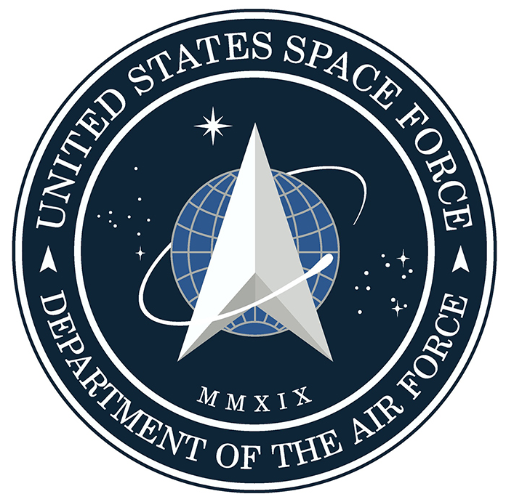

Partnerships
  Building new partnerships and improving data sharing possibilities
  Working closely with U.S. Government agencies to align and share data acquisitions, share evaluation processes, share data requirements and needs.
  Continuing our collaboration with international partners in developing guidelines, data evaluations, and programmatic and technological processes.
  Coordination of Commercial Data Purchase within the U.S. Government with other Federal Agencies
NASA CSDA PROGREAM

Slide 9

USGS Civil Applications Committee Source
CACSource@usgs.gov

Slide 10
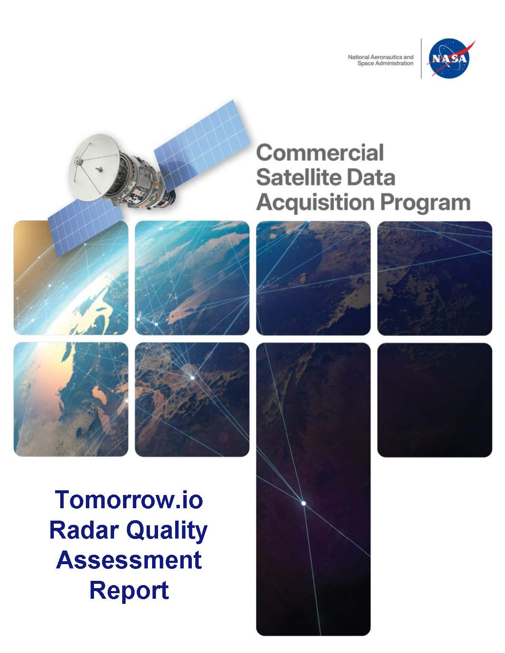
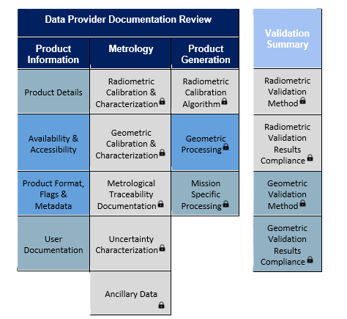
ESA-NASA Joint EO Mission Quality Assessment Framework - Data Evaluation Criteria
ESA and NASA developed the Joint EO Mission Quality Assessment Framework - To ensure that decisions on acquisition of commercial data can be made with confidence; the development of a set of guidelines to assess the data quality of these commercial sources
  Accessibility of vendor supplied imagery and data
    Ease and efficiency of search, discover, and download from vendor systems.
  Accuracy and completeness of metadata
    Accuracy and completeness of metadata provided by vendor.
  Quality of User Support Services
    Availability, responsiveness, and technical expertise required to answer PI inquiries.
  Usefulness of data for advancing Earth system science research and applications
    Ability of data to support Earth system science research and applications activities.
  Quality of vendor supplied imagery and/or data
    Data attributes such as geolocation accuracy, radiometric accuracy, and platform intercalibration. Data quality evaluation will use the ESA-NASA Evaluation Guidelines.

Slide 11
CSDA Data Evaluation Status (as of 4/9/2026)
Commercial Partner | Product | Status | Final Report for Public Release
Umbra | SAR | Ready for brief to NASA HQ | April 2026
Vantor (formerly Maxar) | Multispectral (Legion) DEM | CSDA leveraging evaluation done by ESA Final report in review | July 2026 April 2026
Satellogic | Multispectral | Final report in review | V1 released V2 TBD
Airbus | Multispectral (Legion) DEM/DTM/DSM | Coordinated joint evaluation with partner agencies All DSM received; waiting on remainder of data | TBD July 2026 TBD
Tomorrow.io | Precipitation radar | Final Report Delivered | Released

Slide 12
CSDA Data Evaluation Status (as of 4/9/2026)
Commercial Partner | Product | Status | Final Report for Public Release
Pixxel | Hyperspectral | Data evaluation deferred pending D2 satellite decommissioning and launch of the Firefly constellation (Jan 2025); Firefly is now operational and delivering data for NASA evaluation. | TBD
Wyvern | Hyperspectral (TOA only) | Participated in joint evaluation with NGA | Received NGA draft report Waiting on final report for public release
Polar Geospatial Center (PGC) | EarthDEM | Analysis in progress | April 2026
PlanetiQ | GNSS-RO | Preparing for NASA HQ briefing | May 2026

Slide 13
CSDA Calibration/Validation Support
CSDA supported calibration and validation activities for the commercial data providers:
Pilot: Calibration and Validation of Mid to Thermal Infrared Commercial Data
  The pilot will involve:
    CSDA providing TOA radiances, at the time of vendor satellite-system overpass, over the Lake Tahoe and Salton Sea automated validation sites, convolved to the vendor satellite-sensor system
    12 clear-sky validations will be performed per year, per vendor, for up to 2 years (total of 24 validations per vendor)
    Responsibilities of CSDA and Vendor:
  Commercial data provider: responsible for supplying the clear sky scenes and necessary system response functions for the mid and thermal infrared bands.
  CSDA CalVal team: responsible for supplying skin temperatures and atmospheric profiles at time of overpass, which will be made publicly available. The CSDA team will work with the vendor to perform the forward calculation to TOA radiance and convolution of radiances to vendor satellite-sensor system.
Release of ROSES2026 solicitation that supports the optimization of commercial data:
  Proposals will require researchers to collaborate with commercial data providers (on an unfunded basis) to advance the development and enhancement of the providers’ data products
Communication of all ground sensor network activities, field deployments and airborne field campaigns:
  In coordination with the NASA Earth Science Research Element, information on upcoming field campaigns will be shared with commercial data providers to ensure they are aware of opportunities to use the resulting open‑access data for calibration and validation activities.

Slide 14
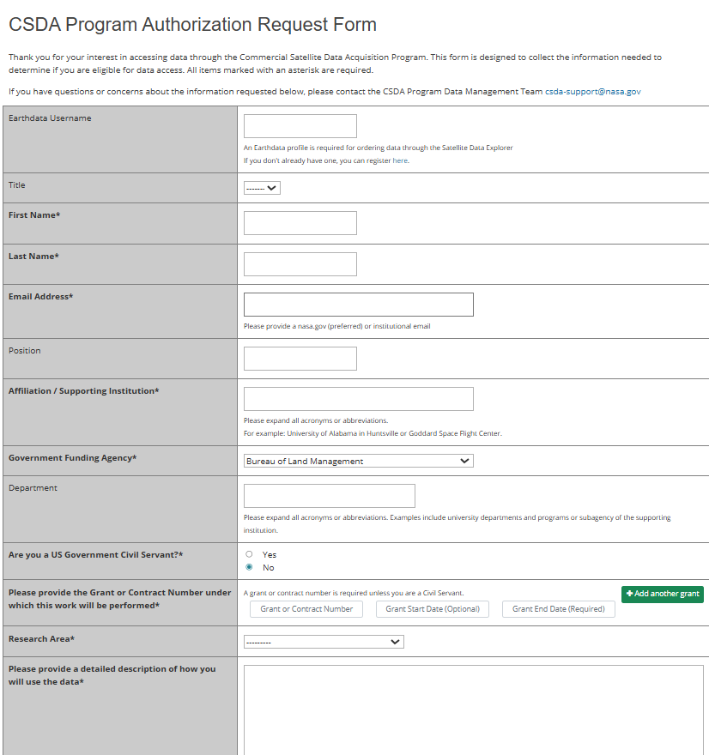
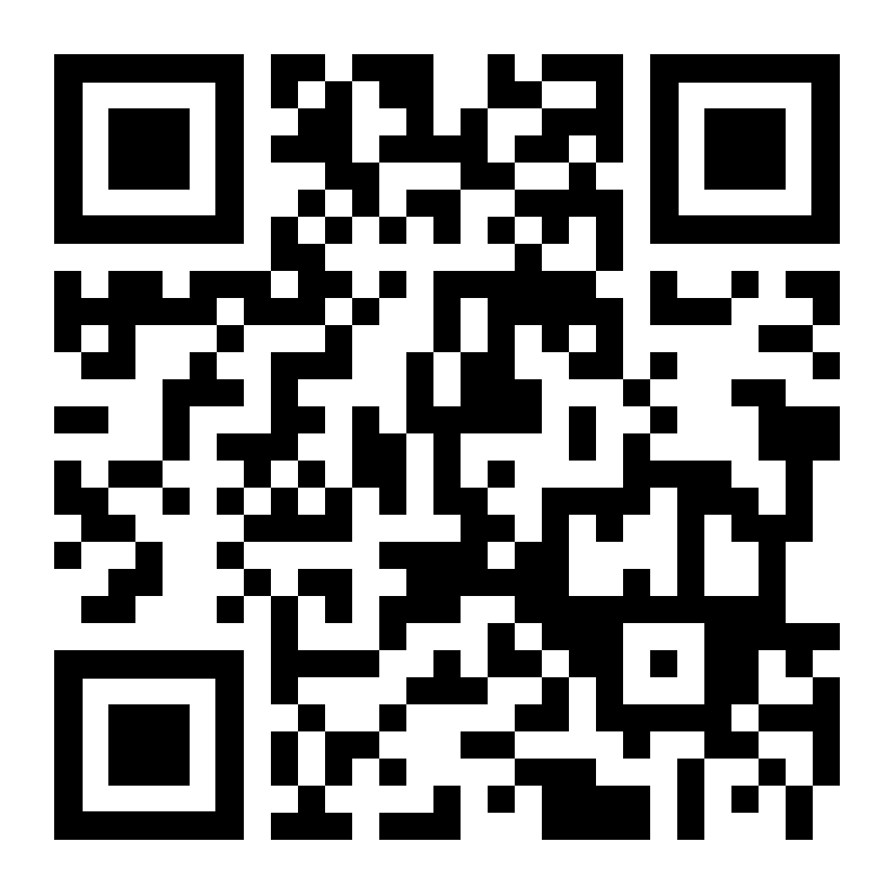
How to Request Access
All prospective users are subject to authorization prior to being provided access to data
A user must:
  Provide basic contact information (name, email, affiliation).
  Provide a high-level description of the science the data will support.
  Concur that you have read and agree to the provided vendor-specific EULAs.
NASA CSDA PROGRAM
Sign-Up Form (Scan Code)
Once approved, users will receive email notification with data access details
Notes:
https://csdap.earthdata.nasa.gov/signup

Slide 15
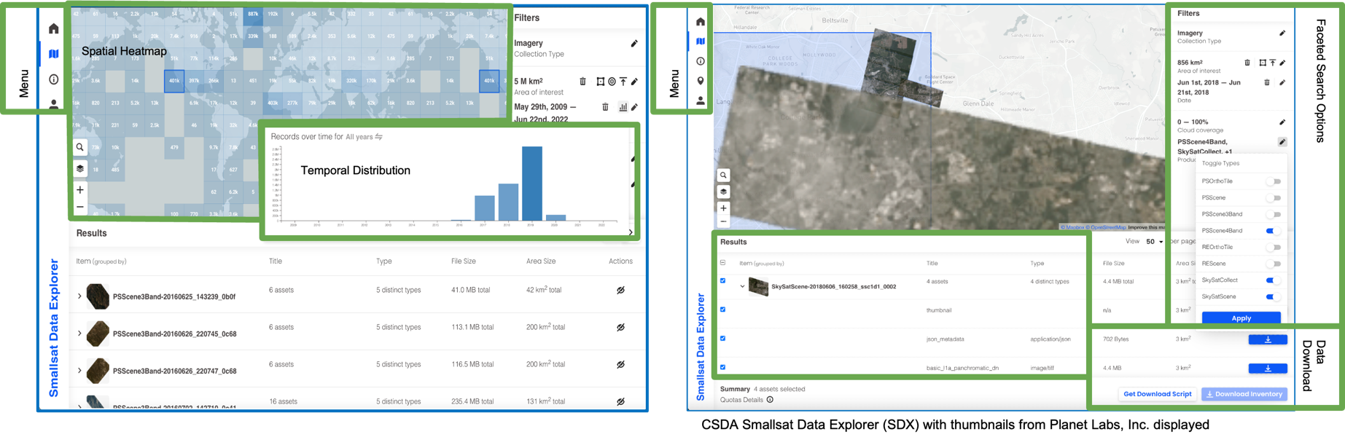
Data Access and Use
Access
If you qualify for data access under our EULA, you can get authorization through the CSDA website: https://csdap.earthdata.nasa.gov/signup
  Eligibility to download validated through USG grant license or NASA email – validation and additional download support by NASA CSDA MSFC team.
Limits on data use based on licenses
NASA CSDA PROGRAM
Satellite Data Explorer (SDX):
Web interface for central search, discovery, and distribution of CSDA data: https://science.nasa.gov/earth-science/csda/satellite-data-explorer/
CSDA Satellite Data Explorer with thumbnails of Planet Labs data displayed.

Slide 16
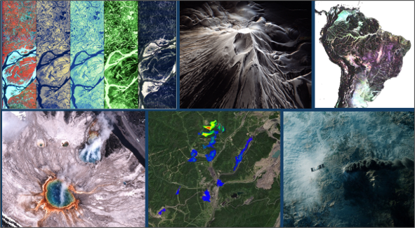
Community Engagement and Outreach
Monthly Webinar Series
Focus on Commercial Vendor Partner Capabilities
  Each month’s event focuses on a different current on-contract commercial vendor partner’s constellations and data products available through the CSDA program.
  Increase user awareness of available user services and support resources for working with NASA CSDA datasets, services, and tools.
Provide Commercial Data Use Cases:
  Highlight use cases that illustrate how commercial Earth observation data complements Earth observing data from NASA and its federal government partners for research and applications.
NASA CSDA PROGRAM
15 Webinars
25+ Countries
1,802 Participants
Vendor/ Partner​ | Month​
MDA Space​ | 29 April 2026​
GeoOptics​ | May 2026​
To be added to our webinar distribution list please contact:
Webinar POC: Jennifer Brennan, Host
Email: Jennifer.L.Brennan@nasa.gov

Slide 17
Questions for the community
Are you using commercial data?
Yes
What type of commercial data are you using?
What is your use case?
No
What is preventing you from using commercial data?
What commercial data do you need?
NASA CSDA PROGRAM

Slide 18

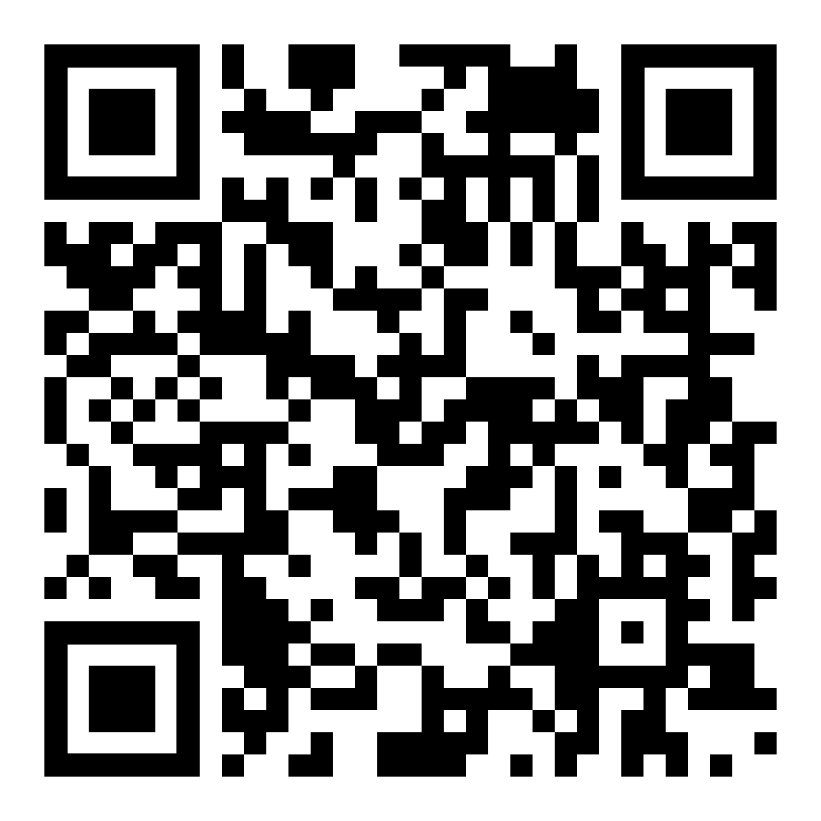
Learn more about CSDA
For information about NASA's CSDA program, its vendors, and available data resources:
NASA CSDA PROGRAM

