Slide 1
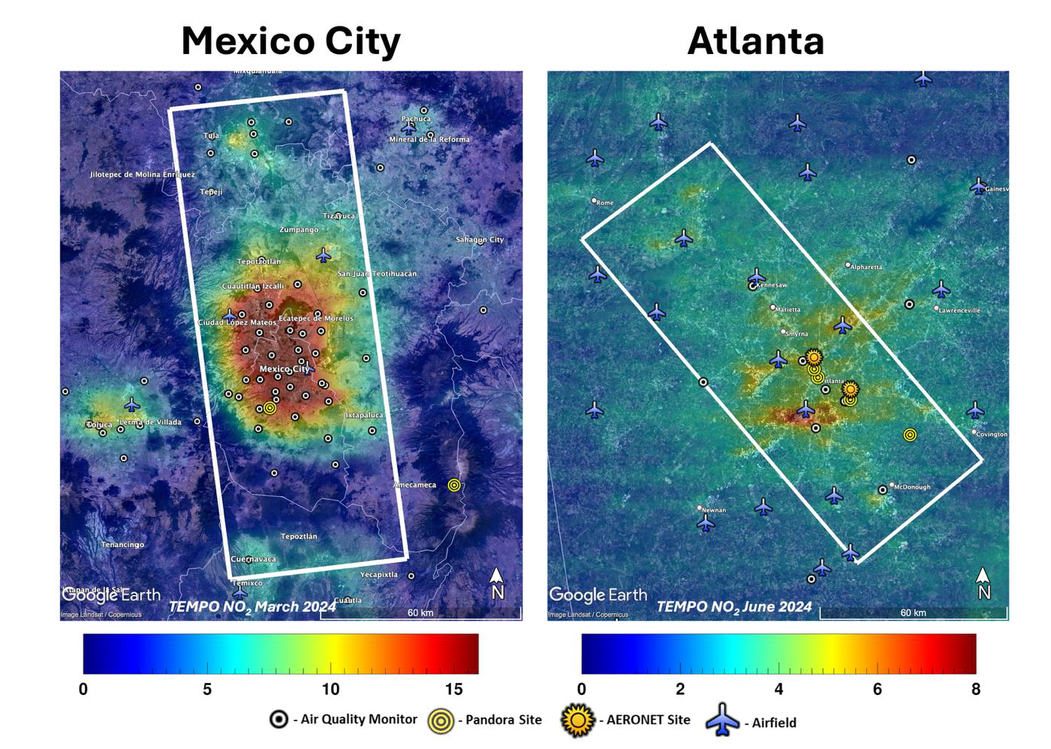
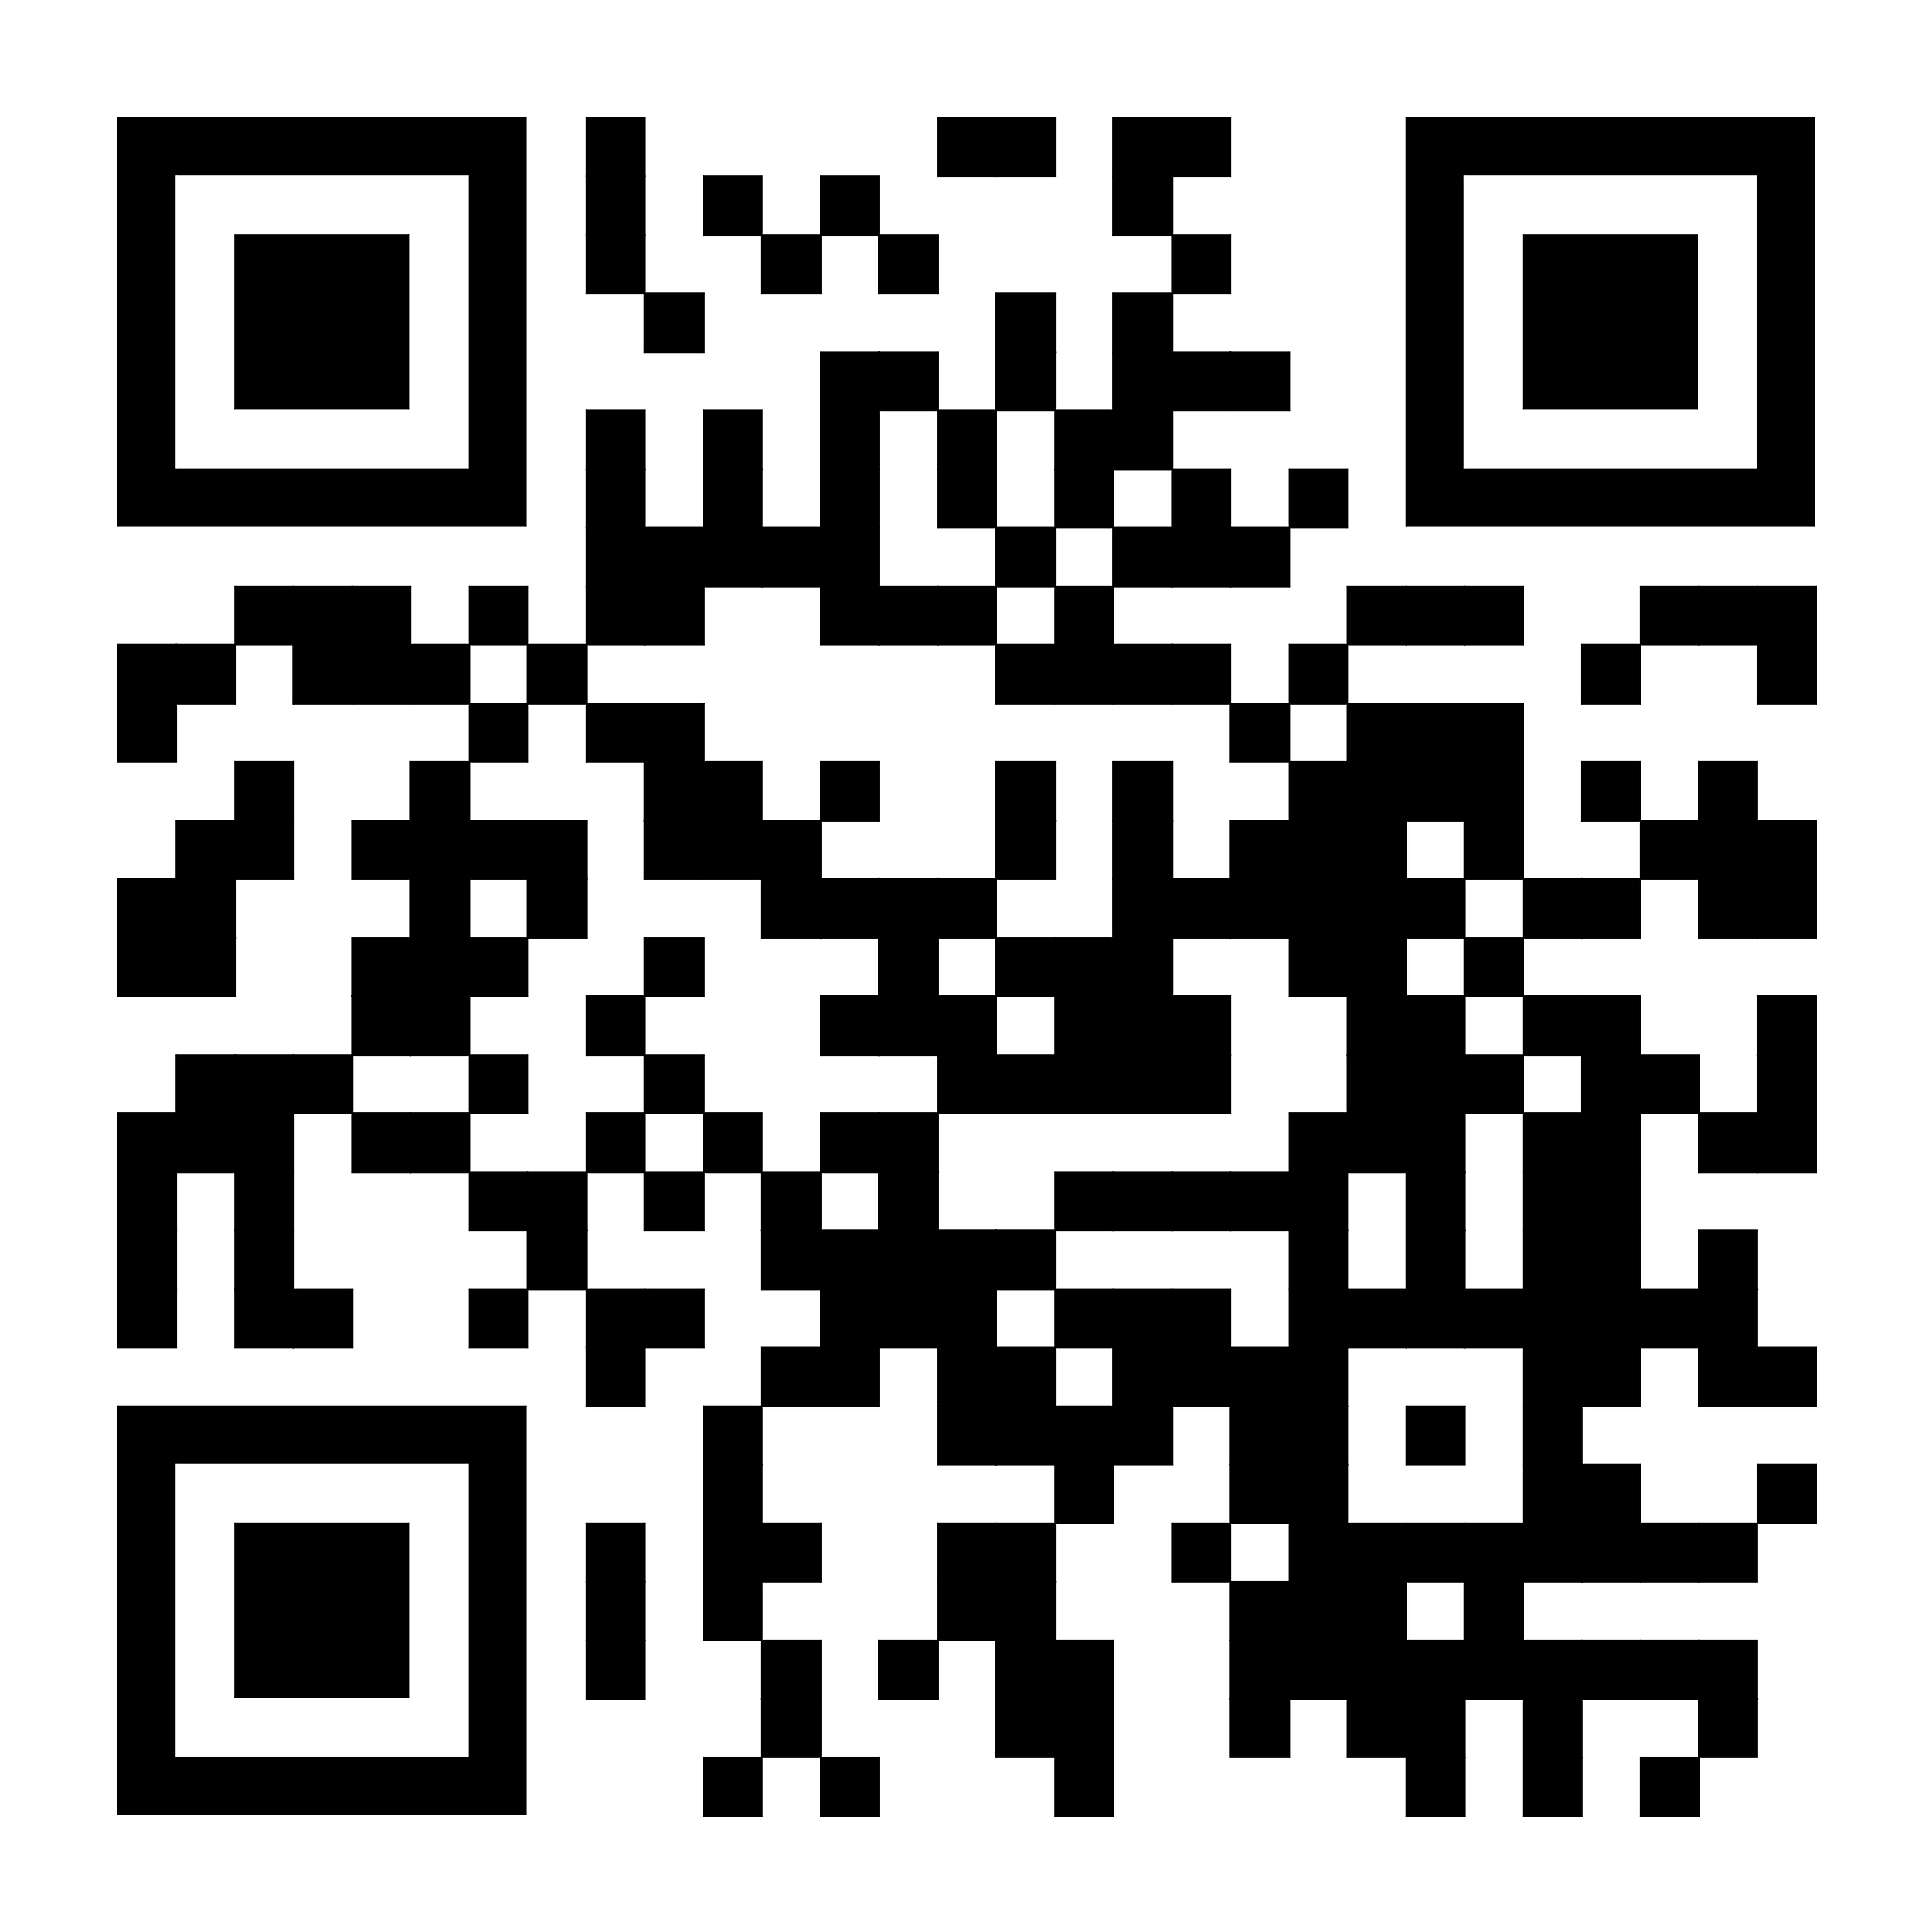
HAMAQ
Hemispheric Airborne Measurements of Air Quality
Solicitation released April 20th
NOI: May 20th
Due date: July 21st

