Slide 1
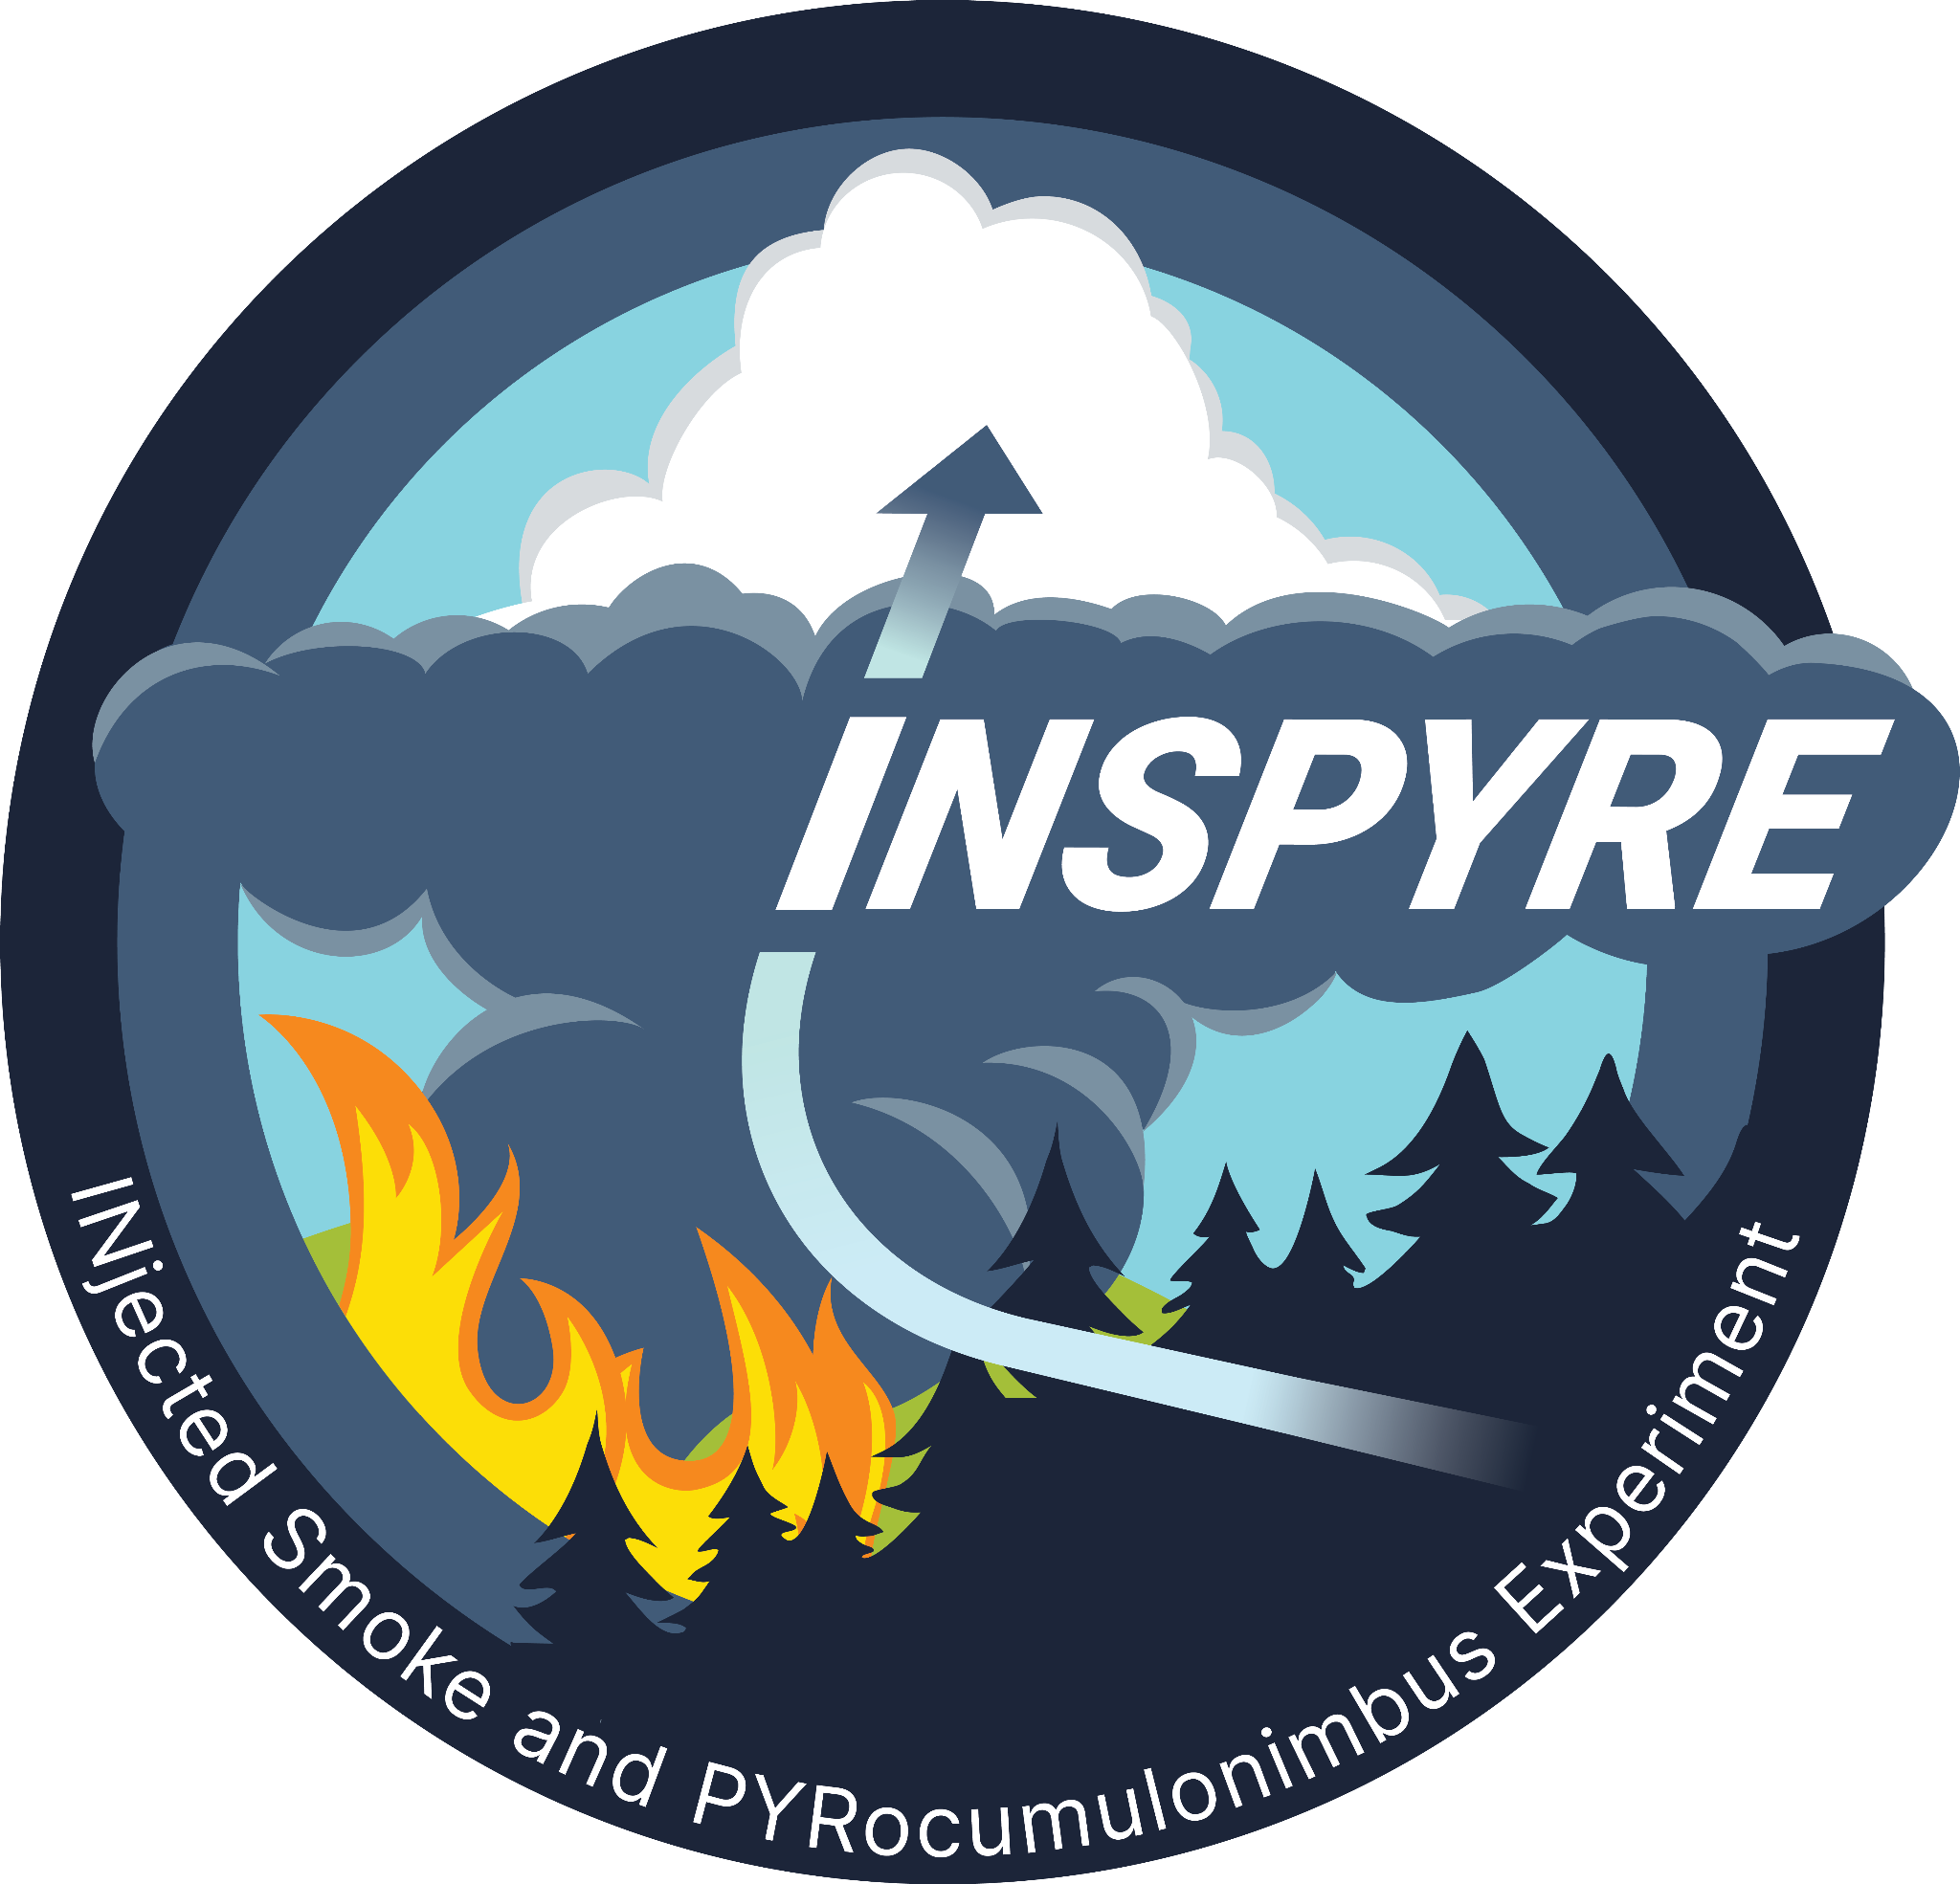




INSPYRE
INjected Smoke and PYRocumulonimbus Experiment
David Peterson Naval Research Laboratory - Monterey, CA
Neil Lareau University of Nevada, Reno
Olga Kalashnikova Jet Propulsion Lab/California Institute of Technology
Vidal Salazar Investigation Manager, NASA ARC
Logo Almost ready!!!!!
2026 Atmosphere Investigator Meeting
April 21, 2026
NASA Langley Research Center

Slide 2
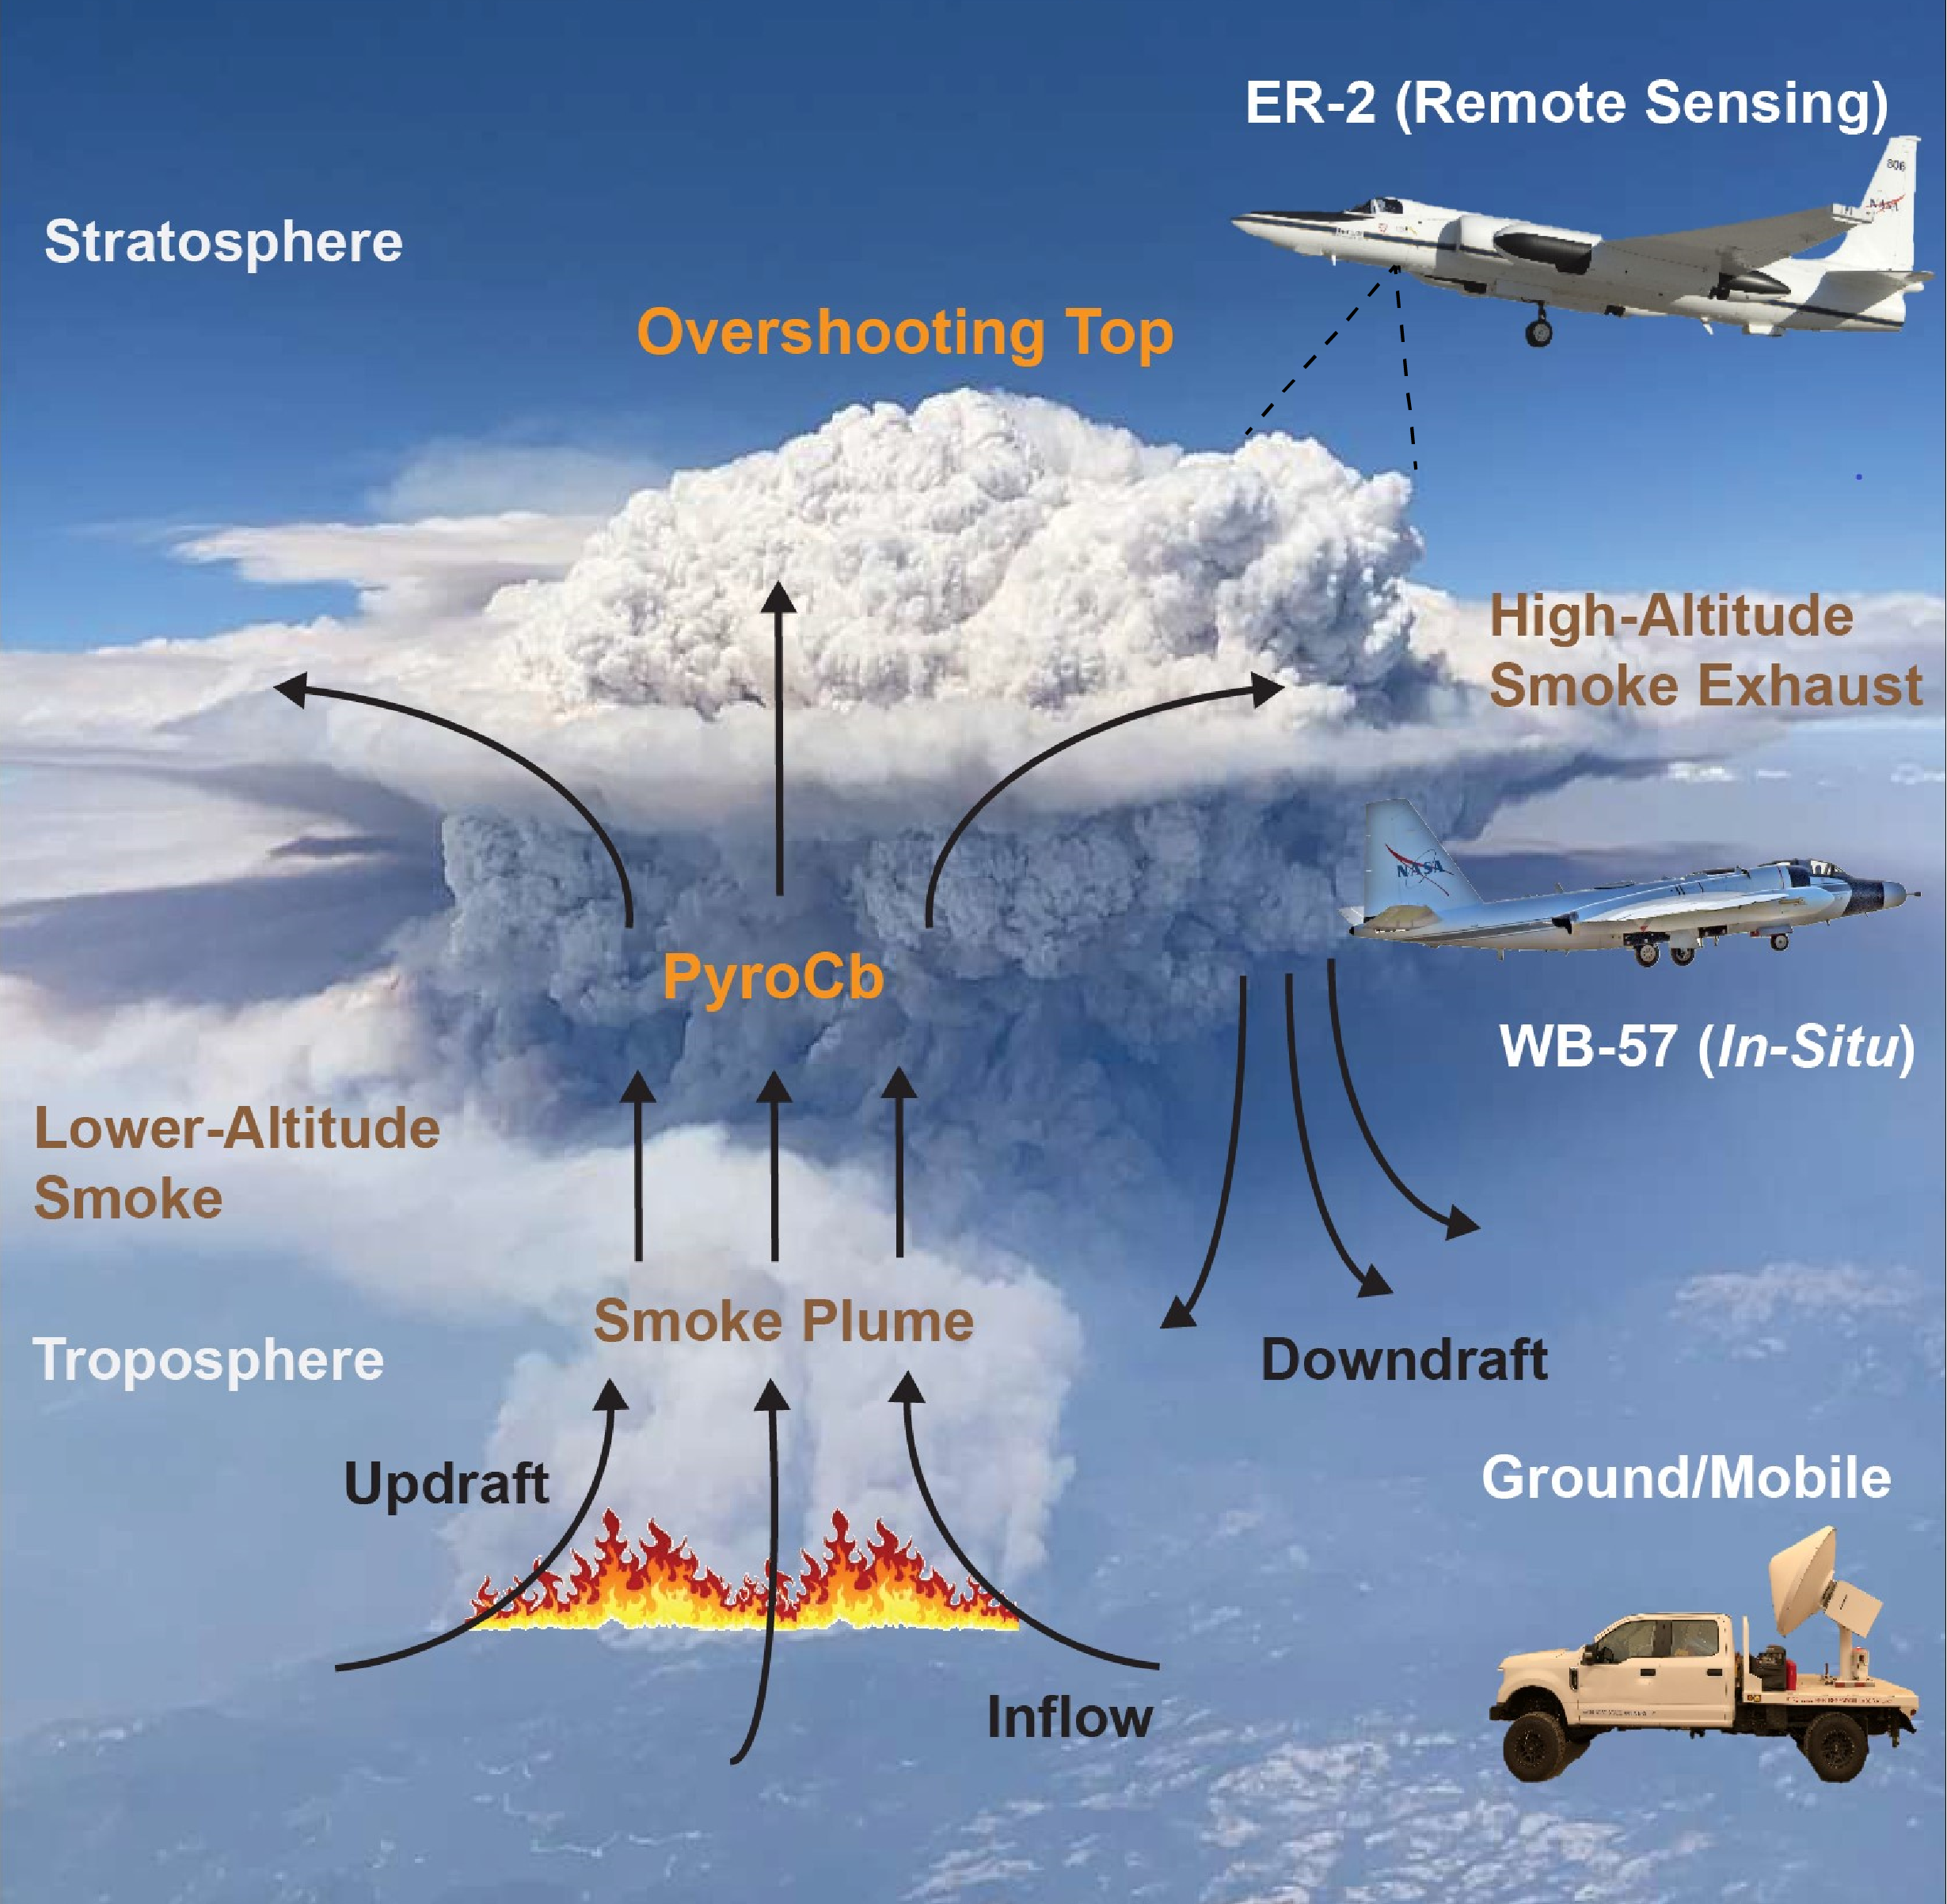
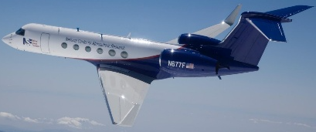
Science Goals and Objectives
Goals:
Characterize physical links between pyroCb development and extreme wildfire behavior.
Constrain the role of pyroCb activity in the Earth system.
Objectives:
Determine the fire and atmospheric conditions that produce pyroCbs.
Identify the mechanisms that control stratospheric smoke injection.
Assess how pyroCb-injected smoke plumes alter the upper troposphere and lower stratosphere (UTLS).
NSF/NCAR GV
(in-situ)

Slide 3
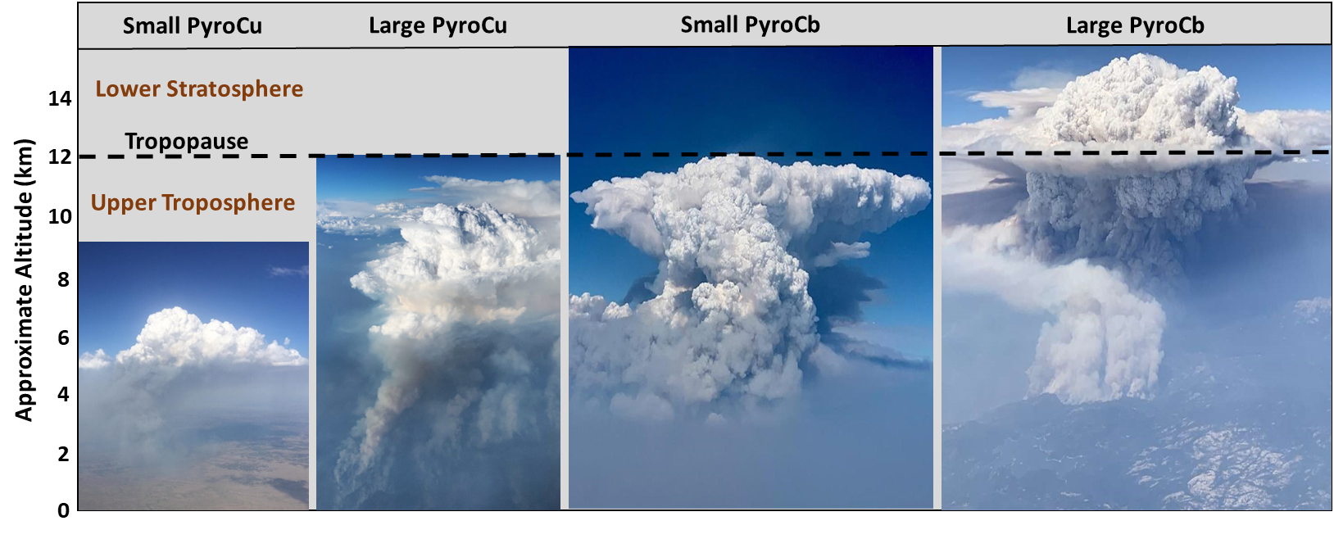
INSPYRE Includes Full Spectrum of Pyroconvection
Typical pyroCb definition requires a minimum 11 µm brightness temperature (BT₁₁) less than -40˚C
-40˚C
More common
Less common

Slide 4
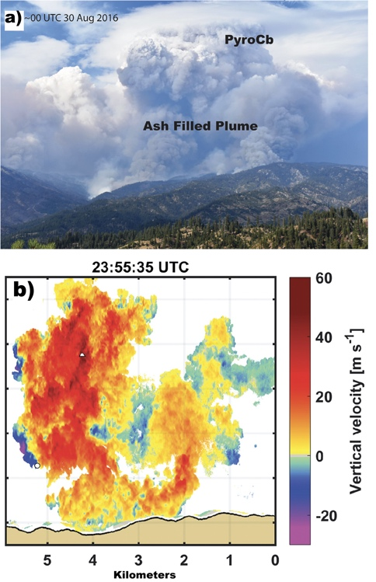
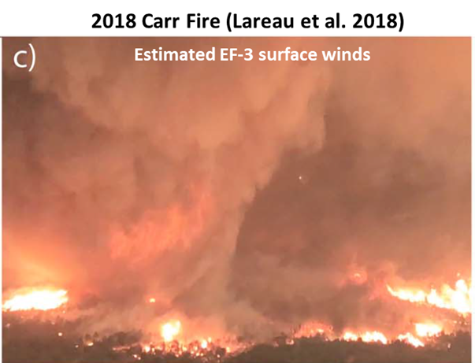
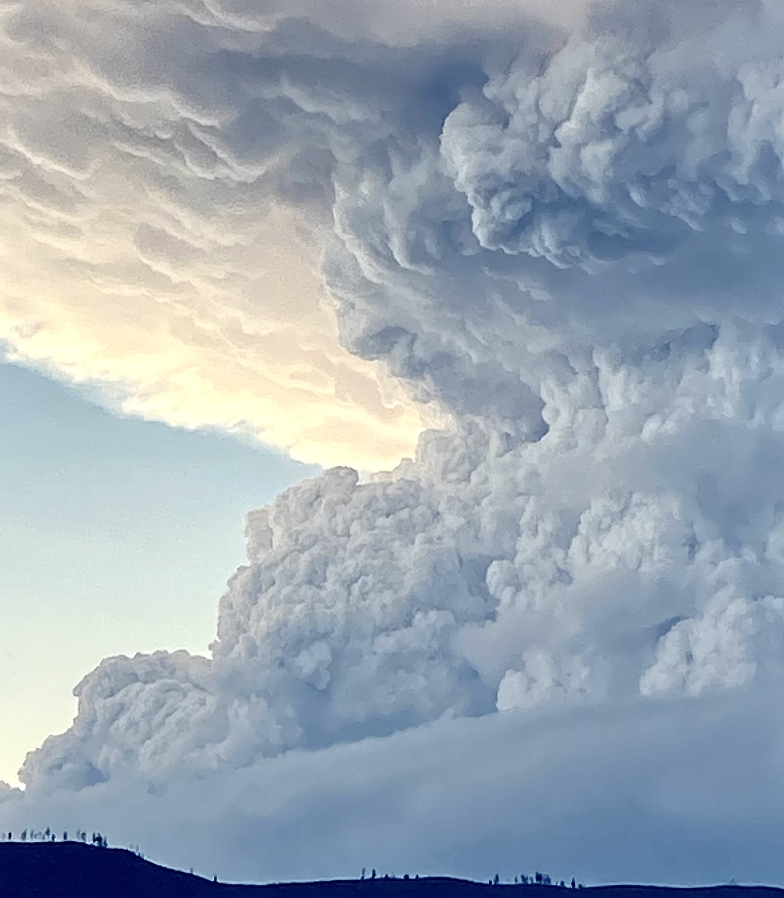
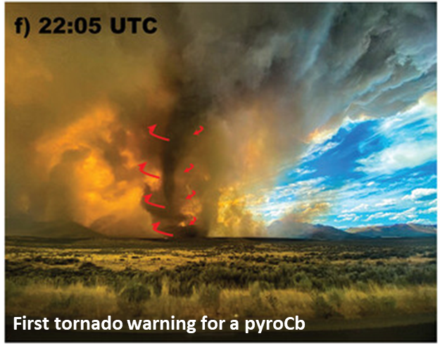
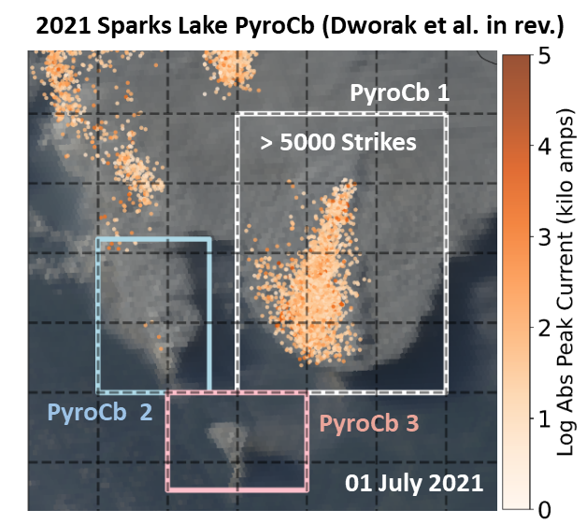
Why do pyroCbs matter? (Fire-scale Impacts)
Extreme Updrafts Near Cloud Base
Fire-Generated Tornadoes
Lightning Strikes
Rodriguez et al. 2020
2018 Carr Fire (Lareau et al. 2018)
2021 Sparks Lake Fire (Dworak et al. 2025)
2020 Loyalton Fire (Lareau et al. 2022)

Slide 5
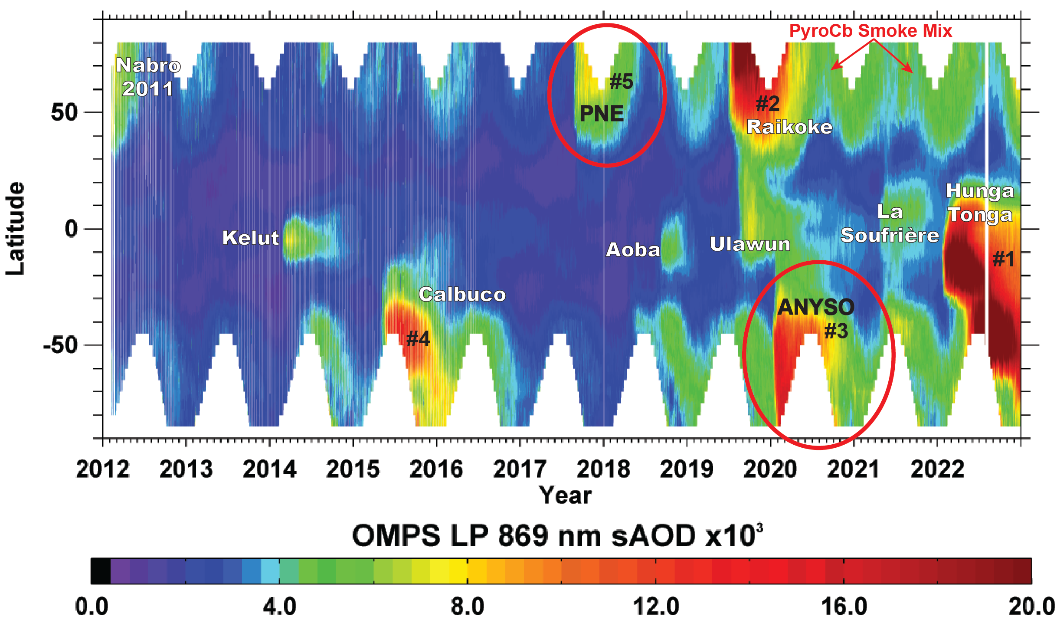
Why do pyroCbs matter? (Climate-scale Impacts)
OMPS LP stratospheric aerosol optical depth (sAOD)
Two of the five largest plumes since 2012 are from pyroCbs
2019-2022 featured the highest levels of sAOD during the entire post-Pinatubo era:
  ANYSO played a significant role
  Impact from additional pyroCbs in N. Hemisphere: 2020-2024
PyroCbs are a first-order driver of variations in stratospheric composition and structure
Peterson et al. 2021
(Nature PJ, Climate and Atmos. Science)
Updated by Ghassan Taha, 2022

Slide 6
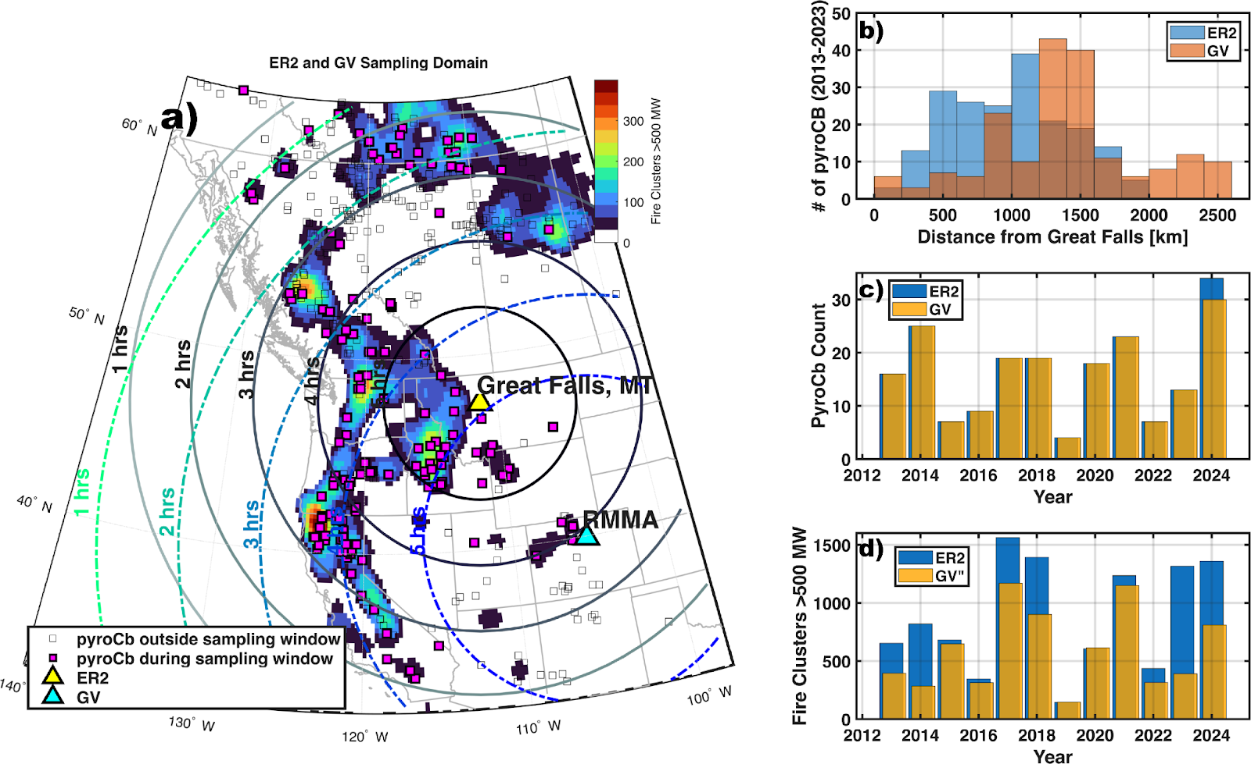
Airborne Mission: Active Pyroconvection Sampling
Deployment July 27-Sept 9:
ER-2 in Great Falls, MT (2026 & 2027)
NSF/NCAR GV in Broomfield, CO (RMMA 2026 only)
Mission Concept 1:
Active pyroconvection
Primary goal of the mission
Capturing the co-evolution of fire activity, plume rise, cloud development, electrification, and smoke injection in real time
Maximum observed: 34 pyroCb
Minimum observed: 4 pyroCb
Mean occurrence: ~17 events per season
PyroCb data from Peterson et al 2025:
https://www.nature.com/articles/s41612-025-01188-5

Slide 7
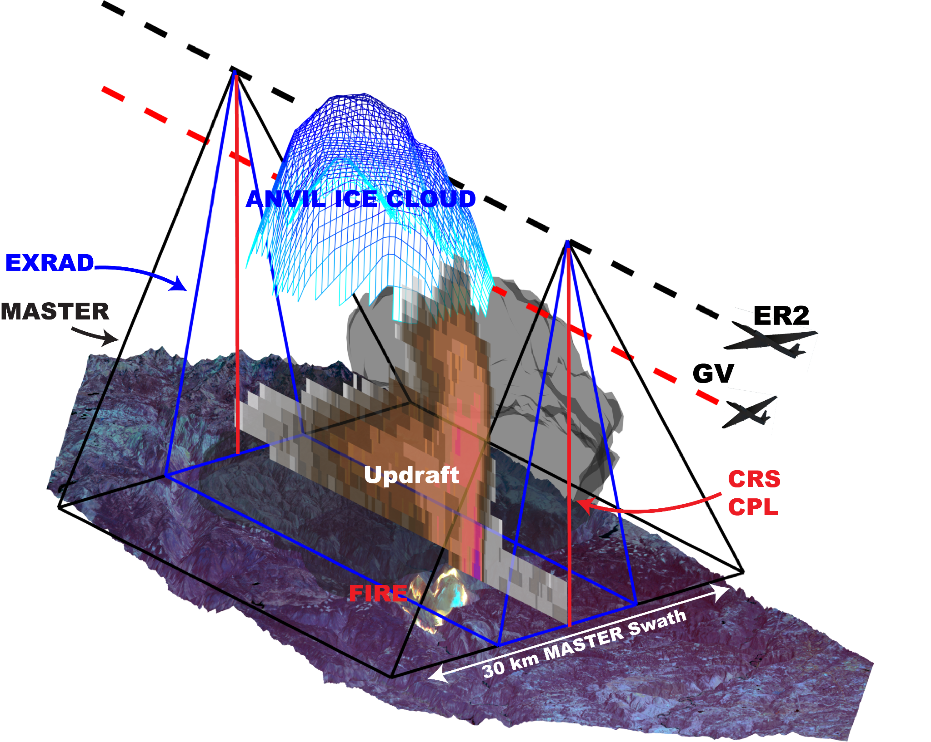
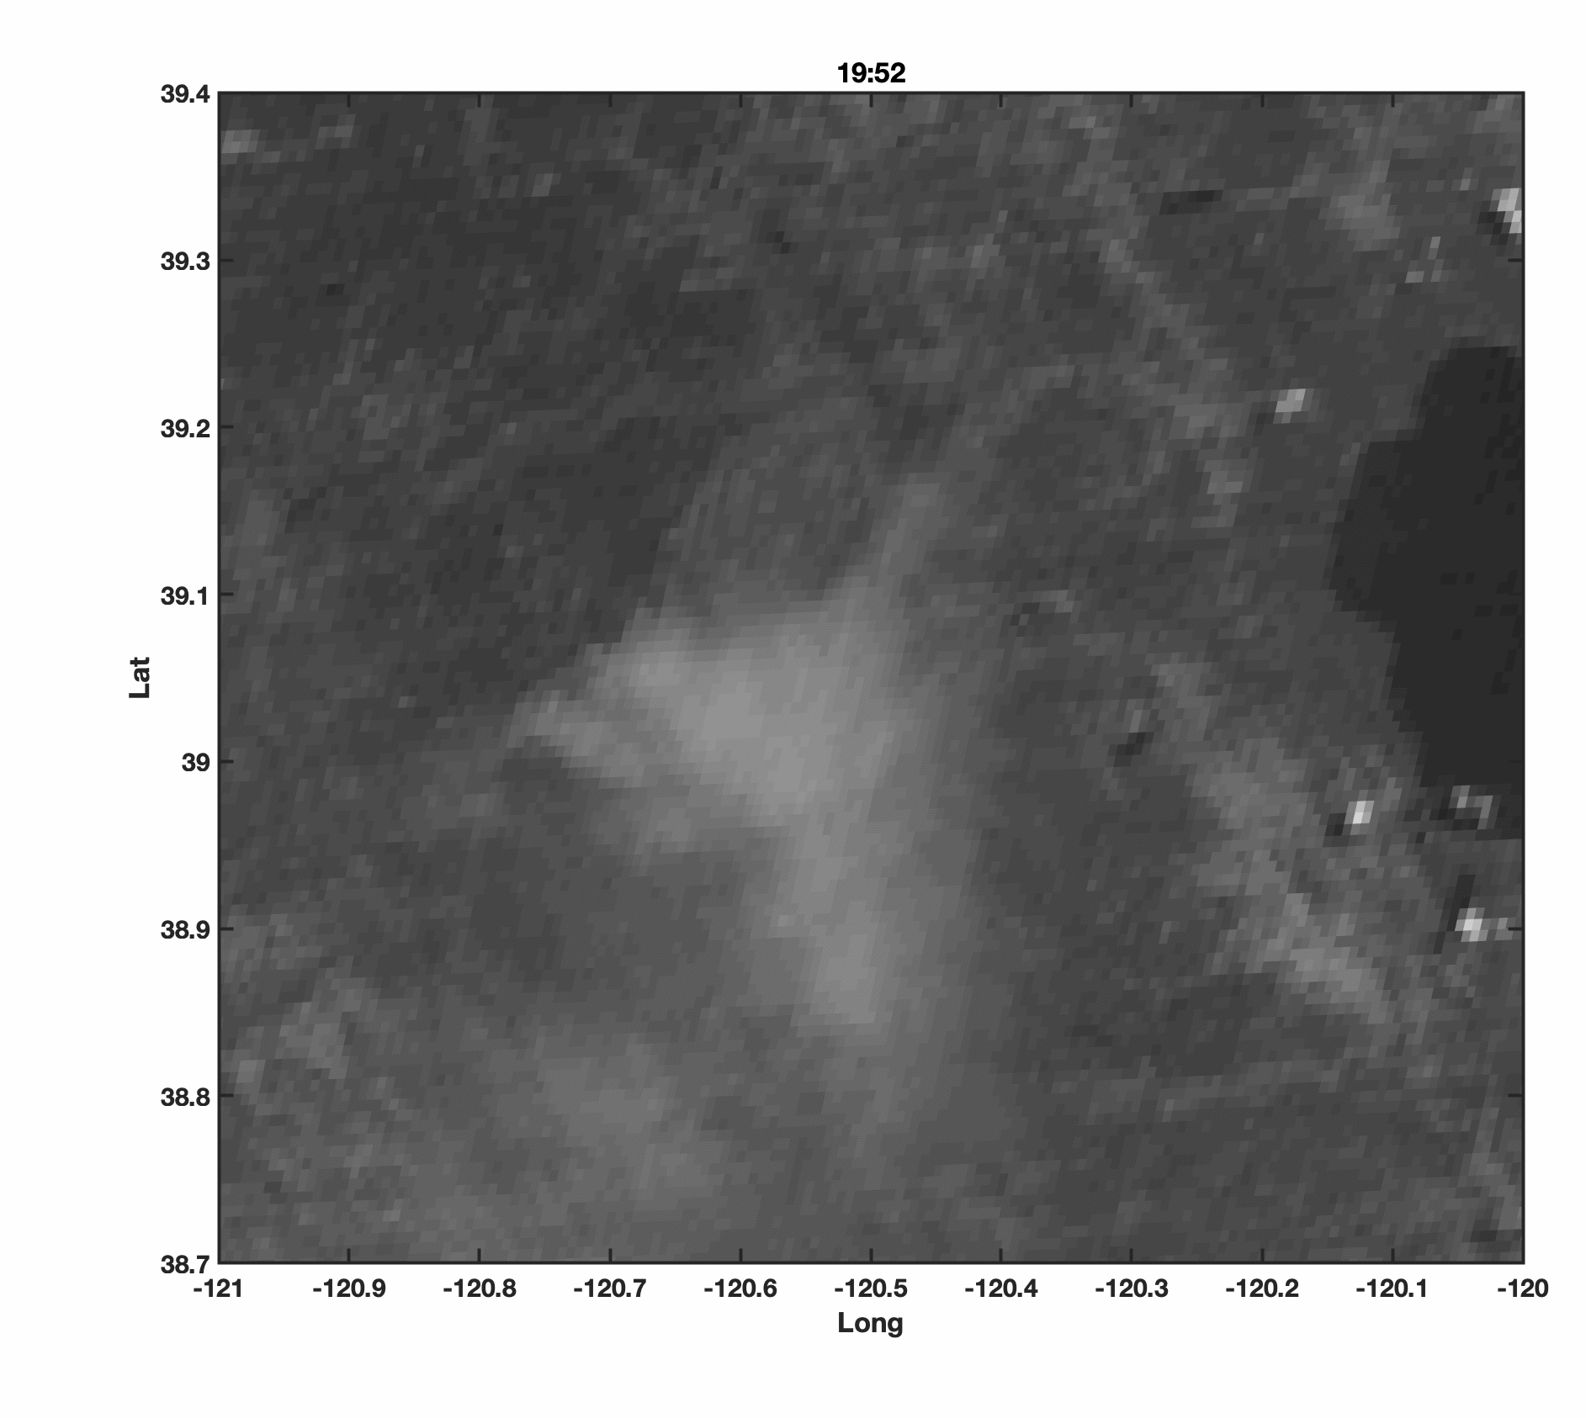
Airborne Strategy: Active Pyroconvection
Several flight modules to choose from depending on fire/plume characteristics
Mosquito Fire
8-Sept, 2022
2026 & 2027
2026 only

Slide 8
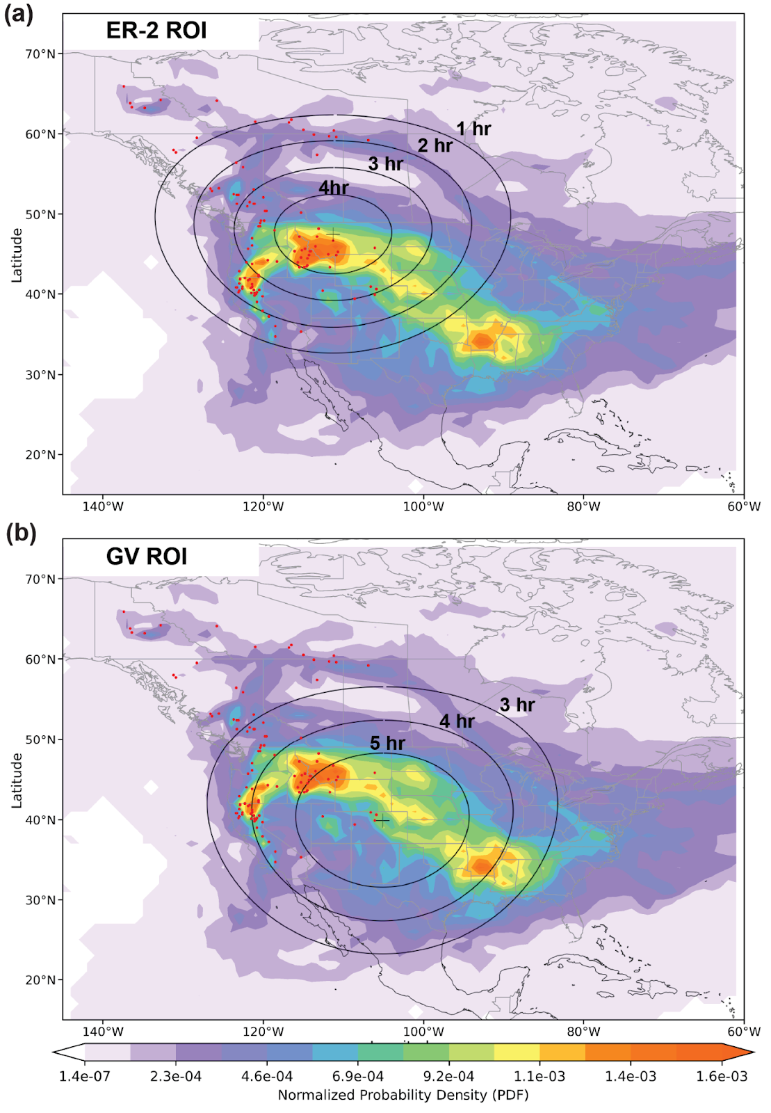
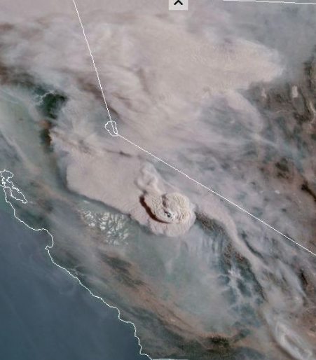
Airborne Mission: Detrained Smoke Sampling
Deployment July 27-Sept 9:
ER-2 in Great Falls, MT (2026 & 2027)
NSF/NCAR GV in Broomfield, CO (2026 only)
Mission Concept 2:
Detrained smoke layers downstream of active pyroconvection
Sampling aged plumes in the UTLS
Measure aerosol composition, size distributions, and radiative properties critical for understanding impacts across large regions
Detrained smoke
Active pyroCb

Slide 9
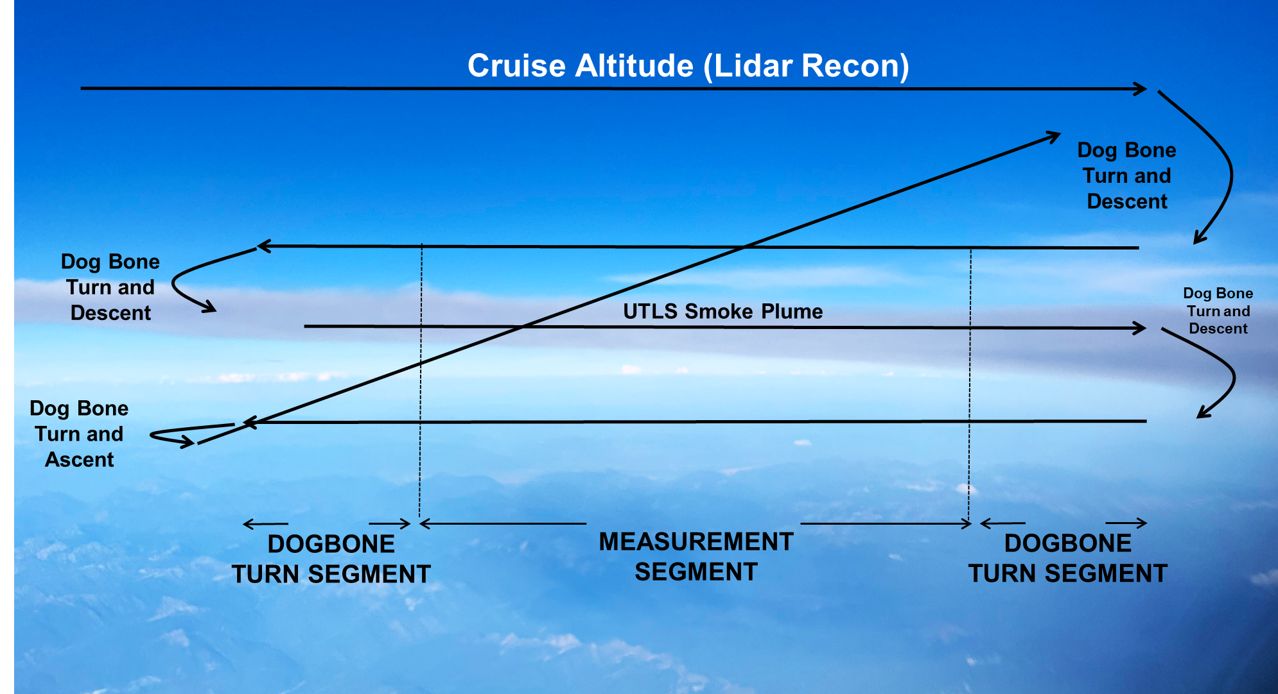
Airborne Strategy: Detrained Smoke Layers

Slide 10
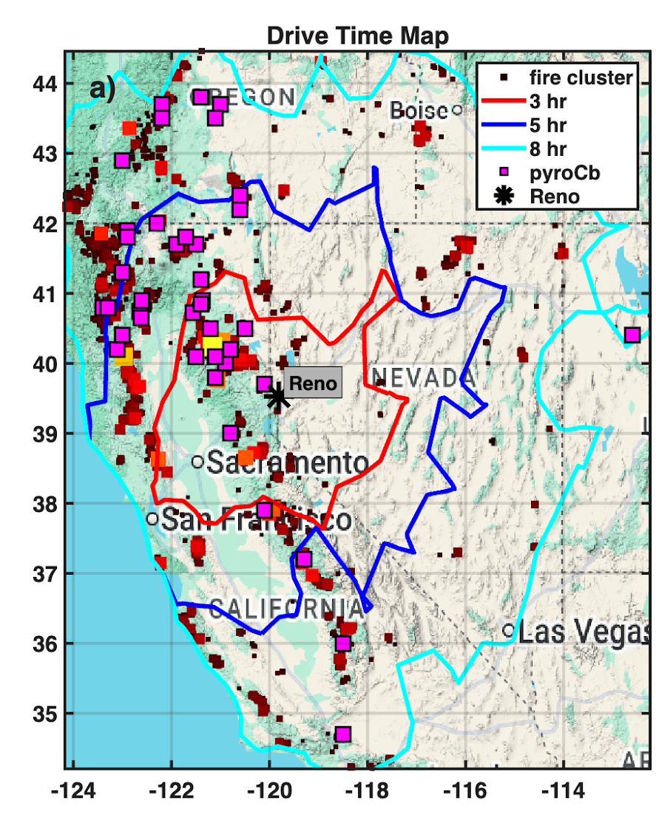
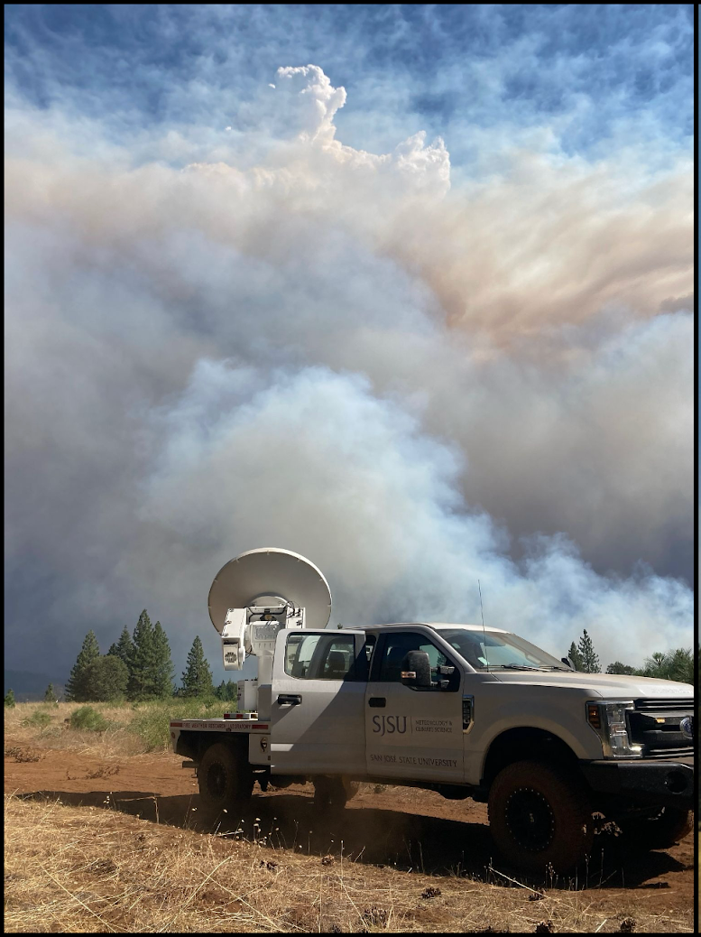
Ground Mission
Linking plume dynamics to fire-behavior:
Radars, lidars, weather balloons will sample:
Plume-dynamics
Fire-generated winds
Cloud microphysics (polarimetry)
Thermodynamic Environment
These data close the feedback loop between the pyroCb initiation and fire evolution.
Primary base: Reno, NV
Secondary bases: Missoula, MT, Salt Lake City, UT, Boise, ID

Slide 11
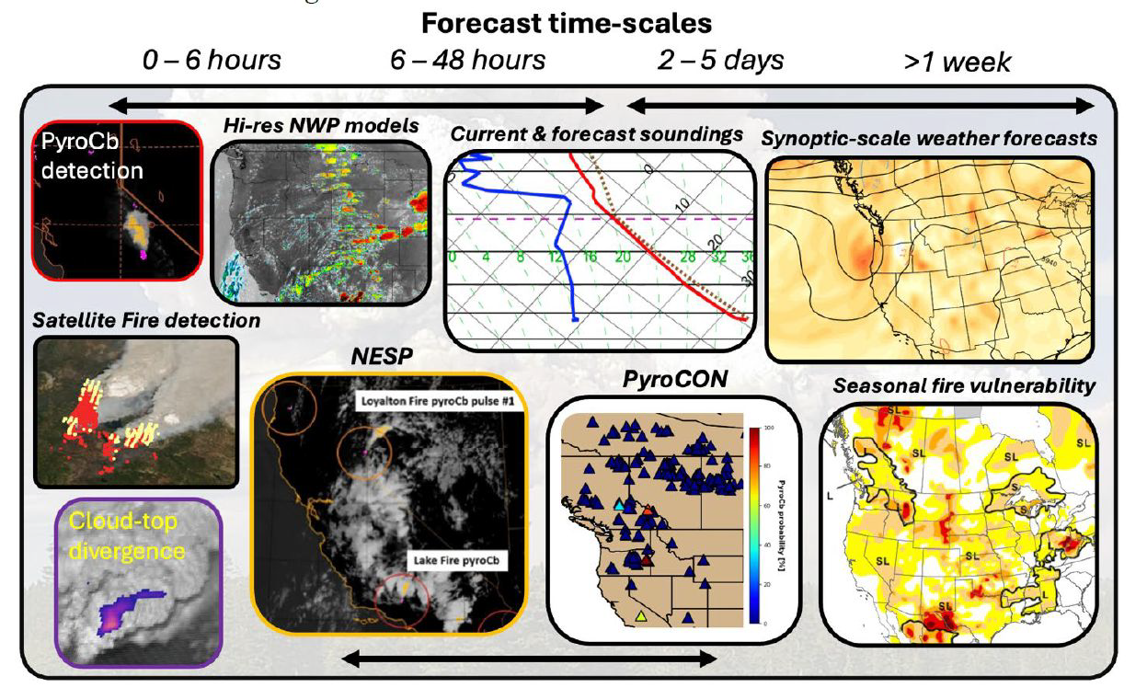
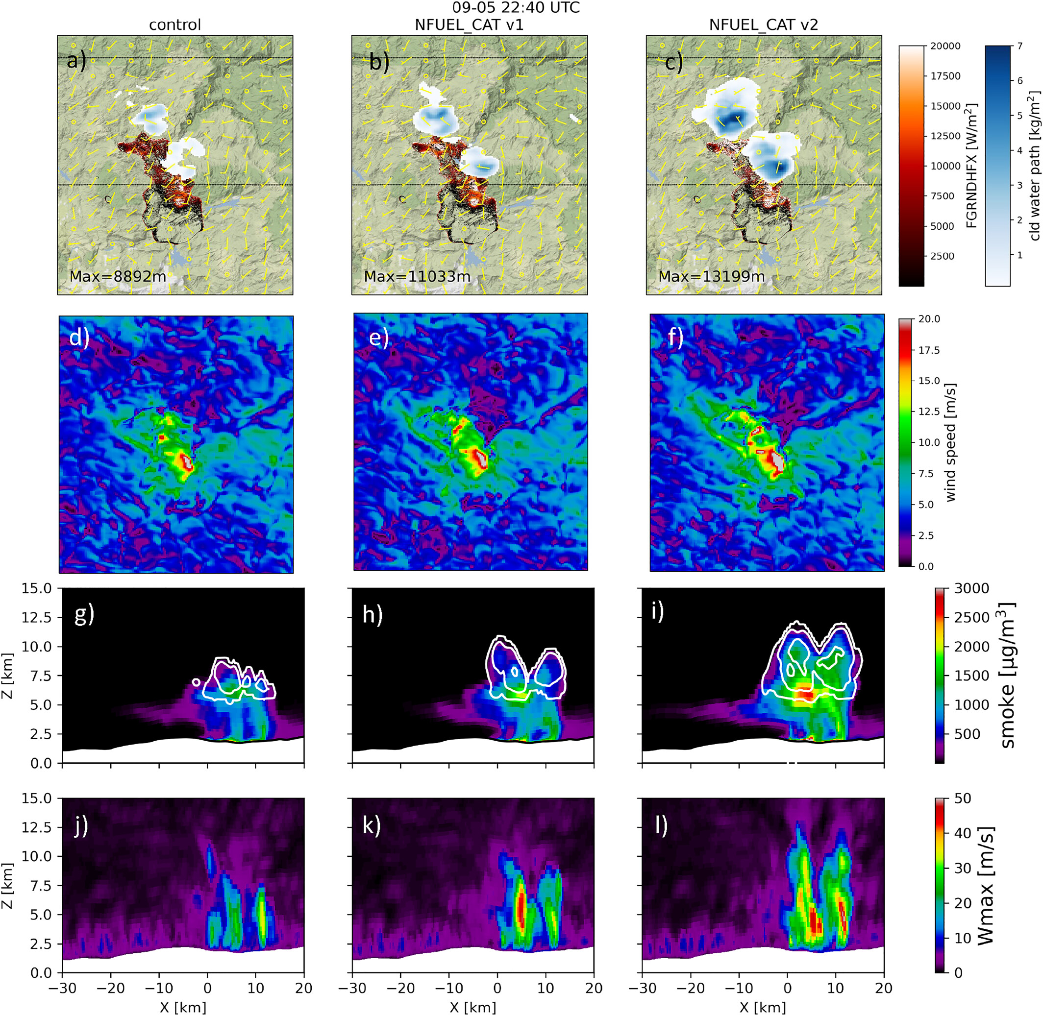
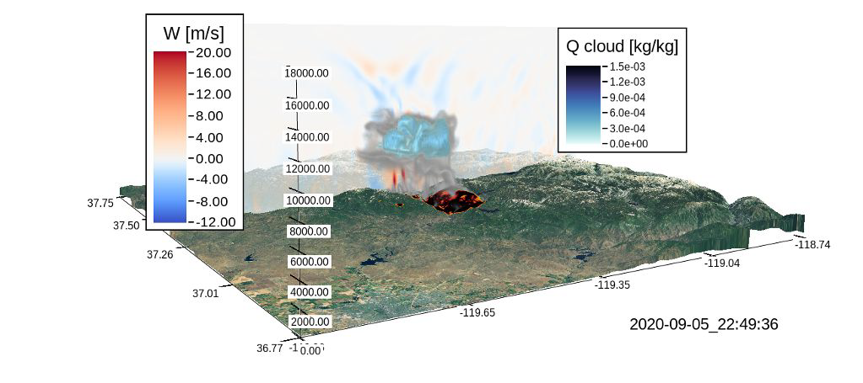
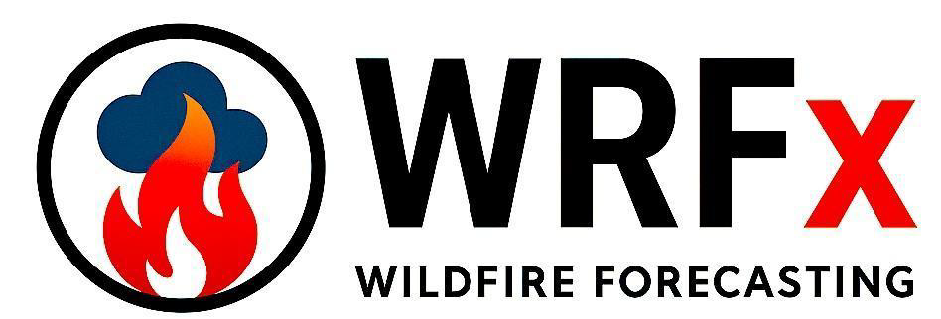
Modeling and Forecasting: Filling the Prediction Gap
Long-range forecasting tools:
Experimental pyroCb prediction products based on thermodynamic profiles
Statistical and physical methods
Coupled fire-atmosphere models:
High-res with up-to-date fuel states and perimeters for target selection
Smoke plume injection:
Plume rise models and injection height ensembles
Coupled with trajectories for smoke plume tracking downstream
Mission support aids development:
INSPYRE provides a critical testing theatre
Improved knowledge for future development of better forecasting tools
Lee et al. 2023

Slide 12
Questions?
Goals:
Characterize physical links between pyroCb development and extreme wildfire behavior.
Constrain the role of pyroCb activity in the Earth system.
Objectives:
Determine the fire and atmospheric conditions that produce pyroCbs.
Identify the mechanisms that control stratospheric smoke injection.
Assess how pyroCb-injected smoke plumes alter the upper troposphere and lower stratosphere (UTLS).
NSF/NCAR GV
(in-situ)

