Slide 1











Glenn Wolfe
PI
Emily Fischer
DPI
Jeff Geddes
DPI
Roy Johnson
IM
Jaden Ta
DIM

Slide 2
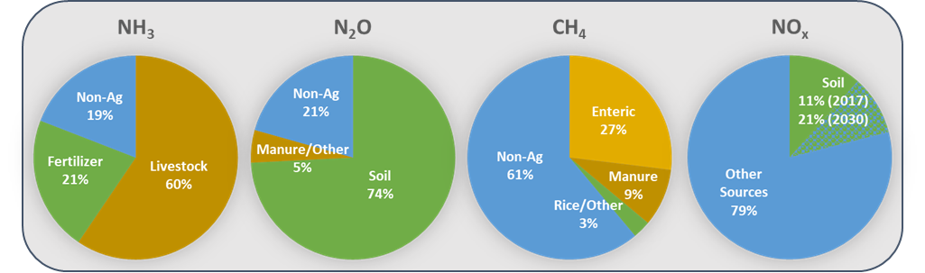
Agriculture is a Major and Uncertain Emission Source
U.S. EPA Inventories

Slide 3
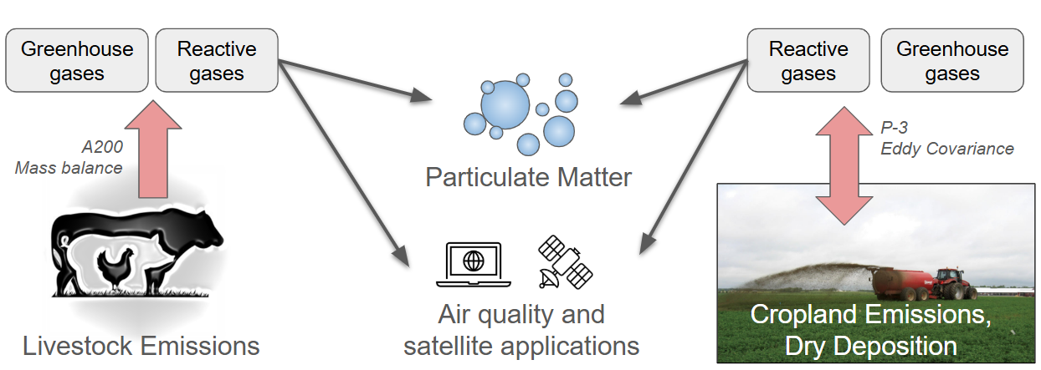
FarmFlux Objectives
Objective 3: Physical and chemical properties of particulate matter
Objective 1: Emissions from livestock operations
Objective 2: Emissions and deposition over croplands
Objective 4: air quality modeling and satellite data applications

Slide 4
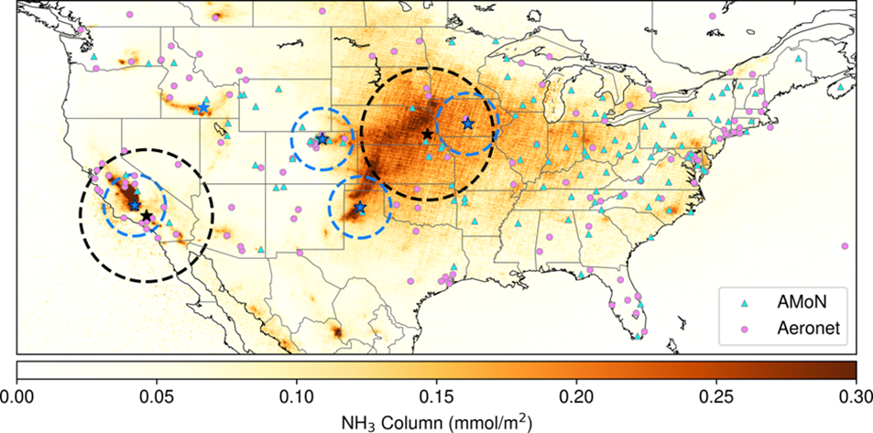
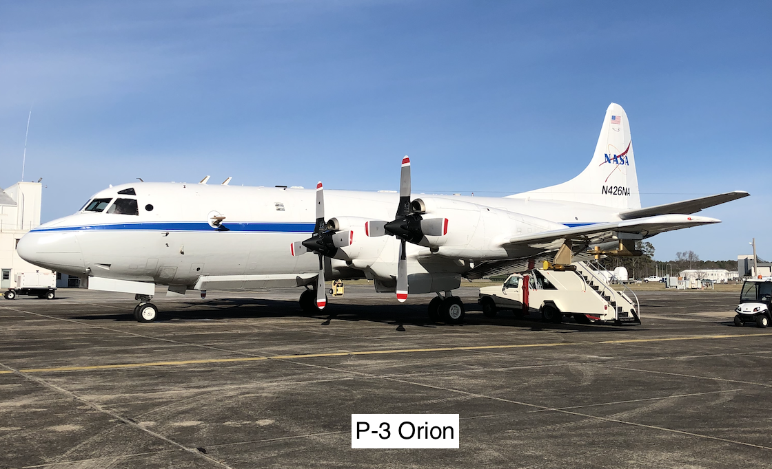
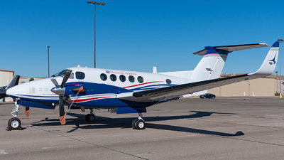
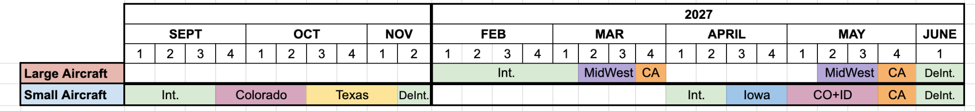
FarmFlux Technical Approach
Livestock
134 flight hours
Colorado
Texas
Iowa
California
Idaho
Croplands
96 flight hours
Midwest
California
NASA P-3 Orion
Dynamic Aviation A200

Slide 5
P-3: Crop Fluxes and Aerosol Science
Payload includes most major N and C-containing gases (working to add VOCs)
Eddy covariance will provide near-direct estimates of emission and deposition fluxes over major cropland types
Aerosol properties probed through perturbation experiments (vertical profiling, urban-rural plume mixing, post-frontal cleanout)
Instrument | PI | Measurements
Data System | Van Gilst | Aircraft state, ground communications
TAMMS | Thornhill | 3-D winds, T, P, aircraft state
DLH | Diskin | H₂O
DACOM | DiGangi | CO, CO₂, CH₄, N₂O
NH3GHG | Pollack | NH₃, N₂O, CH₄, C₂H₆, CO, CO₂, H₂O
No_{y} | Rollins | NO, NO₂, sum-NO_{y}, SO₂
ROZE | Hannun | O₃
CIT-CIMS | Crounse | HNO₃, SO₂, H₂O₂, HCN, HCl, organic acids
LARGE | Ziemba | Aerosol size distributions, number concentrations, speciated aerosol mass (AMS), black carbon (SP2), aerosol scattering and absorption, hygroscopicity

Slide 6
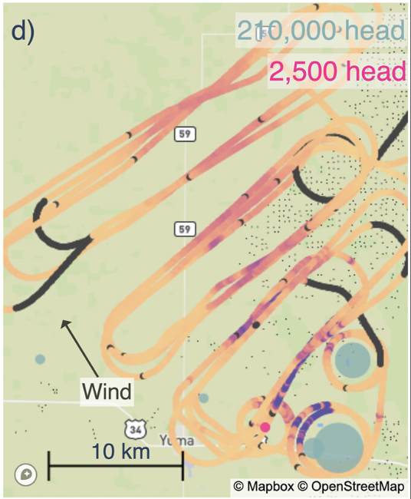
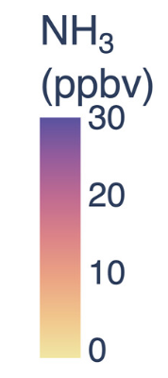
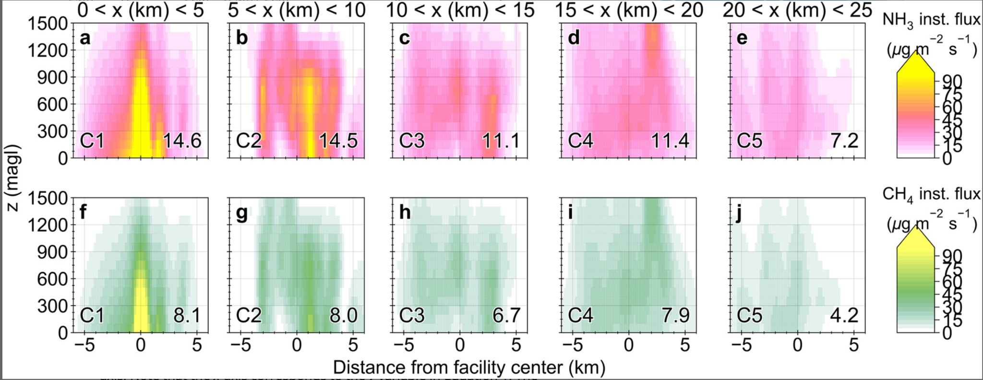
A200: Animal Feeding Operations
Instrument | PI | Measurements
Data System | Van Gilst | Aircraft state, ground communications
TAMMS | Thornhill | 3-D winds, T, P, aircraft state
UMN/CSU | Juncosa Calahorrano | NH₃, HNO₃
UMich | Plant | N₂O, H₂O, CO
UWyo | Caulton | C₂H₆, CO₂, CH₄, H₂O
PILS | Sullivan | Inorganic sub-micron aerosol
PANDA | Delaria | NO₂
Payload includes major gas emissions, tracers to separate mixed emissions, and aerosol composition
Mass balance flights integrate over a plume to measure facility-scale emission fluxes and ratios
Pseudo-Lagrangian sampling quantifies NH₃ lifetime and sink partitioning (dry deposition vs. aerosol uptake)
Juncosa Calahorrano et al. (2025)

Slide 7
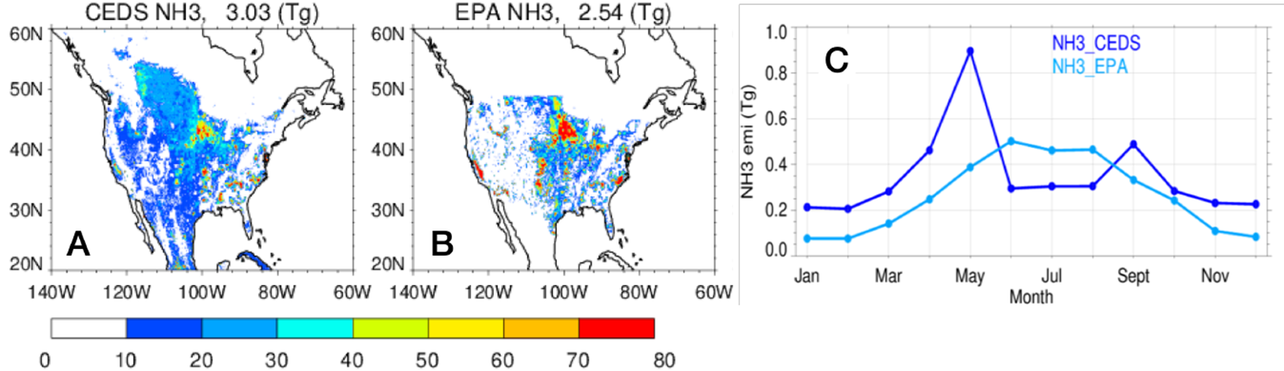
Model and Satellite Applications
Ammonia Emissions
Evaluation of model emissions and deposition
Inverse atmospheric modeling for source-receptor relationships and top-down emission fluxes
Connections between surface emissions and satellite retrievals of NO₂ and NH₃
PI | Model/Analysis Tools
Geddes | GEOS-Chem Classic
Shah | GEOS-CF, GEOS-FP, GEOS-FLEXPART
Wang | DLEM NH₃ & N₂O, WRF-Chem (BDISNP)
Henze | GEOS-Chem Adjoint, STILT, WRF-Chem-DART
Many | TEMPO, TROPOMI, IASI, CrIS

Slide 8
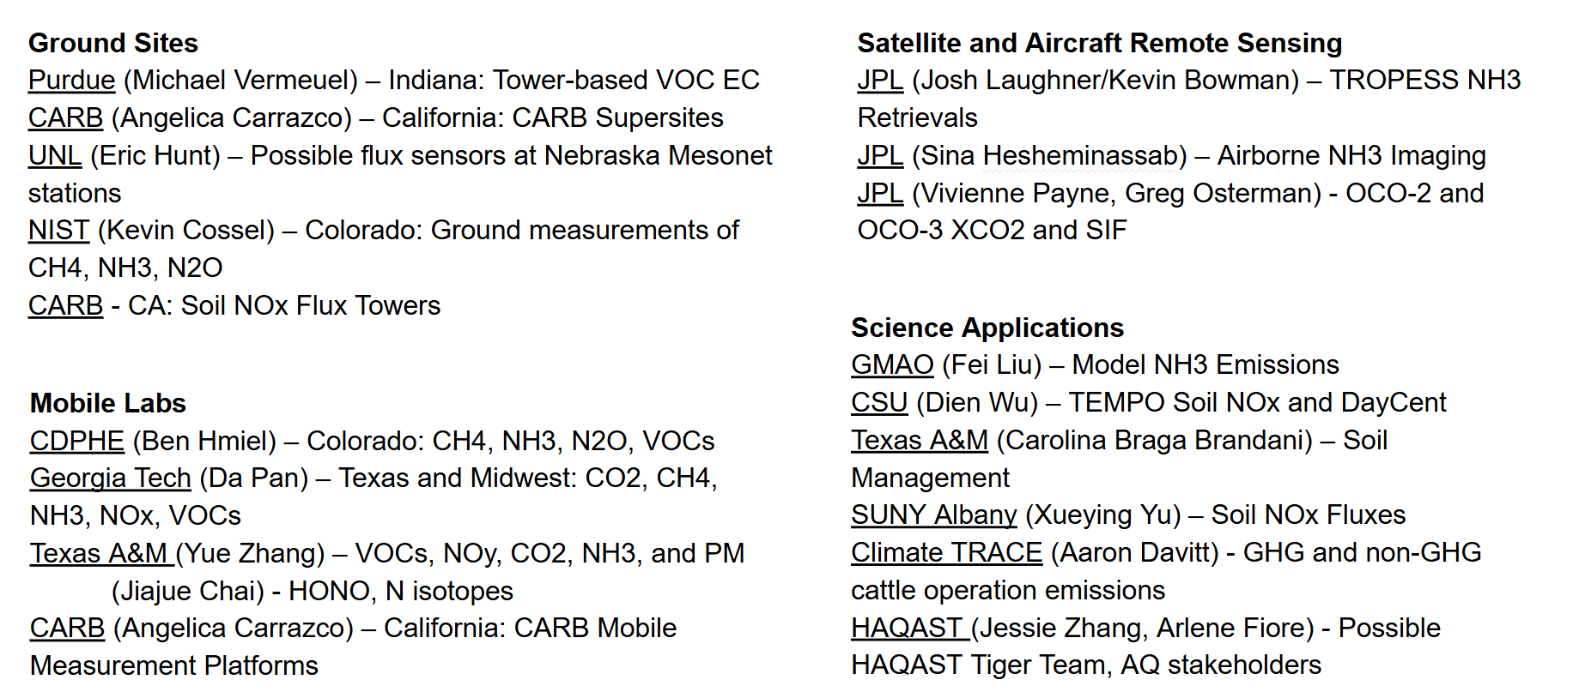

FarmFlux is a Nucleus for Collaboration
Mission Ops Input
Data/model information
Farm practices, patterns
Flight recommendations
Science Output
Collaboration with FF Science Teams
Independent Studies
Parallel Efforts (Measurements, Modeling)
glenn.m.wolfe@nasa.gov

