Slide 1
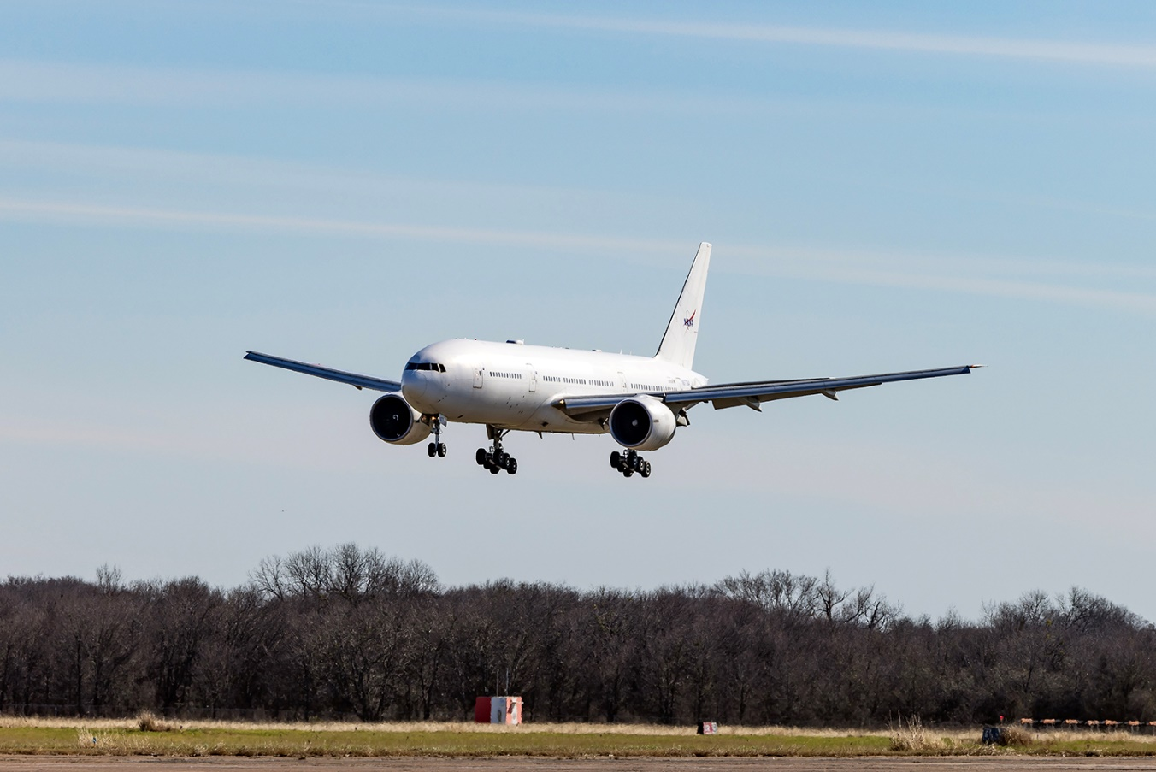
NASA Airborne Science Program
Derek Rutovic
April 2026

Slide 2
ASP Current Status
Post-Covid has been a period of significant transition for the Airborne Science Program
  Completed transitions
    DC-8 retired
    AFRC flight operations successfully moved to Edwards AFB, Palmdale hangar closed out
    WFF closed and transferred P-3 to LaRC
  Ongoing changes
    B777 major structural modification has been completed
      Will support first mission in FY27
    GV purchased at the end of FY25, accelerated efforts to modify
    P-3 placed in flyable storage for FY26
      Operational in FY27 to support EVS-4 mission
    G-IV will replace UAVSAR G-III to support JPL radar operations
    Commercial Air Services (CAS)

Slide 3
B777
Structural viewport modification completed ahead of schedule at L-3 Harris in Waco, TX
First mission, NURTURE, slated for January 2027
  North American Upstream Feature-Resolving and Tropopause Uncertainty Reconnaissance Experiment
    Advances the knowledge of the processes that lead to extreme, high-impact winter weather events
Road ahead to make NURTURE
  Finish internal research modifications
  Scheduled maintenance
  Integrate NURTURE payload
  Aircraft paint, not-to-interfere basis with the above essential program elements

Slide 4
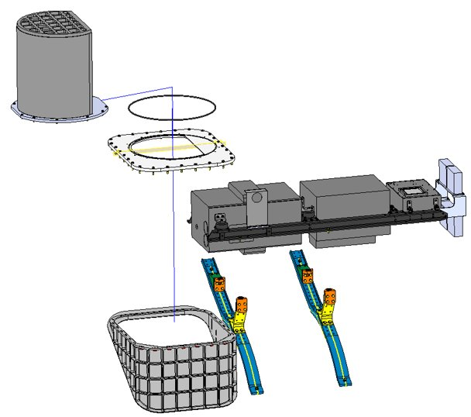
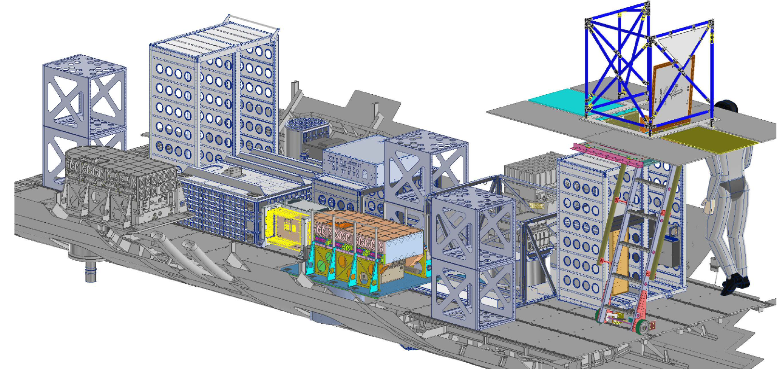
B777
B777 effort larger than just the basic aircraft modifications
  DC-8 instrument support infrastructure not compatible with the larger B777 portals
  Significant parallel effort to integrate NURTURE payload
  Component fabrication in process, fit checks starting in the next couple of months
S-HIS

Slide 5
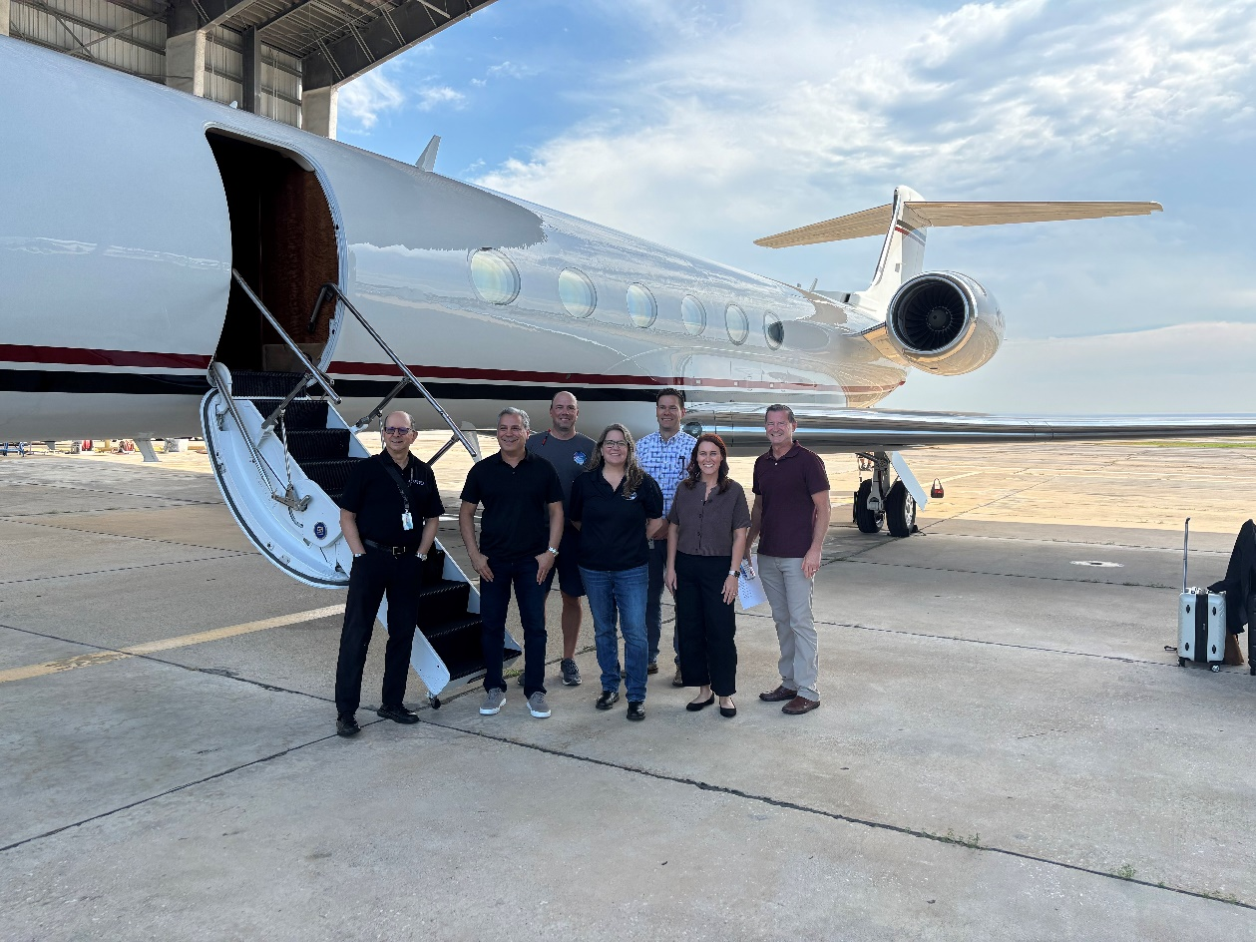
GV
Purchased and received on the final day of FY25 to provide dedicated GV remote sensing platform to Earth Science
Modification contract awarded to Avenger Aerospace on 4/15
  Delivery January 2027
Targeting first mission Spring 2027 for LVIS GEDI Southeast Asia

Slide 6
GV
Initial modifications will heavily “mirror” existing JSC-operated GV
  ASP/AFRC meeting at the airplane this summer to discuss dropsonde tube
Once again, not just aircraft modifications required to build up the program
  Team is working pilot and maintenance training, display and INU upgrades, engine maintenance plan contracting, spare component acquisitions, and more

Slide 7
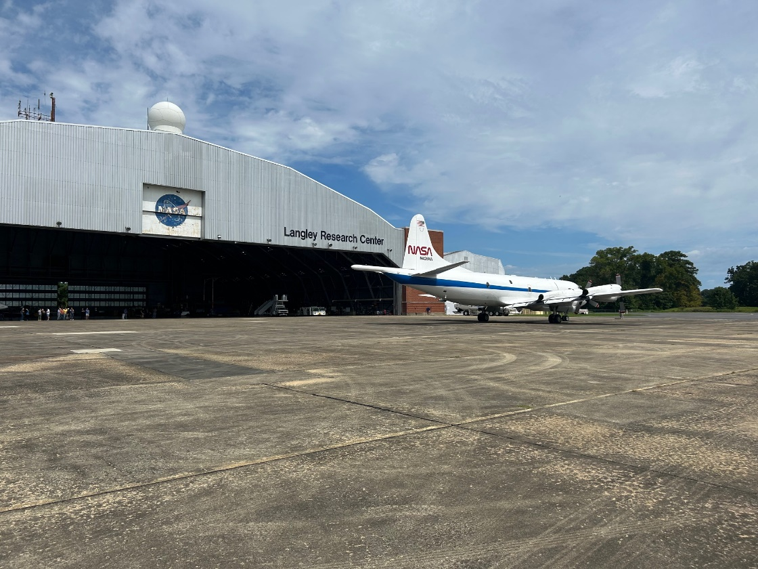
P-3
Transferred to Langley Research Center after the closure of the Wallops aircraft office and placed into “flyable” storage in FY26
Bringing back to full core capability to support FarmFlux in FY27
Retained significant core personnel from Wallops supporting other ASP priorities
  Currently transitioning back to the P-3
Recently hired two mechanics, requisition out for a flight engineer

Slide 8
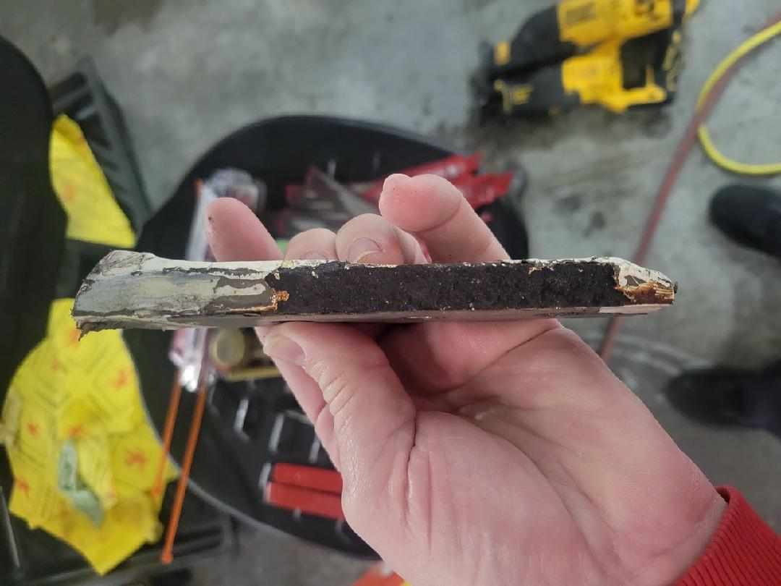
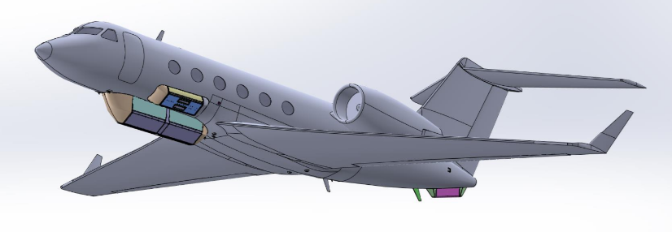
G-IV
G-IV is in modification at Phoenix Air in Cartersville, GA
Installing large canoe to house two SAR antennas to provide-multifrequency capability
  Third antenna designed to be installed as a fuselage blister, modification not funded
Significant corrosion issues associated with a wing attachment fitting
Jet delivery from Phoenix Air slated for 8/2026, mission systems installation through 2/2027

Slide 9
Commercial Aircraft Services (CAS)
Support structure and personnel hit hard by the Deferred Resignation Program and the closure of the Wallops aircraft office
Worked closely with the new centralized CAS office to appropriately prioritize Earth Science vendor audits and fund to support the mission
Increased funding to support internal NASA airworthiness process including the addition of a “CAS Manager” at Goddard
AIR Card for CAS

Slide 10
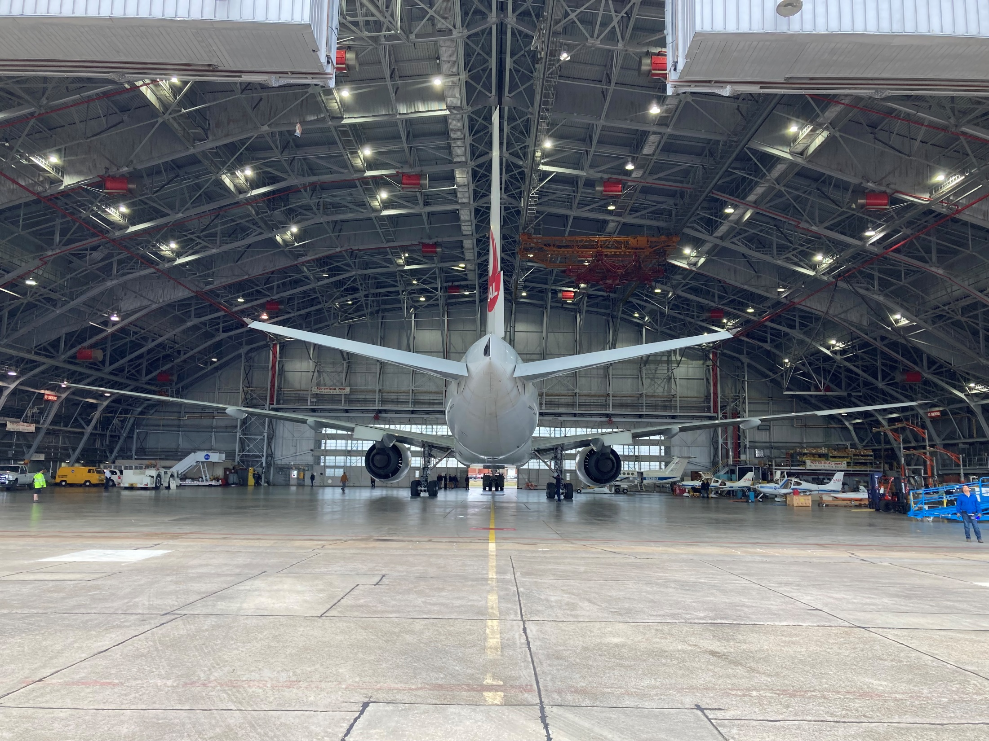
Questions?

