Slide 1
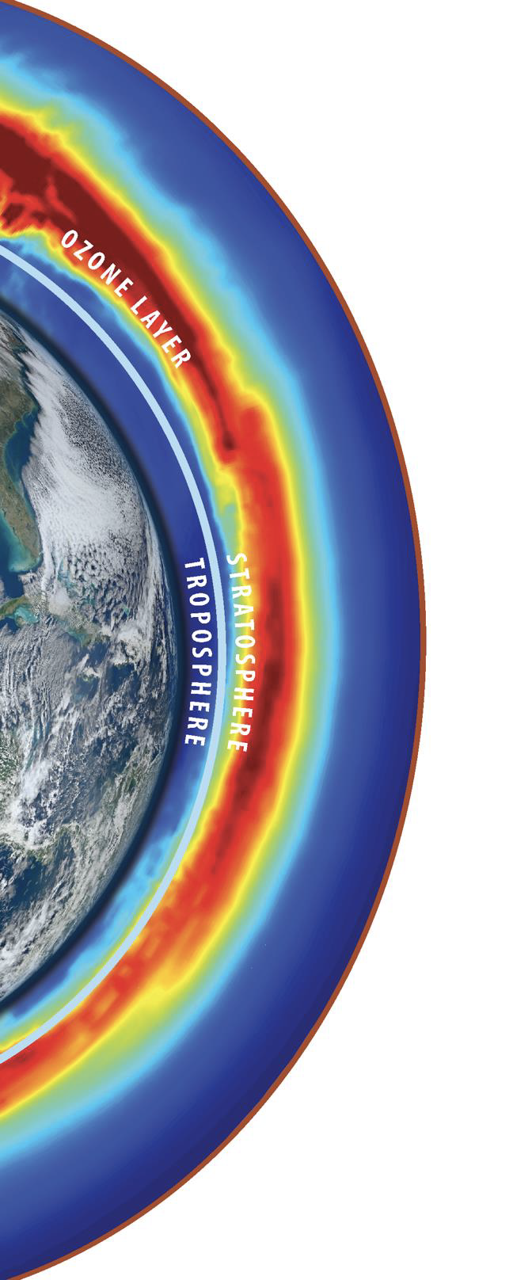





















Stratosphere Troposphere Response using Infrared Vertically-resolved light Explorer (STRIVE) Mission
Lyatt Jaeglé (PI), Jun Wang (Deputy PI), Luke Oman (PS), Tom Hanisco (Deputy PS), Matt DeLand (ARGOS lead), J. Alexander, A. Bourassa, P. Cameron-Smith, P. Colarco, D. Edwards, Q. Errera, G. Frost, Q. Fu, A. Gettelman, J. Gille, L. Harvey, N. Hindley, L. Holt, D. Kim, P. Newman, C. Orbe, R. Stauffer, K. Strong, G. Taha, Q. Tang, A. Turner, K. Wargan, H. Worden, C. Wright, and D. Zawada
Instrument Developers: NASA’s GSFC with BAE Systems, STC with Quantum Space/Leidos
Spacecraft Provider: Northrop Grumman
2026 Atmosphere Investigator Meeting
04/21/26

Slide 2
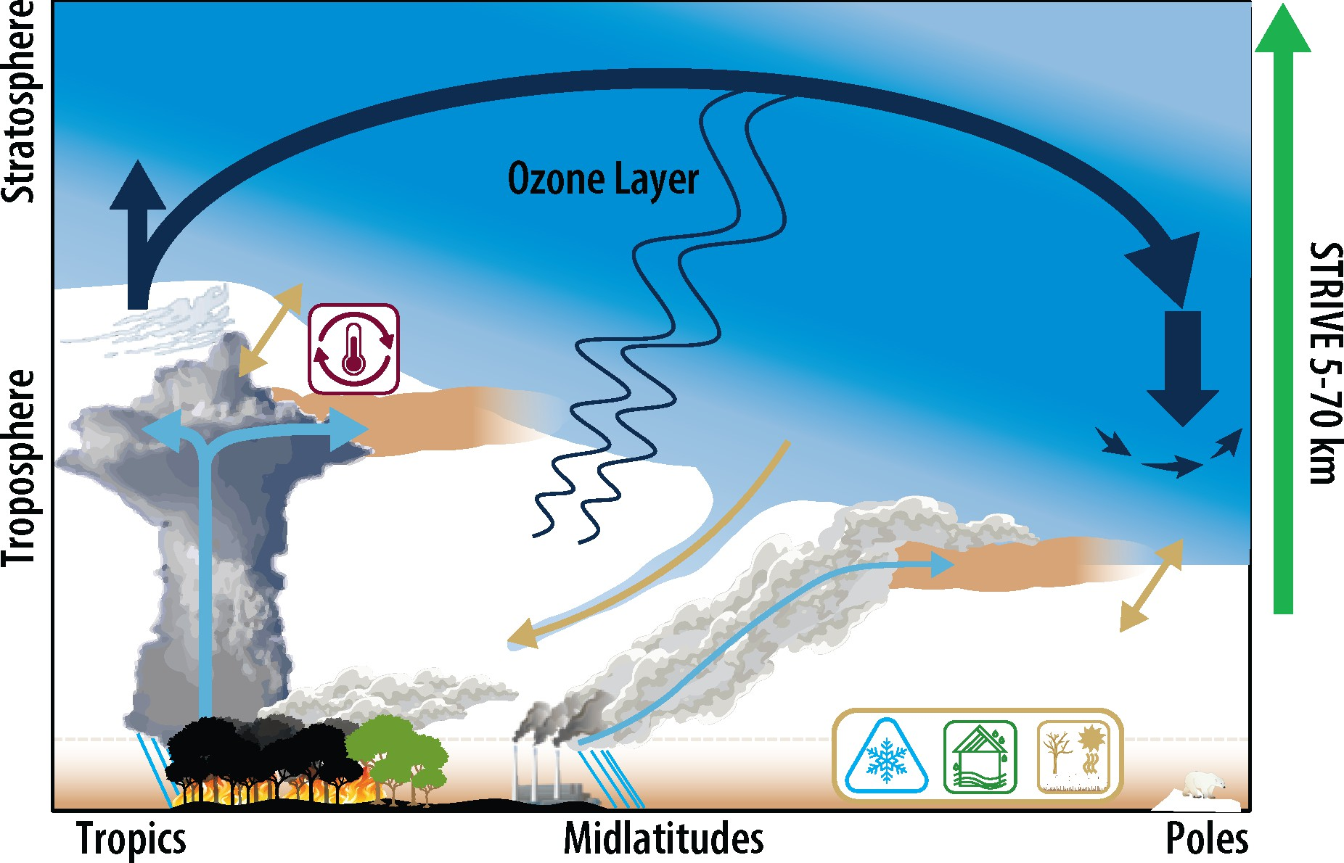
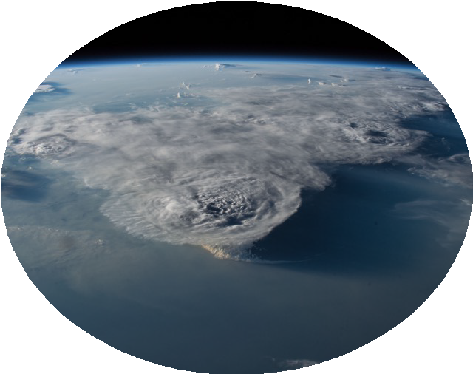
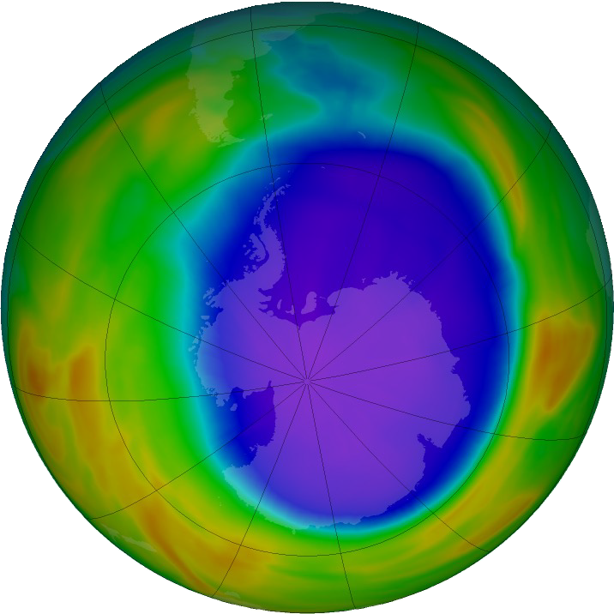
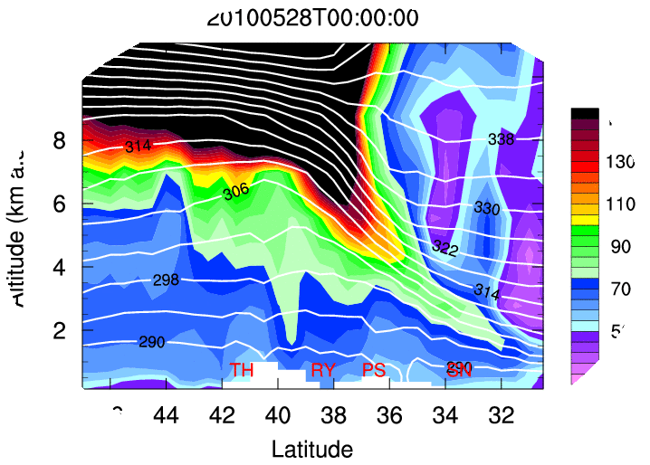
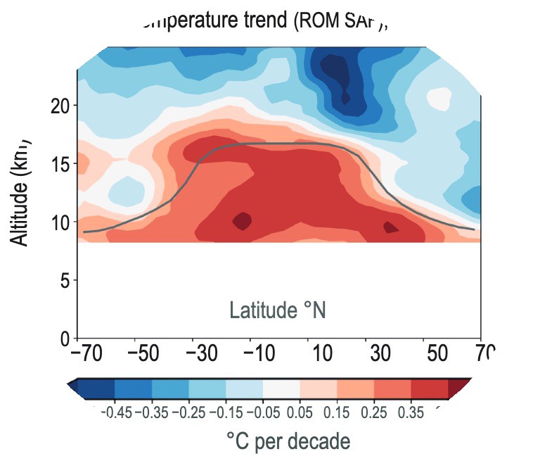
STRIVE: A global 3D view of atmospheric composition and temperature
Composition: O₃, H₂O, CH₄, N₂O, CO, NO₂, HNO₃, ClONO₂, CFCs, aerosols, etc...
Objectives:
Convective and Large-Scale Transport
Ozone Layer Recovery
Stratosphere-Troposphere Coupling
Atmospheric Feedbacks
Complex interactions driven by processes on small spatial (10s km horiz., 1 km vertical) and short temporal scales (days)
STRIVE has the novel ability to resolve small-scale vertical structures of atmospheric composition and temperature, enabling new insights into processes of troposphere-stratosphere interactions
…convective outflow, gravity waves, STE, cirrus clouds, volcanic eruptions, wildfire plumes, monsoon pollution…

Slide 3




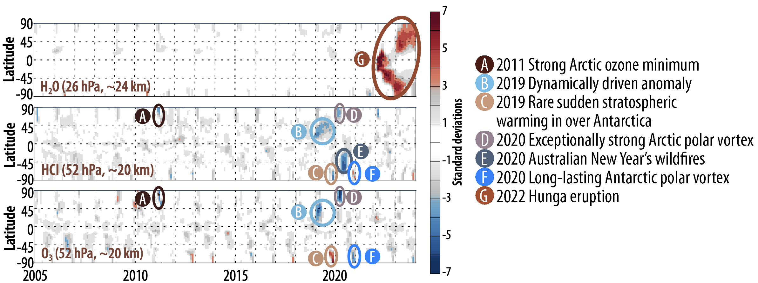
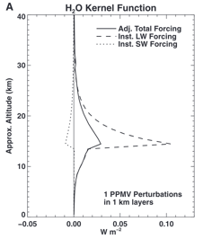
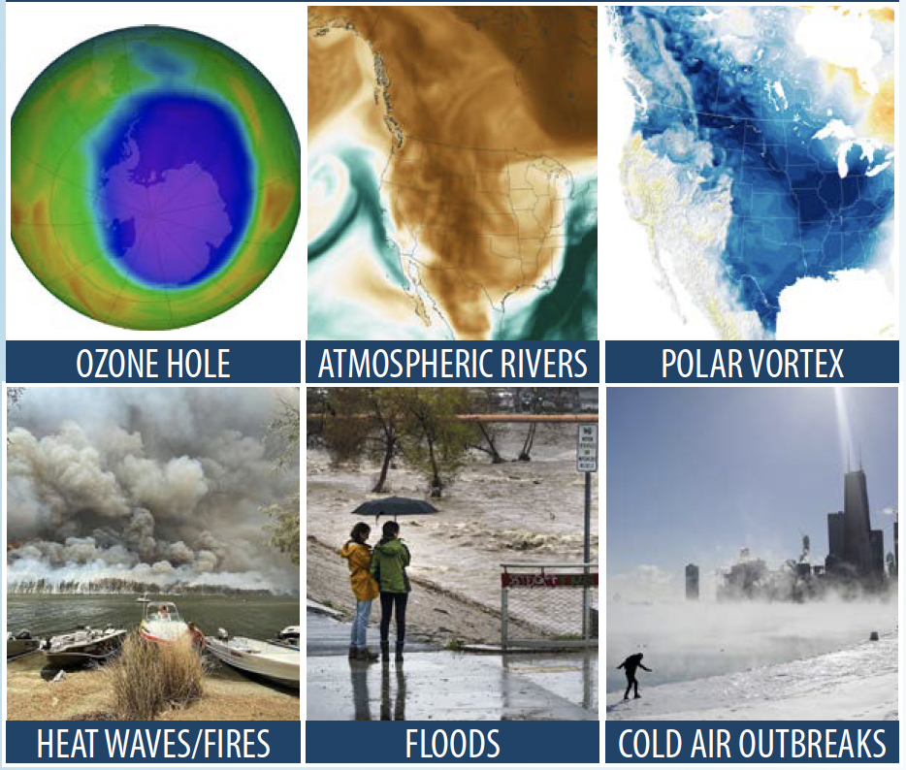

STRIVE: A global 3D view of atmospheric composition and temperature
Atmospheric Feedbacks
Solomon et al. (2010)
STRIVE observes troposphere-stratosphere coupling to view processes key to seasonal weather predictability and directly quantifies stratosphere-troposphere exchange of ozone.
STRIVE measures the fine scale gradients in radiatively active species that are key to quantifying atmospheric feedbacks in the UTLS.
STRIVE’s detailed pollutant, water vapor, aerosol, cloud, and temperature observations in the UTLS will quantify vertical transport fluxes connecting the troposphere to the global atmosphere.
STRIVE’s broad coverage of trace gases, aerosols, and temperature at high resolution provides a comprehensive view of the chemical, radiative, and dynamical mechanisms affecting the stratospheric ozone layer.

Slide 4
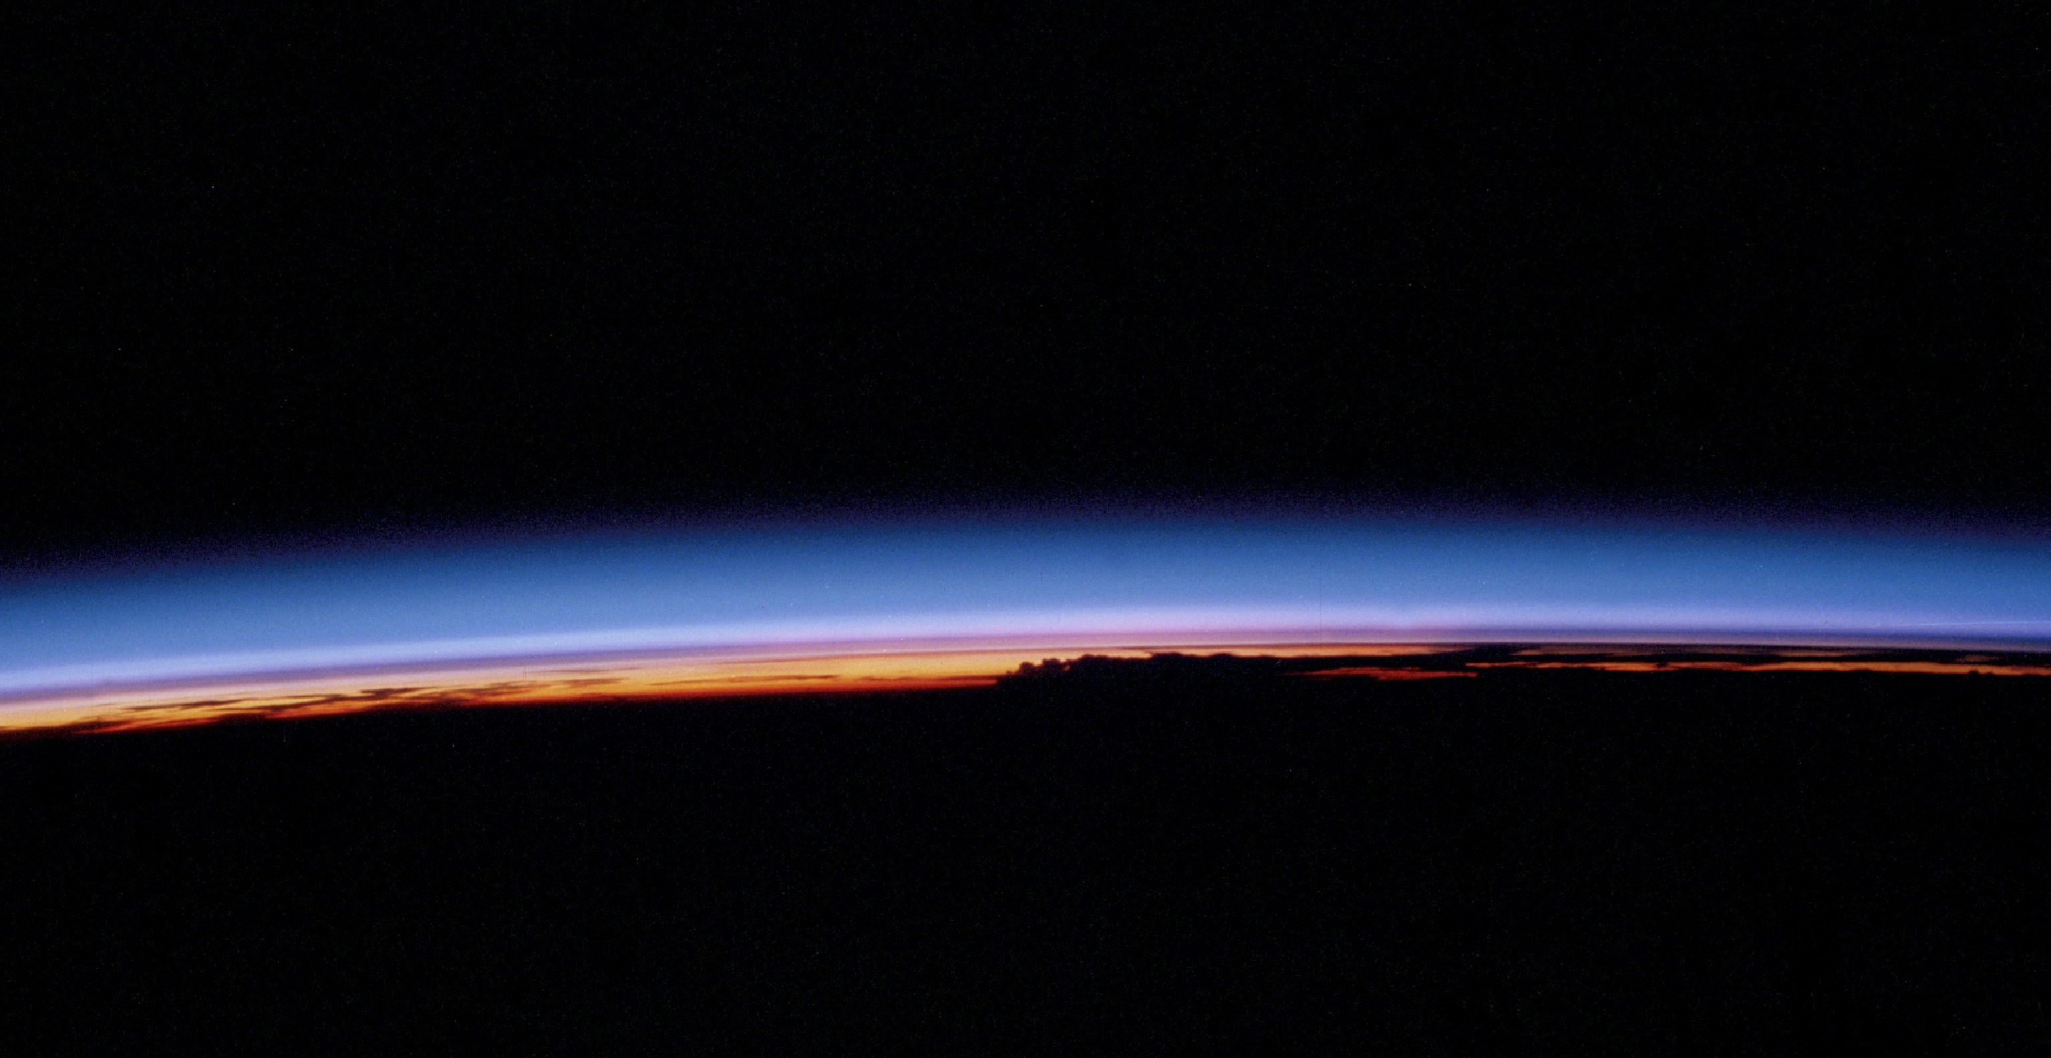
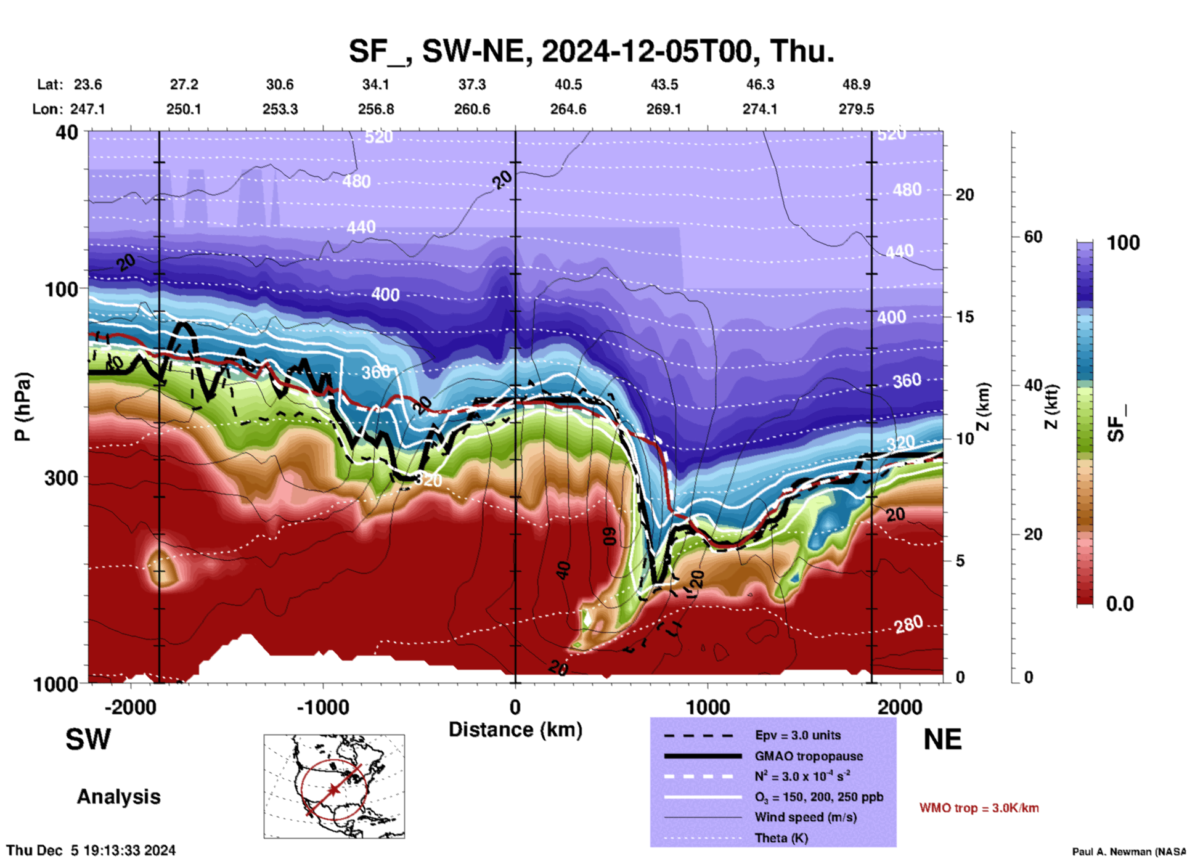
Need for Vertically Resolved Trace Gas, Temperature, and Aerosol Measurements in the UT/LS
From the 2017 ES Decadal Survey
“The tropical UT/LS has long been characterized as a nexus for the interaction of climate and atmospheric composition, and the conduit in the exchanges between stratospheric and tropospheric thermodynamical states. In addition, climate models poorly represent the processes that control the vertical distribution of radiatively active constituents in the UT/LS, even though changes in these constituents have a strong influence on the global climate (SPARC, 2010)”.
Stratospheric Fraction Tracer using O₃ and H₂O
Global high vertical resolution measurements of trace gases, temperatures, and aerosols in the UT/LS was identified in the ESDS as a critical part of our needed observing system to:
Connect the surface to the stratosphere through convective processes
Inform on processes/mechanisms impacting strat.-trop. exchange
Assess the interaction of chemistry and transport in one of the most dynamically active regions
Understand the radiative budget of the UT/S
Provide a robust continued CDR for UT/LS composition

Slide 5
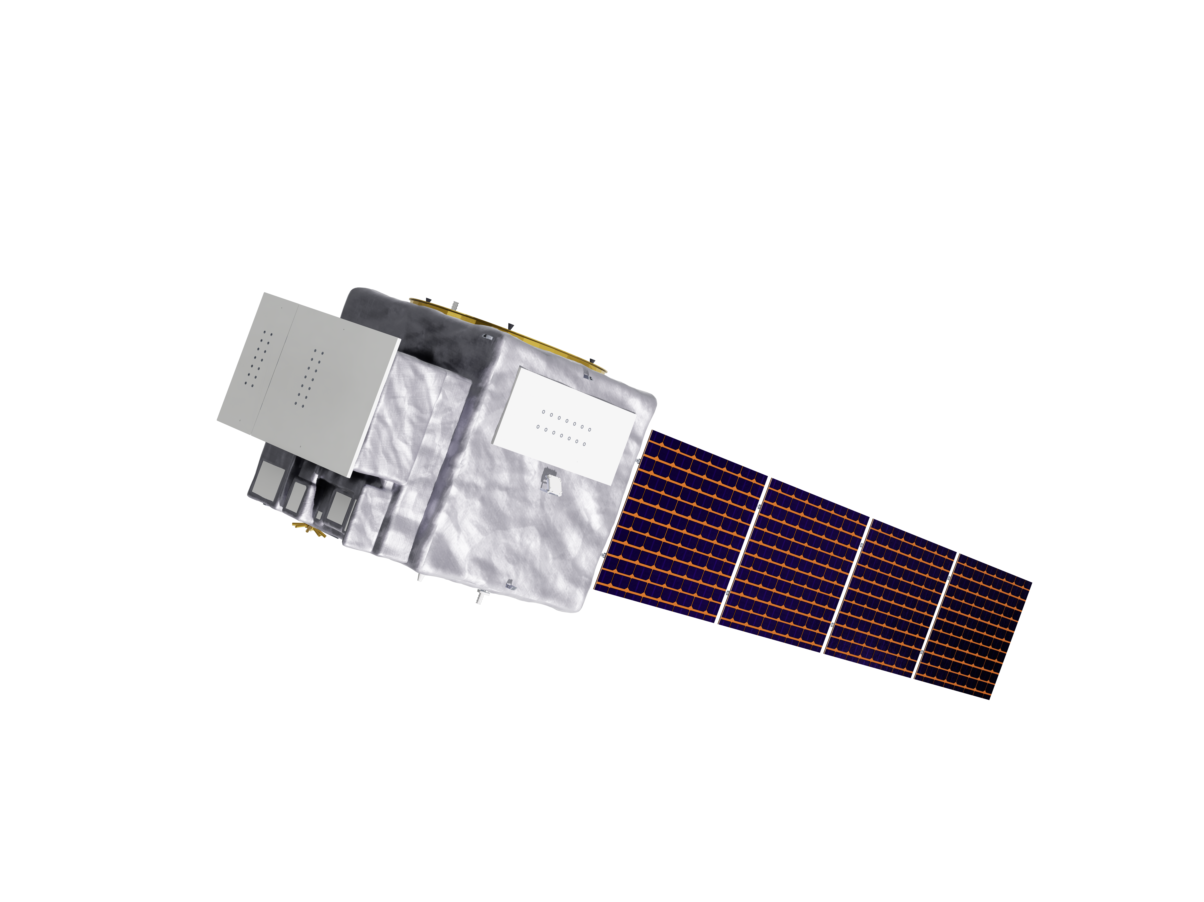
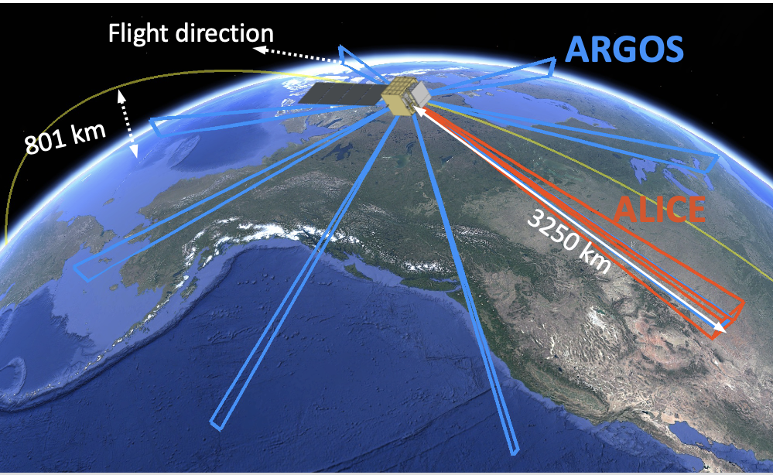
STRIVE Mission Design and Instruments
Sun synchronous orbit (801 km) observing Earth’s Limb at ~3250 km distance
Afternoon equator crossing time (13:30 local time) for connecting to longer term record and synergies with JPSS and FALCON
3-year prime mission with a NET 2030 planned launch
Spacecraft: Northrop Grumman LEOStar-2
Two limb-viewing instruments, providing near-global, daily coverage of the upper troposphere and stratosphere:
ALICE (Advanced Limb Infrared Chemistry Experiment)
ARGOS (Aerosol Radiometer for Global Observations of the Stratosphere)
STRIVE provides the vertical detail and dense global sampling to reveal fine-scale processes

Slide 6

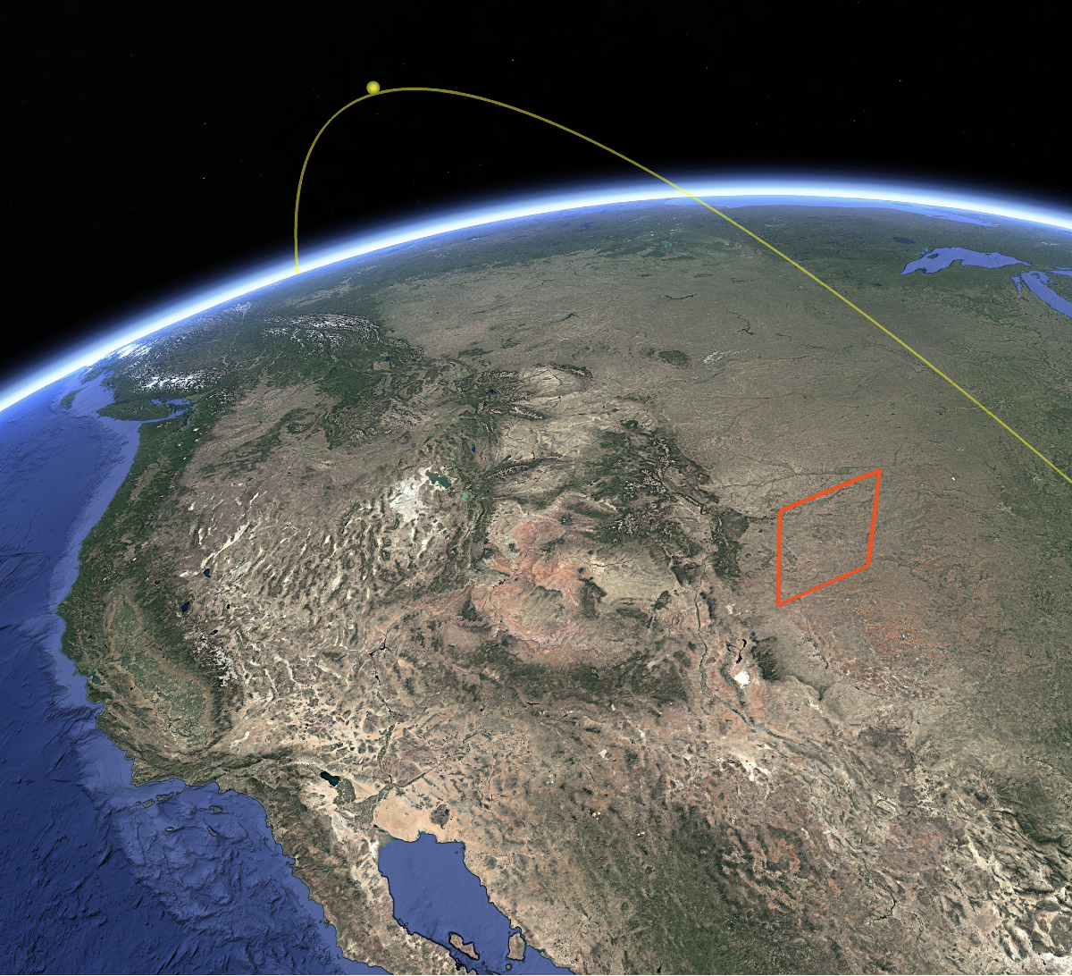
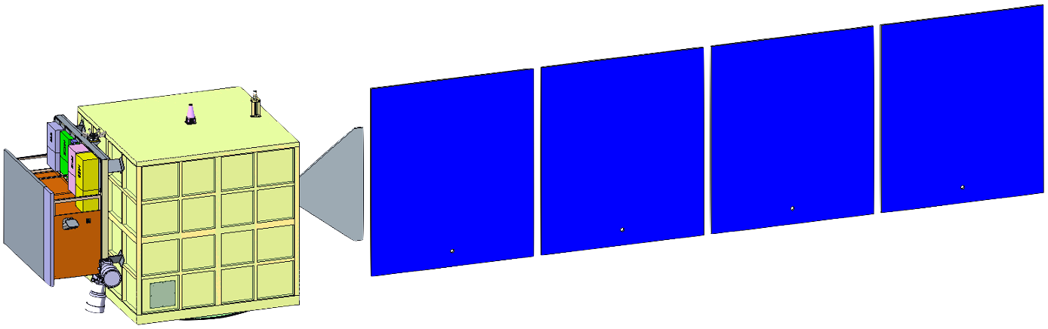
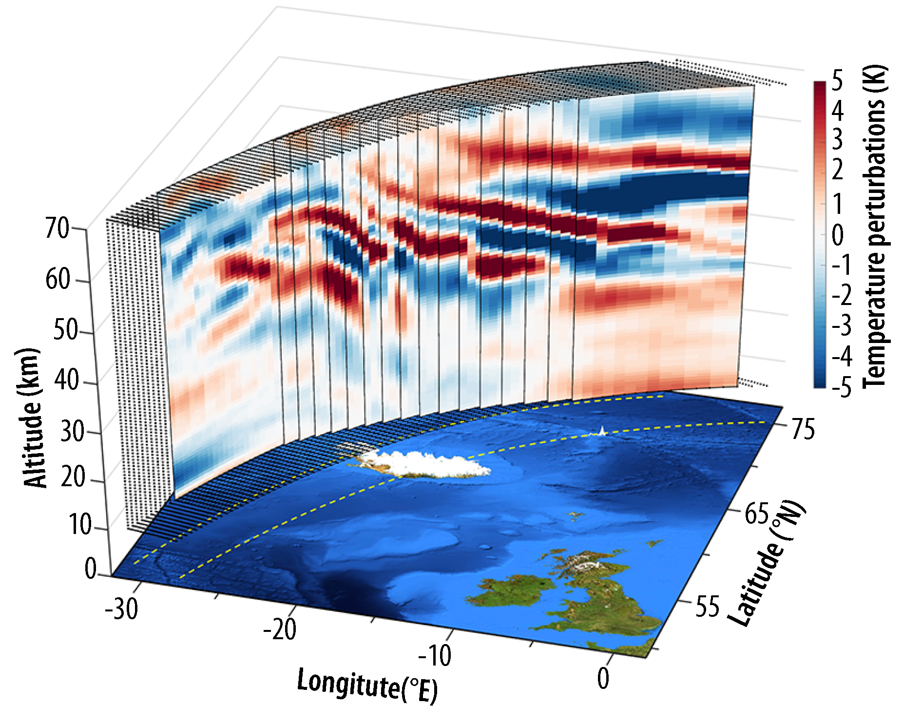
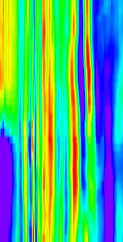
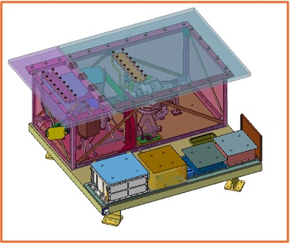
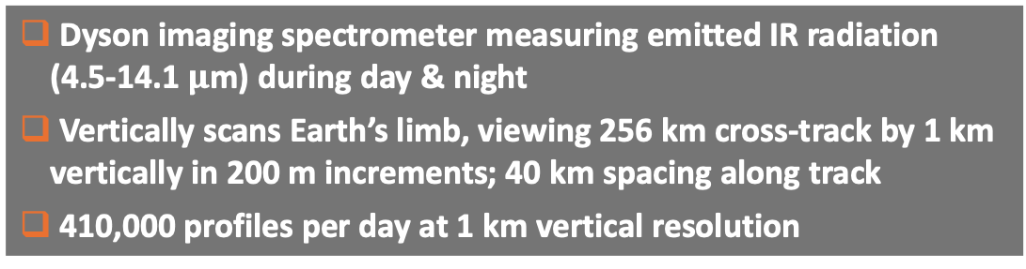
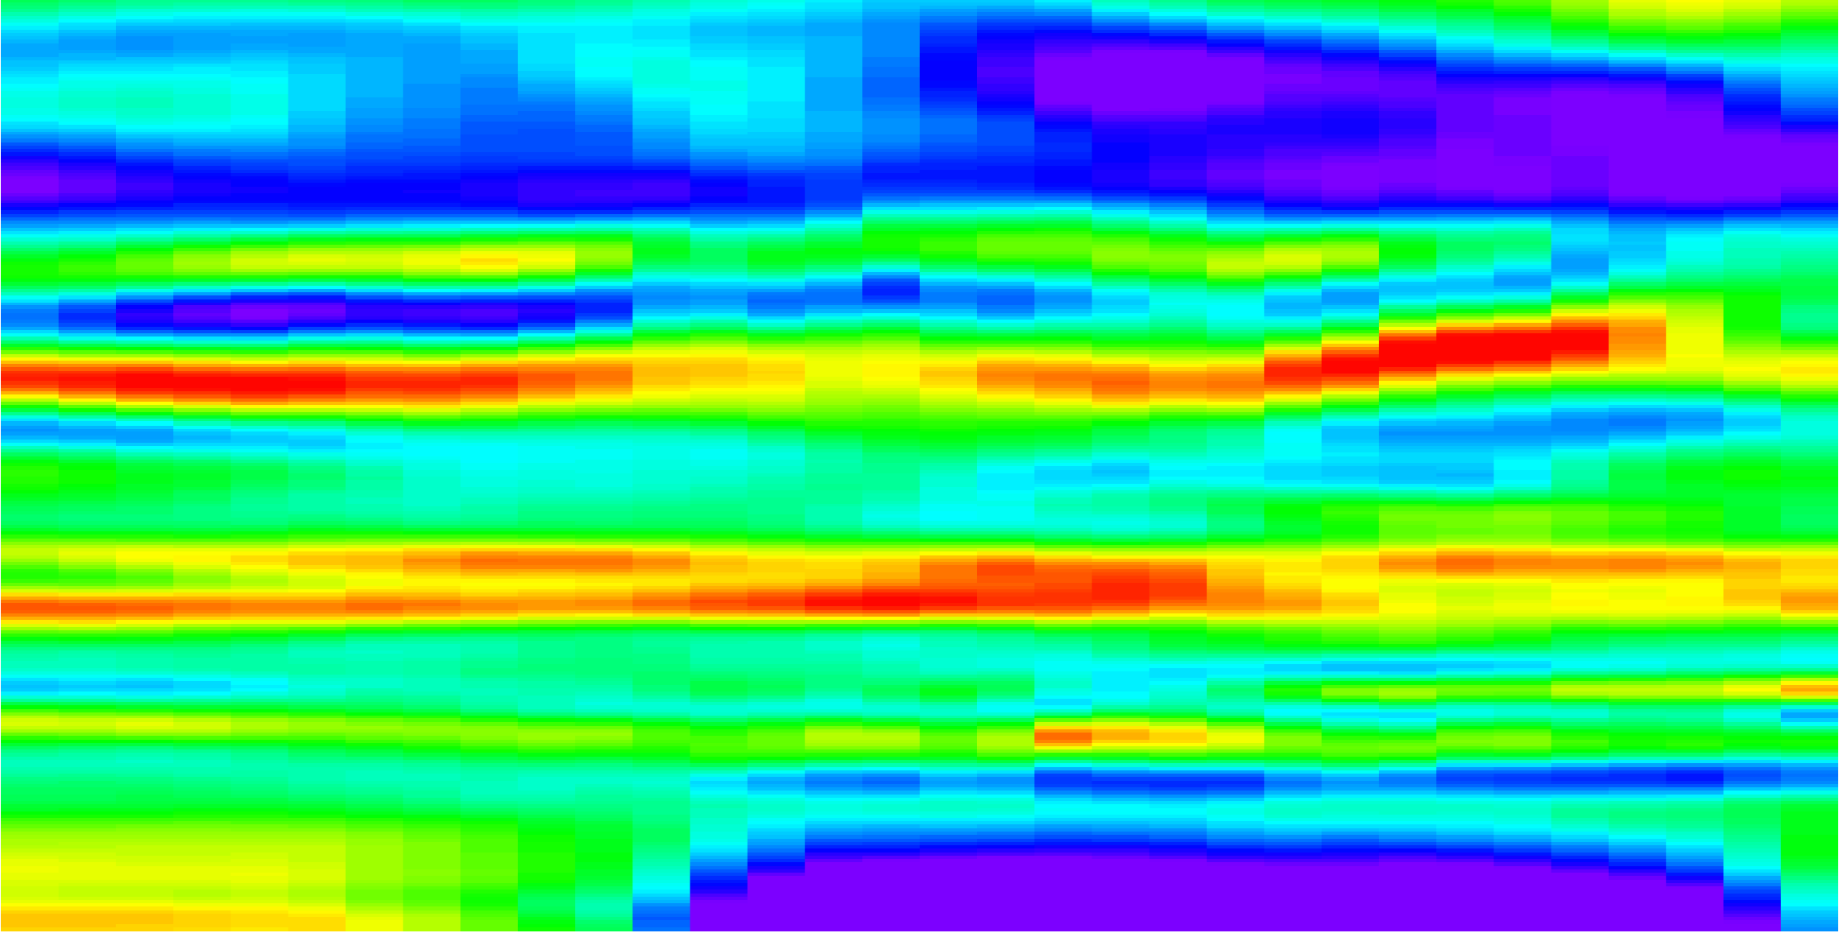
ALICE: The core science instrument of STRIVE
ALICE Products: T, O₃, H₂O, CH₄, N₂O, CFC-11, CFC-12, CO, HCN, NO₂, HNO₃,ClONO₂, N₂O₅, extinction
Additional species (SEO): SO₂, ClO, NH₃, PAN, SF₆, HCFC-22
Builds on HIRDLS scientific heritage, with enhanced spectral coverage, broader swath with finer cross-track resolution, and faster vertical scans for unprecedented detail
Flight direction
First of its kind, 3D-view of atmospheric composition and temperature
5-70 km
profiles every 40 km
256 km swath
8 km cross track res.
Dyson imaging spectrometer measuring emitted IR radiation (4.5-14.1 $μ$m) during day & night
Vertically scans Earth’s limb, viewing 256 km cross-track by 1 km vertically in 200 m increments; 40 km spacing along track
410,000 profiles per day at 1 km vertical resolution
Simulated ALICE gravity wave-induced temperature perturbation over Iceland

Slide 7
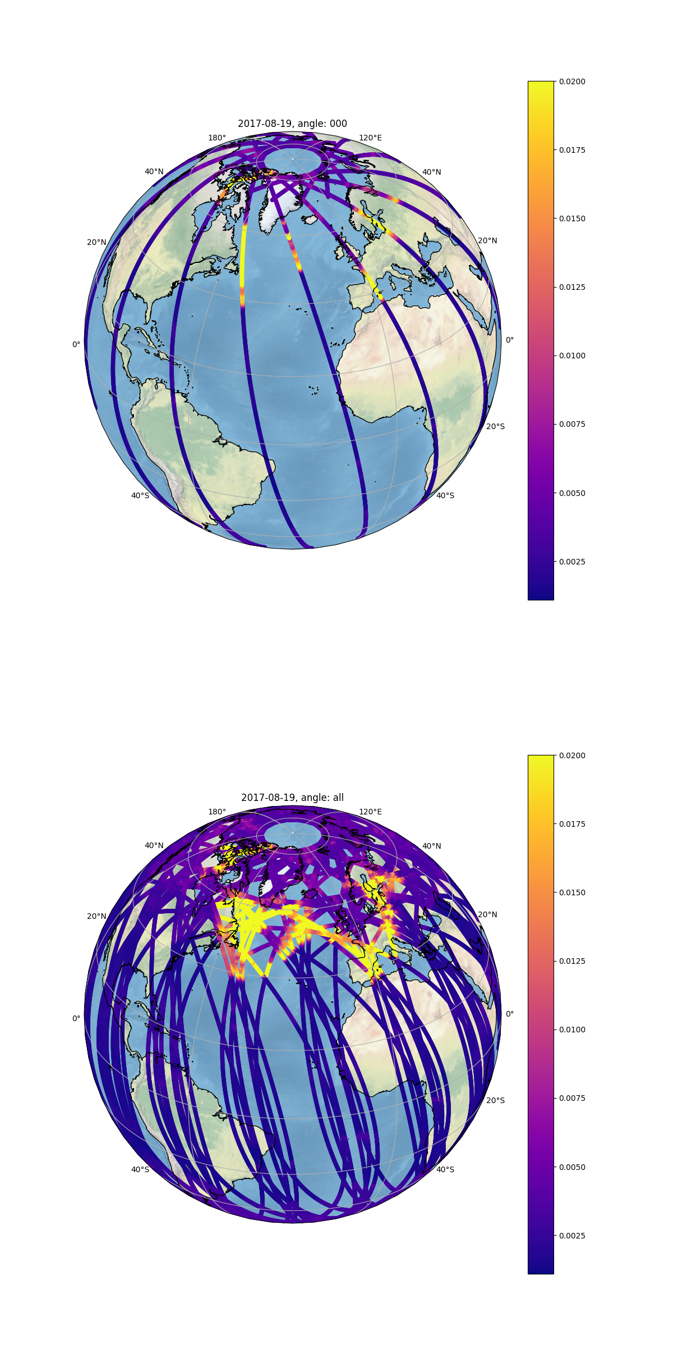
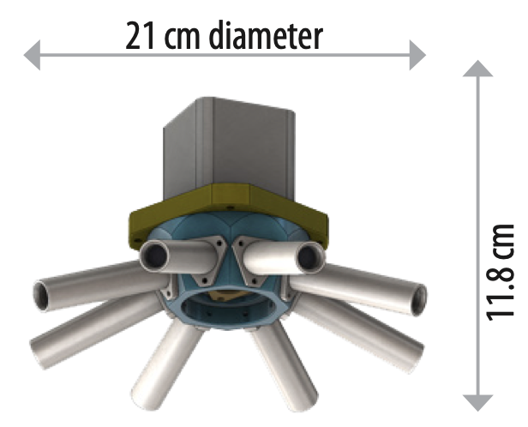
ARGOS: A contributed instrument enhancing the science
Building on OMPS-LP heritage, with 8 viewing directions and faster sampling to deliver major gains in sensitivity, spatial coverage, and constraints on aerosol size
ARGOS Products: aerosol extinction, Ångström exponent, radius, number density, PSCs
Unprecedented global tracking of smoke and aerosols
45°
5-35 km
profiles every 20 km
Simultaneous dual-spectral (870 nm and 1550 nm) and multi-direction (8 angles) radiometer measuring vertical limb profile using scattered solar light
100,000 profiles per day at 1 km vertical resolution; 20 km spacing along track
Successful technology demonstration launched in March 2025
One day of simulated ARGOS sampling of 2017 British Columbia pyroCb smoke plume in stratosphere

Slide 8
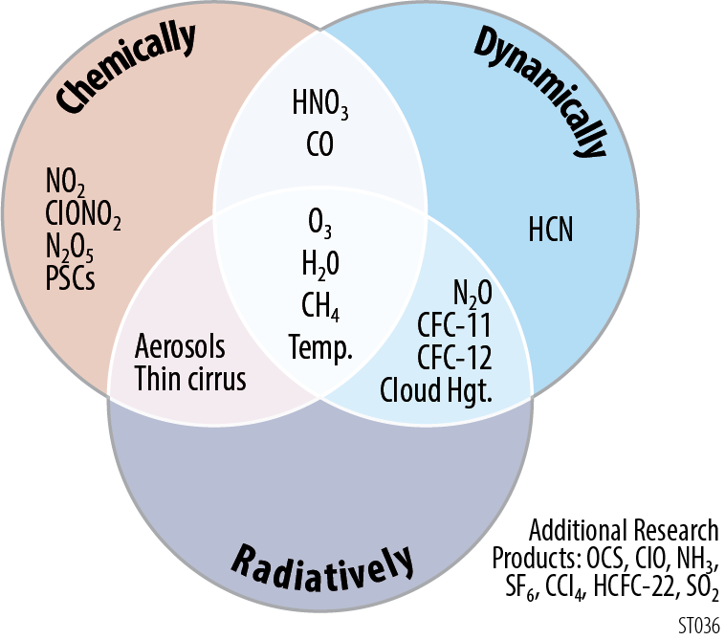
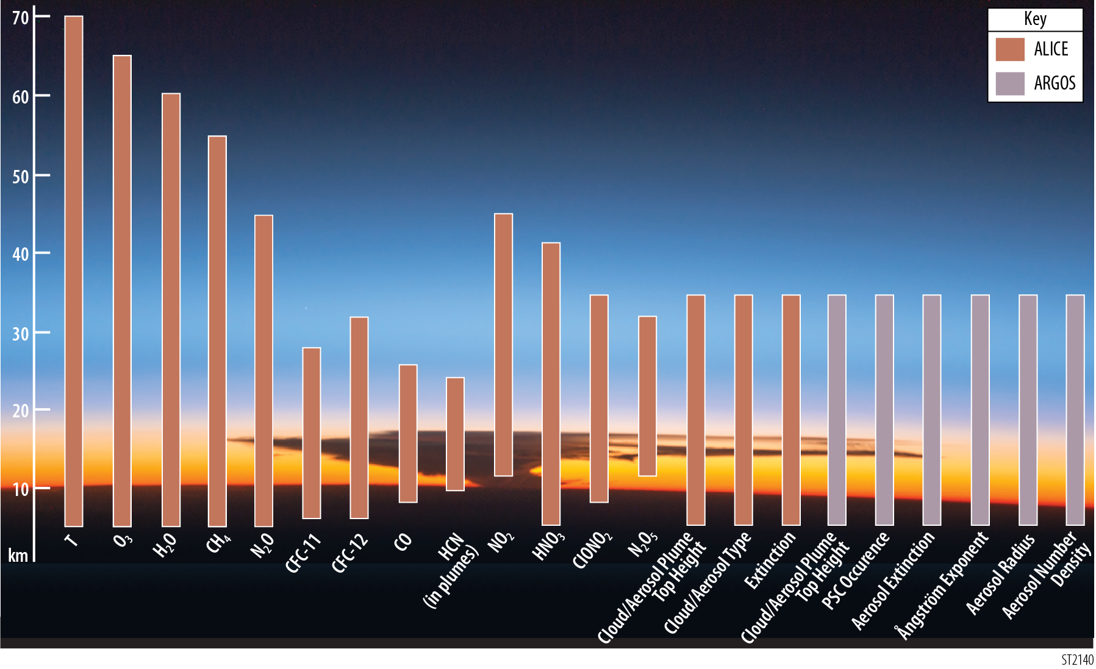
STRIVE Products and Altitude Range
Temperature
O₃
H₂O
CH₄
N₂O
NO₂
Cloud/Aerosol Type
HNO₃
Aerosol Properties
CFC-12
ClONO₂
Extinction
N₂O₅
CFC-11
CO
PSC
HCN
CTH
CTH
Additional species with enhancement options: OCS, polar ClO, CCl₄, HCFC-22, SF₆, NH₃, PAN, plume SO₂, among others
ALICE
ARGOS
ALICE’s measurements in the information rich mid-longwave IR has many more potential species for additional products and is significantly complemented with ARGOS enhanced aerosol measurements.

Slide 9
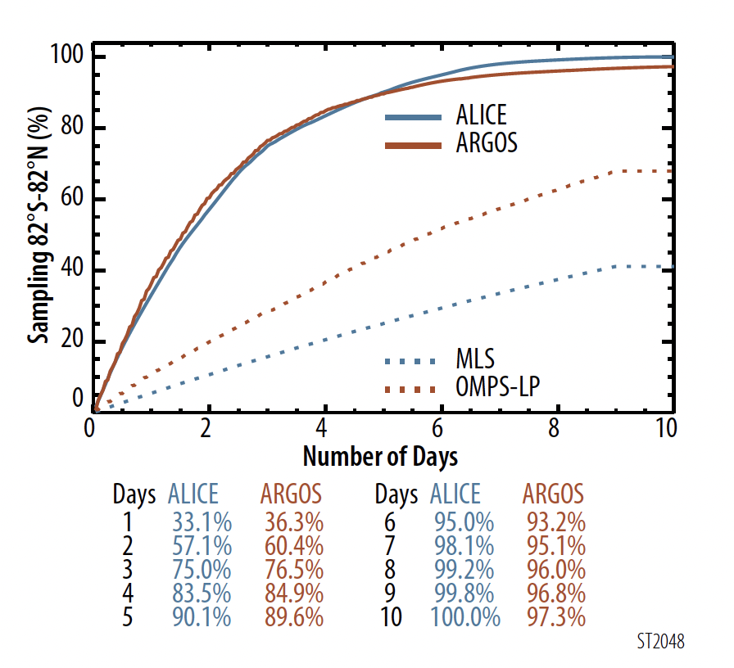
ALICE Measurements Provide Important Vertically-resolved Profiles Well Into the Troposphere
Daily # of Profiles:
20 km - ~ 414,000
12 km - ~ 266,000
6 km - ~ 18,000
Using HIRDLS cloud-free statistics as an example show ALICE would provide orders
of magnitude more information than current and past instruments with significant global coverage each day
ARGOS would provide a similar picture of aerosol measurements with ~¼ of the ALICE profile numbers but more distributed with its 8 apertures views

Slide 10
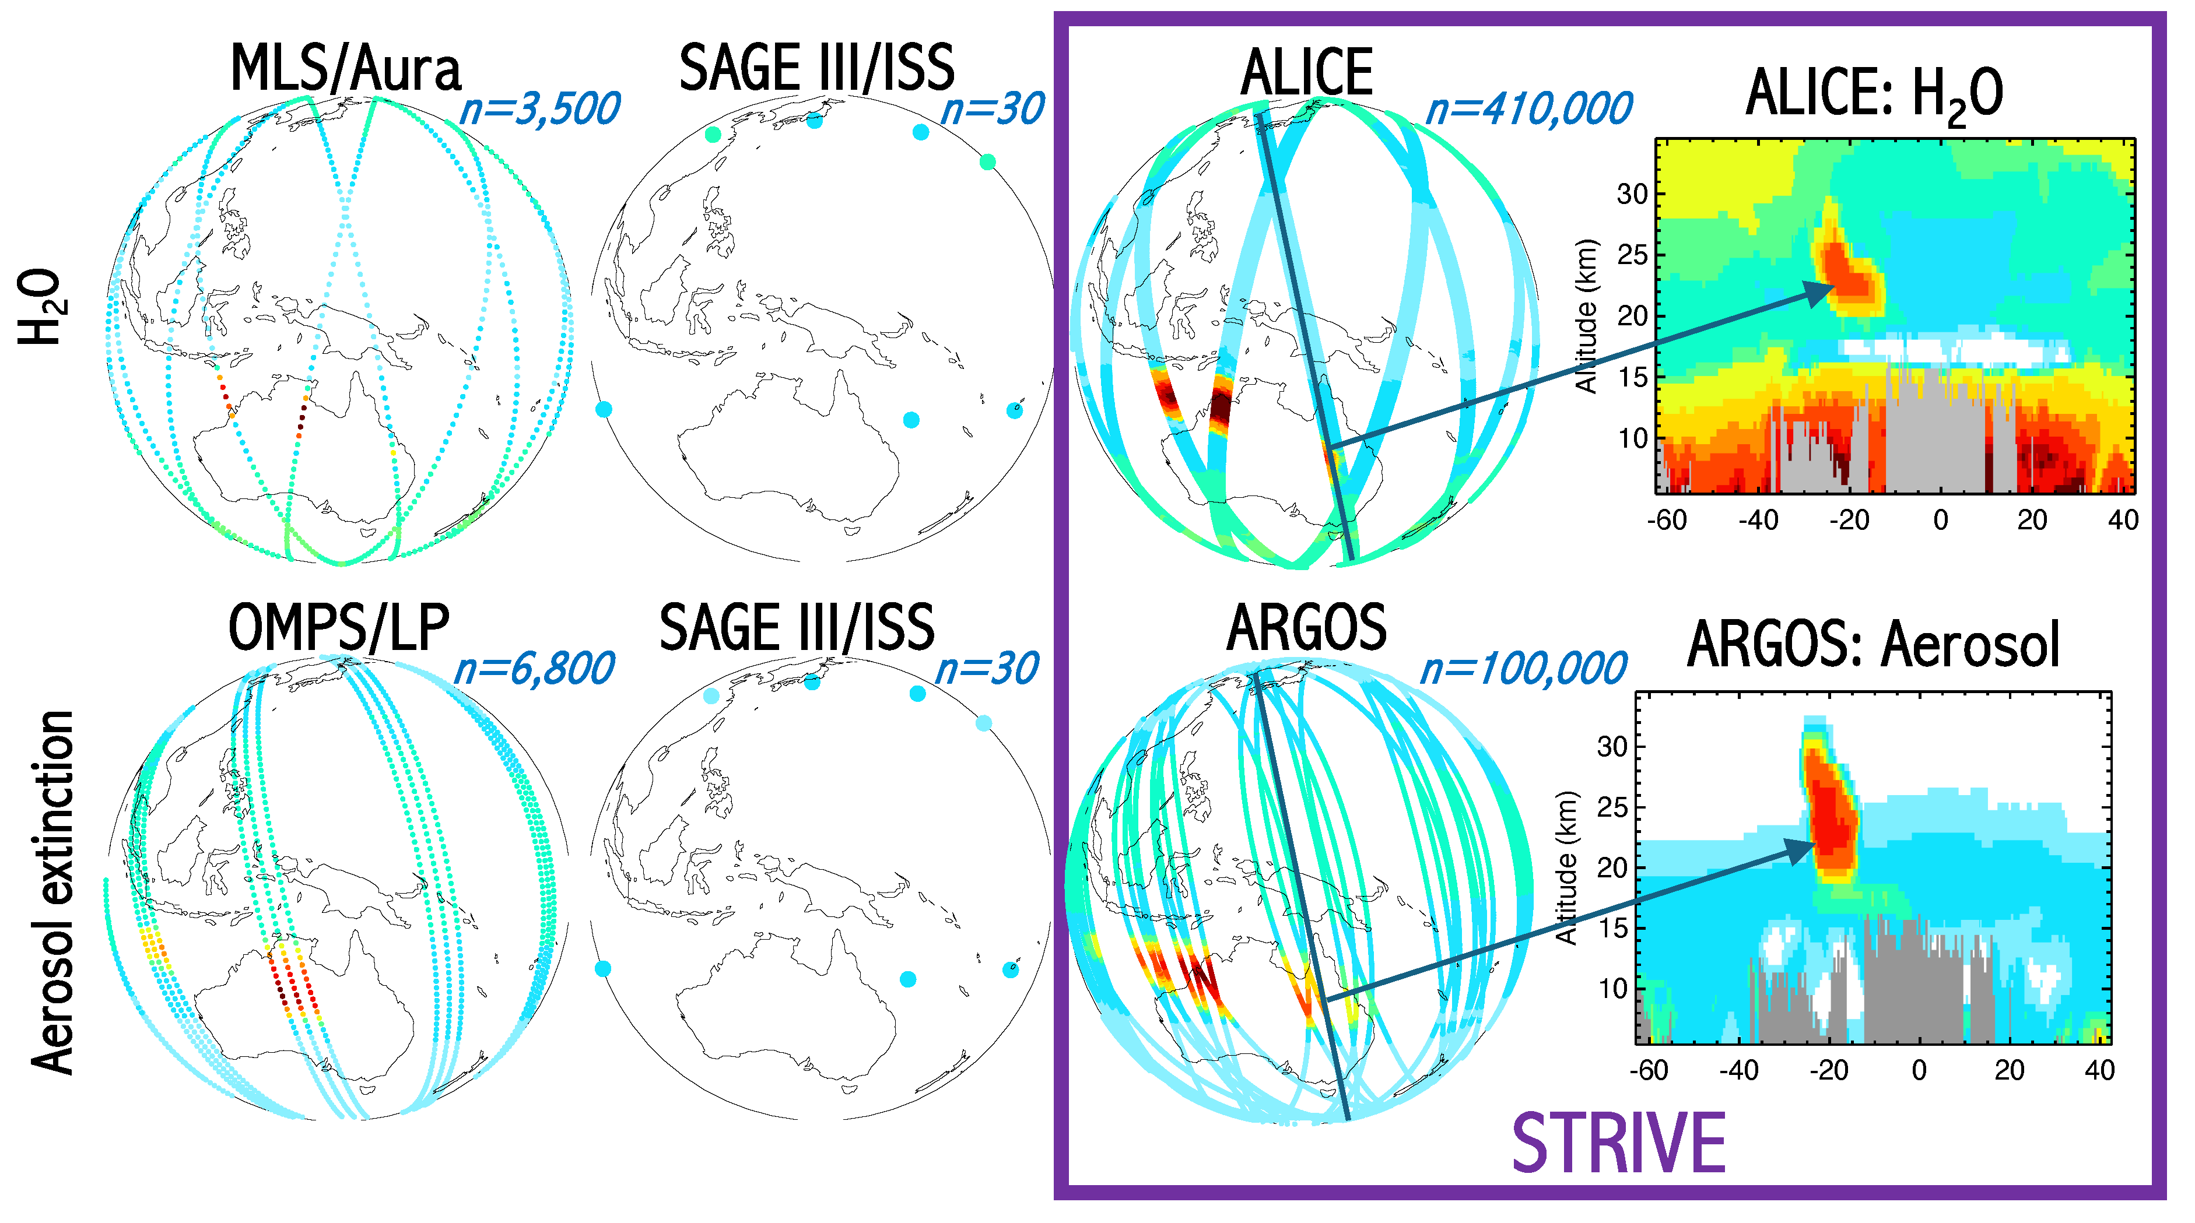
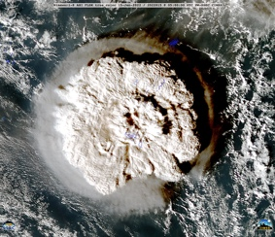
ALICE and ARGOS: unparalleled measurements for exploring chemical-aerosol-radiative interactions in upper troposphere and stratosphere
MODEL “truth”
CURRENT OBSERVATIONS
STRIVE OBSERVATIONS
GEOS model
2028
end-of-life
H₂O
26.5 km (20 hPa)
GEOS model
Hunga
Aerosol
extinction
STRIVE captures volcanic, wildfire, and pollution plume structure with unmatched detail – improving forecasts of their evolution and impacts

Slide 11
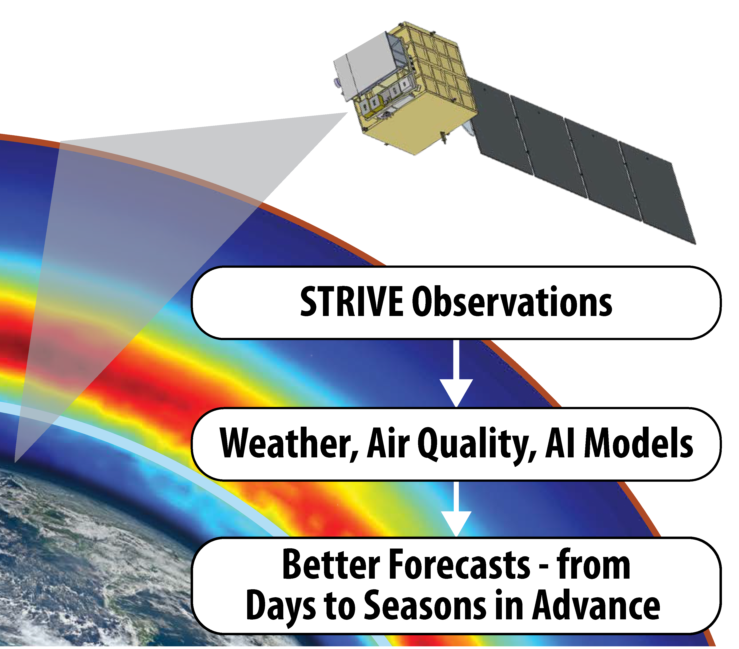






Societal Applications/Benefits
STRIVE reveals how the upper troposphere and stratosphere shape extreme weather, smoke and ash transport, and ozone recovery—and converts that knowledge into meaningful gains in forecast lead time.
Weather & Disaster Preparedness
Provide earlier warnings for floods, heatwaves, cold air outbreaks
Ozone Layer Protection
Track recovery and protect against harmful UV exposure
Air Quality & Public Health
Identify wildfire plumes and stratospheric ozone intrusions
Aviation Safety & Planning
Detect turbulence, volcanic ash, wildfire plumes
Agriculture & Energy
Improve seasonal outlooks for farming and energy needs
National Security & Infrastructure
Support subseasonal-to-seasonal forecasting for planning

