Slide 1
Atmosphere Investigator Meeting
Earth System Science Research
Dr. Barry Lefer
Associate Director for Research
Dr. Michelle Hawkins
Deputy Associate Director for Research
April 21, 2026

Slide 2
Increasing the Speed of Earth Science
NASA’s Earth Science Division is accelerating functions and simplifying processes with the goal of increasing speed of science and scale of impact.
This includes:
Speed to orbit
Speed to science and scientific discovery
Speed and scale of impact of science
Driving interdisciplinary science to go after most complex questions
Notes:
Source: March 2026 CESAS Presentation

Slide 3
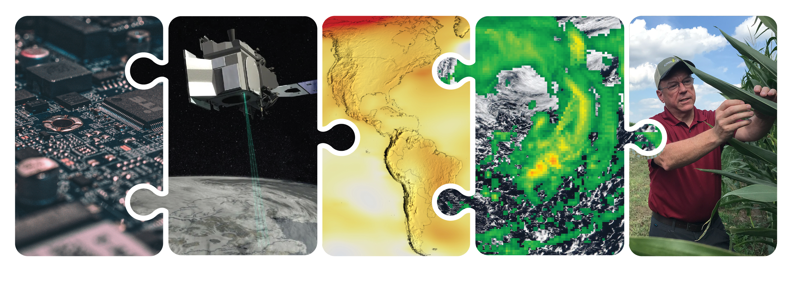
NASA’s End-to-End Earth System Science Capability
Technology
Flight
Research
Data Systems
Earth Action
10 Tech Infusions/year
24 Missions on Orbit
1,330 Active Research Projects
49 States
Collect 160 TB/Day
Serving 600 TB/Day
>10M Users
World-Class Models
Agriculture
Energy
Disasters
Wildfires
& more
12.11.2025
Notes:
Source: March 2026 CESAS Presentation

Slide 4
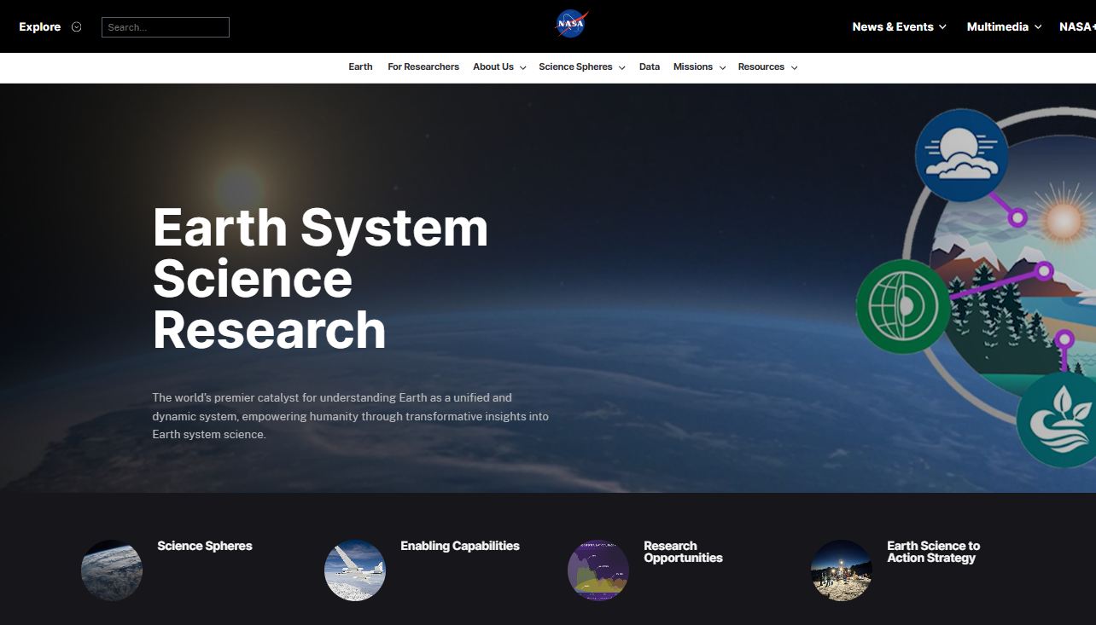

Scan the QR code or go to science.nasa.gov/earth-science/research/

Slide 5
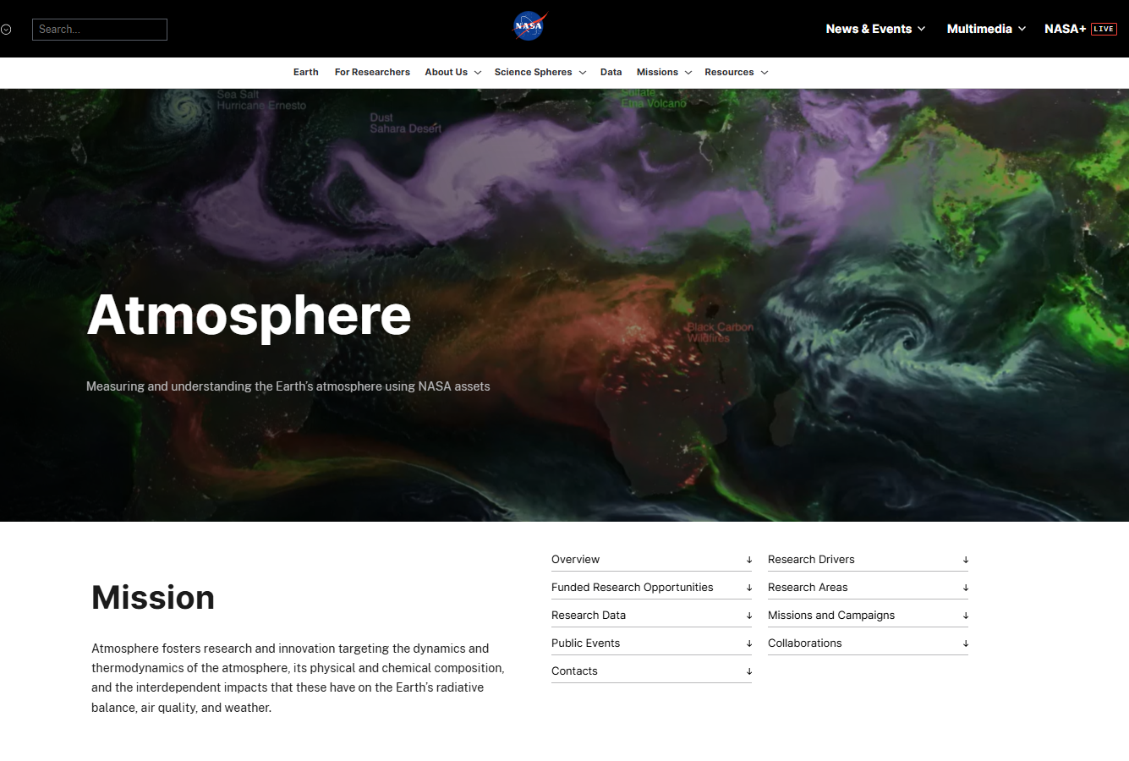

Scan the QR code or go to https://science.
nasa.gov/earth-science/research/atmosphere/

Slide 6

ESD Research Strategy Provides Flexibility
Simplify Research organization structure (transition to Spheres)​​
Use directed funds to maintain community-serving capabilities​​
Provide steady cadence of ROSES opportunities for all
Streamline and accelerate the ROSES application, evaluation, and award process​es
Enhance communication to our science community
Notes:
Source: March 2026 CESAS Presentation

Slide 7

ESD Research advances Earth system science by enabling the use of satellite, airborne, and ground-based observations, along with modeling approaches, to improve understanding of Earth processes.
Atmosphere
Studies the dynamics and thermodynamics of the atmosphere, its physical and chemical composition, and the interdependent impacts that these have on the Earth’s radiative balance, air quality, and weather.
Cryosphere
Studies polar ice, including the Antarctic and Greenland ice sheets, polar glaciers, sea ice in the Arctic and Southern Oceans, and the cryosphere’s link to Earth system
Geosphere
Studies processes and changes in the Earth’s core, mantle, and crust along with surface topography and geology, and the hazards they generate, along with studying geodesy and geodynamics.
Hydrosphere
Improves the observation, understanding, and prediction of water and energy in the Earth System across land, ocean, and the atmosphere through the integration of measurements from satellites, surface networks, and airborne campaigns.
Biosphere
Studies the interactions between/within terrestrial and aquatic ecosystems, along with changes in their biogeochemistry and biodiversity, to further understand the Earth system in which both human-induced and natural changes influence productivity and the availability of natural resources.
Notes:
Source: March 2026 CESAS Presentation

Slide 8
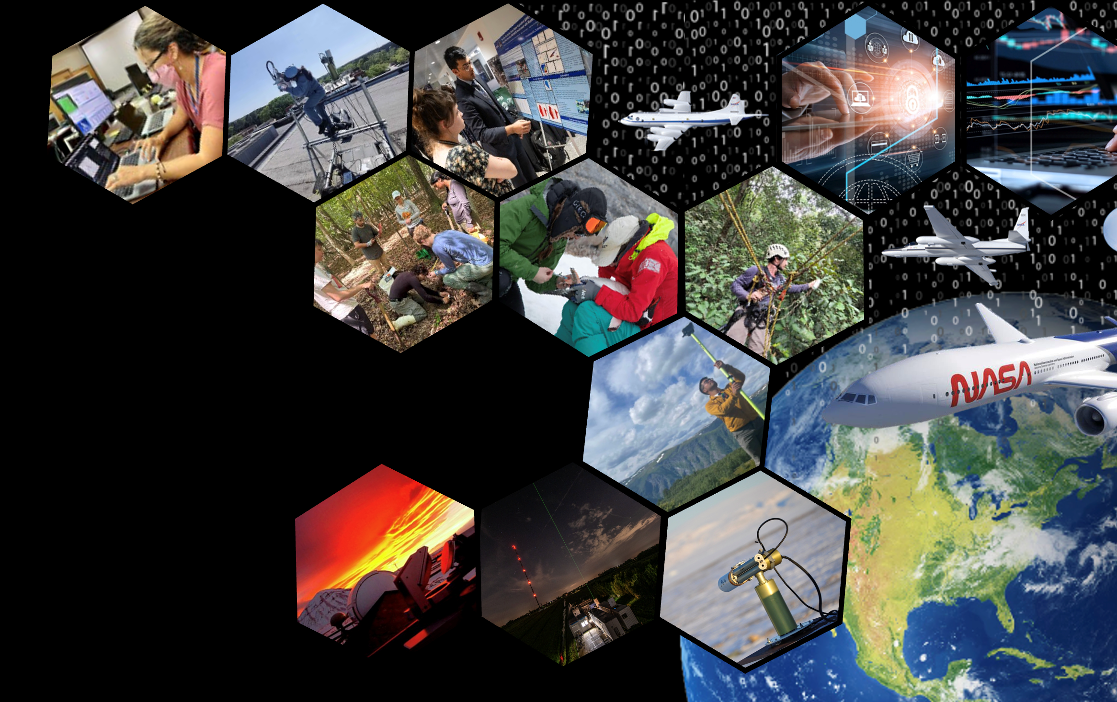
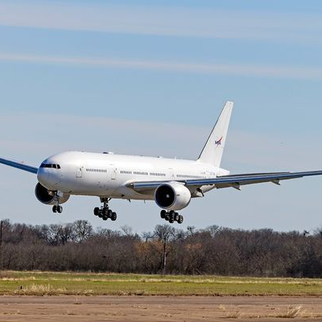
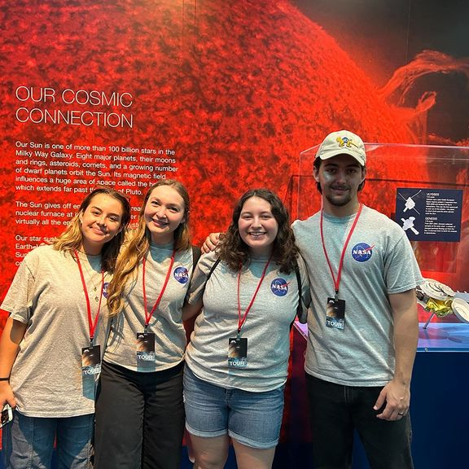
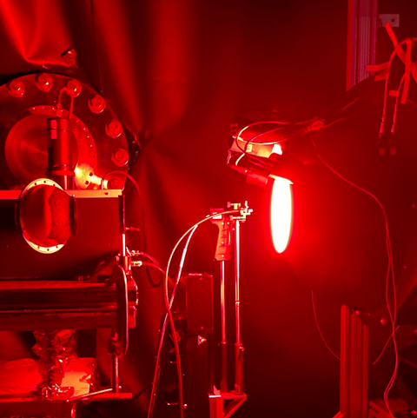
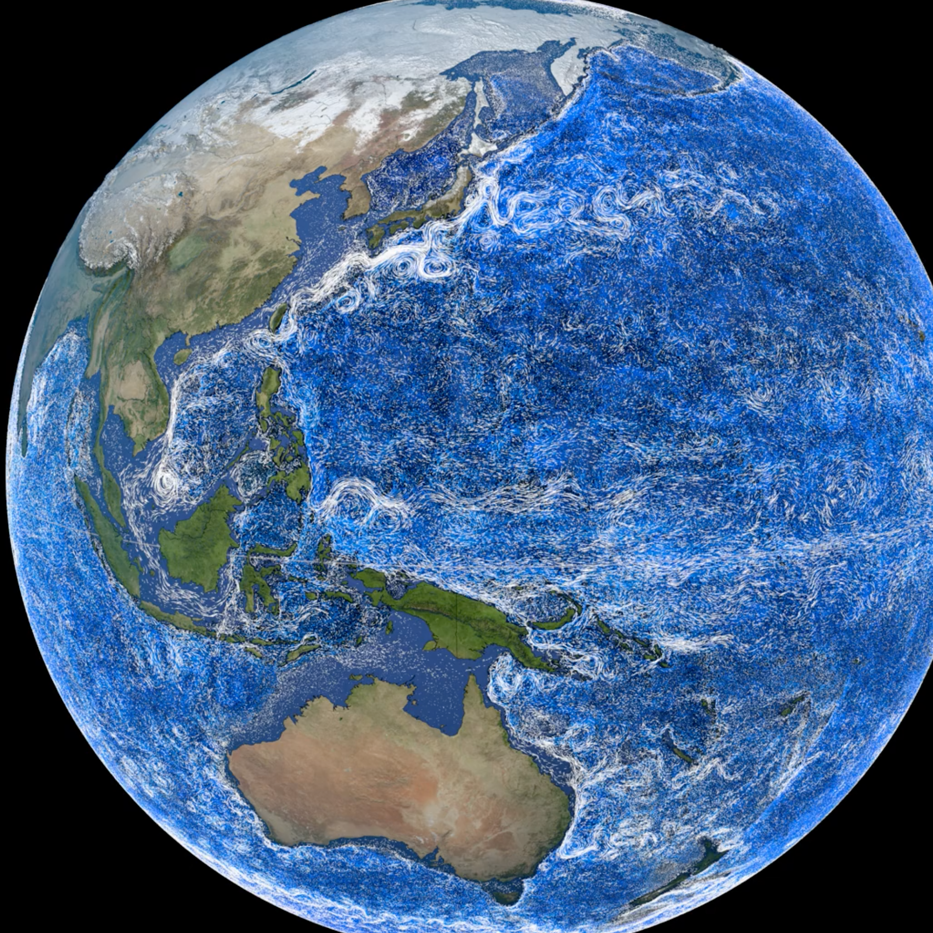
Enabling Capabilities
Foundational cross-cutting activities, opportunities, technologies, systems, or processes that benefit all Earth Science Division elements and Science Spheres.
Airborne Science Program
Early Career Research
Ground Networks, Calibration Labs, and Crowdsourcing
Integrated Earth System Modeling
Notes:
Source: January 2026 CESAS Presentation
Airborne Science Program
Integrated Earth System Modeling
Ground Networks, Calibration Labs, and Crowdsourcing
Early Career Research

Slide 9
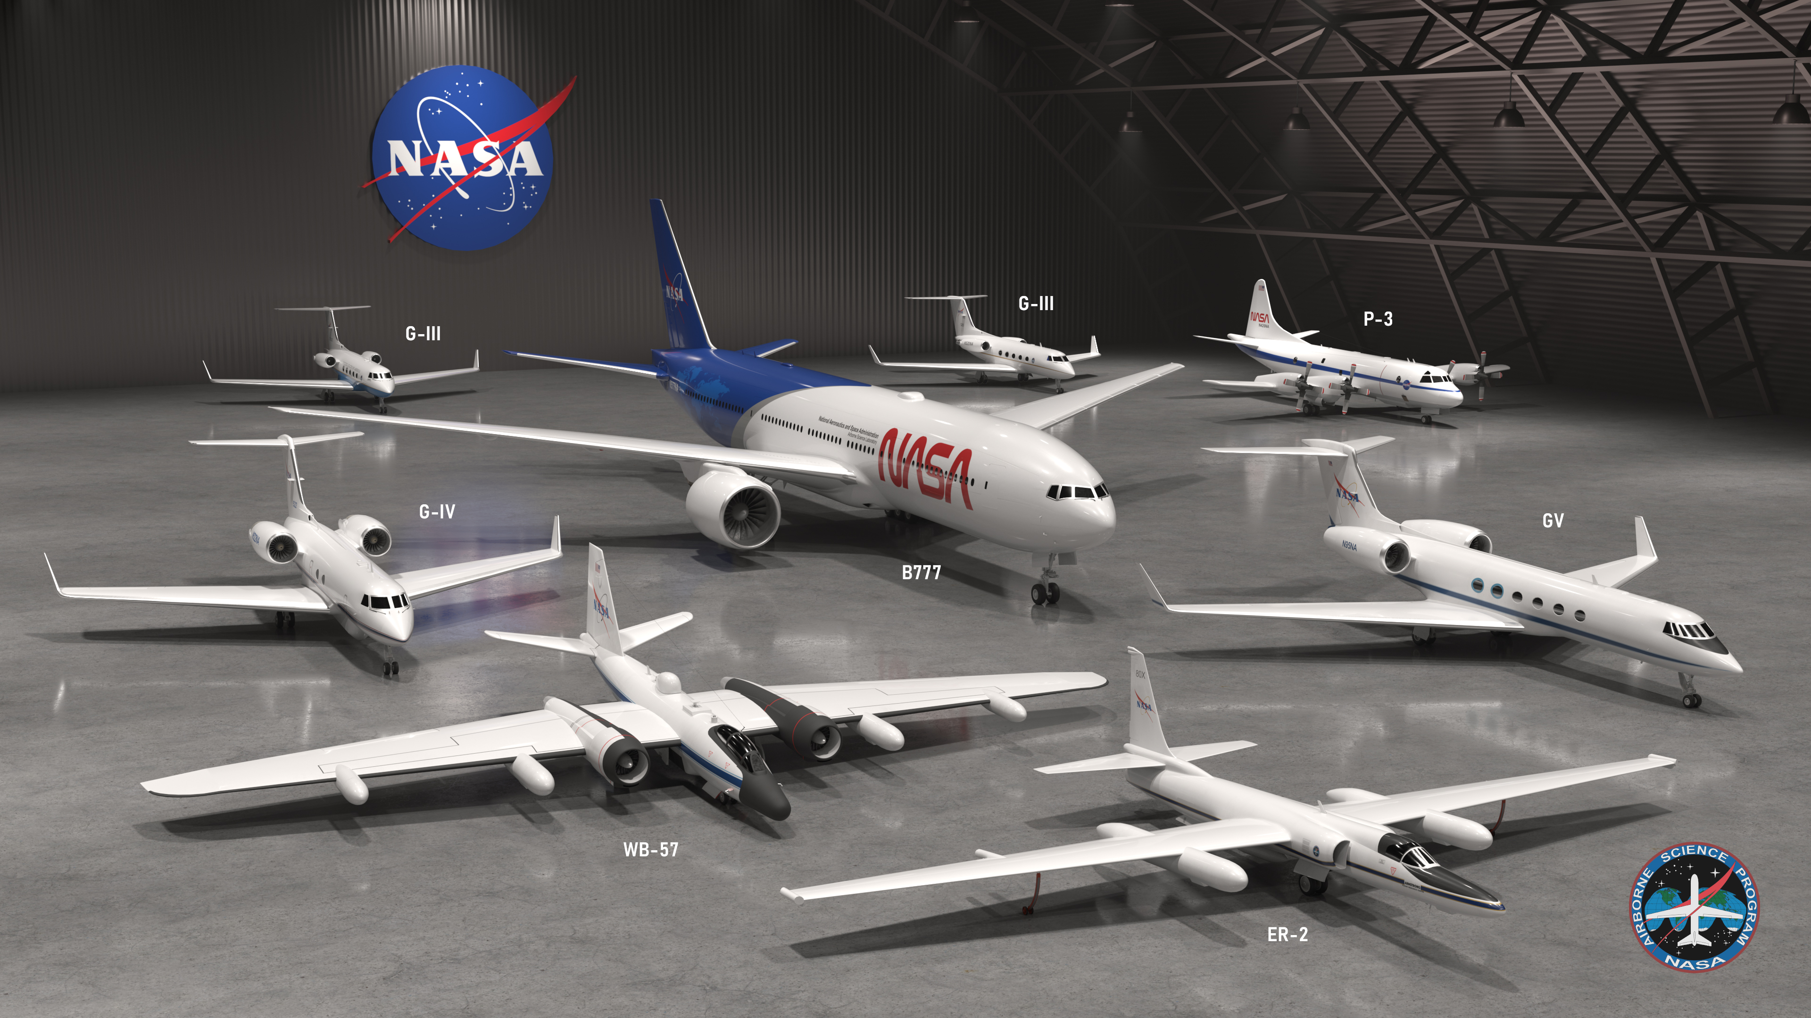
The ESD Airborne Science Program is Modernizing and Recapitalizing a Diverse Fleet to Support World-Class Airborne Science Well into the Future
Notes:
Source: January 2026 CESAS Presentation
The Airborne Science project aims to provide unique airborne platforms needed to collect Earth science observations to support:
Fundamental Earth System Science research;
Development and testing of new sensors/capabilities;
Calibration and validation of satellite/ground observations; and
Rapid instrument deployment for emergency response (as possible)
Unique NASA ESD Airborne Science Platforms:
Ultra High altitude (> 60,000 ft) in-situ sampling: ER-2 and WB-57
Ultra large capacity and extra-long duration (> 18 hr): B777
Large capacity, greater maneuverability, and long duration (>12 hr): P-3
Four engines on this aircraft provide extra safety margin for low altitude (500-1000 ft) obs, ability to land on snow (McMurdo) or gravel runways, truly all-weather aircraft with flight into known icing conditions
Medium capacity, higher altitude (>45,000 ft) with long duration (>10 hrs): GIV and GV
GV has superior cabin environment: lower noise and lower cabin pressure altitude (4000 ft)

Slide 10
Our Goal: Reduce Submission Burden and Reviewer Workload While Increasing Productivity and Efficiency
Some potential changes include:
  ESD Research releasing an element for each Sphere instead of each program
  Implementing a two-step process or mandatory NOI
  Reducing proposal length (5, 10, and 12 pages)
  Proposing a fixed dollar amount with budget submitted and finalized after selection
  Open solicitation with no due dates
  Utilizing pre-panel reviews for modified proposal triage
Implementing some or all of these measures will reduce review time (proposal submittal to selection decision) from six months to under three months.
Notes:
Source: March 2026 CESAS Presentation

Slide 11

Current & Planned ROSES-25 Opportunities
Link to ROSES-25 Table of Solicited Research Programs
Title |  | Element | Deadline | Program Officer(s)
Early Career Investigator Program in Earth Science (ECIP-ES) |  | A.11 | May 18 / June 17 (Mandatory NOI / Proposal) | Yaítza Luna-Cruz, Cyndi Hall
Earth Venture Suborbital-4 Hemispheric Airborne Measurements of Air Quality (HAMAQ) Science Team |  | A.12 | May 20 / July 21 (NOI / Proposal) | Emma Knowland, Jim Crawford
Future Investigators in NASA Earth and Space Science and Technology (FINESST) |  | F.5 | July 14, 2026 | Yaítza Luna-Cruz, Cyndi Hall
Rapid Response and Novel Research in Earth Science (RRNES) |  | A.4 | No Due Date | Krishna Vadrevu
Atmosphere |  | A.X | TBD | Ken Jucks, Emma Knowland, John Sullivan, Ed Nowottnick, Will McCarty

Slide 12




Planned ROSES-26 Elements
Estimated for Summer 2026 (release date and elements subject to change)
Earth System Science
Technology
Earth Action
ESD and SMD
Atmosphere
Biosphere
Cryosphere
Geosphere
Hydrosphere
Integrated Earth System Modeling (IESM)
Professional Engineering and Scientist Exchange Program (PESEP)
FireSense Technology
Intelligent Systems
Venture Technology Accelerator
Accelerating Earth Solutions
Commercial Data Calibration and Validation
Disaster Risk Reduction, Recovery, Resilience
Energy & Infrastructure
INNOVATE
User-Centered Applications from Large Earth Foundational Models
Future Investigators in NASA Earth and Space Science and Technology (FINESST)
Multisource Integrated Observatory (MIO)
Rapid Response and Novel Research in Earth Science (RRNES)
Supporting High-Impact Opportunities for Uniting Teams (SHOUT)
Notes:
4.17.2026: Updated

Slide 13

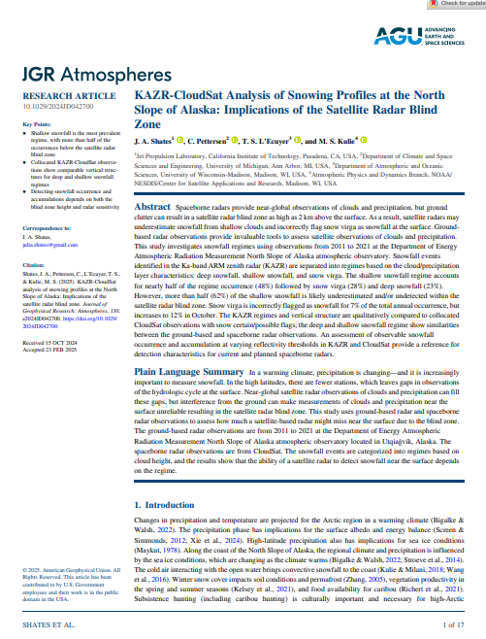
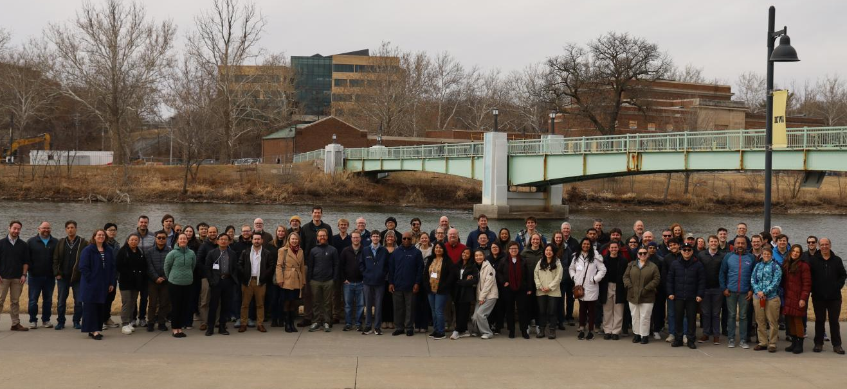
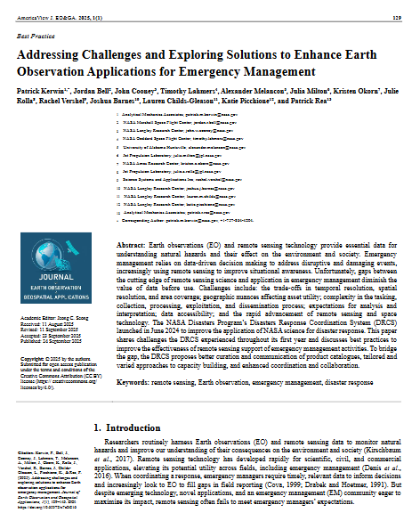
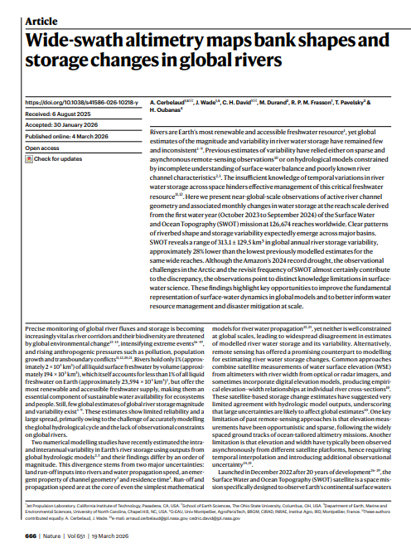
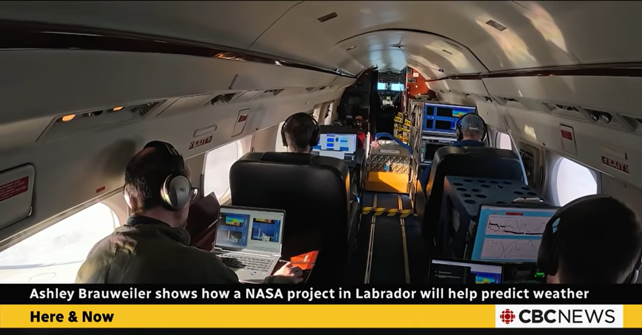
NASA Earth Science Research Results Portal
First INSPYRE Science Team Meeting
esdresearch.nasa.gov
Meetings and Events
Research Results and Scientific Developments
Campaign Highlights
Notes:
Source: March 2026 CESAS Presentation
Link: https://esdresearch.nasa.gov/

Slide 14
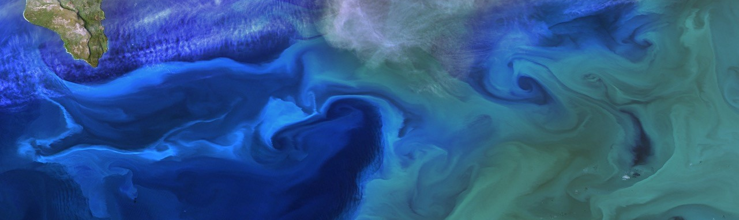


1512
Proposals
Reviewed
110
Panels
1507
Panelists
593
External
Reviewers
ESD Research by the Numbers:
Calendar Year 2025
Thank You!
Notes:
Source: March 2026 CESAS Presentation
239 total selections in calendar year 2025 (all stats here are based on when the steering committee occurred)
182 selectables as of January 8, 2026
FINESST numbers:
55 selections, 565 proposals, 838 panelists, 420 external reviewers, 63 panels
FINESST selection rate: 9.7%
85 of the 110 panels were DAPR

Slide 15
Integrated Earth System Modeling Strategy
Models underpin state-of-the-art prediction and global analyses that support economic growth, national priorities and security:
Streamline: Engage leading experts in the field nationwide to identify streamlined modeling approaches and consolidated workflows for greater effectiveness
Prioritize: Align investments around advanced technologies, mission needs, and new modeling techniques, including AI/ML
Flexible and scalable: Define modular and connected modeling approaches that maximize scientific computing systems
Notes:
Source: March 2026 CESAS Presentation
Models underpin state of the art prediction and risk assessment to support economic growth, national priorities and national security
The strategy:
involves the best experts where they are and workflows for greater effectiveness.
aligns investments around the advanced technologies and techniques.
taps expertise from all the major elements, integrating expertise – GISS, JPL, etc.
Creates an integrated team that was “in pockets” around the agency.

Slide 16
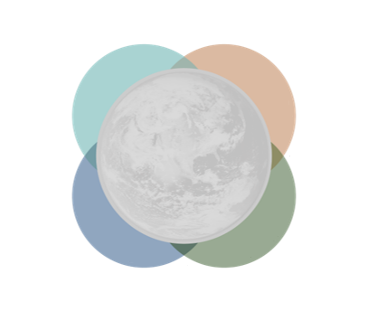
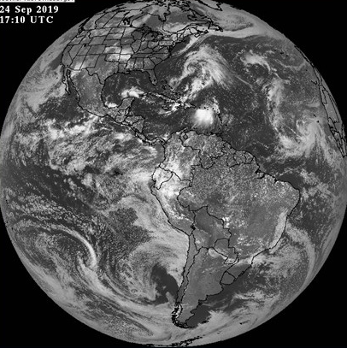
Integrated Modeling Virtual Institute (IMVI):
From Independent to Integrated
INDEPENDENT MODELS TODAY
INTEGRATED MODELING WITH IMVI
Land
LIS (Land Information System)
Atmosphere
Ice
Atmosphere
Ex.: Chemistry, turbulence, cloud processes
Physical, Chemical Processes
ISSM
Earth System
Ocean
ECCO (Estimating the Circulation and Climate of Oceans)
GEOS +
Model-E capabilities
Foundation Models
Partnerships
Core Integration
Ice
ISSM (Ice Sheet and Sea-Level System Model)
Software Engineering
User Needs
Code/Data Repositories
AI/ML, Computing
Ocean
Land
Earth System
Reanalysis and short-term and seasonal prediction
GEOS (Global Earth Observing System Model)
ECCO
LIS
Earth System
Decadal and long-term prediction and planetary atmospheres
Model E (Global Earth Observing System Model)
03.25.2026
Notes:
Source: March 2026 CESAS Presentation

Slide 17







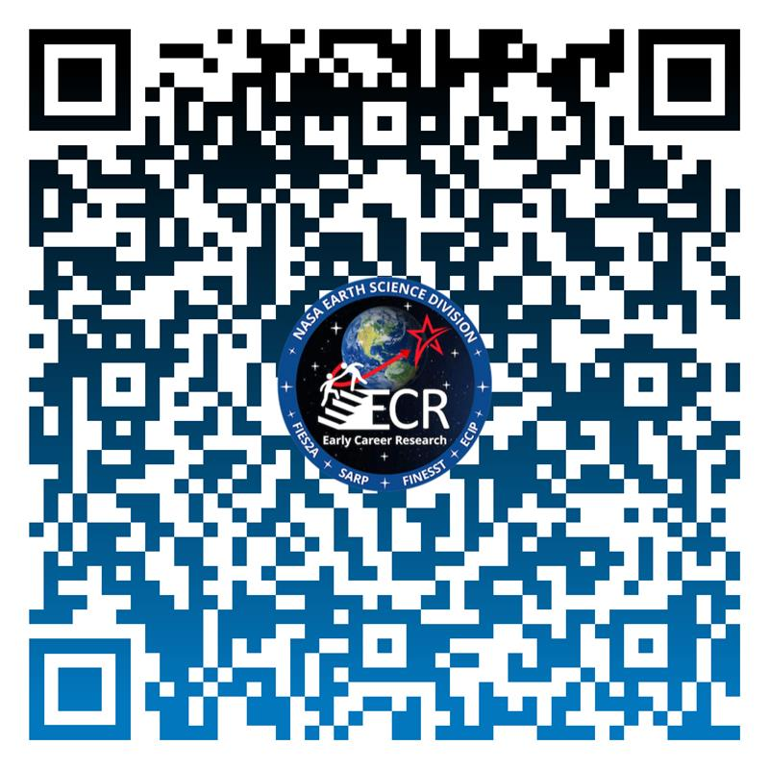


Early Career Research Program
Empowering the next generation of Earth science researchers to create a workforce that enables solutions to benefit society, respond to changes in the Earth’s system, and to support the
Earth Science to Action Strategy.
ECIP
Early Career Investigator
Program in Earth Science
#NASAEarthECR
FINESST
Future Investigators in NASA Earth and Space Sciences and Technology
SARP
Student Airborne Research Project
FIES2A
First Immersion in Earth Science to Action
START
HERE
Notes:
Source: ECR, added February 2026
ECR is a journey towards Excellence… a journey towards discovery, participation, community, and action. Our mission is to Empower the next generation of Earth science researchers to create a workforce that enables solutions to benefit society, respond to changes in the Earth’s system, and to support the Earth Science to Action Strategy. ECR is Striving for Excellence in Earth Science with the following Projects:
FIES2A - An interdisciplinary summer internship for young Earth science-interested students to get immersed in a workforce development experience at one of NASA’s Centers to conduct research focused on Earth System Science.
SARP - A summer internship for rising-senior undergraduates. SARP is a unique NASA internship that gives the students hands-on experience in Earth system science research, as well as in all aspects of a scientific campaign.
FINESST - Competitive Program: NASA research grants for graduate students up to 3 years and up to $50K per year to propose research on all Earth Science Division elements.
ECIP - Competitive Program: NASA research grants for early career researchers (i.e., 6 years after PhD) up to 3 years and up to $100K per year to propose research on all Earth Science Division elements.
ECR also works in collaboration with other workforce development programs across the agency such as the Office of STEM Engagement (MUREP, EPSCoR, Space Grant), Space Apps among others.
Questions: Yaitza Luna-Cruz (Program Manager) or Cynthia Hall (Associate Program Scientist)

Slide 18
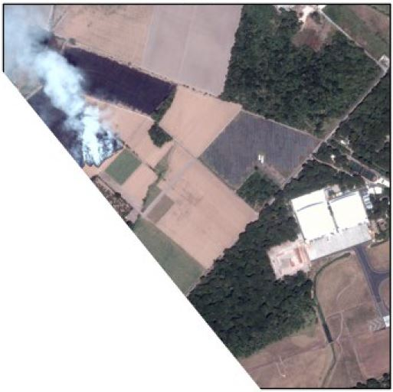
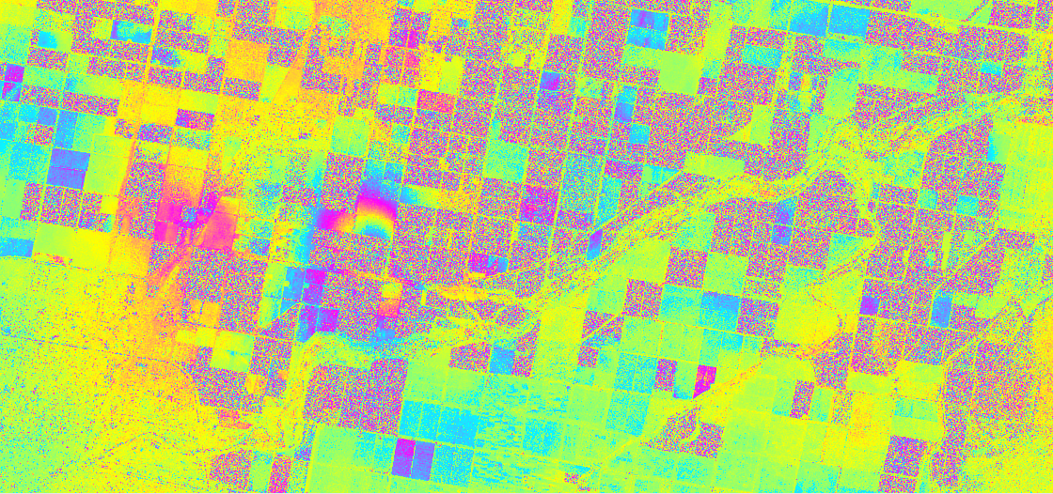

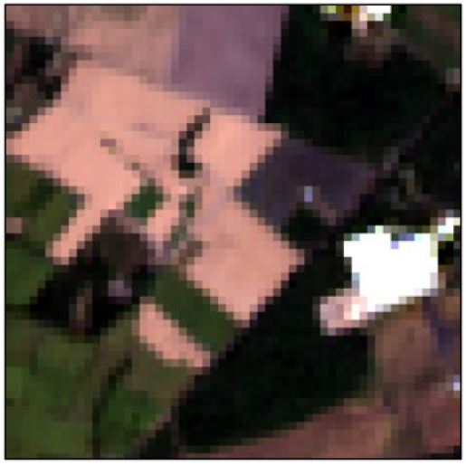
Commercial Satellite Data Acquisition (CSDA) Program
Program Manager: Melissa Martin (HQ)
Project Manager: Dana Ostrenga (GSFC)
Project Scientist: Fritz Policelli (GSFC)
Established by ESD to identify, evaluate, and acquire commercial satellite data that support NASA's Earth science research and application goals.
CSDA Commercial Data complements existing NASA/US Gov satellite fleet with shorter revisit times, higher spatial resolution, and complementary measurements.
CSDA has 15 commercial vendors on contract representing Synthetic Aperture Radar (SAR), Precipitation radar, Multispectral, Hyperspectral, GNSS-R/RO, Methane Emissions, and Digital Elevation Models (DEMs).
US Gov funded researchers covered by End User License Agreement (EULAs). NASA will not prohibit agency usage of the data if it abides by the EULA requirements.
BlackSky 1 m
(Commercial)
Learn more about CSDA
Landsat 30 m (NASA)
Airbus: X-band High Spatial Resolution Interferometry (Lohman, 2022)
Notes:
Added April 2026, from Melissa

Slide 19
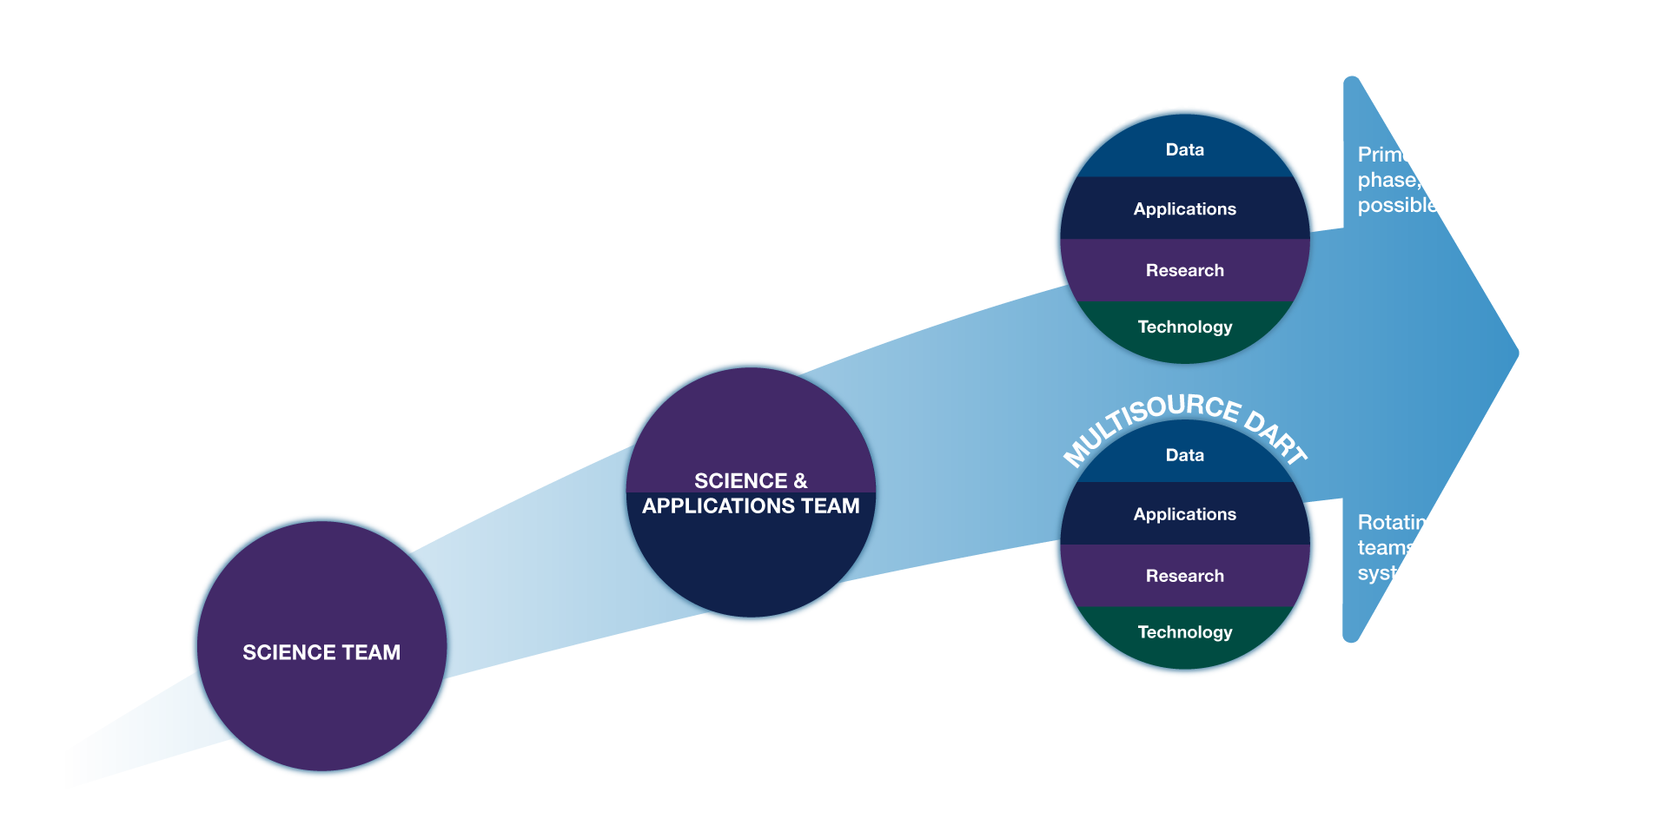
Evolution of NASA Mission Science Teams

Slide 20
Questions?

Slide 21
Backup

Slide 22
iESO Transition to MIO
iESO supported the Earth System Observatory (ESO).
As the ESO is evolving, there is growing opportunity in integrated Earth-observing and encouraging synergies across ESD programs.
ESD is thus transitioning iESO into a new Multisource Integrated Observatory (MIO) project.
This transition involves substantial changes to our approach to current mission science teams.
Multisource Integrated Observatory
Notes:
Created for March 2026 CESAS MIO Presentation
ESO IRB said we weren’t organized to do this collectively, took the action to establish MIO
NASA is uniquely positioned to glue everything together
Restructure the way we did our science teams
How do we get the most out of earth system science and application where it’s the interaction of the systems is where the discovery comes
Broaden to MIO
Budget uncertainty to do best possible science under range of possible futures
Solid thinking from iESO and that applies more broadly across the collection of missions we're able to partner on, fund etc

Slide 23
Multisource Integrated Observatory Goal and Objectives
ESD sees growing opportunities in integrated Earth-observing to answer complex Earth system science questions
Goal: Maximize science and applications from individual missions and observations combined across NASA, partner, and commercial fleets
Objectives
  Integrate the broad spectrum of activities required to accelerate the pace of scientific discovery and innovation
  Deliver high-impact, actionable applications based on multisource data, technology, and science
  Advance science-to-application pipelines across public and private sectors
Multisource Integrated Observatory
Notes:
Created for March 2026 CESAS MIO Presentation
Maximize science and applications from individual missions and observations combined across NASA and partner fleets
Just giving a short MIO highlight here, John Sullivan will provide more information later this afternoon.
We believe integration in Earth observation can really help us maximize the value of our missions, and maintain our position as a leading innovator in Earth science discovery
Science only we can do – multi-mission, cutting edge
Goal of MIO
Making sure the mission focused science teams make the most of each mission and then work across missions to get the max science across the portfolio

Slide 24


Why MIO?
Combining multisource data to advance Earth science and inform critical decisions on national security, resource management, and disaster response
COMPONENTS
Multisource
Integrated
Observatory
Multisource DARTs
Extracting maximum value and impact by combining observations from multiple sources
Including ground-based, airborne, partner, and commercial observations, plus stakeholder insights
Breaking through collaboration barriers to enable cross-cutting teams
Coordinating observations, cross-validation, and measurements across platforms
Unifying the program of record into an enterprise for Earth system science questions
Addressing the most important societal challenges
Multisource Integrated Observatory
Mission DARTs
Project Office
Notes:
Created for March 2026 CESAS MIO Presentation

Slide 25



Multisource Integrated Observatory (MIO)
Maximizing the value and impact of NASA Earth Science by combining observations from multiple NASA missions, domestic and international partners, and commercial industry
3 multisource thematic teams solicited through ROSES 2026
Multisource Integrated Observatory
WATER
LIFE
CHALLENGES (RFI)
Multi-source proposals that advance our understanding and decision-making ability to characterize the complete water cycle
Multi-source proposals that advance our understanding and decision-making ability to protect life on Planet Earth
Identifying large scale interconnected challenges that can be addressed with multisource data
Notes:
Created for March 2026 CESAS MIO Presentation

Slide 26
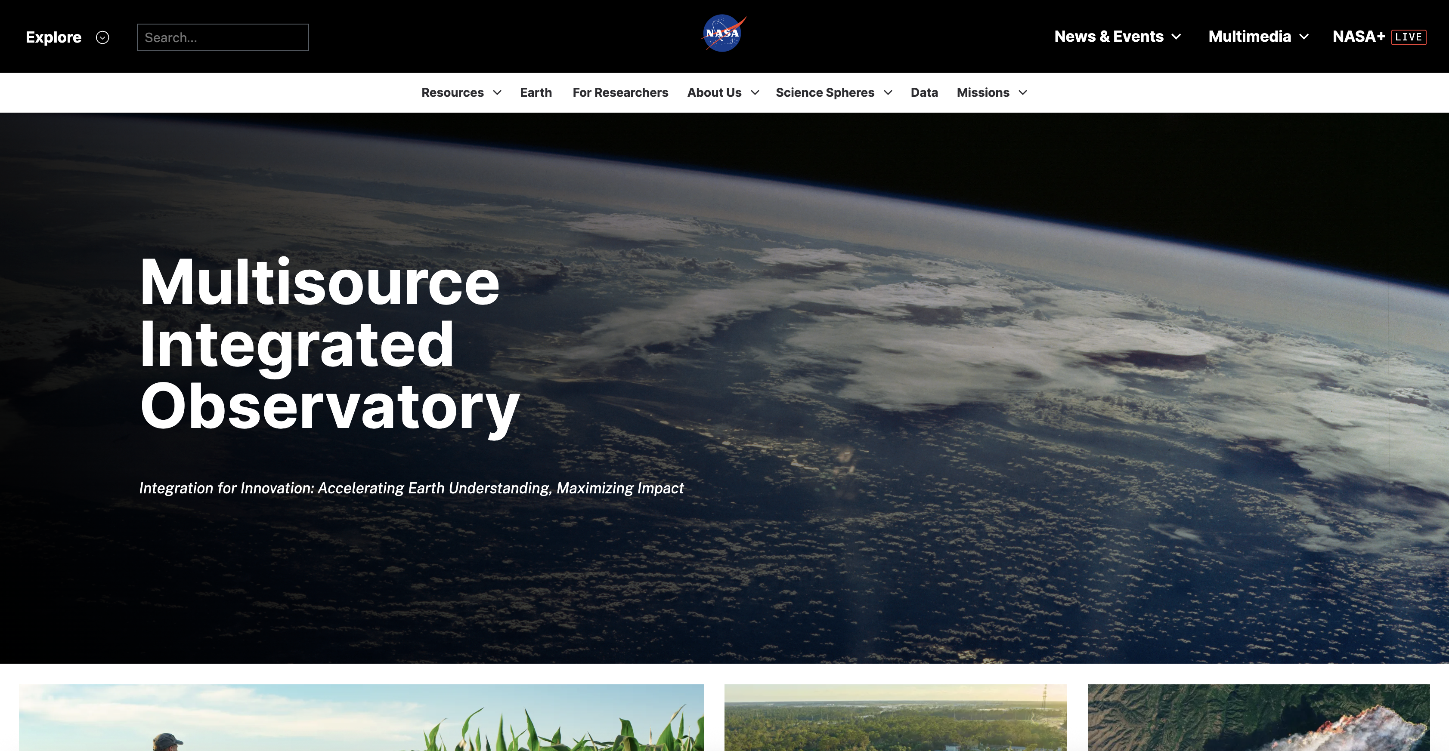

Scan the QR code or go to https://science.nasa.gov/earth-science/mio/

