Slide 1
Radiation: Challenges, Science Questions, Needed and Missing Observations
Bruce Wielicki
NASA Langley Research Center
NASA Atmospheric Composition Workshop
NASA Ames, May 6-8, 2014

Slide 2

Let there be light.

Slide 3
Context
Lack of a rigorous climate observing system
Climate science underfunded by roughly a factor of 3-4.
Economic value of improved climate obs ~ $17 Trillion
Climate science observing requirements often lack rigor
Not just “better” but “how much better” and “what is enough?”
Especially an issue for long term calibration and orbit sampling or field experiment sampling
Climate/process model OSSE studies would often help
Need rigorous hypothesis test, not “back of the envelope”
Science questions need to be more quantitative, less vague
Need more rigor in science prioritization
NRC Decadal Survey
NRC Continuity Study
WCRP grand challenges (Cloud, Circulation and Climate Sensitivity)

Slide 4
WCRP Grand Challenge: Climate Sensitivity

Slide 5
Reducing Uncertainty
Climate Science Uncertainty =>
Climate Modeling Diagnostics & Hypothesis Tests (e.g. CMIP)
Process Modeling Diagnostics & Hypothesis Tests (CRM, LES)
Model OSSEs for Observation Requirements (rarely done)
Field Experiments Observation Requirements (loosely done)
Satellite Observation Process Retrieval Requirements (well done, focus on instantaneous retrieval needs and accuracy/precision)
Satellite Climate Change Observation Requirements (loosely done, ad hoc for calibration, sampling, retrieval algorithms)
Combined Satellite, Surface, In-situ, Aircraft Observation Requirements (typically adhoc discussions of what is currently available to cobble together)
Shortcomings are all symptoms of the lack of a planned rigorous climate observing system and the modeling to define its requirements

Slide 6
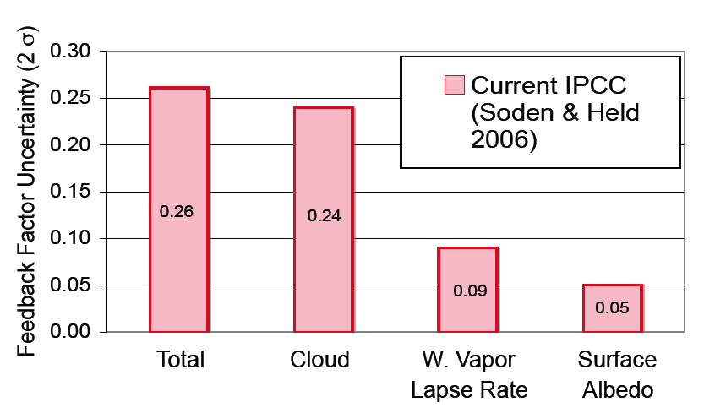
Science Question Prioritization: Quantify Example: Feedback Uncertainty
0.26
0.09
0.05

Slide 7
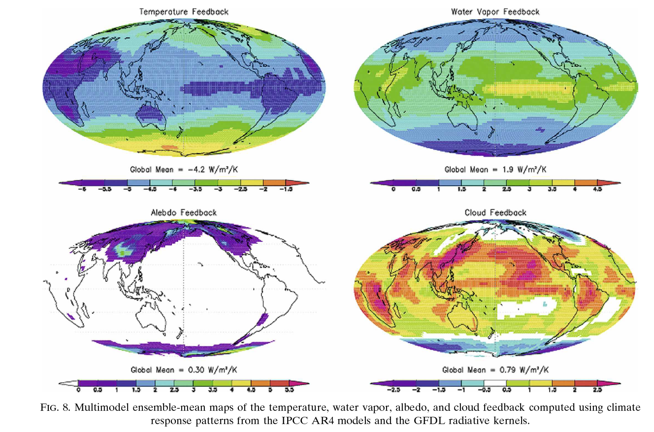
Feedbacks Space/Time Sampling Requirements
Temperature Feedback
Water Vapor Feedback
Land and ocean zonal annual means required for temperature lapse rate and water vapor feedbacks, surface albedo feedbacks
1000 km regional scale required for cloud feedbacks
Seasonal cycle required for reflected solar: cloud feedback, snow/ice albedo feedback
Global Mean = -4.2 W/m²/K
Global Mean = 1.9 W/m²/K
Albedo Feedback
Cloud Feedback
Global Mean = 0.30 W/m²/K
Global Mean = 0.79 W/m²/K
Multi-model ensemble-mean maps of the temperature, water vapor, albedo, and cloud feedback, computed using climate response patterns from the IPCC AR4 models and the GFDL radiative kernels
Soden et al. 2008

Slide 8
Accuracy of
Climate Change

Slide 9
Science Questions: 1
How can we reduce the large uncertainty in climate sensitivity?
Remains the dominant limit on predicting future climate change
Cloud feedback uncertainty dominates
Water Vapor/Lapse rate feedback uncertainty 2.5 times smaller
Soden et al 2008 radiative kernels show relationship to climate change in radiative properties (SW CRE, LW CRE)
Key observations include TOA radiative fluxes, cloud physical properties, surface air temperature, atmosphere dynamic state for cloud process studies
Key missing observations:
Higher accuracy decadal change of TOA fluxes and cloud properties
Higher accuracy boundary layer temperature/humidity profiles especially over ocean (use small UAVs from island bases?)
Higher accuracy vertical velocities
Higher vertical resolution water vapor profiles

Slide 10
Accuracy Requirements of the Climate Observing System
The length of time required to detect a climate trend caused by human activities is determined by:
Natural variability
The magnitude of human driven climate change
The accuracy of the observing system
Uncertainty of Observable Trend
Even a perfect observing system is limited by natural variability

Slide 11
Reflected Solar Accuracy and Climate Trends
Climate Sensitivity Uncertainty
is a factor of 4 (IPCC, 90% conf)
which =factor of 16 uncertainty in
climate change economic impacts
Climate Sensitivity Uncertainty =
Cloud Feedback Uncertainty =
Low Cloud Feedback =
Changes in SW CRF/decade
(y-axis of figure)
Higher Accuracy Observations =
CLARREO reference intercal of
CERES = narrowed uncertainty
15 to 20 years earlier
Wielicki et al. 2013,
Bulletin of the American Meteorological Society
High accuracy is critical to more rapid understanding of climate change

Slide 12
Science Questions: 2
How can we reduce the large uncertainty in aerosol indirect radiative forcing?
Remains the dominant limit on using past modern observations of warming to determine climate sensitivity
No current known algorithm or analysis method to accurately determine directly from observations for large time/space scales (i.e. no equivalent of radiative kernel analysis for feedbacks) or radiative forcing for greenhouse gases.
Dominated by oceanic low cloud/aerosol interactions
Links radiative questions to aerosol area questions (aerosol primary)
Key observations include aerosol physical and radiative properties, TOA radiative fluxes, cloud physical properties, surface air temperature, atmosphere dynamic state to separate cloud dynamics changes from aerosol changes
Key missing observations:
Those in radiative question 1 (climate sensitivity)
Higher accuracy aerosol physical and radiative properties including aerosol composition, absorption
ACE is decadal survey approach but uncertain anthropogenic radiative forcing accuracy

Slide 13
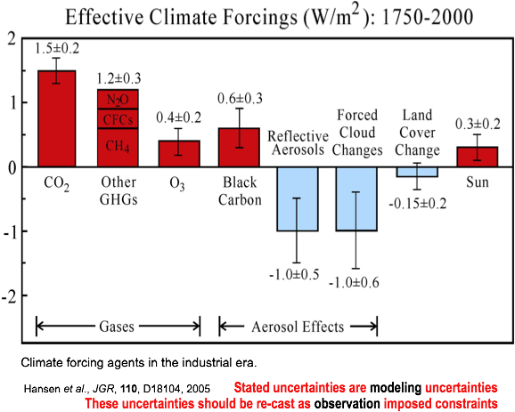

Slide 14
Science Questions: 3
What caused the recent global warming “hiatus” or slowing? Can the current observing system adequately track energy flows to support a definitive answer?
Natural variability?
Time varying rates of ocean heat uptake by deep and abyssal ocean?
Noise in the relationships between surface ocean/air temperature and deeper ocean temperatures (not as tightly tied as the atmosphere)?
Changes in aerosol forcing?
Key observations include tropospheric and stratospheric aerosol physical and radiative properties, TOA radiative fluxes, ocean heat storage vs depth, ocean sea level and ice sheet mass (constrians ocean thermal expansion
Key missing observations:
Sufficient sampling of deep ocean (> 1000m) observations?
Sufficient knowledge of aerosol radiative forcing (link to question 2)
Uncertain climate sensitivity (i.e. “expected warming”: link to question 1)

Slide 15
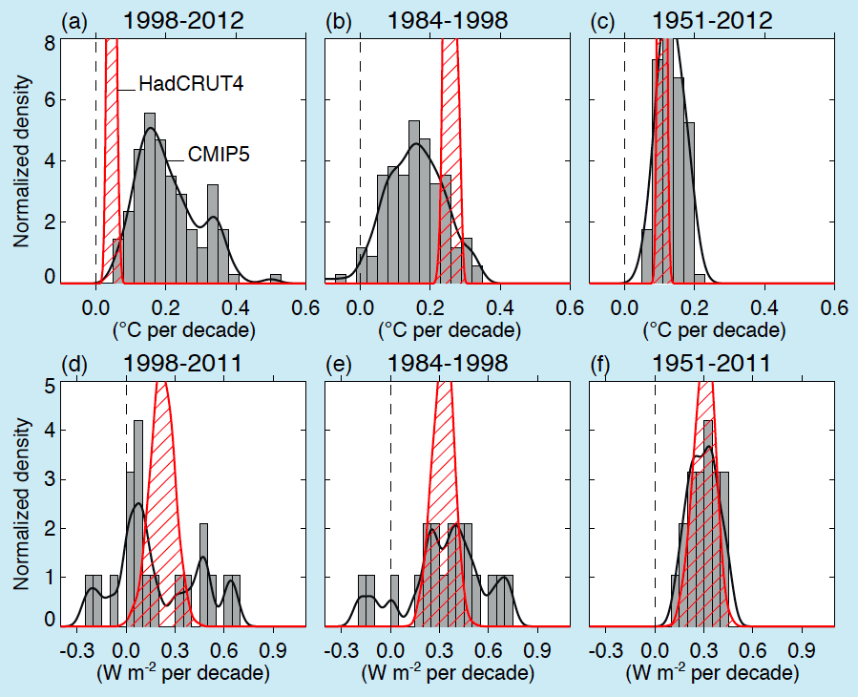
IPCC
AR5

Slide 16
Science Questions: 4
In the current observing system we cannot close the surface and atmosphere energy budgets to better than ~ 15 Wm⁻².
At the surface: either latent heat flux estimates are too low or downward net radiation estimates are too high
In the atmosphere: either radiative cooling is too strong, or latent heating (i.e. precip) is too low
How accurate do we need to know this? 5, 2, 1, 0.2 Wm⁻² ? Mean fields versus climate change?
Key observations include surface radiative, latent, and sensible heat fluxes, atmosphere radiative heating rates, precipitation, ocean sea surface salinity (precip – evaporation)
Key missing observations:
More accurate surface turbulent latent heat fluxes
More accurate precipitation (GPM?)
Improved BSRN open ocean (not islands) sampling: ships? Buoys?
Current land BSRN surface radiative flux accuracy ~ 5 Wm⁻² ?

Slide 17
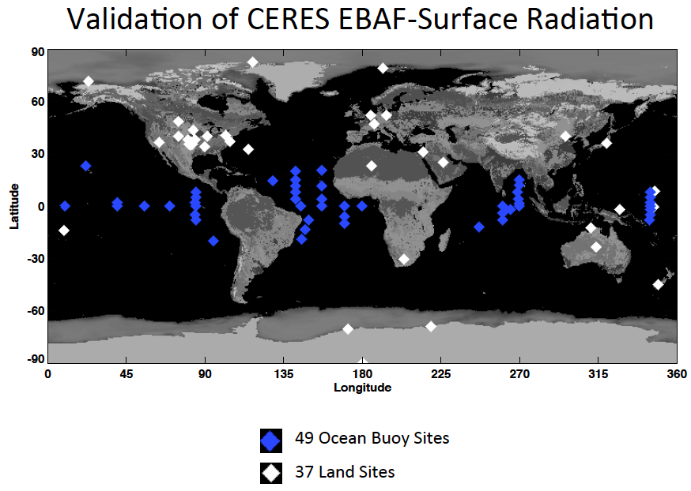

Slide 18
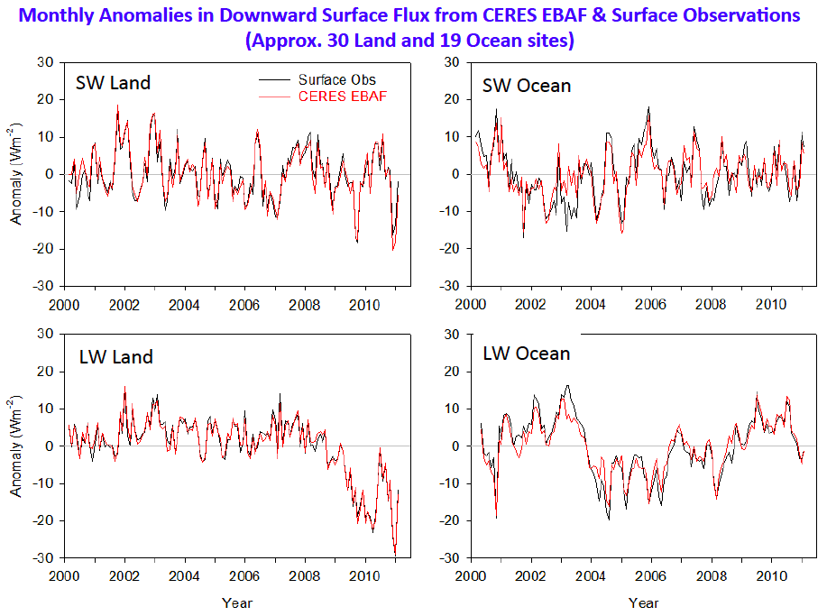

Slide 19
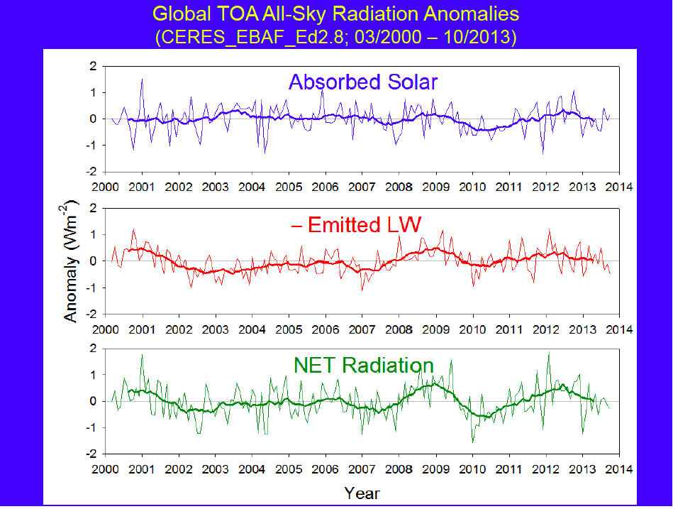

Slide 20
Science Questions: 5
In light of dramatic reductions in arctic sea-ice, are cloud cover or properties changing as well? If so, are those changes reducing or amplifying the radiative effects of sea-ice change?
Need sufficiently long climate record to overcome large arctic natural variability
Need highly accurate cloud properties despite snow/ice backgrounds (active lidar/radar)
Field experiments in spring/summer/fall?
Key observations include TOA and surface radiative fluxes, cloud physical properties, sea-ice extent and thickness, atmospheric dynamic state
Key missing observations:
Accuracy of boundary layer temperature/humidity structure
Mixed phase cloud properties?
Improved BSRN quality open ocean (not islands) sampling: ships? Buoys?

Slide 21
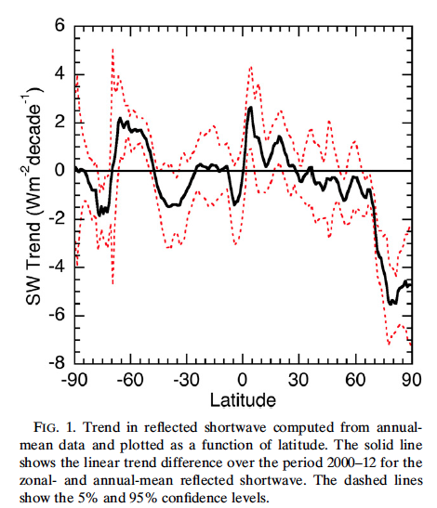
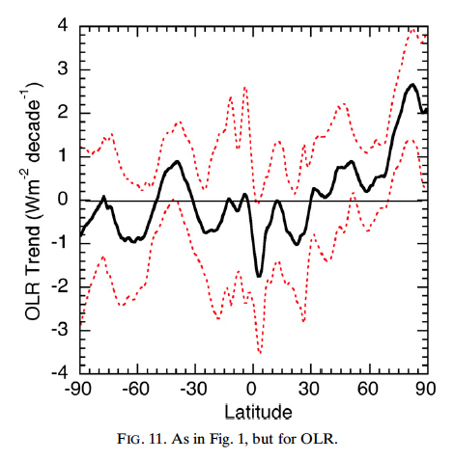
Trend in Annual Mean CERES All-Sky TOA Flux by Latitude (2000-2012)
Reflected SW
Outgoing LW
Hartmann and Ceppi, JCLIM, 2014

Slide 22
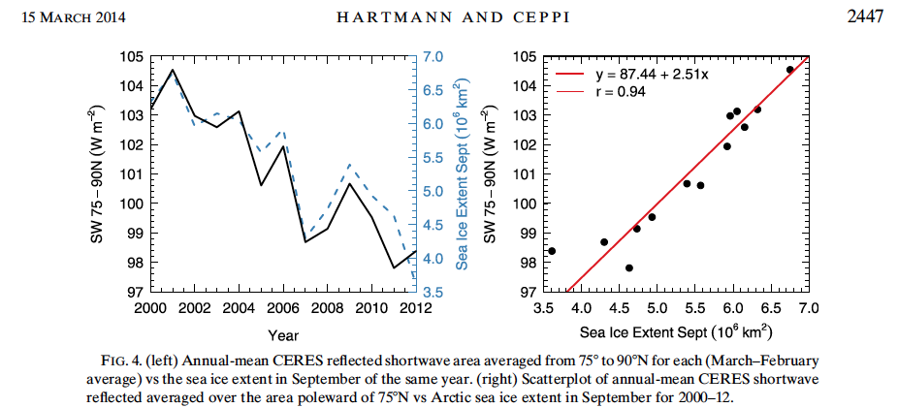
CERES All-Sky SW TOA Flux Trend Tracks Decline in
September Sea-Ice Extent
Hartmann and Ceppi, JCLIM, 2014

Slide 23
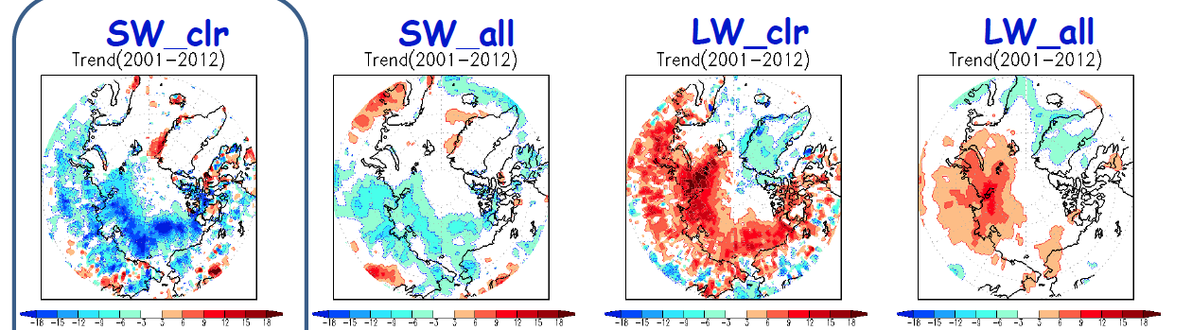
TOA Flux Trends (2001 – 2012; CERES SYN1deg Edition 3)
Clear-Sky
All-Sky
Weaker trends for all-sky than clear-sky TOA flux.
Clouds mask part of the influence of surface and lower atmosphere changes on TOA flux.
Are clouds changing over the Arctic Ocean?
If so, do they enhance or counter radiative effects of sea-ice changes?
How do you separate the radiative effects of cloud changes from those due to non-cloud changes (e.g., sea-ice extent, T & q)?
SW
LW
Loeb et al CERES STM
April, 2014

Slide 24
Science Questions: 6
Can we spectrally verify the water vapor greenhouse effect and water vapor feedback that dominates the Far-Infrared portion of the spectrum (15-100μm)?
We have tested this using broadband fluxes (5 – 100μm integral) but never using spectrally resolved observations
Half of the infrared energy is in the Far-infrared beyond 15 μm
Far infrared is dominated by water vapor absorption/emission in the upper troposphere
Far-IR dominates outgoing infrared energy in polar regions.
Key observations include: Spectral and broadband TOA radiances and fluxes, cloud properties including particle size, temperature and humidity profiles
Key missing observations:
Far-IR spectra at large time/space scales
Accuracy of upper tropospheric humidity?
Surface emissivity in the Far-infrared?
Cirrus particle size radiative effects: particle size ~ wavelength

Slide 25
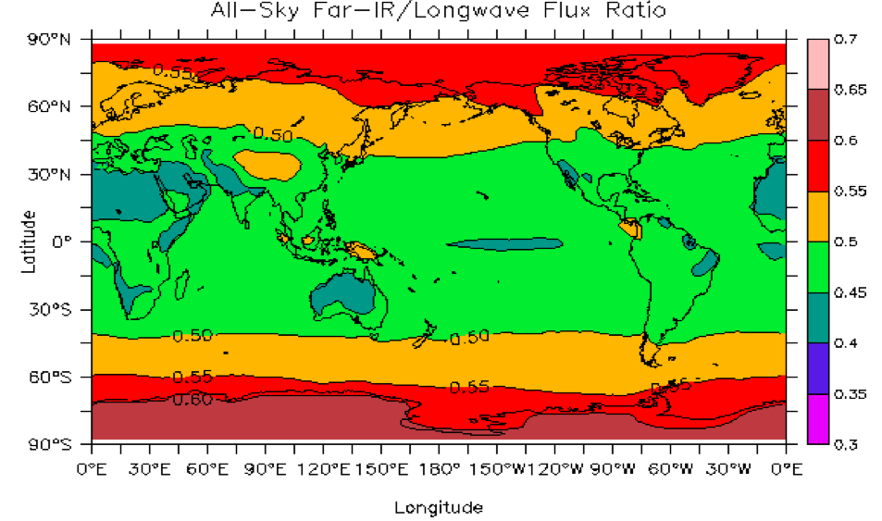

Slide 26
Science Questions: 7
How can we prove that our satellite retrieval algorithms have sufficiently stable bias errors to correctly observe climate change?
Retrieval bias errors typically >> climate change magnitude.
Instantaneous retrieval methods often nonlinear and complex.
As climate changes, retrieval assumptions can vary: e.g. cloud 3-D structure assumptions for cloud optical depth
Cloud optical depth 20 to 30% bias error vs significant 1%/decade climate change
More than just keeping algorithm code constant
Key observations include: Long term validation observations which themselves can demonstrate stability at climate change levels
Modeling or OSSE studies can investigate this aspect of retrieval bias stability
Algorithms for optimal climate change retrievals may differ from optimal instantaneous retrievals

Slide 27
Science Questions: 8
Can we retrieve climate change using averaged radiances and reflectances? Advantages/disadvantages vs averaging instantaneous retrievals?
Maximum information content for instantaneous retrievals.
Maximum linearity for time averaged anomaly retrievals.
Provide an independent analysis method?
Climate change analogy to weather models assimilating IR spectra directly instead of retrievals.
OSSEs being performed and published for infrared and reflected solar spectra: i.e. using spectral fingerprints of climate change
New 30x faster high spectral resolution radiation codes (PCRTM) developed for use in such tests (contact Xu Liu, LaRC)
Studies underway for IR spectra using AIRS/IASI (L. Strow, W. Smith, Sr.)

Slide 28
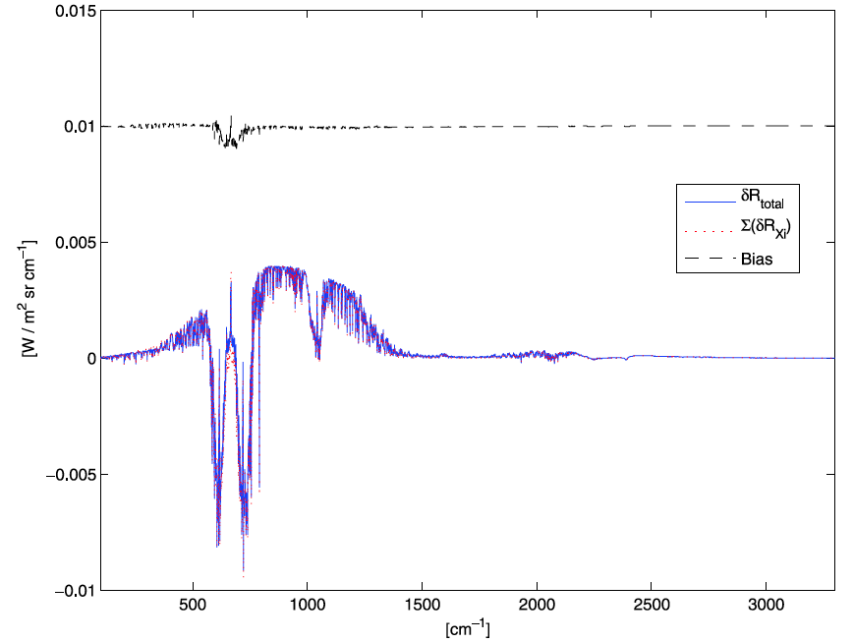
Spectral Decadal Change is Linear
Nonlinear portion of decadal change
Is a few percent of total (offset by 0.01)
Huang et al.
2010
Blue = total of all changes
Red = linear sum of individual
Component changes
Spectral Radiance Change
similar linearity
found for
decadal change
of reflected
solar spectra
Jin et al., 2010
Doubled CO2 change of all-sky
Global spectral radiance from
T(z), q(z), CO₂, clouds, for the
CFMIP CCCMA coupled climate model
20 μm
10 μm
5 μm
Instantaneous changes are nonlinear: decadal change is highly linear

Slide 29
Science Questions: 9
Can we improve the rigor of climate change observation requirements using climate model OSSEs?
More rigorous hypothesis test method.
Encourages more quantitative and rigorous requirements
Clearer relationships between modeling and observations
Better interdisciplinary understanding of modelers/observationalists
Ability to determine the point of diminishing returns with increased capabilities (e.g. accuracy, sampling)
Allows diverse tests for robustness of results by using multiple models (CMIP) or even PPEs.
Allows tests using 100 year IPCC forcing scenarios
Use of observations and climate model nature runs to estimate natural variability (climate change noise)
Use of COSP observation simulators allows use for wide range of climate models

Slide 30
Backup Slides

Slide 31
