Slide 1
Aerosol Aftermath Bottom Line Preamble
Universal recognition that aerosol particles are an inherently interdisciplinary field. Interdisciplinary research in small teams should be strongly encouraged.
There is insatiable demand for 4 dimensional aerosol fields of a host of particle and gas properties along with associated meteorology. To meet this demand, aerosol “data” has to be has to be seen as an integrated system satellite data, and network observations integrated with models, along with targeted field campaigns. There needs to be much more effort on the “how's” of combining datasets and recognition that integrated monitoring is a science in and of itself.
The tallest observational or “system” challenge is constraint of the global vertical distribution of absorption, scattering and emission followed by vertical dimensions in speciated/size resolved mass, CCN, IN,& heterogeneous site properties. That is we are going from column properties to the vertical. There is a lot of “physical process” and societal impacts related to these challenges.
From here, recommendations are have a strong “what is good enough?” or “What can we tie off?” connotation that cut across a number of conceptual dimensions.

Slide 2
Overarching recommendations Holistic integrated aerosol “systems.” There is lots of science to be done. But what floats the most boats?
Top 2 measurements: 3 d absorption and speciation
Absorption is perhaps our communities biggest challenge
How do we segregate natural versus anthropogenic species and their ultimate radiation and thermodynamic effects by constituent?
Vertical dimension part 2
Aerosol system in the surface layer and PBL
Aerosol observations in partly cloudy to cloudy scenes.
Retrievals
How do we put two satellite products together? Not just a-train but polar+geo?
Technology investment in coupled retrievals.
Field campaigns & networks
Let aerosol sensitivity findings be a key defining measurement priorities. E.g., climate hypothesis driven field campaigns
Data reduction/development of predictors/typing of aerosol complexity
Tie in with the climate data record.
Error modeling
AERONET verification as well as primary versus secondary verification methods.
How do remote sensing observational errors relate to the background related to the combined product?
Incubator grants-How do we do all of this? Link with interdisciplinary research?

Slide 3
Science Topical Packaging Climate : Process/Weather : Air Quality
Salawich: The grand challenge of “How anthropogenic aerosol particles effect TOA radiation?” This includes all direct, semi direct-indirect effects. Perhaps not tractable, or even doable, but a focus point?
Aerosol-Climate relationships, past-present-future
(Kondo)How do we set a baseline and help use past climate relationships to help project future changes? Inc. volcanic activity.
(Murphy+) How are projected changes in atmospheric circulation going to effect aerosol lifecycle? Dust, Sea Salt, Biomass Burning, Biogenic precursors. Can you do a first order iteration on feedback?
What is the impact of circulation changes on aerosol related geochemical cycles?
How will aerosol chemistry interface with ozone in a changing stratosphere?
Climate Sensitivities to Aerosol Particles
What regions are most susceptible to aerosol phenomena?
What are the teleconnections between forcing in one region and impact in another?
Winker: Does the aerosol system have a role in the temperature hiatus?

Slide 4
Topical Packaging Climate : Process/Weather : Air Quality (you will notice many ties to Climate)
Aerosol-Meteorology Relationships- Passive
In the absence of feedbacks, how does weather regulate aerosol lifecycle?
Clouds as a transformative and removal processes.
Vertical redistribution, PBL entrainment/detrainment
Weather as a predictor of aerosol sources
How do large scale meteorological modes (e.g., MJO, NAO, ENSO, etc) simultaneously regulate aerosol lifecycle and potentially confounded impacts?
Aerosol-Meteorology Relationships-Feedbacks
What meteorological phenomenon are the most susceptible to aerosol impacts (Radiative, thermodynamic, heat budget)?
What defines the tipping point between aerosol particles impacting precipitation?
Do aerosol particles impact “severe” weather?
What are the processes that cause a polluted non-precipitating airmass to rapidly change to a clean precipitating airmass?

Slide 5
Topical Packaging Climate : Process/Weather2 : Air Quality (you will notice many ties to Climate)
Aerosol Microphysics
What can we tie off, what is good enough in terms of complexity?
Data reduction – what are good predictors to what we want to know?
Aerosol Ice Physics
Are the cloud guys ready for us? Dust is known IN, how much more do we need to know (lab call?)
What is the role of IN in arctic and southern high midlatitude environments ?
Radiation
What are the relative contributions of “clearly sky,” partly cloudy and cloudy scenes to total aerosol warming?
How do semi-direct influences on clouds relate to atmospheric flows
Bruce?

Slide 6
Topical Packaging Climate : Process/Weather2 : Air Quality Community moving towards broader societal impacts of aerosol system science and climate change.
Boundary layer constituents and processes
How do we get speciated aerosol properties for the PBL and surface layer?
Note strong interdisciplinary ties to geochemical cycles/ aerosol lifecycle
As much of a measurement requirement as a science question
Air quality signal processing:
Long term trends versus acute exposure. What is in a mean?
Unified global evaluation.
Strawa: Interdisciplinary not just between NASA scientists, but also with other agency users. (Point, Applied Science has a team for that). Go interdisciplinary science route?

Slide 7
Processes and Air Quality in the Vertical-Take it Dave
Total column | What is the direct aerosol radiative effect at the top-of-atmosphere, within-atmosphere, and at the surface on a regional basis and as a function of aerosol type? What are the sensitivities of regional-scale surface radiative fluxes, in-atmosphere heating, and cloud-climate feedbacks to: changes in the relative proportions of natural vs. anthropogenic and primary vs. secondary aerosols (e.g., from climate change or air quality regulations) the horizontal proximity and vertical stratification of aerosols relative to clouds
Stratosphere | What is the impact of volcanic and large wildfire events on the stratospheric aerosol burden, and how do these aerosols affect the surface temperature record? How will aerosol particles impact ozone in changing climate?
Upper troposphere | What is the impact of transported dust on ice nucleation and precipitation from cold clouds?
Lower troposphere | How does aerosol radiative heating impact convective cloud development as a function of aerosol particle type? What types of clouds, precipitation, and severe weather events are susceptible to modification by aerosols, and under what environmental conditions?
Boundary layer | What are the abundances, compositions, size distributions, and shapes of the particles associated with adverse human health outcomes and environmental degradations? What are the sources, physical-chemical transformation processes, transport pathways, and sinks of these particles?

Slide 8
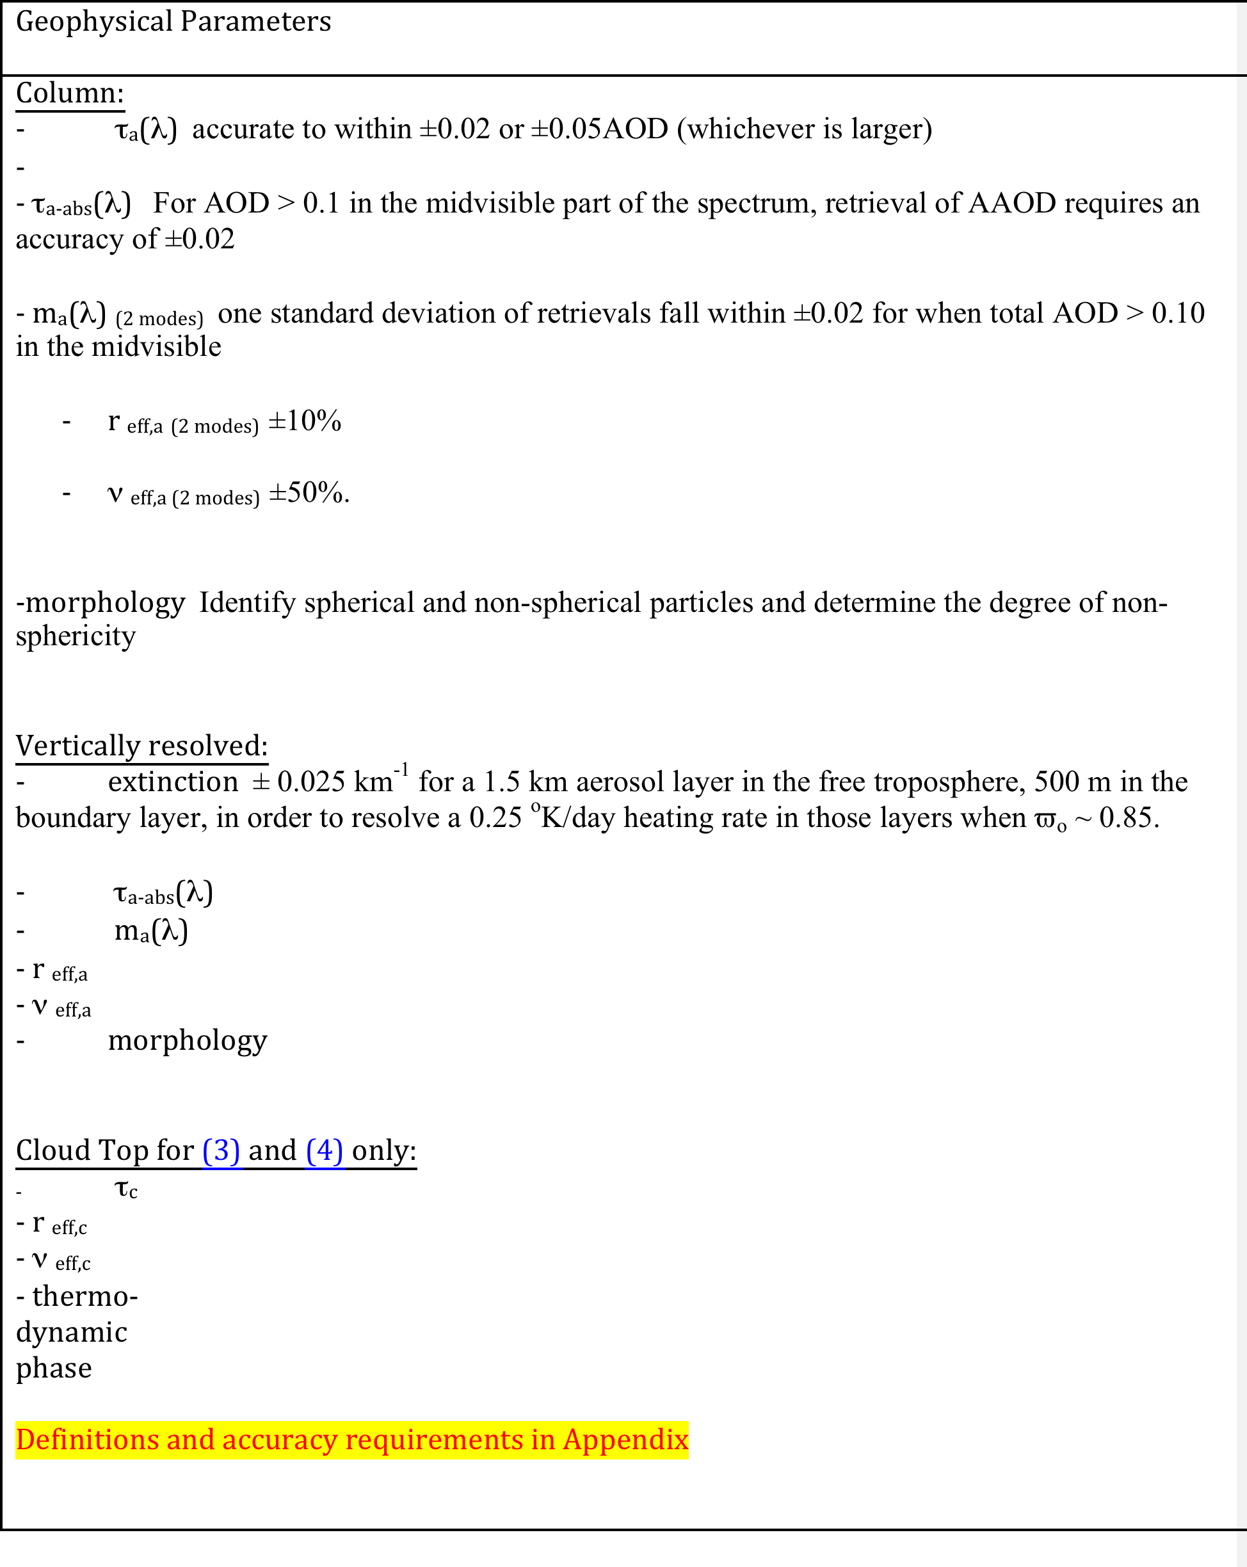
Satellite measurement requirements from the ACE Science Working Group
Total column
Vertically resolved

Slide 9
Overarching recommendations Holistic integrated aerosol “systems.” There is lots of science to be done. But what floats the most boats?
Top 2 measurements: 3 d absorption and speciation
Absorption is perhaps our communities biggest challenge
How do we segregate natural versus anthropogenic species and their ultimate radiation and thermodynamic effects by constituent?
Vertical Dimension part 2
Aerosol system in the surface layer and PBL
Aerosol observations in partly cloudy to cloudy scenes.
Retrievals
How do we put two satellite products together? Not just a-train but polar+geo?
Technology investment in coupled retrievals. Field campaign and network priorities
Field campaigns
Let aerosol sensitivity findings be a key defining field campaign priorities. E.g., climate hypothesis driven field campaigns
Data reduction/development of predictors/typing of aerosol complexity
Error modeling
AERONET verification as well as primary versus secondary verification methods.
How do remote sensing observational errors relate to the background related to the combined product?
Incubator grants-How do we do all of this? Link with interdisciplinary research?

