Slide 1
Atmospheric Circulation Science Questions
Paul A. Newman, Elizabeth A. Barnes, Owen Cooper, Clara Orbe, Michael Prather, Bill Randel, Mark Schoeberl, Ted Shepherd, Darryn Waugh
You don't need a weatherman to know which way the wind blows. – B. Dylan

Slide 2
Why do we care?
Atmospheric circulation controls the transport of trace species that are important for: 1) ozone depletion, 2) climate change, 3) air quality.
Atmospheric dynamics can remotely alter temperatures and other trace gases that have feedback effects on loss processes.

Slide 3
Why do we care?
Atmospheric circulation
Temperatures can affect loss rates (e.g. ozone in mid-upper stratosphere, PSC formation, etc.)
OH, O(¹D), CH₄ distributions can impact oxidation & loss processes

Slide 4
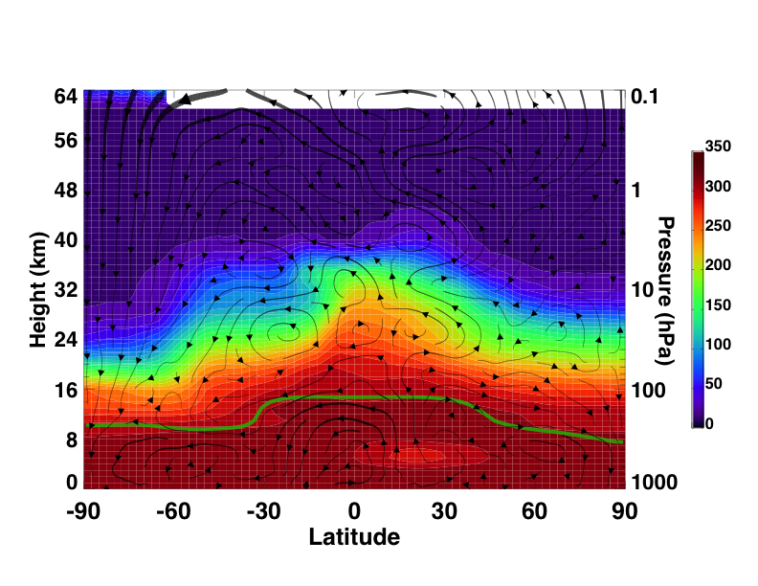
Residual Circulation
Brewer-Dobson Circulation
Hadley
Circulation

Slide 5
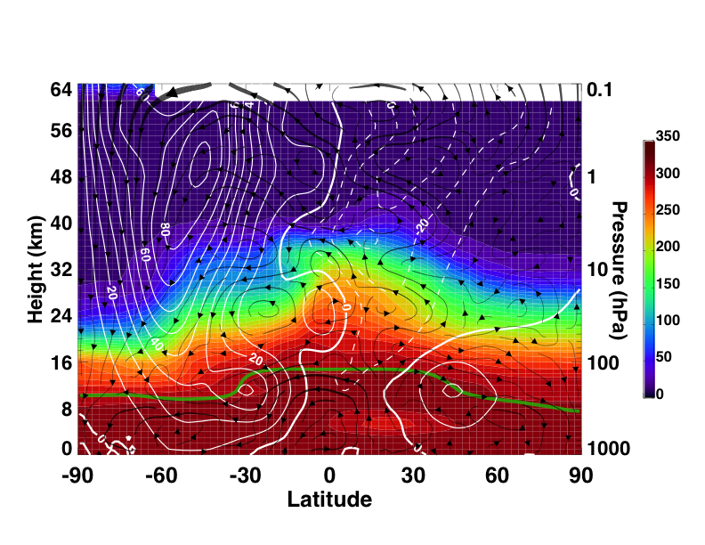
Zonal mean wind (Jun.-Sep. 2006)
Summer
Easterlies
Polar Night Jet
QBO
Sub-tropical Jet

Slide 6
A. Stratospheric Science Questions –implications for ozone change and GHG impacts on the stratosphere

Slide 7
SQ #1: C
Is the BD stratospheric circulation accelerating? How will this acceleration affect trends and trace species’ distributions?
Are observations in the past decades consistent with model predictions of stratospheric circulation changes (e.g., what are the causes and impacts of the Year 2000 change in the circulation and observed trends in age of air)?
How will wave-driven chemical transport (mean circulation and mixing) in the stratosphere change in the next century?
Importance: Ozone will not recover to 1980 levels in the tropics, and will “super-recover” in the extra-tropics.
Butchart & Scaife (2001)

Slide 8
Is the BD stratospheric circulation accelerating? How will this acceleration affect trends and trace species’ distributions?

Slide 9
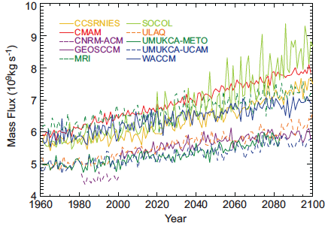
Upward Mass Flux at 70 hPa
Fig. 4.11a (CCMVal-2, On average the 70hPa trend in the upward mass flux (from w*)was about 2% per decade (Figures 4.11b, c, d) with the largest trends occurring in JJA (Butchart & Charlton-Perez, 2010)

Slide 10
SQ #2 (sub bullet under 1)
How will changes in the tropospheric circulation (jets/storm tracks, the tropopause, extreme weather, wave events) impact the stratospheric circulation on multiple time scales? (See SQ #17 under “Troposphere” section) *context for measurements*
How will the winter polar vortex strength/duration change? Increased SSW frequency?
Importance: Wagging the dog. E.g., increased SSWs warm the stratosphere & increase polar ozone levels.

Slide 11
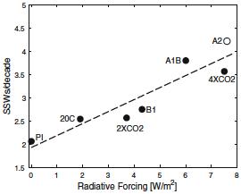
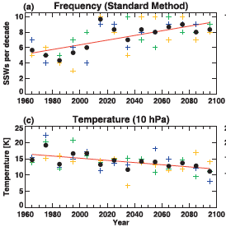
Increasing frequency of SSWs
Fig. 9. The mean values of SSWs/dec during the stabilization periods of all simulations are plotted versus the radiative forcing anomaly compared to PI. The A2 value is shown as an open circle because it is based on 63 years only whereas all other means include at least 200 years. Schimanke et al. (2012)
Fig. 8. Time series of (a) SSW frequency and (c) ΔT10 computed. The three ensemble members are denoted by the blue, green, and yellow symbols, and the ensemble averages by the solid circles. The red lines are the linear fits through the ensemble averages. Results are computed for 10-yr intervals centered about the position of the plotted symbols. McLandress and Shepherd (2009)

Slide 12
SQ #3 (to Strat Comp)
What are the primary factors that control H₂O in the lower stratosphere? Is water vapor increasing in the stratosphere?
How will long-term changes in methane, circulation, and TTL processes affect stratospheric water vapor and implied radiative forcing? What are the expected impacts of and feedbacks associated with those changes? How will lifetimes change?
How will TTL upwelling and water vapor change with changing climate?
Importance: water is radiatively important for surface T & water is a major part of the stratospheric hydrogen budget

Slide 13
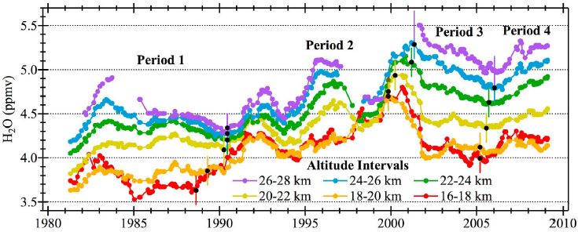
Hurst et al. (2011)
26-28
24-26
22-24
20-22
18-20
16-18
Water vapor trends in the stratosphere

Slide 14
SQ #4 (C)
What is the degree of the mid-to-upper stratosphere cooling in response to GHG increases?
How do N₂O, CH₄, CFCs, HCFCs, and HFCs contribute to this change
Are there direct dynamical responses to this cooling?
Partitioning of change between GHG forcing and internal variability.
Importance: The stratosphere is not going back to it’s pre-industrial state.
Need: Accurate temperatures.

Slide 15
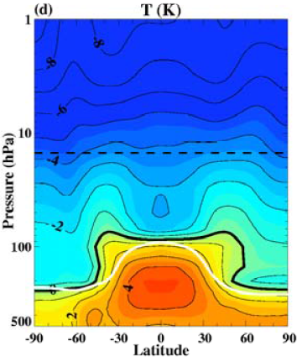
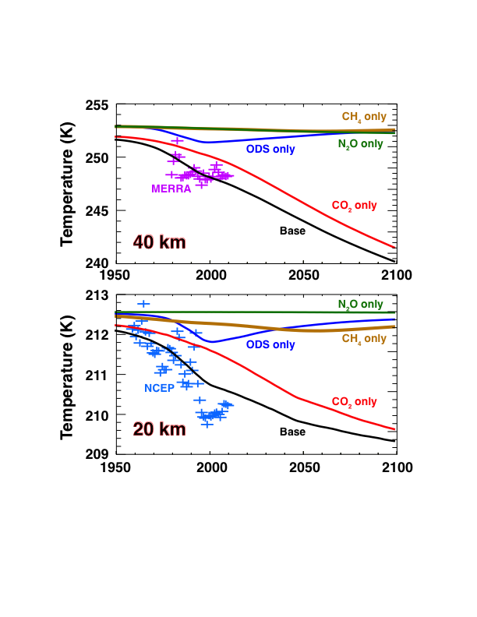
Climate Driven Temperature Change
2065-1980
1980
2065
Are we doing a good job of detecting these changes?

Slide 16
SQ #5 (strat comp)
Do we understand the distribution of aerosols (e.g., the Junge layer) in the stratosphere?
Do we understand how perturbations to this aerosol layer (natural & anthropogenic) impact transport and climate of the stratosphere?
What role (if any) do stratospheric aerosols play in the tropospheric warming hiatus?
Does the Asian monsoon Tropopause Aerosol Layer (ATAL) influence circulation? Is this changing over time?
Importance: aerosols provide surfaces for heterogeneous chemistry and are radiatively active (e.g., Mt. Pinatubo). Aerosols have been proposed in geo-engineering projects.

Slide 17
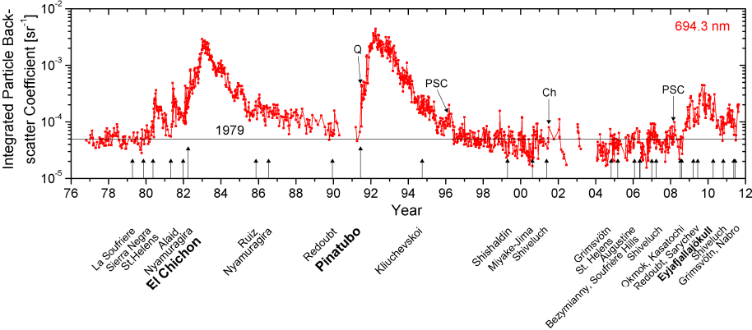
Stratospheric aerosol: from Fuego to Eyjafjallajokull (Trickl et al., ACP, 2013)
Fig. 1. Time series of the integrated stratospheric backscatter coefficient from the lidar measurements at Garmisch-Partenkirchen: the backscatter coefficients are integrated from 1 km above the tropopause to the upper end of the layer. Several minor events are marked in addition: two PSC observations, the Quebec fire (Q) and the Chisholm fire (Ch).

Slide 18
Needed measurements for stratospheric observations
O₃, H₂O, Age-of-air (e.g., CO₂, SF₆), N₂O, CFC-11, CFC-12, CH₄, aerosols
Estimate zonal, monthly means from UT to mesosphere
Lower stratospheric mass flux, winds & temperatures
Daily met observations from UT to mesosphere

Slide 19
B. Strat-Trop exchange questions - and implications for climate, air quality and ozone loss

Slide 20
SQ #11 (C)
How do monsoons/convection contribute to troposphere-stratosphere coupling? Are there stratospheric influences on the monsoons/convection?
What is the depth of circulation influence into the lower stratosphere, and how important are monsoons for the stratospheric overworld?
Importance: The monsoon circulation provides an effective pathway for pollution from Asia, India, Indonesia, and North America to enter the global stratosphere.

Slide 21
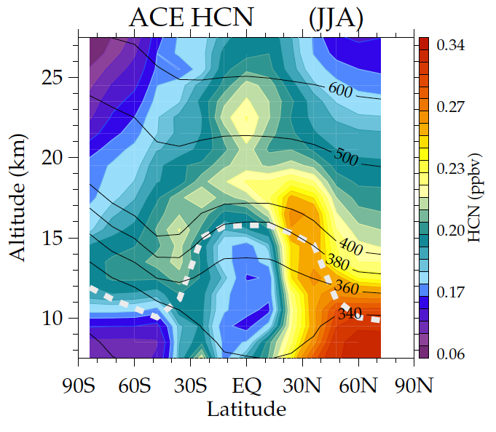
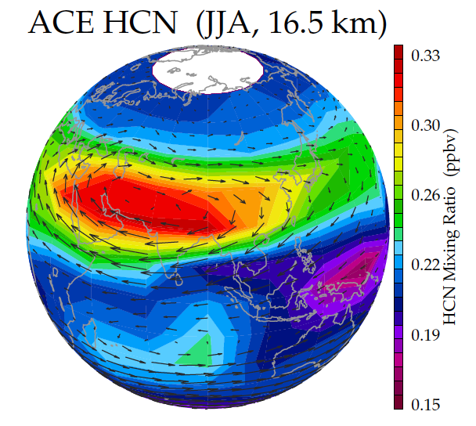
Monsoon transport to the stratosphere observed from ACE-FTS hydrogen cyanide
HCN – biomass burning tracer
Minimum in tropics (ocean sink)
Long lived in free atmosphere
tropical
minimum
transport to
stratosphere
via monsoon
monsoon
maximum
minimum for air with
recent ocean contact

Slide 22
SQ #12 (VI)
What are the chemical and dynamical impacts of stratosphere-troposphere exchange on tropospheric and surface climate?
Mechanisms of STE: What dynamical processes incur (gross vs. net) mass exchange between the strat and trop and what is the net result on trop O₃? Specifically, how are stratospheric intrusions linked to the larger-scale circulation and what is their aggregate impact on tropospheric composition (i.e. O₃)? How will the frequency and positioning of intrusions change in the future?
Compositional constraints on STE: Is the composition (e.g., H₂O, O₃, aerosols) and UTLS temp. having a large affect on the net mass and chemical exchanges between the strat and the trop? What impacts (if any) do these have on surface composition?
Dynamical constraints on STE: How will changes in UTLS dynamics (i.e. subtropical jets, tropopause shifts, wave propagation changes) affect STE. How (if) will these changes propagate down to the troposphere/surface?
Measuring STE: What are the chemical signatures of net STE changes? In terms of O₃, how can the “true” STE O₃ flux be detected (ideally measured) and how we best quantify its impact on surface O₃?
Importance: stratospheric ozone is a major contributor to tropospheric chemistry.

Slide 23
Schematic illustration of the extratropical UTLS (evaluated at a longitude section) (Gettelman et al., The Extratropical Upper Troposphere and Lower Stratosphere, 2011)

Slide 24
Needed measurements for UTLS observations
O₃, H₂O, aerosols, CO₂, & intermediate lifetime species that can be used to trace motion over < seasonal scales (e.g., HDO, HCN, CO, R-222)
Estimate zonal, monthly means from UT to mesosphere
Measure transient episodes at mesoscale wavelengths
Snapshot observations of a range of species that can fingerprint & quantify air mass origin
UTLS winds & temperatures
Daily met observations from boundary layer to stratosphere

Slide 25
C. Tropospheric circulation questions and implication for pollution transport and climate

Slide 26
SQ #13 (I)
How will the Southern Hemisphere tropospheric circulation respond to the recovery of polar stratospheric ozone over the coming decade? How does this compare with model projections?
How will future changes in ozone impact surface climate, ocean circulation, and what will be the impacts on Antarctic warming and ice melt?
Importance: ozone depletion is the dominant SH climate forcing agent.

Slide 27
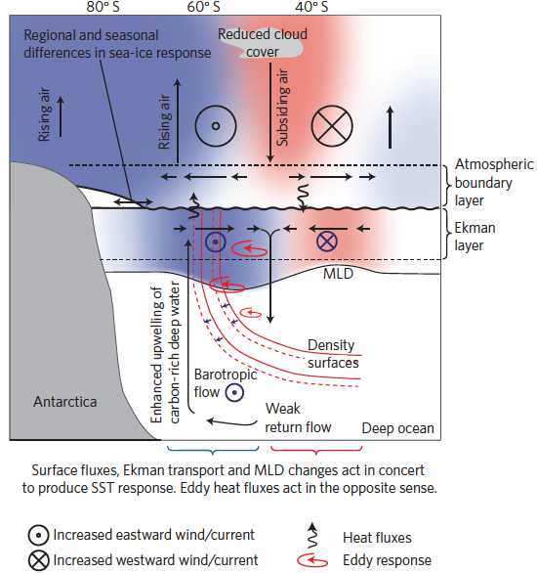
SH response to O₃ hole
Data and models suggest that a number of processes in SH summer are sensitive to long-term change in the SAM.
How is the circulation response to O3 hole communicated downward?
Continued observations are critical to understanding climate in the SH as ozone rebounds.
Thompson et al. (2011)

Slide 28
SQ #14 (sub-question to monsoon/convection question)
What are the transport pathways from the PBL to the stratosphere?
How, when, and where does transport occur?
Residence times from the PBL to the stratosphere?
What is the interplay between emission, chemical lifetime, and transport timescale for these short-lived species?
Importance: H2O, Cl & Br containing short lived species could be transported into the stratosphere, counteracting the improvements from the Montreal Protocol.

Slide 29
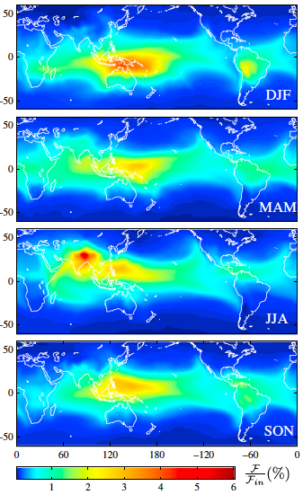
Stratospheric injection of VSLS
Very-short-lived halogens originating from oceanic, land, or anthropogenic sources, when transported into the stratosphere, exerts a significant impact on the chlorine and bromine budgets and ozone depletion in the stratosphere.
Recent years have seen significant progresses in modeling efforts to quantify VSLS contributions to stratospheric inorganic bromine. These modeling studies suggest that VSLB contributes between 3-7 ppt to reactive bromine in the stratosphere, bringing the model estimate in good agreement with satellite and balloon-borne obs.
The VSLS halogen contributions are very sensitive to emission locations.
Figure 1. Sensitivity maps showing % flux into the stratosphere (F/F_{in}) for an idealized tracer with chemical lifetime τ = 20 days. Emissions are uniform and results have been averaged over 4 years (2007-2011). Haines & Esler (2013).

Slide 30
SQ #15 (link to expanding tropics)
Are extratropical basic tropospheric circulation patterns shifting? What are the implications for transport? For example, how will large-scale shifts affect the ventilation of boundary layer pollutants into the free troposphere? (see below)
Changes in convective or other mechanisms that vertically mix the troposphere are very important in predicting the impact of emerging economies on both O₃ and aerosols – for both climate forcing and AQ.

Slide 31
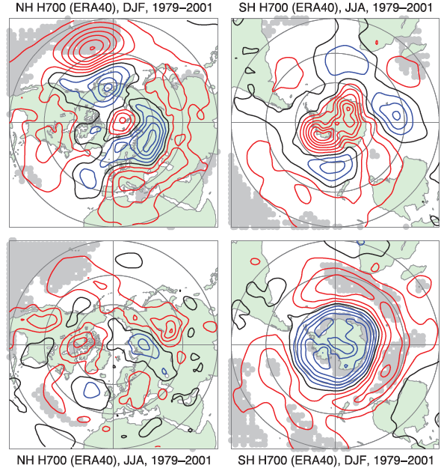
Fig. 3.24 IPCC AR4
Winter
Linear trends in ERA-40 700 hPa geopotential height from 1979 to 2001 for DJF (top left and bottom right) and JJA (bottom left and top right), for the NH (left) and SH (right). Trends are contoured in 5 gpm per decade and are calculated from seasonal means of daily 1200 UTC fields. Red contours are positive, blue negative and black zero; the grey background indicates 1% statistical significance using a standard least squares F-test and assuming independence between years.
Summer

Slide 32
SQ #16 (tropospheric composition – source question)
Do we understand intercontinental transport and its impact on pollutants?
We understand the processes but we don’t know how the rapid changes in emissions in Asia, USA and Europe have impacted the quantity of pollution transported from one continent to another.
Mixing from the free troposphere to the PBL
Importance: Impact of trans-oceanic pollutants.

Slide 33
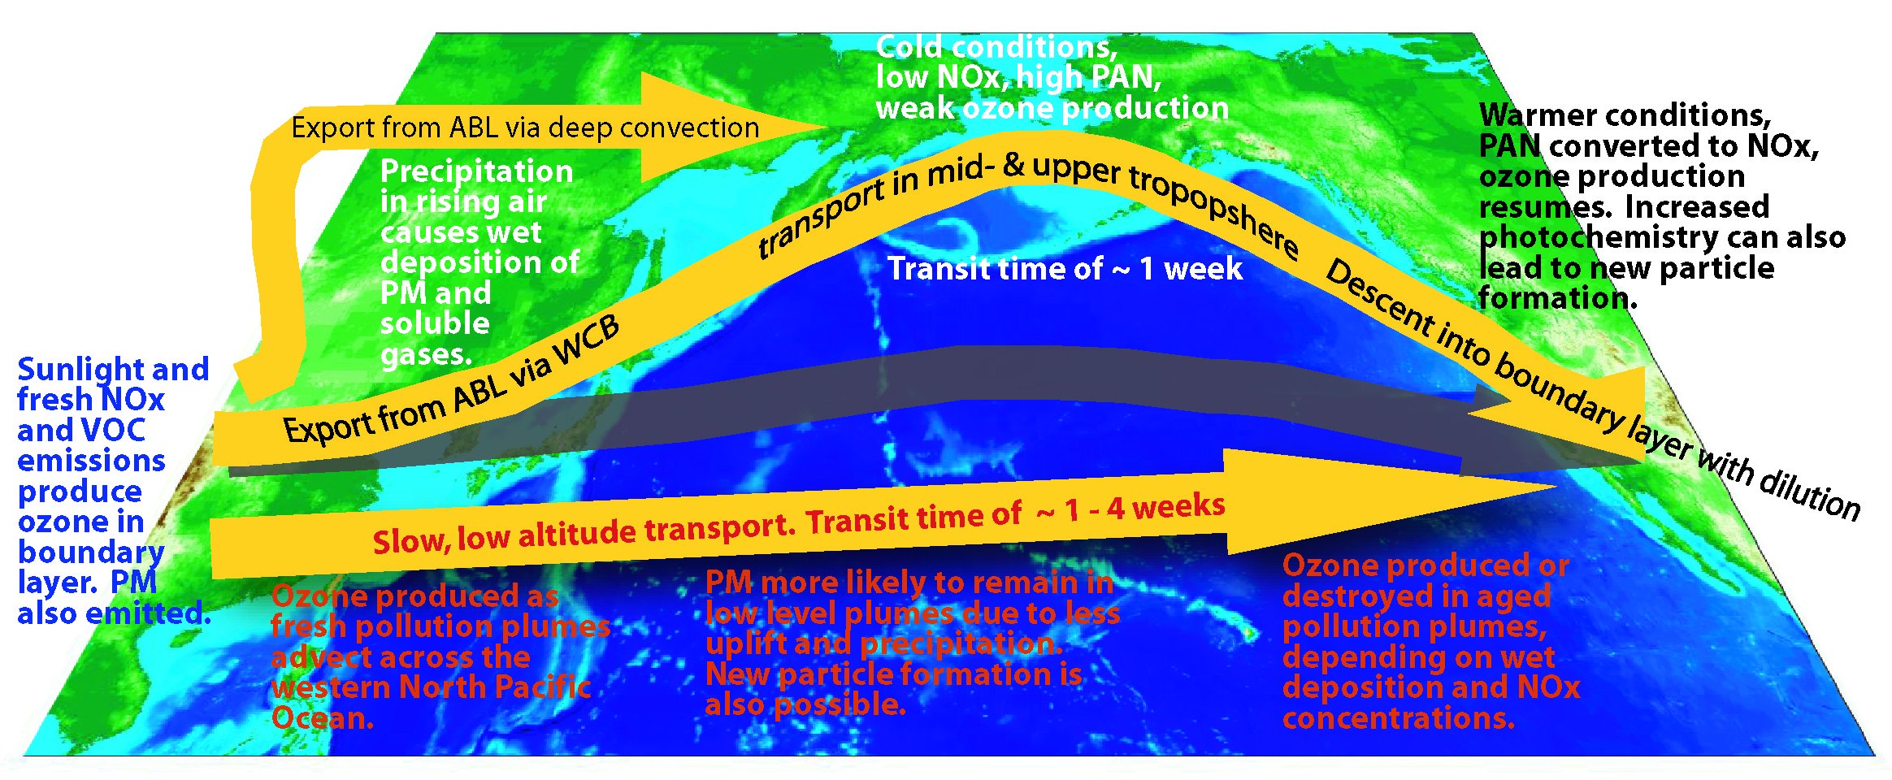
Task Force on Hemispheric Transport of Air Pollution 2010 assessment report
extensive review of intercontinental transport and chemical processes
the major dynamic and chemical processes are well understood
Findings are based on field campaigns that targeted Asian and US pollution plumes:
1993, 1996, 1997 NARE campaigns downwind of USA
Late 1990s: Pacific northwest studies by Dan Jaffe and colleagues
2001: TRACE-P experiment downwind of Asia
2002: ITCT experiment west of California
2004: ICARTT/INTEX A experiments downwind of the eastern USA
2006: INTEX B in the eastern North Pacific
Dentener, F., T. Keating, and H. Akimoto (Eds.) (2011), Hemispheric Transport of Air Pollution 2010: Part A: Ozone and Particulate Matter, Air Pollut. Stud, vol. 17, U. N., New York.
Figure 1.5. from the report describing general inter-continental transport processes.

Slide 34
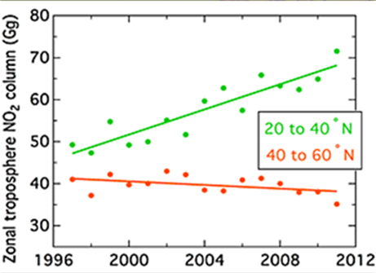
The Chinese economy is growing at 8% yr⁻¹ and emissions are increasing. Since 2006 no in-situ field missions have measured the composition of Asian pollution plumes reaching the USA.
Satellites clearly show the shift in tropospheric column NO₂ from North America and Europe to East Asia.
Parrish, D. D., et al. (2013), Lower tropospheric ozone at northern mid-latitudes: Changing seasonal cycle, Geophys. Res. Lett., 40, 1631-1636
The same dataset shows a southward shift in Northern Hemisphere emissions where sunlight is more abundant.
How much Asian pollution is presently reaching the US boundary layer?

Slide 35
SQ #17 (C)
How is transport across and into the tropics changing?
Are the tropics expanding? Is the Hadley circulation changing? Are the subtropical jets shifting?
What is the NH-SH exchange (interhemispheric exchange time)? Where is it occurring (i.e., pathways)? How could it change with climate? What does it tell us about global trop OH?
How do we define the “atmospheric” equator? ITCZ, mixing minimum?
Importance: Lifetime of CH₄ & HFCs.

Slide 36
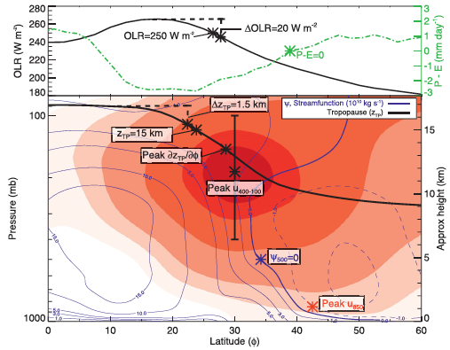
Davis & Rosenlof (2012)
Notes:
FIG. 1. An example monthly-mean zonal-mean cross section of atmospheric properties from the NCEP–NCAR reanalysis and NCEP OLR dataset for January 2008. The zonal-mean zonal wind is shaded (5 m s21 contours), and the mean meridional streamfunction (c) based on the zonal-mean meridional wind is contoured in blue. Tropical edge diagnostics are denoted by asterisks. Dashed vertical lines illustrate the relative threshold metrics, and the solid vertical bar illustrates the vertical range of averaging for the peak wind metric.

Slide 37
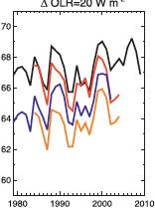
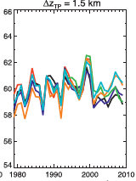
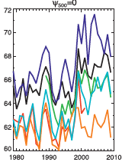
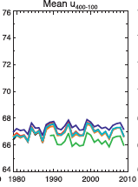
Davis & Rosenlof (2012)
Changing width of the tropics.

Slide 38
SQ #18 (too broad)
How does the large-scale circulation interact with convection, clouds, water vapor and precipitation and how do such interactions determine global and regional climate changes?
Importance: Changing climate, e.g., rainfall patterns, etc. (see impact of Antarctic ozone hole on SH rainfall).

Slide 39
Needed measurements for tropospheric observations
CO₂, CO, CH₄, H₂O, SF₆, O₃, aerosols, & intermediate lifetime species that can be used to trace trans-continental & inter-hemispheric scale motions.
Estimate zonal, monthly means from UT to mesosphere
Measure transient episodes at mesoscale wavelengths
Short-lifetime species that can be used to infer vertical transport by convective processes and synoptic scale motion.
Tropospheric winds & temperatures
6-h met observations from PBL to lower stratosphere.
Snapshot observations of a range of species that can fingerprint & quantify air mass origin

Slide 40
Question Summary
Do we understand the basic pathways of our circulation?
Do we understand the basic forcing mechanisms for the circulation?
How is the atmospheric circulation responding to forcing from ODSs and GHGs?
How does the circulation interact with both sources and sinks of atmospheric trace gases and aerosols?

Slide 41
Some missed Q’s (1)
What role do gravity waves (GWs) play in driving the large-scale circulation? GW sources and sinks? Controls on wave propagation and breaking and resulting impacts on tracer transport? (C)
Is tropical cirrus abundance increasing which would impact climate? (Cloud group)
What differentiates the upper and lower branches of the BDC? Do they interact, and what controls their behavior?
The lower BDC is closely coupled to wave driving in subtropical UTLS. What processes influence subtropical dynamical variability? What are the links to low-frequency tropical/extratropical circulations?
What are the long-term impacts of solar forcing variability on the climate and ozone?

Slide 42
Some missed Q’s (2)
Are the midlatitude storm tracks substantially changing in a systematic way (e.g. shifting poleward, weakening)? What are the associated mesoscale circulations, and are they important for larger-scales? How will their variability change over the coming decade as the troposphere continues to warm?
How do global teleconnections and higher-frequency atmospheric variability impact tropospheric transport (AO, El Niño)? How might changes in this variability over the next decade modify concentrations and travel times?
How are the troposphere and stratosphere dynamically coupled?
Is tropical cirrus abundance increasing which would impact climate?
Will mega-pollution events caused by continental scale stagnation episodes change under a future climate?

