Slide 1
Prioritized Questions
(c) To what degree is the BD stratospheric circulation accelerating? How will variability and trends of the BDC affect trends and distributions of trace species? Pfister & Neu
(c) How is the mid-to-upper stratosphere temperature responding to GHG increases? Newman
(c) What are the transport pathways from the PBL to the stratosphere? Randel
(c) What are the processes that control the transport between the tropics and extratropics and between hemispheres, and how are they changing? Thornberry & Moore
(c) What role do gravity waves (GWs) play in driving the large-scale circulation? GW sources and sinks? Controls on wave propagation and breaking and resulting impacts on tracer transport? What is the contribution to mixing? Robinson
(vi) How will the Southern Hemisphere tropospheric circulation respond to the recovery of polar stratospheric ozone over the coming decade?
(i) What are the chemical and dynamical impacts of stratosphere-troposphere exchange on tropospheric and surface climate?

Slide 2
Circulation questions that are handed-off to other sub-groups
To Strat comp: What are the primary factors that control H₂O in the lower stratosphere? Is water vapor increasing in the stratosphere?
To aerosols & strat comp: Do we understand the distribution of aerosols (e.g., the Junge layer) in the stratosphere?
To Trop comp: Do we understand intercontinental transport and its impact on pollutants?
To Clouds: Is tropical cirrus abundance increasing which would impact climate?

Slide 3
SQ #1: C
To what degree is the BD stratospheric circulation accelerating? How will variability and trends of the BDC affect trends and distributions of trace species?
Are observations in the past decades consistent with model predictions of stratospheric circulation changes (e.g., what are the causes and impacts of the Year 2000 change in the circulation and observed trends in age of air)?
How will wave-driven chemical transport (mean circulation and mixing) in the stratosphere change in the next century? E.g, SSW impact on tropical convection and tropopause T.
Importance: Ozone will not recover to 1980 levels in the tropics, and will “super-recover” in the extra-tropics.
Butchart & Scaife (2001)

Slide 4
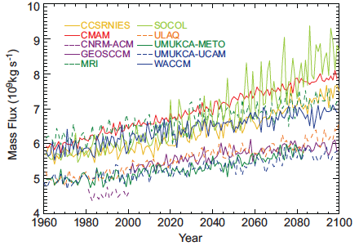
Upward Mass Flux at 70 hPa
Fig. 4.11a (CCMVal-2, On average the 70hPa trend in the upward mass flux (from w*)was about 2% per decade (Figures 4.11b, c, d) with the largest trends occurring in JJA (Butchart & Charlton-Perez, 2010)

Slide 5
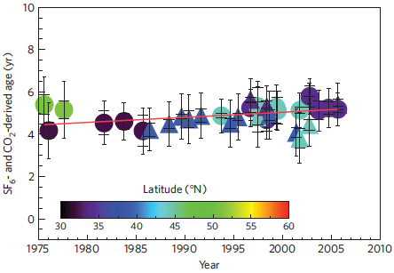
Engel et al. (2009)
Mean age above 24 km. Trend is 0.24±0.22 years of mean age per decade
Notes:
Figure 3. Long-term evolution of mean age above 24 km altitude. SF₆-derived age values are shown by circles; triangles denote CO₂-derived mean age. The colour code shows the (northern) latitude of the measurements. The inner error bars show the 1 sigma standard deviation of the mean-age values between 24 and 35 km for each individual flight. The outer (larger) error bars denote the overall uncertainty of the mean-age value, including an assessment of the representativeness of a single profile observation (see the Methods section and Supplementary Information for more details). The overall uncertainty has been taken into account for the calculation of the long-term trend.

Slide 6
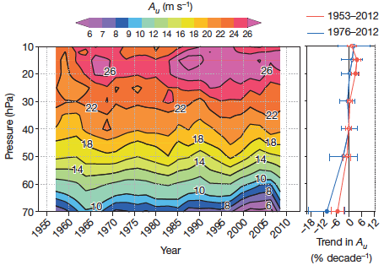
QBO trend (Kawatani & Hamilton, 2013)
Notes:
Figure 1 | Time–height section of the three-cycle mean amplitude of the observed QBO, and the height dependence of the amplitude trend over time. In the main panel, the horizontal axis represents the central date of the three cycle mean of Au; contour intervals are 1ms-1 and 2ms-1 for values less and greater than 10ms-1, respectively. The right panel shows the linear regression trends in the QBO amplitude (in per cent per decade) over time with height from 1953 to 2012 (red) and 1976 to 2012 (blue). Filled circles indicate that the trend at that level is different from zero with a statistical significance P<0.05. Error bars denote P<0.05 confidence intervals in the trend estimates.

Slide 7
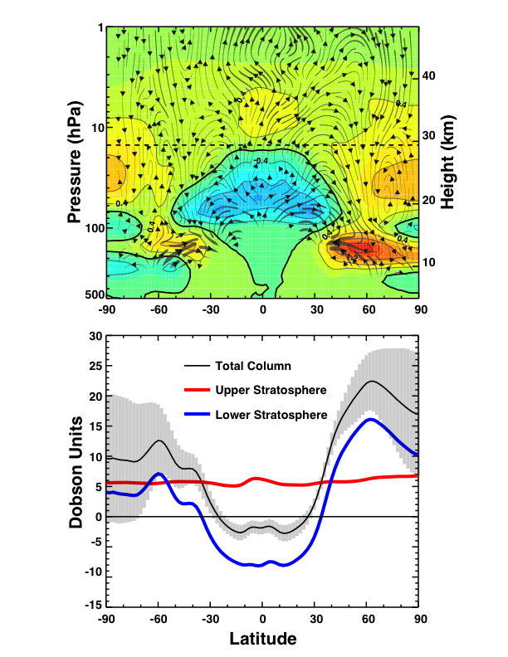
Climate driven changes of ozone transport (2065-1980)
Li et al. ACP (2009)
Change of ozone (top, DU/km) and total ozone in 2 layers and total column.
Stream lines show an increase of both the lower branch of the BD circulation and the upper branch. In the upper stratosphere, the change in column is uniform in latitude, while below 15 hPa, the column changes are transport driven.
Notes:
Fig. 2. Decadal differences between 2060–2069 and 1975–1984 from FREF. (top) Ozone concentrations in DU/km (contour interval: 0.4 DU/km). (c) Total column ozone and contributions from the upper (above 15 hPa) and lower (below 15 hPa) stratosphere. The black vertical lines indicate 2 uncertainties of the decadal difference in the total column ozone.

Slide 8
SQ #2 (C)
How is the mid-to-upper stratosphere temperature responding to GHG increases?
How do N₂O, CH₄, CFCs, HCFCs, and HFCs contribute to this change
Are there direct dynamical responses to this temperature change?
What is the quantitative variability (both annual and interannual) of temperatures in the mid-to-upper stratosphere? Attribution?
Importance: The stratosphere is not going back to it’s pre-industrial state.

Slide 9
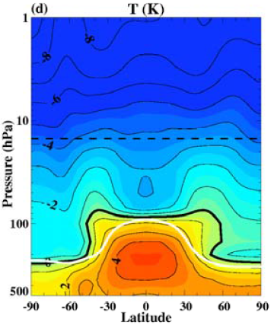
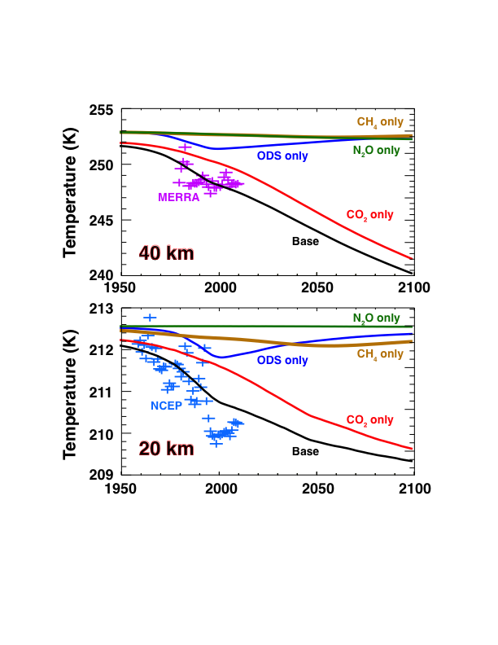
Climate Driven Temperature Change
2065-1980
1980
2065
Are we doing a good job of detecting these changes?

Slide 10
SQ #3 (C)
What are the transport pathways from the PBL to the stratosphere?
How, when, and where does transport occur?
What are the primary mechanisms? Monsoon/convection, US summer convection?
Residence times from the PBL to the stratosphere?
What is the interplay between emission (sources), chemical lifetime, and transport timescale for short-lived species?
What is the depth of circulation influence into the lower stratosphere, and how important are monsoons for the stratospheric overworld?
Importance: The monsoon circulation provides an effective pathway from Southeast Asia, and North America to the stratosphere.

Slide 11
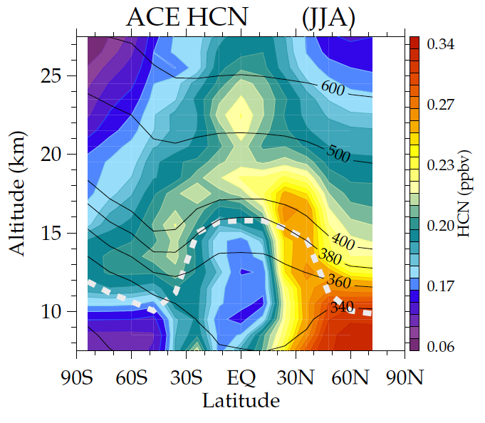
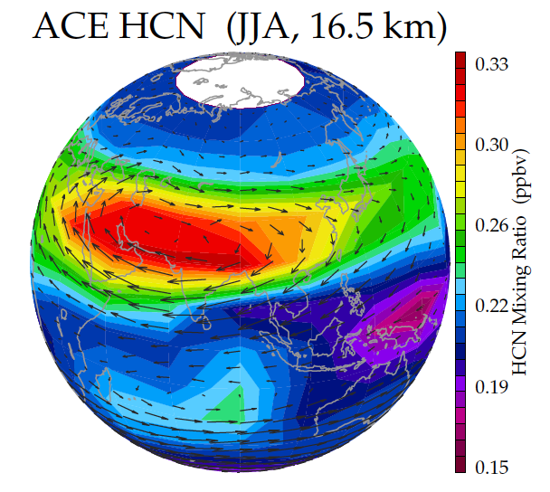
Monsoon transport to the stratosphere observed from ACE-FTS hydrogen cyanide
HCN – biomass burning tracer
Minimum in tropics (ocean sink)
Long lived in free atmosphere
tropical
minimum
transport to
stratosphere
via monsoon
monsoon
maximum
minimum for air with
recent ocean contact

Slide 12
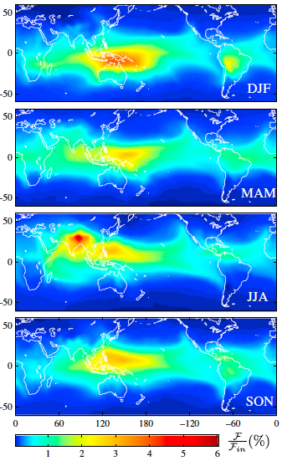
Stratospheric injection of VSLS
Very-short-lived halogens originating from oceanic, land, or anthropogenic sources, when transported into the stratosphere, exerts a significant impact on the chlorine and bromine budgets and ozone depletion in the stratosphere.
Recent years have seen significant progresses in modeling efforts to quantify VSLS contributions to stratospheric inorganic bromine. These modeling studies suggest that VSLB contributes between 3-7 ppt to reactive bromine in the stratosphere, bringing the model estimate in good agreement with satellite and balloon-borne obs.
The VSLS halogen contributions are very sensitive to emission locations.
Figure 1. Sensitivity maps showing % flux into the stratosphere (F/F_{in}) for an idealized tracer with chemical lifetime τ = 20 days. Emissions are uniform and results have been averaged over 4 years (2007-2011). Haines & Esler (2013).

Slide 13
SQ #4 (C)
What are the processes that control the transport between the tropics and extratropics and between hemispheres, and how are they changing?
Are the tropics expanding? Is the Hadley circulation changing? Are the subtropical jets shifting?
What is the NH-SH exchange (interhemispheric exchange temporal and spatial structure)? What are its mechanisms? Where is it occurring (i.e., pathways)? How could it change with climate? What does it tell us about global trop OH?
How do we define the “atmospheric” equator? ITCZ, mixing minimum?
Importance: Lifetime of CH₄ & HFCs.

Slide 14
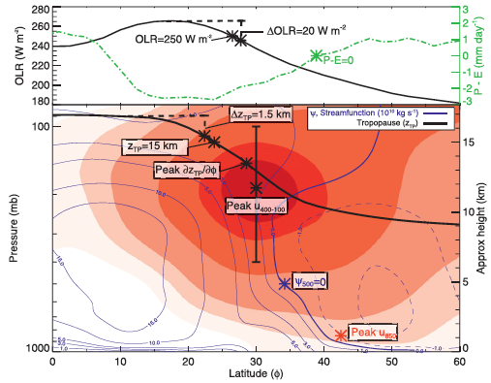
Davis & Rosenlof (2012)
Notes:
FIG. 1. An example monthly-mean zonal-mean cross section of atmospheric properties from the NCEP–NCAR reanalysis and NCEP OLR dataset for January 2008. The zonal-mean zonal wind is shaded (5 m s21 contours), and the mean meridional streamfunction (c) based on the zonal-mean meridional wind is contoured in blue. Tropical edge diagnostics are denoted by asterisks. Dashed vertical lines illustrate the relative threshold metrics, and the solid vertical bar illustrates the vertical range of averaging for the peak wind metric.

Slide 15
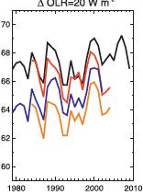
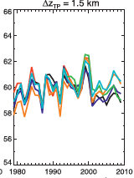
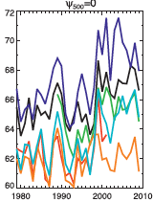
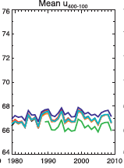
Davis & Rosenlof (2012)
Changing width of the tropics.

Slide 16
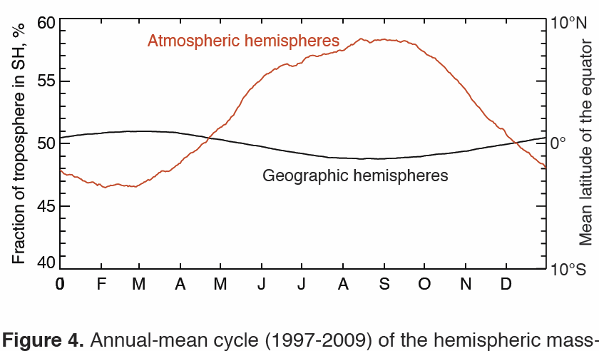
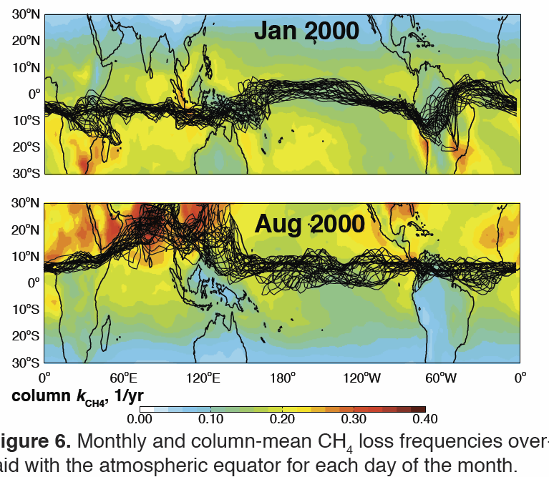
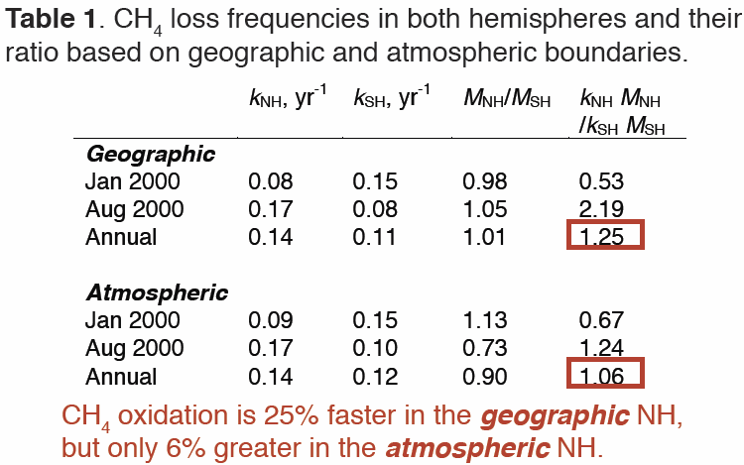
Atmos. Comp.- Atmospheric Circulation – M. Prather
Tropospheric Pole-to-Pole Mixing
Where’s the Waldo (the equator)?
N-S decay of CH₃CCl₃?
Better ID of sources? or OH?
With more interesting diagnostic approaches we
can clearly define mixed regions and surf zones
in the troposphere.
Will these change in the future?
How can we document from in situ?
from space?
Holmes & Prather, 2014, SPARC poster/draft-paper
NASA Ames Atmos. Comp. Decadal Workshop 6-8 May 2014) – M. Prather

Slide 17
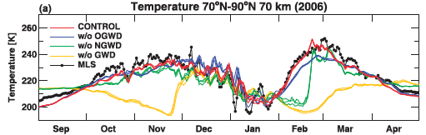
SQ #5 (c)
What role do gravity waves (GWs) play in driving the large-scale circulation? GW sources and sinks? Controls on wave propagation and breaking and resulting impacts on tracer transport? What is the contribution to mixing?
FIG. 2. Polar-cap average temperatures at 70 km: control simulation (red) and the simulations without orographic GWD (blue), without nonorographic GWD (green), and without GWD (yellow). The black dotted curves denote the MLS observations. The three members of each CMAM ensemble are shown. McLandress et al. (2013)

Slide 18
Main Question
Sub questions
Background material
Cross-cuts
Why is this important for NASA composition focus area?
Observational requirements

Slide 19
