Slide 1
Stratospheric Composition
- Outstanding Scientific Questions
Ru-Shan Gao and Karen Rosenlof
NOAA ESRL CSD
Atmospheric
circulation
Atmos-surf
exchange
Aerosol
Tropospheric
composition
Stratospheric
composition
Clouds
Convection
Radiation
NASA Ames, May 6, 2014

Slide 2
Thanks to:
Elliot Atlas, Rich Bevilacqua, P.K. Bhartia, Anne Douglass and the GSFC team, Doug Kinnison, Nathaniel Livesey and the JPL team, Fred Moore, Dan Murphy, Laura Pan, Lenny Pfister, Brad Pierce, Bill Randel, Ross Salawitch, Mark Schoeberl, and Steve Wofsy

Slide 3
Key topics requiring additional research are:
Topic SC1. Stratosphere composition and climate change
Stratospheric perspective:
How will circulation/temperature changes change Stratosphere composition?
Tropospheric perspective:
How will stratosphere/troposphere coupling change?
- Note that coupling can be chemical, dynamical
or radiative
Certain aspects of AQ and surface temperature/precipitation
changes have been linked to stratospheric changes.
Topic SC2. Stratospheric ozone
Topic SC3. Implications of solar radiation management (a.k.a. Geoengineering)

Slide 4
Li et al., J. Climate, 2008
Diallo et al., Atmos. Chem. Phys., 2012
Hegglin and Shepherd, Nature Geo., 2009

Slide 5
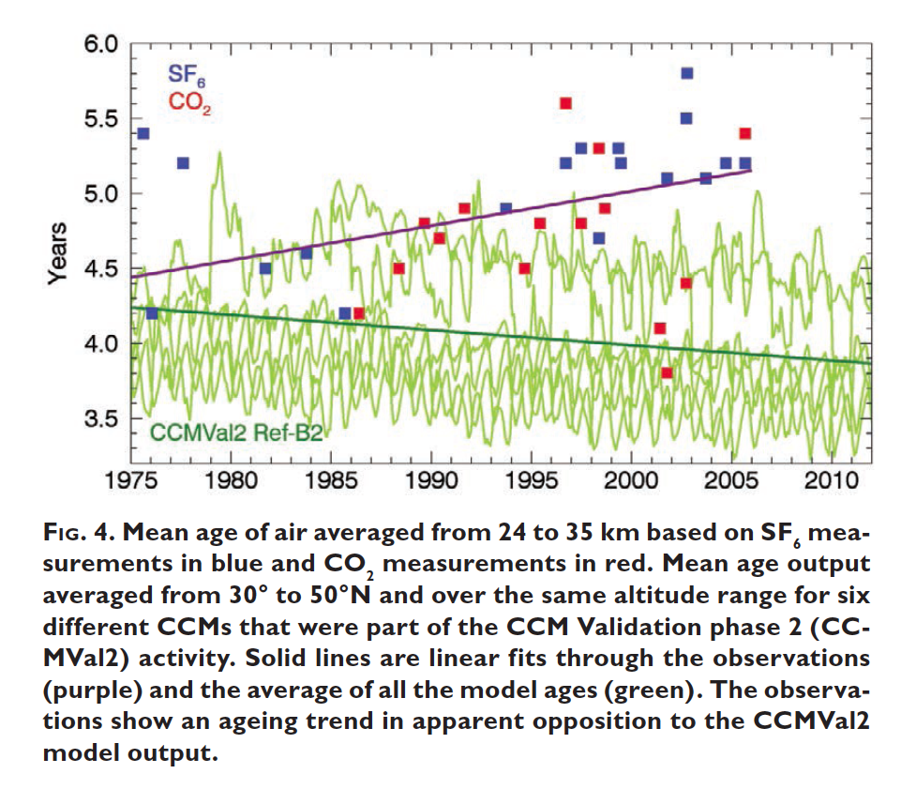
Moore et al., BAMS, 2014

Slide 6
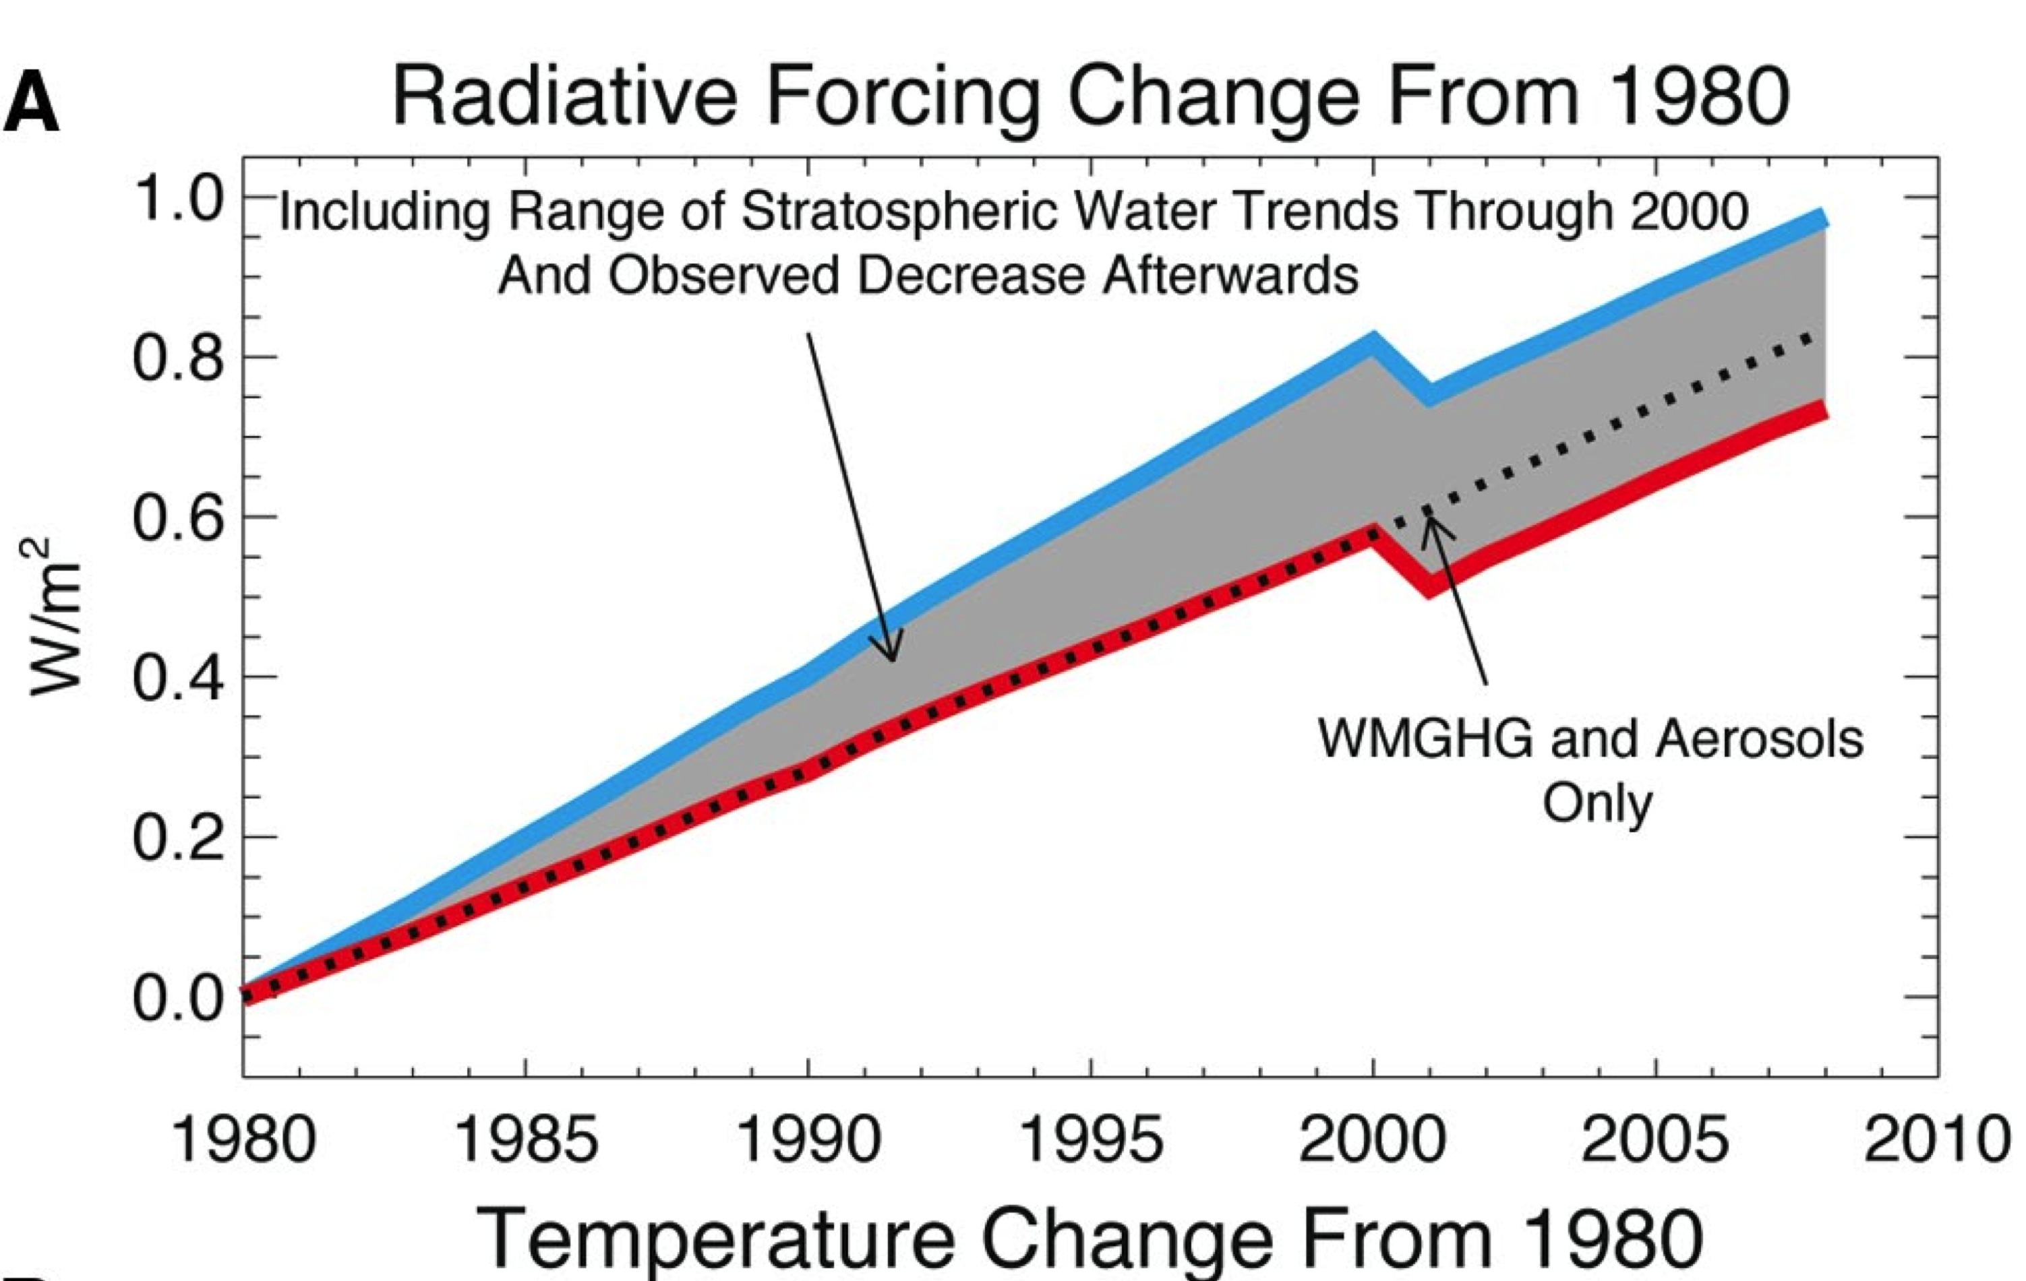
Solomon et al., Science, 2010

Slide 7
Key topics requiring additional research are, cont.:
Topic SC1. Stratosphere composition and climate change
Topic SC1a. Stratosphere composition change due to Brewer-Dobson Circulation (BDC) change
Change of age of stratospheric air
Change of mixing
Topic SC1b. The role of UTLS in the climate system
Mixing across the subtropical jet
Convection impact on the UTLS
Asian and North American monsoons
Topic SC1c. Stratospheric water vapor/WV feedbacks

Slide 8
Key topics requiring additional research are, cont.:
Topic SC2. Stratospheric ozone
Scientific Assessment of Ozone Depletion: 2010

Slide 9
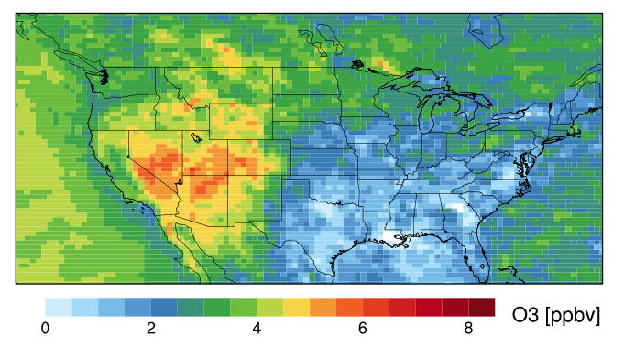
Mean Asian pollution contribution to MDA8 surface O₃ from May–June 2010 as estimated by the GFDL AM3 model
Meiyun Lin, Princeton and NOAA GFDL
Meiyun Lin, NOAA GFDL
Lin, M. Y., Fiore, A. M., Horowitz, L. W., Cooper, O. R., Naik, V., Holloway, J., Johnson, B. J., Middlebrook, A. M., Oltmans, S. J., Pollack, I. B., Ryerson, T. B., Warner, J. X., Wiedinmyer, C., Wilson, J., Wyman, B.(2012), Transport of Asian ozone pollution into surface air over the western United States in spring, J. Geophys. Res, 117, doi:10.1029/2011JD016961.

Slide 10
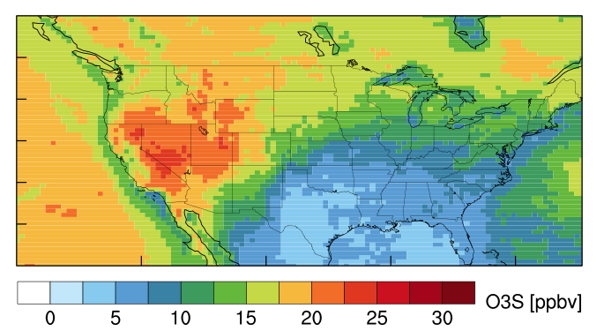
Mean stratospheric contribution to MDA8 surface O₃ from May–June 2010 as estimated by the GFDL AM3 model
Meiyun Lin, Princeton and NOAA GFDL
Lin, M. Y., A. M. Fiore, O. R. Cooper, L. W. Horowitz, A. O. Langford, H. Levy, B. J. Johnson, V. Naik, S. J. Oltmans, and C. J. Senff (2012), Springtime high surface ozone events over the western United States: Quantifying the role of stratospheric intrusions, J. Geophys. Res, 117, doi:10.1029/2012JD018151.

Slide 11
Key topics requiring additional research are, cont.:
Topic SC2. Stratospheric ozone
Topic SC2a. O₃ recovery/Polar stratospheric O₃
Topic SC2b. ODS in stratosphere (VSL, CFCs)
Topic SC2c. Sulfur, aerosol comp, SAD, PSCs
Topic SC2d. Strat O₃ and AQ – Climate-change effect?

Slide 12
Key topics requiring additional research are, cont.:
Topic SC3. Implications of solar radiation management (a.k.a. Geoengineering)
Shepherd et al., Geoengineering the climate – Science, governance, and uncertainty, 2009

Slide 13
On the other hand:
• Canty et al. [ACP, 2013] argue that stratospheric aerosol is less effective than previous studies suggested
• Other “side effects” such as increased O₃ loss

Slide 14
Topic SC1a. Composition change due to BDC change
Rank | Science question | Approach | Measurements | Resolutions
C | How is stratospheric composition responding to changing circulation? | Satellite observations augmented balloon measurements for trends and changes; GCM models | Satellite: O₃, CH₄, N₂O, SF₆, H₂O (Note: have to be accurate enough so direct comparisons can be made to in situ measurement, and long-term precision is critical for trends) Balloon: O₃, CH₄, N₂O, SF₆, H₂O | Satellite: Monthly, global, 1-2°, 1-5 km Balloon: seasonal
C | What are the consequences of changing stratospheric composition?
I | Is mixing (tropical/midlatitude, vertical) changing?
I | How is the mid-to-upper stratosphere composition changing?
Ranking: Critical, Very Important, Important

Slide 15
Moore et al., BAMS, 2014

Slide 16
Topic SC1b. The role of UTLS in the climate system
Topic SC2b. ODS in stratosphere (VSL, CFCs)
Topic SC1C (WV) and Topic SC2C (sulfur)
Rank | Science question | Approach | Measurements | Resolutions
C | How will changes in the UTLS circulation affect stratospheric composition, and what are the associated feedbacks? | Trace species’ response to the trends and variability in jets, the tropopause, and convections; Models, especially Lagrangian models | Satellite: O₃, H₂O, aerosol, tracer w/ different lifetimes, ClO, BrO | 1-km vertical resolution Better than 1-month time resolution?
VI | What is the impact of VSL ODSs (including ClO and BrO) transported through the UT into the stratosphere? Are there emission regions from which transport is more effective?

Slide 17
Topic SC1b. The role of UTLS in the climate system
Rank | Science question | Approach | Measurements | Resolutions
VI | How do monsoons affect stratospheric composition (link to VSL ODS)? | Campaign-based in situ observations aided by satellites (has to include Asian), models, especially Lagrangian models | O₃, H₂O, CH₄, N₂O, CO, aerosol, aerosol composition, tracer with different lifetimes, clouds, water isotopes
I | What controls the existence of ATAL and NATAL? What role do they play in the climate system? How will they be impacted by increase GHGs?

Slide 18
Randel et al. Science, 2010
Randel et al. JGR, 2012

Slide 19
Topic SC1c. Stratospheric water vapor (SWV)
Rank | Science question | Approach | Measurements | Resolutions
C | What is the future trend of SWV due to changes in methane and other GHGs, and its feedback to the climate? | Long-term trend measurements coupled with models | Stratospheric methane and other tracers via satellites. | Global, monthly.
VI | Do we understand the decadal SWV variations? | Measurements of short-term variabilities coupled with measurements | Tropical and sub tropical temperature profiles, tracers, WV
VI | How can we improve our understanding of microphysics and dehydration? | Measurements at entrance points of stratospheric air and cold points in the UT, models | In situ WV, ice, temperature, temperature profiles

Slide 20
Topic SC2a. O₃ recovery/Polar stratospheric O₃
Rank | Science question | Approach | Measurements | Resolutions
VI | What are the spatial and temporal dependences of halogen-catalyzed ozone loss? | Combination of satellite and in situ measurements and model studies | Satellite Column O₃, O₃ and temperature profiles, HCl. HO_{x}, NO_{x}, NO_{y} Are in situ measurements needed? | Satellite: Daily, 1° or less, 1 km or less, polar
I | What are the spatial and temporal dependences of other ozone loss processes?
I | How do we separate the climate impacts of GHGs increases from those of O₃ changes due to reduction in ODSs?

Slide 21
Topic SC2a. O₃ recovery/Polar stratospheric O₃, cont.
Rank | Science question | Approach | Measurements | Resolutions
VI | How will future changes in ozone impact surface climate, and what will be the impacts on Antarctic warming and ice melt? | Long-term monitoring O₃ and surface parameters; coupled with models | Global ozone, surface temperature, low-level winds, ice mass. | Daily-weekly, low res?
I | Will future Arctic ozone loss become severe enough to strongly affect the tropospheric circulation and surface climate, as is happening now in the Antarctic? | Long-term monitoring O₃, HCl, and meteorological parameters; coupled with models | Global ozone profiles, temperature, reservoir and active chlorine, long-lived tracers, PSCs, nitric acid, water vapor. | Daily

Slide 22
Topic SC2b. ODS in stratosphere (VSL, CFCs)
Rank | Science question | Approach | Measurements | Resolutions
VI | (What is the impact of VSL ODSs transported through the UT into the stratosphere? Are there emission regions from which transport is more effective?) | Addressed with SC1b
VI | How do long-lived halogen-containing species evolve? | Long-term measurements in troposphere and in stratosphere, compare to models | Ground- and space-based measurements of halogen and other compounds | Monthly, low spatial resolution

Slide 23
Topic SC2c. Sulfur, aerosol comp, SAD, PSCs
Rank | Science question | Approach | Measurements | Resolutions
VI | What controls stratospheric aerosol distributions and changes in stratospheric aerosol amount? | Partially addressed with SC1b | Satellite and in situ: SO₂, OCS | 1-km vertical resolution Better than 1-month time resolution?
I | What are the relative contributions of sulfate aerosols, PSCs and cirrus clouds to chlorine activation and how will these factors impact ozone depletion in a changing climate? | Satellite observation augmented by in situ measurements, coupled with models | Global O₃ and temperature profiles, reservoir and active chlorine, long-lived tracers, aerosols, PSCs, cirrus clouds, HNO₃, WV. | Daily

Slide 24
Topic SC2c. Sulfur, aerosol comp, SAD, PSCs
Rank | Science question | Approach | Measurements | Resolutions
I | How can we improve our ability to model denitrification and springtime chlorine re-activation? | Models coupled with in situ measurements | In situ measurements of PSCs, HNO3, aerosol, WV, temperature

Slide 25
Topic SC2d. Stratospheric O₃ and AQ – Climate-change effect?
Rank | Science question | Approach | Measurements | Resolutions
I | Will transport of O₃ from the stratosphere change with increased GHGs? Do we fully understand the current contribution of stratospheric ozone on the tropospheric O₃ budget? | Regional studies: Ground-based in situ and lidar measurements coupled with models | O₃, CO, WV

Slide 26
Topic SC3. Implications of solar radiation management (SRM)
Rank | Science question | Approach | Measurements | Resolutions
C | How will various SRM methods work, and what additional climate parameters besides surface temperature they will affect? | Determination of the sulfur baseline with measurements; separation of natural and anthropogenic contributions; models. Be prepared to study next big volcanic explosion | Sulfur budget at the entrances of stratospheric air; monsoon contributions
VI | Should we monitor unannounced stratospheric SRM test? If so, how?

Slide 27
Other thoughts:
MINIMUM ACCEPTABLE measurement sets
- Rate measurements (Critical, Very Important, Important)
Resolution, coverage, and # of species
New vehicles/sensors/samplers (e.g. CubeSats, StratCore)
Email to rushan.gao@noaa.gov
or karen.h.rosenlof@noaa.gov for a copy this ppt

Slide 29
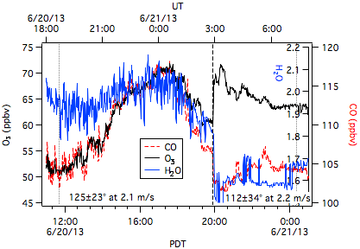
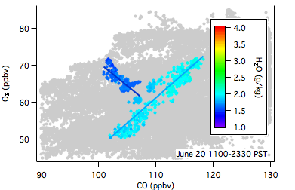
June 20-21, 2013 Stratospheric intrusion and Asian pollution
+10 ppbv
Stratospheric intrusion:
Drier with anticorrelation
Asian pollution:
Dry with correlation

