Slide 1
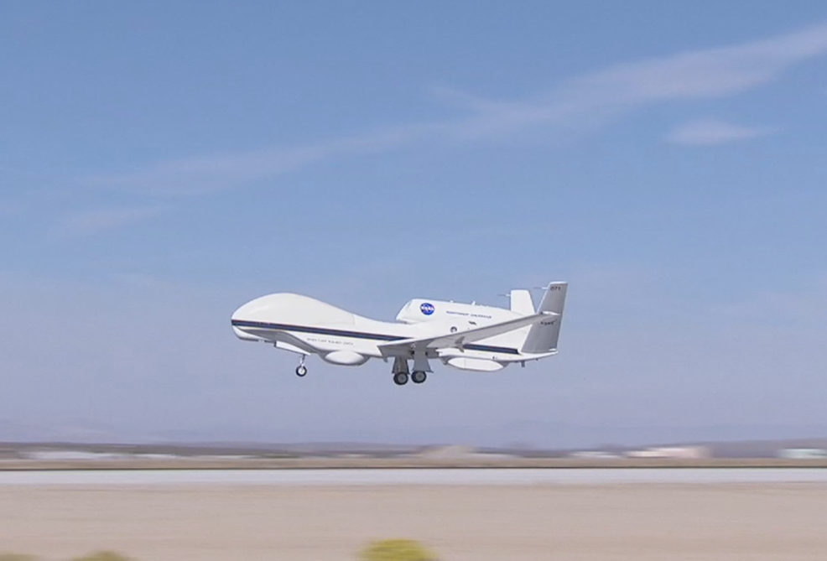

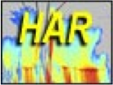

High-Altitude Imaging Wind and Rain Airborne Profiler (HIWRAP) Status
Gerry Heymsfield NASA/Goddard Space Flight Center
Lihua Li, Matt Mclinden, NASA/Goddard Space Flight Center
Michael Coon, M. Perrine,
Amber Reynolds
Stephen Guimond U. MD/ESSIC
Lin Tian Morgan State Univ.
James Carswell Remote Sensing Solutions
HAMSR
HIWRAP
HIRAD
Picture of AV-1 Aircraft at Edwards AFB

Slide 2
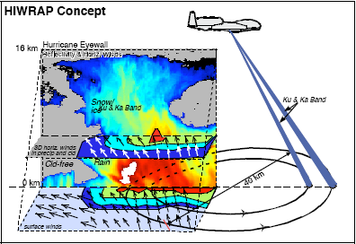
High-Altitude Imaging Wind and Rain Airborne Profiler (HIWRAP)
Parameters | Specifications
 | Ku-band | Ka-band
Inner/Outer Frequency (GHz) | 13.91,13.47 | 35.56, 33.72
Peak Transmit Power (W) | 25 | 4
3 dB Beamwidth (º) | 2.9 | 1.2
Polarization | H (inner beam), V (outer beam)
Dynamic Range (dB) | > 65
Min. Detect. Reflectivity (dBZe ,60m,10 km range) | 0 | -5
Doppler Velocity (ms⁻¹) | 0-150 (< 1.5 ms⁻¹ @ SNR > 10)
Conical Scanning | 10-30 RPM (nom. 16 RPM)
30 km
MEASUREMENTS GOALS:
Precipitation and 3-D winds
Ocean surface vector winds in clear to light rain regions
New technologies in HIWRAP: Solid-state transmitters with novel frequency diversity pulse compression waveforms & Ku/Ka-band single aperture antenna.
Notes:
GPM frequencies
Combine volume scattering signal and surface scattering

Slide 3
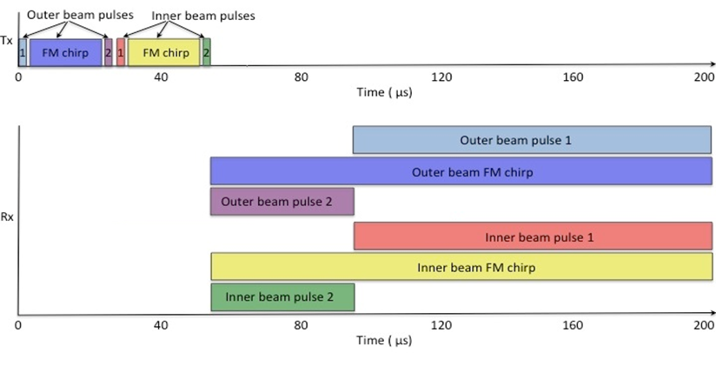
HIWRAP Pulse Sequence
IF Frequencies (MHz)
 | OP1 | OC | OP2 | IP1 | IC | IP2
Ku | 122 | 112 | 130 | 126 | 116 | 134
Ka | 115 | 108 | 122 | 118 | 111 | 125
8-frequencies
Short pulse 1 is for near-surface measurement (2 μsec )
Chirp is for higher resolution/sensitivity (20 μsec )
Short pulse 2 is for ranges close to radar (2 μsec )
Dual PRF for unfolding
Pulse Repetition Time 1 (PRT)
Pulse Repetition Time 2 (PRT)
~4000 Hz
~5000 Hz
Notes:
Move me

Slide 4
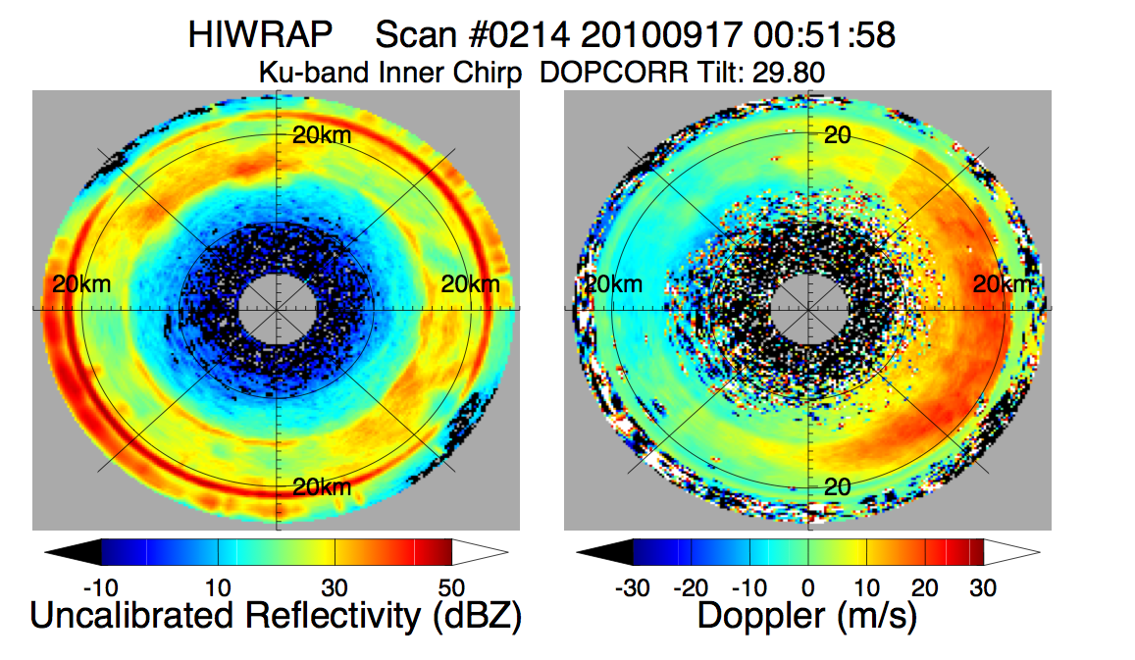
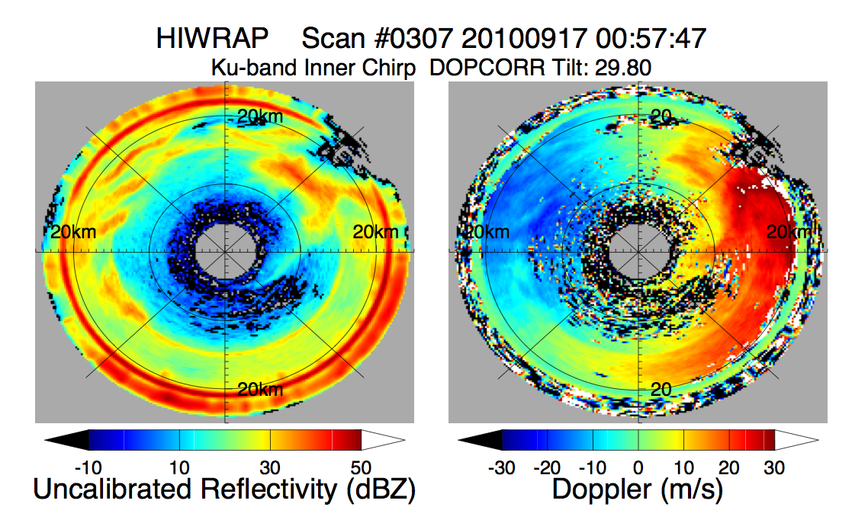
Polar Plot: 17 Sept 2010 Hurricane Karl
Reflectivity Doppler (air+fall speed)
HIWRAP: 20 crossings of Hurricane Karl on Sept. 17, 2010 during GRIP over 14 hours.
Doppler line of sight wind measurements are continually profiled during the conical scans.
Ku-band 30º H
Measurement Geometry
Ku-band 30º H

Slide 5
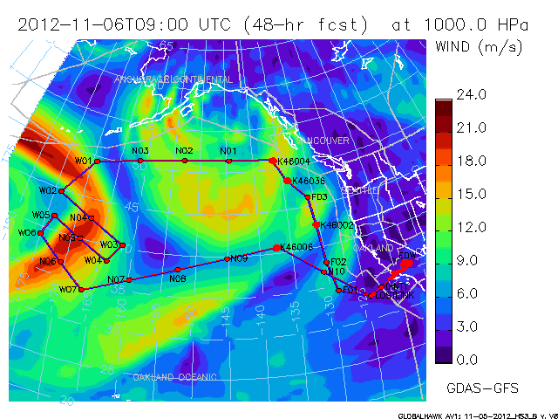
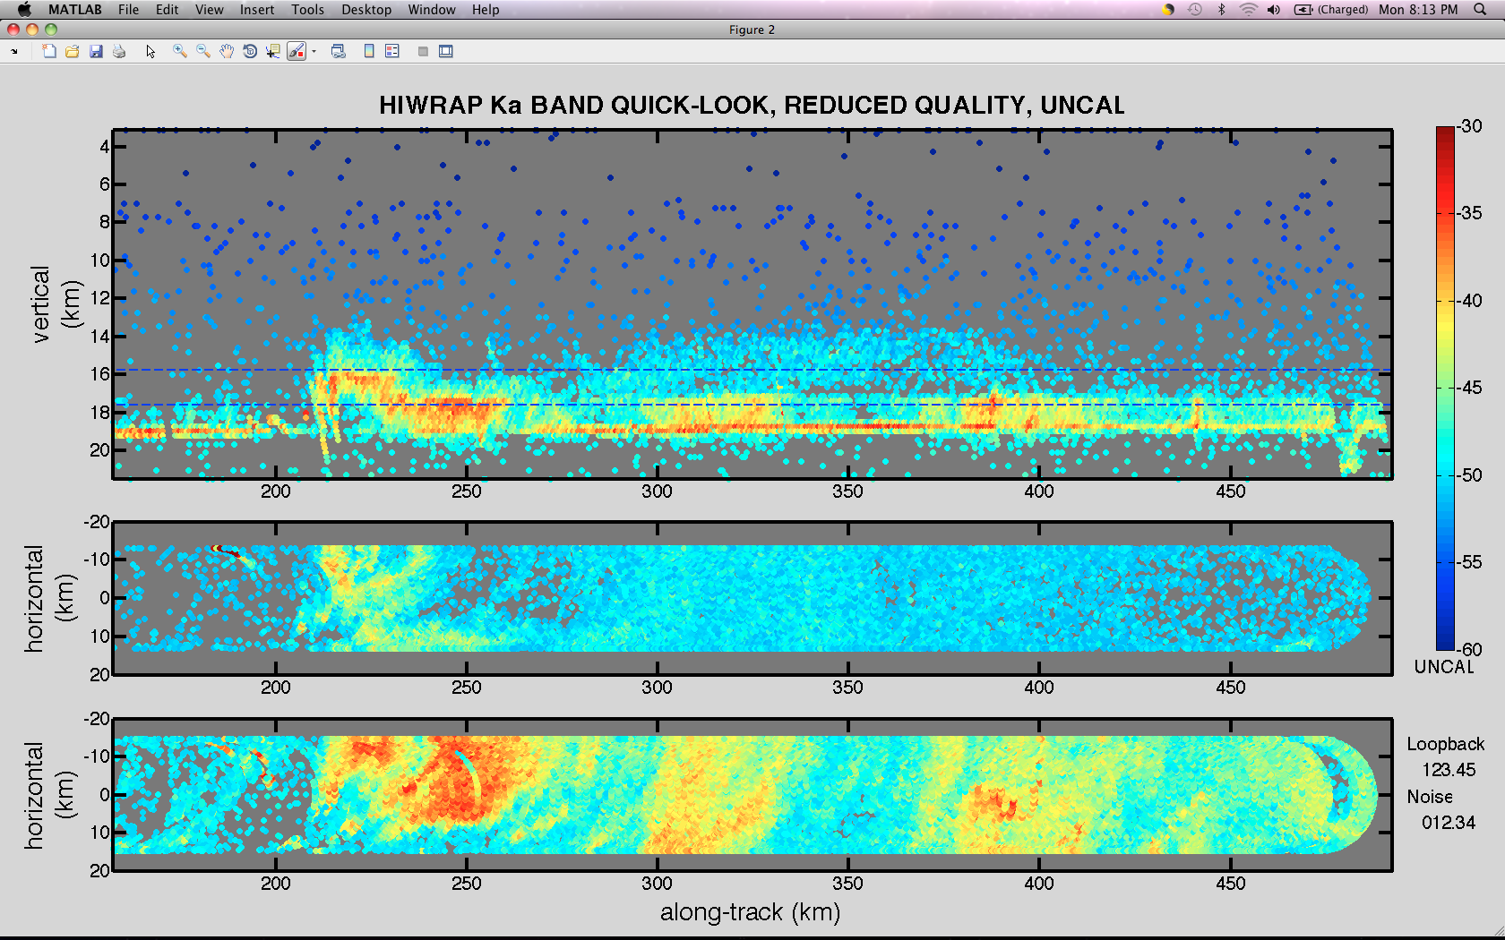
HS3 5-6 Nov 2012 Flight
Flight over the Pacific with emphasis on obtaining ocean surface winds.
Develop/evaluate HIRAD ocean wind retrievals.
HIWRAP obtained the first real-time data plots during AV-1 flights.
HIWRAP performance improved over GRIP.
vert
4 km
<- First real-time data collected.
2 km

Slide 6
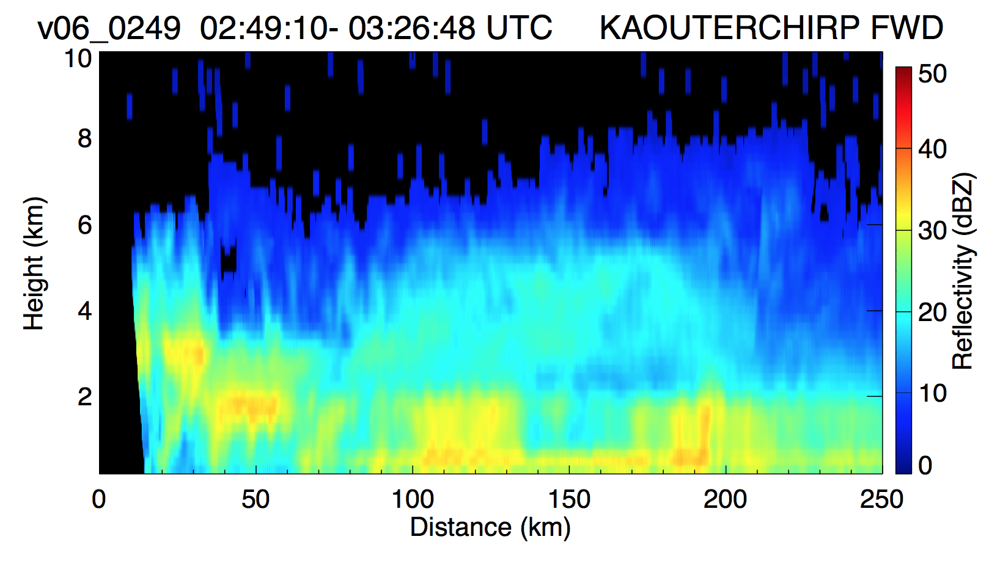
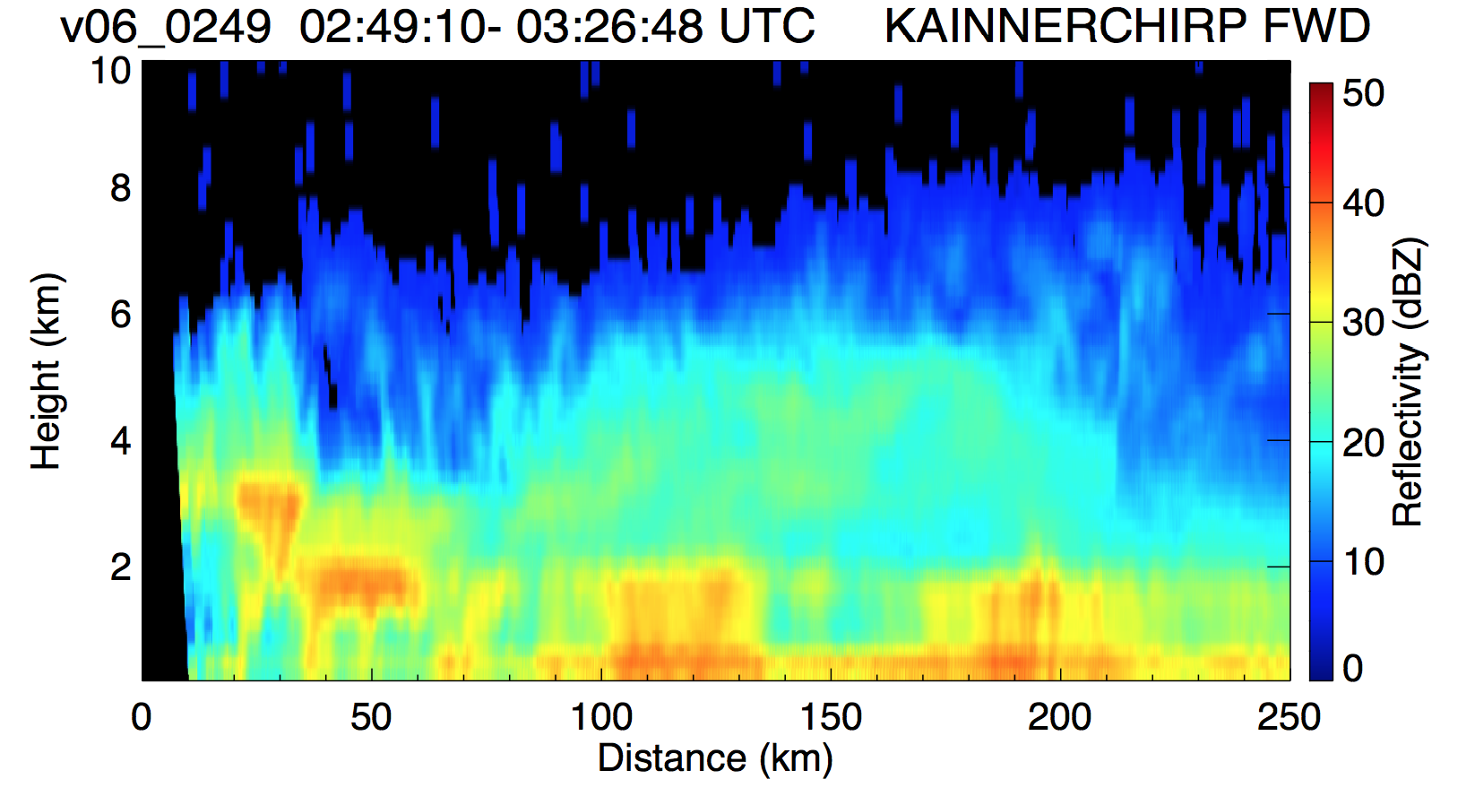
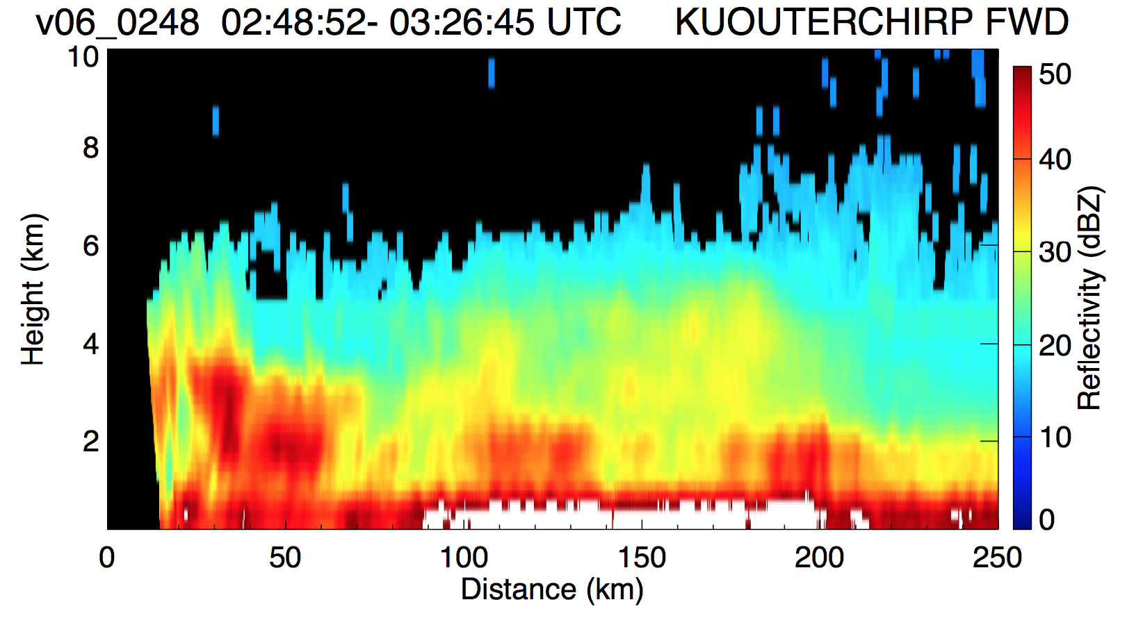
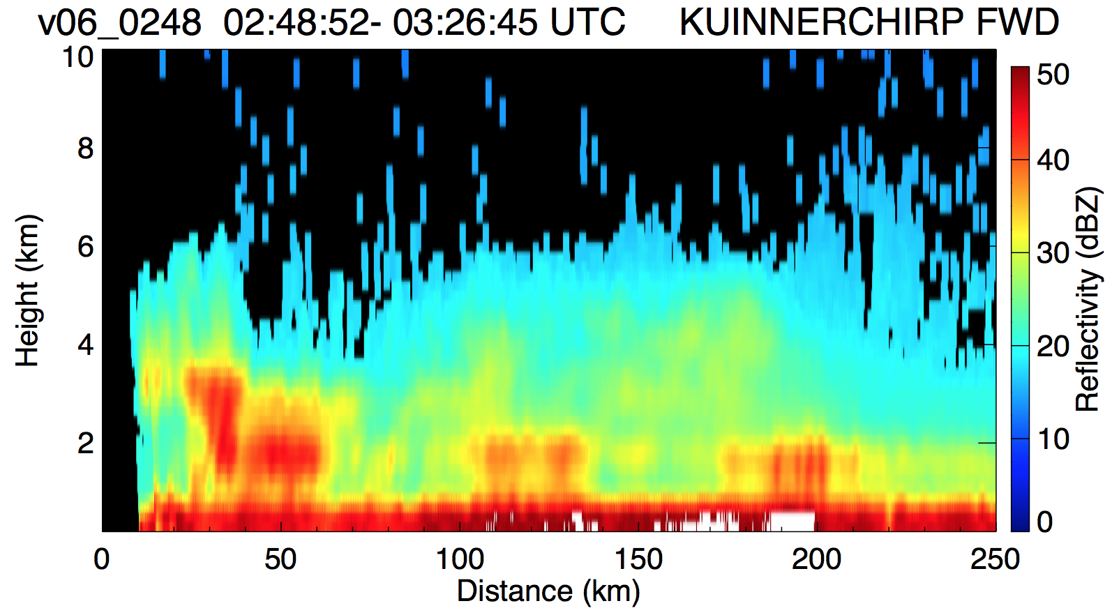
Reflectivity 5-6 Nov 2012
Frontal System off Oregon Coast
Outer, Inner Beam. Ku- and Ka-Band..
-> Ka higher sensitivity and resolution.

Slide 7
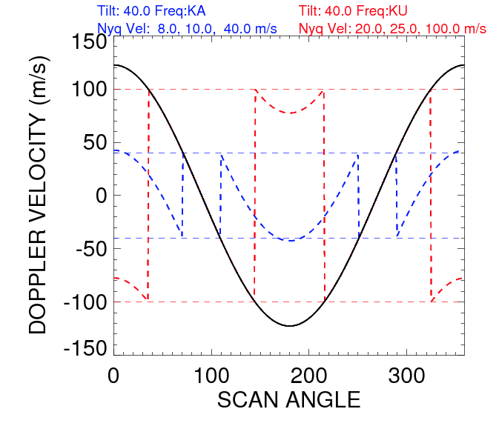
HIWRAP Doppler Unfolding
Automated “Dual-PRF” unfolding followed by a second unfold based on aircraft Doppler component.
Working through details to make this more reliable.
Ka-band is more problematic because of low Nyquist velocity
Future: frequency diversity unfolding: Testing 2013.
Ka
folded
Ku
folded
Aircraft motion
PRF: 4000, 5000 Hz
Pulse-pair velocities: low PRF, high PRF, dual PRF
Ku: 20, 25, 100 m/s
Ka: 8, 10, 40 m/s

Slide 8
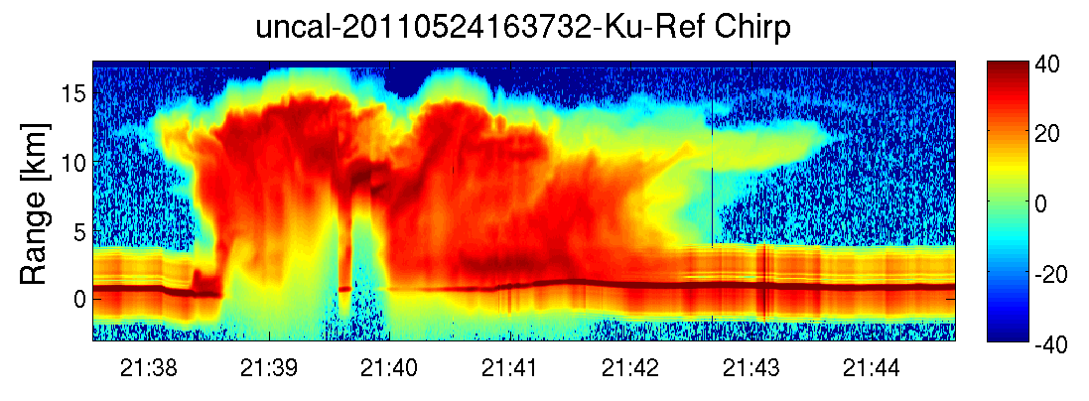
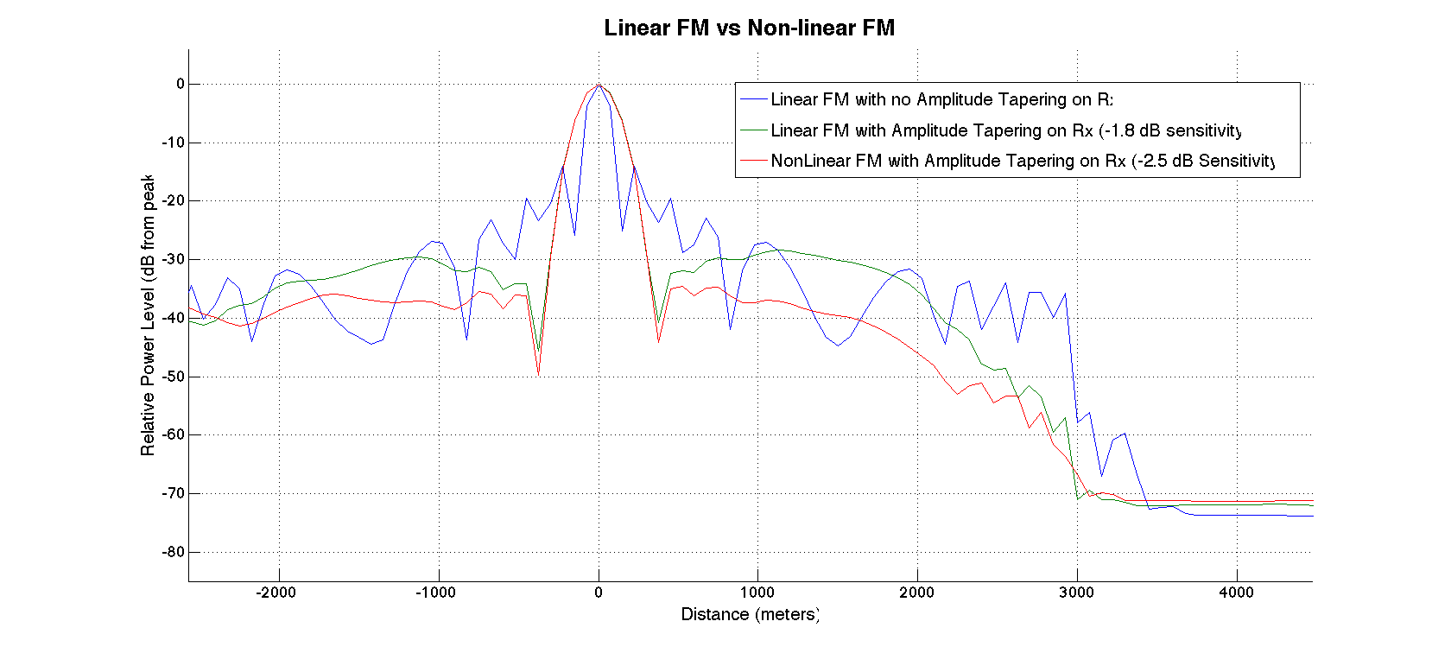


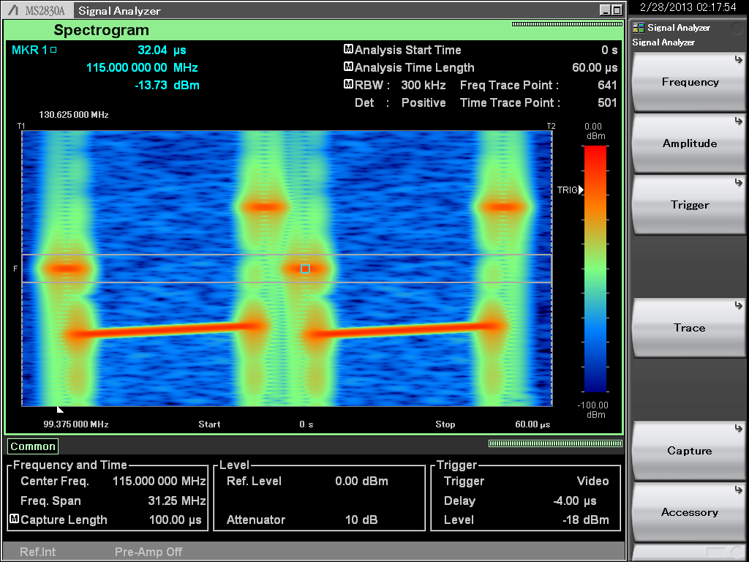
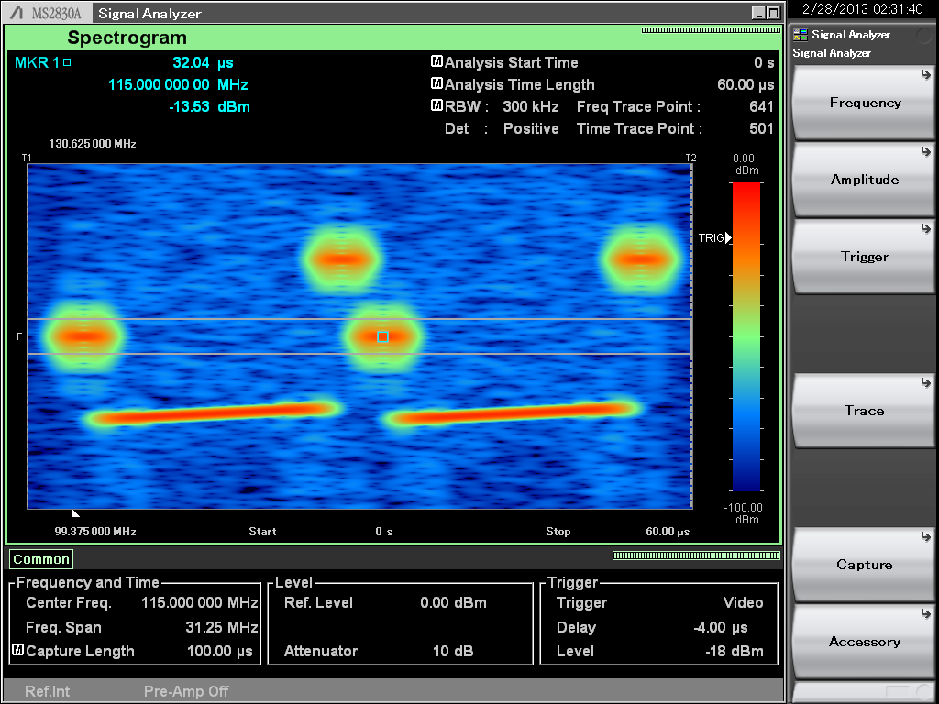
Pulse Compression – Range Side-lobes
Extreme Case with nadir pointing HIWRAP
Comparison between Linear and Non-linear frequency modulation (NLFM)
Surface sidelobes
Linear FM Un-tapered Waveforms
Prior to 2013 flights
Nonlinear FM Tapered Waveforms (2013)
Frequency
Frequency
Time
Time
Amplitude tapering improves channel isolation

Slide 9
HIWRAP Data Flow
Antenna Rotation Angle
Raw I, Q
8 sub channels
2-freq, 2-beams, chirp, pulse (~6 TB/flight)
Data System
Navigation
Stored on plane
Radar Status
Disk File
Pulse Compression Filter & Pulse Pair
Data Merge
Post Processed
Calibration
Unfolding
Chirp & pulse merge*
Merged File
netCDF file

Slide 10
Wind Retrieval Algorithms (Atmosphere)
Grid point analysis -> 3D winds
Guimond et al. Poster at meeting.
VAD analysis -> 2D plane at nadir with linear assumption.
Tian et al. Poster at meeting.
“Coplane” 3D analysis (Didlake) experimental
Good progress on wind algorithms and wind error analysis -> testing hampered by noisy GRIP data and unfolding issues.

Slide 11
Grid-point Analysis of Hurricane Karl (2010) Intensification During GRIP
~ 3 km height Ku-band Reflectivity (dBZ) & Wind Vectors
Grid-point analysis using inner (30 degree) beam.
Notes:
These are North to South GH overpasses of Hurricane Karl from HIWRAP. The passes span a total of ~ 12 hours with roughly 2 hrs between each N-S pass.
Actual delta T between each pass is: 2.25 h, 2.2 h, 2.5 h, 3 h, 1.67 h

Slide 12
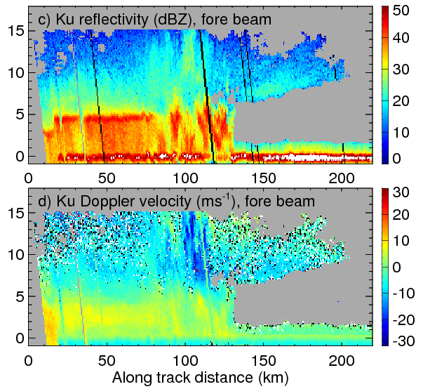
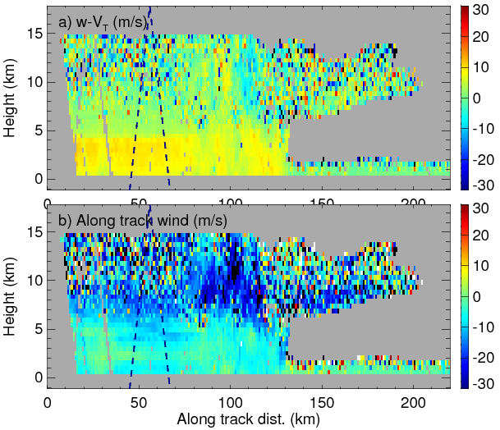
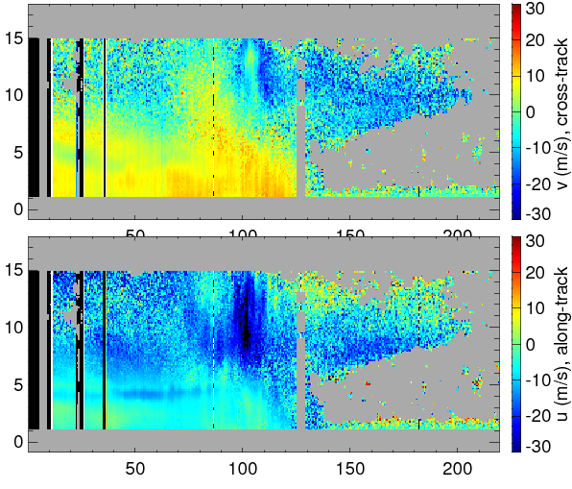
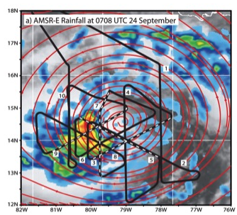
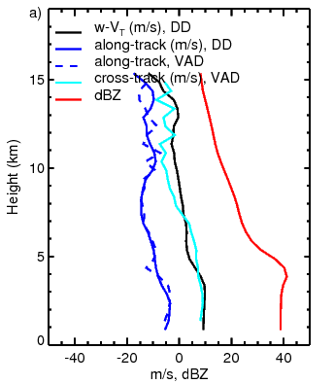
Nadir Wind retrieval for HIWRAP
Reflectivity (dBZ), Ku, inner, fore
Vertical particle velocity (m/s)
Cross-track wind, VAD, (m/s)
Doppler, Ku, inner, fore
Along-track wind, DD, (m/s)
Along-track wind, VAD, (m/s)
Along –track wind from dual-Doppler and VAD analyses agree in general;
Vertical wind from dual-Doppler analysis is used to compute the divergence assuming linear wind field in each VAD scan.

Slide 13
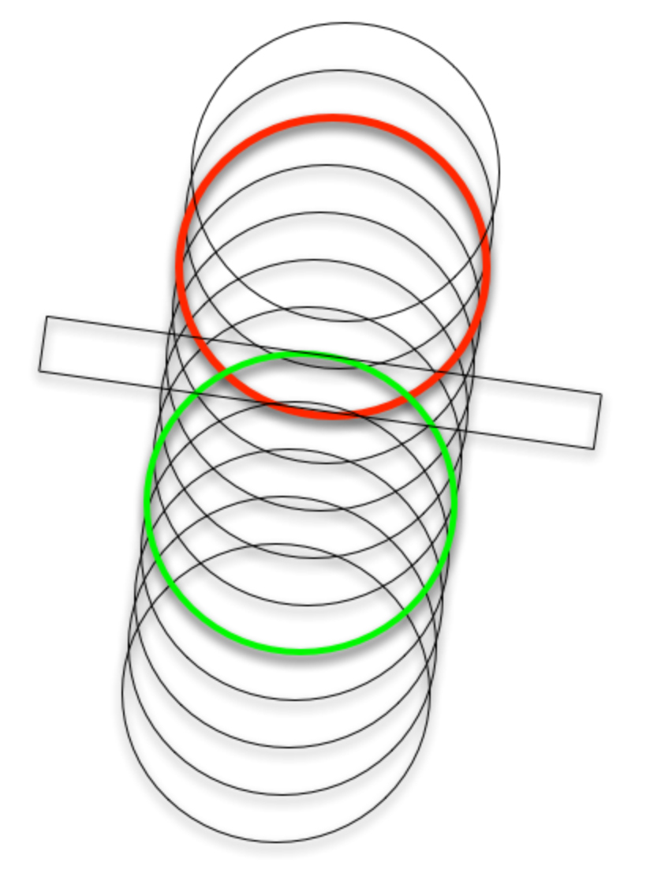
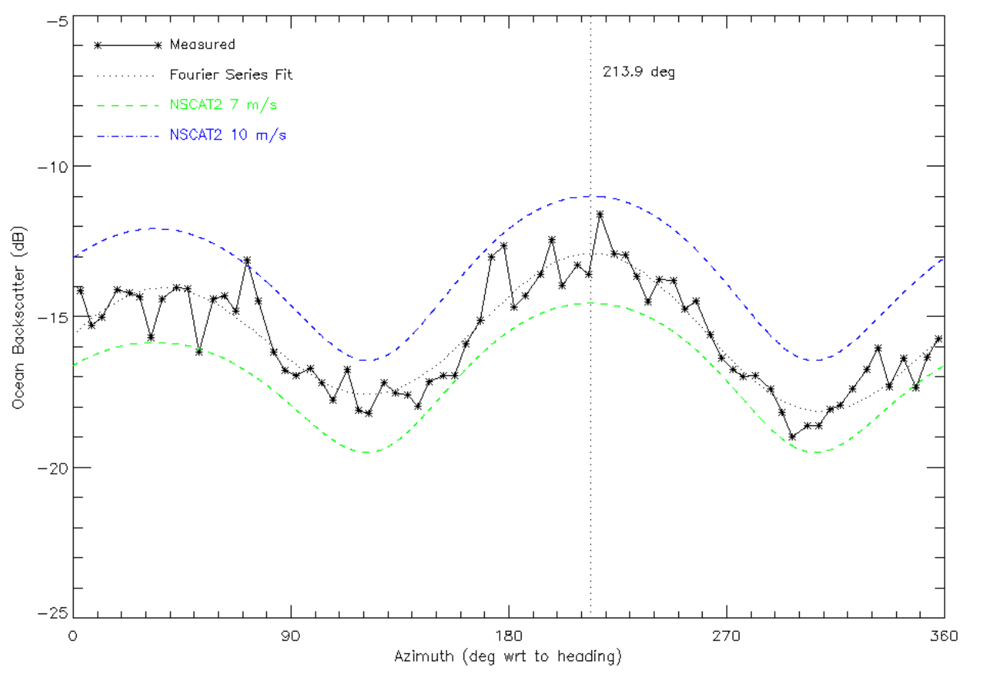
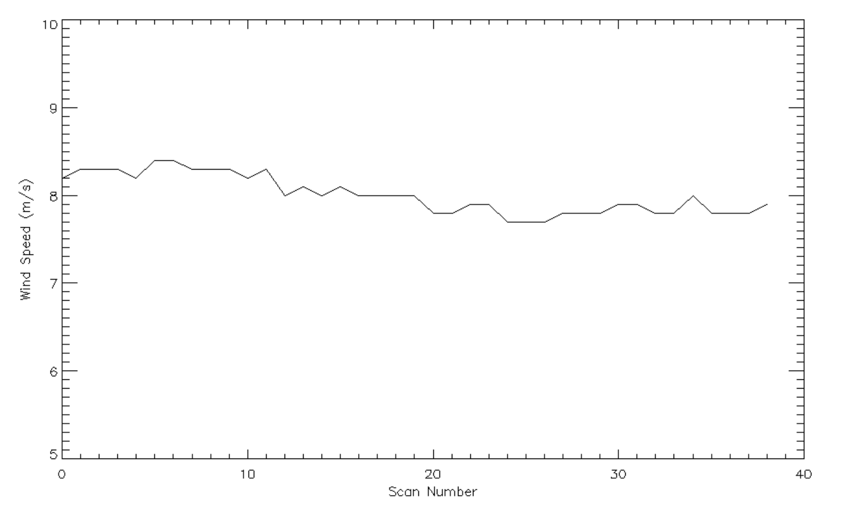
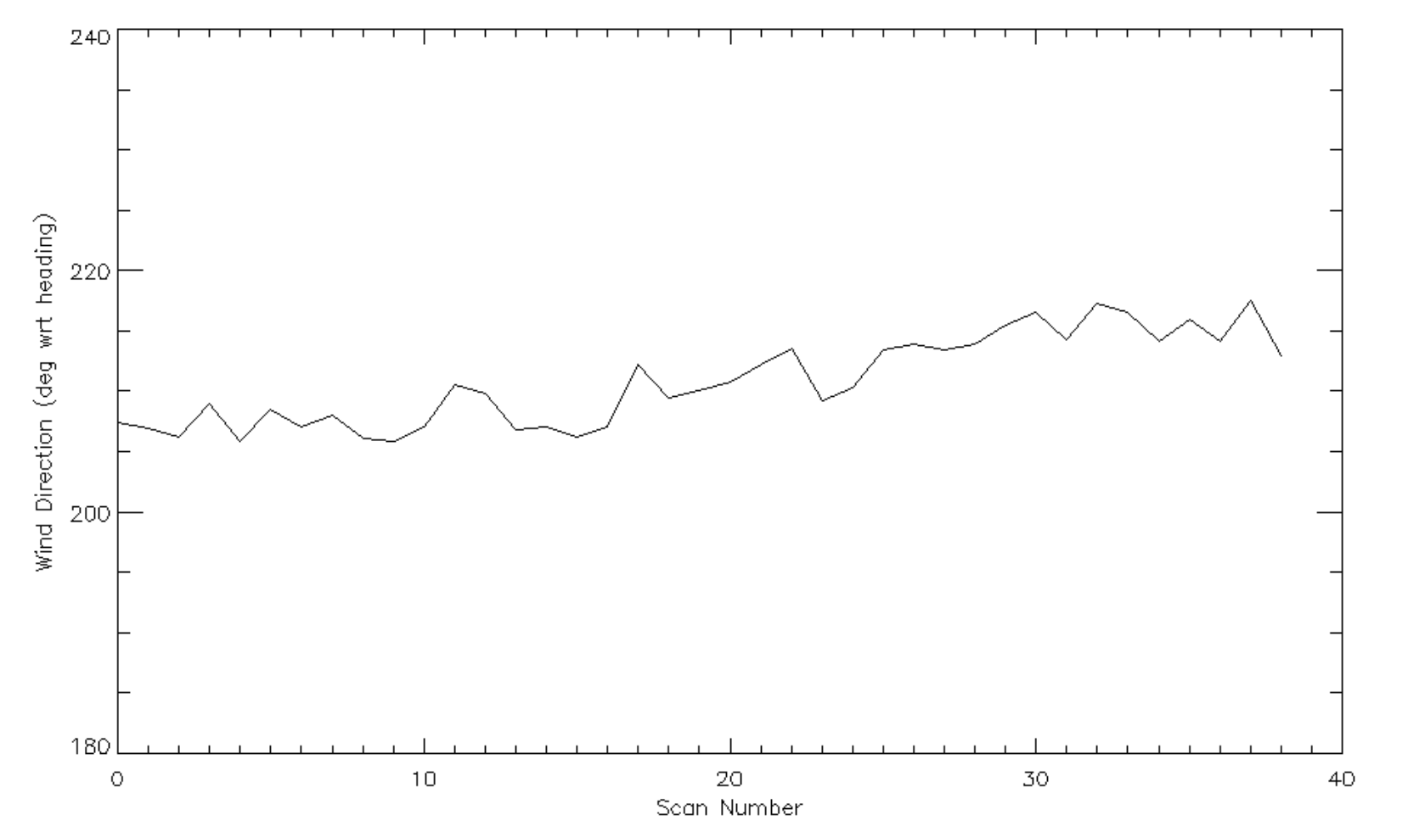
Ocean Winds
Calibration Stage
Along-track pixels
6 Nov 2013Flight
Calib. NRCS at 40º incidence angle bounded by 7 and 10 m/s NSCAT2 Geophys. Model Function
NRCS vs Scan Number
One scan
Wind direction
214º
40 scans
10
240
Wind Speed vs Scan Number
Wind Direction vs Scan Number
10 m/s
7 m/s
0
180

Slide 14
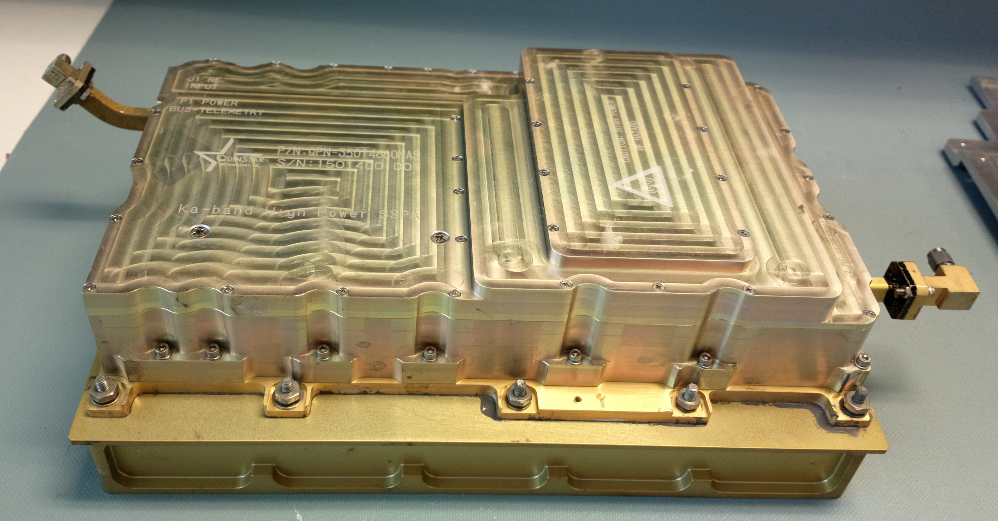
Planned HIWRAP Upgrades for
2013 HS3 Flights
Ka-band transceiver upgrade ~10 dBZ sensitivity improvement.
Upgrade from ~6 Watt to 50 Watt peak power
Improved receiver noise floor.
IF subsystem upgrade/replacement resulting in improved channel-channel isolation.

Slide 15
Planned HIWRAP Upgrades for
2013 HS3 Flights
Pulse compression improvement with NLFM.
New FPGA-based waveform generator capable of non-linear waveforms with amplitude tapering.
Expected range sidelobe reduction of 7+ dB.
Onboard Pulse Pair and Pulse Compression processing.
Reduction of data volume.
Enabling tech for real-time Doppler data.
Improved data disk reliability.
Outstanding Issues:
GPS battery control
GPS interference from Irridium?.
Thermal issues with solid state disks.

Slide 16
Real-Time Data Plans
Planned 2013
Real-time uncalibrated reflectivity plots available in the control room for scientist use.
(Experimental) Real-time Doppler velocities corrected for aircraft motion made available for possible real-time wind vector estimates.
Reflectivity will be available in two horizontal slices and a vertical curtain below the aircraft.
Future Possibilities
Low resolution wind products (gridded, VAD, ..)
Doppler data for assimilation
Ocean surface wind vector

Slide 17
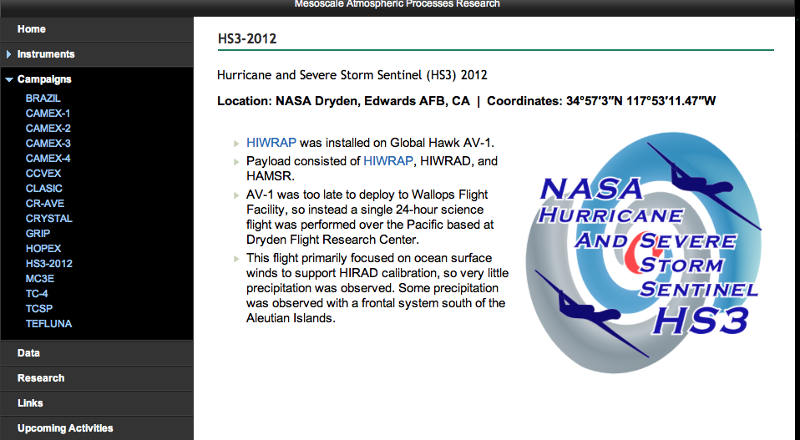
HAR Web Site http://har.gsfc.nasa.gov

Slide 18
Questions?

