Slide 1
Real-time assimilation of Global Hawk dropsonde observations for improved hurricane track and intensity forecasts from NCEP’s operational HWRF model
Jason Sippel & HWRF team Environmental Modeling Center,
NCEP/NOAA/NWS, NCWCP, College Park, MD 20740.

Slide 2
Outline
Background: Configuration, workflow, performance
Successes and Challenges
Results: Improvements due to HS3 dropsondes
New approaches

Slide 3
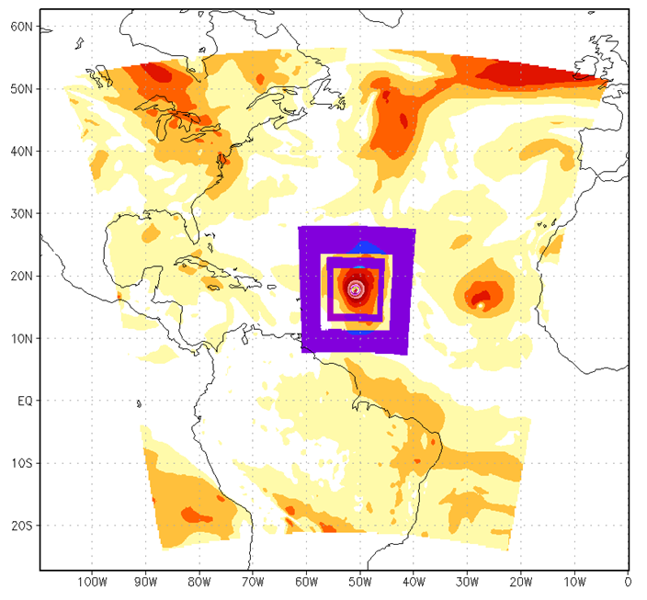
Background: Configuration
Triply-nested configuration
Outer domain from GDAS
Analysis (ghost) domains larger than forecast domains for boundary continuity
D02 data: Conventional, satellite radiances and wind, GPS RO bending angle, TDR, TC vitals
D03 data: Conventional, TDR, TC vitals
Outer domain
Ghost d02
Ghost d03
Inner Nest
Middle Nest

Slide 4
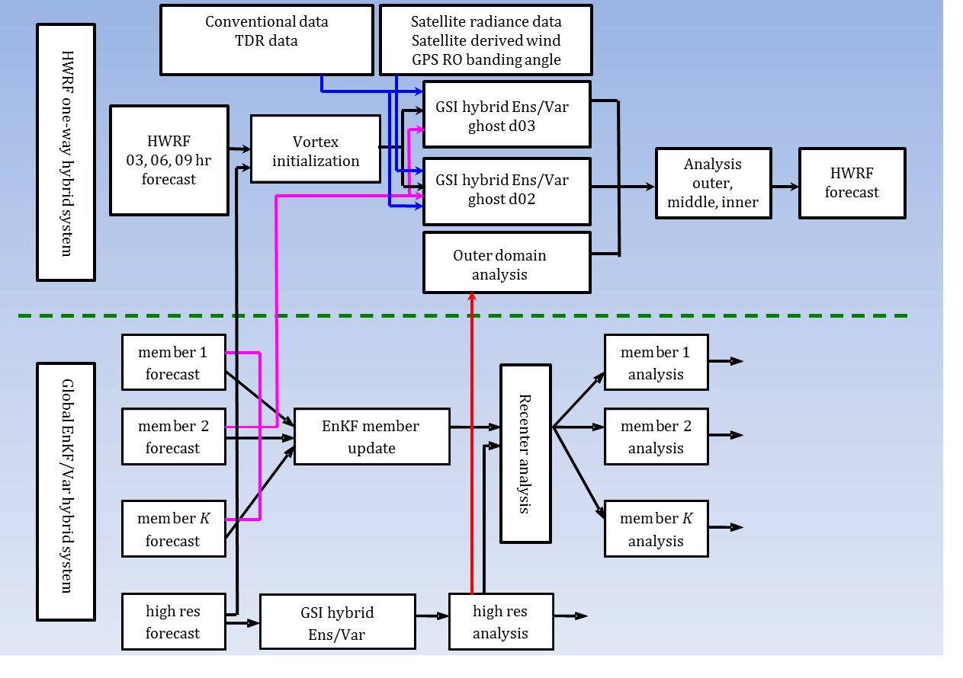
Background: Workflow
Vortex initialization is used to match TC vitals
GDAS ensemble covariance used in hybrid DA for D02-D03

Slide 5
Background: 2015 Upgrades
Increase the horizontal resolution of atmospheric model for all domains from 27/9/3 to 18/6/2 km
Upgrade and improve HWRF vortex initialization scheme in response to both GFS and HWRF resolution increases
Physics upgrades (microphysics, radiation, PBL)
HWRF ensemble-based warm start for TDR assimilation (covariance still not cycled)
Expand HWRF capabilities to all global basins with 7-storm, year-round capability
Added the assimilation of tcvitals MSLP data along with all dropsonde data (including GH-based sondes)
k

Slide 6
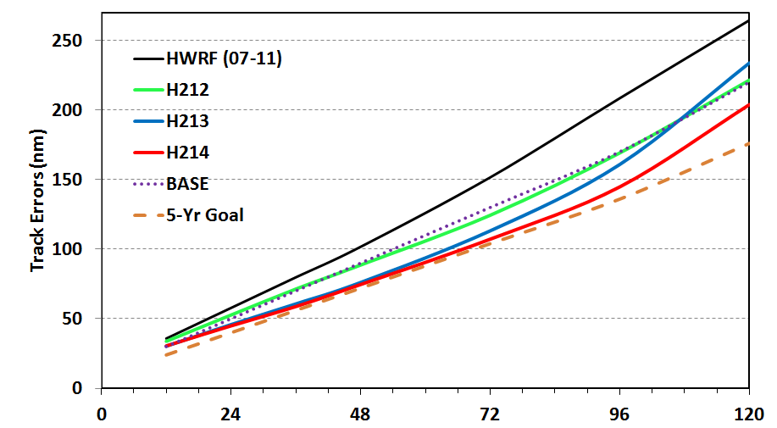
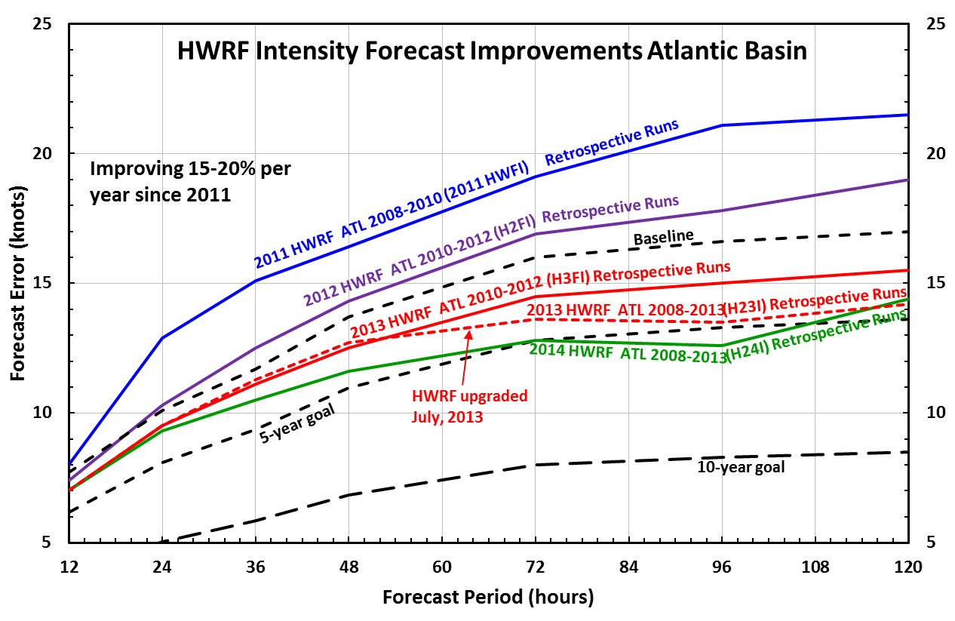
Success: Forecasts are better!
10-15% intensity improvement per year
2013 retro intensity better than statistical models for days 2-3
Track forecasts are comparable to GFS
Short-term intensity error still isn’t where we’d like it to be

Slide 7
Challenge: Initialization
We need a way to initialize the vortex reasonably close to size, location, intensity to operational estimate, especially when data is sparse
Vortex initialization is the way we do that now
While vortex initialization addresses some problems, it creates others:
Improves intensity forecasts for strong storms
Creates a vortex that is too strong aloft, which causes inner-core DA problems and bad forecasts for weaker/sheared storms

Slide 8
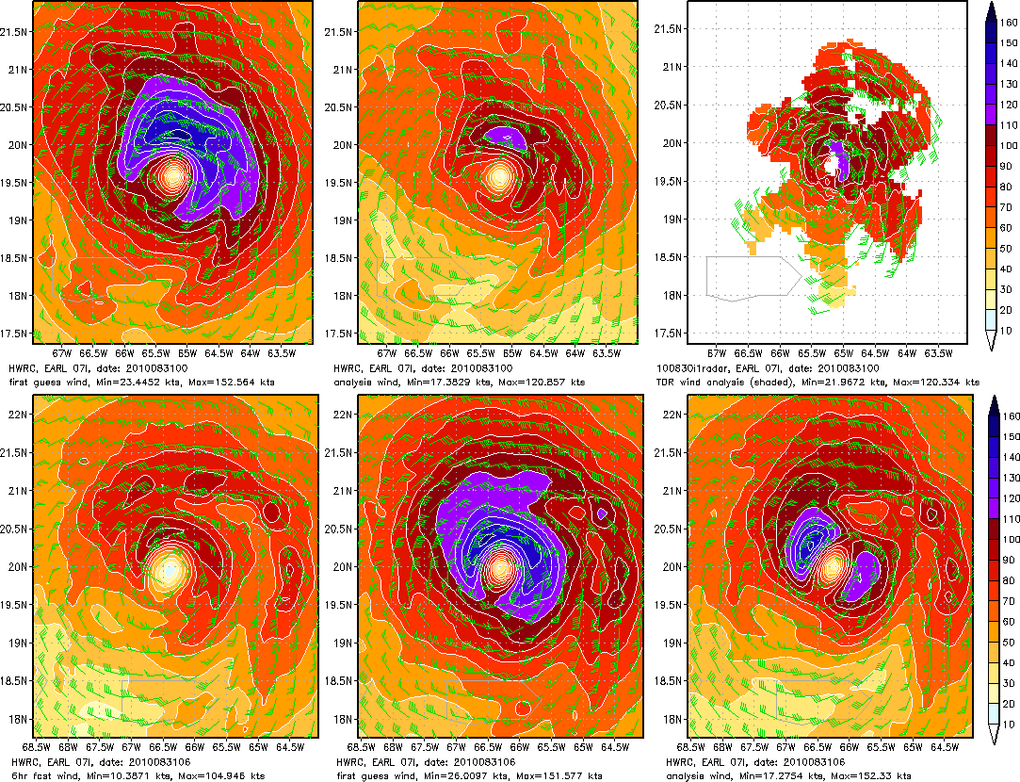
Challenge: Initialization
Initialization problems in Hurricane Earl
We need a way to initialize the vortex reasonably close to size, location, intensity to operational estimate
Vortex initialization is the way we do that now
Unfortunately, this
0Z First guess
0Z Analysis
0Z TDR Analysis
6-h Forecast
Vortex initialization/
06Z First guess
06Z Analysis

Slide 9
Challenge: Initialization
Data assimilation tries to correct the extremely strong vortex aloft produced by vortex initialization
Generally, the result is a surface vortex that is far too weak
The temporary solution is to not use DA increments within 150 km of center
300 km
150 km
No DA increment
Partial increment
Full increment
“Blending” initialization

Slide 10
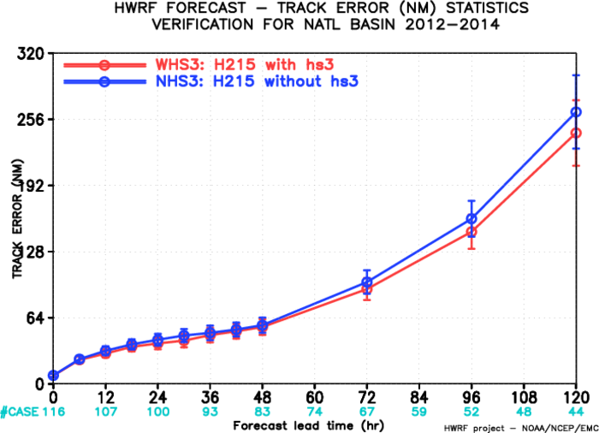
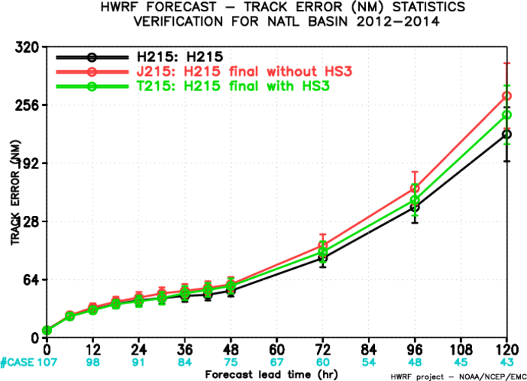
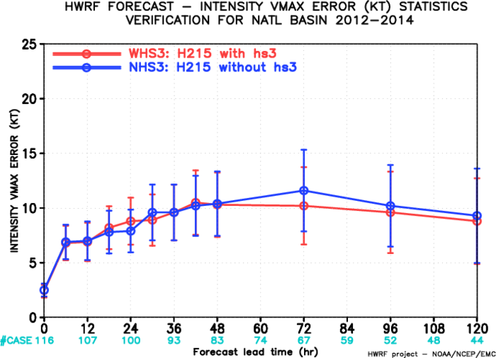
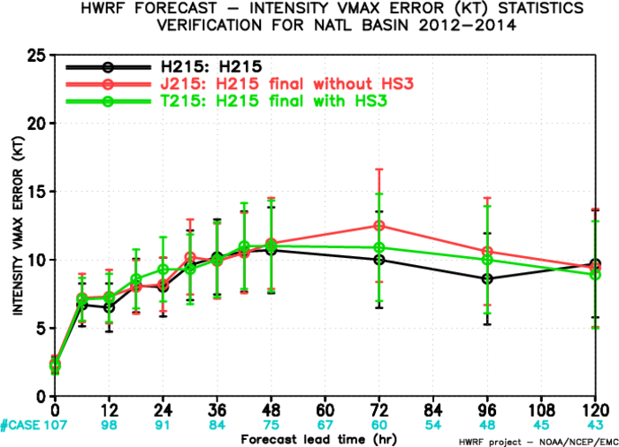
HS3 Results: Intensity/track
Assimilating HS3 dropsondes results in small track improvements that grow with lead time
Intensity improvements are confined to long-term forecast
Short-term improvements probably limited by blending

Slide 11
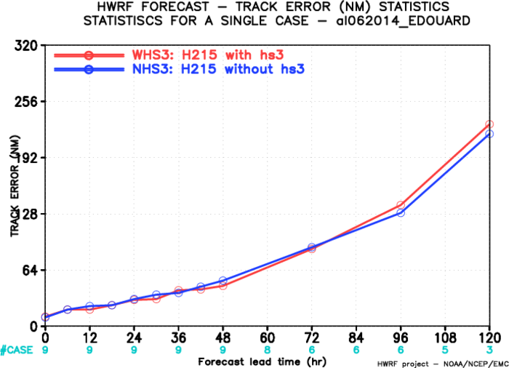
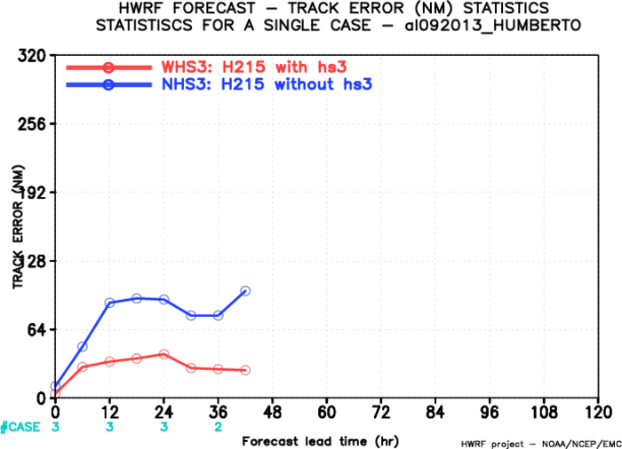
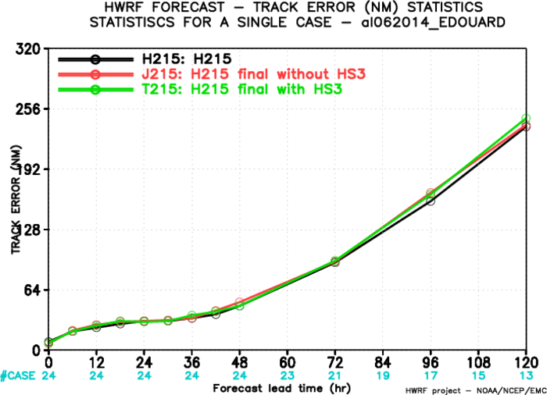
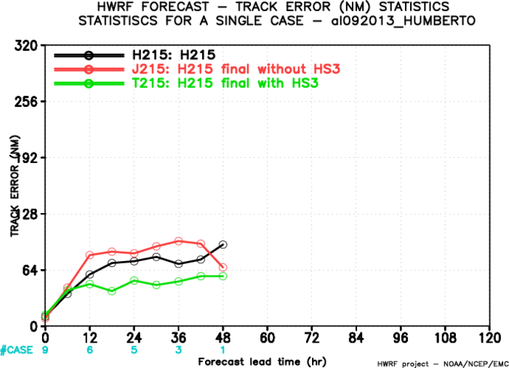
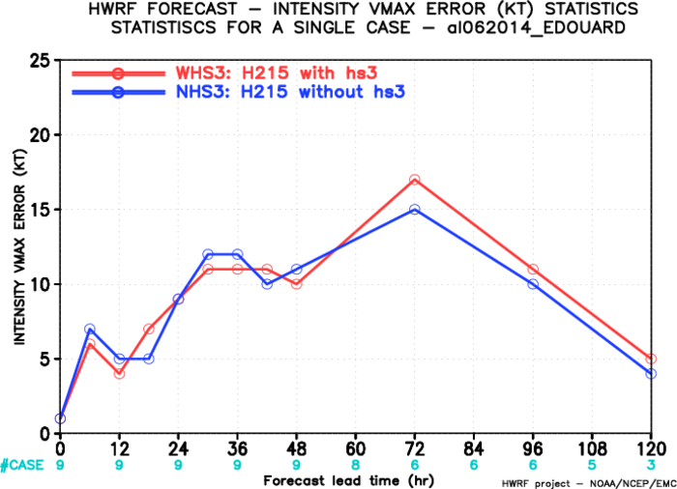
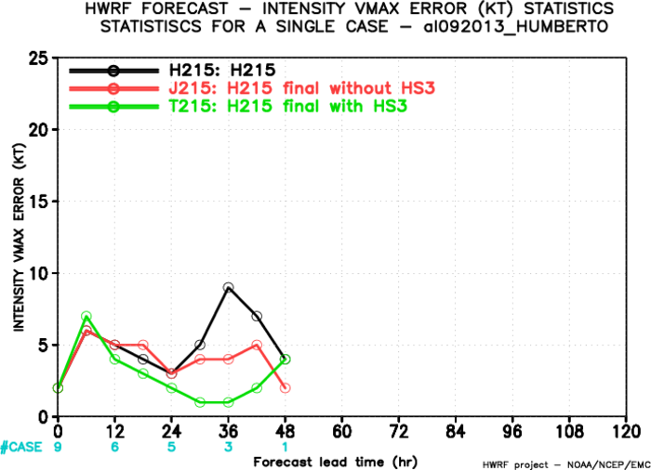
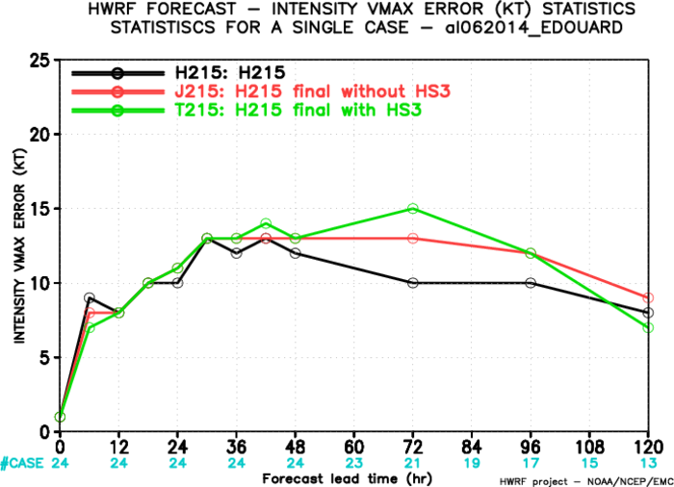
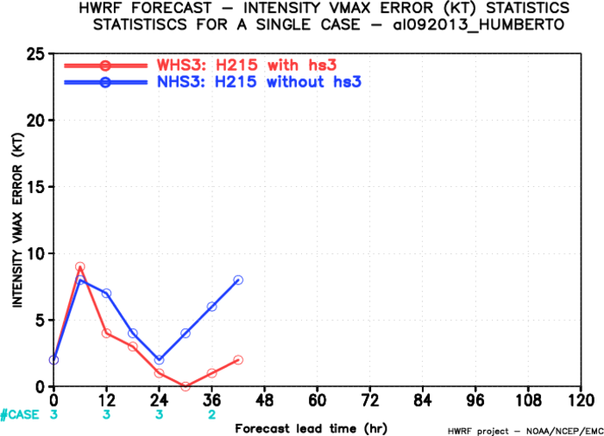
HS3 Results: Variability
Other recon available (TDR, drops, etc)
Other recon unavailable

Slide 12
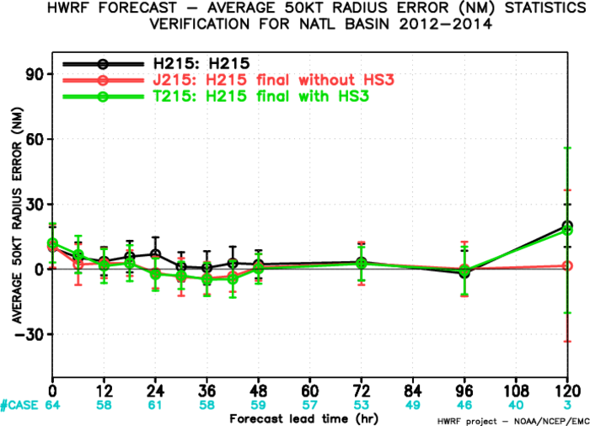
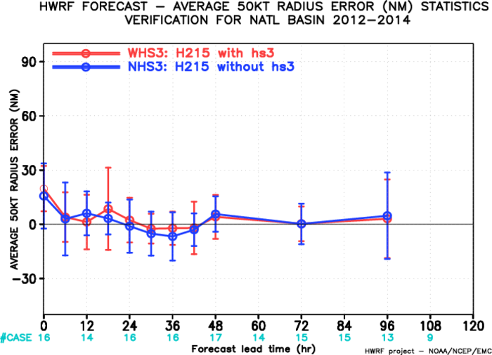
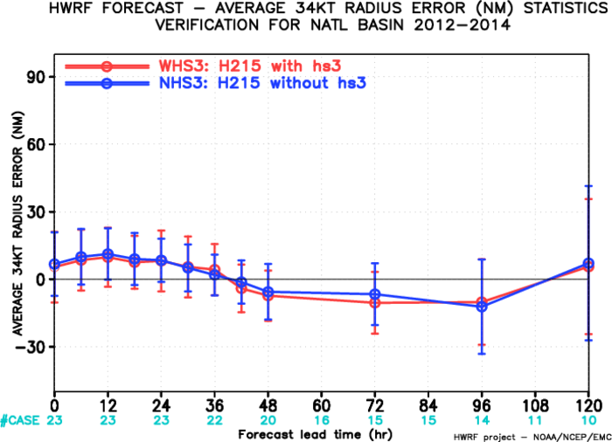
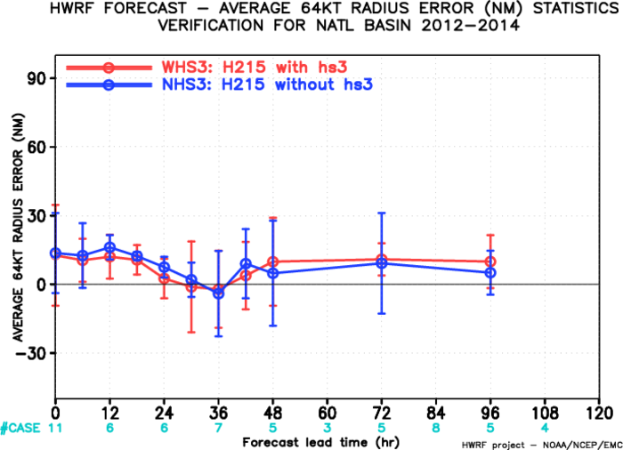
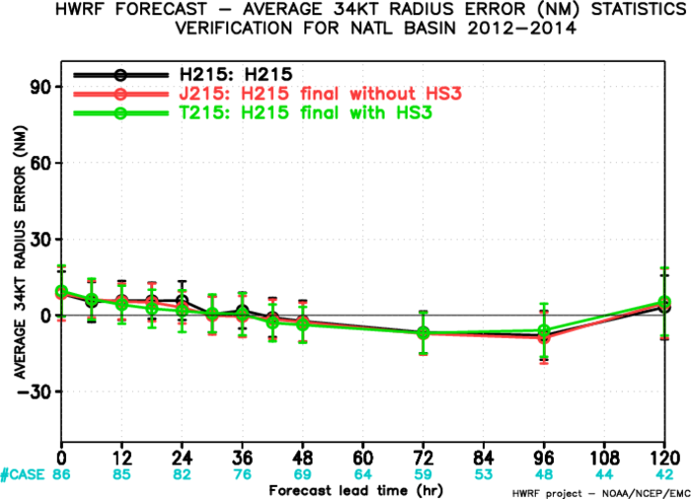
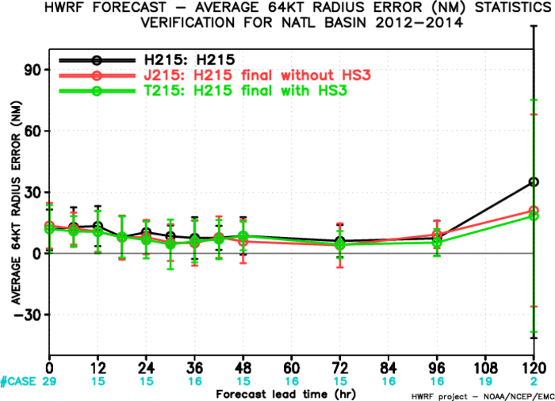
HS3 Results: Storm size
No meaningful impact of HS3 data upon storm size forecasts

Slide 13
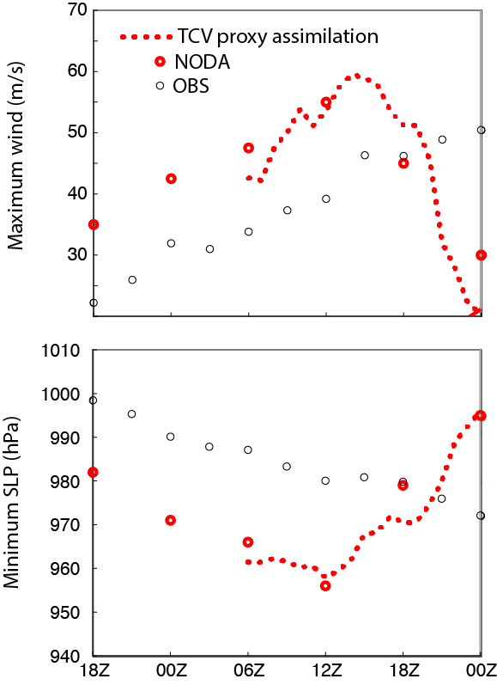
Future work
TCV proxy assimilation
OBS
NODA
Find a way to get rid of vortex initialization
Assimilate proxies for TC vitals?
Cycle covariance for full EnKF or hybrid system
Jeff Whittaker, ESRL: Fully-cycled HYBRID
Fuqing Zhang, PSU: Fully-cycled EnKF
Observed and forecast intensity of Hurricane Karl. Forecasts are from NODA and from cycling EnKF analysis that assimilates proxies for TC vitals.

Slide 14
Future self-consistent cycled HWRF hybrid EnKF/Var system
Fcst 01
Fcst 02
Fcst 03
……
Fcst K
EnKF anl 01
EnKF anl 02
EnKF anl 03
……
EnKF anl K
Fcst 01
Fcst 02
Fcst 03
……
Fcst K
EnKF anl 01
EnKF anl 02
EnKF anl 03
……
EnKF anl K
Fcst 01
Fcst 02
Fcst 03
……
Fcst K
EnKF anl 01
EnKF anl 02
EnKF anl 03
……
EnKF anl K
Relocation
Recenter
Relocation
Recenter
Relocation
Recenter
Obs: conv, sat (radiance, AMVs, GPS RO), aircraft recon (TDR, HDOB ……)
Obs: conv, sat (radiance, AMVs, GPS RO), aircraft recon (TDR, HDOB ……)
Obs: conv, sat (radiance, AMVs, GPS RO), aircraft recon (TDR, HDOB ……)
High res GSI
Hybrid anl
High res GSI
Hybrid anl
High res GSI
Hybrid anl
vortex
relocation
vortex
relocation
vortex
relocation
High res forecast
High res forecast
03 Z
06 Z
09 Z
12 Z
15 Z
18 Z
IAU
forecast
IAU
forecast
Dual resolution hybrid
Can be extended to 4DEnVar
Improve balance through IAU (Bloom et al. 1996)
IAU

Slide 15
Summary
HWRF has made tremendous progress over past few years and is now a viable track/intensity model
We still have problems with initialization and are trying to meet operational demands while making optimum use of data
We will be assimilating all GH sondes, though analysis increments in the inner core will not be used due to “fight” between initialization and assimilation
We are working on ways to change initialization and assimilation procedures

