Slide 1
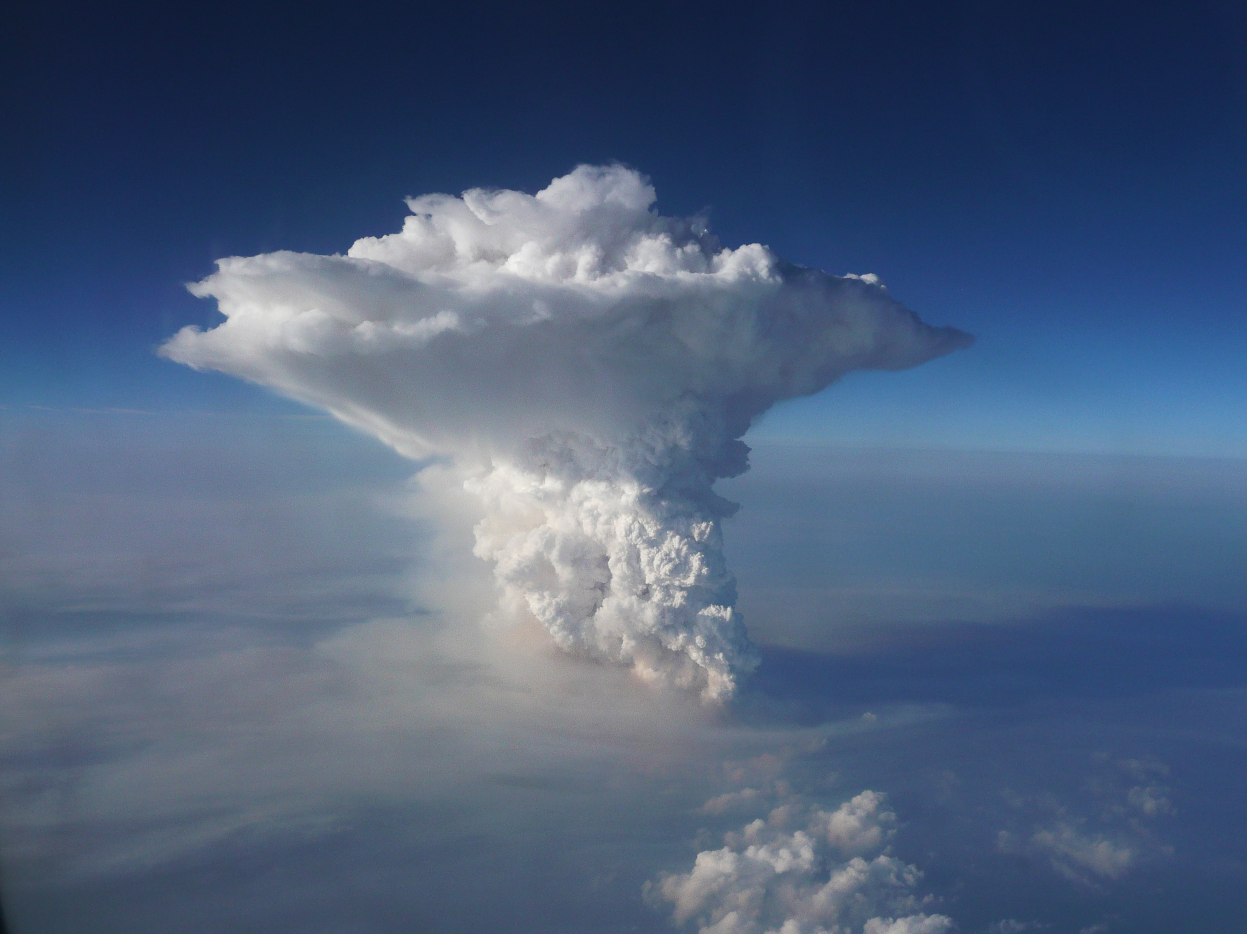
Ice crystal properties in high-altitude tropical anvil cirrus
E. Jensen, P. Lawson, S. Woods, S. Lance, B. Gandrud
Entrainment dry air at cloud top ➔ sublimation of small crystals
Detrained ice R_{e} importance:
Cloud albedo
Anvil cirrus persistence
Redistribution of H₂O
Entrainment of aerosols into updrafts ➔ increasing ice concentration with height
Outline:
Past measurements of tropical anvil cirrus microphysical properties
What do Guam ATTREX observations tell us?

Slide 2
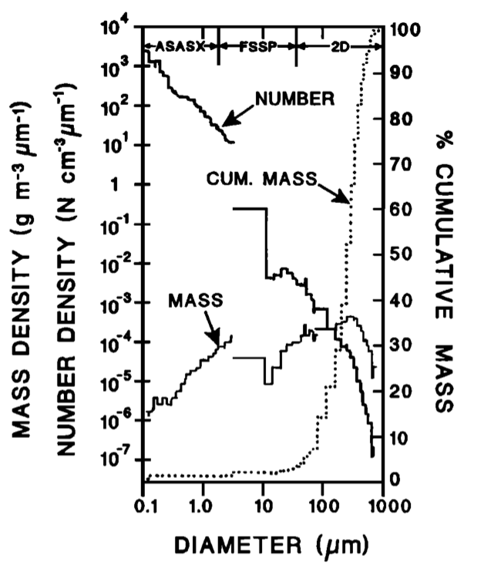
STEP ER-2 (Darwin, 1987)
Knollenberg et al. (JGR, 1993):
Extremely high ice concentrations (10–100 cm⁻³)
Modified 2D optical-array probe to mimic FSSP (accuracy difficult to assess)

Slide 3
Geophysica campaigns
APE THESEO (1999), Scout-O₃ (2005), TROCCINOX (2005), SCOUT-AMMA (2006)
Ice concentrations in cold anvil cirrus up to 1 cm⁻³ (Krämer et al., 2009); higher concentrations in fresh MCS outflow (Frey et al., 2011)
Mostly FSSP only (+CIP on AMMA): shattering artifacts in anvil cirrus likely, crystals larger than 25–50 μm not measured ➔Not very useful for anvil cirrus
Hector sampling
EMERALD-II (2003), TWP-ICE (2006)
Grob 520T Egrett (up to ~14.5 km), CPI and FSSP (Connolly et al., 2005)
Proteus (up to ~16 km), FSSP, CDP, CIP (McFarquhar et al., 2007)

Slide 4
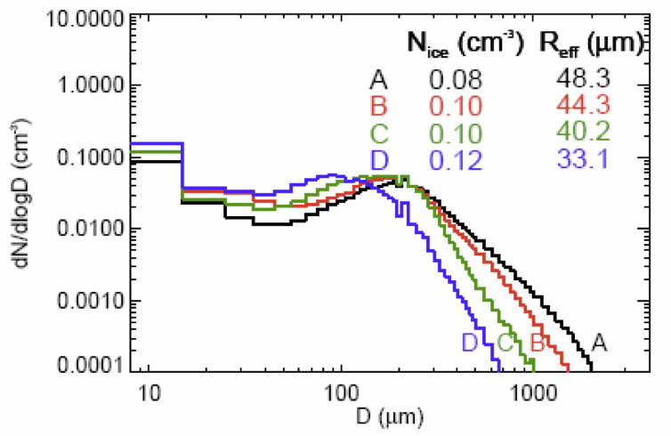
TC4 DC-8 (EastPac, 2007)
2D-S with shattering artifacts removed
No higher than 12–13 km (sub-TTL)
Mature anvil ice concentrations ~0.1 cm⁻³
Up to 10 cm⁻³ in updraft cores at 12 km ➔ depletion by dilution and sublimation
Information lacking for TTL anvil cirrus!

Slide 5
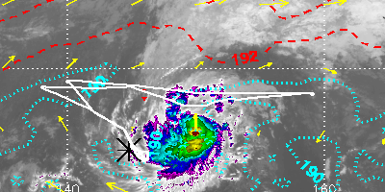
4–5 March Global Hawk flight (RF03)

Slide 6
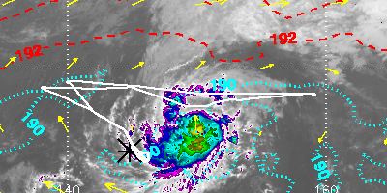
4–5 March Global Hawk flight (RF03)

Slide 7
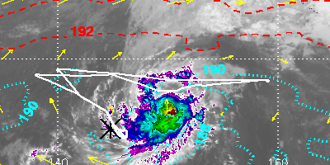
4–5 March Global Hawk flight (RF03)

Slide 8
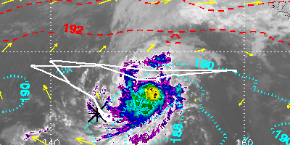
4–5 March Global Hawk flight (RF03)

Slide 9
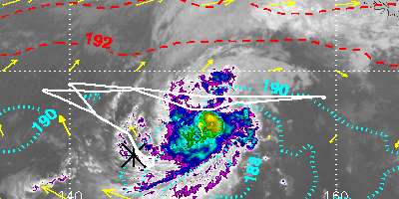
4–5 March Global Hawk flight (RF03)

Slide 10
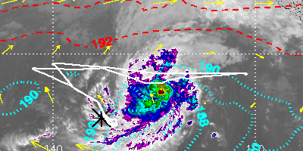
4–5 March Global Hawk flight (RF03)

Slide 11
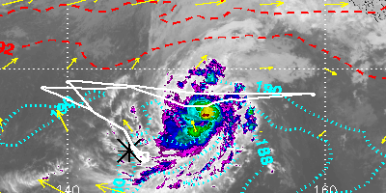
4–5 March Global Hawk flight (RF03)

Slide 12
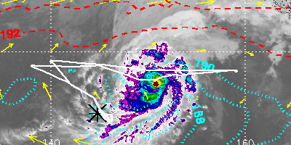
4–5 March Global Hawk flight (RF03)

Slide 13
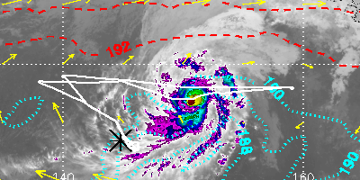
4–5 March Global Hawk flight (RF03)

Slide 14
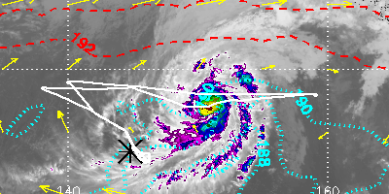
4–5 March Global Hawk flight (RF03)

Slide 15
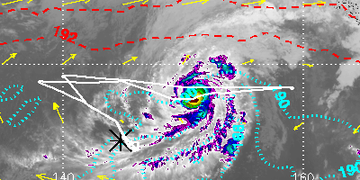
4–5 March Global Hawk flight (RF03)

Slide 16
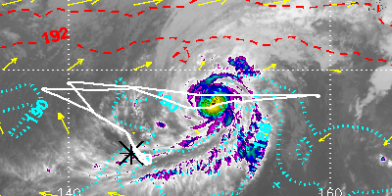
4–5 March Global Hawk flight (RF03)

Slide 17
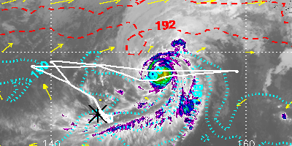
4–5 March Global Hawk flight (RF03)

Slide 18
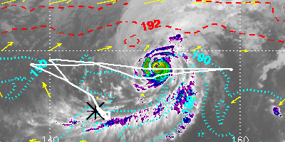
4–5 March Global Hawk flight (RF03)

Slide 19
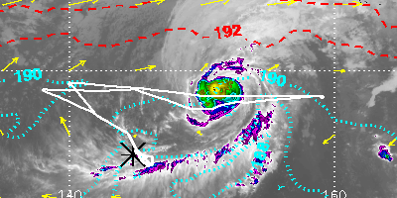
4–5 March Global Hawk flight (RF03)

Slide 20
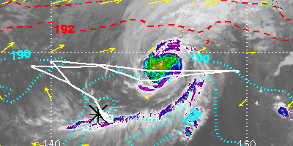
4–5 March Global Hawk flight (RF03)

Slide 21
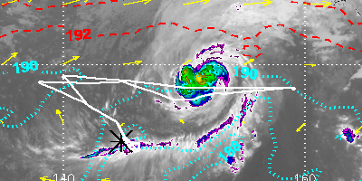
4–5 March Global Hawk flight (RF03)

Slide 22
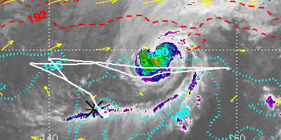
4–5 March Global Hawk flight (RF03)

Slide 23
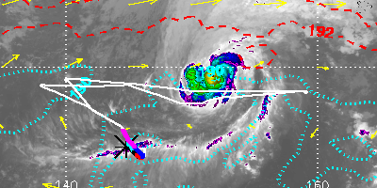
4–5 March Global Hawk flight (RF03)
Vertical profile through Faxai cirrus band on GH climbout from Guam

Slide 24
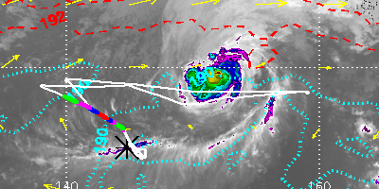
4–5 March Global Hawk flight (RF03)

Slide 25
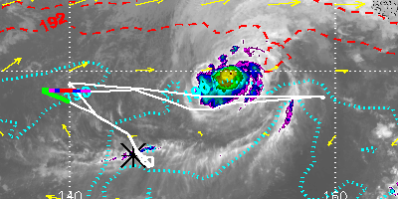
4–5 March Global Hawk flight (RF03)

Slide 26
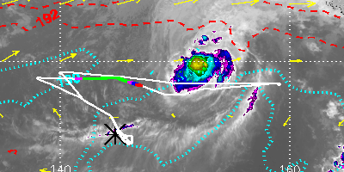
4–5 March Global Hawk flight (RF03)

Slide 27
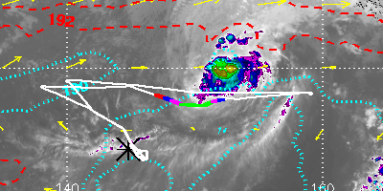
4–5 March Global Hawk flight (RF03)

Slide 28
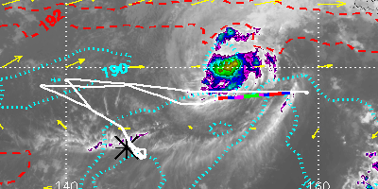
4–5 March Global Hawk flight (RF03)

Slide 29
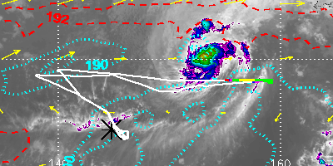
4–5 March Global Hawk flight (RF03)

Slide 30
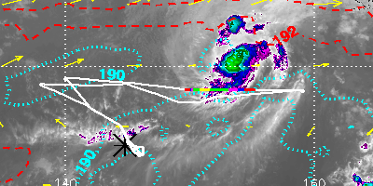
4–5 March Global Hawk flight (RF03)
Cirrus band sampled just south of Faxai

Slide 31
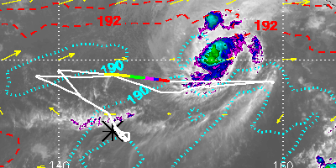
4–5 March Global Hawk flight (RF03)

Slide 32
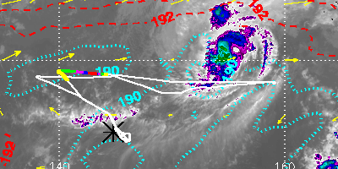
4–5 March Global Hawk flight (RF03)

Slide 33
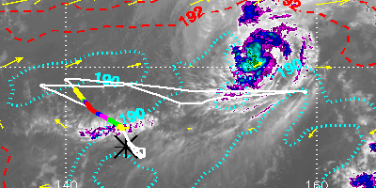
4–5 March Global Hawk flight (RF03)

Slide 34
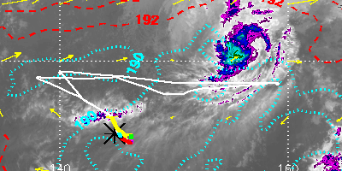
4–5 March Global Hawk flight (RF03)

Slide 35
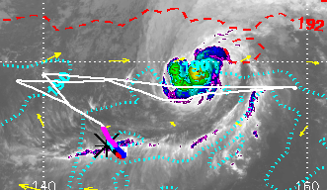
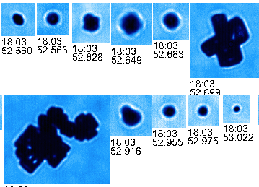
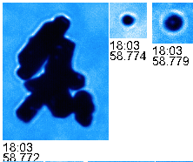
March 4-5 climbout through cirrus
Aggregates and rosettes near cloud base

Slide 36
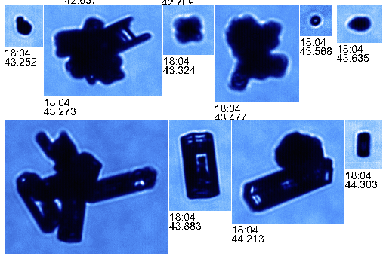
March 4-5 climbout through cirrus
Aggregates and rosettes near cloud base

Slide 37
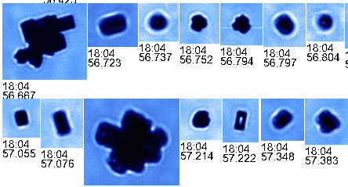
March 4-5 climbout through cirrus

Slide 38
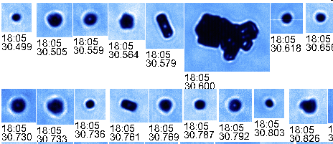
March 4-5 climbout through cirrus

Slide 39
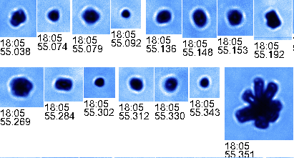
March 4-5 climbout through cirrus
Rosettes and small crystals at intermediate altitudes

Slide 40
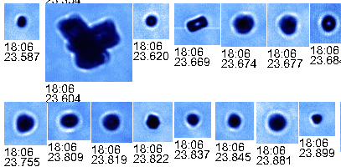
March 4-5 climbout through cirrus

Slide 41
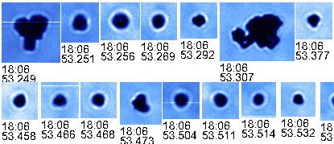
March 4-5 climbout through cirrus

Slide 42
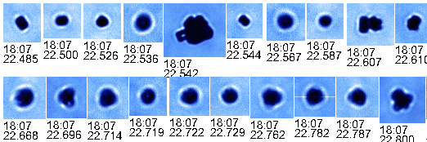
March 4-5 climbout through cirrus

Slide 43
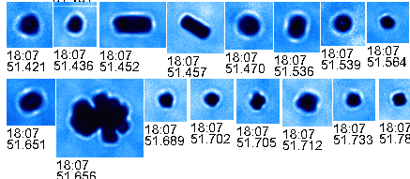
March 4-5 climbout through cirrus

Slide 44
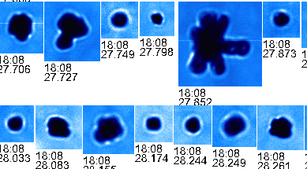
March 4-5 climbout through cirrus

Slide 45
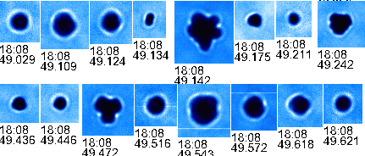
March 4-5 climbout through cirrus

Slide 46
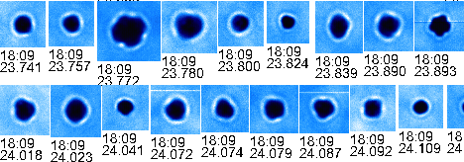
March 4-5 climbout through cirrus
Only small crystals near cloud top

Slide 47
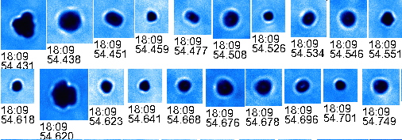
March 4-5 climbout through cirrus

Slide 48
March 4-5 climbout through cirrus

Slide 49
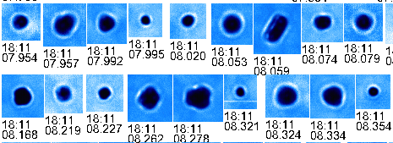
March 4-5 climbout through cirrus

Slide 50
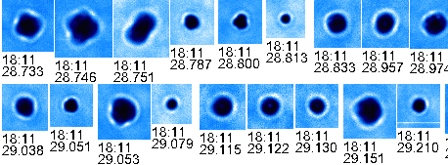
March 4-5 climbout through cirrus

Slide 51


March 4-5 closest approach to Faxai

Slide 52

March 4-5 closest approach to Faxai

Slide 53

March 4-5 closest approach to Faxai

Slide 54

March 4-5 closest approach to Faxai

Slide 55

March 4-5 closest approach to Faxai

Slide 56

March 4-5 closest approach to Faxai

Slide 57

March 4-5 closest approach to Faxai
Mostly rosettes and budding rosettes

Slide 58

March 4-5 closest approach to Faxai

Slide 59

March 4-5 closest approach to Faxai

Slide 60

March 4-5 closest approach to Faxai

Slide 61

9-10 March Global Hawk flight (RF05)

Slide 62

9-10 March Global Hawk flight (RF05)

Slide 63

9-10 March Global Hawk flight (RF05)

Slide 64

9-10 March Global Hawk flight (RF05)

Slide 65

9-10 March Global Hawk flight (RF05)
Fresh anvil cirrus sampled

Slide 66


March 9-10 anvil cirrus

Slide 67

March 9-10 anvil cirrus

Slide 68

March 9-10 anvil cirrus
Large compact crystals, budding rosettes, some aggregates

Slide 69

March 9-10 anvil cirrus

Slide 70

March 9-10 anvil cirrus

Slide 71

March 9-10 anvil cirrus

Slide 72

March 9-10 anvil cirrus

Slide 73

March 9-10 anvil cirrus
Numerous small crystals (D<100 μm)

Slide 74
2DS ice number concentration comparison

Slide 75
2DS ice number concentration comparison

Slide 76
2DS ice number concentration comparison

Slide 77
2DS ice number concentration comparison
ATTREX anvils (14–16 km) generally have larger ice concentrations than lower TC4 anvils (<12 km) [1]
Differences between ATTREX cases likely attributable to location in cloud, cloud age, etc.
[1] Differences between TC4 2DS and ATTREX 2DS (Hawkeye) cannot be ruled out

Slide 78
Summary and outlook
Relatively high-altitude anvil cirrus sampled during ATTREX appears to have more numerous, smaller crystals than lower TC4 anvils.
  Convective parameterization R_{e} assumptions should be adjusted accordingly.
No evidence for extremely high ice concentrations reported by Knollenberg.
Information about TTL anvil cirrus ice concentrations and sizes remains limited.
Predominance of bullet rosettes suggests that much of the TTL “anvil” cirrus nucleates and grows in situ (consistent with Connolly et al. [2005]).

