Slide 1
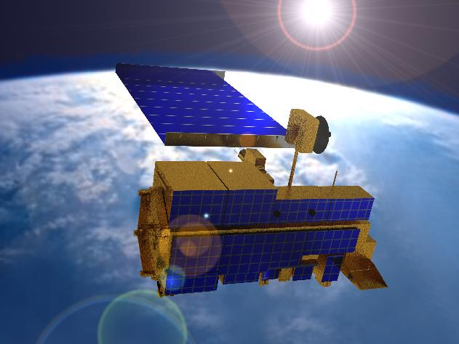
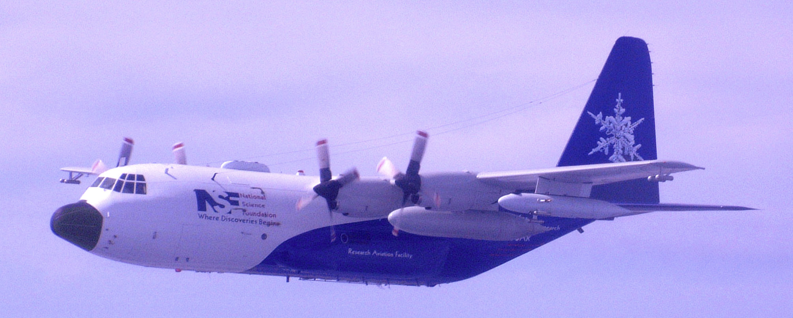
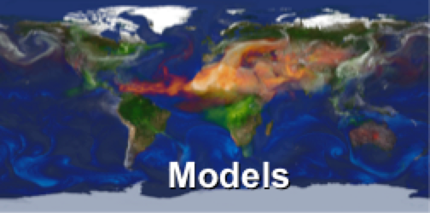
Remote-sensing Analysis
• Retrieval Validation
• Assumption Refinement
Satellites
Suborbital
frequent, global
snapshots;
aerosol amount &
aerosol type maps,
plume & layer heights
Regional Context
targeted chemical &
microphysical detail
Aerosol-type
Predictions
CURRENT STATE
• Initial Conditions
• Assimilation
Model Validation
• Parameterizations
• Climate Sensitivity
• Underlying mechanisms
point-location
time series
space-time interpolation,
DARF &
Anthropogenic
Component
calculation and prediction
Kahn, Survy. Geophys. 2012

Slide 2
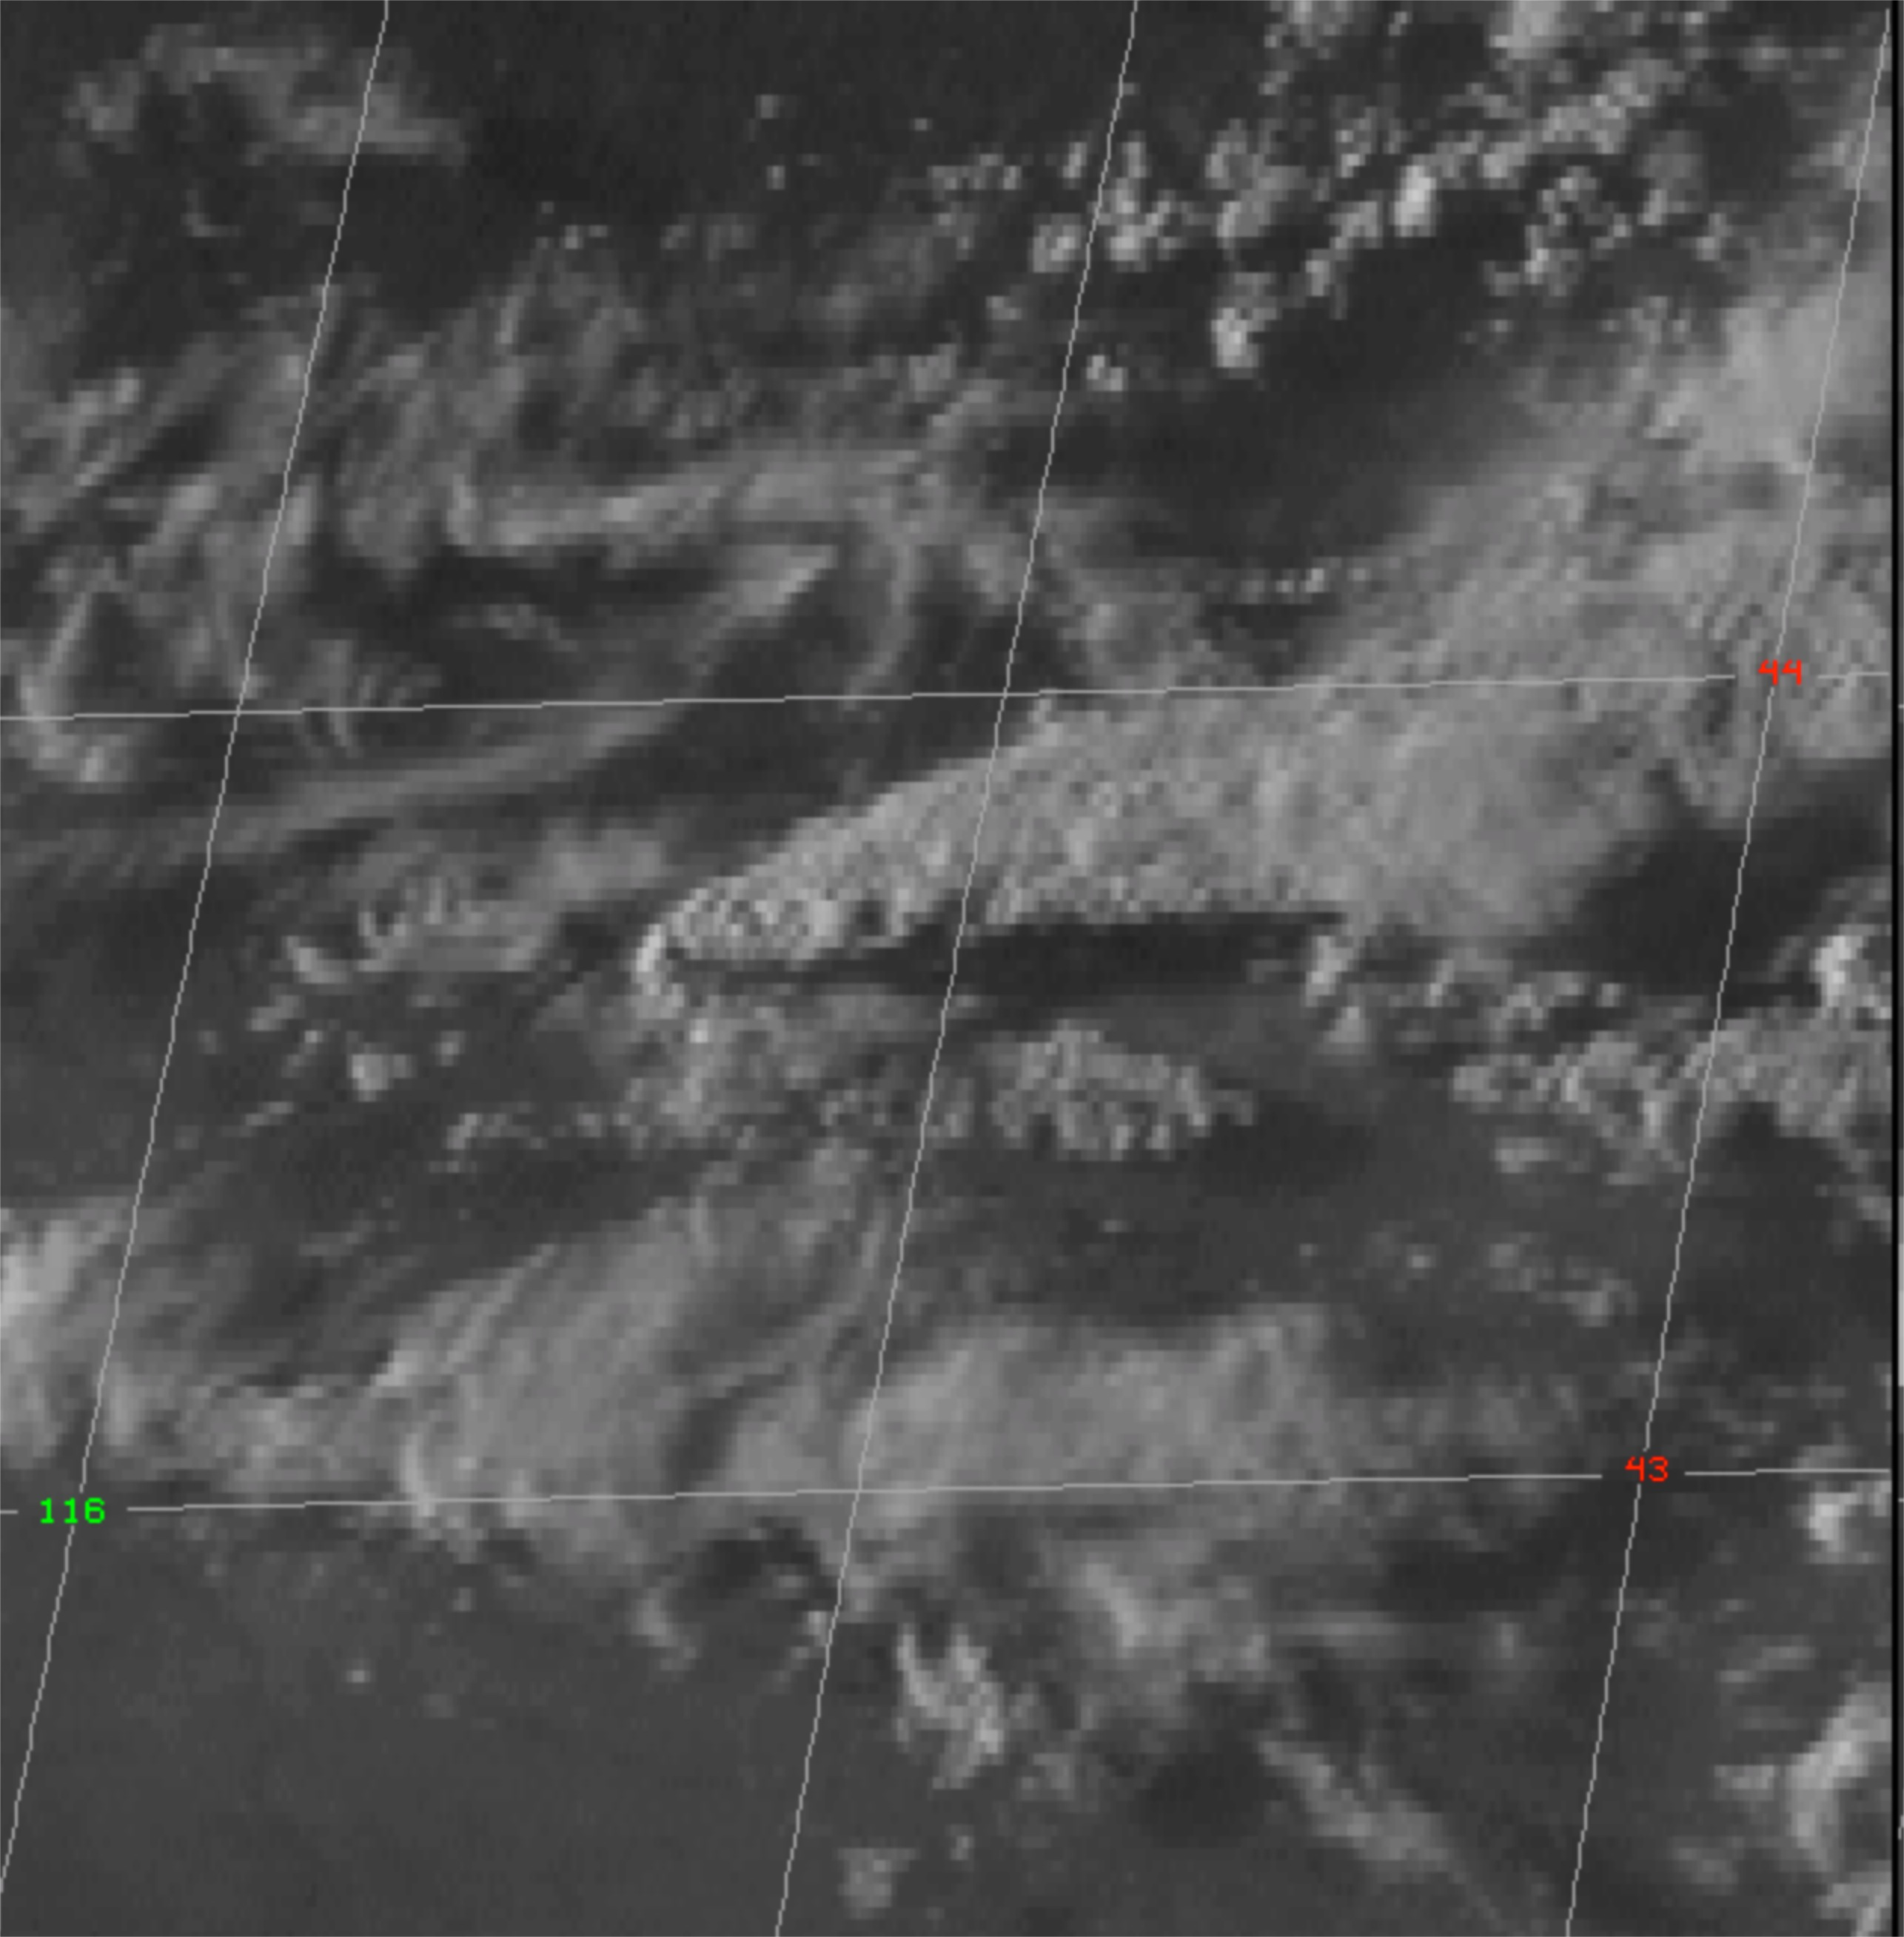
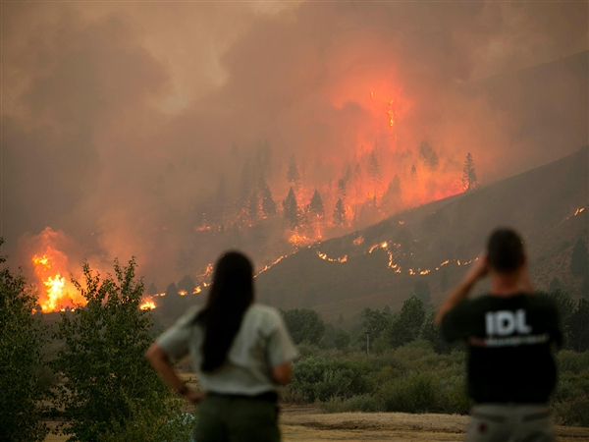
Three Stories:
• Aerosol Air-Mass-Type Validation
• Upwind Smoke Source & Injection Height
• Regional Aerosol Characterization

Slide 3
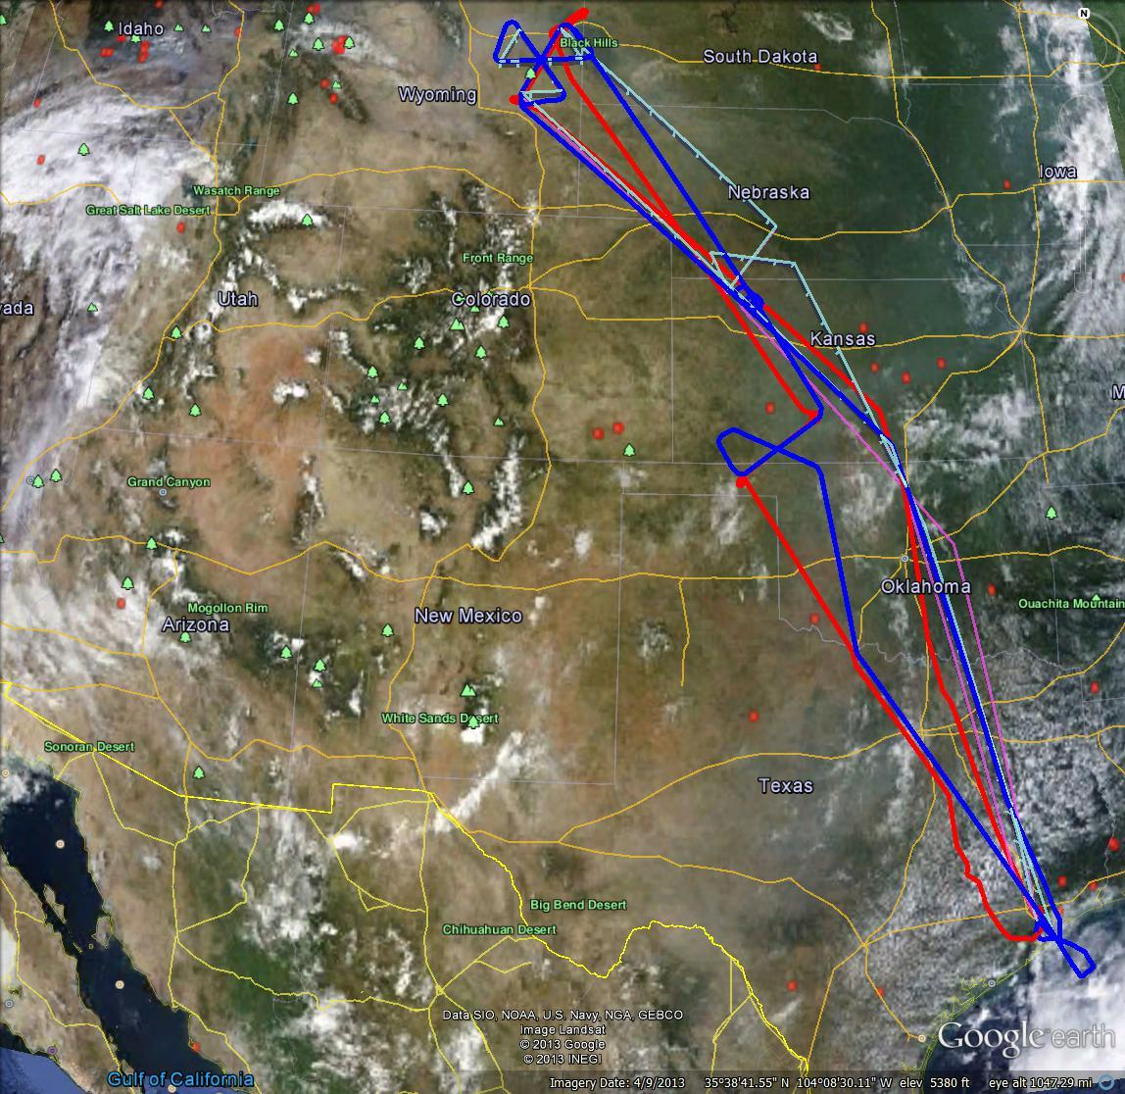
Story 1: Aerosol Air-Mass-Type Validation
2
Extreme Upwind
~18:00
ER-2: Rosette
DC-8: 5-Wall
In situ
3
Model
Satellite
Downwind
~22:00
ER-2: Bow Tie
DC-8: 3-Wall
1
Cart Site AERONET
Comparing the retrieved and modeled AOD, size, shape, and SSA with in situ measurements
qualitatively and
(b) quantitatively
for five regions
[3 Smoke Plumes; Continental Background; Continental-Smoke Mix]
4
Terra
17:40 UTC
Transit
Home

Slide 4
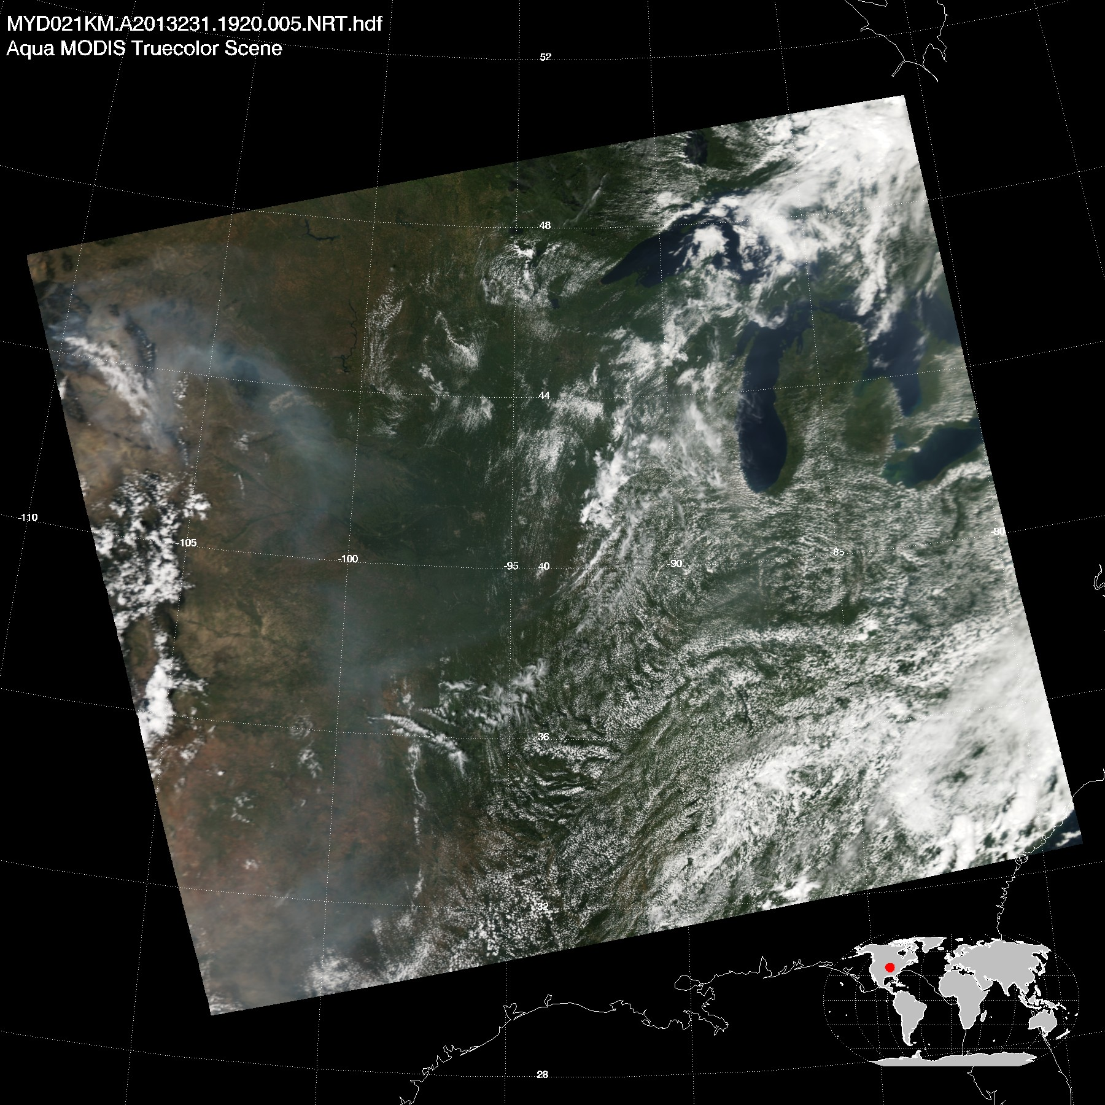
Story 2: Upwind Smoke Source & Injection Height
In situ
Satellite
Model
Using the 3-D AOD distribution from satellite and in situ measurements to constrain the model, which in turn identifies probable source locations and injection heights
(also aerosol type)

Slide 5
Story 3: Regional Aerosol Characterization
AOD
In situ
Satellite
Model
Continental
Site 2
Continental
Site 3
Smoke
Plumes
Using the in situ measurements to add microphysical detail to the satellite aerosol type mapping, and then use the satellite 2-D AOD and type distributions, plus available 3-D data, to constrain larger-scale model aerosol amount and type mapping
Continental
Smoke-
Continental Mix

Slide 6
Measurement Inventory
Aerosol Air Masses
• Plume 1
• Plume 2
• Plume 3
• Continental Background
• Continental-Smoke Mix
Particle Properties
AOD
ANG
Particle Size
Sphericity
SSA
Composition
Supporting Information
3-D Location
Areal Extent
Acquisition Time
Measurement Uncertainty
Other Constraints
Gases
Meteorological Conditions

