Slide 1
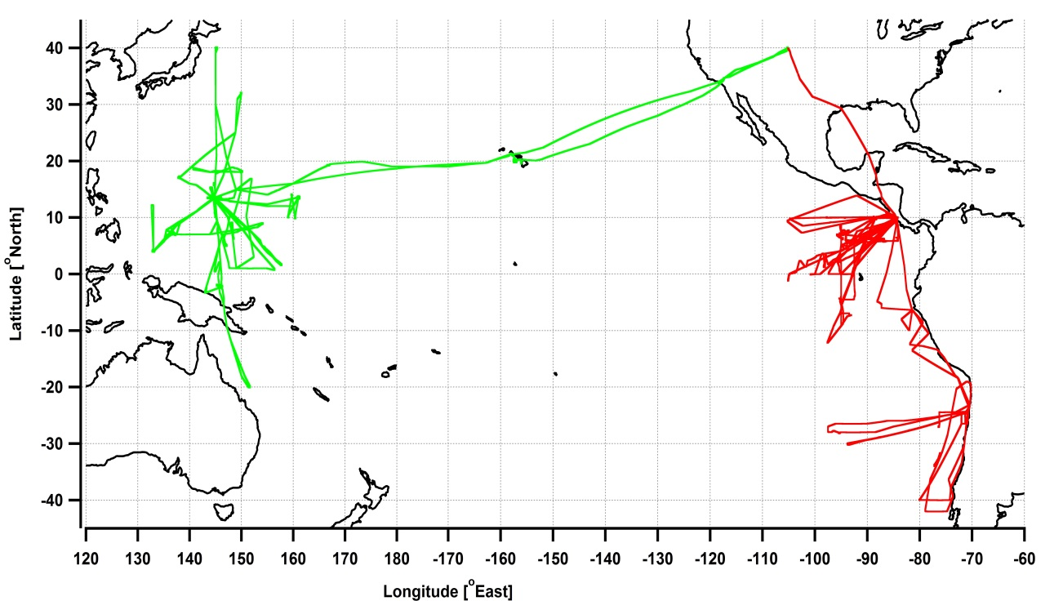


BrO in the Tropical and Subtropical UTLS
R. Volkamer, S. Baidar, B. Dix, T. Koenig, SY. Wang, J. Schmidt, D. Chen, G. Huey, D. Tanner, A. Weinheimer &
the TORERO and CONTRAST science teams
CU Boulder, Harvard, Georgia Tech, NCAR
Introduction BrO conundrum
CU AMAX-DOAS (BrO, IO, NO₂, H₂O, O₄)
& data status
Robustness of NO₂ and BrO VMR conversion
Comparison of VMRs from remote-sensing with in-situ and model data
CONTRAST
Jan/Feb 2014
TORERO
Jan/Feb 2012

Slide 2
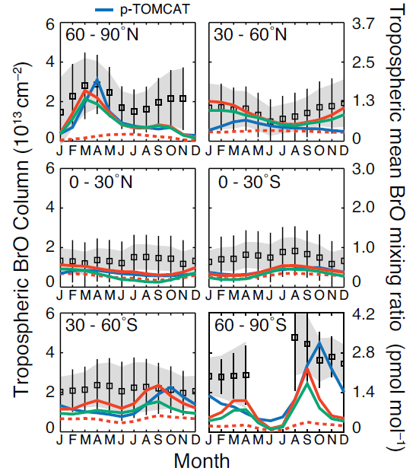
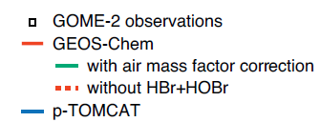
BrO overview: observations and models
Satellite: 1-3 x10¹³ molec cm⁻²
(Chance et al., 1998; Wagner et al., 2001; Richter et
al., 2002; Van Roozendael et al., 2002; Theys et al.,
2011)
Ground : 0.2-3 x10¹³ molec cm⁻²
(Schofield et al., 2004 , Hendrick et al., 2007; Theys et
al., 2007; Coburn et al., 2011; Coburn et al., 2014,
in prep.)
Balloon: 0.2-0.3 x10¹³ molec cm⁻²
(Pundt et al., 2002; Dorf et al., 2008)
Models: 0.2-1.0 x10¹³ molec cm⁻²
(~ 0.2-0.5 ppt)
(Saiz Lopez et al., 2012; Parrella et al., 2012)
– in the tropics
Theys et al. [2011]
Halogens deplete the O₃ column by ~10% in the tropics (Saiz-Lopez et al., 2012)
Notes:
I moved Schofield, 2004 (Lauder, NZ) from “balloon” to “ground” and changed VCD accordingly; removed Schofield 2006 as this is Antarctica only
BIG PICTURE CONUNDRUM!
Satellites and ground see more than models and balloons.
stronger model-sat gap in southern hemisphere

Slide 3
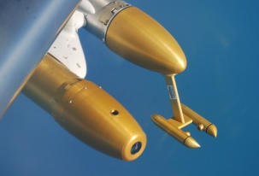
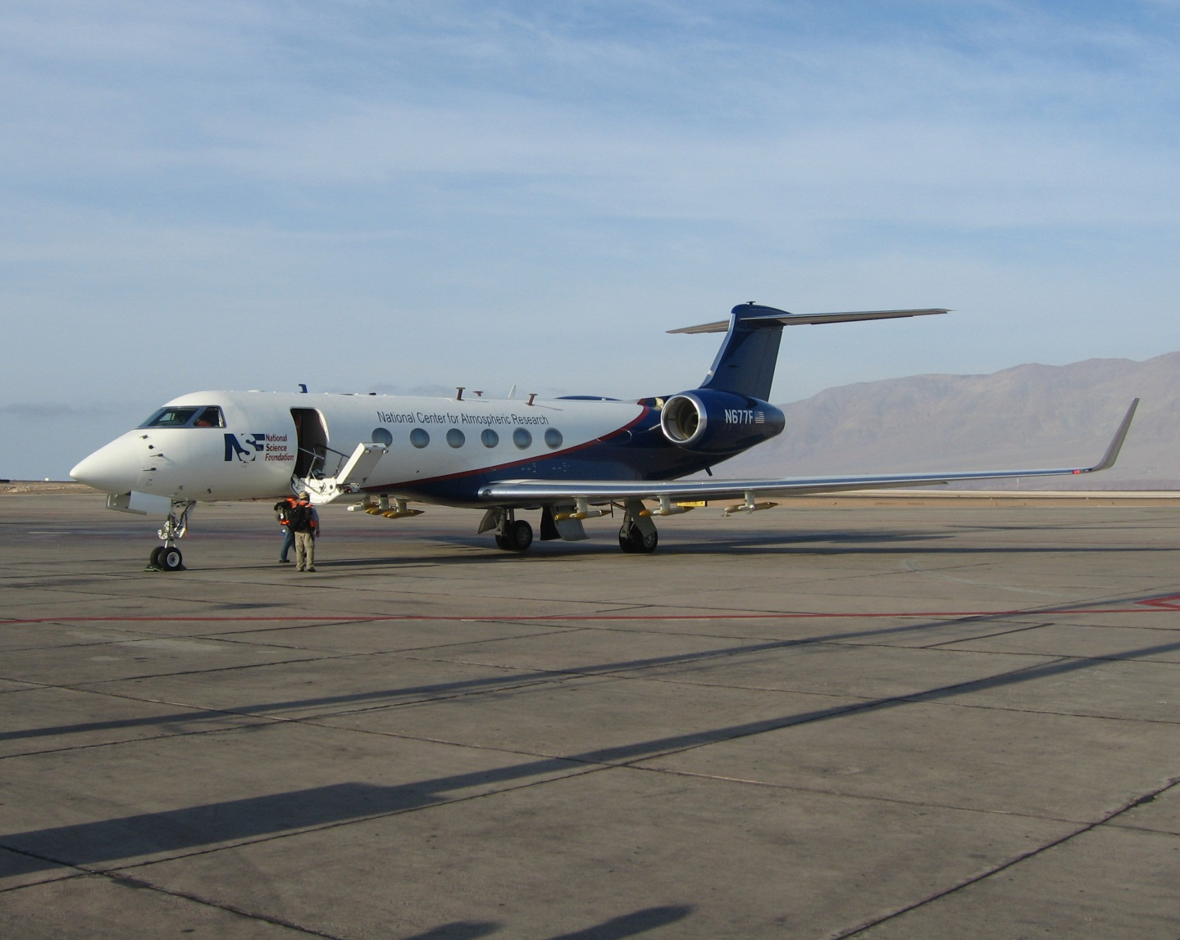
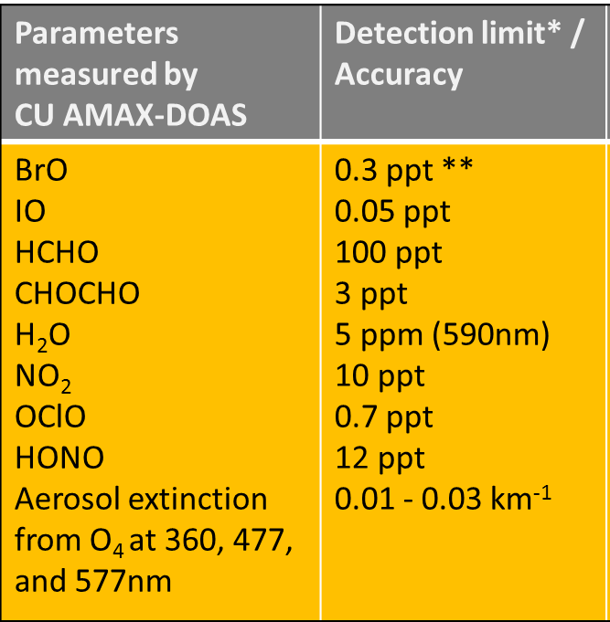
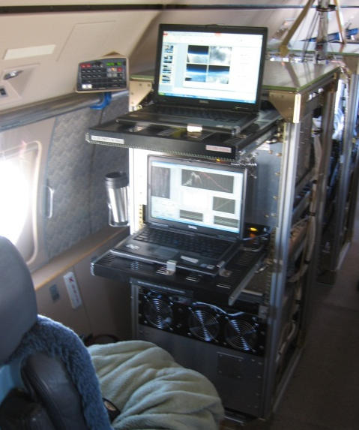
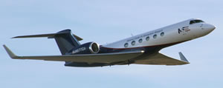
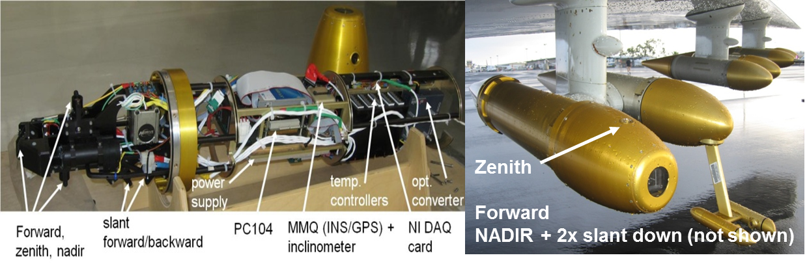
CU-AMAX-DOAS instrument aboard NSF/NCAR GV
University of Colorado Airborne Multi-AXis
Differential Optical Absorption Spectroscopy
Telescope pylon
Sinreich et al., 2010, ACP
Coburn et al., 2011, AMT
Baidar et al., 2013, AMT
Dix et al., 2013, PNAS
Oetjen et al., 2013, JGR
Sun
motion
stabilized
height
solar zenith angle
elevation angle
* 30 sec, ** 60 sec integration time
Passive remote sensing column observations
Trace gases and aerosols
spectrographs/detectors
concentration
Volkamer et al., 2009

Slide 4
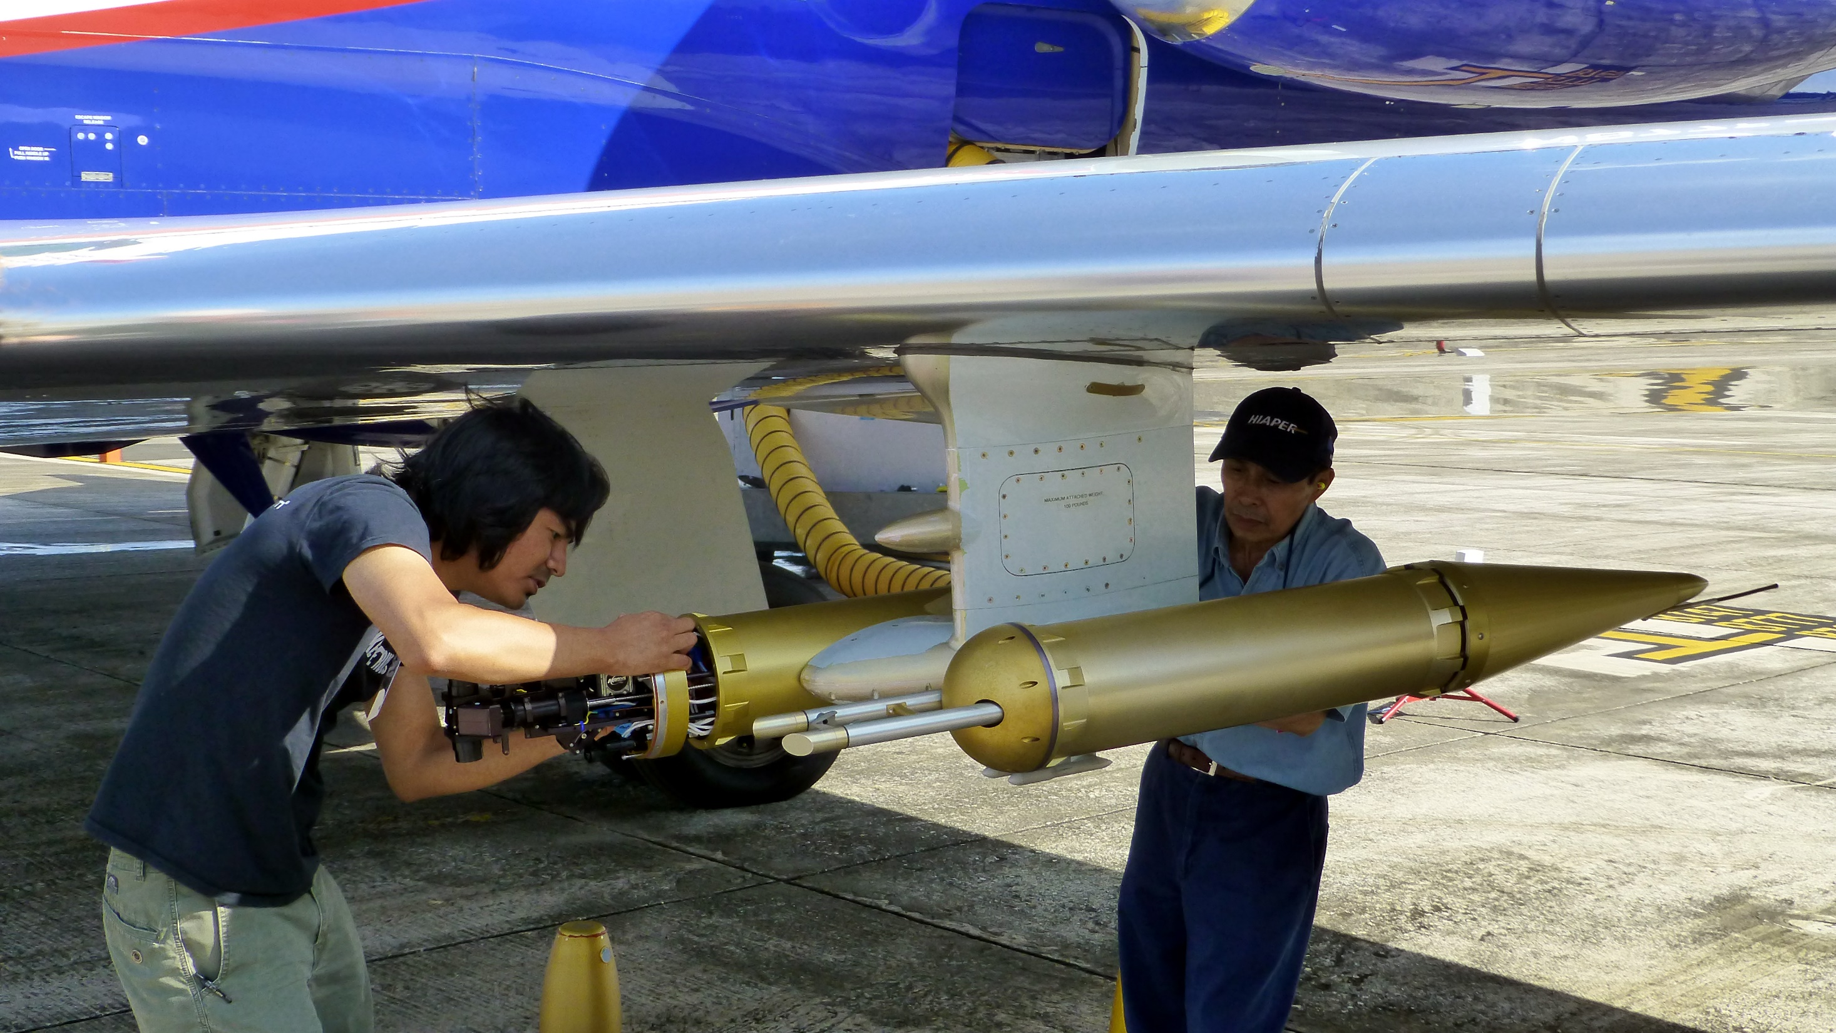
CU-AMAX-DOAS instrument aboard NSF/NCAR GV
Hardware: new telescope design implemented for CONTRAST
Software: Autonomous deployment on the NSF/NCAR GV
zenith
limb
* 30 sec, ** 60 sec integration time
nadir
Successful: more flexibility to record reference spectra
Successful: remote control in flight (RF07)
Primary benefit is added flexibility

Slide 5
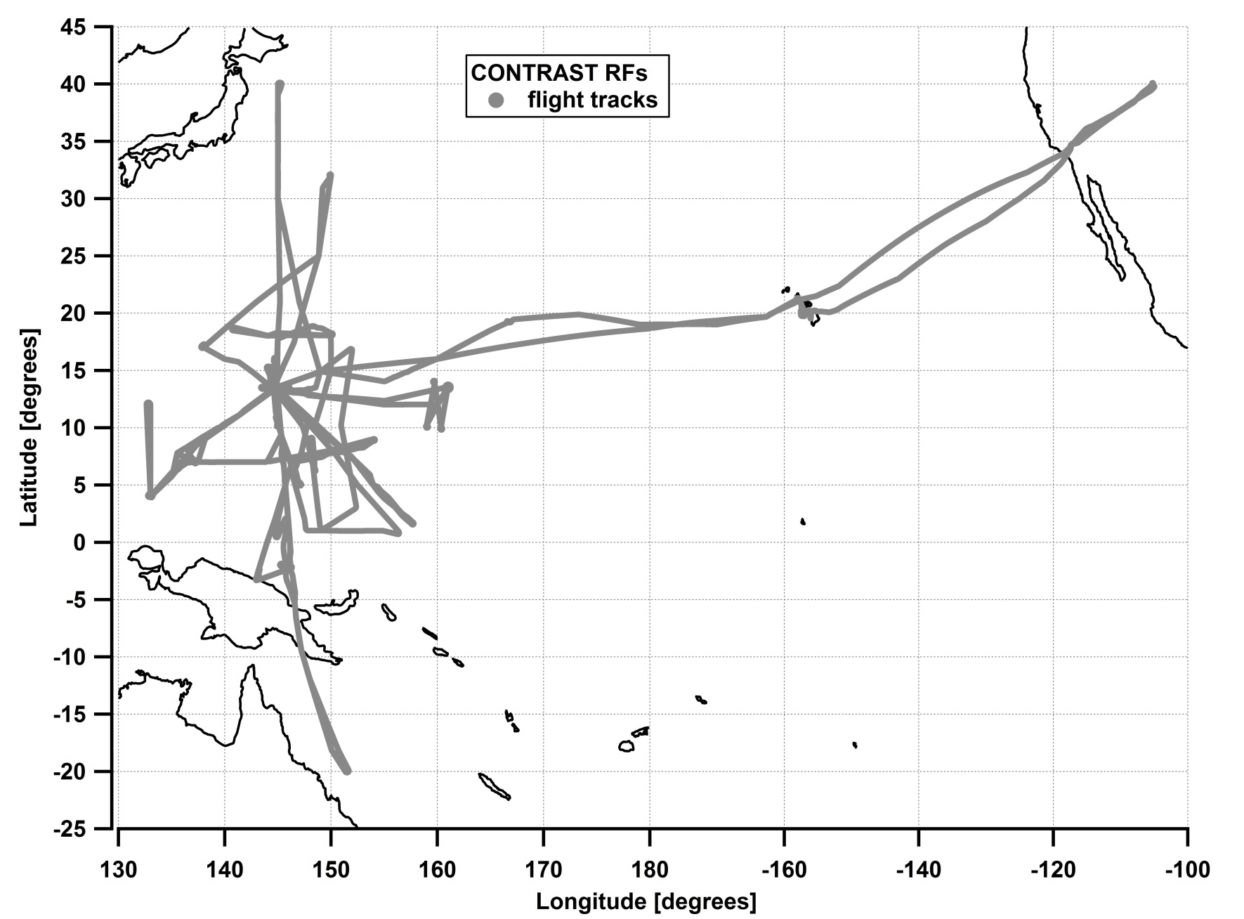
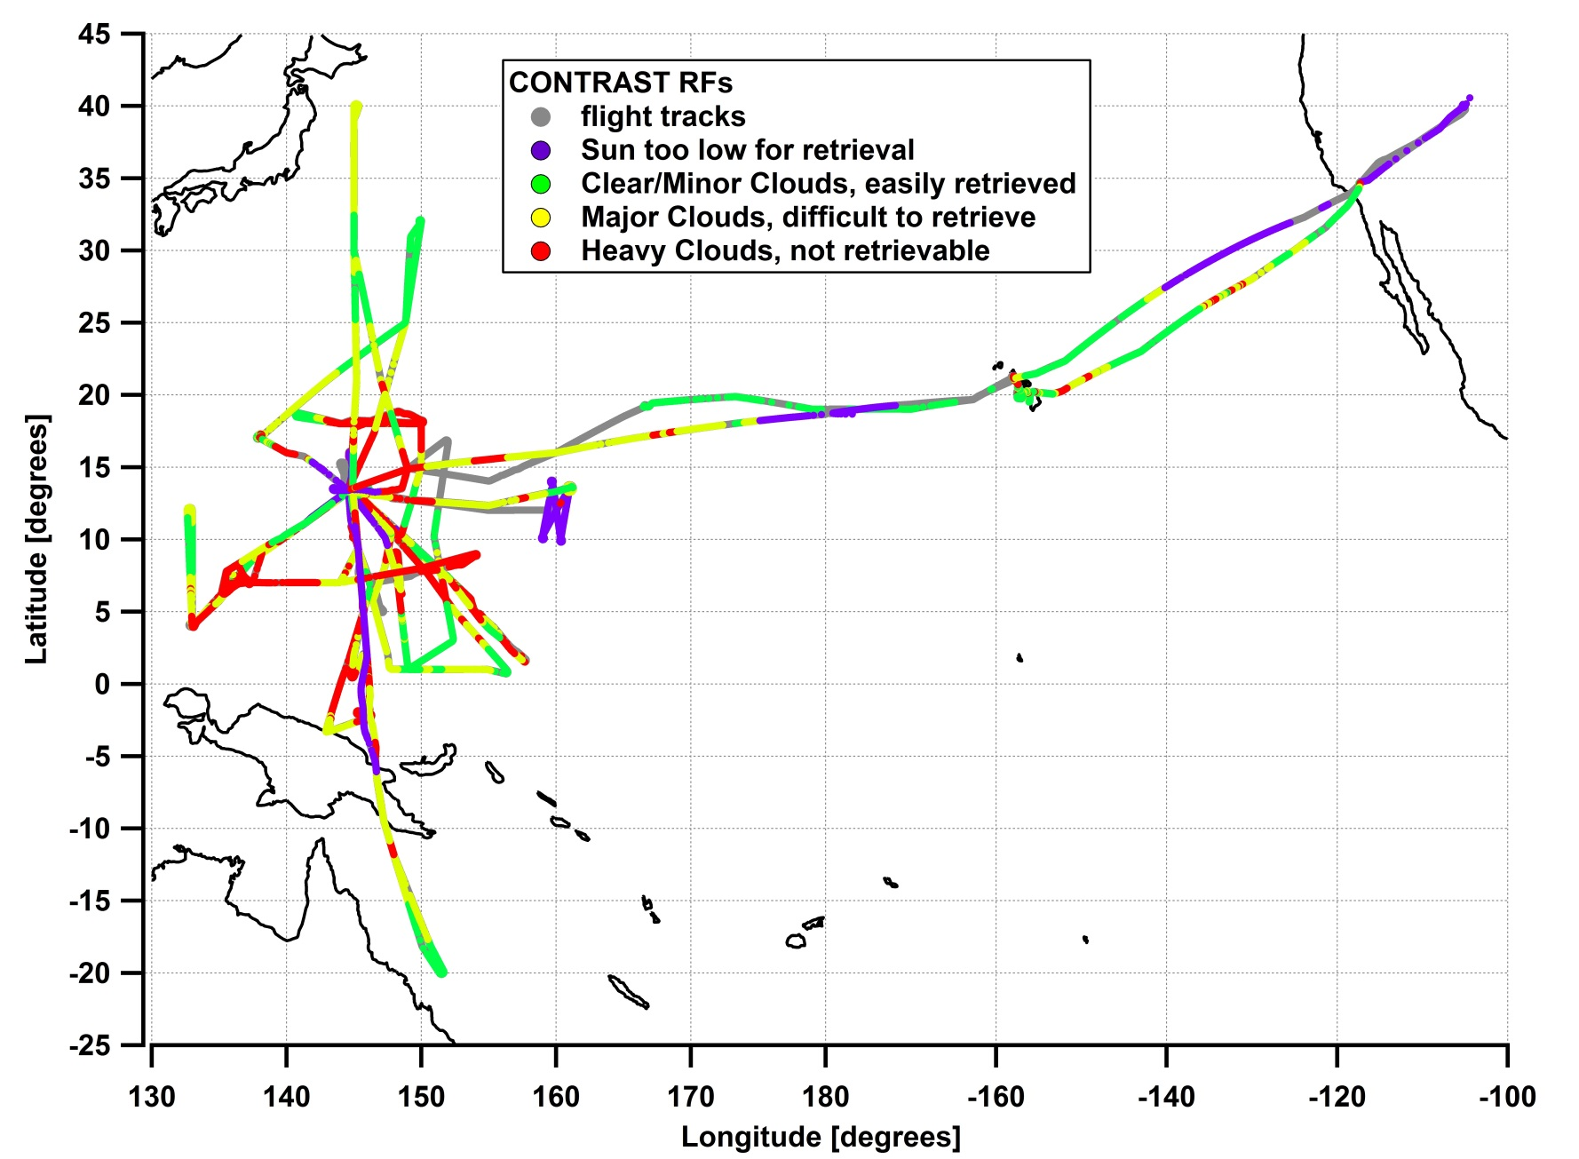
CU-AMAX-DOAS data status
- premise -

Slide 6
CU-AMAX-DOAS data status
Flight number | AMAX-DOAS data | Final dSCDs | mixing ratios | major/heavy clouds [%]
RF01 | yes | yes | BrO | 39.1
RF02 | partially | yes | BrO | 17.5
RF03 | yes | yes | BrO | 59.3
RF04 | yes | yes | BrO,IO,NO₂ | 51.2
RF05 | yes | yes |  | 68.6
RF06 | yes | yes | BrO | 50.2
RF07 | yes | yes |  | 87.1
RF08 | no | - | - | -
RF09 | yes | yes |  | 79.6
RF10 | yes | yes |  | 45.2
RF11 | yes | yes |  | 62.6
RF12 | partially | yes |  | 100
RF13 | yes | yes |  | 45.8
RF14 | yes | yes |  | 61.6
RF15 | yes | yes | BrO, IO, NO₂ | 62.8
RF16 | yes | yes |  | 70.5
RF17 | yes | yes | BrO,IO | 13.8
Notes:
I included older mixing ratio data as well as current progress as “partially”

Slide 7
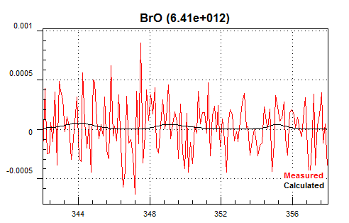
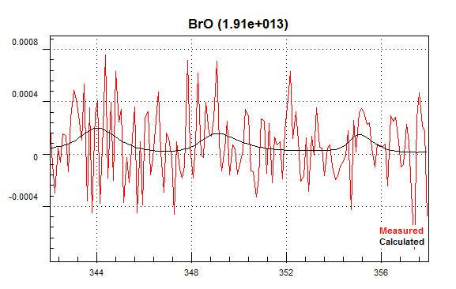
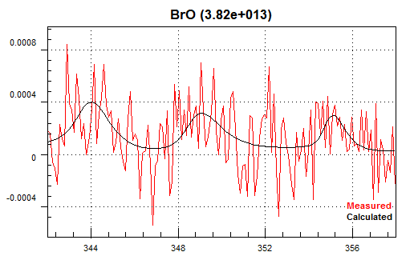
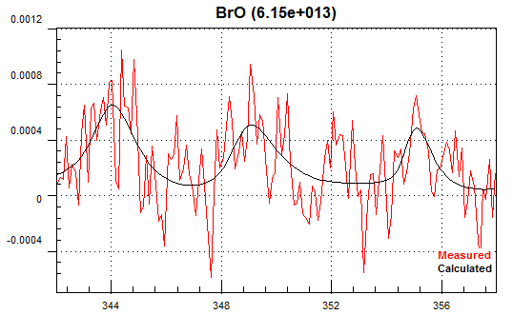
BrO detection during CONTRAST (RF04)
0.1km
5.5km
8.4km
13.1km
→ significant BrO detection above 8km

Slide 8
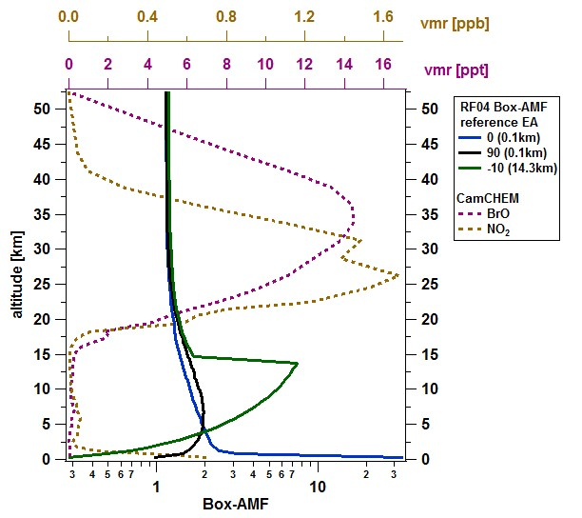
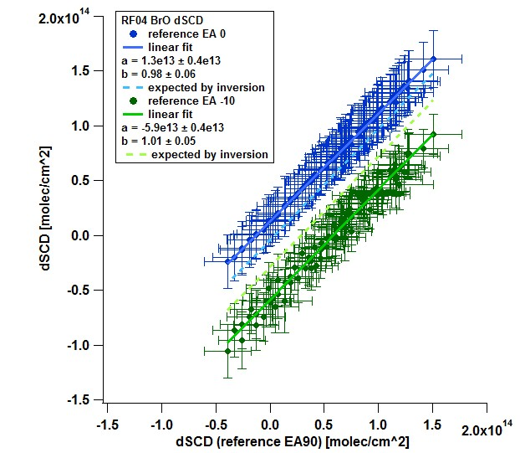
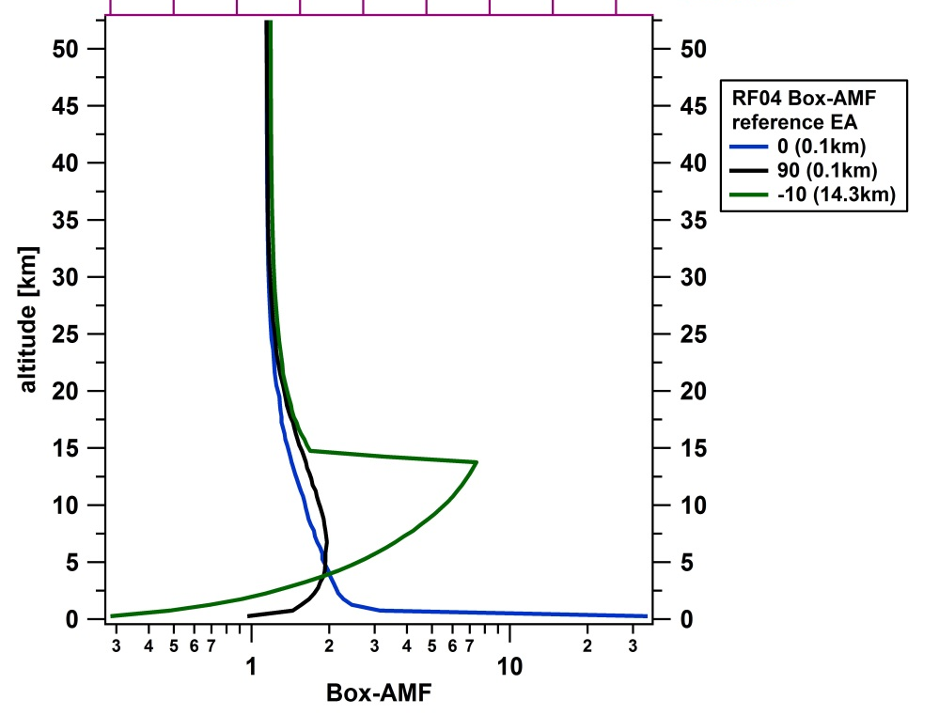
BrO retrieval - robustness
stratospheric correction
consistency between references
→ stratospheric contributions are reliably cancelled out
→ consistent dSCD offset between different reference geometries

Slide 9
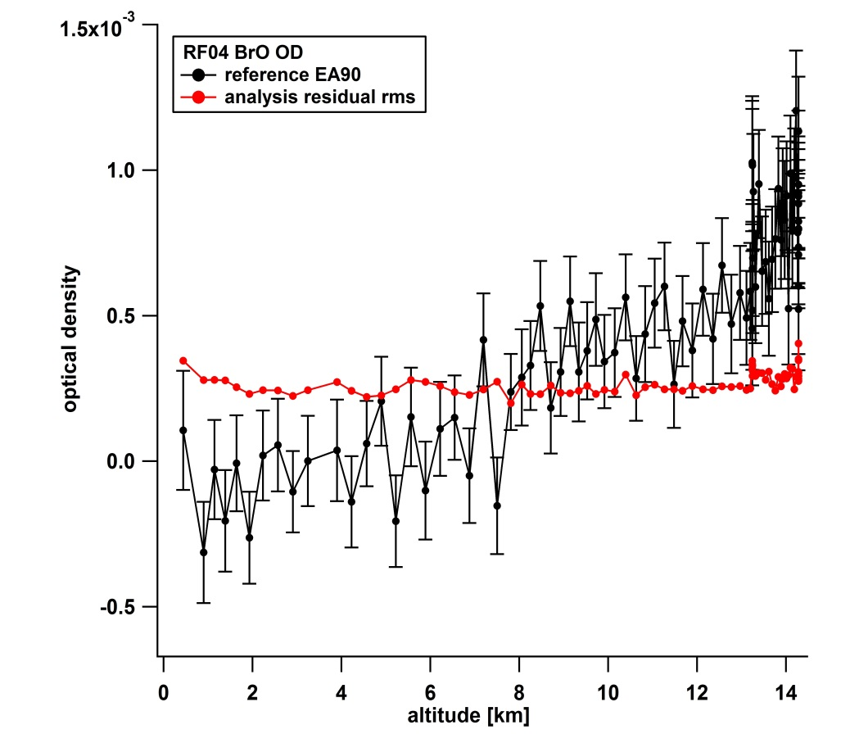
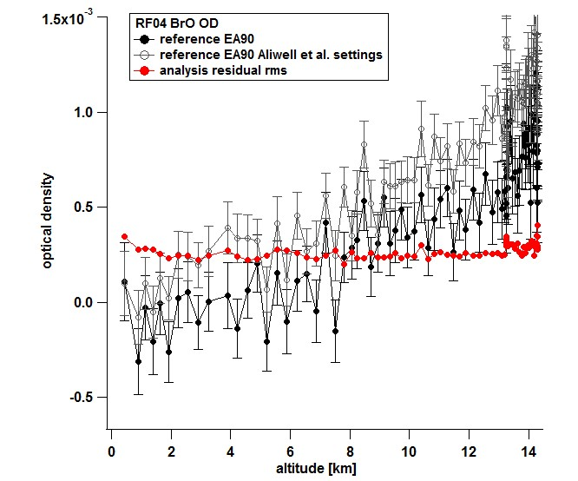
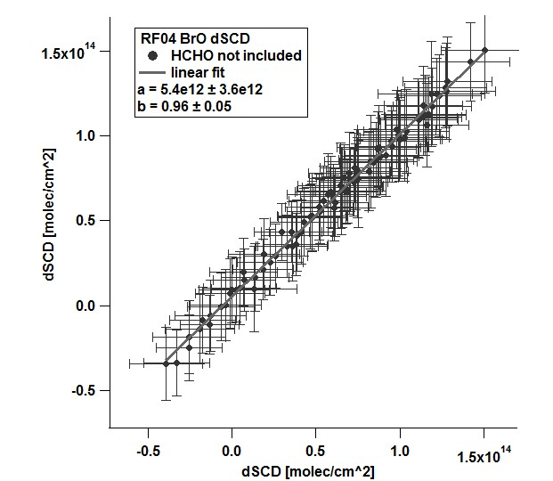
BrO retrieval - robustness
comparison with “Aliwell” settings
sensitivity to HCHO cross section
→ BrO fit settings: 3-band analysis; BrO is conservatively bound
→ Including/excluding HCHO has no effect on BrO dSCDs

Slide 10
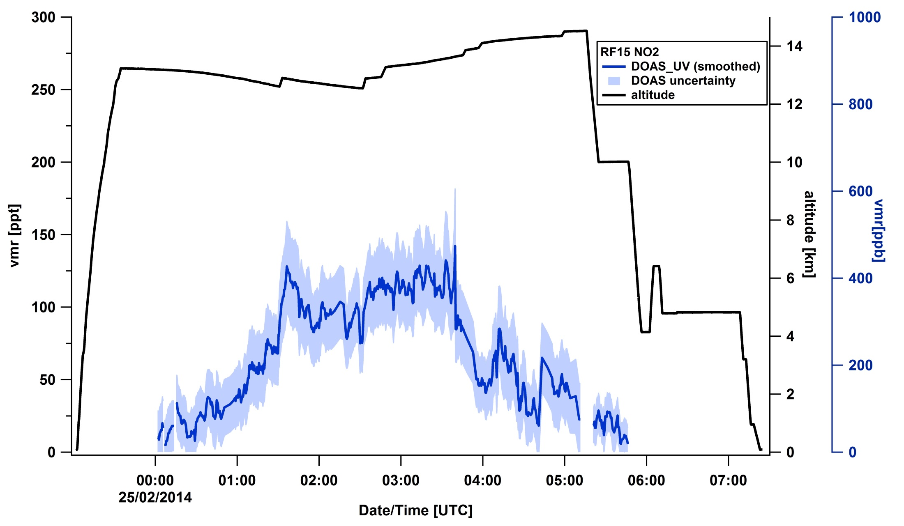
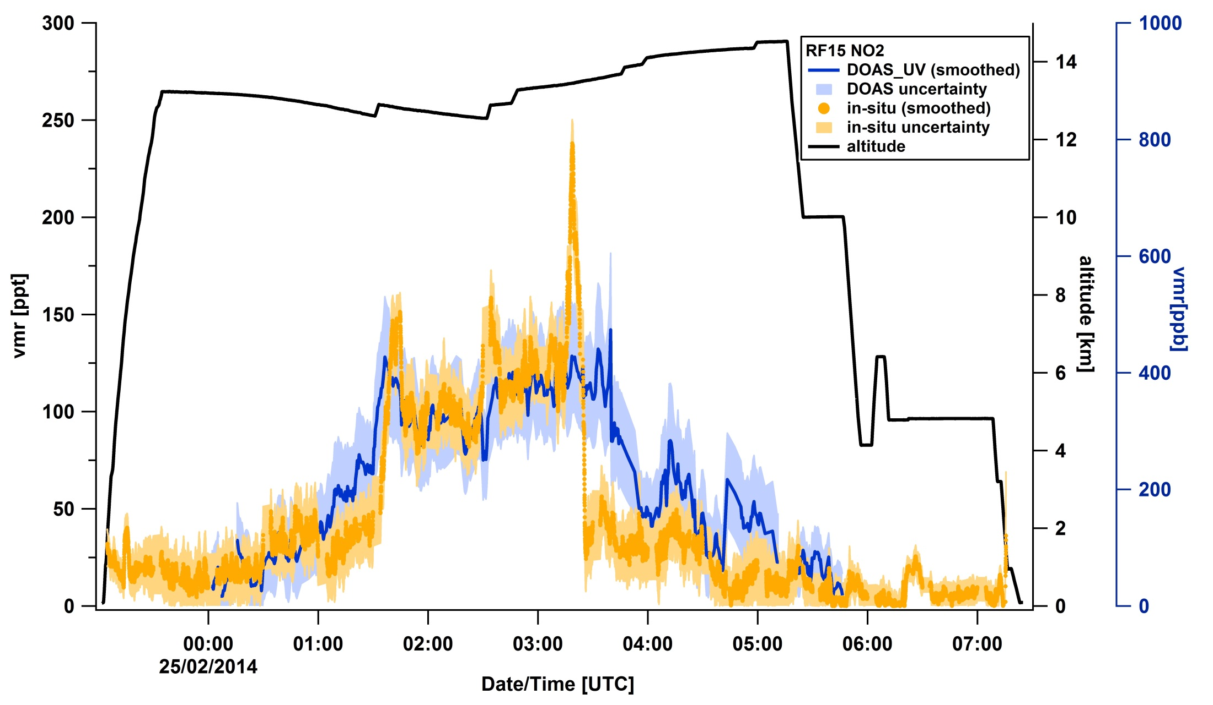
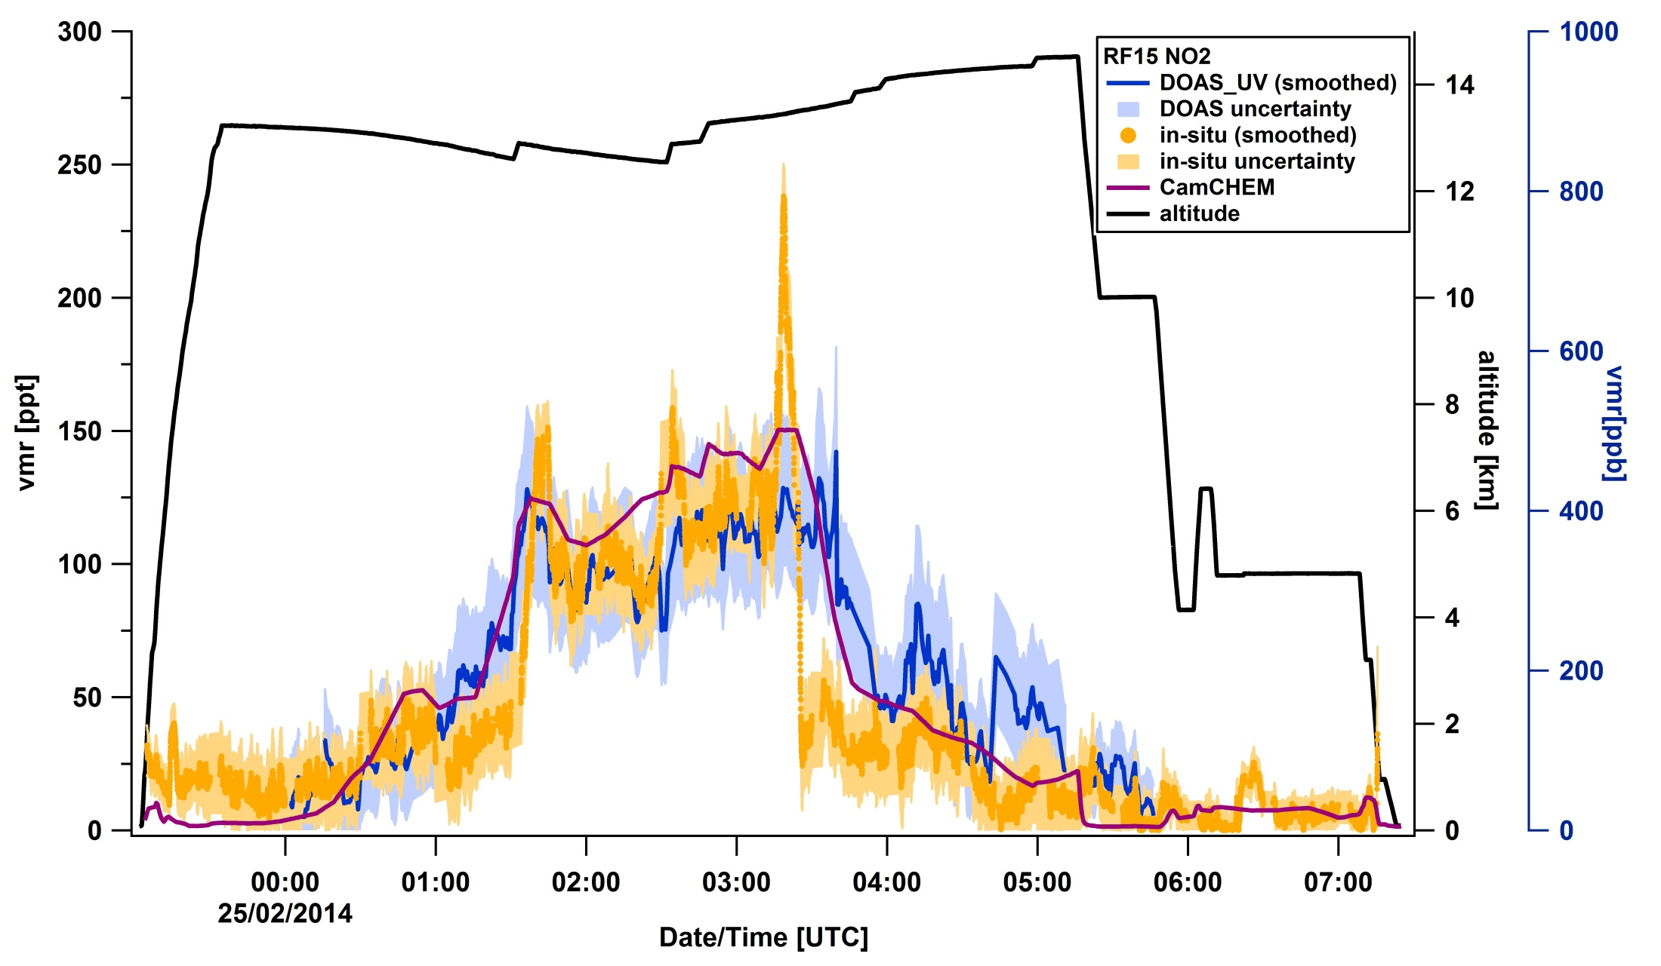
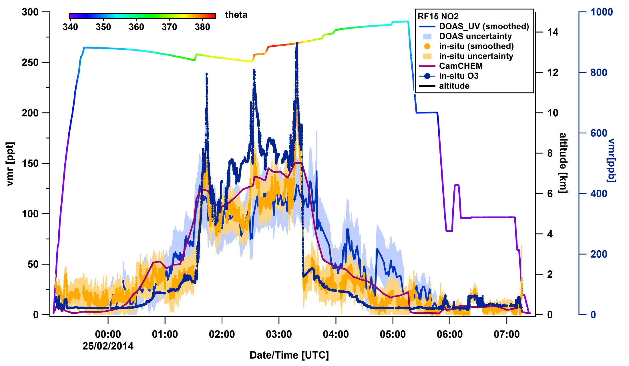
RF15 NO₂ – comparing column and in-situ vmr
very good agreement: → RTM control → Homogeneity

Slide 11
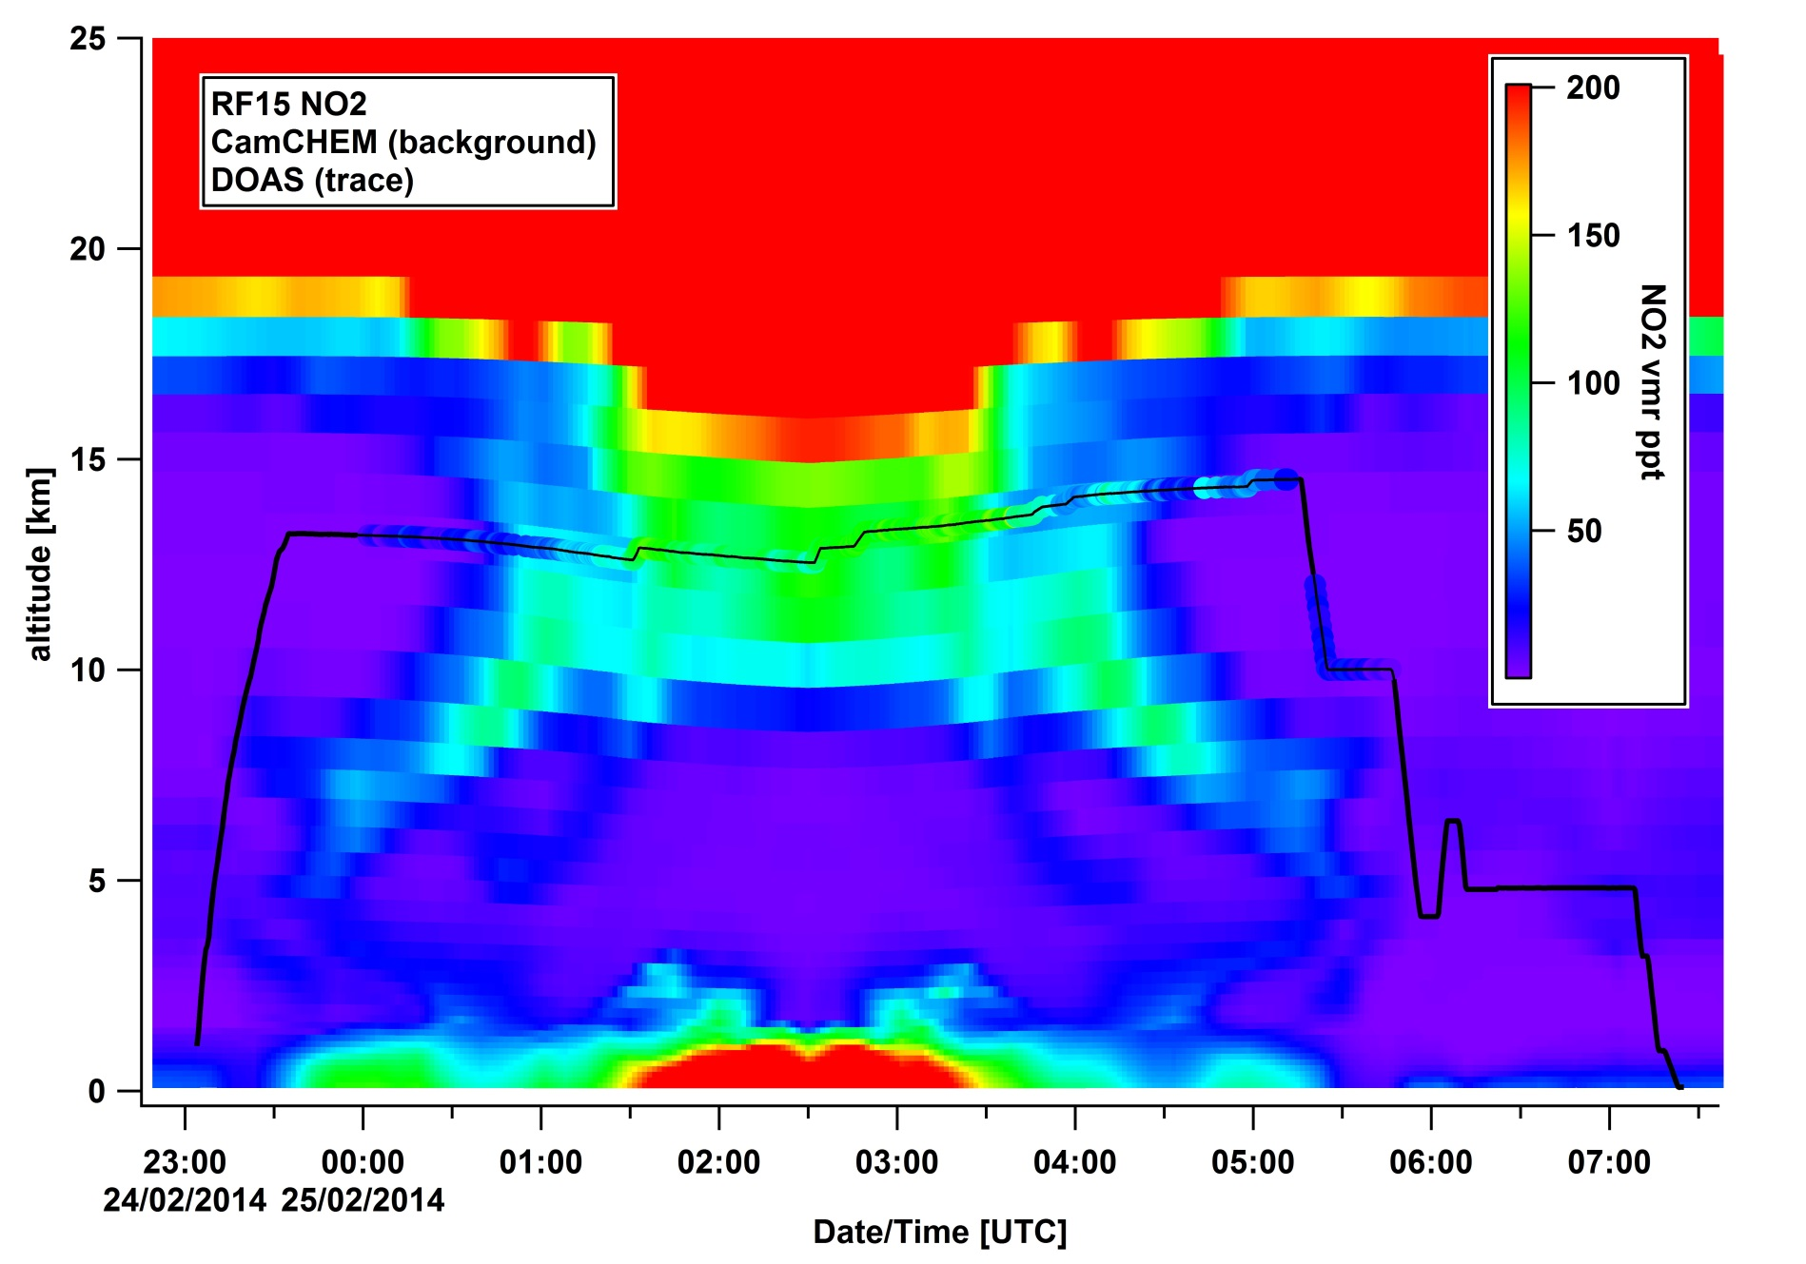
RF15 NO₂ DOAS/CamCHEM
very good agreement: → RTM control → Homogeneity
Notes:
RMV: NO2 extends beyond the model? Lets see Andi’s median/average…
in-situ NO2 is below model while flying out

Slide 12
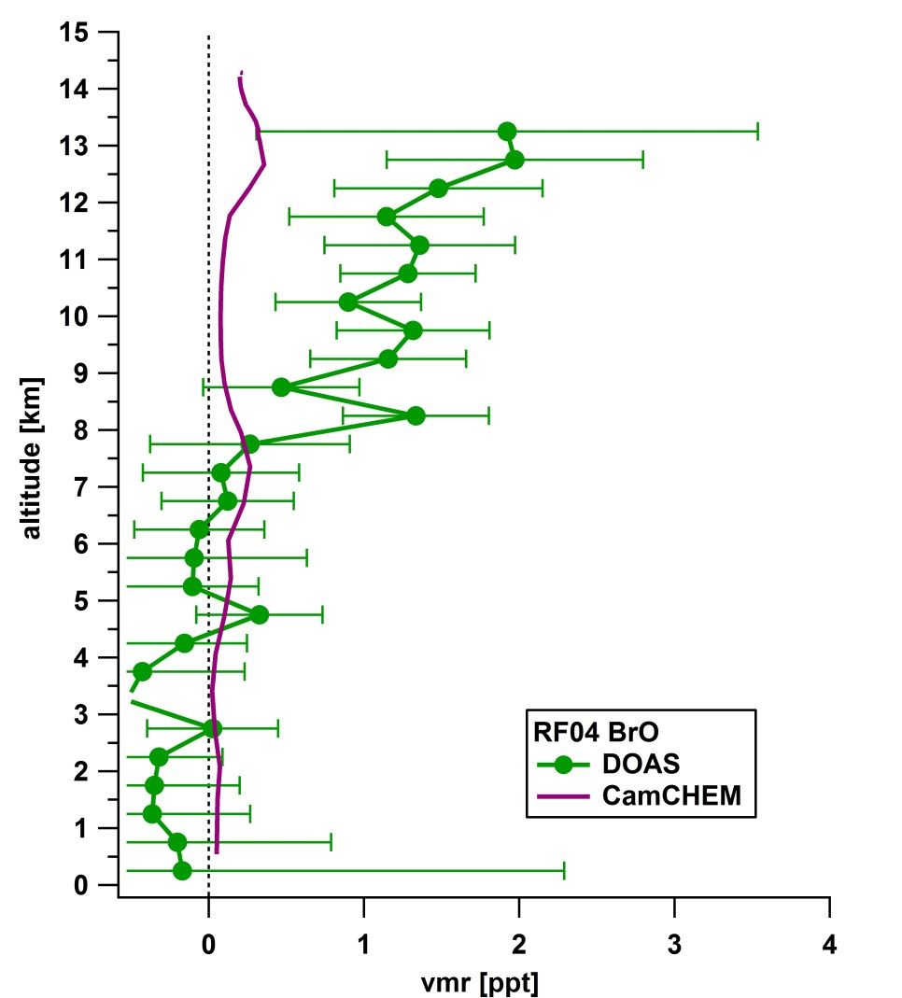

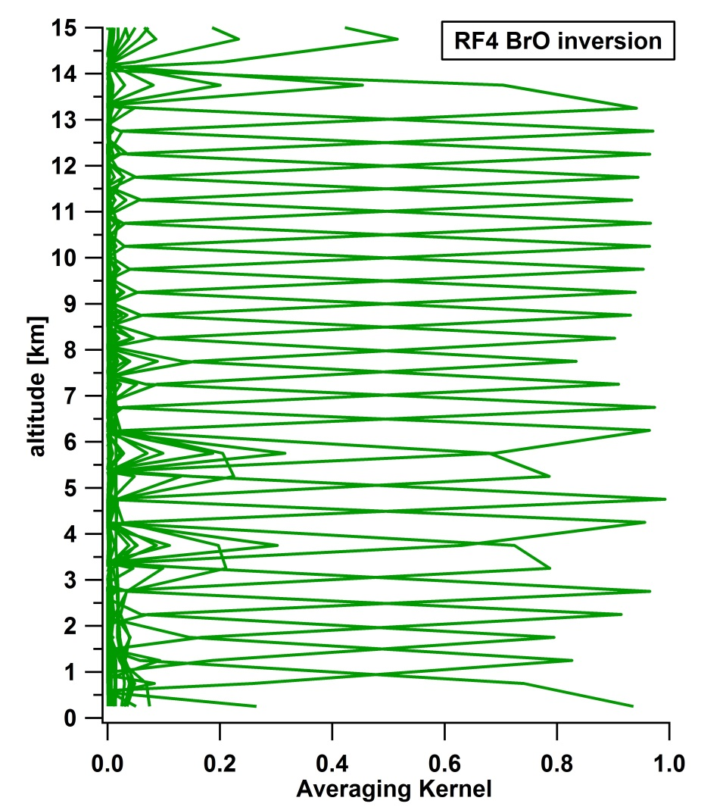
RF04 BrO vertical profile
VCD
(0.6±0.3) x10¹³ molec cm⁻²
0.2 x10¹³ molec cm⁻²
→ high DoFs; inversion is fully constrained by measurements
→ observed BrO underestimated in upper FT by model
Notes:
RMV: values below DL? I either show negative values (caused by slightly negative dSCDs) or force it to 0 and have the profile and AVK only above 8km

Slide 13
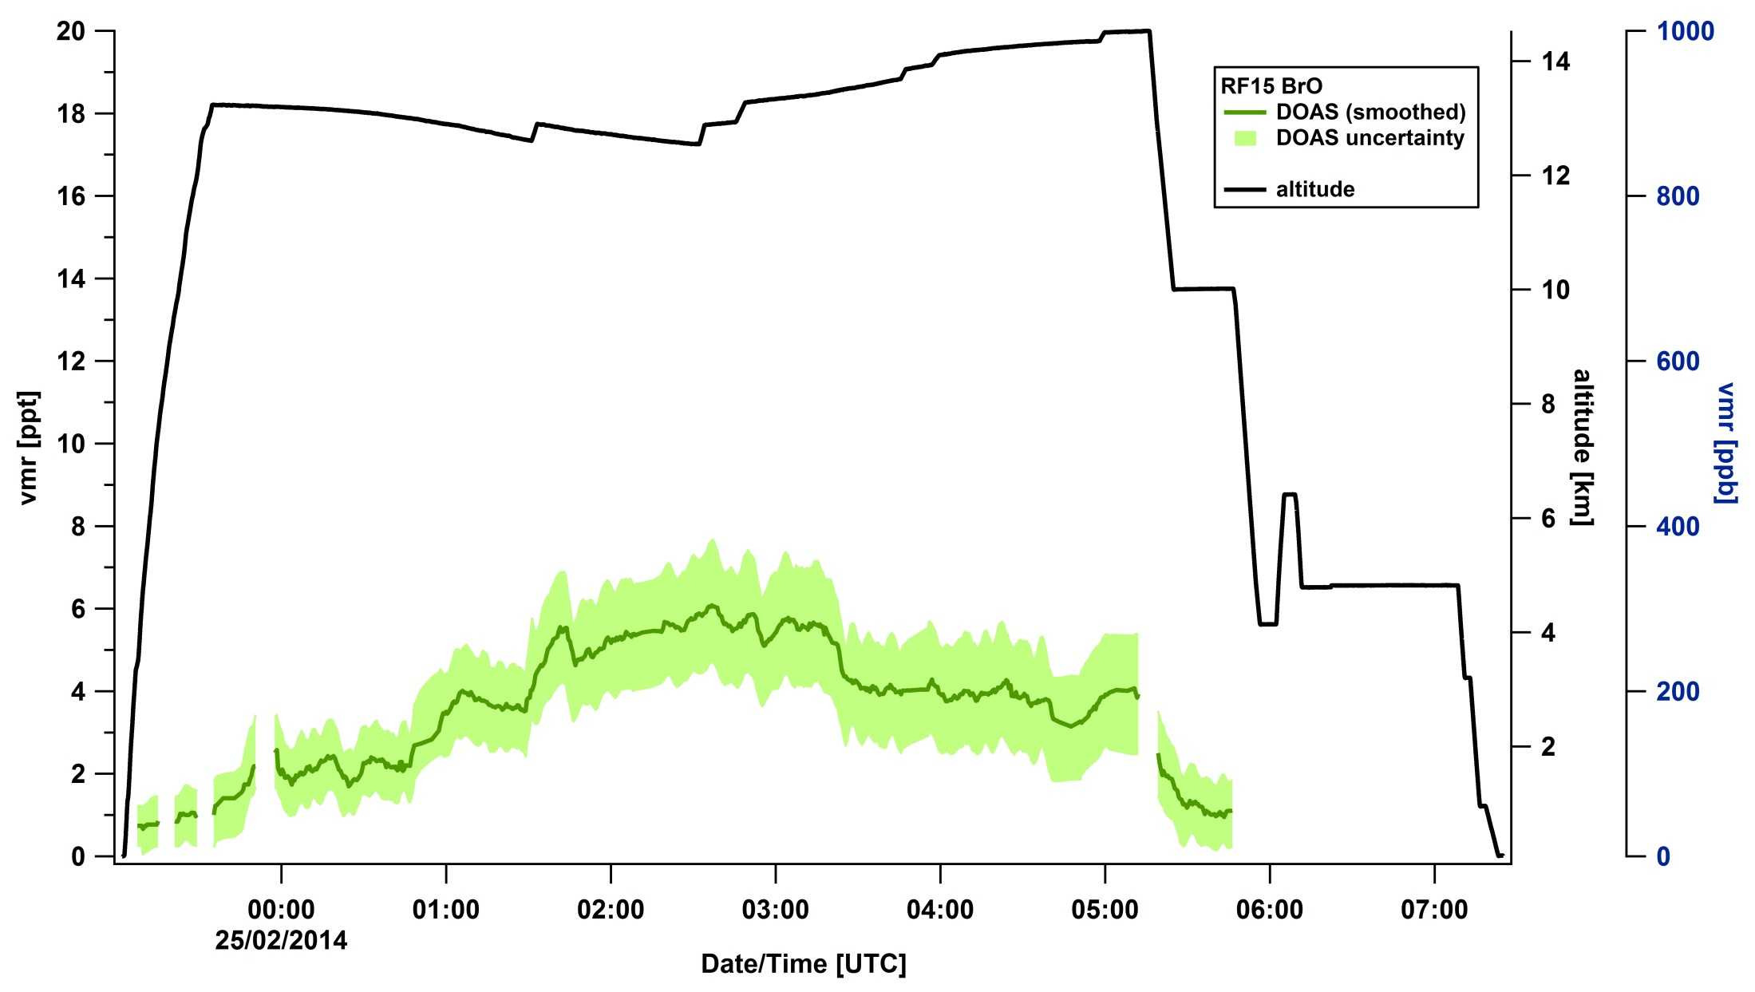
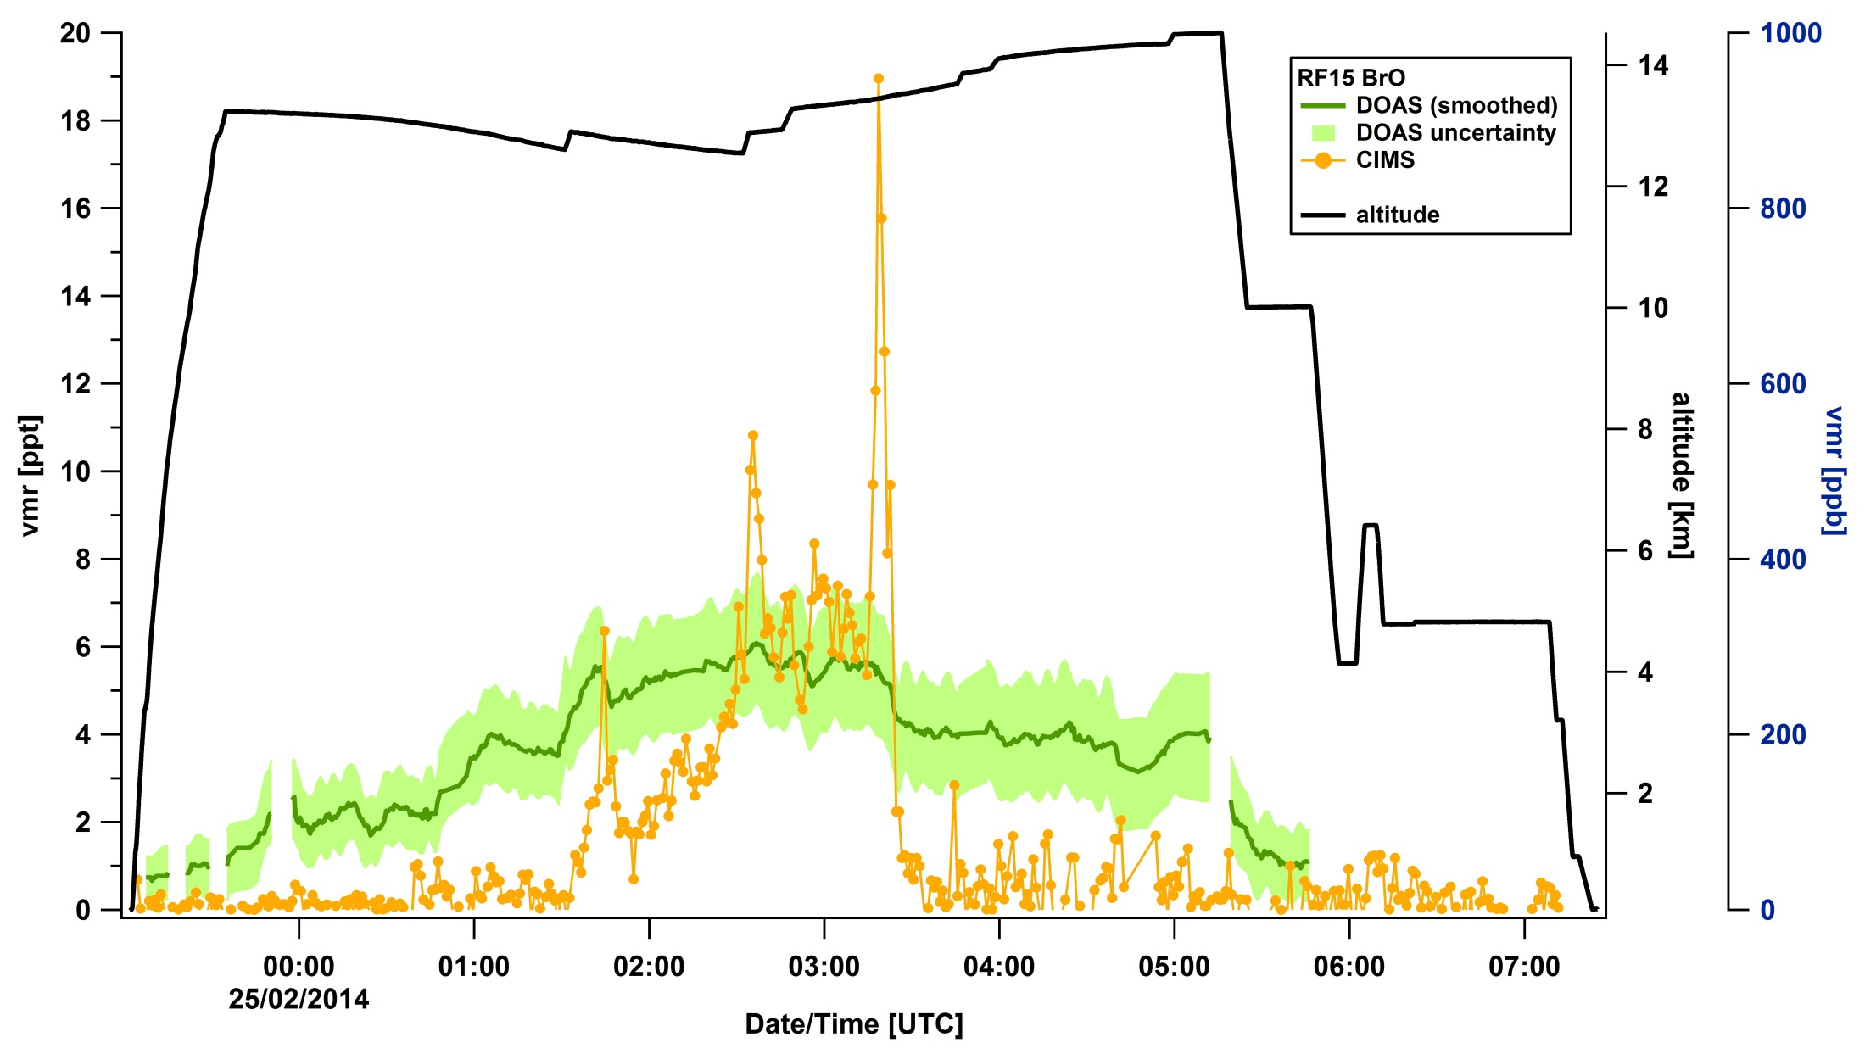
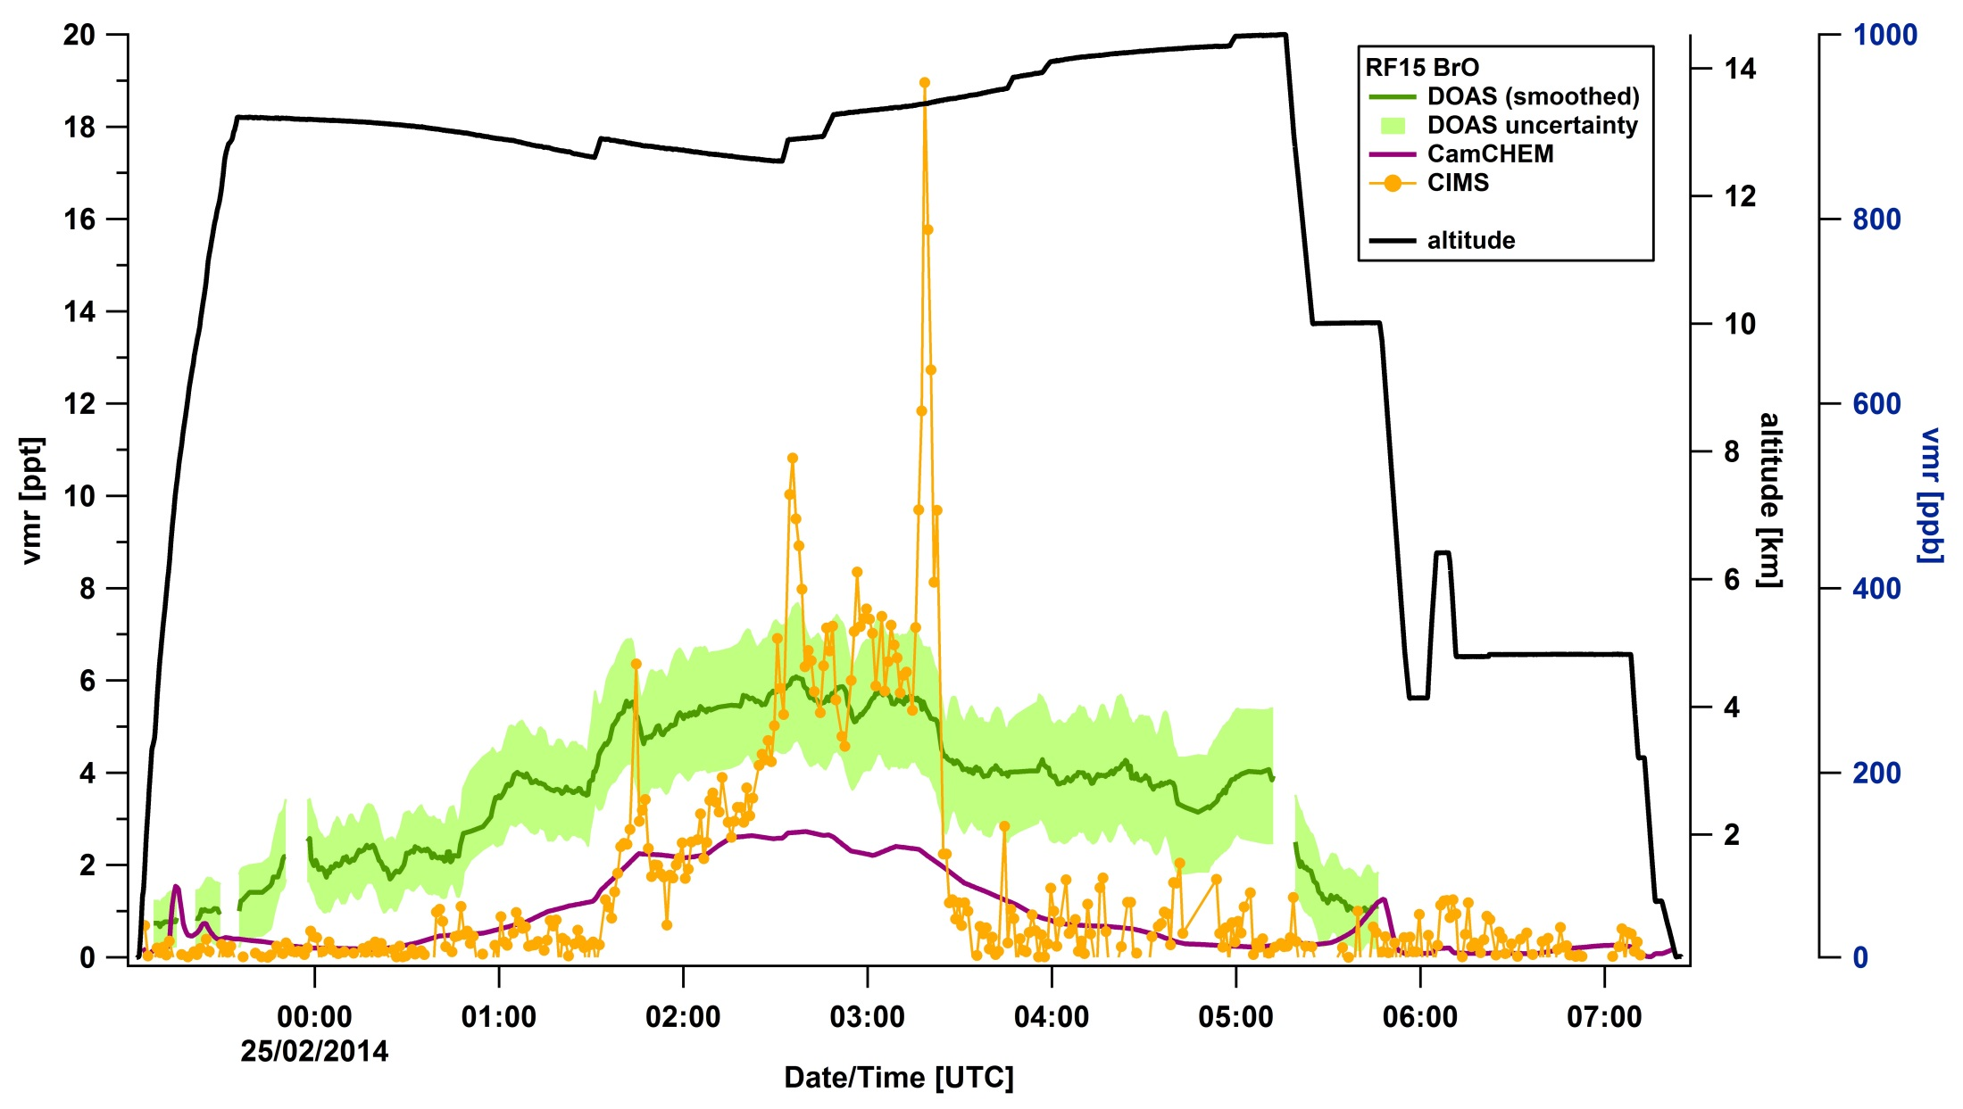
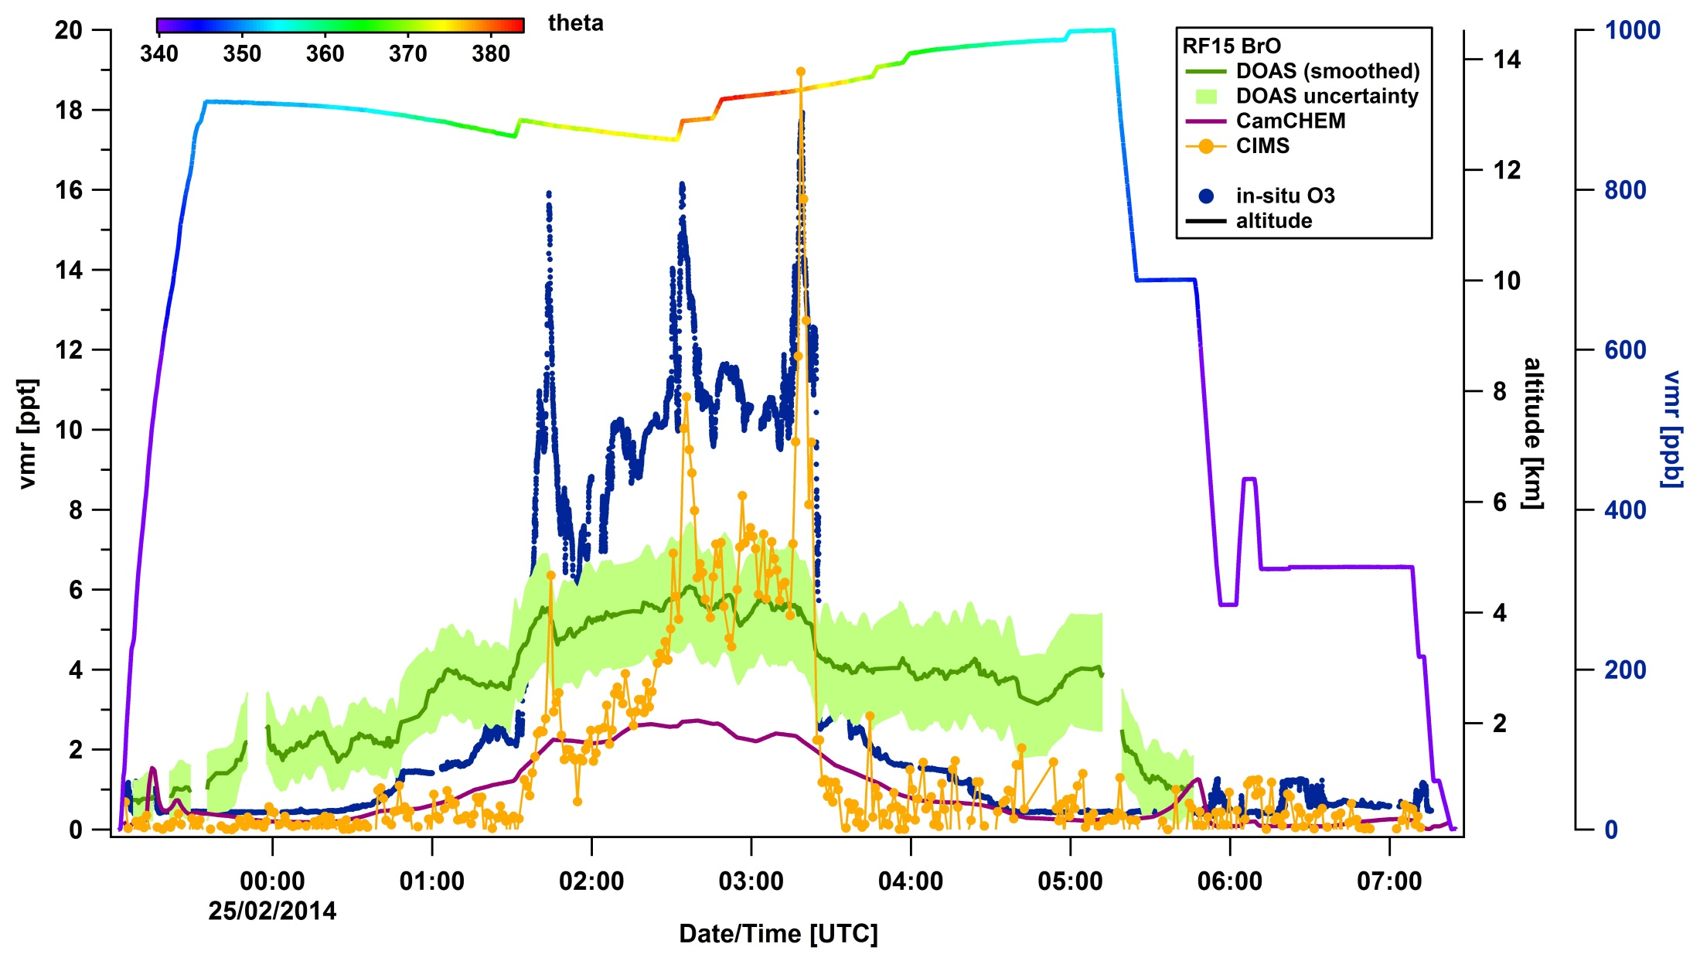
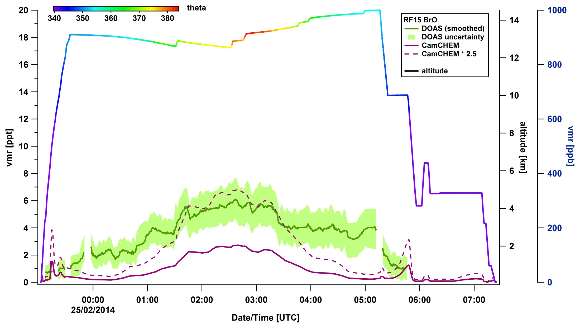
RF15 BrO DOAS/CIMS/CamCHEM along flight track
DOAS and CIMS agree at theta(max)
DOAS BrO reproduces model gradients
observed BrO ~factor 2.5 higher in stratosphere and >2.5 outside
Notes:
3:00 delta BrO 2.4 ppt

Slide 14
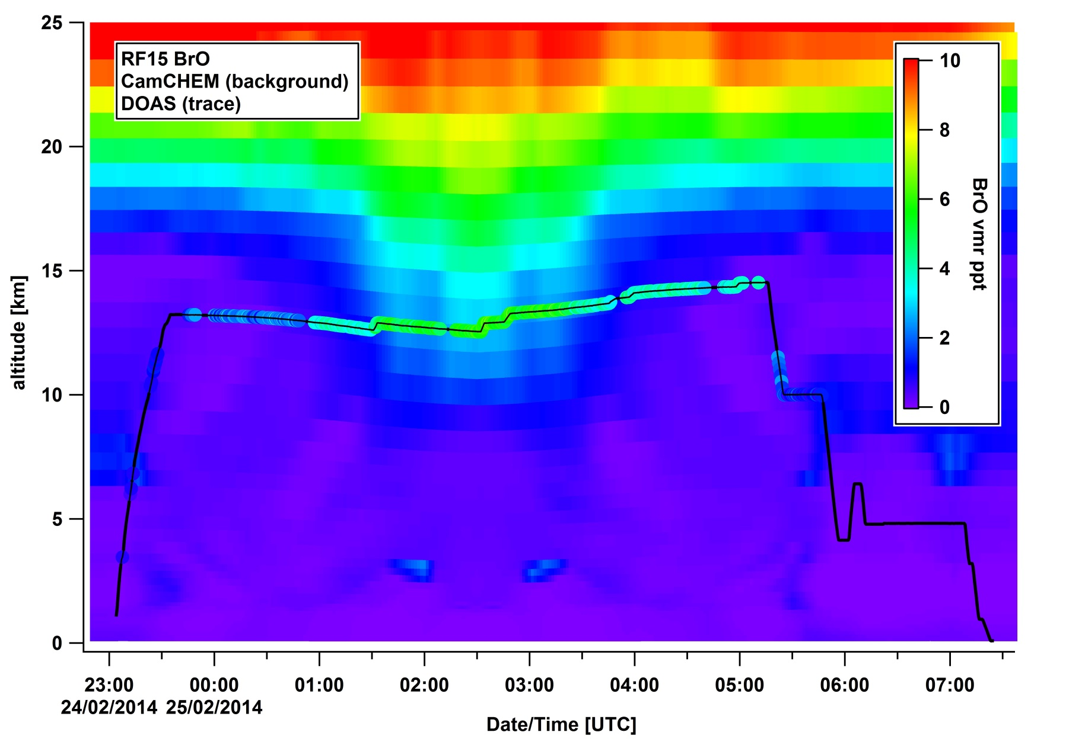
RF15 BrO: comparing DOAS & CamCHEM
DOAS BrO follows model gradients but shows higher BrO, particularly in upper FT

Slide 15
TORERO ΔBrO (unexplained BrO) – correlations
Tropospheric air
Lower stratospheric air
Unexplained BrO in the upper tropical FT:
  correlates with uFT exposure, decreasing H₂O/O₃ ratios (stratospheric tracer)
  Is anti-correlated with aerosol SA
  BrO in the lower stratosphere seems underestimated
Notes:
unexplained delta BrO
BrO in East Pacific strongly correlates with stratospheric indicators -> speaks against source coming from lower FT

Slide 16
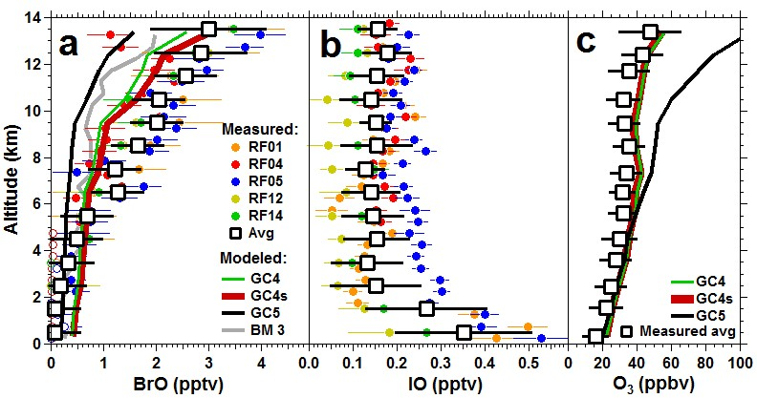
TORERO vertical profiles & comparison with models
GC4s: GEOS-4 Met + 25% Bry in LS (~1 pptv BrO); BM3: Box model with faster het. chemistry.
upper FT: sensitivity to dynamics and Bry in LS
EAST: VCD [molec cm⁻²]
NH/SH tropics: (1.5 ± 0.3) x10¹³
SH sub-tropics: (1.7 ± 0.3) x10¹³
SH mid-latitudes: (1.0 ± 0.3) x10¹³
West: VCD [molec cm⁻²]
RF15: (0.6 ± 0.4) x10¹³
RF04: (0.6 ± 0.3) x10¹³

Slide 17

Conclusions
BrO is significantly detected above 6 km during RF04 and RF15.
  Retrievals are robust
  NO₂ shows RTM control and homogeneity for RF15
  Western Pacific: BrO in UT is lower than over the Eastern Pacific, but higher than predicted by models (Western and Eastern Pacific)
  BrO VCD is 60% /12% lower than GOME-2, consistent with ground-based MAX-DOAS data (Theys et al., 2011)
  BrO in the lower stratosphere is higher than predicted
Eastern Pacific: stratospheric sources are underestimated
  Elevated BrO is sensitive to BrY in the LS (injected as bromocarbons over Western Pacific?), and UTLS dynamics (GEOS4/GEOS5).
  Stronger convection (GEOS4) leads to improvements in O₃ profiles, and invigorates UTLS transport
Comparison of RF01/RF17 BrO with ground based MAX-DOAS at MLO presented at AGU 2014
Funding: NSF-CAREER award, NSF-AGS (CONTRAST/TORERO)
Acknowledgements: NCAR/EOL, RAF, CONTRAST and TORERO teams
Notes:
GOME-2: 1.2E13

Slide 18
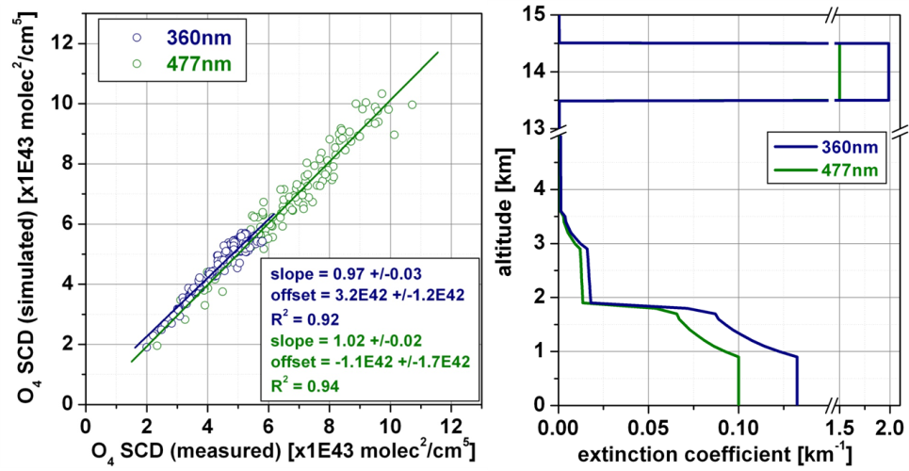
Confirmation of excellent motion control
Technological innovation:
Motion stabilization & low RMS
1σ ~ 0.2^{O}
O₄ observations in a Rayleigh atmosphere & GV C-migit sensor
Trace gases and aerosol extinction profiles
Baidar et al., 2013 AMT Dix et al., 2013 PNAS

Slide 20
Robustness of the BrO dSCD retrievals
References: consistent dSCD offset between different geometries
MBL limb, zenith, -10EA reference contain variable amount of Ring
BrO in MBL: no evidence in our spectra (upper limit ~ 0.5 pptv)
BrO fit settings: 3-band analysis; BrO is conservatively bound
Including/excluding HCHO has no effect on BrO dSCDs

