Slide 1
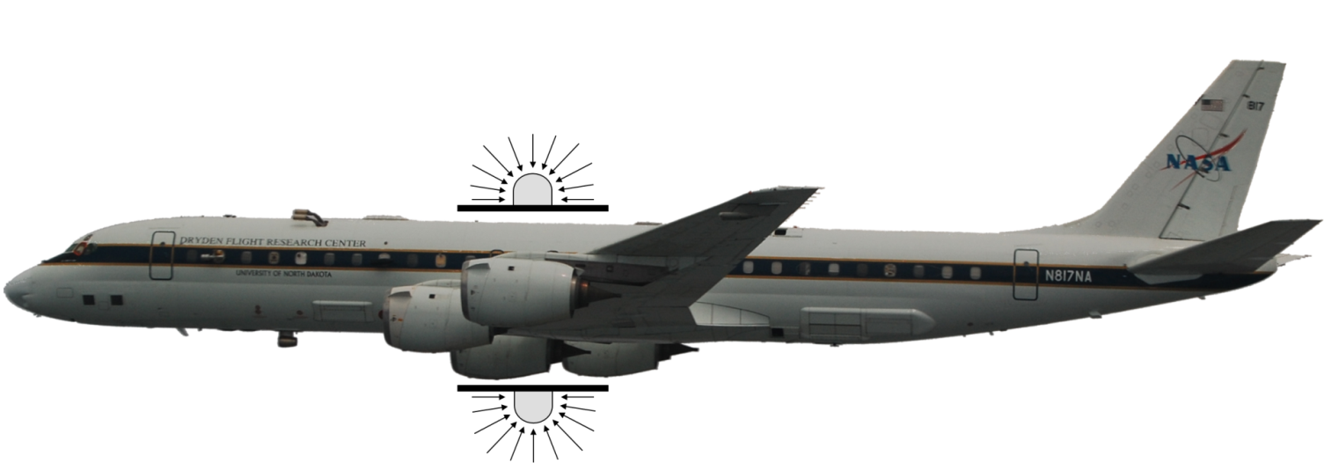
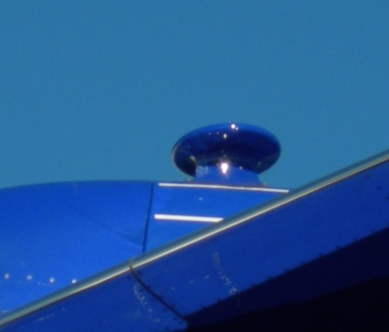
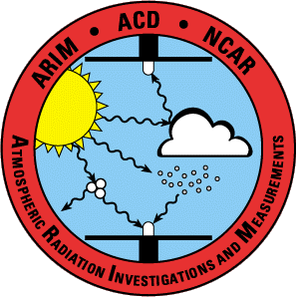
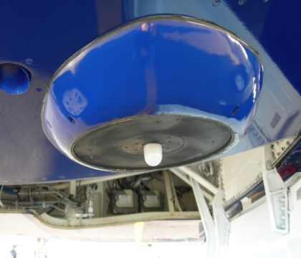
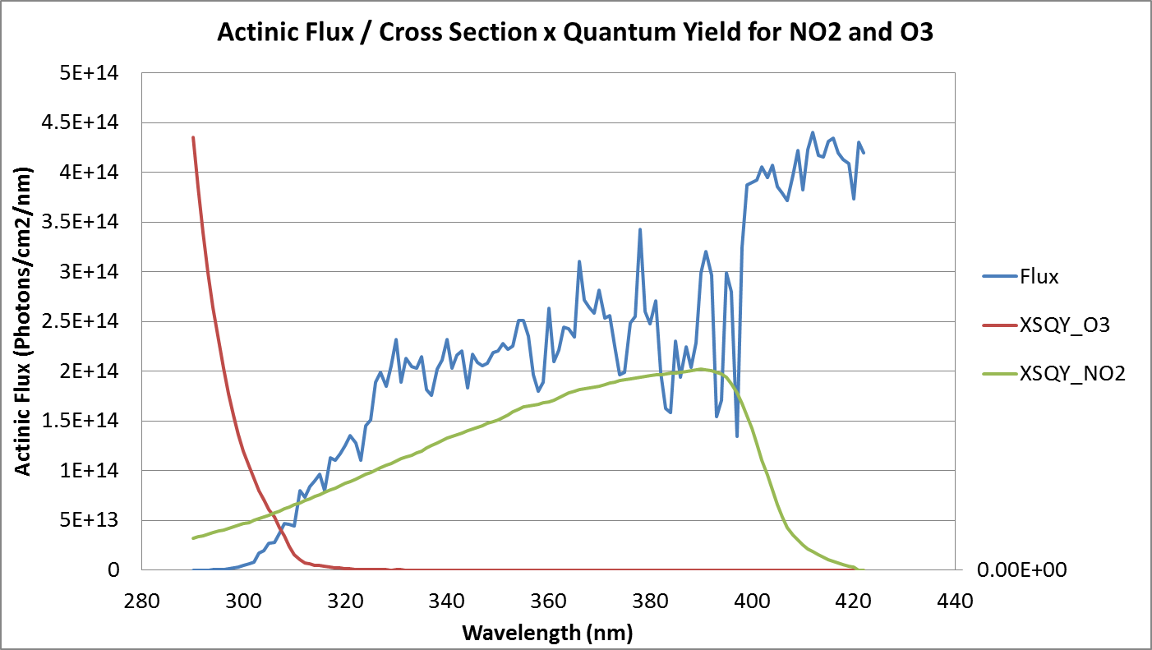
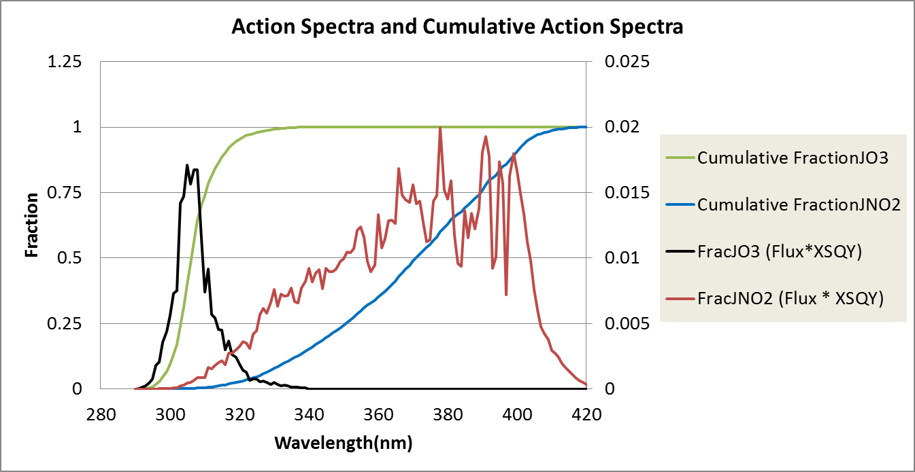
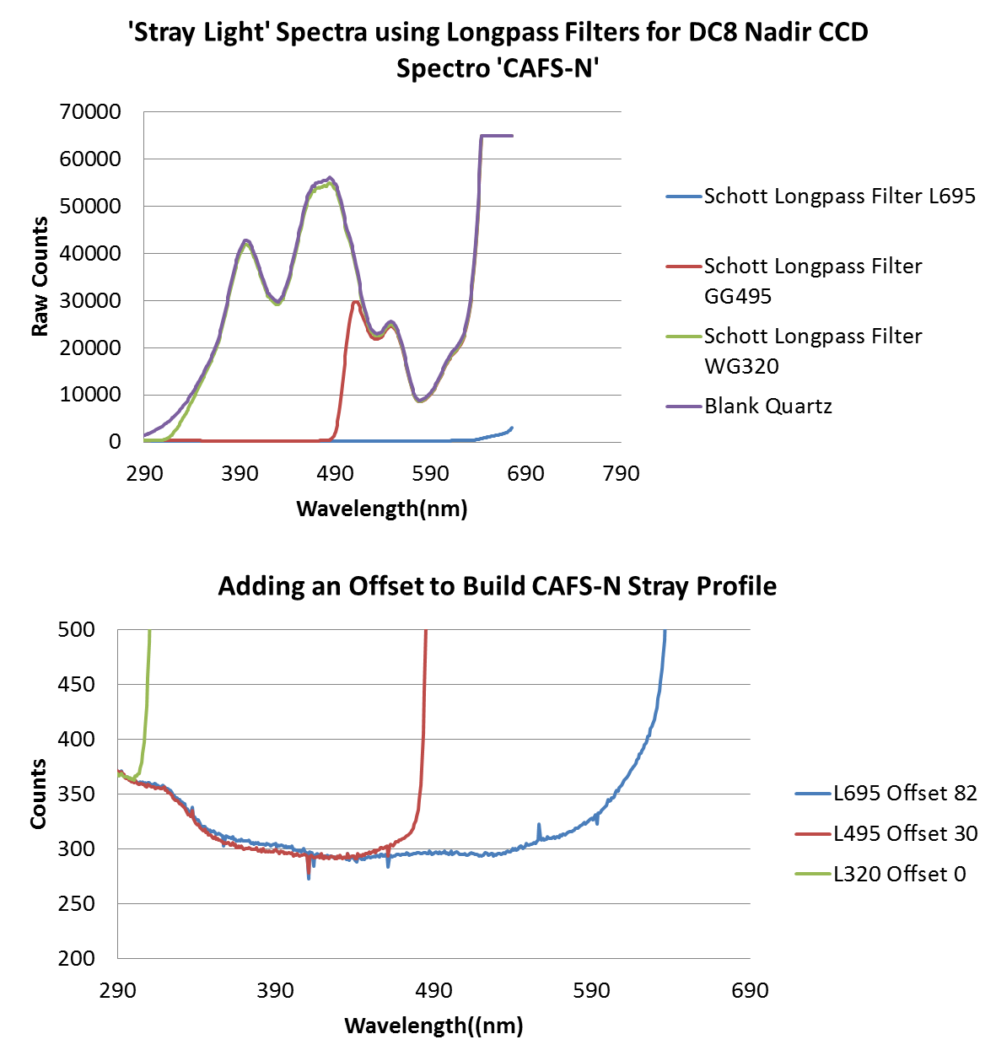
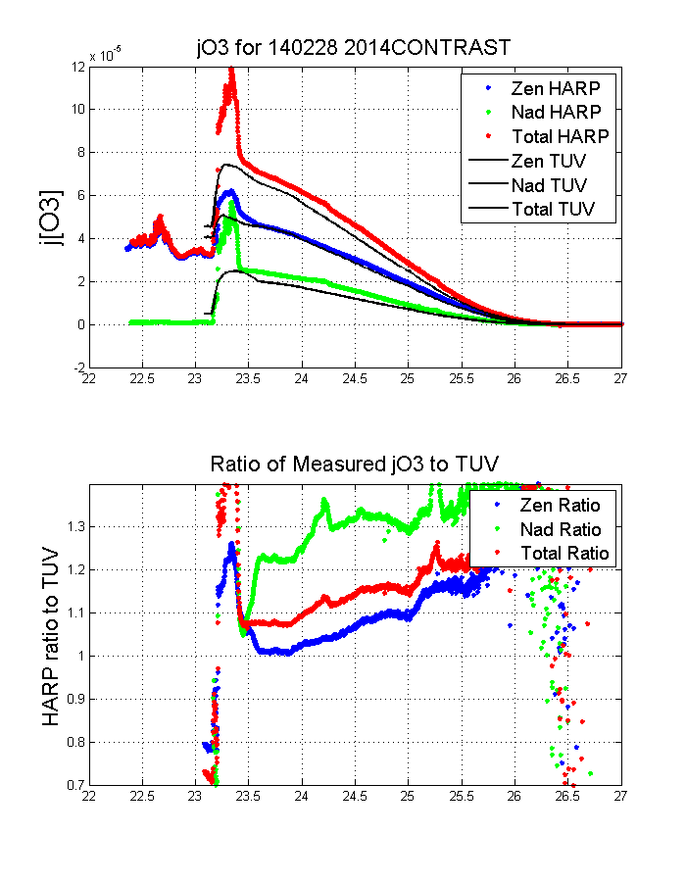
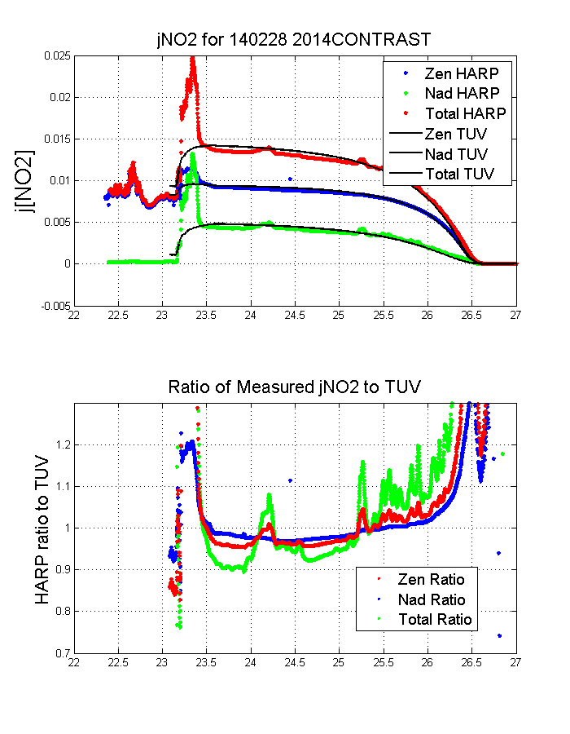
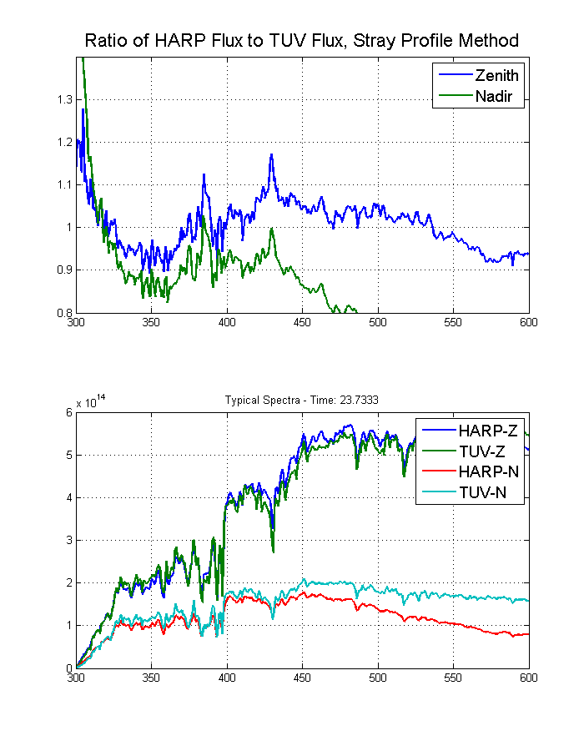
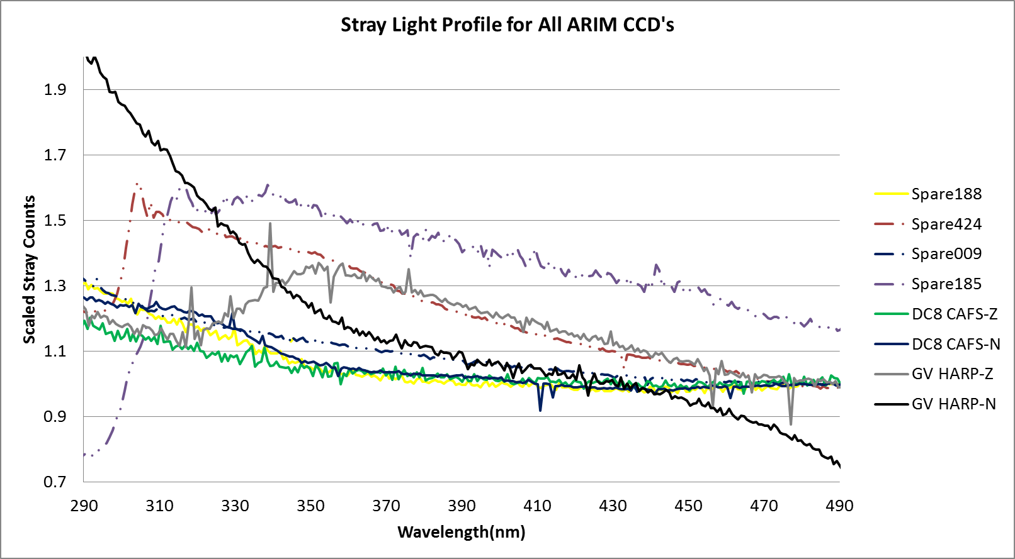
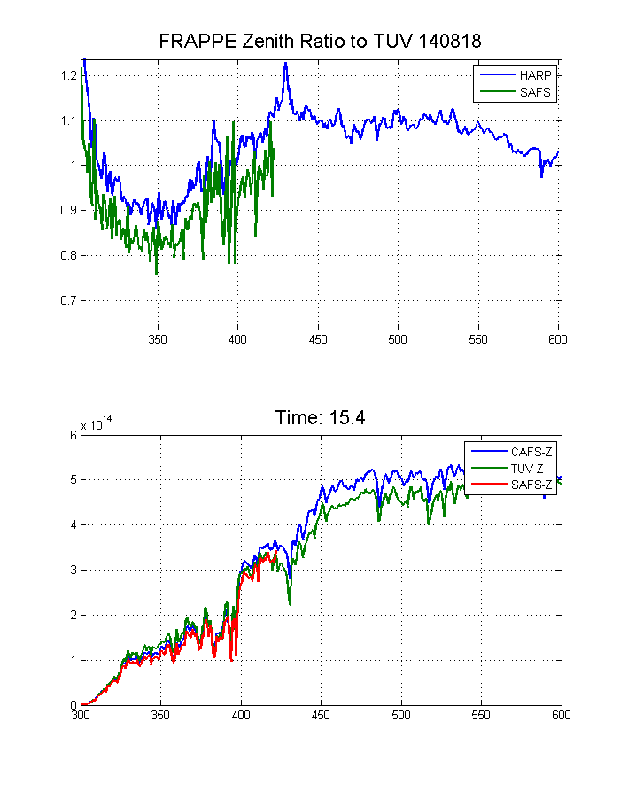
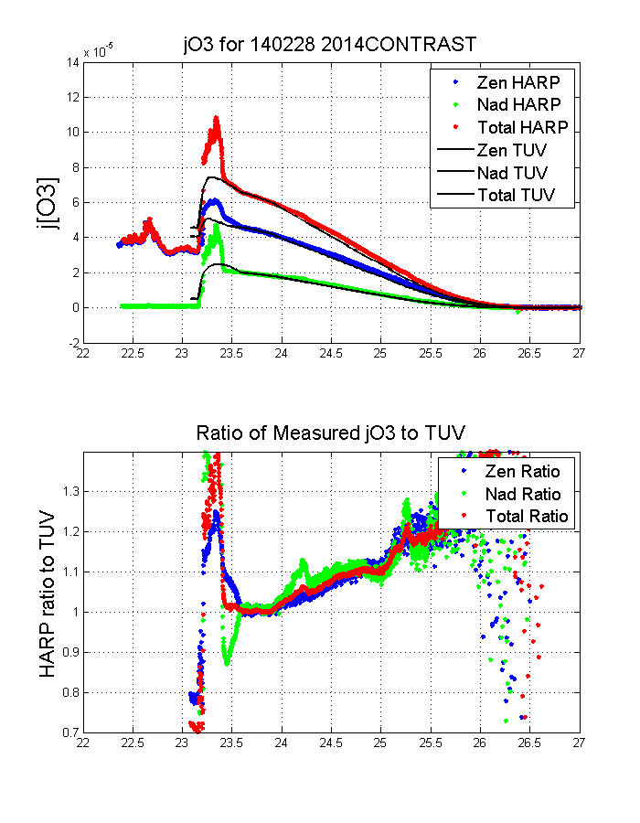
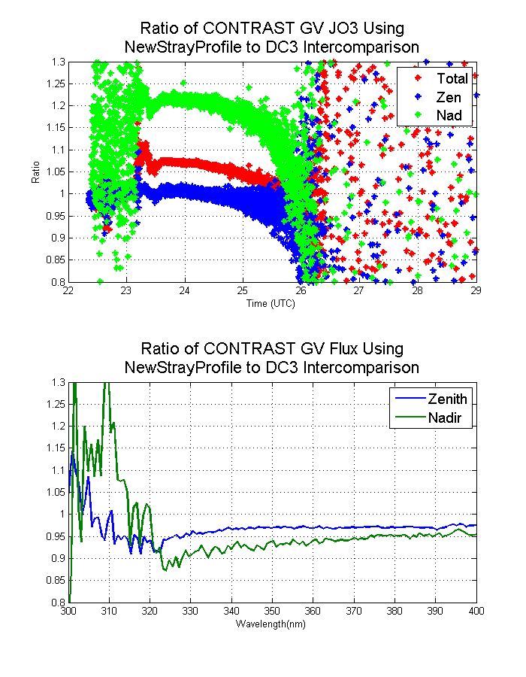
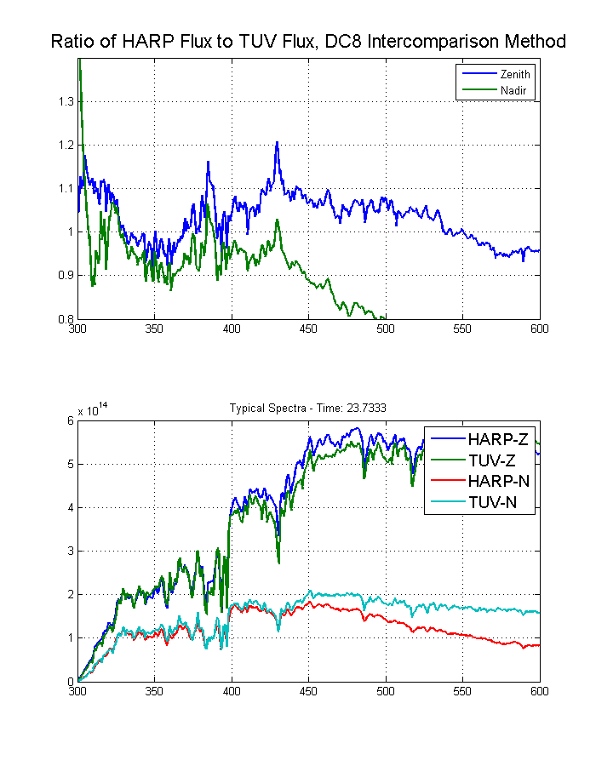
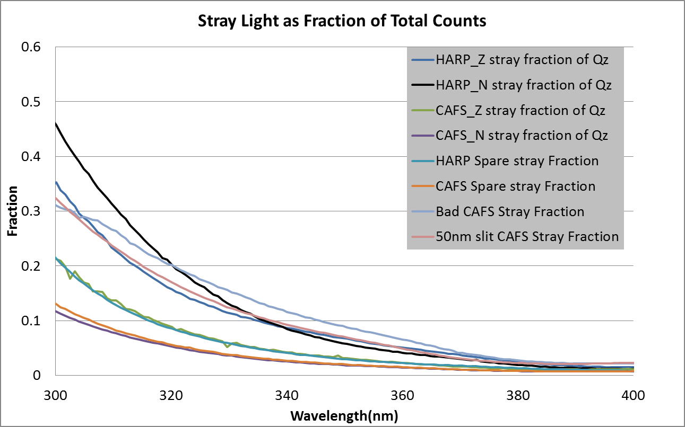
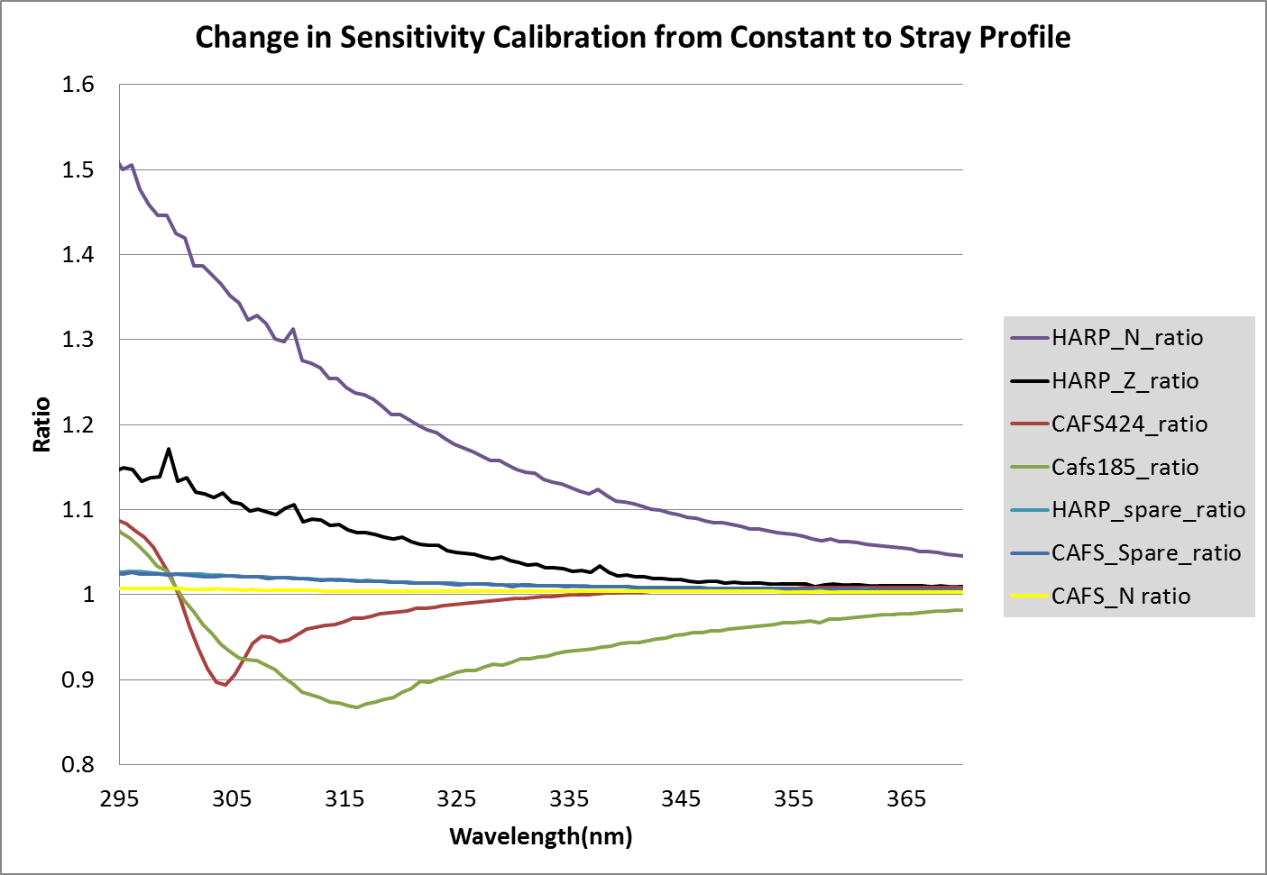
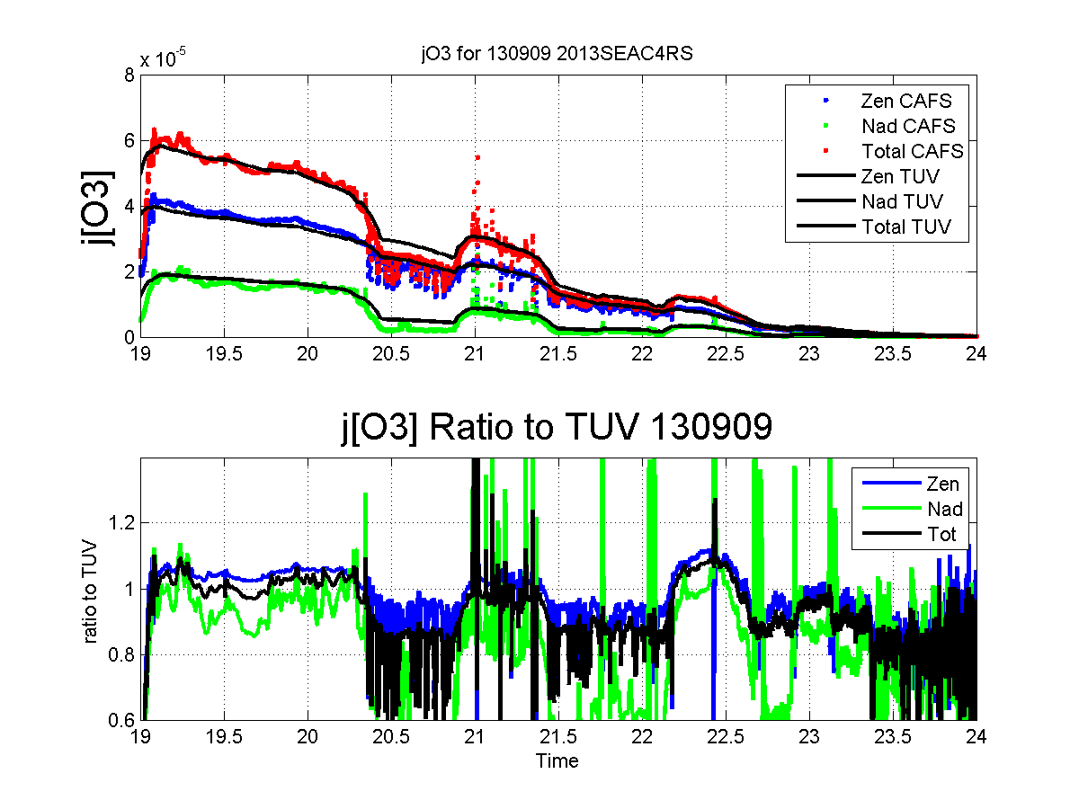
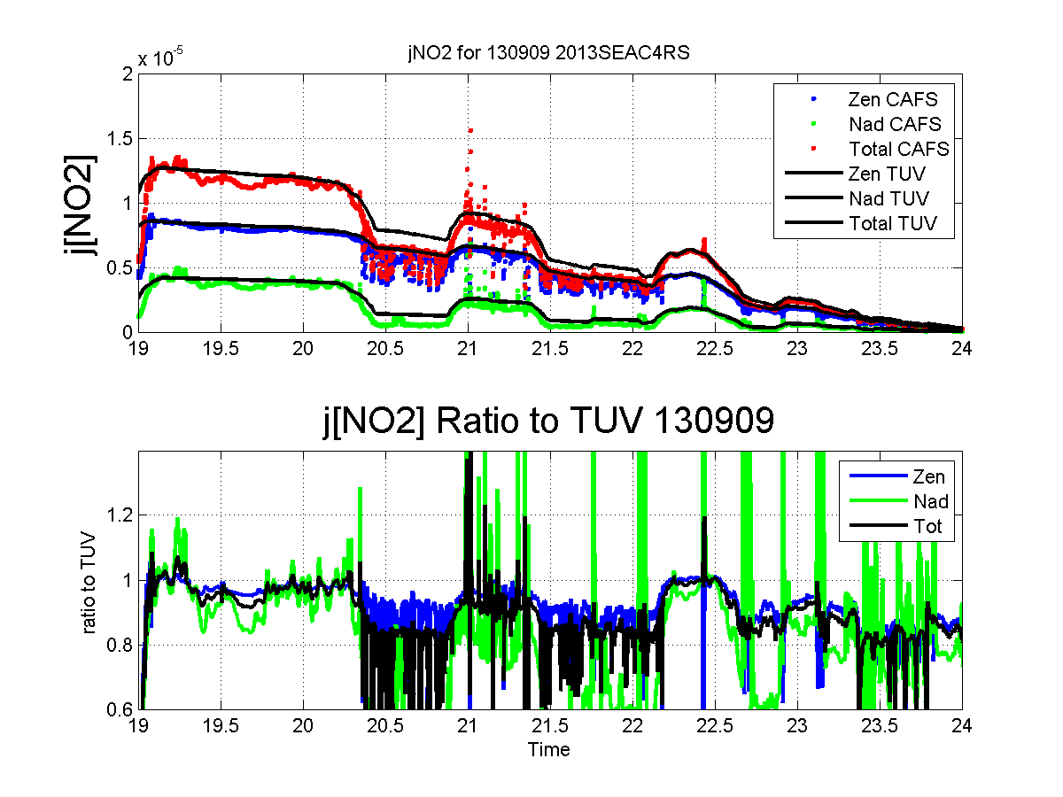
Characterterization of Stray Light Effects on Actinic
Flux Measurements And Calculated Ozone Photolysis
K. Ullmann, S. R. Hall, S. Madronich
National Center for Atmospheric Research (NCAR), Boulder, CO
Actinic Flux/Photolysis Frequency Measurement
Actinic Flux is an angular independent measure of light at a particular point in the atmosphere – this value is used to calculate the rate at which a molecule dissociates in a photochemical process. Two important atmospheric reactions are:
j [O₃ → O₂+O(¹D)]
j [NO₂ → NO+O(³P)]
The figures to the left show a sample spectrally resolved actinic flux density and the product of the cross section and quantum yield for these two reactions, and show the normalized contribution - in 1nm wavelength bins - of actinic flux at each wavelength. J[O3] is driven by UV-B photons in a region where the flux density is at least an order of magnitude less than in the visible range.
Our group deploys aircraft based instruments to measure actinic flux and uses a modified version of the NCAR TUV (Troposheric and UltraViolet Radiation Model) to calculate photolysis frequencies from the measured actinic flux.
These instruments consist of (2) external optical collectors designed to have little variance in the transmission across input angles and (2) spectrometers housed inside the aircraft. The zenith and nadir mounted collector measure downwelling and upwelling radiation separately.
The latest generation instruments (flown on the NASA DC8 as ‘CAFS’ since 2008 and on the NCAR/NSF GV as ‘HARP’ starting 2012) use a CCD-based spectrometer that use a single monochromater configuration to read 512 wavelengths simultaneously (ranging from ~280nm-650nm). But because of this configuration, and the small light levels in the UV-B range for calculating jO3, light pollution or stray light has the potential to affect calibrations and measurements in the UV-B range.
The 2007 paper by Jakel et al (A CCD Spectroradiometer for Ultraviolet Actinic Radiation Measurements, JOURNAL OF ATMOSPHERIC AND OCEANIC TECHNOLOGY, DOI: 10.1175/JTECH1979.1) describes a method using long wave pass filters for characterizing and correcting stray light during the calibration process for CCD based instruments. We have performed these test for all of our CCD spectrometers and see a large variance in the shape/slope of stray light in the UV-B region between instruments which lead to a large variance in the impact on jO3 measurements.
Abstract
Due to their configuration using a single monochromator, actinic flux detectors have issues with stray light affecting the calibration of UV-B spectra. This in turn affects the calculation of ozone photolysis frequencies. Stray light corrections to UV-B calibrations can vary widely between different units of the same model spectrometer. We will present flux and j-value comparisons with the NCAR TUV model during high altitude, clear sky flight legs during the SEAC4RS and DC3 campaigns to evaluate the impact of stray light corrections. Data from multiple intercomparisions between actinic flux instruments on the NCAR GV and NASA DC8 during DC3 will be used to demonstrate the validity and also the limitations of stray light corrections on jO3 calculations. CCD spectrometers for the NASA SEAC4RS mission were chosen to have the smallest UV-B stray light issues and impact on jO3.
Using comparisons of flight data to TUV to assess performance of our CCD instruments – CONTRAST RF18 2014-02-28 and SEAC4RS RF15 2013-09-09
Because these stray light corrections do not affect wavelengths used to calculate jNO2, if jNO2 matches TUV in clear sky, and a proper ozone column is used in the TUV model, looking at how well jO3 calculated from measured actinic flux matches jO3 calculated in TUV along the flight track is one way to assess the validity of the stray light corrections and how they affect CCD-instrument performance. Nadir data comparisons also require albedo as an input to TUV, which is often quickly varying. For the SEAC4RS DC8 CAFS instruments (also used on DC3 and ARCTAS), the stray light corrections are nominal, and we find good agreement with TUV for jO3. CONTRAST RF18 provides a great data set for comparison to TUV due to its long distance in very clear skies over ocean and a variety of solar zenith angles as it flew past sunset. For the GV based HARP instruments, the zenith instrument show agreement between TUV and separately calculated corrections: one from the in lab stray light calibration corrections described in the Jakel paper, another via a wavelength by wavelength flux correction via multiple intercomparisons to the DC8 CAFS in DC3. The GV HARP nadir instrument has a much larger stray light correction, and the stray light calibration corrected UV-B spectra and jO3 do not match either TUV (20-30% difference) or data corrected using the DC3 intercomparison. The calibration correction due to stray light does not always ensure a properly calibrated/functioning instrument.
GV HARP data from CONTRAST using calibrations corrected for stray light, Compared to clear sky TUV model with OMI O3 and 0.10 albedo
CCD-based compared to Scanning Monochromater measuremnts (SAFS)
Below is a preliminary comparison from FRAPPE where we flew both HARP Zenith (CCD based) and an older retired scanning double monochromator instrument (SAFS) with superior stray light rejection. While the overall calibration difference is not nominal (still a preliminary calibration on SAFS at this point), the shape of the flux and its relation to TUV show similarities to HARP Zen as well. Are the differences with TUV from an incorrect O3 column or other parameters?
Head/angular response changes with wavelength artifacts?
The calibration process, either in the NIST traceable lamps or our lab setup?
GV HARP data using sensitivity derived from DC3 comparison to DC8 CAFS, clear sky TUV model using OMI O3 and 0.10 albedo
Assessing/Characterizing CCD Spectrometer Peformance
During the 2012 TORERO and DC3 flight campaigns, we saw significant disagreement between our measured jO3 (increased UV-B actinic flux) from HARP and the modeled clear sky TUV actinic flux for our flight track. To correct for this, we used multiple in flight side by side intercomparisons between the DC8 CAFS instruments and GV HARP instruments to re-scale the HARP actinic flux values in the UV-B. Improved GV j-values were calculated and were in better agreement with TUV (for simplicity, applicable in clear sky only) and the DC8 values.
After CONTRAST, we performed extensive calibration/stray light testing on all the CCD spectrometers. A wavelength dependent stray light profile is built using multiple long pass colored glass filters to allow visible to pass while blocking UV. While the shape varies greatly across the different CCD’s, the tests show stray light predominately comes from the visible region beyond 400 nm (we also use a UG5 colored glass filter in the head to block visible light, but it does not block past 650nm).
The figure to the left show two different ways of characterizing the stray light contribution/correction to our calibrations. By both measures, the HARP instruments perform much worse in UV-B stray light than the CAFS instruments. The DC8 CAFS nadir instrument has only a 1% flux difference (@ 300nm) between using a constant and wavelength defendant stray profile. Due to the shape of the O3 cross section, stray light has a quickly decreasing effect on the jO3 measurments at wavelengths past 310nm.
130909 SEAC4RS DC8 CAFS, clear sky TUV model using OMI O3 and 0.10 albedo
Conclusions
While in lab stray light testing is essential to proper calibrations and can help characterize and assess the UV-B characteristics of a given CCD spectrometer, only side by side tests using outdoor solar flux can verify the performance of a given spectrometer. Comparisons of TUV model runs and higher altitudes, clear sky actinic flux date also provide useful in verifying a single instrument’s performance. In one case (HARP-Z), stray light calibration corrections yields jO3 value that are comparable to TUV model runs and cpmparisons to the DC8 instruments. In another case (HARP-N), the stray light calibration corrections are insufficient.
Future Tests
We are considering running various instruments (CCD, diode array, filter radiometers, SAFS) side by side in a similar fashion (but smaller, in house on roof) to the IPMMI intercomparison in 1998, possibly an instrument configuration that would allow for stray/longpass filter tests with solar spectra instead of calibration spectra. We are also looking into a more UV centered calibration lamp which would help with both spectral cals and stray light and angular response cals of our optical heads in the UV-B.
Approximate jO3 change due to corrected calibration:
CAFS-N: 1.0% (DC8) Spare242: 7.5% (TC4)
CAFS-Z: 1.4% (DC8) HARP-Z: 8% (GV)
Spare185: 4% (TC4) HARP-N: 15% (GV)
Acknowledgements: NCAR is operated by the University Corporation for Atmospheric Research under the sponsorship of the National Science Foundation (NSF). SEAC4RS research was funded by NASA under award No. NNX12AB82G S01. GV/HARP research funded NSF-NCAR funds.

