Slide 1
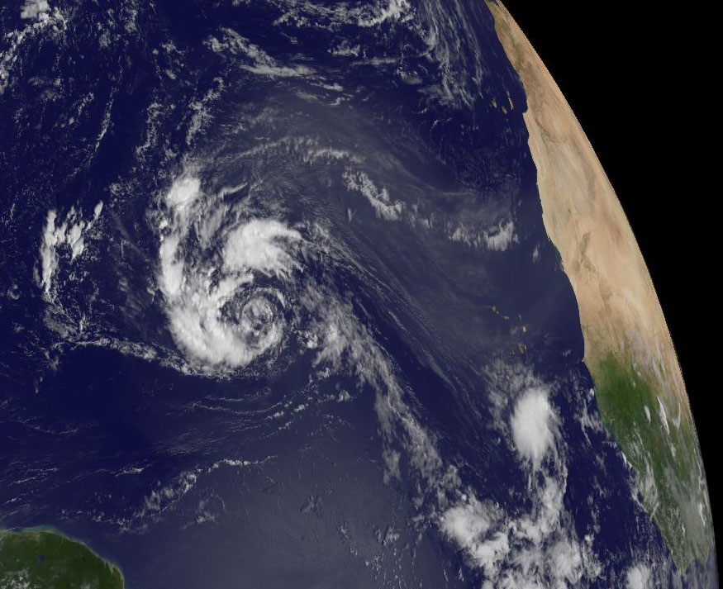
Factors that influence the probability of tropical cyclogenesis associated with AEWs
Chris Thorncroft and Alan Brammer
Department of Atmospheric and Environmental Sciences,
University at Albany
Chris Thorncroft and Alan Brammer
Department of Atmospheric and Environmental Sciences
University at Albany
Acknowledgement: NASA HS3 (AGS1321568)

Slide 2
Overview
Statistical Analysis of Developing and Non-Developing favorable waves
Overview of 2012 AEWs (including Analysis and Modeling of Nadine)
Overview of 2013 AEWs (including preliminary analysis of non-developing AEW – SAL flight August 24th )
Final Comments

Slide 3
1. Statistical Analysis of Developing and Non-Developing favorable waves

Slide 4

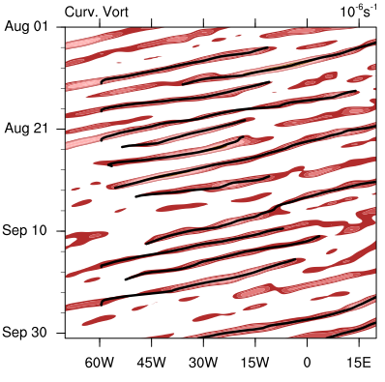

1. Statistical Analysis of Developing and Non-Developing waves
AEW tracking based on CFSR analyses (1979-2012)
Curvature Vorticity
Averaged 5:15N
Filtered
2-10 days
Extract continuous features that cross the coastline

Slide 5
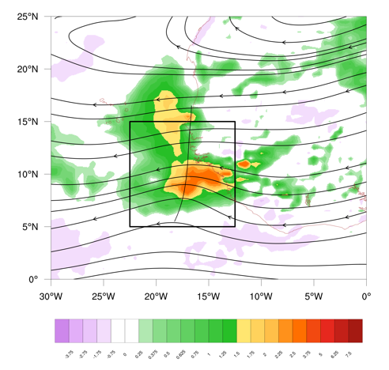
Coastal Characteristics
Characteristics were taken of waves over the coastal region
Areal averages were taken over a 10° x10° box;
this was varied and didn't impact the results significantly.

Slide 6
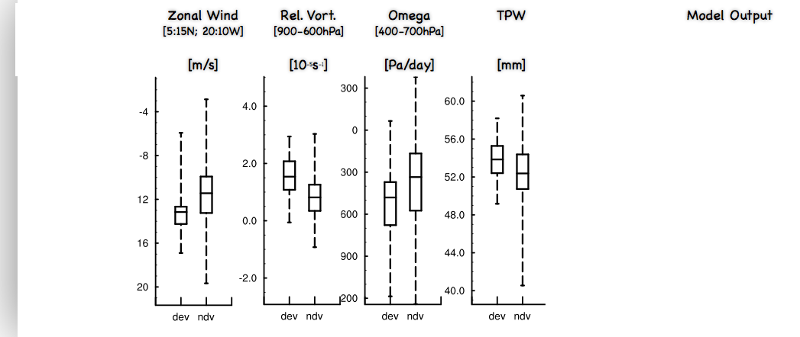
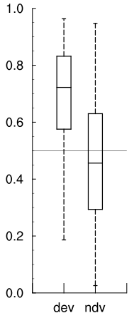
AEW Genesis Diagnostic

Slide 7
Logistic Regression Model
Combine variables through a logistic regression model to calculate a probability for development downstream.

Slide 8
AEW Genesis Diagnostic

Slide 9
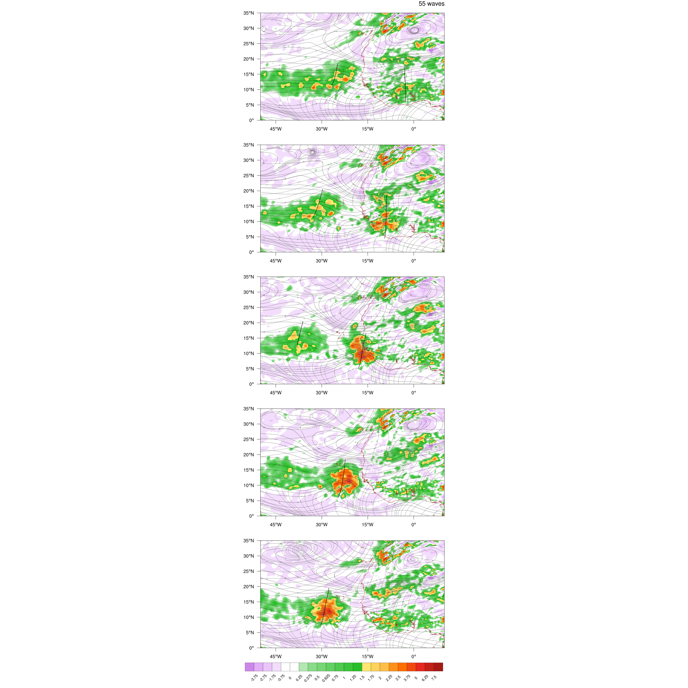
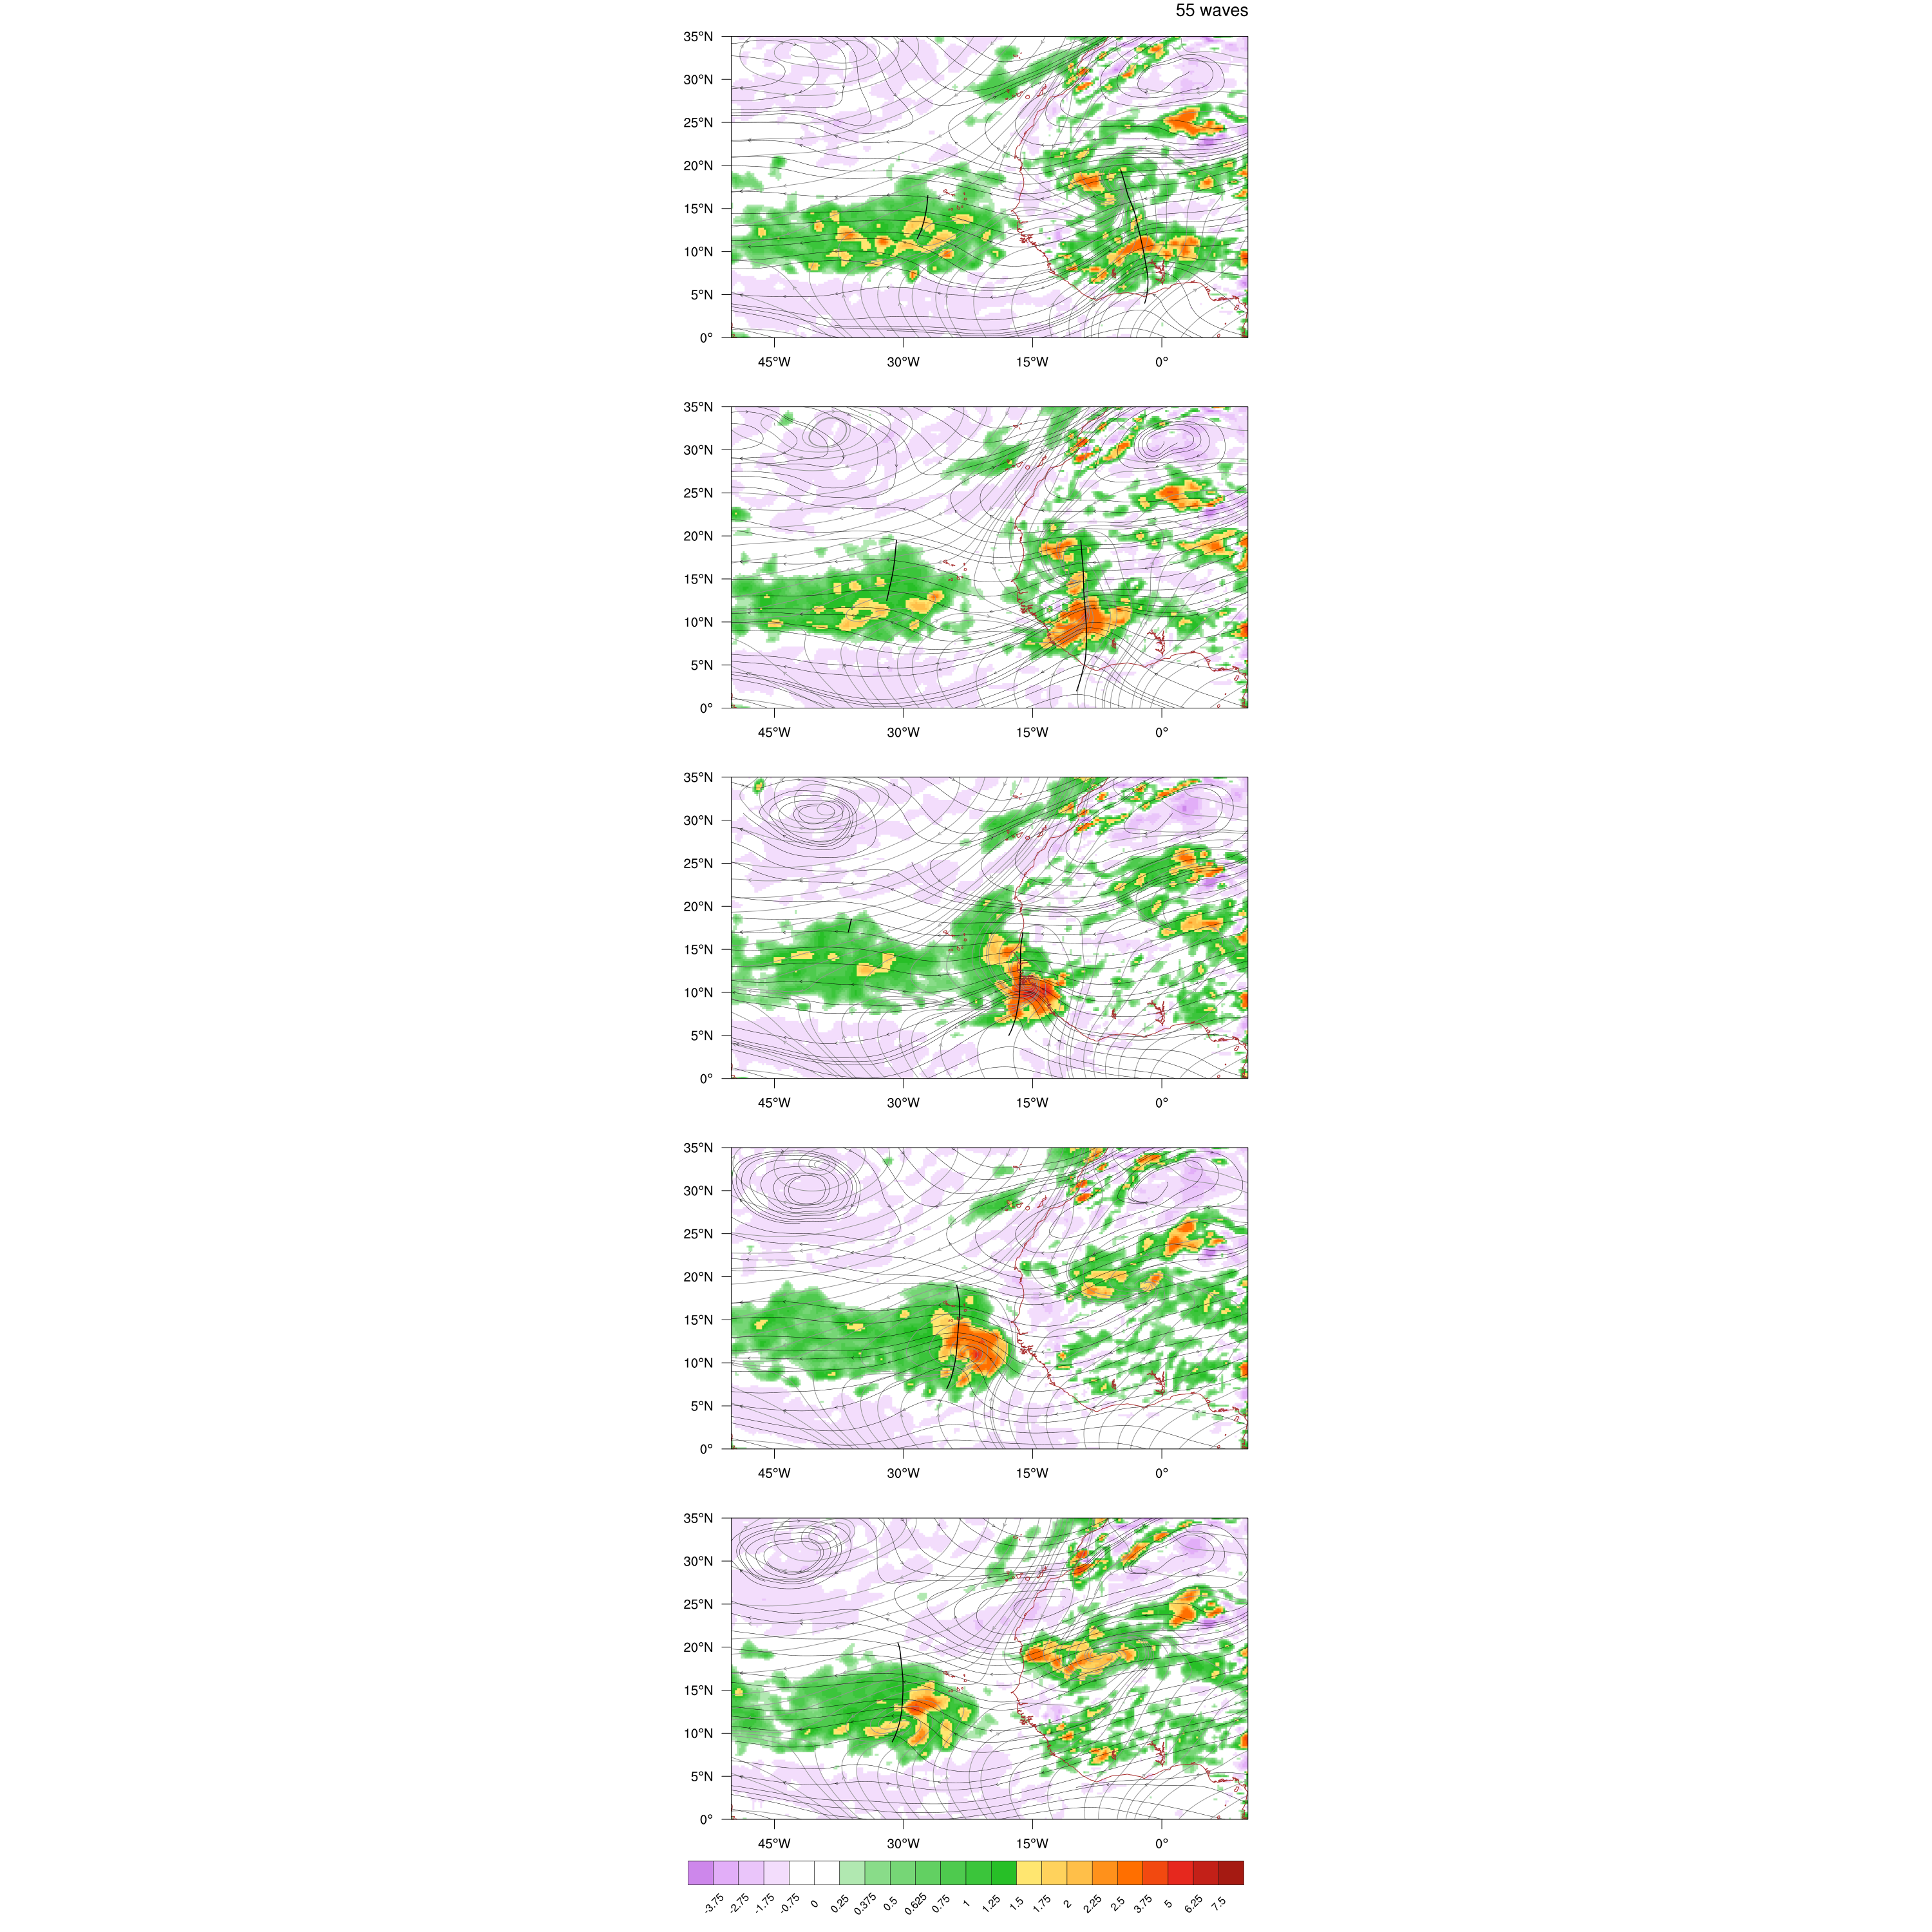
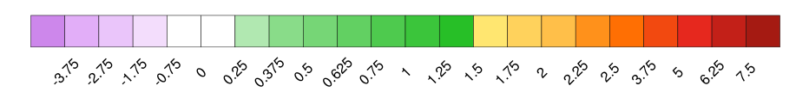
Developers
Non-Developers
Day -2
850hPa Rel. Vort.
[10⁻⁵s⁻¹]
925hPa Streamlines (Grey)
700hPa Streamlines (Black)
Objective Mean Trough Locations
(Thick Black Contours)
Day -1
Day 0
￼

Slide 10
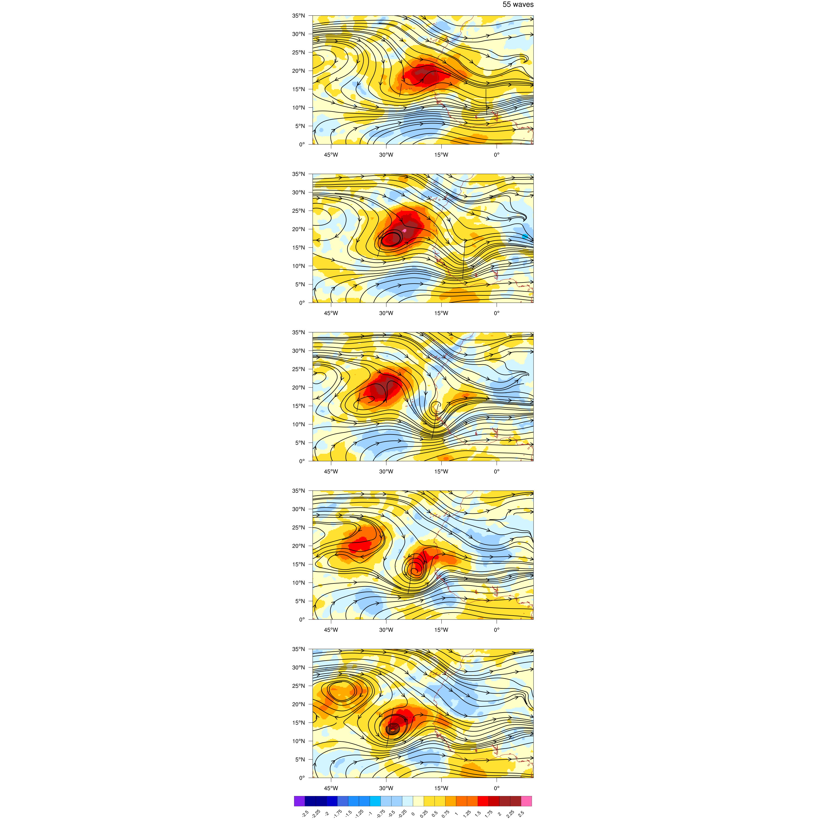
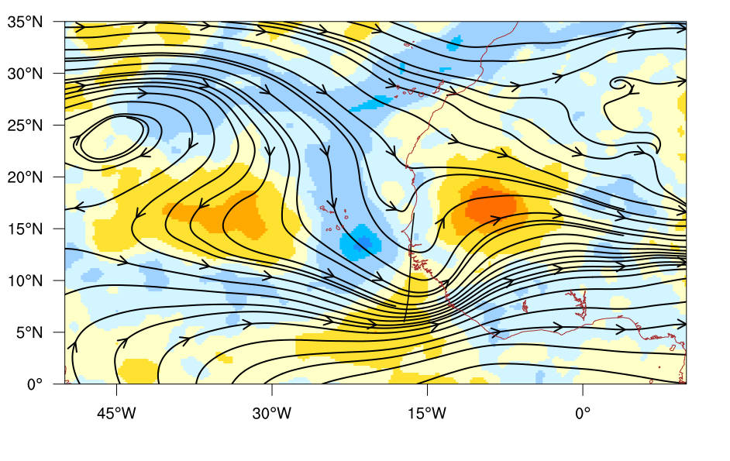
Day 0
Developing Non-developing
850hPa Rel. Vort
850hPa q [g/kg]
Wave Relative flow
Day 2

Slide 11
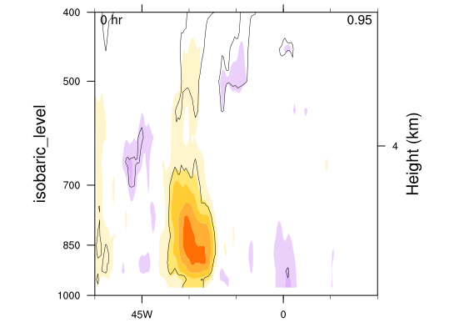
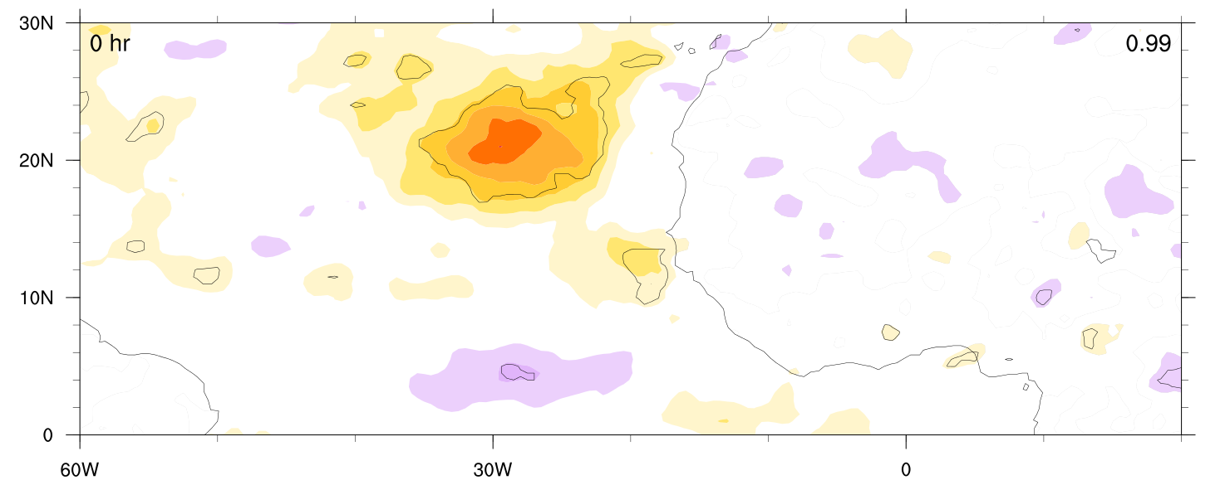
Vertical structure of moisture anomaly

Slide 12
2. Overview of 2012 AEWs

Slide 13
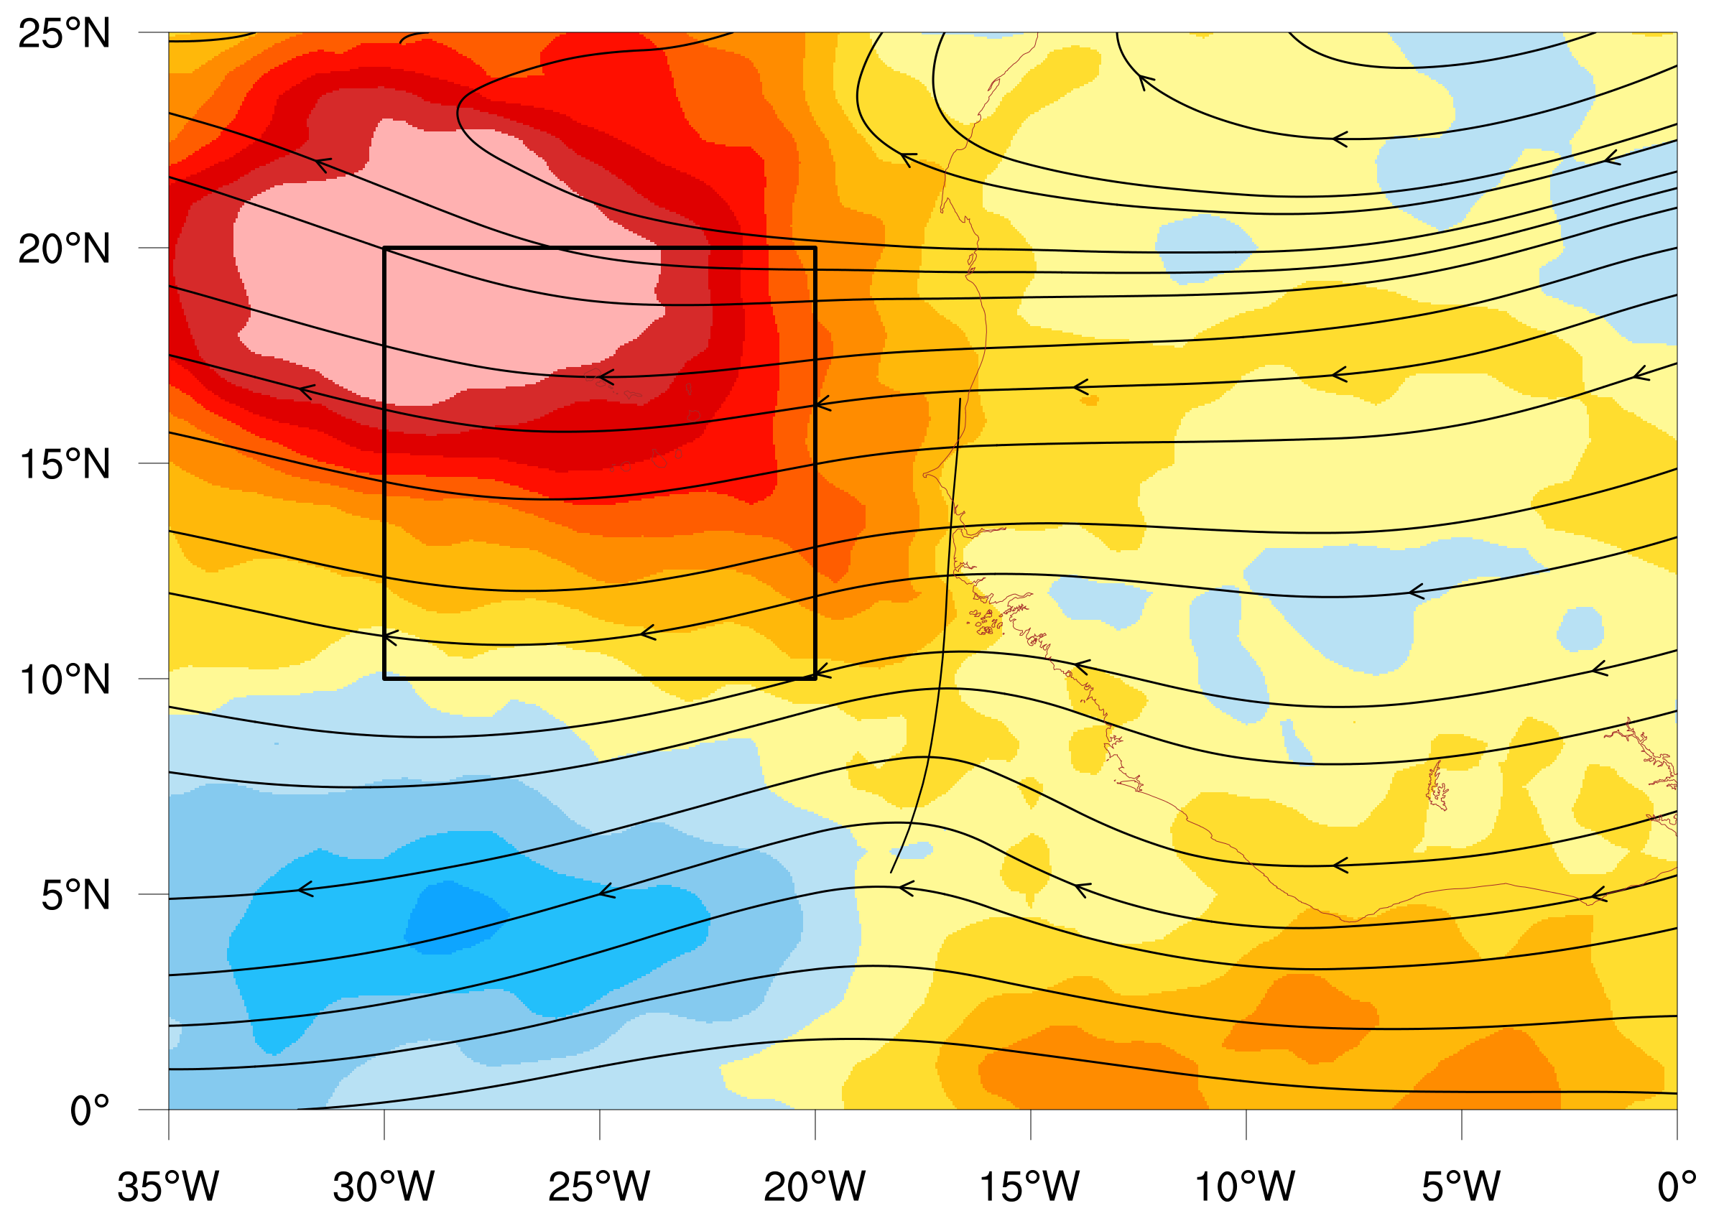
Characterising AEWS
Trough Scale
Environment
EA- Precipitable Water
PW - Precipitable Water
W - Vertical Velocity (700-400hPa)
RV - Relative Vorticity (900-600hPa)

Slide 14
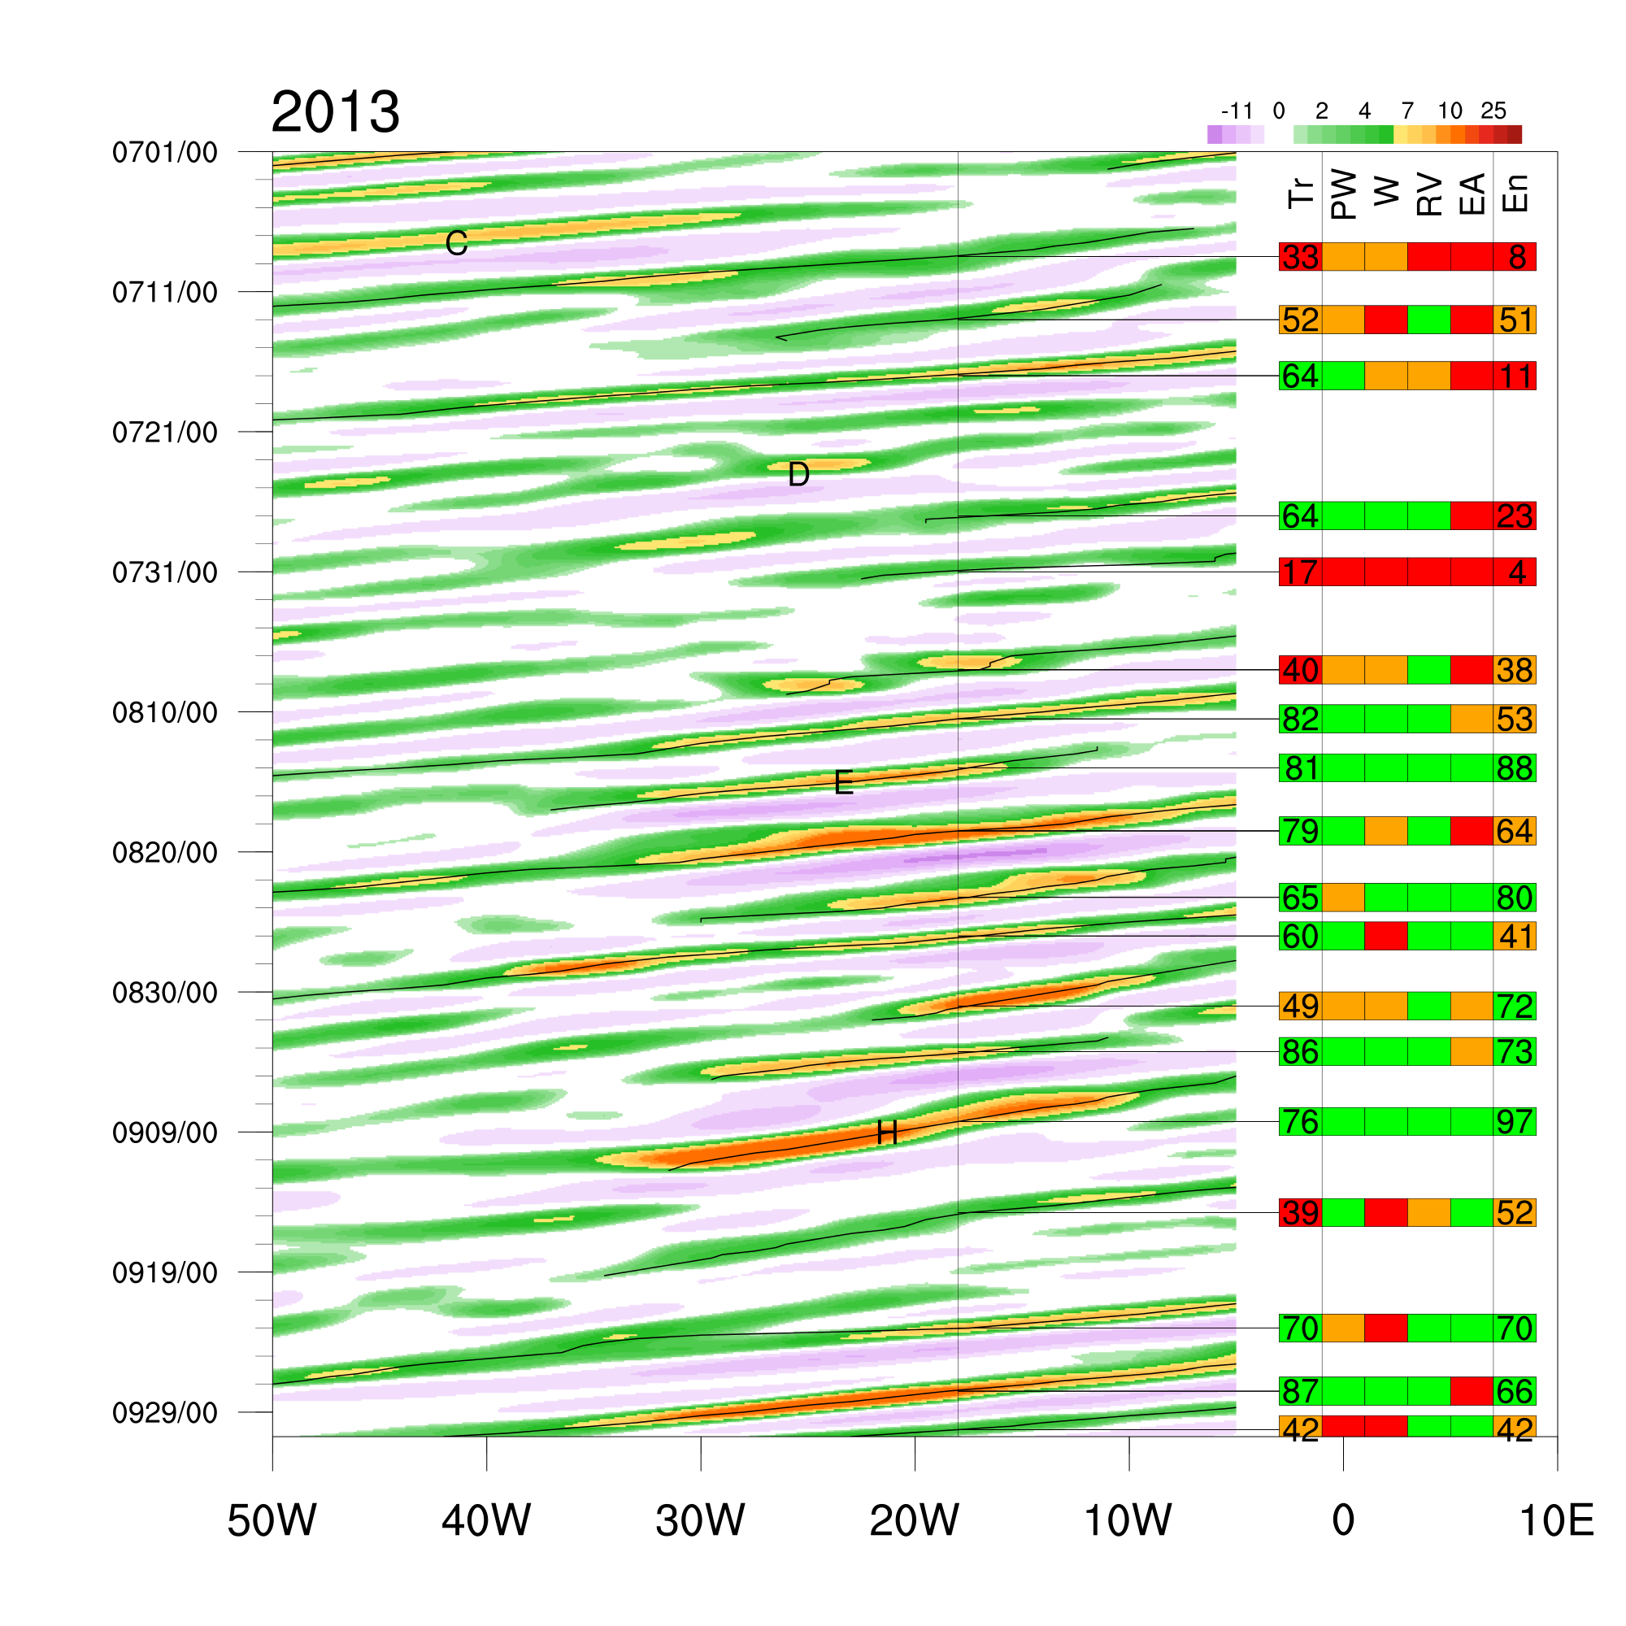
Characterising AEWS
Favourable characteristic based on wave climatology
CFSR 1979-2012
Top 33%
Mid 33%
Bottom 33%
Wave 1
Wave 2
Wave 3
PW
W
RV
EA
PW - Precipitable Water
W - Vertical Velocity (700-400hPa)
RV - Relative Vorticity (900-600hPa)
EA - Eastern Atlantic Precipitable Water

Slide 15
Characterising AEWS
Based on Wave climatology
Top 33%
Mid 33%
Bottom 33%
Trough scale diagnostic
PW
W
RV
EA
Trough + Environmental Diagnostic

Slide 16
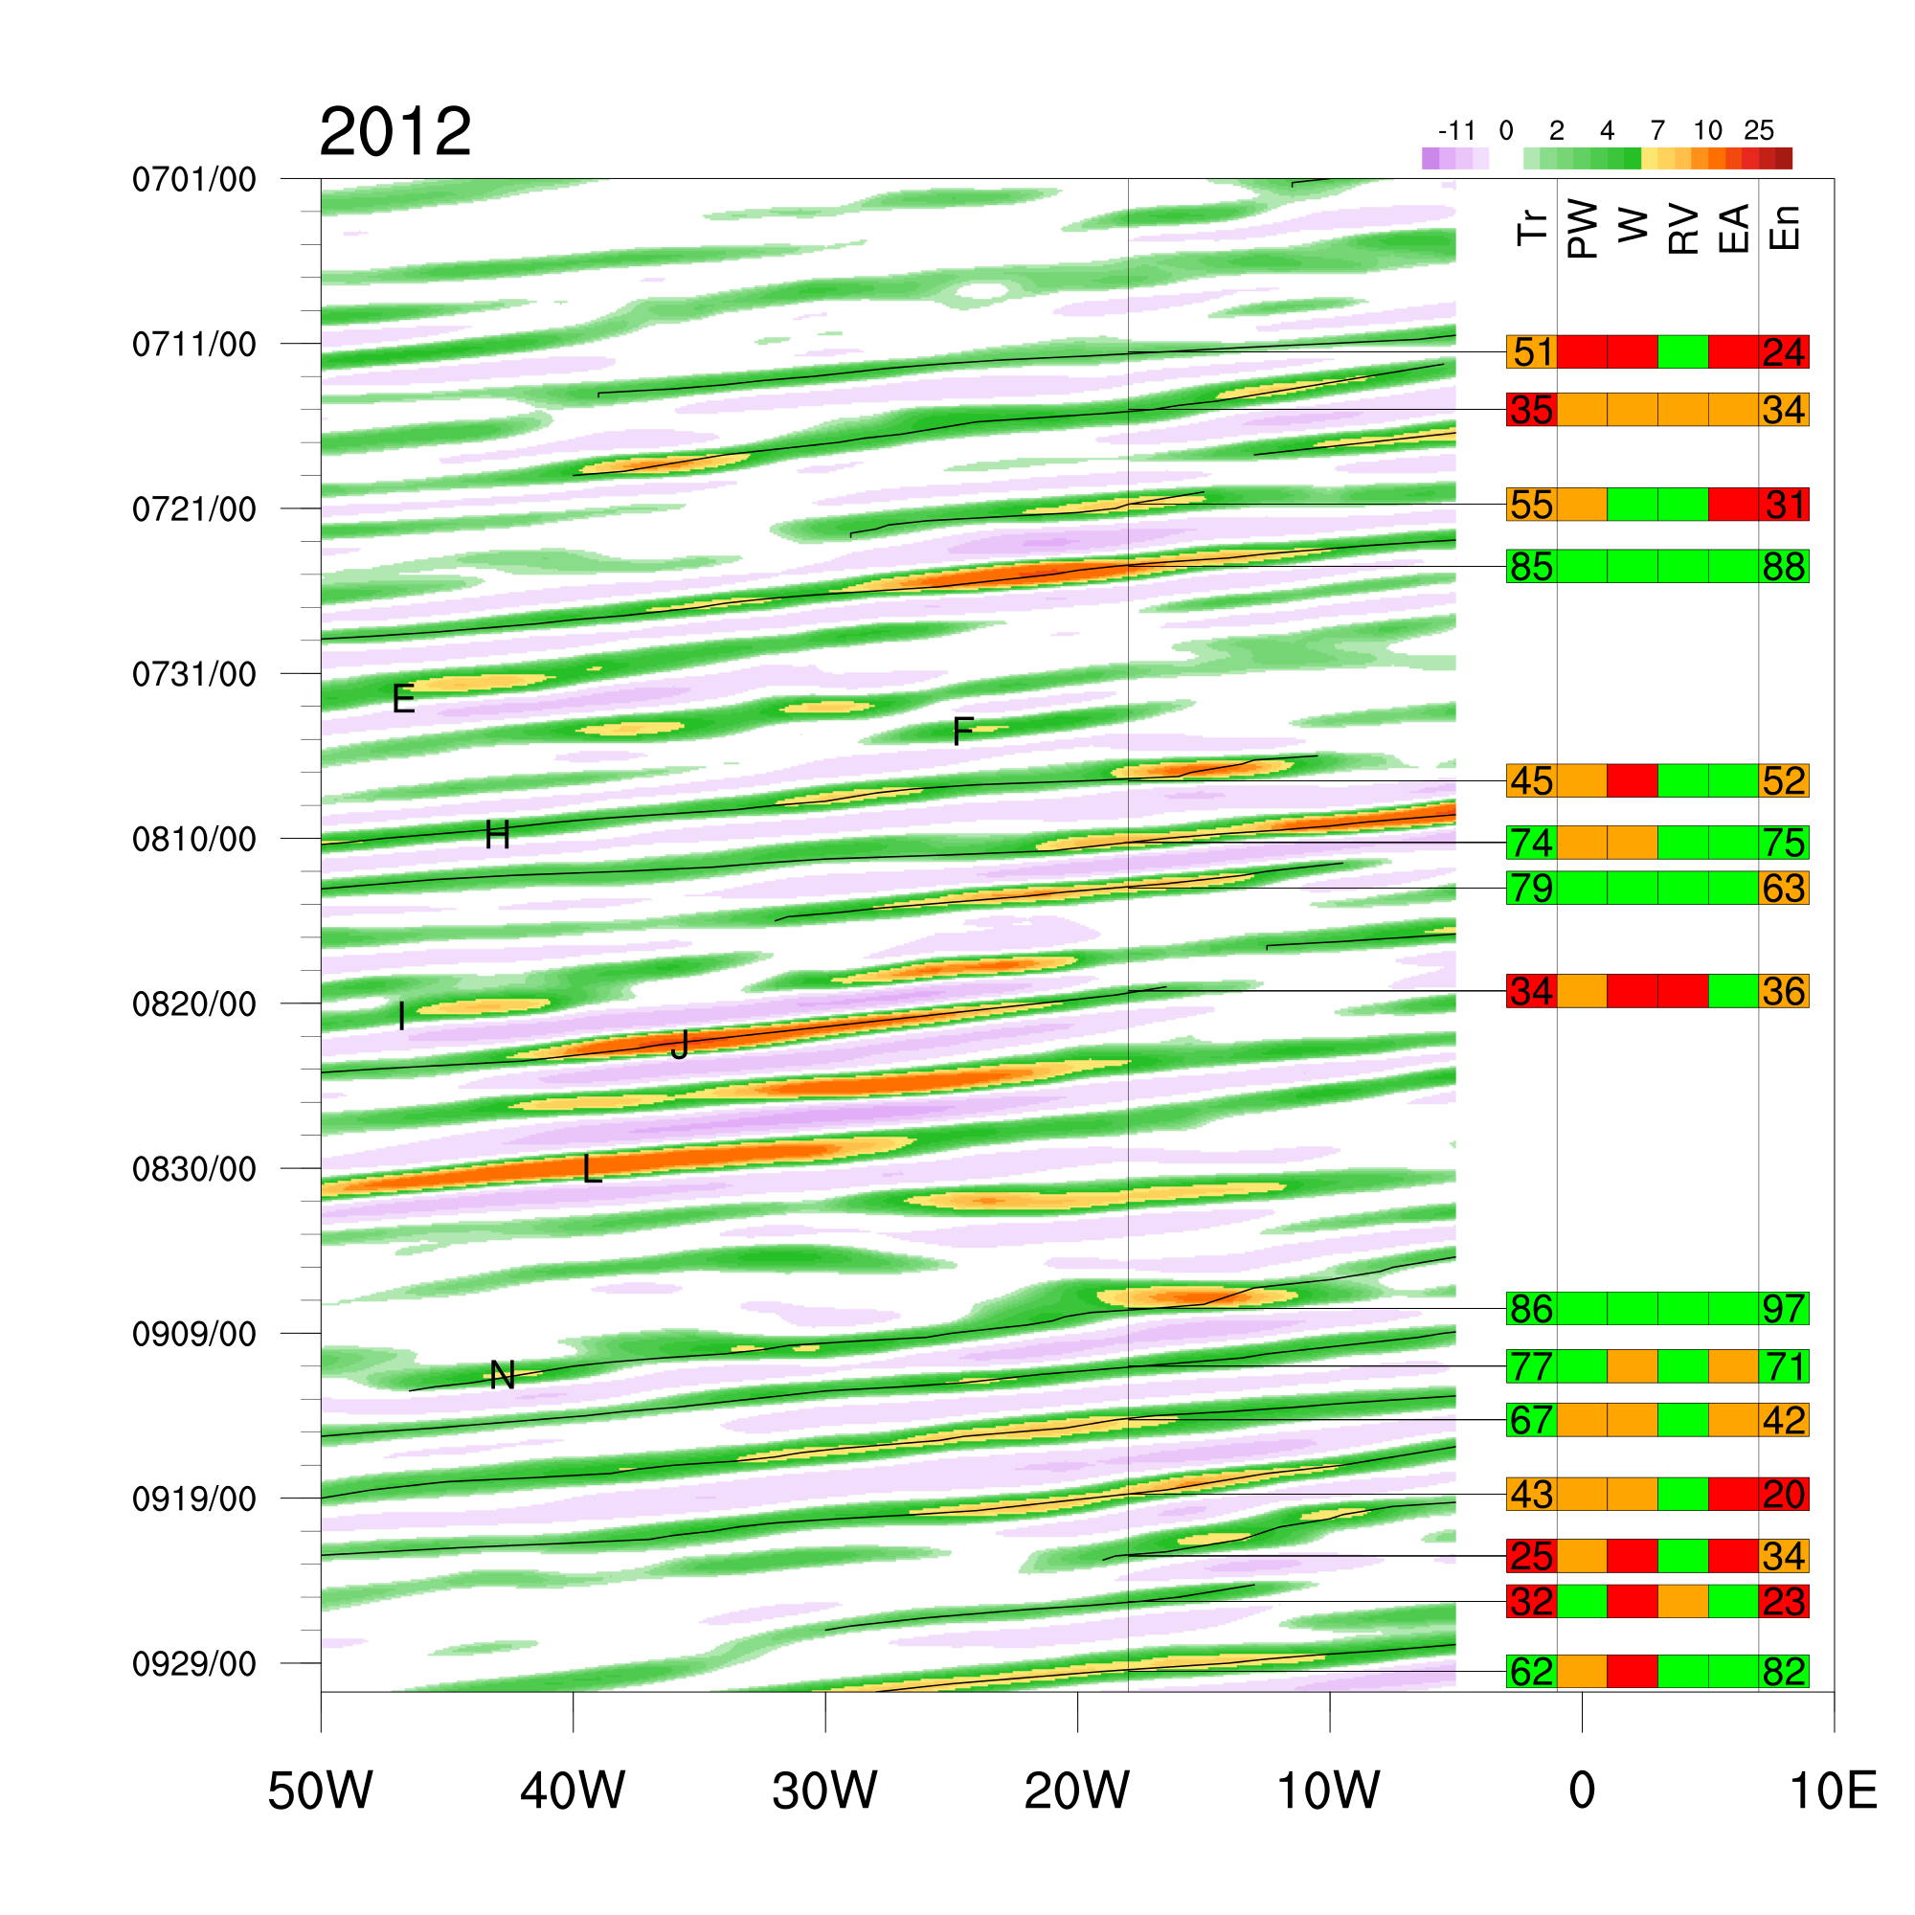
Variability of AEWs 2012
Curvature vorticity 700mb
Wave characteristics vary a lot during the season.

Slide 17
Variability of AEWs 2012
Curvature vorticity 700mb
Wave characteristics vary a lot during the season.
Very Unfavorable Waves

Slide 18
Variability of AEWs 2012
Curvature vorticity 700mb
Wave characteristics vary a lot during the season.
Very Favorable Waves

Slide 19
Variability of AEWs 2012
Curvature vorticity 700mb
Wave characteristics vary a lot during the season.
Unfavorable developing
wave –moving into favorable phase of MJO

Slide 20
Variability of AEWs 2012
Curvature vorticity 700mb
Wave characteristics vary a lot during the season.
Will compare these two now

Slide 21
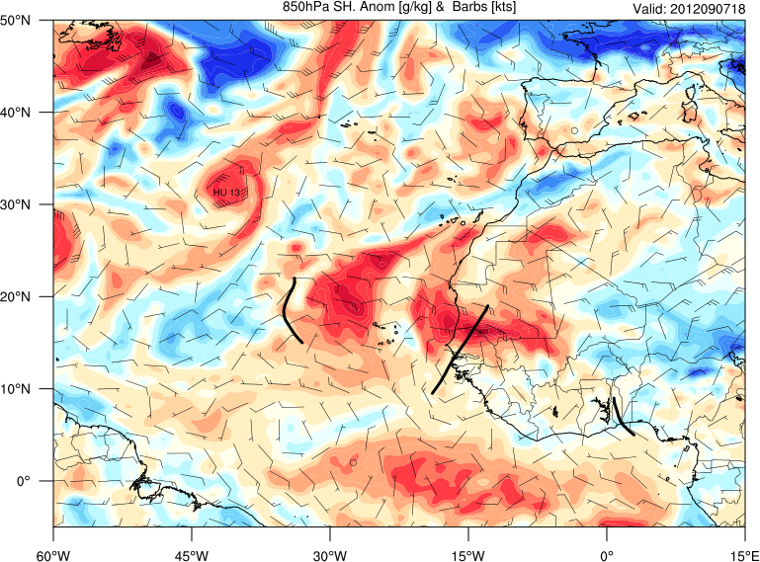
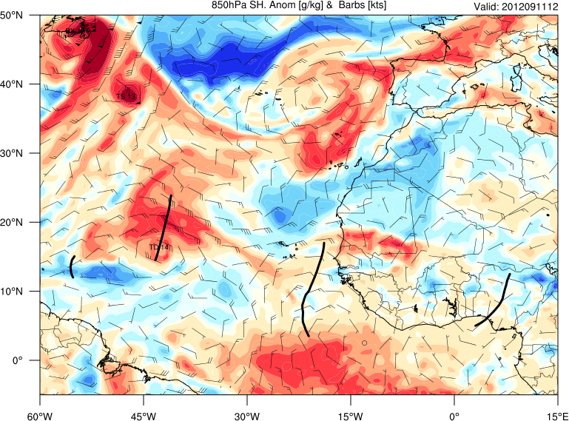
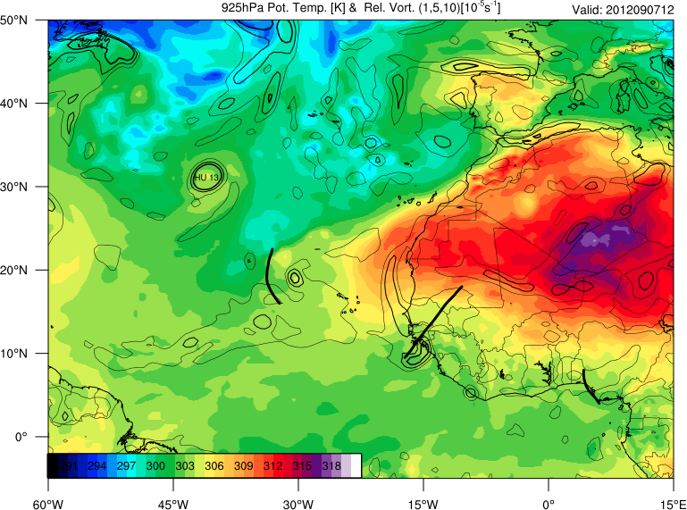
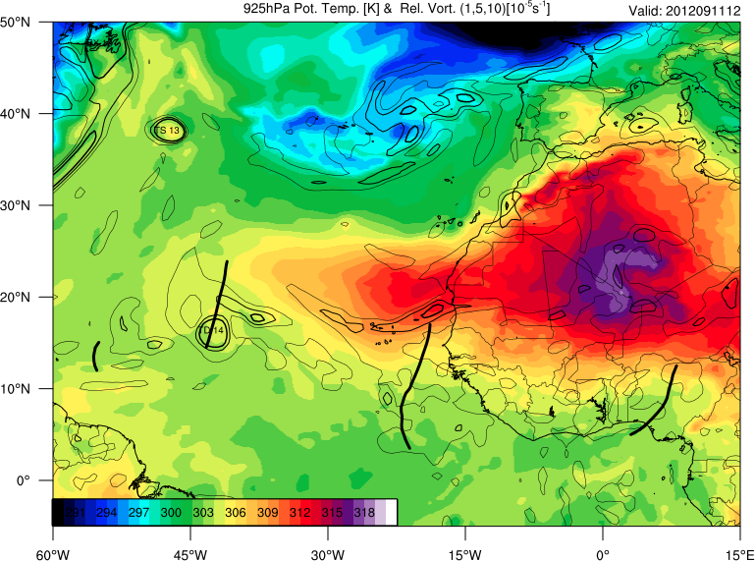
Nadine 9/7/12 18Z Non-developing AEW9/11/12 12Z
q anomaly 850mb
q anomaly 850mb
T 850mb
T 850mb

Slide 22
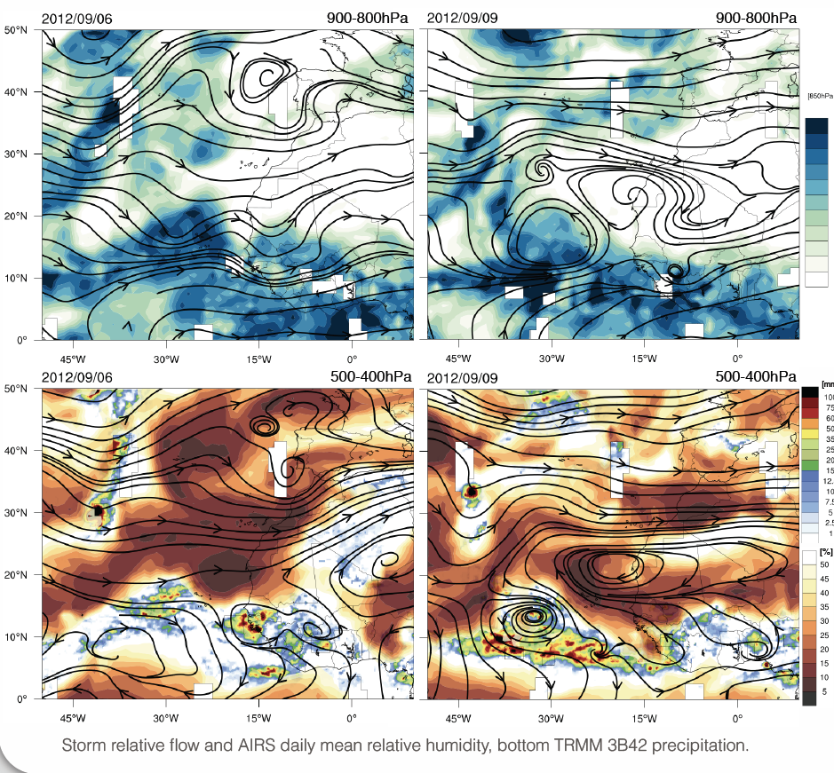

Slide 23
WRF Simulation of Nadine AEW
WRF v3.5
3km horizontal grid length
51 vertical levels
Initialised at 00Z 6th August
Trajectories based on 5 minute winds

Slide 24
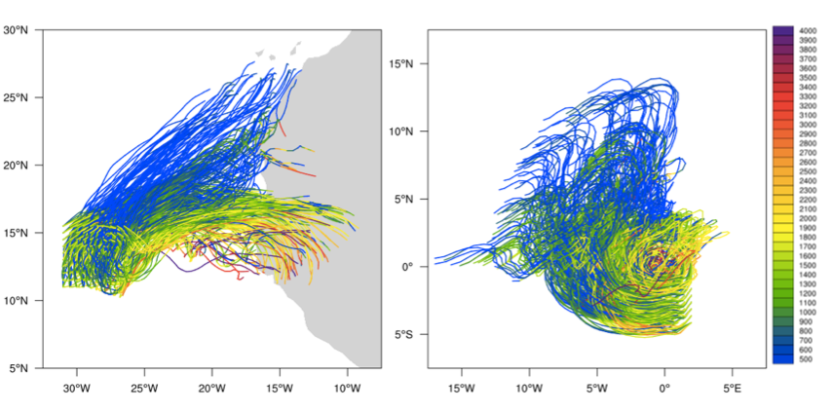
Nadine Trajectories
Trajectories initialised around vortex
~1000-1750 m.a.s.l
Trough relative trajectories

Slide 25
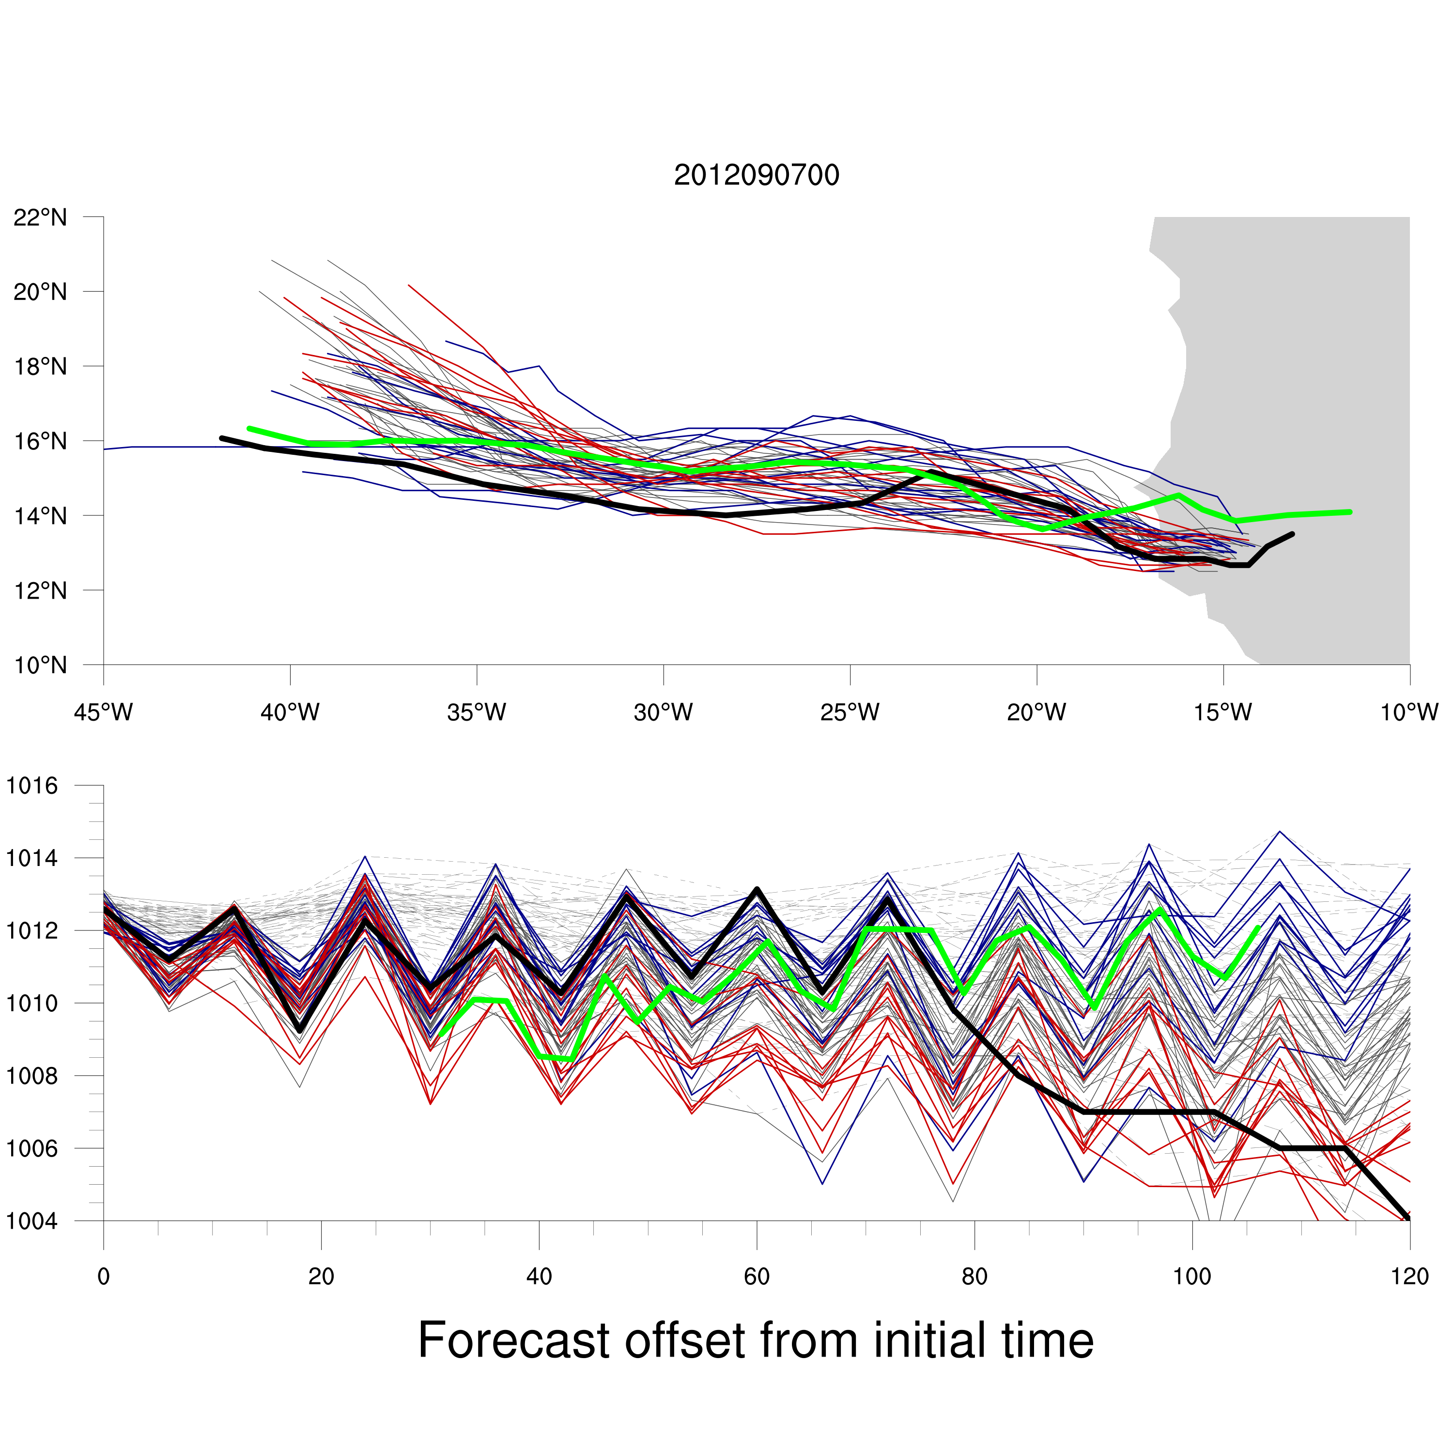
Simulated AEW is NOT associated with tropical cyclogenesis!
Green – WRF
Black – EC Analysis
Blue/Red – EC Forecasts

Slide 26
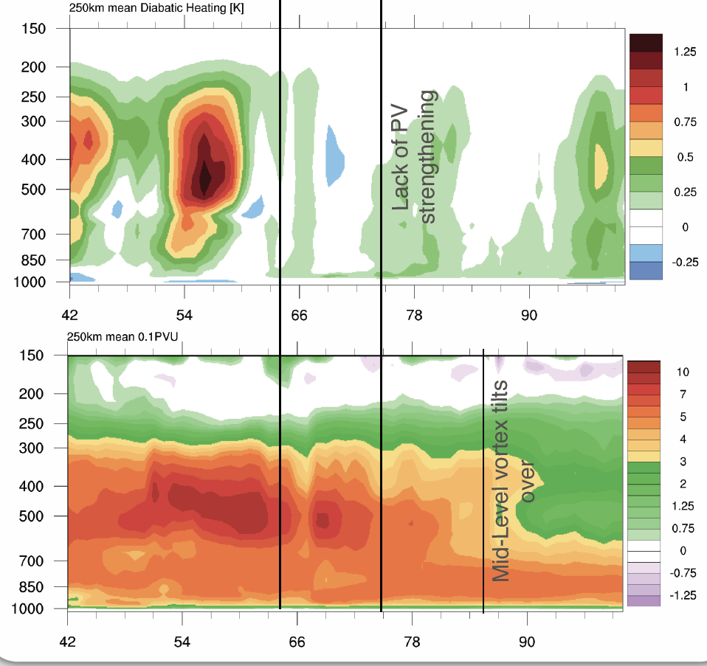

Slide 27
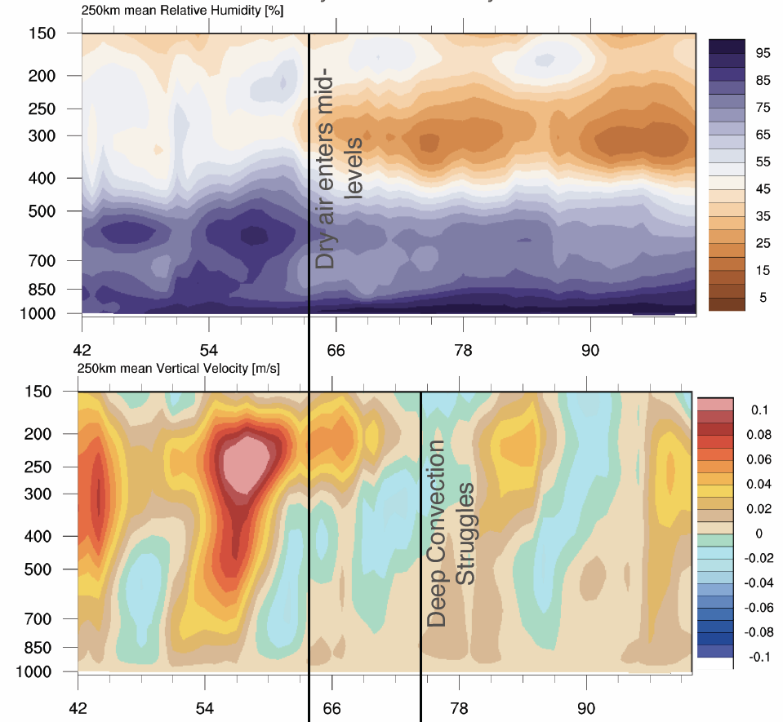

Slide 28
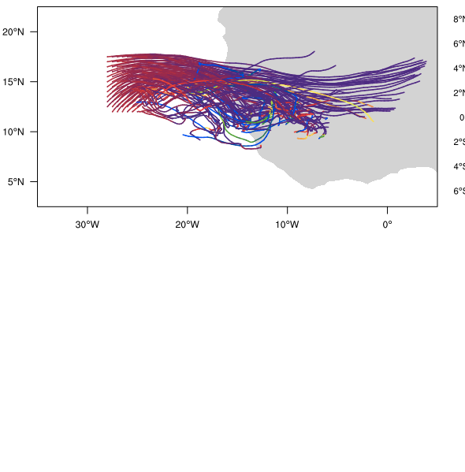
Dry air at mid-levels encroaches from east

Slide 29

3. Variability of AEWs 2013
Curvature vorticity 700mb
Wave characteristics again vary a lot during the season.

Slide 30
Variability of AEWs 2013
Curvature vorticity 700mb
}
Very unfavorable waves

Slide 31
Variability of AEWs 2013
Curvature vorticity 700mb
Very favorable waves

Slide 32
Variability of AEWs 2013
Curvature vorticity 700mb
Erin wave
Non-developing AEW in very dry environment
Wave in SAL flight

Slide 33
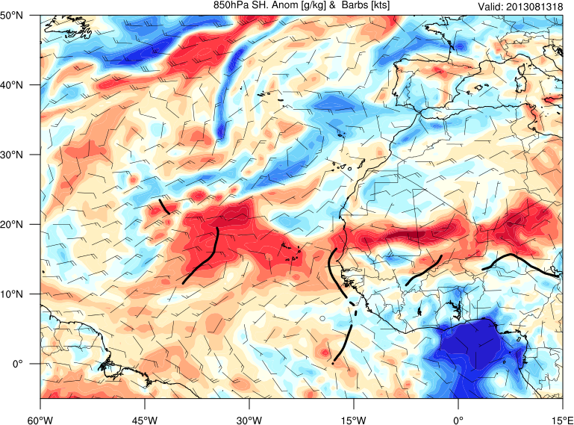
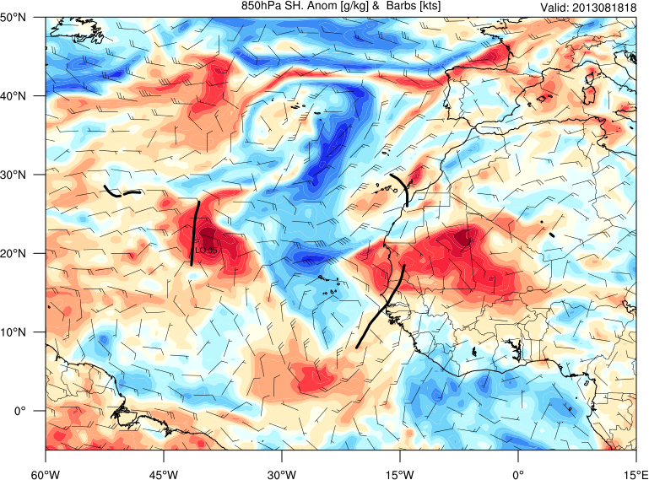
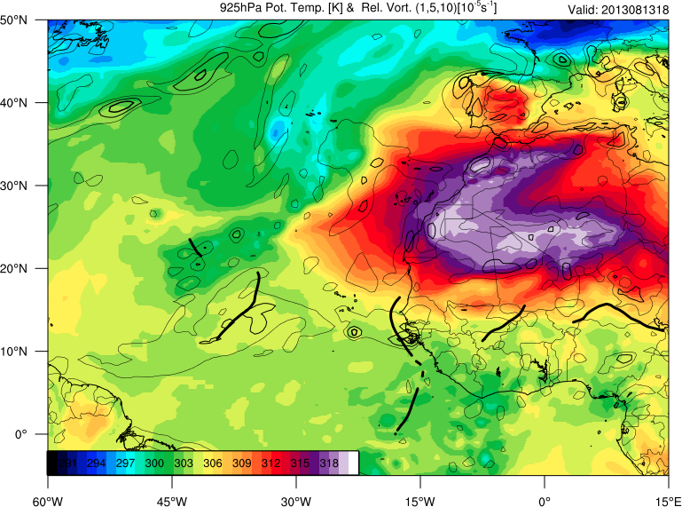
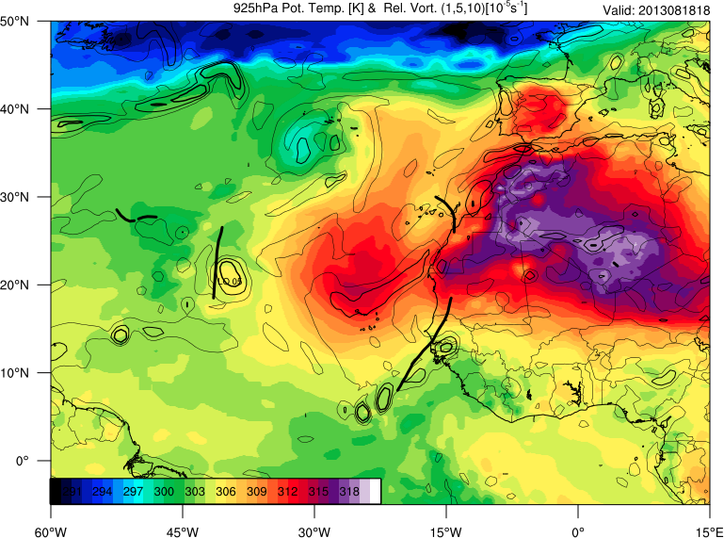
Erin 8/13/13 18Z Non-developing AEW 8/18/13 18Z
q anomaly 850mb
q anomaly 850mb
T 850mb
T 850mb

Slide 34
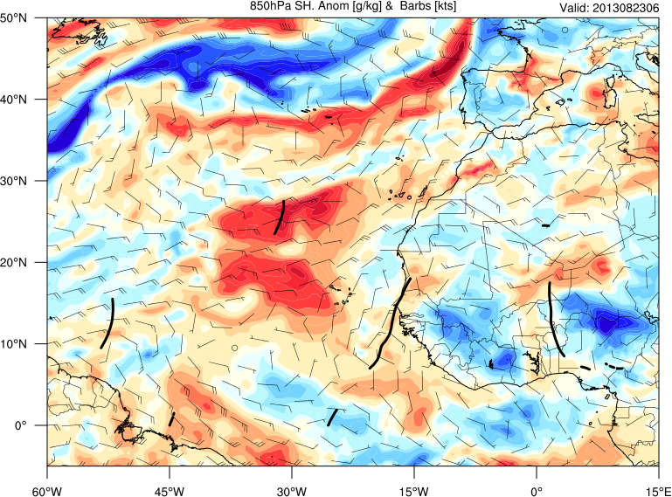
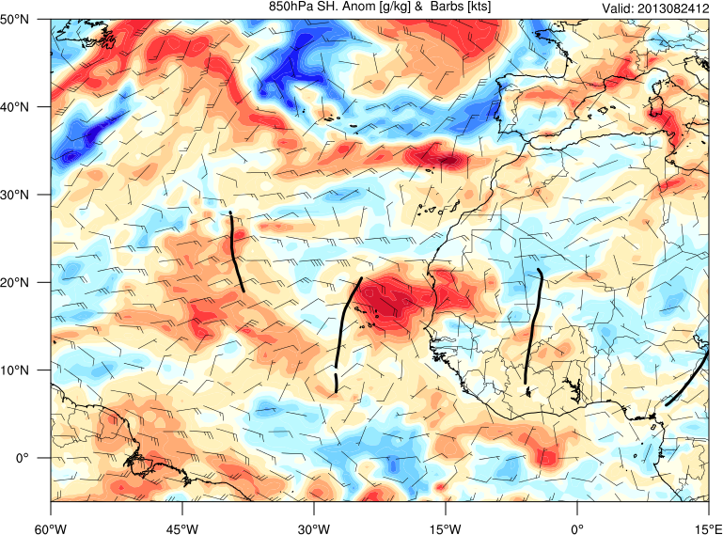
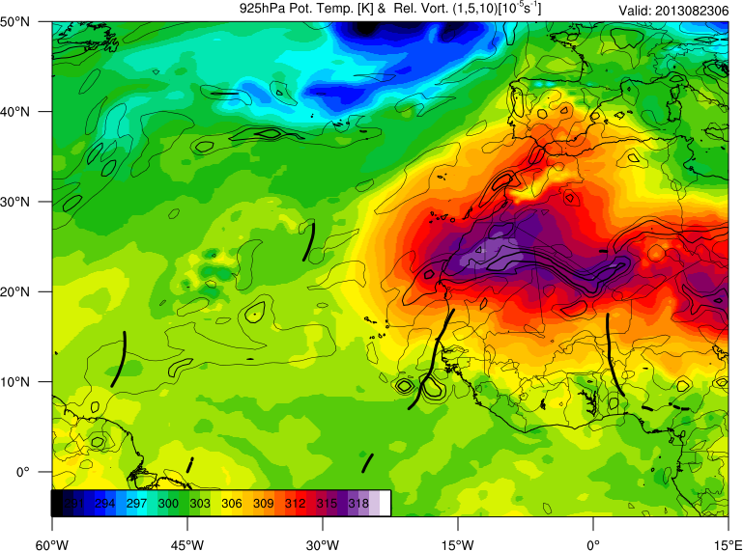
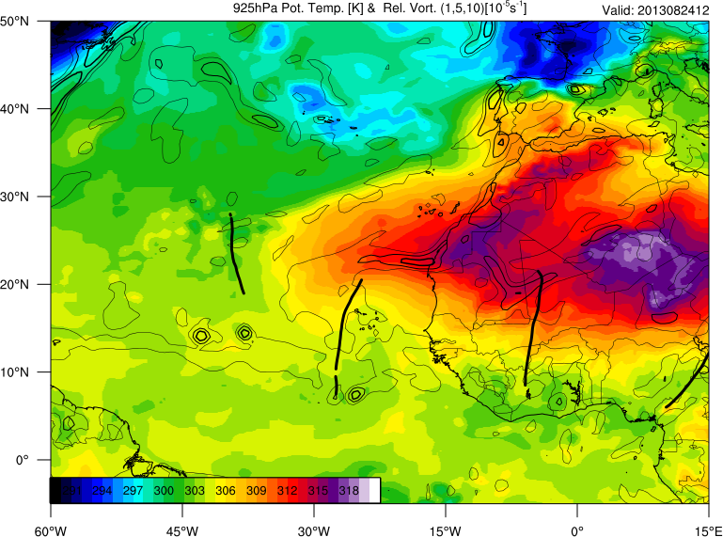
Non-developing AEW Evolution – SAL Flight
23rd August 06ZZ 24th August 12Z
q anomaly 850mb
q anomaly 850mb
T 850mb
T 850mb
Notes:
SAL Flight - 2 day evolution. The time on the right is basically when the trajectories on the next slide start.

Slide 35
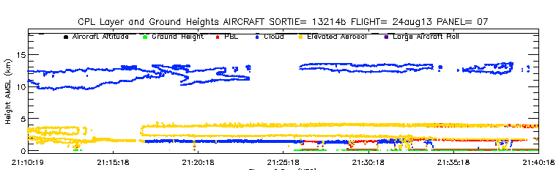
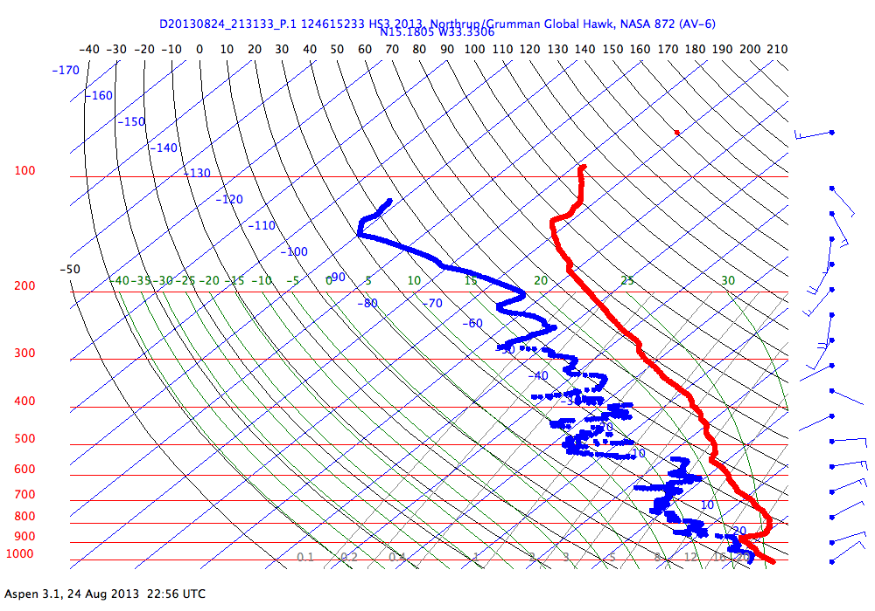
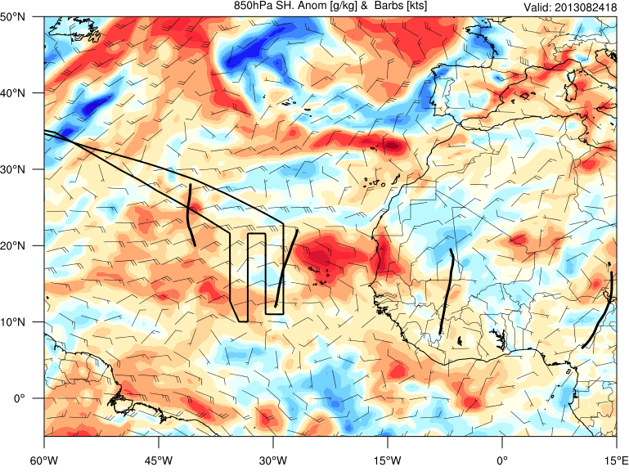
Preliminary analysis highlights low-level air getting into system originates from NW of the trough leaving coast
Notes:
Arrows drawn over the real trajectories (48hr trajectories; trough is over the coast, coincident with the air being at the start of the arrows; i.e. mostly NW of the trough). Just to enlarge and make them easier to see. From NW to E every 100hPa from 900-600. (Red 900, blue 800, beige 700, green, 600).
CPL and drops show the dry air which has reached down to ~13N. Unfortunately no real convection / vortex associated with this wave though.

Slide 36
Final Comments
An important feature that tends to characterise the probability of tropical cyclogenesis in the East Atlantic is the low-level humidity NW of the system – this offers significant targeting opportunities for the Global Hawk.
For the case of modeled Nadine mid-level dry air behind the system was able to negatively impact the development.
-------------------------------------------------------------------------------------
We will repeat the statistical analysis for AEWs further west.
We will provide the “traffic lights” in real-time this season – including satellite products to supplement the model variables for real-time monitoring.

Slide 37
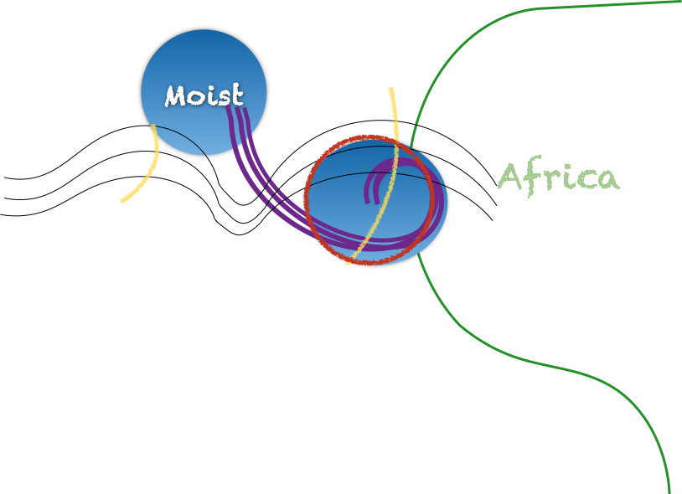
Low-level relative inflow

Slide 38
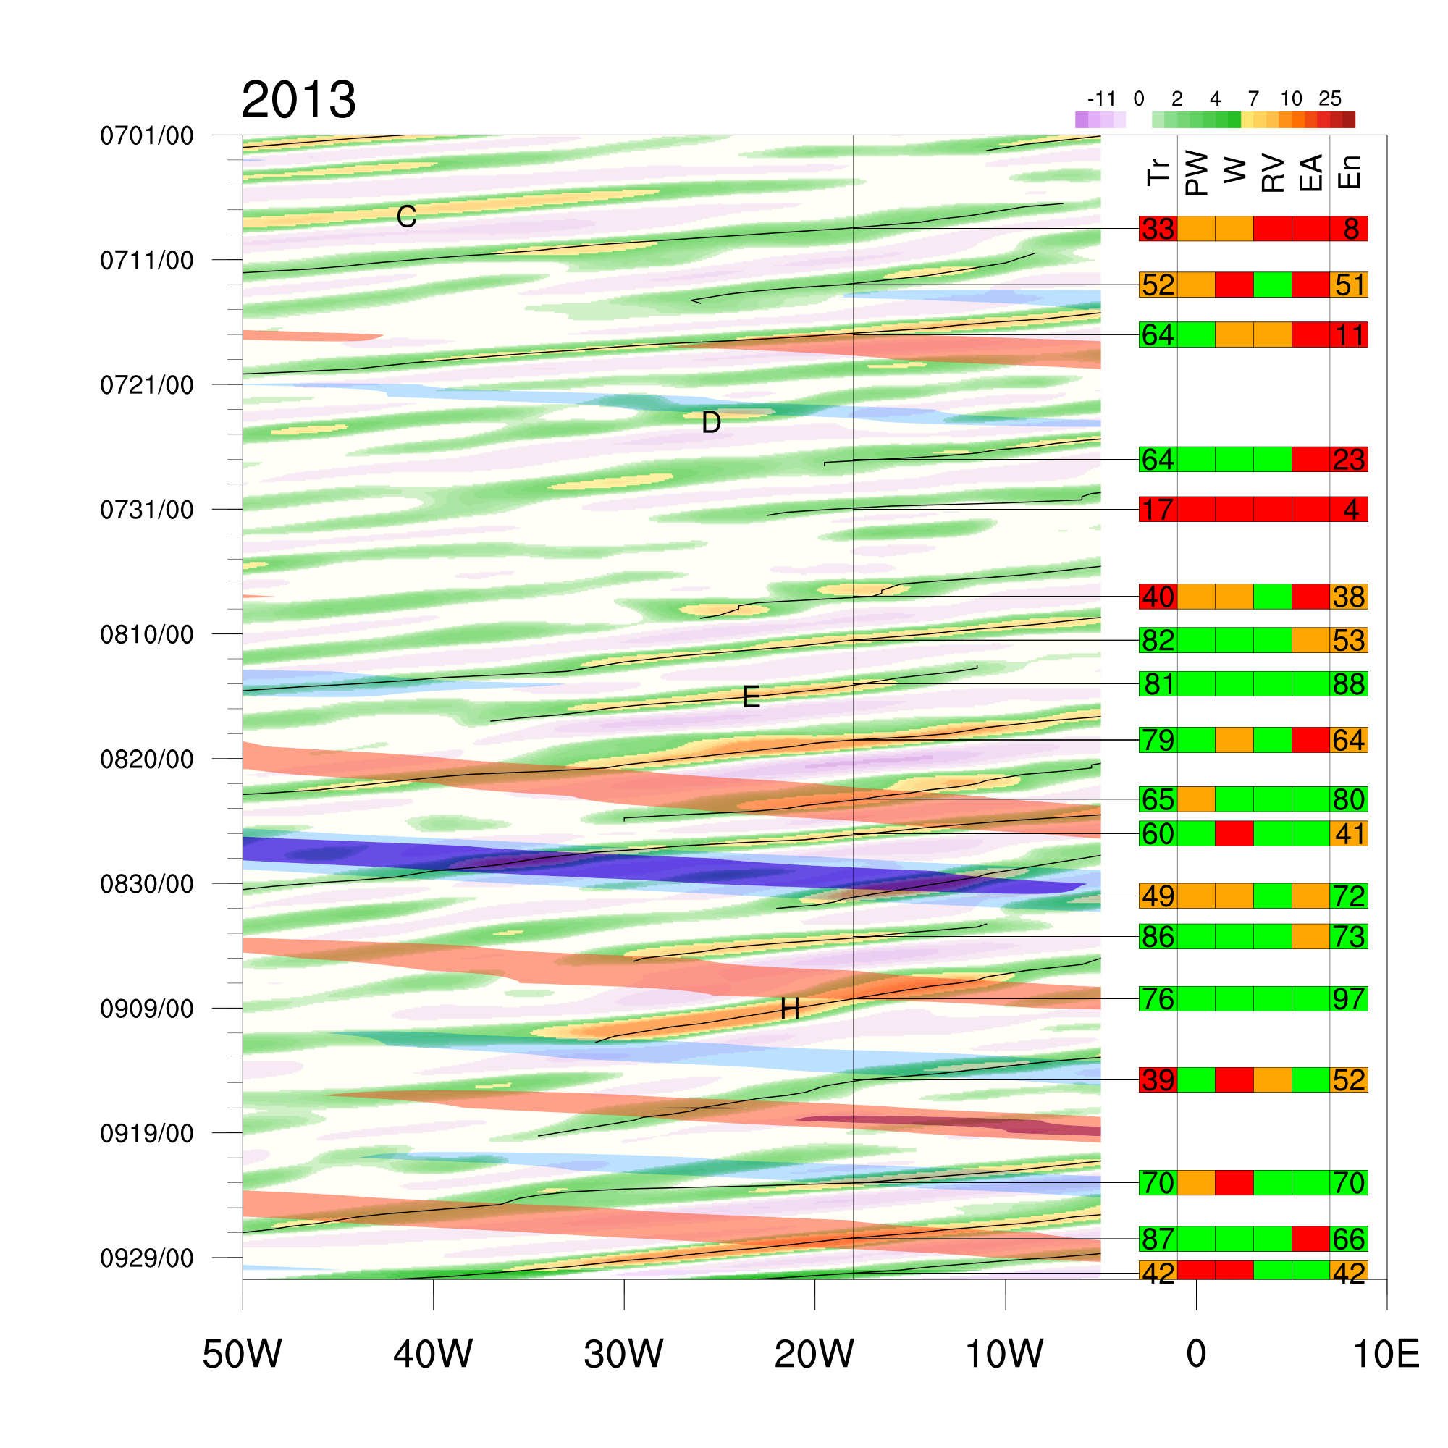
Variability of AEWs 2013 – and Kelvin waves (filtered VP)

