Slide 1





In situ observations of water vapor and cirrus IWC in the Pacific TTL during ATTREX
Troy Thornberry, Drew Rollins, Ru-Shan Gao, David Fahey
Paul Bui, Sarah Woods
2014 Western Pacific Airborne Campaigns Science Team Meeting Boulder Colorado, October 21, 2014

Slide 2
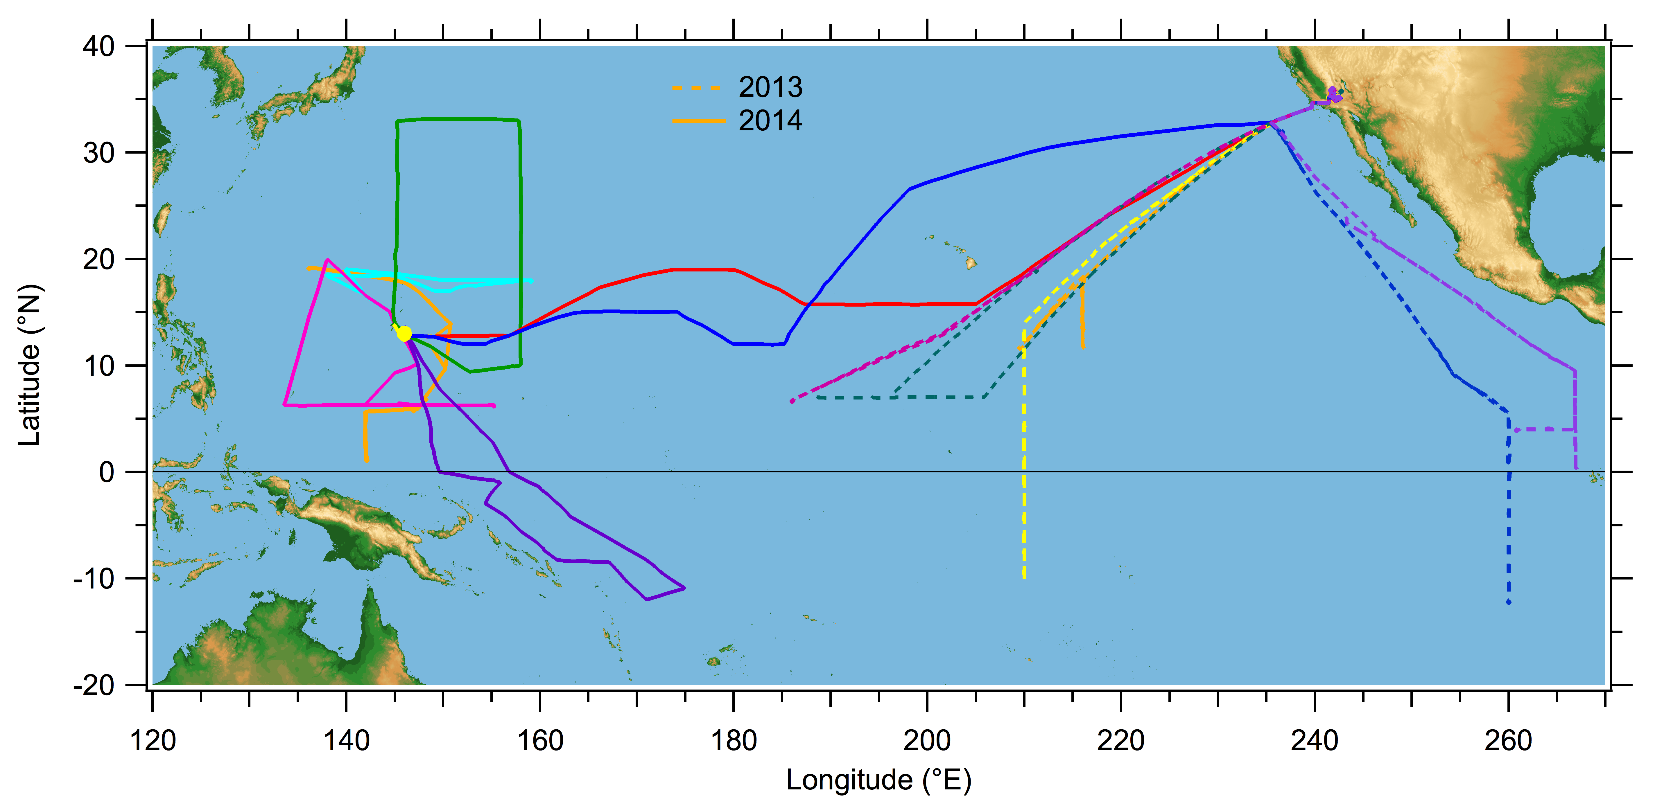
ATTREX 2 & 3 Flights
Sampling of the TTL over the Pacific with the goal of improving understanding of
the dynamical and microphysical processes related to the final dehydration of air entering the stratosphere.

Slide 3
ATTREX 2 & 3 Flights
Extensive in situ sampling of the Pacific TTL with measurements of water vapor and
cirrus properties.
However, some sampling limitations…

Slide 4
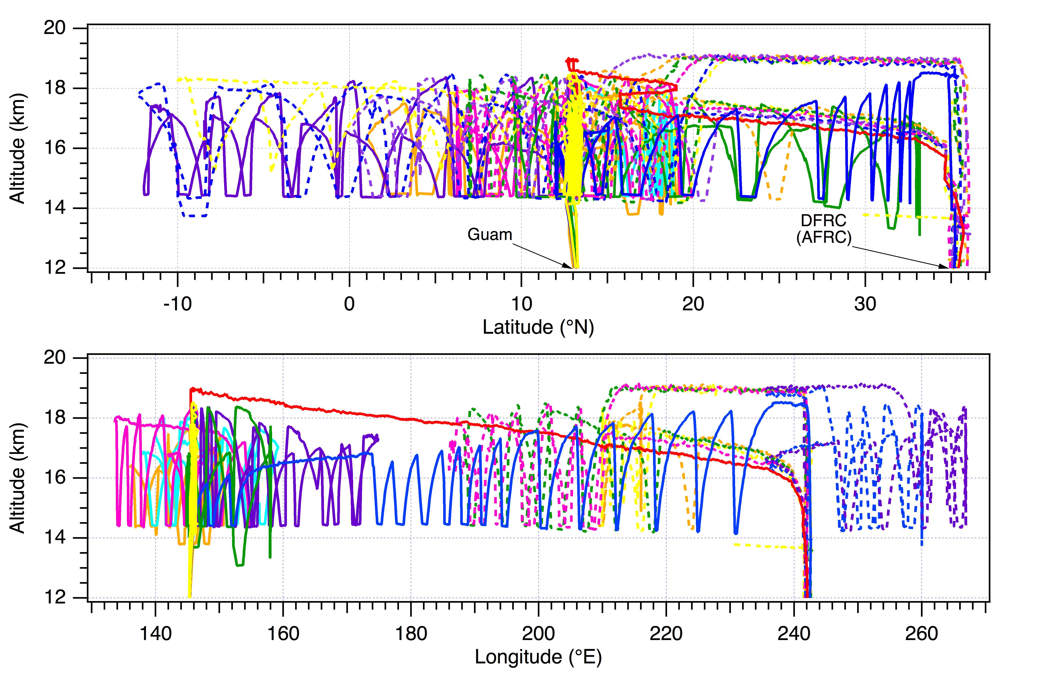
Latitude and Longitude

Slide 5
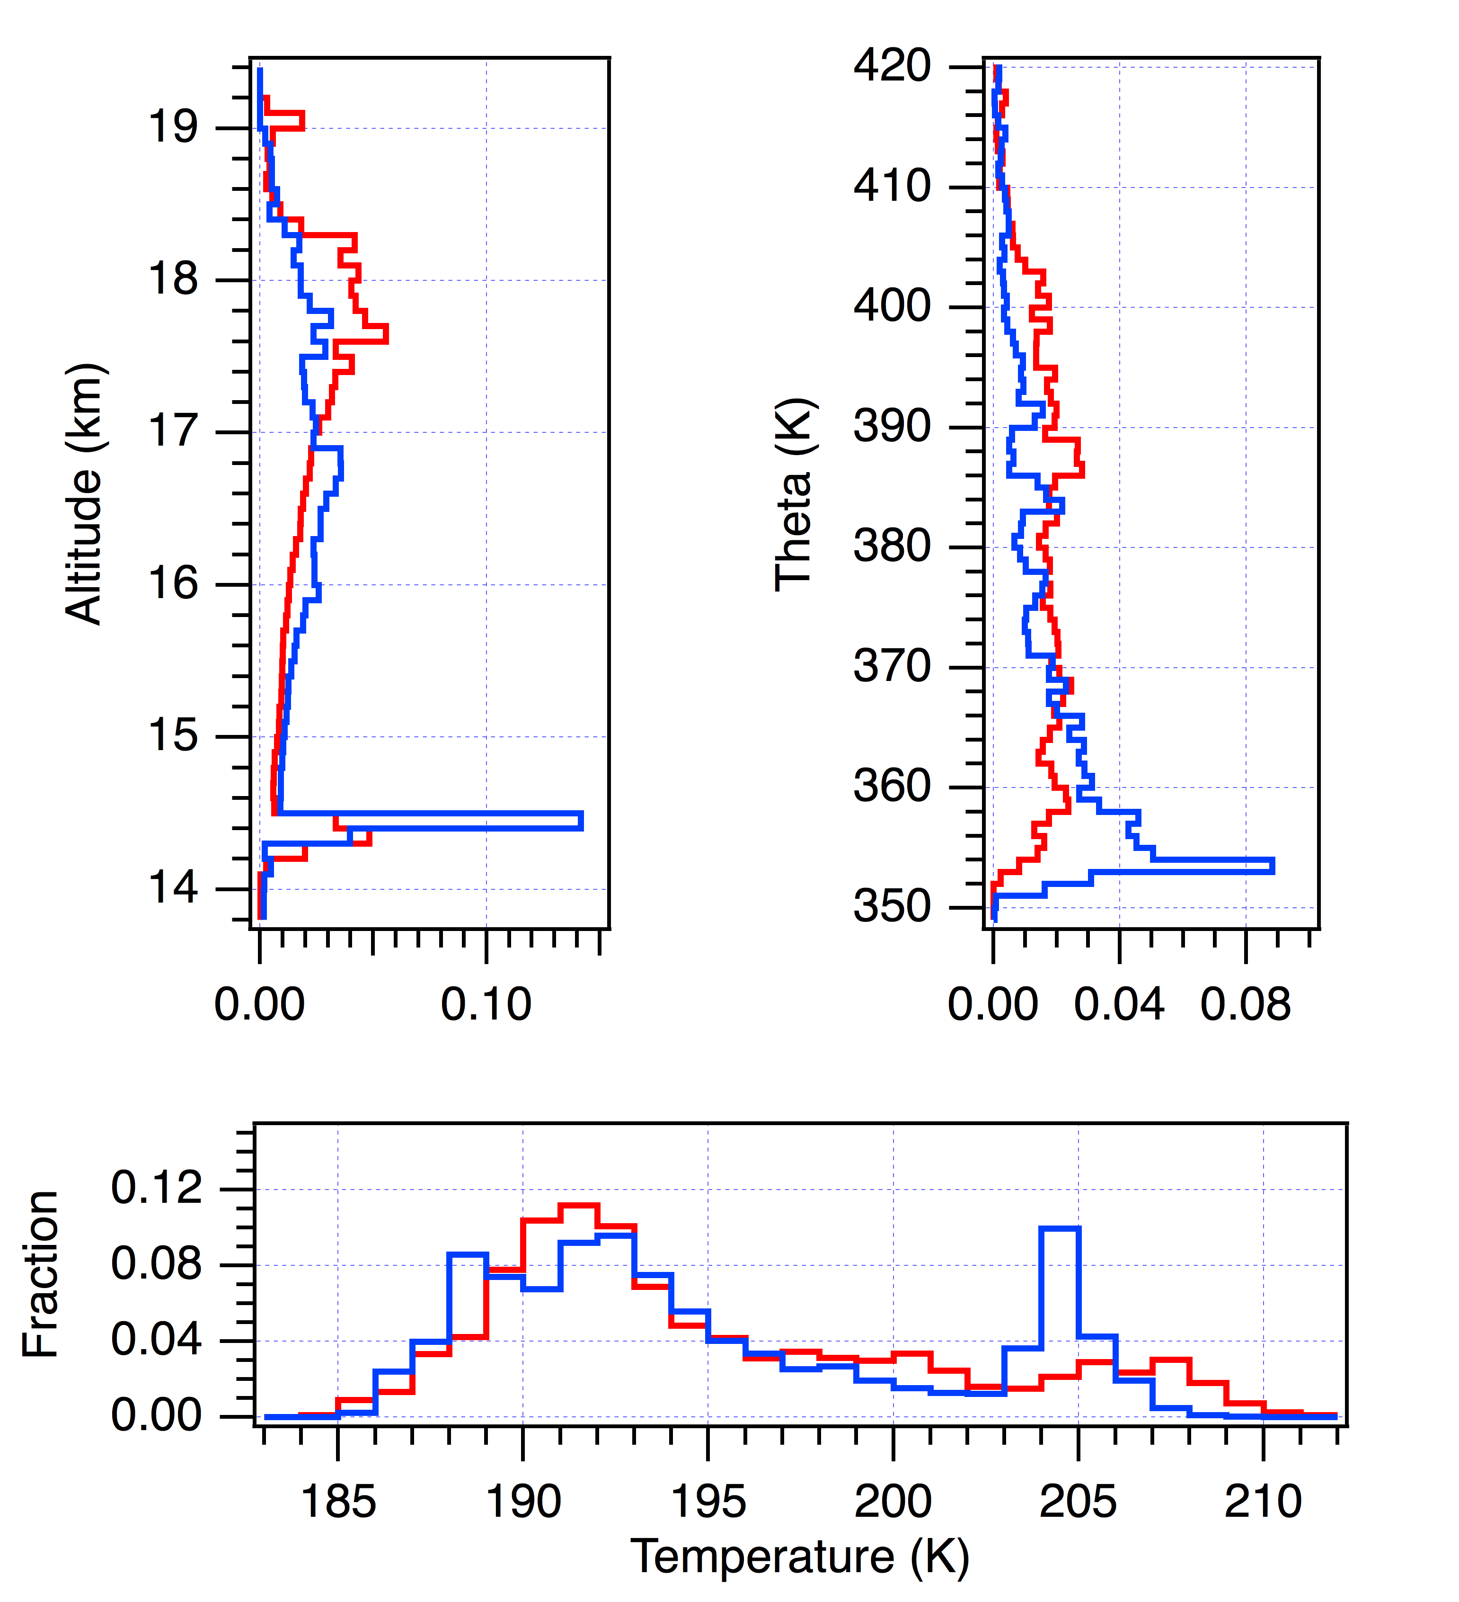
Sampling Histograms
Comparison of 2013 and 2014 from GH sampling perspective
2013: > 74 hours in the TTL
2014: > 108 hours in the TTL
Limited sampling in either year at temperatures < 186 K

Slide 6
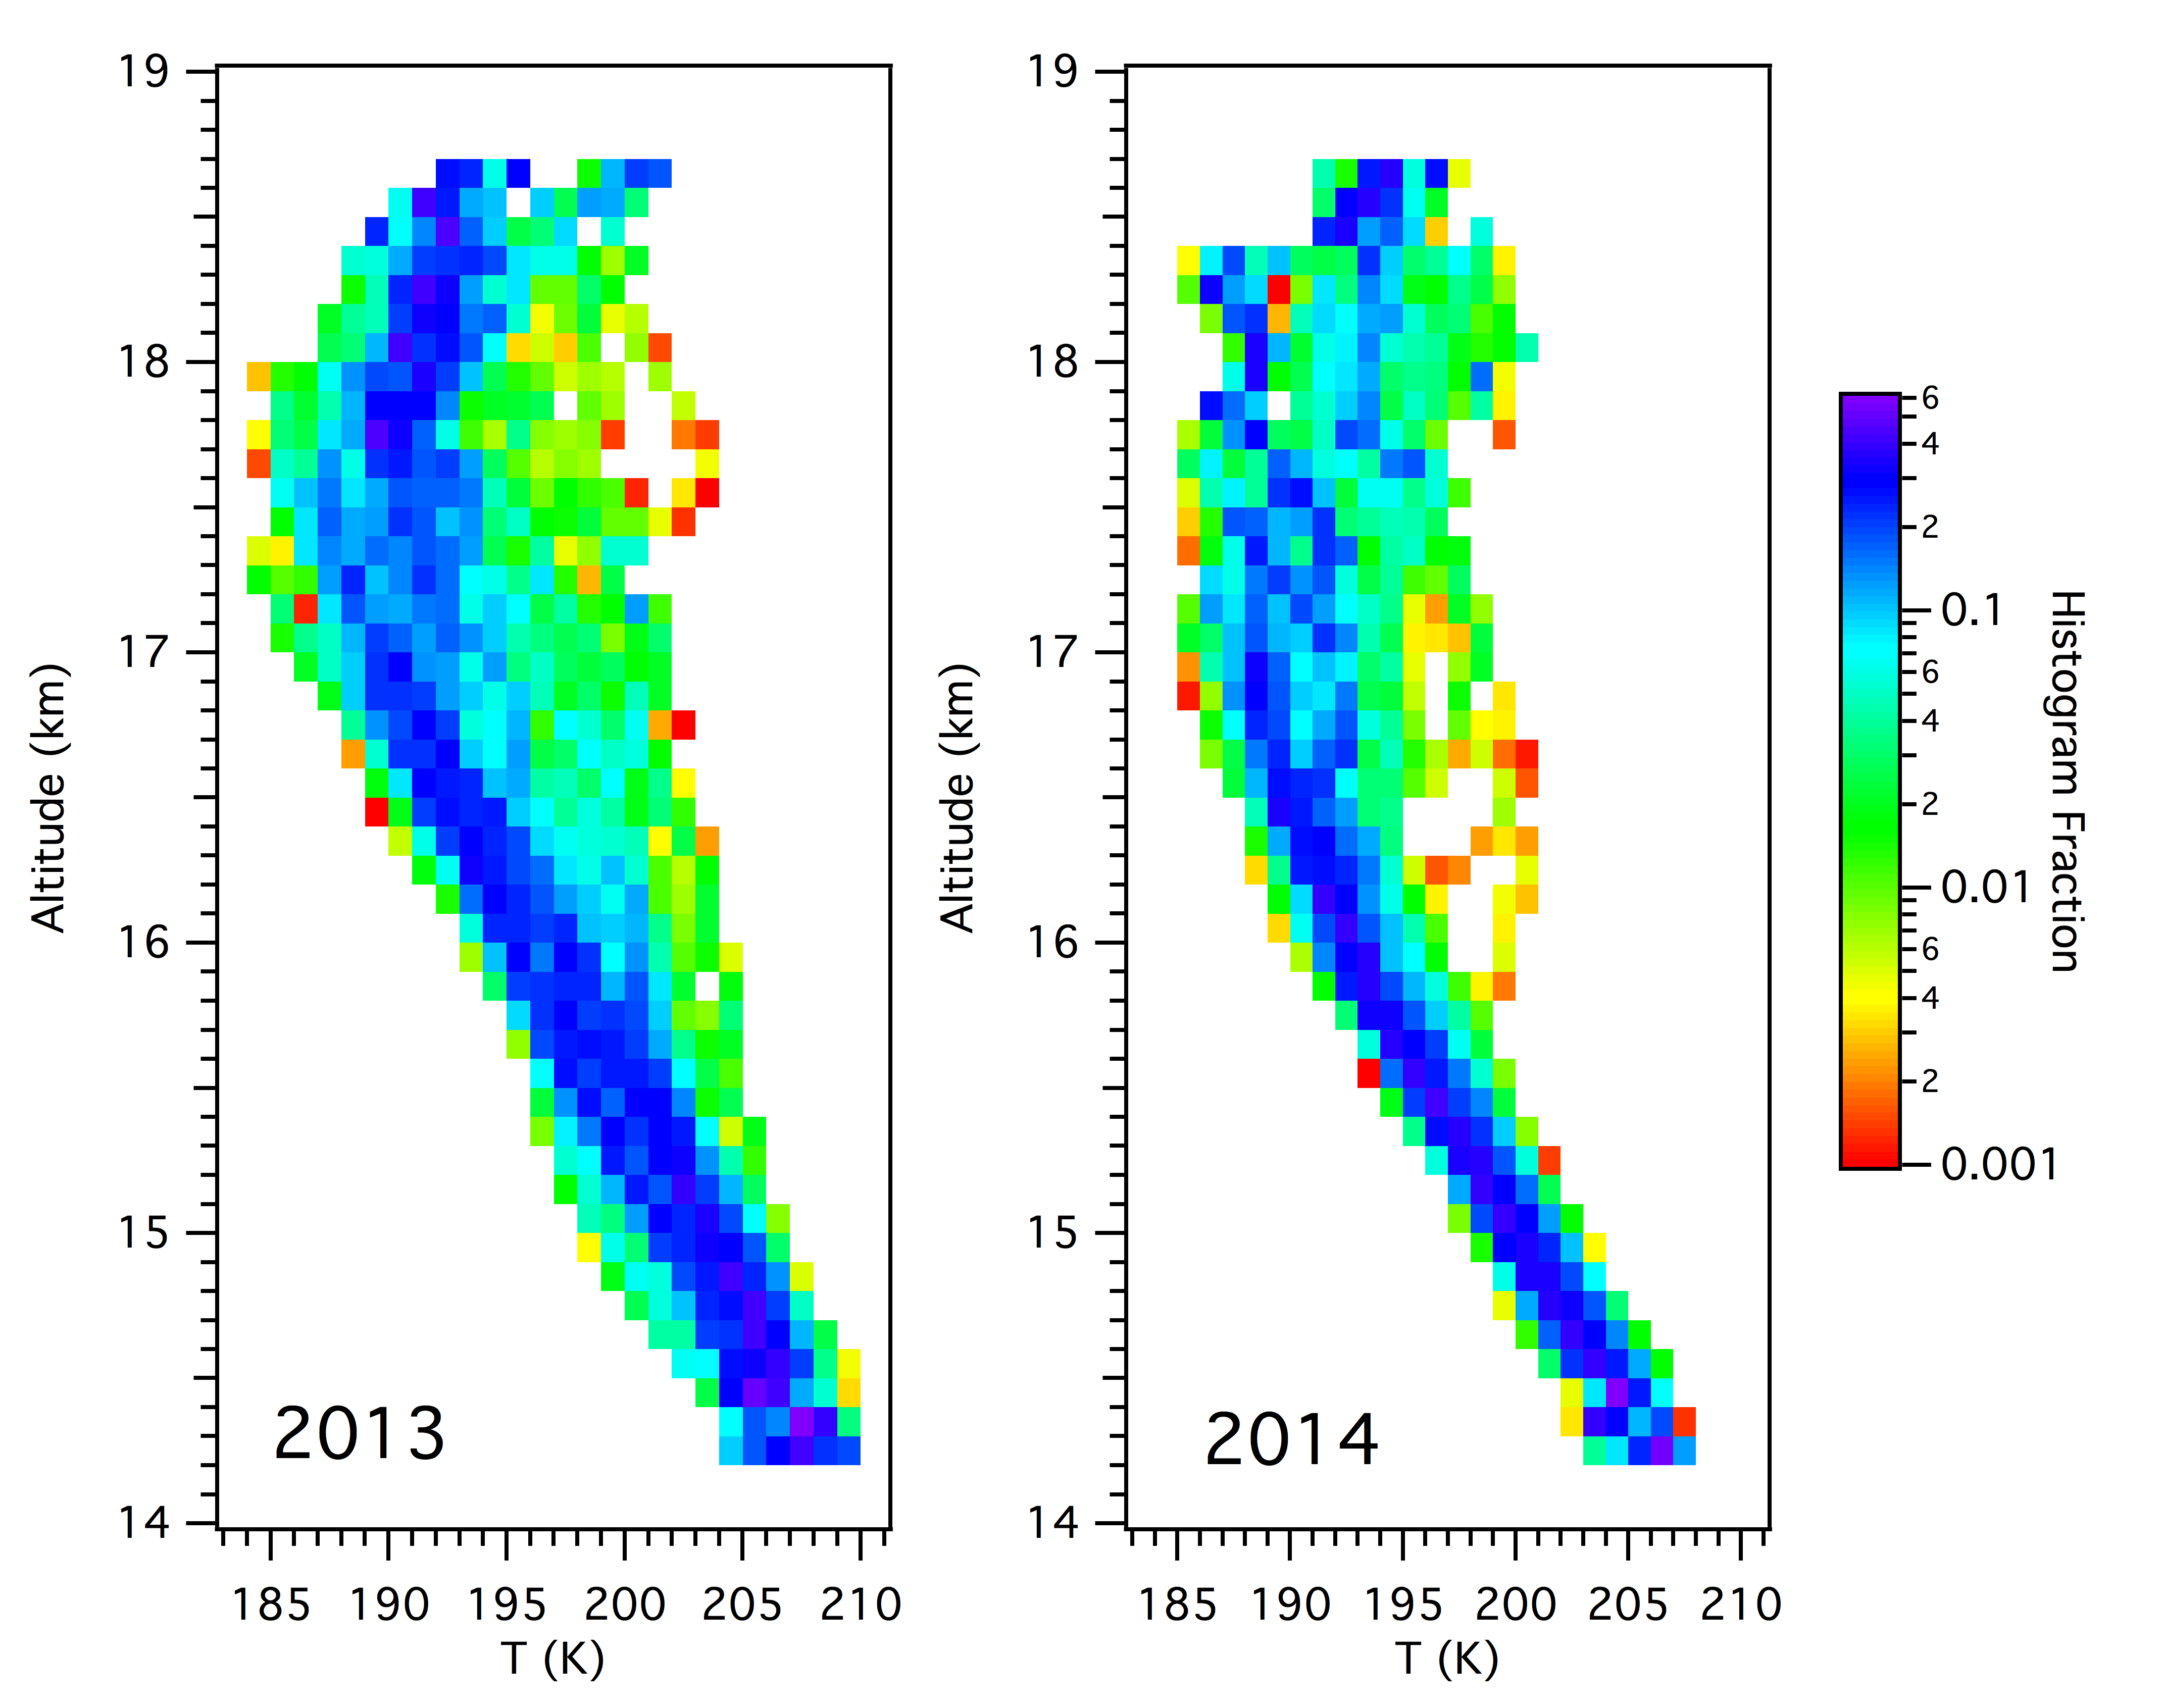
TTL temperature profiles
Higher CP tropopause observed in 2013
More consistent T structure above the CPT in 2013
Similar lower T values in both years determined by GH sampling limits

Slide 7
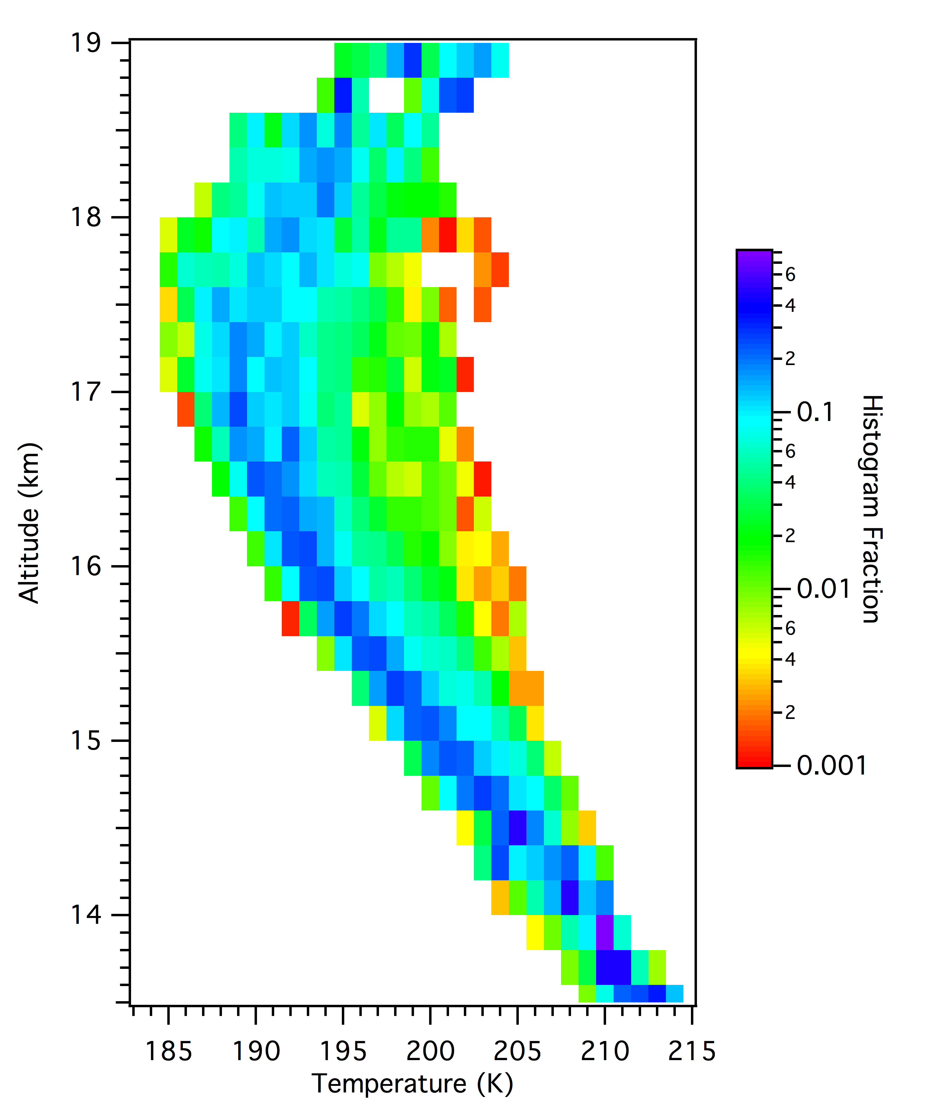
Combined Temperature profile
Combined profile looks reasonable
During both 2013 and 2014 a number of warm profiles were measured

Slide 8
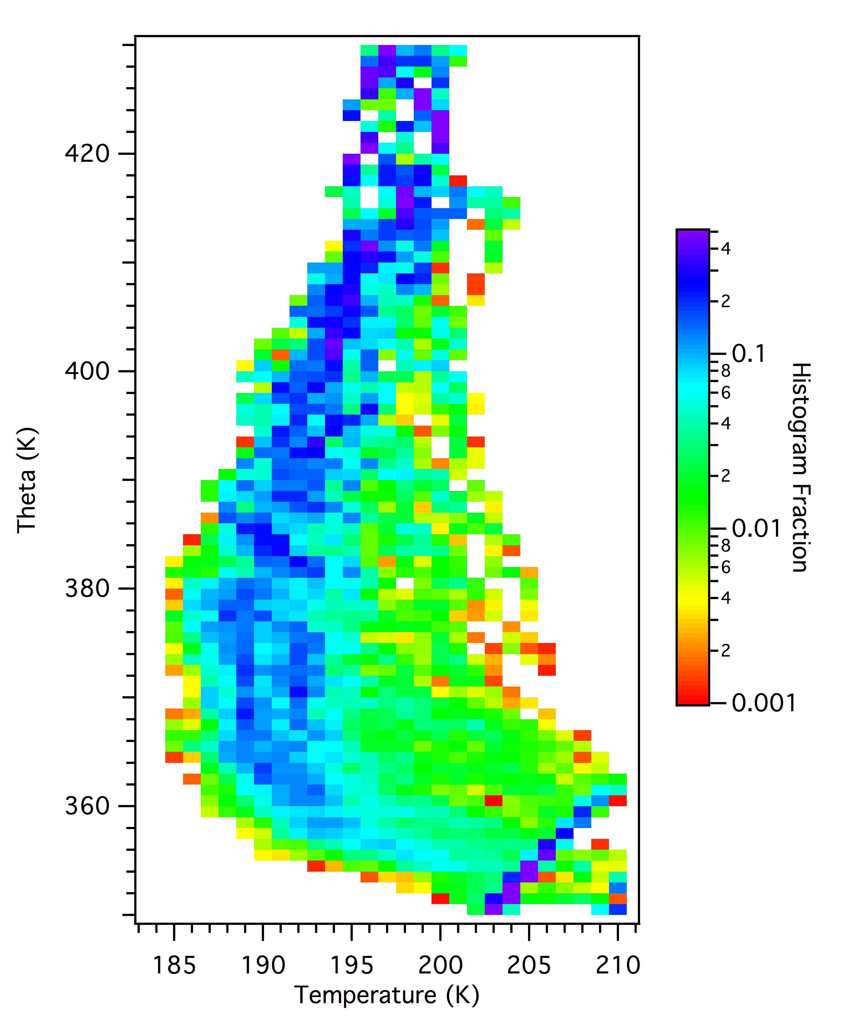
Temperature vs Theta profile
Coldest temperatures sampled between 365 and 380 K potential temperature

Slide 9
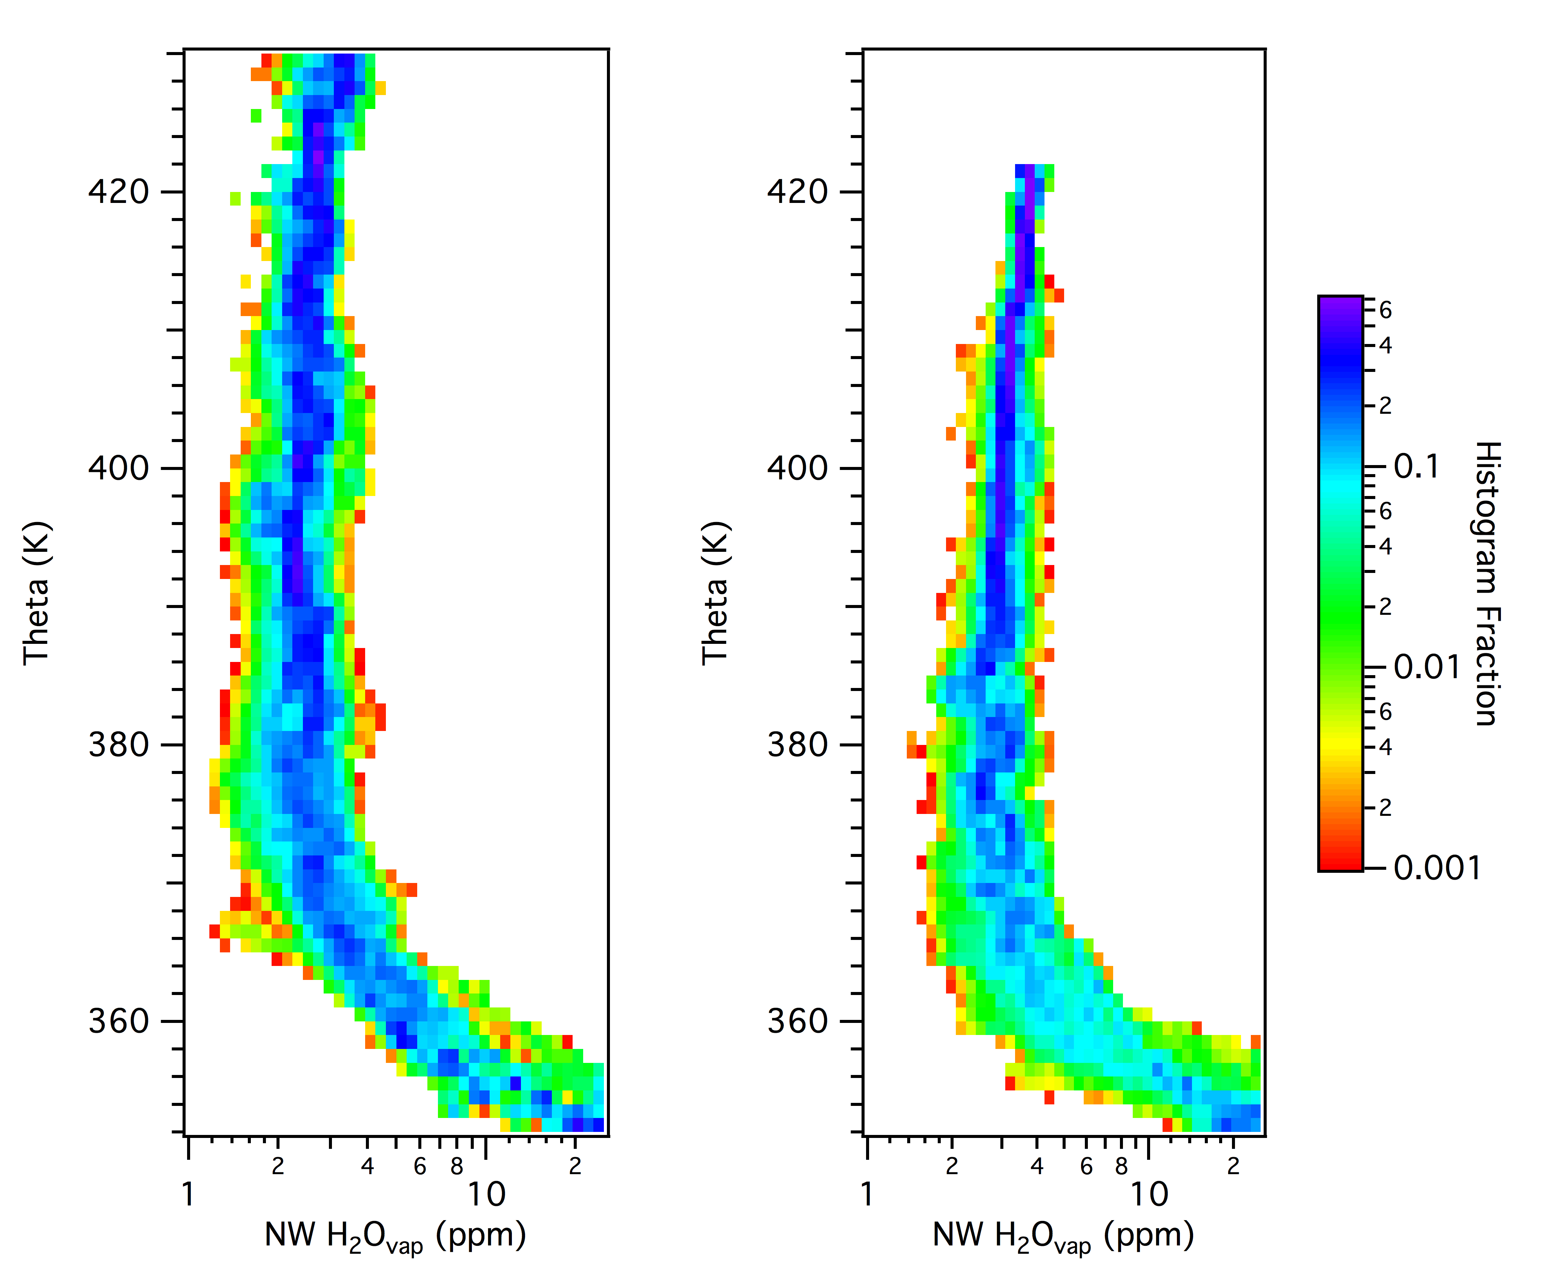
Water vapor profiles
2014
2013
Typical WV values above CP lower by ~ 05 ppm in 2013 than 2014
Consistent with zonal mean value difference

Slide 10
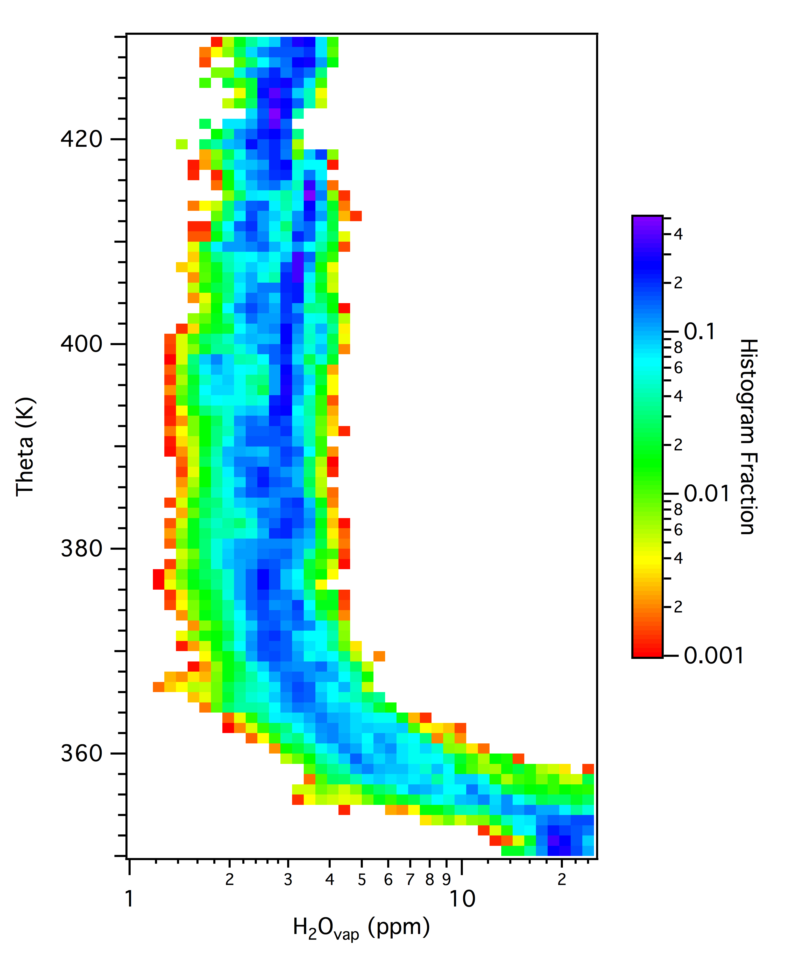
Combined WV profile
Apparent discontinuity above 410K due to difference in profile top between ATTREX-2 and ATTREX-3

Slide 11
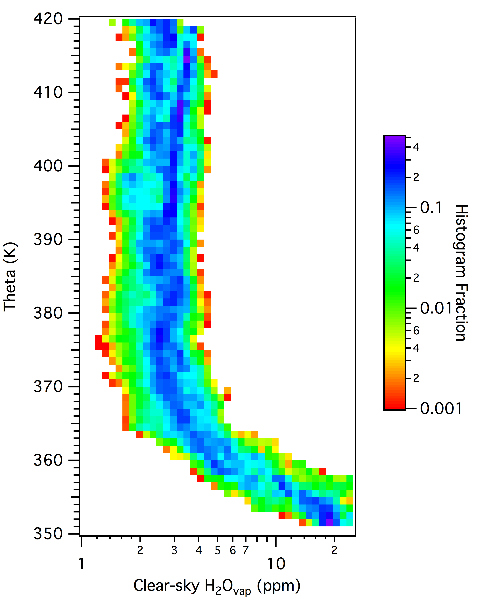
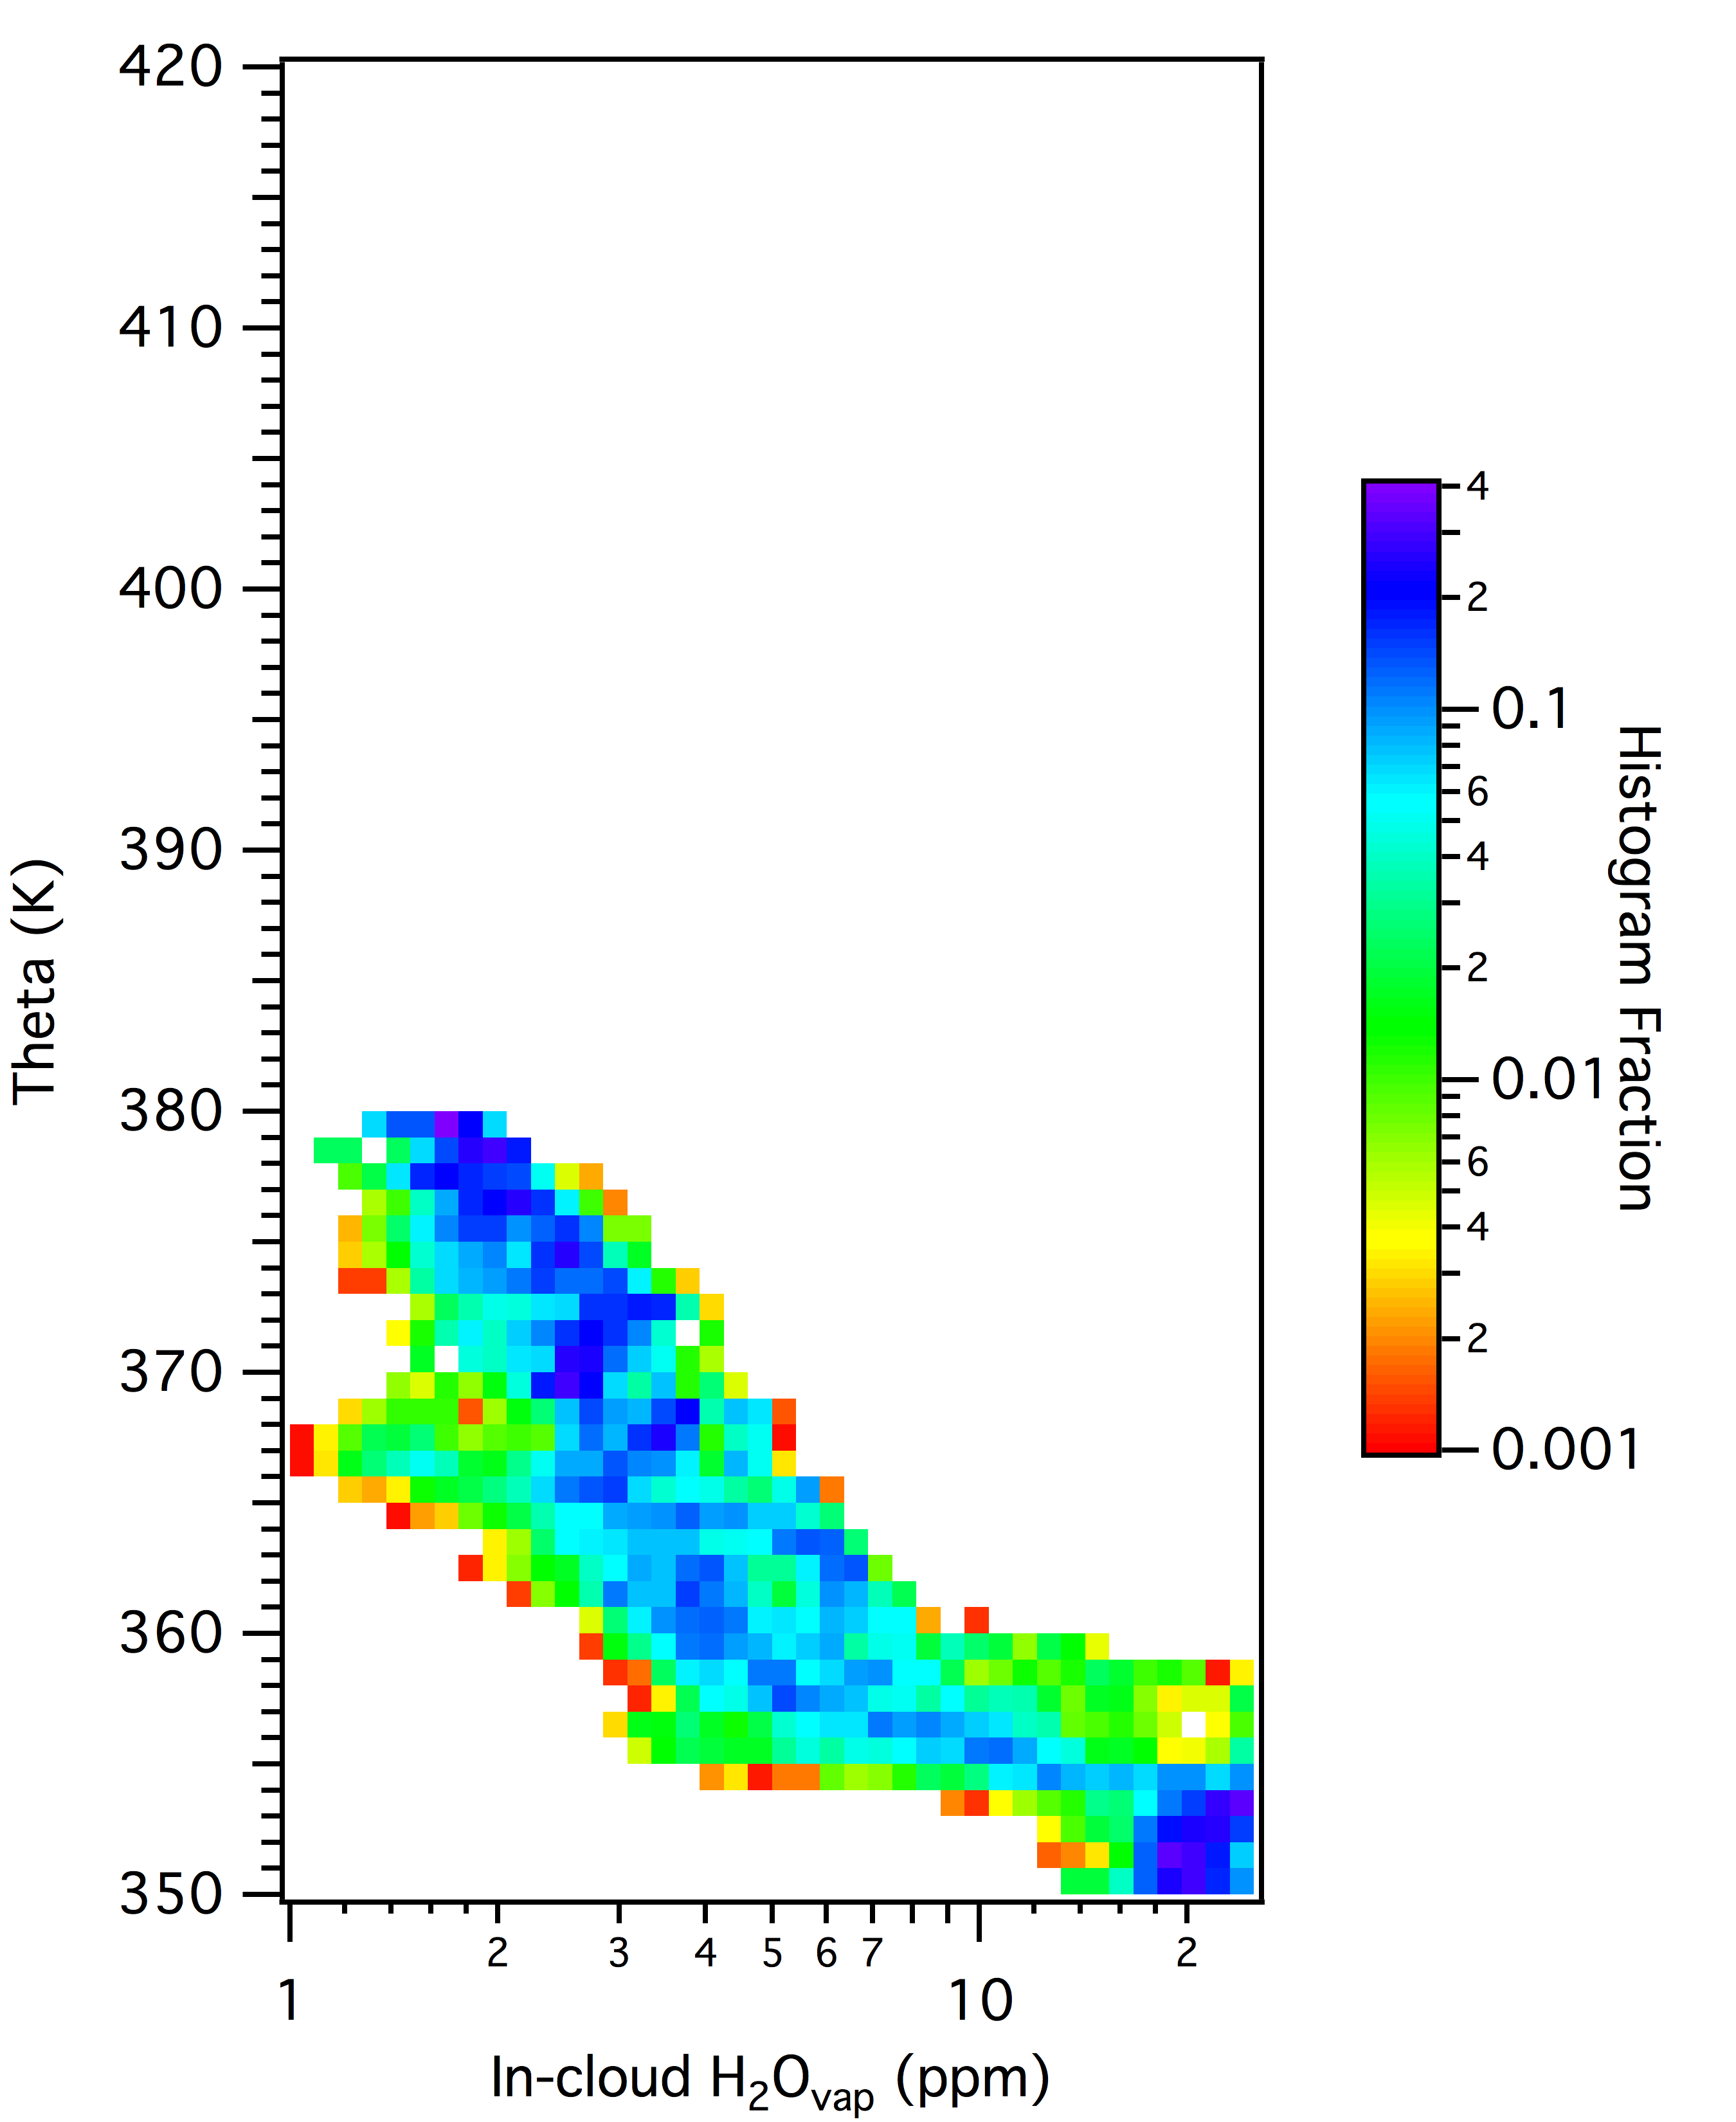
In-cloud vs Clear-sky

Slide 12
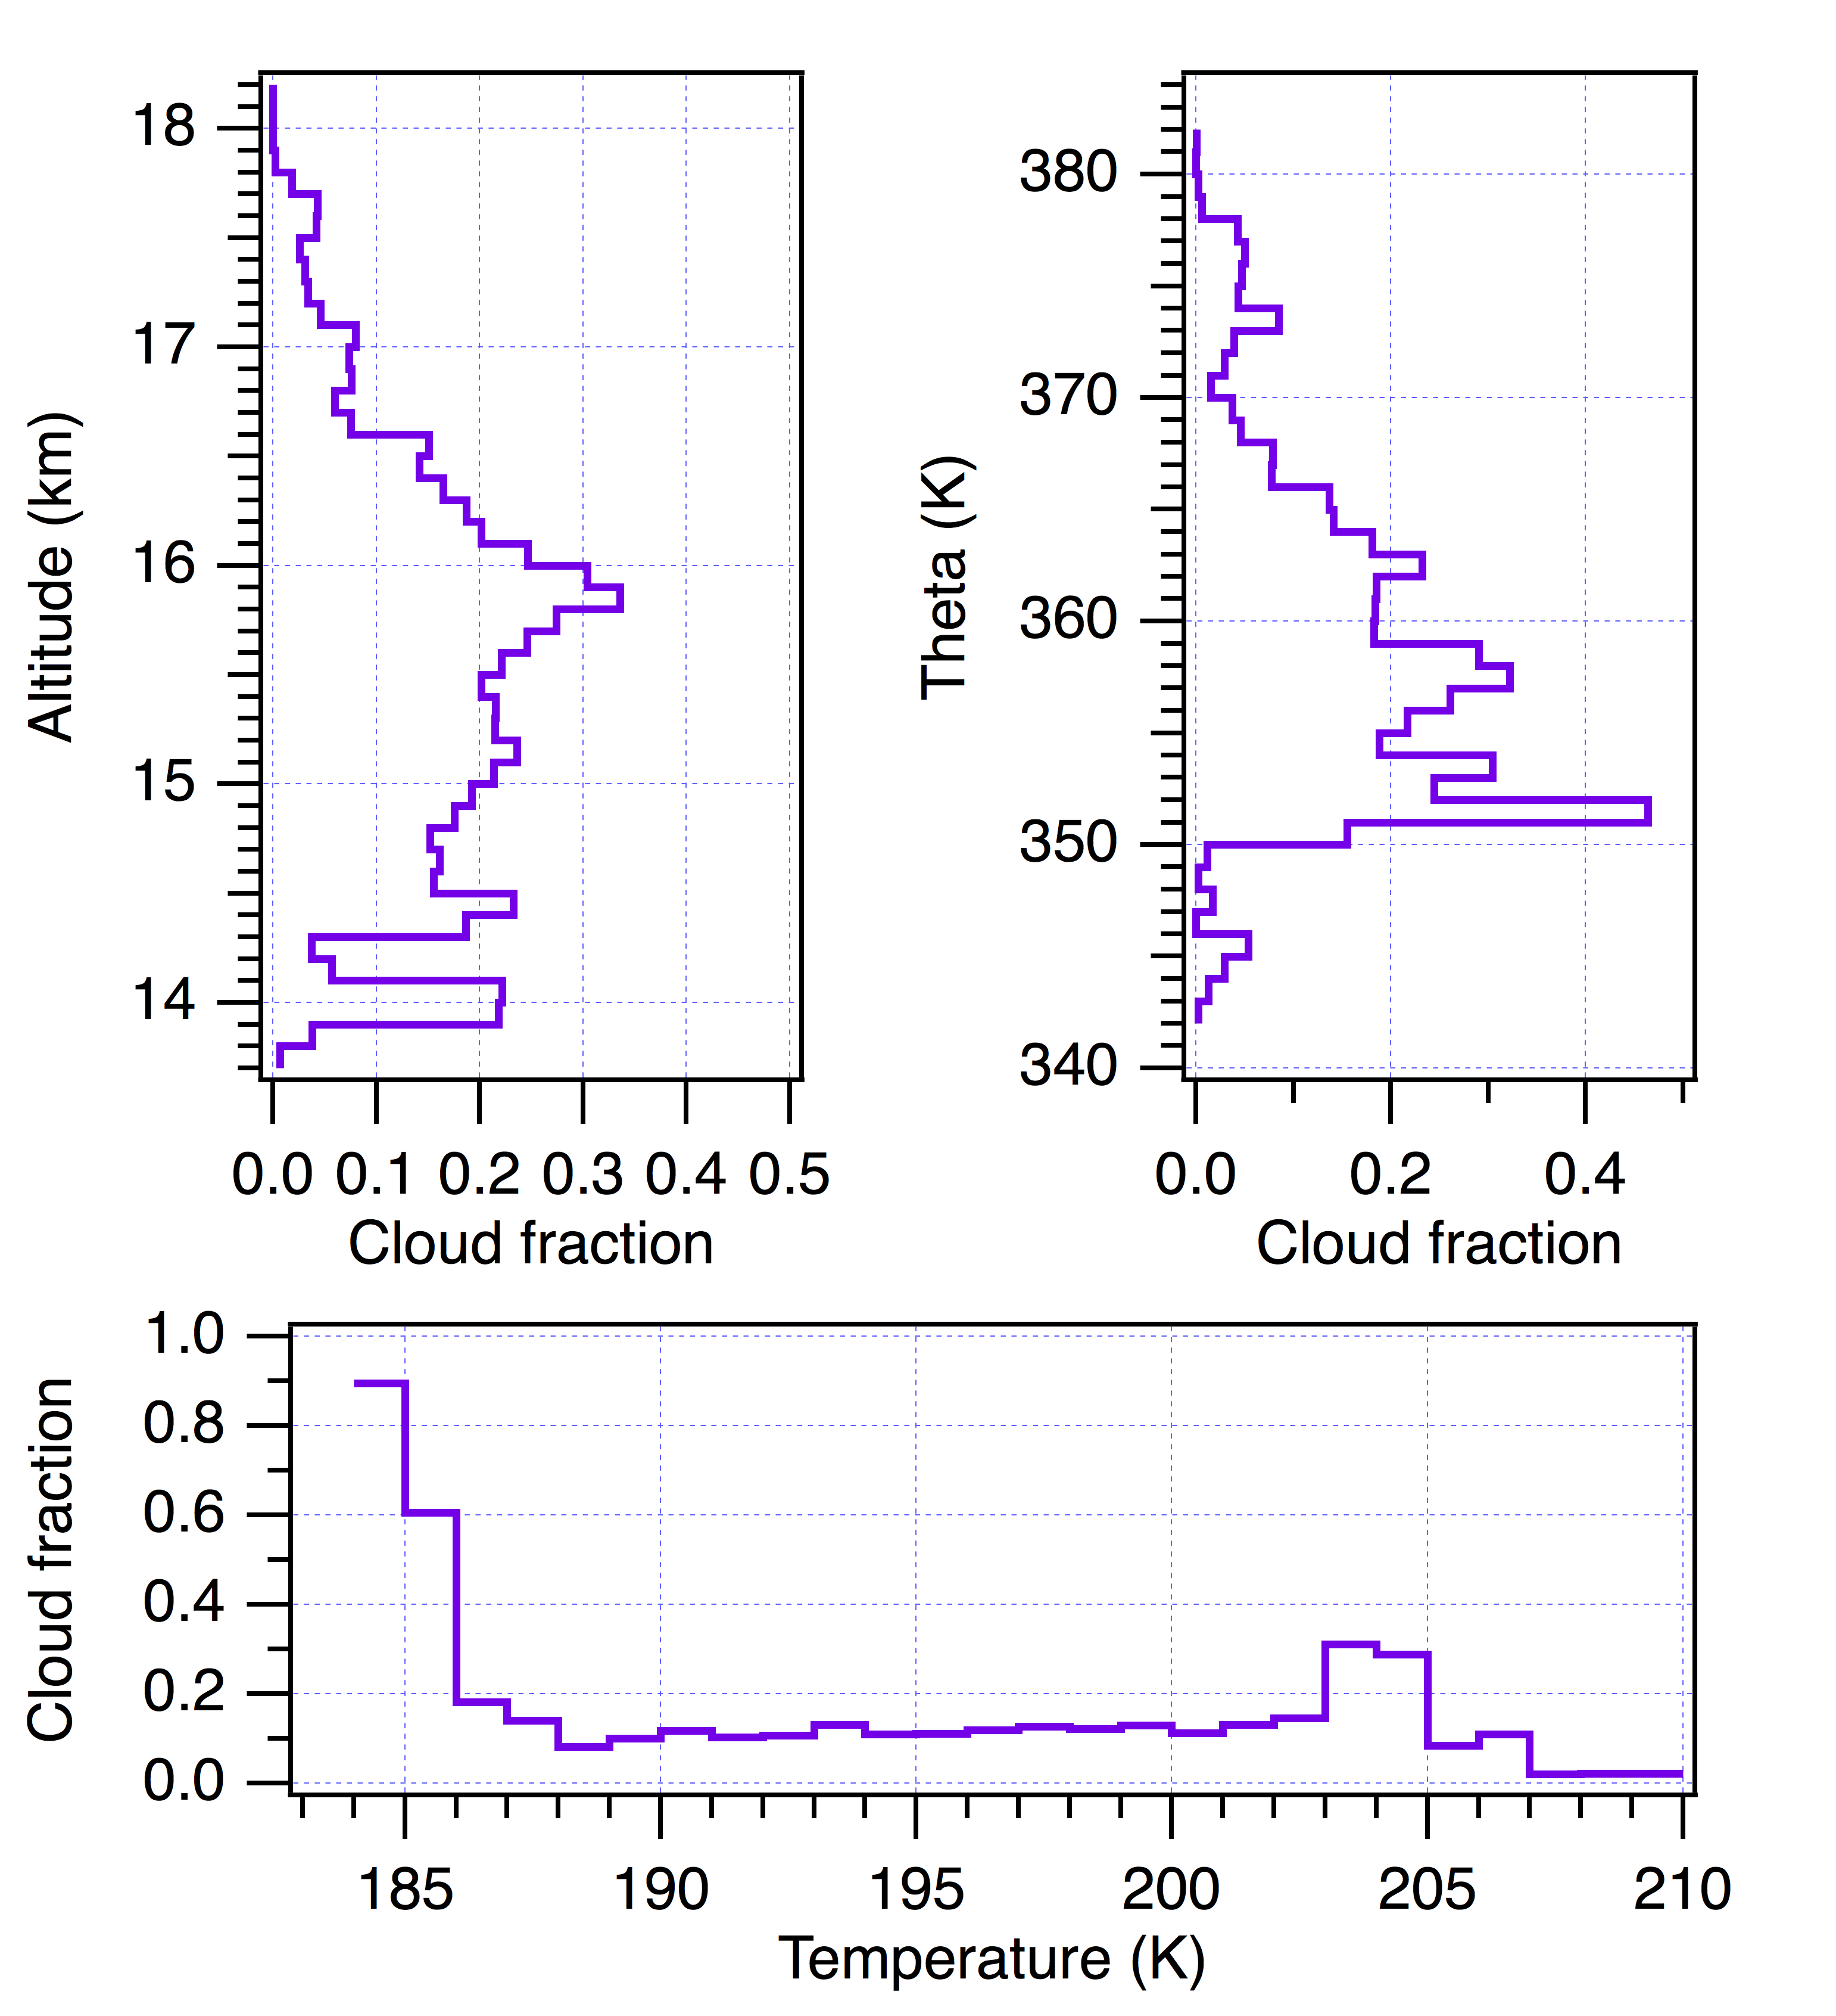
ATTREX cloud fraction
Define cloud using FCDP and NW IWC measures
Sampled cloud fractions similar to satellite climatology
Particularly high cloud fraction observed at lowest sampled temperatures

Slide 13
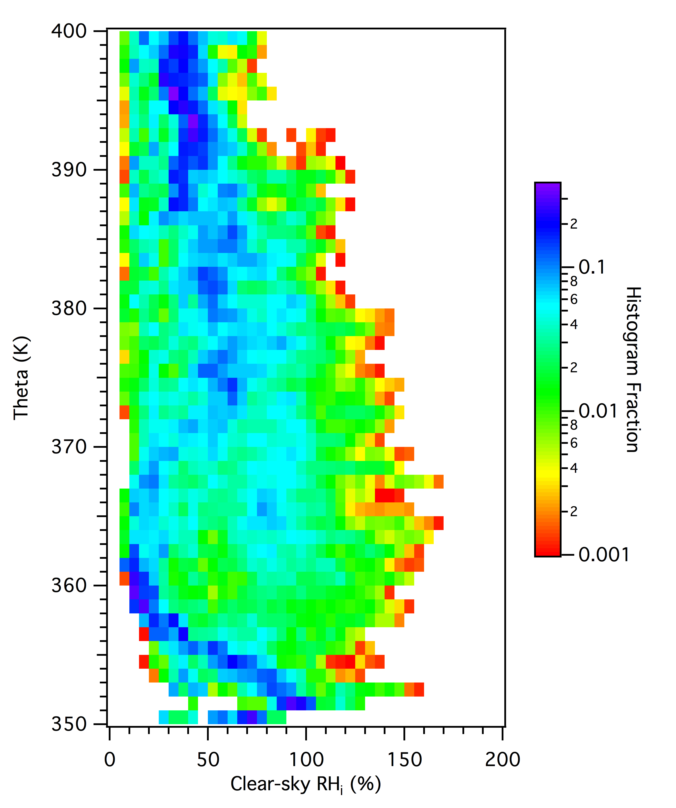
Clear-sky RH_{ice} profile
Broad range of RH_{ice} observed in clear air from very dry to supersaturated
Frequent dry values observed near 360K

Slide 14
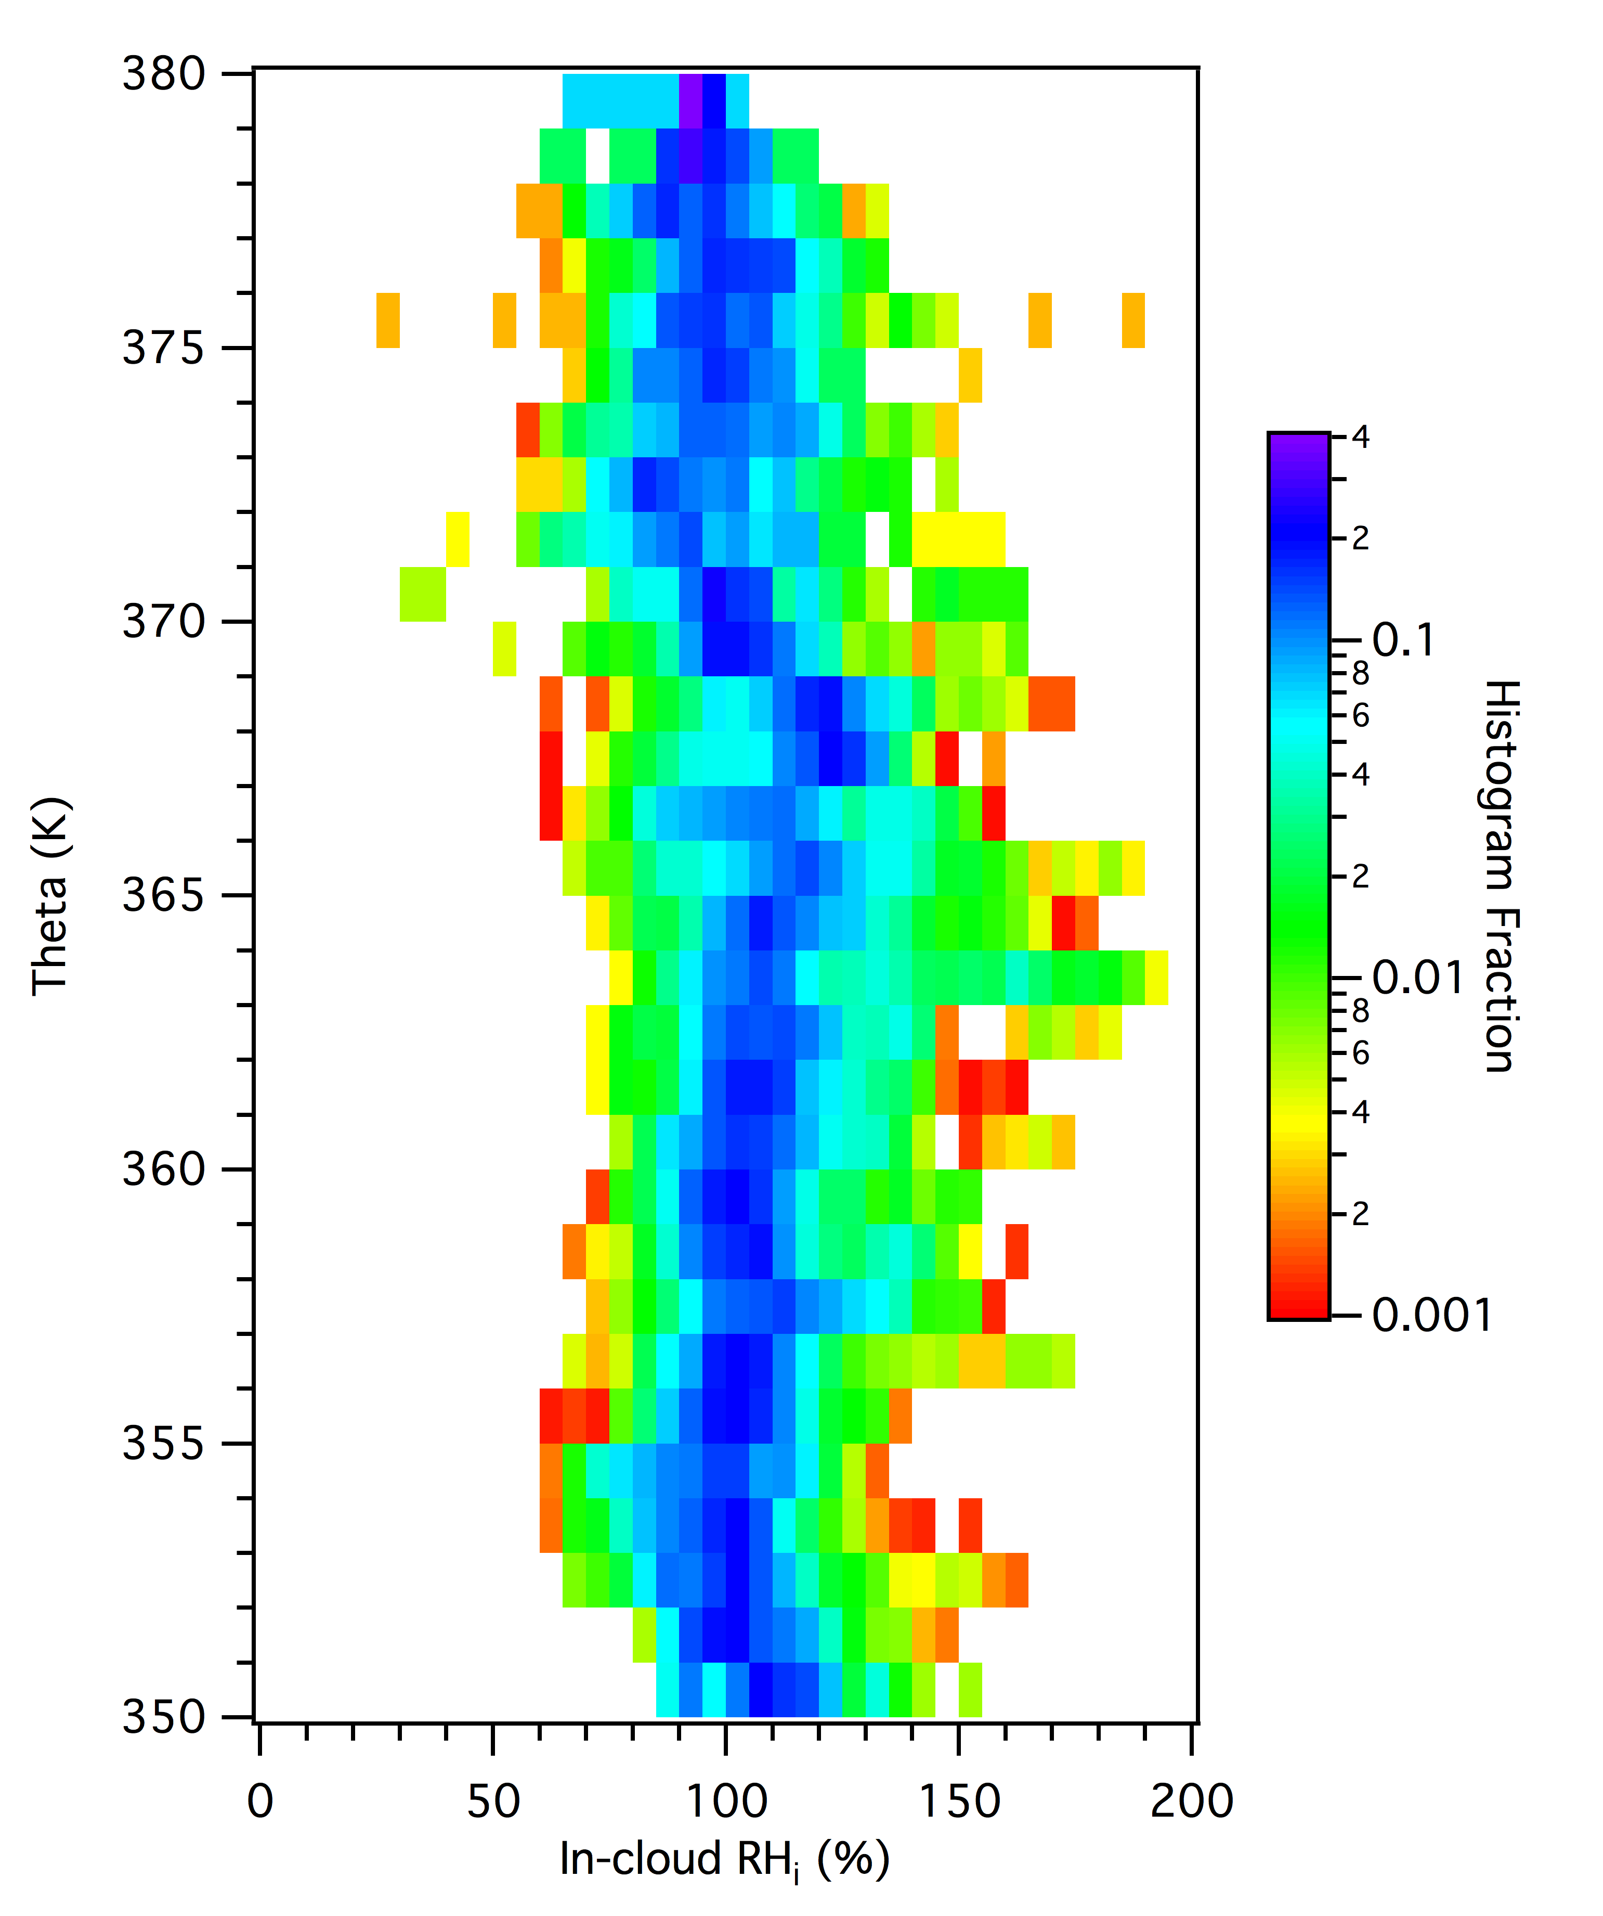
In-cloud RH_{ice} profile
Distribution of RH_{ice} within cirrus centered near 100% throughout profile
Values range from ~50% to above homogeneous freezing threshold

Slide 15
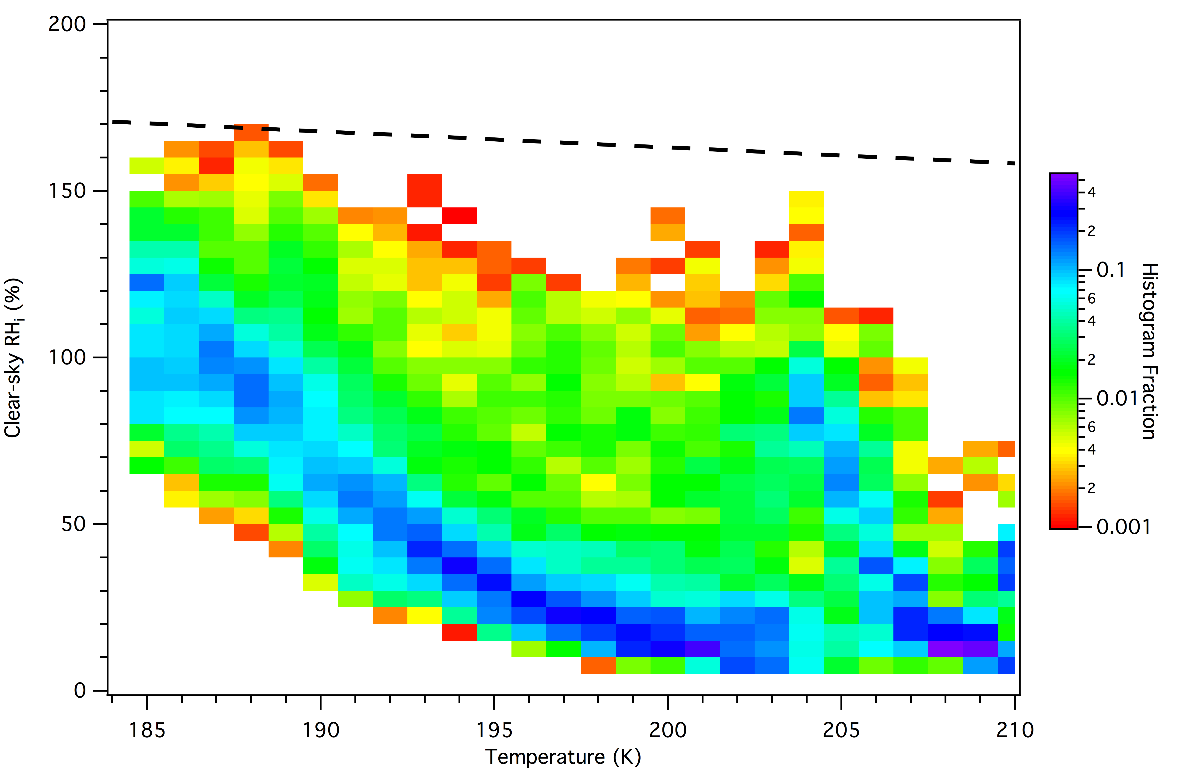
Clear-sky RH_{ice} vs T
Koop et al. (Nature 2000)
Homogeneous freezing threshold

Slide 16
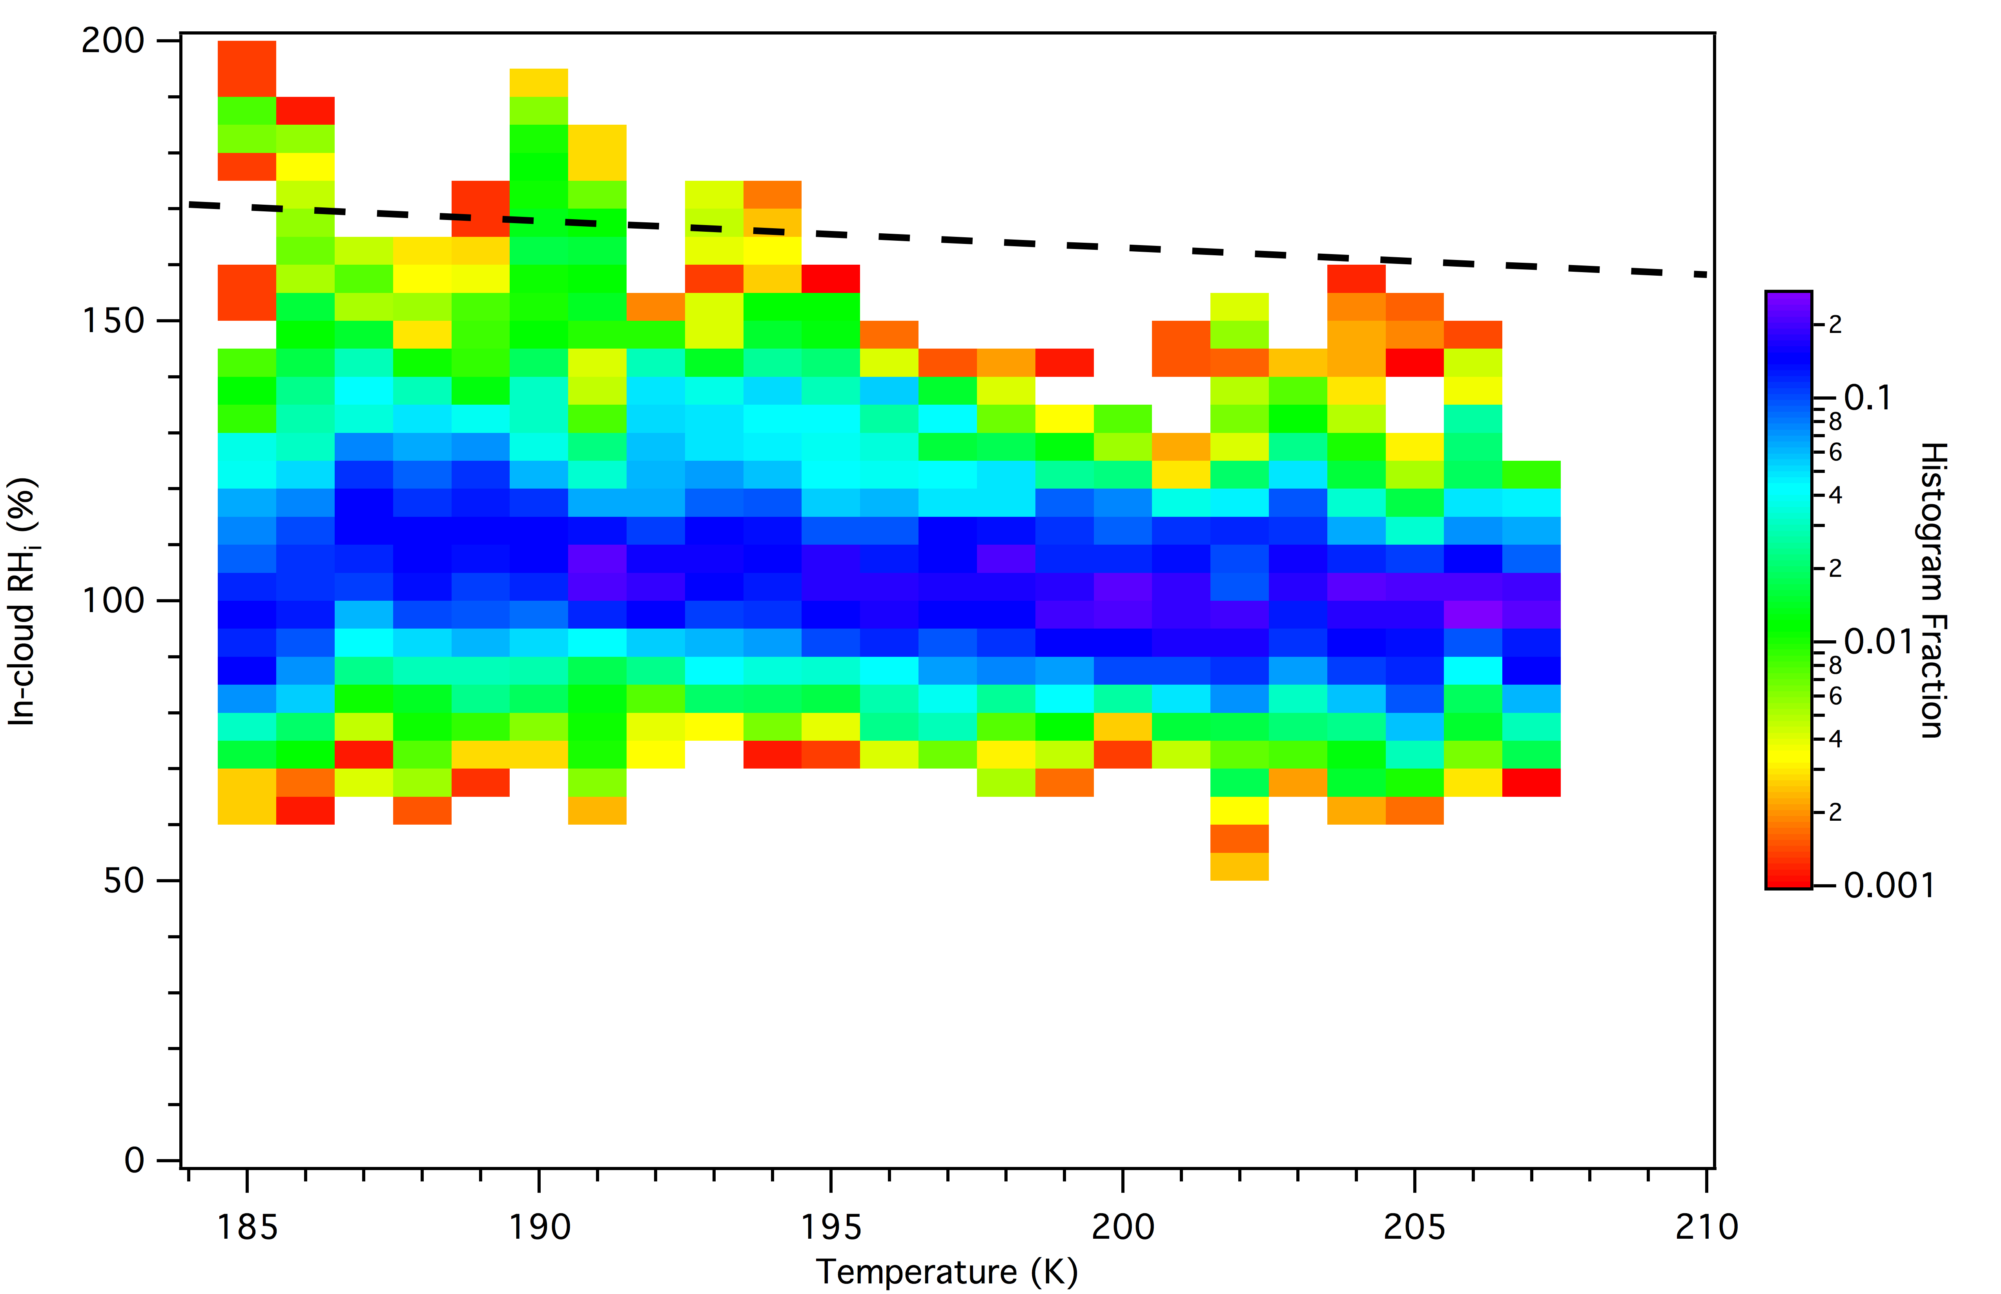
In-cloud RH vs T

Slide 17
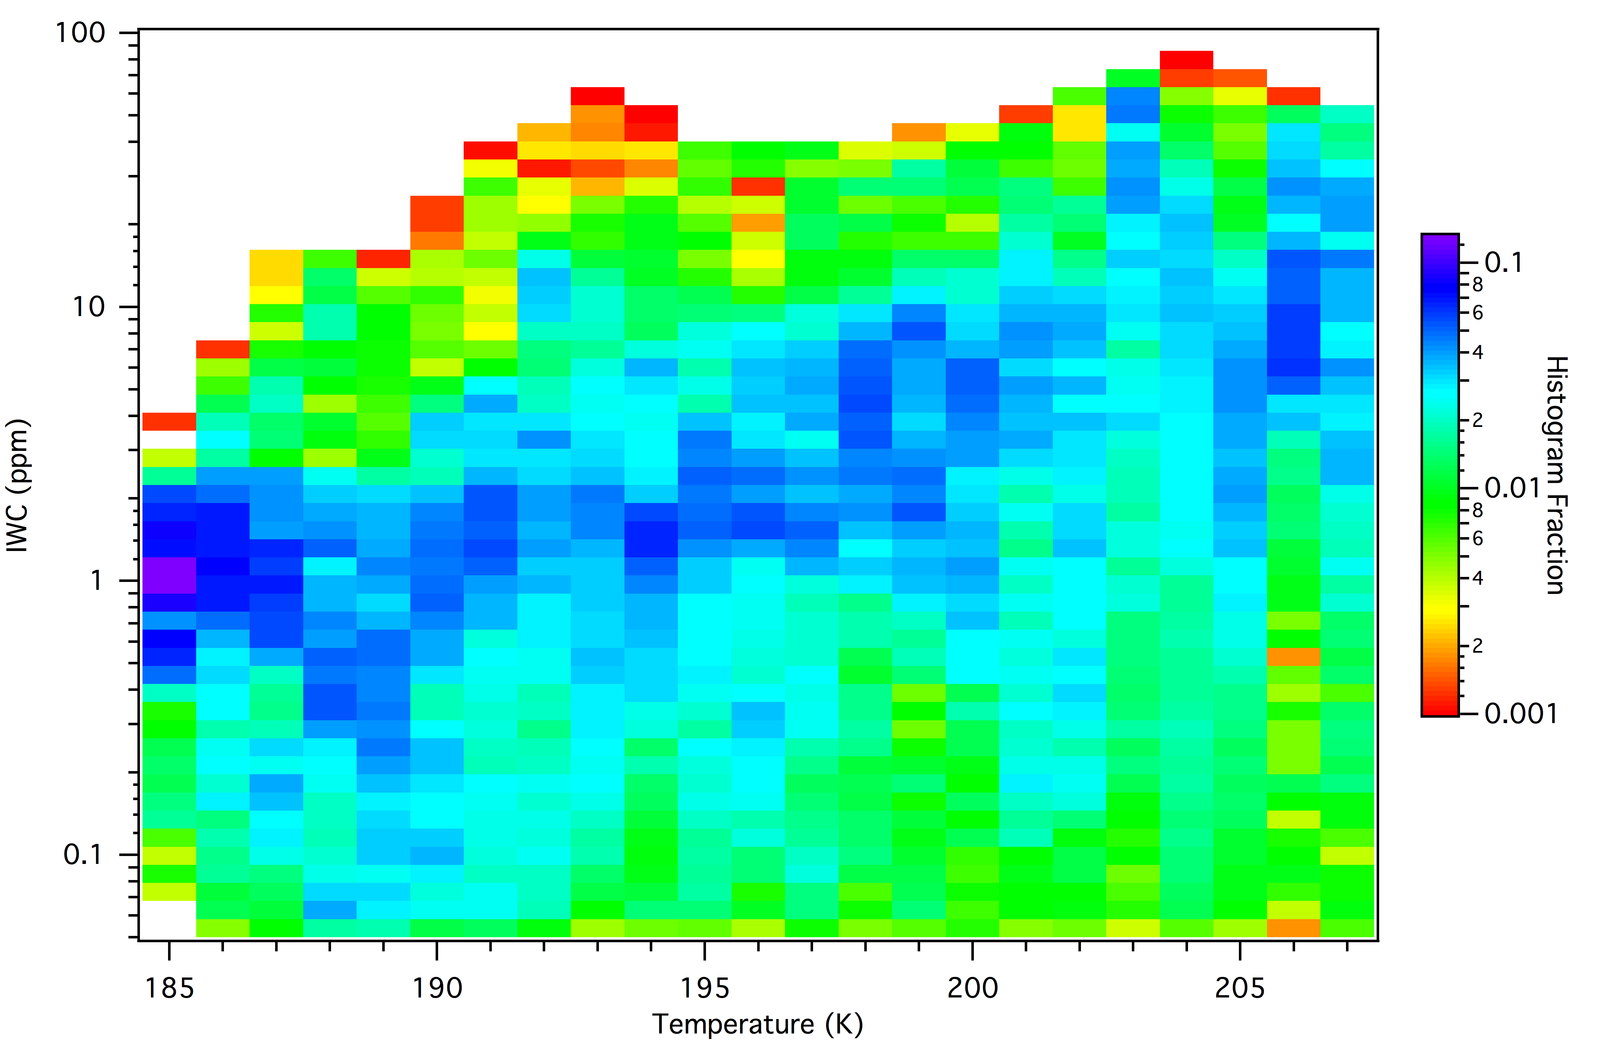
IWC vs T

Slide 18
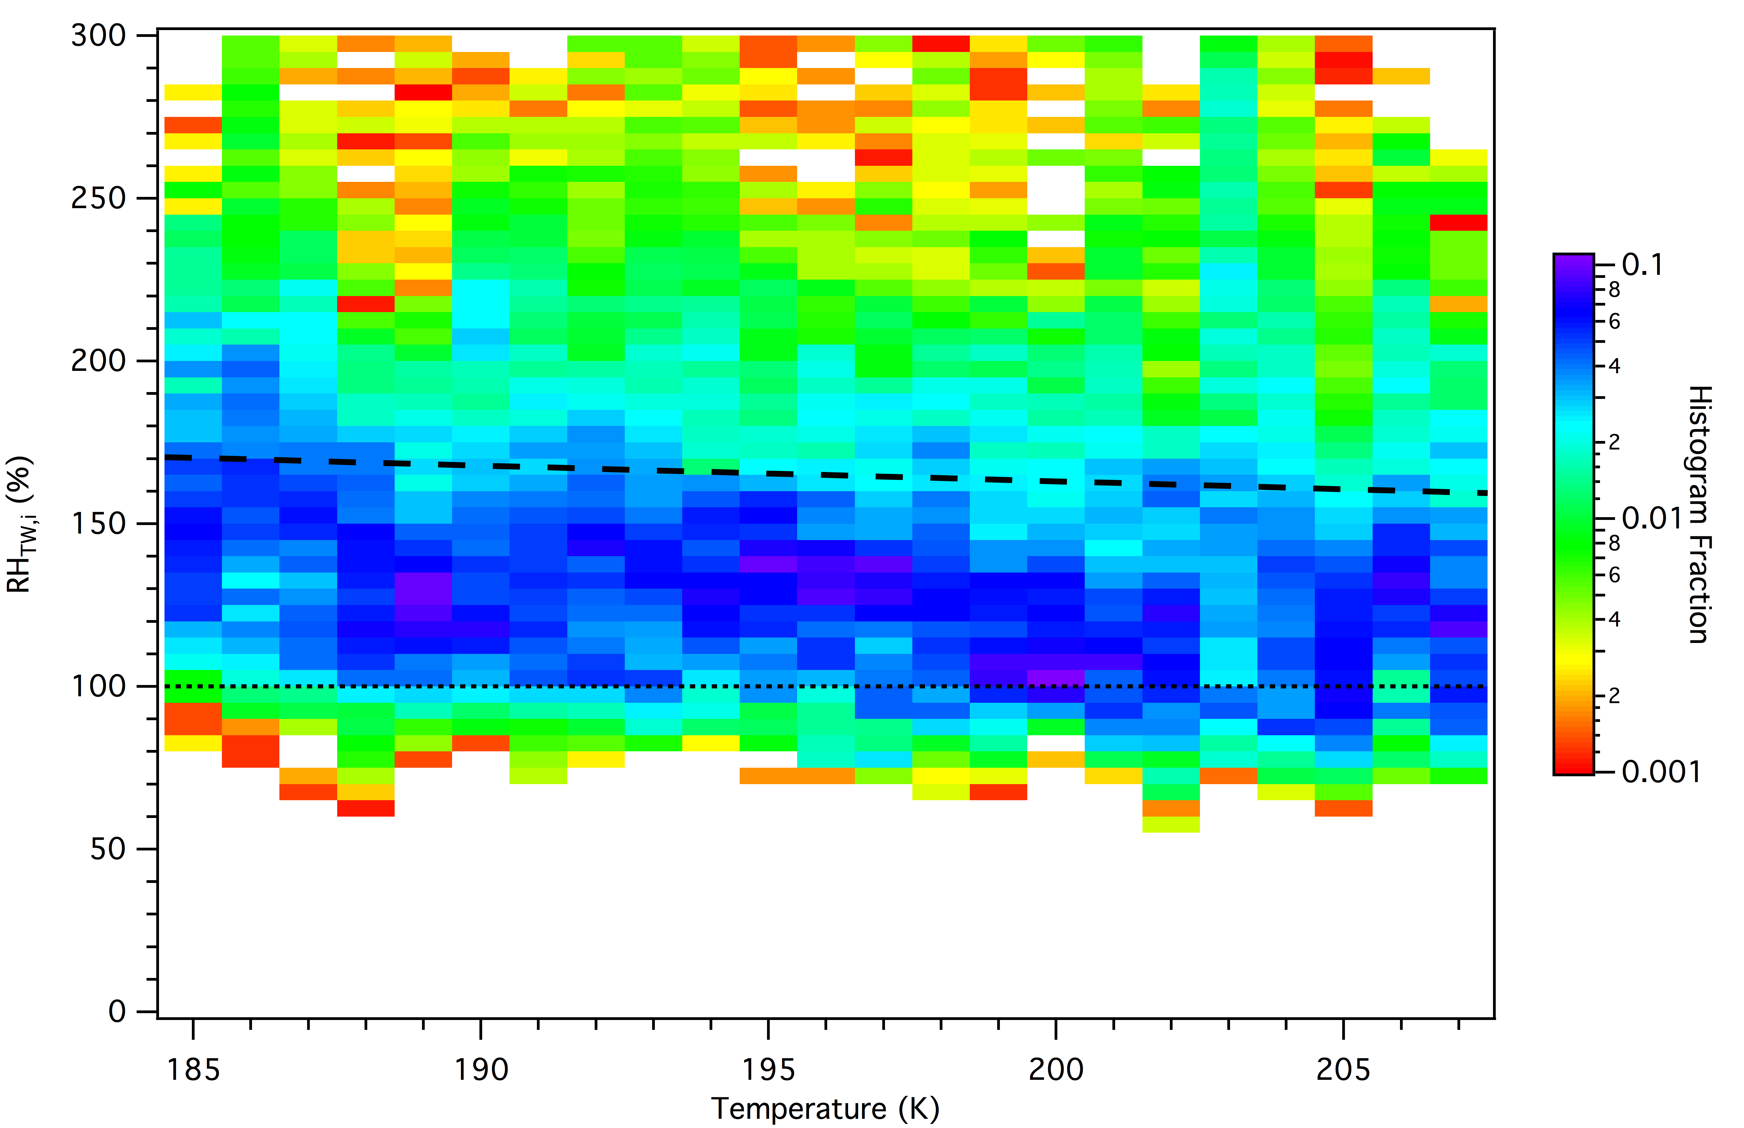
S_{TW} vs Temperature

Slide 19
Summary
GH observations of temperature and water vapor profiles are consistent with the zonal mean differences between 2013 and 2014
Sampled cloud fractions higher than satellite climatology
RH_{ice} below homogeneous freezing threshold in clear air
Distribution of RH_{ice} in cirrus peaks near 100% but has a broad range and potentially some very high values
Significant cirrus IWC measurements along with cirrus properties measurements
Distribution of TW (vapor + IWC) includes a number of values significantly exceeding homogeneous freezing threshold

Slide 20
Directions
NW and FCDP/Hawkeye IWC closure
Investigation of in situ cirrus nucleation mechanisms
Dehydration efficiency…

Slide 21
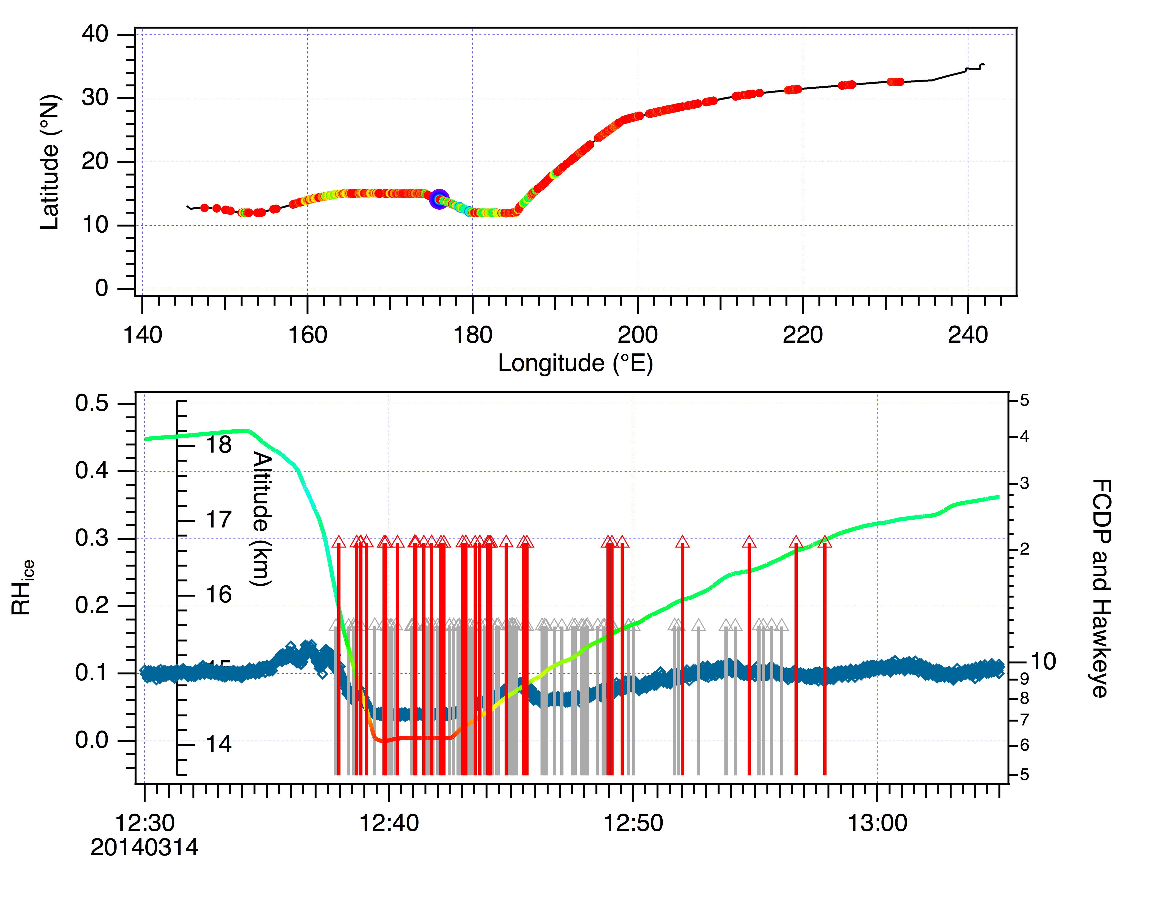
Non-water containing particles in the LS?

Slide 22
END

Slide 23
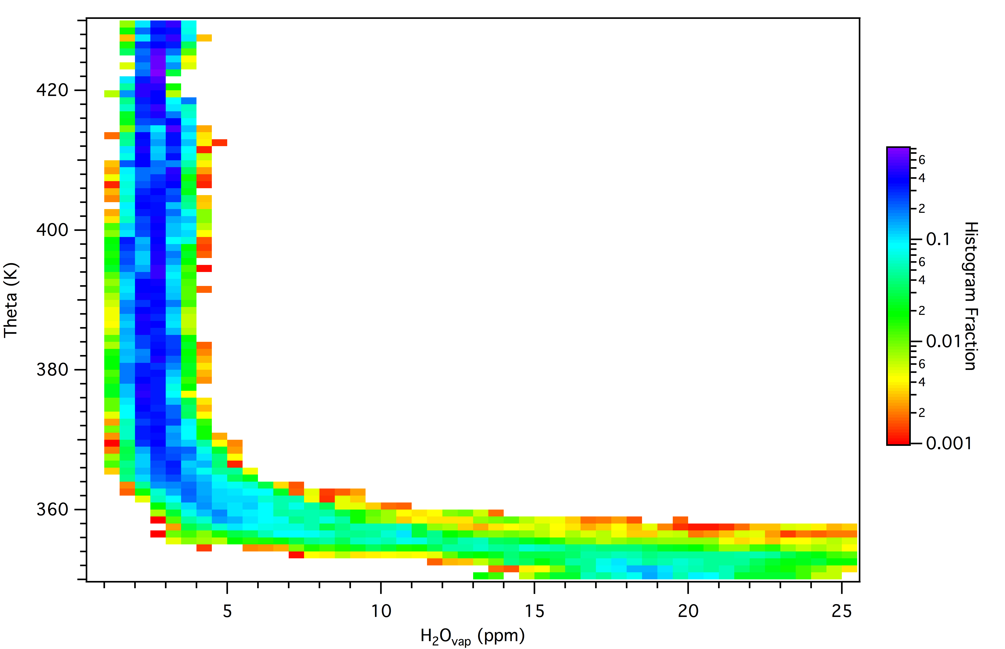
WV profile

Slide 24
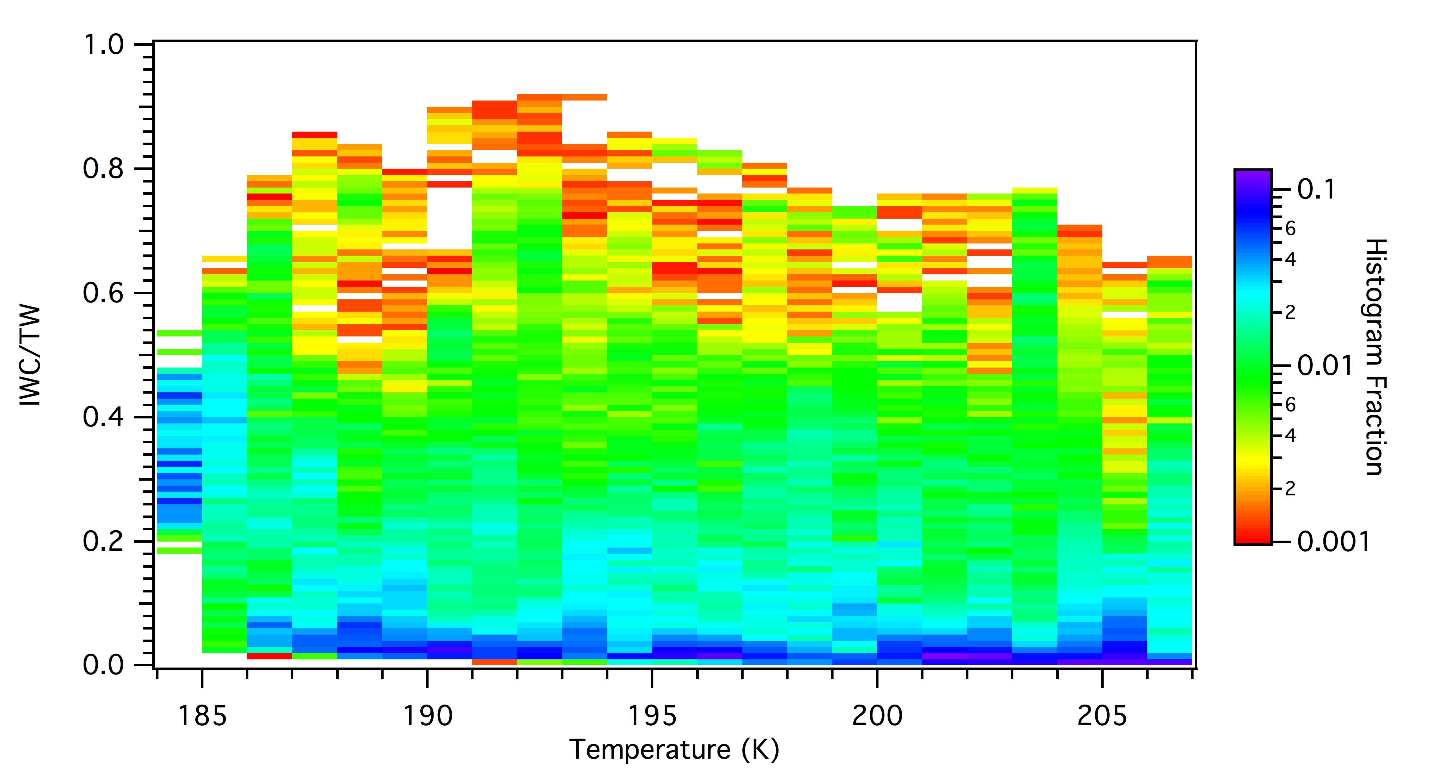
IWC/TW ratio vs T

Slide 25
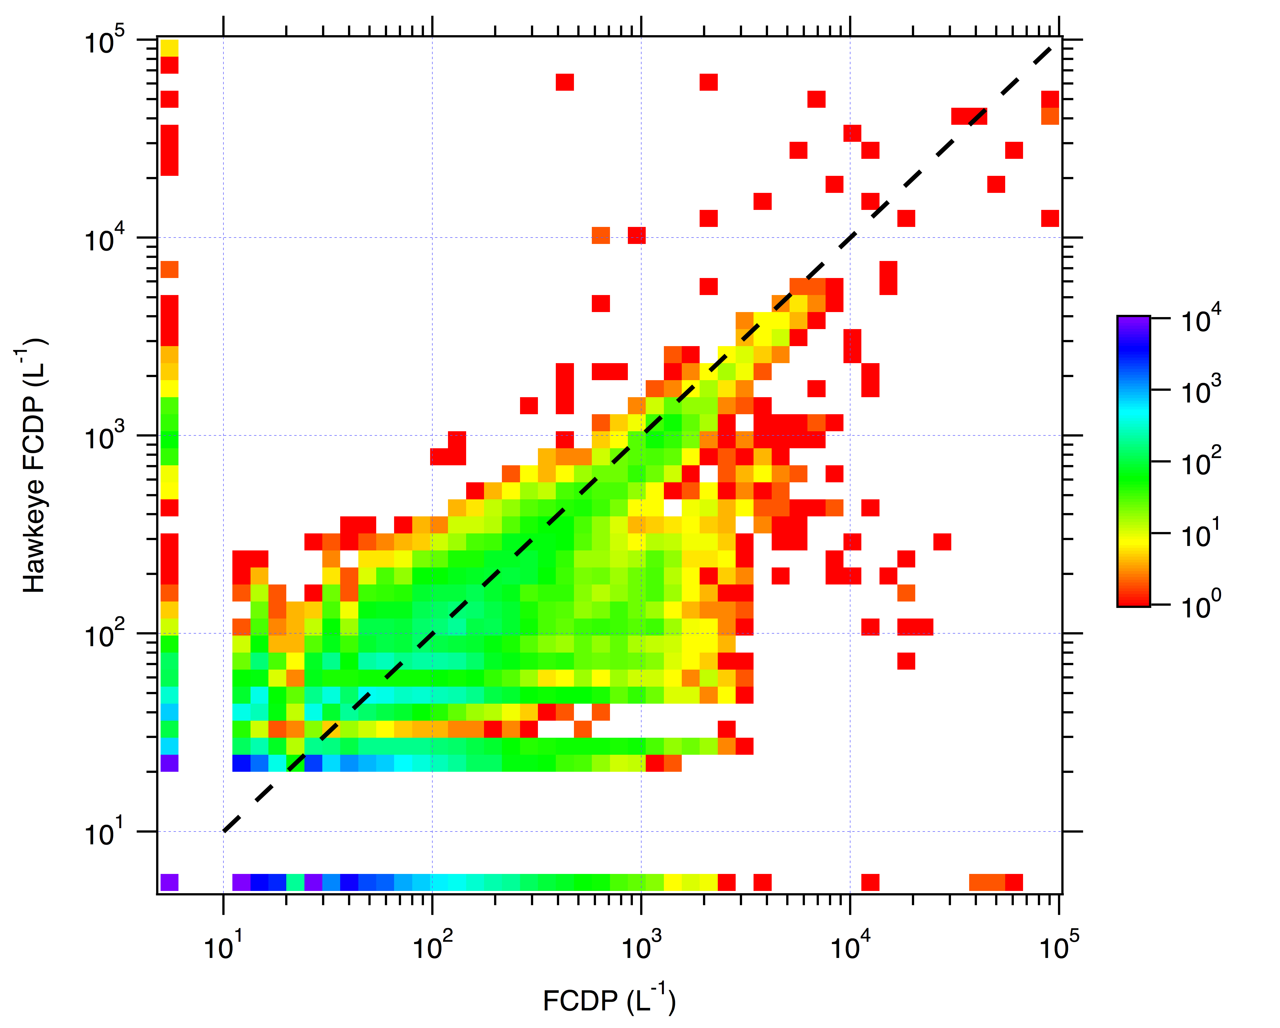
Hawkeye FCDP vs FCDP

