Slide 1
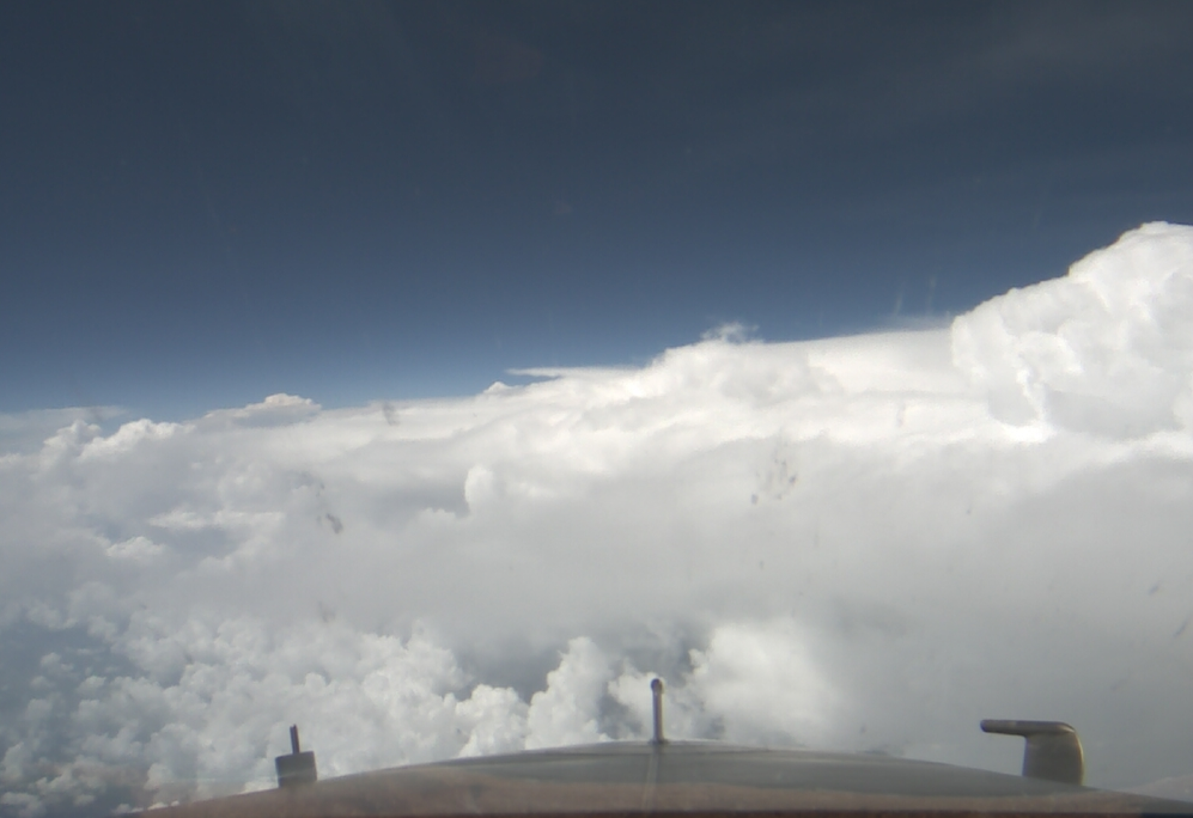
Formaldehyde Scavenging Efficiency Determinations in Convective Clouds: Comparisons of Select SEAC⁴RS Data with DC3 Results
Alan Fried, Dirk Richter, Petter Weibring, James Walega
Institute of Arctic & Alpine Research
University of Colorado
Johnny Luo, Mary Barth, Megan Bela, Brian Toon, Nicola Blake, Don Blake, Eric Apel, and many other contributors

Slide 2
DC3 in 2012
DFGAS
CAMS

Slide 3
Enhanced CH₂O Consistently Observed in & Above Convective Clouds, even in the UT/LS – Why?
An important source of HO_{x} radicals & O₃ to UT/LS

Slide 4

Scientific Questions (Cont.)
Can we accurately measure CH₂O scavenging efficiencies (SEs)?
  wide range of SE’s (0 to 39%) in previous studies
  why?
Relationship between CH₂O enhancements & microphysical cloud properties, vertical velocity, etc.
  ice degassing/retention

Slide 5
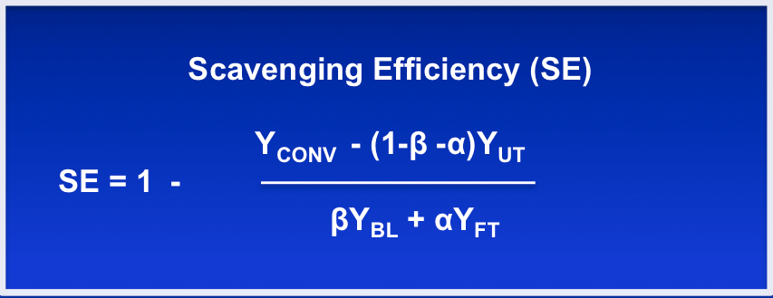
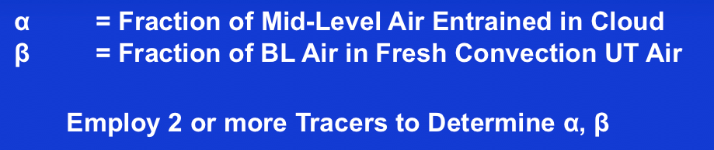
3-Component Mixture Model CH₂O SE’s – Borbon et al. JGR, 2012

Slide 6
For DC3
Developed 3 additional approaches
  Altitude-dependent entrainment model using HCs followed by extrapolation back to core
    ratios of ratios:
      1 - {(CH2O/n-Butane)_{OF}/(CH2O/n-Butane)_{IF}}
    WRF-Chem with and without scavenging on
For SEAC⁴RS (Sept 18)
Weaker convection & multiple passes through convective cores
  Altitude-dependent entrainment model using CO2

Slide 7
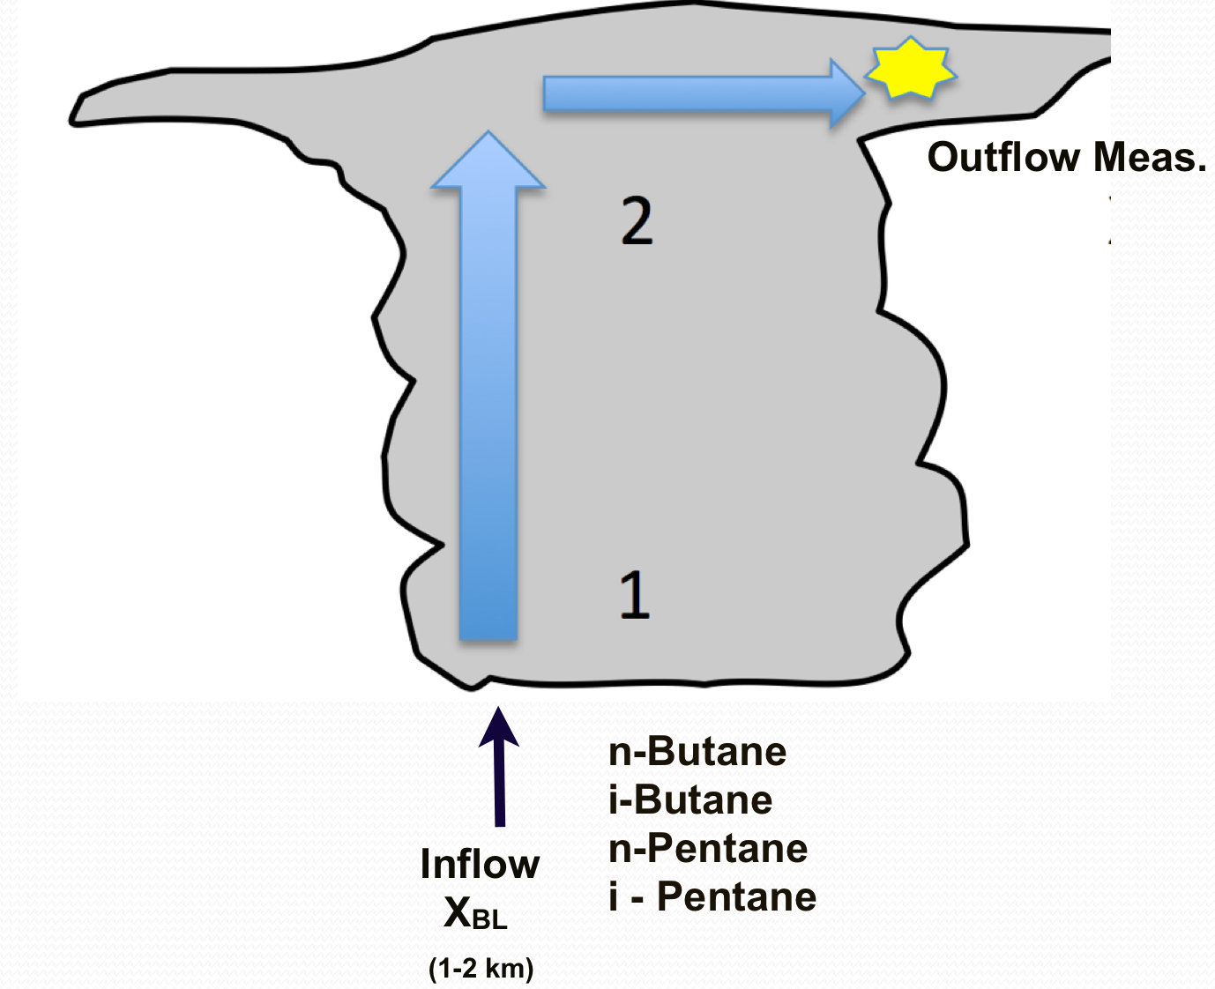
All approaches require that IF & OF are coherently related (i.e., same air mass)
i/n Butane
i/n Pentane
i/n Butane
i/n Pentane

Slide 8
DC3 & SEAC⁴RS Sampling
X_{UT}
Must Consider
UT/LS Dilution
Production
Destruction

Slide 9
Altitude-Dependent Entrainment Model
DC3 Analysis – 3 Step Process

Slide 10
1. DC3 Analysis – Determine Entrainment α using HC Tracers in Iterative Calc.
X_{UT}
35 -45 m/s
X_{(BKG)} = Median CF value at that Alt.

Slide 11
2. Employ α to calculate (Y_{core})_{calc.}
CH₂O in Core diluted by entrainment but not scavenged
(Y_{core})_{calc.}
35 -45 m/s

Slide 12
3. DC3 Analysis – Extrapolate From OF Measurements to Storm Core
(Y_{core})_{calc.}
(Y_{extrap} _{t=0})
35 -45 m/s

Slide 13
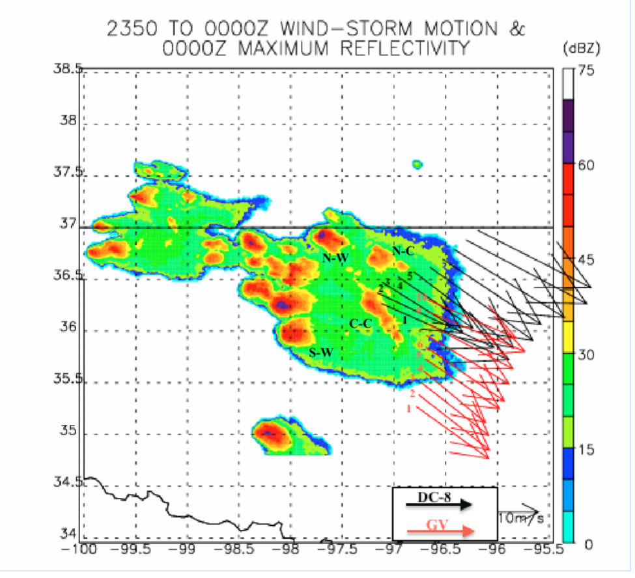
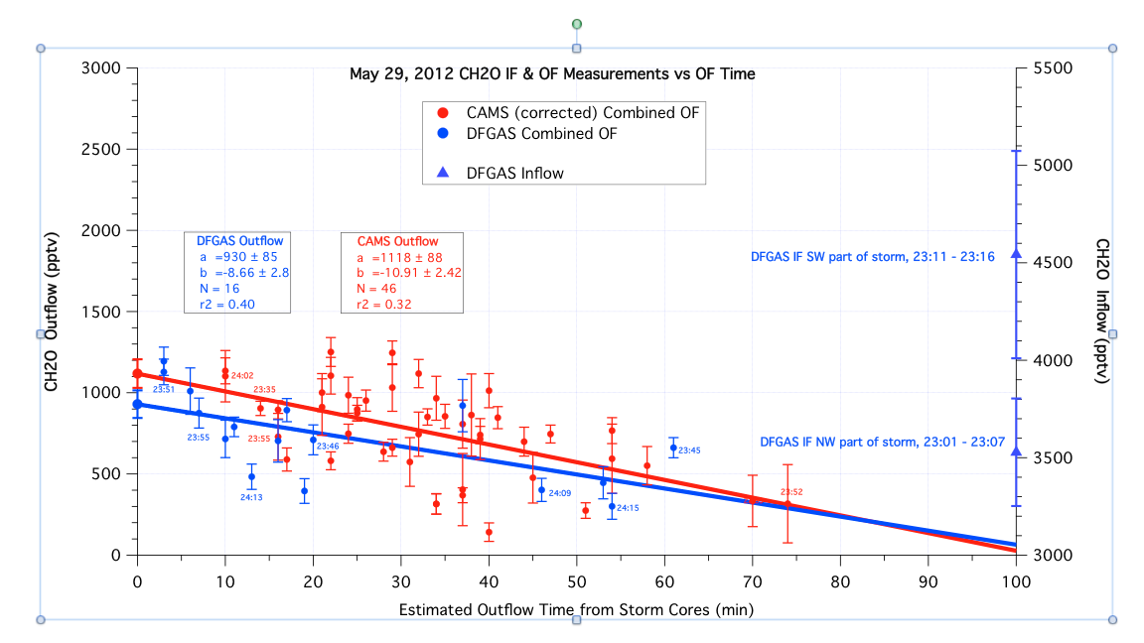
May 29, 2012 DC3 MCS Over Oklahoma
Graphically estimate OF times from:
Storm relative radar images
Measure linear distance along wind vectors
From closest intense storm core to airplane
Use distance & WS to determine OF time

Slide 14
May 29, 2012 DC3 MCS Over Oklahoma
(Y_{core})_{calc.} - (Y_{extrap t=0})
SE =
(Y_{core})_{calc.}

Slide 15
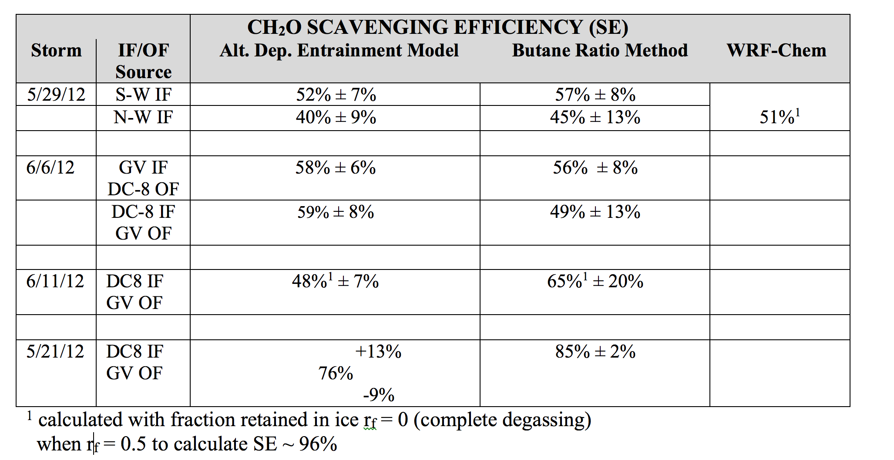
DC3 CH₂O SE’s
Ice ret = 0
Fried et al. JGR Paper in Preparation

Slide 16
SEAC⁴RS Sept. 18, 2013
Sample Directly in Core
Eliminate Extrapolation to Core
X_{UT}
< 7 m/s

Slide 17
Sept. 18, 2013 SEAC4RS Flight

Slide 18
Sept. 18, 2013 SEAC4RS Flight

Slide 19
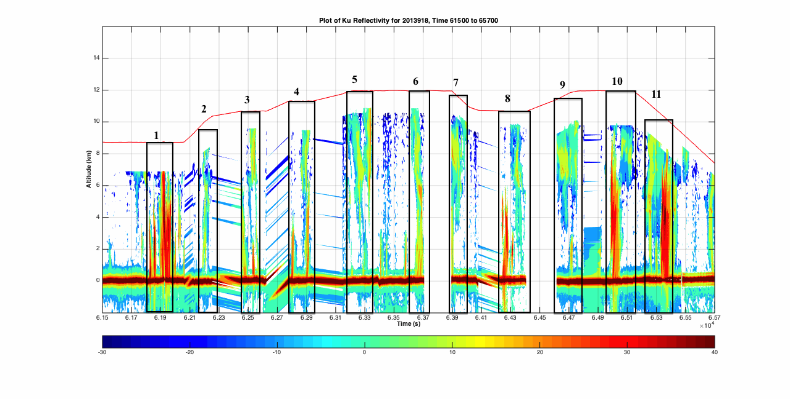
SEAC⁴RS Sept 18 Radar Images
From APR-2 Radar Simone Tanelli - JPL

Slide 20
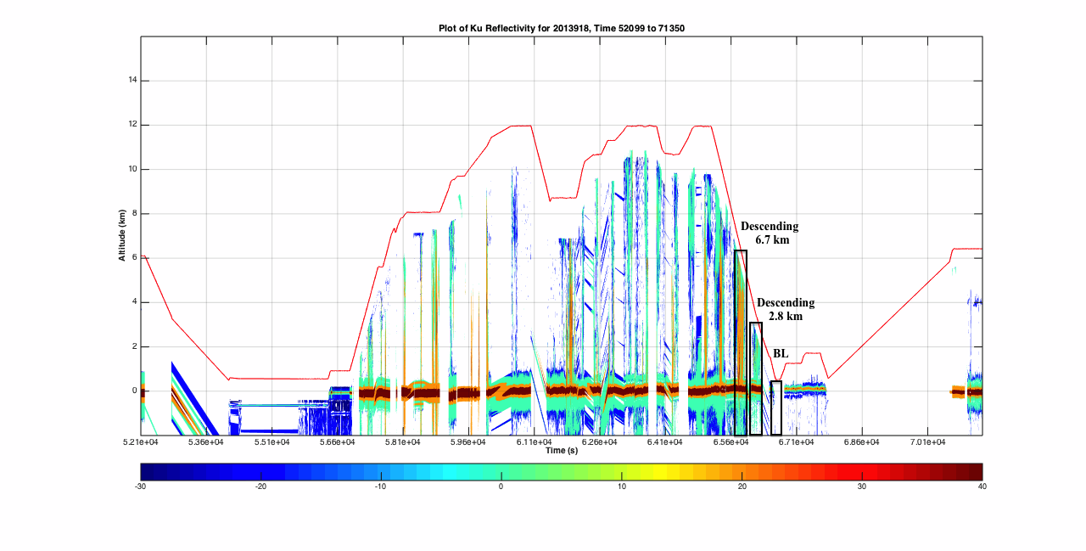
SEAC⁴RS Sept 18 Radar Images

Slide 21
Sept. 18, 2013 SEAC4RS Flight
CO2 – M. Yang, NASA
2DS - S. Woods, SPEC
MMS – P. Bui, NASA

Slide 22
Sept. 18, 2013 SEAC4RS Flight

Slide 23
Sept. 18, 2013 SEAC4RS Flight

Slide 24
Sept. 18, 2013 SEAC4RS Flight
Expected more scavenging:
~ 18 min more contact time
~ factor 100 higher HL
Unless: a) complete ice rejection or b) ice coating prevents further uptake?
All ice

Slide 25
Tentative Conclusions & Ongoing Work
With coherently related IF & OF (i.e., same air mass) get very similar CH2O SE’s from various approaches in various storms
  DC-3 SE 40 – 65% range for 3 strong storms
  SEAC⁴RS SE 43 – 57% range from 6 core intercepts
  Quite different from previous SEs in both range and magnitude – why?

Slide 26
Tentative Conclusions & Ongoing Work (Cont.)
Complete rejection of CH2O from ice?
  vastly different vertical velocities yield similar SEs
    measurements at 2 altitudes yields same SE
  WRF-Chem requires complete rejection from ice. (more analysis required to rule out errors in microphysics, missing aqueous chem., etc.)
Ice coating may prevent further uptake?
Extend SEAC⁴RS analysis to other storms – multiple core intercepts when liquid phase dominant

Slide 27
Thank You

