Slide 1

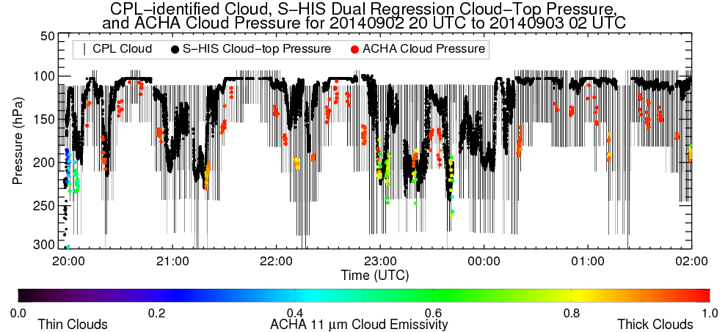
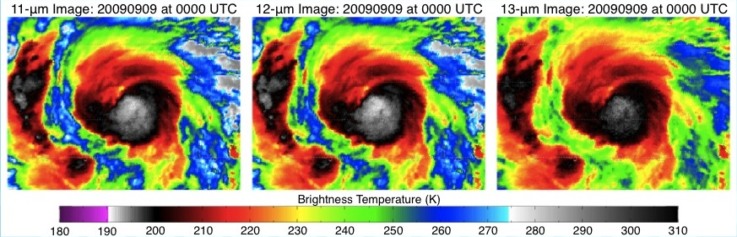
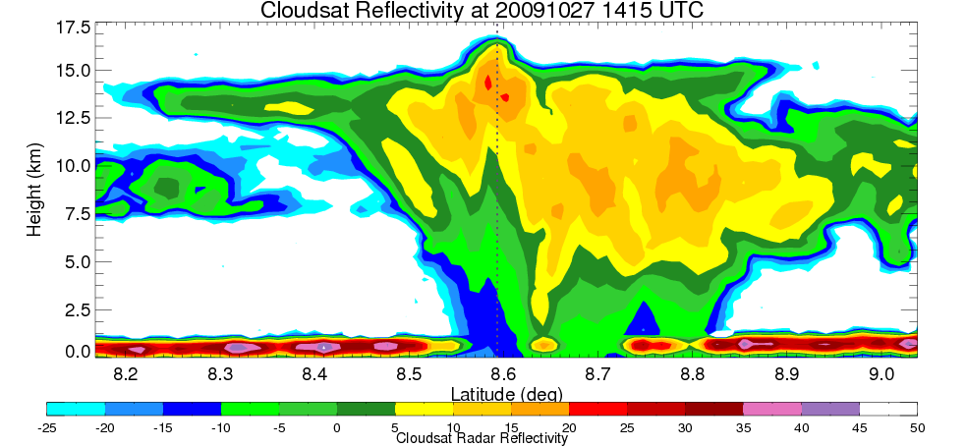
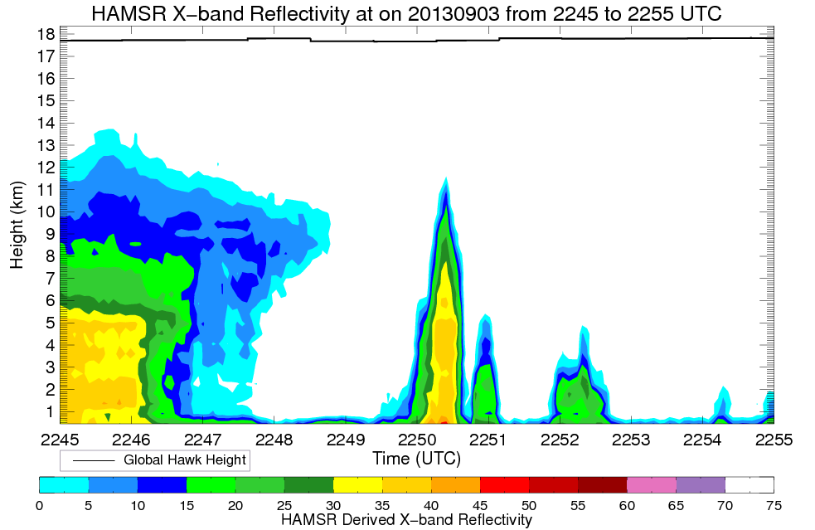
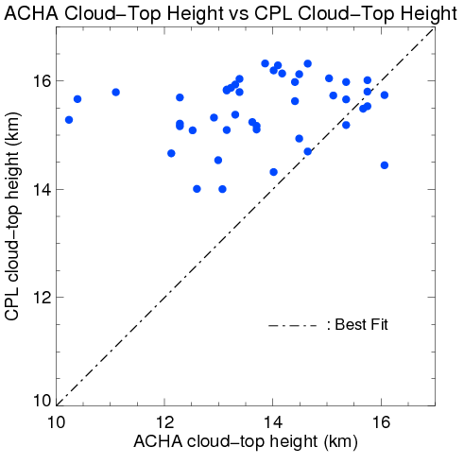
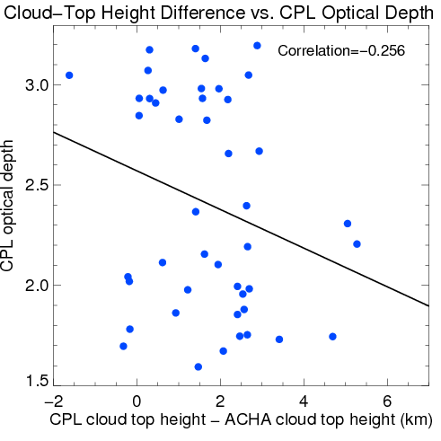
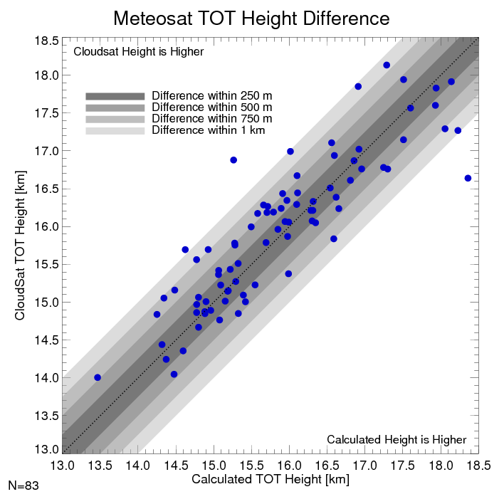
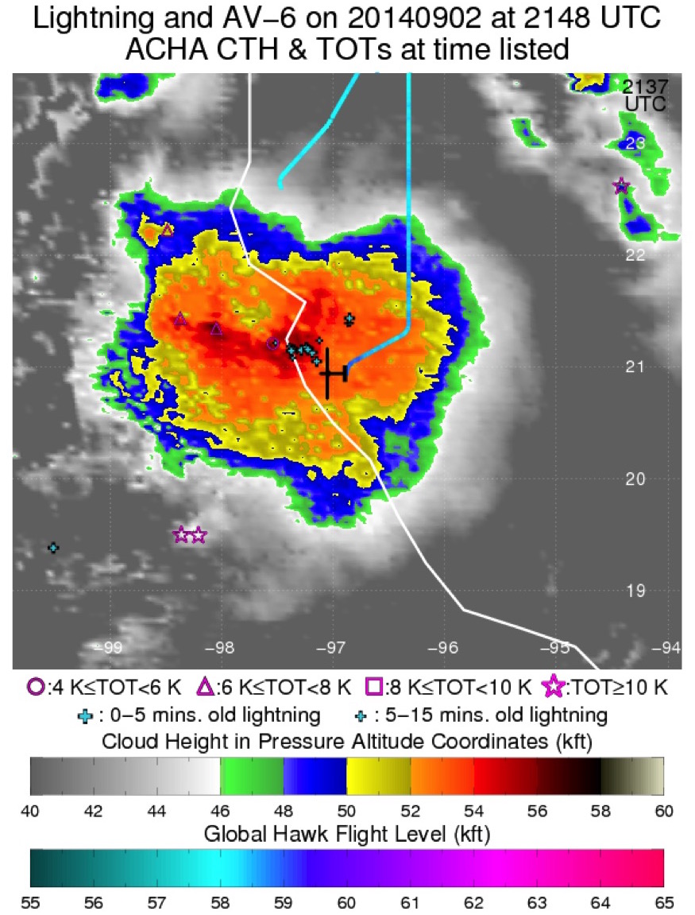
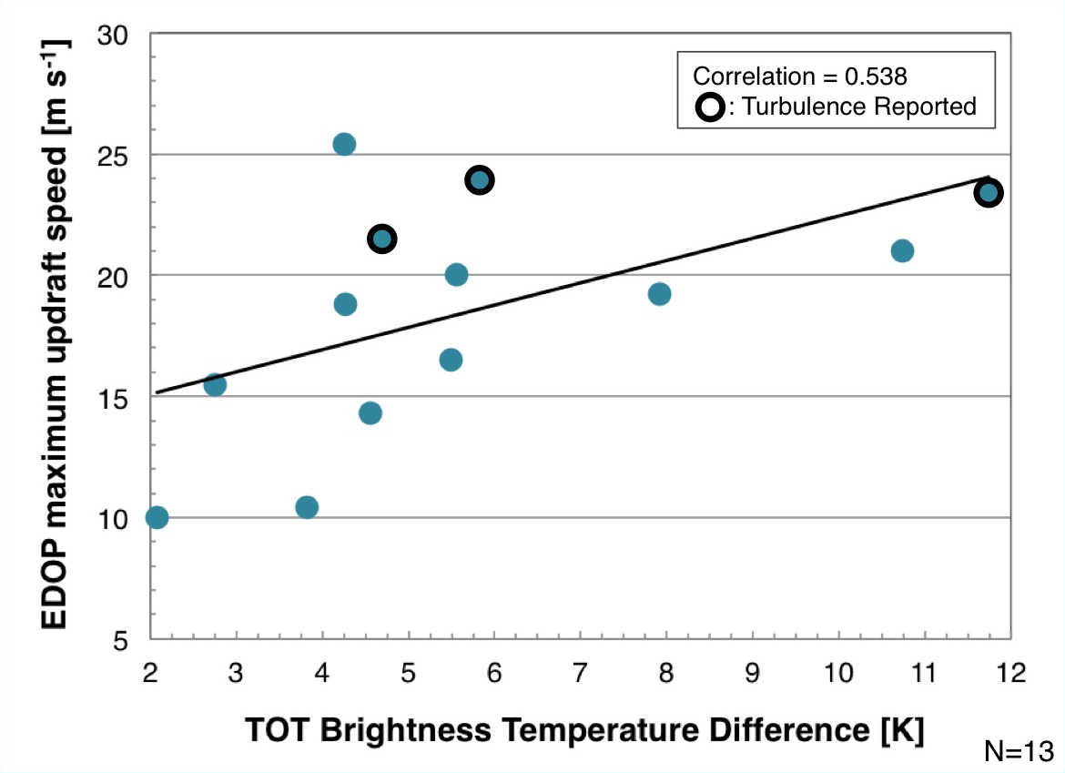
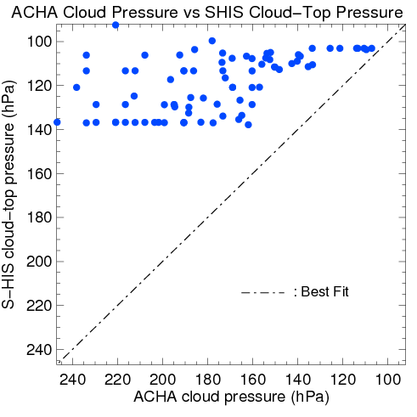
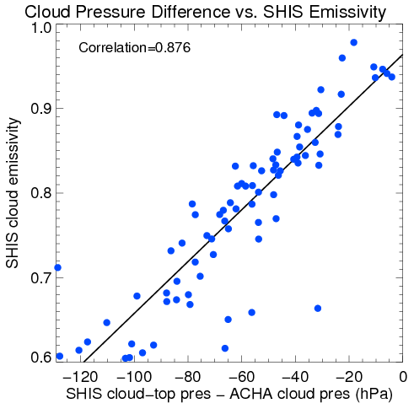
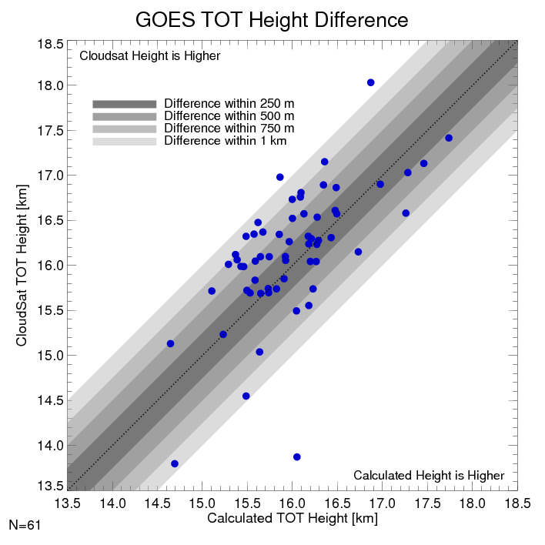
Summary of Tropical Cyclone Cloud-Top Products and Analyses from Satellite during the HS3 Project
Christopher S. Velden and Sarah M. Griffin
Cooperative Institute for Meteorological Satellite Studies, University of Wisconsin-Madison
Contacts: Christopher Velden: chrisv@ssec.wisc.edu Sarah Griffin sarah.griffin@ssec.wisc.edu
Support: NASA Hurricane Science Research Program
  About the ABI Cloud Height Algorithm (ACHA):
Developed by NESDIS in preparation for the GOES-R Advanced Baseline Imager (ABI).
Utilizes satellite IR data, as well as a radiative transfer model to obtain other cloud properties.
Employs the 6.5, 11, and 13.3 µm (Meteosat) or 6.7, 11 and 13.3 µm (GOES) LW-IR band, so can operate night and day.
Steps to achieve an ACHA cloud height (each pixel):
Identifies cloud-top brightness temperature, and determines cloud emissivity and optical depth.
Calculates the cloud-top temperature from the above variables.
Compares the cloud-top temperature to a collocated temperature profile provided by Numerical Weather Prediction data (GFS model) to derive cloud-top height (CTH) and pressure.
Note: For HS3, cloud-top pressure was also converted to pressure altitude coordinates for aviation purposes.
Comparing ACHA to the Cloud Physics Lidar (CPL) and Scanning
High-resolution Interferometer Sounder (S-HIS) aboard the GH :
About Tropical Overshooting Tops (TOTs):
Automated algorithm employs the 6.7 and 11 µm LW-IR bands from GOES/Meteosat: can operate night/day.
Utilizes Numerical Weather Prediction (GFS model) to derive tropopause pressure.
Steps to identify a TOT:
Consider only 11 µm cloud pixels colder than 215 K.
Sample surrounding anvil at an 8 km radius.
Calculate TOT probability based on comparison of candidate pixel’s 6.7 and 11µm BT, and difference between 11µm pixel and anvil BT.
Identified as a TOT if Bayesian probability exceeds empirically-determined threshold.
Calculating the Height of TOTs:
TOT Anvil Height: height of the mean anvil BT from an NWP model collocated profile of temp. and height
TOT BTD: TOT pixel BT – Anvil mean BT
Lapse rate: -7.32 K km⁻¹ based on a careful analysis of 107 high-resolution MODIS TOT lapse rates.
Validating the Height of TOTs:
Calculated TOT heights are compared to highest collocated CloudSat Cloud Profiling Radar (CPR) Reflectivity ≥ -25 dBZ .
Comparison between ACHA cloud pressure, CPL-identified cloud, and S-HIS cloud-top pressure over Tropical Storm Dolly (2014). ACHA values are derived from 15-min GOES scans and only plotted if within ±5 minutes and +/- 5km of the Global Hawk and therefore time gaps exist. Overall, ACHA cloud pressures are generally higher (cloud top heights lower) than CPL, likely a result of sensor resolution and cloud top emissivity characteristics.
Example profile of a TOT from the CloudSat CPR. The CloudSat height is the height of the -25 dBZ contour at the dotted line.
High Altitude MMIC Sounding Radiometer (HAMSR) onboard the Global Hawk identifies a narrow band of high reflectivity extending to ~12 km at the location of an identified TOT (est. at ~14 km from a GOES image a minute or two later).
About 70% of Meteosat calculated TOT heights are within 500m of the collocated CloudSat heights.
For more opaque clouds (optical depth > 1.5) with tops above 14 km, ACHA cloud heights are generally lower than the CPL cloud top heights. Some of the ACHA variability can be explained by the CPL-estimated optical depth, with more opaque clouds having a smaller estimated cloud height difference.
About 57% of GOES calculated TOT heights are within 500m of the collocated CloudSat heights.
TOTs are generally associated with updrafts of significant velocity, that can produce turbulence (Lane et al. 2012). Comparison of TOT Brightness Temperature Difference (the TOT magnitude or “strength”) to ER-2 Doppler Radar measured updraft speeds in tropical cyclone conditions (Heymsfield et al. 2010) yields a moderate correlation.
For denser clouds (emissivity > 0.6) above 14 km, ACHA cloud pressures are higher than the S-HIS cloud pressures. Much of the variability 76.7% can be explained by the S-HIS-estimated emissivity. Denser clouds have smaller pressure differences between S-HIS and ACHA.
Global Hawk investigates Tropical Storm Dolly (2014) over cloud tops estimated by ACHA at 52-54 kft.

