Slide 1
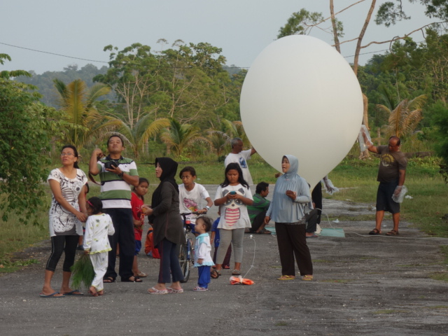
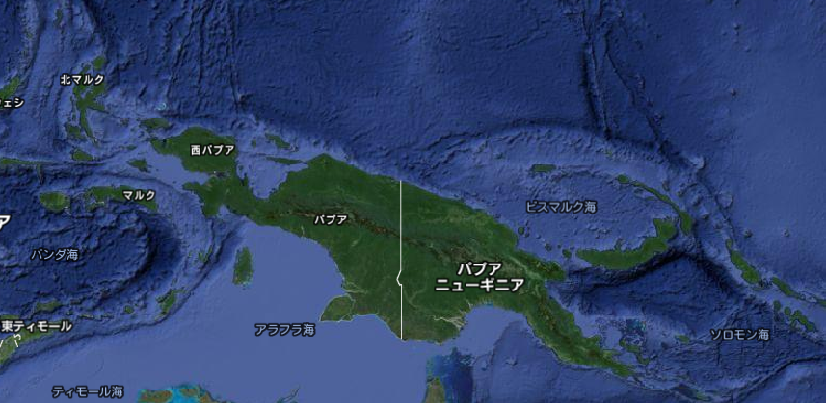
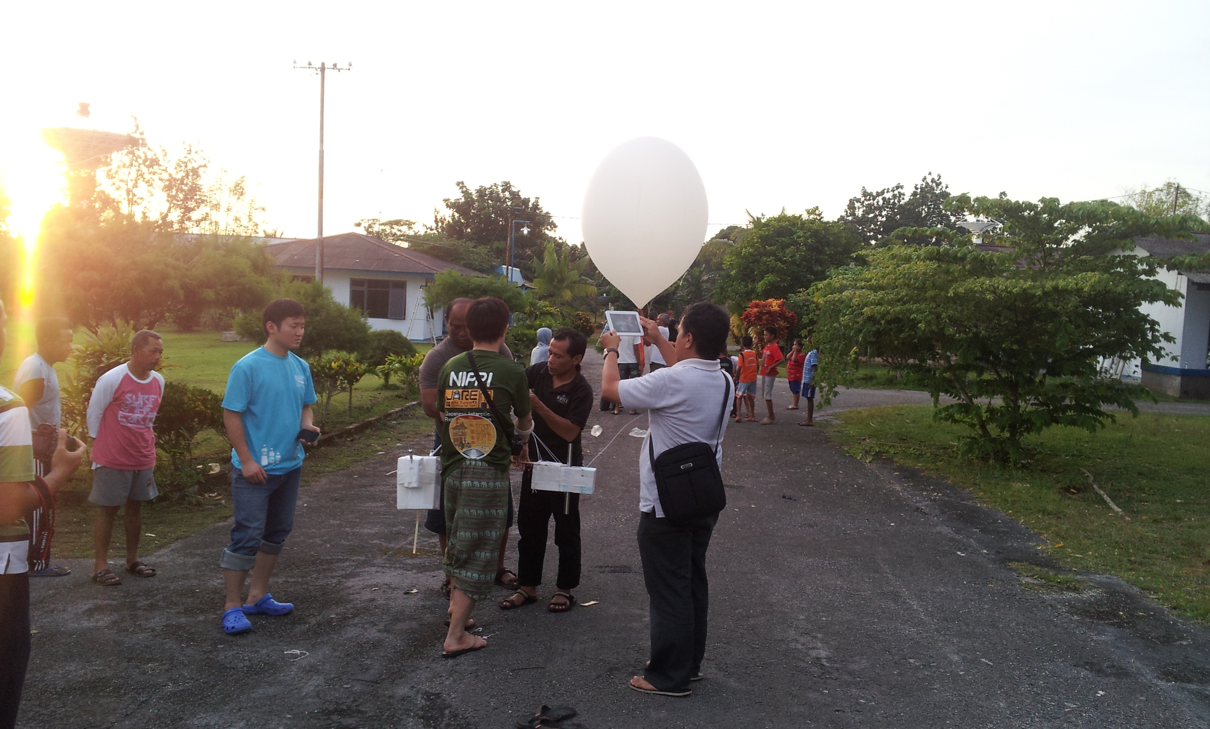
Preliminary findings from the LAPAN-SOWER collaborative observations at Biak, Indonesia in February 2014
Biak at North-West of Papua
Yoichi Inai
(RISH Kyoto Univ.)
and the SOWER LAPAN
science team
SOWER member:
F. Hasebe, M. Shiotani, M. Fujiwara,
T. Shibata, K. Miyazaki, N. Nishi,
J. Suzuki, S-Y. Ogino, M. Hayashi,
S. Iwasaki, …..
photos taken just before sonde launch

Slide 2
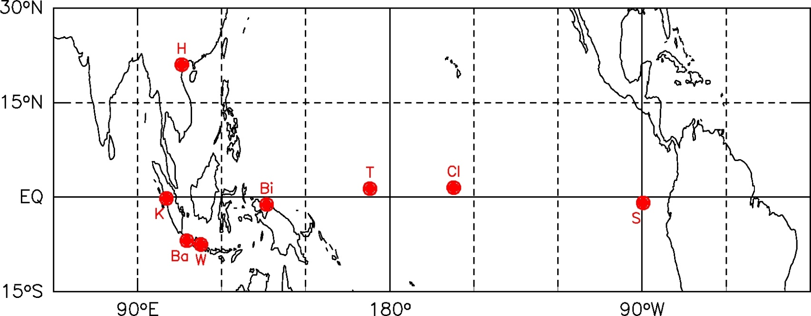
SOWER (Soundings of Ozone and Water in the Equatorial Region)
Balloon-borne campaigns for O₃/H₂O in Tropo/Strato over tropical Pacific (western Pacific-SE Asia in recent yrs)
Proposed by Fumio Hasebe and Masato Shiotani
Started in March 1998 at the Galapagos Is. by F. Hasebe & M. Shiotani, in collaboration with S. Oltmans & H. Voemel
Many researchers and students participated
Ha Noi 2004-5
2006 2007 2008 2009
2010 2011 2012 2013
Location and year of observations
Biak
2004-5
2006
2007
2008
2009
2010
2011
2012
2013
2014
Christmas Is.
1999
2000
2001
2002
2003
San Cristbal
1998
1999
2000
2001
2002
2003
Tarawa
2004-5
2005-6
2007
2010
Kototabang
2006
2007
2008
R/V Mirai
2004-5
R/V Shoyomaru
1999
R/V Hakuho 2012
R/V Mirai
2006/2011
Bandung
2003-4
2004-5
Watukosek
2001
2003
>200 sondes were launched

Slide 3
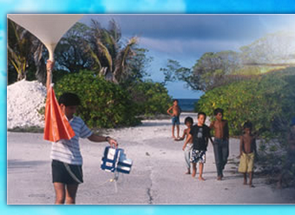
The motivations are providing a long term meteorological record in the UT/LS over WP and understanding of the stratosphere-troposphere exchange (STE) via the TTL.
Especially, we focus on
Understanding of dehydration/
hydration processes in the TTL
Understanding of wave actively
and its role in the STE
Understanding of microphysics
in the UT/LS
For these purposes, we have operated the SOWER campaigns
and conducted 2014 campaign.

Slide 4
Timeline of SOWER 2014 in Biak
: )
Success
) ;
Something wrong
 | 2/17 | 2/18 | 2/19 | 2/20 | 2/21 | 2/22 | 2/23 | 2/24 | 2/25 | 2/26 | 2/27
Morning
15:00 (LT) | Start up | Start up | Test sonde |  |  |  | WV-O3 |  |  |  | Finishing
18:00 (LT) |  |  | WV-O3 | WV-O3 | WV-O3 | WV-O3 | WV-ICE | WV-O3 | WV-O3 | WV-O3
Inai | Sugidachi Mimura Didik Thohirin |  |  |  | Sawada |  |  | Takashima
Success
: )
: )
) ;
) ;
: )
: )
: )
: )
) ;
: )
BB 19km
BB 14km
CFH got wet
In 2014 campaign, we launched 10 sondes;
3 were something wrong, 7 were successful.
WV: CFH, newWV
O3: ECC
ICE: newCPS

Slide 5
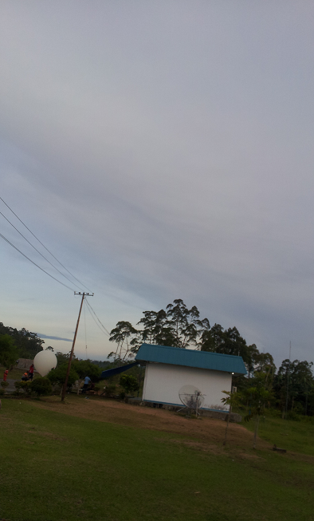
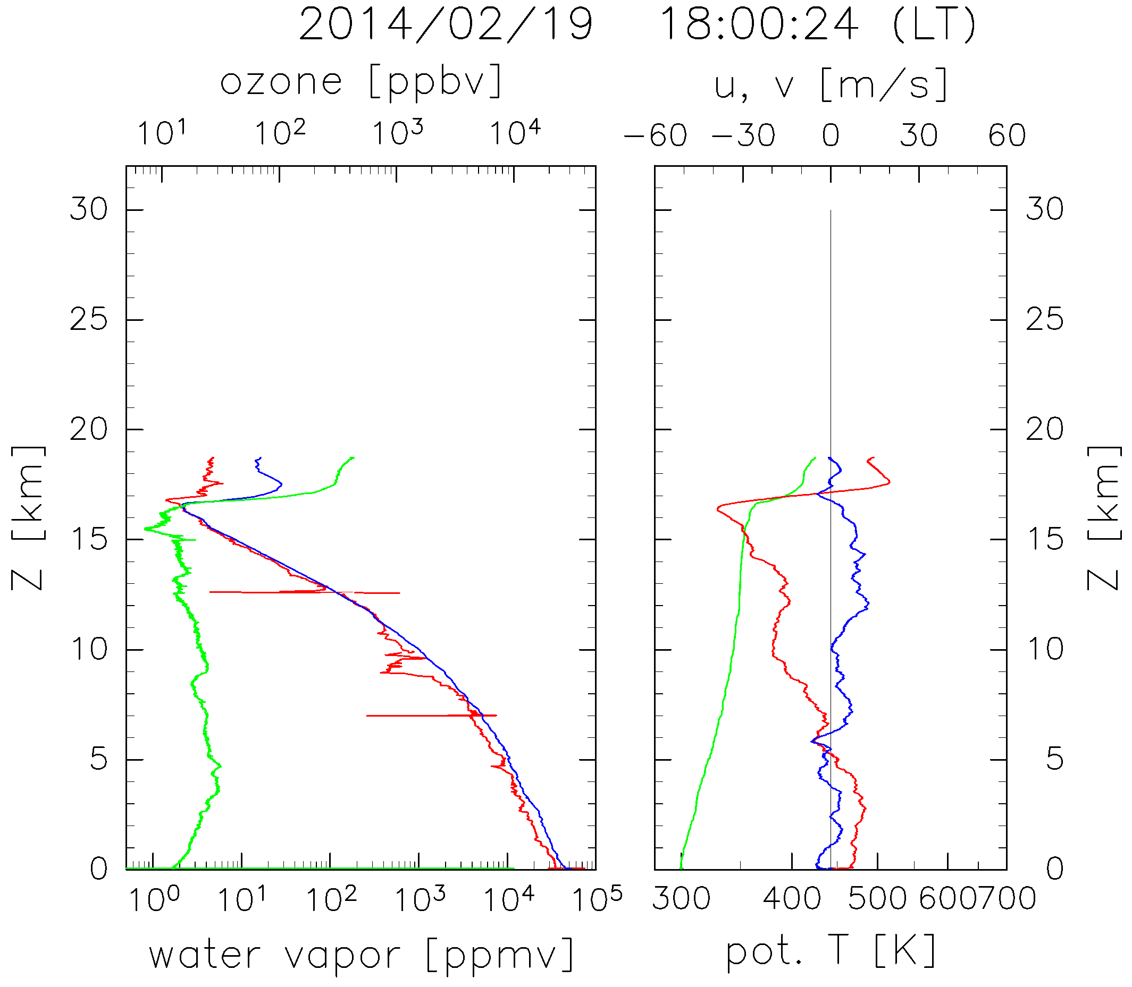
1st WV-O3 sounding
(CFH-ECC)
Balloon 1.2 kg
Payload 2.0 kg
Buoyancy 2.1 kg
TA1200
Photo:
sky at 1st CFH-ECC sounding
Observation Date [yyyy/mm/dd] : 2014/02/19
Launching Time [hh:mm:dd] : 18:00:24
Parachute 160 cm
1st and 2nd CFH-ECC sonde
could not measure the strato.
due to balloon burst
at low altitude.
Unwinder 51m
●メモ
放球時、下層に雲が広がっている
19kmバースト
ECCの暗電流値は当日チェックの値を使用
放球直前は測定せず。（以下８回全て同様）
Separator
CFH
ECC, RS-06G
Configuration
) ;
WV
SWV
19 km
u, v
O3
PT
Profiles
measured by
the 1st sounding.
Unfortunately,
the balloon
burst at 19 km.

Slide 6
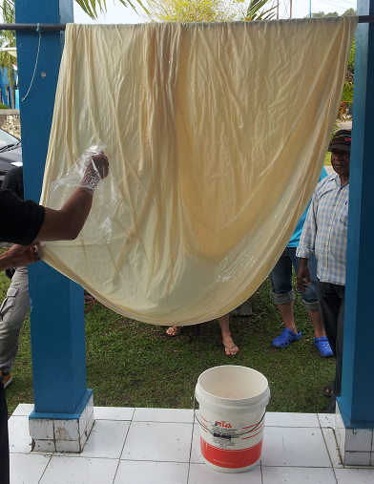
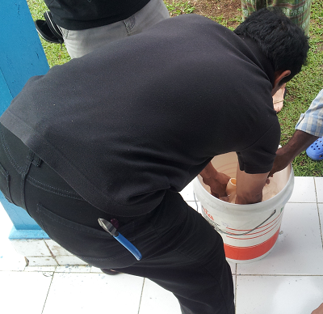
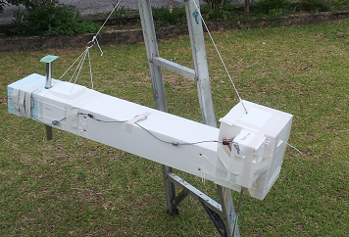
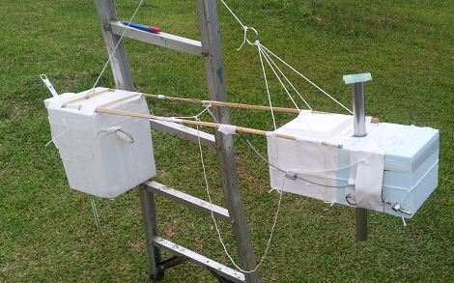
21日以降は全て油漬けを実施
●放球40～50分前くらいに灯油に浸して干す。
・かなり臭い。
・LAPANスタッフは「ガソリン」と呼んでいる。
（家庭用のコンロで使用するものらしい。）
Anti balloon-burst effort
After 1st and 2nd soundings,
we took action to prevent balloon from its burst
as follows.
1. Oil-soaking
Hang
out
Heating oil makes
balloon rubber to be strong.
We soaked balloon in
heating oil and hanged out
40 min. before launch.
・油漬けの効果
確かに油漬けした後の観測は全て、圏界面を突破した。しかし、油漬け以外にも、ペイロードの軽量化して、ガス量を減らすなども同時に行ったので、油漬けのみの効果とは言い切れない。
2. Weight saving
Weight saving of sonde reduces strain of balloon rubber.
We could reduce 600 g of balloon strain by re-formation of our payload and saving He gas.
Balloon strain
— 600 g

Slide 7
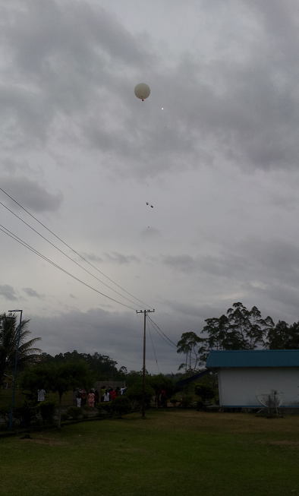
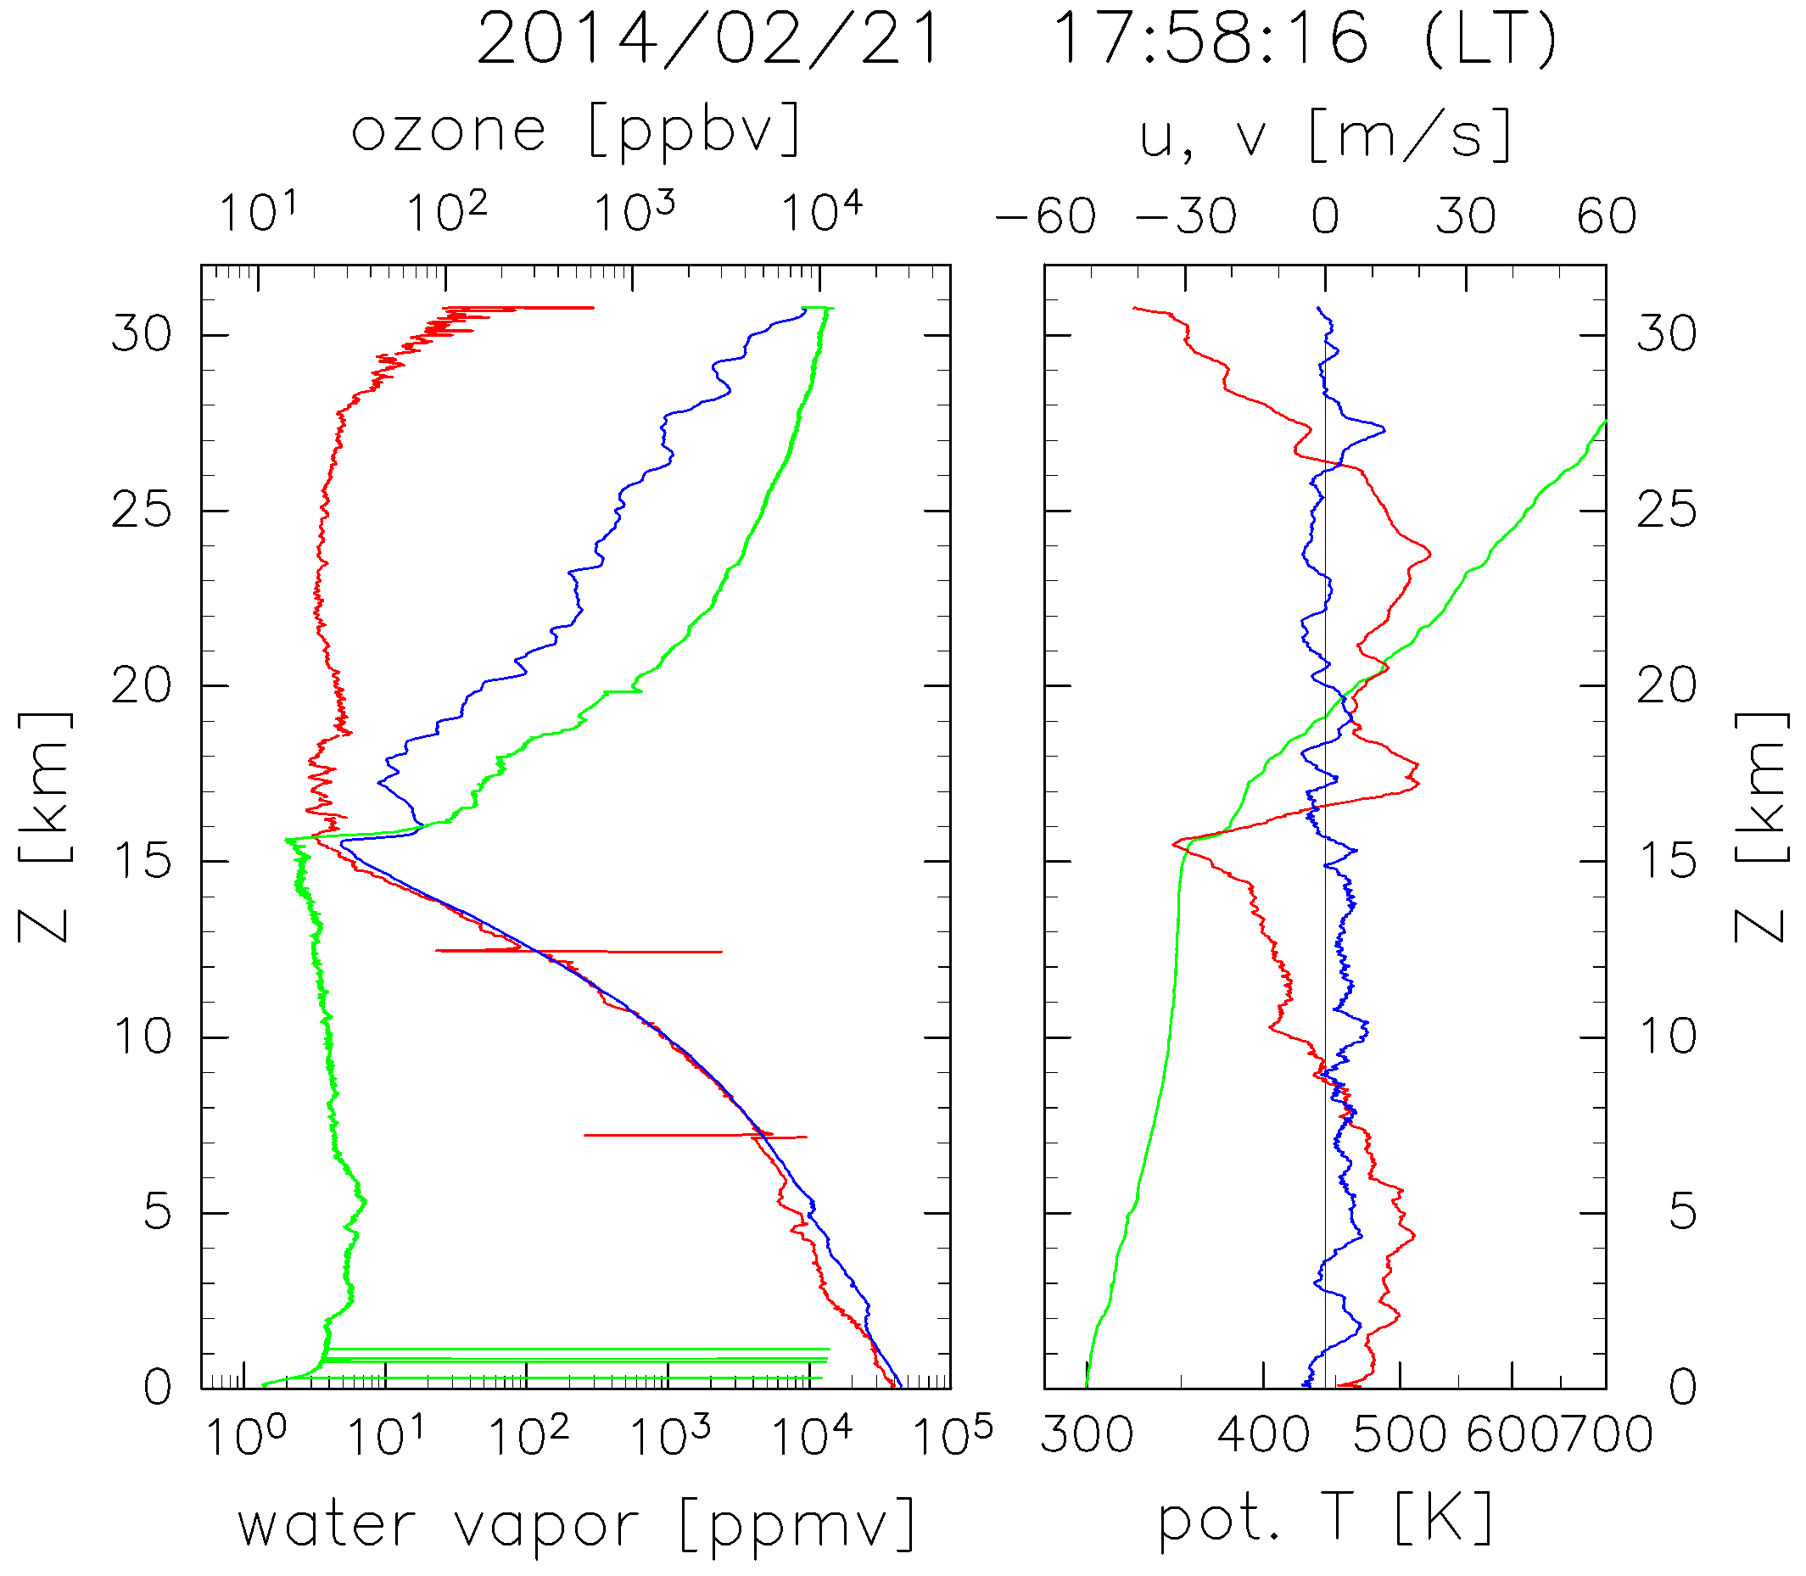
3rd WV-O3 sounding
(CFH-ECC)
TA1200
Oil-soaked
Photo:
sky at just after
the 3rd CFH-ECC launch
Balloon 1.2 kg
Payload 1.8 kg
Buoyancy 1.7 kg
Observation Date [yyyy/mm/dd] : 2014/02/21
Launching Time [hh:mm:dd] : 17:58:16
Parachute 160cm
Our effort for anti balloon burst
enabled our sonde to go up
to the stratosphere
and it allowed us
to measure the strato.
Extension 15m
Unwinder 51m
●メモ
・低高度バーストを防ぐため、軽量化に取り組む
（連結材300g --> 竹80g）
・ガス量を減らす。
・油漬けを実施（LAPANスタッフに頼む）
・
2-3 m
CFH
ECC, RS-06G
RS-11G
: )
Configuration
31 km
WV
SWV
u, v
O3
PT

Slide 8
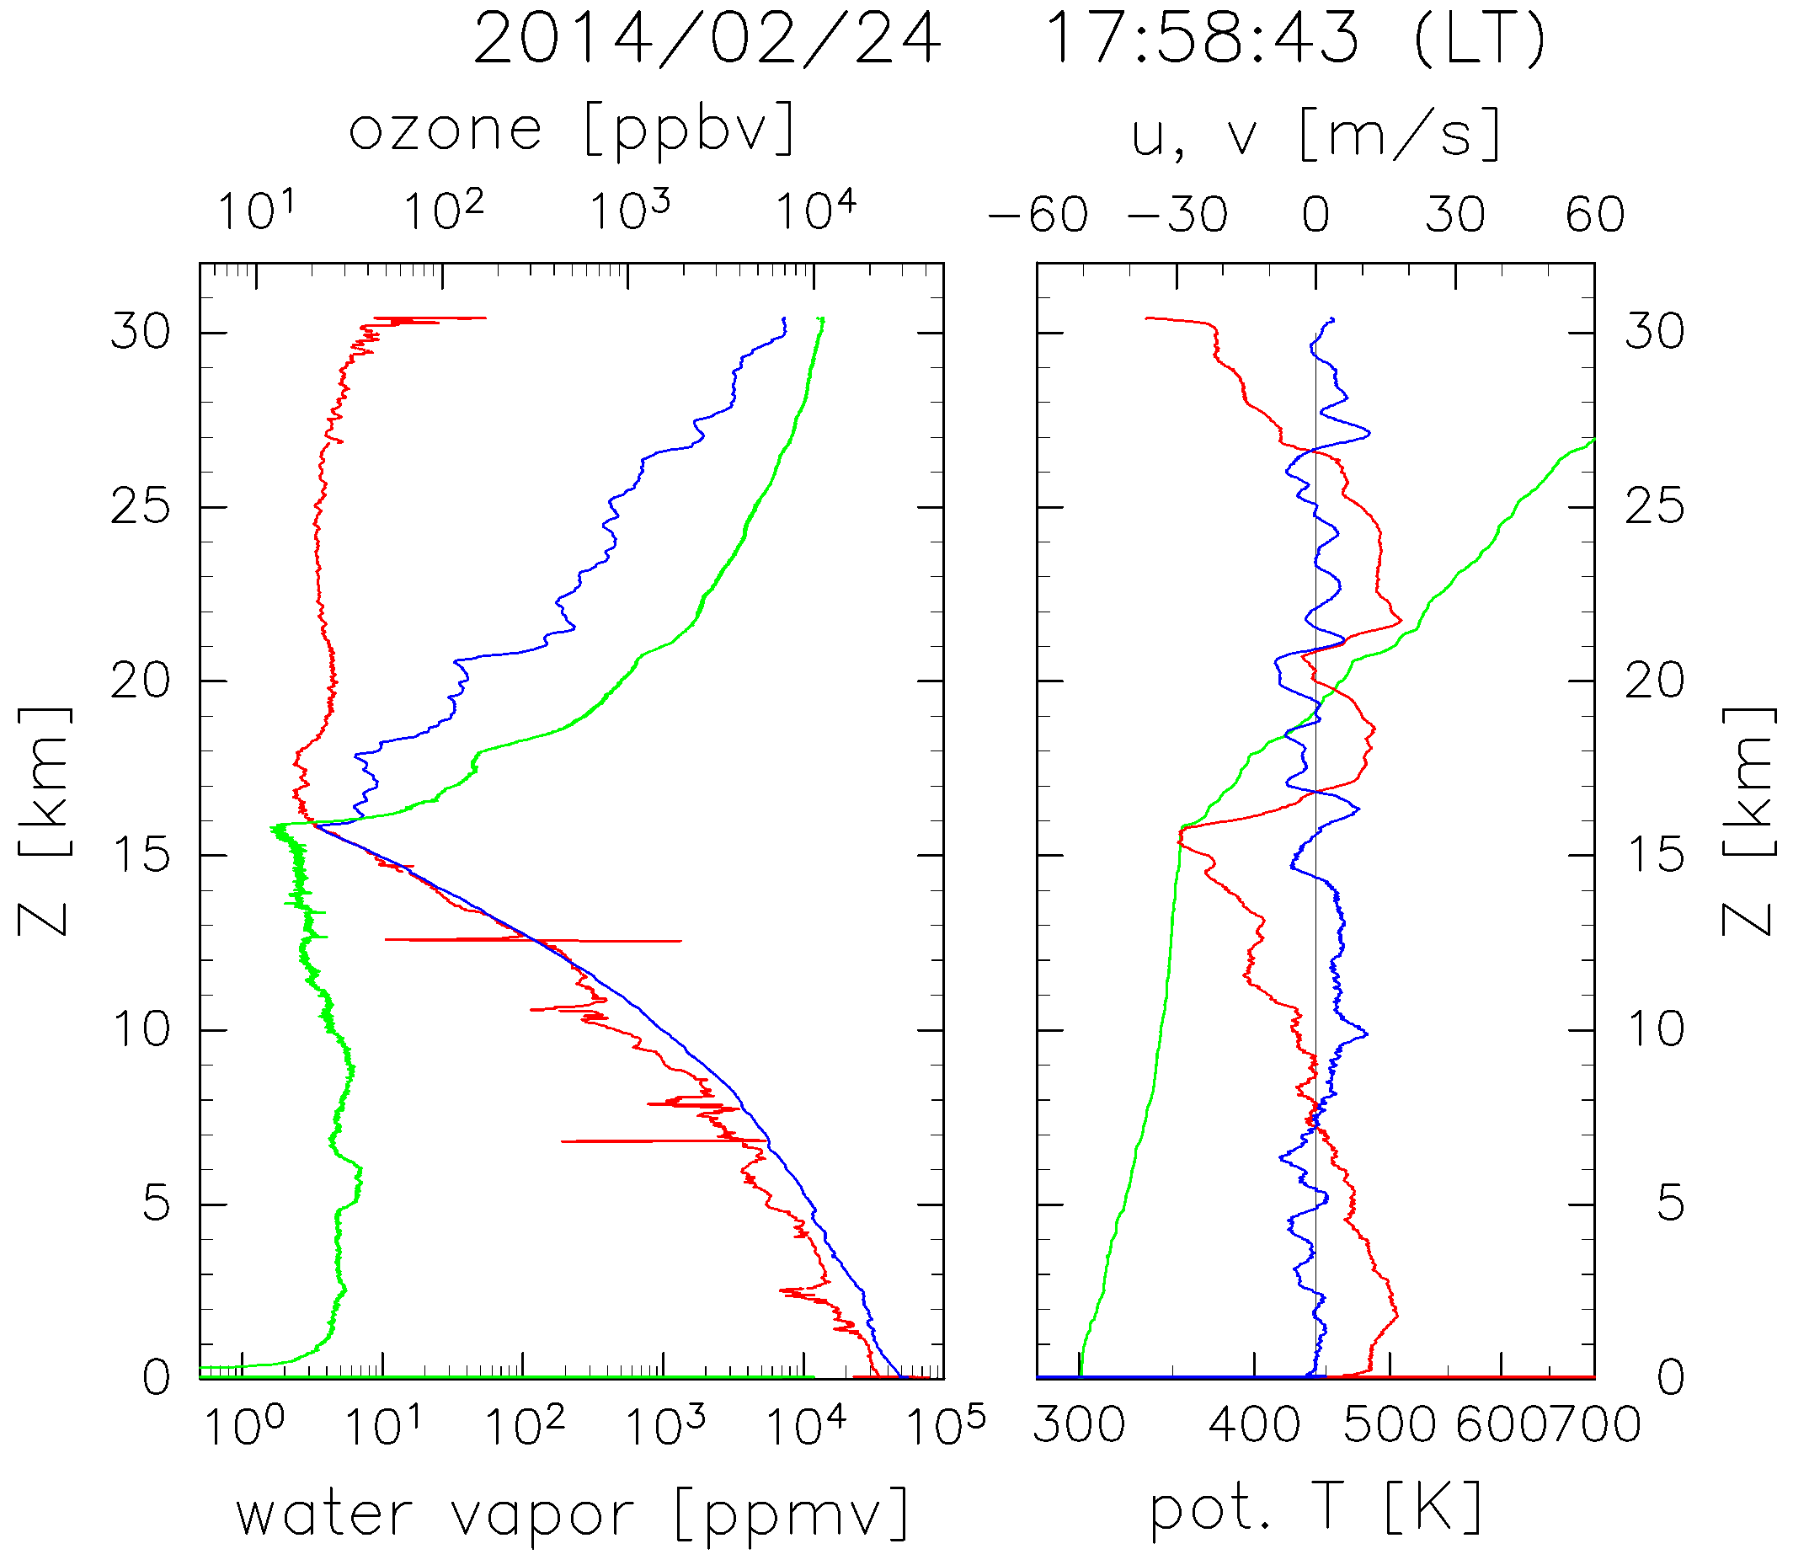
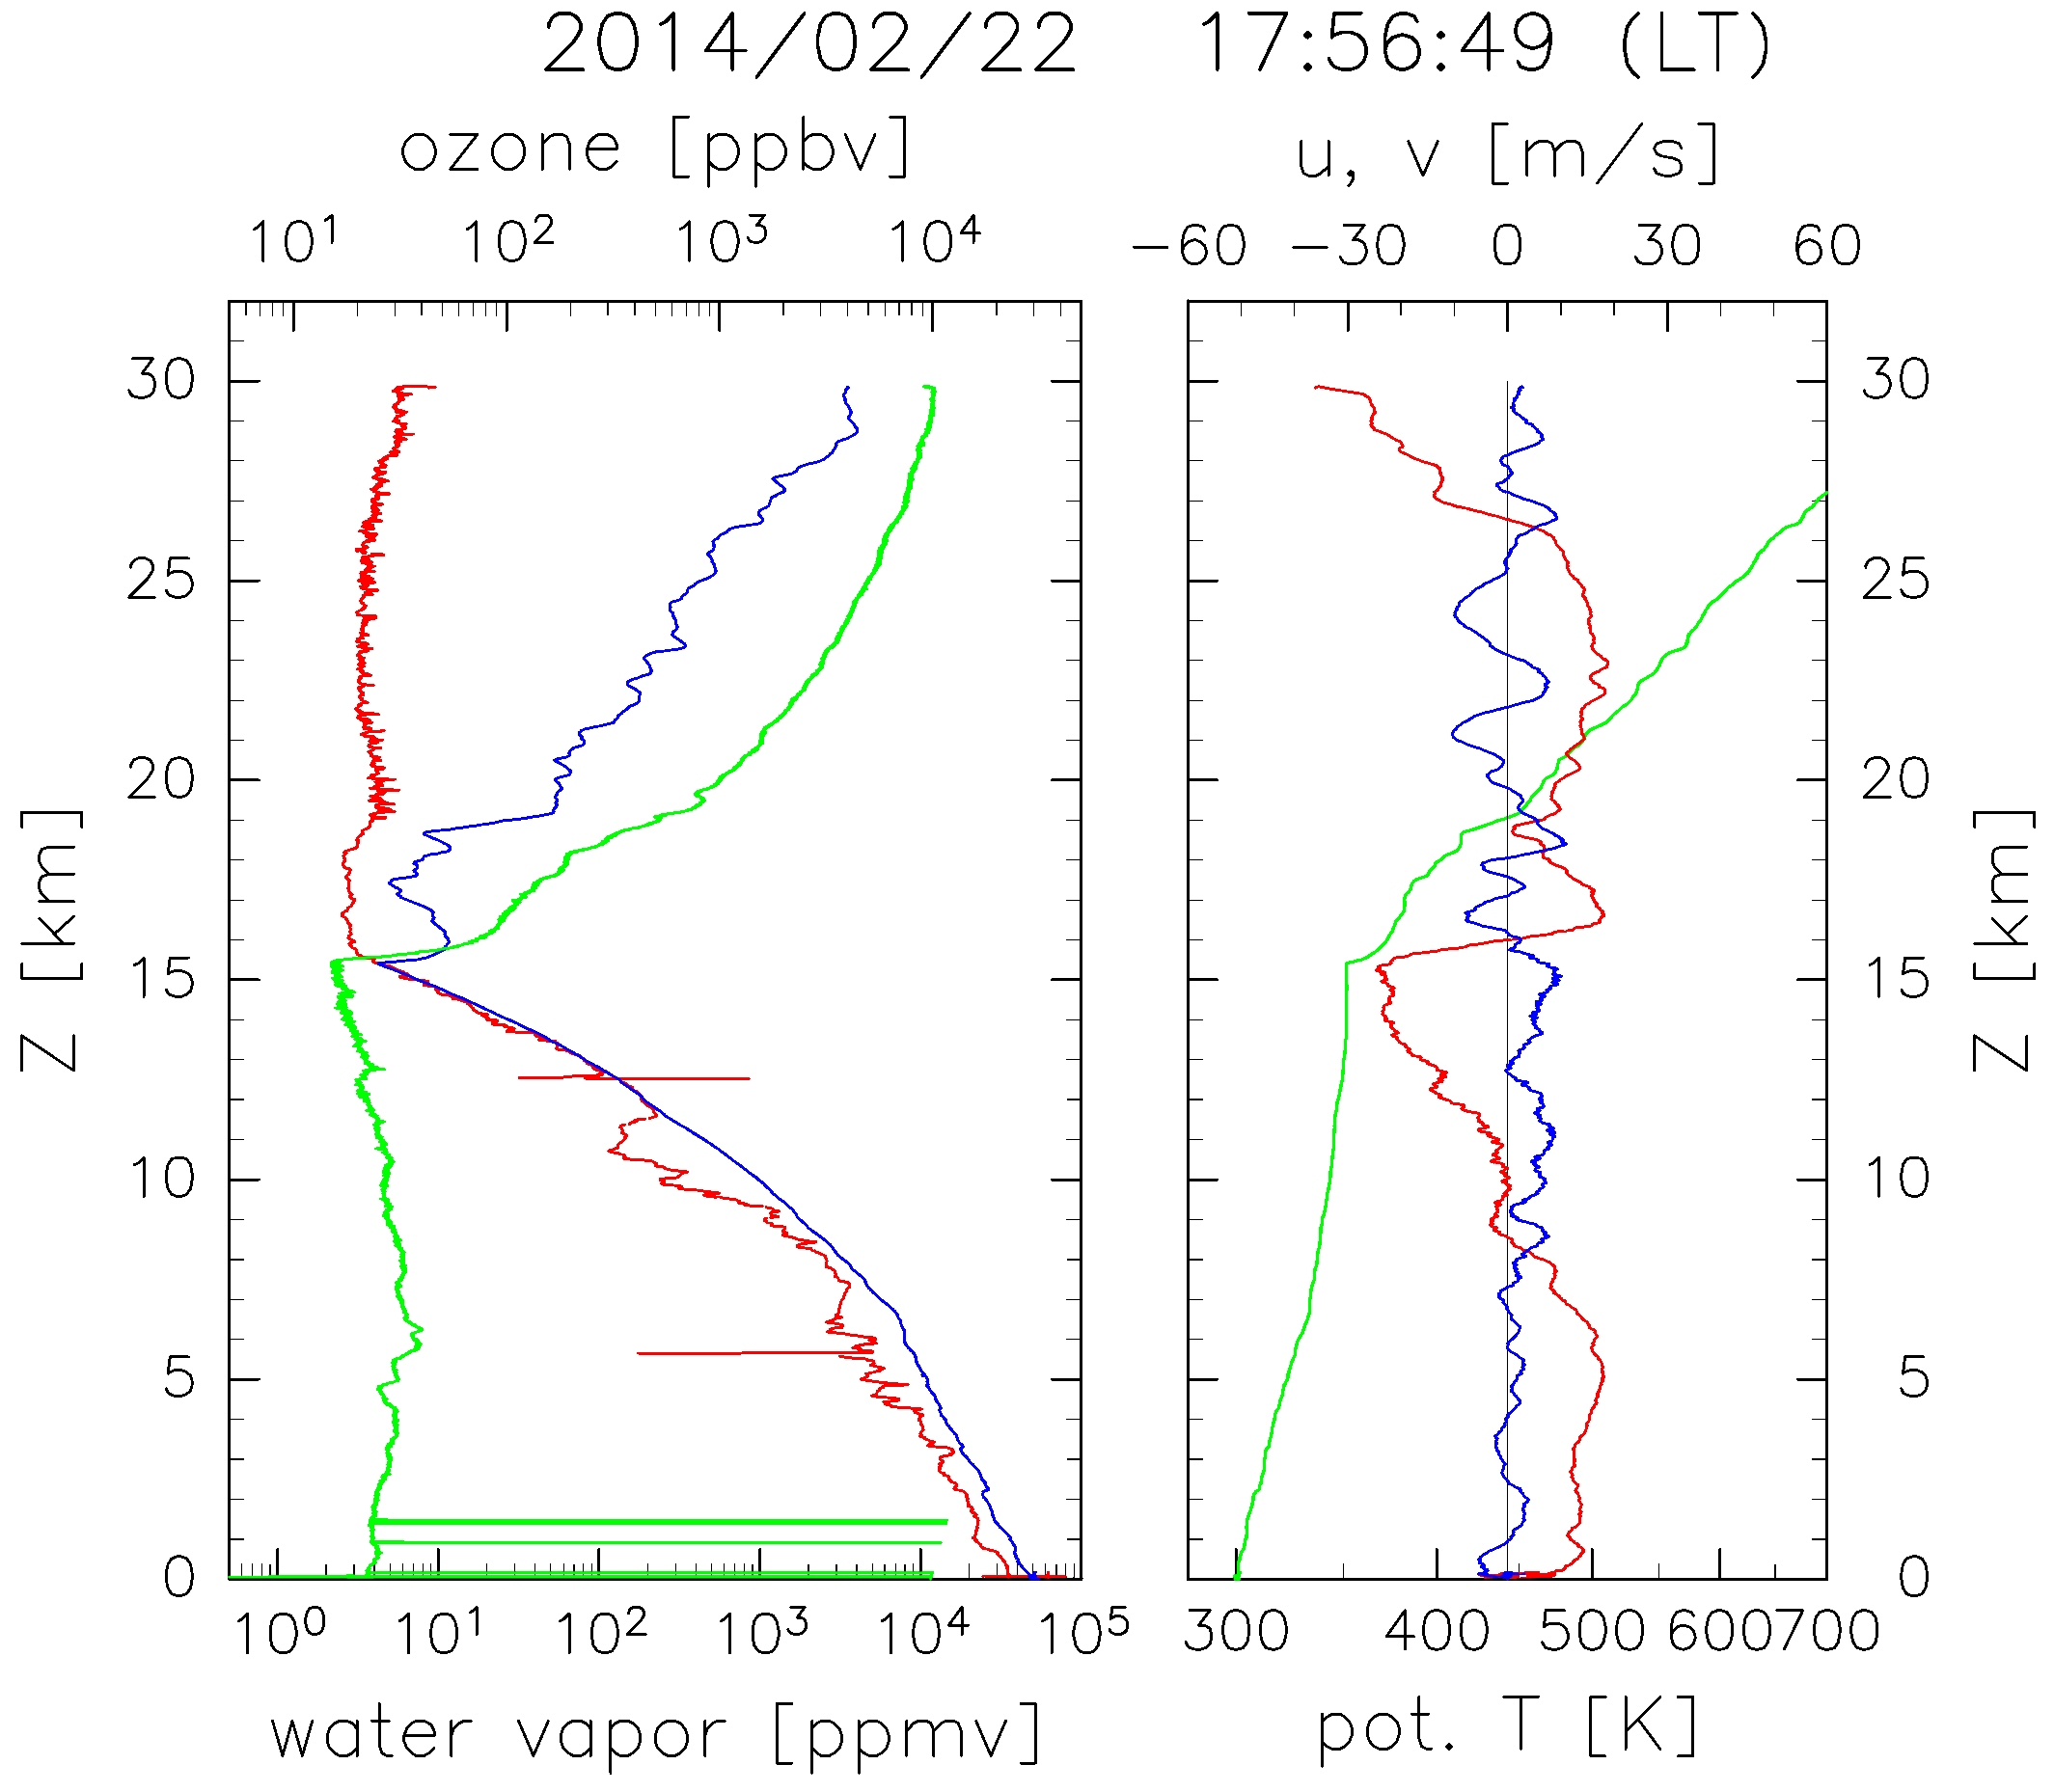
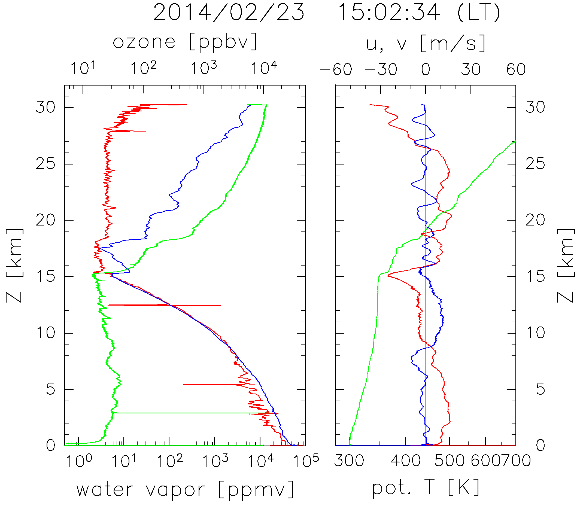
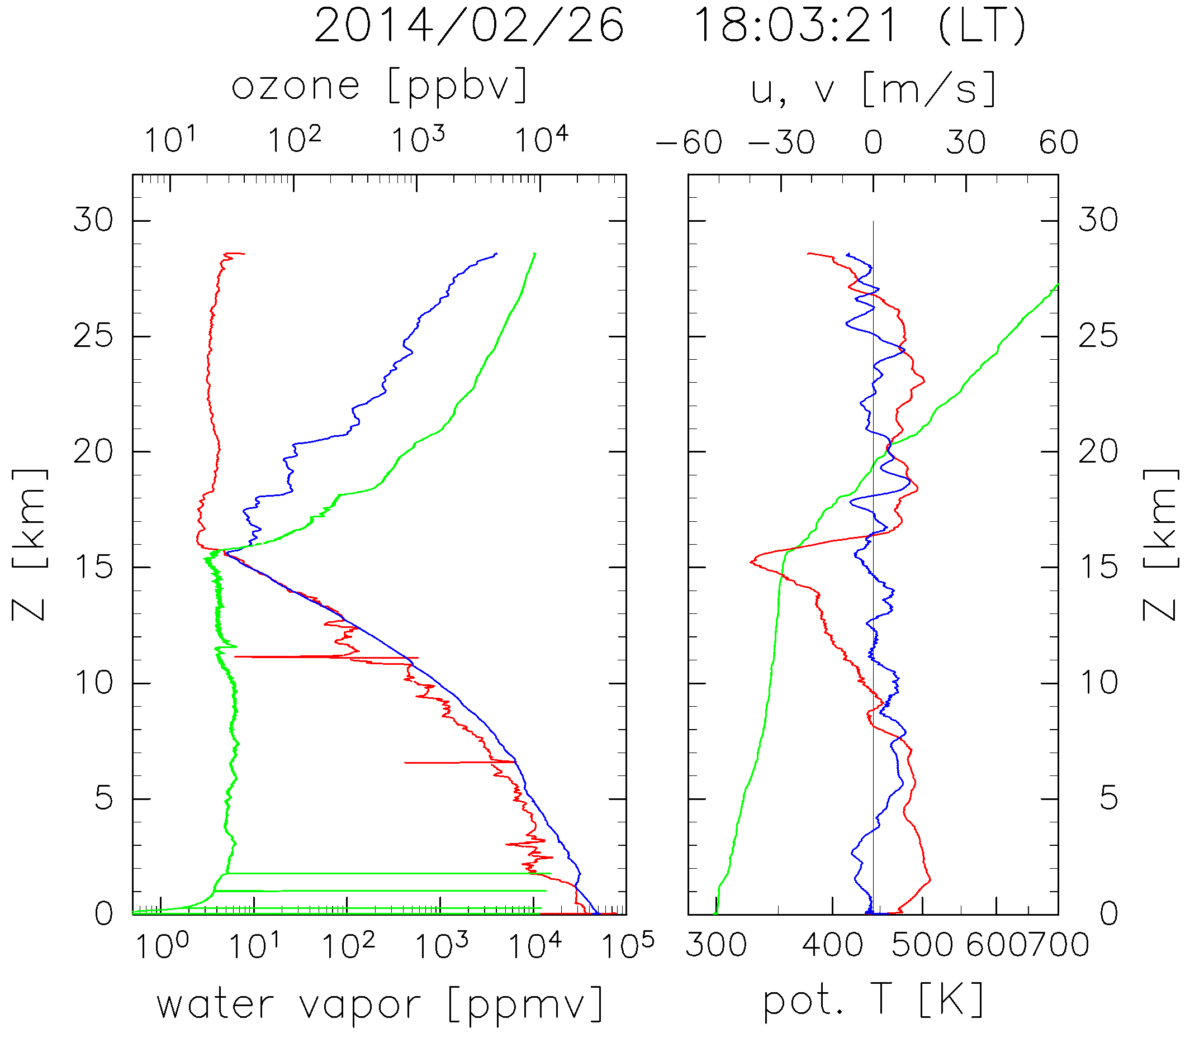
WV and O3 profile
Period: 21 – 26 Feb, 2014.
profiles of
WV, SWV, O3, u, v, PT
superposed 5 successful
CFH-ECC soundings.
WV
SWV
O3
u, v
PT
The tropopause located
at 16 km where 03 and
u have steep gradients.
WV is 3 ppmv
at const. value
from 16 km–18 km.
Vertical gradients of
WV, SWV, O3, PT
change at 18 km.
WV have a maximum
at around 20 km.

Slide 9
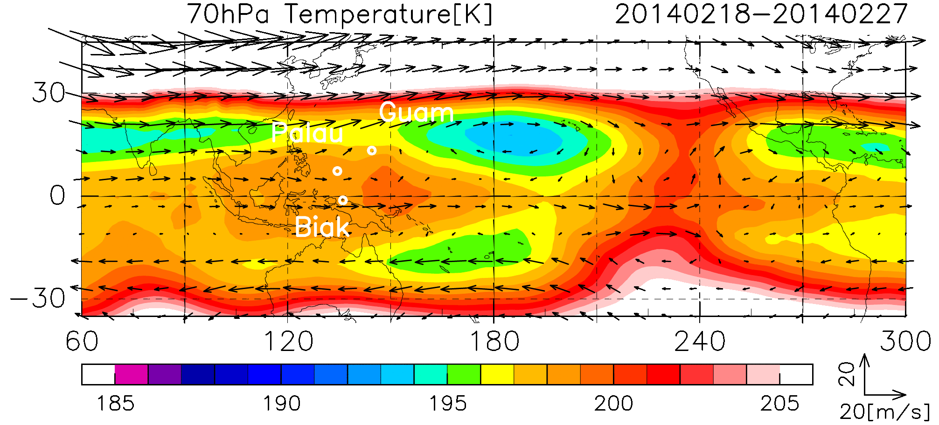
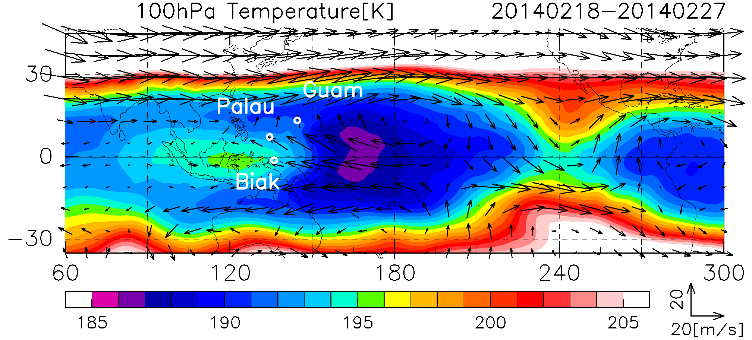
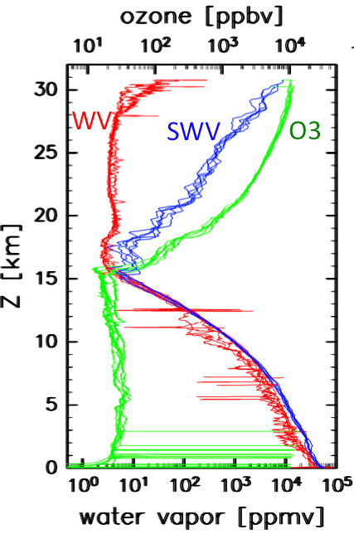
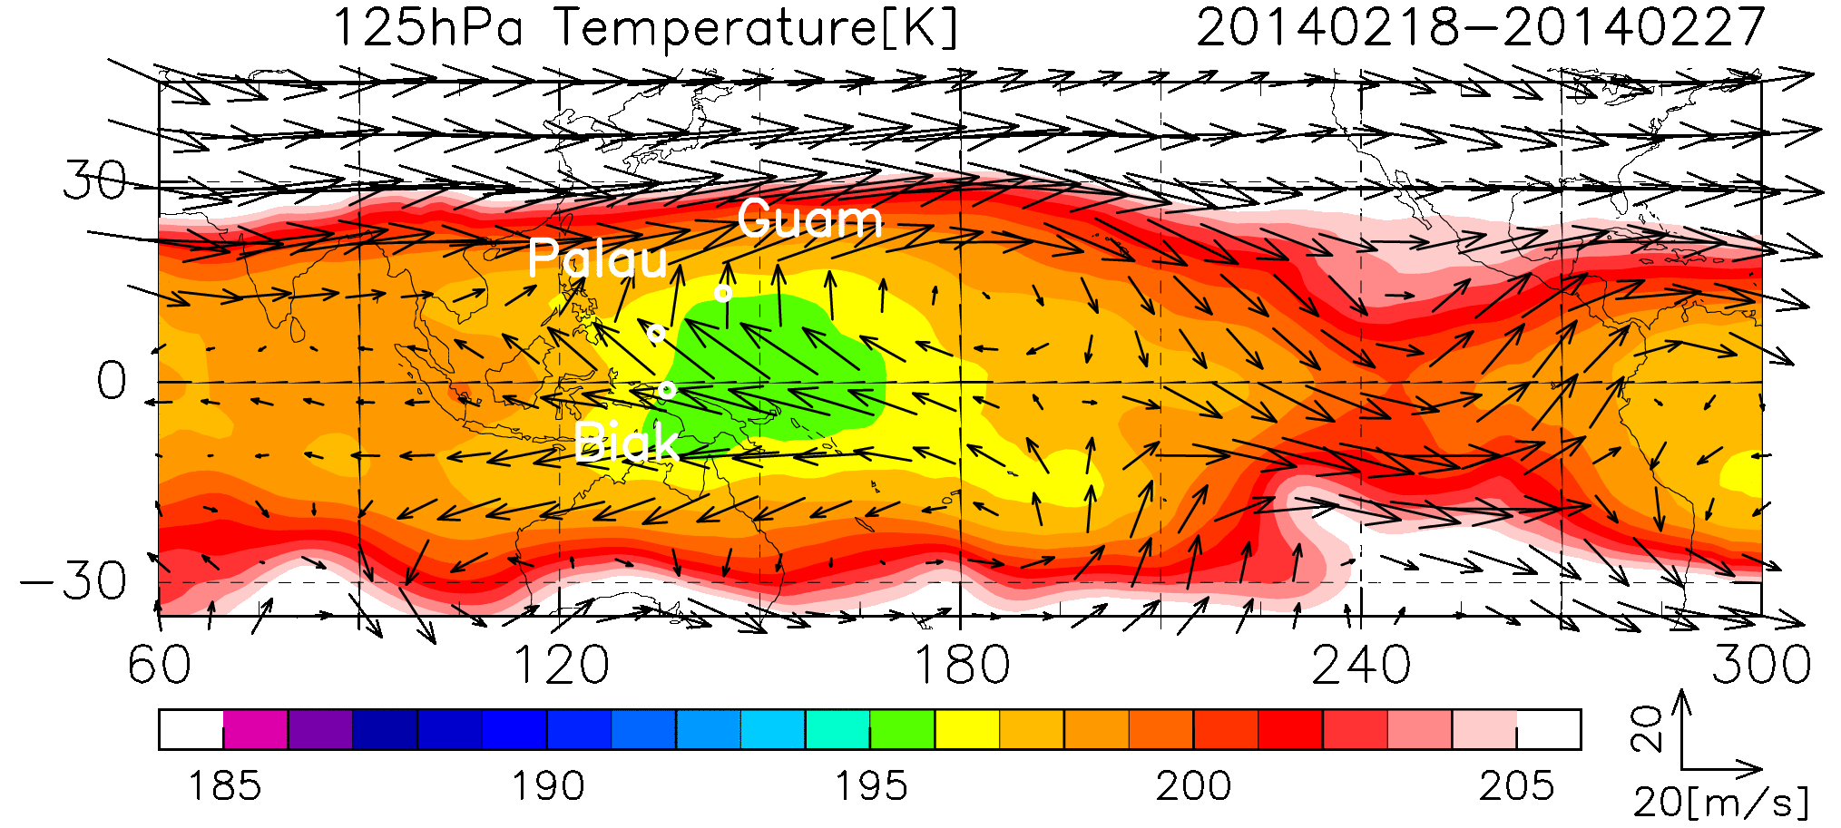
Meteorological field
during obs. period
Biak is here
X
70 hPa
Horizontal distribution of T at
Warm region
X
100 hPa
Cold region
X
125 hPa
(ERA interim)
X
Horizontal distribution of
Cloud Top Height [km]
According to CTH data, those T structure may be formed
by large scale disturbance located at just east of Biak.

Slide 10
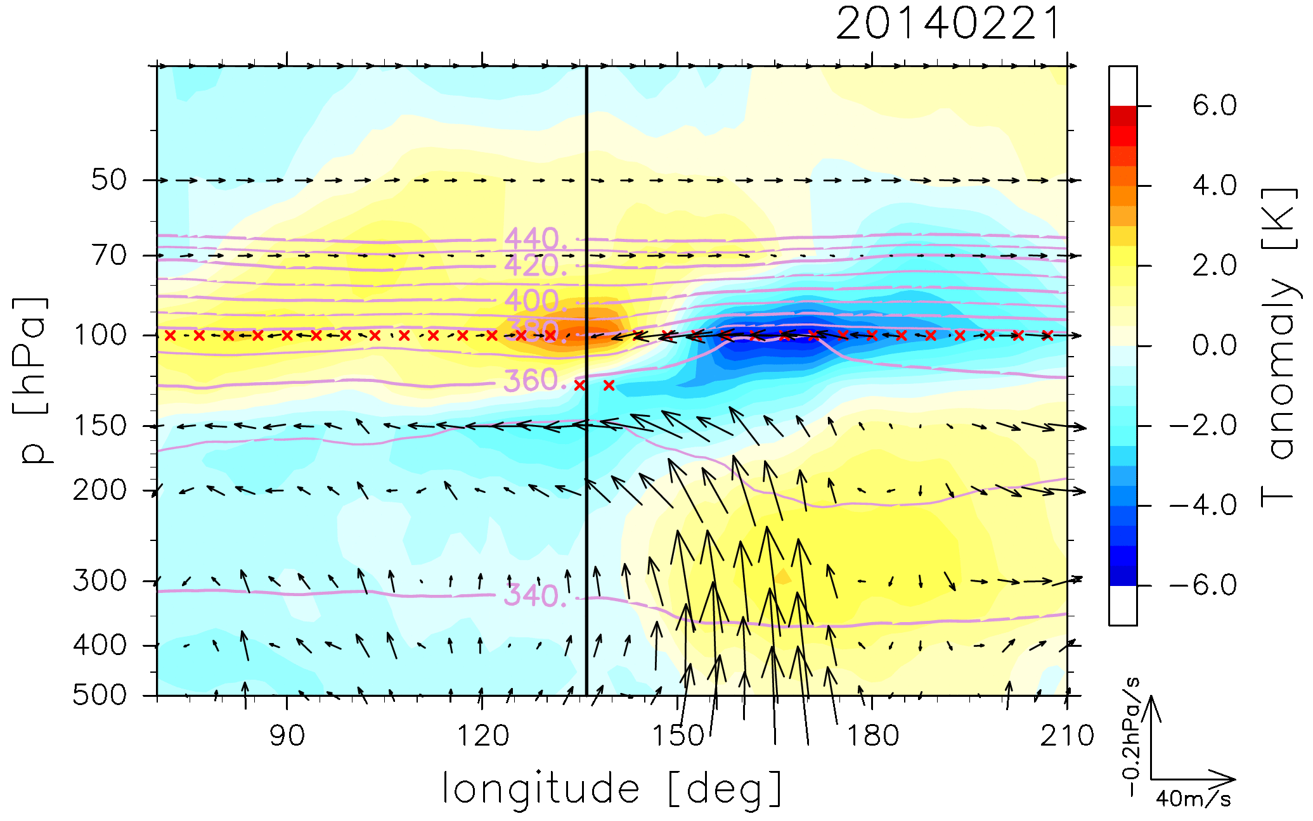
Large scale disturbance
makes a cold/warm anomalies in the UT/LS that is tilted upward and eastward extending
from 150 hPa to 70 hPa as its dynamical response.
19km
15km
Those T anomalies produced
SWV max. at around 100 hPa
during obs. period.
(ERA interim)
Biak
To estimate where these air mass come from
we calculate traj. at 15 km and 19 km

Slide 11
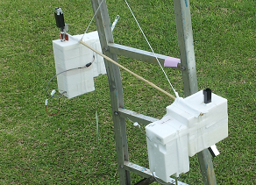
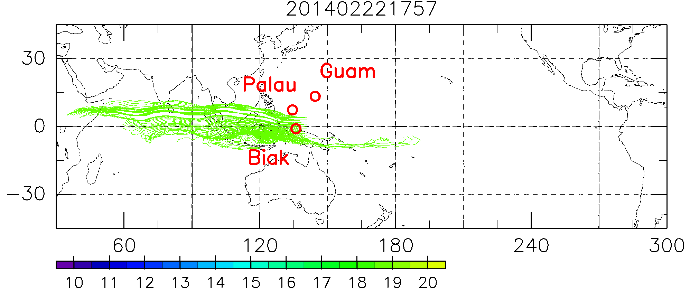
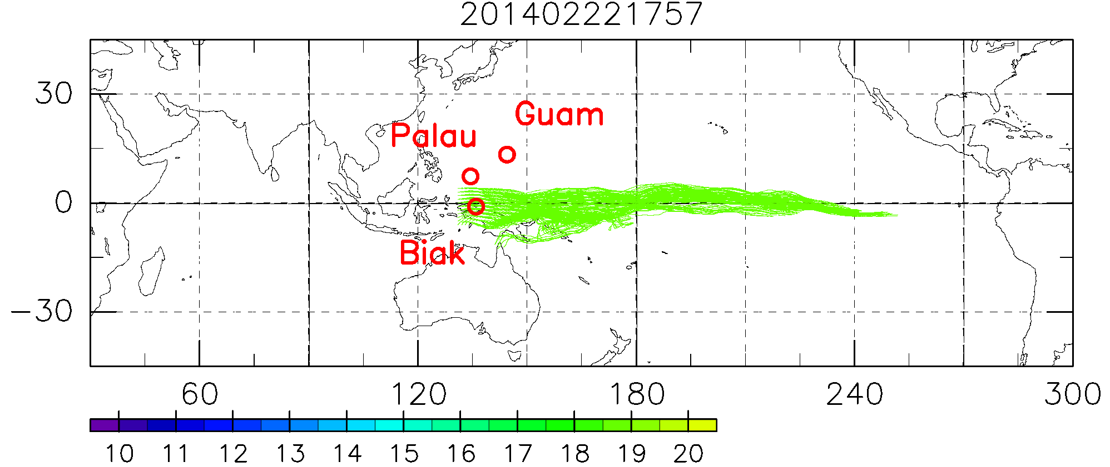
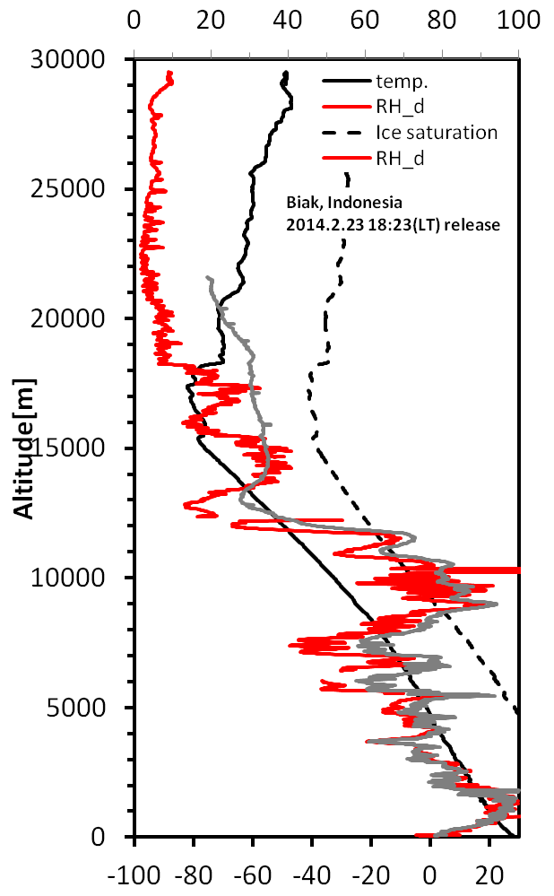
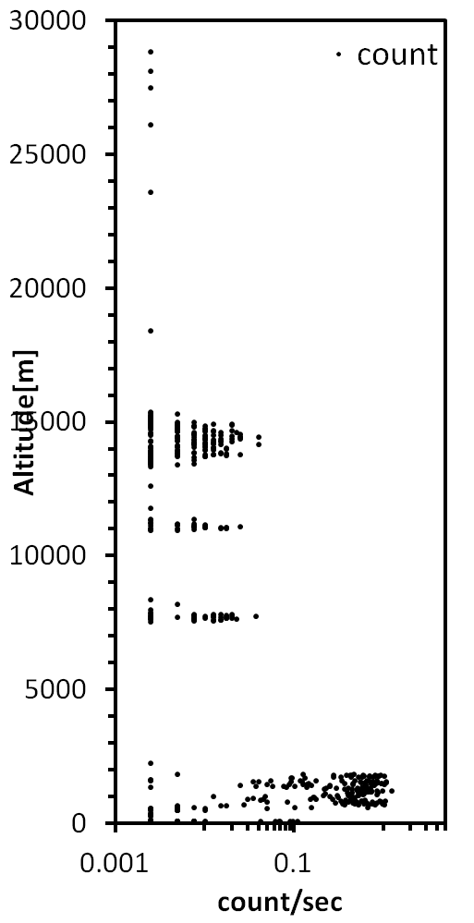
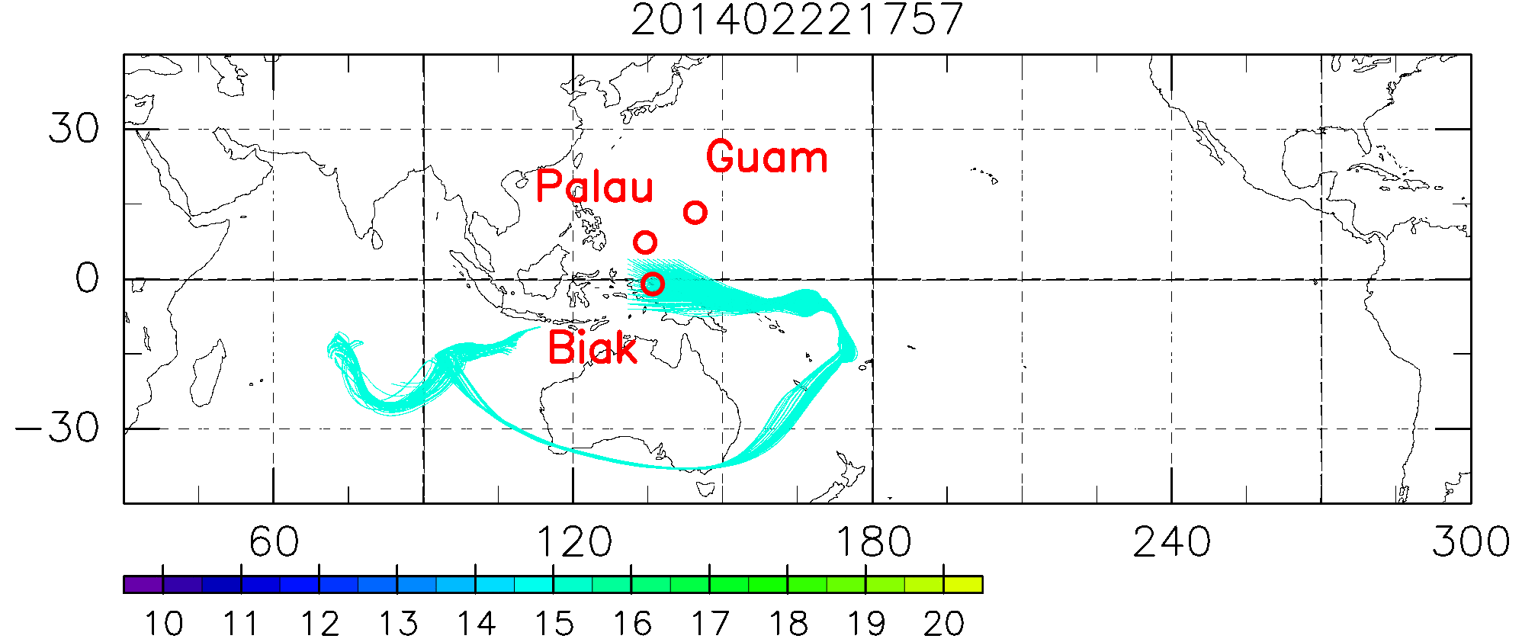
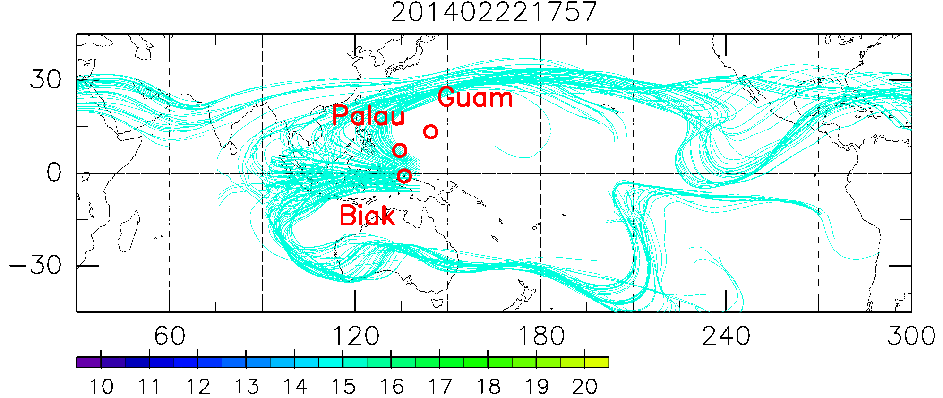
Traj. (isentropic) for 4th sounding
Backward
Forward
CPS
at 19 km
above Trop.
at 15 km
below Trop.
RH
Ice particles
These air mass
moved away eastward
like above.
Air mass below Trop. came from conv. area.
This is consistent with the existence of
ice particles detected by CPS at the same altitude.

Slide 12
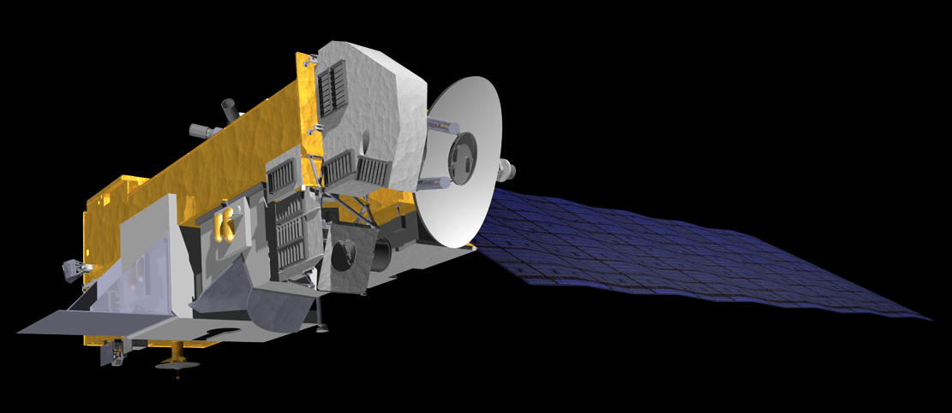
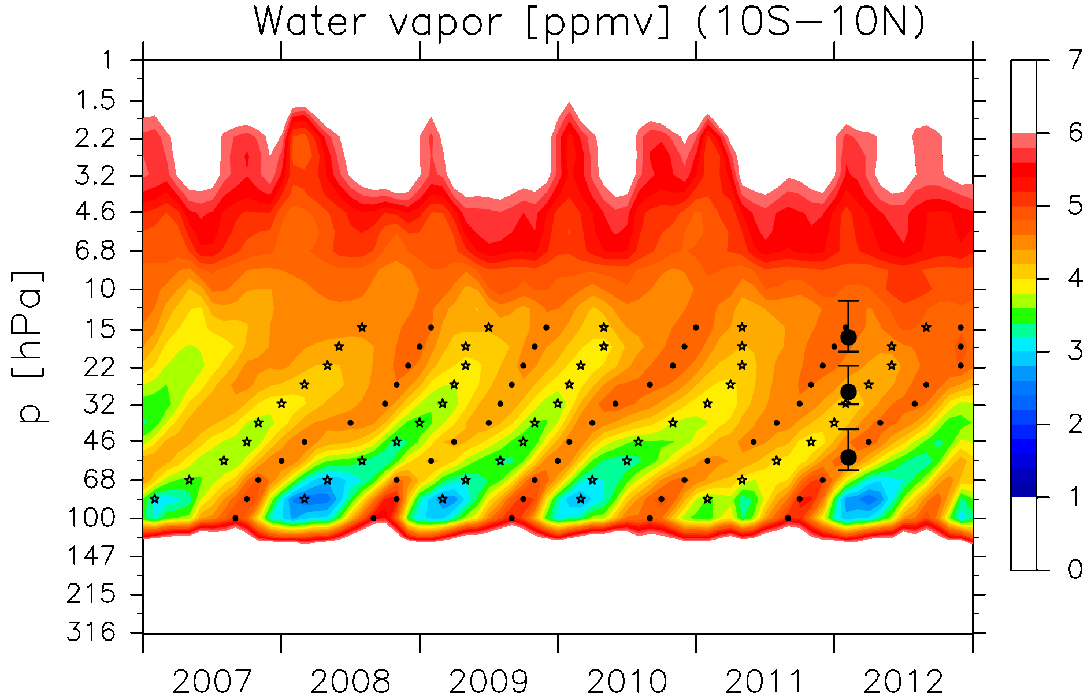
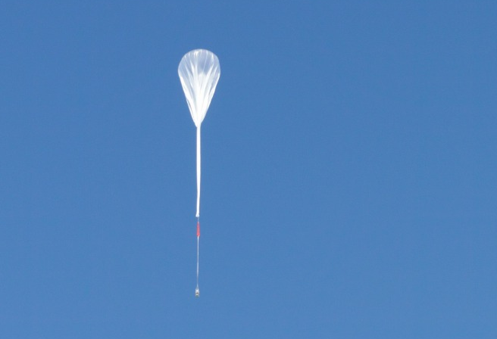
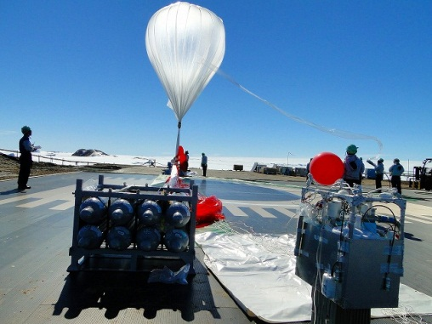
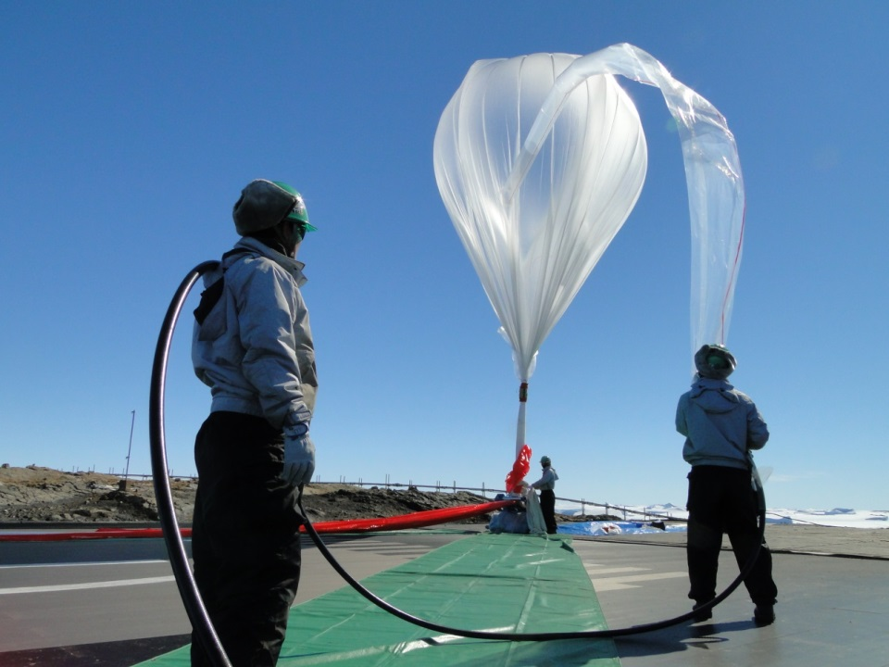
A new challenge: Sampling of air in the TTL/LS
We are planning cryogenic whole air sampling system
(e.g., CH₄, N₂O, CO₂, SF₆; isotopes, isotopomer)
with a large plastic balloon
for the strato. measurement at Biak in Feb. 2015.
Aerosol sampling system with
a balloon-borne unmanned glider
<Fukuoka Univ., Kyushu Univ.>
We try to observe again upwelling air mass that located in the TTL 1 year before and observed by ATTREX/CONTRAST/CAST
following the tape recorder.
(Syowa/Antarctica 2013)
Courtesy of Masahiko Hayashi

Slide 13
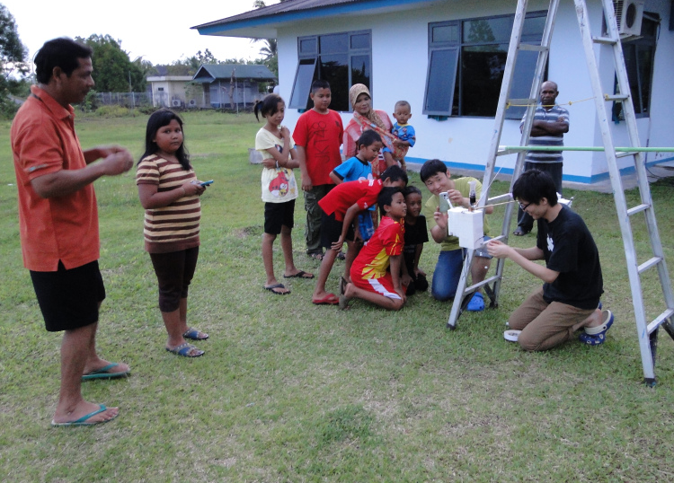
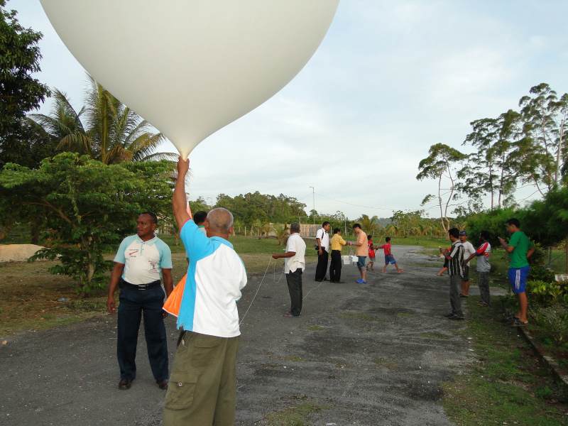
Summary
In the SOWER 2014 campaign 5 CFH-ECC and 1 newWV-CPS were successful.
Large scale disturbance was active at eastside of Biak in obs. period (19-26 Feb. 2014) and it affected to meteorological field over Biak.
Now we are planning for SOWER 2015 campaign including strato. whole air sampling, we try to measure upwelling air mass which located TTL/LS 1 year before.
Due to preparation for the 2015 campaign, Fumio could not come this meeting and then I made this presentation. Thank you.
Biak, February 2014

Slide 14
Stratospheric WV: Schematic explanation
Brewer-Dobson
circulation
Ozone hole
Chemistry
Water vapor
Stratosphere
Altitude
dry
18 km
Cold
dehydration
Tropical Tropopause Layer
(TTL)
14 km
10 km
Troposphere
wet
convection
Global warming
Pole
Equator
Pole

Slide 17
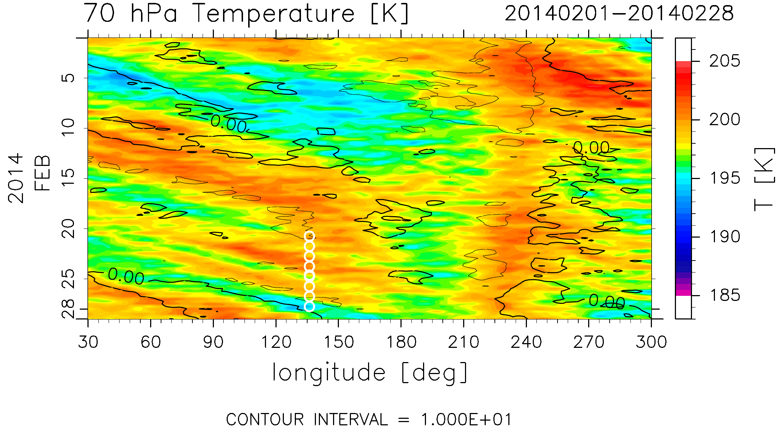
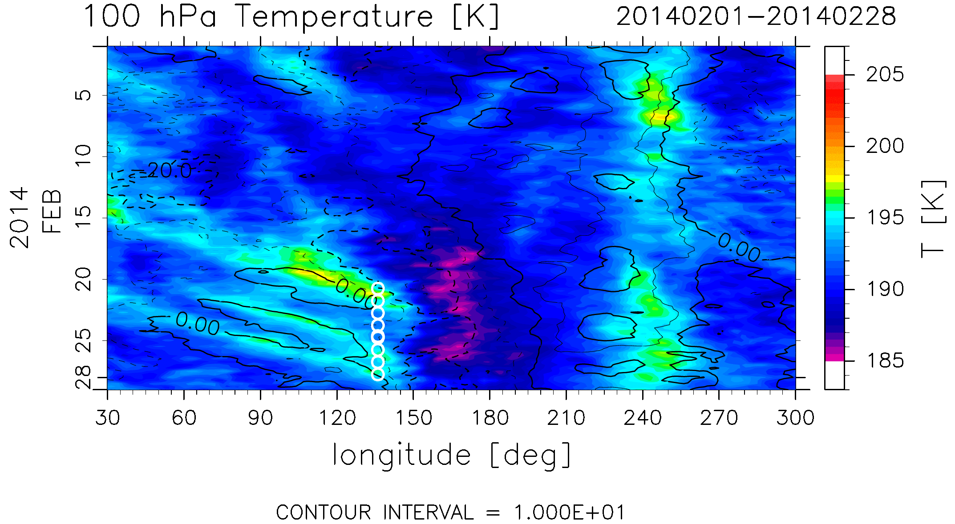
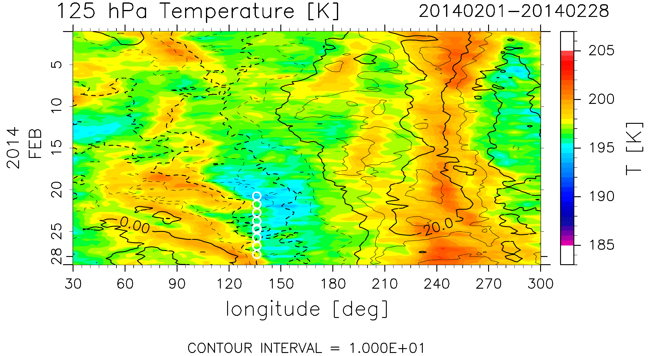

Slide 18
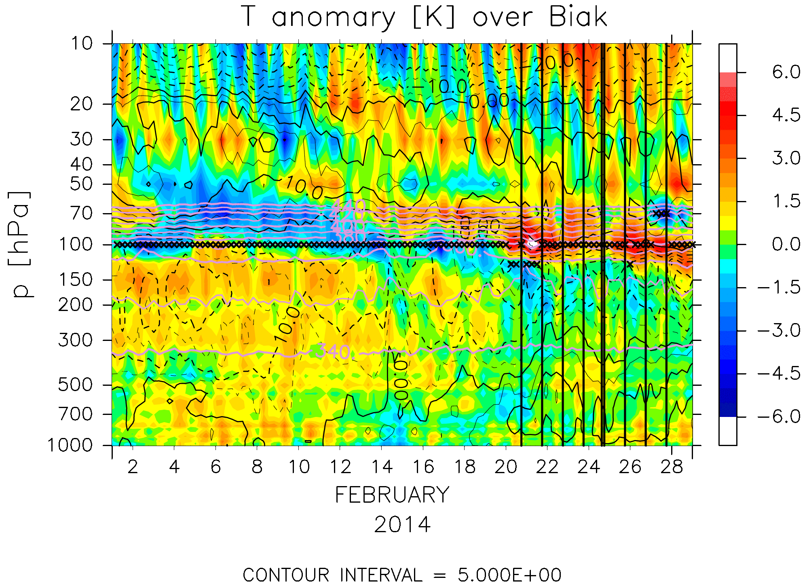

Slide 19
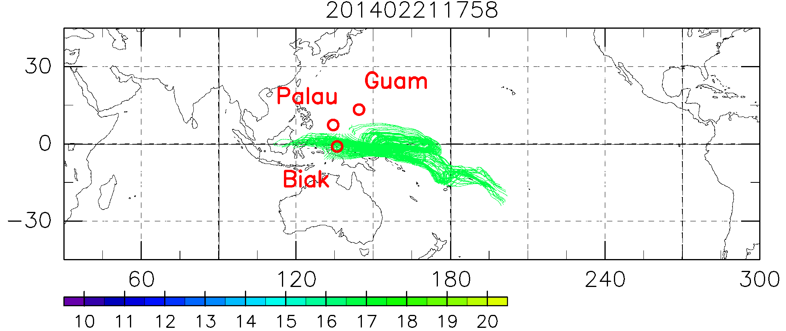
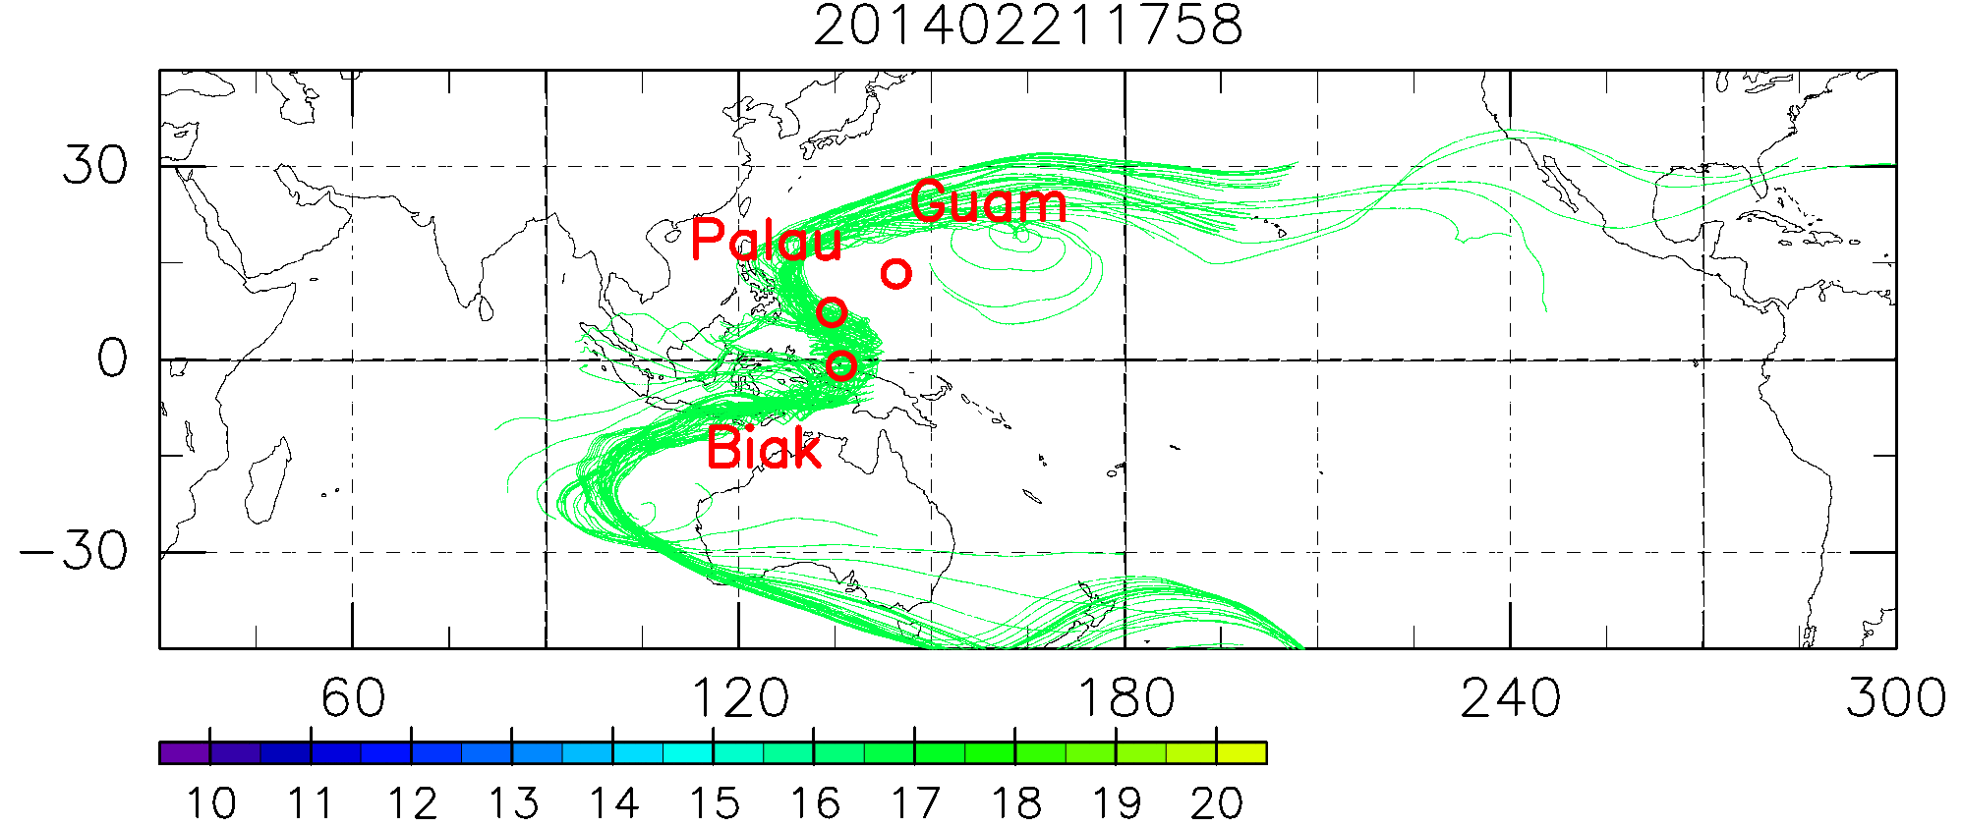
Trajectories
Back
Forward
at 19 km
above CPT
at 17 km
at 15 km
below CPT

Slide 20
CFHトラブル Biak, 2014
CFH一台（2L3707）は、ゾンデ接続時にシリアル番号が正しく入らない。
⇒澤田さんにキャリブレーションファイルを書き直してもらい解決。
キャリブレーションファイルは以下から取得可能。
cires.colorado.edu/~voemel/strato/cal.4point.resistances.dat
※12月の事前チェックではちゃんと読みこめていた。何が原因で突然おかしくなったかは不明。
冷媒を入れる所の蓋に穴が開いていない。
同時期に製造されたCFHで穴があるのもあった。製造時に開け忘れか？
⇒小さな自分で穴をあける。
3. いくつかの観測で高高度(~27km)から水蒸気濃度上昇。コンタミ？なぜ高高度だけ？？
4．低高度でバーストしてしまう。
⇒軽量化（専用連結材300gを竹40g×2本に変更）。ガス量減らす。
油漬けを実施。

Slide 21
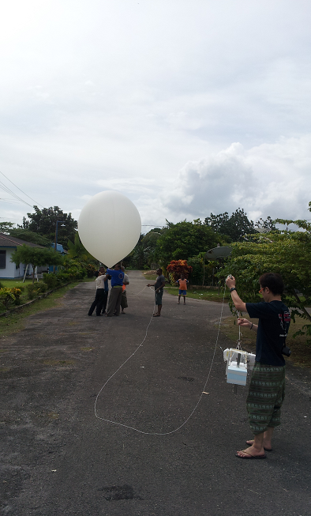
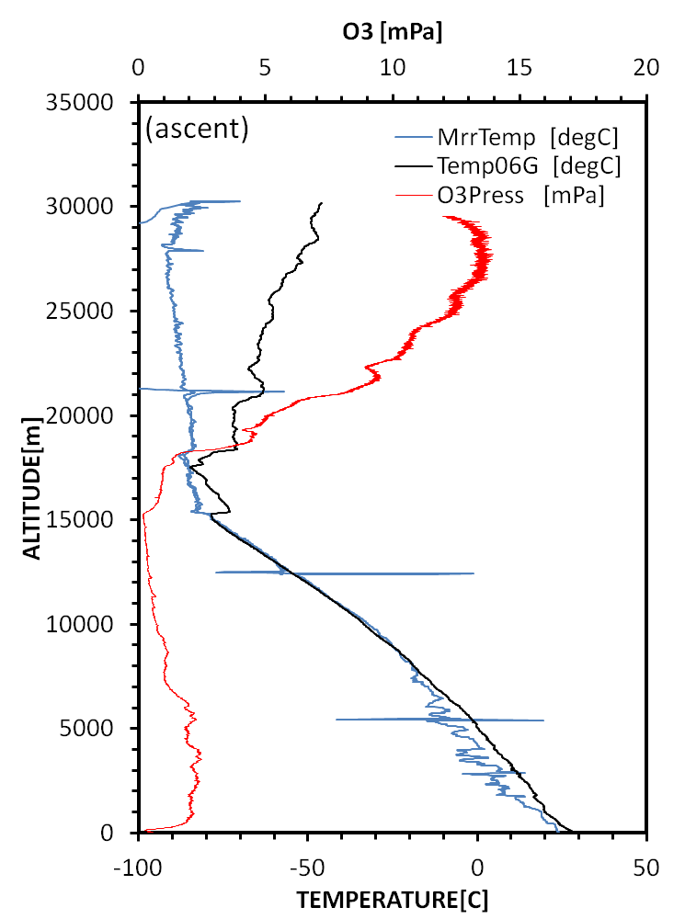
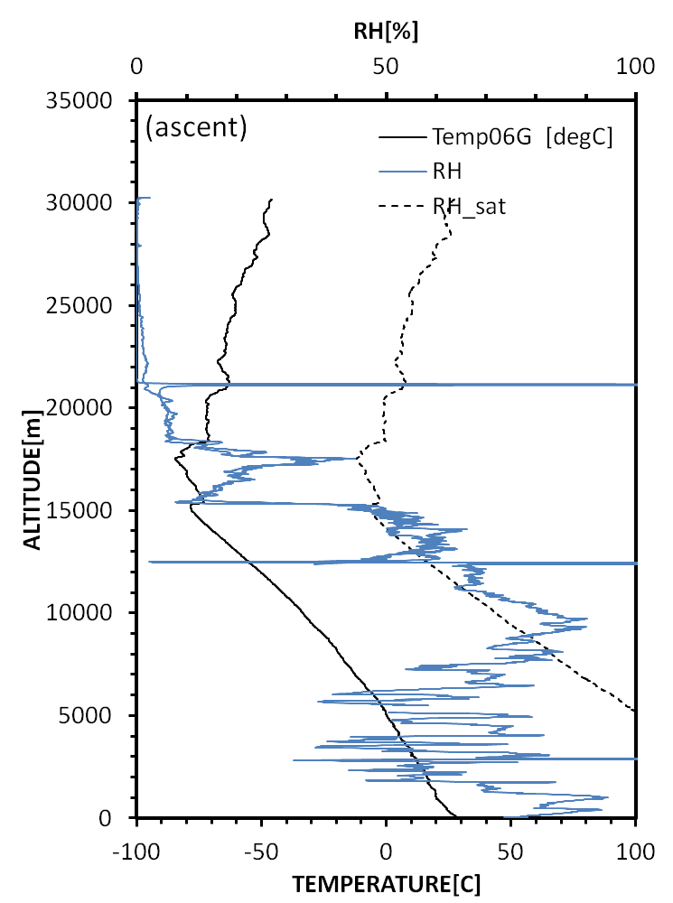
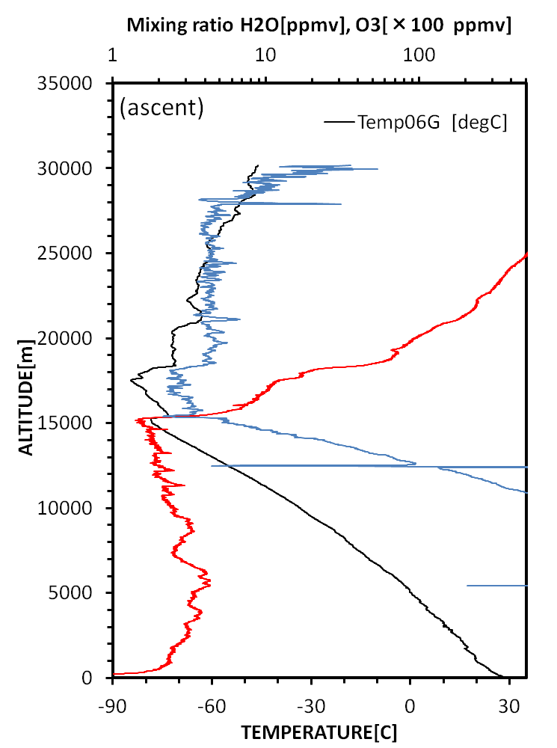
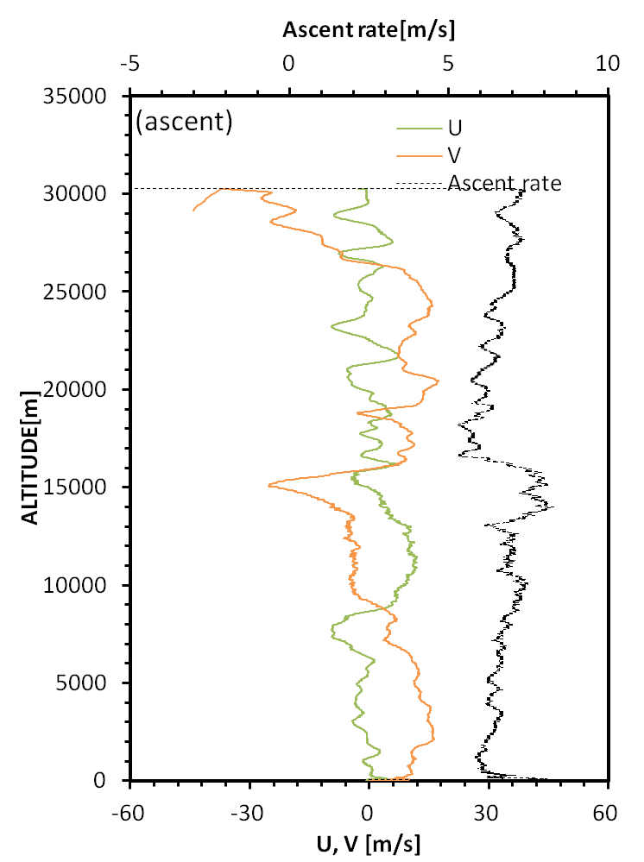
CFH-ECC
TA1200
油漬け
Balloon 1.2 kg
Payload 1.8 kg
net浮力 1.7 kg
Observation Date [yyyy/mm/dd] : 2014/02/23,,,,,,
Launching Time [hh:mm:dd] : 15:02:34,,,,,,
GPS Radiosonde Serial Number : 7301772,,,,,,
パラシュート 160
紐 15m
●メモ
・昼間の観測
同日1800枠でFinedew + Cloud Particle Sensor
放球。
巻下器 51m
Micro-sonde
竹
CFH
ECC, RS-06G

Slide 22
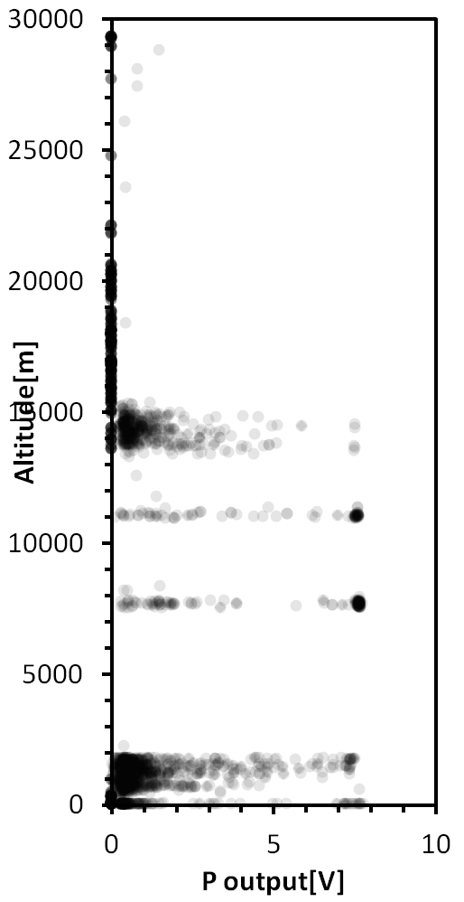
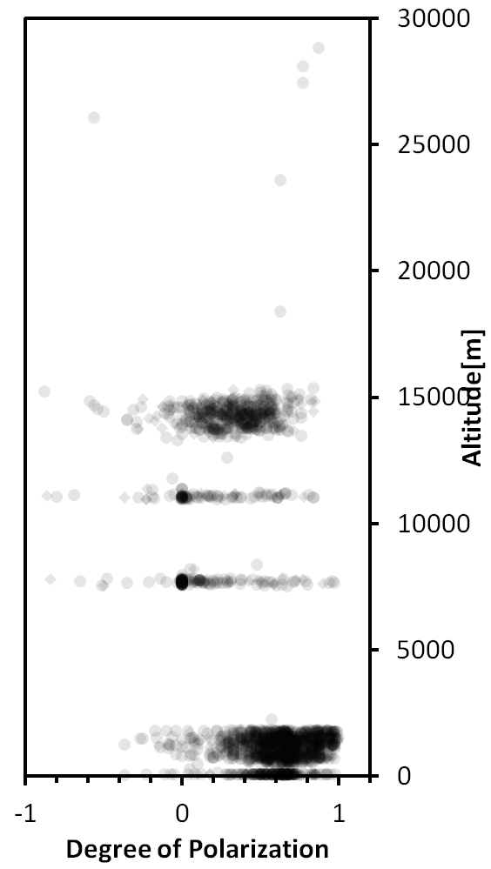
ゾンデ上昇時のデータ
Red: 露点ゾンデ
Gray: RS-06G RH
※露点ゾンデは補正済み（次頁以降を参照）
Water clouds
Ice clouds

Slide 23
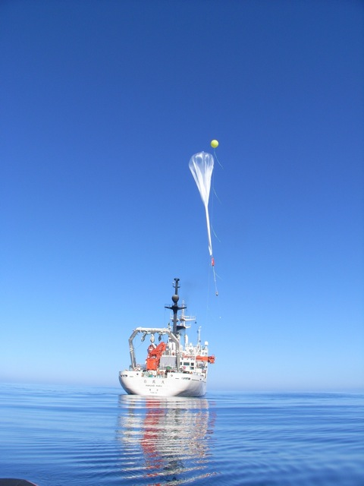
A new challenge: Sampling of air and particles in the TTL/LS
Cryogenic air sampling system
(e.g., CH₄, N₂O, CO₂, SF₆; isotopes, isotopomer)
with a large plastic balloon
<Tohoku Univ., ISAS/JAXA>
Aerosol sampling system with
a balloon-borne unmanned glider
<Fukuoka Univ., Kyushu Univ.>
Courtesy of Mitsuo Uematsu (R/V Hakuho 2012)
Courtesy of Masahiko Hayashi

Slide 24
Renewing SOWER web page to open our dataset
SOWER web page
http://sower.ees.hokudai.ac.jp/
Please check it out
R/V Mirai
2004-5
R/V Shoyomaru
1999
R/V Hakuho 2012
R/V Mirai
2006/2011

Slide 25
Accomplishments
http://sower.ees.hokudai.ac.jp/
(Takashima et al., JGR, 2008)
Seasonal variation of ozone over Christmas Is.
FPH
Time series of WV mixing ratio over
the equatorial region (68 – 37 hPa)
CFH
(Fujiwara et al., JGR, 2010)
R/V Mirai
2004-5
R/V Shoyomaru
1999
R/V Hakuho 2012
R/V Mirai
2006/2011
Recent focus: Dehydration processes in the TTL, Match campaigns

Slide 26
(Takashima et al., JGR, 2008)
2007-2008
(Inai et al., GRL, 2012)
2004 – 2011 Ha Noi
(Ogino et al., JGR, 2013)
(Fujiwara et al., JGR, 2009)

Slide 27
SOWER
2014 Plans
Japan Agency for Marine-Earth Science and Technology
JAMSTEC
Station: Biak
10 sets of CFH (WV) + ECC (ozone)
and some cloud particle sondes
(under development)
period: Mid-Jan. – End of Feb.
Station: Koror
4 sets of CFH + ECC
Mie Lidar will be active
period: 2 weeks
during 20 Jan. – 12 Feb.
The ideas
Simultaneous measurement with aircrafts
Aircraft-to-sonde “match”
Payload
Guam
Yoichi Inai
Team SOWER
Kyoto University
Guam
Koror
Koror
Biak
Biak
launched by balloon

Slide 28
Dehydration process in the TTL
The key process:
“cold trap” dehydration process,
i.e., air mass in the TTL is dehydrated
during horizontal advection through
the cold trap region over
the western/central tropical Pacific
(Holton and Gettelman, 2001;
Hatsushika and Yamazaki, 2003).
To quantify the dehydration
associated with horizontal advection,
Water Vapor “Match” in the TTL
- In situ measurements of
Lagrangian H₂O changes -.
Western Pacific
“Cold Trap” dehydration
(Holton and Gettelman, 2001)
Inai et al., ACP, 2013
GCM study
(Hatsushika and Yamazaki, 2003)
Notes:
Test test

Slide 29
Data: Soundings of Ozone and Water in the Equatorial Region (SOWER) campaign
Biak
Kototabang
Tarawa
R/V Mirai
The number of soundings (all together with ECC ozonesonde).
Multipoint coordinated sounding campaigns in the tropical western Pacific to measure the same air parcel twice or more (i.e., “match”) to quantify the Lagrangian water vapor changes in air parcels in the TTL.
Site | Dec.2004 | Jan.2006 | Jan.2007 | Jan.2008 | Jan.2009 | Jan.2010
Bandung | 4 (CFH) | - | - | - | - | -
Biak | 3 (SW) | 12(SW), 9(CFH) | 6 (CFH) | 7 (CFH) | 4 (CFH) | 6 (CFH)
Hanoi | 8 (SW) | 15 (SW) | 6 (CFH) | 5 (CFH) | 4 (CFH) | 5 (CFH)
Kototabang | - | 10 (SW) | 5 (CFH) | 4 (CFH) | - | -
R/V Mirai | 15 (SW) | - | - | - | - | -
Tarawa | 10 (SW) | 11(SW), 2(CFH) | 5 (CFH) | - | - | 5 (CFH)
SOWER 2004 – 2009: Inai et al. (ACP, 2013)
SOWER 2010: included in this talk
CFH: Cryogenic Frostpoint Hygrometer (61) SW: Snow White peltier-cooler dew/frostpoint hygrometer (84)
Notes:
Trajectory forecast had been done during each campaign. But, in practice, trajectories were re-calculated after the campaigns to seek sonde-to-sonde match cases. (The launch timing at each site depends strongly on the local conditions such as local weather.)

Slide 30
Summary
“Match” technique is applied to dehydration process associated with horizontal advection in the TTL
Significant dehydration occurs in lower TTL (below 365 K PT)
ice nucleation should start < 146 +/- 19% RHi
dehydrated to 75 +/- 23% of the SMRmin
the dehydration efficiency is quite high at this alt. region
However, the dehydration around CPT is not yet clear
dehydration around CPT may take much longer time than 5-day
dehydration may occur in different region from our campaign region
SOWER 2014 Plans: Collaboration aircraft measurements
The idea is follows,
Simultaneous measurement with aircrafts
Aircraft – sonde “match”

