Slide 1
TTL cooling and drying during the January 2013 Stratospheric Sudden Warming
ATTREX STM, October 20, 2014
Stephanie Evan; LACy/CNRS
Karen Rosenlof; NOAA ESRL CSD
Troy Thornberry; CIRES, University of Colorado & NOAA ESRL CSD
Andrew Rollins; CIRES, University of Colorado & NOAA ESRL
Sergey Khaykin; LATMOS/CNRS
Paper submitted to QJRMS

Slide 2
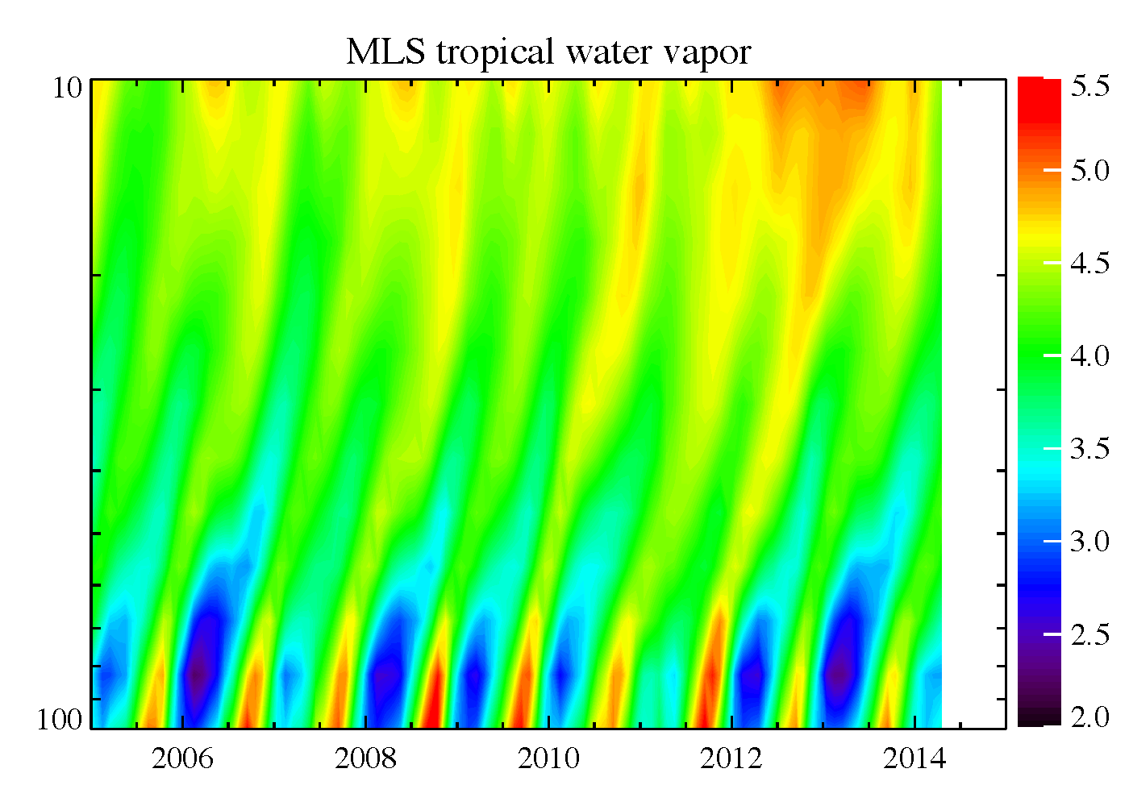
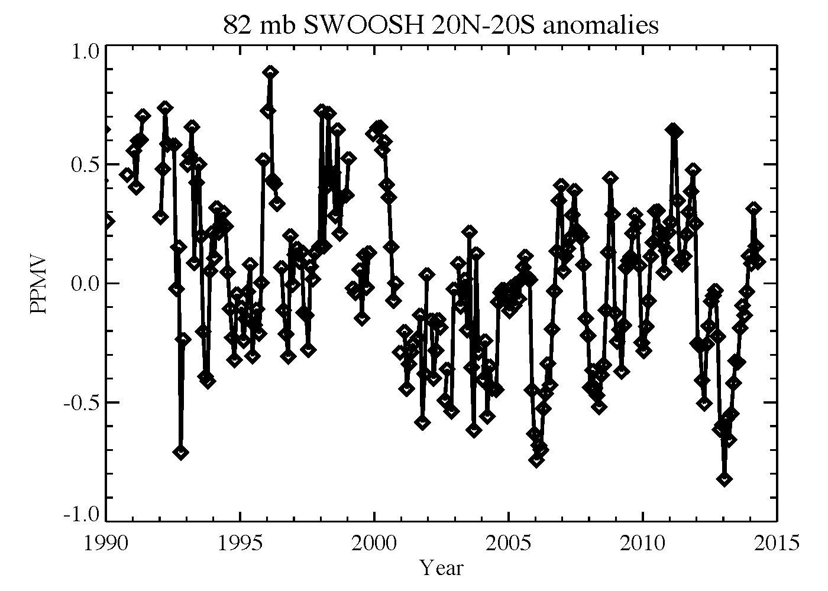
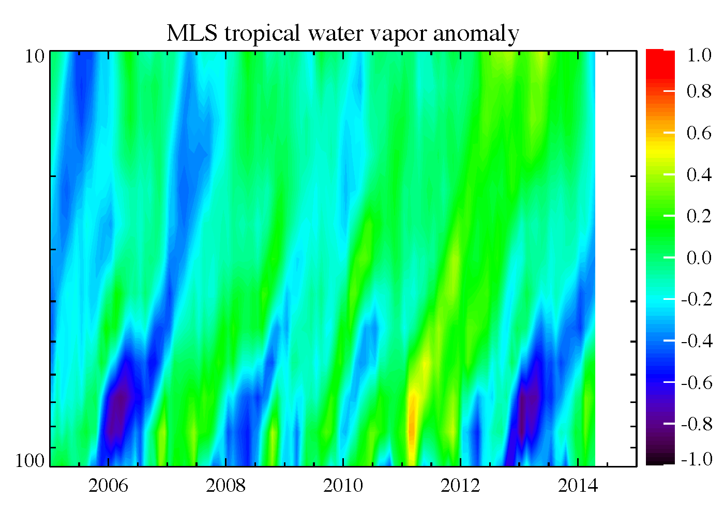
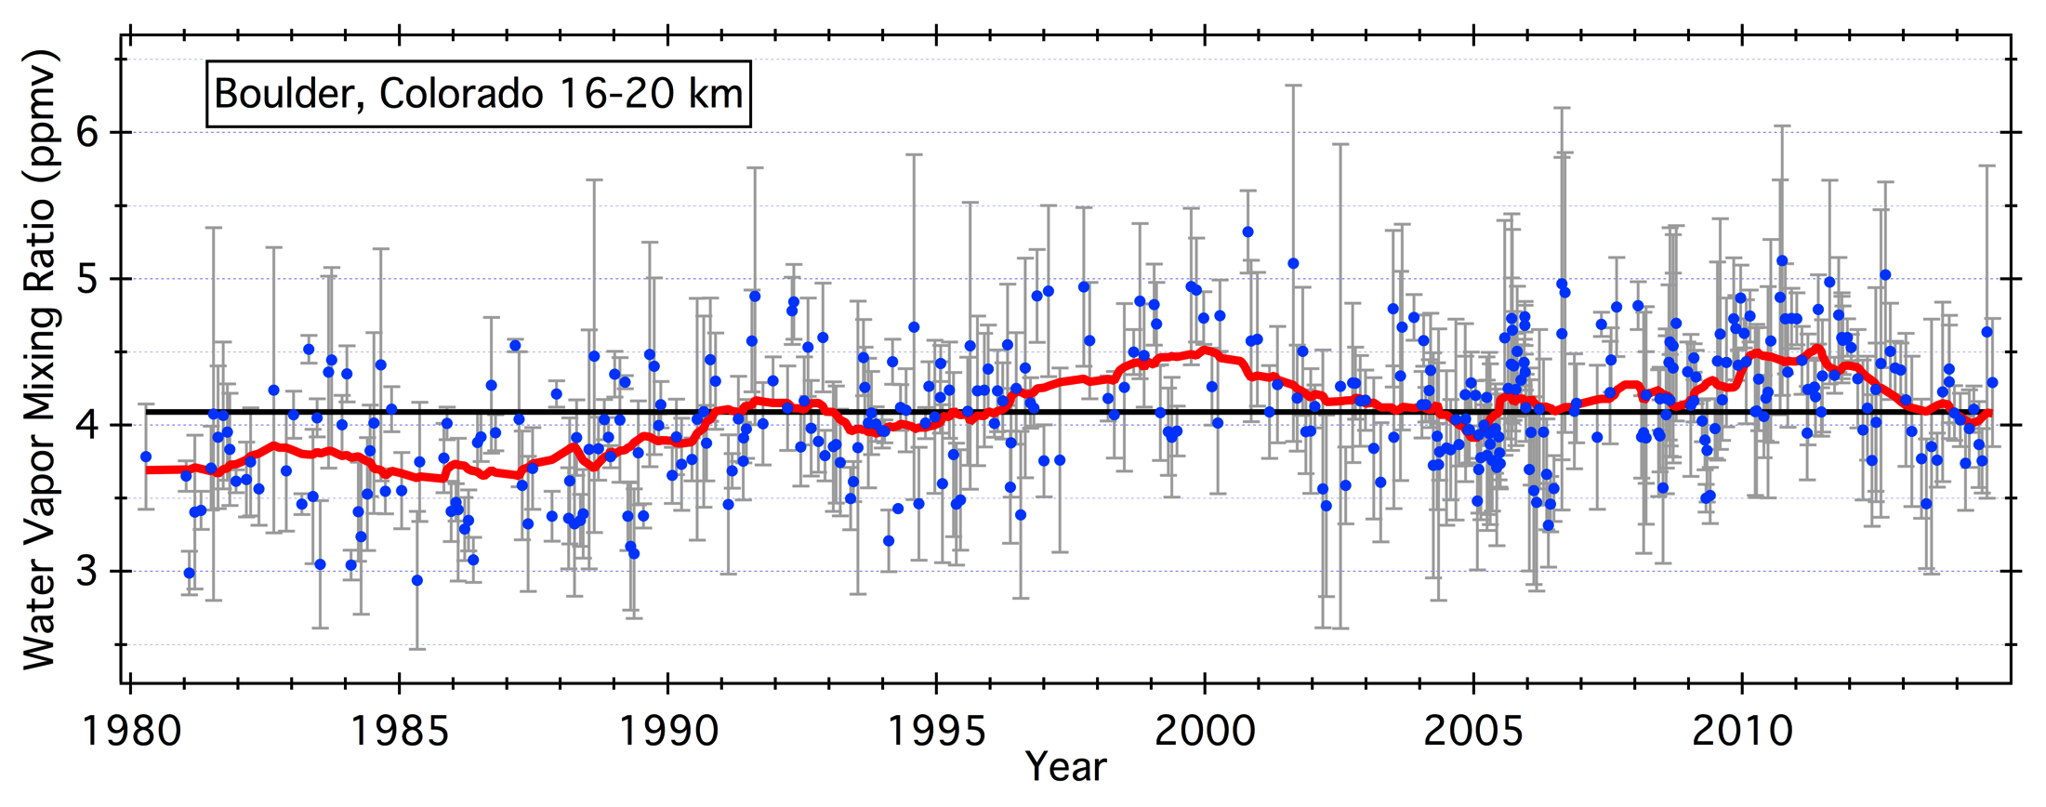
ATTREX STM, October 20, 2014
1
2
3

Slide 3
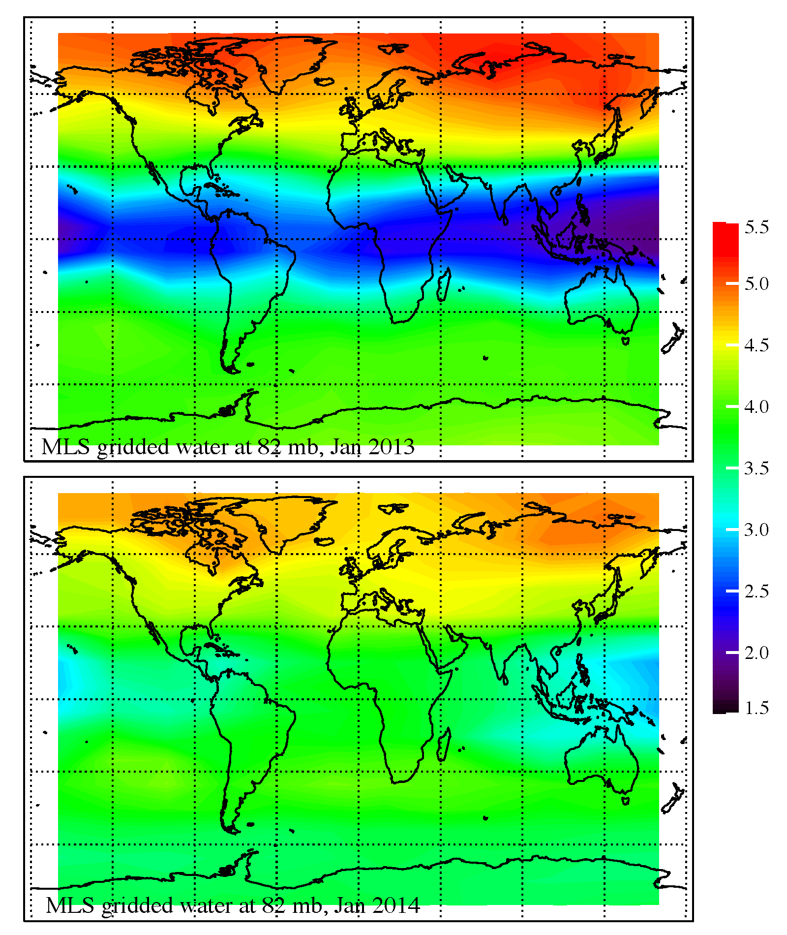
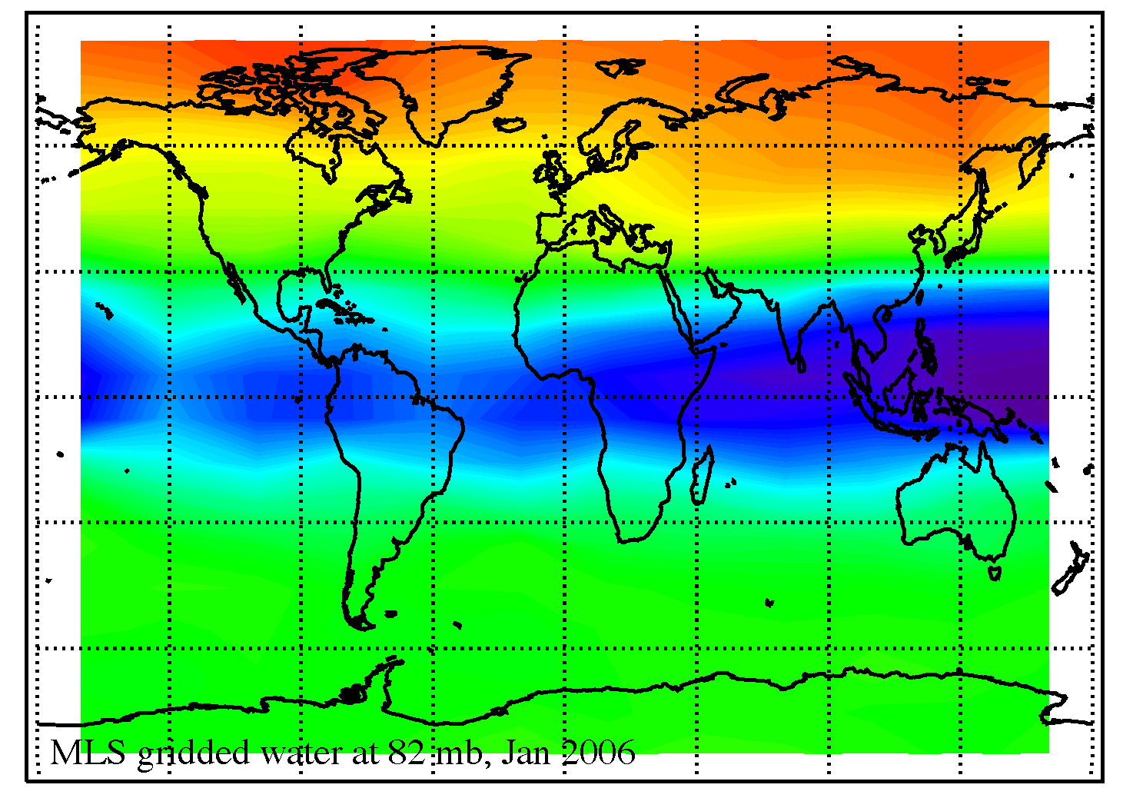
ATTREX STM, October 20, 2014
Contrasting 2013 with 2014, using gridded MLS water vapor at 82 mb.
Note: 2006 is similar to 2013

Slide 4
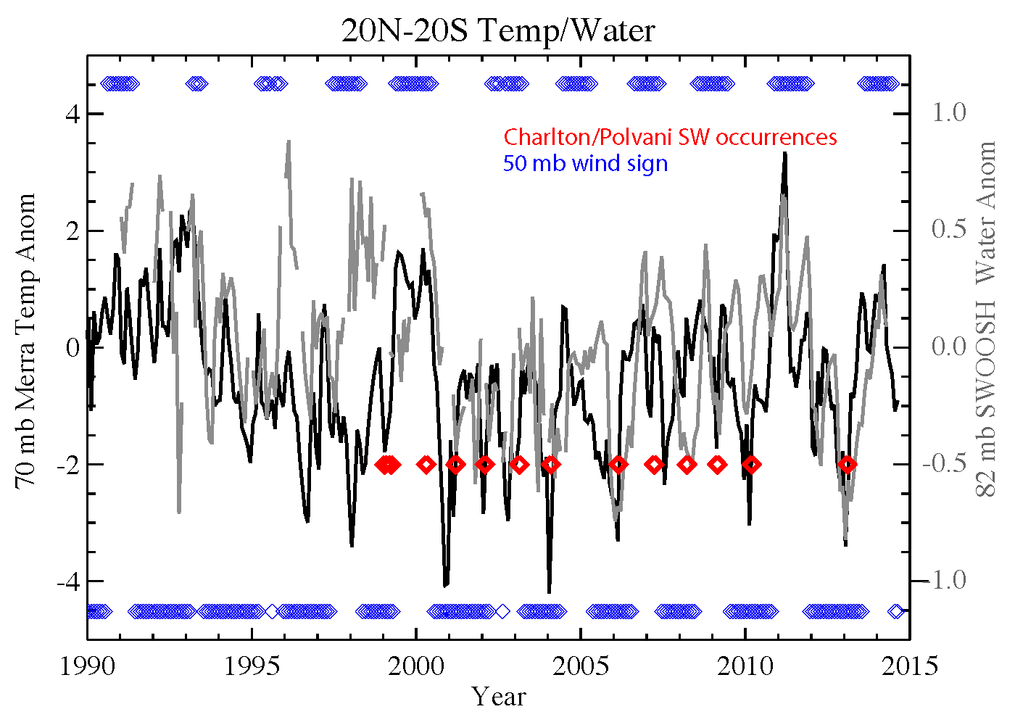
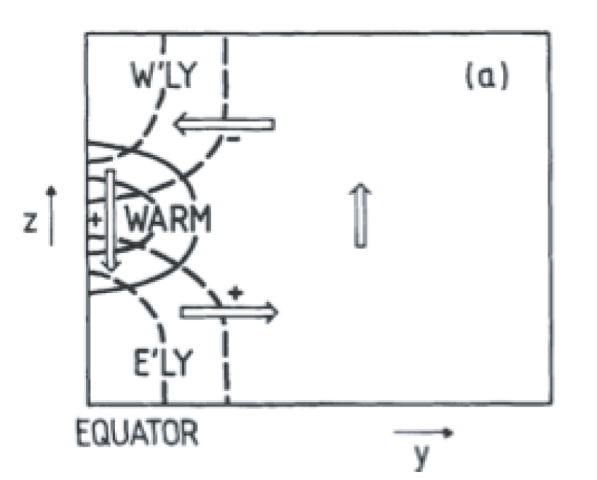
ATTREX STM, October 20, 2014
Plumb&Bell 1982

Slide 5
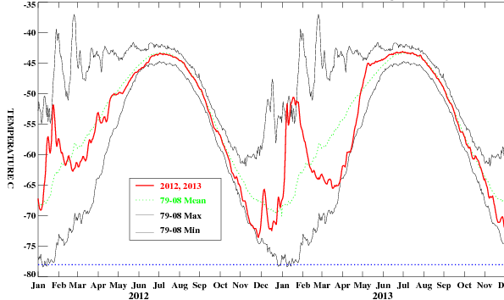
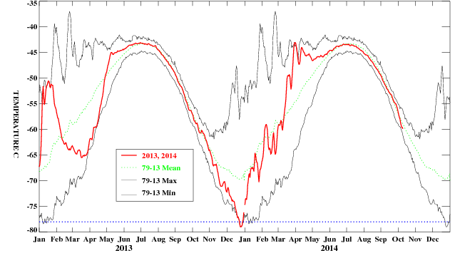
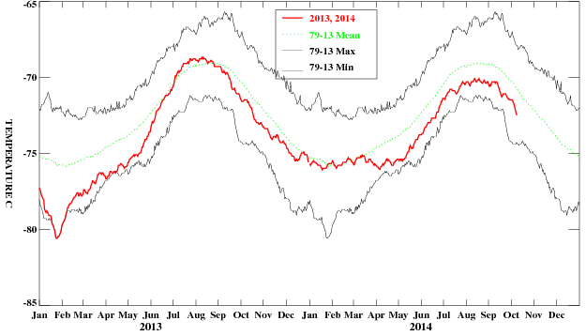
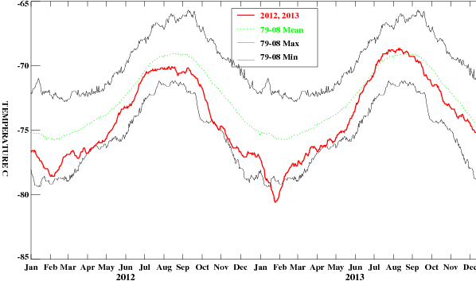
ATTREX STM, October 20, 2014
30 mb 65N-90N Temps
2012
2013
2014
70 mb 25S-25N Temps
Data from NOAA CPC
Notes:
Green line, 79-2008 mean (for 2013), 29-2013 for 2014 (and grey lines)

Slide 6
ATTREX STM, October 20, 2014
The 2013 case was a strong event that apparently impacted zonally averaged water vapor, and, conveniently with aircraft data to back up the satellite observations of very low stratospheric water vapor.
Stephanie’s paper looks at this event in detail:
Examining the relation between tropical tropopause cooling, the SSW, and convective activity in the Western Pacific.

Slide 7
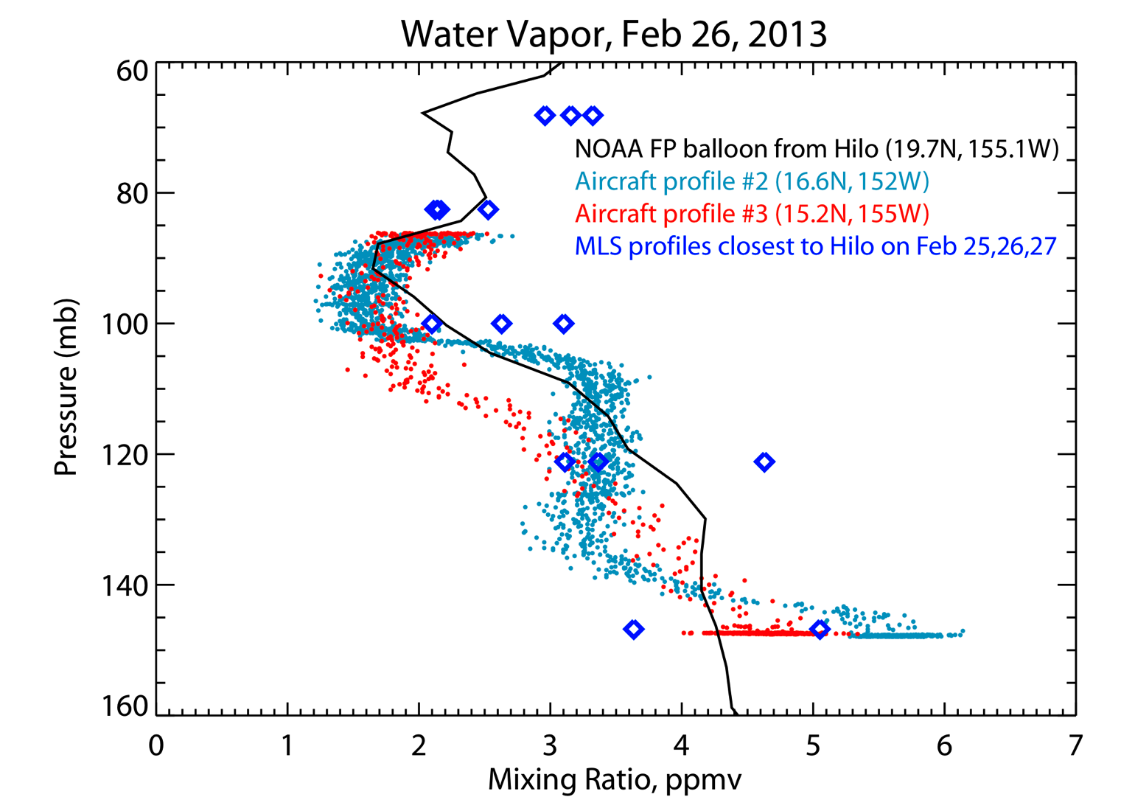
ATTREX STM, October 20, 2014
Verify that satellite measurements are reasonable
Note: MLS 82 mb tropical zonal average for Jan 2005-2014 is 3.13 ppmv; value for 2013 is 2.56 ppmv
Aircraft data: from NOAA_Water (Thornberry, Rollins, Gao)
Balloon data: NOAA_FPH, launched from Hilo (Hurst)
Notes:
Cold temperatures in January should imprint on the tropical water vapor.

Slide 8
ATTREX STM, October 20, 2014
During winter 2012/2013, conditions were similar to that in winter 2005/2006
Easterly shear (cold) phase of the QBO
Major Sudden Stratospheric Warming
Strong convection over the western Pacific
SSW = rapid temperature increase in the polar vortex over a few days in winter; they are preceded by an increase in wave activity from the troposphere; these waves break in the stratosphere and strengthen the mean meridional circulation…downwelling with warming at high latitudes, upwelling with cooling in the tropics.
Tropical link:
Gomez-Escolar et al., 2014, JGR, show that enhanced tropical cooling in the lower stratosphere occurs preferentially during the QBO easterly sheer phase.
Several studies have also shown that a SSW may enhance tropical convection
(Kodera, Eguchi, Yoshida and Yamasaki)
Change in wave activity -> changes mean meridional circulation and cools tropical lower stratosphere (as well as warming the polar stratosphere)-> change in TTL static stability -> possible impact on convection

Slide 9
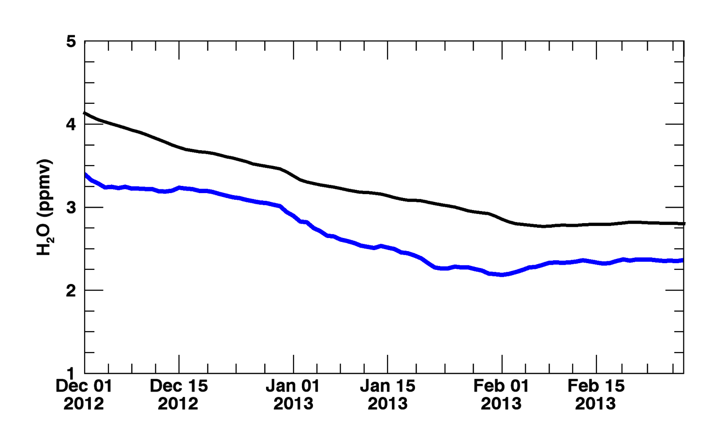
ATTREX STM, October 20, 2014
Stephanie’s hypothesis:
2013 low water vapor values were a result of the combined effects of the SSW, changes in convection and the QBO
Black line: MLS tropical average H₂O at 82 mb
Blue line: 2012/2013 winter
Daily values plotted
2012/2013 starts out low (due to QBO) and has accelerated drying (due to SSW of Jan 6)

Slide 10
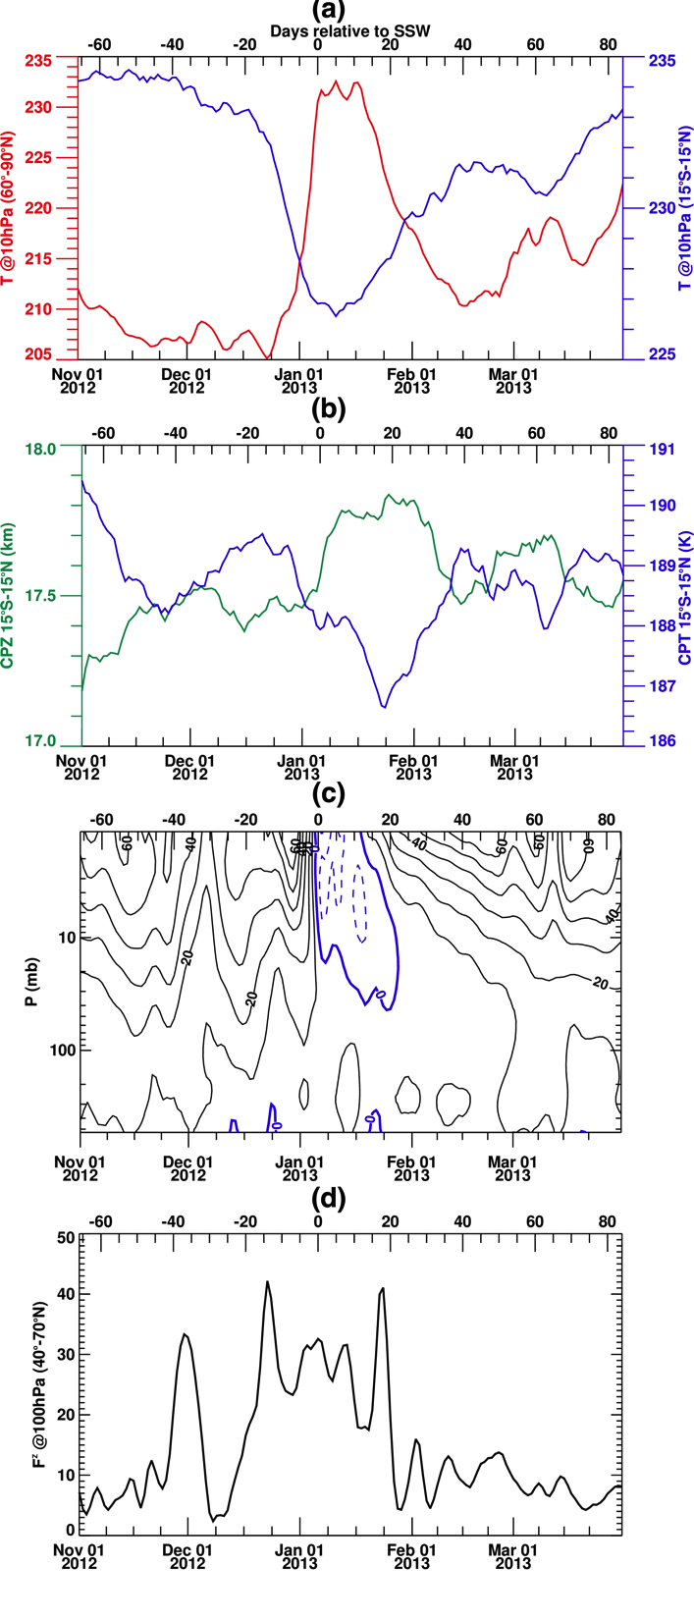
ATTREX STM, October 20, 2014
tropical
10 mb GPS T
60N Ubar
polar
40-70N vertical EP Flux at 100 mb
GPS CP T and Z
Z
T
Day 0 = Jan 6, 2013

Slide 11
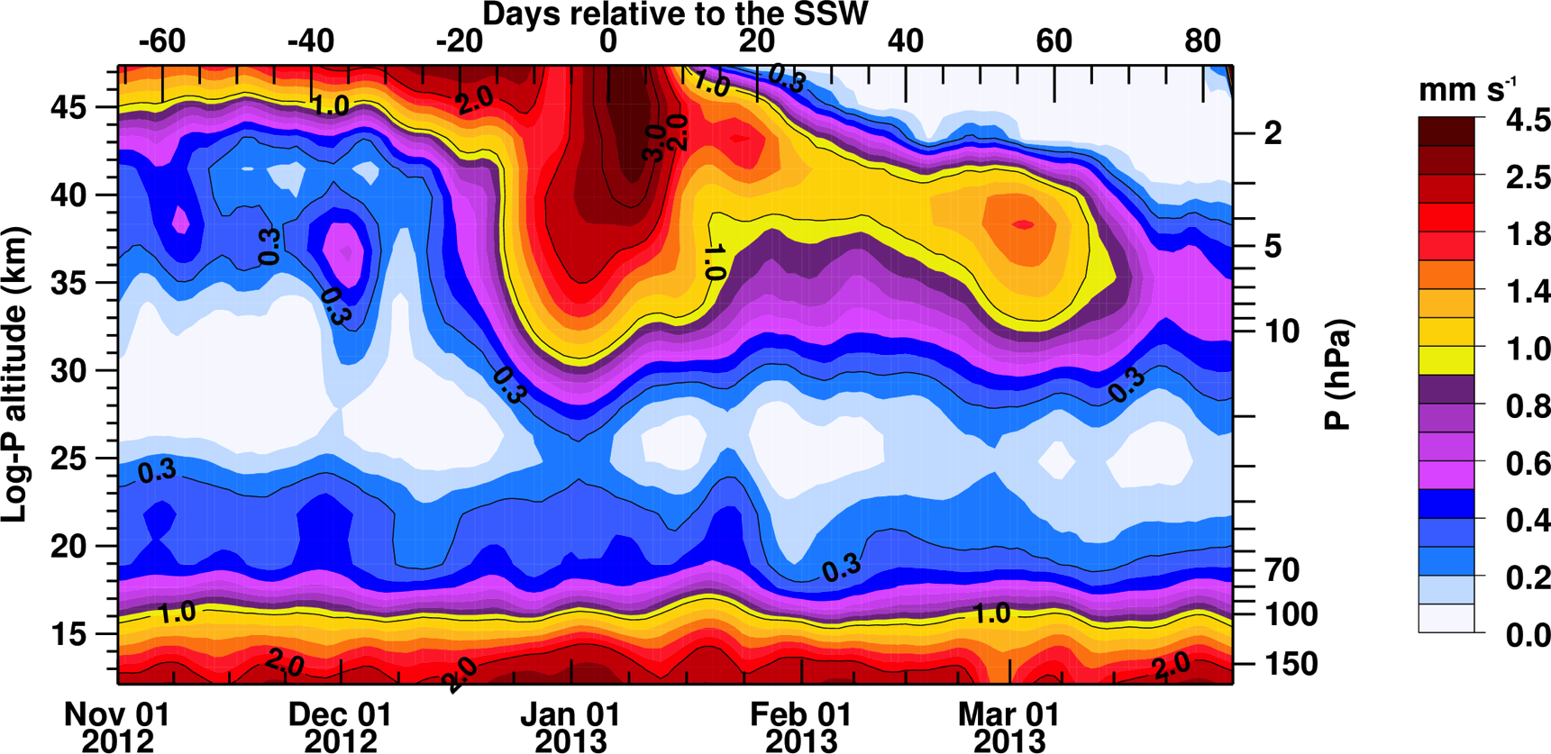
ATTREX STM, October 20, 2014
Time series of the tropical (15N-15S) wbarstar
Enhancement of 150-70 mb upwelling due to subtropical wavebreaking.

Slide 12
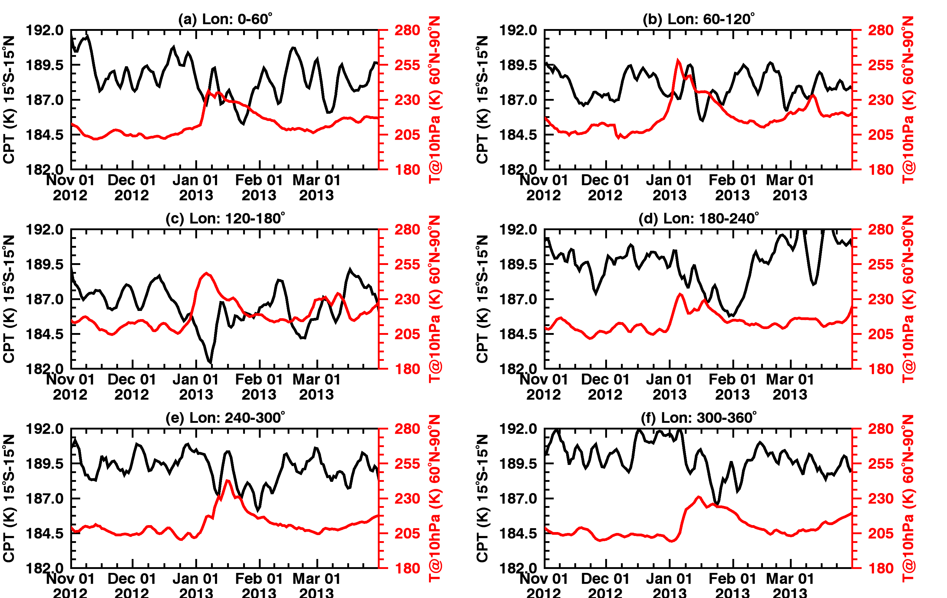
ATTREX STM, October 20, 2014
Now a longitudinally resolved view: larger tropical temperature response in the western Pacific (panel c), greater increase in polar temperature from 60-180 degrees longitude.
Red, 10 mb polar, black CPT tropics
Notes:
Red is polar temps at 10 mb, black is CPT in tropics

Slide 13
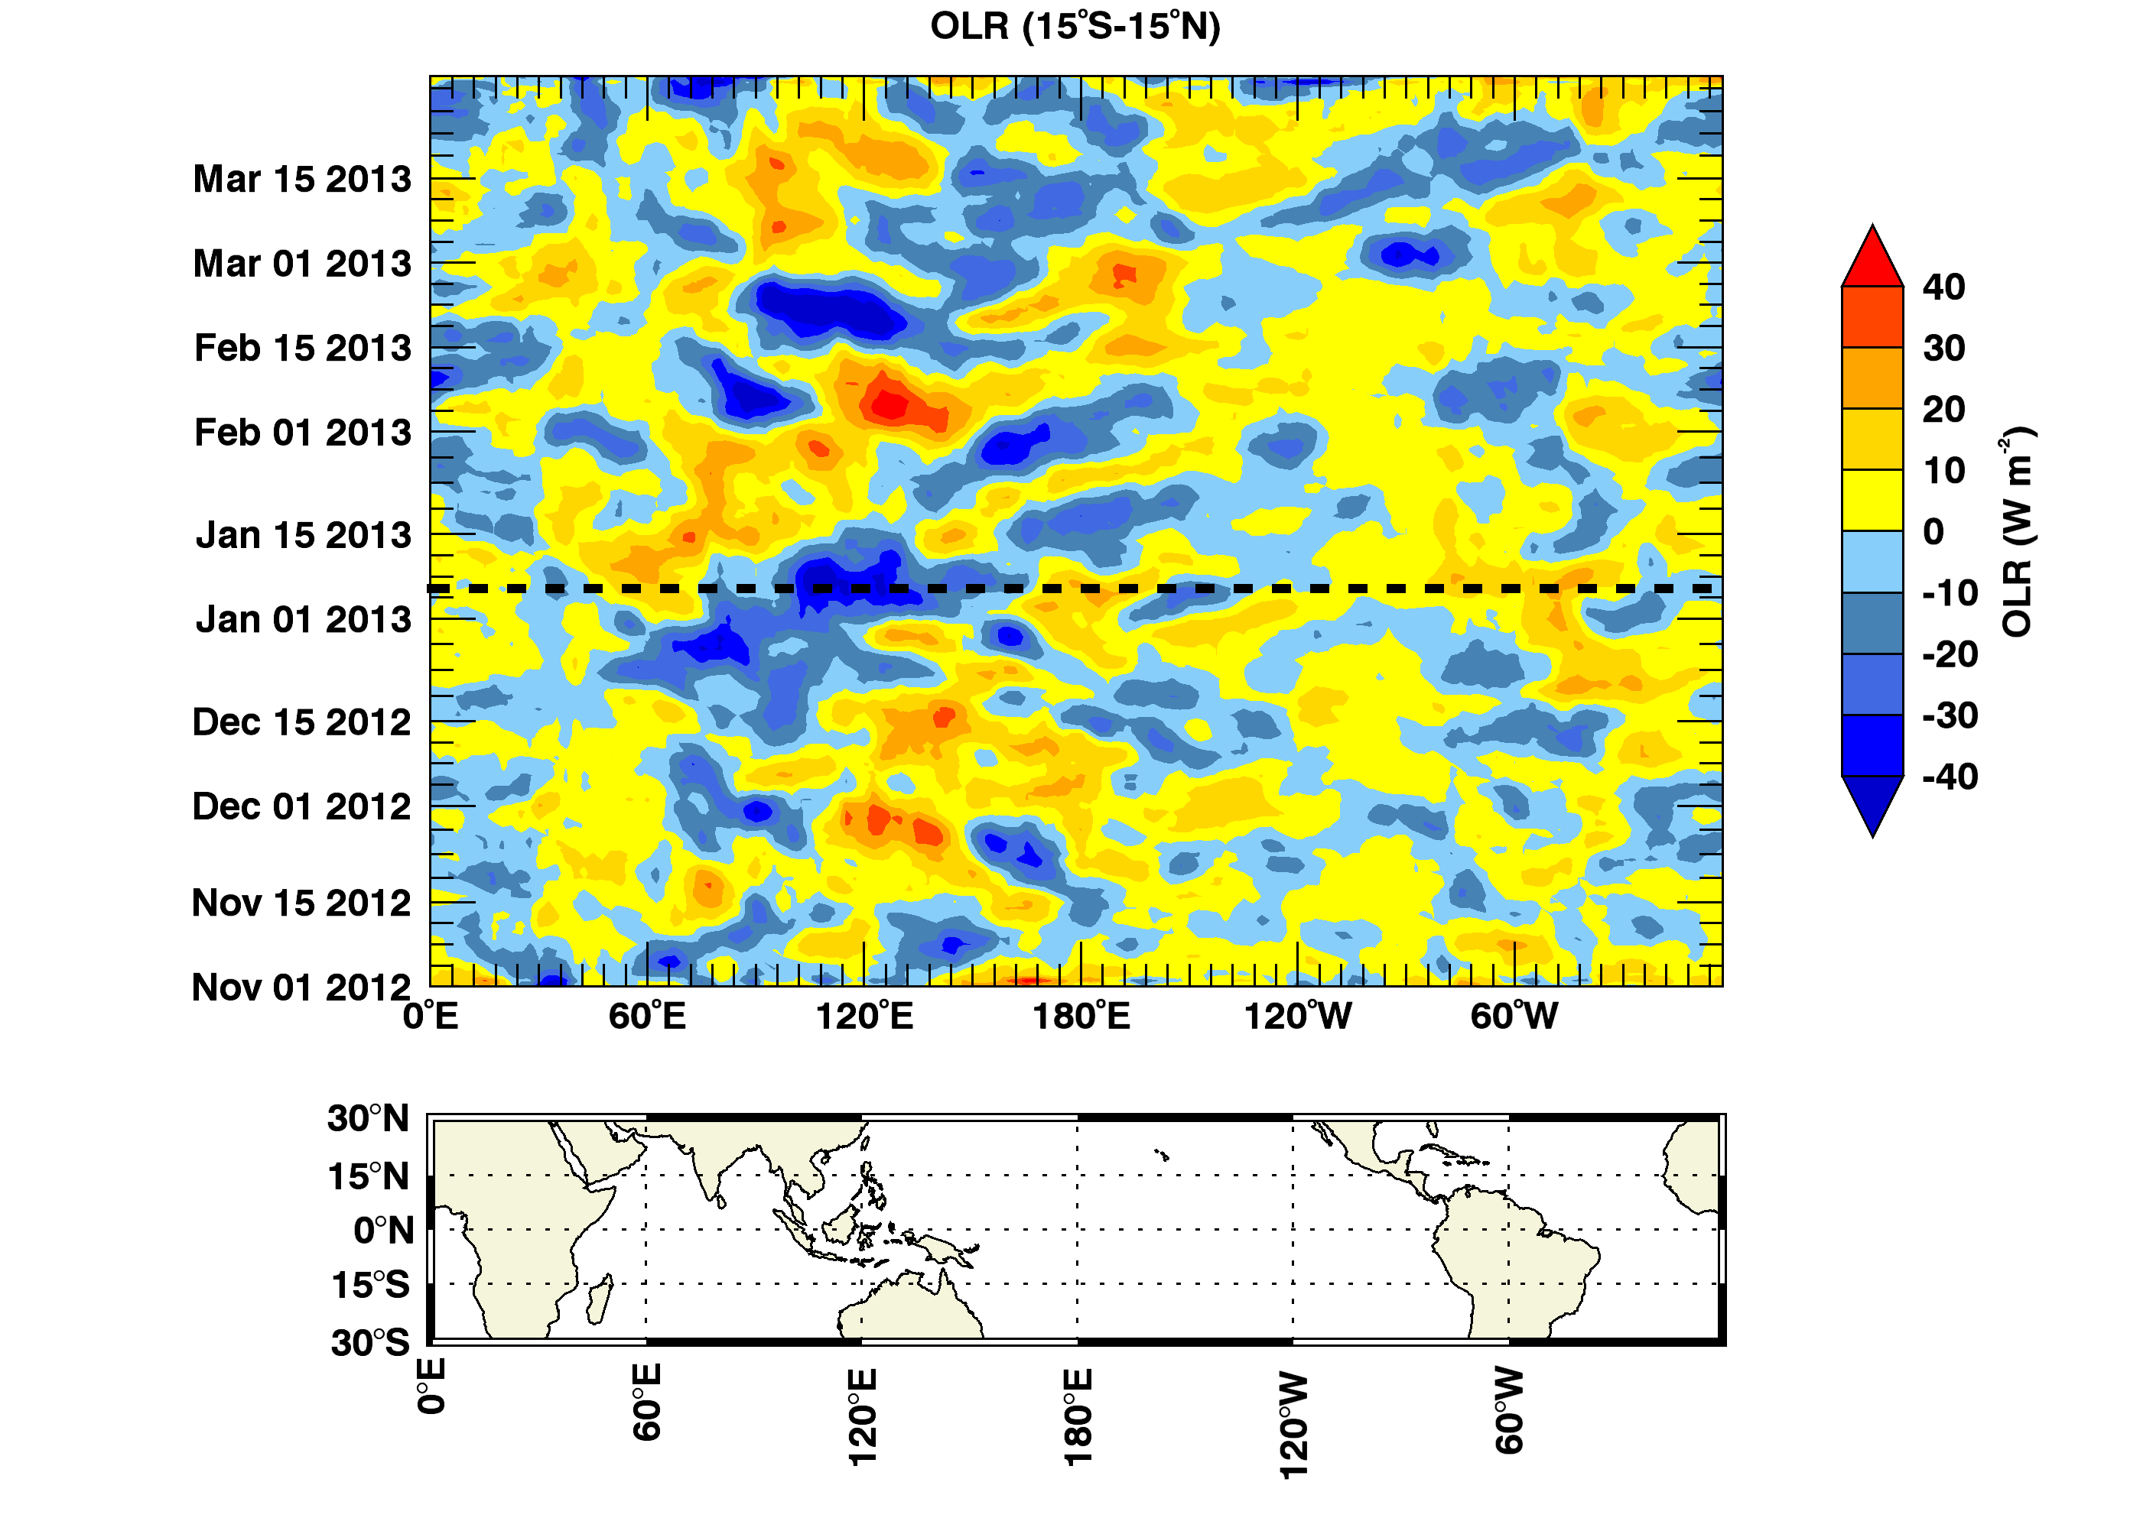
ATTREX STM, October 20, 2014
Daily tropical OLR anomalies, blue=active convection, this strengthens at time of SSW, and at the longitude band of maximum polar warming.

Slide 14
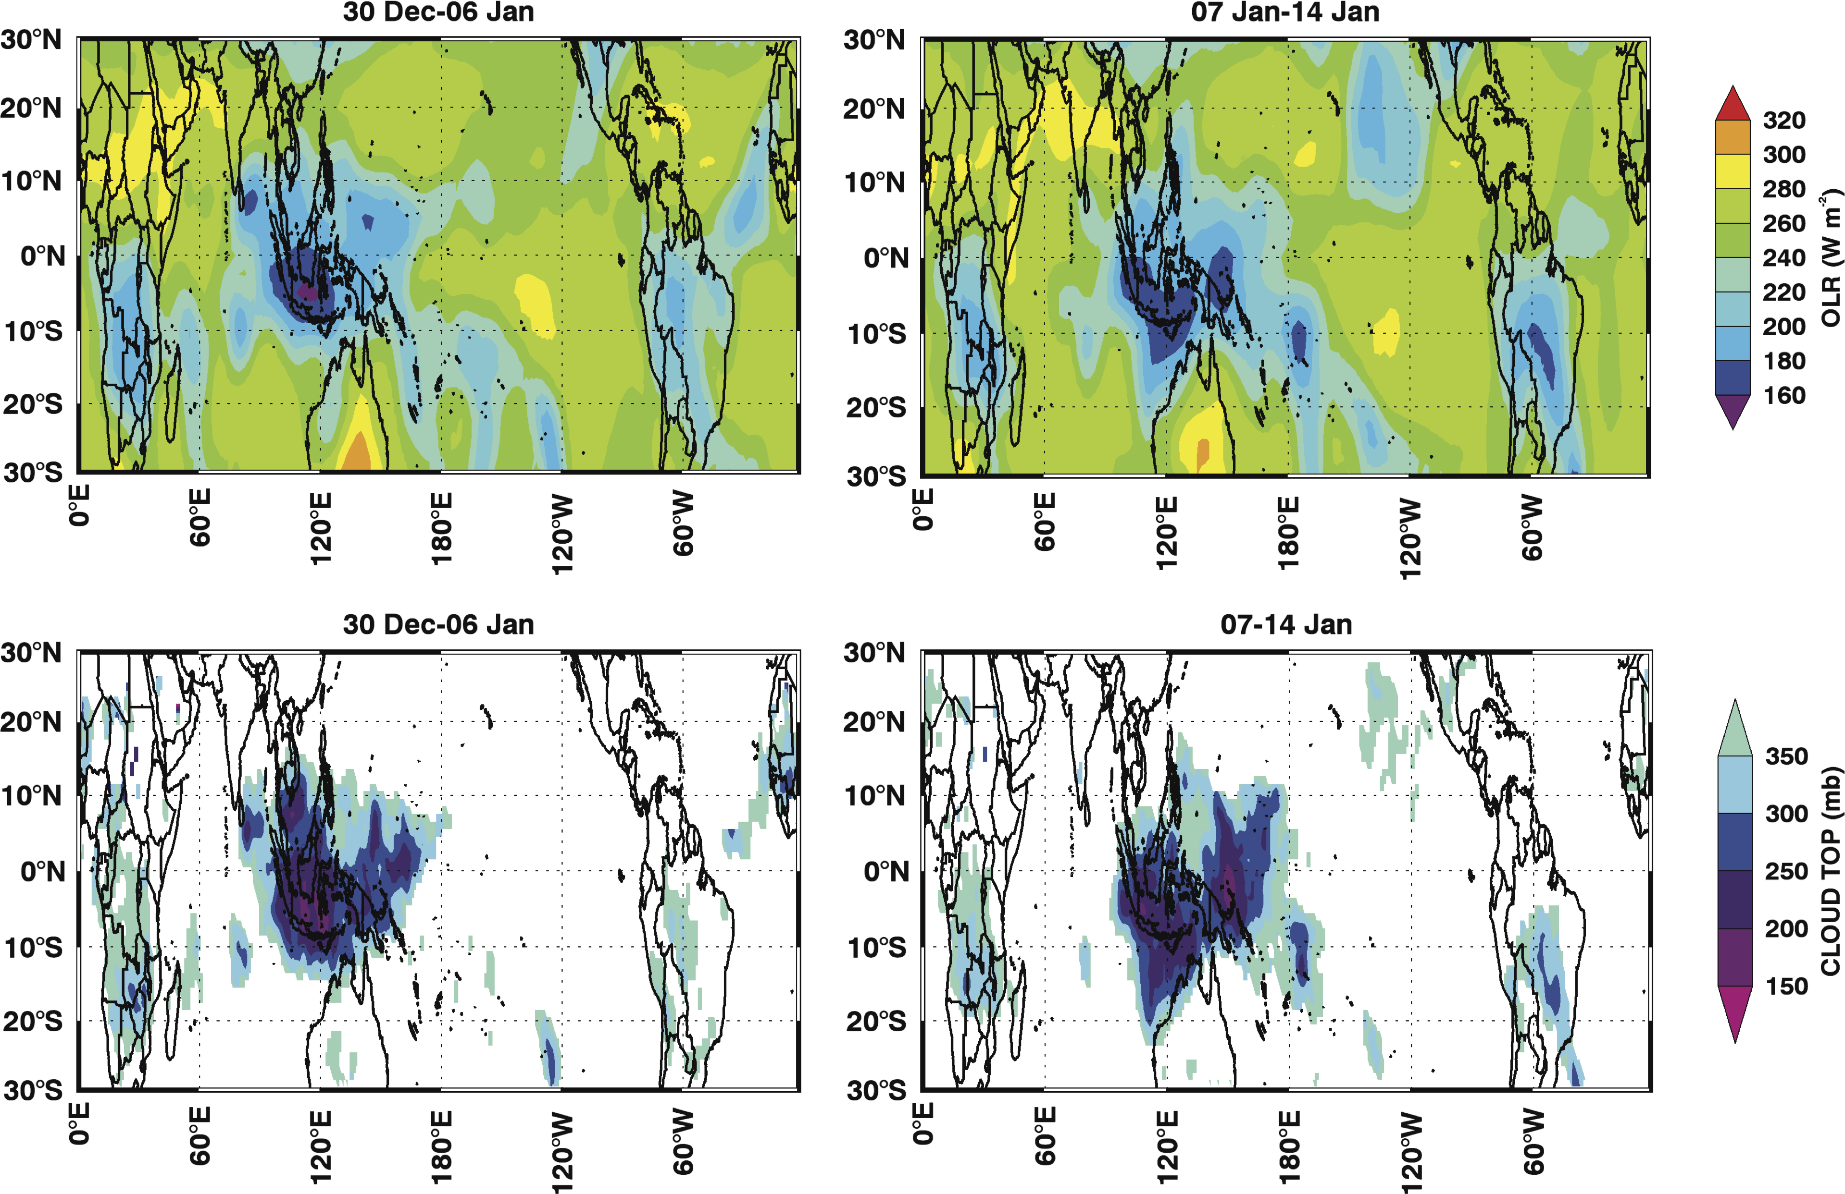
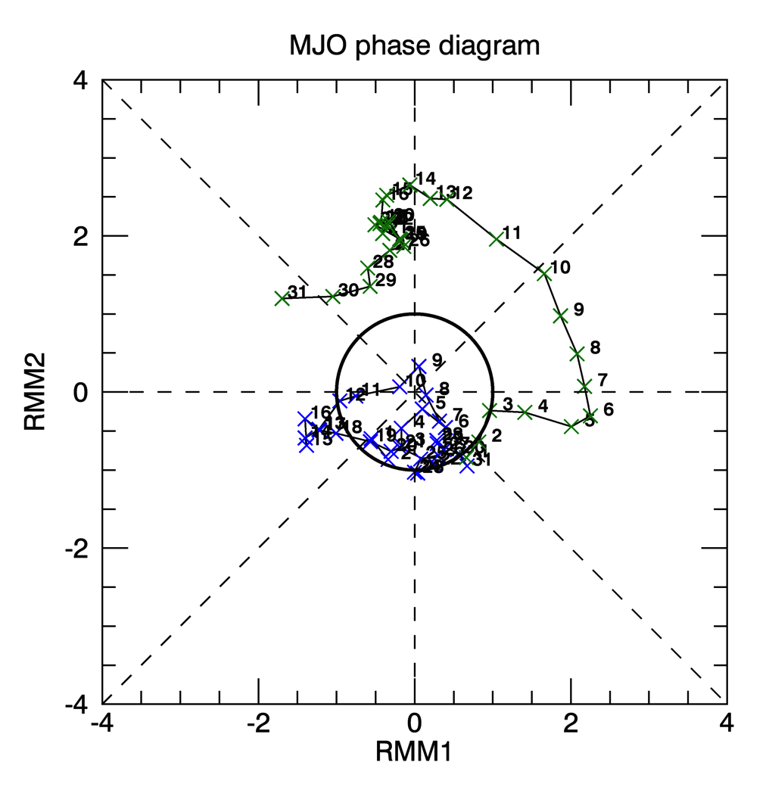
ATTREX STM, October 20, 2014
OLR and MODIS cloud top pssr, before and after the SSW
MJO phase diagram
Southward shift of convective activity consistent with Kodera, Eguchi, and Yoshida and Yamazaki studes.
Blue: Dec Green: Jan

Slide 15
ATTREX STM, October 20, 2014
Before SSW: enhanced mid latitude wave activity
This increases strength of the mean meridional circulation
Cools UTLS
Changes static stability
Changes height convection can reach

Slide 16
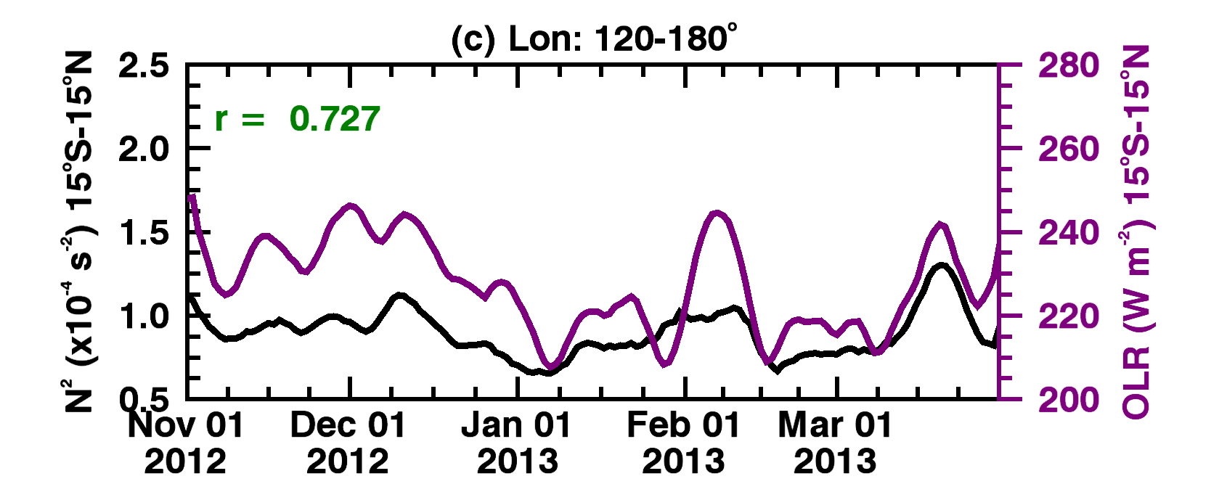
ATTREX STM, October 20, 2014
OLR (purple) N² (black), 13-16 km (UT), 120-180 longitude region that has the with largest tropical temperature cooling.

Slide 17
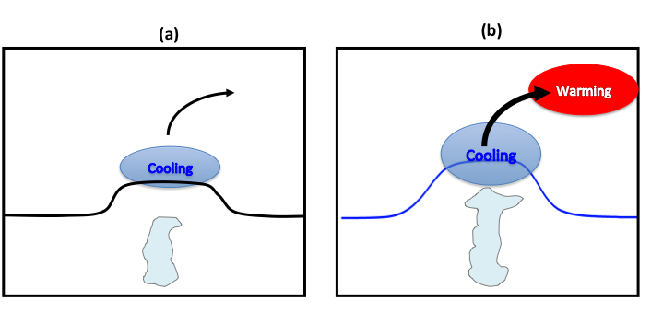
ATTREX STM, October 20, 2014
Change in convection with the SSW
Higher, colder cloud tops, leads to enhanced drying of air entering the stratosphere.

