Slide 1





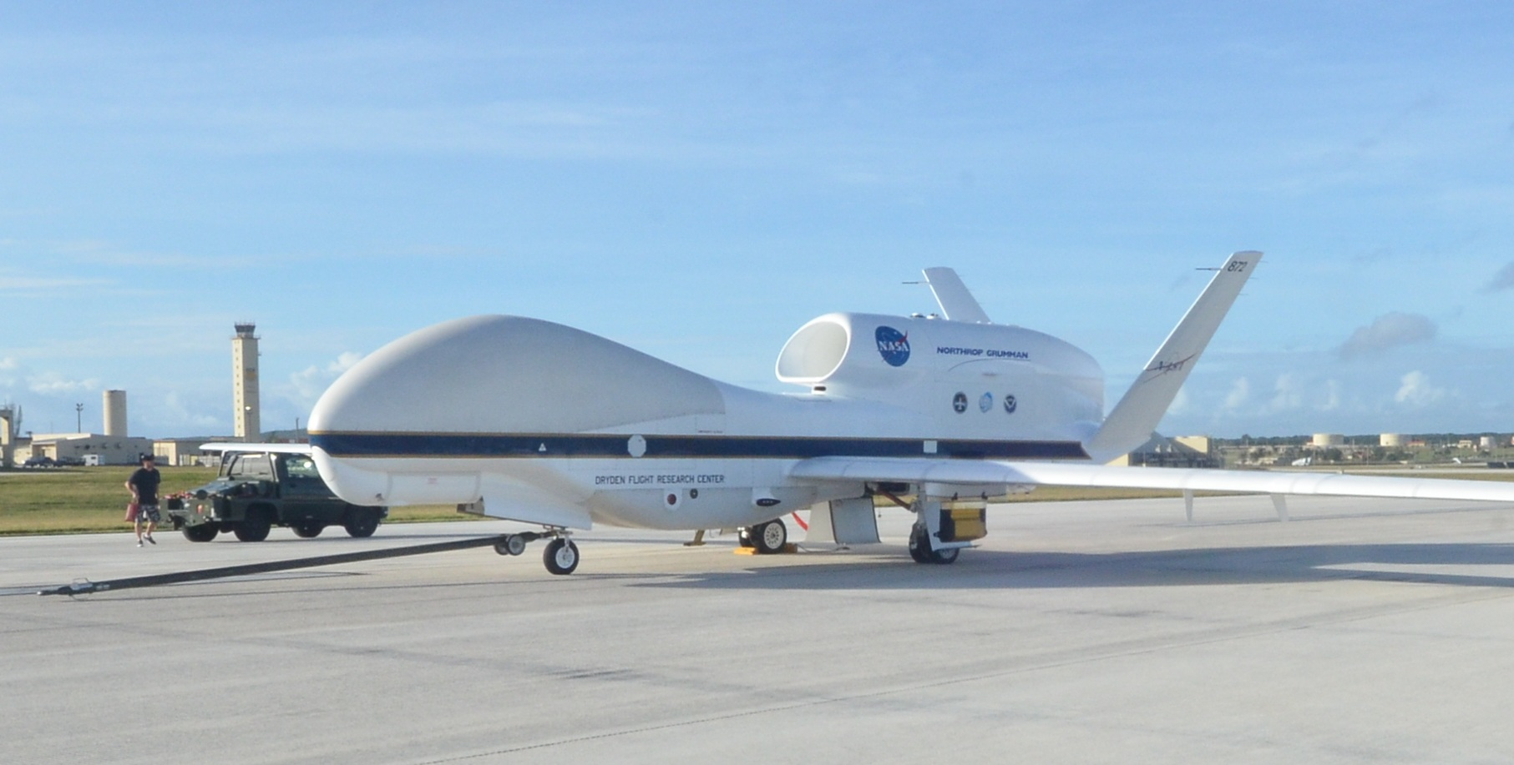
CAM5/CARMA Comparisons to Global Hawk Observations: A Look at In Situ vs. Detrained Ice Model Parameterizations
C. Maloney, O.B. Toon, C. Bardeen, G. Diskin, M. McGill, A. Rollins,
T. Thornberry, and S. Woods
Photo by Dave Fratello

Slide 2
Focus
To evaluate CAM5/CARMA at 1x1 degree resolution with aircraft observations.
- Improve cirrus cloud representation in the
model
Can we learn anything new about cirrus cloud microphysics with this comparison?
- in situ clouds vs. detrained clouds?
Notes:
----- Meeting Notes (10/13/14 16:04) -----
* Change font larger and more bold
* To evaluate CAM5/CARMA at 1x1 degree resolution
take out heterogenous line
* Look at lower resolutions

Slide 3
We compare global model simulations to aircraft observations
Model was run at 1x1 degree resolution
Interpolated grid boxes along the flight track
- 4 closest horizontal grid boxes
- Last and current time step
Model nudged by GEOS5 re-analysis data
CAM5/CARMA uses subgrid parameterizations
Notes:
----- Meeting Notes (10/13/14 16:04) -----
* check on vertical interpolate
* GEOS5 has 56 levels, check on CAM5/CARMA levels
* Model use hexigonal plates for in situ ice with 1:3 aspect ratio, detrained ice has variable density to catch wide range of sizes and shapes seen in detrained ice (density is determined with ratio between maximum dimension and mass). Based off Heymsfield and Westfield [2010] and Heymsfiedl and Schmitt [2010]

Slide 4
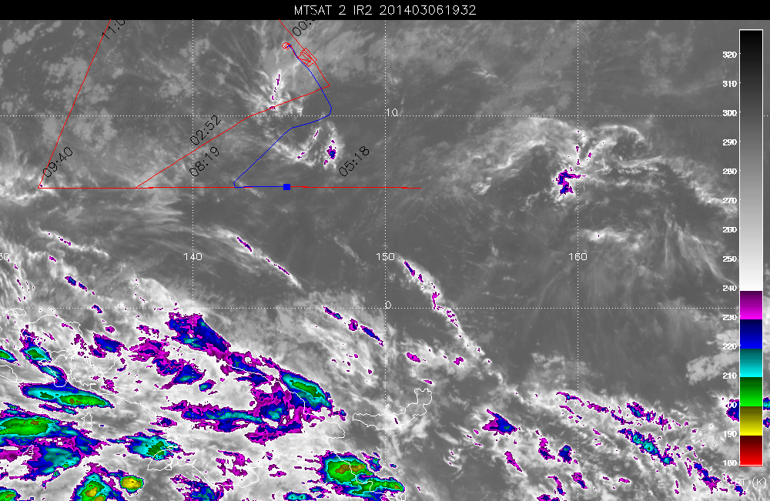
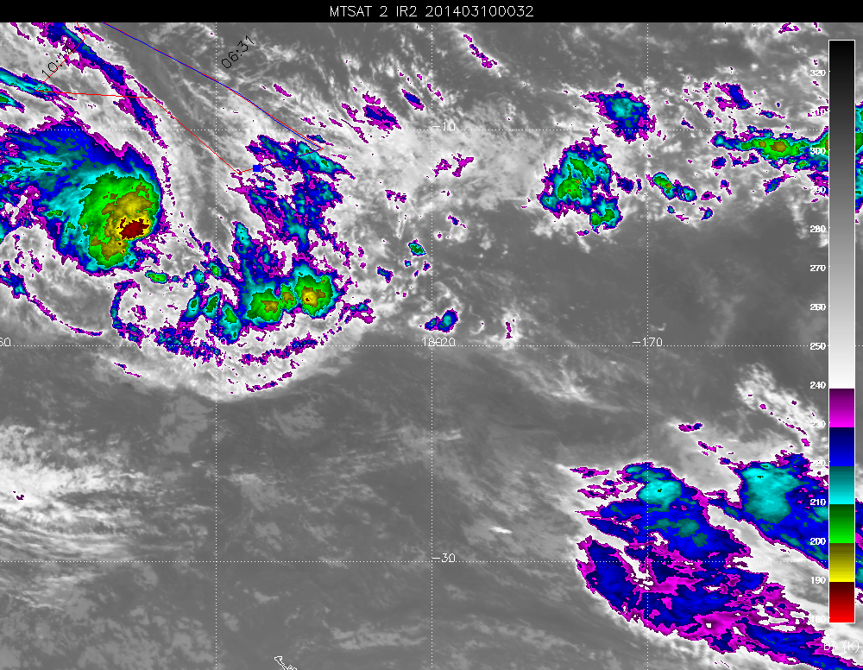
Two flights that might be very different
03/06/14
03/09/14
Notes:
03/06/14 had relatively little convection interacting with flight track so might be a good study for in situ cirrus
03/09/14 the aircraft skirted Tropical Storm Lusi
Might allow us to determine differences between in situ and detrained in observations

Slide 5
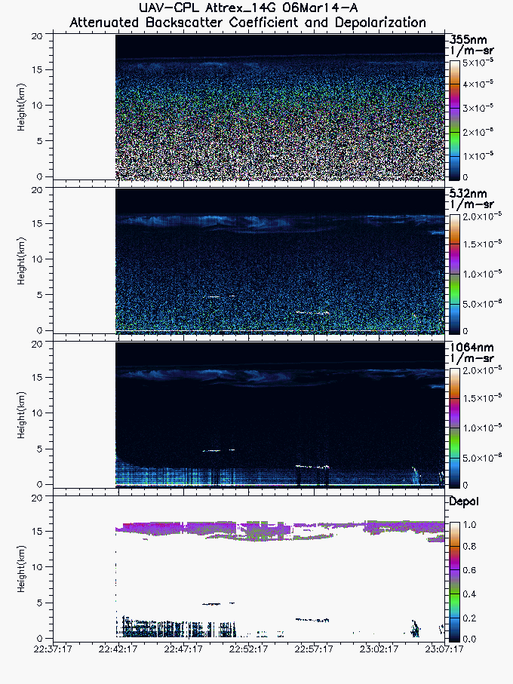
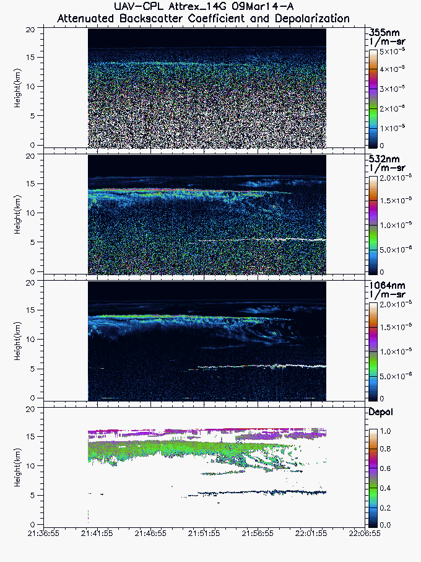
Do They Look Different?
03/09/14
03/06/14
Notes:
03/06/14 flight exhibits high thin cloud consistently
03/09/14 Southern portion of the flight generally shows two layers of cloud: 1) high thin cloud (15 – 16 km), 2) more optically thick cloud between 13 – 14 km

Slide 6
Do They Look Different?
03/09/14
03/06/14
Notes:
03/06/14 flight exhibits high thin cloud consistently
03/09/14 Southern portion of the flight generally shows two layers of cloud: 1) high thin cloud (15 – 16 km), 2) more optically thick cloud between 13 – 14 km

Slide 7
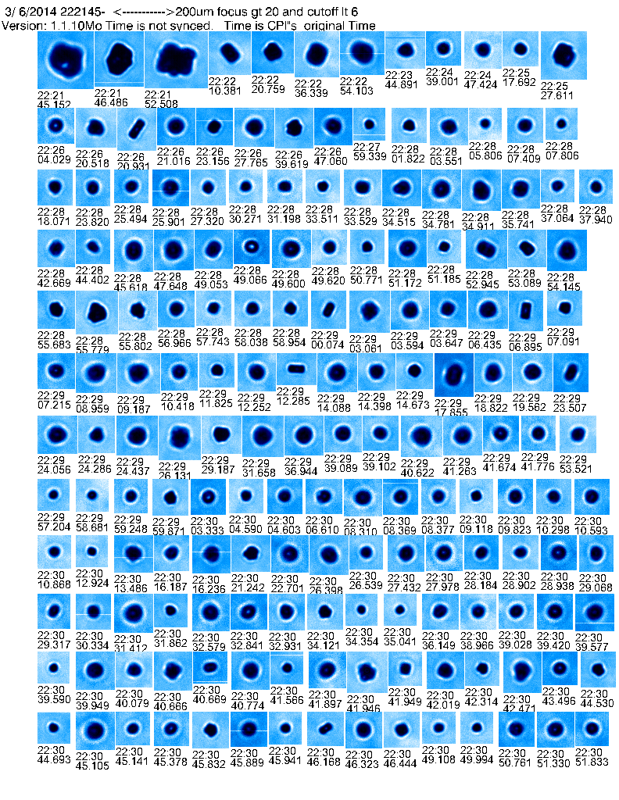
Thin clouds on 03/06/14 flight appear to be in situ
22:21 to 22:30 UTC from 13.7km to 15km
Notes:
CPL image from 22:37 – 23:07, CPI image from 22:21 – 22:30
Presumably the aircraft intersected this cloud in the latter half of this CPI image
Small indistinguishable shapes seen by CPI. Such a high depolarization leads me to believe spherical in shape, so in situ? (investigate depolarization claim a little more)

Slide 8
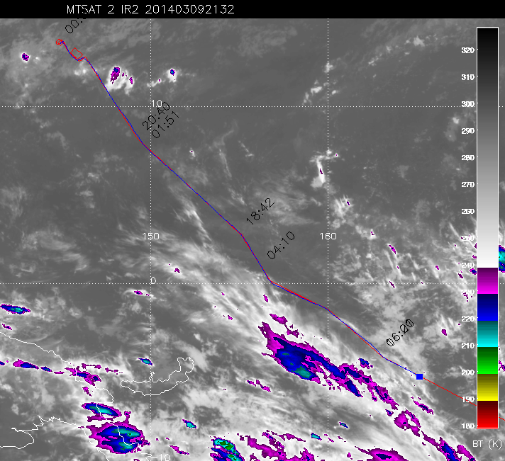
Two cloud layers seen in 03/09/14 flight
Image at 21:32 UTC
Notes:
Dense cirrus experienced just north of tropical storm Luci
MTS image at 21:32 UTC

Slide 9
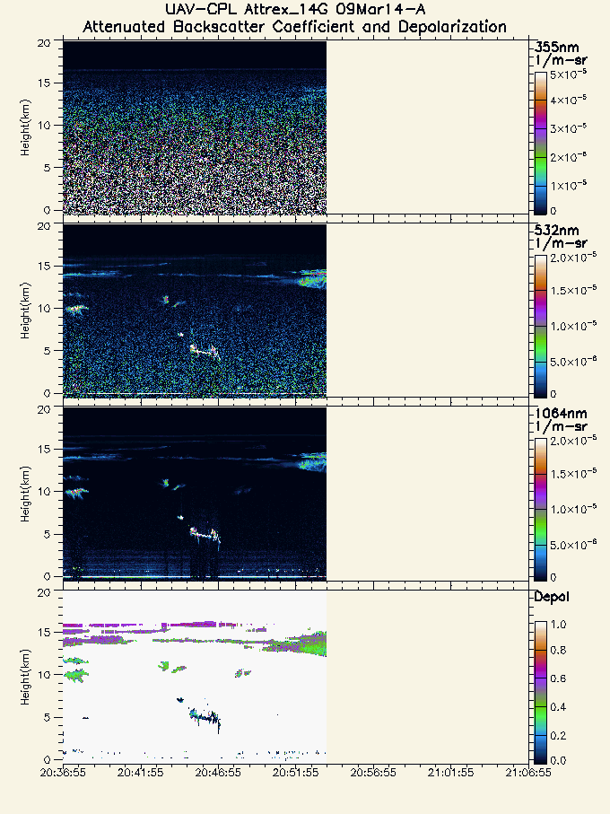
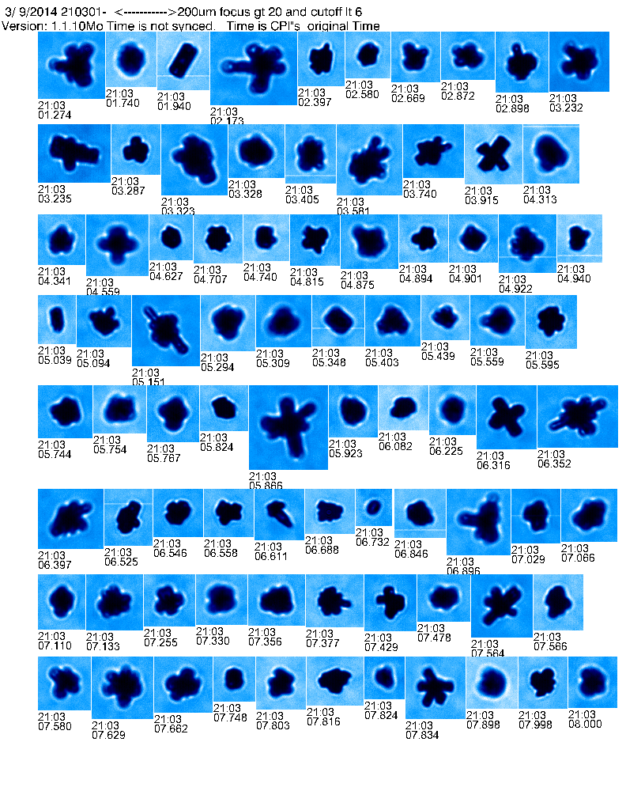
Low cirrus shows large bullet rosettes
Images at 21:03 at 14.7 km
Notes:
CPL image from 20:38 – 21:06, CPI image at 21:03
This CPI image is presumably in descent through heavy cloud in CPL image at right most portion of the image
CPI image shows large bullet rosettes and budding rosettes in lower warmer cloud, this is believed to be in situ cirrus

Slide 10
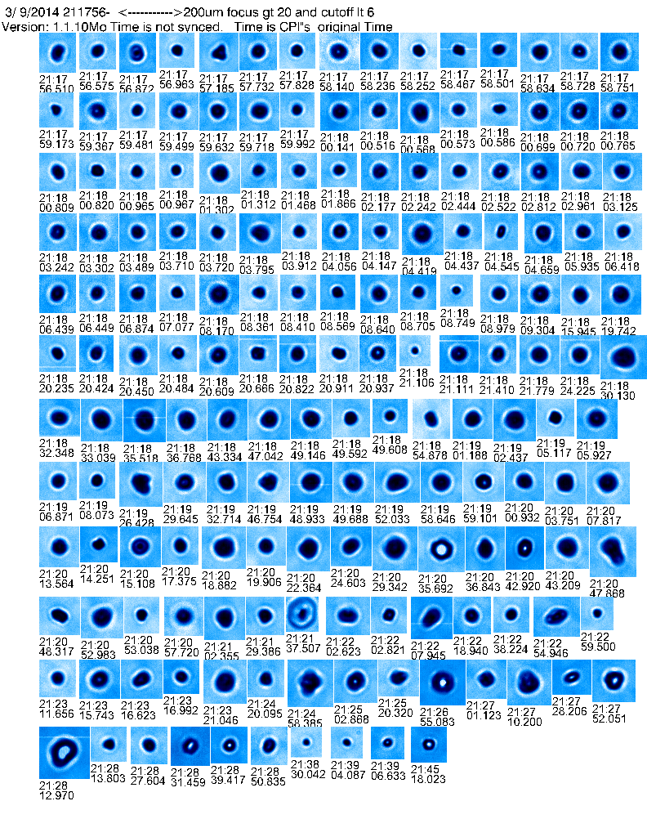
High cirrus layer shows small spheroids and plates
Images from 21:17 – 21:45 UTC at 13.7 km to 15.7 km
Notes:
CPL image from 21:38 – 22:06 UTC, CPI image between 21:17 – 21:45 UTC (ascent)
While ascending through high thin cloud, small indistinguishable shapes and plates are seen (break in low cloud during ascent)
Our model makes a hexagonal plate shape assumption for in situ clouds, so does it agree?

Slide 11
What does our model show?
Notes:
Full 03//06/14 flight
Chucks CF1 modifications (note Chuck has made more modifications since then)
CAM5/CARMA agrees well in the small particle regime, but there is too much detrained ice in the large particle range
CAM5/CARMA presents too much mass for both in situ and detrained in the large particle range

Slide 12
What does our model show?
Notes:
Full 03/09/14 flight
CAM5/CARMA again does well representing observations
NOTE: Detrained now dominates the small particle regime, why is this? (need to investigate)
Could the high thin cirrus seen in CPL images with plate shapes (CPI) actually be cirrus blow off ice? This would make our plate assumption be incorrect and need to be addressed
Or is this a resolution artifact?

Slide 13
Model representation of 03/06/14 flight segment of interest
Notes:
Flight segment including the CPL and CPI images shown before
Model greatly under predicts observations during such a small time frame and barely sees any ice.

Slide 14
Flight Segment Profile
Notes:
Profile’s of flight segments with model data
Model is generally too wet here compared to observations in time segment (5.35-5.50) so not enough nucleation occurring to remove water vapor from the air
This is confirmed by IWC profile which shows model under predicting in this time frame

Slide 15
Model representation of 03/09/14 flight segment of interest
Notes:
Model adequately represents 10 um – 50 um range, but misses smaller particles and overpredicts particles larger than the FCDP upper limit (no 2DS?)
Same case in IWC
Again detrained ice is dominating this flight at smaller sizes

Slide 16
Flight Segment Profile
Notes:
Model is too dry at lower altitude, but does better on the ascent in the latter half of the time segment
Difficult to compare mass as observations are sporadic, hence why the size distributions looked so strange

Slide 17
Recap
Performed a comparison of the CAM5/CARMA model to observations from the Global Hawk at a 1x1 degree resolution
Different types of in situ cirrus are seen in the observations, but the model ice habit in the 03/09/14 case disagrees.
Model struggles capturing detailed features along the flight track
Notes:
----- Meeting Notes (10/13/14 16:04) -----
#2: if you lower supersaturation, detrained ice becomes more important as it has less mass, but that may not be the answer to the problem
#3: it is difficult to tell whether there are nucleation problems in here, in situ is important in obs, but model is not nucleating enough,
#4 further analysis needed

Slide 18
Future work
Increase field of view to compare gross features such as cloud fields in the region
- Use CALIPSO data
Evaluate best ice habit assumptions for CARMA
Continue to modify treatment of water vapor in CAM5/CARMA

Slide 19
Thank You

Slide 20
Extra Slides

Slide 21
Full 03/06/14 flight profile

Slide 22
Full 03/09/14 flight profile

Slide 23
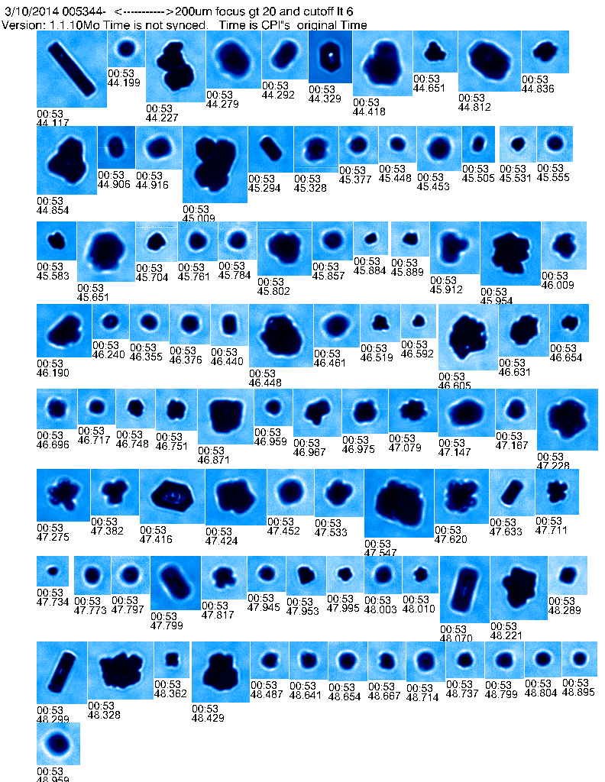
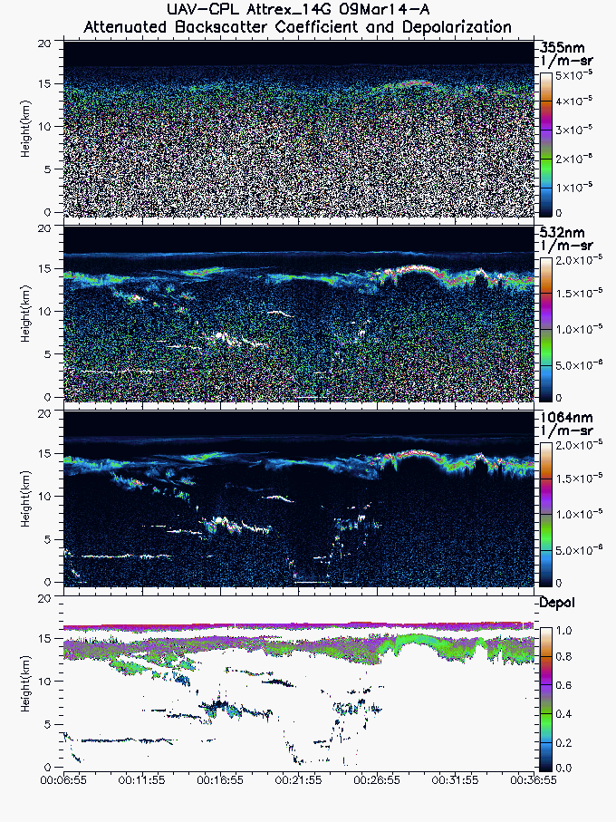
Southern convection of 03/09/14 flight
Notes:
CPI at 91 hPa

Slide 24
Model representation of flight segment

Slide 25
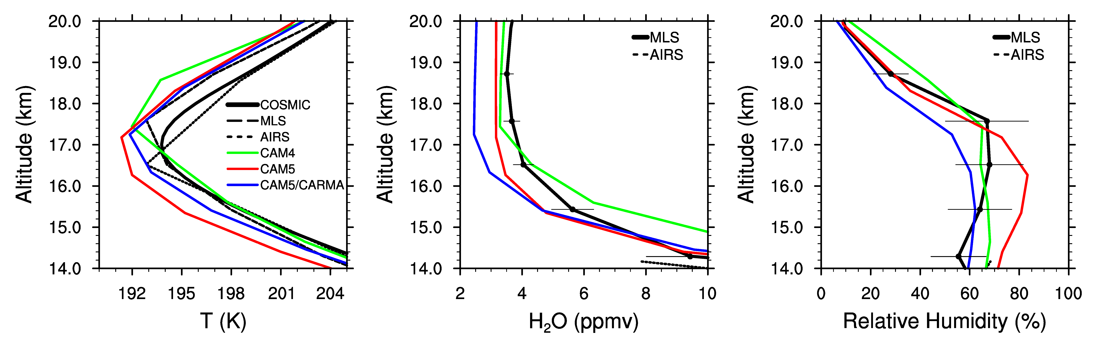
Previous studies show CAM5/CARMA improves on CAM5
Figure 9 from Bardeen et al (2013) showing annual tropical averages compared to MLS, AIRS, COSMIC satellite data sets
CAM5/CARMA excels at altitudes below Tropopause

Slide 26
We compare global model simulations to aircraft observations
Model was run at a resolution of 1x1 degrees
We then interpolated grid boxes along the flight track
- 4 closest horizontal
grid boxes
- Last and current time step
Model was nudged by GEOS5 re-analysis data
CAM5/CARMA uses subgrid parameterizations
Notes:
----- Meeting Notes (10/13/14 16:04) -----
* check on vertical interpolate
* GEOS5 has 56 levels, check on CAM5/CARMA levels
* Model use hexigonal plates for in situ ice with 1:3 aspect ratio, detrained ice has variable density to catch wide range of sizes and shapes seen in detrained ice (density is determined with ratio between maximum dimension and mass). Based off Heymsfield and Westfield [2010] and Heymsfiedl and Schmitt [2010]

