Slide 1
Sensitivity to Humidity Data Assimilation for Hurricane Intensification and Heavy Rains T.N. Krishnamurti HS3 Science & Deployment Preparation Meeting April 29 – May 1, 2014 NASA Research Park, Moffett Field, CA +
Collaborators: J. Bielli, V. Kumar, A. Bhardwaj, A. Simon, A. Thomas, S. Das, R. Ross.

Slide 2
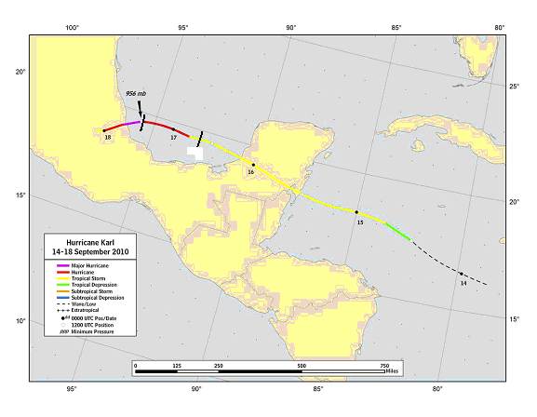
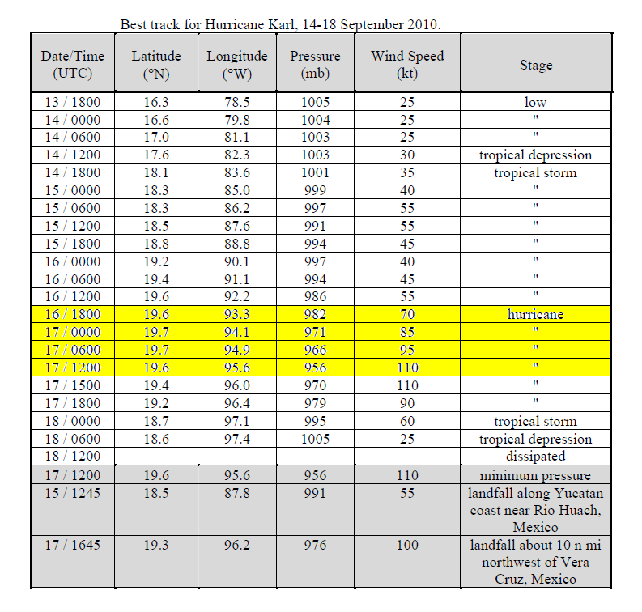
Track and Intensity of Hurricane KARL 14th-18th Sep 2010
The observed track of HURRICANE KARL during September 14 to 18 2010 is shown here.
The red portion of the track, as the hurricane makes a landfall over Mexico is of interest here. Physical initialization at radar resolution was carried out starting on august 16th at 12 UTC and continued for a 24 hour period, thereafter a free forecast was continued.

Slide 3
Alvarado radar loop as received from Mexico. This is the radar reflectivity animation covering the period September 16 , 2010 16Z to September 17, 2010 17Z. This is Hurricane KARL that made landfall in Mexico.

Slide 4
Spin-up of correlations between physically initialized rain and rain based on the Alvarado radar, during 22 hours
This illustration shows the spin up of model rain towards the radar based rainfall estimates. The ordinate shows the correlation among these two rainfall (this is within a 100km square centered at the storms center). The correlation starts out with a value of 0.1 and spins up to a value close to 0.8 by around 16 hours (abscissa) of physical initialization.

Slide 5
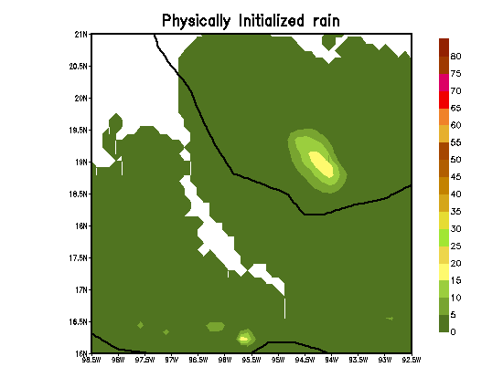
ANIMATION OF PHYSICALLY INITIALIZED RAIN
The animation shows the spin up of rains for Hurricane KARL during physical initialization. Frames were interpolated from the radar reflectivity movie provided by the Mexican weather service. Those radar reflectivities were carefully interpolated to a 1.33 km grid and frames were taken for every 5 minutes in time to convert the radar reflectivity to rain rates using a z = r relationship that was carefully calibrated and validated against rain gauges over Mexico. This animation shows that the WRF/ARW model catches up to the radar rains very closely by around 16 hours after the start of the physical initialization.

Slide 6
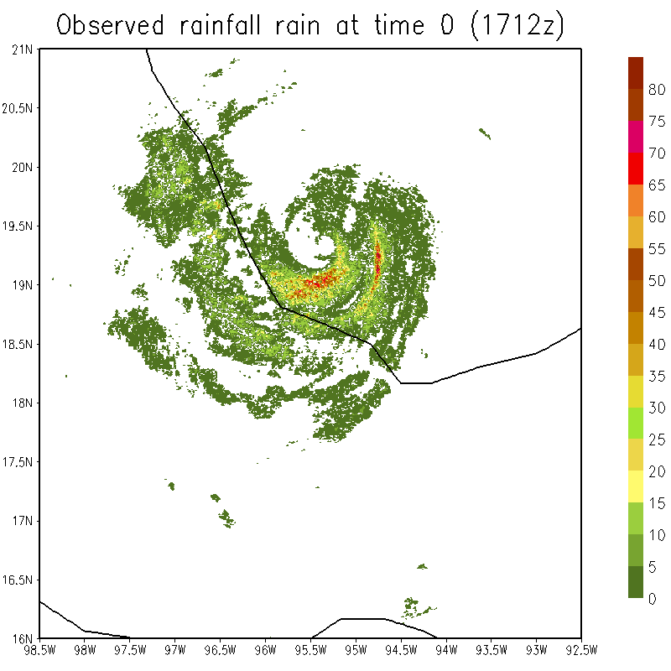
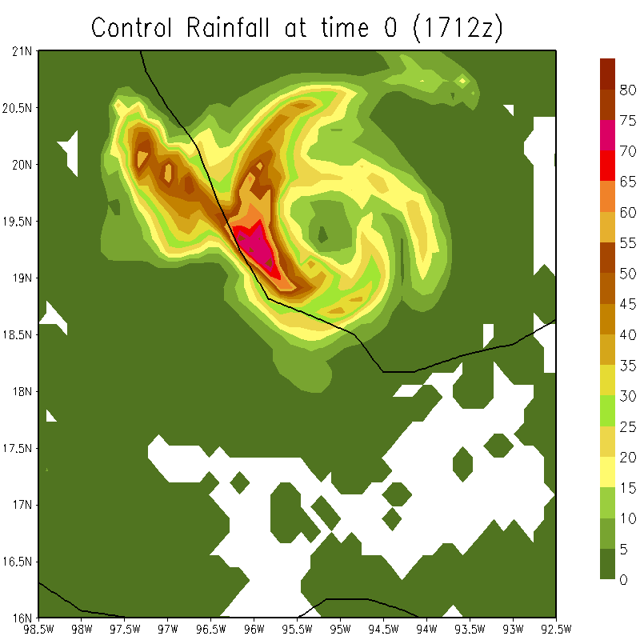
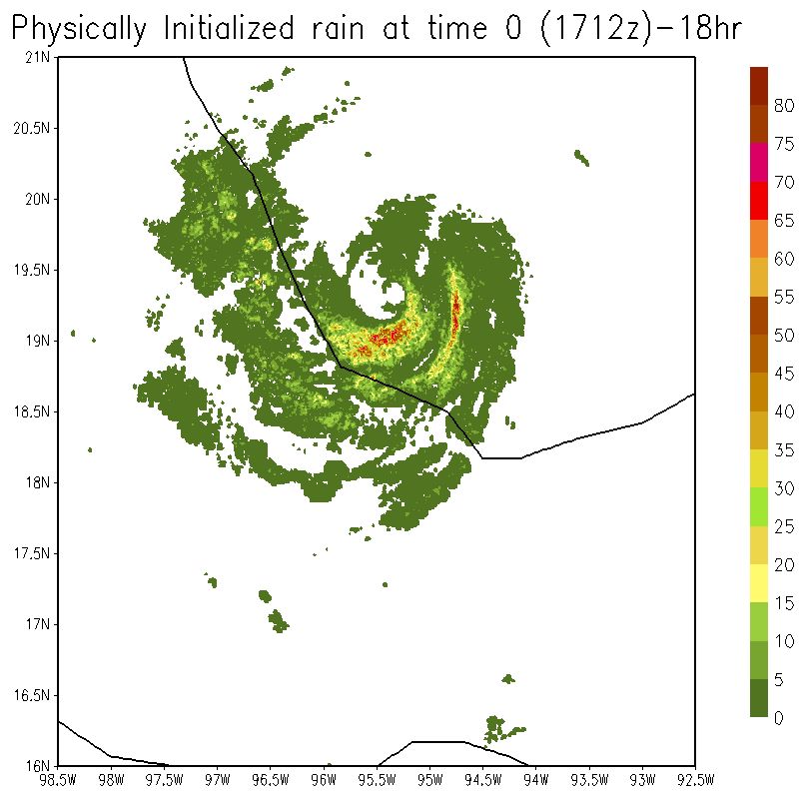
RMSE =10.4mm/hour
Corr. = 0.32
FIELDS AT THE END OF PHYISCAL INTIALIZATION t=0
OBSERVED RAIN BASED ON ALVARADO RADAR
CONTROL
ETS SCORE
RMSE =5.24mm/hour
Corr. = 0.74
PHYSICALLY INITIALIZED RAIN
Heavy rains

Slide 7
Observed
Physical Initialized Exp.
Control Exp.
Location
20.89N, 95.05W
Location
19.4N, 95.5W
Forecast
Forecast
THESE SHOW COMPARISONS OF THE TIME HISTORY OF OBSERVED, PHYSICALLY INITIALIZED AND FORECAST RAINS (mm/hour) AT SPECIFIC LOCATIONS
Location
18.79N, 95.8W
Extreme rainfall of the order of 60mm/hour predicted from radar resolution physical initialization
Forecast

Slide 8
Buoyancy History in a Extreme Rain Event During Passage of Monsoon Depression

Slide 9
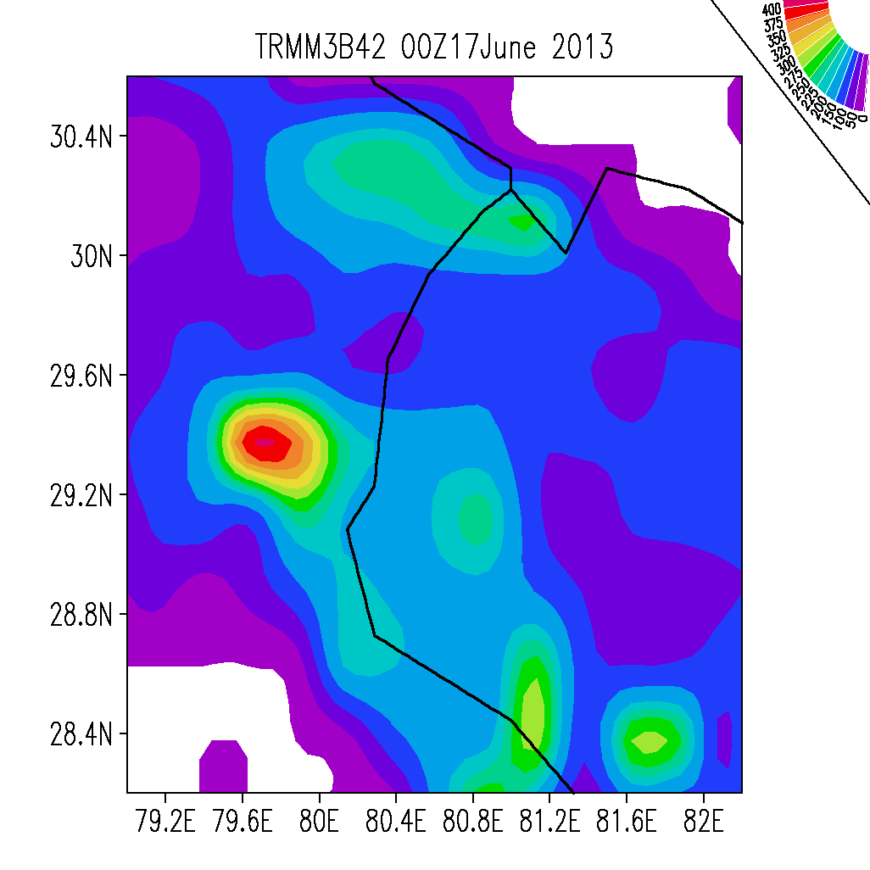
mm/day
Maximum rainfall based on TRMM, 375mm/day for the extreme event

Slide 11
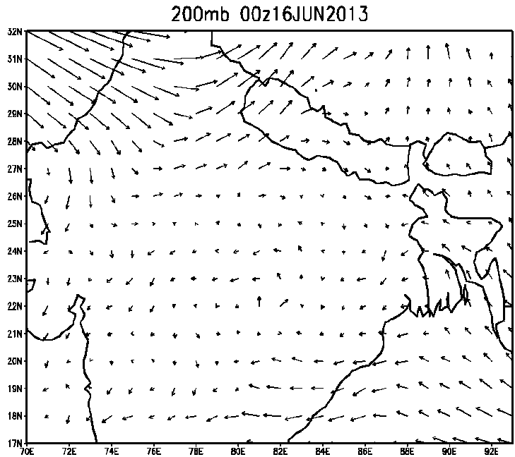
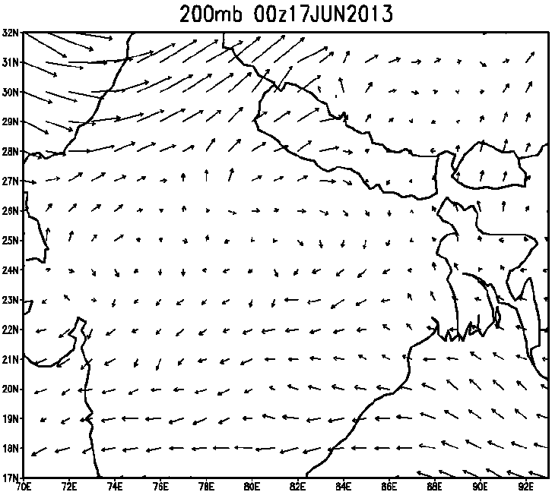
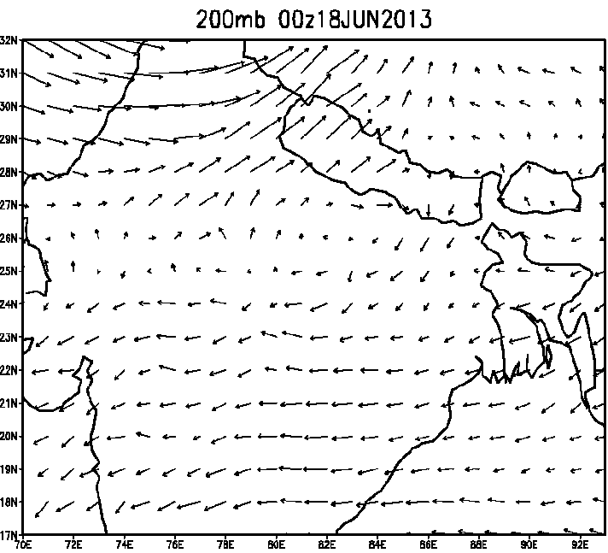
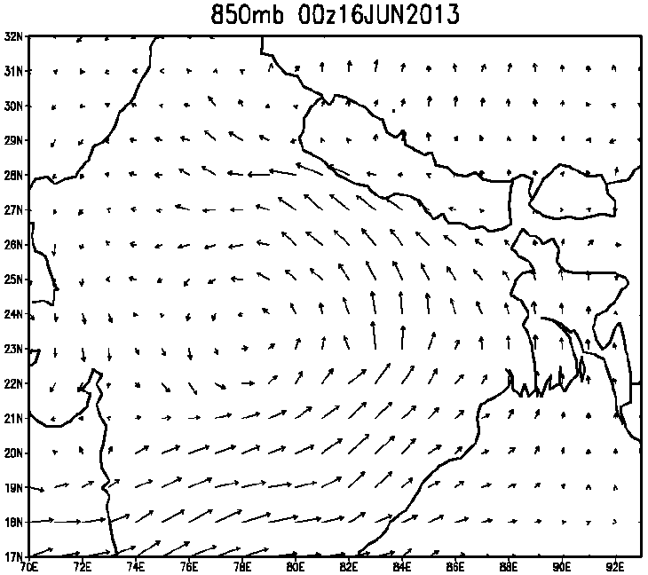
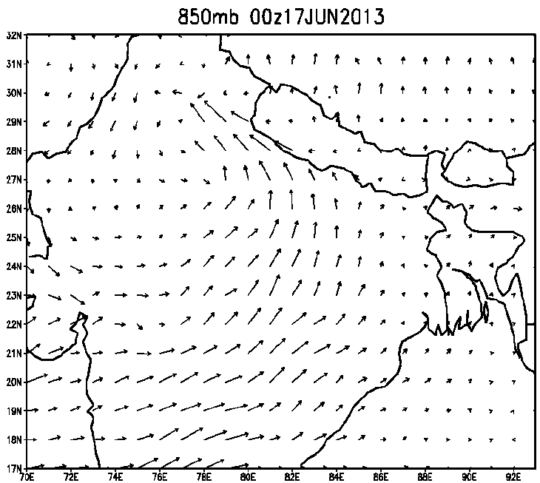
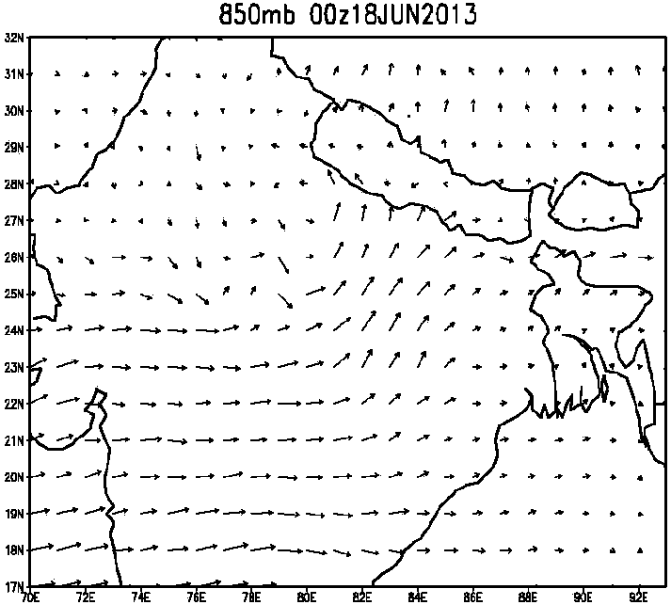

Slide 12
Physical Initialization for Uttarakhand rains

Slide 13
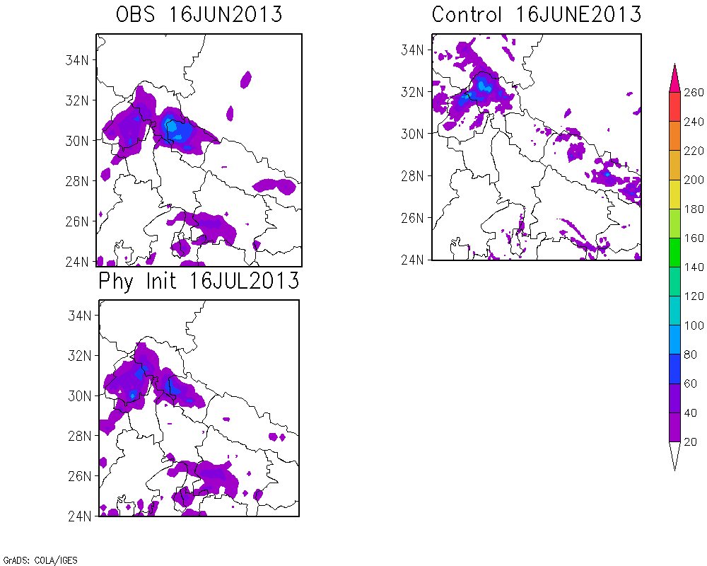
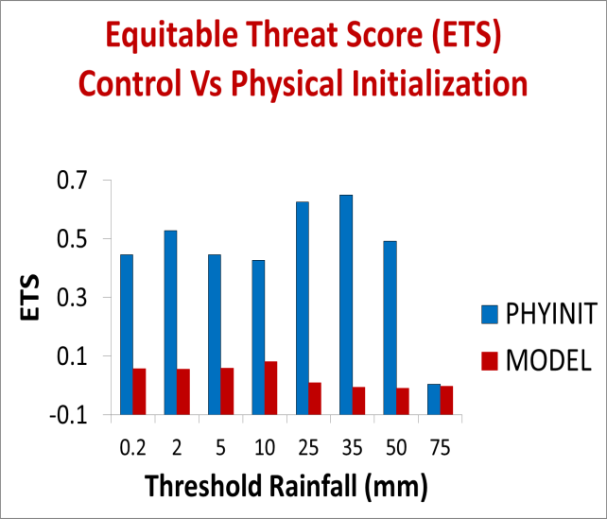
CC = 0.06
RMSE =17.82
mm/day
CC = 0.77
RMSE =9.24
Day 0

Slide 14
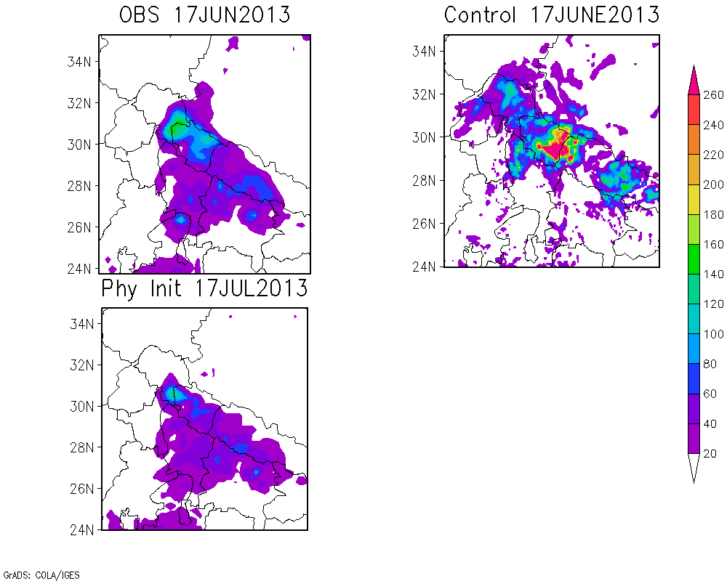
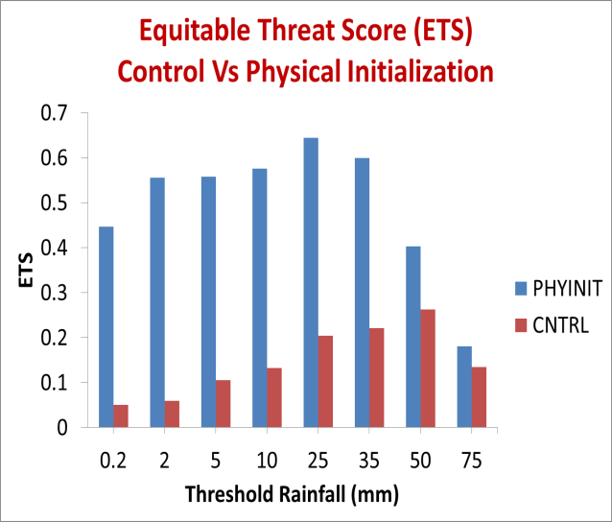
mm/day
CC = 0.25
RMSE = 40.66
Day 1
CC = 0.79
RMSE = 10.13

Slide 15
WRF-ARW OUTLINE
46 Vertical levels
Microphysics : Goddard
Longwave Radiation : rapid radiative transfer model
Shortwave Radiation : Goddard
Planetary boundary Physics : Yonsei Univerity Scheme
Cumulus_parametrization :
Explicit clouds (resolved)
Initial Conditions : GFS (1⁰x1⁰)
Lateral Boundary Conditions: GFS (1⁰x1⁰)
Domain1/2/3: NIL/NIL/KF Scheme
nested
nested
29.9N,80E
1km x 333 ~ 333km
3km x 333 ~ 999 km
9km x 333 ~ 2997 km

Slide 17
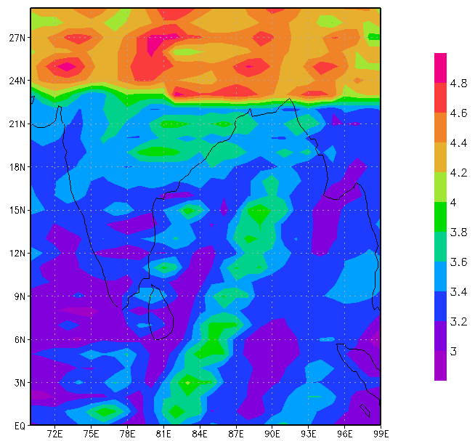
ADAPTIVE OBSERVATIONAL STRATOGY
Run 20 forecast experiments using initial Monte Carlo type perturbations for
specific humidity. Range of experiments from hours 0 to 48.
2. Take the specific humidity fields at hour 48, 850 hPa level and compute a field of
standard deviation with respect to the forecast mean field of hour 48.
Find the 20 forecasted strings of specific humidity at the location of
maximum standard deviation
Uttaranchal region
High contrast in color scheme is due to the large standard deviation among the forecast to the north of 22N

Slide 18
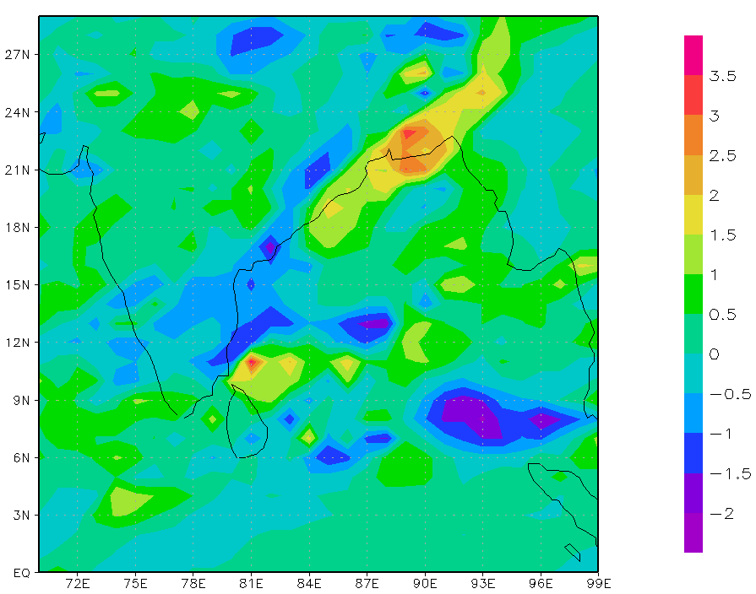
Back correlate the above string of 20 with all strings of 20 forecast value for the hour 12 forecast values.
Find the region of maximum back correlation.
6. This region is boxed below.

Slide 19
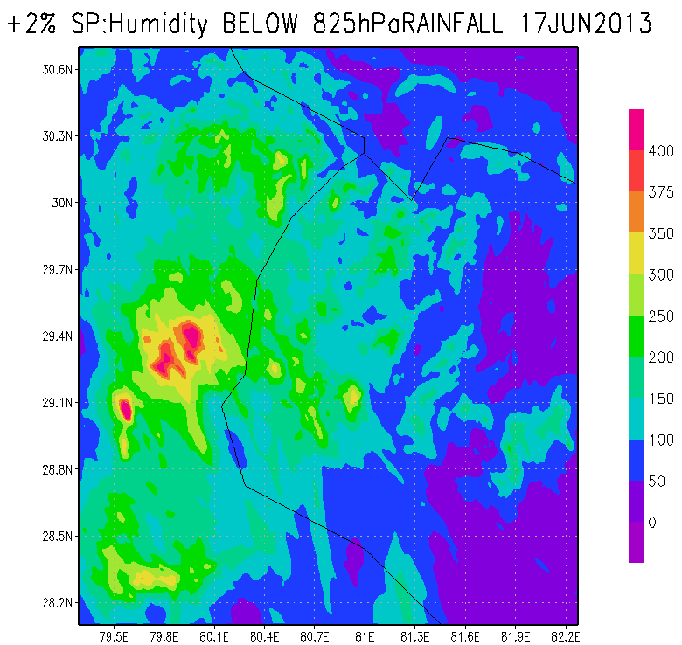
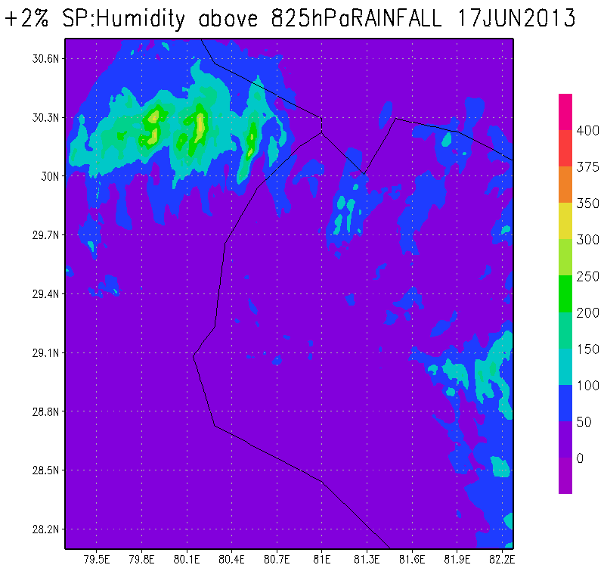
RAINFALL

Slide 20
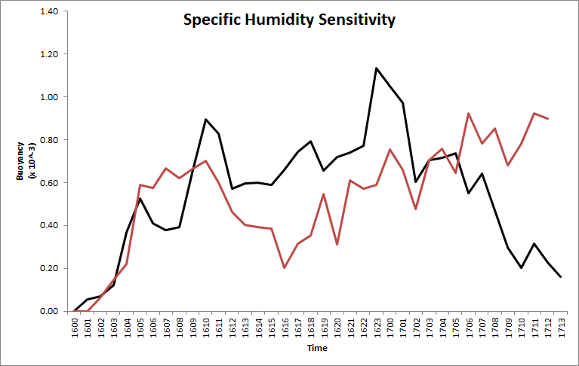
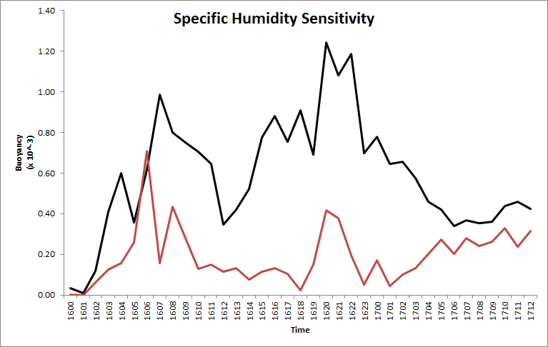
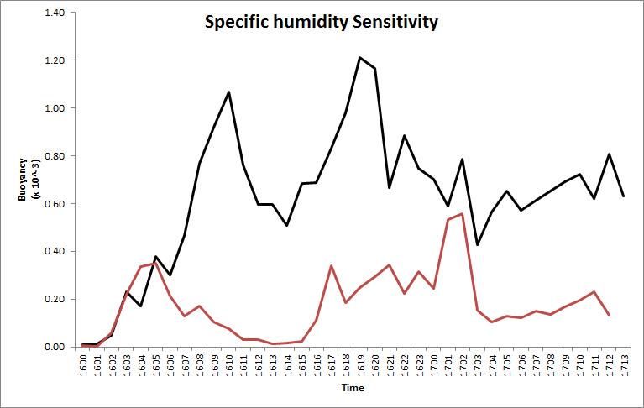
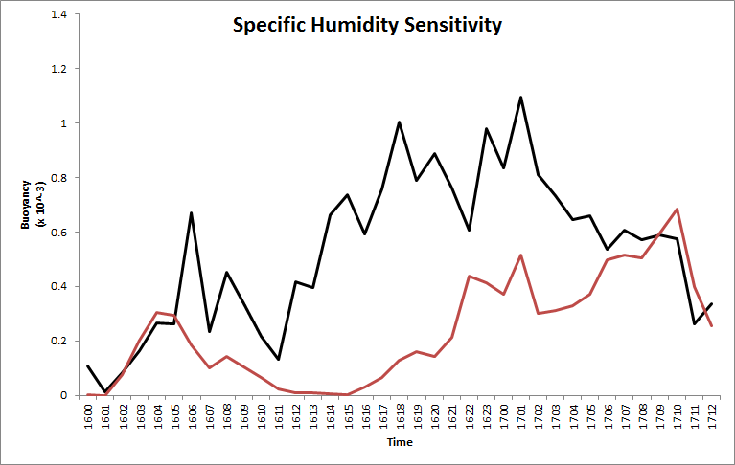
(1%)
(2%)
Area occupied
by Buoyancy
Black solid line – Moisture enhanced by 1%,2%, 3% and 4% below 825hPa
Red solid line – Moisture enhanced by 1%,2%, 3% and 4% % above 825hPa
(3%)
(4%)

Slide 21
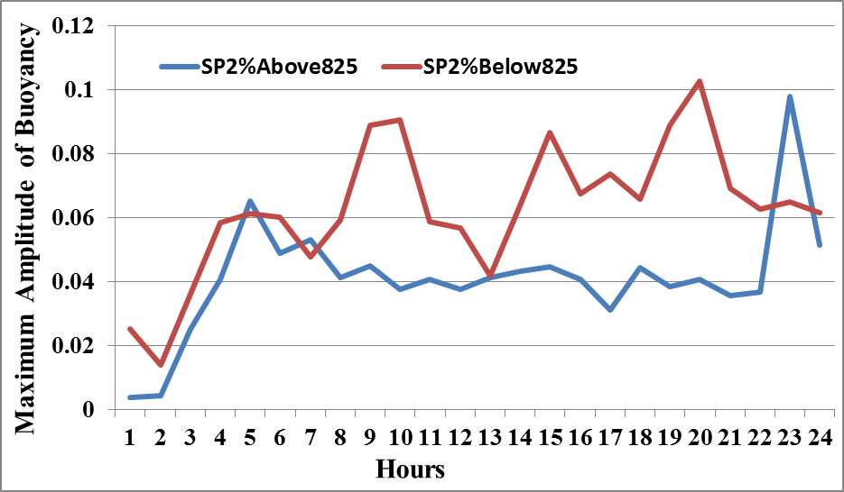
Maximum Amplitude of Buoyancy (m sec⁻²)
(00Z16-00Z17 June 2013)

Slide 22
Buoyancy
Experiment: SP2%below825
BUOYANCY UNITS (x10⁻³ ms⁻²)
Click once on the image to start the animation

Slide 23
Buoyancy
Experiment: SP2%above825
BUOYANCY UNITS (x10⁻³ ms⁻²)
Click once on the image to start the animation

Slide 24
RATE OF CHANGE OF BUOYANCY
Term on the right hand side denote:
1. Horizontal Convergence of Flux of Buoyancy
2. Vertical Convergence of Flux of Buoyancy
3. Local change of virtual temperature of cloud
4. Horizontal Advection of virtual temperature
5. Vertical Advection of virtual temperature
6. Change of virtual temperature of parcel of air in the environment
7. Change in Buoyancy from accumulation or depletion of parcels liquid water mixing ratio

Slide 25
Noting that
is obtained from the WRF’s use of the first law which is
The thermal equation can be written as:
$\frac{∂θ}{∂t} = −\overset{⃑}{V} . ∇θ −w\frac{∂θ}{∂z} − \frac{1}{ρ}\frac{∂}{∂z}\overline{ρw′θ′} +D_{θ}+\frac{L_{v}}{C_{P}}\left(c−e_{c}−e_{r}\right)+\frac{L_{f}}{C_{p}}\left(f−m\right) +\frac{L_{s}}{C_{p}}\left(d−s\right)+Q_{R}$
The moisture equation is expressed by :
$\frac{∂q_{v}}{∂t} = −\overset{⃑}{V} . ∇q_{v} –\overline{W } \frac{∂\overline{q}}{∂z} −\frac{1}{ρ} \frac{∂}{∂z}ρ\overline{w^{′q_{v}′}} +\overline{Dq_{v}} –\left(c−e_{c}−e_{r}\right) –\left(d−s\right)$
The liquid water mixing ratio is expressed by :

Slide 26
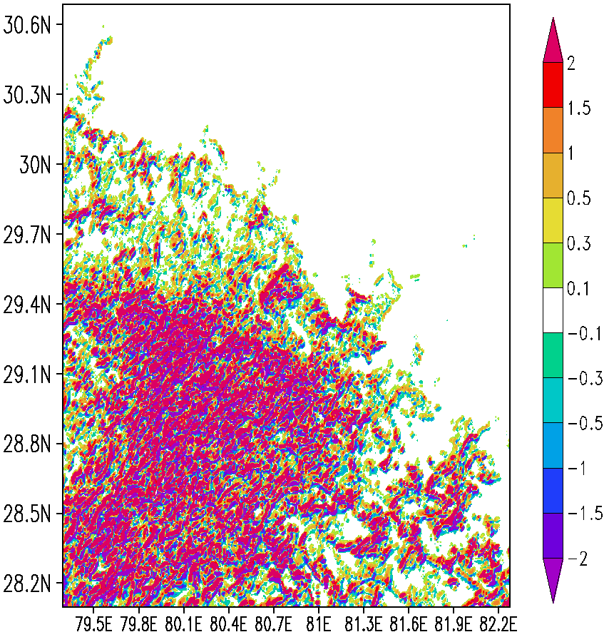
Experiment: SP2%below825
HORIZONTAL CONVERFENCE OF FLUX OF BUOYANCY (*1E-6)
averaged for 01Z16-22Z16 June at 2013 750mb
Unit: m sec⁻³

Slide 27
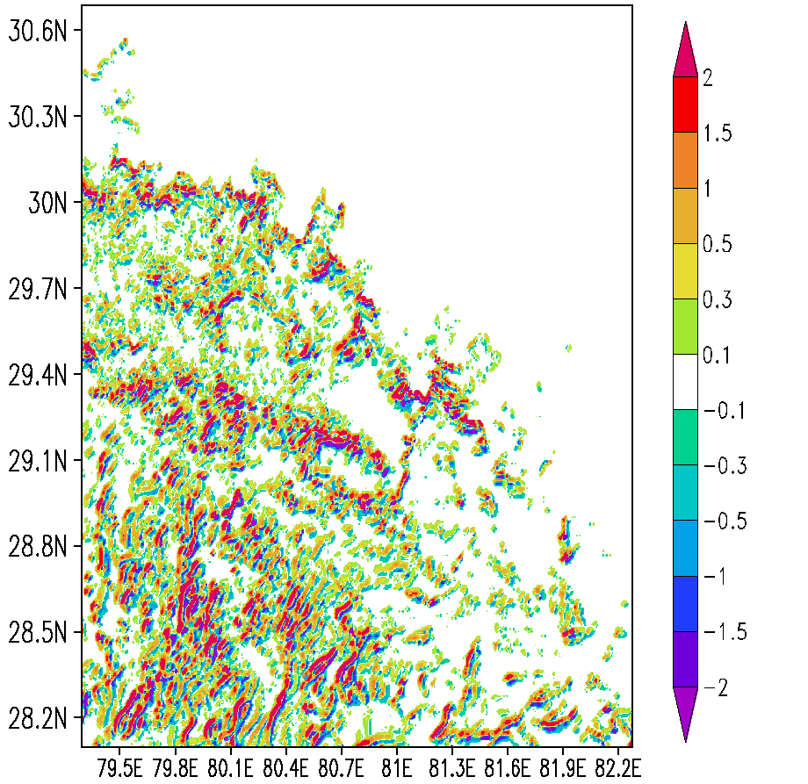
Experiment: SP2%above825
HORIZONTAL CONVERFENCE OF FLUX OF BUOYANCY (*1E-6)
averaged for 01Z16-22Z16 June at 2013 750mb
Unit: m sec⁻³

Slide 28
HURRICANE
INGRID AND GABRIELLE

Slide 29
SYNOPTIC HISTORY
The origin of Ingrid was complicated. One contributor was a tropical wave that moved westward from the coast of Africa on 28 August and showed little distinction through 1st 0f September. On 2nd September, shower activity increased near the northern end of the wave axis. This area of weather would eventually be absorbed into Tropical Storm Gabrielle, which was developing near and north of Puerto Rico during the 3rd – 7th September period. The southern part of the wave continued westward and eventually moved into a large area of low-level cyclonic flow extending from the western Caribbean Sea across Central America into the eastern north Pacific. The combination of this flow and the wave produced two areas of disturbed weather between 8-10 September. One, over the Pacific, moved westward and eventually helped spawn Hurricane Manuel. The second, which appeared over the northwestern Caribbean Sea on 9 September, became Ingrid. Slow development of the Caribbean disturbance led to formation of a low pressure area on 11 September. While the system showed signs of organization before moving over the Yucatan Peninsula later that day, surface observations indicate that it had not developed into a tropical cyclone. The low moved west-northwestward, with the center apparently reforming over the Bay of Campeche early on 12 September. Subsequent development led to the formation of a tropical depression around 1800 UTC that day about 150 n mi east-northeast of Veracruz, Mexico. The “best track” chart of the tropical cyclone’s path is given in Fig. 1, with the wind and pressure histories shown in Figs. 2 and 3, respectively.

Slide 30
The best track positions and intensities are listed in Table 11 The depression initially moved westward, but turned toward the west-southwest on 13 September while the cyclone intensified into a tropical storm. Later that day, Ingrid made a hairpin turn when it was centered about 50 n mi east of Veracruz. On 14 September a combination of a mid/upper-level trough over northeastern Mexico and low/mid-level ridging over the southeastern United States steered Ingrid north-northeastward and then northward. Although the trough and upper-level outflow from Manuel caused moderate westerly vertical wind shear over Ingrid, the cyclone managed to intensify into a hurricane later on 14 September. Thereafter, it reached a peak intensity of 75 kt early on 15 September while centered about 215 n mi southeast of La Pesca, Mexico. The hurricane turned northwestward near the time of peak intensity, and this motion continued for the rest of the day. On 16 September, a mid-level ridge over Texas caused Ingrid to turn west-northwestward. Increasing vertical shear caused the cyclone to weaken below hurricane strength, and it is estimated that the maximum winds had decreased to 55 kt when the center made landfall just south of La Pesca around 1115 UTC that day. After landfall, Ingrid moved slowly westward until it dissipated over northeastern Mexico on 17 September.

Slide 31
HS3 Dropsonde Coverage
Tropical Storm Gabrielle
Hurricane Ingrid

Slide 32
Hurricane Ingrid 2013
Developing Case

Slide 33
Hurricane Ingrid 2013 Sea Level Pressure
Image courtesy of the National Hurricane Center

Slide 34
Hurricane Ingrid 2013 Wind Speed
Image courtesy of the National Hurricane Center

Slide 35
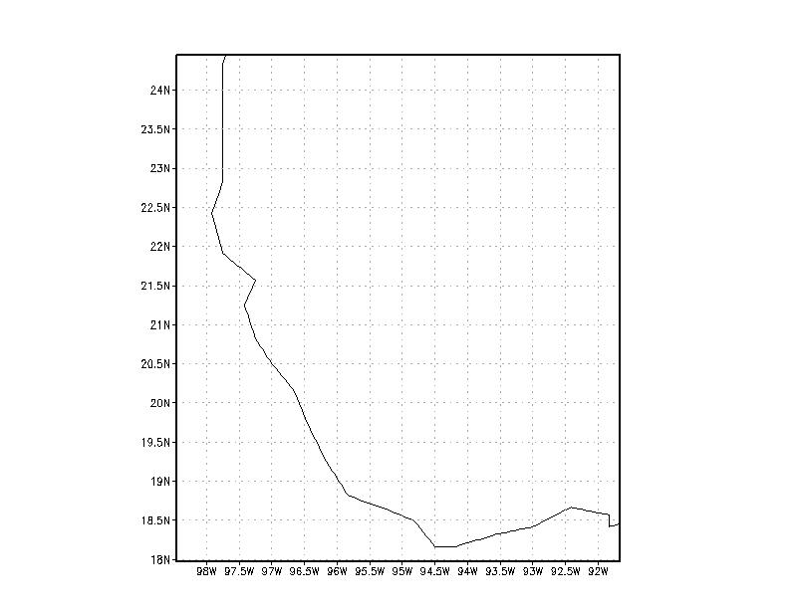
Single simulation domain 3 km resolution over Mexico Domain (98.2481W-91.8703W, 18N-24.5N).

Slide 36
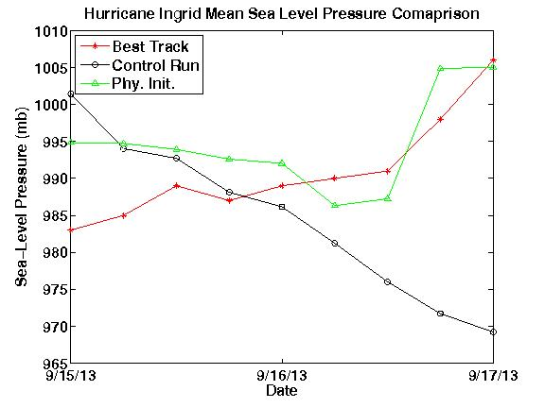
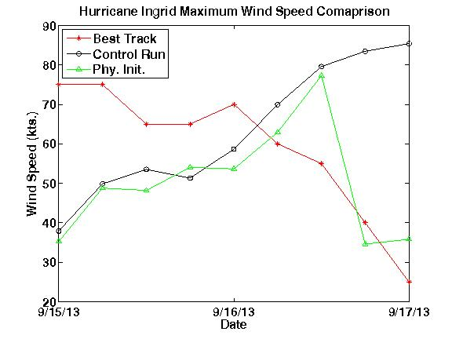
Intensity Comparison

Slide 37
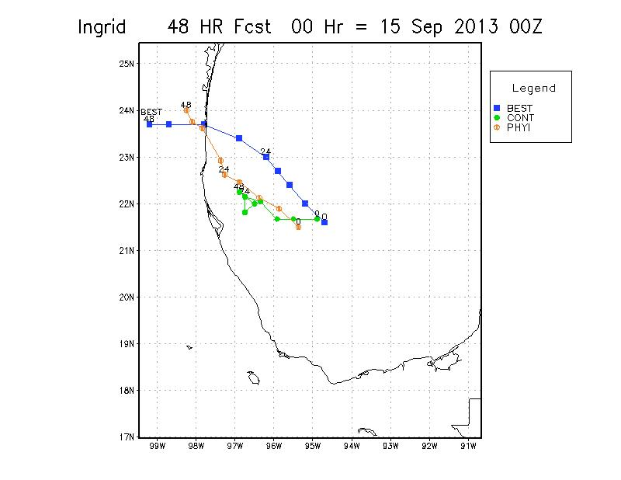
Track Comparison

Slide 38
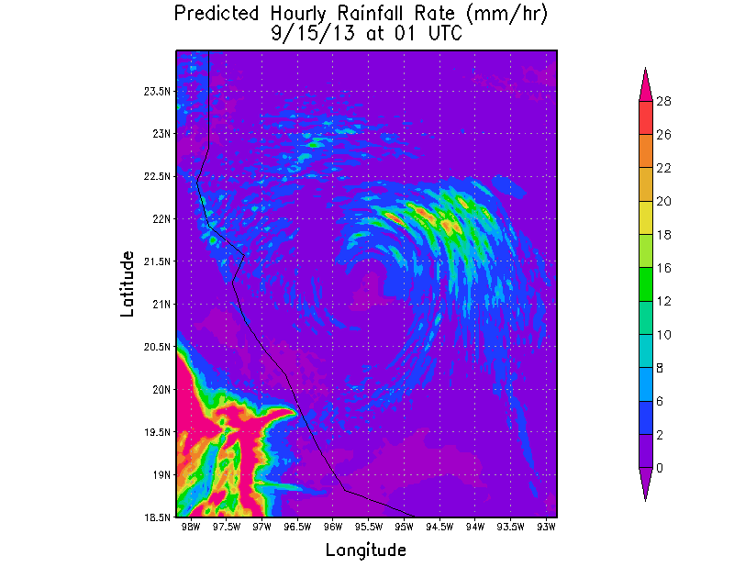
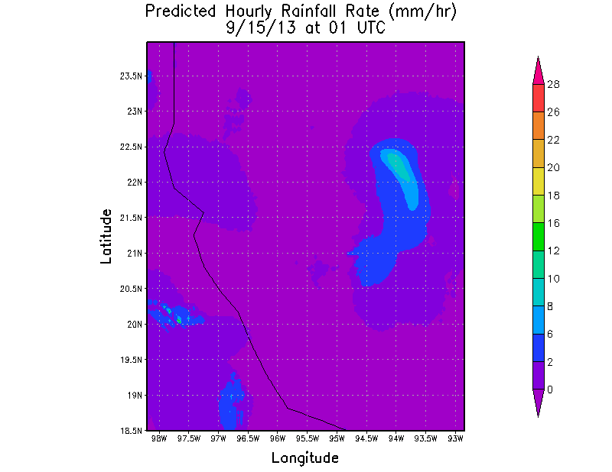
Precipitation Analysis
Physical Init.
Control

Slide 39
Tropical Storm Gabrielle 2013
Non-developing Case

Slide 40
Tropical Storm Gabrielle Track
Image courtesy of the National Hurricane Center

Slide 41
Tropical Storm Gabrielle Wind Speed
Image courtesy of the National Hurricane Center

Slide 42
Tropical Storm Gabrielle Sea Level Pressure
BUOYANCY UNITS (x10⁻³ ms⁻²)
Image courtesy of the National Hurricane Center

Slide 43
BUOYANCY – GABRIELLE CONTROL
Click once on the image to start the animation
BUOYANCY UNITS (x10⁻³ ms⁻²)

Slide 44
BUOYANCY - GABRIELLE PHYSICAL INITIALIZATION
Click once on the image to start the animation
BUOYANCY UNITS (x10⁻³ ms⁻²)

Slide 45
BUOYANCY - INGRID CONTROL RUN
BUOYANCY UNITS (x10⁻³ ms⁻²
Click once on the image to start the animation

Slide 46
BUOYANCY - INGRID PHYSICAL INITIALIZATION
BUOYANCY UNITS (x10⁻³ ms⁻²)
Click once on the image to start the animation

Slide 47
Delta q of Gabrielle = Specific Humidity of Phy. init. - Specific Humidity of Control
Click once on the image to start the animation

Slide 48
Delta q of Ingrid = Specific Humidity of Phy. init. - Specific Humidity of Control
Click once on the image to start the animation

Slide 49
Animation: Buoyancy (m sec⁻²)
for Ingrid Hurricane
15:00Z to 17:00Z Sept 2013
(Integrated, 950-500hPa)
Ingrid _Control
Ingrid_Physical Init

Slide 50
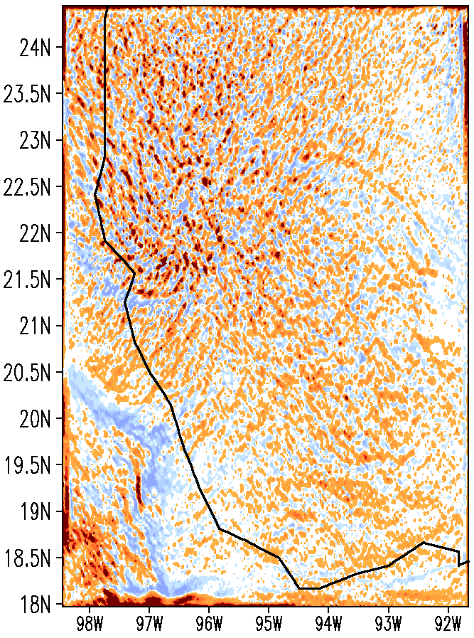
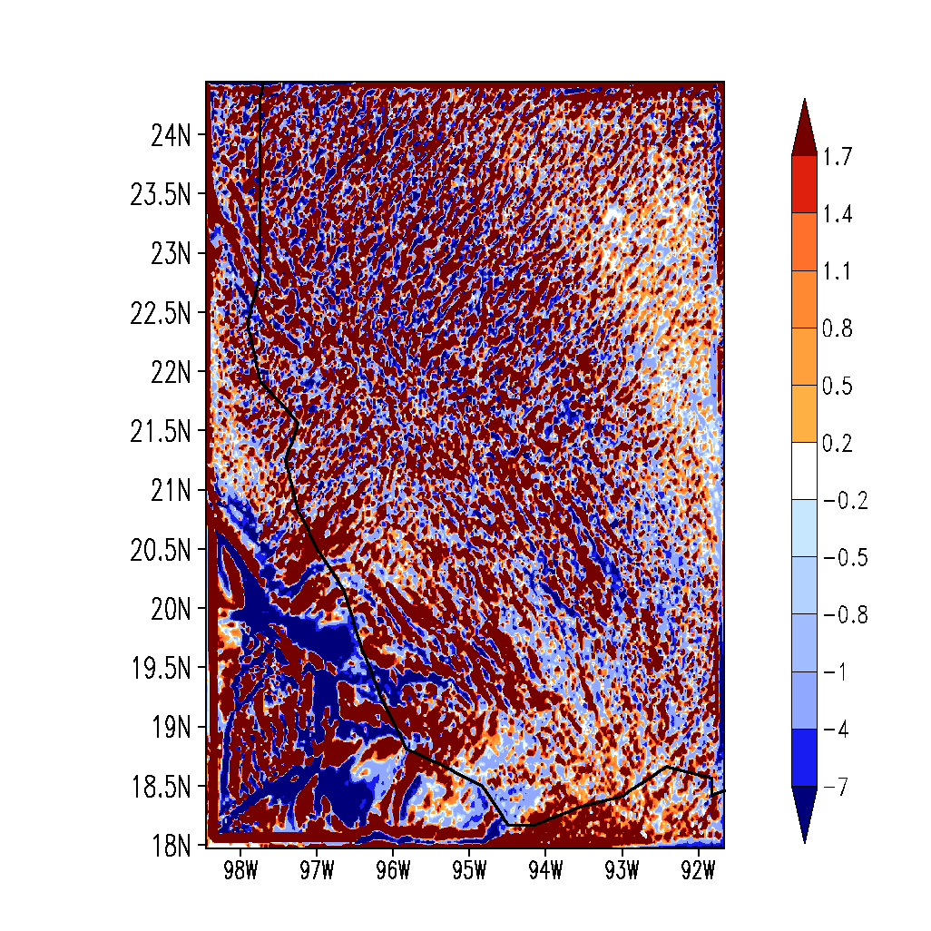
HORIZONTAL CONVERFENCE OF FLUX OF BUOYANCY (*1E5)
averaged for 15:00Z to 17:00Z Sept 2013 at 832mb : Unit: m sec⁻³
Experiment
Ingrid _Control
Ingrid_Physical Init

Slide 51
HORIZONTAL CONVERFENCE OF FLUX OF BUOYANCY (*1E6)
averaged for 7:00Z to 9:00Z Sept 2013 at 832mb; Unit: m sec⁻³
Experiment
Gabrielle _Control
Gabrielle _Physical Init

Slide 52
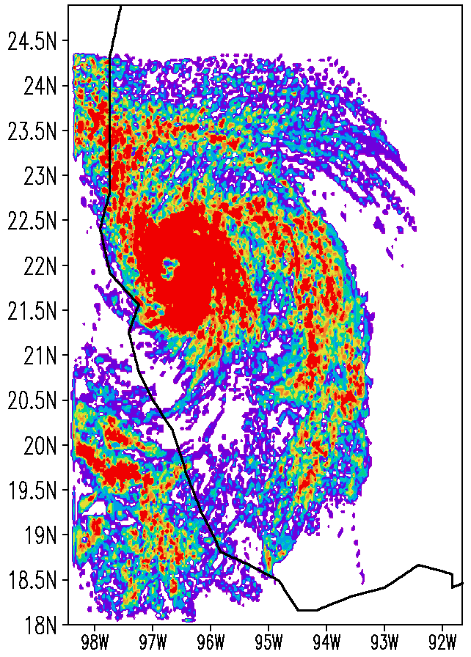
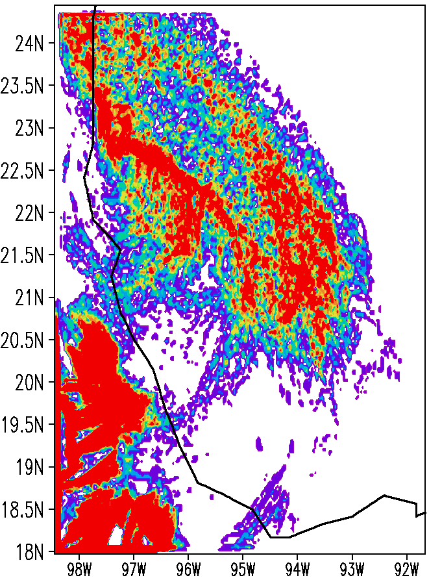
Vertical advection of cloud’s virtual temperature (*1E8)
averaged for 15:00Z to 17:00Z Sept 2013 at 832mb ; Unit: m sec⁻³
Experiment
Ingrid_Control
Ingrid_Physical Init

Slide 53
Vertical advection of cloud’s virtual temperature (*1E8)
averaged for 7:00Z to 9:00Z Sept 2013 at 832mb; Unit: m sec⁻³
Experiment
Gabrielle _Control
Gabrielle _Physical Init

Slide 56
CONCLUDING REMARKS

Slide 57
1. THIS RESEARCH STEMS FROM PREVIOUS WORK WE HAVE COMPLETED ON PHYSICAL INITIALIZATION AND LASE DATA IMPACTS ON HURRICANE FORECASTS IN REFERENCE TO THE SENSITIVITY TO THE MOISTURE FIELD. 2. THIS WORK STARTED WITH THE STUDIES OF MONSOON DEPRESSIONS WHERE WE IMPLEMENTED A NEAR RADAR RESOLUTION PHYSICAL INITIALIZATION.MAJOR IMPROVEMENTS . 3. FOR HURRICANES MAKING LANDFALL WE FOUND THAT RAIN RATE INITIALIZATION (VIA PHYSICAL INITIALIZATION) NEAR RADAR RESOLUTION RAINS, IMPROVES THE NOWCASTING AND ESPECIALLY THE DAY 1 FORECAST SKILLS. ( THIS WAS SHOWN FOR GRIP HURRICANE KARL, TROPICAL CYCLONE THANE OF 2011 OVER NORTH INDIAN OCEAN, HURRICANE IRENE OVER THE NEW ENGLAND COASTAL AREA ,2011). PHYSICAL INITIALIZATION HELPS TO IMPROVE SKILLS OF DAY 2nd AND 3rd FOR HURRICANE FORECASTS. 4. THIS SAME WORK WAS FOLLOWED FOR AN EXTREME RAIN EVENT ( 370 MM/DAY RAINS) OVER UTTARAKAND NEAR HIMALAYAS IN INDIA. THAT WORK SUPPORTED BY ADAPTIVE OBSERVATIONAL STRATEGY SUGGESTED THE NEED FOR MOISTURE OBSERVATIONS. THAT STUDY SHOWED A GREAT SENSITIVITY TO MOISTURE FOR THE EVOLVING HISTORY OF CLOUDS, RAINS AND ESPECIALLY THE LIQUID WATER MIXING RATIOS AND BUOYANCY. BUOYANCY CAN BE REGARDED AS A FIELD VARIABLE.IF MOISTURE DATA ARE IMPROVED THEN THE FORECASTS SHOW AN ARMY OF BUOYANCY ELEMENTS COVERING A LARGER AREA MOVE TOWARDS THE HIMALAYAS AND GIVING RISE TO EXTREME RAINS ( AROUND 370 MM/DAY) FOR THE EXPERIMENT WITH PHYSICAL INITIALIZATION.

Slide 58
5. THE SAME IDEA WAS EXTENDED TO TWO HS3 STORMS, NAMED INGRID AND Gabrielle OF 2013. 6. INGRID STRENGTHENED INTO A HURRICANE OF CATAGORY 1 to 2 PRIOR TO LANDFALL. WHEREAS GABRIEL REMAINED A WEAK STORK AND WEAKENED DURING OUR FORECAST PERIODS. 7 PHYSICAL INITIALIZATION REVEALED MAJOR DEFICIENCIES IN MOISTURE ANALYSIS OF THE INITIAL STATES FOR INGRID AND GABRIEL. PHYSICAL INITIALIZATION IMPROVED THE MOISTURE ANALYSIS SOMEWHAT. 8 THAT IMPROVEMENT CALLED FOR AN ENHANCEMENT OF BOUNDARY LAYER MOISTURE, ESPECIALLY ON A SOUTHEASTERN RAINBAND OF INGRID AND RESULTING IN IMPROVED FORECASTS OF INTENSITY AND RAINS .HOWEVER IN GABRIEL THE OPPOSITE TYPE OF ERROR WAS NOTED THIS RESULTED INA REDUCTION OF BOUNDARY LAYER MOISTURE BY THE PHYSICAL INITIALIZATION THAT KEPT GABRIEL AS A WEAK STORM DURING ITS FORECAST PERIOD. 9. ADAPTIVE OBSERVATIONAL STRATEGIES IN HURRICANES FOR OBSERVATIONS AND MODELING MAY BE WORTH EXPLORING.

