Slide 1
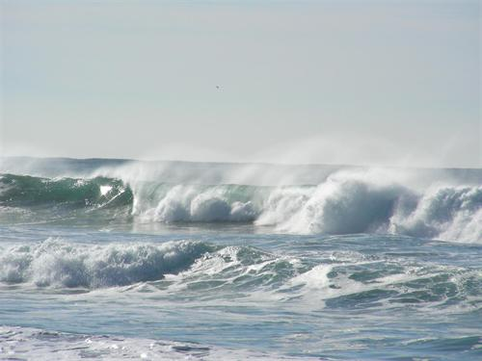
Br radicals in the tropical troposphere: a GEOS-Chem perspective
Johan Schmidt
Harvard University
CONTRAST/ATTREX/CAST STM (October 22nd)
Thanks to: D. Jacob, R. Volkamer, Q. Liang, C. Keller, M. Evans,
T. Sherwen, E. Apel, R. Salawitch, and others
Notes:
I am Johan Schmidt, a post doc with Daniel Jacob at Harvard.
Thanks to all the people who have been providing data, discussions ...
Thanks to Ross for allowing to join this meeting.
Really exciting to see all the new Bry (and org Br) measurements
We will benifit alot from the new constraints

Slide 2
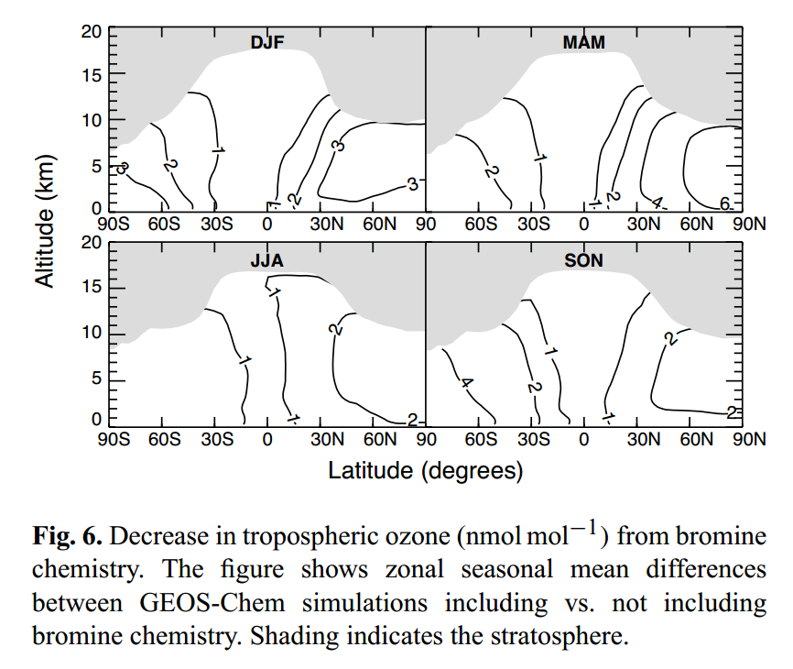
Why do we care about bromine in the (sub) tropical troposphere?
Role of Br in tropical troposphere still unclear
Increasing evidence for significant bromine radical activity in the tropical troposphere
Tropospheric bromine chemistry affect:
Trop. O₃: GHG; air pollution; OH precursor => CH₄.
NO_{x}: O₃ precursor.
Hg: Pollutant; Neurotoxin; Bio accumulate.
DMS: Sulfate precursor.
Parrella et al. ACP (2012)
Notes:
Role of Br in tropical trop unclear
But increasing evidence for extensive Br activity
This is important because Br catalytically destroy O3 and NOx, is central for Hg removal etc

Slide 3
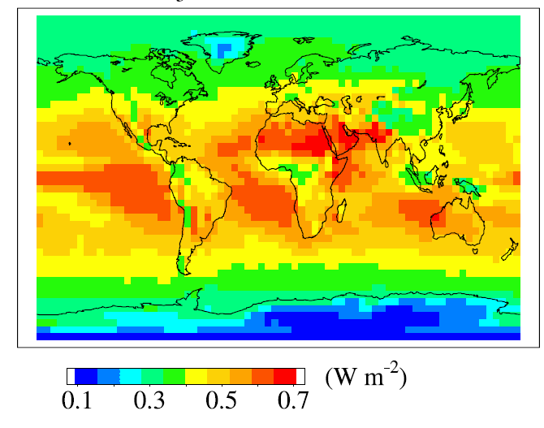
Why do we care about bromine in the (sub) tropical troposphere?
Fig. 3 of Mickley et al. (2004): Change in forcing due to uniform 18 ppb increase to pre-industrial tropospheric ozone.
Notes:
This is just to show that the forcing is partically sensitive to changes in tropospheric ozone in the tropics. And O3 – Br coupling in the tropics is therefore particulary interesting

Slide 4
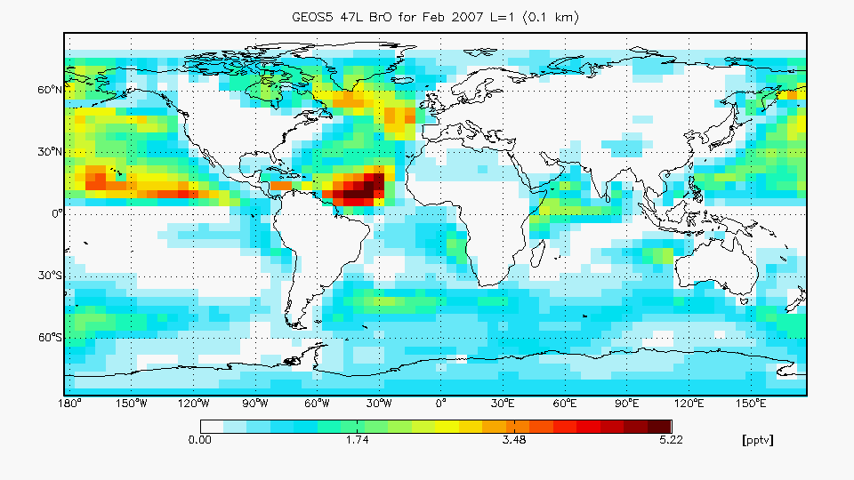
Overview of the GEOS-Chem Chemical Transport Model
Global 3-D model of the troposphere
Offline Stratospheric Bry from GEOSCCM
Driven by meteorological data
GEOS-5 model
Contains ~80 transported species:
Ox (O₃, HO₂ ...)
NOx (NO, NO₂, HNO₃)
Br (Br, BrO, Br₂, CHBr₃ ...)
Etc ...
Contains ~10² chemical reactions:
gas phase
Photolysis
heterogeneous (surface)
Emissions
Wet and dry deposition
Daytime surface BrO from GEOS-Chem with new halogen chemistry mechanism.
Notes:
Here I just want to give a brief overview/introduction to GEOS-Chem.
3-D model of troposphere
Offline stratospheric Bry from GEOSCCM
Driven by GEOS-5 metrology
~80 transported tracers
Hundreds of different reactions

Slide 5
Main points:
Standard GEOS-Chem(v9-02) simulation cannot reconcile observed high levels of BrO in the tropics
Multi-phase bromide oxidation in sea salt aerosols and clouds enhance BrO in the MBL and FT
BrO in the tropical UT is highly sensitive to LS inorganic bromine (Bry)
GEOS-Chem bromocarbon sources are consistent with observation in and outside the tropics

Slide 6
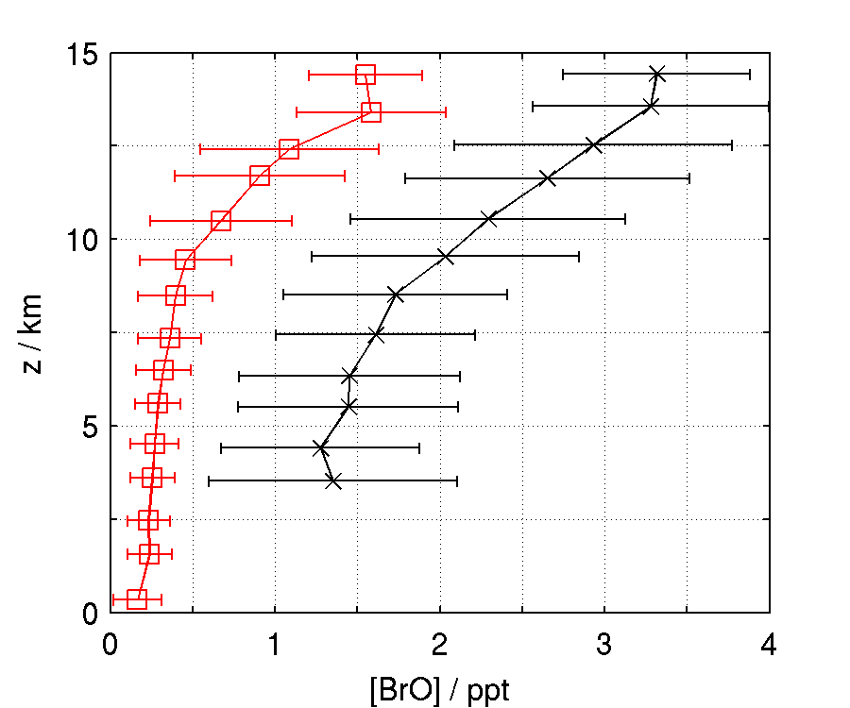
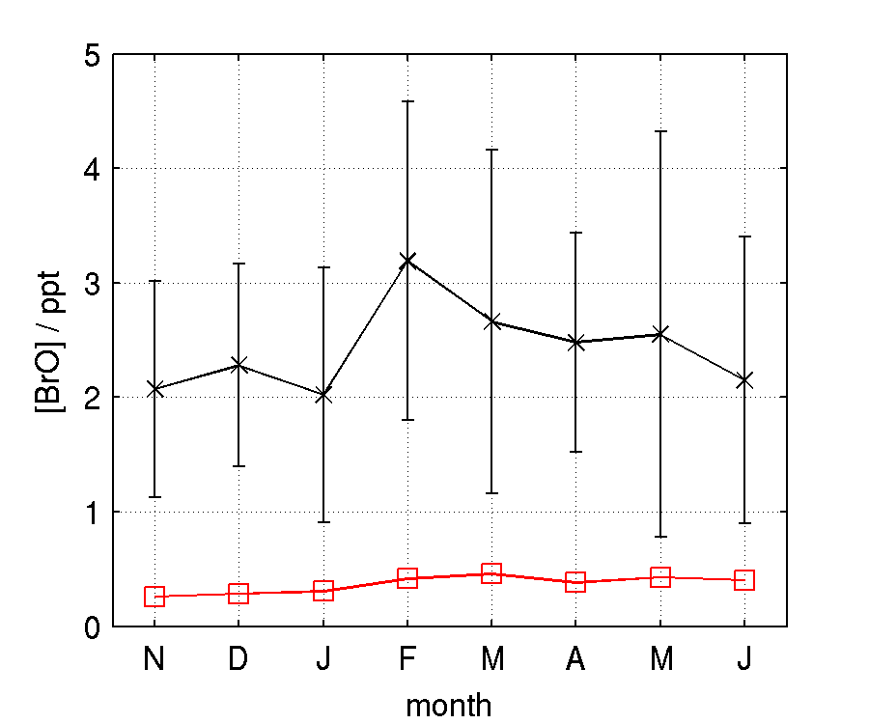
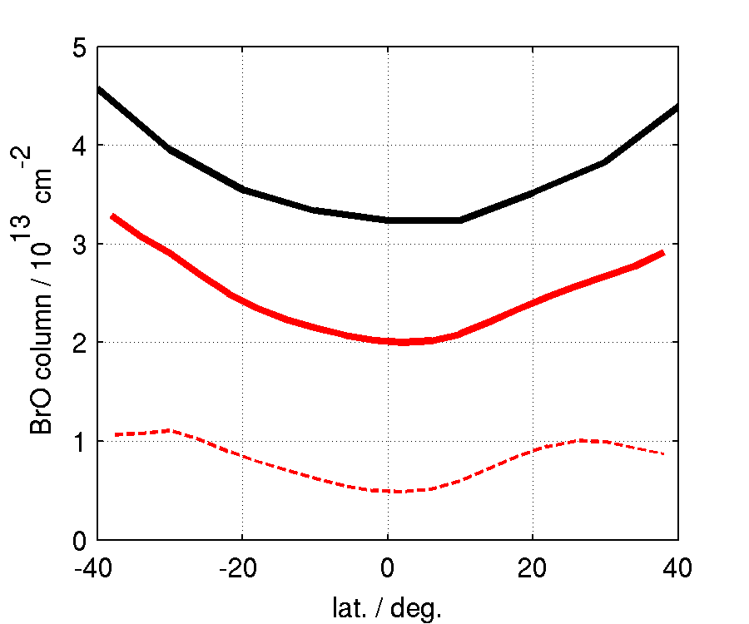
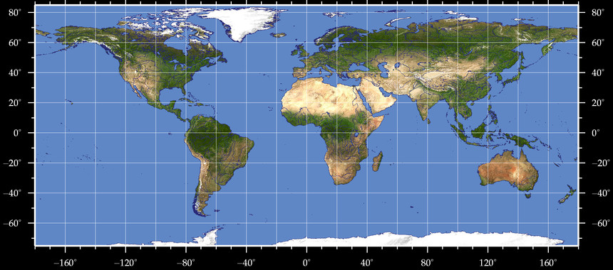
Std. GC simulation cannot reconcile high obs. BrO in tropical troposphere
Cape Verde (Read et al.)
LP-DOAS
GC(std)
TORERO
AMAX-DOAS
GC(std)
OMI sat.
GC(std)
Notes:
The standard (or current) version of GC underestimate BrO in the tropics.
-OMI columns are larger than the combined column from the GEOS-Chem troposphere and GEOSCCM stratosphere. As seen here
-The model also underestimate BrO in both lower FT and UT compared to TORERO aircraft obs.
- And is unable to reproduce the high BrO levels observed in MBL near cape verde

Slide 7
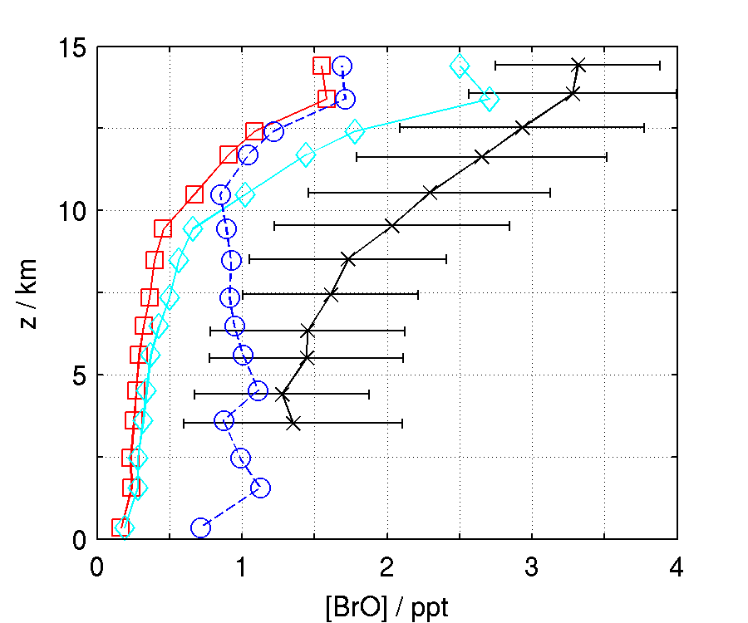
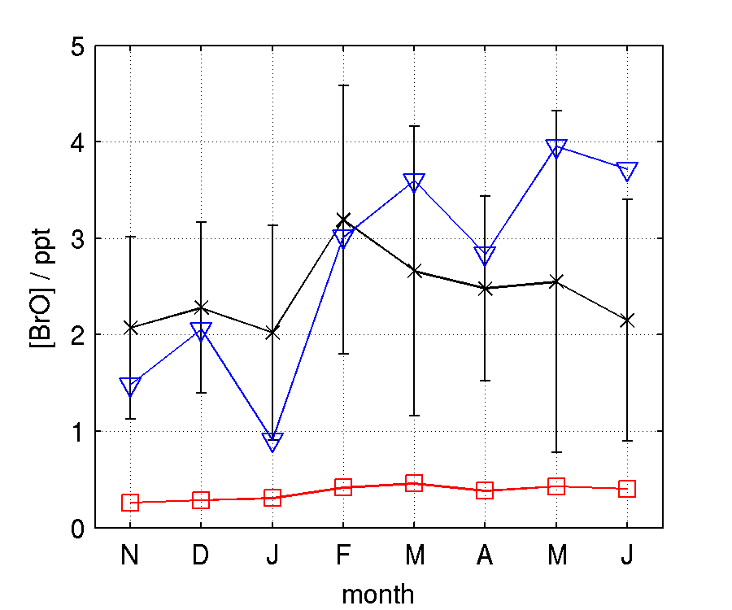
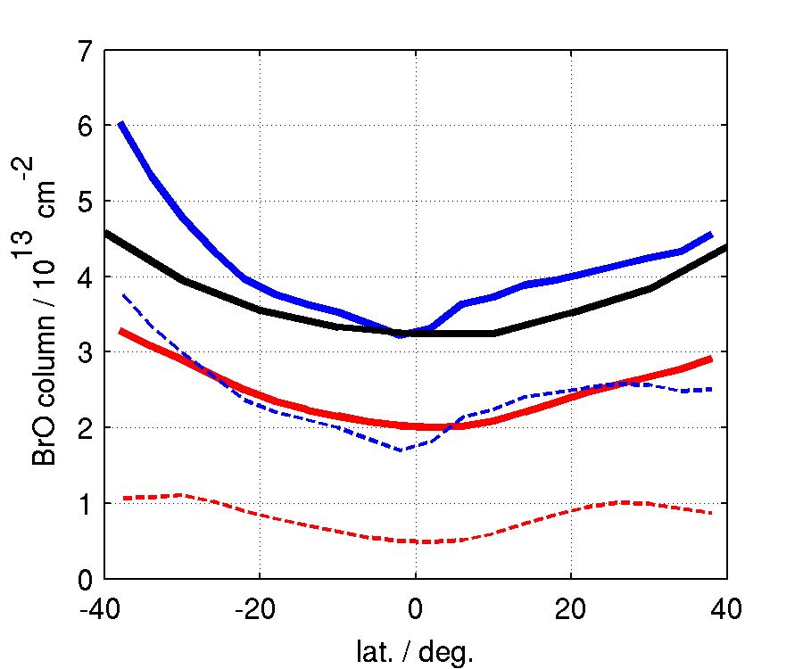
Multi phase chemistry and increased Bry input from strat. can reconcile obs.
LP-DOAS
GC(std)
GC(EHC)
AMAX-DOAS
GC(std)
GC(EHC)
GC(2xStr-Bry)
Total (OMI)
GC(std)
GC(EHC)
BrO column figure credit: Qing Liang
Notes:
Today I will present a new GEOS-Chem simulation (EHC) which multiphase chemistry recycling Bry as recommended by IUPAC.
The new simulation help close the gap between model and obs.
Although not in the UT, later I will show that the UT is very sensitive to LS Bry

Slide 8
Model underestimates BrO in the tropical troposphere
BrY sources
too low
BrY sinks
too strong
BrO/BrY
partitioning off
Transport
wrong
Stratosphere
0.1 Gg Br / day
Radical:
Br
BrO
CH₂O, NO₂, HO₂
Inorganic:
HBr, Br₂
HOBr
BrONO_{x}
Wet deposition
HBr (55%) / HOBr (40%)
hv, OH, het. chem.
Dry deposition
4.4 Gg Br
34.1 Gg Br
3.9 Gg Br / day
1.5 Gg Br / day
Sea salt aerosol
Organo bromines:
CHBr₃, CH₂Br₂, CH₃Br
Parrella et al., ACP (2012), Ann. mean budget
GC(v9-01-3)/GEOS-5
Notes:
Model bias must be caused by either
- too low sources
- too efficient sinks
- wrong BrO / Bry partitioning
- problems with transport scheme
Here is an overview of standard GEOS-Chem bromine scheme.
- 3 sources: SSA, Org-Br and small but very important Strat input
- Hydrophilic HBr (and to lesser extend HOBr) very important for wet dep loss.
- Bry part. Determined by gas phase, photolysis and multiphase chemistry

Slide 9
Updated GC halogen heterogeneous chemistry mechanism (EHC)
On going work (Further obs. constraints needed!)
Multi phase reactions on liq. and ice clouds (GEOS-5 IWC / LWC)
Multi-phase reaction on hydrophilic aerosol
Explicit (chem. driven) SSA debromonation
Online reactive uptake coefficients
IUPAC recommendation (Ammann et al. 2013)
Update also incl. Chlorine
Stratosphere
BrO
BrNOx
HBr
Br
Br2
HOBr
OrgBr
(Br⁻)_{SSA}
Ocean
γ(T, radius, pH, [Br⁻], air density) = 1/( 1/Γ_{diff} + 1/α + 1/Γ_{rxn})
Notes:
-Emphasis that this is ongoing work and needs additional constraints from observations (especially Bry)
- Considers multiphase reactions on clouds (both liq and ice), cloud data from GEOS-5 met field
- Considers reactions on hydrophilic aerosol
- Explicit SSA debromonation mech. In the sense that SSA-Bromide is co-emitted and deposited with SSA but can also be activated by multiphase chem
- Reactive uptake coef (multiphase rate const) calculated online, see below
- Scheme and parameters based on recent IUPAC recommendation for gas / liq multi phase reactions
- In std. Cld are essentially only a sink, but now also recycler, very important as it shift Bry away from HBr

Slide 10
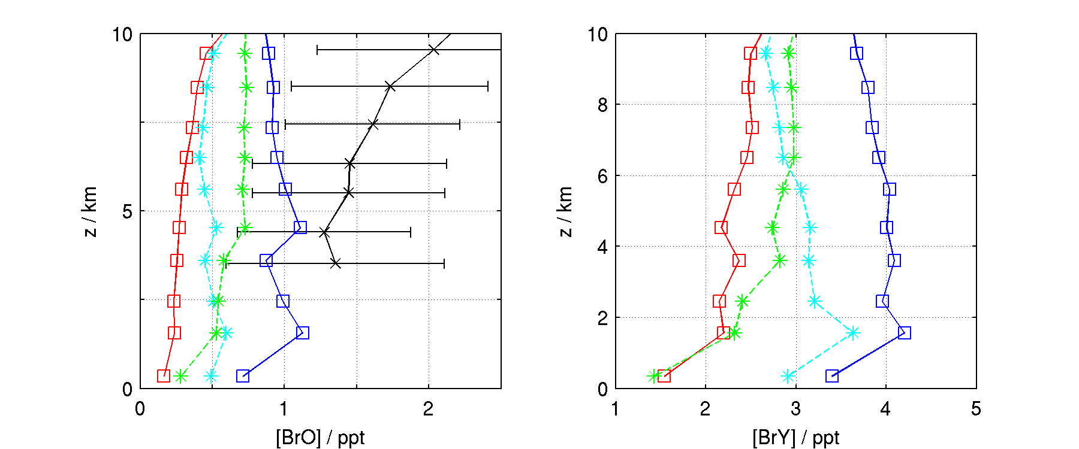
Multi phase HBr recycling on liquid cloud droplets enhance Lower FT BrO
Average along all 17 TORERO RFs
Obs. (AMAX-DOAS)
GC(std)
GC(EHC)
GC(EHC) alkaline SSA
GC(EHC) no HBr recycling on clouds
Multiphase chemistry (GC(EHC)) enhance LT BrO by a factor of ~4
Multiphase chemistry (GC(EHC)) only enhance LT Bry by about ~2
Sensitive to SSA-Bry emissions throughout the FT (note gap between green and blue)
Results very sensitive to recycling of HBr (and HCl) on liquid cloud droplets
Notes:
- 17 TORERO Rfs average compared model output along flight trajectories
- Simulation with updated multiphase chemistry shows enhanced BrO (~4) compared to Std. and is closer to observation.
- Multiphase chem only enhance Bry by about ~2
- Multi phase is highly sensitive to recycling of bromide on liq. cloud droplets

Slide 11
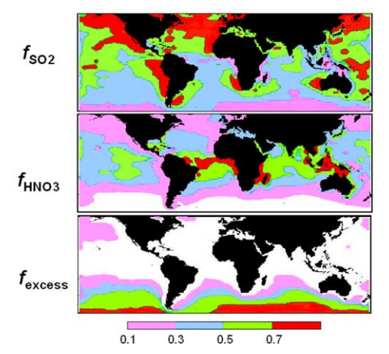
Multi-phase recycling of HBr enhance the tropospheric BrO column in tropics
Total BrO column (-) and Trop col (- -)
OMI
GC(std)
EHC/G5
OMI credit: K. Chance, R. Suleiman (Q. Liang)
SSA alkalinity (Alexander et al. 2005)
EHC/G-5 tropospheric BrO column larger than stratospheric column
EHC/G-5 BrO column too large in S. Mid-lat.
SSA excess alkalinity would prevent debromonation in S. ocean
Notes:
- Simulation with new multiphase chem scheme (over)closes the gap between obs and mod BrO col.
- Large BrO col at S. Mid latitudes appear to be caused by excessive seasonal SSA debromonation
- Which is perhaps unrealistic given that SSA in S. Ocean retains alkalinity

Slide 12
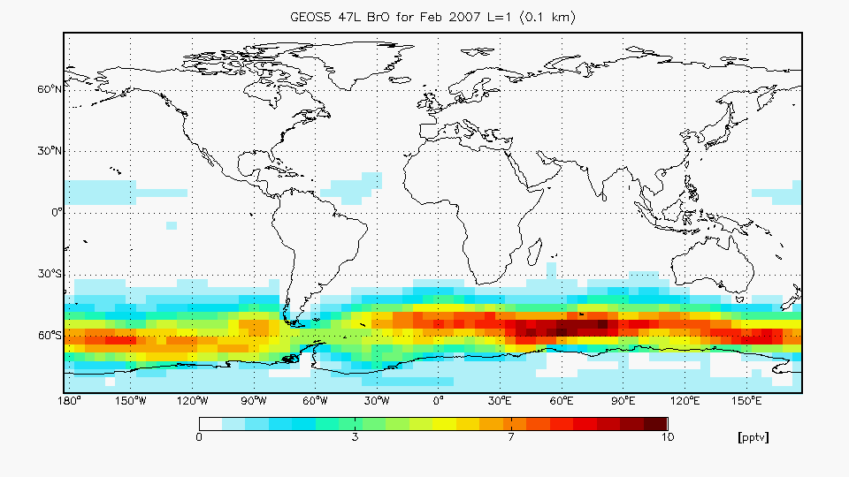
Extensive BrO “plume” over the tropical Atlantic ocean
Feb 2007 surface BrO (GC(EHC))
Cape Verde (Read et al.)
LP-DOAS
GC(std)
GC(EHC)
0 5 pptv
0 5 pptv
Feb 2007 surface BrO (GC(std))
Shift MBL SSA-Br emissions away from S. Ocean
Shift reflect sensitivity to “seed” Bry initiating debromonation, temperature and other phys/chem conditions.
Model SSA bromide depletion consistent with obs.
0 10 pptv
Notes:
- New multiphase chem scheme find high BrO in tropical Atlantic MBL
- Surface BrO consistent with Cape Verde obs.
- The surface BrO is changed dramatically between GC(std) and GC(EHC)
- SSA bromide depletion peaks in tropics which is consistent with observations.

Slide 13
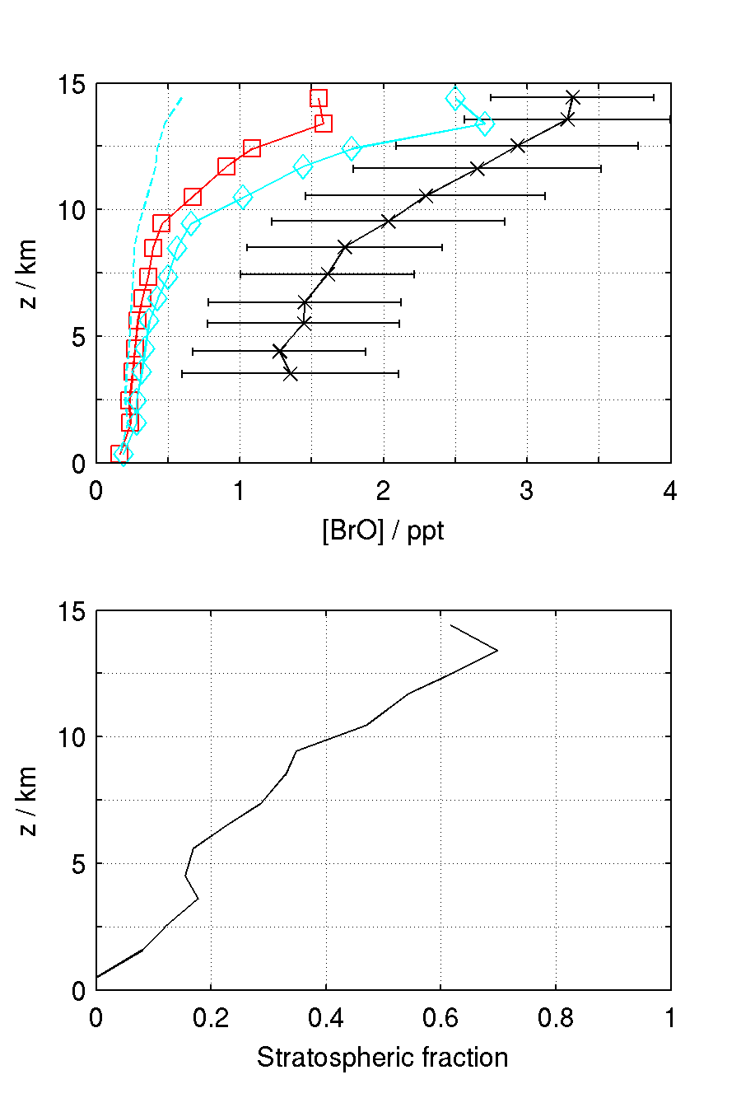
TORERO UT BrO is highly sensitive to changes in Stratospheric Bry
GC w\ no Strat-Bry
Model sensitivity to changes in strat Bry and Strat-Trop Exchange evaluated by increasing strat Bry by a factor 2
TORERO RF04 and RF05 suggests model Bry in LS is underestimated by 25% to 75%
MLS CO obs. indicate GC/GEOS-5 vertical velocities underestimated in tropics.
40 – 70% of UT (10-15 km) BrO derived from input of stratospheric Bry
Large gap between model and obs. remain below the UT which is not affected by increased Strat. Bry flux.
TORERO
AMAX-DOAS (x)
GC(std) (□)
GC w\ 2xStrat-Bry (◊)
[BrO]_{std} - [BrO]_{no S-Bry}
[BrO]_{std}
Notes:
- Here I show results from a sensitivity study
- We see that UT BrO is very sensitive to changes in stratospheric Bry.
- We note TORERO RF04 and RF05 flight found BrO in LS to be underestimated in model by 25% - 75%
- We also note that vertical transport in tropical region is known to be too weak in GC/GEOS-5 simulations compared to MLS CO obs.
- By comparing results from std sim to sim with no Strat Bry we find that between 40 – 70% of UT BrO originates from input of Strat Bry.
- Large gap between model and obs remain below the UT regardless of Strat Bry burden

Slide 14
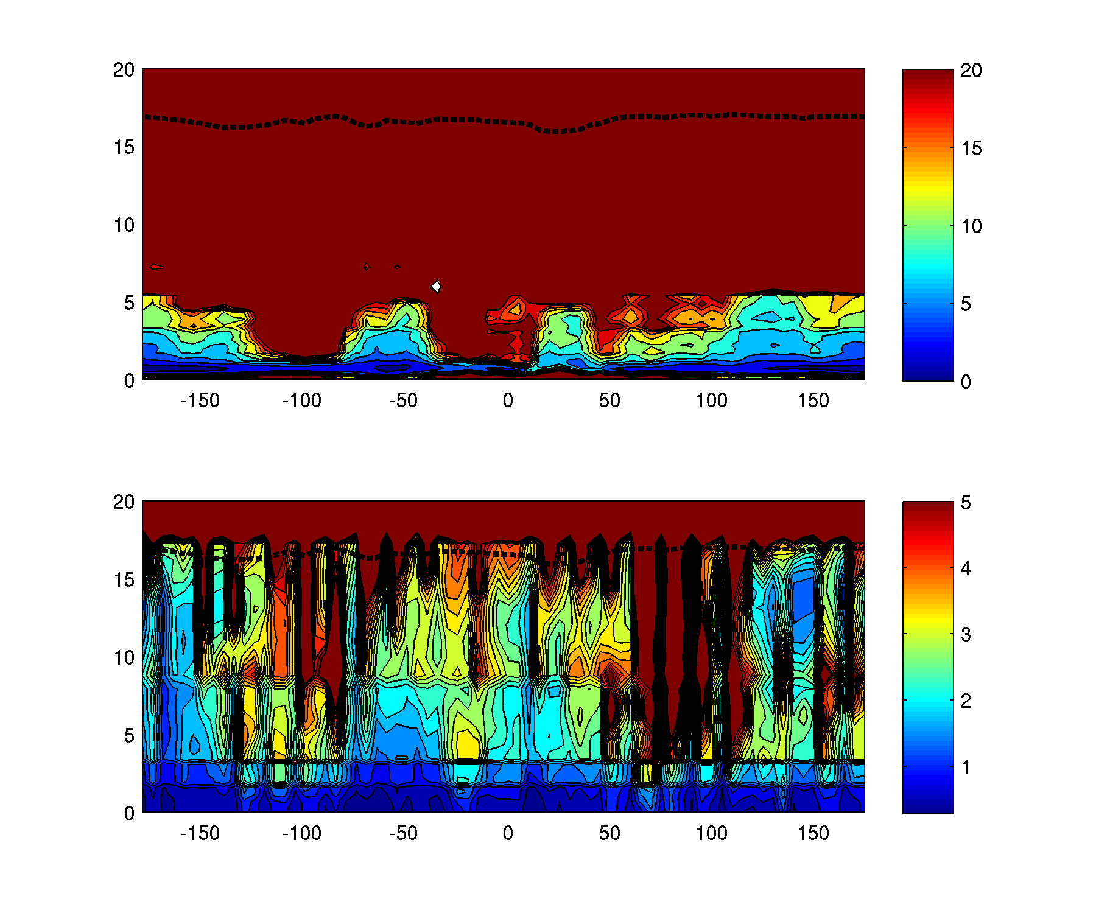
Why is Bry input from the stratosphere important? Point of entry matters!
0.1 Gg Br / day
Stratosphere
z / km
Bry wet dep.
time scale / days
Sea salt aerosol
3.9 Gg Br / day
Bry vertical trans.
time scale / days
z / km
Bry injected in UT will linger
Bry injected in PBL will be washed out
Latitude
GC/GEOS-5 (Feb 2006; 22S - 22N)

Slide 15
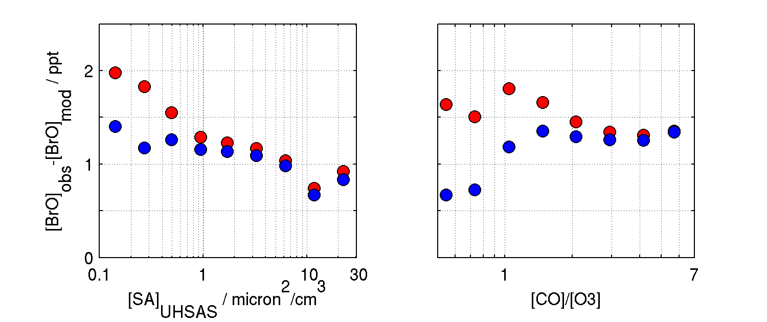
Obs. - Mod. deviation correlated to stratospheric influence signatures
TORERO
AMAX-DOAS (x)
GC/G-5 (□)
GC/G-5 w\ 2xStrat-Bry (◊)
∆BrO = [BrO]obs – [BrO]mod averaged across all TORERO flights
GC/G-5 ∆BrO correlated with stratospheric influence tracers
Correlation is weaker for model with enhanced stratospheric input
Base deviation of ~1 ppt (Other process enhancing BrO)
Is there any reason to suspect too low model stratospheric transport?
Notes:
- Difference between mod and obs becomes larger for air masses that show sign of stratospheric influence.
- Trend is less pronounced for run with higher Strat Bry flux.
- Significant base line deviation remain regardless of air is influenced by strat or not

Slide 16
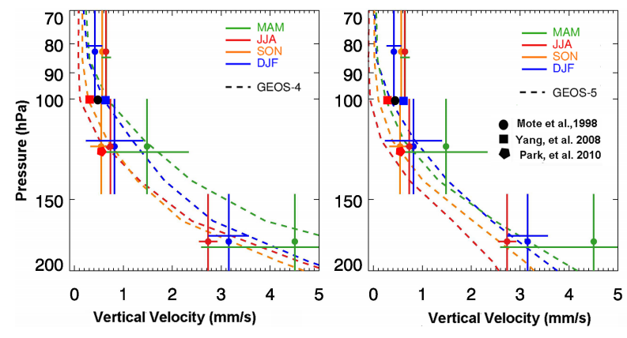
GC/GEOS-5 underestimate vertical transport near the tropical UTLS
Liu et al., ACP, (2013). Vertical velocity derived from satellite CO profiles.
GC/GEOS-5 underestimates vertical transport near tropical UTLS
GC/GEOS-4 more consistent with MLS CO derived transport
Notes:
- This is just to show that comparison of GC/GEOS-5 CO to MLS CO observations indicated vertical velocities in tropics is underestimated in model.

Slide 17
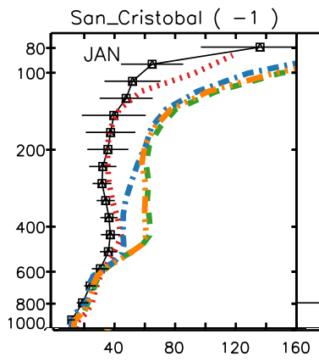
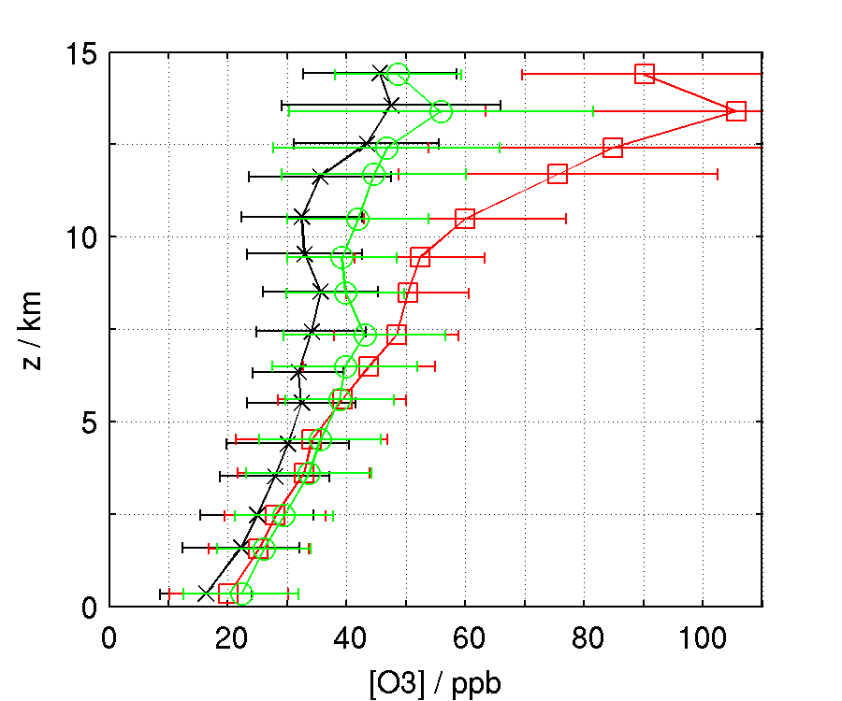
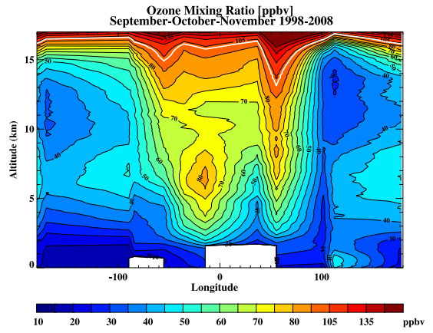
GC/GEOS-5 underestimates convection and circulation in the tropics
San Cristobal
Observation
GC/GEOS-5
GC/GEOS-4
TORERO
Observation
GC/GEOS-5
GC/GEOS-4
UT ozone diluted by LT air in tropical Pacific
GC/GEOS-5 underestimates vertical transport
Results in high bias in GC/G-5 UT ozone
Thompson et al. (2011) O3 sonde obs. in S. Tropics
Notes:
- Here I want to note GC/GEOS-5 underestimate convection in the tropics.
- The problem manifested in UT O3 that is much to high both in TORERO and in comparison to sonde data.
- Figure illustrates the dilution of the UT by low O3 air convected in surface of W. Pacific and carried to the E. Pacific UT.

Slide 18
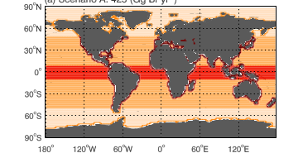
GEOS-Chem bromocarbon mixing ratios consistent with observation
Global source strength in Gg Br/yr
CHBr3 emission field
NOT in GC
Other*
(56)
CH3Br
(56)
CH2Br2
(57)
CHBr3
(407)
(Q. Liang et al (2010))
Seasonality added to CHBr3 emissions
Other = CHBrCl2, CHBr2Cl, CH2BrCl
(Est. from WMO Ozone report)
Notes:
- GEOS-Chem include Bromoform, dibromomet. and methylbromide.
- VSLH emission described using Qing Liangs emission field with added seasonality for CHBr3.
- Source strength of other short lived halomethanes estimated be similar to dibromomethane.

Slide 19
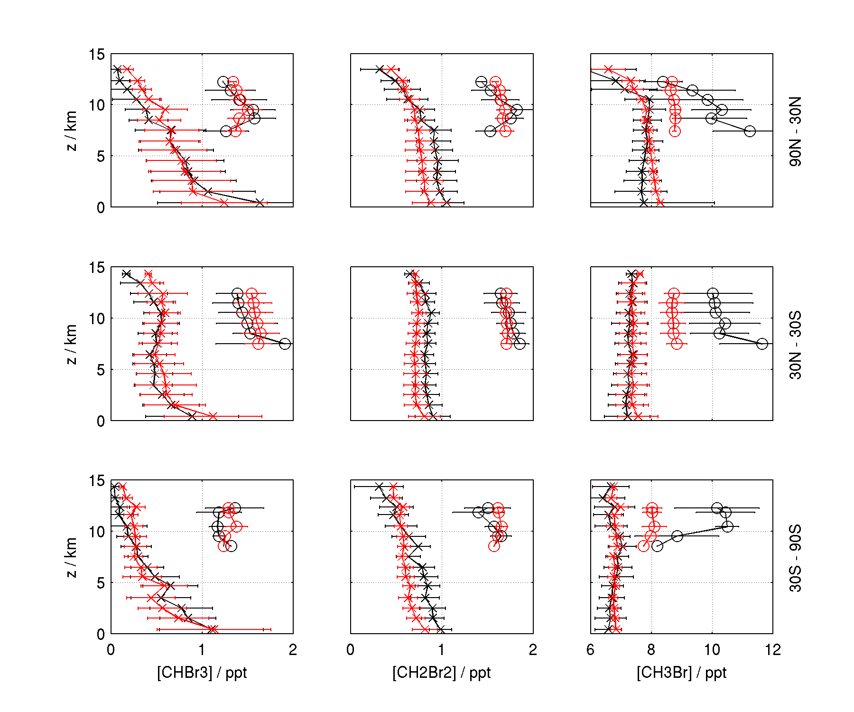
GC bromocarbon consistent with HIPPO and CARIBIC observations
CHBr3:
Good agreement
CH2Br2:
Small low bias (~10%)
CH3Br:
Low bias against CARIBIC. Model lacks inter annual variability (decreasing trend).
HIPPO: 2009 – 2011
CARIBIC: 2005 – 2009
Observation
GC/GEOS-5
CARIBIC shifted by 1 ppt
Notes:
- CARIBIC shifted by 1 ppt for clarity!!!
- Model bromocarbon mixing ratios generally consistent with HIPPO and CARIBIC obs.
- Small low bias in CH2Br2 ~10%
- Model CH3Br has no inter annual varibility (fixed to 2008 levels)
- CH3Br has been decreasing year by year due to ban.
- Model CH3Br low bias wrt to CARIBIC is likely due to missing IAV.

Slide 20
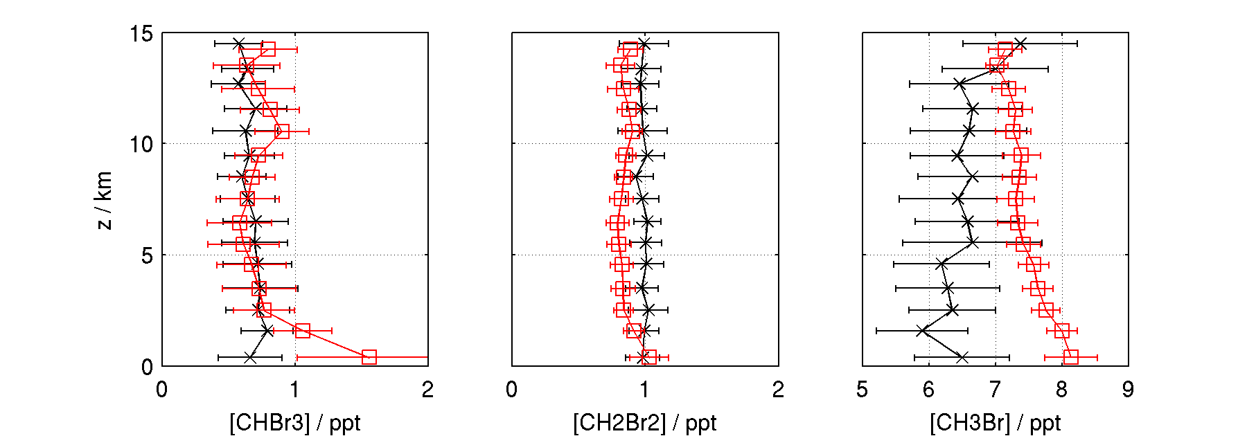
GC bromocarbon consistent with CONTRAST TOGA observations
Over all good agreement
Observed VSLH profiles more “straight” than model.
Could indicate insufficient vertical transport in model (GC/GEOS-5)
Model CH3Br high bias reflect missing inter annual trend.

Slide 21
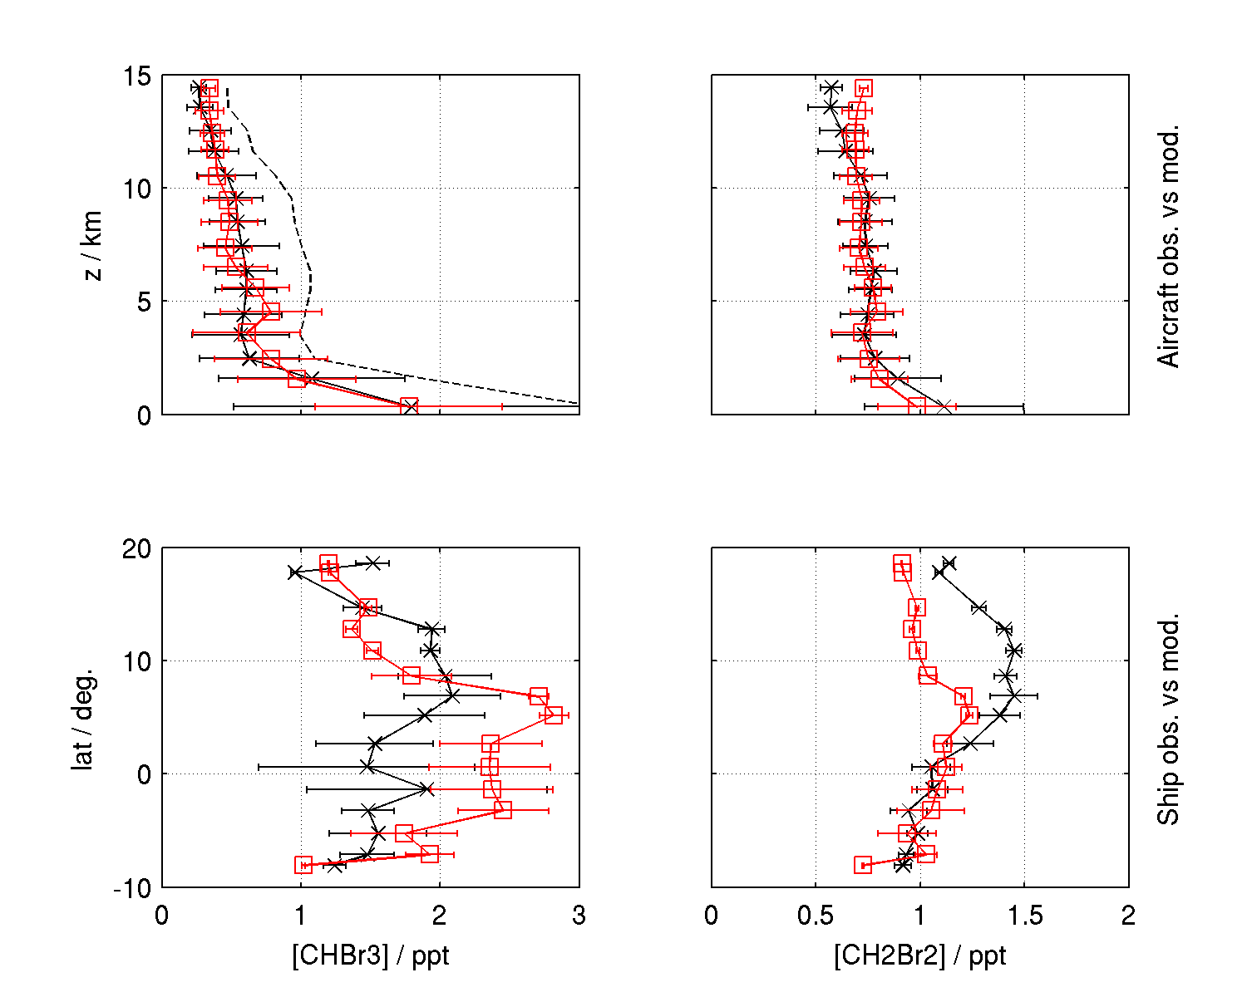
GC bromocarbon consistent with TORERO TOGA and VSLH ship obs.
Observation
GC/GEOS-5
TOGA CHBr3 calibration
Broken line: Local std.
Full line: NIST std.
Model agrees well with observations based
NIST CHBr3 standard

Slide 22
Summary and outlook:
Current GC(std) underestimate recent observation of high levels of BrO in the tropics.
Inaccuracies in model bromocarbon source gas emission is unlikely to contribute significantly to model BrO low bias.
GC BrO UT low bias is likely linked to insufficient input of stratospheric Bry.
GC(std) BrO low bias in MBL and FT is likely linked to an incomplete description of multi-phase bromine chemistry in SSA, other hydrophilic aerosols and clouds.
Updated halogen multi phase chemistry mechanism help close gap between BrO observations and model in tropics below the UT.
CONTRAST/CAST BrO and HOBr observations will provide crucial constraints on multi-phase Br_{y} recycling.
CONTRAST/CAST/ATTREX data will help constrain GC halocarbon emissions and vertical transport in the tropics.

Slide 23
Acknowledgments
Danish Council for Independent Research
NASA / ACMAP
Observations: R. Volkamer et al. (AMAX-DOAS BrO), L. Carpenter et al. (VSLH obs.), E. Apel et al. (TOGA), C. Brenninkmeijer et al. (CARIBIC), HIPPO
Discussions: Q. Liang, T. Sherwen, M. Evans, R. Salawitch, R. Volkamer and many others
GC Support: M. Sulprizio and C. Keller.

Slide 24
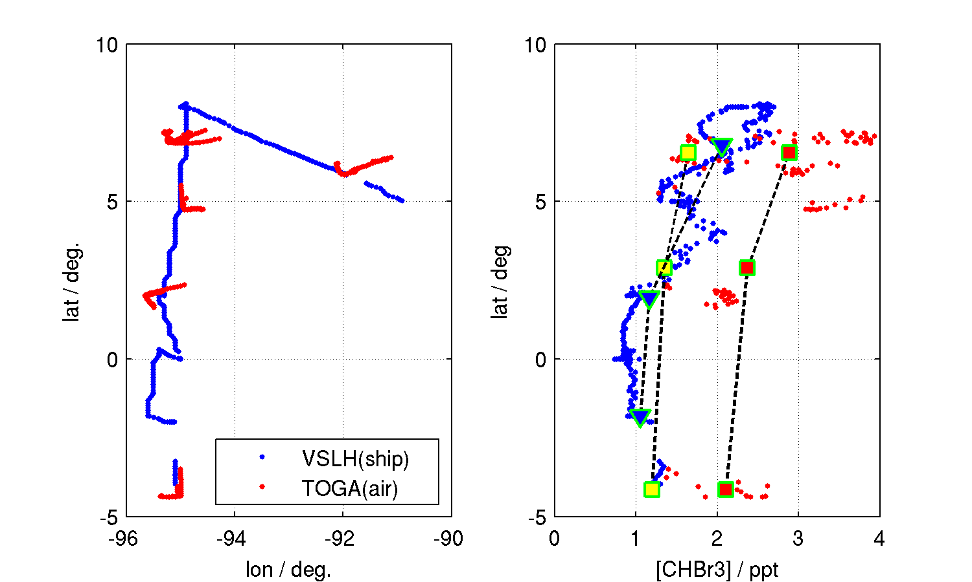
Good agreement between TOGA and ship observation during over flight
TOGA CHBr3 (local std.)
TOGA CHBr3 (NIST std.)
VSLH CHBr3 (NIST std.)
Observation below 2 km during GV aircraft overflight of Ka'imimoana ship (Feb. 20 -26, 2012)

Slide 25
Model underestimates BrO in the tropical troposphere
Bry sources
too low
Bry sinks
too strong
BrO/BrY
partitioning off
Transport
wrong
Bromocarbon
Sea salt aerosol debromonation
Stratospheric input
Photolysis
Gas phase chemistry
Heterogeneoues chemistry
(multi-phase)
Vertical transport (in tropics)

Slide 27
Model underestimates BrO in the tropical troposphere
BrY sources
too low
BrY sinks
too strong
BrO/BrY
partitioning off
Transport
wrong
Bromocarbon
Sea salt aerosol debromonation
Stratospheric input
Photolysis
Gas phase chemistry
Heterogeneoues chemistry
(multi-phase)
Vertical transport (in tropics)

Slide 28
Bromine in GEOS-Chem: Source, Sinks and Partitioning
Stratosphere
0.1 Gg Br / day
Radical:
Br
BrO
CH₂O, NO₂, HO₂
Inorganic:
HBr, Br₂
HOBr
BrONO_{x}
Wet deposition
hv, OH, het. chem.
Dry deposition
4.4 Gg Br
34.1 Gg Br
3.9 Gg Br / day
1.5 Gg Br / day
Sea salt aerosol
Organo bromines:
CHBr₃, CH₂Br₂, CH₃Br
Parrella et al., ACP (2012), Ann. mean budget
GC(v9-01-3)/GEOS-5

Slide 29
Diagnosing the problem: Why is GC underestimating BrO?
Stratosphere
Source
Bromocarbon
Sea salt aerosol
Stratosphere
Sink
Dry deposition
Wet deposition
Partitioning
Brx ↔ Bry
HBr ↔ Bry
HBr
Het chem and OH
Br
BrO
BrNO₃
Br₂
CHBr₃
CH₂Br₂
CH₃Br
Br_{x}
Br_{y}
SSA
BrC
55 %
40 %

